Slide 1


Welcome to our special
National Health IT Week Innovation Webinar –
Open Source Tools for Electronic Clinical Quality Measures
Please stay tuned. This presentation will begin at 3PM EST.
Notes:
Opening slide

Slide 2



Welcome to the OSEHRA Innovation Webinar
Open Source Tools for Electronic Clinical Quality Measures
Seong K. Mun, PhD
President and CEO
OSEHRA
David Hill
Principal Software
Systems Engineer
The MITRE Corporation
Peter Li
Director of Engineering and Infrastructure
OSEHRA
Notes:
Opening slide

Slide 3

Open Source Tools for Electronic Clinical Quality Measures
February 21, 2017
CMS ALLIANCE TO MODERNIZE HEALTHCARE
OSEHRA Webinar
October 3, 2017

Slide 4
About MITRE
The MITRE Corporation operates seven FFRDCs, including the CMS Alliance to Modernize Healthcare FFRDC
MITRE works in the public interest by applying systems engineering expertise to address the most challenging problems facing government.
---------------
CAMH seeks to advance the nation's progress toward an integrated health system with improved access and quality at a sustainable cost

Slide 5
Using tools to improve quality reporting
eCQM Conceptualization
eCQM
Specification
eCQM
Testing
eCQM Implementation
eCQM Certification
eCQM Collection
eCQM Interoperability
Bonnie
Robust eCQM Testing
Cypress
Certifies EHR products
Crucible
Promotes correct FHIR implementations
Free flow of information to inform clinical decision making & improve patient care
Cypress Validation Utility
Pre-submission QRDA validation
Cedar
Validates QRDA collection systems
NCQT Evaluates CQMs against real and synthetic patients
Juniper
Consistent calculations and submissions across EHRs
NCQT Representative patients and populations
Juniper
Consistent calculations and submissions across EHRs
Improve accuracy, make eCQMs cheaper and faster to develop
Reduce submission errors
Improve quality care through collaboration
Assurance that EHRs produce accurate results

Slide 6
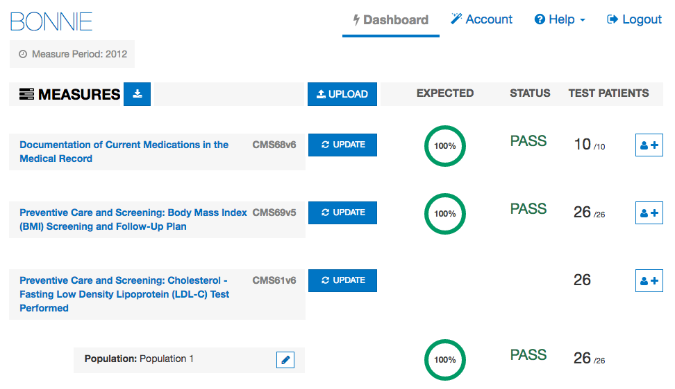
Bonnie
bonnie.healthit.gov

Slide 7
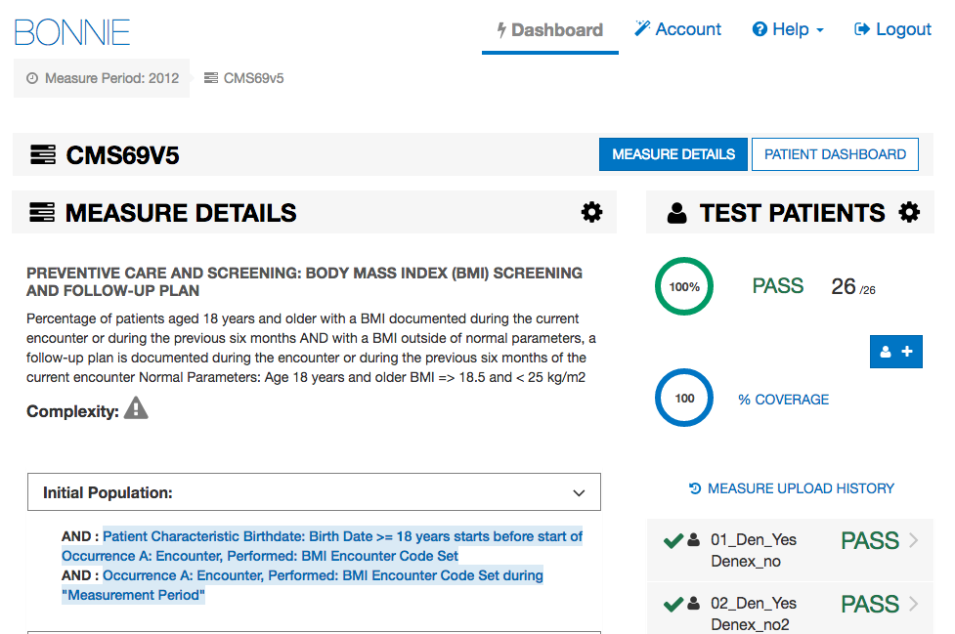
Bonnie (continued)
bonnie.healthit.gov

Slide 8
Cypress
Rigorous and repeatable testing tool for certifying Electronic Health Records (EHR) and EHR modules in the capture and calculation of eCQM.
Open source and freely available for use or adoption by the health IT community including EHR vendors and testing labs.
Certified Health IT Products and Vendors
www.healthit.gov/cypress

Slide 9
Crucible
projectcrucible.org

Slide 10
Crucible
projectcrucible.org

Slide 11
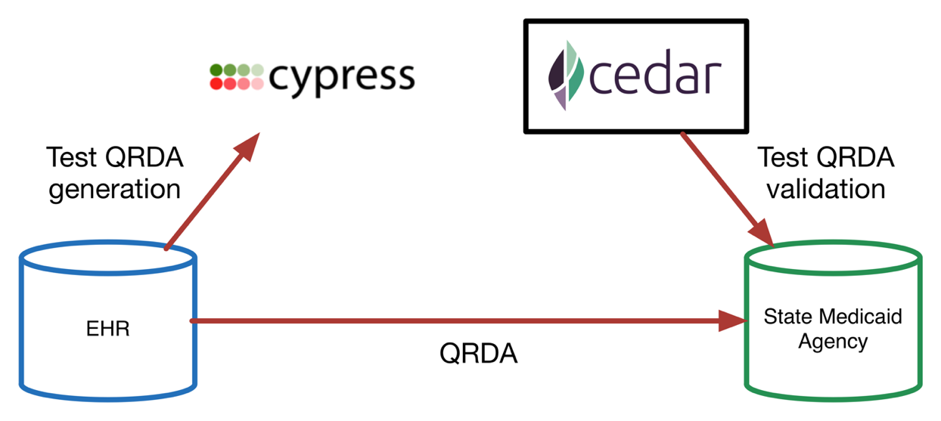
What is Cedar?
Cedar is an open-source tool for testing the strength of eCQM collection systems that receive Quality Reporting Document Architecture (QRDA) files
EHR
eCQM Collection System
projectcedar.org

Slide 12
Why was Cedar developed?
QRDA files are messy and full of errors!
Of the files submitted to the Physician Quality Reporting System in 2014
  Approximately 25% of QRDA I files contained errors
  Over 93% of QRDA III files contained errors
  Most errors stemmed from the various sources that QRDA files are collected, and due to calculation errors introduced in file transfer
A tool that ensures eCQM collection systems can consistently and correctly identify common QRDA file errors would help address this issue
Software industry standard is to have all software tested; Cedar fills this gap for eCQM collection systems
https://www.cms.gov/eHealth/downloads/2014_EP_Submission_Data_Issues.pdf

Slide 13
How was Cedar developed?
Shares libraries with Cypress
  health-data-standards
  patient-generator
  qrda-generator
Built on Ruby on Rails and MongoDB
Built to target known QRDA errors
Piloted with state partners to identify errors ‘in the wild’
Posted code on GitHub for all to use and engage

Slide 14
How is Cedar intended to be used?
As a complement to Cypress, popHealth, Bonnie, and Tacoma to improve the overall quality reporting ecosystem
By measure collectors,
  to ensure that eCQM collection systems are correctly identifying common errors, either via one-time testing or regression testing
  to structure conversations with EHR vendors re: QRDA file rejections
By the open source community,
  to update the tool to address newly identified errors and updated eCQM specifications, etc., and integrate the tool with existing systems

Slide 15
Demo

Slide 16
How can you get involved?
Download Cedar from GitHub!
  Link can be found at www.projectcedar.org
Join Cedar’s listserv!
  Learn about new versions, updates, presentations, etc.
  Email dwhill@mitre.org and request to be added.

Slide 17
OSEHRA
popHealth®
eCQM
Peter Li
Director of Engineering October 3, 2017
Notes:
The slides included in this deck shows the precise formatting to use for the Title Slide at slide one of this template.

Slide 18
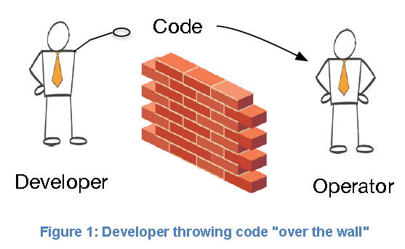

eCQM & Gov’s Role
Develop and Maintain Standards
Develop and Maintain Models and Vocabularies
Define the Process
Develop Software Tools
Release them as Open Source Software
  Then Disengage
GOV
USER

Slide 19
OSEHRA popHealth®
An open source tool of choice for the reporting and visualization of eCQMs
Developed by the US Government in 2012 and transitioned to OSEHRA in 2014.
Released version 4.0 in 2015 and version 5.0 in 2017

Slide 20
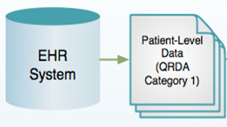
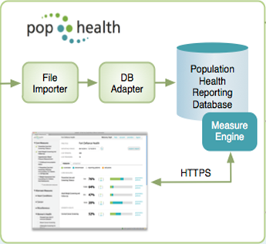

OSEHRA popHealth Use Case
Healthcare Providers
Multi-tenancy Architecture
●
●
●

Slide 21
PopHealth Dependencies
Project Cypress Managed
PopHealth
(OSEHRA)
Quality Measure Engine
Measure Bundle*
Cypress
(MITRE)
Project Tacoma Managed
Health Data Standard
HQMF2JS
Bonnie
(MITRE)
*Contains measure algorithms & code sets that are intellectual property of the American Medical Association, the National Committee for Quality Assurance, and the Quality Institute of Pennsylvania

Slide 22
Community based Product Management
(Key Open Source Developments)
Road Map
Frozen by ONC OSEHRA Transition
Sep 2014
Version 4.0
Dec 2015
Version 4.0.2
Jan 2016
Version 5.0
Mar 2017
OSEHRA
Trunk
MITRE Trunk
•
•
OSEHRA
MU-2 Cert.
•
•
eHealthConnecticut
Multiple Practice Operations (12 pull requests)
Alabama Medicaid
Flexible Reporting Period
Northwestern University
Static Baseline Reporting
Zato Health &
Northwestern University
Patient & Provider Filters
2015 Edition HIT CQM Cert.

Slide 23
2015 Edition Health IT Certification
Criteria 170.315 (c)(2,3,4)*; (d)(1-3, 5); (g)(4,5) (CHPL Certification ID: IG-3684-17-0010)
29 Eligible Hospital (EH) eCQMs for 2017 reporting period
64 Eligible Professional (EP) eCQM for 2017 reporting period
* Criteria for importing, calculating, reporting, and filtering eCQMs

Slide 24
Future Plan
Roadmap for development of v6.0 release next year
  Refresh shared components per Cypress 3.2.1 release and incorporate 2017 EH/EC measure bundle
  eCQM trend analysis
  Improve support for C-CDA import

Slide 25
popHealth Demo
Demo Site:
  http://pophealth-demo.osehra.org
  username:pophealth
  password:pophealth
Installation Guide:
  https://github.com/OSEHRA/popHealth/wiki/Installation-v5.0

Slide 26
Questions?
Please contact Dave Hill (dwhill@mitre.org) or Sejal Patel (patel@mitre.org) if you have questions, or would like to arrange a Cedar demo.
Please contact Peter Li (lip@osehra.org) if you have questions, or would like to arrange a popHealth demo.
Notes:
Opening slide

Slide 27

Thank You for Attending the OSEHRA
Innovation Webinar!
Join us for our November Webinar:
Clinical Data Quality Issues and Achilles for Sharable and Interoperable Data Characterization
Presenters:
Chunhua Weng, PhD, FACMI
Associate Professor of Biomedical Informatics
Columbia University
Nicole G. Weiskopt, PhD
Assistant Professor
Dept. of Medical Informatics and Clinical Epidemiology
Oregon Health and Science University

Slide 28
Backup Slides

Slide 29

Cedar End-User Process
For the prototype, end users will begin and end their testing in Cedar, but will also need to directly interact with their eCQM collection system
Input Test Details and Select Validations
Download Generated QRDA Files
Enter Actual Results from eCQM Collection System
Compare Expected and Actual Results
Process QRDA files in eCQM Collection System

Slide 30
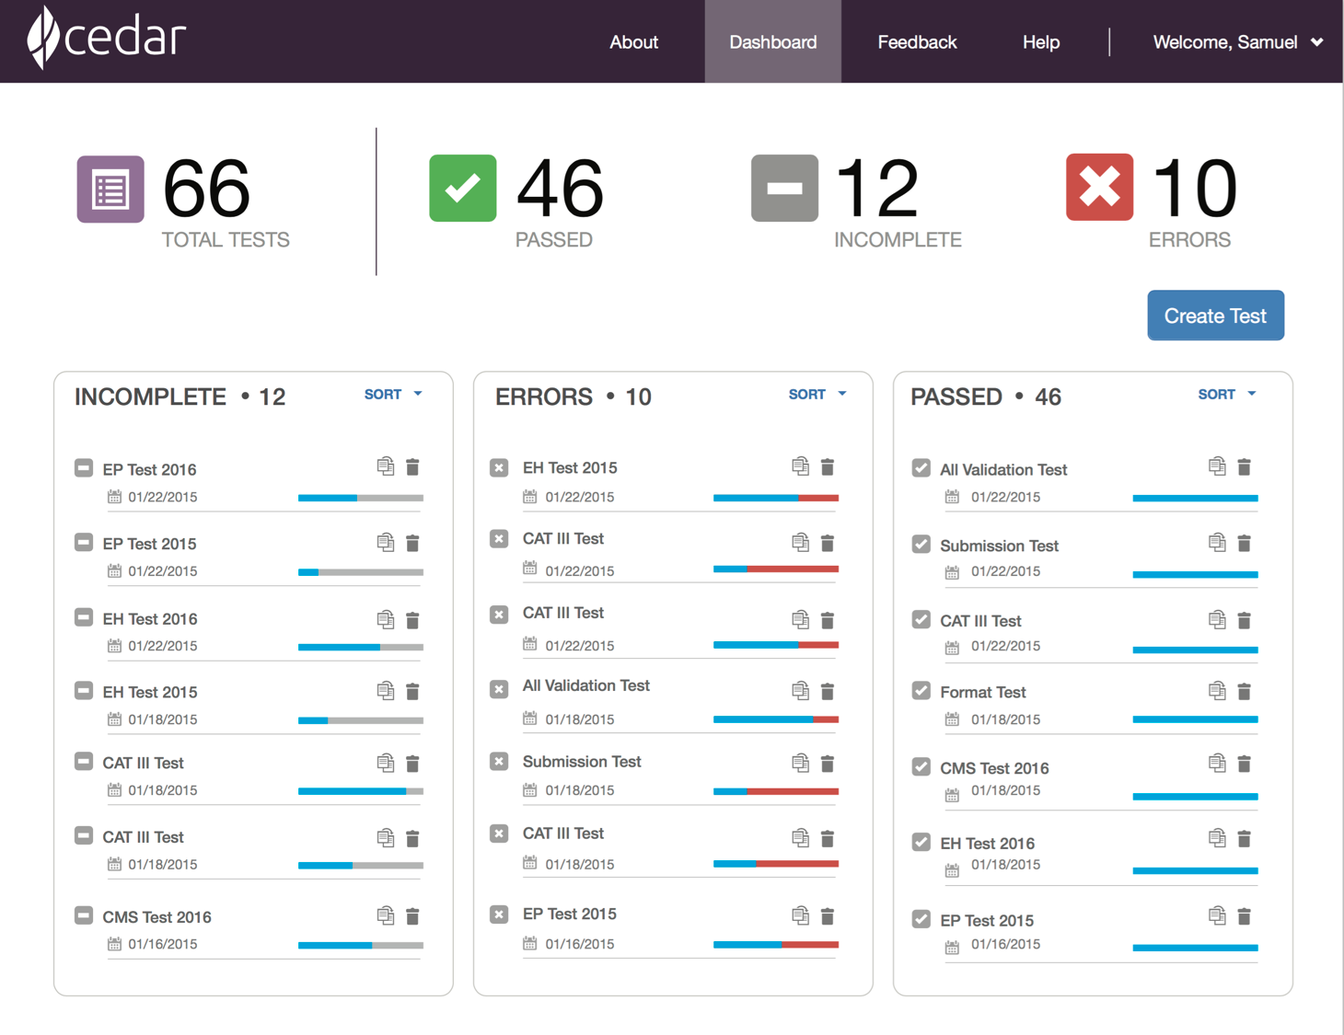
Cedar Dashboard
The dashboard provides a consolidated, sorted view of tests that a particular user has run in Cedar. Users can test their eCQM collections systems piece-by-piece to determine which set of validations work properly.
Test status
at a glance
Create New Tests
Re-run a test
Delete a test
All tests with
progress indicators

Slide 31
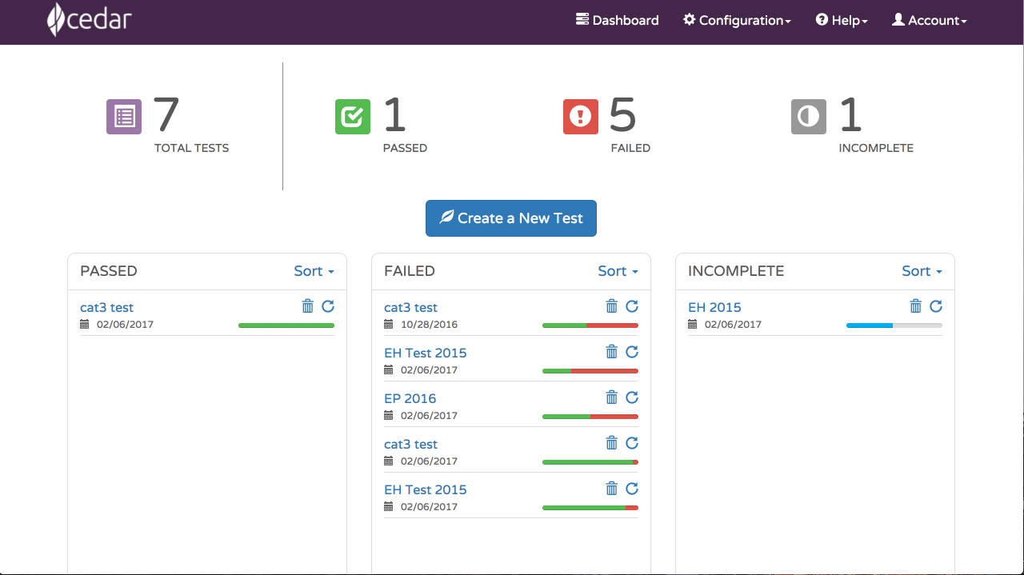
Cedar Dashboard
The dashboard provides a consolidated, sorted view of tests that a particular user has run in Cedar. Users can test their eCQM collections systems piece-by-piece to determine which set of validations work properly.
Test status
at a glance
Repeat a test
All tests with
progress indicators

Slide 32
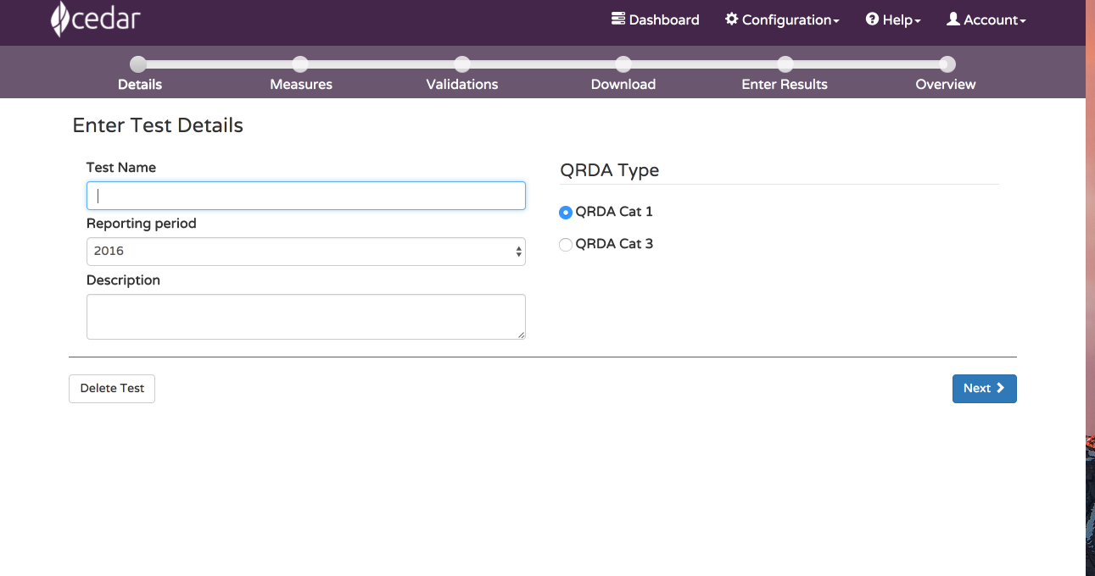
Cedar Test Creation

Slide 33
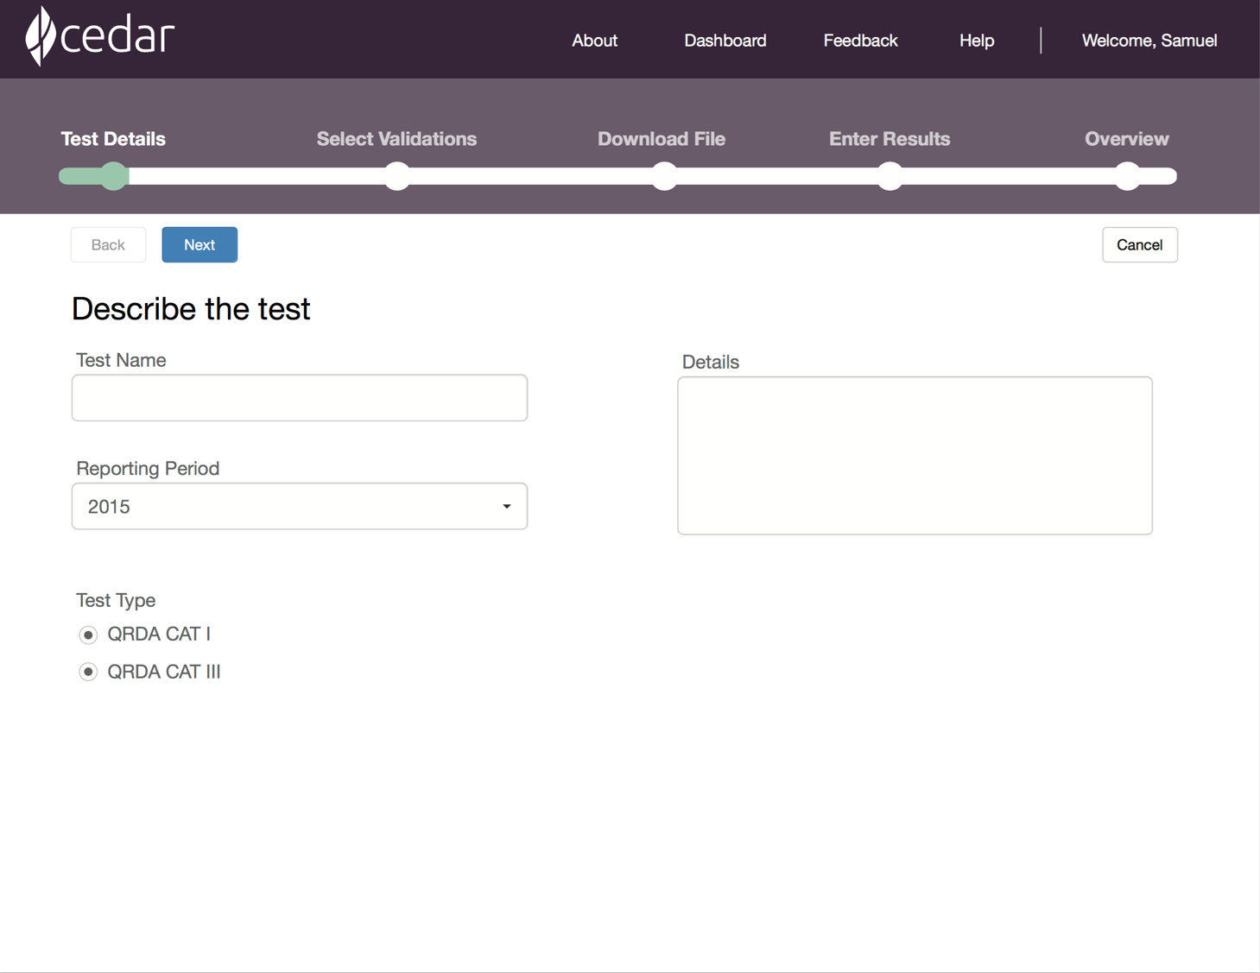
Cedar Test Creation
During test creation, users can specify basic information like the type of QRDA, certain eCQMs that should be used, and the expected reporting period.
Persistent
progress bar
Navigation buttons
Basic test
information

Slide 34
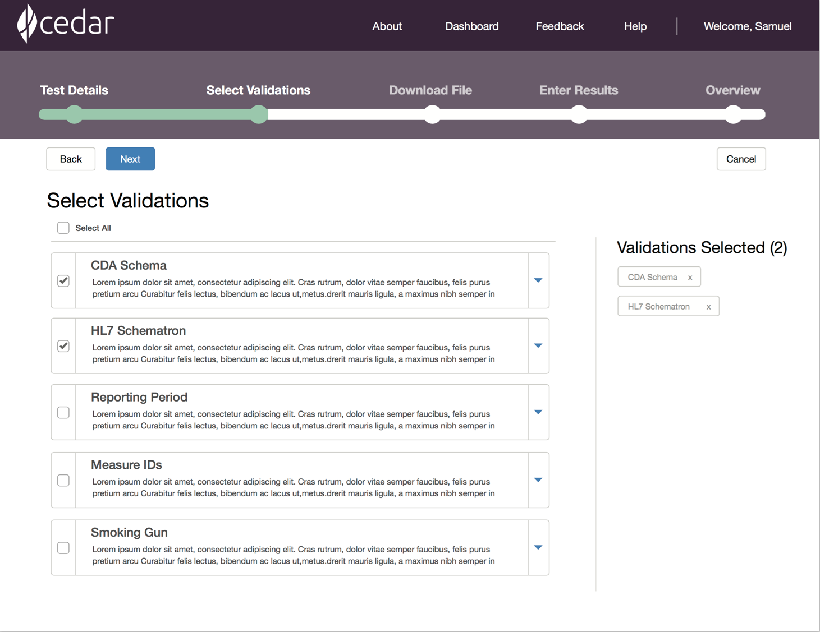
Cedar Validation Selection
Once a test is created, the user selects specific validations that they want to perform on their eCQM collections system.
List of validations to
select (expandable)

Slide 35
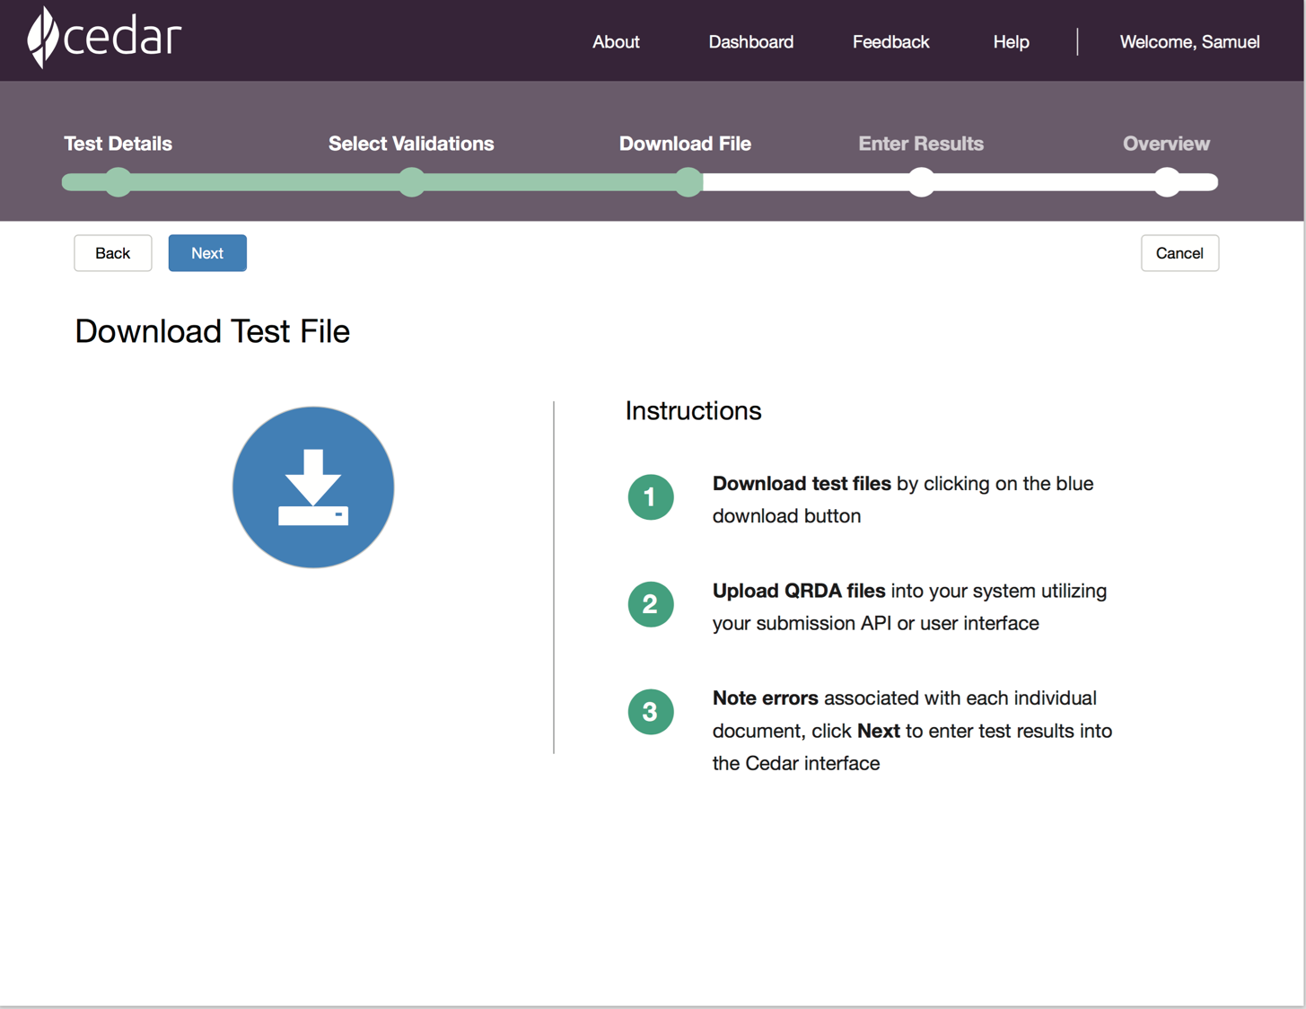
Cedar Test File Download
Based on the test information and the selected validations, Cedar will generate a zip file containing a series of QRDA files – some of which are valid and others that are invalid based on the selected validations. This screen allows you to download that zip file.
Giant download button

Slide 36
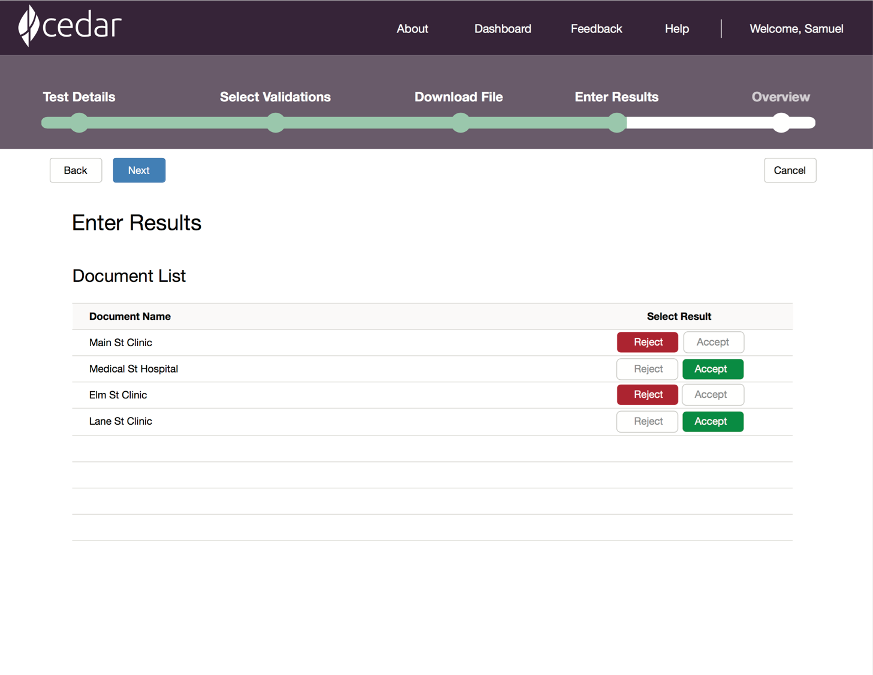
Cedar Actual Results Entry
When all of the Cedar-generated QRDA files have been processed in the eCQM collections system, the user records those actual results on this screen by clicking “Accept” or “Reject” for each QRDA file.
Quick entry of
actual results

Slide 37
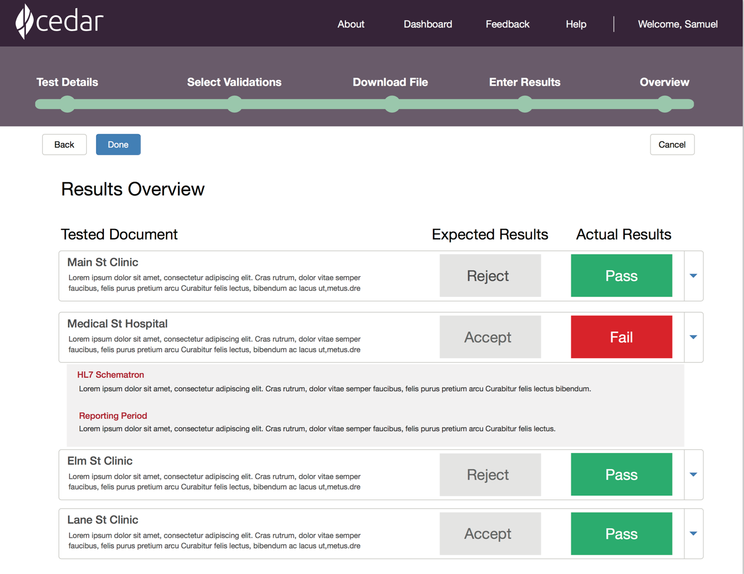
Cedar Test Results Overview
Cedar checks the actual results against its expected results for the files it generated and presents this overview page showing where error checking in the eCQM collections system can be improved.
Appropriately
rejected file
File that should
have been rejected,
with explanation of
expected errors
Appropriately
accepted file

Slide 38
Backup Slides

Slide 39
Collaboration with MITRE
Transition to Community Based Sustainment Beyond GOV Development
OSEHRA’s Role
  Form a community of interested parties
  Community based financing

Slide 40
Basic Reference Implementation Functionalities
Import QRDA-I patient level data:
  File upload via web UI
  File upload via patient API
CQM calculation
CQM Dashboard
Export QRDA-3 eCQM report
REST APIs for import, calculate, and export functions

Slide 41
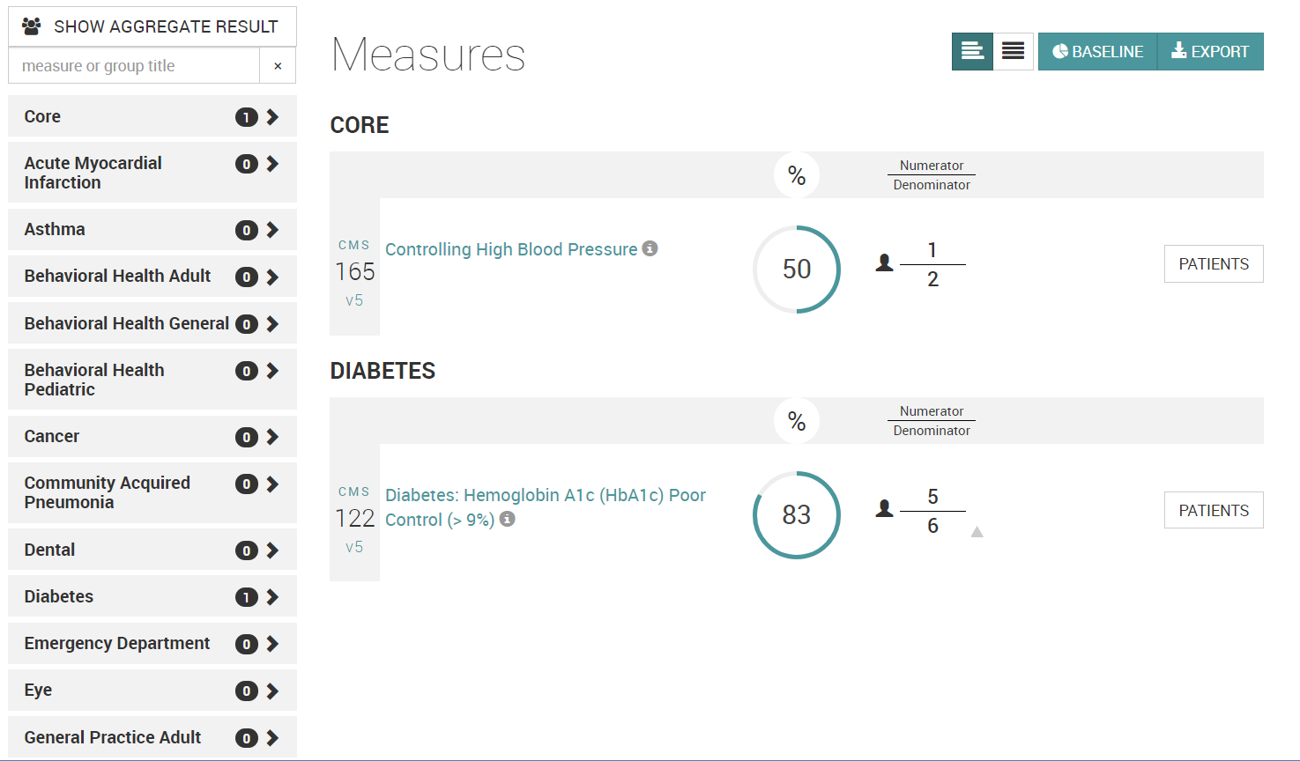
PopHealth Dashboard – EP and EH Measures

Slide 42
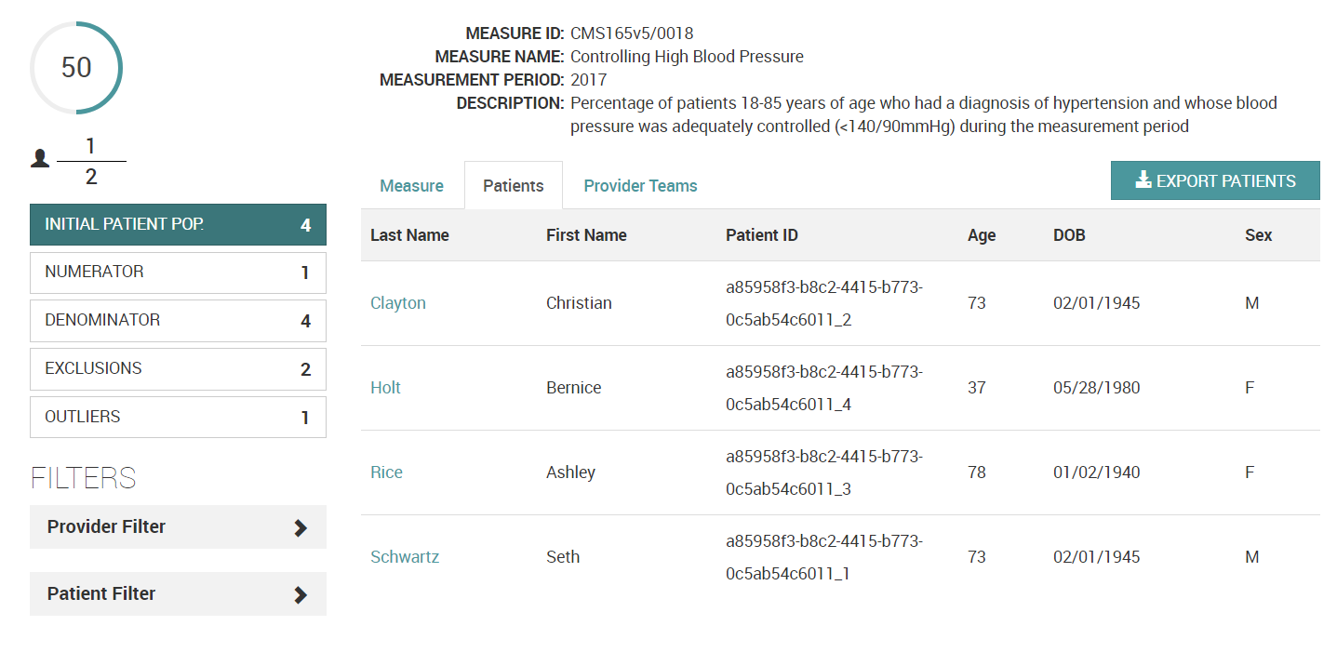
PopHealth Dashboard – Individual Measure

Slide 43
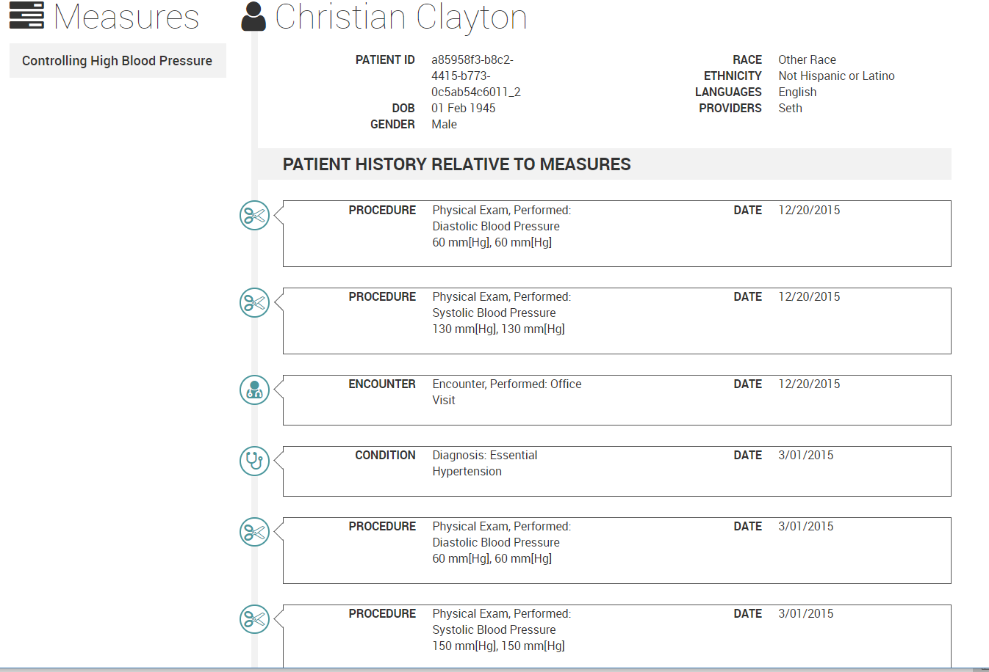
PopHealth Dashboard – Patient

Slide 44
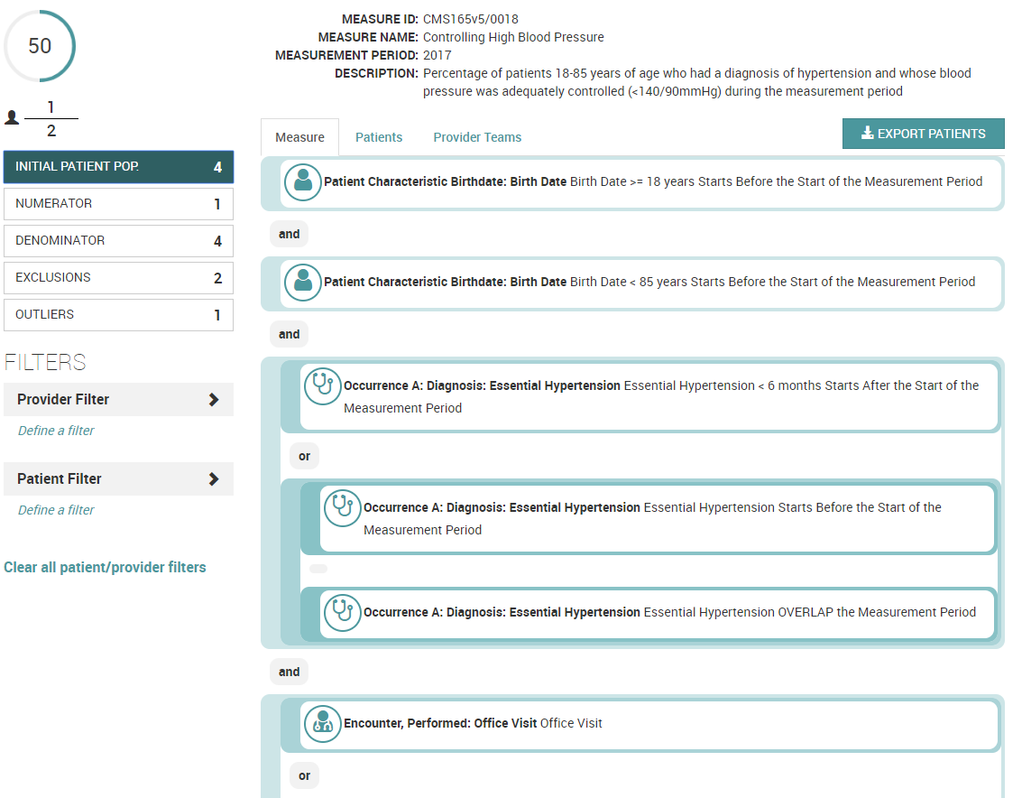
PopHealth Dashboard – Measure Rules

Slide 45
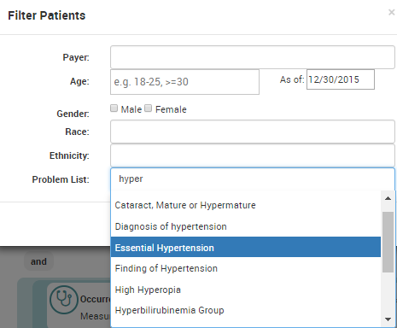
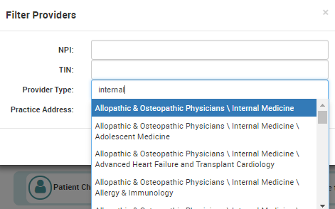
Patient and Provider Filters

Slide 46
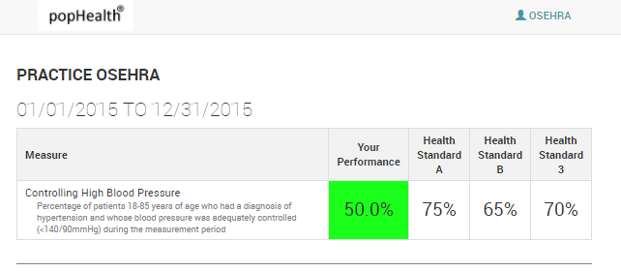
eCQM Benchmark
Notes:
Allows providers and practices to compare their current quality measure progress against a configurable list of static baselines/goals

