Slide 1
April, 30, 2019

Slide 2
Welcome to the April Innovation Webinar
Omnibus Care Plan (OCP):
21st Century Software Infrastructure
Kenneth Salyards
Information Management Specialist
SAMHSA
Notes:
Opening slide

Slide 3
Omnibus Care Plan Care Coordination System
Substance Abuse and Mental Health Services Administration

Slide 4
OCP Highlights
Patient Centered
Care Team can be members of any organization
Open Source Infrastructure
Open Source Care Coordination
Open Source Consent Management
Proprietary Components
Care Management – Clinical Documentation at point of care
Explanation of Benefits
CUBS – BH Psycho/Social Screener
Data Analytics and Data Visualization

Slide 5
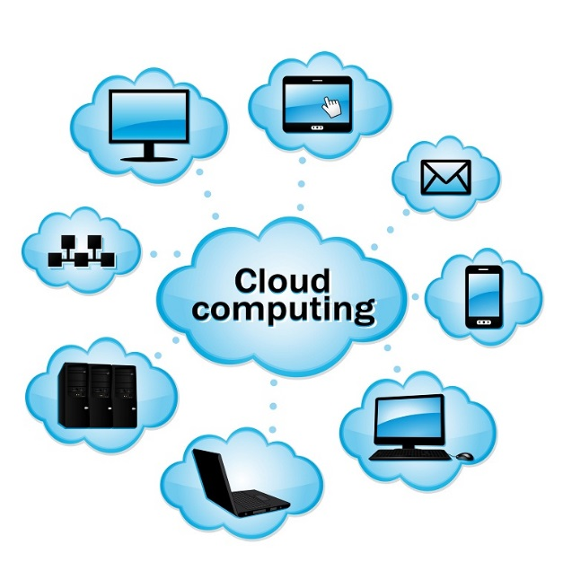
Omnibus Care Plan Premise
Patient-centered care revolves around effective and efficient care coordination across care providers, patient engagement, social connectedness, and facilitating the patients’ treatment beyond episodic or chronic treatment.
Today, the healthcare environment is fragmented and ineffectual in providing 360⁰ whole-patient care with the mix of private and public insurers and self-pay with a large number of no pay patients.
SAMHSA is devoted to the care and treatment of behavioral health patients. New models of paying for care are being developed and initiated with the objective to reduce the cost of healthcare.

Slide 6
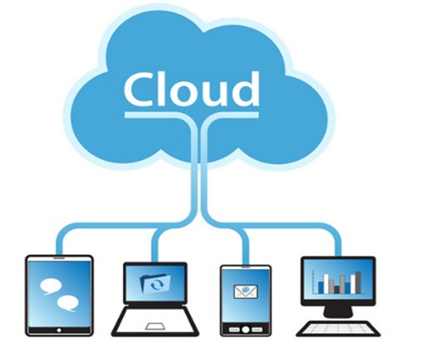
Omnibus Care Plan Functional Overview
Administrative
Program, Services, Locations
Patient Enrollment
Practitioners, Organizations
Episode of Care
Care Coordination
Caseload Mgmt. Dashboard
Program Mgmt.
Screener/ Assessment
Scored screening and assessments (MA Assessment, PHQ9, PHQ4, etc.)
BH-Works Comprehensive Assessment
Care Planning
SOAP/Visit Notes
Outreach/ Activity Management
Smart Notes
Dynamic Care Plan Summary
Scheduling/ Appointment
New Appointments
Encounter Management
Goals and Interventions based on Outcomes/scores
Patient Consent
Computable Scores/sub-scores (LOINC)
Enrollee/ Consumer Dashboard
Standards-based Data Shared Among Applications

Slide 7
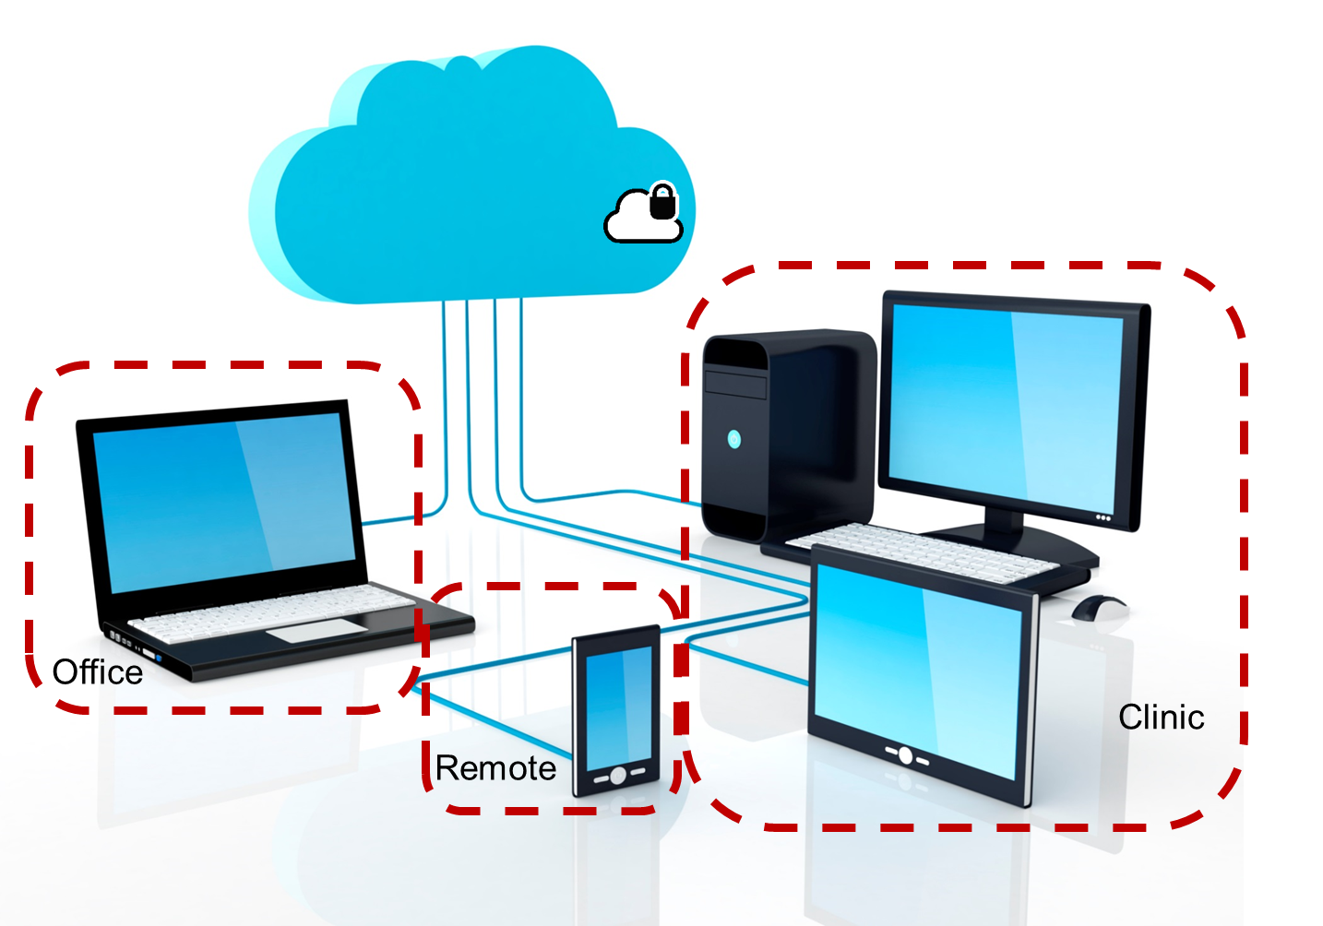
Omnibus Care Plan Technical Architecture Cloud-based, Secure, HIPAA-Compliant, Scalable, Extensible web platform
Standards-based Data Services
Encryption
User roles (Permissions)
Patient Consent
Automatic increase in memory, storage to match user needs cloud services
Identity & Access Mgmt.
Scalable
Web-application
Browser-based, supports phone/mobile
Low Information Technology (IT) overhead
HL7 Fast Healthcare Interoperability Resources (FHIR),
Cloud-based & HIPAA-Compliant
Integration with Electronic Health Record (EHR), billing, quality systems
Reuses existing software components
Extensible to integrate other applications
Security/Privacy
HIPAA compliant cloud services
Business Associate Agreement
Centralized management, secure, scalable
Reusability and Extensibility

Slide 8
Omnibus Care Plan Roadmap: Data Standards, Interoperability, and Analytics
Data Standards
Sharing data among applications in a seamless manner
Interoperability
EHR systems
Pre-authorization
Quality reporting system
Monitor and report patient outcomes
Patient engagement through mobile devices
Expanded provider access to telemedicine
Analytics
Business intelligence (BI) reporting and health analytics
Quality outcome reporting
Clinical decision support
Data warehouse and integration
Electronic Visit Verification
Billing system
Health and Human Services (HHS) agencies are driving interoperability efforts and change in US healthcare
Office of National Coordinator for Health IT (ONC) is leading interoperability through standardization workgroups, collaboration with Standards Development Organizations (SDO) and certification programs of the healthcare systems
SAMHSA is leading interoperability specifically for the behavioral health domain by working with SDOs and other federal agencies

Slide 9
Omnibus Care Plan Solution Overview: Solution Component Diagram
Clinician
Patient
Care Team
Clinical Decision Support (CDS)
Analytics & Reporting
Workflow Coordination
Functional Services
Care Coordination
Task/Activity Management
Referral Management
Program Management
Alerts & Notifications
Consent2Share Consent Management
Scheduling/ Appointments
Security
EHR/HIE Integration
Semantic Interoperability Workbench (SIW)
Infrastructure Services
BH-Works
Quippe
Care Plan
Assessment
LOINC Observations
Knowledge Base
HL7 Fast Healthcare Interoperability Resources (FHIR)

Slide 10
Omnibus Care Plan Overview: Patient Centered Care
Clinicians
Patient
Care Team
Program Administration
Billing Support
Continuity of Care
Functional Services
Screening
Assessments
Intake
Scheduling/ Appointments
Security/ Privacy
Reporting
- Provider
-State
-Federal
EHR & HIE Integration
Infrastructure Services
Analytics
Social
Determinants
Clinical Management
Referral Management
Grant
Reporting
SMART-on-FHIR
FHIR
Standards
C-CDA
Notes:
We need the EOB
?

Slide 11
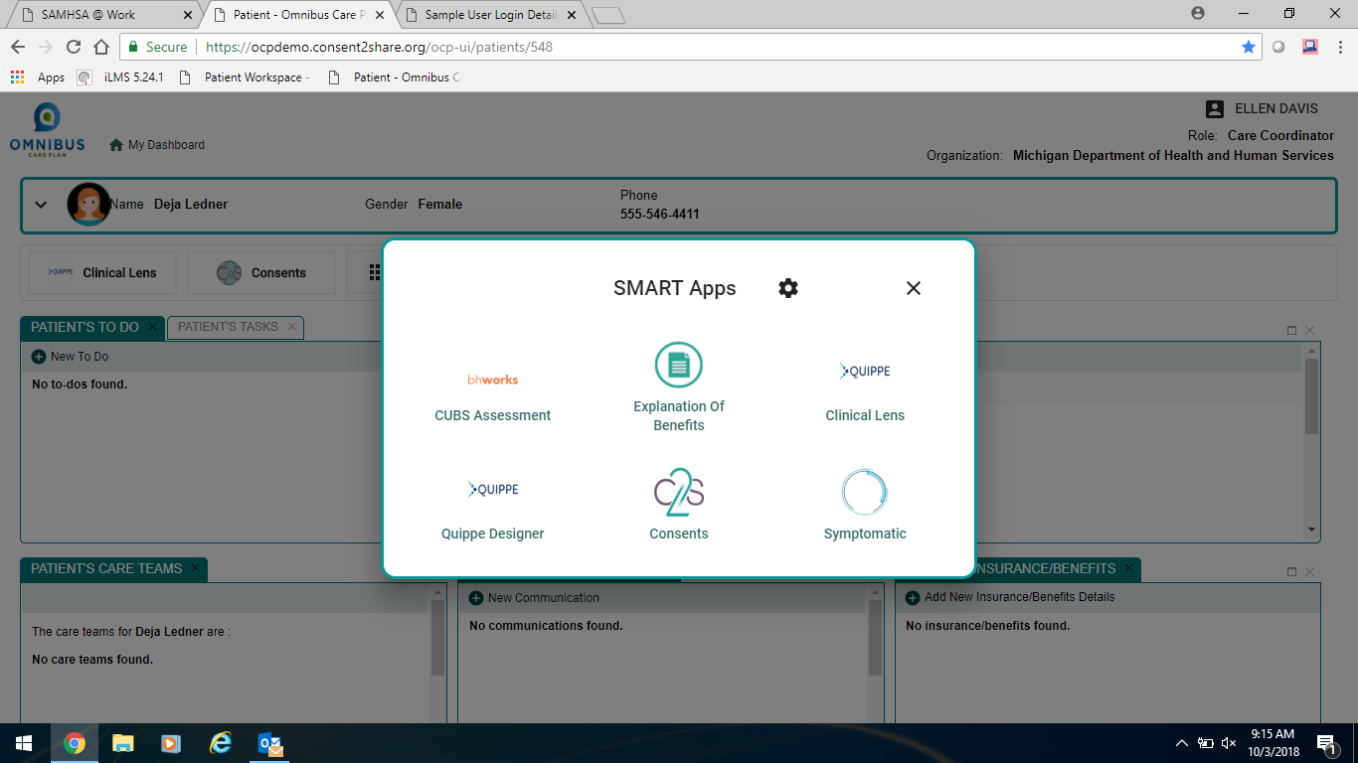
Omnibus Care Plan Smart on FHIR Apps: Simple means to add application functionality

Slide 12
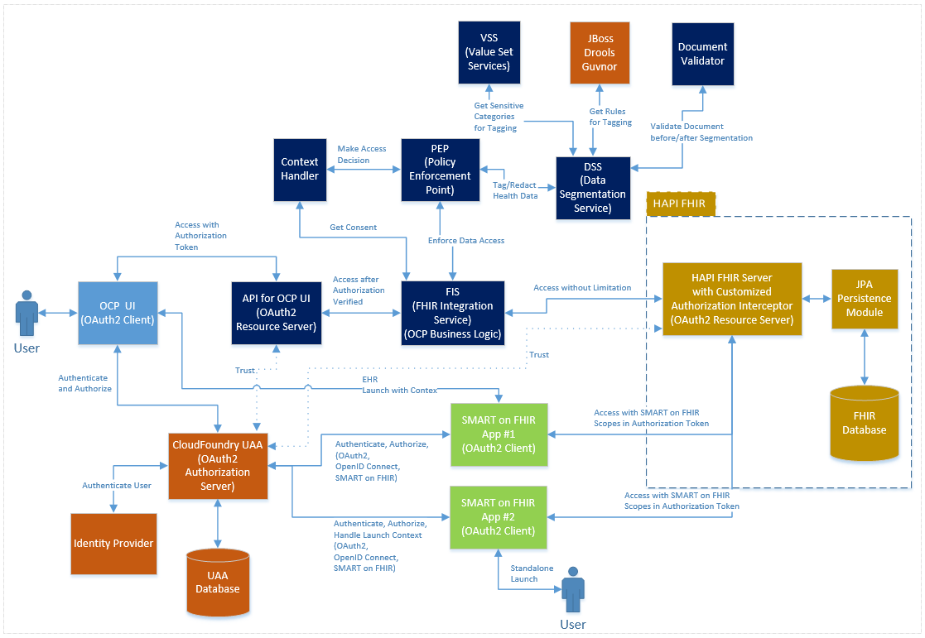
Omnibus Care Plan Solution Overview: System Architecture Diagram

Slide 13
Omnibus Care Plan Solution Overview: Key Technologies
Frontend:
React.js
Backend:
Java 8/9
Database and Infrastructure:
PostgreSQL
Standards:
OAuth2
Golden Layout
Redux/Redux Saga
CSS in JS, CSS3/CSS Next
HTML 5
JavaScript (ES6/7)
Spring Framework
Spring Boot
Spring Cloud
HAPI FHIR API
CloudFoundry UAA
AWS EC2
AWS RDS
OpenID Connect
FHIR
HAPI FHIR Server
SMART-on-FHIR

Slide 14
Omnibus Care Plan Solution Overview: Modules/FHIR Resource
Administration
Organization
PractitionerRole
Patient
Practitioner
Location
HealthcareService
RelatedPerson
EpisodeOfCare
Communication
Task
Appointment
Appointment/Task State Machine
Notifications
Conformance and Terminology
Workflow
StructureDefinition
Valueset
CapabilityStatement
CodeSystem
Security and Privacy
AuditEvent
Provenance
Outlook Integration
ReferralRequest
DiagnosticReport
Observation
Specimen
MedicationRequest
MedicationDispense
MedicationStatement
ProcedureRequest
CareTeam
CarePlan
Goal
AllergyIntolerence
Condition
Procedure
ClinicalImpression
Care Provision and Medications
Clinical
ActivityDefinition
Flag
Consent
Medication
Program
Insurance Coverage
Users Management

Slide 15
Omnibus Care Plan Solution Overview: FHIR US Core Profiles Supported
US Core
Practitioner Profile
Patient Profile
PractitionerRole Profile (new)
Location Profile
CarePlan Profile
CareTeam Profile
OCP
RelatedPerson Profile
EpisodeOfCare Profile
Communication Profile
Flag Profile
ActivityDefinition Profile
Appointment Profile
Organization Profile
HealthcareService Profile
Program Profile
RelatedArtifact Profile
Task Profile

Slide 16
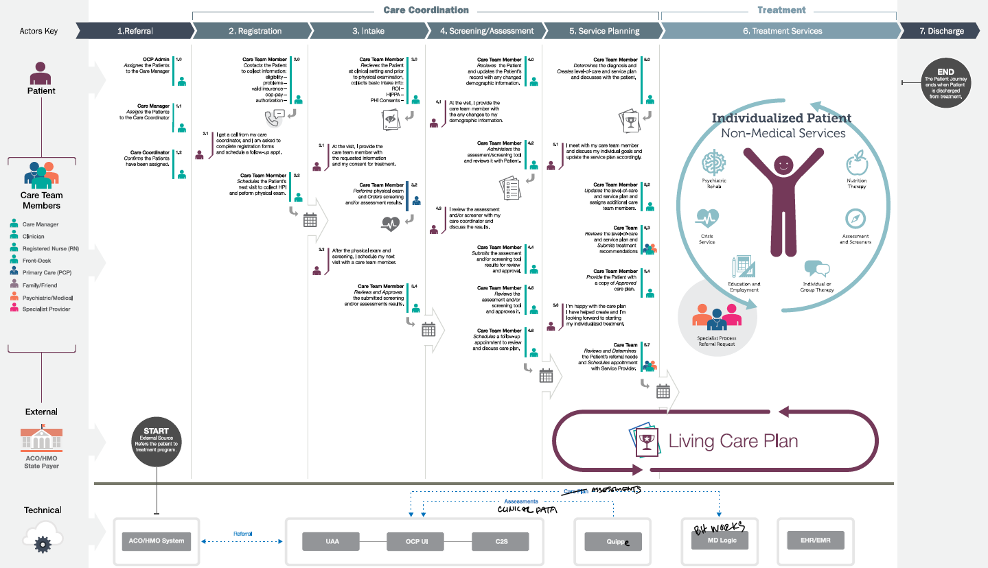
Omnibus Care Plan Portal Introduction: Care Coordination Journey Map

Slide 17
Omnibus Care Plan Portal Introduction: Focus of the Demonstration
OCP Admin
Onboarding of organizations to OCP and adding practitioners to OCP
Managing roles/users in UAA and Helpdesk/Troubleshooting
Org Admin
Managing organization locations, healthcare services, activity definitions
Associating practitioners to organization/location and assigning roles
Care Manager
Manage patient information, care teams, and assign care coordinators
Patient consents
Care Coordinator
Tasks, To Do, Appointments, Communication, Assessments
Care Coordination activities and care plan management
Patient
Other Possible Functional Roles
Similar Care coordination activities for Benefits specialist, Front Office, Health Assistant, and so on
Patient information, Care Team
Business Function Role
Capabilities to be demonstrated
Appointments, Communication, Consents

Slide 18
Disruption of the Health Software Status Quo
20th Century Software does not and cannot meet 21st Century needs
Software constructed with Proprietary Data Models
Software Architecture creates inability to use modern technology
Creates millions of data sinks across the nation
Severe impedance mismatch when mapping to standard formats
HL7 CDA is obsolete, and will be phased out over time
21st Century Software
HL7 FHIR allows building software using the standard
Open API eliminates Proprietary Data Models
Smart on FHIR facilitates application components that can be combined to create new software capabilities
Functional Modules, Clinical Decision Support, Cloud Computing, Data Analytics, Data Visualization
Open Source paradigm facilitates new business models
Significant reduction in software costs
Optimized patient centered care
Shared Patient Care Plan becomes a reality

Slide 19
OCP Demonstration https://1drv.ms/v/s!AqbNunor4WUgoFRzZ3KEwsF-BTQQ

Slide 20
Questions and Next Steps

