Slide 1
June, 25, 2019

Slide 2
Welcome to the June Innovation Webinar
2019 Summit Preview
Introduction Mun
Plenary Overview Hewitt
Major Demonstrations Hewitt
Pre-Summit SQL Training Course Hewitt
Closing Remarks Hewitt
Notes:
Opening slide

Slide 3
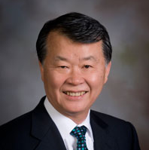
Welcome to the June Innovation Webinar
Today’s Moderators:
Seong K. Mun, PhD
President and CEO
OSEHRA
Don Hewitt
Vice President, Business Operations
OSEHRA
Notes:
Opening slide

Slide 4
Morning Plenary Overview
8:30 AM – VistA in Transition - Government Perspective
10:45 AM – VistA in Transition - Industry Perspective

Slide 5
Afternoon Plenary Overview
1:00 PM – Preparing for Transition - The HHS/IHS Health Information Technology Modernization Research Project
1:45 PM – Federal Open Source Progress and Challenges
3:00 PM – Care Without Boundaries - Government & Private Sector Interoperability
4:00 PM – Care Without Boundaries - An Industry Solution to Interoperability

Slide 6
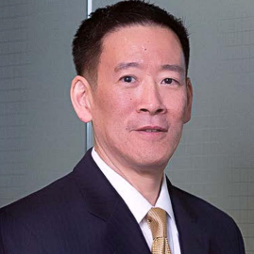
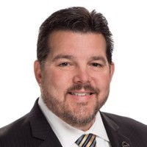
Major Summit Demonstrations
Care Without Boundaries – An Industry Solution to Interoperabilty
Bo Dagnall, Perspecta
Veterans Data Integration
and Federation (VDIF)
Enterprise Platform
George Hou, InterSystems
CareNexus Care Coordination Platform
Brian Book, BookZurman
Synthetic Patient Data
Open Source Project Group Roundtable
Peter Li, OSEHRA

Slide 7
Pre-Summit SQL Training Course
Christopher Edwards
Software Programmer
YottaDB LLC

Slide 8
Closing Remarks

Slide 9
Questions?
Please use the chat or Q&A feature to submit your questions.
summit@osehra.org

Slide 10
Visit summit.osehra.org to register today!

