Slide 1



Handling Data Overload
HIM Track
VeHU August 15, 2012
Janet Zuroske, RHIA
Clinical and Health Informatics Quality Manager
Preventive Ethics Coordinator
VA Puget Sound Health Care System
Adam Chin, RHIA
Chief, HIMS
VA Eastern Colorado Health Care System
American Lake
Seattle Division
Notes:
Becky Introduction
Handling Data Overload:

Slide 2

Welcome to the Data World
Notes:
Adam:
Hello Everyone…as Becky mentioned, I’m Adam Chin, and this is my co-presenter, Janet Zuroske.
Today, we will be diving into the topic of how to handle data in the environment we work in. Here are some questions we will be answering. What are the some of the methods we use to collect data? What are some of the ways we use data? And How do we transform data into information and display it?
Now, think about what type of data you collect and use at your facility…
Do you collect data when performing
1. Medical Records Committee/Health Record Reviews, or…
2. Run Reports in QuadraMed and export the data into an excel spreadsheet or…
3. Any data retrieved and pulled from VistA (On the stop data request from the front office/Director/Associate Director/Boss – knee jerk data request), or…
4. External data (VSSC, ARC, NPCD), or…
Collecting data due to a Data Requirements (segway into next slide of Data Requirements)
As you can tell, we are surrounded by data.
Janet:
Managing data involves understanding how much data you have, where that data might be stored, how it’s collected, and the content of information it holds. It’s important to understand your data and its meaningful use.

Slide 3

Data Collection Methods Overview
Notes:
Adam:
Have you been in a situation where you had to…
1. Pull data from a source
2. Been given an excel spreadsheet with data to manipulate and analyze, or…
3. Use a paper or electronic method to collect data (health record review)
Well, there are 4 identification items that are useful to think about when collecting data in any of the situations I just described.
Identifying the purpose for collecting your data will help with understanding the reasons why we are handling the data. In turn, it can lead to you deciding how to collect, use and analysis the data.
Identifying Data Elements to collect first before running a report or pulling data from a source can be very helpful. This goes back to understanding the data requirements and purpose of the data. Time savings can be had if you obtain clarification on what data elements are needed. Also, if someone is requesting data, you want to make sure you are providing them the correct data elements. There are times when requesters don’t really know what they are asking for and when you provide them data the first time around, they may indicate that is not the data they wanted.
Now, Identifying the method on how to collect your data is a very important step in the process. There’s the Paper method and many electronic methods, which we will cover. Deciding and developing a collection method can be a time saver and can help with analyzing and displaying data.
Identify the audience for the data is important in determining how you will display data. You may present data differently if your audience is the clinical executive board versus your direct boss versus your facility director. There are multiple ways to display data and we will cover a few of them later in our presentation.
Janet:
We’ll touch more upon these subjects as we go through our presentation today. But let’s go ahead and move on to our first polling question.

Slide 4

Poll Question
Do you have the means to collect
data in your service/section?
A. YES
B. NO
C. UNSURE
Notes:
Janet:
Do you have the means to collect data in your service/section? Please select from: Yes, No, or Unsure.
To submit your answer, please use the blue polling icon above my head. Also, while you are up there, now is a perfect time to submit your questions using the orange “ask the presenter” button. We will answer your questions at the end of the presentation. For now, we are going to continue on with our content and we will review the poll results in just a few minutes.

Slide 5

Data Requirements
Notes:
Adam:
It is important to understand why we collect, use, and report data. Data requirements can drive us to handle a massive amount of data. Let’s explore data requirements briefly. Data requirements within VA are all around us. Most importantly, to be compliant with TJC to maintain accreditation requires data collection. In addition, the VA Office of Inspector General requires facilities to provide data to demonstrate compliance with certain aspects. Then, we have VA and VHA directives and handbooks that require us to collect data to demonstrate compliance. In addition, there are facility performance measures that are completely data driven.
Now, for HIM specific data requirements, there’s monitoring of each unit. For example, for a coding unit, you may want to pull data from QuadraMed to look at coder productivity and turnaround time. Same goes for Release of Information and Scanning in accessing the DSS ROI software and VistA imaging to pull productivity reports for each of the two units.

Slide 6



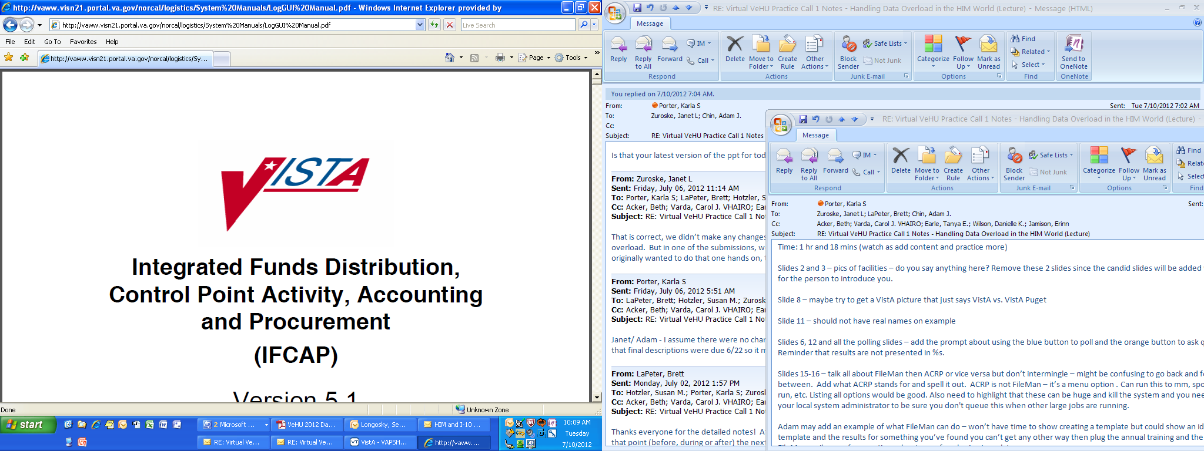

Notes:
Janet
The world of health information and health care data is expanding and will continue to present itself in many forms.
The VA provides us with many program tools, but are you aware of those tools and how to effectively use them?
Programs you can easily design to manage and report information.
SharePoint
Databases (One type: Microsoft Access)
Microsoft Excel
Microsoft Word
These effective tools will help you lay out the foundation for any department or operating system.
The world of health information and health care data is expanding and will continue to present itself in many forms.
But before we get into these electronic methods, remember those days when all we had was paper? Well, in many facilities paper is still a major form of data collection.
And now let’s take a look at our poll results (wait until you see the results to advance the slides).

Slide 7
Poll Results #1
Notes:
Do you have the means to collect data in your service/section?
YES
NO
UNSURE

Slide 8

Data Collection Methods - Paper
Notes:
Adam:
Now that we have discussed data requirements and items to identify and think about, let’s discuss data collection methods. There’s no one correct way to collect data. Although, It’s important to know what your options are and the pros and cons of each. Let’s start with how paper can be used. A paper form can be created to have someone hand write in data. A good example of this is the Environmental Agents exam worksheets. The worksheets are used to capture data elements such as the signs and symptoms. This paper form is filled out and the data on the form is entered into the Environmental Agents registry websites.
Another example at Eastern Colorado is a paper form we use to capture mortality data. (CLICK TO NEXT SLIDE)

Slide 9
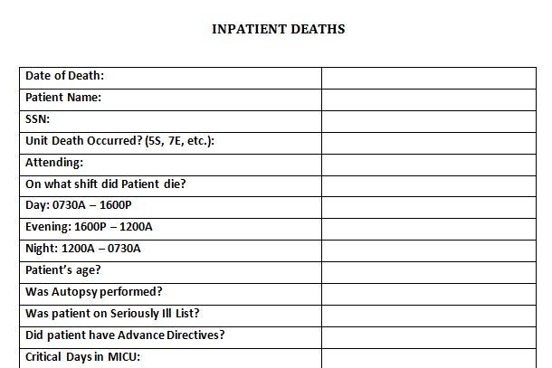
Notes:
Adam:
I realize that you cannot see the details of this form, but I wanted to give you a global perspective of the paper form that my inpatient coders fill out on all Veterans who expire as an inpatient. If you would like to see the details, please use the download button above my head to download a copy of the presentation. Once a coder completes the form, it is sent to me and from there, I populate an excel spreadsheet with the results. We find it useful to use this paper form because we obtain the spreadsheet with all of the expired Veterans from another service after the fact.

Slide 10
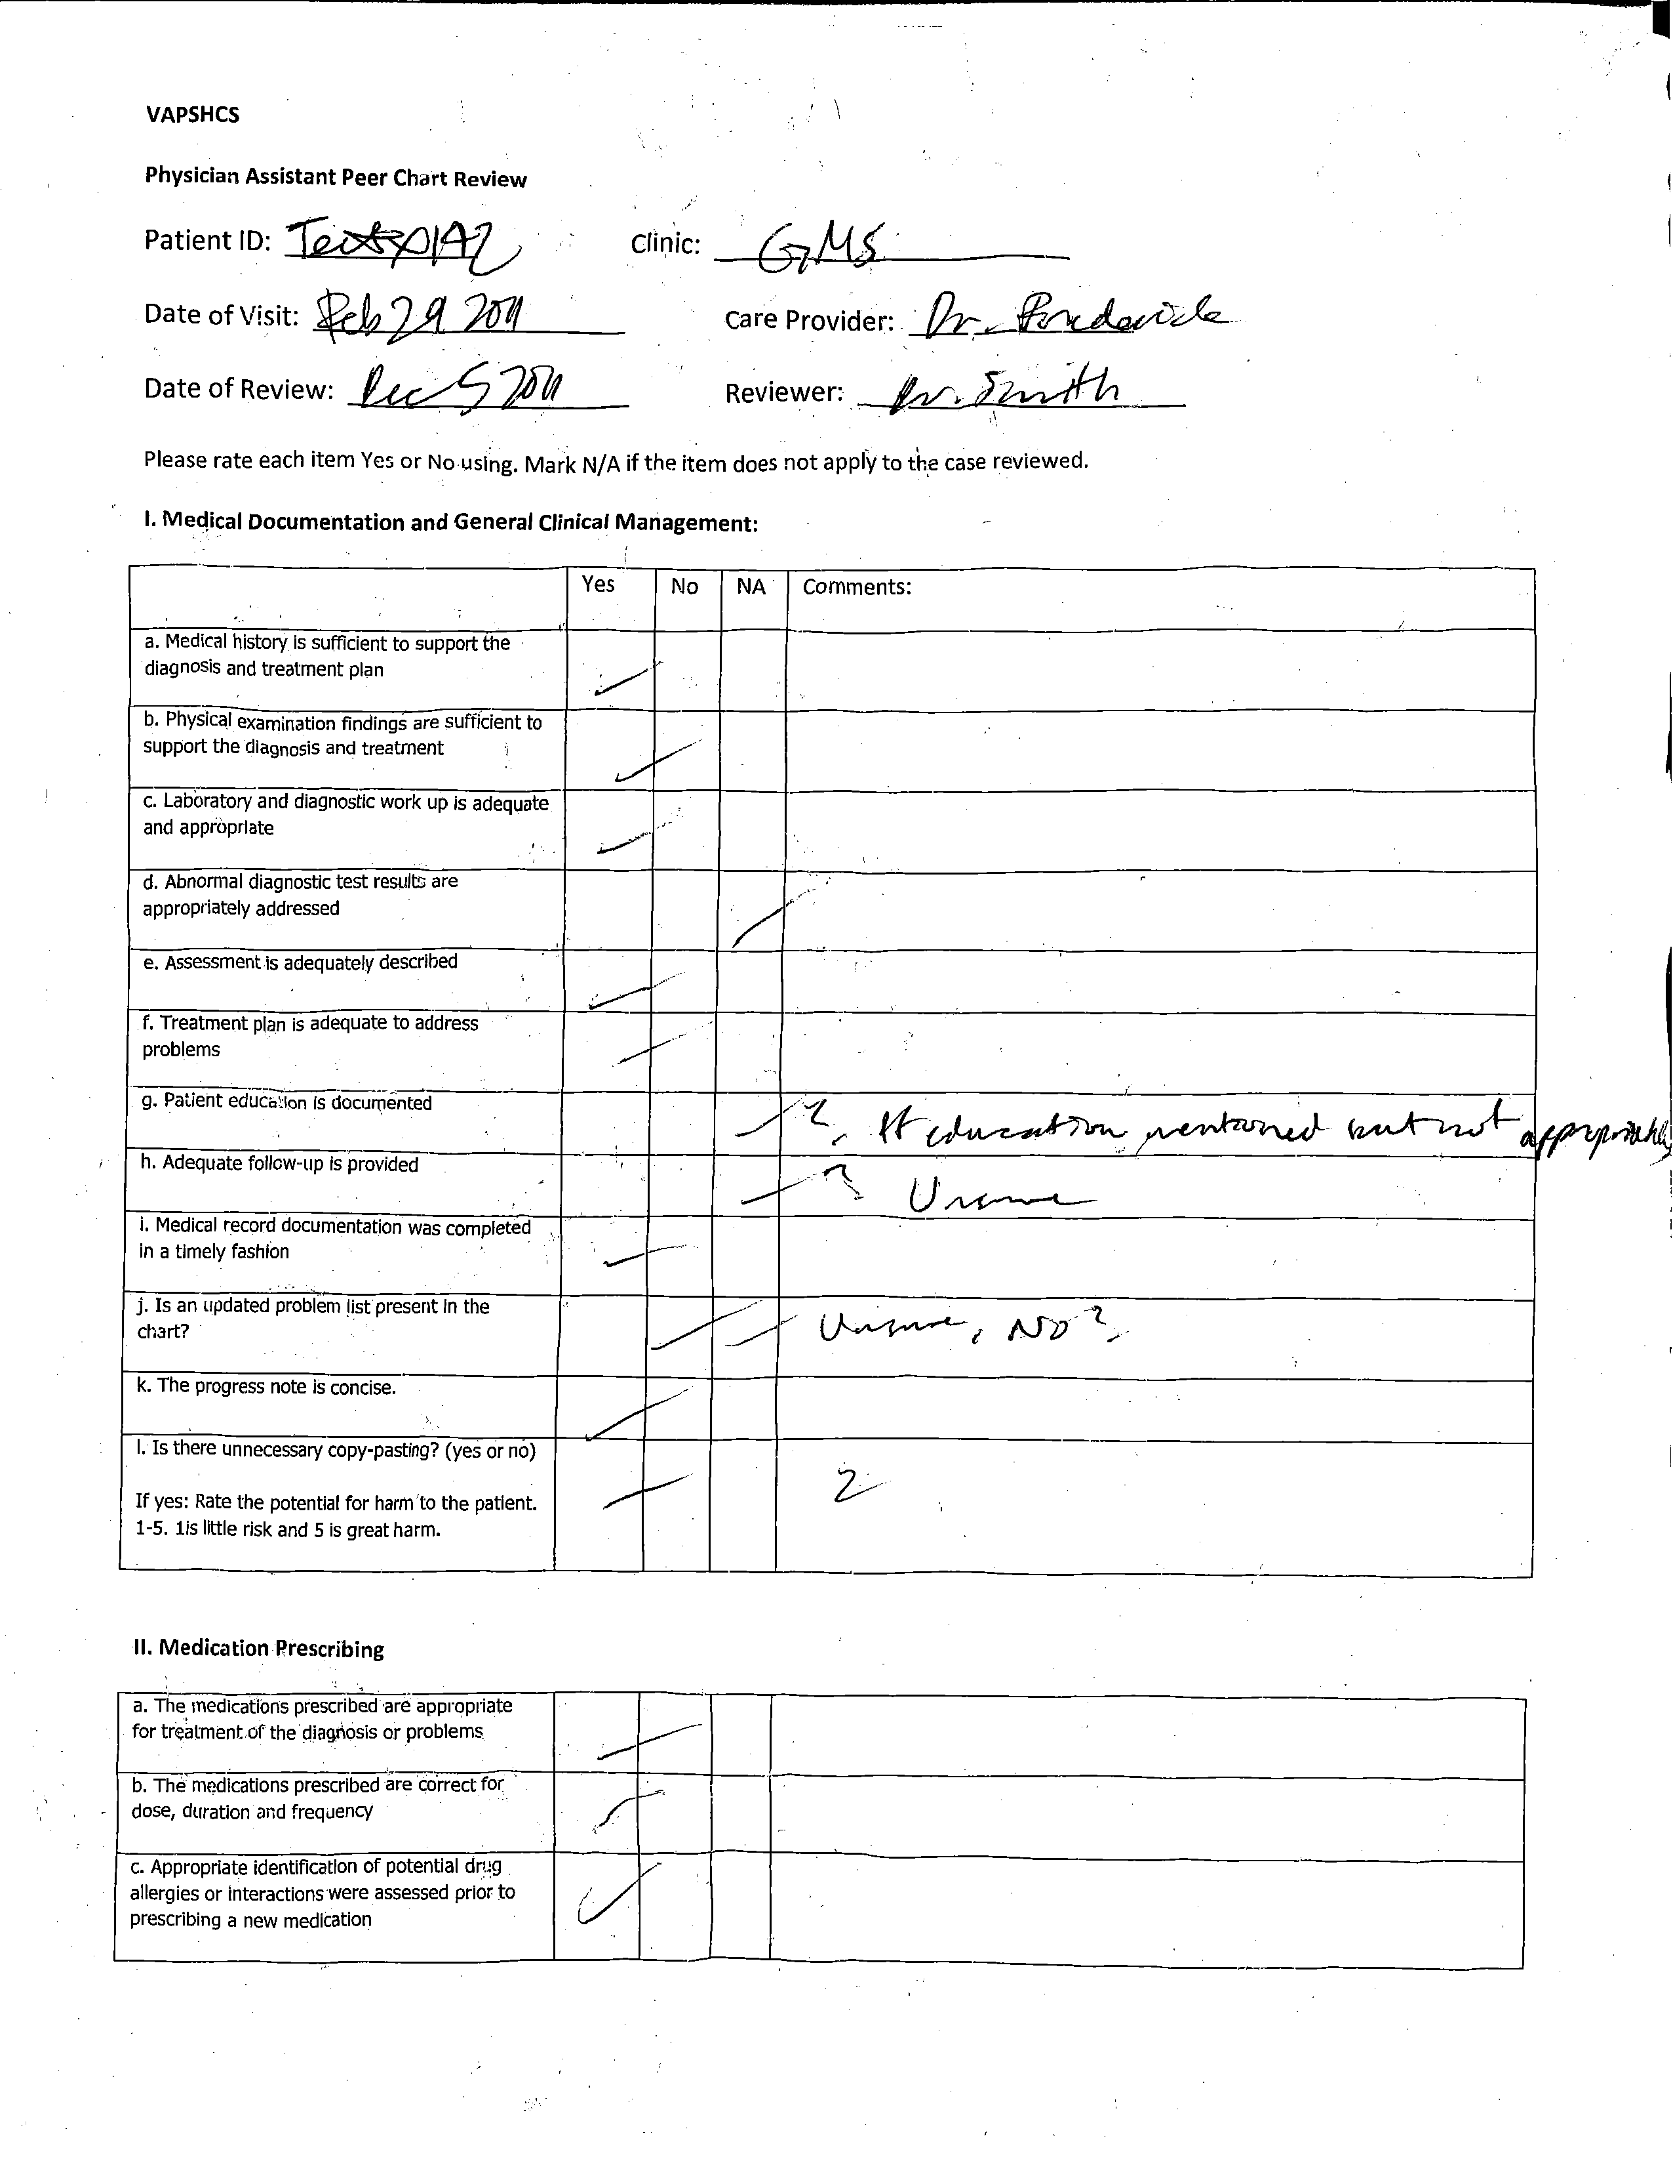
10
Notes:
Janet:
Great examples Adam. Even though we are fully electronic at Puget Sound, a few of our forms are still documented on paper and by hand. This is an example of how illegible hand writing can be and that sometimes the paper document doesn’t always come back in the best shape. However, we understand that some systems still use paper and paper is still a form of data collection.

Slide 11
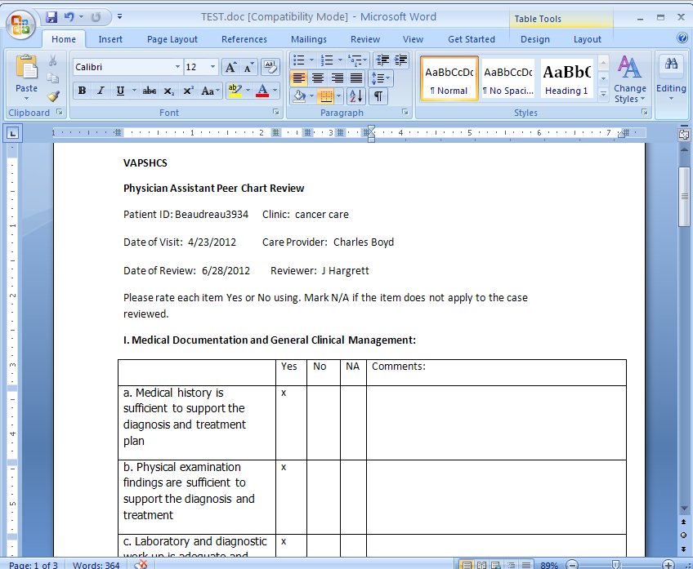
Notes:
Janet:
However, just because you have paper, doesn’t mean it must be documented by hand. Typically as paper forms are created by Word, you can provide the option to complete forms electronically through the program Word itself, rather than providing printed copies. In the case of this PA Peer Chart Review, you can see the difference in legibility and standardization.

Slide 12
Poll Question
Are you currently using a paper
method for the collection of data?
YES
NO
UNSURE
Notes:
Janet:
In regards to paper, let’s go to our second poll.
Are you currently using a paper method for the collection of data? Please select from: Yes, No, or Unsure.
Remember, to submit your answer, please use the blue polling icon above my head. Also, while you are up there, now is a perfect time to submit your questions using the orange “ask the presenter” button and we will be sure to answer your questions at the end of the presentation. For now, we are going to continue on with our content and we will review the poll results in just a few minutes.

Slide 13





Data Sources
Notes:
Adam:
Moving on, now that we have talked about paper methods of collecting data, let’s discuss electronic Data Sources.
A main source of data is VistA. VistA can be utilized to obtain Veteran demographic data, outpatient visit data, inpatient data, surgery data, and much more. There are many reports to run in VistA and I’ll mention a few here. The Ambulatory Care Reporting Package (ACRP) has several canned reports and an Ad Hoc report option to pull outpatient visit and encounter data.
There’s also the Text Integrated Utilities menu that provides unsigned and uncosigned progress note report functionality.
In addition, you can create a FileMan report in VistA that takes a look at specific files and data fields that you can manually specify to pull. If you know certain data elements are entered into Vista, you will most likely be able to create a report in FileMan that will display the data you want.
One example of a FileMan report that is useful is a report that identifies Veterans who have not been seen at a facility for 3 years and more. This report can be used to identify an “inactive Veteran pull list” for the medical record retirement process.
Now, there are other electronic sources of data from a HIM perspective. Quadramed reports in both ACM and VIP Director are very useful to look at coder productivity, coding turnaround time, and identify backlogs for both outpatient and inpatient. The Quadramed Quantim application can also be used to run reports on VERA edit usage and much more. The majority of the QuadraMed reports can be imported into an excel spreadsheet for manipulation which is a great feature.
There are two other applications worth mentioning. An HIM supervisor can obtain reports from the DSS Release of Information application to look at ROI clerk productivity and turnaround time. Also, an HIM Supervisor can obtain reports from the DSS FBCS Doc manager application to look at Non VA purchased care documents that have been scanned in and moved into VistA Imaging.
Janet:
Wow Adam those are some great resources, I personally love VistA and all of the different sets of data I’m able to pull for a multitude of functions.

Slide 14




External Data Sources
Notes:
Adam:
Data…Data…Data…I hope you all didn’t think I was finished talking about electronic data sources. It’s important to know about external data sources that directly relate to your facility. The first source to bring up is the VHA Support Service Center, aka VSSC.
The VSSC website has a slew of reports such as the HIM Metrics, CBI metrics, Non-VA workload, Outpatient workload, and inpatient workload. The important thing to keep in mind about VSSC data is that the sources of many of the reports are from where workload credit is counted for VERA purposes.
Add web address?
The Allocation Resource Center website is a great source for VERA data. The data you can collect can assist in identifying Non-Vested, potentially non-vested, potentially lost complex patients, and much more. If you want the drill down to the specific SSNs of the patients, you’ll need to make sure you have the appropriate access first.
On the National Patient Care Database website, you can run facility specific outpatient workload reports that have successfully transmitted for workload capture. A few of the reports are “Outpatient Encounters by DSS identify and Division, Most frequent 50 CPT codes by division, and DSS Identifying by frequency.
With Local/Regional Data Warehouses, access to this data may need to be requested or you may need to request to have the report ran. Local and regional data warehouses are usually extracts of VistA data from a specific point in time so, keep in mind that local and regional data warehouse data are not real time.
Another source of data is from your local or VISN Decision Support Service, aka DSS. The DSS folks usually have a system in place for users to request data. My VISN has an electronic way to request data through a website. DSS can provide workload reports by stop codes and other identifiers.
(CLICK TO ADVANCE TO NEXT SLIDE)
VHA HIM Metrics
VHA Support Service Center (VSSC)
http://vssc.med.va.gov/
Allocation Resource Center (ARC)
http://vaww.arc.med.va.gov/
National Patient Care Database (NPCD)
https://vaww.npcd.aac.va.gov/
Local/Regional Data warehouse
DSS Requested Reports
VHA HIM Metrics
https://securereports2.vssc.med.va.gov/Reports/Pages/Report.aspx?ItemPath=%2fMgmtReports%2fHIMS%2fProductionHIMS%2fHIM+Metrics+Report&rs:Command=Render

Slide 15
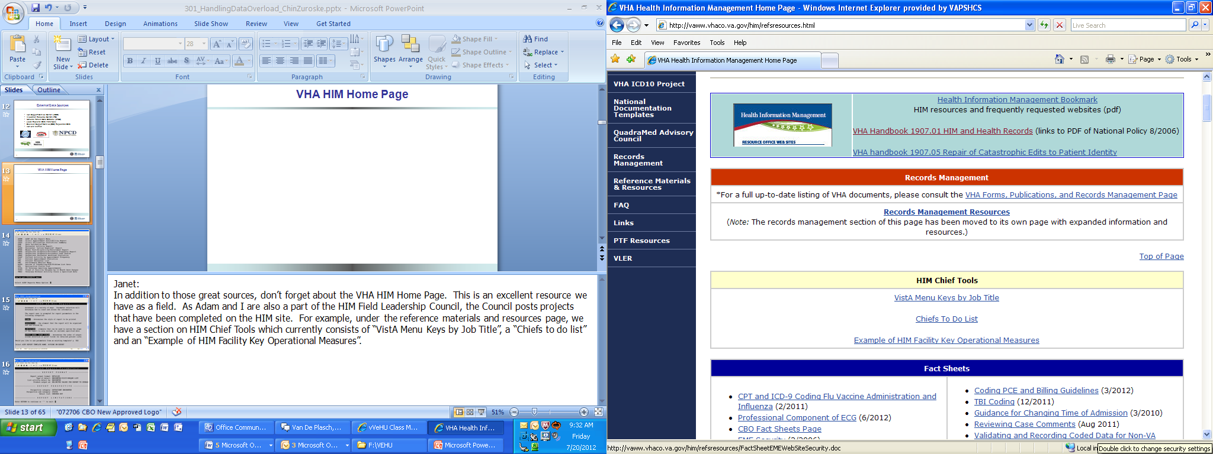
VHA HIM Home Page
Notes:
Janet:
In addition to those great sources, don’t forget about the VHA HIM Home Page. This is an excellent resource we have as a field. As Adam and I are also a part of the HIM Field Leadership Council, the Council posts projects that have been completed on the HIM site. For example, under the reference materials and resources page, we have a section on HIM Chief Tools which currently consists of “VistA Menu Keys by Job Title”, a “Chiefs to do list” and an “Example of HIM Facility Key Operational Measures”.

Slide 16
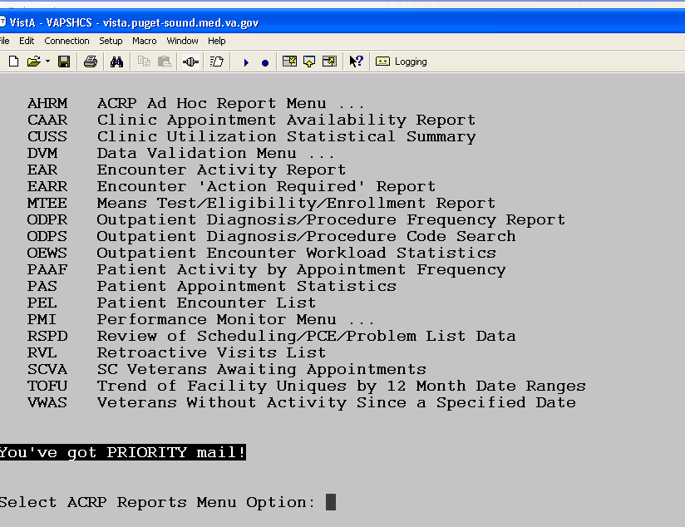
Notes:
Janet
You may not be able to see the details of all of these screen shots, but you are welcome to download a copy of the presentation using the download button above my head if you want to take a closer look.
Let’s go ahead a start with one of your most common data housing resources when it comes to health information, VistA.
For those of you that may not be aware, VistA stands for Veterans Health Information Systems Technology Architecture.
VistA has many functions which Adam explained earlier.

Slide 17
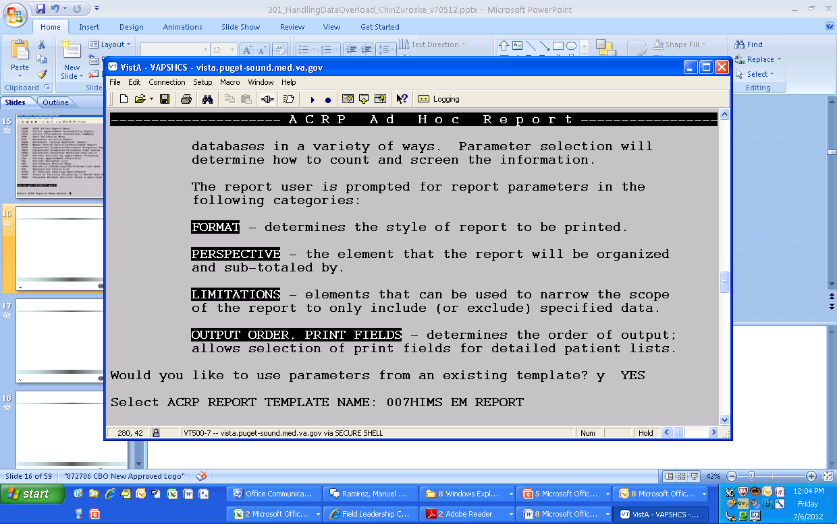
Notes:
Janet
However, for this example I am going to specifically show you an Ad Hoc report in ACRP.
ACRP stands for Ambulatory Care Reporting Package. This is a very powerful package in the way that it can be used to track Joint Commission monitors as well as produce reports on health information.
I am going to run through a local report for collecting Evaluation and Management codes
As you may notice I am using an existing template, which means all of the report parameters are established.

Slide 18
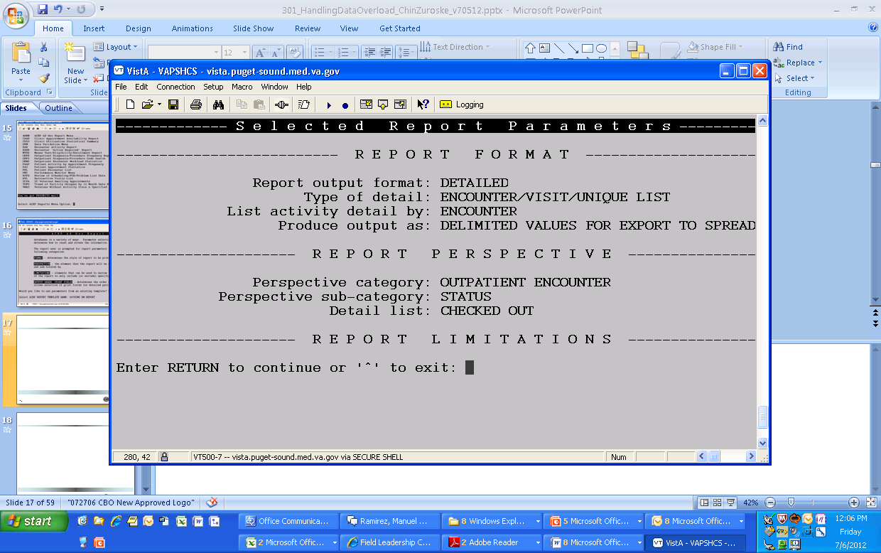
Notes:
This screen here, shows you those specific report parameters.
Keep in mind, when you are using the ACRP ad hoc report function, the parameters may be selected as you go through the format.
An existing template is not required.

Slide 19
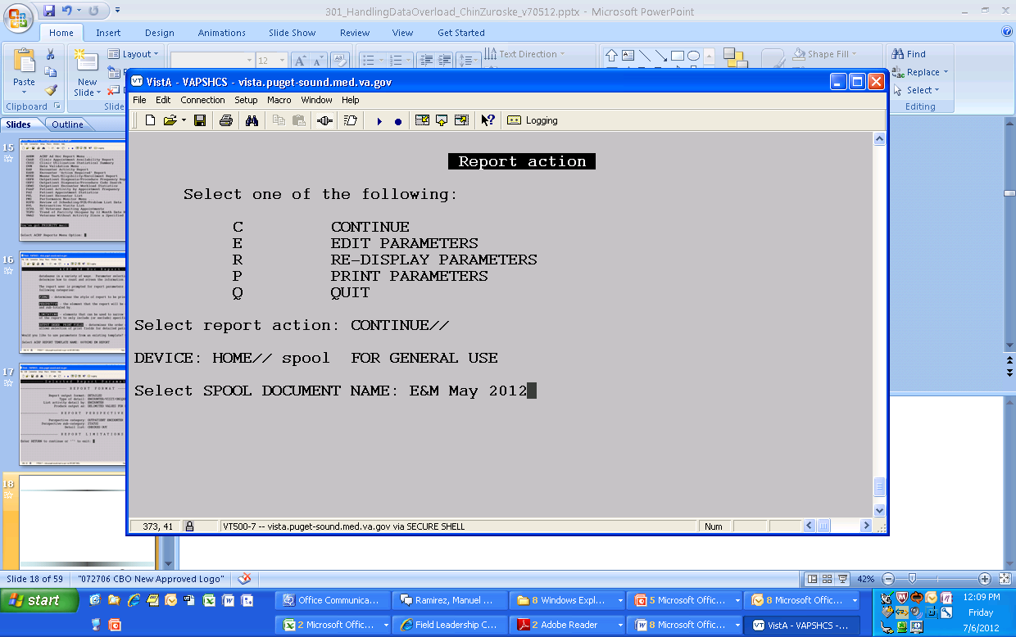
Notes:
For reports containing a lot of data, you would want to spool to the data if you have the option available.

Slide 20
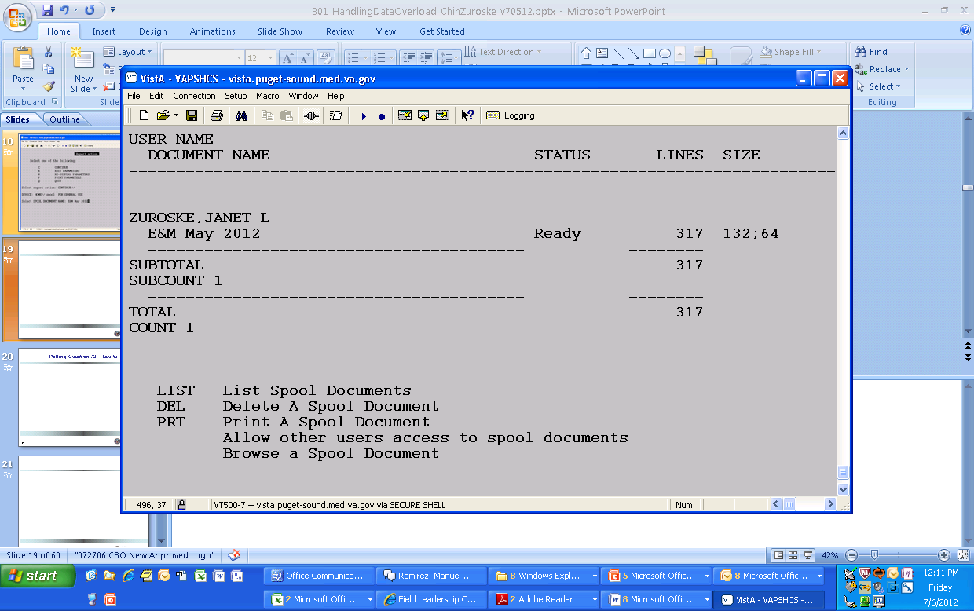
Notes:
Once your report is ready in the Spooler, you will go ahead and print the document but again, as there is a lot of information it is best to log the data.

Slide 21
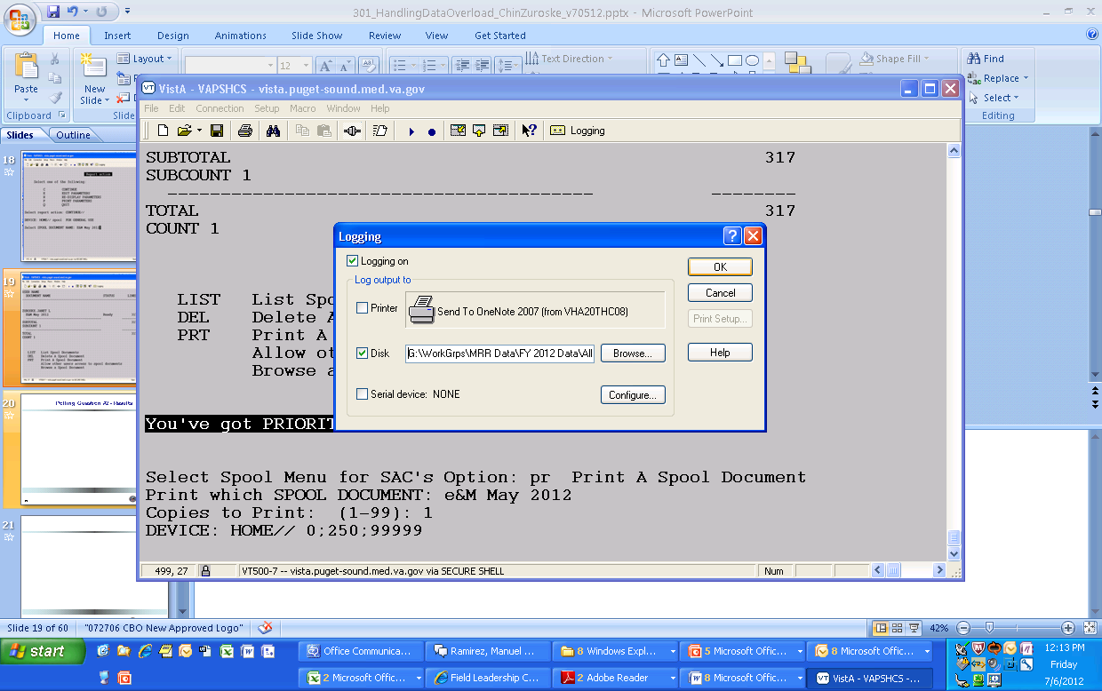
Notes:
To log the data, you want to either go to File, Logging, or as you can see on the screen I have logging in my toolbar for quick access as I use it so often.
In this example, we are using “Reflections” as the VistA emulator. If you use a different emulator such as CRT, you may need to initiate the logging function differently.
You want to make sure that both the “logging on” and “disk” boxes are checked. You would then click the browse button to make sure the data is being saved in the appropriate location. Once you have finished, go ahead and click the OK button. This has activated the logging function.
Back on your VistA screen, you want to now hit enter after the parameters you have set. Once the data has stopped running, go ahead and turn off the logging function by the buttons selected earlier

Slide 22
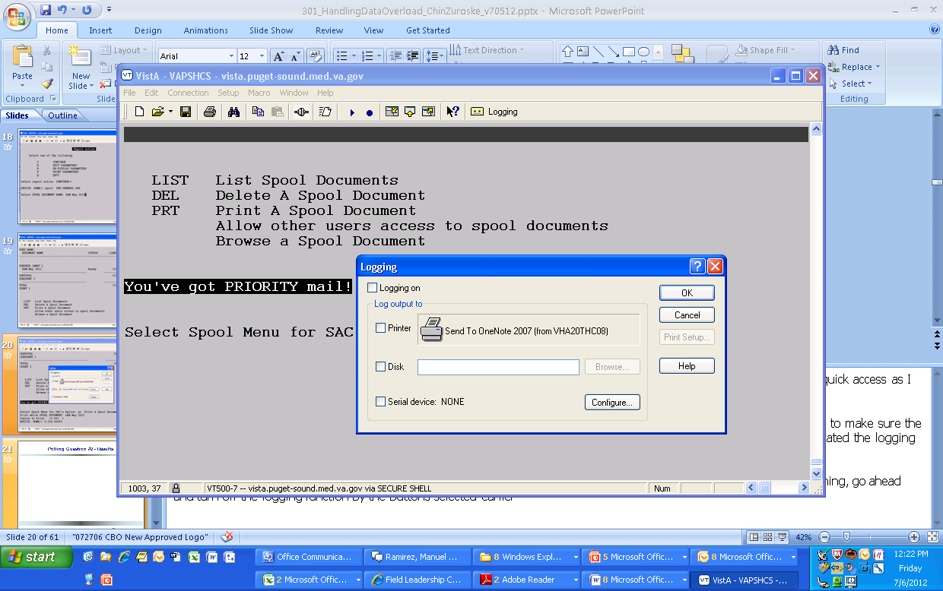
Notes:
Once the data has stopped running, go ahead and turn off the logging function by the un-selecting the check boxes marked earlier so that it looks like this. Hit ok. You have now successfully captured your data in a .txt file so that you may open it in a program such as Excel.
Before we move onto capturing and manipulating data in Excel, let’s review the polling results from questions #2 (wait to see results before clicking to the next slide)

Slide 23
Poll Results #2
Notes:
Are you currently using a paper method for the collection of data? Please select from: Yes, No, or Unsure

Slide 24

Data Collection Methods – Excel Spreadsheet
Notes:
Adam:
Excel Spreadsheets are very useful with collecting and manipulating data. The majority of data from the sources I described earlier can be captured in an excel spreadsheet. We will show you examples of how to import data from an external source and also examples on entering data into a spreadsheet.

Slide 25
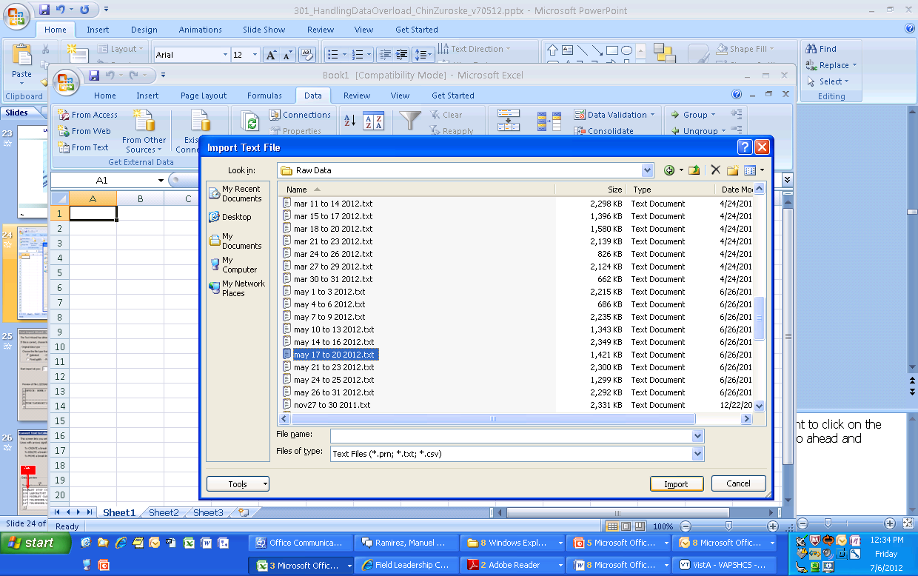
Notes:
Janet:
The first step to manipulating data in Excel would be to open up a blank worksheet. Under the data tab, you would want to click on the “from text” button which will allow you to navigate through your folders to open up any saved .txt file. Once selected, go ahead and click on the import button.

Slide 26
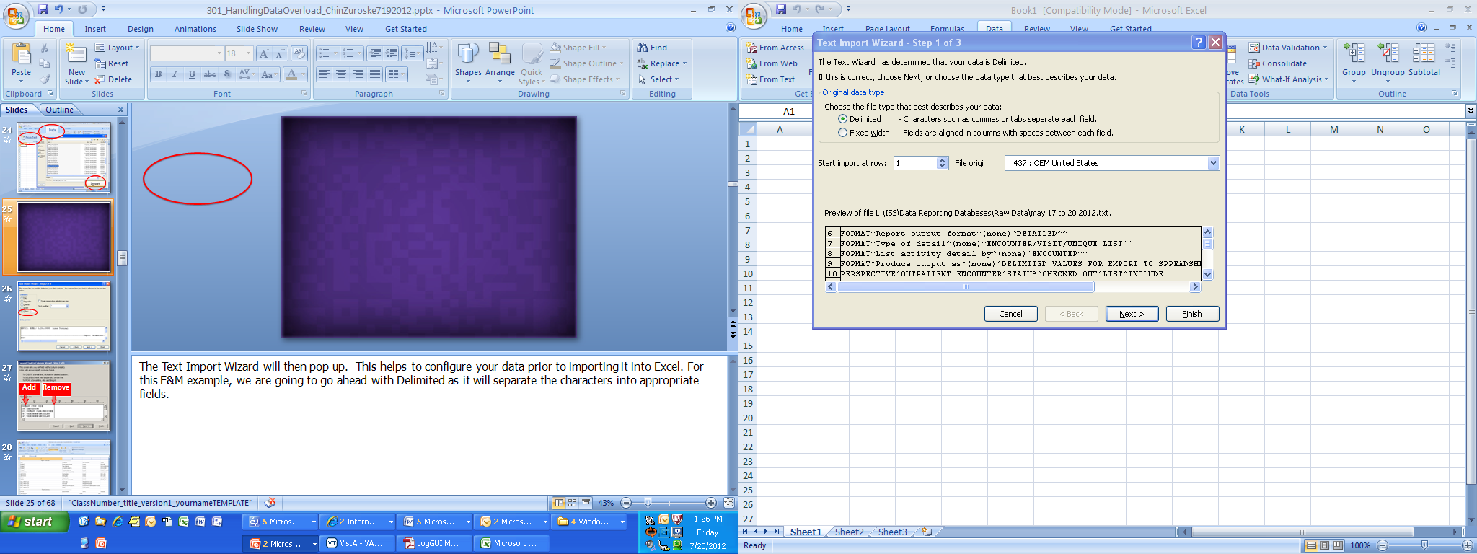
Notes:
Janet:
The Text Import Wizard will then pop up. This helps to configure your data prior to importing it into Excel. For this E&M example, we are going to go ahead with Delimited as it will separate the characters into appropriate fields.

Slide 27
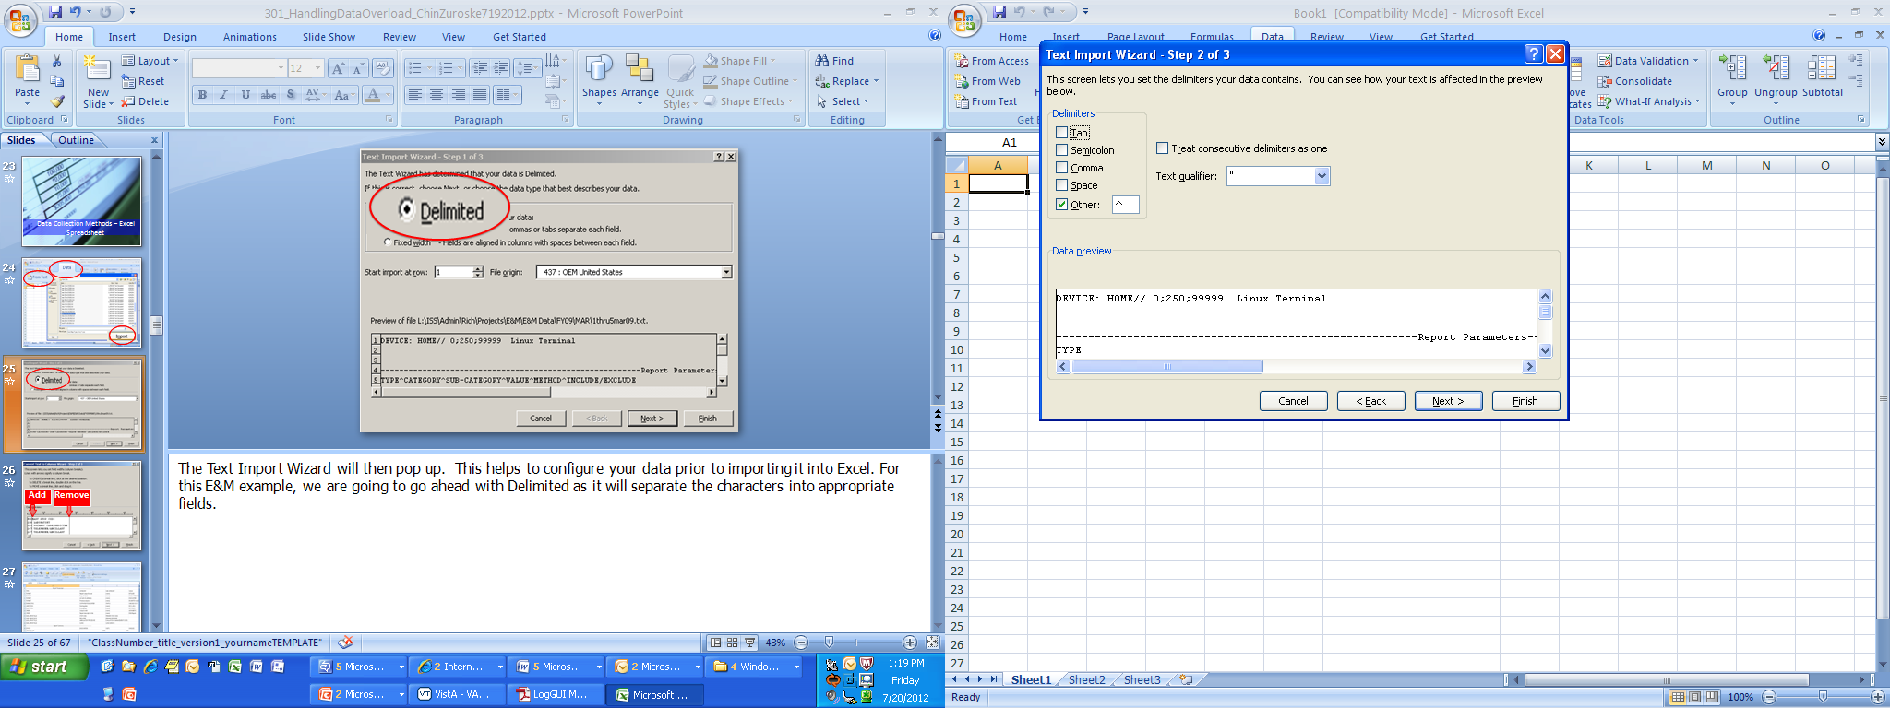
Notes:
Janet:
This screen allows you to go ahead and set the delimiters. We have chosen the box other and entered the caret in order to set our delimiters.

Slide 28
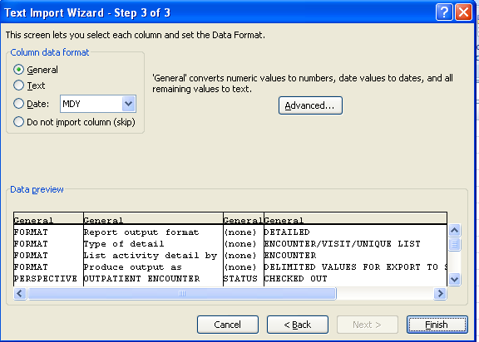
Add
Remove
Notes:
Janet:
The following steps will ask you to remove or add lines between the text. Once completed, hit Finish.

Slide 29
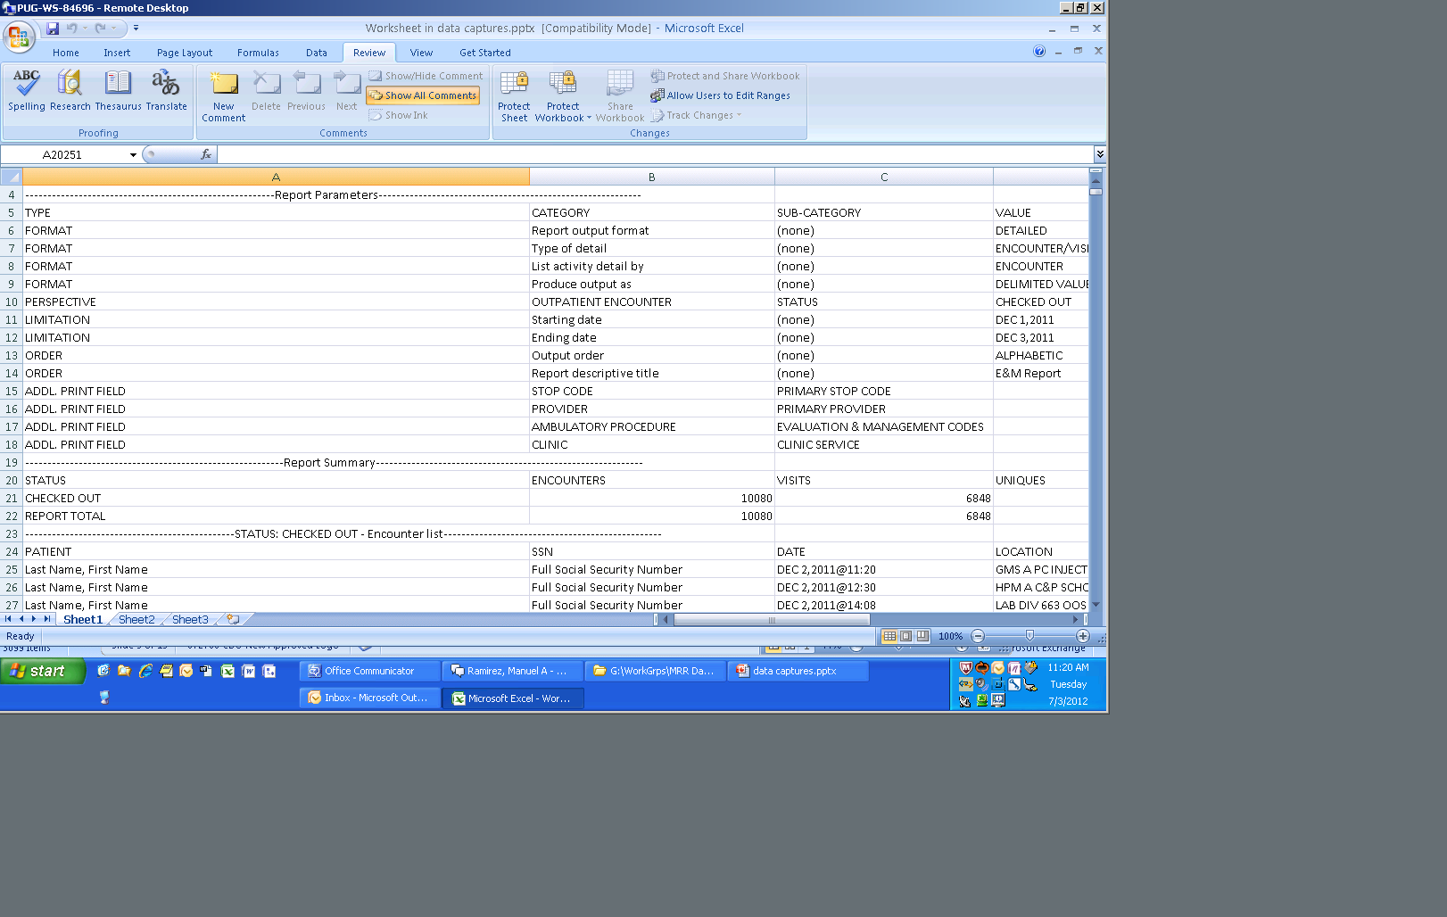
Notes:
Janet:
This slide is to give you an overall view of how your data will then be displayed nicely in Excel. From here you can change the order from ascending to descending, change your title headers, delete any unnecessary data or even incorporate some formulas.

Slide 30
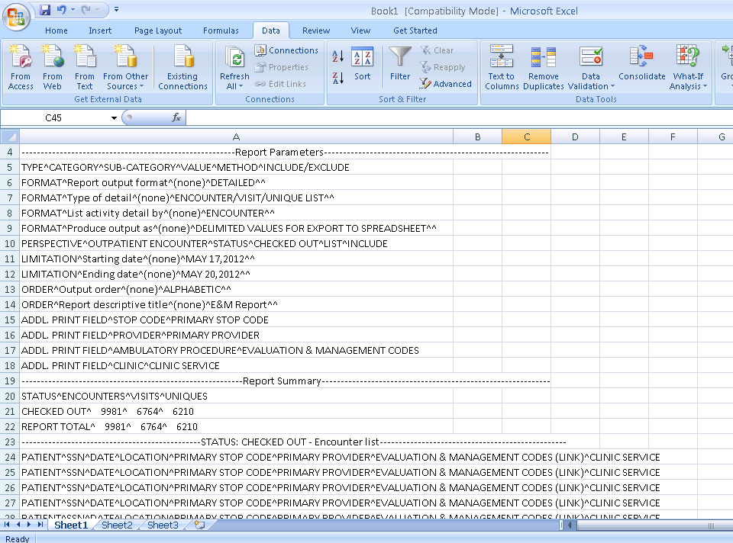
Notes:
Janet:
If you had not chosen to use the text import wizard your data your data wouldn’t have separated nicely into columns but rather all meshed into one.

Slide 31
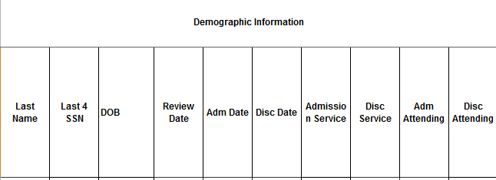
Eastern Colorado’s Health Record Review
Notes:
Adam:
That’s definitely a great example of using the import wizard in excel.
Now, let me show you the spreadsheet we use at Eastern Colorado for our inpatient health record review process. We start off with data capturing the demographic information for the each inpatient case we review.

Slide 32
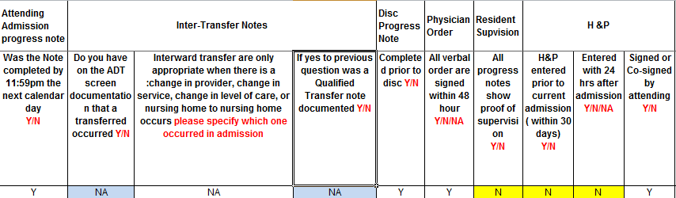
Notes:
Adam:
From there, you can see that we review multiple data elements for each inpatient case. The majority of the answers the reviewers provide in the spreadsheet are “Y” for yes, “N” for no and when applicable, “NA” for not applicable. The reviewers enter the data top to bottom on the spreadsheet for the different cases so that one row is for one patient and the subsequent row below is the next patient.

Slide 33
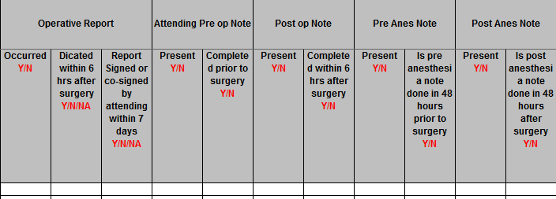
Notes:
Adam:
If an inpatient case involved surgery, here’s the screen shot of the data elements the reviewers monitor. Again, the reviewers provide Y, N, and NA answers. The majority of the review is to determine if the documentation is present and in the record timely.
The few screen shots that I have shown you may not be the prettiest when it comes to formatting. When creating the spreadsheet, we went simple and didn’t go for making the data entry spreadsheet look appealing. The most important part is to make sure the calculations of the data entered data is correct and that the results are displayed pleasingly. We will go into data display later on this presentation.

Slide 34
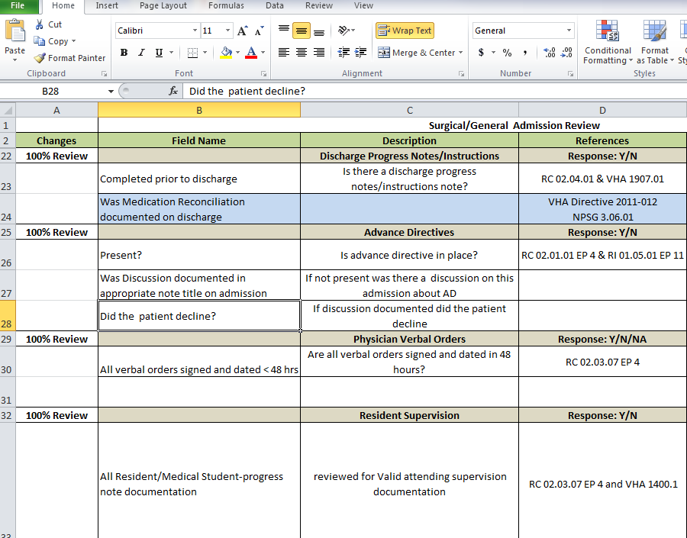
Notes:
Adam:
This next screen shot is our Data Definition and Instruction spreadsheet for our health record review process. It describes each data element and provides the reference for each data element, or in other words, the reason why we review the specific element. Also, we have the location in CPRS of where to find the data element. We have found that this spreadsheet is very useful when we train new reviewers.

Slide 35
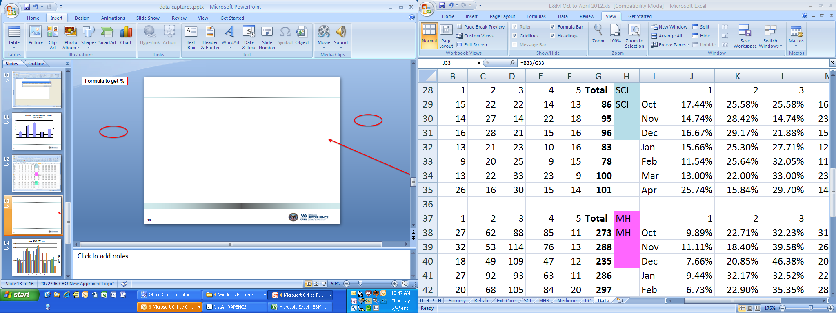
Formula to get %
35
Notes:
Janet:
In addition to data capture and manipulation, Excel is a great tool to develop statistics and graphs.
Here is an example of E&M data from Oct 2011 to April 2012 all collected into one spreadsheet. As we look at this data, we have the levels of E&M at the top, 1,2,3,4 and 5. Cell G represents the total of cases represented. In order to show the percentage rate of each individual E&M level, you would want to divide that number by the total. So, in the case of Excel, you should type in the cell =B33/G33 and then hit enter. Your percentage rate will then appear.

Slide 36
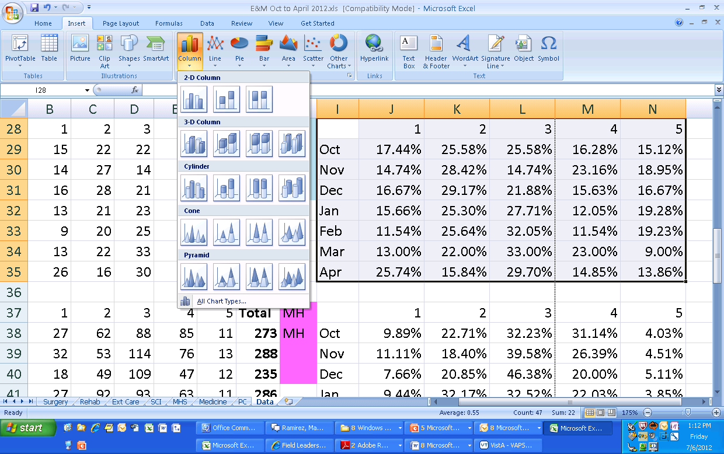
Notes:
Once the statistics are captured, go ahead and capture that data by highlighting the cells you wish to reflect in a chart. While that data is selected go to your toolbar and hit insert From there choose which chart you’d like the data to be represented with. For this example, I have chosen a 2-D column.

Slide 37
Notes:
This is what the final result looks like. You have now created a medium in which depicts meaningful health information by the way of capturing, importing and manipulating data.

Slide 38
Data Collection Methods – Access Database
Notes:
Adam:
Let’s now talk about using Microsoft Access for a data collection method. We will discuss basic, important concepts to know before venturing into creating an Access database and show you some examples of how we have used access databases at both of our facilities. For further education on Microsoft Access, it is good to check with your local education folks to see what types of training is available in a classroom setting and in TMS.

Slide 39
Step 1 – Building a Library
StopCodes
  StopCode
  SCService
  SCName
tblMain
  Patient
  SSN
  Date
  Location
tblEandM
  E and M
  Vesting Level
Notes:
Janet
Databases are an effective tool for storing large amounts of information. But, did you know that data may also be entered, manipulated and exported to other files? Yes one system can do all this!
However, in order to start your database it is vital to have a well-define process and to understand your relationships. Before starting the design of the database, always ask yourself, what is the purpose of this database? You may find this question resurfacing several times throughout the design process. That is okay. This means you are most likely creating a database that is in line with its purpose.
Let’s use the example of the Evaluation and Management database. The purpose of this E&M database is to hold information on the facility’s evaluation and management codes.
In designing your database you want to start by looking at it as a library. For example, in a library, you have authors, book genres, publishers and perhaps a standard format as to where the books are held. You can look at a database in the same exact way.
Using the example of the E&M database, we understand that stop codes, patient information and vesting levels must be included as fields. We would then group these fields into tables as you see here. This could also be looked at as our table relationships. Remember, a relationship for a database can be compared to what a blueprint means to building a hospital. It is important to identify any and all relationships. Otherwise, it may be a very short lasting database.

Slide 40
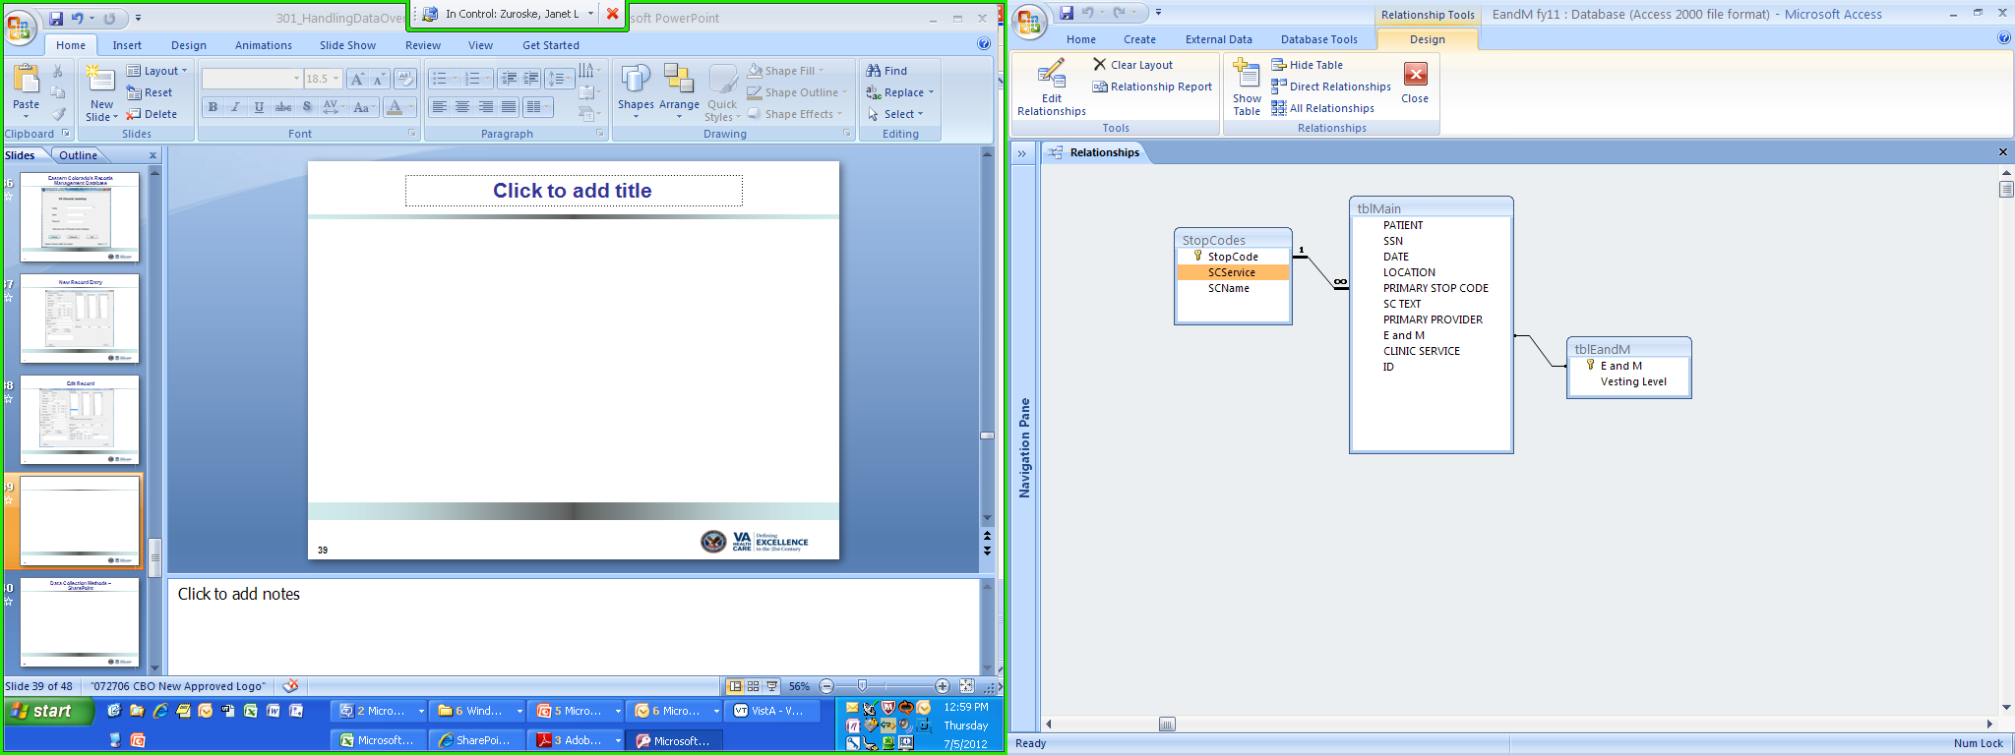
Notes:
Janet:
In Access, here is what your table relationships would look like with the library you we just created. Of course there are many other aspects to Access, but as access is a very large tool, we won’t go into all of the details here.
Please look into your facility’s education department for courses on Access and/or other programs such as Excel and Word.

Slide 41
Poll Question
Have you already utilized the different program trainings at your facility for those such as Access, SharePoint, etc?
  A. Yes
  B. No
Notes:
And now let’s go to our third poll. Have you already utilized the different program trainings at your facility for those such as Access, SharePoint, etc? Yes or No. As a reminder, to submit your answer, please use the blue polling icon above my head. Also, while you are up there, don’t forget to submit your questions using the orange “ask the presenter” button. We will answer your questions at the end of the presentation. For now, we are going to continue on with our content and we will review the poll results in just a few minutes.

Slide 42
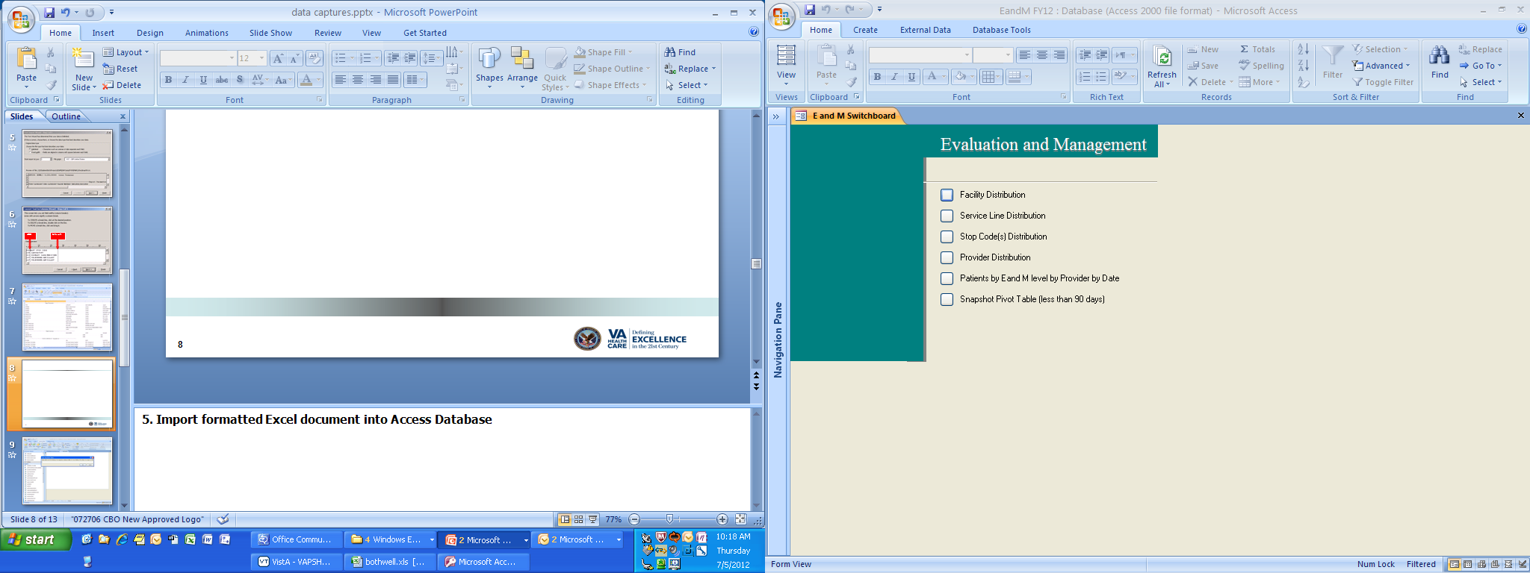
Notes:
This is a screenshot of our E&M database. As you can see, we have the switchboard set up by Facility Distribution, Service Line Distribution, Stop Code Distribution, etc.
For this example, we are going to look at the Facility Distribution. We would do this by clicking the box next to it.

Slide 43
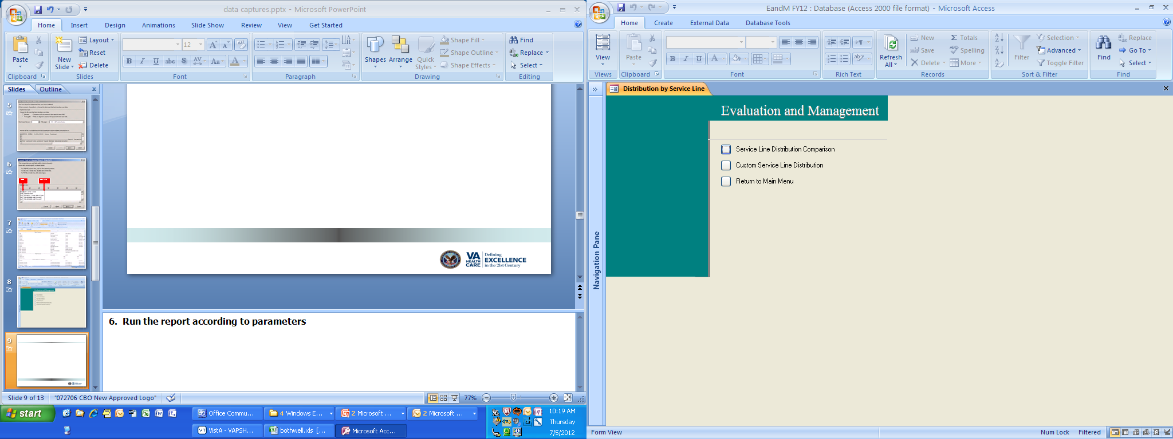
Notes:
When you click on that box, this screen will appear. We are then going to choose our distribution to be compared by Service Line.

Slide 44
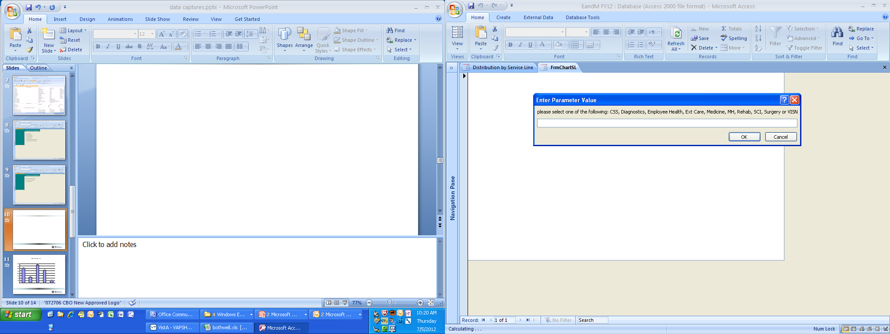
Notes:
The parameter value box will then appear. You will simply enter the service line that you want shown here. For this example, we want to look at Spinal Cord and Injury, so we would type in SCI.

Slide 45
Notes:
After your selection, the graphic depiction will then display. It looks like we are doing pretty well with the level 3s for this service line.

Slide 46
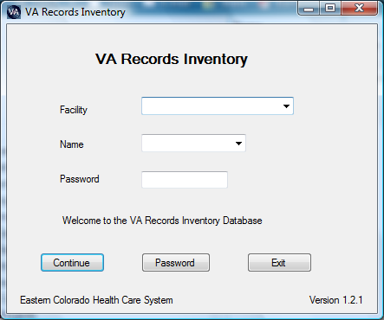
Notes:
Adam:
At Eastern Colorado, my records manager created an Access Database to capture our facility records management inventory. I am very fortunate for my Records Manager’s interest in Microsoft Access and willingness to create the database. All of our records liaisons have access to the database to enter in their record inventories for their service. This screen shot is of the initial login screen. When a liaison logs in, they only see the record items they have entered in and not of any of the other records entered by other liaisons.

Slide 47
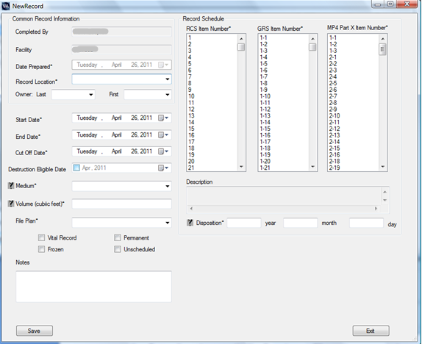
Notes:
Adam:
This next screen shot is of the “New Record Entry” screen where a liaison enters in a new record into the inventory database. When my records manager was creating the database, she first figured out what items are important to capture when conducting an record inventory. As you can see, there are multiple items we capture. We have a field for the Record Liaison, owner of the record, location of record, start and end dates, Disposition eligibility date, type of record, the ability to select specific record item number from RCS-10 and GRS, format of record, and free text notes.
This information can easily be captured in an excel spreadsheet but using an access database to enter in the data can be visually more appealing.

Slide 48
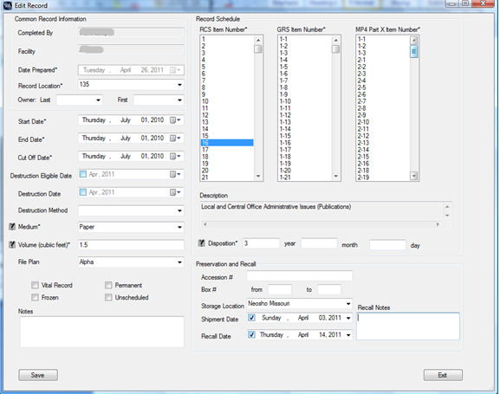
Notes:
Adam:
This next screen shot shows the ability to “edit” a record entry. Editing a record entry is used to record offsite storage of records for retirement purposes or space purposes. We capture the Accession number, box numbers, offsite storage location, shipment date, recall date, and recall notes. You can also edit any of the previously entered items.
This access database does not have any reporting functions right now. There’s only a main screen that shows all of the items a iiaison has entered. Each record item is listed vertically in rows. I know many of you have asked about when the database will be available. To answer your question, we are working on making a “user friendly” version of the database that will be easy to setup.

Slide 49
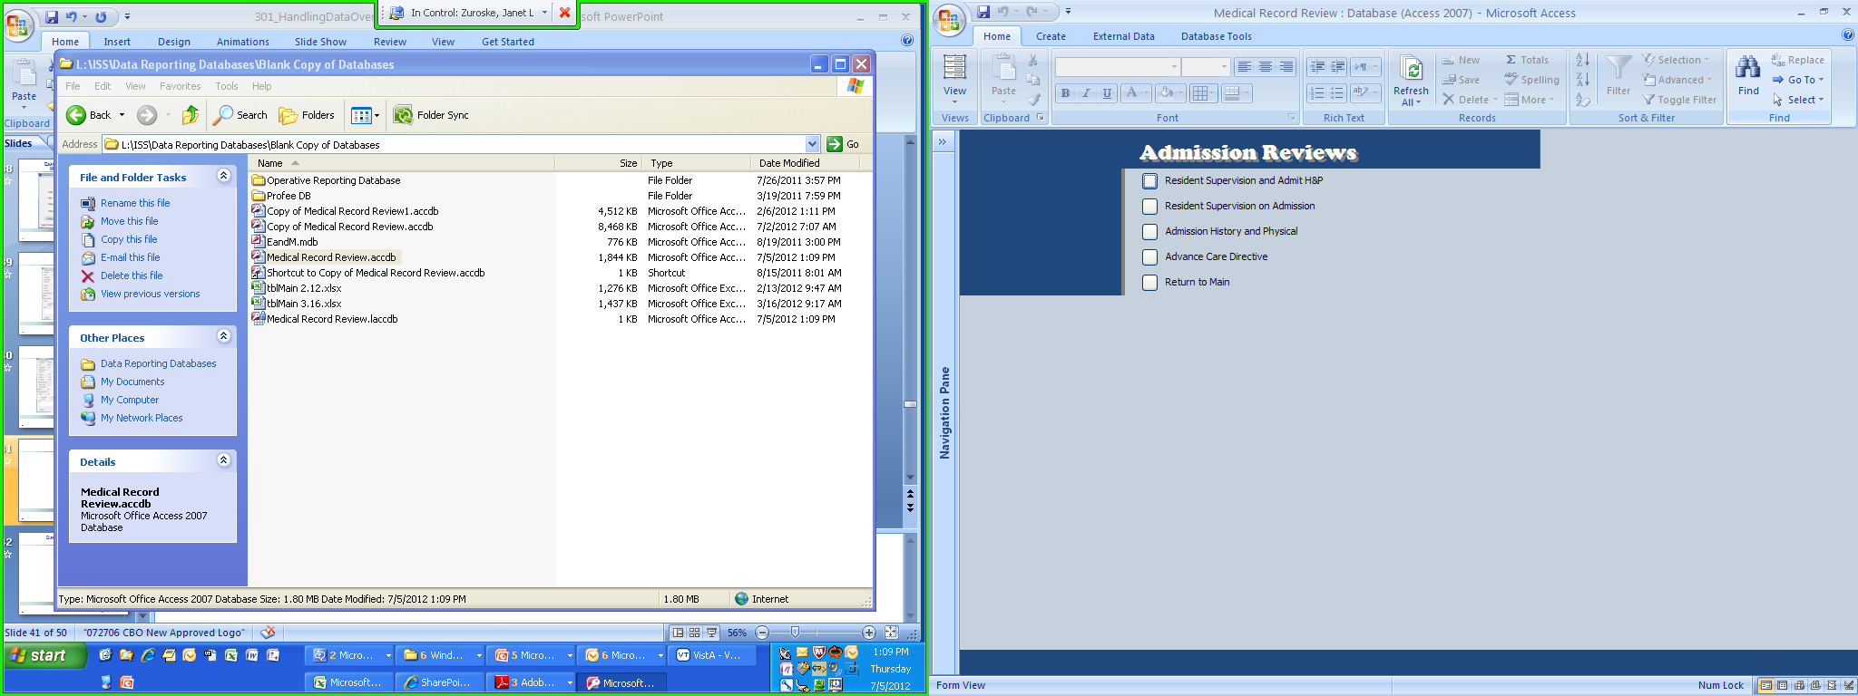
Notes:
This is another type of Access Database at Puget Sound. This happens to be our Health Record Review Database, with the focus of admission reviews. We are then going to go to the next level and choose resident supervision and admission H&Ps.

Slide 50
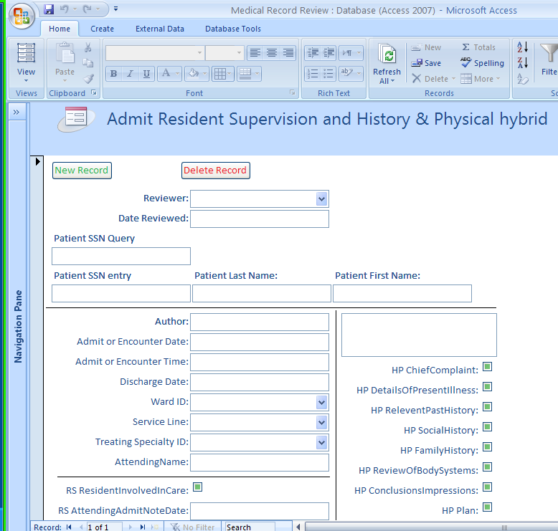
Notes:
This database tool was designed to represent what a form may look like on paper.
As you can see, the reviewer would populate this form with information such as the Patient’s Social Security Number, Author of the note, admission or encounter date, service line, etc.
And now let’s take a look at our poll results (wait to advance the slides until you see the results).

Slide 51
Poll Results #3

Slide 52
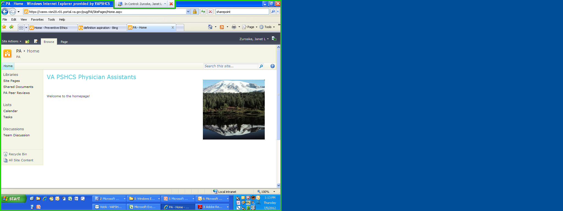
Data Collection Methods – SharePoint
Notes:
Janet:
Moving onto SharePoint. Did you know SharePoint can be used as a central location for data from committees to team workgroups?
Earlier I showed you how Physician Assistant Peer Review data was being collected by hand and by paper.
As the peer reviews are considered non-protected I approached the PA Lead with the idea of capturing all of this information through one simple tool – SharePoint.
This is the homepage that I have since then created for the PA group. You can see that it is a little bare, but as this site’s intention was for peer review collection, I did that intentionally to avoid any confusion.
To the left of the pate you’ll notice under Libraries a link to “PA Peer Reviews”

Slide 53
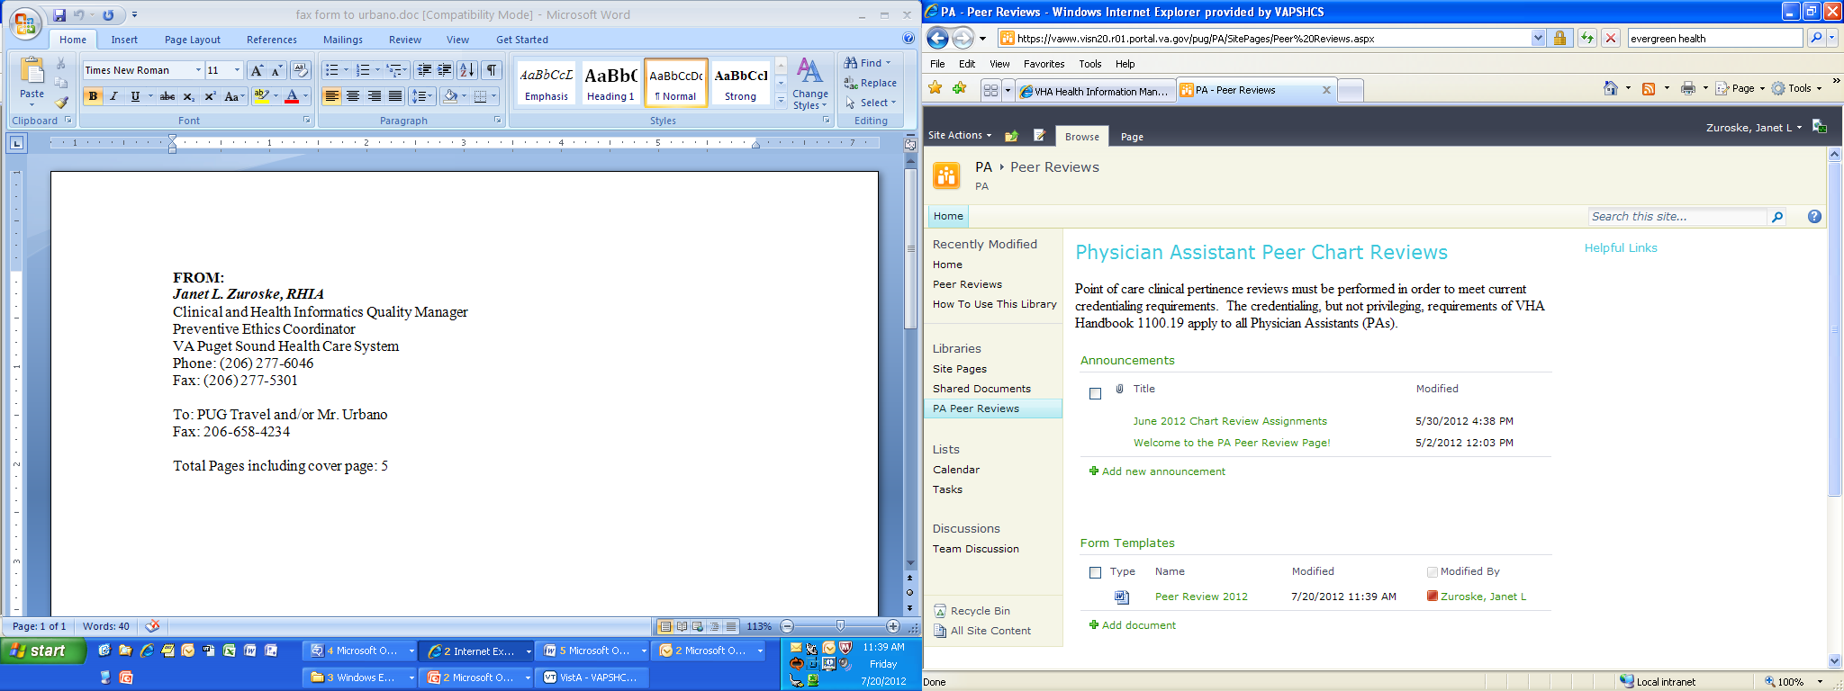
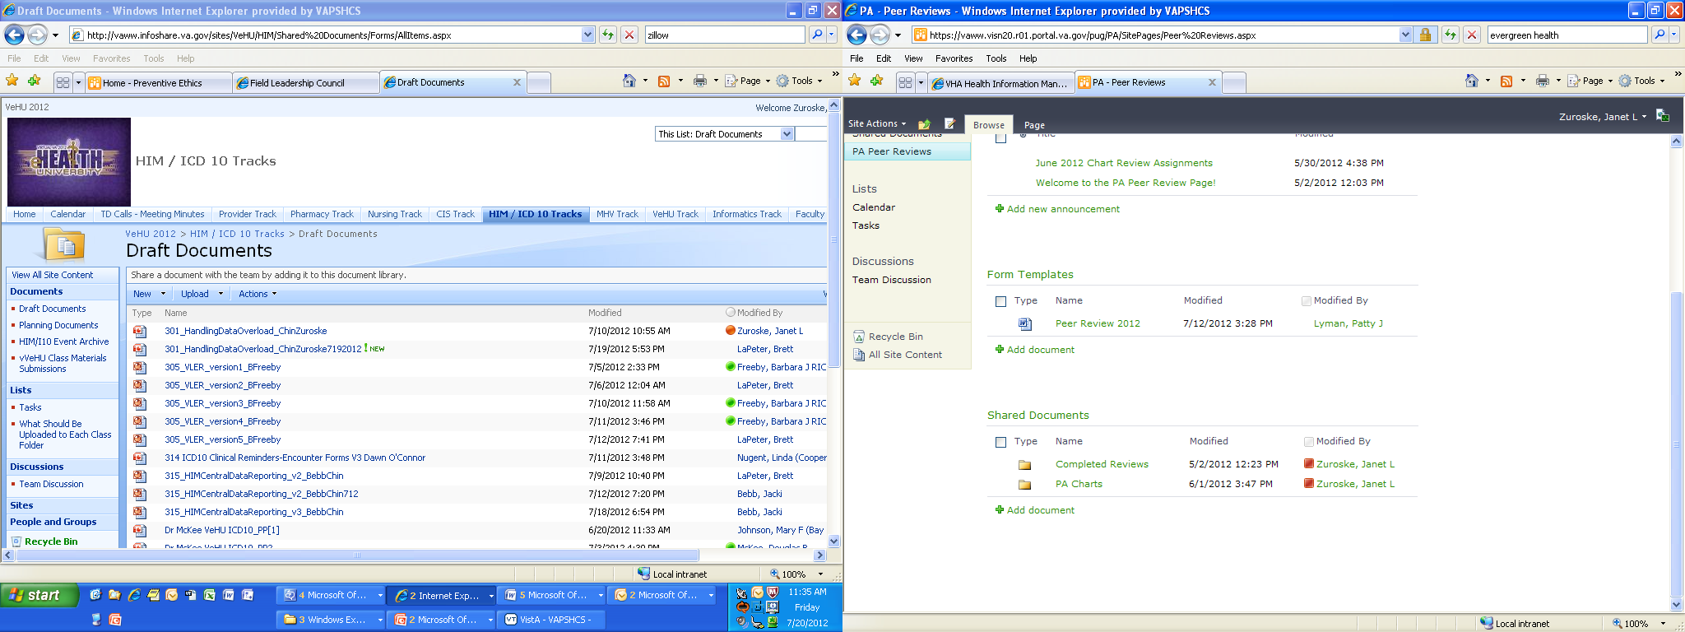
Notes:
Janet
Under this Library PAs at Puget Sound will find the information they need in order to conduct their reviews.
It may take a little training for the user initially, but I have found this to be a very useful tool for the PA group at Puget Sound
We no longer have the paper problems that we had before when it came to this specific peer review as everything is conducted and available electronically. The PA lead doesn’t have to worry about bad handwriting or trying to find the other PAs in order to collect their review.
This saves the facility time and money, which feeds back to our main focus of patient care.

Slide 54
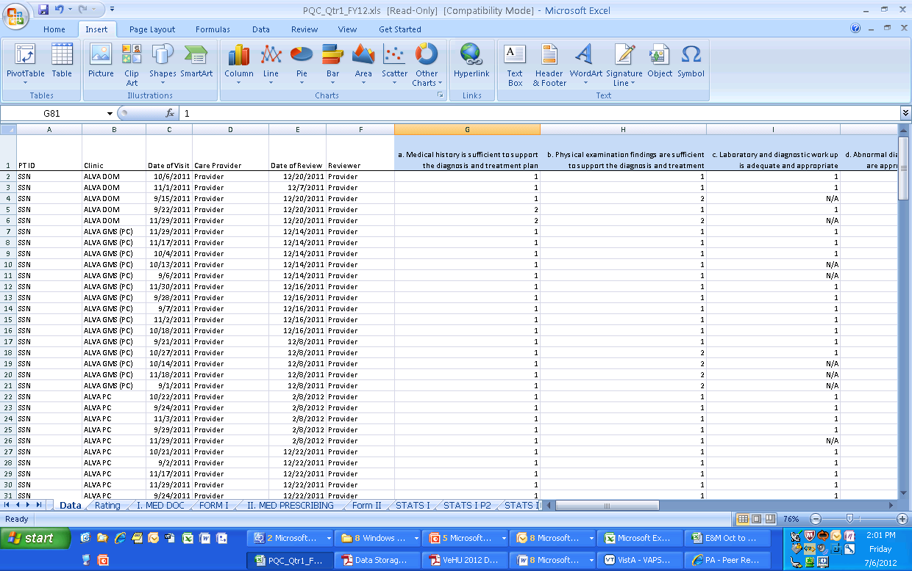
Notes:
Janet
But hold on, I didn’t just stop there. As we started to capture this data electronically, I was able to import the information into an Excel spreadsheet for data capture.
We are able to track and see how our PAs are doing when it comes to the peer review of their practice of care.

Slide 55
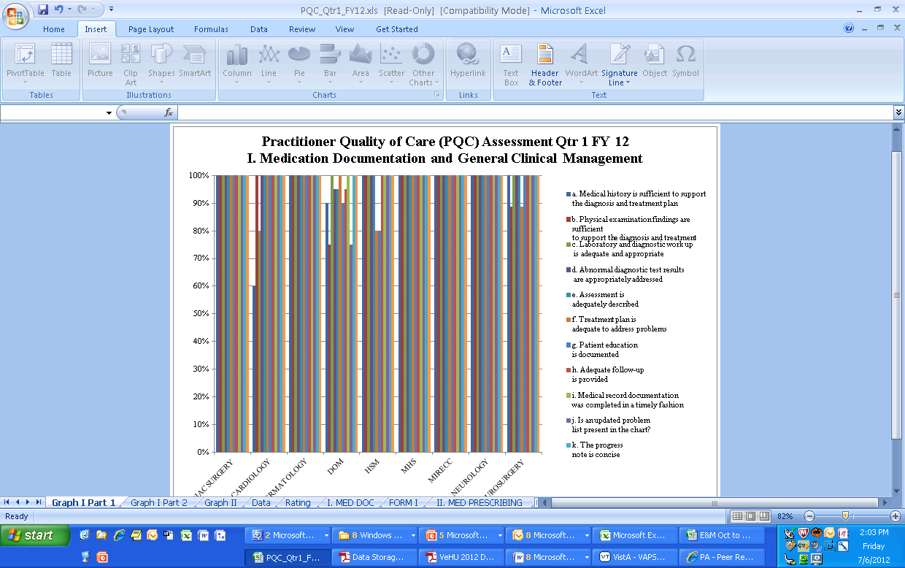
Notes:
Janet
This graph is a snap shot of how the data can be represented in a graphical format. For our purposes today, the details are not important as it is a bit hard to read.
This is part of the 27 different health record reviews I conduct at Puget Sound, which happens to also be an OIG and JC requirement.

Slide 56
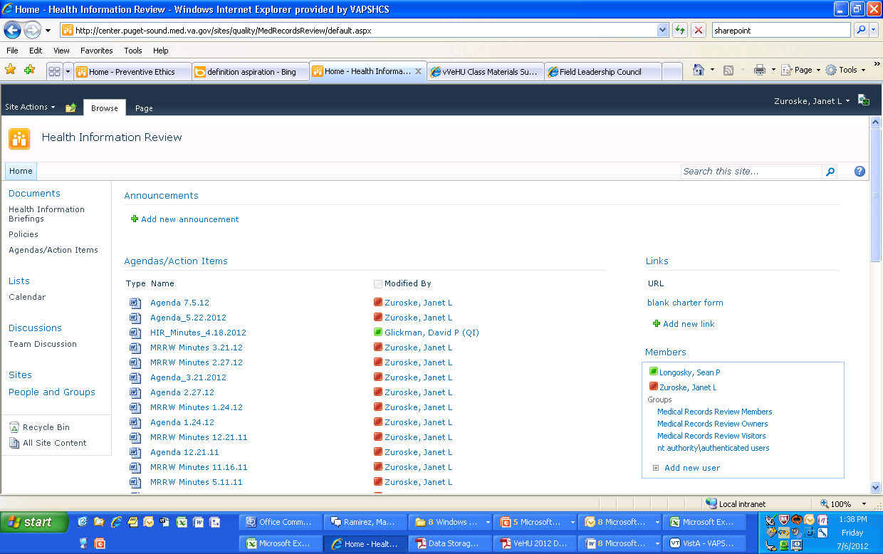
Notes:
Janet
Another way to utilize SharePoint would be for a committee. I have a SharePoint site for my Health Information Review Committee which allows all members to easily access the minutes, agenda, reviews and any policies or documents we like to refer people to.

Slide 57
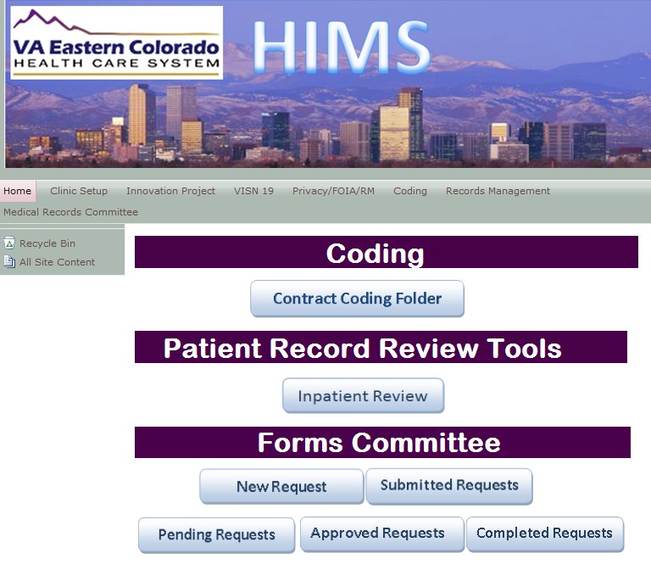
Notes:
Adam:
I like how you all use SharePoint at Puget Sound to store files. At Eastern Colorado, we have a dedicated HIM SharePoint that I utilize for many purposes. On the top of the screenshot, right below the picture of downtown Denver, you’ll notice I have multiple SharePoint sites that someone can access. There’s the Home site, VISN 19 HIM site, Privacy Compliance Assurance assessment site, Records Management, and Medical Records Committee site.
In the middle of the home site, you can see we have created visual buttons to click on that links to shared folders, document libraries, and Microsoft infopath forms. These are good examples of different ways to use SharePoint.
If you click on the “Contract Coding Folder” icon, a new window will appear that will display the shared drive folder. This folder is access controlled so only those who have access can successfully see files in the folder.
If you click on the icons for “Pending requests” approved requests, and completed requests, these will link you to the three document libraries on the sharepoint site. Document libraries are similar to creating folders on a computer but they are located on the SharePoint site.
If you click on the “new request” icon under the Forms Committee section, a new window will appear with an InfoPath form (show next slide)

Slide 58
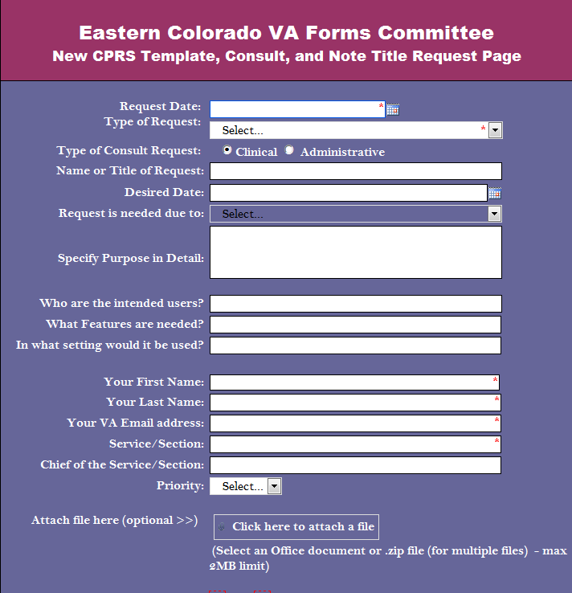
Notes:
Adam:
This form was created in Microsoft InfoPath. We are currently testing this form out for the purpose of users requesting new progress note titles, templates, consults, and forms. After a user completes this form, a file is created and entered a document library on the sharepoint site. From there, the folks who review and approve these requests receive an outlook e-mail that indicates there’s a new request in the document library. A neat thing about an InfoPath form is that you can customize the input fields to capture a calendar date, free text, specific drop down items, specific radio buttons, and check boxes. The screen shot demonstrates all of these options. Using InfoPath and SharePoint together is a great way to go from paper to electronic for a request process or any other process that involves data submission.

Slide 59

Importance of Data Validation
Notes:
Janet
Now you have learned the foundation for storing, retrieving and displaying data in a variety of ways. While we have showed you how to think of data in a relational sense and use several types of programs it is important to remember why we do this and that data validation is key to any successful program.
Adam:
It’s important to understand that the data you may be responsible for collecting, manipulating, and reporting can be information that senior leadership at your facility take actions on or reported for facility performance measures. With that said, it is very important for your data to be valid.
A data validation committee can be utilized to assist in validating reports. Also, where ever you are obtaining data from, it is good to be familiar with what the data should look like for normal results and abnormal results. For example, if you are collecting data for workload purposes for a specific clinic where you know patients are being seen but the data shows no workload at all. In this example, something is wrong. Either you may have run a report incorrectly or something is wrong with how the clinic is capturing workload. The takeaway point here is to be familiar with the data and the processes of how the data is compiled. This will go a long ways with understanding your data and validation.

Slide 60
VHA Guidelines
VHA Handbook 1907.01
VHA Handbook 1400.01 Resident Supervision
VHA Handbook 1004.02 Advance Directives
HIM Practice Brief
Local Facility Policies
Notes:
Janet:
There are several VHA Handbooks which contain specific requirements when it comes to Health Information and documentation. These are an excellent resource for gathering health record review criteria. But for any VHA program you may be working on, the VHA Guidelines is one of your best methods of understanding what data is needed and why.

Slide 61

Data Mapping Methods - Word
Notes:
Janet
Mapping data is simply a way of showing data in a meaningful sense.
One example that you probably already have floating around your facility are your own hospital policies such as a memorandum.

Slide 62
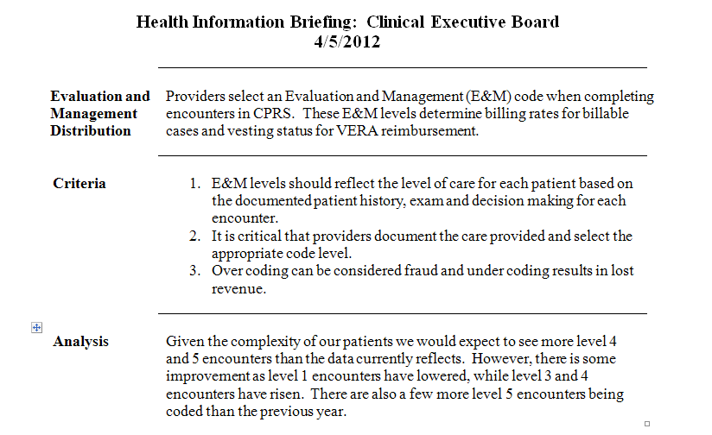
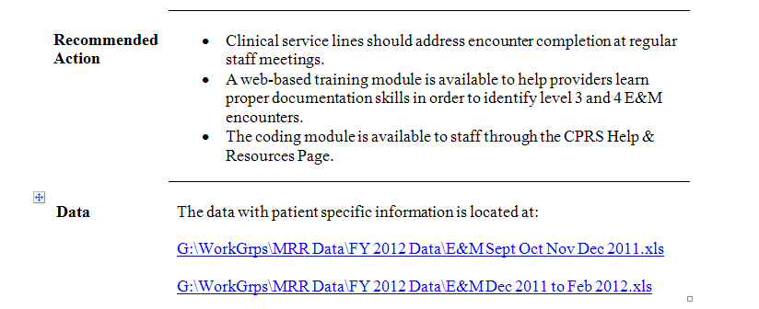
Notes:
Janet
Here is a data mapping method that I created using Word for our health record reviews. In fact, for the 27 different reviews that I conduct, I use this basic template for each report to maintain clarity and consistency.
Throughout the presentation I have showed you a specific example on Evaluation and Management Distribution codes.
In this document, I have taken all of the information from VistA, Excel and Access and turned it into a document that easily communicates to the audience the content I want to get across.
Now notice the many different formatting techniques I have used in this one document. Bold words help to illuminate the area of focus while the lines separate the content into a hierarchy of information.
The numbering versus the bullet points tells the audience if I’m simply listing key points or if I want the information to be read and followed in a set order.
For easy user access, I have even inserted a couple of hyperlinks that link back to the Excel document which contains all of the raw data and statistical equations. This is a very user-friendly way of getting information across.
Overall, I’m simply turning the data analysis I conducted, into information that is readily available and understandable to its audience.

Slide 63
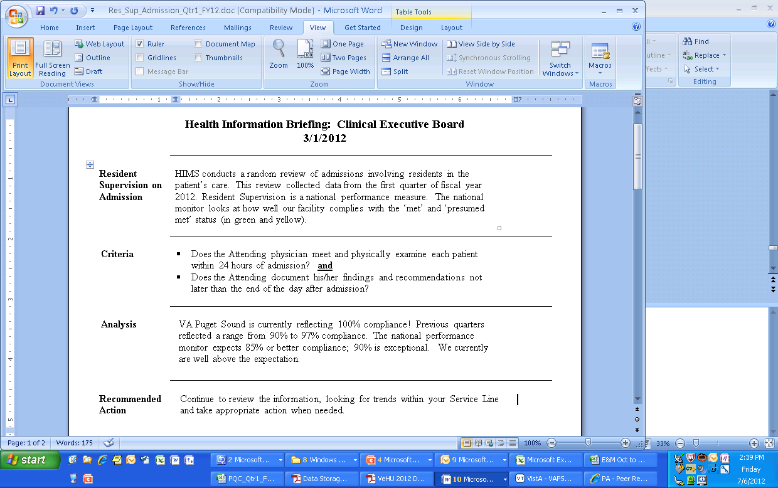
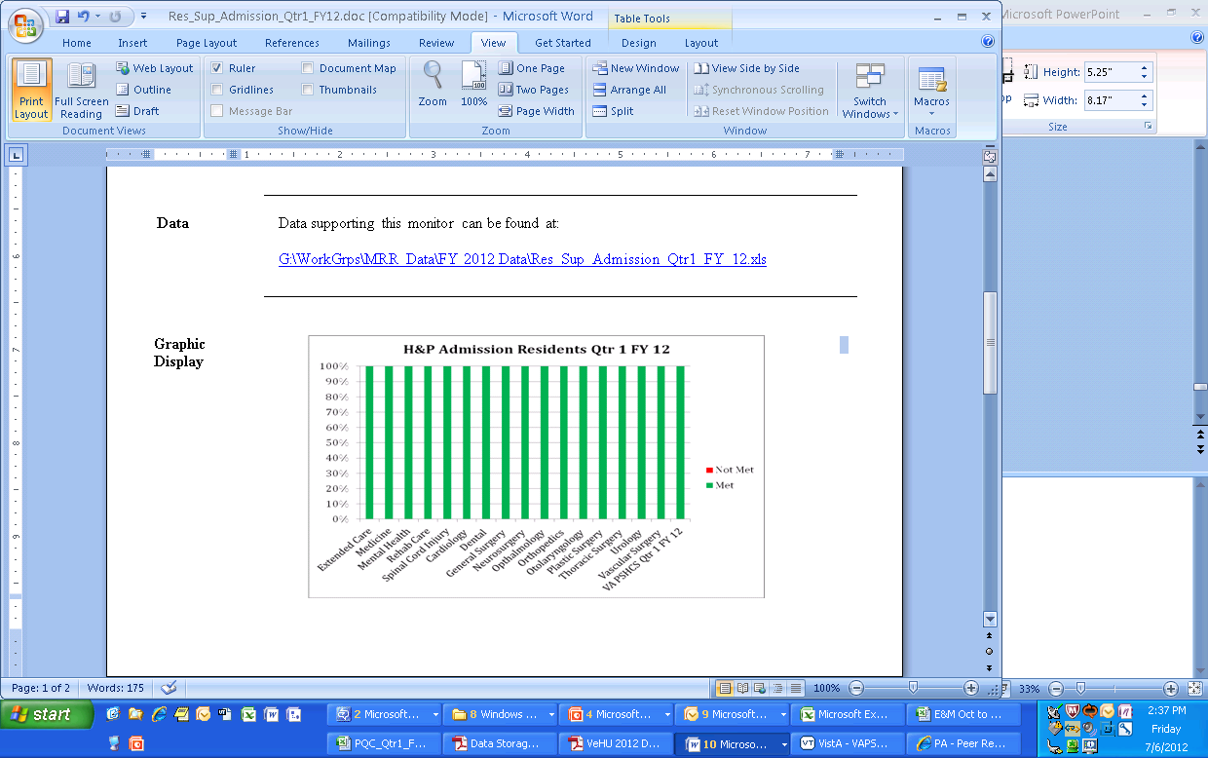

Slide 64
Poll Question
Out of the tools we discussed today, which tool would you say you use the most?
Paper
Excel
Access
SharePoint
Word
None
Notes:
And now let’s go to our fourth poll. Out of the tools we discussed today, which tool would you say you use the most? Paper, Excel, Access, SharePoint, Word, Note. To participate, please use the blue polling icon above my head. Also, while you are up there, take a moment to submit your questions using the orange “ask the presenter” button. We will answer your questions at the end of the presentation. For now, we are going to continue on with our content and we will review the poll results in just a few minutes.

Slide 65
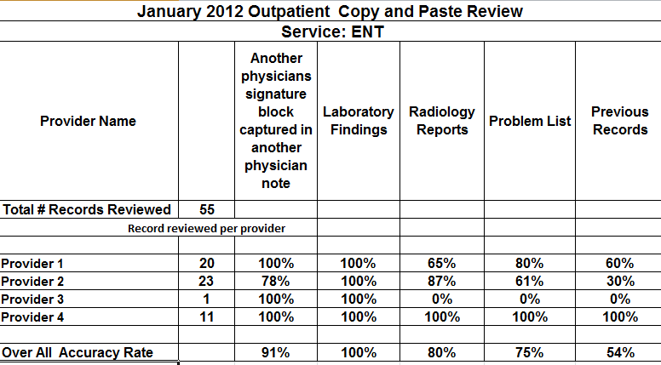
Data Display Methods
Notes:
Adam:
Janet’s method of using memos and graphs are great ways to transform and interpret data into meaning information.
This screen shot is an example at Eastern Colorado of how we present our copy and paste reviews. As you can see, we use an excel spreadsheet and show compliance percentages for each of the copy and paste elements for each of the providers we review monthly. Learning how to format cells using the wrap text and merge cell functions are very useful with playing around with how the spreadsheet looks. You can see few examples of these functions in this screen shot. The “January 2012 outpatient and Service ENT” rows have the merged cell function applied. The cell that starts with “Another physicians signature block” has the wrap text function applied. Other functions to know about are the “sum function” and formatting a cell as percentage function. All of these functions help with manipulating and displaying data in a spreadsheet

Slide 66
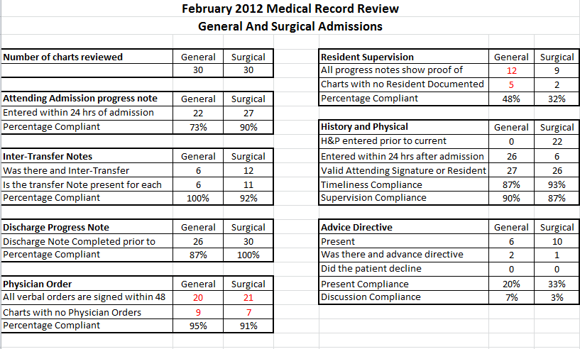
Notes:
Adam:
Here’s a second example of how we use Excel spreadsheets to display our inpatient health record review results. For each review element, we show the number of correct items and the compliance percentages. This can be a nice summary of the monthly review results. We are always looking at ways to improve how we report this type of data and how best visualize it. Would a graph for each element be better instead of this format? Or would a graph supplement this spreadsheet? If you are struggling with these questions, it can be good to ask the audience of this data for recommendations.
Now, let’s take a look at the results of polling question #4. (wait until you see the poll results to advance the slides).

Slide 67
Poll Results #4
Notes:
Out of the tools we discussed today, which tool would you say you use the most? Paper, Excel, Access, SharePoint, Word, Note.

Slide 68

Thank You!
Handling
VistA Reports, Outside Sources
Paper, Excel, Access, SharePoint, Word
Data Validation, TJC, OIG, VHA guidelines
Data
Overload!
Notes:
Janet
Well we hope you have discovered some useful ways of handling data overload.
Using sources such as VistA and CPRS to import information into a data collection and manipulating tool like Excel and Access is a powerful and useful way of creating data validity for your facility’s accreditation standards and overall system functions.
Remember that these important components all build the foundation for data storage, retrieval and display. Ultimately, giving you the keys to handling data overload!
Please keep in mind that if you are interested in learning more about using Microsoft Excel, Access, or SharePoint, it’s best to ask your local education folks to see if there are any in-person classes. There are also a few trainings available in TMS.
Adam and I would both like to thank you for joining in our virtual VeHU class today!

Slide 69

Ask the Presenter
Notes:
Adam
There is still time to submit your questions. Just go up to the orange “ask the presenter” button above my head. And now we are going to take a short break and we will be back in just a moment to answer your questions.

