Slide 1
Maximizing the Role and Outcomes of the Clinical Pharmacy Specialist in Team-Based Models of Care
Julie Groppi, PharmD
Darin Rubin, DO
Notes:
Thank you Dawnell! I am happy to be here today to talk about the role clinical pharmacy services play in team based models of care. There are a variety of teams in VHA from primary care to specialty care as well as inpatient to outpatient services. Clinical pharmacists are integrated into all of the models of care seen in VHA. This presentation will describe the multiple roles of the pharmacist in teams, and examples of how the pharmacist complements the practice of the provider, in management and identification, of high risk patients with medication management needs

Slide 2

Poll Question
Which of the following best describes your position in the healthcare team?
    Pharmacist
    Physician, Physician Asst (PA), APRN
    Nurse
    Clerical Associate
    Additional team member not listed above
Notes:
DR
So to start us out, I’d like to ask a poll question.
Which of the following best describes your position in the healthcare team?
To answer this question, use the blue polling icon above my head. We’ll move on and come back to your results in just a moment.

Slide 3
Medication Issues
Shortage of Help
Access
Demand
Healthcare Problems Exist
Notes:
JG
We know that healthcare problems exist in today’s world. There are a variety of issue to include:
1. There are medication issues that result in medication Errors and adverse reactions:
The use of medications to treat disease has grown exponentially
Seniors experience 36% of all adverse drug reactions
25-30% of medication related problems are preventable and less than 50% of patients are adherent to their medications at 12 months
But we also know that there are other problems…
DR
We know there is a Shortage of Help
Primary Care Physicians have inadequate time and support
Medical graduates choose specialties over primary care
Extending the roles of non-physician providers is one of the most viable options to bridge the gap
Access is always a concern within VA. Busy PC providers with an average panel of patients of 1200, can only see the patients 2.4 times per year.
There is a projected 22% increase in demand anticipated for physician services by the year 2020
During the same period there is only anticipated to be a 13% increase in the number of physicians providing that patient care
Gaps will Exist! So tell us, how can clinical pharmacists help?

Slide 4
Pharmacists Impact Team Care
Comprehensive Medication Management
Preventative Care
Medication Reconciliation
Population Management
Care Coordination
Rural Health
Notes:
JG
In dealing with some of the healthcare problems that exist, the pharmacist can play a key role in a variety of areas to include Preventative care, medication recon, population management, care coordination, rural health and Comprehensive Medication Management in PC, specialty care and acute and long-term care . So you can see there are multiple areas in which a pharmacist could impact care.
Now let’s take a look at your poll results

Slide 5
Poll Results
Which of the following best describes your position in the healthcare team?
    Pharmacist
    Physician, PA, APRN
    Nurse
    Clerical Associate
    Additional team member not listed above
Notes:
DR
Which of the following best describes your position in the healthcare team?

Slide 6
Poll Results
    Pharmacist
    Physician, PA, APRN
    Nurse
    Clerical Associate
    Additional team member not listed above
Notes:
(Cue to Tech Team that you’re moving on) “Click” again to move on
So Julie, can you tell us a bit more about the pharmacist

Slide 7


Your Pharmacist is the Medication Management Expert!
Notes:
JG
Over the years there has been a transition in the role of the pharmacist from the traditional roles depicted in the picture on the left to a more integrated role in the healthcare team. Pharmacists of today are well versed in the pharmacotherapy, kinetics, dynamics of medication therapy and play a key role in the healthcare team as the “Medication Expert”. When we look at the transition of practice we can see changes starting in the 1960s. In 1995 VHA implemented policy which allowed CPS the ability to prescribe medications under a scope of practice system-wide. This was a huge step in the transformation of pharmacy practice that we see today.

Slide 8
Who are the Clinical
Pharmacists in VHA Today?
Doctor of Pharmacy degree
Residency training in Clinical Pharmacy Practice
Board Certified in Pharmacotherapy
Non-physician providers under a Scope of Practice
“Medication Expert”
Notes:
JG
So many of you may be familiar with the traditional roles for pharmacists however you may not be as familiar with the clinical pharmacists in VHA today. So let’s talk about who they are:
Doctor of Pharmacy Degree or equivalency; PharmD=4 years of pharmacology training and clinical application
Post Graduate Residency training in Clinical Pharmacy Practice
Board Certified in Pharmacotherapy and other specialty certifications
DR Thank you Julie these are clearly impressive credentials and these are some ways which I know they can help their teams:
Many function as non-physician providers under a Scope of Practice
They are the “Medication Expert” for the team
Tell us a bit more about the pharmacist scope of practice…

Slide 9
Functions under a scope of practice with similar “core” elements
Therapeutic plans
Notes:
JG
There are some “core” elements that are similar in all pharmacists that function with an advanced scope of practice. These core elements allow the pharmacist to practice autonomously and function to address the medication management needs of the Veterans. This includes:
Addressing the medication management needs of patients with defined diagnoses
Providing Management of medication-related adverse events and Ongoing and acute medication monitoring
As well as Collaborating with other healthcare providers for management of new diagnoses
Those core elements are:
Development of Therapeutic plans
Ordering and interpretation of laboratory tests and other diagnostic studies
Prescribing medications, devices and supplies
Performing physical measurements and assessments
Ordering and administering vaccines
Taking independent corrective action to resolve medication related issues
Ordering consults for referrals to other team members such as dieticians, social workers
Providing clinical pharmacy expertise, comprehensive medication management and monitoring
SO how does all of this “fit together”?

Slide 10

Social Work
Dietician
Pharmacist
Patient Advocate
Patient
Laboratory
RN
Physician
Notes:
DR
It is imperative that whenever we consider team based care that we ensure that the patient or veteran remains our top priority or focus. All decisions should be shared with the patient and the healthcare team. All the team members must coordinate care to provide high quality care.
Almost 700 organizations and all major health plans are utilizing this team approach. Surveys indicate that the patients are much more satisfied because they believe that they have better access to their health care team , when they need it, and when they want it. The days are over when a patient is told that he or she will need to wait 4-6 weeks for an appointment to get a question answered.
So Julie, tell us about our VA pharmacists

Slide 11
VHA has approximately 7,050 Pharmacists
Pharmacists with Scope of Practice exceeds 2,800 (41%)
Of These 2,800
Residency = 62%
BPS Certification = 34%
Other Certification = 10%
Residency & Certification = 72%
Notes:
JG
The clinical pharmacy practice office began in 2010 under the leadership of Drs. Virginia Torrise and Anthony Morreale. One of their goals was to characterize the clinical pharmacy workforce in VA. A thanks to Dr. Heather Ourth for her inaugural work providing us with this information. The 7,050 is pharmacists
You can see our clinical pharmacists in VA are well trained to take on these roles as non-physician providers with residency training, board certifications in pharmacotherapy as well as other certifications such as in areas of geriatrics, anticoagulation and diabetes.
Now that we know a bit more about our pharmacists, let’s see where they practice..

Slide 12
Notes:
DR
So from this slide you can see the different disease states that VA pharmacist have a scope of practice
There are a number of practice areas and disease states in which pharmacists may function as an essential member of the team. The pharmacist with a scope of practice provides expertise to the team and patients by performing these medication management functions thru prescribing new medications, making dosage changes and discontinuing medications. This is clearly a vital function for busy teams with limited access.
Now let’s drill into a few of these areas on the next slide

Slide 13
Notes:
DR
So this slide drills into some of the larger areas where pharmacists have a scope of practice. You can see the large number of pharmacists (over 1100 out of 2800) have a global scope of practice that includes a variety of common disease states and is more focused on the practice area such as Primary Care or Acute Care. You can also see large numbers of pharmacists with scopes of practice to include anticoagulation and the inpatient area, helping internal medicine teams to manage acute patients. There are also specialty area pharmacists such as mental health, geriatrics, pain management and nephrology. We will describe their role on the team later in this presentation.
You might now be thinking how you can get your hands on one of these pharmacists, or how many pharmacists have a scope of practice. For that answer I am going to turn it over to Julie.

Slide 14
Pharmacists With a Scope of Practice – Growth Over Time
46%
Notes:
JG
Over time, VA has seen a growth in the number of pharmacists practicing with a scope of practice. Since 2011, there has been a 46% increase in the number of pharmacists with a documented scope of practice. As the role of the pharmacist further expands and the team recognizes the unique skills that the pharmacist possesses, we expect these numbers to grow exponentially.
Your team clinical pharmacist is ready to take on these medication management roles and doing so across the country.
Let’s take a closer look at the PACT model in VA

Slide 15
Team
Teamlet
Patient & Caregiver
Clinical Pharmacy Specialist
Social Work
Nutrition
Integrated Behavioral Health
Specialty Care
The Patient Aligned Care Team
Primary Care Provider
RN Care Manager
Clinical Associate
Clerical Associate
Notes:
DR
You can see how this graphic describes how the team works together towards the patient centered approach:
-Remember that the patient’s needs should be taken care of with minimal trips to the office
-The health care team should have reviewed what is needed and the plan should be outlined to the patient and family
-The family and patient also have input or shared decision making
-When all this occurs satisfaction and compliance are usually likely
JG-Overview of the team
All of these members together help to ensure our patients receive the care they need and deserve!

Slide 16
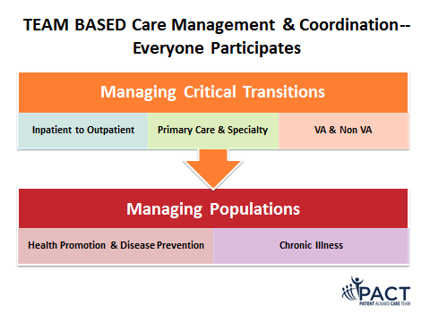
All Team Members Play a Role
Managing Critical Transitions
Inpatient to Outpatient
VA & Non VA
Managing Populations
Health Promotion & Disease Prevention
Chronic Illness
Primary Care & Specialty
Notes:
DR
When do mistakes in health care occur: TRANSITIONS OF CARE
Medication errors are among the most frequent mistakes!!
Who is best suited to help with these transitions-THE PHARMACIST
Health promotion should be highlighted at all transitions
Chronic illnesses need continual re-alignment during these transitions
Julie, please tell us more.

Slide 17
Focused Clinical Pharmacist Integration
Disease State Clinics
Comprehensive Medication Management in the Team
Paradigm Shift
Notes:
JG
A paradigm shift has occurred in the clinical pharmacy services over time. Initial clinical pharmacy integration included practice mainly limited to Anticoagulation Clinics, Polypharmacy, Medication Reconciliation. This then evolved into chronic disease state clinics in which pharmacists were assisting providers by managing some key areas in which multiple medication changes and monitoring are required such as in hyperlipidemia, DM, or HTN. Now sites have fully integrated clinical pharmacy specialists into the teams have moved to comprehensive services where the pharmacist evaluates the entire patients and their medication management needs.
Dr. Rubin, can you describe the focus of PACT and how the pharmacist can impact care?

Slide 18
Access
Care Coordination
Practice Redesign
Pharmacists Impact Patient Care
Notes:
DR
This slide depicts the PACT pillars of access, practice redesign, and care coordination. The Pharmacist at your site may be involved in many of these areas. In describing Access, remember without access the whole system breaks down, access does not need to be face to face but can be virtual or team access. Pharmacists help by Bridging the gap to specialty care in areas such as Hepatits C which will be discussed later in the presentation. We have all seen the patient with elevated BP on multiple medications or have polypharmacy?These patients can take up a lot of time for the PC team. This is a great opportunity to utilize the Pharmacist with a scope of practice.. In addition, what about the patient that shows up with a bag of 15 meds from outside the VA? While all members of the team involved but for the difficult cases the pharmacist is especially important in helping to sort thru these medications and provide assistance with conversions to formulary drugs.
Julie, what about care coordination and practice redesign?
JG
In relationship to CARE COORDINATION, the pharmacist can help provide Comprehensive Medication Management.
Anticoagulation
Dual Care Support
Population Management
In PRACTICE REDESIGN The CPS is usually the first person on the team in identifying changes in medication based on recent evidence and safety and communicates those changes directly to patients and the medical staff.
Leaders in Evidence-based Medicine support
Virtual Care
Medication Safety and Cost Avoidance
So let’s take a look at how the clinical pharmacist may improve access to care

Slide 19
Initial Visit PC Visit LDL not at Goal
6 Month PC Visit
12 Months
18 Months
Without Clinical Pharmacy Specialist
Notes:
DR
So here we see a visual depiction of how a patient would transition through the PC clinic without the help of the Clinical pharmacy specialist. As can be seen in the slide this patient is seen every 6 months by his/her provider and may not get to his goal LDL for 18 months.
In the next slide, Julie will discuss how the CPS may improve this process.

Slide 20
8-12 Wk CPS
6 Month PC Visit
8-12 Wk CPS
12 Months
8-12 Wk CPS
18 Months
Initial PC Visit LDL not at Goal
With Clinical Pharmacy Specialist
Notes:
JG
Now you can see how that approach differs when you add a clinical pharmacy specialist in managing medication issues. This approach has been shown to improve access and quality of care. Studies have shown that 78% of patient care occurs post-diagnosis and By utilizing the CPS between visits, it has been in my experience that patients achieve their goals faster when utilizing the CPS between the normal PC visits.

Slide 21
Patient Complexity, Health Status, Needs
PACT
Specialty Care
Clinical Pharmacy Specialist
Specialists
Clinical Nurse Specialist (NP)
Teamlet &
Expanded Team
Team
Coordination of Care
Disease/Cohort Management
Management of Care
Notes:
DR
Pharmacists with a scope work in many specialty clinics to bridge the gap between PACT teams and specialty services. This is particularly important in a variety of area such as ID, Cardiology, Hem-Onc, and MH.
Julie, would you like to elaborate
JG
In today’s environment and with the complex medication management needs of our veterans it takes all team members working together across the entire care continuum. This includes the clinical pharmacy specialist as well as the teamlet, clinical nurse specialist, RN care managers as well as our patients and caregivers.
Let’s talk about how this would look when you are taking care of our Veterans.

Slide 22


Midlevel Model with CPS
Physician
Nurse Practitioner/ Physician Assistant
Clinical Pharmacy Specialist (CPS)
Notes:
DR
So within VA – the CPS serves as a Mid-level Provider to provide comprehensive medication management to complex patients. When a pharmacist serves in this capacity several positive results occur:
You can reduce teamlet burden by managing chronic diseases-Lipids, DM,HTN and others
They provide Expertise in optimizing drug therapy for complex high risk patients such as those patients one multiple medications or polypharmacy
JG
The CPS is best utilized to:
-Identify patients who do not achieve a variety of performance goals and assist in chronic disease management to achieve therapeutic outcomes
-Enhance drug information by functioning as a therapeutic consultant to providers and other health care workers
-Relieve providers by assisting them with patient follow-up after normal visits, therapeutic drug monitoring, and patient medication adherence and compliance assessments.
-Increase patient satisfaction by decreasing overall appointment wait times while providing the highest quality of care for our veterans

Slide 23
Clinical Pharmacy Specialist
Medication Management
Teamlet 1200 patients
Population Management
Teamlet 1200 patients
Teamlet 1200 patients
Notes:
JG
So the CPS plays roles in both medication management as well as population management for the team. You can see from this depiction that a CPS does not serve one team alone or one teamlet but rather helps to manage multiple teamlets of patients. This ratio is further defined in the PBM Guidance Pharmacy Business Rules for PACT as well as the PACT Handbook which is undergoing final concurrences. The ratios include
1 PACT CPS for every 3 full-time PACT teamlet panels
1 Anticoagulation CPS for every 5 full-time PACT teamlet panels
Staffing ratio may be adjusted upward locally to provide appropriate comprehensive medication management in other disease states.
Let’s delve a bit deeper into the successful programs we have seen with pharmacist’s integrated into care

Slide 24

Clinical Pharmacy Outcomes
Notes:
DR
Well now that we understand the roles for the pharmacist in the team, let’s explore some of the outcomes we have seen from integrating pharmacists into VA teams. Julie please tell us about what Indianapolis is doing to help veterans with HTN.

Slide 25
Clinical Pharmacists Impact Hypertension
Blood Pressure (mm Hg) | All Patients (N=573) | Diabetes (n=196) | Kidney Disease (n=43)
Referral Systolic Diastolic | 152.9 ± 16.5 85.8 ± 11.3 | 153.5 ± 15.2 83.5 ± 13.8 | 159.3 ± 22.2 85.1 ± 13.8
First Visit Systolic Diastolic | 141.3 ± 18.5 79.1 ± 12.2 | 141.1 ± 18.2 75.9 ± 12.0 | 142.7 ± 17.5 73.2 ± 12.6
Final Visit Systolic Diastolic | 130.1 ± 13.8* 74.5 ± 10.3* | 128.5 ± 15.2* 71.1 ± 9.9* | 128.2 ± 13.9* 68.2 ± 9.4*
* P<0.001
Notes:
JG
This example comes from Dr. Bex and associates at the Indianapolis VA. The project included 573 patients with HTN referred to CPS
The group wanted to determine the following outcomes:
Primary outcome: Difference between systolic and diastolic blood pressure at the initial and final visit with the CPS
Secondary Outcome: Proportion of patients achieving their blood pressure goal
You can see from referral to final visit there were significant improvements in BP control across all patient cohorts
What about another area of medication management?
Bex SD, et al. Pharmacotherapy. 2011;31(1):31-38.

Slide 26

Clinical Pharmacists Impact Lipid Goal Achievement
Notes:
DR
There are also similar examples in lipid management involving the pharmacist. One example comes from the VA San Diego.
Dr. Ito and colleagues examined the use of a pharmacy managed algorithm to get more patients to lipid goals.
Over 1000 patients completed the program. Overall, 69% of patients met their LDL goal after conversion
When the relative Relative risk of a future cardiovascular disease events was calculated it was only 0.87 when it was evaluated four years after conversion. A 13% reduction in events was predicted.
And now Julie will discuss an example discussing diabetic control
References:
Ito, M et al. AJHP; 58:1734-1739

Slide 27
Notes:
JG
Now let’s look at how Clinical Pharmacists Impact Diabetes Care
This example comes from Dr. Cripps and Associates at the Tennessee Valley VA HCS and their Pharmacist Managed Diabetes Clinic
They evaluated a team based approach in patients meeting ADA treatment goals for diabetes individually and in combination after 6 months of Clinical Pharmacy Specialist intervention and the percentages of patients meeting the three VA measures of performance individually and combined.
After 6 months of follow-up,
43% of patients met the ADA HbA1c goals
55% of patients met the LDL goal of < 100 mg/dl;
45% were at a SBP goal of < 130 mmHg and
51% were at DBP goal of < 80 mmHg.
DR
And that did not just result in improvements in objective measures, Clinical pharmacist intervention resulted in improvement in the number of patients achieving ADA and VA performance measures
79% of patients met all 3 VA performance measures at 6 months
JG
These are just a few great examples of how a pharmacist may be integrated into care in PACT, but what about other areas?
Reference: Cripps RJ, Gourley ES, Johnson W, et.al. An evaluation of diabetes-related measures of control after 6 months of clinical pharmacy specialist intervention. Journal of Pharmacy Practice. 2011; 24:332

Slide 28
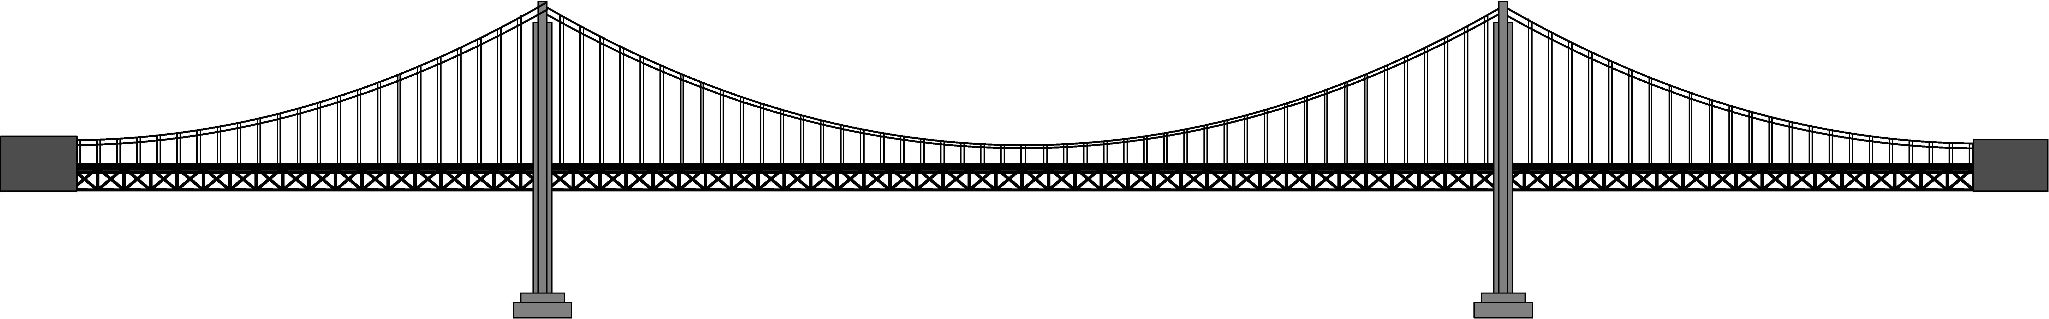
Bridging the Gap to Specialty Care
SCAN-ECHO
Neighborhoods
E-Consults
Notes:
DR
So what are some areas where specialty care is bridging the gap and pharmacists can be involved? Some of you may have heard of SCAN-ECHO as a way to bridge the gap. It uses the technology of video telehealth to bring specialists and other experts to primary care. There are many pharmacists that are involved in SCAN-ECHO programs across the country helping to discuss medication management options for difficult to treat patients. The second way is thru the use of Specialty Care Neighborhoods. These focus on the development of “care platforms” which might include specialists, nurse(s), clinical pharmacists, social work and other professionals to care for complex patients within a “neighborhood” approach. A third way to bridge the gap is thru the use of E-consults. Pharmacists are involved with E-consults in many areas, particularly when a question arises concerning a medication management issue such as medication tapering, recommendations for therapy or other needs to the provider. This is particularly useful when a pharmacist may not be physically present at the same location as the provider.
Julie, can you show us some examples of how pharmacists have worked successfully in specialty care?

Slide 29

Multispecialty Care Neighborhood Care Coordination Post Transplant
Notes:
JG
Multispecialty Care Neighborhood Care Coordination Post Transplant
VISN 12 Transplant Task Force under the oversight of Dr. Donna Leslie
Clinical Pharmacy Specialist dedicated to post transplant medication management and involved with:
Development of CPRS informatics solutions to standardize documentation
Development of data warehouse resources for medication monitoring
Implementation of SCAN-ECHO program to enhance education
Implement E-consult system with CPS and VA Transplant center
DR
Furthermore, the clinical pharmacy specialist provides comprehensive medication management for patients throughout VISN 12
They provide medication management by utilizing virtual care modalities will include patient counseling, lab entry and analysis, and interdisciplinary access with secure messaging. They also serve as resource for primary care providers in the management of post-transplant patients and perform chronic disease management services as referred from primary care providers. We all know post transplant care is a complex area of management, what about other areas?

Slide 30

Clinical Pharmacy Specialists in Mental Health are Fully Integrated Team Members
Notes:
JG
There are similar examples on how the CPS integrates into another area that has had a particular emphasis on in recent years: Mental health. There have been strong examples of CPS in mental health over the years.
Currently there are over 130 Mental Health Pharmacists with a Scope of Practice (March 2013)
The pharmacist in this area has worked for years to
Improve Mental Health Access
Provide Comprehensive Medication Management including Adverse Drug Event Management and Prevention
Assist in Transitions in Care
Serve as the Medication Use and Safety Experts
DR
Pharmacists also impact care and Mental Health Performance Measures such as the MH post-discharge measure and suicide risk assessment.
In addition to the success in MH practices, the partnership has grown stronger through the Academic Detailing Project
Julie, tell us more about academic detailing..

Slide 31
Increase the use of evidence-based treatments for Veterans with mental illness
Quality collaboratives
Identify priorities and strategies
Identify and share strong practices and resources
Evaluate prescribing patterns
Notes:
JG
The academic detailing project has been dedicated to increase the use of evidence-based treatments for Veterans with mental illness through a variety of means depicted on this slide. Dr. Melissa Christopher helped to lead the project in VISN 21/22 and they were the first to embark on an academic detailing project. Some of the results from the VISN 21/22 pilot include:
Increased Evidence Based Practices in PTSD
mild reductions in benzodiazepines and antipsychotics
3.1% Increase in Clozapine
Estimated over $ 600,000 direct drug cost avoidance through a Decrease of Off-label Prescribing
Now let’s see how AD improves provider education

Slide 32
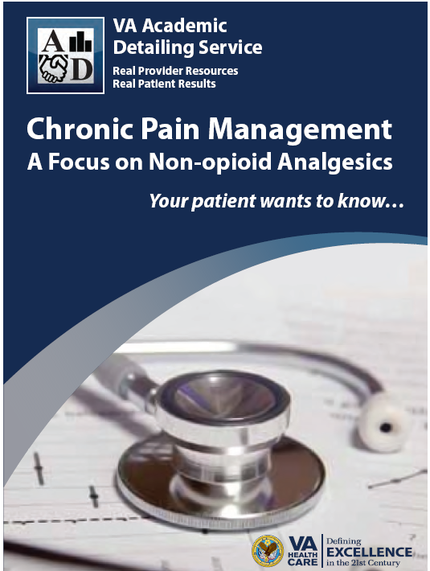
Academic Detailing
Educational Materials
Notes:
DR
Academic detailing has developed several educational materials that may be useful at your own site on Mental Health, Addiction and Pain Management. All of these documents can be found on the PBM Academic Detailing SharePoint. You can find the sharepoint link in the speaker notes from today’s presentation.
These can be found on the SharePoint link:
http://vaww.sandiego.portal.va.gov/sites/Pharmacy/academicdetailing/default.aspx?RootFolder=%2Fsites%2FPharmacy%2Facademicdetailing%2FShared%20Documents%2FEDM%20in%20progress&FolderCTID=0x012000266589D2EDF8194E86132111286163F3&View=%7b240753CF-5BDC-4FFC-9CF5-

Slide 33
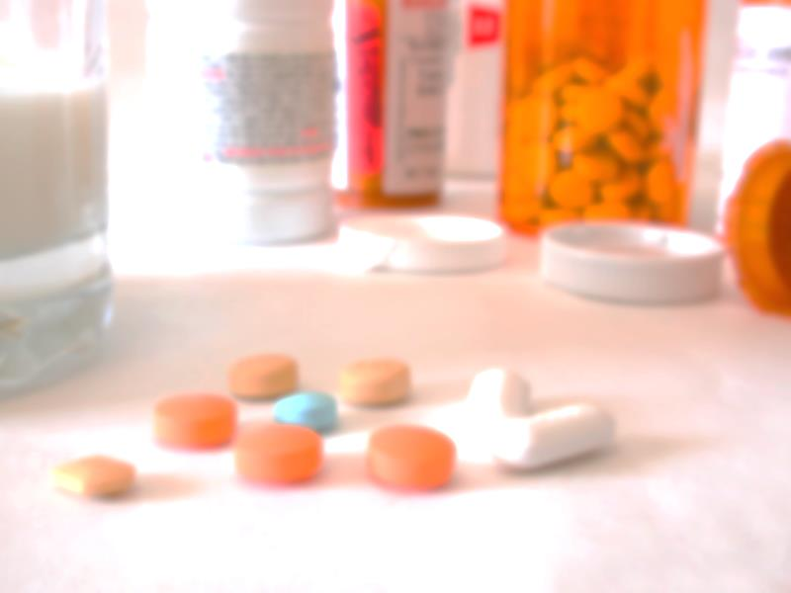
The Pain Crisis
An example from the State of Florida
Notes:
DR
We know that there is a pain crisis throughout the nation. This is especially apparent in the State of Florida
The state has tightened drug regulations. Federal officials first began cracking down on the black market in 2009. Although the regulations are effectively curbing prescription drug abuse, they are also taking a toll on the well-being of patients with painful medical conditions and valid prescriptions. Many states have implemented Prescription Drug Monitoring Programs to monitor prescribing of controlled substances
One example is E-FORCE which is a database that collects and stores schedule II, III, and IV controlled substance dispensing information. Pharmacists are often involved at the medical center level with these programs and can be a valuable resource to the provider when questions arise about patient’s controlled substance prescriptions.

Slide 34


Good First Steps to Manage Inappropriate Prescribing
But how do we ensure patients are treated appropriately?
Pharmacists are Integral in the Pain Management Continuum
Notes:
DR
While theses are Good First Steps to Manage Inappropriate Prescribing, many questions remain.
But how do we ensure patients are treated appropriately?
JG
CPS function in a variety of areas from Interprofessional Pain Management Clinics to PACT
Services Include: Ongoing assessment and monitoring, Evaluation of UDS and interpretation, Prescribe/maximize non-opioid pharmacotherapy
And Recommend changes to opioid therapy (opioid tapering/titration, conversion, rotation, and discontinuation)
Now let’s see an example of a pharmacist in pain management

Slide 35
Denver VAMC
Opioid Pain Clinic
Indicator | Six Months Prior | Six Months post | Percent Change
Pain Contacts | 484 | 127 | - 73.8%
Aberrant Behaviors | 143 | 20 | - 86%
Notes:
JG
So here is an example from Dr. McKelvey and associates from the Denver VA where a Clinical Pharmacy Specialist was included in the interprofessional team approach. This included 55 patients enrolled Oct 08-Oct 09
Overall you see a decrease in both pain contacts to PC as well as aberrant behaviors to include dose escalations, concurrent use of illicit drugs with the implementation of this interprofessional approach with the pharmacist. Every PCP knows the difficultly in dealing with many of our chronic pain patients and so these results are integral to improving the care provided to the pain patient.
DR
But when it comes down to the end of the day, it is the patient outcomes that are something you really can’t put a number on… In addition patient satisfaction increased and one quote from a patient heard was:
“This is the most pain relief I’ve experienced in 15 years”
In addition to patient outcomes, Providers were highly satisfied with the services provided
“This service is invaluable! I have used it and appreciate it greatly”
Now let’s look at another example of a successful pain initiative

Slide 36
Minneapolis VA
Opioid Safety Initiative (OSI)
A PACT “Pain Champion” identified
PACT Pharmacists given the “high-risk” list for each provider on team(s)
Pharmacist Case Management Highlights
Notes:
JG
Dr. Elzie Jones and his colleagues at the Minneapolis VA also embarked on a similar initiative to improve opioid safety at their facility. To do this a PACT “Pain Champion” was identified. PACT Pharmacists were given the “high-risk” list for each provider on team(s). Patients were consulted to Taper down or off and/or convert to formulary. Review non-opioid, adjunct meds, alternative therapies, pain groups, and Explain rationale for the OSI. This approach Needed the support from the whole PACT team
Dr. Rubin, let’s see some of the results from this project

Slide 37
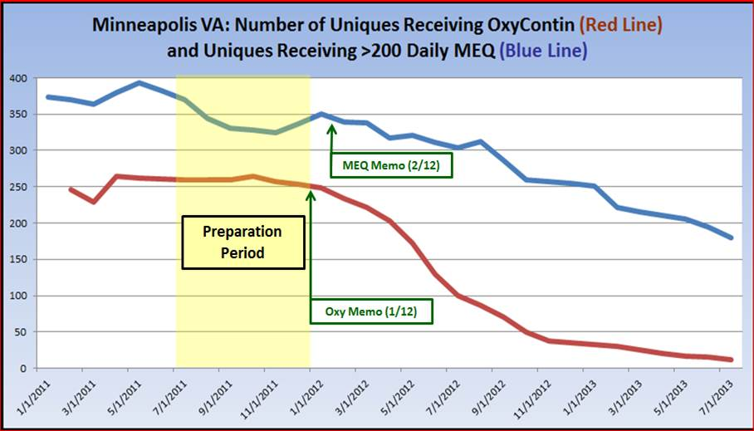
Notes:
DR
The results from the Opioid Safety Initiative (OSI) were reductions in both the number of patients receiving oxycontin over time (red line) as well as those receiving over 200 mg of morphine equivalents (MEQ) per day (blue line). From Jan 2012 to June 2013 the following results were seen
94 % decrease in OxyContin patients
54 % decrease in patients on greater than 200mg of morphine equivalents per day
So overall a great success at Minneapolis in improving care provided to these patients. This initiative involved the entire medical center and support was provided from the Medical Center Director as well as the Chief of Staff. This helped to lend to the success of the initiative.
Now let’s take a look at some individual teamlets have handled their chronic opioid patients using shared medical appts.

Slide 38
Central Alabama VA HCS
Access
Reduce Phone Calls
Reduce Walk-ins
Clinical
Initiate/increase long acting opioids
Optimize adjunctive pain medications
Optimize breakthrough regimens
Missed Opportunity Rate
Notes:
JG
There are several examples throughout the system of how pharmacists have become integrated into roles in pain management. This example demonstrates that there is not just one way to do improve care. Dr. Ragan and her clinical pharmacy associates at the CAVAHC started a SMA for their pain patients to try and reduce the number of walk-ins and phone calls. While this “pain cohort” was a relatively small percentage of their panel they felt like they consumed a large amount of their time. They disrupted their clinics, sometime they demanded to be seen and would create havoc in the waiting room. They also wanted to improve the quality of their scheduled yearly or semi-yearly provider visit so that the patient/provider could focus on something other than pain during their scheduled visit. So with that primary goal in mind they began. Now let’s take a look at how they did it….

Slide 39
 | Teamlet 1 | Teamlet 2
Start Date | Jan 2011 | Feb 2011
SMA Frequency | Twice a month | Once a Month
Length of SMA | 3 Hours | 2 Hours
Number of Patients per Visit | 15 | 6-8
Patient Attendance Frequency | Every patient on chronic opioids encouraged to attend SMA every month | At least once every 6 months
Notes:
DR
There were 2 teamlets identified and SMAs were developed with team Input. The pharmacists used the VISN 7 Data Warehouse to identify their teamlet patients on chronic opioids . You can see that they were different which shows how they can be individualized. Both groups included all patients on CII and then any high quantity CIII patients. You can see the differences between the 2 SMAs listed on the slide. Every patient was required to attend after they agree to be a part of SMA
The SMAs included a Physician, clinical pharmacist, nurse and clerk. The teams also used Physical therapists, social workers, and psychologists as needed
Julie, can you share some results from this project?

Slide 40
Teamlet 1 SMA Pain Therapy Interventions
Decrease QTY PRN Opioids
Initiate or Increase Long-Acting Opioids
Improve Breakthrough Med Regimen (D/C tramadol, ratio LA/SA)
Initiate or Adjust Adjunctive Pain Meds
Notes:
JG
You can see the improvements made in Teamlet 1’s patients 5 months after the start of the SMA. The parameter with the most change is shown in purple as improving breakthrough medication regimens.
There was also an increase in the number of patients initiated on long acting opioids.
Dr. Rubin, can you tell us how teamlet 2 did?

Slide 41
Teamlet 2 SMA Pain Therapy Interventions
Decrease QTY PRN Opioids
Initiate or Increase Long-Acting Opioids
Improve Breakthrough Med Regimen (D/C tramadol, ratio LA/SA)
Initiate or Adjust Adjunctive Pain Meds
Notes:
DR
In addition to what Julie mentioned with the previous team, similar results were seen with teamlet 2, and this slide depicts clinical outcomes at 1 year since start of the program. There was a 40% Decrease in the QTY of PRN Opioids (orange) and a 52% increase in the amount of Adjunctive Pain Meds. In this example the teamlets had the flexibility to decide how to best care for their patients. They included all team members in the planning and implementation and demonstrated successful outcomes. Due to the success of this project, the SMA has now moved to primarily telephone care due to the good control of their patient population
You can see that pharmacists across the country are fully integrated into a variety of models and assisting with the pain crisis, but there are also opportunities in Hepatitis C management. Let’s take a look

Slide 42
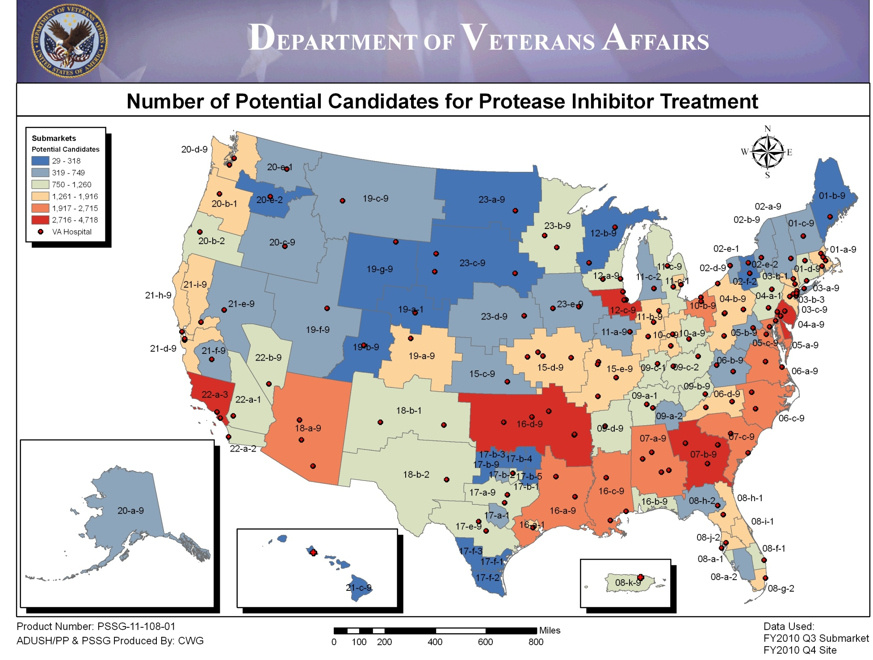
Notes:
DR
When we look at Hepatitis C (HCV) Care Issues, there are multiple issues where a pharmacist can be involved.
We know that the following problems exist:
High number of untreated patients in Primary Care
Lack of expertise and time in primary care to perform initial assessment and treat patients
Capacity issues at many sites within Specialty Care to take all the referrals from primary care resulting in backlogs
Recognition that access is a major issue that will need multiple strategies to overcome
JG
In looking at this heat map you can see the number of potential patients for protease inhibitor therapy in VA. The areas depicted in Red are over 2700 potential patients, Orange (1917-2700), cream (1200-1900), followed by green, light blue, and finally dark blue with less than 318 patients. The biggest issue you do not see on this map is that most HCV+ Veterans have never received antiviral treatment
So that leads us to a challenge to treat over 127,000 pts . Generally 3,000 per year are usually treated. So How do we treat these patients?

Slide 43

Roles of VA Pharmacists in HCV
Notes:
DR
We have made some successes over the years with over 5,000 veterans treated with Hepatitis C Protease Inhibitors in 2012-13
PBM Management & Public Health have collaborated to develop strategies to get more CPS involved with curing patients
Thanks to many of our clinical pharmacy leaders in Hep C, in particular Dr. Pam Belperio, The number of clinical pharmacists with a Scope of Practice in Hep C is growing quickly. The pharmacist may function as either as an independent treating provider or in the capacity of a multi-disciplinary team.
JG
PACT Pharmacist-HCV Screening/Testing and Baseline pre-treatment evaluation
PACT and HCV Specialty CPS roles-Managing adverse effects (ESAs, GCSF), Drug interaction management, Treatment eligibility and initiation and HCV medication therapy management (dose reductions, response, treatment duration). Now Let’s see how the pharmacist’s could impact quality indicators

Slide 44
National VA HCV Indicator | % of patients deficient (n=173,416)
Hepatitis A screening and vaccination | 29
Hepatitis B screening and vaccination | 23
HIV testing | 27
Influenza vaccination | 41
Screening for hepatocellular carcinoma in patients with HCV and cirrhosis | 44
Tobacco cessation with pharmacologic treatment | 46
Notes:
DR
Where else can the Pharmacist intervene? The pharmacist may intervene on many of the National VA HCV indicators listed on this slide. Opportunities and gaps in care exist. Which types of HCV patients could be referred to a CPS? Consider scheduling patients that have not been seen by GI/ID specialty services. These are the patients that likely have not had all the National Indicators completed, and not received education on HCV. Now let’s see some results from clinical pharmacists managing medications in HCV
http://vaww.hepatitis.va.gov/data-reports/ccr-index.asp

Slide 45
 | VA Experience | Literature | Pharmacist Managed HCV Clinics
 |  |  | Smith et al | Marińo et al
GT1 SVR | 26% | 35%-46% | 60% | 48%
GT2/3 SVR | 62%/54% | 76% | 67% | -
Adherence | - | Goal: 80% of rec dose for 80% of tx duration | No self-reported missing doses | 85.7% of doses taken
DC due to ADEs | - | 4-9% | 7% | 4%
Incomplete | 40% | - | 11% | 30%
Cost of SVR in models with a Pharmacist vs Without¹: $33,318 vs $38,082
Notes:
JG
Just in other disease states, this slide summarizes the aspects of patient education and drug therapy management in which pharmacists can assist patients receiving HCV treatment. Based on a review of the literature, there are a few examples from the Veterans Affairs systems in Los Angeles, San Francisco, and Long Beach, California. From these results you can see the benefits to include enhanced patient empowerment and adherence to therapy, Effective management of HCV drug therapy, As well as reductions in incomplete therapy regimens and improvements in management of adverse reactions related to therapy. Now let’s see how pharmacists can help to identify other high risk patient populations requiring treatment.
*********************
VHA Public Health Strategic Healthcare Group, Clinical Public Health Programs, HCV Protease Inhibitor Therapy for Chronic Hepatitis C: Utilization and Pharmacy Cost Considerations within VHA, September 2010; CCR Clinical Case Registry Data.
Yee HS, et al. Management and Treatment of Hepatitis C Viral Infection: Recommendations from the Department of Veterans Affairs Hepatitis C Resource Center Program and the National Hepatitis C Program Office. Am J Gastroenterol 2006;101:2360-2378.
Smith J, Dong M, Kaunitz JD, Evaluation of a Pharmacist-managed Hepatitis C Care Clinic, Am J Health Syst Pharm. 2007 Mar 15;64(6):632-6.
Marino EL, Alvarez-Rubio L, Miro S, Modamio P, Banos F, Lastra CF, Alberdi-Leniz A. Pharmacist Intervention in Treatment of Patients with Genotype 1 Chronic Hepatitis C, J Manag Care Pharm. 2009 Mar;15(2):147-50.
Smith et al
Evaluation of pharmacist run hepatitis C clinic at VA Greater Los Angeles from Oct 2002 to March 2004.
Total of 31 pts referred, 27 started treatment.
17 of 27 pts (63%) overall achieved SVR
9 of 15 (60%) for GT1
8 of 12 (67%) for GT2/3
11% (3 pts) stopped treatment due to refractory nature of ADEs
Others were managed with appropriate dosage reductions and/or medications
12 pts (57%) required dose reductions or use growth factors
Adherence not formally evaluated, no patient reports of missing doses.
No patients lost to follow-up.
Marino et al
Evaluation of pharmacist interventions in Hep C Genotype 1 treatment at a 373 bed secondary care hospital in Catalonia, Spain.
Total of 50 patients
24 of 50 (48%) achieved SVR
2 patients (4%) stopped treatment due to ADEs
94% pts reported ADEs with mean of 5 episodes of ADE per patient
5 patients required dose reductions due to serious anemia and/or neutropenia (study did not employ ESA or GCSF, though unclear if they were used if referred back to hepatologist)
85.7% adherance rate of treatment – measured by pill box inspections
No patients lost to follow-up
McHutchison J, Manns M, Patel K, et al, for the International
Hepatitis Interventional Therapy Group. Adherence to
combination therapy enhances sustained response in genotype-
1–infected patients with chronic hepatitis C. Gastroenterology
2002;123:1061–9.
Jacobson IM, et al. Hepatology 2007;46:971-81

Slide 46

High risk patient identification
Notes:
DR
So let’s move on to an area that has boomed in the last few years, rather than waiting for the patient to come to a visit with a problem or issue how can we identify those at high risk? Traditionally you may have used drug file reports to identify high risk patients. Now there is a Movement to the use of Integrated Dashboards and Databases. These have become a Component of day to day patient management
Before we move on, Julie will ask a quick poll question

Slide 47
Poll Question
Does your site have a dashboard for pharmacists to identify high risk patients?
    Yes
    No
Notes:
JG
Thank you Dr. Rubin, we would like to know…
How many sites have pharmacists using dashboards to identify high risk patients?
To answer this question, use the blue polling icon above my head. We’ll move on and come back to your results in just a moment.
Let’s talk about some tools that could be used.

Slide 48
VA Population Management Tools
PACT Compass
PC Almanac
VSSC reports
EPRP data
SHEP Survey Data
Medical Home Builder data
VISN Dashboards
CDW and RDW
CDW and RDW
Notes:
DR
Focus on the variety of tools used by VA for population management. All team members need access to these tools to help identify high risk patients. The types of patients identified depends on the role of the individual on the team. Now let’s go back to our poll results

Slide 49
Poll Results
Does your site have a dashboard for pharmacists to identify high risk patients?
    Yes
    No
Notes:
JG
How many sites have pharmacists using dashboards to identify high risk patients?

Slide 50
Poll Results
    Yes
    No
Notes:
(Cue to Tech Team that you’re moving on) “Click” again to move on

Slide 51
Population Management Strategies
Who?
All clinical practice pharmacists
What?
National or local clinical dashboards
When?
All patients with A1c greater than 9%
How?
Traditional appointments
TeleHealth
Notes:
JG
So when we discuss pharmacist population management you have to ask the following questions:
Are we waiting to be asked to participate or seeking opportunities to become engaged?
Are we waiting for patients to come to us or seeking them out?
Questions to Answer:
Who should perform at this level?
What type of tools are needed?
When will patients be referred?
How will patients be taken care of?
Now Let’s take a look at one of these dashboards and how it can be used.

Slide 52
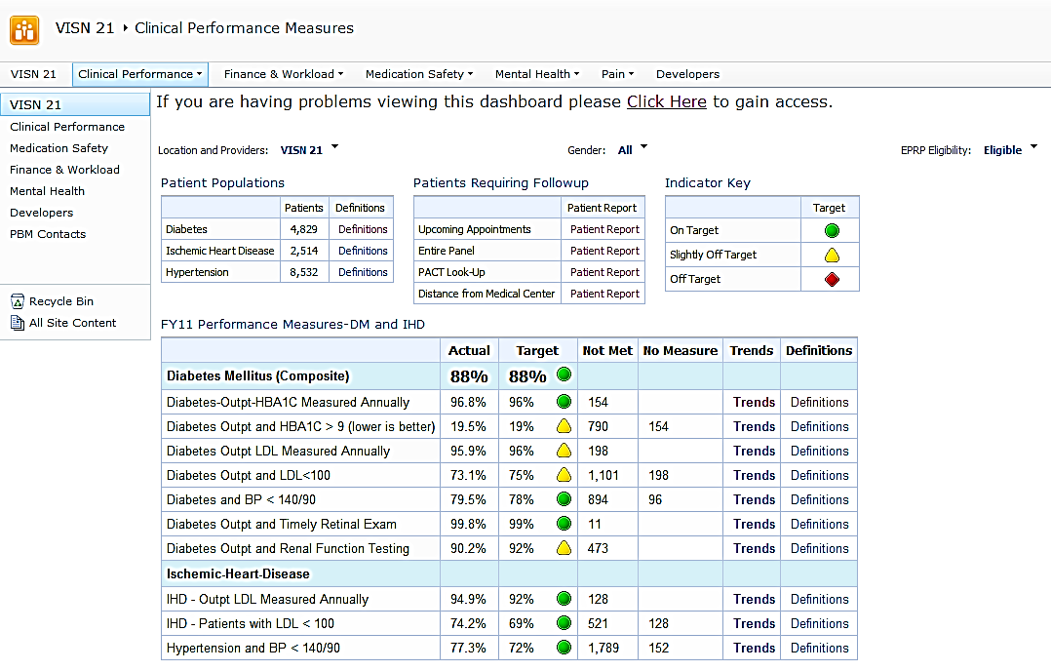
Notes:
DR
This is an example of a clinical dashboard that is used for performance as well as identification of patients in need. In addition to performance dashboards there are also dashboards that focus on medication safety.
An example of using dashboards to improve performance was seen in the VA Sierra Pacific Network (VISN 21) Dashboard. Dr. Jan Carmichael and colleagues compared VA performance measures between 2008 and 2010. They were able to demonstrate statistically significant improvement in multiple care measures including more DM patients meeting LDL goals, BP and A1c goals. Julie can you show us how clinical pharmacists are intervening on patients system-wide?

Slide 53
Pharmacists Achieve Results with Medications Documentation =
PhARMD
Project
Interventions
Proven to reduce harm to patients
Focus on medication management decisions
Improve care to patients
Notes:
JG
Clinical reminder tool used by pharmacists to document clinical interventions. Pharmacists functioning as non-physician providers. Grassroots project that began separately at 2 medical centers in 2010. Drs. Spencer Schaefer and Allyce Schenk of the Kansas City VAMC developed a tracking tool for documenting pharmaceutical care Then Dr. Rob Hough at the West Palm Beach VAMC utilized the reminder tool concept to develop an intervention tool for PACT CPS . PBM Chartered a Workgroup in 2011 to assess feasibility of development of national tool. I really have to recognize the hard work of our PBM PhARMD workgroups and all of our volunteers on this project.
Expansion pilot (9 sites total), started April 2012
VISN Expansion Pilot (21 sites added), started December 2012
Recent expansion in June 2014 has brought total number of facility sites to 63

Slide 54
Metric | FY12 | FY13
Number of Pharmacist Tool Users | 117 | 893
Disease State Interventions | 15,410 | 180,019
Additional Pharmacotherapy interventions | 16,717 | 129,917
Avg Number of Interventions per visit | 1.87 | 1.75
Notes:
JG
Discuss PBM PhARMD Project Results
You can see how impressive the number of interventions our pharmacists are logging on a day to day basis. But how does that relate to particular disease states they are treating?
Data Pull 10/1/13
Reflects data from 62 facilities

Slide 55
PhARMD Project
Diabetes Patient Interventions
(N= 957)
Biomarker | Baseline | Treatment | P value (T-Test)
HbA1c | 9.05 | 8.08 | <0.000001
Notes:
DR
So when we further evaluated the diabetic patients seen by the pharmacist using the PhARMD tool we evaluated their HbA1c control at the first intervention with the pharmacist compared to the most current visit and found that A1c decreased by approximately 1% point. We have to note that these are preliminary outcomes from the patients treated by the clinical pharmacist using the PhARMD tool and we are further refining our data analysis. The patient care goals for each patient were individualized by the pharmacist. It is also important to remember that these were complex patients with many of their disease parameters not at goal including LDL and BP. A great decrease in A1c seen on these preliminary results but what does this mean in relationship to patient outcomes?

Slide 56
PhARMD Diabetes Patients
Numbers Needed to Treat (NNT)
Bilateral Blindness
284
Chronic Kidney Disease
150
Macro
albuminuria
34
81
Foot Amputation
Notes:
JG
The following outcomes were a result of our PhARMD demographics being added to the Archimedes Database to calculate numbers of patients needed to treat to prevent 1 complication. We used the patient demographics from the 957 patients treated by the pharmacist for diabetes and entered this into this simulation model to create a virtual world with simulated patients. The model can be used to analyze a wide range of questions about the occurrence and management of those conditions. We used this model to assess the non-cardiovascular risk reduction in achieving the A1c goals Dr. Rubin described in the previous slide. you can see that for every 34 patients that reach goal you can predict that you prevent 1 foot amputation, every 81 patients prevents 1 case of macroalbuminuria and most importantly in this patient population for every 150 patients you prevent 1 case of stage 3 or above CKD. In addition blindness and retinopathy is a significant complication of uncontrolled diabetes and for every 284 patients that are treated to goal by the pharmacist, it is predicted that you would prevent 1 case of bilateral blindness. Now let’s take a look at a similar population of HTN patients.

Slide 57
PhARMD Project
Hypertension Patient Interventions
(N= 370)
Biomarker | Baseline | Treatment | P value (T-Test)
Systolic BP | 153 | 133 | <0.000001
Diastolic BP | 93 | 79 | <0.000001
Notes:
DR
We also evaluated the hypertension patients seen by the pharmacist using the PhARMD tool we evaluated their BP control at the first intervention with the pharmacist compared to the most current visit and found that BP decreased to goal levels for most patients seen by the pharmacist. The mean arterial pressure for the HTN group decreased from 113 to 97. Again, a very complex patient population with multiple comorbidties and on multiple medications. Let’s take a look at the number of patients needed to treat to see the benefit of these interventions.

Slide 58
PhARMD Hypertension Patients
Numbers Needed to Treat (NNT)
Stroke
152
Myocardial Infarction
63
43
Death
Notes:
JG
We then applied our HTN patient population to the Archimedes Database to calculate numbers of patients needed to treat to prevent 1 complication. The numbers are impressive. Only 152 patients need to be treated to goal BP levels to prevent 1 stroke, 43 patients to prevent 1 MI, and 63 patients to prevent 1 death from any cause. We are further evaluating the PhARMD outcomes and calculating cost benefit ratios and cost avoidance information for pharmacists treating these patients to goal. We hope this data matched with the archimedes modeling software will provide valuable information to the benefits of the pharmacist in the team. Again these are all preliminary outcomes but we hope that the interventions logged by the over 900 pharmacist users at each facility site will help to give us more information in the future about how pharmacists impact the care of our veterans.

Slide 59
Poll Question
Pharmacists are essential members of the healthcare team
    True
    False
Notes:
DR
So we have given you a lot of information during this presentation and have just one final poll question.
True or False: Pharmacists are essential members of the healthcare team?
To answer this question, use the blue polling icon above my head. We’ll move on and come back to your results in just a moment.

Slide 60

Clinical Pharmacy Services are Essential to the Team
Notes:
DR
Today we have demonstrated that the Clinical Pharmacist is the team’s Medication Expert and can function in the role of a provider performing essential medication management services. Clinical Pharmacists need integrated into all team based models of care to improve access, decrease medication costs, and impact patient outcomes. In fact, an economic analysis performed in 2008 showed that for every $1 invested in clinical pharmacy services, more than $4 in benefit can be seen. By extrapolating the average salary data for pharmacists, VA expects to see almost 400,000 in savings benefit from providing clinical pharmacy services in primary care for each clinical pharmacist.

Slide 61

Where do we go from here?
Notes:
JG
Healthcare in VHA is rapidly expanding and changing but gaps still exist. The multitude of medications used to treat diseases makes medication management complicated for the team and Veteran. Increased training and deployment of Clinical Pharmacists in both PACT and Specialty care
Focus on systems redesign to free pharmacists to provide more direct patient care and comprehensive medication management services.
But before we leave you today, let’s go back to our poll

Slide 62
Poll Results
Pharmacists are essential members of the healthcare team
  True
  False
Notes:
JG
Pharmacists are essential members of the healthcare team

Slide 63
Poll Results
  True
  False
Notes:
(Cue to Tech Team that you’re moving on) “Click” again to move on

Slide 64

Ask the Presenter
Notes:
JG
We hope you have enjoyed our presentation today and we have sparked some new ideas on how you may further integrate your clinical pharmacist into new areas. Remember your clinical pharmacist may be an untapped resource with an expertise for managing medications in PACT, specialty care and other team based model. Integration of a pharmacist as an essential member of the healthcare team provides an opportunity to improve access and care for our Veterans.
Thank you very much for your time and attention today!
DR
If you haven’t submitted your questions yet, there is still time to do so by clicking on the orange “Ask The Presenter” icon. We’re going to show a brief announcement and be right back to answer your questions.
(Stand still and smile until you see the video come up full screen)

