Slide 1
Strategies for Preventing Medication Errors
Bruce McIntosh, Pharm.D.
National Manager, Product Recall Office
VA National Center for Patient Safety
Office of Quality Safety and Value
Notes:
Thank you Joe! I am happy to be here today to talk about Preventing Medication Errors.
>>>>
Now I’d like to ask a poll question before we get started.

Slide 2
Poll Question
Do you believe we have made significant advances in patient safety since the 1999 Institute of Medicine (IOM) Report?
Yes
No
I don’t know
Notes:
Do you believe we have made significant advances in patient safety since the 1999 IOM Report?
To answer this question, use the blue polling icon above my head. We’ll move on and come back to your results in just a moment.

Slide 3
Preventing Medication Errors-Overview
Background
Systems
Culture
NCPS
Challenges
Strategies
Questions
VA Process

Slide 4
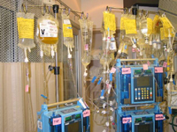
"Medicine used to be simple, ineffective, and relatively safe. It is now complex, effective, and potentially dangerous.”
-Sir Cyril Chantler

Slide 5
System Process Complexity
Anarchy
Complex
Complicated
Simple

Slide 6
Things That Can Kill You In A Hospital
Misdiagnosis
Unnecessary treatment
Unnecessary tests and deadly procedures
Medication errors
Never events
Uncoordinated care
Iatrogenic infections
“Accidents”
Missed warning signs
Going home
Notes:
Huffington Post 2013

Slide 7
Dennis Quaid Case
Kimberly Hiatt Case
Notes:
Nationally, publicly documented reported cases about medication errors.
Both involved children, but one is from the perspective of the patient/family and the other from the healthcare provider.
First case was a positive outcome:
A champion for patient safety from a celebrity
Chasing zero documentary: wining the war on healthcare harm
Second case was a negative outcome:
Lack of a Just culture
Second victim
Hospital did change to adopt a Just culture mindset

Slide 8
Definitions
Adverse Event
Medical Error/ Event
Adverse Drug Event (ADE)
Medication Error/ Event
Medication Error Rate
Intentionally Unsafe Act
Notes:
Medication error rates- unable to compare from hospital to hospital
Not very meaningful.
Intentionally unsafe act- will discuss more in detail later.

Slide 9
Preventable Medication Event
Medication Event
ADE
Close Call
Notes:
>50% medication errors are preventable

Slide 10
Actual Events
Close Calls
Notes:
Refer to my driveway!

Slide 11
Types of Medication Errors
Errors of Commission
Errors of Omission
System Errors
Wrong Patient
Wrong Drug
Wrong Dose
Wrong Route
Wrong Time
Monitoring Error
Omission
Other

Slide 12
Incidence and Costs
Preventable medication errors
at least 1.5 Million in the U.S. each year
One error per hospital patient per day
Notes:
From IOM 2006 Quality Chasm Series.
Significant underestimate.
350-450K hospitals
800K LTC
500K outpatient
But outpatient visits outnumber inpatient visits 25 to 1
True number is larger

Slide 13
Incidence and Costs
100,000
or
> 400,000
DEATHS
Notes:
From IOM 1999 ‘To err is human’ and 200K to > 400K from 2013 meta-analysis
True number is likely greater as limited research on true incidence in a voluntary reporting system, let alone in a monitored global trigger study.
#’s apply to Medical errors in general, but medication errors likely account for 50%.
Equivalent to a jumbo jet airliner crashing daily. Would you fly?
Greater than auto accidents and now ranks as a top five cause of death in U.S.
Like auto accidents, these deaths occur quietly across the country, but add up.
Unlike auto deaths, many of them are unknown or not reported (e.g. patient was going to die anyway).

Slide 14
Incidence and Costs
Costs
$ ? billion
Notes:
$3.5 billion/year (hospitals) per IOM 2006 data
But this is for inpatients
Some data reports that this may be up to 50B to 177B
True $ greater.
Now, let’s take a look at your poll results !!

Slide 15
Poll Results
Do you believe we have made significant advances in patient safety since the 1999 Institute of Medicine (IOM) Report?
Yes
No
I don’t know
Notes:
Do you believe we have made significant advances in patient safety since the 1999 IOM Report?
Ad-lib to the audience results, then advance to move on.

Slide 16
Poll Results
Yes
No
I don’t know
Notes:
Cue to the tech team (click again)

Slide 17
Studies Suggest Impact Unclear
NEJM (2010)
Health Affairs (2011)
OIG Report on Medicare (2010)
Why?
What are the barriers?
Notes:
How do we shape Healthcare Systems into HROs

Slide 18
Preventing Medication Errors-Overview
Background
Systems
Culture
NCPS
Challenges
Strategies
Questions
VA Process

Slide 20
Aviation Culture Healthcare
Team emphasis
Human factors
Core work
SOP
Non-punitive reporting
Perpetual training
Competence checked
Hierarchical relationships
Human factors varies
Non-core work
Variable standards
Fear/shame reporting errors
CME/ACPE, etc.
Competence assumed

Slide 21
Safety Matters
99.9% Reliability =
20,000
Incorrect prescriptions per year
500
Incorrect operations per week
1 hour
Unsafe drinking water per month
22,000
Bank checks deducted from the wrong bank account per hour
Notes:
Reaching for High Reliability
NCPS Curriculum

Slide 22
3 Step Approach for Safety
Prevention
Reporting
System Focus
Notes:
Reference only:
NCPS 3 step System-focused approach
VHA's patient safety program has implemented a three-step approach to improving patient safety
which includes:
Understanding the health care continuum as a system, and exploring system vulnerabilities that can result in patient harm; this being an emphasis in VHA’s patient safety improvement initiatives.
(2) Reporting of adverse events and close calls. This is the primary mechanism through which VHA NCPS learns about system vulnerabilities and how to address them. Since 2000, more than 1,000,000 adverse events and close calls have been reported to the VHA NCPS from VA medical facilities. These reports have provided valuable opportunities to evaluate the identified root causes and contributing factors, as well associated actions and outcome measures to mitigate future events from reoccurring within that facility.
(3) Emphasizing prevention rather than punishment this is the preferred method to mitigate system vulnerabilities and reduce adverse events; is an important aspect of VHA’s patient safety initiatives.
c. The three-step approach promotes the implementation of knowledge-based actions that can be formulated, tested, and implemented at the local and national levels to effectively mitigate system vulnerabilities that can lead to patient harm. NOTE: Ultimately, this effort can be successful only if emphasis on safety and the responsibility for improving it resides at all levels of the organization; it requires a team effort.

Slide 23
Where do Medication Errors Occur?
Purchasing
Prescribing
Transcribing
Dispensing
Administration
Monitoring
Notes:
80% of errors occur in prescribing and administration
This is the med use system– our focus of attention to prevent medication errors

Slide 24
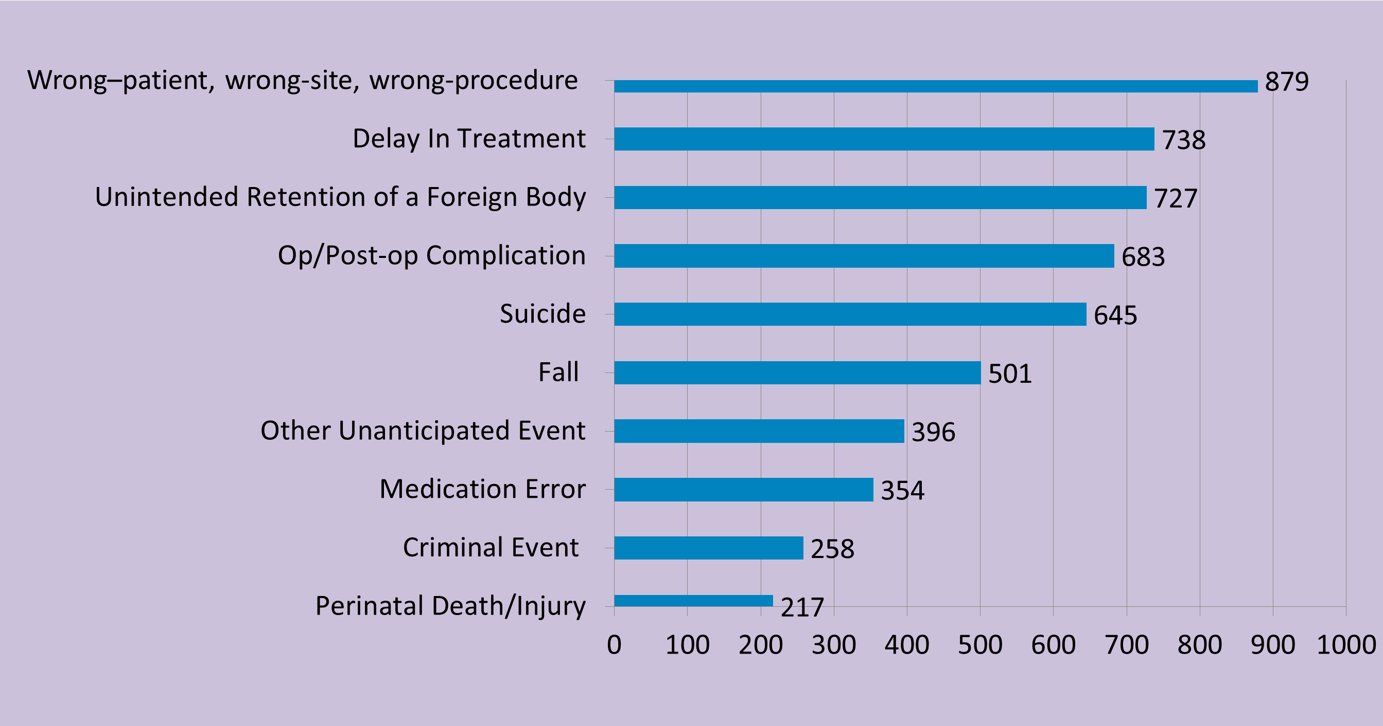
Notes:
2004- 2Q2012
Total Incidents Reviewed = 6554
Reported Sentinel Events TJC (Top 10)
In the VA, this includes wrong patient, side, site, implant, person, or level
Callout for medication error--- new data shows 4th leading death related Sentinel event.
2004-2Q 2012
Total Incidents Reviewed = 6554

Slide 25
VA Root Cause Analysis (RCA)
SPOT Database
Communication 28.5%
Rules/Policies/Procedures 23.2%
Training 16.4%
Environment/Equipment 12.8%
Barriers 11.0%
Fatigue/Scheduling 8.2%
Notes:
What is the most common system based failure = COMMUNICATION!
75% -80% when look at root causes and contributing factors
VA National Center for Patient Safety SPOT Database. Accessed Sept. 22, 2011.
SPOT Database from 2000-2011
13,120 adverse events studied in detail
9,822 reports cite “communication” as a “triage category” for at least one of the root causes.
75% of adverse events have “communication” as a contributing factor.

Slide 26
Adverse Event
Report and Review
Safety Report
RCA
Aggregate
NCPS
Notes:
Where do RCAs fit in to a system-focused approach?

Slide 27
Preventing Medication Errors-Overview
Background
Systems
Culture
NCPS
Challenges
Strategies
Questions
VA Process

Slide 28
A Positive Safety Culture
Open
Just
Learn
Report
Inform
Notes:
All five elements are needed for a positive patient safety culture
First reported by UK NHS

Slide 29
Individual vs. System Accountability
The Unsafe Acts Algorithm
James Reason 1997
Intend to cause harm? Y/N
Come to work drunk or equally impaired? Y/N
Knowingly and unreasonably increase risk? Y/N
Would another similarly trained and skilled employee in the same situation act in a similar manner? Y/N
Notes:
So errors occur, no one is ever held accountable, no one is blamed, nothing changes . …….No sir!
It is just that the root cause of most errors in healthcare are not human error, there is an underlying system factor. (focus is on fair blame culture)
Did the employee intend to cause harm? Y/N
Did the employee come to work drunk or equally impaired? Y / N
Did the employee knowingly and unreasonably increase risk? Y / N
Would another similarly trained and skilled employee in the same situation act in a similar manner (Reason’s substitution test)? Y / N
First three answers ‘‘No’’ and the last ‘‘Yes’’ the origin of the unsafe act lies in the organization (system) not the individual.
Reference only:
Also referenced in: Frankel, A.S. (2006). Fair and just culture, team behavior, and leadership engagement: The tools to achieve high reliability. Health Services Research, 41, 1690-1709.
Dr. Frankel takes us through a very quick set of screening questions upon analysis of an adverse event.
Example: nurse that gave the heparin to the Quaid twins at Cedars Sinai

Slide 30
Preventing Medication Errors-Overview
Background
Systems
Culture
NCPS
Challenges
Strategies
Questions
VA Process

Slide 31
Background
NCPS
History
Mission
Programs
Notes:
History:
In 1999, the VA National Center for Patient Safety (NCPS) was established to lead the effort to improve the safety of patients cared for in the VA health system
Mission:
Remove harm from Veterans Health Care
Programs: next slide

Slide 32
Programs
Tools
Products
HFE/ PRO
CTT
PM/ PS Network
Other
RCA
Website
PSAT
HFMEA
Other
Alerts
Advisories
Other
Recalls
Research
Training
Notes:
Reference only:
Programs
PRO
HFE
CTT
Network
Consultants
Training
Analysis
Research
Fellowship
PSCI
Tools
SPOT
RCA Reports
Aggregated Data
Safety Reports
Alerts and Recall Website
PSAT
HFMEA
Site Visits
Materials
Products
Recalls
Alerts
Advisories
Patient Safety Logs
TiPs Newsletter
Topics Summaries
Hazard Summaries
Daily Plan
Website

Slide 33
VHA Alerts and Recalls Website
Notes:
Reference only:
-- download for internet access
Access for searching without logging in for VA employees:
http://vaww.recalls.ncps.med.va.gov/WebRecalls/Recalls.html
Established by VHA Directive 2008-080
64.92% Compliance for Class I recalls prior to the Directive
98.90% Current compliance for Class I recalls
Consolidated several existing medical product recalls programs as a single source for documentation and reporting.
The VHA Alerts and Recalls website allows the Product Recall Office (PRO) to give near “real time” report to VACO or any other customer on recalls
Scope is medical devices, biologics, veterinary products(research), drugs, and food.
Currently working with PBM and VHA Center for Engineering and Occupational Safety and Health (CEOSH) to establish access to post their device notifications (non-recall)

Slide 34
Preventing Medication Errors-Overview
Background
Systems
Culture
NCPS
Challenges
Strategies
Questions
VA Process

Slide 35
Poll Question
Have you participated on a Root Cause Analysis (RCA) team investigation as a pharmacist?
Yes
No; I have never been asked
No; I don’t have time
Notes:
Now I’d like to ask a poll question.
Have you participated on a RCA team investigation as a pharmacist?
(not just interviewed, but a team member)
To answer this question, use the blue polling icon above my head. We’ll move on and come back to your results in just a moment.

Slide 36
Report
Alert
Learn
Best Practice
Monitor
Review
Act
Remove
Harm
Notes:
VA process meeting core mission for safety– remove harm

Slide 37
WHAT is an RCA?
Process for identifying contributing/causal factors that underlie variations in performance associated with adverse events or close calls
Process that features interdisciplinary involvement of those closest to and/or most knowledgeable about the situation
Notes:
VA Process for adverse events is the RCA tool
To allow facility, network and VHA-wide learning about adverse events, NCPS developed a standardized method for “root cause analysis” (RCA)
The RCA process involves the identification of basic or contributing causal factors to adverse events or close calls, and then using that information to develop actions to address the identified causes and prevent harm to patients in the future

Slide 38
RCA (The NCPS Model)
A rigorous, legally protected, and confidential approach to answering…
What Happened?
Why?
What?
How?
Notes:
What happened? (event or close call)
What happened that day?
What usually happens? (norms)
What should of happened? (policies)
Why did it happen?
What are we going to do to prevent it from happening again? (actions)
How will we know that our actions improved patient safety? (outcomes)

Slide 39
Questions typically asked in…
Healthcare
High reliability organizations:
Whose fault is it?
Who do we blame?
How did we get here?
How do we prevent it from happening again?
Notes:
Unfortunately, healthcare in general is not taking the RCA systems-based approach

Slide 40
Harm
Communication – 24%
Training – 11%
Policies & Procedures 43%
Infrastructure Design or Layout 5%
Equipment or Software 14%
Notes:
This slide is a little hard to read, but you can download this powerpoint by clicking on the green download button above my head.
Actions Identified by RCA Teams
Adapted from REASON, J. (1997) Managing the risks of organizational accidents, Hampshire, England, Ashgate Publishing Limited.
N = 270 Actions
NA = 3%

Slide 41
How we
do it
Policy
Notes:
Short cut and work-around
Normalization of deviance – drift in to failure

Slide 42
Actions
Policy
Training
Notes:
But aren’t training and policy important?
>>>
Now let’s pause for a moment and take a look at your poll results.

Slide 43
Poll Results
Have you participated on a Root Cause Analysis (RCA) team investigation as a pharmacist?
Yes
No; I have never been asked
No; I don’t have time
Notes:
Have you participated on a RCA team investigation as a pharmacist?
Ad-lib to the audience results, then advance to move on.

Slide 44
Poll Results
Yes
No; I have never been asked
No; I don’t have time
Notes:
Cue to the tech team (click again)

Slide 45
Root Cause Analysis (RCA)
Notes:
What we have seen at NCPS
May be a correlation between pharmacist satisfaction and participation
Draft 2012 NCPS analysis of the membership of RCA teams from FY06 through FY11

Slide 46
Adverse Events and Close Calls
Notes:
Draft 2012 NCPS analysis FY06 through FY11

Slide 47
RCA and Medication Events
NCPS received 20,724 Med event reports (FY 2008)
The most common reported Med event was omission (18%)
6,607 Actions were recommended
Notes:
Draft 2012 NCPS analysis

Slide 48
Preventing Medication Errors-Overview
Background
Systems
Culture
NCPS
Challenges
Strategies
Questions
VA Process
Notes:
Before we look at challenges, let’s ask another poll question…..

Slide 49
Poll Question
Which of the following do you think poses the greatest challenge to medication safety?
Opioid prescribing
Smart infusion pumps
Outsourcing compounded sterile products
Notes:
Now I’d like to ask a poll question.
Which of the following poses the greatest challenge to medication safety?
To answer this question, use the blue polling icon above my head. We’ll move on and come back to your results in just a moment.

Slide 50
Challenges
Purchasing for safety
Outsourcing compounded products
Integrating new medications & technology
Managing drug shortages
Opioid Safety
Recognized medication safety hazards
Clinical informatics
Communication and team work
Managing distractions
Designing safety into work flow

Slide 51
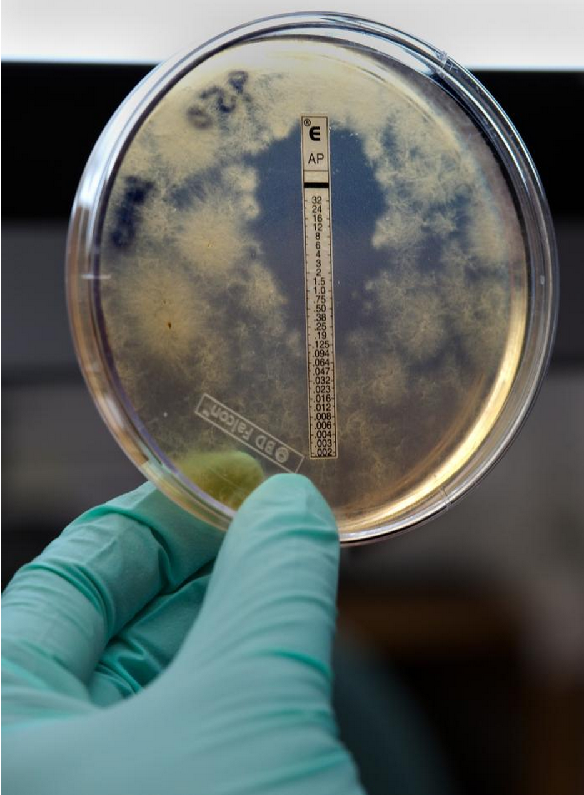
CSP Outbreaks Exserohilum rostratum
Notes:
Exserohilum rostratum
Greatest pharmacy tragedy in U.S. Healthcare
No VA or patients impacted.
No Veteran affected from outside VA, that we know of.

Slide 52
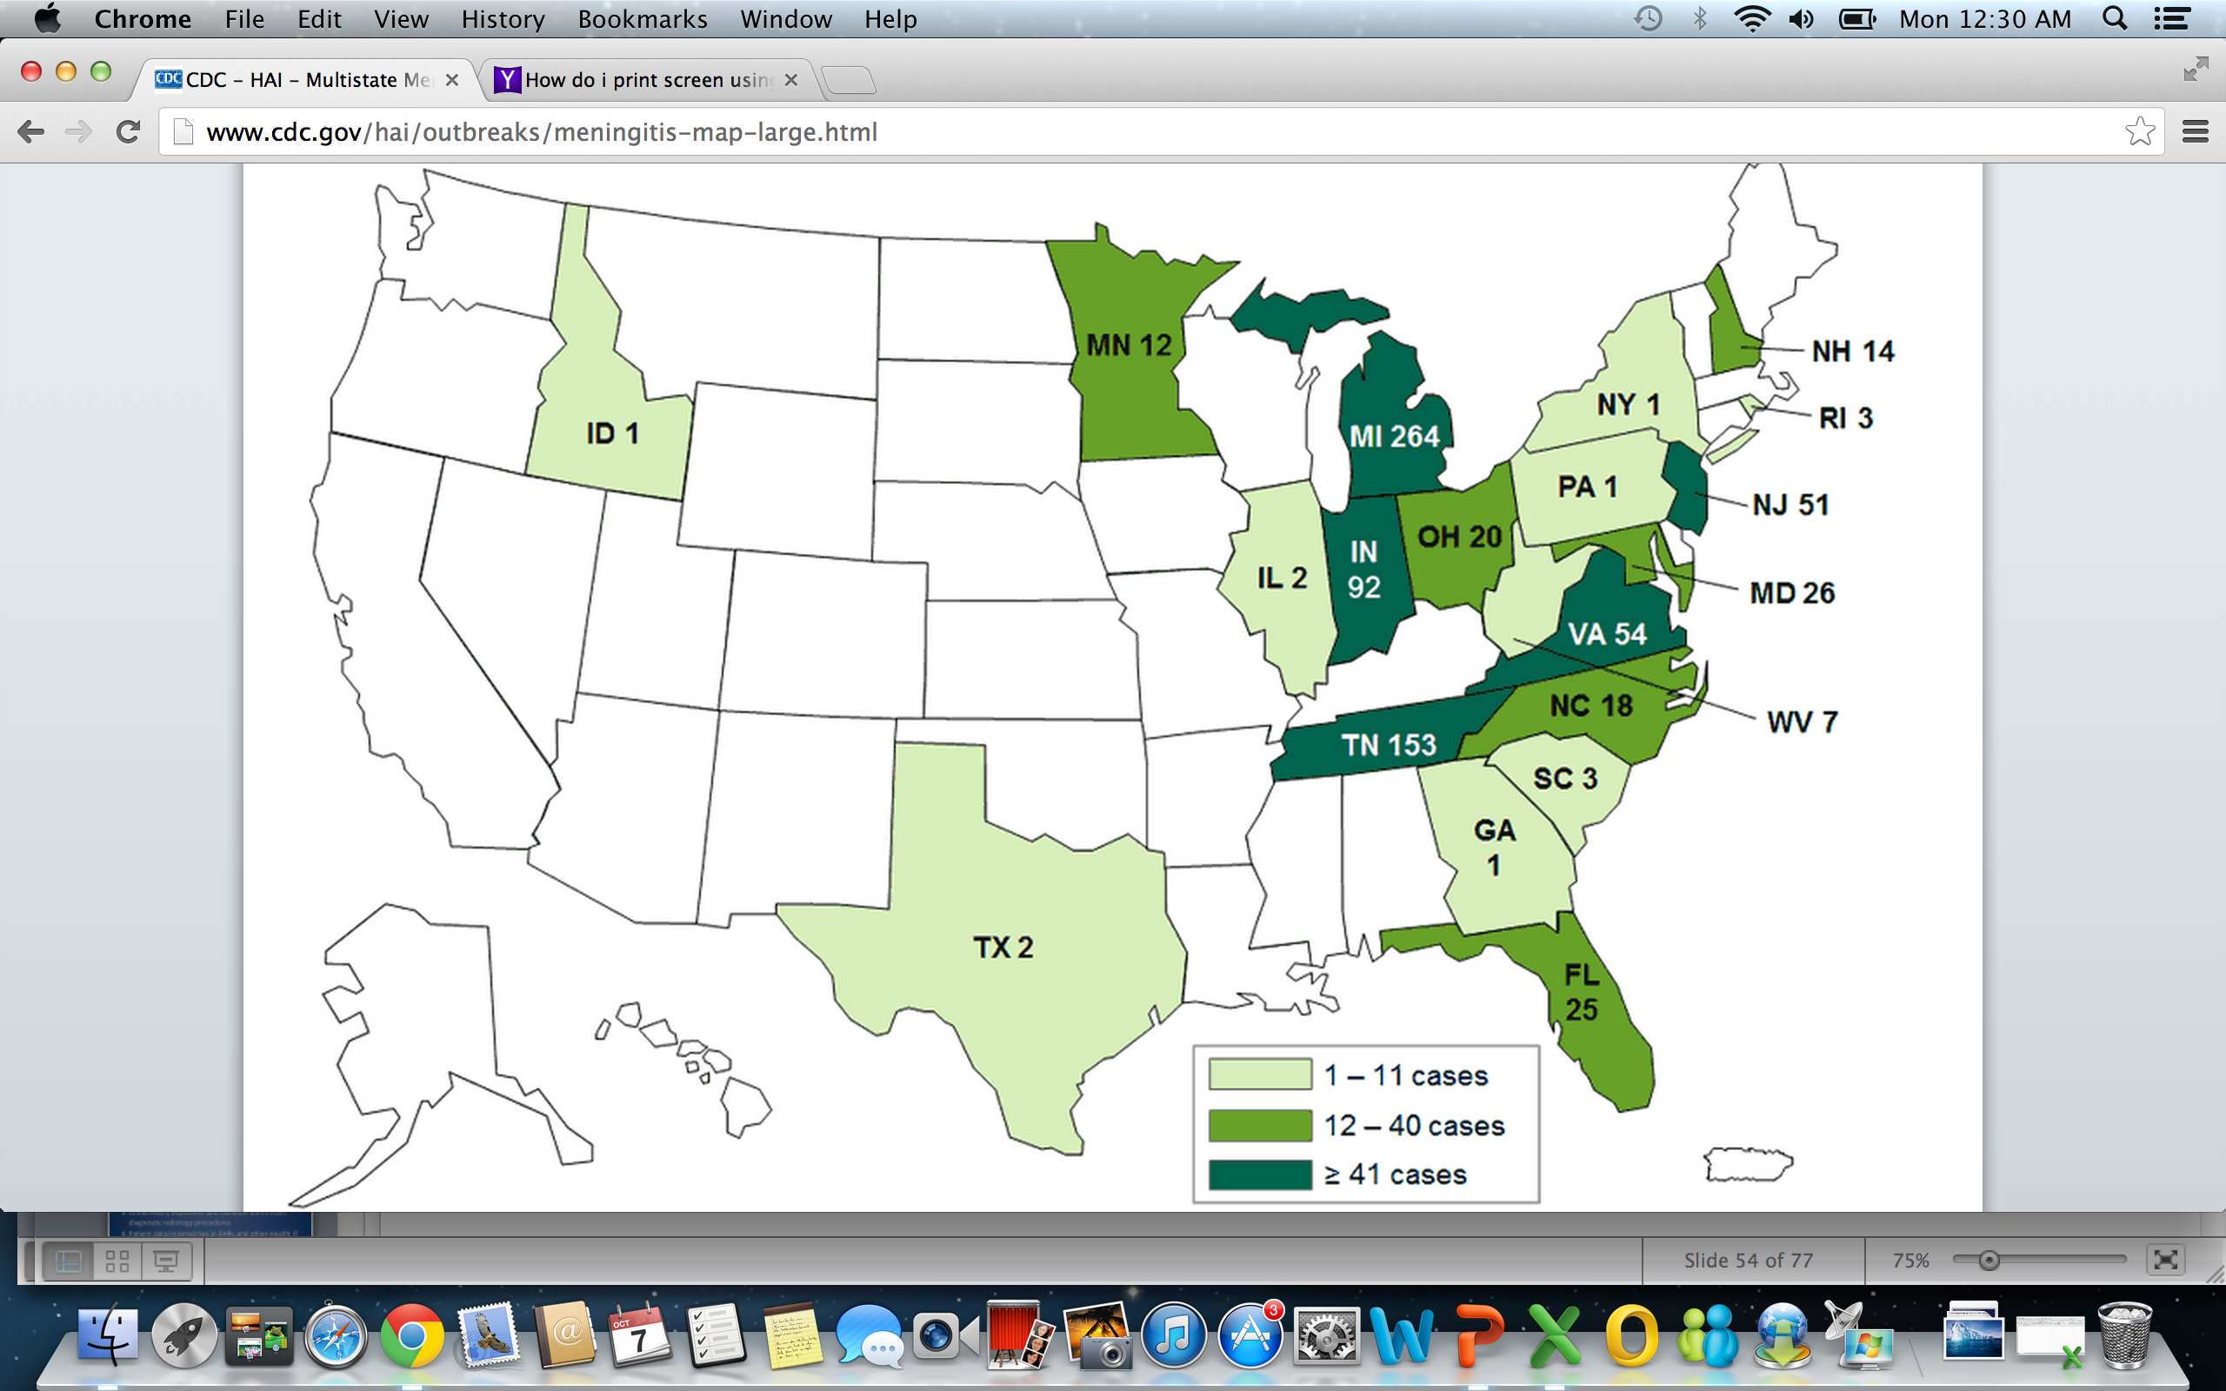
Notes:
Picture from CDC meningitis outbreak
9/6/2013

Slide 53
74% Shortages for sterile injectibles
U.S. Drug Shortages
Notes:
Reference only:
Taken from FDA U.S. Food and Drug Administration:
Protecting and Promoting Public Health http://www.fda.gov
The number of reported drug shortages annually has tripled from 61 in 2005 to 178 in 2010.
Of the 127 studied shortages in 2010-11, 80 percent involved drugs delivered to patients by sterile injection, including oncology drugs, antibiotics, and electrolyte/nutrition drugs.
The leading reasons for the reported shortages were problems at the manufacturing facility (43%), delays in manufacturing or shipping (15%), and active pharmaceutical ingredient shortages (10%).
Manufacturing quality problems that have resulted in shortages can be serious, including findings of glass shards, metal filings, and fungal or other contamination in products meant for injection into patients.
Patient safety concerns:
Patient may take both medications
Patient may take neither medication
ADEs and Med Events (errors)
Therapeutic substitution
Dose conversion and follow-up
Example: Coreg to Toprol XL
Withdrawal syndrome
Communication Breakdown:
Look Alike / Sound Alike (LASA)
Example- Amlodipine vs. Felodipine
Rx Sig. changes due to change
Example- ISDN vs. ISMN
Patient may not be taking medication anymore
Active status in CPRS
Communication to clinicians and health care team
Drug substitution
Mass letters vs. telephone call
Patient literacy (for letter and Rx label)
No replacement available/suitable
Alternative too expensive and low risk medication (e.g. Nasal Steroid Inhalers)
High Risk medications
Medication use process

Slide 54
Notes:
http://www.oneandonlycampaign.org/content/cdc-guidelines
--Download (green icon)
Example of device human interface issues– sharing of insulin pens in VA – Alert from NCPS

Slide 55
ECRI Top 5 Health Technology Hazards 2013
Alarm hazards
Medication administration errors using infusion pumps
Unnecessary exposures and radiation burns from diagnostic radiology procedures
Patient data/mismatches in EHRs and other Health IT systems
Interoperability failures with medical devices and health IT systems
Notes:
Released 2014 top 10 hazards now.

Slide 56
Smart Pump Issues Reported to ECRI
Notes:
Reference only:
Smart pump issues: Random sample of 100 reports to ECRI (may 2010- March 2012)
Standardize concentrations of high alert medications in VHA
Require standard concentration programing in smart pumps
Limit who can change smart pump settings
Require use of smart pump safety guardrails including concentrations
Not all Smart Pumps are created equal
2010 Standardization of IV Infusion and PCA Pumps in VHA through IPTs (Integrated Product Teams)
86% brand compliance
51 out of 74 Integrated EtCO2
2010 AAMI/FDA Infusion Devices Summit generated top 13 priorities
2007 and 2012 ECRI Institute’s Health Devices Evaluation
2008 and 2012 ISMP Smart Pump Guidance
2013 Journal of Clinical Engineering: Infusion Pump Reliability and Usability by VHA
Pulse oximetry is a late detector of respiratory depression (RD)
Supplemental O2 delays detection of RD
EtCO2 monitoring, (ie, capnography) detects hypoventilation/apnea immediately
All patients on PCA’s should be monitored with both EtCO2 and SpO2

Slide 57
ED Medication Events
Wrong route 3%

Slide 58
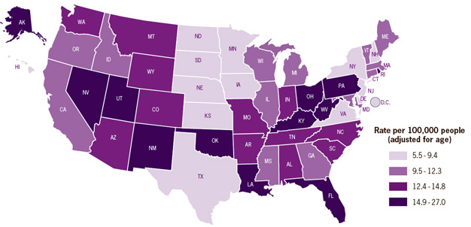
Drug overdose death rates by state per 100,000 people (2008)
Notes:
Reference only:
National Vital Statistics System, 2008
Medical education and VHA policy through the 1990’s emphasized “pain as the 5th vital sign.”
Opioids cause harm:
Fourfold increase in death due to overdose from prescription opioids.
Risk of death with over-sedation from IV opioid medications, including Patient-Controlled Analgesia (PCA).
Effective Processes—Create and implement policies & procedures for:
Ongoing clinical monitoring of patients receiving opioid therapy: respiration & sedation with pulse oximetry & capnography (EtCO2 monitoring)
Revise SOPs and Opioid Infusion Policies
Addition of capnography with Guardrails software®
2. More………………..

Slide 59
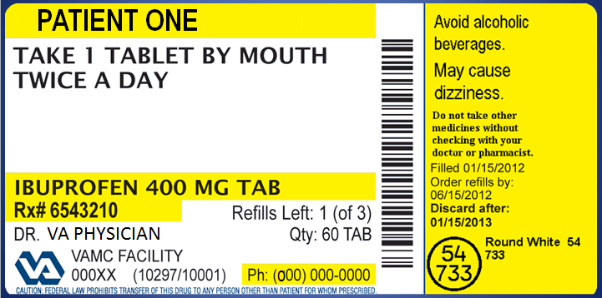
VA Patient-Centric Rx Label
Notes:
Health Literacy and Numeracy issues in VA.
>>>>>>
Now let’s pause for a moment and take a look at your poll results.

Slide 60
Poll Results
Which of the following do you think poses the greatest challenge to medication safety?
Opioid prescribing
Smart infusion pumps
Outsourcing compounded sterile products
Notes:
Which of the following poses the greatest challenge to medication safety?
Ad-lib to the audience results, then advance to move on.

Slide 61
Poll Results
Opioid prescribing
Smart infusion pumps
Outsourcing compounded sterile products
Notes:
Cue to the tech team (click again)

Slide 62
Preventing Medication Errors-Overview
Background
Systems
Culture
NCPS
Challenges
Strategies
Questions
VA Process

Slide 63
A Systems Based Approach
Identify
Prevent
Mitigate
Communicate
Monitor

Slide 64
Safer Systems
Mental Workload
Distractions
Environment
Physical Demands
Product Design
Teams
Process Design

Slide 65
Healthcare Organization Strategies
Notes:
IOM Committee on Identifying and Preventing Medication Errors. Preventing Medication Errors: Quality Chasm Series. ISBN: 0-309-65856-x, 480 pgs. 2007. PDF available from NAP: http://www.nap.edu/catalog/11623.html (available for download)
General
Improved communication (patient & provider)
Medication Reconciliation – Friday presentation
Patient-centered care model
Support and implement a positive patient safety culture
Follow literature on medication safety
Lead medication reconciliation programs
Employee medication safety pharmacists
Allocate resources (DSS, Barcoding, Counseling areas/time)
TJC National Patient Safety Goals (NPSGs)

Slide 66
Where do Medication Errors Occur?
Purchasing
Prescribing
Transcribing
Dispensing
Administration
Monitoring
Notes:
80% of all errors occur in prescribing and administration stages
Medication Reconciliation at all stages
-- Maureen and Rose Friday presntation

Slide 67
Where do Medication Errors Occur?
Purchasing
Prescribing
Transcribing
Dispensing
Administration
Monitoring
Notes:
Purchasing
Follow guidance on outsourcing CSPs
Barcode Verification (NDC, Lot, Exp.)
Designated storage for high-risk medications
Drug shortage plan for safety
Formulary maintenance/ planning

Slide 68
Where do Medication Errors Occur?
Purchasing
Prescribing
Transcribing
Dispensing
Administration
Monitoring
Notes:
Prescribing
CPOE with clinical decision support services
Avoid alert fatigue in CPOE
Medication Reconciliation
Pharmacist participation on patient rounds
Conservative prescribing principles
Academic detailing of providers
Point of care drug references

Slide 69
Where do Medication Errors Occur?
Purchasing
Prescribing
Transcribing
Dispensing
Administration
Monitoring
Notes:
Transcribing
CPOE
Cautious use of abbreviations
Look-alike / Sound-alike drugs
High-risk medications/ classes
Read back verbal orders
Tall-man lettering

Slide 70
Where do Medication Errors Occur?
Purchasing
Prescribing
Transcribing
Dispensing
Administration
Monitoring
Notes:
Dispensing
Automated dispensing systems
Barcode Verification (Patient, NDC, Lot, Exp.)
Drug use evaluation
Provide double checks in dispensing
Provide environmental controls
Minimize distractions in workflow
Avoid alert fatigue in pharmacy prescription processing
User centric medication labels

Slide 71
Where do Medication Errors Occur?
Purchasing
Prescribing
Transcribing
Dispensing
Administration
Monitoring
Notes:
Administration
Maximize use of BCMA
Smart use of smart pump technology
Provide environmental controls
Minimize distractions and interruptions in workflow
“Five rights” of medication safety

Slide 72
Where do Medication Errors Occur?
Purchasing
Prescribing
Transcribing
Dispensing
Administration
Monitoring
Notes:
Monitoring
Monitor for errors and correct systems issues
Implement a medication error prevention plan
Educate and counsel patients and providers
Report and share medication errors (learning)
Evaluate and monitor new technology
Provide Medication Therapy Management (MTM)
Provide special attention to high-risk patients (e.g. recently discharged)
Monitor patient self-medication use

Slide 73
Medication Event
Actual
Close Call
Potential
Immediate Actions
Proactive Risk Assessment
Report
Analyze
Implement and Evaluate Corrective Action Plan
Safer Systems/ Safer Care
Notes:
-Ensure Medication events get reported and acted on
-HFMEA

Slide 74
Broad Strategies
Critical thinking
Collaboration
Anticipate failure
Adaptability
Initiative
Analysis
Creativity
Communication
What can you do?
Notes:
Anticipate failure
Preparing for the known
Preparing for the unknown

Slide 75
Fault Tolerance
MITIGATE
TRAP
AVOID
Notes:
Anticipate complications
Be prepared for complications
“Read-back”
“Time Out”
Right person – right job
Good communication
Team briefing
No short cuts
Checklists
Training
Culture: Immediate reporting
Procedure: Anticipate & be prepared for complications
Culture: Open inquiry/advocacy
Procedure: “Time Out”
Culture: Open inquiry/advocacy
Procedure: Handoff & Briefing
Supervision: Clear expectations, Clear lines of authority, Notify supervisor

Slide 76
Notes:
Download handout- green icon
This is the Effective Followership Algorithm Tool. This is your tool to use and help you to become an effective follower. Carry your card with you.
Lets start at the bottom and work our way up to the top.
Avoid hint and hope
Use the 3Ws: Be specific, direct and concise.
Next, use the 4 step assertive tool
If still no response, engage the team: Turn to team members and ask “what do you think?”
Go up the chain of command.
REMEMBER- It’s all about WHAT’S RIGHT, NOT WHO’s RIGHT!

Slide 77
Notes:
Lets start at the bottom and work our way up to the top.
Avoid hint and hope
Use the 3Ws: Be specific, direct and concise.
Next, use the 4 step assertive tool

Slide 78
Notes:
If still no response, engage the team: Turn to team members and ask “what do you think?”
Go up the chain of command.
REMEMBER- It’s all about WHAT’S RIGHT, NOT WHO’s RIGHT!
http://vaww.oqsv.med.va.gov/stoptheline/

Slide 79
Situational Awareness
Mental Load
Task Load
Time Pressure
Distractions
Fatigue
Threats
Medication Error
Fall with Injury
Wrong Patient
Wrong Procedure
Codes (ACLS)
Failure to Rescue
ERROR
Attentional
Narrowing
Notes:
How do we deal with threats to our situational awareness in pharmacy?
Garland, Wise & Hopkin, 1999
Handbook of Aviation Human Factors

Slide 80
Human Factors Engineering (HFE)
Proactive Risk Assessment
Task Excursion Analysis™
Use Error Analysis
Usability Analysis
Notes:
Use error analysis:
What is most likely to trip up the user?
Usability analysis:
Based on the real data, what else could go wrong?
Proactive risk assessment:
How does the user complete this task comparing different personnel in various environments?
What could possibly go wrong?
TEA:
Where is allowance for excursion, and remain safe?
Not all do task the same way

Slide 81
Ask the Presenter
Notes:
If you haven’t submitted your questions yet, there is still time to do so by clicking on the orange “Ask The Presenter” icon. We’re going to show a brief announcement and be right back to answer your questions.
(Stand still and smile until you see the video come up full screen)

