Slide 1
Event Delayed Orders
Sheri Kreuz
April Brenner
Notes:
April: Thank you (moderator name)! Sheri & I are happy to be here today to talk about CPRS EVENT DELAYED ORDERS!!

Slide 2

Notes:
Sheri: So…does this look/sound familiar? This poor doctor has been up all night with a sick patient. It’s 7:15 am and he’s finally found a place to get a little rest. However, his scheduled admission has just arrived. Luckily, he used the Delayed Orders feature in CPRS. Delayed Orders helps health care providers to better manage their work flow by allowing them to enter patient orders in advance, at a more convenient time. The orders will remain on hold until they are released or needed. This doctor entered his orders for his patient’s scheduled admission the day before. So, he can just keep on snoozing.

Slide 3



Notes:
April: Delayed orders can be set up to automatically release when a patient event (such as an admission, a transfer, change in hospital location) takes place. The release of delayed orders at the right time results in happier staff. They get what they need in order to take care of the patient, when they need it. And the patient get what they need. Delayed orders works well for everyone…

Slide 4

Notes:
April: ….Including the doctor…who can some extra sleep!!!

Slide 5

Poll Question
Do you use DELAYED ORDERS at your facility?
    Yes
    No
Notes:
Sheri: So before we get into the guts of the presentation, let’s ask our audience about their experience w/Event Delayed Orders…using the Blue POLLING ICON above our heads, go ahead answer appropriately…
Do you use DELAYED ORDERS at your facility?
A. YES
B. NO
We’ll get started and then come back to view our results in a few minutes…

Slide 6
Auto DC Rules
Release Events
Delayed Orders
Notes:
April: Before we dive in, a reminder that if you have any questions during the presentation, go ahead and submit them using the “ASK THE PRESENTER” icon above our heads.
So, lets get started. The Delayed Orders functionality includes two components: Auto DC rules and Release Events. Auto DC rules can be used to discontinue orders that are no longer needed. For example, an Auto DC rule can automatically discontinue obsolete inpatient orders after a patient is discharged. We go into a lot more detail about Auto DC rules in a little bit, but first lets take a look at Release Events. A release event tells CPRS when to release or activate delayed patient care orders.

Slide 7
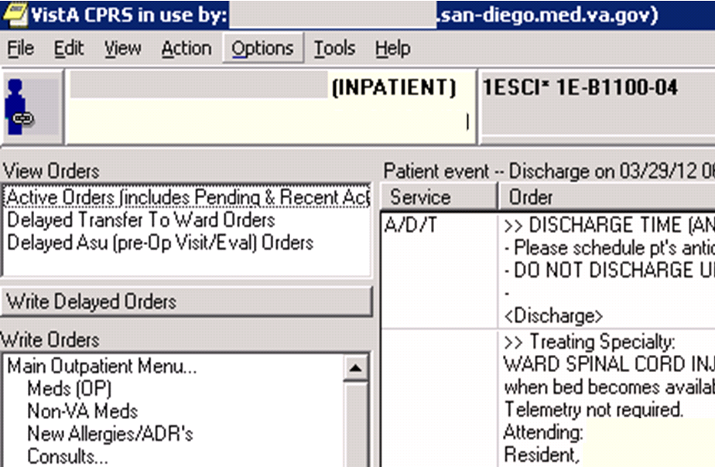
Notes:
Sheri: A good time to use a Release Event is when a patient is admitted. Here’s how it works. The clinician enters orders for admission in CPRS by clicking on the Write Delayed Orders button under the VIEW ORDERS section on the ORDERS tab….

Slide 8
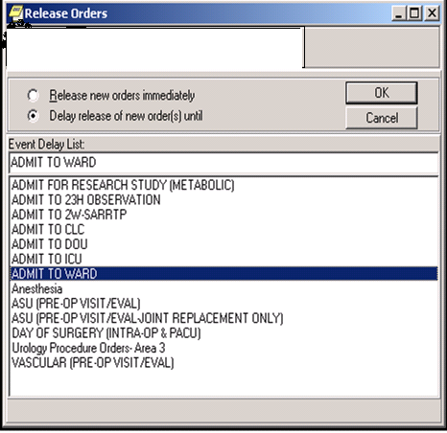
Notes:
Sheri: Here you see a list of release events that will display to the clinician. In this example, the release event is called “ADMIT TO WARD”. The orders are delayed and stay hidden and not part of the active orders view in CPRS until the patient is admitted. Let’s take a look (behind the scenes in VistA) at how a release event is created.

Slide 9
Select Reminder Dialog Management Option: ^Delayed Orders/Auto-DC Set-up
  Select one of the following:
  1 Auto-DC Rules
  2 Release Events
Enter response: 2 Release Events
Release events Jul 16, 2013@14:55:29 Page: 1 of 2
Event set up and maintenance – All entries/Truncated view
Event Name Display Text Active? Event
ADMIT TO 23H OBSERVATION ADMIT TO 23H OB
ADMIT TO 2W-SARRIP ADMIT TO 2W-SAR
ADMIT TO CLC ADMIT TO CLC
ADMIT TO DOU ADMIT TO DOU
+ Select number or enter action desired >>>
AE Add/Edit CC Create Child Event DD Detailed Display
AI Activate/Inactivate CD Change Display EP Edit Event Delay Par
Select action: Next Screen//
+ Select number or enter action desired >>>
Notes:
April: In VISTA, let’s type ^ (or press shift-6) DELAYED ORDERS to get to the DELAYED ORDERS/AUTO DC SET UP menu. This menu contains two choices: Auto-DC Rules, which I promise we will take about later and “Release Events”, which we’re going to examine right now. When we select the RELEASE EVENTS option we see a screen that displays existing release events. And from this same screen we can edit these existing events as well as create new ones. We’re going to create a new release event called ADMIT TO ORTHOPEDICS.
But before we actually start setting up, let’s check our results…

Slide 10
Poll Results
Do you use DELAYED ORDERS at your facility?
  Yes
  No
Notes:
Sheri: We see that a number of you are already using this functionality…but that some of you are new to it. And…maybe the set up was done years ago by other local staff that have moved on…and no one has touched them since!!! So hopefully we’ll have a little bit of something for everyone!!!

Slide 11
Poll Results
Do you use DELAYED ORDERS at your facility?
  Yes
  No
Notes:
“Click” again to move on

Slide 12
Select action: Next Screen// AE Add/Edit
Enter item number to edit or press enter to create a new entry
Select item(s):
Select OE/RR RELEASE EVENTS NAME: ADMIT TO ORTHOPEDICS
Are you adding ‘ADMIT TO ORTHOPEDICS as
a new OE/RR RELEASE EVENTS NAME (the 25TH)? No// y (Yes)
OE/RR RELEASE EVENTS TYPE OF EVENT: ?
Enter the type of event that should cause delayed orders to be released.
Choose from:
A ADMISSION
T TRANSFER
D DISCHARGE
O O.R.
M MANUAL RELEASE
OE/RR RELEASE EVENTS TYPE OF EVENT: A ADMISSION
Notes:
April: Back to creating an ADMIT TO ORTHOPEDICS release event. The first thing we need to do is select the “Add/Edit” action. The first prompt we see is the “Select item(s)” prompt. If we wanted to edit an already existing release event, we could enter the name of that event. But to create a completely new one, just press return and enter the name of the new event at the “Select OE/RR RELEASE EVENTS NAME “ prompt. Again, ours is going to be called, “ADMIT TO ORTHOPEDICS”. Type a “Y” for “Yes” to confirm the addition of the new OE/RR RELEASE EVENT.`
The next step is to select the type of event that will trigger the release of any delayed orders associated with this new event. We can choose from an admission, transfer, discharge, O.R. event, or manual release. We’re going to select “A” for admission. Sheri, I’m assuming that O.R. is related to a patient coming/going from SURGERY in an operating room, correct?

Slide 13
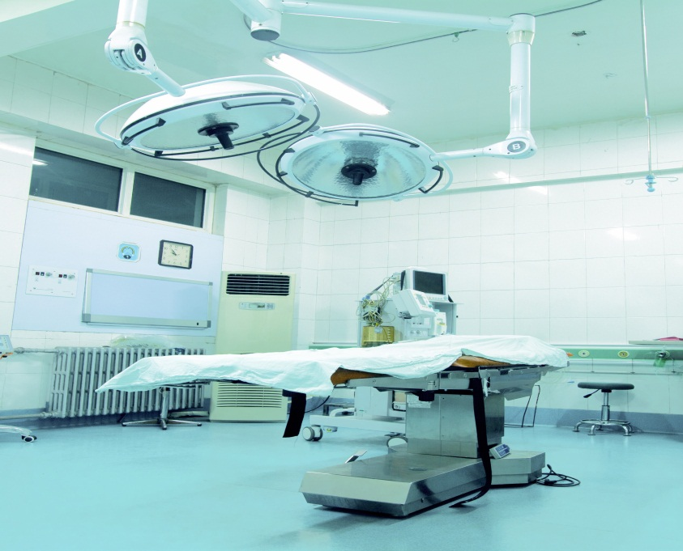
TYPE OF EVENT: TRANSFER// ??
This is the event that should cause delayed orders
to be released to the service(s) for action; for OR
(Surgery) events, the orders will be released when
TIME PAT IN OR (#130,.205) is entered in the
Surgery Package
Notes:
Sheri: Yep…you are right April!! This help text describes what triggers orders to be released. This trigger comes from data entered into a specific field in the Surgery package…so for a patient who is post-op and in the recovery room there is the ability to release post-op orders automatically when the field that represents the TIME THAT THE PATIENT GOES INTO THE O.R., is entered.

Slide 14


Select action: Next Screen// AE Add/Edit
Enter item number to edit or press enter to create a new entry
Select item(s):
Select OE/RR RELEASE EVENTS NAME: ADMIT TO ORTHOPEDICS
Are you adding ‘ADMIT TO ORTHOPEDICS as
a new OE/RR RELEASE EVENTS NAME (the 25TH)? No// y (Yes)
OE/RR RELEASE EVENTS TYPE OF EVENT: ?
Enter the type of event that should cause delayed orders to be released.
Choose from:
A ADMISSION
T TRANSFER
D DISCHARGE
O O.R.
M MANUAL RELEASE
OE/RR RELEASE EVENTS TYPE OF EVENT: A ADMISSION
Notes:
April: Thanks Sheri. Can you also tell us about a MANUAL RELEASE event? Let’s hope that doesn’t involve throwing a manual at the computer to get the orders to release. Get it? Manual/book. Release/throw?

Slide 15

Notes:
Sheri: Too funny. No…it’s not quite that complicated or DANGEROUS!!! Manually Released orders are types of events that do NOT happen automatically…it’s part of the technology that requires some human intervention…either by design or if something goes wrong w/the automatic process…but it’s used when a VISTA patient movement event does NOT release the orders.

Slide 16
OE/RR RELEASE EVENTS DIVISION: 664
1 664 SAN DIEGO HCS CA VAMC 664
2 6649AA SAN DIEGO NHC CA NHC 6649AA
3 664BU SAN DIEGO DOMICILIARY CA DOM 664BU
4 664BY MISSION VALLEY CA OPC 664BY
5 664CU NAVAL MEDICAL CENTER SAN DIEGO USNH 664CU
Press <RETURN> to see more, ‘^’ to exit this list, OR
CHOOSE 1-5: 1
Notes:
April: Good thing we have that manual release event available. At the next prompt, we are asked to add a Release Events Division. Many VA Health Care Systems are made up of several smaller locations, each one a unique Division of the overall system. Examples of divisions include an inpatient facility, outpatient clinics, nursing home care unit, spinal cord injury unit, etc. When we enter 664, which is the site number associated with San Diego, we can select see several of San Diego’s Divisions. Since San Diego HCS is an inpatient facility, it works perfectly for our ADMIT TO ORTHOPEDICES release event. Here’s how it works: when a patient is admitted to the San Diego HCS inpatient facility any delayed orders entered using the ADMIT TO ORTHOPEDICS release event will automatically release and become active orders.

Slide 17
Do you want to copy from an existing entry? NO//
NOTE: New entries start INACTIVATED
NAME: ADMIT TO ORTHOPEDICS Replace
DISTPLAY TEXT: ADMIT TO ORTHOPEDICS Replace
TYPE OF EVENT: ADMISSION//
ADMIT TO DIVISION: SAN DIEGO HCS//
MAS MOVEMENT TYPE:
Notes:
Sheri: The next prompt asks if we want to copy the settings from an existing entry? If we have a similar release event that we already created, we could copy it and simply make modifications to it to create a new one, which would save some time. We are going to accept the default NO here. Next, we could give our release event a whole other name. I’m going to leave this as ADMIT TO ORTHOPEDICS.
The system gives us a second opportunity to change the TYPE OF EVENT and DIVISION…we’re going to leave that as is…

Slide 18
MAS MOVEMENT TYPE: ?
For ADT events, enter an MAS Movement Type to further define the
event if necessary.
You may only select MAS MOVEMENT TYPES that are associated
with the TYPE field selection above.
Answer with MAS MOVEMENT TYPE ENTRY NUMBER, or NAME
Do you want the entire MAS MOVEMENT TYPE List? y (YES)
Choose from:
8 AMBULATORY CARE (OPT-AC)
9 TRANSFER IN
15 DIRECT
18 READMISSION TO IMLTC/NHCU/DOMICILIARY
28 NON-SERVICE CONNECTED (OPT-NSC)
29 PRE-BED CARE (OPT-PBC)
30 NON-VETERAN (OPT-NVE)
36 WAITING LIST
Notes:
April: The next prompt is the MAS MOVEMENT TYPE, which is a special type of MOVEMENT, and I’m not talking about a dance move, like the Macarena (although that is a fun little dance). The movements we’re talking about here are the ADMISSION movement types that are defined in the MAS/ADT package. Specifying a Movement Type is optional, but can be useful if you want to further define a release event.

Slide 19
Select INCLUDED TREATING SPECIALTIES:
Select INCLUDED LOCATIONS:
Select INCLUDED TRAINING SPECIALTIES: ?
Answer with FACILITY TREATING SPECIALTY NAME, or ABBREVIATION
Do you want the entire FACILITY TREATING SPECIALTY List? Y (Yes)
Choose from:
23 Hr Observation-Medical GENERAL SURGERY 1F
ALCOHOL TREATMENT ALCOHOL DEPENDENCE TRMT UNIT 72
OR ORTHOPEDIC ORTHOPEDIC
ANESTHESIOLOGY ANESTHESIOLOGY
BLIND REHAB BLIND REHAB 21
BLIND REHAB OBERSERVATION BLIND REHAB OBERSERVATION
CARDIAC INTENSIVE CARE UNIT CARDIAC INTENSIVE CARE UNIT
Notes:
Sheri: The next two prompts, INCLUDED TREATING SPECIALTIES and INCLUDED LOCATIONS, are very important because they can be used to further customize when you want the Delayed Orders to release. They can be used to release Delayed Orders when a patient is admitted to a certain Treating Specialty or to a specified location. Since we created a release event called ADMIT TO ORTHOPEDICS , we would want to select Treating Specialties or Locations that were appropriate for our release event.

Slide 20
Select INCLUDED TREATING SPECIALTIES: OR ORTHOPEDIC
Are you adding OR ORTHOPEDIC as
a new INCLUDED TREATING SPECIALTIES (the 1st)
No// y (Yes) OR ORTHOPEDIC
INCLUDED TREATING SPECIALTIES: OR ORTHOPEDIC
DEFAULT
Notes:
April: Well, it makes sense to add the OR ORTHOPEDICS treating specialty…as well as any other ORTHOPEDICS-related treating specialties that we may have defined locally in our FACILITY TREATING SPECIALTY file. Coordination w/your local MAS/HIMS ADPAC is probably a good idea.

Slide 21
Select INCLUDED LOCATIONS: 5
1 5E23MD
2 5E23SUR
3 5EMED
4 5EMEDTEL
5 5EORTHO
6 5ENEUTEL
7 5ESURG
8 5ESURTEL
9 5NASU
10 5SD23MED
Notes:
Sheri: Hospital locations can also be identified for our ADMIT TO ORTHOPEDICS release event. In this scenario, we would want to select those LOCATIONS that are appropriate for ORTHOPEDICS, in particular 5EORTHO from our list.
A word of caution in using ‘only’ Locations for release events. Let’s say that we selected 5EORTHO as an included location. If there are no beds on 5EORTHO and the bed control folks decide to admit the patient to another ward where there ‘is’ an available bed, say 5EMED, the delayed orders will not auto release.
In this example, we have decided NOT to include 5EORTHO as an Included Location.

Slide 22
CHOOSE 1-5: 2 5EORTHO
Are you adding 5EORTHO as a new INCLUDED LOCATIONS
(the 1ST for this RR RELEASE EVENTS)? No// y (Yes)
INCLUDED LOCATIONS: 5EORTHO//
Select INCLUDED LOCATIONS:
*Warning: You have defined locations and treating specialties for this event. As such, both must be true for orders to be released.
Be sure this is what you want.
Notes:
April: Here’s a warning: When you use BOTH Treating Specialties and Locations in the same release event, then both the Treating Specialty and Location must be an exact match for the Delayed Orders to auto release.
And to our Audience out there… Here’s another reminder, please submit your questions using the “ASK THE PRESENTER” icon at the top left of your screen!!!

Slide 23
Poll Question
In thinking about whether to include TREATING SPECIALTIES and/or specific LOCATIONS in a release event…what are potential “got ya’s”?
    Wrong Treating Specialty selected for the patient movement
    Wrong Location selected for the patient movement
    Both A & B
Notes:
Sheri: Before we go on further, let’s ask our audience another poll question…we want to keep them awake & on their toes!!
Using the Blue POLLING ICON button above our heads, go ahead and select your answer to this question…
In thinking about whether to include TREATING SPECIALTIES and/or specific LOCATIONS in a release event…what are a potential “got ya”?
A. Wrong Treating Specialty selected for the patient movement
B. Wrong Location selected for the patient movement
Both A & B
We’ll continue on and then check our results shortly…

Slide 24
SHORT NAME:
EVENT ORDER DIALOG: ?
Enter the dialog to be used to create an order for this event. Only DIALOG type entries may be selected.
Answer with ORDER DIALOG NAME, or DISPLAY TEXT
Do you want the entire ORDER DIALOG List? n (No)
EVENT ORDER DIALOG: OR GXMOVE ADMIT PATIENT
Notes:
April: We’re not quite done with our ADMIT TO ORTHOPEDICS release event. The next prompt allows us to enter a “SHORT NAME” for the release event, which is nothing more than a short name.
But the EVENT ORDER DIALOG prompt can be very useful!!!

Slide 25
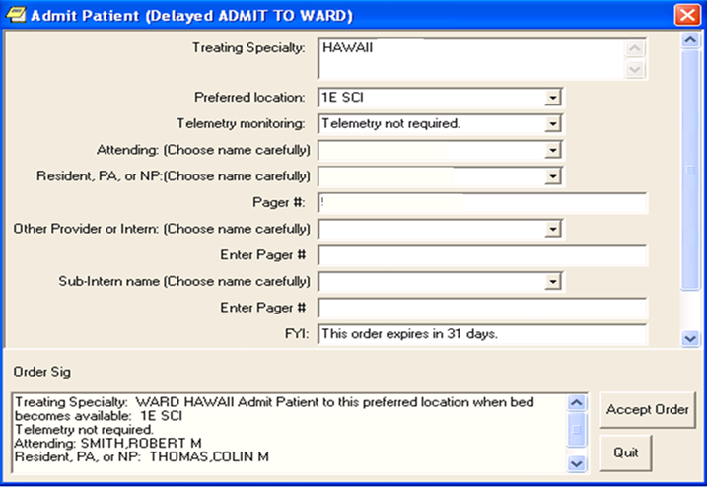
EVENT ORDER DIALOG: OR GXMOVE ADMIT PATIENT
Notes:
April: At this prompt, you can enter an order dialog that you have created in advance. In this example, when the provider selects the WRITE DELAYED ORDERS button, then selects a release event, the order dialog associated with that release event can be used to obtain important information for the clerk admitting the patient. The first field asks the provider which Treating Specialty the patient is admitted to. At San Diego, we created a custom order dialog for each release event that only allows the provider to select the Treating specialties associated with that release event. The provider selected “ORTHOPEDICS” in this example. Also, this particular order dialog allows the provider to select ‘any’ location where there is a bed available, and the delayed orders will still release. The reason for this is because we decided not to specify ‘any’ locations in our release event ADMIT TO ORTHOPEDICS.

Slide 26
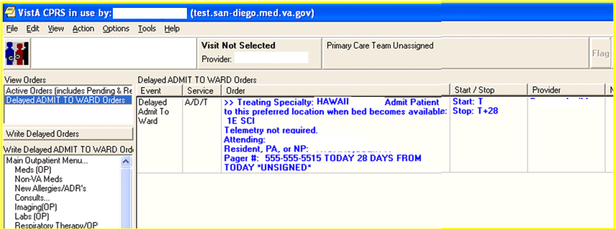
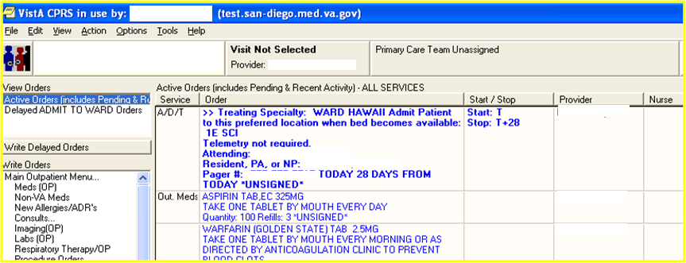
Delayed ADMIT TO WARD Orders
Active Orders (includes Pending & Re
Notes:
Sheri: Another reason this order dialog is so important is because it generates a text order that will display as both a DELAYED ORDER and an ACTIVE ORDER. So when this order displays to your admitting clerk, they will know exactly what Treating Specialty to put the patient in upon admission.
So let’s take a look at those poll results.

Slide 27
Poll Results
In thinking about whether to include TREATING SPECIALTIES and/or specific LOCATIONS in a release event…what are potential “got ya’s”?
  Wrong Treating Specialty selected for the patient movement
  Wrong Location selected for the patient movement
  Both A & B
Notes:
April: Our question was: In thinking about whether to include TREATING SPECIALTIES and/or specific LOCATIONS in a release event…what are potential “got ya’s”?
A. Wrong Treating Specialty selected for the patient movement
B. Wrong Location selected for the patient movement
Both A & B
All answers are correct!! But C is the best answer!!!

Slide 28
Poll Results
In thinking about whether to include TREATING SPECIALTIES and/or specific LOCATIONS in a release event…what are potential “got ya’s”?
  Wrong Treating Specialty selected for the patient movement
  Wrong Location selected for the patient movement
  Both A & B
Notes:
“Click” again to move on

Slide 29

ORDER SET/MENU: ?
Enter the order set/menu to present to the user when
delaying orders for this event.
Select any ORDER DIALOG entry EXCEPT prompt types.
Answer with ORDER DIALOG NAME, or DISPLAY TEXT
Do you want the entire ORDER DIALOG List? n (No)
ORDER SET/MENU:
LAPSE IN #DAYS: ?
Type a Number between 1 and 9999, 0 Decimal Digits
LAPSE IN #DAYS: ??
Notes:
Sheri: You can also make the release event even more powerful by associating it w/a customized order dialog or order set. For example, if you created an “Admit to Telemetry” release event, you could include an order set with items such as EKGs, Consult to Cardiology, Cardiac-related labs, telemetry monitoring orders, etc.
The next prompt, LAPSE IN #DAYS, is the number of days your delayed orders will be available for release before they are lapsed. If the Delayed Orders lapse, the entire Delayed Order event will be terminated.

Slide 30
COPY ACTIVE ORDERS: ?
Enter YES if the user should be prompted to copy active orders when writing new delayed orders for this event.
Choose from:
1 YES
0 NO
Notes:
April: The COPY ACTIVE ORDERS is another interesting prompt. If we say “Yes” here , it will allow the user to copy active orders to delayed orders. It’s a good time saver but make sure you train your providers to select orders carefully and to review the entire list of Delayed Orders to make sure they are complete and correct.
As an FYI, there are some orders that can not be copied. These include TPN order, Non-VA meds, Pharmacy orders that are no longer active or pending.
If there are orders in a particular display group that you would like to exclude from the copy function, there is a VistA option called EXCLUDE DISPLAY GROUPS FROM COPY.

Slide 31
Auto DC Rules
Release Events
Delayed Orders
Notes:
Sheri: Ok…at the beginning, we mentioned that Delayed Orders included two components. Now that we have an understanding of Release events, lets take a look at AUTO-DC rules. And as a reminder, an AUTO-DC rule will automatically discontinue orders.

Slide 32


Notes:
April: Yep…Auto DC rules are very helpful when a patient is being discharged from an inpatient stay…and the provider wants certain types of orders to cancel or auto-dc when the clerk enters the DISCHARGE patient movement into the computer system.

Slide 33



Notes:
Sheri: These could be inpatient medication orders…

Slide 34


Notes:
April: Laboratory orders…

Slide 35

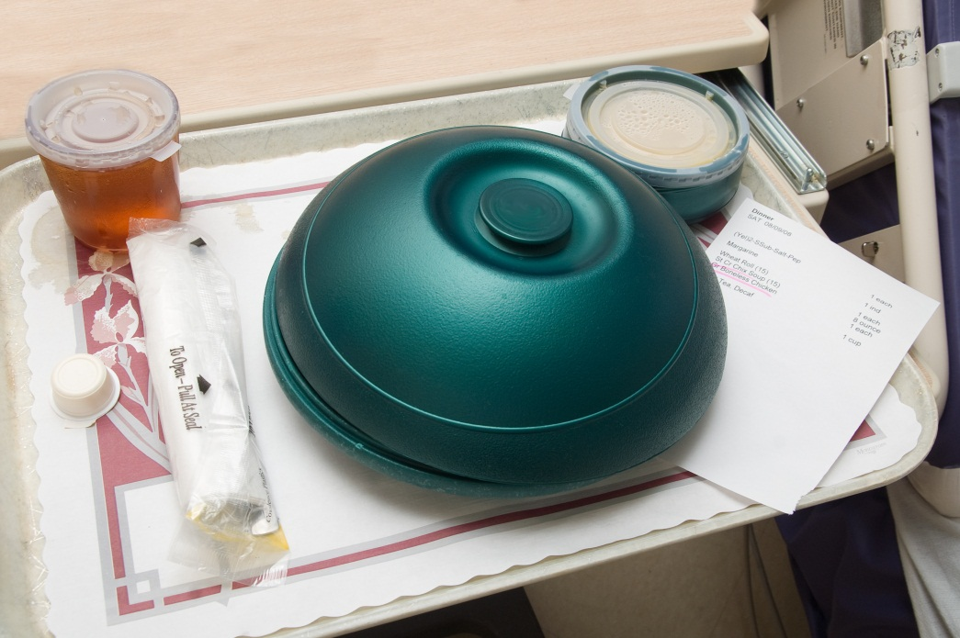

Notes:
Sheri:…diet orders…

Slide 36
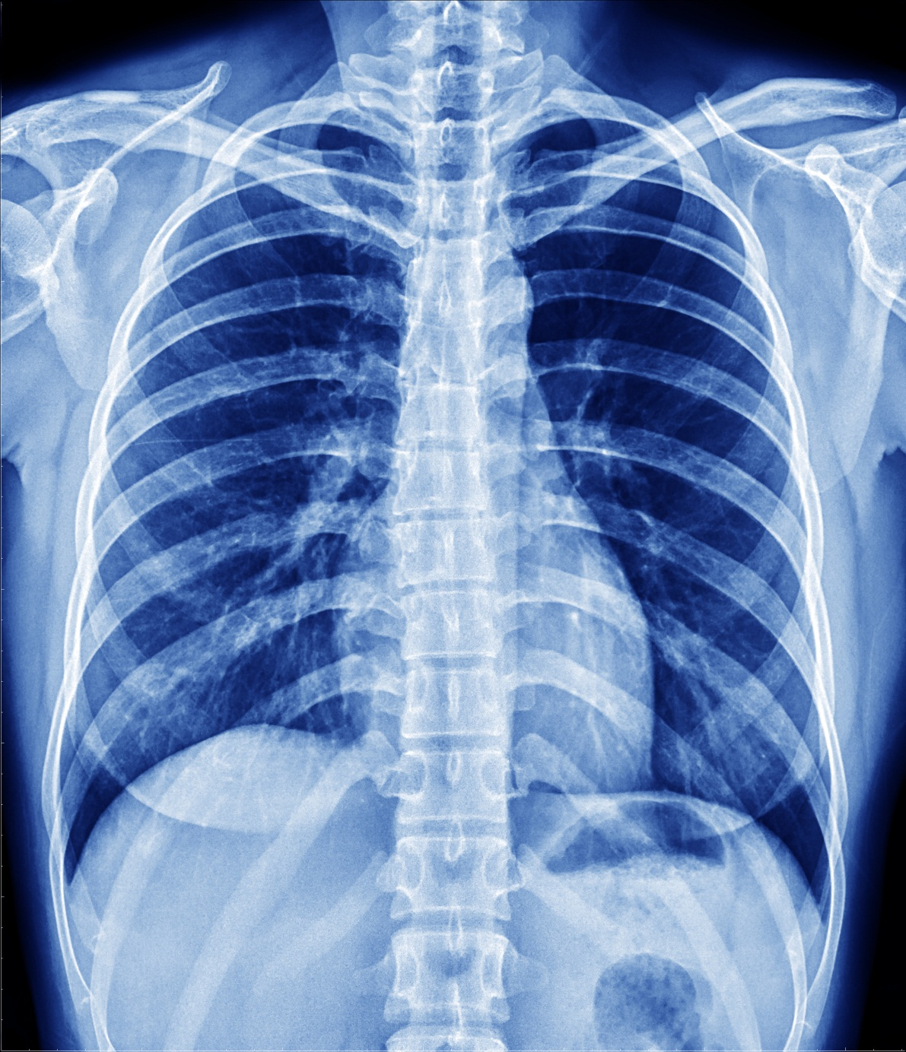
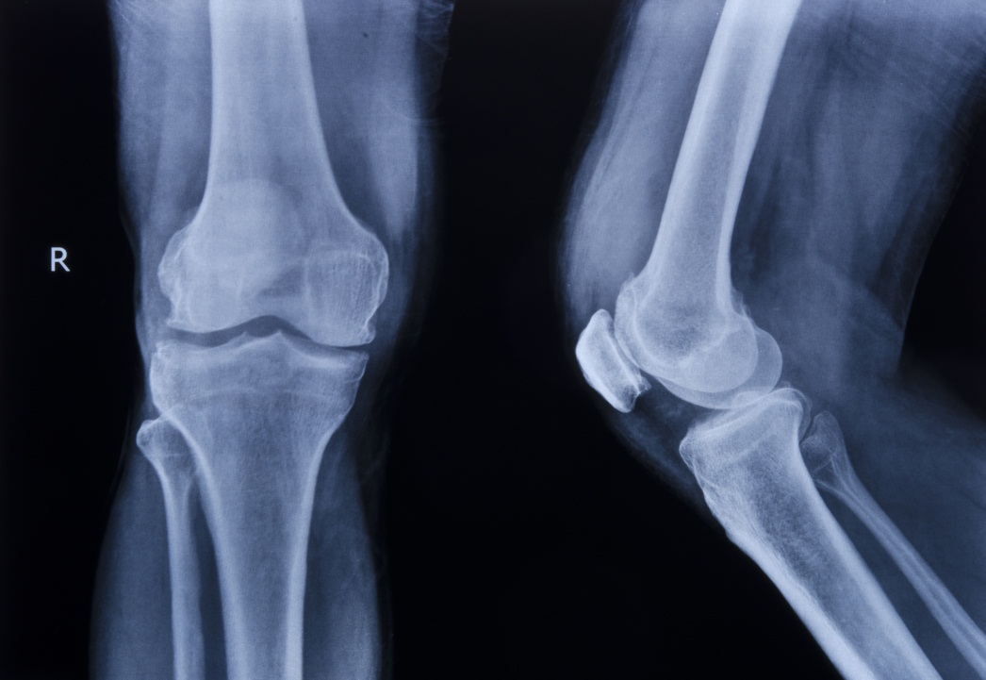
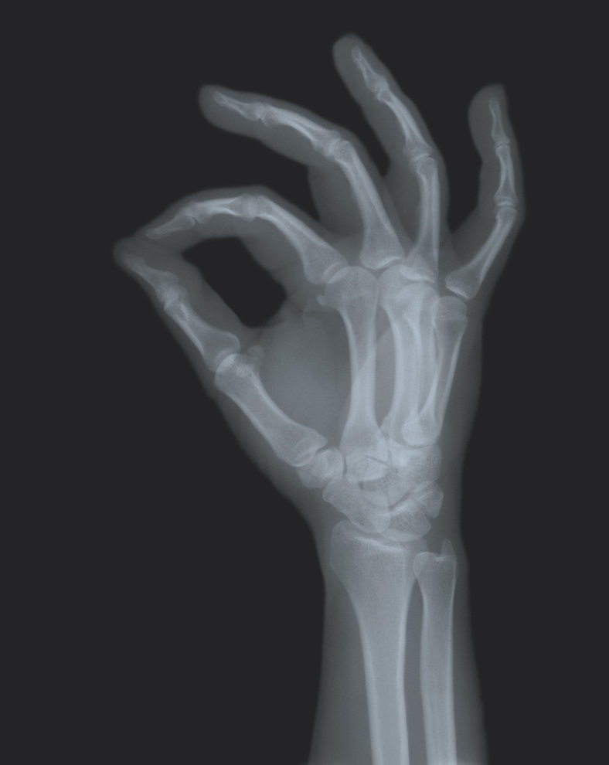

Notes:
April: … X-RAYS…

Slide 37



Notes:
Sheri: …and nursing, patient care & activity orders. It’s fantastic when you can use an auto DC rule to make all these designated orders auto-discontinue auto-magically…

Slide 38

Auto-DC set up and maintenance
DEATH
DISCHARGE
FROM ASIH
IC/ADMISSION
SURGERY
TO ASIH
TREATING SPECIALTY CHANGE
TROY DISCHARGE
WARD TRANSFER
Event Name
Notes:
April: We are going to set up an AUTO-DC rule for a EVENT NAME called DISCHARGE; you can name the event whatever you want…such as DISCHARGE FROM ACUTE CARE or DISCHARGE FROM NHCU/DOM…and based on where you are discharging the patient from will “drive” what types/groups of orders you will discontinue.

Slide 39
NAME: DISCHARGE//
DISPLAY TEXT: Discharge from San Diego VAMC
Replace ??
This field is the name of the rule as it will appear to the user in CPRS
Notes:
Sheri: The NAME and DISPLAY TEXT fields can be edited. Since we can make the DISPLAY TEXT whatever we want, whatever fits the scenario, we’re going to set the display text here to DISCHARGE FROM SAN DIEGO VAMC.

Slide 40



TYPE OF EVENT: DISCHARGE//
  Enter the type of event that should trigger orders to be auto-dc’d.
  Choose from:
  A ADMISSION
  T TRANSFER
  D DISCHARGE
  S SPECIALTY TRANSFER
  O O.R
Notes:
April: At the TYPE OF EVENT prompt, we will select Discharge. So…the discharge movement will be the “trigger” that will auto-dc specified orders.
Note that there are other patient movements that can be selected to trigger orders to auto-dc and we’ll talk about that in a bit…

Slide 41


DISCHARGE FROM DIVISION: SAN DIEGO HCS// ?
Enter the division this auto-dc rule applies to.
Notes:
Sheri: Then we select the DIVISION from which this DISCHARGE AUTO-DC rule will apply…could be from your VAMC division…or from your CLC/NH division…or your DOM division…

Slide 42

Select MAS MOVEMENT TYPE: DISCHARGE FROM IMLTC/NHCU/DOM WHILE ASIH// ?
Answer with MAS MOVEMENT TYPES
Do you want the entire 15-Entry MAS MOVEMENT TYPES List? Y (Yes)
Choose from:
CONTINUED ASIH (OTHER FACILITY)
DISCHARGE FROM IMLTC/NHCU/DOM WHILE ASIH
DISCHARGE TO CNH
IRREGULAR
NON-BED CARE
NON-SERVICE CONNECTED (OPT-NSC)
NON-VETERAN
OPT-SC
REGULAR
TO DOM FROM HOSP
TO IMLTC/NHCU FROM DOM
TO IMLTC/NHCU FROM HOSP
Notes:
April: At the next prompt, we can select MOVEMENT TYPES, like the Macarena….. Just kidding. Actually, the only movement types that are available to associate with an AUTO –DC Rule are MAS Movements. Note that the prompt will screen out irrelevant MOVEMENT TYPES and only display MAS MOVEMENT TYPES that are related to a DISCHARGE.

Slide 43

EXCEPT FROM OBSERVATION: IF READMITTING// ?
If discharge from an observation specialty should be an exception to this rule, enter YES or IF READMITTING.
Choose from:
0 NO
1 IF READMITTING
2 YES
Notes:
Sheri: This prompt, EXCEPT FROM OBSERVATION, might get a little complicated…but it’s important to understand since it provides some powerful functionality that is being used more & more. In the VA, there are traditional hospital wards/locations and “non-traditional” ones, with observation locations being one example.
As many of you know, or maybe have experienced like I did while working on site at the Brooklyn VAMC a few years ago, an observation “admission” is a temporary admission process that can be used to stabilize a patient for a specified # of hours (24 hours traditionally but soon to be changed to 48 hours). If the provider writes orders for a patient while that patient is on the observation treating specialty, and the patient is going to be admitted “fully” to a traditional hospital/acute care location, then it may be handy to have those observation-related orders carry-over to the hospital admission.
You can answer this prompt with a (one) 1=IF READMITTING. This prompt along w/a specific protocol, will prompt the clerk performing the DISCHARGE movement, with a question. The question is “Will the patient be re-admitted immediately?” The patient’s observation orders are “held” for up to 1 hour between the time that the clerk answers the question, and the follow-up admission to the acute care location. When the subsequent admission happens, the “held” orders will be active…and since they are still appropriate for the patient, can save the provider time by NOT having to re-write a whole set of admission orders when many of the observation orders are still valid.

Slide 44

DC REASON: Discharge// ?
Enter the reason to be saved with the order when dc’d.
Notes:
April: Whenever an Auto DC rule automatically discontinues. CPRS needs to know the reason ‘why’. Because of this, we need to associate a DISCONTINUE REASON with our Auto DC rule. We’re going to select ‘DISCHARGE‘. The DC REASON prompt points to a file in VISTA that stores all ORDER REASONS related to CPRS order processing. A CAC can add ORDER REASONS to this file to fit their local needs for identifying why an order is DISCONTINUED or CANCELLED. Once the patient is discharged all orders that are AUTO-DC’d will have the text “Discharge” associated with each order.

Slide 45

Select TYPE OF ORDERS TO DC: RADIOLOGY/NUCLEAR MEDICINE// ?
Answer with INCLUDED PACKAGES TYPE OF ORDERS TO DC
Choose from:
LAB SERVICE
RADIOLOGY/NUCLEAR MEDICINE
ORDER ENTRY/RESULTS REPORTING
INPATIENT MEDICATIONS
CONSULTS/REQUEST TRACKING
You may enter a new INCLUDED PACKAGES, if you wish
Enter a package whose orders should be dc’d by this rule.
Choose a package whose orders can be entered within CPRS
Notes:
Sheri: So, here is where you enter in the type of orders (by VISTA PACKAGE) that you DO want to auto-dc for this DISCHARGE rule. We’ve chose to include LAB, RAD/NUC MED, OE/RR, INPT MEDS & CONSULTS. Each VAMC will have to decide, based on clinical practices and local processes, which types of orders should be discontinued. April, is there anything at San Diego that you don’t include here?
April: Yes, at the San Diego VAMC, we have decided to NOT auto-dc CONSULTS on a couple of our AUTO-DC rules for DISCHARGE. We did that because we wouldn’t want any pending consults that were needed after discharge to be discontinued. Just as an FYI, active or partially-resulted consults will NOT be auto-dc’d even if you decide to include CONSULTS in this list of included packages.

Slide 46
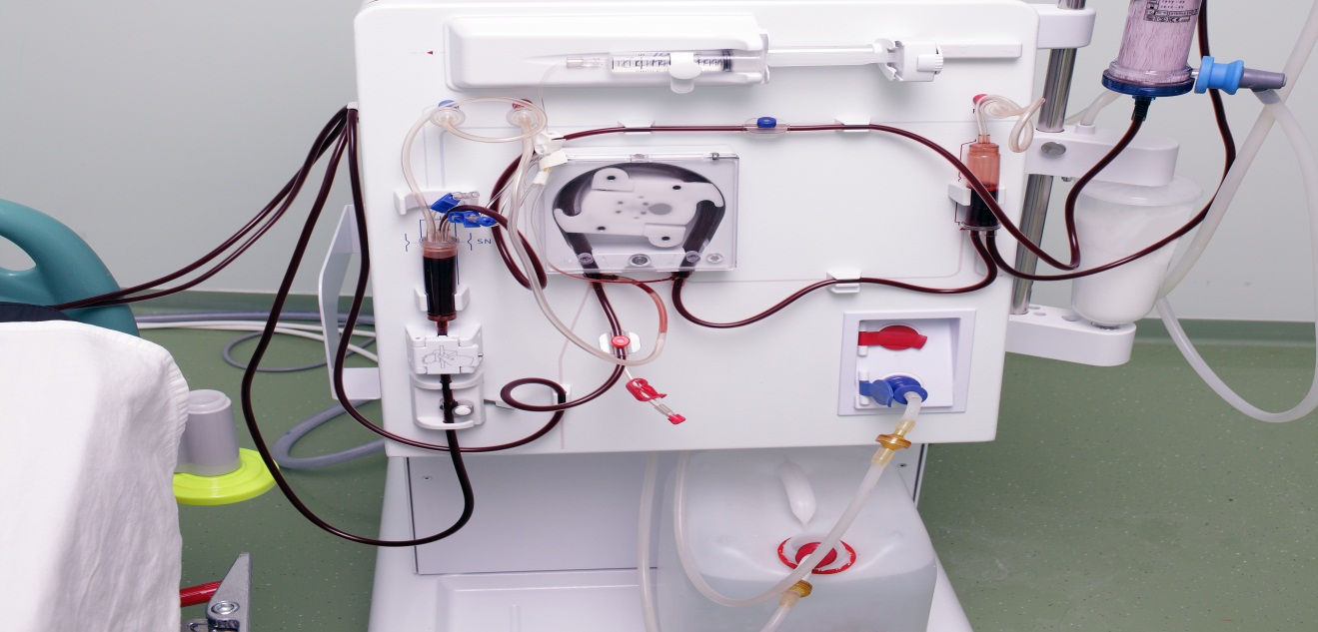
Select EXCEPT ORDERS IN DISPLAY GROUP: HEMODIALYSIS//
Answer with EXCLUDED DISPLAY GROUP EXCEPT ORDERS IN DISPLAY GROUP: HEMODIALYSIS
You may enter a new EXCLUDED DISPLAY GROUP, if you
wish
Orders related to this display group will not be auto-discontinued
Only allow selection of operating room type entries
Notes:
April: There are also times when it is NOT appropriate to include some other types of orders in the auto-dc rule. With this prompt we are ‘excluding’ them by their DISPLAY GROUP. At the San Diego VAMC, we excluded the HEDMODIALYSIS display group. This Display Group is used for HEMODIALYSIS protocol orders. If those orders were discotinued, the dialysis treatment orders would be auto-discontinued and we wouldn’t want that..

Slide 47


Select EXCEPT FOR ORDERABLE ITEM: MRSA SURVL NARES
AGAR// ?
Answer with EXCLUDED ORDERABLE ITEMS EXCEPT FOR
ORDERABLE ITEM: MRSA SURVL NARES AGAR
You may enter a new EXCLUDED ORDERABLE ITEMS, if you wish
Orders related to this display group will not be auto-discontinued
Only allow selection of operating room type entries
Notes:
Sheri: And lastly, you can also choose to NOT auto-dc specific orderable items; this is the most “granular” level of exclusion…
Whew…this is a lot of stuff!!! I’m ready to change topics…how about you April?

Slide 48
Poll Question
What Types of Events can Trigger the AUTO-DC of Orders?
Admissions, Discharges
Birthdays
Scheduling an Appointment
Thunderstorms
ORMTIME
Notes:
April: Yep…but before we change topics, let’s remind our audience to submit your questions using the orange ASK THE PRESENTER icon above our heads…
AND…we’re also going to take our next poll… Audience, using the Blue POLLING icon button above our heads, select the answer to this question…
What Types of Events can Trigger the AUTO-DC of Orders?
Admissions, Discharges
Birthdays
Scheduling an Appointment
Thunderstorms
ORMTIME
We’ll move on and review the poll results in few minutes…

Slide 49

Notes:
Sheri: How about if we created some rules related to a TRANSFER TO PLASTIC SURGERY treating specialty? I’ve got a “vehicle” that could really use some plastic surgery…could I get some “work” done on this poor old truck???

Slide 50
Name: TRANSFER TO PLASTIC SURGERY
Short name: PL SURG
Inactivated:
Type of event: TRANSFER
Trans to/within division: SAN DIEGO HCS
Event order dialog: OR GXMOVE TRANSFER
Order set/menu: ORZ ADD MENU CLINICIAN
Lapse in #days: 30
Mas movement type: Transfer to Plastic Surgery
Display text:
Ordering parameters location:
Copy active orders: YES
PLASTIC SURGERY (Default)
Included Treating Specialties
Notes:
April: Great idea…I just happen to have a RELEASE EVENT already set up for PLASTIC SURGERY!!! It’s for an INTERWARD TRANSFER movement type associated w/the SAN DIEGO HCS. The default TREATING SPECIALTY is PLASTIC SURGERY…the provider can copy active orders…and if a transfer to the Plastic Surgery Treating Specialty never happens, then the orders will lapse w/in 30 days.

Slide 51
NAME: TRANSFER TO PLASTIC SURGERY Replace
DISPLAY TEXT: Transfer to Plastic Surgery TS Replace
TYPE OF EVENT: SPECIALTY TRANSFER//
T.S. CHANGE WITHIN DIVISION: SAN DIEGO HCS//
Select MAS MOVEMENT TYPE: ?
You may enter a new MAS MOVEMENT TYPE, if you wish
Enter a movement type to further define this rule.
Select an MAS MOVEMENT TYPE that can be used with the TYPE OF EVENT that you selected.
Answer with MAS MOVEMENT TYPE ENTRY NUMBER, or NAME
Do you want the entire MAS MOVEMENT TYPE List? Y (Yes)
Choose from:
20 PROVIDER/SPECIALTY CHANGE
Select MAS MOVEMENT TYPE: 20 PROVIDER/SPECIALTY CHANGE
Are you adding ‘PROVIDER/SPECIALTY CHANGE’ as a new MAS MOVEMENT
TYPES (the 1st for this OE/RR AUTO-DC RULES)? No//Y (Yes)
MAS MOVEMENT TYPE: PROVIDER/SPECIALTY CHANGE//
Notes:
Sheri: Okay…so we have our release event for creating NEW orders when a patient is transferred to PLASTIC SURGERY…but we also need to auto-dc orders that are not going to be appropriate for our patient while they are having their plastic surgery.
I’ve started to create an AUTO-DC rule that is specific for a SPECIALTY TRANSFER w/in the SAN DIEGO HCS division…and I think I’ve selected the correct “MOVEMENT TYPE” of PROVIDER/SPECIALTY CHANGE…but I still want to try to make this specific for the Plastic Surgery Treating Specialty…I’m just not sure if I can narrow it down that specifically.

Slide 52
Select EXCEPT FROM SPECIALTY: PLASTIC SURGERY PSURG
Are you adding ‘PLASTIC SURGERY’ as
a new EXCLUDED TREATING SPECIALTIES (the 1ST for this
OE/RR AUTO-DC RULES)? No// Y (Yes)
Select TO SPECIALTY: ?
You may enter a new TO SPECIALTY, if you wish
Enter a specialty that is an exception to this rule, when the patient is transferred to it.
Notes:
April: Well, it looks like it will let us select PLASTIC SURGERY at this “EXCEPT FROM SPECIALTY” prompt…but I don’t believe that’s what we want to do since the next prompt is TO SPECIALTY…and it looks like this pair of treating specialties would be the EXCEPTION to the auto-dc rule…and not the way to specify a unique treating specialty.
So…can we actually do we want to do w/this AUTO-DC rule??? If not, do we even need to create it when there is already a “standard” auto-dc rule for TREATING SPECIALTY change. Let’s take a look at it and see if it will suffice.

Slide 53

Name: TREATING SPECIALTY CHANGE
Inactivated:
Type of event: SPECIALTY TRANSFER
Tr sp change within division: SAN DIEGO HCS
Dc Reason: Treating Specialty Change
Display text: TREATING SPECIALTY CHANGE
PROVIDER/SPECIALTY CHANGE
IV MEDICATIONS
INPATIENT MEDICATIONS
ORDER ENTRY/RESULTS REPORTING
DIETETICS
LAB SERVICE
Movement Types:
Included Packages:
Notes:
Sheri: Here it is. Great…I see the DIVISION…the MOVEMENT TYPES…and the INCLUDED PACKAGES for order types that we want to auto-dc…so this looks like it will meet our needs perfectly!!!!
So…no need to re-invent the wheel. More often than not, a TREATING SPECIALTY change will warrant re-writing of new orders since w/the TS change comes a different level of care or type of care.
Let’s see how this might work on our “fixer upper truck” !!!
April: But before we get to our truck …let’s look at our poll results…

Slide 54
Poll Results
What Types of Events can Trigger the AUTO-DC of Orders?
  Admissions, Discharges
  Birthdays
  Scheduling an Appointment
  Thunderstorms
  ORMTIME
Notes:
April: It looks like the majority of you are paying close attention and selected A from the options…

Slide 55
Poll Results
What Types of Events can Trigger the AUTO-DC of Orders?
  Admissions, Discharges
  Birthdays
  Scheduling an Appointment
  Thunderstorms
  ORMTIME
Notes:
“Click” again to move on…

Slide 56

Before…
Notes:
Sheri: Here is our patient’s orders BEFORE the PLASTIC SURGERY event. As you can see from the top of the ORDERS ‘box’, these are the ACTIVE ORDERS for the patient…

Slide 57
Delayed…
delayed
delayed
delayed
delayed
delayed
delayed
delayed
delayed
delayed
delayed
Notes:
April: Here are the DELAYED orders that we want to be released upon transfer to PLASTIC SURGERY.

Slide 58

After…
9f Plastic Sur
9f Plastic Sur
9f Plastic Sur
9f Plastic Sur
Notes:
Sheri: And here is our patient’s orders AFTER the PLASTIC SURGERY event. An amazing “auto-magic” transformation!!!

Slide 59

Notes:
April: Now we’re going to move into the TROUBLESHOOTING section of our presentation and provide some tool, tips, & tricks that help us determine what might have happened when something goes wrong with a release event or an auto-dc rule…
I know….it’s hard to imagine…but things do go “wrong” related to event delayed orders!!!

Slide 60

Problem #1
Notes:
Sheri: This guy has a really frustrating problem. All the orders he entered for his patient’s transfer to a treating specialty called SPINAL CORD REHAB did not release. It’s 3am. He’s tired and the nurses want him to rewrite all of the orders. But never fear, April, CAC EXTRAORDINAIRE, to the rescue.

Slide 61
Select ADT Menu Option: Bed Control Menu
Admit a Patient
Cancel a Scheduled Admission
Check-in Lodger
Delete Waiting List Entry
Detailed Inpatient Inquiry
Discharge a Patient
DRG Calculation
Extended Bed Control
Lodger Check-out
Provider Change
Schedule an Admission
Seriously Ill List Entry
Switch Bed
Select PATIENT NAME: VETERAN, ONE
CHOOSE FROM:
1> MAR 24,2013@03:15:39 TO: 5EMED
2> JAN 7,2012@03:18:59 TO: 3AMED
3> DEC 31,2011@00:39:54 TO: 3AMED
CHOOSE 1-3
Notes:
April: One of the menus we can look at is the Bed Control menu, the Detailed Inpatient Inquiry option. Let’s select a patient, then the current admission….

Slide 62
ADMISSION:
MAR 24,2013@03:15:39 OPT-NSC TO: 5EMED
TRANSFER:
MARCH 25,2013@16:00 INTERWARD TRANSFER TO: 1
TREATING SPECIALTY CHANGES:
MARCH 24,2013@03:15:39 SPECIALTY: MEDICINE
PROVIDER:
ATTENDING: :Annual SCI Rehab Eval
MARCH 24,2013@08:30:38 SPECIALTY: MED STEP DOWN
PROVIDER:
ATTENDING:
MARCH 25,2013@16:00 SPECIALTY: SPINAL CORD I
PROVIDER:
ATTENDING: DX: UTI
DISCHARGE:
Notes:
April: …and review the details. I think I see the problem. The treating specialty the delayed orders were associated with was SPINAL CORD REHAB. The treating specialty that the patient was transferred to is SPINAL CORD I…so they don’t match!
So all that needs to be done is to transfer the patient to the correct Treating Specialty.

Slide 63
Select ADT Menu Option: Bed Control Menu
Admit a Patient
Cancel a Scheduled Admission
Check-in Lodger
Delete Waiting List Entry
Detailed Inpatient Inquiry
DRG Calculation
Extended Bed Control
Lodger Check-out
Provider Change
Schedule an Admission
Seriously Ill List Entry
Switch Bed
Transfer a Patient
Treating Specialty Transfer
Waiting List Entry/Edit
Notes:
Sheri: One way to do that would be to use the Treating Specialty Transfer option….no change in location…just a “transfer” from SPINAL CORD I to SPINAL CORD REHAB will release the delayed orders.

Slide 64


Problem #2
Notes:
April: here’s another problem. This doctor just placed delayed orders for his patient to be transferred to the MEDICAL STEP DOWN treating specialty. His orders didn’t release and the poor doctor’s wife is in labor. He needs to leave but the nurses are holding him hostage for another set of orders. And to make things worse his patient takes 27 different medications!!!

Slide 65
Select ADT Menu Option: Bed Control Menu
Admit a Patient
Cancel a Scheduled Admission
Check-in Lodger
Delete Waiting List Entry
Detailed Inpatient Inquiry
Discharge a Patient
DRG Calculation
Extended Bed Control
Lodger Check-out
Provider Change
Schedule an Admission
Seriously Ill List Entry
Switch Bed
Select PATIENT NAME: VETERAN, ONE
CHOOSE FROM:
1> MAR 24,2013@03:15:39 TO: 5EMED
2> JAN 7,2012@03:18:59 TO: 3AMED
3> DEC 31,2011@00:39:54 TO: 3AMED
CHOOSE 1-3
Notes:
Sheri: Let’s go back to our detailed inpatient inquiry and select the current admission.

Slide 66
ADMISSION:
MAR 24,2013@03:15:39 OPT-NSC TO: 5EMED
TRANSFER:
MARCH 25,2013@16:00 INTERWARD TRANSFER TO: 1
TREATING SPECIALTY CHANGES:
MARCH 24,2013@03:15:39 SPECIALTY: MEDICINE
PROVIDER:
ATTENDING: :Annual SCI Rehab Eval
MARCH 24,2013@08:30:38 SPECIALTY: MED STEP DOWN
PROVIDER:
ATTENDING:
MARCH 25,2013@16:00 SPECIALTY: SPINAL CORD I
PROVIDER:
ATTENDING: DX: UTI
DISCHARGE:
Notes:
April: Well…in this scenario the treating specialty looks correct…it says MED STEP DOWN…hmmm…

Slide 67

Notes:
Sheri: Yikes! This user is getting ugly!!! Is that the provider turning into a hulk…or the CAC who has the provider yelling at him??? Let’s check something else, quick before he does a lot of damage! This time, let’s check the actual release event itself…

Slide 68
Release events Jul 16, 2013@14:55:29 Page: 1 of 2
Event set up and maintenance – All entries/Truncated view
Event Name Display Text Active? Event
ADMIT TO 23H OBSERVATION ADMIT TO 23H OB
ADMIT TO 2W-SARRIP ADMIT TO 2W-SAR
ADMIT TO CLC ADMIT TO CLC
ADMIT TO DOU ADMIT TO DOU
ADMIT TO ICU ADMIT TO ICU
ADMIT TO WARD ADMIT TO WARD
ADMIT TO WARD ADMIT TO WARD
CHG TX SPEC TO MED STEP TRANSFER TO DOU
CHG TX SPEC TO ICU TRANSFER TO ICU
CHG TX SPEC TO PALLIATIVE TRANSFER TO PALL
+ Select number or enter action desired >>>
AE Add/Edit CC Create Child Event DD Detailed Display
AI Activate/Inactivate CD Change Display EP Edit Event Delay Par
Select action: Next Screen//
Delayed/Orders/Auto-DC Set-up [OR DELAYED ORDERS EDITOR] (DO)
Select one of the following:
1 Auto-DC Rules
2 Release Events
+ Select number or enter action desired >>>
Notes:
April: Good idea. Here is the release event that was used, CHANGE TREATING SPECIALTY TO MEDICAL STEP DOWN. Let’s select ‘DD’ for detailed display and do some sleuthing.

Slide 69
Name: CHG TX SPEC TO DOU
Short name: TRANS TO MEDICAL STEP DOWN
Inactivated:
Type of event: TRANSFER
Trans to/within division: SAN DIEGO HCS
Event order dialog: ORZ GXMOVE TREATING SPECIALTY
Order set/menu: ORZ ADD MENU CLINICIAN
Lapse in #days: 31
Mas movement type:
Display text: TRANSFER TO MEDICAL STEP DOWN
Ordering parameters location: 5WORPACU
Copy active orders: YES
Included Treating Specialties:
DOU CT SURGERY
DOU GENERAL SURGERY
DOU HEAD/NECK SURGERY
Notes:
Sheri: I see the problem. We forgot to include MEDICAL STEP DOWN as an included treating specialty. We can select AE for add/edit and enter the missing treating specialty…but just adding the missing specialty will not trigger the current delayed orders to release. We still need to trigger a patient movement event somehow…
We could transfer the patient away from MEDICAL STEP DOWN TS…and then transfer them back to MEDICAL STEP DOWN…but it might just be easier to MANUALLY RELEASE the delayed orders. This will quickly release the orders…and not be dependent upon finding a clerk to perform the 2 treating specialty transfers.
We’ll be going into more detail shortly on Manually Releasing orders…

Slide 70

Problem #3
Notes:
April: Here’s yet another problem: The provider just placed an order for her patient to be transferred to NURSING HOME (NH) RESPITE CARE treating specialty. The delayed orders DID release. However, the orders from the previous Treating Specialty SHORT STAY REHABILITATION did NOT auto-DC and now the patient has a “mix” of appropriate & not appropriate active orders!
She’s looking pretty frustrated…hope we can figure out this one too!!! And we better do it quick…

Slide 71

Notes:
Sheri: ….or this might happen! She is so frustrated, she turned her whole office green!

Slide 72
Release events Jul 16, 2013@14:55:29 Page: 1 of 2
Event set up and maintenance – All entries/Truncated view
Event Name Display Text Active? Event
ADMIT TO 23H OBSERVATION ADMIT TO 23H OB
ADMIT TO 2W-SARRIP ADMIT TO 2W-SAR
ADMIT TO CLC ADMIT TO CLC
ADMIT TO DOU ADMIT TO DOU
ADMIT TO ICU ADMIT TO ICU
ADMIT TO WARD ADMIT TO WARD
ADMIT TO WARD ADMIT TO WARD
CHG TX SPEC TO MED STEP TRANSFER TO DOU
CHG TX SPEC TO ICU TRANSFER TO ICU
CHG TX SPEC TO PALLIATIVE TRANSFER TO PALL
+ Select number or enter action desired >>>
AE Add/Edit CC Create Child Event DD Detailed Display
AI Activate/Inactivate CD Change Display EP Edit Event Delay Par
Select action: Next Screen//
Delayed/Orders/Auto-DC Set-up [OR DELAYED ORDERS EDITOR] (DO)
Select one of the following:
1 Auto-DC Rules
2 Release Events
+ Select number or enter action desired >>>
Notes:
Sheri: Let’s re-check our AUTO-DC rules for the SPECIALTY CHANGE…once again, DD detailed display action is selected…

Slide 73
Detailed Display July 16, 2013@15:38:27
Name: SPECIALTY CHANGE
Inactivated:
Type of event: SPECIALTY TRANSFER
Trans sp change within division: SAN DIEGO HCS
DC reason: Treating Specialty Change
Display text: SPECIALTY CHANGE
Movement Types:
PROVIDER SPECIALTY CHANGE
Notes:
April: Hmmm…I’m not seeing anything “amiss” here on this first page…division looks correct, movement type looks right…let’s check the next few pages…

Slide 74
Detailed Display July 16, 2013@15:38:27 Page: 3 of 5
Excluding From Treating Specialties: To Treating Specialties:
SHORT STAY REHABILITATION EXTENDED CARE CENTER SHORT-STAY CONTINUING CARE
NH LONG STAY SKILLED NURSING
LONG-STAY CONTINUING CARE
NH RESPITE CARE (NHCU)
SHORT-STAY CONTINUING CARE EXTENDED CARE CENTER
SHORT STAY SKILLED NURSING
AE Add/Edit AI Activate/Inactive HIS Add/Remove Histories
Select Item(s): Next Screen//
+ Enter ?? For more action >>>
Notes:
April: I think I see the problem. This auto DC rule specifies that the orders will NOT auto DC when a patient is transferred from SHORT STAY REHABILITIATION to NH RESPITE CARE (NHCU). In this case the AUTO DC rule is working as designed. Maybe there is a change in clinical process that we need to inquire about or some training that is needed.

Slide 75

Problem #4
Notes:
Sheri: In our next problem, a patient was just admitted but no admission orders released into the system…and this nurse looks pretty upset!!! In fact, she looks so upset she looks like she’s yodeling! And I can understand why. The admitting doctor can’t be reached. He’s the same doctor that left earlier to be with his wife, who is in labor. The reason the delayed orders didn’t release is because there weren’t any entered!!! April, how would we confirm that no admission orders were entered?

Slide 76
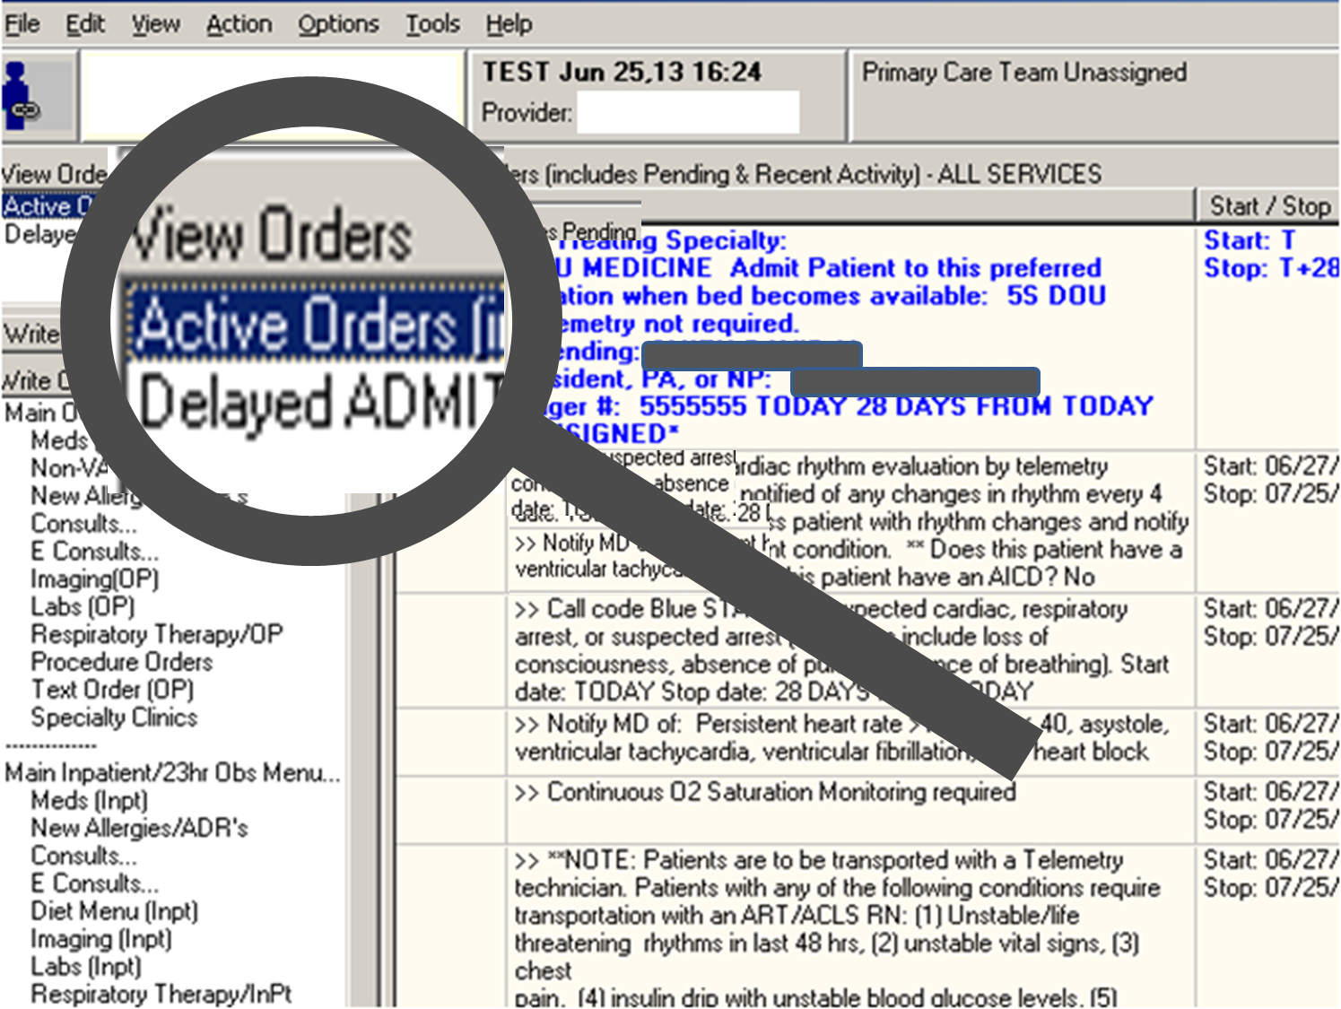
Notes:
April: To explain, let’s first take a look at a patient who DOES have a set of pending delayed orders. We can see a reference to the delayed orders in the VIEW ORDERS section…

Slide 77
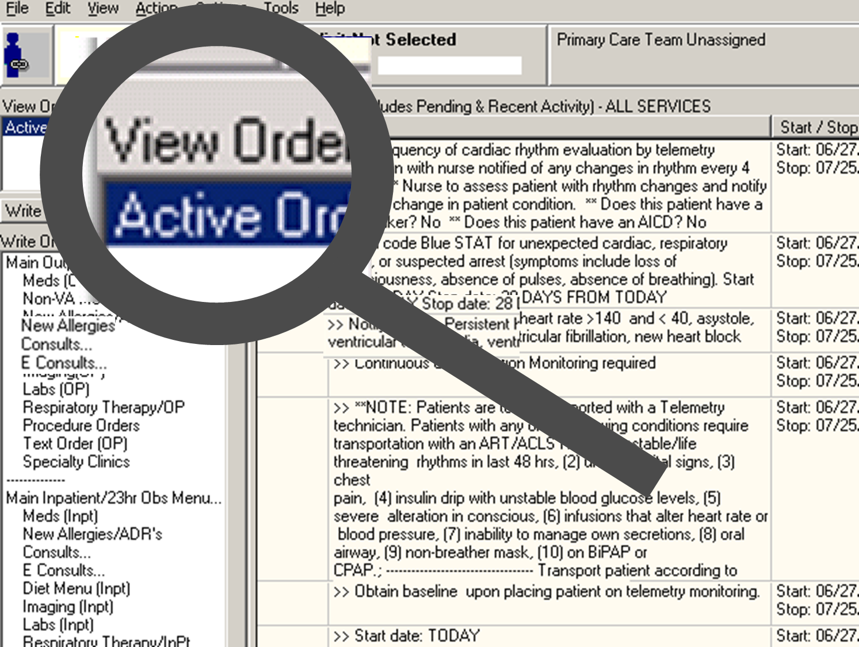
Notes:
Sheri: Now let’s look at our problematic patient. I’m not seeing any evidence of any delayed orders under the VIEW ORDERS section of the CPRS chart. Looks like the doctor had so much on his mind he forgot to enter them before he left…no wonder the nurse is so frustrated. It looks like she’s going to have to find someone else to write the patient’s admission orders. I hope this patient doesn’t experience any delay in care!!!

Slide 78

Problem #5
Notes:
April: In this scenario, the delayed orders would not release, and looks like the medical clerk went to extremes and dove into her computer looking for them. It’s 3am on a Saturday morning and the CAC is called at home. What do you suppose the CAC should advise in this situation, Sheri?

Slide 79



Notes:
Sheri: I would say this is one of those times the Manual release option should used.

Slide 80
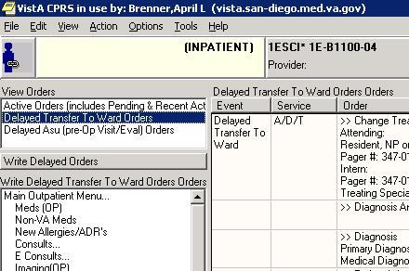
Notes:
April: I agree. First step, have the clerk highlight the orders that need to be released. Then click on ACTION…

Slide 81
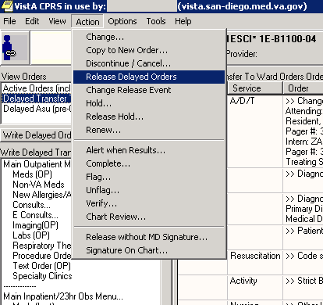
Notes:
April: then click on RELEASE DELAYED ORDERS, and problem solved, at least for the moment. But more investigation will be needed Monday morning by the CAC.

Slide 82

Problem #6
$ZE=<UNDEFINED>LAPSED+7^OREVNTX^ORE(100.2,0,0)
Last Global Ref: ^ORE(100.2,0,0)
S ORN=$P(^ORE(100.2PTEVT,0),U,4)
Notes:
Sheri: In this problem, this ordering provider is trying to enter event delayed orders on a patient, however he cannot access the ORDERS tab in this patient’s chart…the provider is getting this error message in CPRS GUI and is getting “thrown out” of VISTA/CPRS. Provider is getting a bit “frantic” since he needs to be able to enter some Surgery-related orders on this patient.
It looks like he’s trying to do a “mind-meld” of the orders from his head/brain directly into VISTA!!!! Wouldn’t that be cool!!!???

Slide 83
ORDERS
OE/RR PATIENT EVENT
OE/RR RELEASE EVENT
OE/RR AUTO-DC
Notes:
April: To understand the current scenario and the error message being generated, we need to understand the relationships between key files involved. Each ORDER that is either released or auto-dc’d by an event, has a file pointer to the OE/RR PATIENT EVENT file, a file that stores lots of great information. In turn, this file, has it’s own pointer relationships to 3 other files. #1, a pointer to the OE/RR RELEASE EVENT file…#2, a pointer to the OE/RR AUTO-DC file…#3 a pointer BACK to the ORDERS file.
So, if something gets accidently deleted or if a process in CPRS GUI gets interrupted, there is the potential for ORDERS to point to a non-existent OE/RR PATIENT EVENT. Likewise, there is the potential for OE/RR PATIENT EVENT to point to non-existent OE/RR RELEASE EVENT and/or a non-existent OE/RR AUTO-DC entry. These non-existent pointers, also referred to as “dangling” pointers, can cause these UNDEFINED errors.

Slide 84














Notes:
Sheri: So…how do we fix this error so that the provider can get into the patient’s orders!?!?!? Usually, the fix for this type of error involves recruiting your local, regional, or national friendly OI&T staff (someone who has VISTA programmer access) to look in the VISTA error trap, find the error that we saw 2 slides ago, and looking for the ORDER or the OE/RR PATIENT EVENT data involved in generating the error. That data needs to be edited/fixed or the bad “pointer” deleted.
Very “in the weeds” at this point…and I may have lost some folks out there…but this particular error happened to me very recently and so it’s fresh in my mind…AND, if it’s happened before, you know that it can happen again…but now you’ll be prepared!!!!

Slide 85

Problem #7
Notes:
April: WOW…this guy may not have any hair left!!!! Let’s see what’s going on w/him!!
In this problem, the orders that were released are showing up as both DELAYED ORDERS and ACTIVE ORDERS…and the release event is still showing in the WRITE ORDERS box…usually the event goes away once all orders are released correctly.
So…in this scenario, what happens is that a “rogue” order(s) are displayed on the ORDERS tab as both PENDING and DELAYED…for some reason, the order doesn’t complete the releasing process (we’ve seen lab orders and consult orders not release), and so that “stops” the RELEASE EVENT from completing fully and disappearing from the WRITE ORDERS box.

Slide 86

Notes:
Sheri: This fix for this problem is to either DISCONTINUE the problematic order…or MANUALLY RELEASE it…and then the RELEASE EVENT should disappear from the WRITE ORDERS box.

Slide 87

Problem #8
Notes:
April: This CAC just received a call from the Admissions Clerk who notified him that the doctors are still entering delayed orders for admissions to a treating specialty called O.R. Suite that was supposed to have been inactivated last week.

Slide 88
Release events Jul 16, 2013@14:55:29 Page: 1 of 2
Event set up and maintenance – All entries/Truncated view
Event Name Display Text Active? Event
ADMIT FOR RESEARCH STUDY ADMIT FOR RESEA
ADMIT TO 23 HR OBSERVATION ADMIT FOR 23HR O
ADMIT TO 2W-SARRIP ADMIT TO 2W-SARR
ADMIT TO CLC ADMIT TO CLC
ADMIT TO DOU ADMIT TO DOU
ADMIT TO ICU ADMIT TO ICU
ADMIT TO WARD ADMIT TO WARD
ANESTHESIA Anesthesia
ASU (PRE-OP VISIT/EVAL) ASU (PRE-OP VISIT/
CHG TX SPEC TO DOU TRANSFER TO DOU
+ Select number or enter action desired >>>
AE Add/Edit CC Create Child Event DD Detailed Display
AI Activate/Inactivate CD Change Display EP Edit Event Delay Par
Select action: Next Screen//
1 Auto-DC Rules
2 Release Events
Y A
Y A
Y A
Y A
Y A
Y A
Y A
Y M
Y M
Y T
+ Select number or enter action desired >>>
Notes:
Sheri: The CAC goes to Vista, selects the Release Events menu option and the ADMIT TO WARD Release event.

Slide 89
Detailed Display Aug 08, 2013@15:11:01 Page: 1 of 2
Name: ADMIT TO WARD
Short name: ADMIT TO WARD
Inactivated:
Type of event: ADMISSION
Trans to/within division: SAN DIEGO HCS
Event order dialog: ORZ GXMOVE ADMIT NEW
Order set/menu: ORZ SUB TELEMETRY MENU
Lapse In #days: 31
Mas movement type:
Display text: ADMIT TO WARD
Ordering parameters location: 5WORPACU
Copy active orders: YES
Included Treating Specialties:
OR SUITE *Intra-op*/PACU
GENERAL SURGERY
EAR, NOSE, THROAT (ENT)
Notes:
April: Sure enough, the OR SUITE treating specialty is still there. So he selects AE Add/Edit to try to remove it.

Slide 90

Select INCLUDED TREATING SPECIALTIES: OR SUITE *Intra-
op*/PACU // ??
You may enter a new INCLUDED TREATING SPECIALTIES, if you wish
AE Add/Edit AI Activate/Inactive HIS Add/Remove Histories
Select Item(s): Next Screen// AE Add/Edit
**This event has delayed orders associated with it!**
+ Enter ?? For more action >>>
Notes:
Sheri: Just as an FYI, you can ADD or DELETE treating specialties to an active release event, as long as it’s not currently in use, but that’s not the case here. Since there are pending delayed orders associated with one or more of the treating specialties in this release event, he can’t perform any edits without inactivating this event, which could cause some problems. Specifically, if a patient with delayed orders is admitted to one of the identified treating specialties in this release event, while it is inactive, the orders will not release. What do you think about this situation April?

Slide 91


Notes:
April: Since the ADMIT TO WARD release event is a very heavily-used event, I think this is one of those times where CAC needs a lot of friends…especially the admissions supervisor. It’s 1:00pm in the afternoon. Here’s an idea…the CAC could call the admissions clerk supervisor and ask her to instruct all the admitting clerks to ‘not’ enter any admissions into the computer system from 2p-2:15p.

Slide 92
Release events Jul 16, 2013@14:55:29 Page: 1 of 2
Event set up and maintenance – All entries/Truncated view
Event Name Display Text Active? Event
ADMIT FOR RESEARCH STUDY ADMIT FOR RESEA
ADMIT TO 23 HR OBSERVATION ADMIT FOR 23HR O
ADMIT TO 2W-SARRIP ADMIT TO 2W-SARR
ADMIT TO CLC ADMIT TO CLC
ADMIT TO DOU ADMIT TO DOU
ADMIT TO ICU ADMIT TO ICU
ADMIT TO WARD ADMIT TO WARD
ANESTHESIA Anesthesia
ASU (PRE-OP VISIT/EVAL) ASU (PRE-OP VISIT/
CHG TX SPEC TO DOU TRANSFER TO DOU
+ Select number or enter action desired >>>
AE Add/Edit CC Create Child Event DD Detailed Display
AI Activate/Inactivate CD Change Display EP Edit Event Delay Par
Select action: Next Screen//
1 Auto-DC Rules
2 Release Events
2:05 PM
Y A
Y A
Y A
Y A
Y A
Y A
Y A
Y M
Y M
Y T
+ Select number or enter action desired >>>
Notes:
Sheri: At 2pm (actually I would make it 2:05pm, just to play it safe) the CAC will go back to the Release Events menu, select the ADMIT TO WARD release event and use the A/I Activate/Inactivate action to inactivate the release event.

Slide 93
AE Add/Edit CC Create Child Event DD Detailed Display
AI Activate/Inactive CD Change Display EP Edit Event Delay Param
Select action: Quit// AE Add/Edit
NAME: ADMIT TO WARD
DISPLAY TEXT: ADMIT TO WARD
TYPE OF EVENT: ADMISSION//
ADMIT TO DIVISION: SAN DIEGO HCS//
MAS MOVEMENT TYPE:
Select INCLUDED TREATING SPECIALTIES: OR SUITE *Intra-Op*/PACU
//@
SURE YOU WANT TO DELETE THE ENTIRE INCLUDED TRAINING SPECIALTIES? Y (Yes)
+ Select number or enter action desired >>>
2:08 PM
Notes:
April: We’re doing good with time. It’s 2:08p. Now we select the Add/Edit action. At the Select INCLUDED TREATING SPECIALTIES prompt select the OR SUITE treating specialty and use the @ sign to remove it from the ADMIT TO WARD release event.

Slide 94

2:10 PM
AE Add/Edit CC Create Child Event DD Detailed Display
AI Activate/Inactive CD Change Display EP Edit Event Delay Param
Select action: Quit// AI Activate/Inactive
+ Select number or enter action desired >>>
Notes:
Sheri: Almost done, with 5 minutes to spare, we need to use the AI ACTIVATE/INACTIVATE action to reactivate the ADMIT TO WARD release event. So are we done fixing this problem?

Slide 95
2:12 PM
DGPM TS PATIENT INFORMATION Treating Specialty Inpatient Info
Treating Specialty Transfer
Notes:
April: We’re done editing the release event, with just three minutes to spare. But the CAC still has to inactivate the O.R. SUITE treating specialty. And before he can do that he needs to make sure that any inpatients who are currently associated with the OR SUITE treating specialty are moved to another treating specialty.
To find these patients, he can use a VistA option called DGPM TS INPATIENT INFORMATION, then use the TREATING SPECIALTY TRANSFER option on the BED CONTROL VistA menu to transfer patients out of the OR SUITE treating specialty. Then, finally, the obsolete treating specialty can be inactivated.

Slide 96

Notes:
Sheri: One more reminder to our audience to click on the ASK THE PRESENTER button to submit your questions to us and we’ll review them at the end of the presentation. April, we have a few other helpful troubleshooting options…how about if we show them to the audience?

Slide 97
DO Delayed Orders/Auto-DC Set-up
EP Parameters for event delayed orders
IN Inquire to OE/RR Patient Event File
Select Event Delayed Orders Menu Option: IN Inquire to OE/RR Patient Event File
Select OE/RR Patient Event: ?
Answer with OE/RR PATIENT EVENT, or AUTO-DC RULE, or PARENT
Do you want the entire 289360-Entry OE/RR PATIENT EVENT List? ADMIT??
Answer with ‘Yes’ or ‘No”:
Select OE/RR PATIENT EVENT: NSC VETERAN
NO NSC VETERAN
Enrollment Priority: Group 8c Category: Enrolled End Date:
1 NSC VETERAN SD ADMIT TO WARD 06-03-03
2 NSC VETERAN SD ADMIT TO WARD 06-03-03
3 NSC VETERAN SD 06-03-03
4 NSC VETERAN SD 06-03-03
5 NSC VETERAN SD ASU (PRE-OP VISIT/EVAL)
Press <RETURN> to see more, ‘^’ to exit this list, OR
CHOOSE 1-5:
Notes:
April: Great idea! Here’s a good troubleshooting tool. On the EVENT DELAYED ORDERS MENU, there is an option called INQUIRE TO OE/RR PATIENT EVENT FILE. In this example, we entered the patient’s name and selected the release event to view the details.

Slide 98
DEVICE: HOME// HOME (CRT)
PATIENT: VETERAN PATIENT EVENT: ADMIT TO WARD
ADMISSION: JUN 03,2003@12:10 CREATED ON: JUN 03,2003@16:09
CREATED BY: VA DOCTOR EVENT DATE/TIME: JUN 03,2003@12:10
PATIENT MOVEMENT: JUN 03.2003@12:10 AUTO-DC RULE: ADMISSION
DISCONTINUED ORDER: 13520885
DISCONTINUED ORDER: 14174810 BY PACKAGE: PHARMACY
DATE/TIME OF ACTIVITY: JUN 03,2003@16:21:16
TYPE OF EVENT ACTIVITY: NEW USER:
EVENT TYPE: ADMISSION MAS MOVEMENT TYPE: DIRECT
TREATING SPECIALTY: WARD NEUROSURGERY
WARD LOCATION: 5WORPACU
DATE/TIME OF ACTIVITY: EDITED USER:
TYPE OF EVENT ACTIVITY: EDITED USER:
EVENT TYPE: ADMISSION MAS MOVEMENT TYPE: DIRECT
TREATING SPECIALTY: OR SUITE
WARD LOCATION: 5WORPACU
Notes:
Sheri: In this display, we see some helpful information…we can see what RELEASE EVENT was involved…what AUTO-DC RULE was involved…the orders that were DISCONTINUED and if a “backdoor” VISTA package (like PHARMACY here) discontinued the order. We can also see who entered the patient movements and when…and sometimes even more helpful…if that patient movement was EDITED…and by whom & the date/time. Editing patient movements may have “unknown consequences” to the orders that are active/delayed/etc…use w/caution!!!

Slide 99
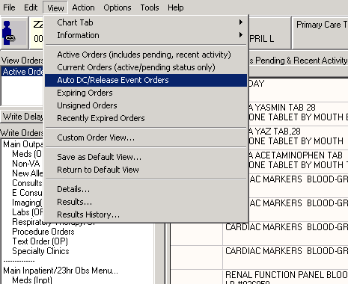
Notes:
April: Another place we can look is in the CPRS GUI. Click on View, then select AUTO DC/RELEASE EVENT ORDERS to view the details of past delayed order events.

Slide 100
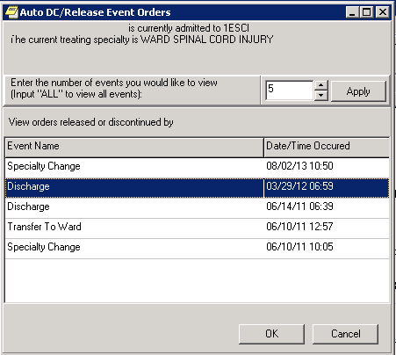
Notes:
Sheri: On this screen, the number of past delayed order events can be specified. In this example we requested the last 5 events. Typically you will see a list of patient movement events such as Admissions, specialty changes, transfers, and discharges. Selection of one of these patient movements will display all the auto-dc’d and/or released orders that were impacted by a patient movement. In this example we selected the Discharge that took place in March 29, 2012.

Slide 101
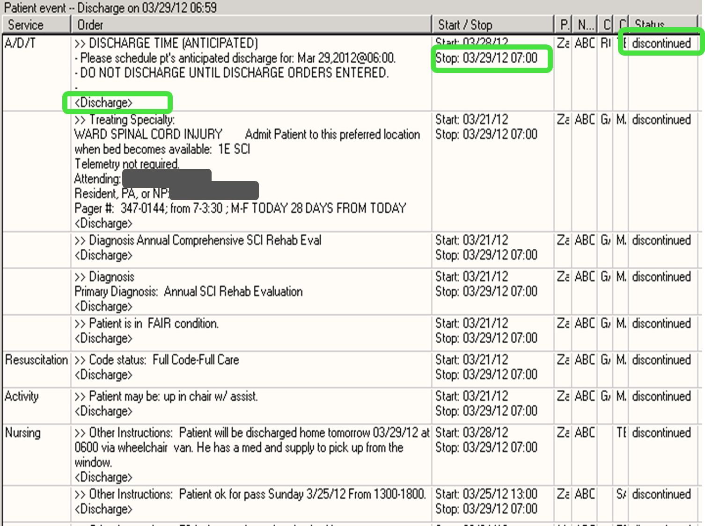
Notes:
April: Here we can see all the orders that were auto-discontinued by our auto DC rule. And the reason for the auto DC is ‘Discharge’. We can also see the date and exact time the orders auto-DC’d. This is a good tool to have when you need to take a look at individual orders affected by an auto DC rule or Release Event.

Slide 102
Select OPTION: SEARCH FILE ENTRIES
OUTPUT FROM WHAT FILE: OE/RR PATIENT EVENT//
-A- SEARCH FOR OE/RR PATIENT EVENT FIELD: EVENT
1 EVENT
2 EVENT DATE/TIME
CHOOSE 1-2: 1 EVENT
-A- CONDITION: = EQUALS
-A- EQUALS OE/RR RELEASE EVENTS: ⬅=ENTER NAME OF RELEASE EVENT
-B- SEARCH FOR OE/RR PATIENT EVENT FIELD: PATIENT MOVEMENT
-B- CONDITION: NULL
-C- SEARCH FOR OE/RR PATIENT EVENT FIELD: ACTIVITY (multiple)
-C- SEARCH FOR OE/RR PATIENT EVENT ACTIVITY SUB-FIELD: .01 DATE/TIME OF ACTIVITY
-C- CONDITION: NULL
-D- SEARCH FOR OE/RR PATIENT EVENT ACTIVITY SUB-FIELD:
-D- SEARCH FOR OE/RR PATIENT EVENT FIELD:
IF: A&B&C EVENT EQUALS 3 (NAME OF RELEASE EVENT and PATIENT MOVEMENT NULL and OE/RR PATIENT EVENT DATE/TIME OF ACTIVITY NULL
Notes:
Sheri: Here’s another trouble shooting tool. It’s a FILEMAN search that can be used to locate sets of pending Delayed Orders that have not yet been released for a specified RELEASE EVENT.
Audience, no need to try to copy this all down. We will make this available to you in the DOWNLOAD section above…so you can just sit back & listen…
This is the first half of search in the OE/RR PATIENT EVENT file. We search for the EVENT equal to the name of the RELEASE EVENT…and for the PATIENT MOVMENT field that is empty or null…and for the ACTIVITY sub-field, DATE/TIME field that is also empty or null…

Slide 103
DO YOU WANT THIS SEARCH SPECIFICATION TO BE CONSIDERED TRUE FOR CONDITION -C-
1) WHEN AT LEAST ONE OF THE 'ACTIVITY' MULTIPLES SATISFIES IT
2) WHEN ALL OF THE 'ACTIVITY' MULTIPLES SATISFY IT
3) WHEN ALL OF THE 'ACTIVITY' MULTIPLES SATISFY IT,
OR WHEN THERE ARE NO 'ACTIVITY' MULTIPLES
CHOOSE 1-3: 3// 3
OR:
STORE RESULTS OF SEARCH IN TEMPLATE: ⬅==GIVE A TEMPLATE NAME HERE
DESCRIPTION:
No existing text
Edit? NO//
Notes:
April: And here’s more of the FM search. Because the ACTIVITY field is a MULTIPLE (can have multiple entries for any given entry in the OE/RR PATIENT EVENTS file), FILEMAN asks if we want our search criteria to be true for certain conditions…and in this search we want #3…WHEN ALL OF THE ACTIVITY MULTIPLES SATISFY IT or WHEN THERE ARE NO ACTIVITY MULTIPLES.
To re-use this template, you could store the results by giving it a TEMPLATE NAME.

Slide 104
SORT BY: NUMBER//
START WITH NUMBER: FIRST//
FIRST PRINT FIELD: CAPTIONED
Include COMPUTED fields: (N/Y/R/B): NO// BOTH Computed Fields and Record Number (IEN)
Heading (S/C): OE/RR PATIENT EVENT SEARCH Replace
DEVICE: TELNET PORT Right Margin: 80//
OE/RR PATIENT EVENT SEARCH AUG 9,2013 15:32 PAGE 1
-----------------------------------------------------------------------------
NUMBER: 1019 PATIENT: VETERAN PATIENT
EVENT: NAME OF RELEASE ORDER: 48397
CREATED ON: AUG 09, 2013@15:22 CREATED BY: VAWORKER
1 MATCH FOUND.
Notes:
Sheri: And here’s the rest of the FM search. We are just printing the [CAPTIONED output to the screen or device.
This is a really nice tool to have when you need to identify which patients have unreleased delayed orders for a specific RELEASE EVENT.

Slide 105

Notes:
Sheri: Hey April, have you ever been falsely accused of making a change to a release event or an Auto DC rule?
April: Yes, as a matter of fact I have, especially when we were trying to set them up for the first time.
Sheri: Did you know there was a cool tool in VistA that can get you off the suspect list?
April: No, but I’d sure like to know where that is.

Slide 106
Release events Jul 16, 2013@14:55:29 Page: 1 of 2
Event set up and maintenance – All entries/Truncated view
Event Name Display Text Active? Event
ADMIT FOR RESEARCH STUDY ADMIT FOR RESEA
ADMIT TO 23 HR OBSERVATION ADMIT FOR 23HR O
ADMIT TO 2W-SARRIP ADMIT TO 2W-SARR
ADMIT TO CLC ADMIT TO CLC
ADMIT TO DOU ADMIT TO DOU
ADMIT TO ICU ADMIT TO ICU
ADMIT TO WARD ADMIT TO WARD
ANESTHESIA Anesthesia
ASU (PRE-OP VISIT/EVAL) ASU (PRE-OP VISIT/
CHG TX SPEC TO DOU TRANSFER TO DOU
+ Select number or enter action desired >>>
AE Add/Edit CC Create Child Event DD Detailed Display
AI Activate/Inactivate CD Change Display EP Edit Event Delay Par
Select action: Next Screen//
Y A
Y A
Y A
Y A
Y A
Y A
Y A
Y M
Y M
Y T
+ Select number or enter action desired >>>
Notes:
Sheri: It’s in both the Release Event or Auto DC rule menus in VistA. Here I have selected the Release Events menu. You first need to select a Release Event, ADMIT TO WARD in this example, then select DD for Detailed DISPLAY.

Slide 107
Display Text: ADMIT TO WARD
Ordering parameters location: 5WORPACU
Copy active Orders: YES
Included Treating Specialties:
THORACIC SURGERY
GENERAL SURGERY
EAR, NOSE, THROAT (ENT)
WARD NEUROLOGY
WARD NEUROSURGERY
WARD OPTHAMOLOGY
AE Add/Edit AI Activate/Inactivate HIS Add/Remove Histories
Select Item(s): Next Screen// HIS Add/Remove Histories
Currently, the audit and activation histories are not appearing on the detailed display.
Do you want to include them on the detailed display? N// y YES
Histories are now included.
+ Enter ?? For more actions >>>
Notes:
April: I see it. It’s the HIS Add/Remove Histories action!

Slide 108
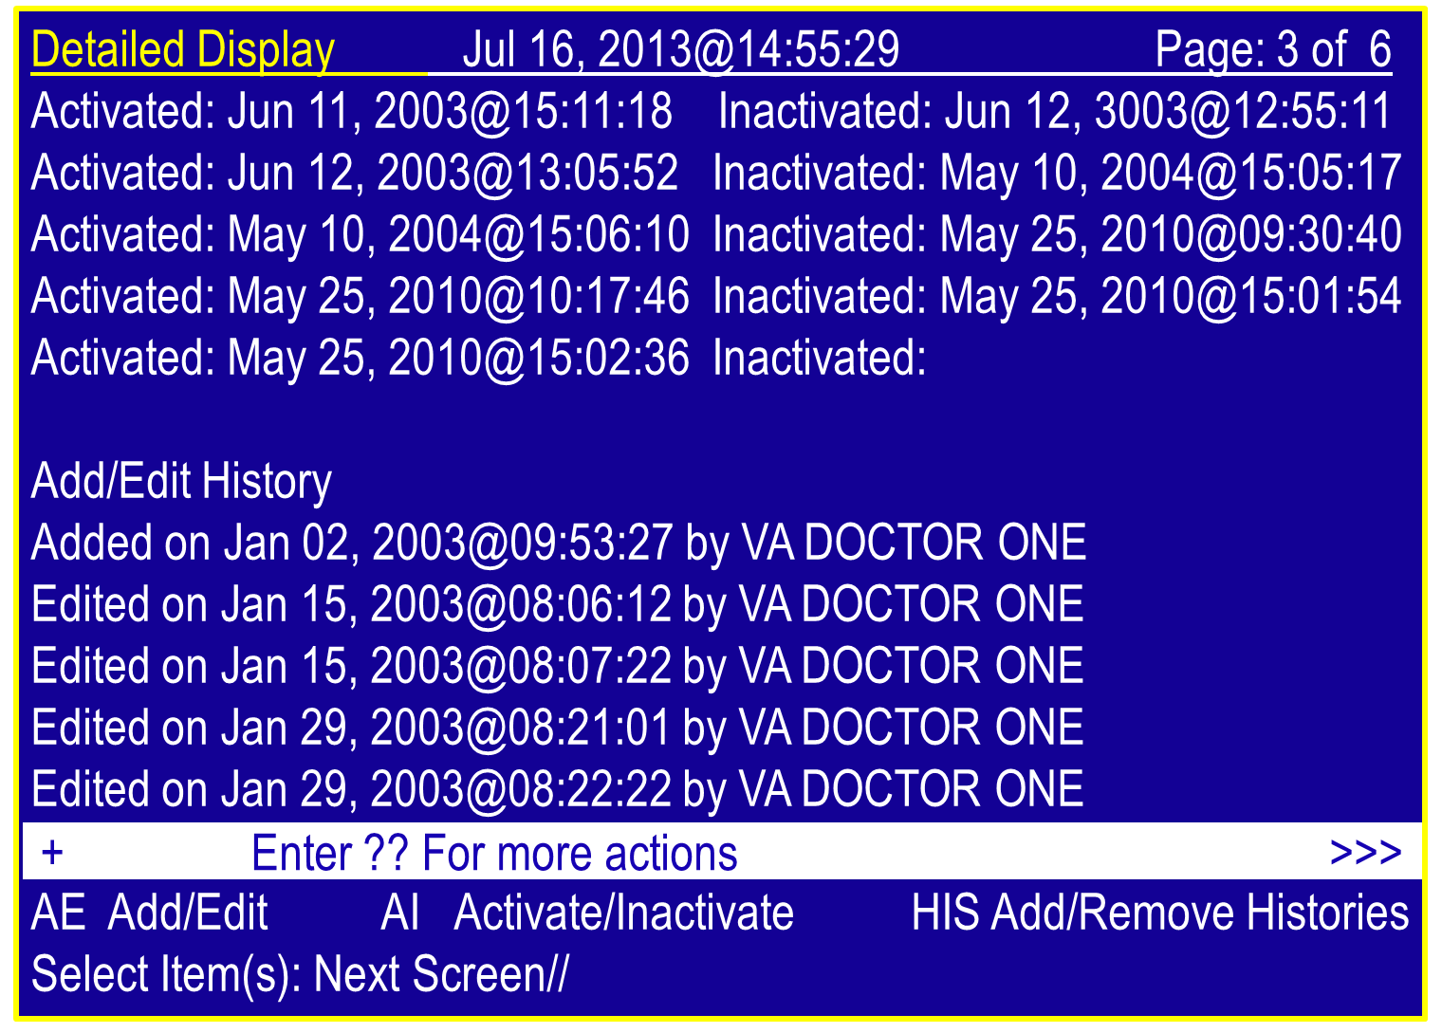
Notes:
Sheri: After adding the Histories to the detailed display , we can see the activation and inactivation dates as well as the individuals who made edits to the Release Event. And we can see that YOU never made any edits!! So you’re off the hook!!!!

Slide 109
OPTIONS
FILES
CPRS
Orderable Items
Order Dialogs
Patient Movement File #405
Hospital Location File #44
Ward Location File #42
Facility Treating Specialty File #45.7
Order Menus
Extended Bed Control
Patient Inquiry
A/D/T Process
Business “Flow”
View Auto DC/Release Event Orders
Add/Remove Histories (audit tool)
Notes:
April: That’s a nice tool to have to keep me out of the hall of shame!
We have quite a list of helpful resources that can be used in managing Event Delayed Orders. Here’s a list of the ones we talked about in the presentation: Patient Inquiry, Extended Bed Control, Add/Remove Histories for sure. I also like to be able to inquire to the HOSPITAL LOCATION file #44…the WARD LOCATION file #42…the FACILITY TREATING SPECIALTY file #45.7.
Besides the MAS-related options & files, CACs also need to be familiar w/ORDERABLE ITEMS, ORDER DIALOGS, ORDER MENUS, ETC…and the PROCESS that the clerks go through when entering patient movements. It’s a lot of stuff to know. It’s also important to collaborate with other key staff including clinicians, ADPACS, ITACS, etc.

Slide 110

Notes:
Sheri: WOW!!! It sure sounds like it’s critical to have a coordinated team to implement and understand RELEASE EVENTS and AUTO-DC RULES!!!

Slide 111

Notes:
April: Absolutely!!!
We hope we were able to shed some light on how Event Delayed Orders are set up…how they work…some key things to remember… some troubleshooting tools… and to remember that Delayed orders is a coordinated/team effort. But, Sheri if this is the team that’s looking for us, I say we should get outta here!!!

Slide 112

Ask the Presenter
Notes:
Sheri: Yes, let’s shake a leg. But before we run…. Hey audience, If you haven’t submitted your questions yet, there is still time to do so by clicking on the orange “Ask The Presenter” icon. We’re going to show a brief announcement and be right back to answer your questions.
(Stand still and smile until you see the video come up full screen)

Slide 113
#1
What INCLUDED PACKAGE controls NURSING and ACTIVITY orders?
Notes:
The Package is ORDER ENTRY/RESULTS REPORTING. NURSING is a DISPLAY GROUP as well as ACTIVITY. All “text” type orders are included in the OE/RR package.

Slide 114
#2
Are PENDING Lab orders and ACTIVE Lab orders handled the same in an AUTO-DC rule?
Notes:
Pending lab orders are auto-dc’d since they have not yet been drawn. ACTIVE lab orders are already in progress so cannot be auto-dc’d. In addition, future send patient orders will not be discontinued by the auto-dc process either, unless the patient has expired. There are other packages that will also not auto-dc orders if the order is active (radiology, blood bank) or if there are partial results available (consults).

Slide 115
#3
Can a patient have more than one set of delayed orders at once?
Notes:
Yes, and each set of delayed orders will release according to the auto-release event it is tied to

Slide 116
#4
Sometimes I see orders that don’t AUTO-DC as I would expect…why is that?
Notes:
There could be lots of reasons for this:
The TREATING SPECIALTY and/or LOCATION did not match the release event as the provider entered it.
Some orders are associated w/previous PATIENT LOCATIONS and so may not be appropriate to auto-dc.
Some orders are ACTIVE (like lab orders) and are “in progress” so should not be auto-dc’d.
Packages not being included
Exceptions for orderable items
Exceptions for identified display groups
Coming from an observation ward.
Enter a remedy ticket for assistance

Slide 117
#5
How are the “EXCLUDING FROM TREATING SPECIALTIES” in AUTO-DC rules used…these are very confusing.
Notes:
Yes, they are. This is really a way for us to specify which types of treating specialty changes should be excluded from the rule. So, we set up specific “from-to” relationships that will bypass this rule. Remember that for specialty changes, we auto-dc orders unless we find an exception. On ward transfer we don’t auto-dc orders unless told to do so. There is confusion with all of this because we have a different method for locations than we do for specialties. For specialties you have to name the “from-to” relationships while we allow wildcards (*) in locations where you enter one location to all (or many). A good example that helps to illustrate this is the NH-related treating specialties that are functionality significant from an MAS point of view; however from a clinical point of view don’t necessarily warrant the discontinuation of orders…many which have been active for patients on those locations for quite some time.

Slide 118
#6
Does the INCLUDED PACKAGE of DIETETICS actually control the auto-dc’ing of diet-related orders?
Notes:
The N&FS VISTA package manages all diet-related processing. The auto-dc process cannot discontinue active diet orders and if the diet is to be replaced then a new diet should be ordered. Also, if a package has parameters for controlling the discontinuing of orders, or if the package is hard coded to discontinue orders, then coordination is needed between those packages and CPRS. In general, all other package specific process occurs before CPRS processes orders. So, if you’ve got a package set up to not auto-dc orders but do have CPRS set up to do so then things might not work like you expect them to.

