Slide 1
Back to Basics: Order Menu Management
Rebecca A. Starks, MSN, RN
Notes:
Thank you (moderator name)! I am happy to be here today to talk about Back to Basics-Order Entry/Results Reporting, Order Menu Management. This class looks at the basic construction of an order from creating the orderable item to creation of order menus. Orders are the backbone of communicating what a patient needs between nurses and doctors or between providers and other services such as lab, pharmacy or administrative services. Orders range from a basic quick order to complex generic orders. So let’s get Back to Basics.

Slide 2


Notes:
Why talk about the basics? One of the most common requests an informaticist receives is “Can you make an order that will do XXXX”? This question is rarely as simple as it seems. Medicine continues to try to find ways to provide quality cost effective care by standardizing and decreasing variables in treatment of certain conditions such as CHF, pneumonia, stroke, and managing day to day care in Patient Aligned Care Teams.
As a novice or seasoned informaticist they turn to us to make those ideas a reality. Passing this information on to each other allows the chance for all of us to learn and grow. Sometimes starting at the beginning and looking at the basics provides those ah hah moments that solve a challenging problem that you have set aside hoping for a time when you can get BACK TO THE BASICS.

Slide 3

Poll Question
How long have you been a CAC/ Informatics Specialist?
    0-5 years
    6-15 years
    16-25 years
    As long as I can remember (>25 yrs)
Notes:
First I’d like to ask a poll question.
How long have you been an Informaticist (CAC/Informatics Specialist)?
0-5 years
6-15 years
16-25 years
As long as I can remember (>25 yrs)
To answer this question, use the blue polling icon above my head. We’ll move on and come back to your results in just a moment.

Slide 4
Orderable Item
Order
Veteran Order
Veteran Order
Notes:
The actual order placed in CPRS is the end result of an informaticist putting the building blocks in place that will allow the provider to click a single button, maybe fill in some blanks and quickly create the order. That order starts a cascade of events leading to the Veteran receiving the necessary service such as nursing care, labs, radiology exams, medications or an appointment.
The informaticist starts by creating an orderable item or using a package generated orderable item such as lab, radiology or pharmacy that is placed in an order. This order is placed on a menu and when selected by the user results in an order in VistA/CPRS to the appropriate service.

Slide 5

Notes:
So what is an order?
Sometimes orders are referred to as OE/RR which refers to Order Entry/Results Reporting portion of VistA
Users can enter orders into CPRS several ways
Quick Orders
Generic Orders
Order Sets
All of these can be picked from Order Menus or embedded into Reminder Dialogs
Before we move on, let’s take a moment and look at your poll results.

Slide 6
Poll Results
How long have you been a CAC/Informatics Specialist?
    0-5 years
    6-15 years
    16-25
    As long as I can remember (>25 yrs)
Notes:
Adlib to results

Slide 7
Poll Results
How long have you been a CAC/Informatics Specialist?
    0-5 years
    6-15 years
    16-25
    As long as I can remember (>25 yrs)
Notes:
Click to move on

Slide 8

ORDERABLE ITEM
Notes:
Let’s get started with looking at the construction of an order. I like to think of creating an order as a puzzle. Each piece must fit together to create the finished puzzle. So let’s take apart the pieces of the order and talk about each piece and how important each piece is to the final product. Let’s start with an orderable item.
- An Orderable item (OI) is the basic component of an order dialog.
- The OI
- Tells what type of order the order dialog is,
- Where the information is stored in VistA,
- How the order is processed in VistA and CPRS,
- Where the order is displayed in CPRS
- Who is notified of the signed and released order, and
- What the order dialog specifically orders for the patient.
There are five key ideas you must understand when working with orderable items and in creating orders.
First every order dialog should have an orderable item.
Next the type of order is defined by the type of orderable item in it.
Orderable items are the links to different packages in VistA (Lab, Radiology, Pharmacy).
When creating an orderable item a strong practice is to always search for existing orderable items before building a new one. The reason to make this part of your routine is that multiple OIs for the same intervention can cause enormous problems later.
Certain packages like lab, radiology and pharmacy you do not need to build an orderable item. The orderable items are part of the package.
We are building orderable items for text orders, not package generated orderable items. However, if an orderable item doesn’t exist from packages such as lab, radiology or pharmacy you may need to work with the ADPAC for that service to create the orderable item so you may use it in creating orders. For example, you have a request for specific medication. When you search for that orderable item you don’t see that item in the list of pharmacy orderable items. You will need to contact the Pharmacy ADPAC to create or activate that orderable item and make it available for use in an order if appropriate.

Slide 9
Quick Orders
Generic Orders
Finding Items
Notifications
Health Summary
Reminder Patient Lists
Notes:
Orderable items can then be used to create quick orders and generic orders as well as used in finding items in reminders, notifications, reminder patient lists and health summaries.
The type of orderable items include but are not limited to:
Nursing
Lab Test
Medications
Radiology
Activity
Condition/Diagnosis
Supplies/Devices or
Vitals just to name a few.

Slide 10
Select Clinical Coordinator Menu Options: CPRS CPRS Manager Menu
CL Clinician Menu
NM Nurse Menu
WC Ward Clerk Menu
PE CPRS Configuration (Clin Coord)….
Select CPRS Manager Menu Option: PE
Notes:
Now lets start by creating an ORDERABLE ITEM. Each site and user base menu may be different but most informaticists start with the CLINICAL COORDINATOR MENU . From your base menu you use the ^ (up carrot) and type in clinical coordinator and select the Clinical Coordinator Menu from your list of available menu options. The next step is to select CPRS or the CPRS Manager menu as shown in the highlighted area at the top of this slide.
The CPRS Manager Menu is then displayed and you select PE for CPRS Configuration

Slide 11
AL Allocate OE/RR Security Keys
KK Check for Multiple Keys
DC Edit DC Reasons
GP GUI Parameters…
GA GUI Access – Tabs, RPL
MI Miscellaneous Parameters
NO Notification Mgmt Menu…
OC Order Checking Mgmt Menu…
LI Patient List Mgmt Menu…
FP Print Formats
PR Print/Report Parameters…
US Unsigned orders search
EX Set Unsigned Orders View on Exit
NA Search orders by Nature or Status
CM Care Management Menu
DO Event Delayed Orders Menu
LO Lapsed Orders search
Select CPRS Configuration (Clin Coord) Option:
MM Order Menu Management
Notes:
Selecting PE takes you to the list of options as seen on your screen. Select MM or Order Menu Management.

Slide 12
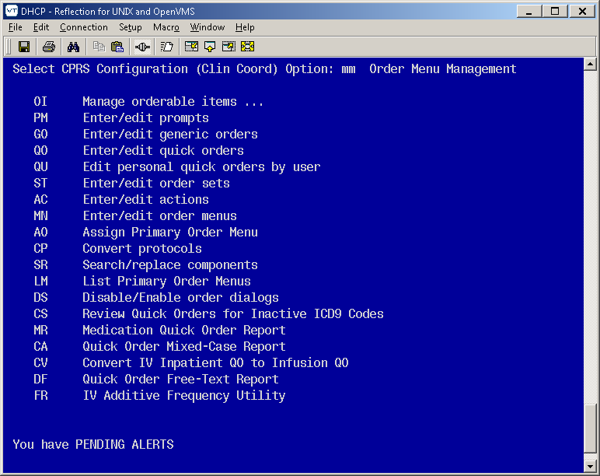
Notes:
As you can see, the Order Menu Management screen has multiple options. We want to create an Orderable Item so we select “OI Manage orderable items”

Slide 13
OI Enter/edit orderable items
QO Enter/edit QO restriction
SR Search/replace orderables
VB Edit VBECS item display names
Notes:
Once you select OI Manage Orderable items VistA will display the options above. Once you pick the “OI Manage Orderable Items” VistA takes you deeper into the menu. The “OI Manage Orderable Items” offers you several options related to orders.

Slide 14
OI Enter/edit orderable items
Allows you to create or edit existing orderable items
QO Enter/edit QO restriction
Allows you to restrict use of certain orderable items
Notes:
For the moment let’s look at these two options. The first: “OI” allows you to create or edit existing orderable items. We will focus on this option in a few moments.
“QO” is the second option, which is also important when working with Quick orders. This option allows you to restrict the use of orderable items. Example: A certain chemotherapy medication should only be entered into a patient’s record by an oncologist you can restrict the use to oncologists via a menu Another example is placing an herbal medication only on the Non-VA meds orders.

Slide 15
OI Enter/edit orderable items
QO Enter/edit QO restriction
SR Search/replace orderables
VB Edit VBECS item display names
Notes:
Since we are interested in creating an ORDERABLE ITEM I selected “OI- Enter/edit orderable items” as highlighted in yellow.

Slide 16
Type
OTHER HOSPITAL SERVICES:
NURSING: Used in a nursing order
ACTIVITY: Used in an activity order
Choose from:
This defines which type of order dialog can be built with this orderable item
Type of Orderable:
Answer with DISPLAY GROUP NAME
Notes:
After selecting OI Vista asks for the Type of Orderable. This defines which type of order dialog can be built. VistA then asks you to select the DISPLAY GROUP name. The Display group tells what service to send the order to and is how the orders are grouped on the orders tab. Display groups are configurable by the site but there are set display groups as well. This shows two of the display groups Activity and Nursing.

Slide 17
Do you want the entire DISPLAY GROUP List? Y (Yes)
Choose from:
ACTIVITY
BLOOD PRODUCTS
CONDITION
CONSULTS
DIAGNOSIS
DIET ADDITIONAL ORDERS
DIET ORDERS
EARLY/LATE TRAYS
GENERAL RADIOLOGY
IMAGING
IV MEDICATIONS
LABORATORY
Notes:
This is a screen shot of the VistA list of DISPLAY GROUPS. Your site’s display groups may vary slightly.

Slide 18
Select Manage orderable items Option: OI Enter/edit orderable items
Type of Orderable: NURSING
Select ORDERABLE ITEMS: VITAL SIGNS EVERY 15 MIN
Are you adding ‘VITAL SIGNS EVERY 15 MIN’ as a new ORDERABLE
ITEMS? No// Y (Yes)
NAME: VITAL SIGNS EVERY 15 MIN Replace
Notes:
So back to building an orderable item. In this example Nursing needs an orderable item for Vital Signs every 15 minutes. My former site chooses to place all Vital signs under nursing display group other sites may use a separate display group for vitals signs.
“Select orderable item” is a little confusing since I have not yet built the orderable item. This is the field to name the new orderable item.
When you are creating an orderable item you should:
- Use appropriate local naming conventions and rules based on your sites recommendations. We will talk about that a little more in a few moments
- Think about future reporting or reminder uses for the order. This may define how you name the orderable item.
If I wanted to check to see if there is an existing orderable item for this I would type in a question mark at “Select Orderable ITEMS” and the full list would be displayed. To make a new orderable item I typed in VITAL SIGNS EVERY 15 and hit return.
VistA echoed back with the question Are you adding ‘VITAL SIGNS EVERY 15 MIN’ and I answered yes. The name was then displayed and the orderable item was created. When you are first creating an orderable item you expect something else to pop up or confirm you have actually created the item. VistA does not confirm the creation. You may check by selecting OI again and using the question mark at the “Select ORDERABLE ITEMS” as described earlier.
Creating an orderable item is not very difficult but is a critical step as you move forward in creating orders.

Slide 19

ORDER
ORDERABLE ITEM
Notes:
Ok, so now we have created an orderable item. What do we do with that? The next step in the puzzle is to create an order. As I mentioned earlier an orderable item, either created by a package or created by an informaticist is a basic component of an ORDER.
An order may define:
specific information such as an admission order stating the diagnosis and condition.
a specific item such as a test or medication
an action that needs to be taken such as monitoring vitals signs

Slide 20
Quick Orders
Generic Orders
Notes:
There are two basic types of orders Quick orders and Generic orders. Quick orders allow the user a quick and easy way to order something for a Veteran without having to go to the specific package such as lab, radiology, or pharmacy and build their own order.
For an informaticist it is an easy method to build an order. Quick orders allow us to prefill required data such as the orderable item, comments, or start and stop dates with the goal of decreasing the time necessary for a user to order a specific item or action that is done frequently or has specific requirements.
This is what you see most often on CPRS order menus.

Slide 21
ORZ
OE/RR
PSIV
PSO
RA
LR
PSJ
GMRC
Notes:
Earlier when creating the orderable item I mentioned naming conventions. There are basic naming conventions that are used for the type of order such as
Radiology: RA
Lab: LR
Outpt Meds:PSO
Inpt Meds:PSJ
IV Meds: PSIV
Consults:GMRC
Vital Measurements: GMRV
Dietetics: FH
These acronyms refer to the packages where the orderable items reside. These are just suggestions and your site might use variations or not use them at all. My former site opted for a different naming convention to make it easier for new Health Informatics staff such as adding LAB instead of LR, CONS instead of GMRC. Talk with your sites expert informaticist regarding your naming conventions.

Slide 22
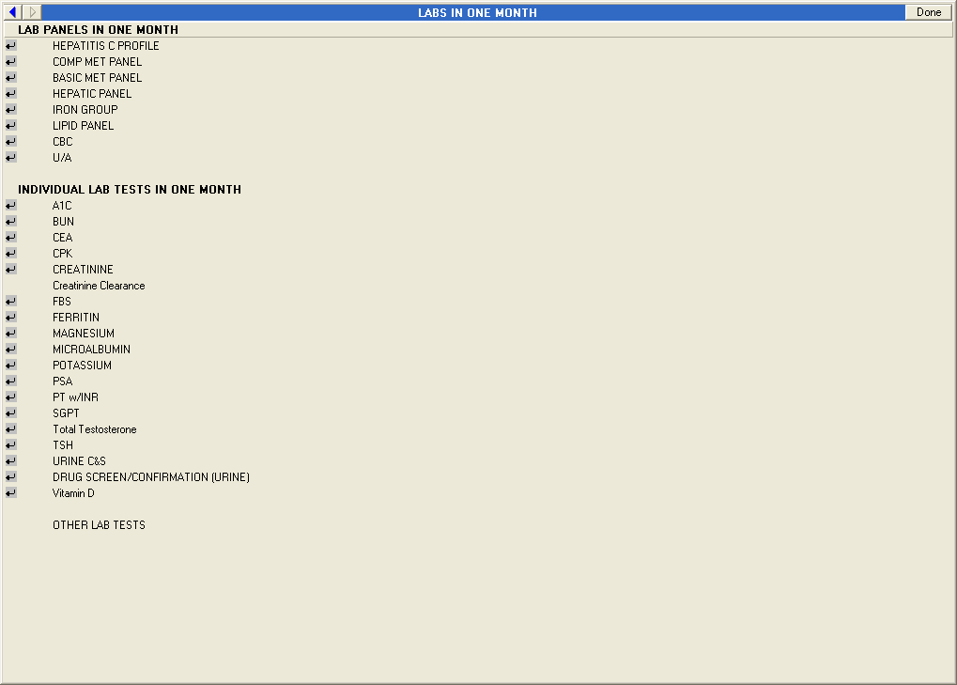
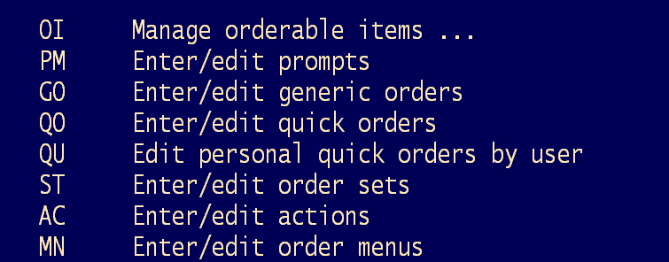
Notes:
Now let’s take a closer look at the quick order. Here is an sample quick order menu for lab panels. Each of the items is a quick order that has been placed on an order menu. So let’s get started building the quick order. Remember when we were building an orderable item, we started on the Order Menu Management menu. I returned to the Order Menu Management menu but now I am selecting QO Enter/edit quick orders as shown on your screen.

Slide 23
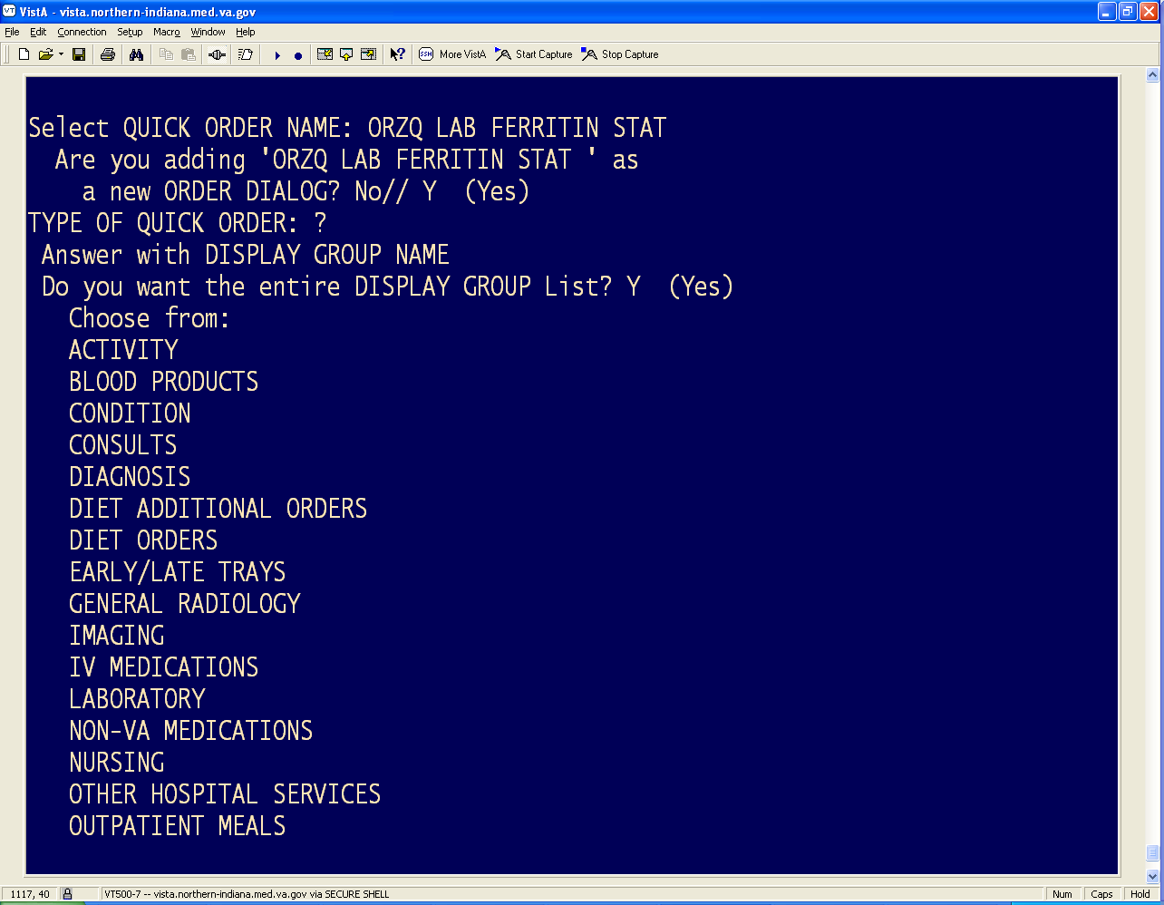
Notes:
Once you select QO Enter/edit quick orders VistA asks you to select the order name. Again, it is a good idea to check that a quick order for this purpose doesn’t already exist. This can be checked by starting to type in your naming convention or using a question mark. Keep in mind if using the ? you will get hundreds or perhaps thousands of quick orders since the question is merely a query to the list of quick orders
Once you have determined that you do not have a quick order that meets your need you start by typing in the name using your sites naming conventions. In this example I have used the prefix ORZQ , signifying a quick order, the type LAB, based on my sites naming convention, then the name of the specific test, in this case Ferritin. I highly recommend you state the frequency or urgency. This helps when selecting the appropriate QO for a different request such as a new menu.
After hitting ENTER, VistA asks if I am adding ORZQ LAB FERRITIN STAT as a new order dialog and I added Y (Yes). In this case, order dialog refers to creating the order. Now we need to know the Type of order. Picking the display group defines what orderable items are selectable.

Slide 24
TYPE OF QUICK ORDER: LAB LABORATORY
NAME: ORZQ LAB FERRITIN STAT Replace
DISPLAY TEXT: Ferritin Stat
VERIFY ORDER: N NO
DESCRIPTION:
No existing text
Edit? NO//
Lab Test: ferritin FERRITIN
Notes:
When VistA asked me for the Type of Quick Order, I selected lab. Next, I must type the name of the quick order.
We use the same name we used earlier. This is not what the user will see only what the infomaticist sees behind the scenes. So the VistA name is appropriate
Then you will enter the name that WILL be displayed for user. In this case I entered the name of the lab test and it’s urgency . Ferritin STAT and hit return.
The next prompt VERIFY order is a YES or NO . Yes forces the user to view the details of the order before signing. NO places the item on the orders without being seen. Working with the end user and knowing the end goal makes this simple question a very pivotal question in how this order will function. Yes provides the chance to edit the order but requires additional mouse clicks. Plan ahead this field can be changed at a later date if it doesn’t function as desired by the end user.
Description is the next prompt and some sites like a brief description of how or where it was used. For example, “Primary Care menu” or the date created or the name/initials of the creator. The description is only seen by the informaticist. In this case, Ferritin Stat was self explanatory and could be used on multiple menus so no description was added. Again follow your sites decisions on the use of this field.
Lab Test is the next prompt and VistA is asking for the test name. I typed in Ferritin. This is an example of an orderable item created by the package. In some cases you will need to contact your LAB ,PHARMACY or RADIOLOGY ADPAC to be sure you are selecting the correct test or medication or if you don’t see what you need. In some cases they may need to make the orderable item available for use in orders.

Slide 25
Collected By: Immediate collect by blood team
Collection Sample: BLOOD (GOLD)//
Collection Date/Time: NOW+3' (AUG 13, 2013@10:26)
How often: O
1 ONCE
2 ONE TIME
CHOOSE 1-2: 2 ONE TIME
Notes:
The next prompt is specific to the lab order. Depending on the type of quick order you are creating, the prompts at this point will vary. In this scenario a lab order requires the creator to specify how the specimen will be collected.
The options are:
SP - Send to lab - this means the veteran is ambulatory and will be sent to the laboratory to collect the appropriate specimen. Generally used with outpatients only.
WC - Ward Collect - Means the staff will be collecting the specimen in the clinic or on the ward. This can be inpatient or outpatient
LC - Lab blood team- a lab phlebotomist will draw the blood on the ward at a defined lab collection time
IC - Immediate collect by blood team - Blood team draws at the time requested instead of the defined lab collection time.
Collection sample: Defines the type of specimen. In this case blood. Lab has defined the color of tube for this type of test and may have other comments or directions for staff.
Collection date/time: Defines when you want this collected. You will note that I stated NOW+3’ which stand for Now + 3 min. Occasionally VistA does not recognize NOW. Remedy clinical support teams recommend adding a couple of minutes to the order to ensure it is received as desired.
How often: Is this recurrent or one time? In this case I entered O and I was presented with Once or one time. I selected ONE TIME since this is a single order request.
The individual prompts for the lab order are now satisfied and VistA displays the order as it stands now. (next slide)

Slide 26
------------------------------------------------------------------------
Lab Test: FERRITIN
Collected By: Immediate collect by blood team
Collection Sample: BLOOD (GOLD)
Specimen: SERUM
Collection Date/Time: 3 MINUTES FROM NOW
How often: ONE TIME
------------------------------------------------------------------------
(P)lace, (E)dit, or (C)ancel this quick order? PLACE// PLACE
Auto-accept this order? NO// YES
Notes:
There are a couple more prompts to complete before the order is ready for placing on a menu. You are asked to choose:
P (lace) - Selected if the order is correct-Saves the order
E (dit) - Provides you the chance to correct any errors. This returns you to the prompts and allows you to make corrections or
C (cancel) - The order is not created.
The last prompt asks you if the order should be Auto-accepted. This is a yes/no. Enter yes if the order should be placed on the chart just by selecting the quick order, or no if the order should be reviewed before completing the order. YES only works if the verify order is set to NO.

Slide 27
Verify | Auto-Accept | Behavior
No | No | Full ordering dialog shows
Yes | No | Accept/Edit/Cancel dialog shows before order is placed
No | Yes | Order is placed without further user interaction
Yes | Yes | Accept/Edit/Cancel dialog shows before order is placed
Notes:
This box defines if the ordering dialog box will show before the order is placed based on the settings of the VERIFY and AUTO-ACCEPT prompts.

Slide 28
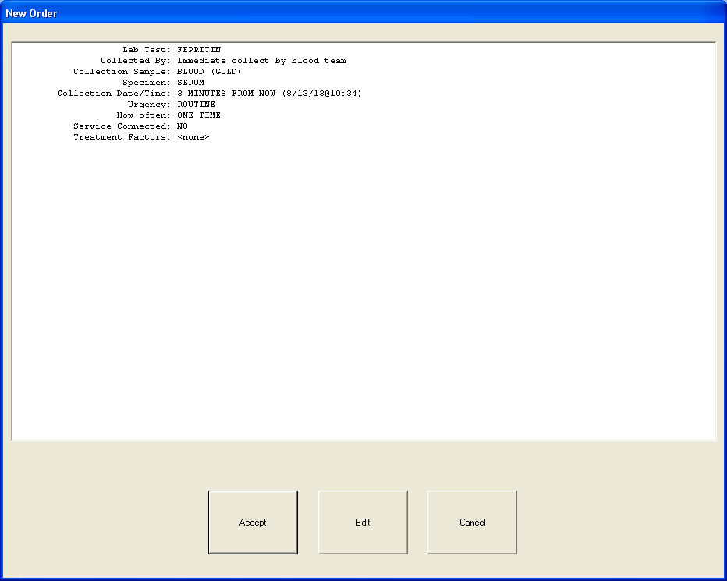
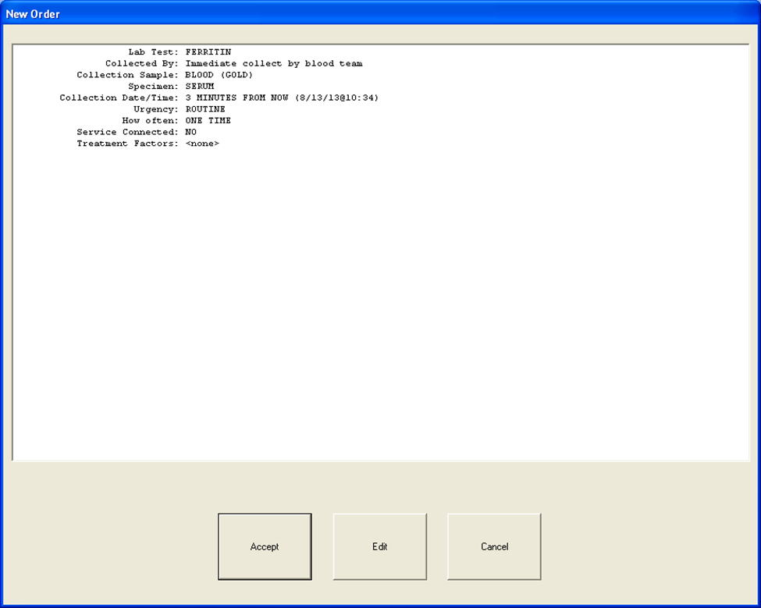
Accept
Edit
Cancel
Notes:
If I had stated Yes for “Verify order” the new order would be displayed. This gives the user the chance to ACCEPT, EDIT or CANCEL the order. Providers can edit parts of the order such as the collection date/time, urgency, and frequency.

Slide 29
Quick Orders
Notes:
Quick orders are both easy to make and quick for users if constructed correctly. Quick orders have limited flexibility and have certain prompts based on the type of order you are creating. For additional information and specifics on the individual type of quick orders and prompts available see the handout Creating Quick Orders which is available in the Downloads Section, just click on the green download icon above my head. A big thank you to Jeff Fahner, Clinical Applications Coordinator, Richard L Roudebush VAMC, Indianapolis and VA-IDEA for allowing me to share this great resource.

Slide 30
Quick Orders
Generic Orders
Notes:
Now we move on to brief overview of generic orders. So what is a GENERIC order? Nursing and activity were common uses for generic orders. They are text orders. A generic order allows a user to quickly order an item for a patient similar to a quick order however, generic orders allow for more flexibility and creativity in creating orders to meet a specific unique or specialized need. In fact a generic order is not very generic. The informaticist has the ability to define and create:
Drop-down prompts that point to FileMan
Unique text and work processing prompts
Unique drop-down menu prompts
Choose specific orderable items such as the one we created earlier and
Allows attachment of TXML templates to orders
This allows creation of generic orders that can be tailored to meet many unique situations. In this class we can only scratch the surface of the multiple ways to use generic orders but plan to offer a future vVEHU class dedicated to generic order creation. So let’s get BACK TO BASICS and look at the basic makings of a generic order.

Slide 31
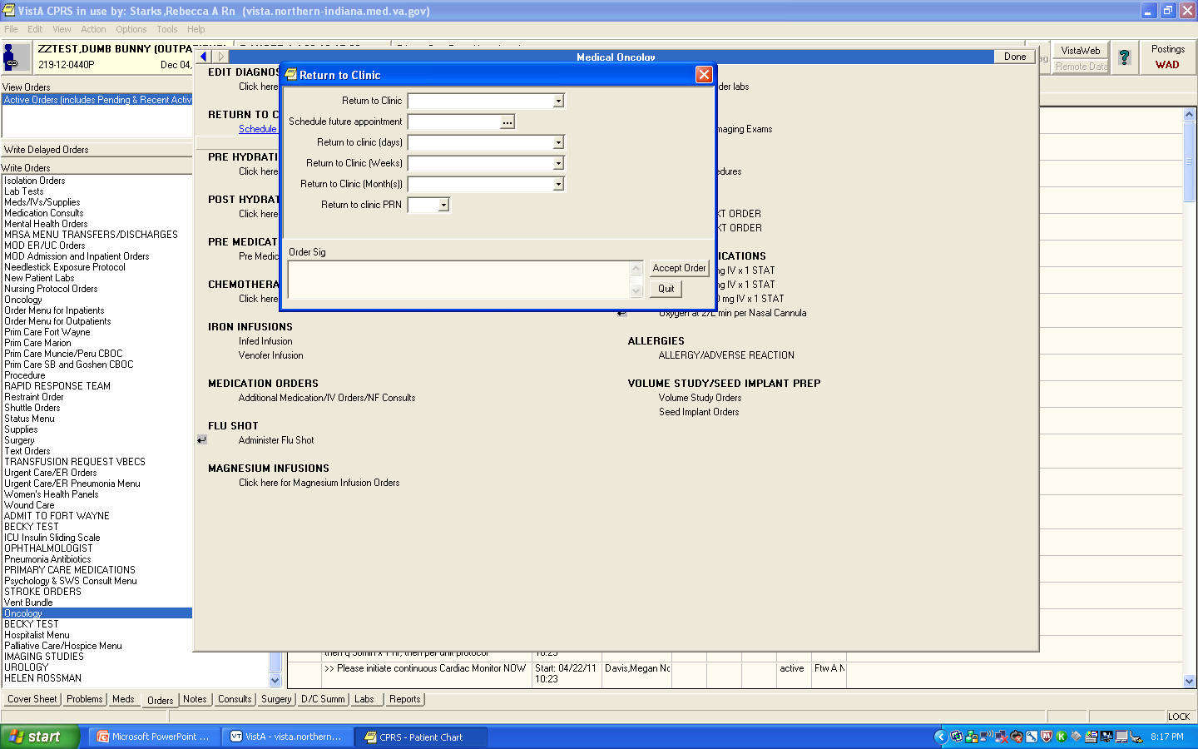
Notes:
This is an example of a generic order for users to specify when a patient should return to clinic. In this example prompts were created with drop down boxes as noted by the down arrow to the right of the box. The informaticist creates the unique lists that will show when clicked. In addition, prompts for date and numbers were used. So let’s get started.

Slide 32
Select Clinical Coordinator Menu Option: CPRS CPRS Manager Menu
CL Clinician Menu…
NM Nurse Menu…
WC Ward Clerk Menu…
PE CPRS Configuration (Clin Coord)…
Select CPRS Menu Option: PE
Notes:
As we did previously we start from the CLINCIAL COORDINATOR MENU. Select CPRS or the CPRS Manager menu as shown in the highlighted area at the top and select PE.

Slide 33
AL Allocate OE/RR Security Keys
KK Check for Multiple Keys
DC Edit DC Reasons
GP GUI Parameters…
GA GUI Access – Tabs, RPL
MI Miscellaneous Parameters
NO Notification Mgmt Menu…
OC Order Checking Mgmt Menu…
LI Patient List Mgmt Menu…
FP Print Formats
PR Print/Report Parameters…
US Unsigned orders search
EX Set Unsigned Orders View on Exit
NA Search orders by Nature or Status
CM Care Management Menu
DO Event Delayed Orders Menu
LO Lapsed Orders search
Select CPRS Configuration (Clin Coord) Option:
MM Order Menu Management
Notes:
Then select MM for ORDER MENU MANAGEMENT.

Slide 34
OI Manage orderable items ...
GO Enter/edit generic orders
QO Enter/edit quick orders
QU Edit personal quick orders by user
ST Enter/edit order sets
AC Enter/edit actions
MN Enter/edit order menus
PM Enter/edit prompts
GO Enter/edit generic orders
Notes:
By now this menu should look familiar. You can see the OI and QO that we used previously. During the creation of generic orders we will use two options:
PM Enter/Edit prompts
And
GO Enter/Edit generic orders
Generic order, unlike quick orders take some planning and a map. When you are first working with generic orders you might want to sketch/map out what the order should look like when completed. This will guide you in deciding what prompts or orderable items you will need or may need to make prior to putting the order together.

Slide 35
Set of Codes
Word Processing
Pointer to File
Numeric
Relative Date/Time
Yes/No
Orderable Item
Free Text
Notes:
Prompts are the basic elements or building blocks of a generic order. How the generic order functions is determined by the type of prompts used in building the order. The list above shows the various types of prompts. So let’s start building the prompts for the generic order Return to Clinic

Slide 36
Notes:
In this order we need prompts created for:
Return to clinic- In this case the service wants the PCP/PACT teams name in the drop down box. Then the providers want the choice of specifying a specific date, a specific number of days, weeks, or months or PRN for the return visit.
We will need to have prompts for all the options. Let’s start by creating the PACT teams name prompt which will populate the box RETURN TO CLINIC.

Slide 37
OI Manage orderable items ...
GO Enter/edit generic orders
QO Enter/edit quick orders
QU Edit personal quick orders by user
ST Enter/edit order sets
AC Enter/edit actions
MN Enter/edit order menus
PM Enter/edit prompts
Notes:
On the menu screen select PM Enter/Edit prompts

Slide 38
Select PROMPT: ORZP PCP TEAM vVEHU
Are you adding 'ORZP PCP TEAM vVEHU' as a new ORDER DIALOG? No// y
Notes:
The first menu option is Select Prompt. Since we are creating a new prompt I typed in the naming convention ORZP and used the P to specify that this order dialog was a prompt. Then I named the prompt PCP TEAM vVEHU since I am creating a prompt of PCP team /PACT team for vVEHU.
VistA then asks if I want to add this new order dialog. It is important to note that VistA uses the term order dialog to specify the name of the Fileman file where the prompt will be stored. So in this case, you are adding ORZP PCP TEAM vVEHU as a new prompt, which gets stored in the ORDER DIALOG file. As you can see I selected Y for Yes.

Slide 39
NAME: ORZP PCP TEAM vVEHU//
TEXT OF PROMPT: Primary Care Team
Notes:
The next field is the name. We keep the VistA name and our prompt name the same. Hit ENTER.
TEXT OF PROMPT appears next: I entered Primary Care Team. This is the text that leads the prompt in the order and displays to the user. Hit Enter

Slide 40
TYPE OF PROMPT: Set of Codes set of codes
INTERNALLY-STORED CODE: PI WILL STAND FOR: PACT PINK
Notes:
VistA now asks you for the type of prompt. You may remember earlier I stated there were eight types of prompts:
Orderable item
Numeric
Relative Date/Time
Set of Codes
Word Processing
Free Text
Point to a file
Yes/No
Based on the type of prompt you select, the fields will vary. In this case I selected: Set of Codes. VistA then asked for an Internally-stored code
I remember when I made my first set of codes this terminology was very confusing to me and I was clueless as to what was needed. The Internally-stored code is an abbreviation that is stored in files and represents what you really want on the list.
So in this case I typed the abbreviation (internally-stored code) PI and hit enter. VistA then asks WILL STAND FOR: Here you are defining what the abbreviation of PI really means. So I want PI to stand for the team name PACT PINK so I enter PACT PINK in the WILL STAND FOR field.

Slide 41
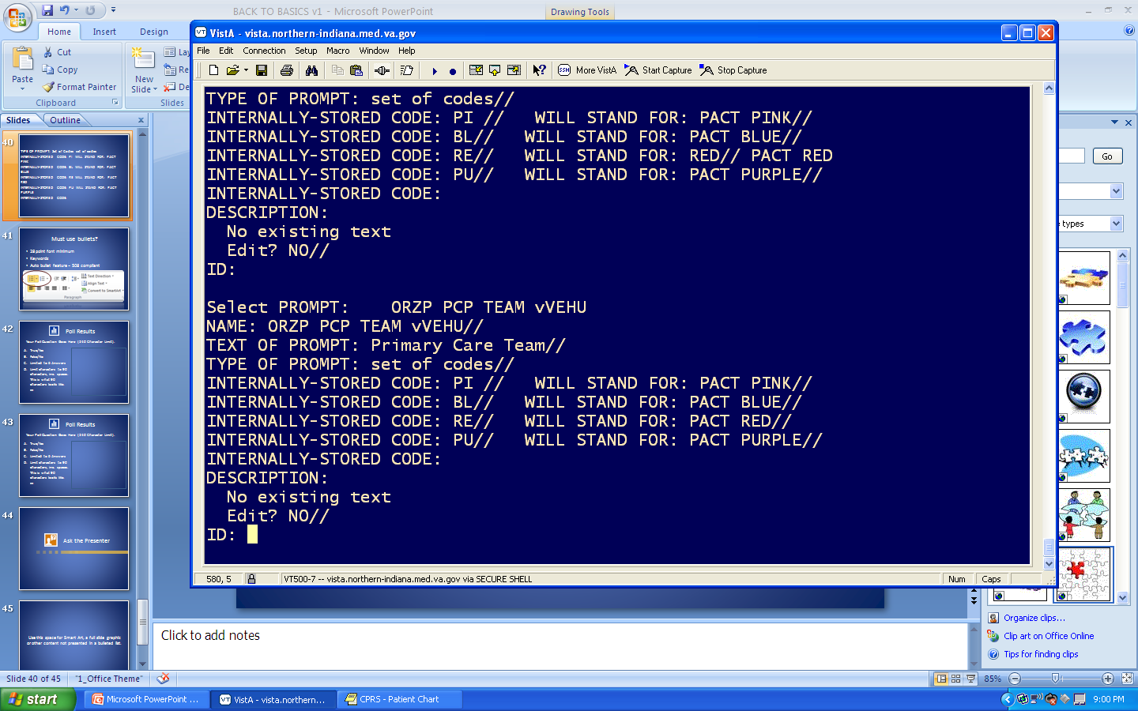
Notes:
After I hit enter VistA asked for another Internally-stored code. You can see I entered BL which stand for PACT BLUE , RE for PACT Red, and PU for PACT Purple . After inputting your final abbreviation/code hit enter twice.
Description is the next field: Like other description fields you can enter a description of the prompt for reference or other information as defined by your site such as date or name of the creator. One note of caution there is a limit on the number of codes you can create in a single prompt. This is based on the total number of characters used in the set of codes and is limited to approximately 250 characters.
Hit enter to move to the next field. This is the ID field. This can be used to create a single name identifier that is placed in the ORDERS file #100 , where it is indexed for quick reference. This is not a required field and I usually leave the field blank.
We have now created a new prompt for a set of codes. Unfortunately due to the limited class time we cannot review or create each type of prompt. In the downloads section, there is a handout created by Jeff Fahner and VA-IDEA that provides additional information on creating each type of prompt for your convenience. An additional resource is the CPRS Setup Guide available in the VistA Documentation Library.

Slide 42
OI Manage orderable items ...
PM Enter/edit prompts
GO Enter/edit generic orders
QO Enter/edit quick orders
QU Edit personal quick orders by user
ST Enter/edit order sets
AC Enter/edit actions
MN Enter/edit order menus
GO Enter/edit generic orders
Notes:
Now we will actually build the generic order. Back on the Order Menu Management screen you now select GO Enter/Edit Generic orders

Slide 43
Select ORDER DIALOG NAME: ORZG RETURN TO PCP vVEHU CLINIC
NAME: ORZG RETURN TO PCP vVEHU CLINIC Replace
DISPLAY TEXT: Return to Clinic//
SIGNATURE REQUIRED: ORES//
VERIFY ORDER: NO
ASK FOR ANOTHER ORDER: NO//
Notes:
As we did previously you enter the naming convention for this new ORDER DIALOG. In the case ORZG (G for generic order) return to PCP vVEHU. Hitting enter returns the name. Here you have the option of replacing/changing anything in the name. If no changes, hit enter.
Now VistA asks for the Display Text: This is what the user will see on the order menu be sure it is clear to the user.
The next field asks if a signature will be required on the order. The choices are
0 or None
1 ORELSE which is usually give to RN’s
2 ORES which is usually given to Providers
If left blank the default is none. In this case they requested that the order be signed by a provider so I entered ORES.
After hitting return VERIFY Order is the next field. You will notice I highlighted this field. That is because you begin to see the how VistA repeats certain fields between Quick Orders and Generic Orders. Just like in the Quick Order this is a YES/NO question. Yes will present the user the dialog for review/NO will not.
The next field ASK FOR ANOTHER ORDER is another YES/NO. Answering Yes asks the user if they want to enter another order when exiting CPRS. This is a field that adds little if any value and often doesn’t seem to function as designed so I usually default to NO.

Slide 44
DESCRIPTION:
No existing text
Edit? NO//
DISPLAY GROUP: CLERICAL//
Select PROMPT: 1
SEQUENCE: 1//
PROMPT: ORZP PCP TEAM vVEHU set of codes DISPLAY TEXT: Return to Clinic
REQUIRED:
MULTIPLE VALUED:
Notes:
Description is next and we have already discussed the uses of this field .
Display Group: Just like in a quick order we select under which “service” or display group the order will be placed.
In this case since this is for making a future appointment I selected Clerical and hit enter
Now we have the opportunity to begin adding the prompt(s) we created. Each prompt must have a sequence number. Referring back to your map or outline of the order we know this is the first field we want in the order dialog or the 1st sequence so I enter 1. When selecting a sequence consider the complexity of the order. You may choose to start the sequence at 5 to allow space for modifications. Deciding the sequence frequency comes with experience and knowing how likely the user is to change a particular order. The more complex the more likely modifications will be made.
Now back to our order. After confirming the sequence VistA now simply returns the word PROMPT: it is asking for the name you gave the prompt when creating it. So we enter our name ORZP PCP TEAM vVEHU. As you type, VistA will search for existing prompt using the characaters you are typing. Keep typing until you see the appropriate prompt.
Display text: This is the leading text for the prompt to display in the order. This can be 1-80 characters; can’t use semi-colons, comma, up arrow, dash, or equal sign. This will override the DISPLAY Text you set when you built the prompt.
Required: “Yes” to make the field mandatory. “No” if you do not want the field to be mandatory.
Multiple Valued: This field determines if the prompt can have multiple values or be used just once.

Slide 45
ASK ON EDIT ONLY: NO
ASK ON ACTION:
HELP MESSAGE: Select the PACT Team for return appt.
DEFAULT:
ORDER TEXT SEQUENCE: 5//
FORMAT:
OMIT TEXT:
LEADING TEXT: Schedule next appointment on
TRAILING TEXT:
START NEW LINE: YES
Notes:
The next section of building the dialog is where as a new CAC I felt lost and confused. You will begin to see why you must understand why you are creating this order and how the end user will need it to function. This is also where the flexibility of a generic order starts to be demonstrated.
ASK ON EDIT ONLY: If you do not want this particular prompt to be asked when initially creating the order enter YES. That would mean the prompt would only show if the user was editing the order. Otherwise you enter no.
ASK ON ACTION: This determines the behavior of the prompt when a particular action is taken on the order. You have four choices
“R”-Prompt displays when the order is renewed
“C”-Prompt displays when the order is changed
“W”-Prompt displays when the order is rewritten
Leaving this field blank means the prompt will always display.
HELP MESSAGE: This is a free text field (1-160 characters) that displays the message when the user hovers over the field. Examples might include “Select the PACT Team for return appt.
Depending on your access level you may see different prompts at this point. You will not see these on the screen. If you have programmer @access you may see the following fields:
XECUTABLE HELP
ASK ON CONDITION
INPUT TRANSFORM To see how these fields function you should reference the CPRS Setup Guide in the VistA Documentation Library.
So why do I mention these fields? Regardless, if you have programmer access the ASK ON CONDITION field can assist when creating generic orders. If you don’t have access, find a new friend with access. Let’s say you are creating an order that would only be relevant with a specific population like female veterans. So if you have a prompt asking if a Veteran is pregnant you may have a programmer insert code here to check the sex of the current Veteran so this order prompt would only be asked for female Veterans.
The next field we see is DEFAULT: Hit Enter –Some Prompts may have selections here that can be accessed by a ??
ORDER TEXT SEQUENCE. This defines the order in which the answered prompts will display in the SIGNED ORDER. This field always defaults to the next sequence number but can be changed. It is important to note that this cannot be left blank or the prompt will not display in the order text in the signed order. This may be different than the prompt order. This is very useful with start and stop dates.
FORMAT is the next field. This field is often left blank but can be utilized for formatting the answer especially dates and pointers. Our limited time prevents further discussion but the options can be viewed by using a ?? and consulting the CPRS Setup Guide.
OMIT TEXT: Enter the specific text from the current prompt that you want to exclude from the SIGNED order. This is an optional field. If I wanted the urgency to be displayed, unless it was “ROUTINE”, I would type “ROUTINE” in this field and “ROUTINE” would not display in the signed order.
LEADING TEXT: Text entered in this field will appear in front of the text entered in the field by the user in the signed order. Example in this case” Schedule next appointment on” could be added. 1-80 characters
TRAILING TEXT: Text entered in this field will appear immediately behind the text entered in the field by the user in the signed order
START NEW LINE: Determines if the prompt should start on a new line in the order. Enter YES or NO
Congratulations! We made it through putting in our first prompt!

Slide 46
Select PROMPT:
Auto-accept this order? NO//
Notes:
PROMPT: If you need to enter another prompt you can start by entering the next prompt number. The next field again asks if we want to auto-accept the order. Remember the rules regarding verify order and auto-accept we discussed earlier.

Slide 47
Select PROMPT: ?
Answer with ITEMS, or SEQUENCE
Choose from:
1 ORZP PCP PACT TEAMS
2 OR GTX DATE/TIME
3 ORZP APPT RETURN RANGE OF DAYS
4 ORZ APPT RETURN RANGE OF WEEKS
5 ORZ PC RETURN RANGE OF MONTHS
6 ORZ RETURN TO CLINIC PRN
Notes:
In creating the order I showed at the beginning I needed to add additional prompts that were created previously. We added prompt number one.
Then I added prompts 2 to 6 repeating the steps for each prompt that we outlined.

Slide 48
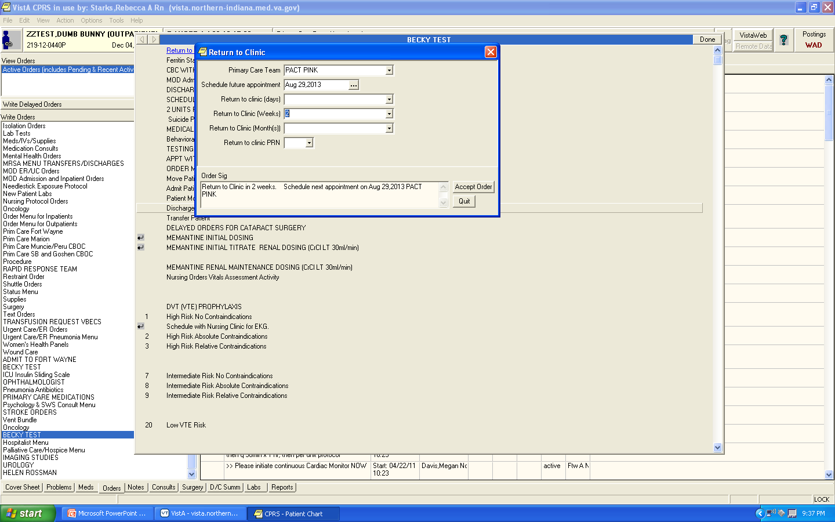
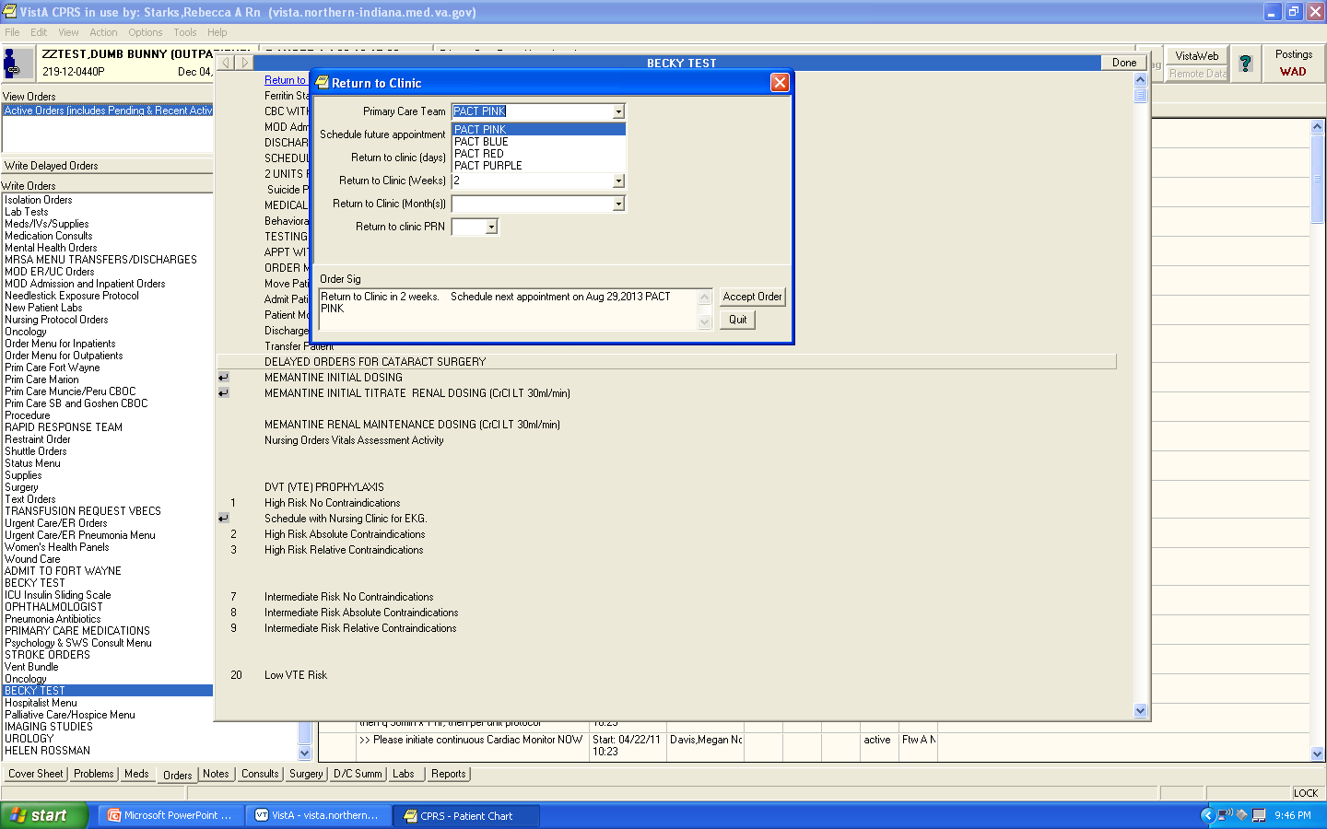
Notes:
Here is the completed generic order we just constructed. You can see the drop down box shows the Primary Care Teams PACT PINK, BLUE etc. we created when we made the prompt. The ORDER SIG shows the selections the user has made; in this case, the provider selected a specific date of August 29 but also specified this was in 2 weeks. We usually think of ORDER SIG being associated with pharmacy orders. In Generic Orders, Order Sig displays the text of the order.

Slide 49
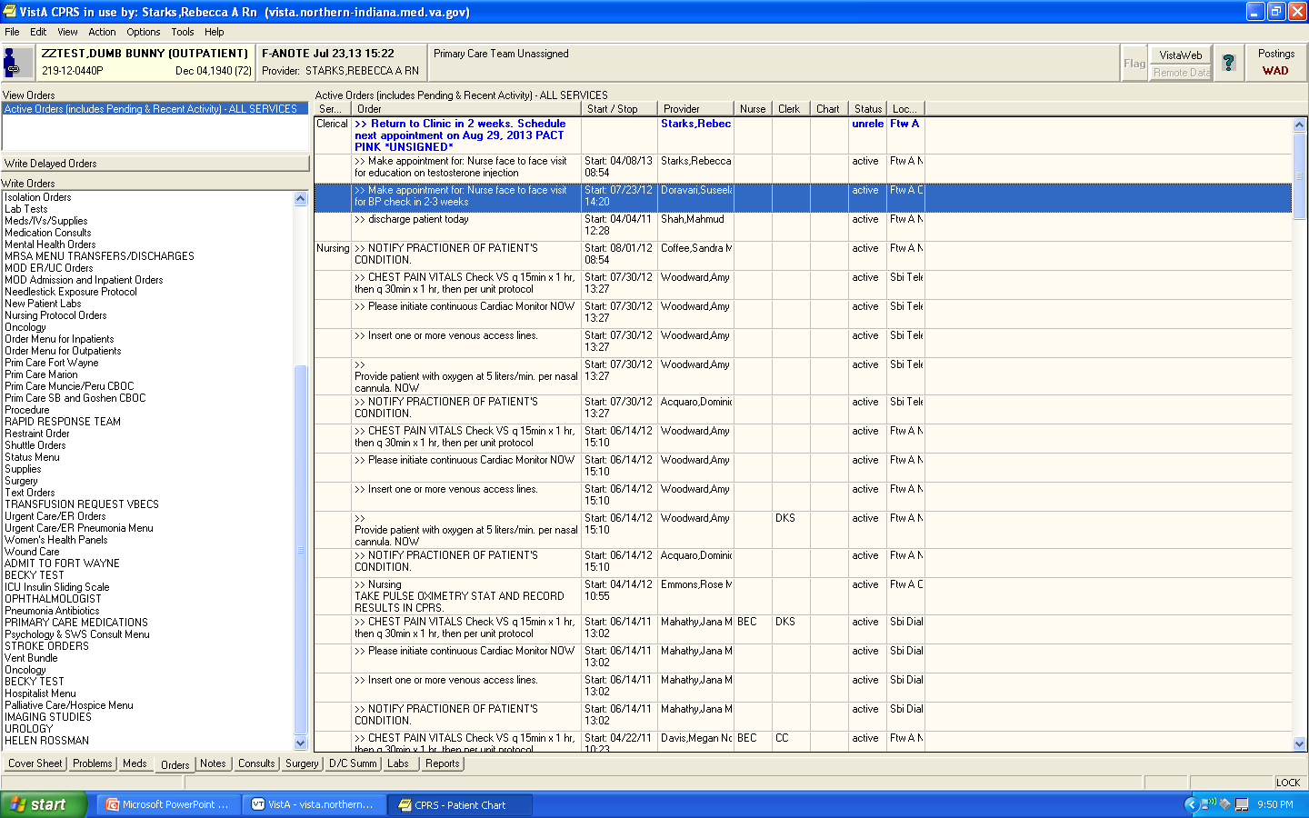
Notes:
Here is the order as it appears on the orders tab. This is a simple example of an generic order. We have barely touched the surface of what can be done with Generic Orders. For additional information click on the download icon.

Slide 50
Poll Question
I learned how to create orders:
  I was taught by an experienced CAC/Health Informatics Specialist with a formalized curriculum
  Learned the VA way-Trial and error
  A combination of a little mentoring and a little trial and error.
Notes:
Now I’d like to ask a poll question.
I learned how to create orders by:
A. I was taught by an experienced CAC/Health Informatics Specialist with a formalized curriculum
B. Learned the VA way-Trial and error
C. A combination of a little mentoring and little trial and error.
To answer this question, use the blue polling icon above my head. We’ll move on and come back to your results in just a moment.

Slide 51
Orderable Item
Order
Order Set/Menu
Notes:
Ok so now we have created an orderable item and two types of orders. What do we do next? Each of these orders could stand alone and be placed on an order menu or within an order set. Order sets are individual orders grouped together so they can be ordered with one click. This allows for standardizing orders for specific diagnosis, such as Emergency Department orders for a new chest pain patient. Order sets can be a combination of quick orders, generic orders, other order sets, and even menus. Let’s briefly look at an order set.

Slide 52
OI Manage orderable items ...
PM Enter/edit prompts
GO Enter/edit generic orders
QO Enter/edit quick orders
QU Edit personal quick orders by user
AC Enter/edit actions
MN Enter/edit order menus
ST Enter/edit order sets
Notes:
Back on the Order Menu Management Screen we now select ST Enter/edit order sets

Slide 53
Select ORDER SET NAME: ORZS NURSING ACS vVEHU
Are you adding 'ORZS NURSING ACS vVEHU' as
a new ORDER DIALOG? No// y (Yes)
Notes:
Creating an order sets takes some planning. Prior to creating the order set you will want to gather the name of each order you need to add and identify the sequence of the orders. VistA asks for the name of the order set. Since this is an order set, I use the name ORZS signifying it is a set and confirm that I am adding the new order set. Order dialog is used here to mean order set.

Slide 54
Do you wish to copy an existing order set? YES// NO
NAME: ORZS TEST VvEHU//
DISPLAY TEXT: ED ACS NURSING ORDERS
DESCRIPTION:
No existing text
Edit? NO//
Select COMPONENT SEQUENCE#: 1
SEQUENCE: 1//
ITEM: ORZ STAT EKG
Notes:
A new option is provided. Do you wish to copy an existing order set? If you have a set and will only be making a few changes you will want to copy the original set, rename it and make the necessary changes. In this case I was making a new set versus revising an existing set so I entered NO.
Display text: Just like when building the order this is what the user will see. In this example I used ED ACS NURSING ORDERS.
Description has also been discussed previously so I skip to COMPONENT SEQUENCE. Each order we are adding is a component of the set.
So I enter the number 1 to enter the first order in the set.
Again the number is echoed back and after I hit enter ITEM: appears. ITEM is the name of the order you previously identified as a component of this set.
In this case the order name is ORZ STAT EKG

Slide 55
ORDER SET COMPONENTS:
1 ORZ GXNURS ACS ER CP VITALS
2 ORZ GXNURS ACS CARDIAC MONITOR
3 ORZ STAT EKG (F)
4 ORZ GXNURS ACS IV ACCESS
5 ORZ GXNURS ACS ER OXYGEN
6 PSO ACS ASPIRIN 325 MG ONCE OP
7 PSO ACS NTG 0.4 MG ONCE
8 ORZ GXNURS ACS NOTIFY PRACTITIONER
9 ORZ STAT CBC ER
10 ORZ STAT BMP ER
11 ORZ STAT MAGNESIUM LAB
12 ORZL CK-MB
13 ORZ STAT TROPONIN I
15 ORZ STAT PORTABLE CXR OP
16 ORZ STAT PTT
17 ORZ STAT PT/INR
Notes:
VistA will continue to offer you the opportunity to add additional sequences/components as you can see in the example above.

Slide 56
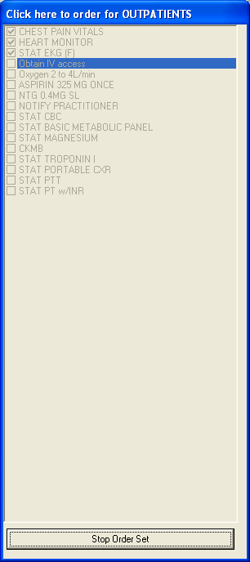
Notes:
Once the order is placed on an order menu and selected CPRS starts to work through the orders in the sequence you defined. The order set appears greyed out to the provider. If an order requires an action to be taken by a provider, the set will momentarily stop and allow the provider to take the action. For exampl, if one of the orders you used in the set requires verification, it would stop and ask the provider to accept the order. Think carefully about the orders you are adding to the set. The goal is for the set to go seamlessly with minimal additional action. Order checks will also stop the sequence momentarily and require the appropriate action and cannot be avoided.
Users also have the option of stopping the order set at any time by selecting the STOP ORDER SET button. This should be discouraged since order sets are meant to standardize care.
Now let’s take a moment and look at our poll results.

Slide 57
Poll Results
I learned how to create orders:
I was taught by an experienced CAC/Health Informatics Specialist with a formalized curriculum
Learned the VA way-Trial and error
A combination of a little mentoring and a little trial and error.
Notes:
Ad lib to poll results

Slide 58
Poll Results
I learned how to create orders:
I was taught by an experienced CAC/Health Informatics Specialist with a formalized curriculum
Learned the VA way-Trial and error
A combination of a little mentoring and a little trial and error.
Notes:
Click to move on.

Slide 59

ORDER MENU
ORDER MENU
ITEM
ORDER MENU
Notes:
So we have now created several pieces in our puzzle and we come to the third piece. The order menu itself. The order menu pulls together everything we have created.

Slide 60
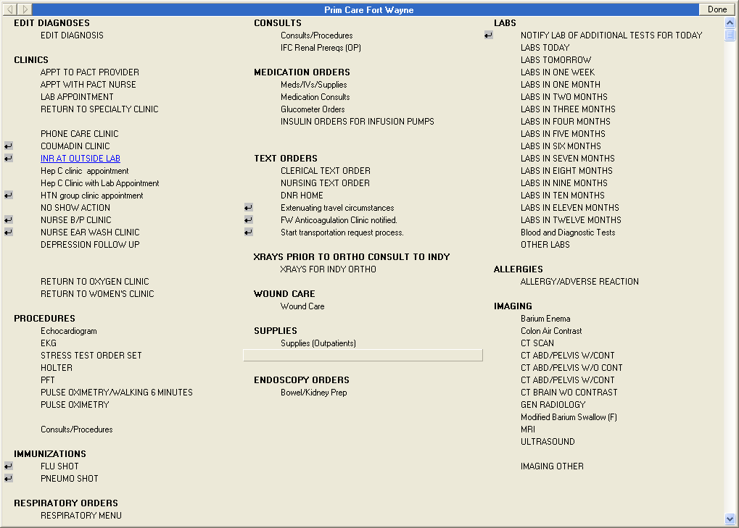
Notes:
Here is an example of an order menu. An order menu organizes the display of order for the users. In this case this provides Primary Care Providers access to the common orders they frequently use. Order menus can contain individual orders, sets of orders, and other order menus. They are accessed off the CPRS orders tab.

Slide 61
OI Manage orderable items ...
PM Enter/edit prompts
GO Enter/edit generic orders
QO Enter/edit quick orders
QU Edit personal quick orders by user
ST Enter/edit order sets
AC Enter/edit actions
MN Enter/edit order menus
Notes:
Back on Order Menu Management menu we now select MN Enter/edit order menus.

Slide 62
Select ORDER MENU: ORZ GMENU vVEHU
Are you adding ORZ GMENU vVEHU as a new ORDER DIALOG? No//YES
Do you wish to copy an existing menu? YES//NO
DISPLAY TEXT: vVEHU Menu
DESCRIPTION:
No existing text
Edit? NO//Y
Notes:
By now you can see that VistA duplicates the basic fields.
Select ORDER MENU: Enter the VistA name for a new menu using your site’s naming convention.
VistA asks if we are adding a new ORDER DIALOG and in this case it is referring to a new ORDER MENU.
Just like in an order set it asks if you want to copy an existing menu? This can be useful and a short cut but if you will be making many changes to the menu starting from scratch may be your best option. I said no in this example
DESCRIPTION: Unlike the previous items, orderable item/orders, you should consider adding a description. Important elements include the date created, purpose and who/what service the menu was constructed for.

Slide 63
COLUMN WIDTH: 40
MNEMONIC WIDTH:
PATH SWITCH:
ENTRY ACTION:
EXIT ACTION:
Notes:
COLUMN WIDTH: This field allows you to define the number of columns that will be seen on the menu by entering the width of each column. There are 80 possible characters.
1 column=80
2 columns=40
3 columns= 26 Keep in mind that the narrower your column the more succinct your display text must be since you have fewer characters available.
MNEMONIC WIDTH: Allows you to define the number of characters permitted for a mnemonic (rarely used).
PATH SWITCH: Allows the user, when traversing back UP the tree of menus and items, to select a new path back down the tree. That means the menu is redisplayed when returning to that menu’s level in the tree and processing back down the tree is possible from that point. If nothing is selected from the menu, the path continues back up the tree.
ENTRY ACTION AND EXIT ACTION are MUMPS code for a MUMPS routine and are rarely used.
We are now done and the menu is created.

Slide 64
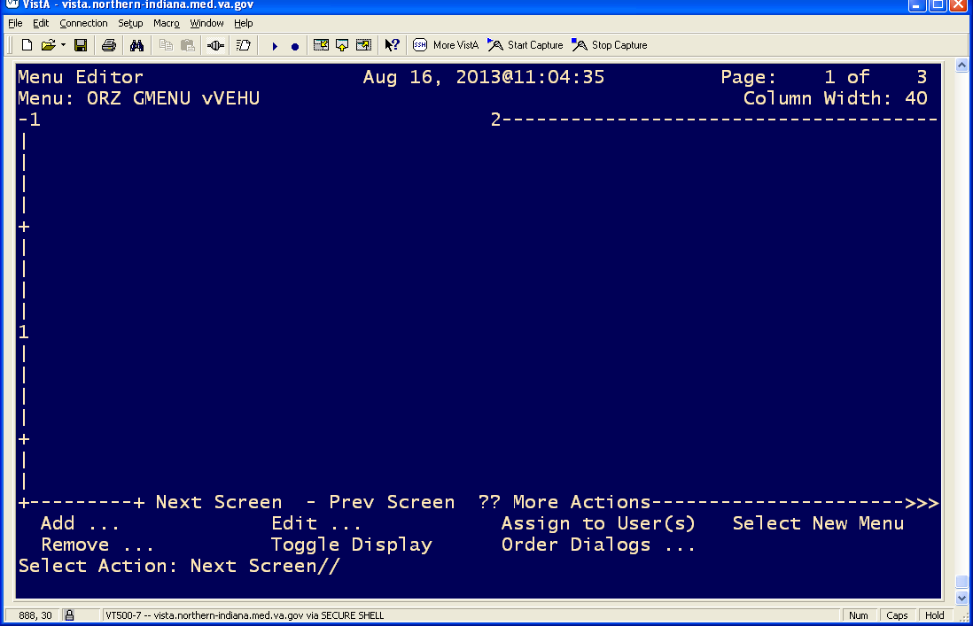
Notes:
The menu is just an empty shell at this point. You see the name on the left and the width of the columns. Below the width you see the numbers one and two signifying where each of column starts. The numbers down the left are the row numbers, each plus sign equals 5 rows and the 1, 2, 3 represent row 10, 20,30 etc.
Now we need to add items to the menu. The options are at the bottom of the menu shell. So let’s select ADD:

Slide 65
Select Action: ADD
Menu Items Text or Header Row
Add: T
DISPLAY TEXT: LABS
ROW: 1
COLUMN: 1
HEADER: NO// Y
DISPLAY TEXT:
Notes:
After selecting Add, we need to decide if we are adding a: Menu Item, a Header, or a Row. In this case we want to organize our menu by putting a header so I selected T for TEXT or HEADER
DISPLAY TEXT: Enter the Header name in this case LABS
ROW: Enter the row number where you want this header. Since this is a empty shell and I want the header in the top left corner of the menu I select row 1
COLUMN: Enter the column number. This will be a number between 1-3. In this case we have only two columns . I select column 1.
HEADER: If this is a HEADER you select YES. This will make the column header bold

Slide 66
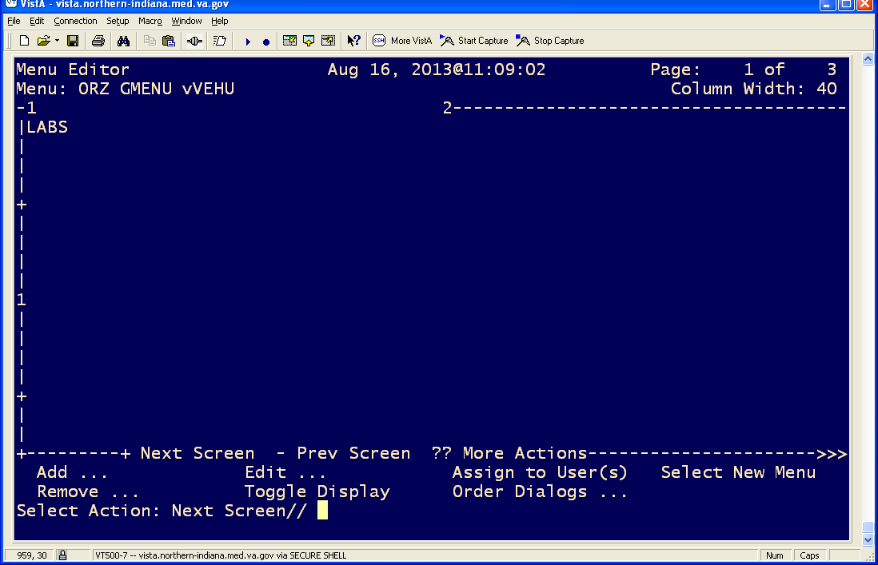
Notes:
This is how our menu looks now. So now we need to add a lab order. Let’s add a CBC.

Slide 67
Select Action: ADD
1 Add ...
2 Assign to User(s)
CHOOSE 1-2: 1 Add ...
Menu Items Text or Header Row
Add: M
ITEM: ORZL CBC WITHOUT DIFF
ROW: 2
COLUMN: 1
DISPLAY TEXT: CBC WITHOUT DIFF
MNEMONIC:
ITEM:
Notes:
After selecting ADD we are asked again what we are adding. Now we want to add a menu item so I select M for Menu Item.
ITEM: I enter the VistA name of the order ORZL CBC WITHOUT DIFF
ROW: Enter the row number where you want this order The header was in row 1 so the next row down is 2.
COLUMN: Enter the column number. Since I want this below the header LAB in column one I enter the number 1
DISPLAY TEXT: Enter the name you want the user to see. HINT: If you know the display name you gave the order originally you can leave this blank and it will default to the original display name. If you are unsure, just enter what you want displayed in this field and this field will override the original order display text.
MNEMONIC: This is optional; you can use the row number if desired.
ITEM: If you are adding additional items you can start adding here. Hit ENTER if done.

Slide 68
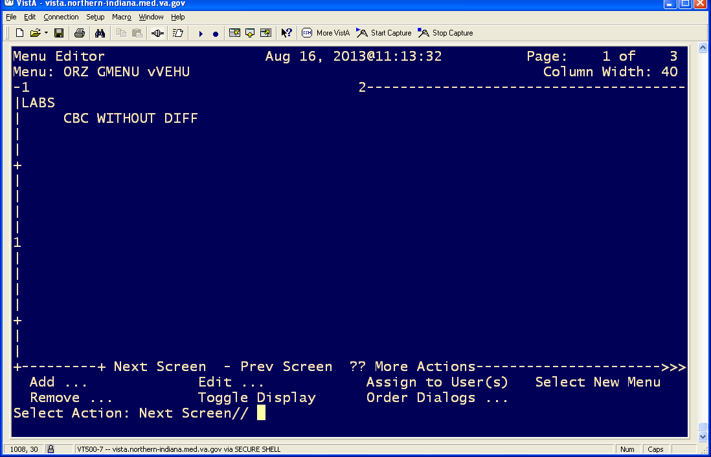
Notes:
Now you can see our header of LABS with our CBC order displayed below.

Slide 69

Notes:
This shows the menu with the display name. If you forget the VistA name select T for toggle.

Slide 70
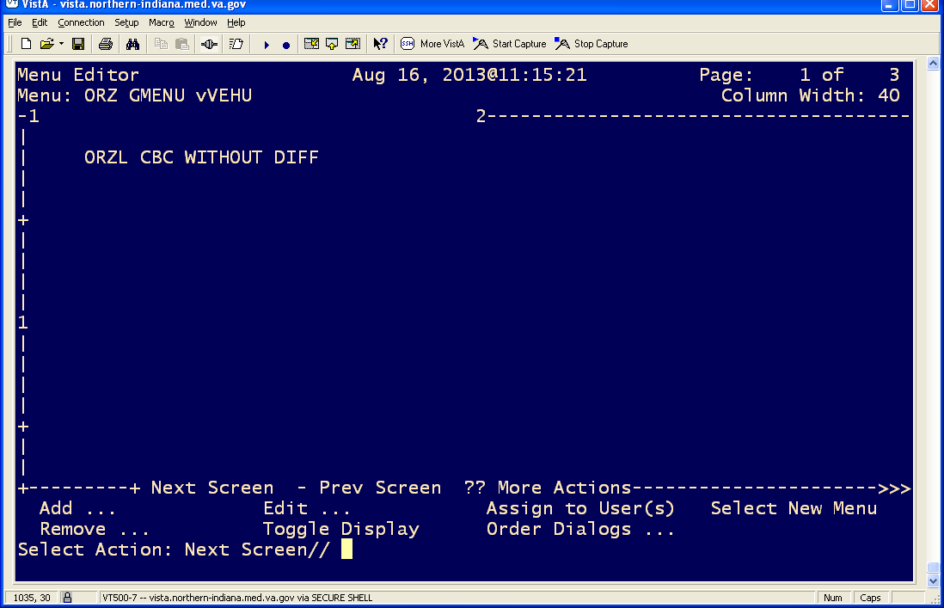
Notes:
You now see the VistA name. You can reverse this process to see the Display name. Note there are additional options available
REMOVE: Used to remove existing items, text, or rows from the current menu. Be careful if you have more than one column and are removing a row. Remember the row spans all columns.
EDIT: Allows editing of the menu configuration such as menu name, column width or an individual item.
ASSIGN TO USER: This is a short cut to the ORDER MENU DEFAULT PARAMETER for user, location, service, division, system or package.
I was creating a menu for use by only specific providers like Oncology and I did not want other providers to have access to the menu I can assign the menu to the specific users directly from this menu as a default menu. You can also use the GENERAL PARAMETER: ORWOR WRITE ORDERS.
ORDER DIALOGS: Allows editing of the following components within VistA. Orderable items, Generic Orders, Quick Orders, Prompts, Order Sets
SELECT NEW MENU: Allows you to view or edit another menu.

Slide 71
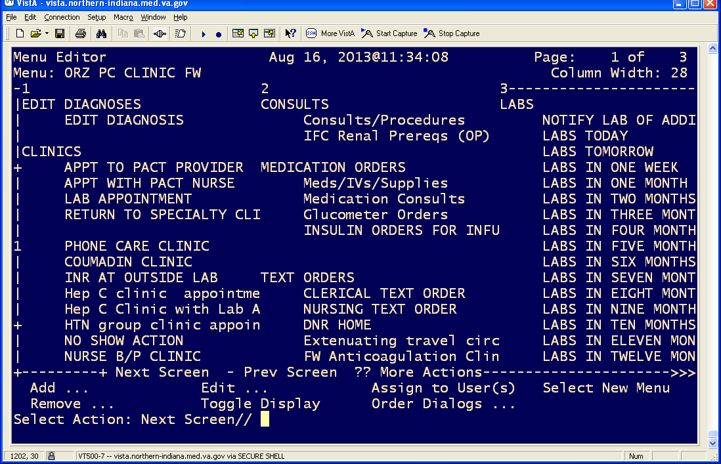
Notes:
Here is an example of the order menu showing the display name.

Slide 72
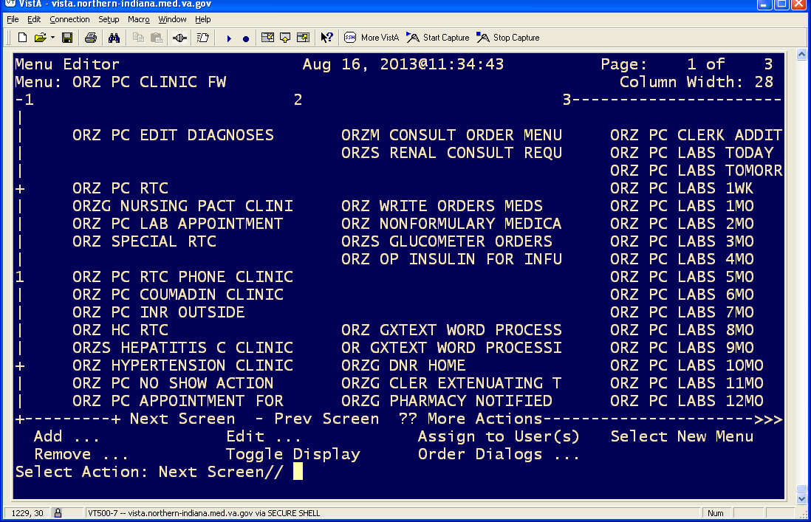
Notes:
By toggling I see the same order menu with the VistA name displayed

Slide 73
Notes:
Here is the same menu as viewed from the CPRS orders tab.

Slide 74
ORDER
ORDERABLE ITEM
INFORMATICIST
ORDER MENU
Notes:
So now we have created several pieces in our puzzle and we come to the final piece. You as an informaticist pull all the pieces together and make sense of the individual parts. You thought carefully about the purpose of the order, the needs of the end user and the service receiving the order. You created all the pieces and developed the order. It may be as simple as quick order to a complex generic order. The end result is that order will provide a Veteran with care needed. Informaticists work tirelessly to make someone's idea reality and many times only another informaticists understands how hard it was. The pats on the back are few. Recently a colleague in Fort Wayne worked tirelessly to create a complex order menu for our consulting Oncologists. A new young oncologist started and she introduced him to CPRS and the Oncology order menu. After his first day he commented to her that he had seen many computerized records but this order menu was the best he had seen. Be proud of the work you do to help provide care for our nation’s veterans. I hope Back to Basics provided at least one or two kernels of new knowledge or ah hah moments that help you along the way. Thank you for sharing the time with me in BACK TO BASICS-Orders Menu Management

Slide 75

Ask the Presenter
Notes:
If you haven’t submitted your questions yet, there is still time to do so by clicking on the orange “Ask The Presenter” icon. We’re going to show a brief announcement and be right back to answer your questions.
(Stand still and smile until you see the video come up full screen)

