Slide 1
Back to Basics: Order Checks
Bethann Greenawalt, MSN, RN-BC
Notes:
Thank you (moderator name)! Good afternoon everyone. I am happy to be here as your instructor for today’s class.
Talk about the pictures…

Slide 2

Notes:
We’re going to go through the order check menu during this afternoon’s class. We’ll focus on a basic review of the options and we’ll also demonstrate how the functionality is viewed by the users within CPRS.

Slide 3

Poll Question
What is your Informatics background?
    New CAC/HIS
    Seasoned CAC/HIS
    Service ADPAC
    Other
Notes:
Before we get to the basics of the class, I’d like to ask a poll question so that I know a bit more about my audience.
What is your Informatics background?
New CAC/HIS
Seasoned CAC/HIS
Service ADPAC
Other
To answer this question, use the blue polling icon above my head. We’ll move on and come back to your results in just a moment.

Slide 4
Course Objectives
Locate Menu
Understand Components
Describe Provider Perspective
Troubleshoot
Notes:
Let’s take some time today to push pause on the hectic day to day operations of a VA medical center and get back to basics.
Our objectives for today’s class are to
Locate the Order Check Menu
Demonstrate an understanding of all components of the menu and their function
Describe order check appearance and the personal order check settings from the provider’s point of view
Convey troubleshooting techniques
If you are a new health informatics staff order checks may be new to you and this could be the class to give you a foundation.
For you seasoned CAC staff this menu may appear familiar but you may use it infrequently, so this may be an opportunity for you to brush off the dust on this menu and remember the finer details.

Slide 5
What are Order Checks?
System of Rules
Criteria Met
Message Displayed
Notes:
So what exactly are order checks? Order checks are based on a system of rules that review an order to see if defined criteria are met. If the specified criteria is met then CPRS displays a specific message to the ordering provider. The provider can then choose to cancel the order or override the alert to continue to place the order.
The menu we will go over, allows for sites to have some flexibility to determine which order checks are sent, what criteria is used to trigger the alert and how important the alert is.
Some examples of common order checks that can be triggered include No Allergy Assessment and Significant Drug Interaction
A No Allergy Assessment order check is triggered if the provider attempts to enter an order for a medication and the allergy window found on the coversheet indicates no allergy assessment has been done yet which means the patient has no allergy data on file and the record cannot check drugs for allergic components.
A Significant Drug Interaction is triggered if the patient is on a medication and then the provider enters another medication order and the new medication order could potentially cause an interaction between the two drugs.
Throughout today’s presentation, we’ll take time to review various types of order checks.

Slide 6
How Do Order Checks Work?
Query CPRS Expert System
Use Other Packages
Enhanced with Data Caching
Notes:
Order checks work by evaluating the requested order against existing patient data. Most order checks are processed via the Order Check Expert System which is based on a set of rules or Medical Logic Modules but a few are processes in the pharmacy, allergy tracking, and order entry packages.
To minimize the system making multiple calls, there are some order checks that, once fired, will not trigger again for 5 minutes.
Data caching is another process used to improve the speed of order checks. The first order check retrieves the patient data from other VistA package and keeps it for 5 minutes in the global. This saves time. An example would be if an order check took 3 seconds to retrieve and there were 12 orders to check, the clinician might have to wait 36 seconds but with data caching the first order check may take 3 seconds but subsequent ones might only be 0.03 seconds for a total of 3.33 seconds.
You can find out more about the order check menu options or parameters in the CPRS Technical manual, Appendix E.
Now let’s pause for a moment to take a look at our poll results

Slide 7
Poll Results
What is your Informatics background?
  New CAC/HIS
  Seasoned CAC/HIS
  Service ADPAC
  Other
Notes:
(Respond to the results, explain to the audience why their participation was helpful, or why it was a good learning point before moving on.)

Slide 8
Poll Results
What is your Informatics background?
  New CAC/HIS
  Seasoned CAC/HIS
  Service ADPAC
  Other
Notes:
Click to move on

Slide 9
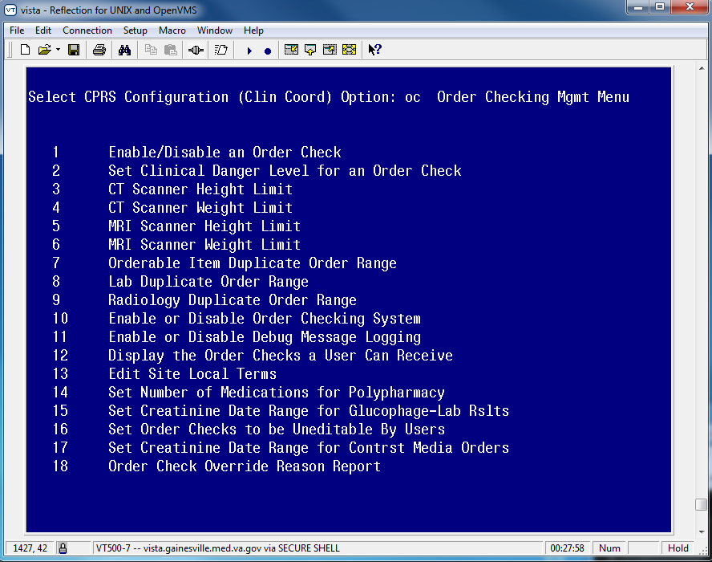
Notes:
No matter where you are from, this is the set of tools you use for Order Checking Management.
To get to this menu you’ll have to follow your menu pathway to get to the CPRS Configuration (Clinical Coordinator’s) menu options.
From there you select the option OC. Your menu should be the same or very similar to the above.
You may notice during your virtual VeHU classes in regards to VistA menu options that yours may vary slightly. It all depends on your facility. Some CACs have different access than others and some sites have created other routines or options that are added on. But in general, the above should be the core Order Checking Management Menu options.
We’ll refer back to this main menu throughout the class today. For many of the options you can make setting changes by user, location, service, division, package or system. One thing I learned while preparing for this class is that parameters that have a “location” are for inpatient locations only. So if you set it for an outpatient location, it will be ignored.
For the purposes of today’s class we’ll make our adjustments at the system level.

Slide 10
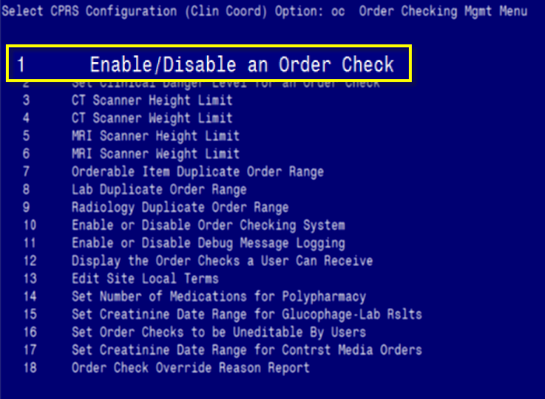
Notes:
We’ll start with the first option: Enable/Disable an Order Check. Option #1
This is the option used to turn on or off individual order checks.
Order checks can be triggered by four main actions:
when the provider selects the order dialog to begin the ordering session
when selecting a specific orderable item
when the provider clicks on the accept button
or when the provider enters their signature code to complete the ordering session

Slide 11
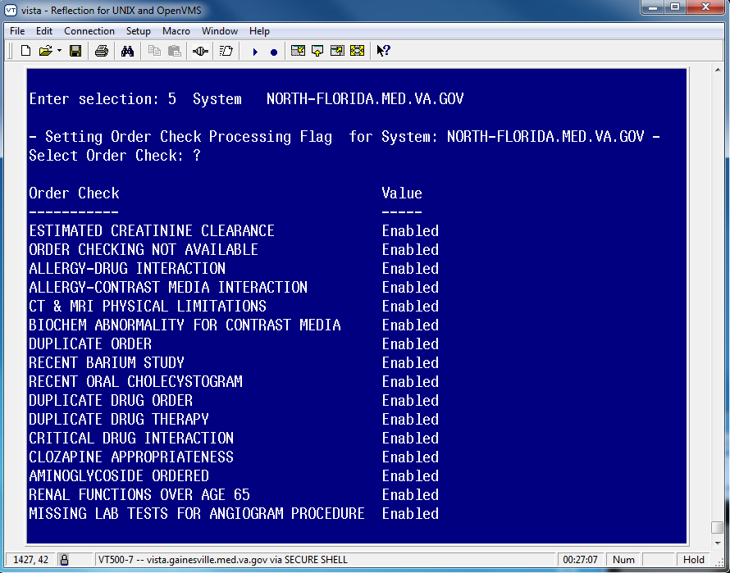
Notes:
As described on the previous screen, we are looking at the settings for order checks based on the system level.
Here I’ve displayed each individual order check and its value.
There are 30 possible order checks. 24 of them had settings marked at the system level at my site. The choices are Enabled or Disabled.
To make a change to an order check, enter the name of the order check at the Select Order Check prompt and then at the value prompt enter your selection for Enabled or Disabled. Only Enabled order checks will be processed.
The order check displayed here is the Duplicate Drug Therapy. It will trigger if medications in the same class or exact same drug ingredient are ordered and notifies the provider of potential problems if the patient takes two medications that are similar.

Slide 12
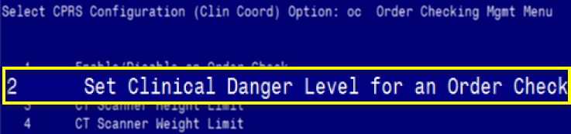

Notes:
We’ll move on to the second menu option called Set Clinical Danger Level for an Order Check
This is where you determine if you want to set a specific hierarchy on an order check and what that level should be. You do not have to set a danger level for each order check.

Slide 13
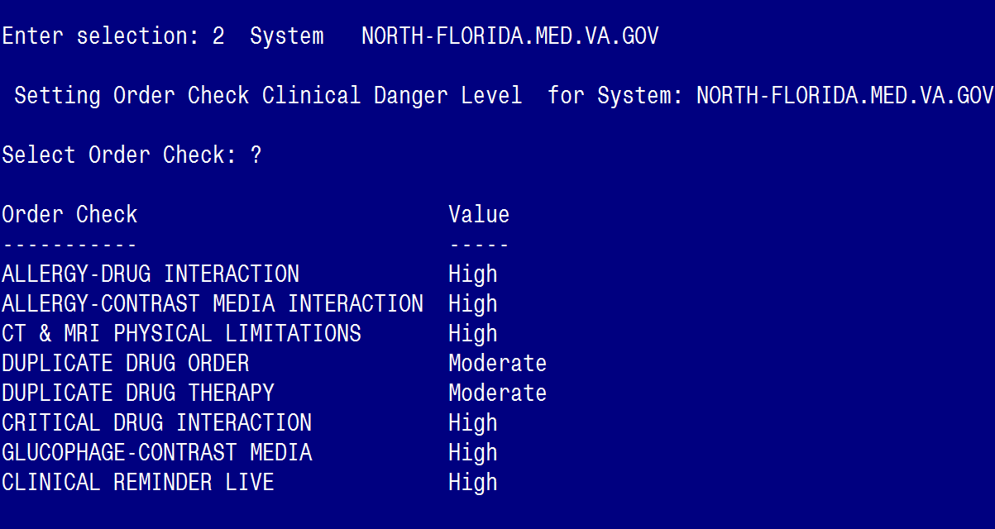
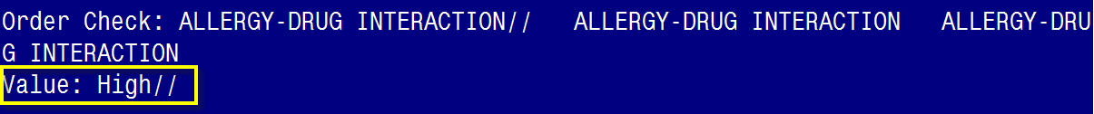
Notes:
I really appreciate being able to enter a “?” and having VistA display the current options and their values.
As you see here, I chose to highlight the Allergy-Drug Interaction order check. This is currently set at high.
The choices are High, Moderate, and Low.
High choices require justification for overriding before signing the order. Moderate and low priority alerts require review but not entry of an overriding notification. Information about these order checks are stored with the order itself which is file #100 in fileman. If an order check is not set here it is a low priority alert.

Slide 14
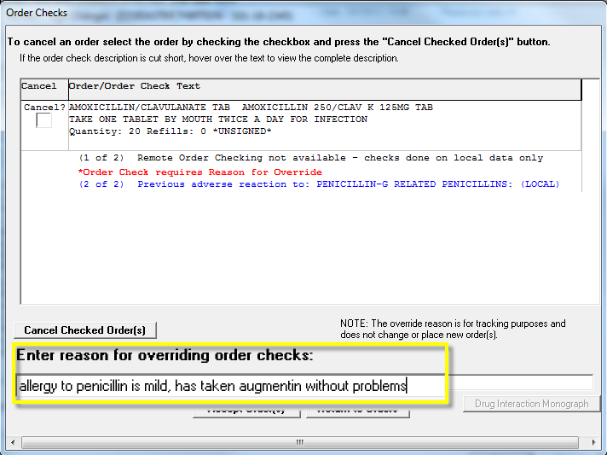
Notes:
This is a display of what the order check override window looks like in CPRS. This appears when the provider attempts to sign the order after they enter their signature code. They have to put information in to the free text field. To get this to appear, I ordered augmentin which is amoxicillin/clavulanate acid on a patient who has an allergy to penicillin. When the order check override window appeared, I entered a comment as indicated on this slide.
The drug amoxicillin is in the same drug class as penicillin so an order check is triggered for ALLERGY-DRUG INTERACTION.
The allergy-drug interaction alert will trigger if the patient has an allergy to the drug that is being ordered or to a related drug class. We encourage users to enter allergies in the national drug file. This allows the order checks to function properly by looking not just for the drug item but also related drugs that could potentially cause similar allergic reactions in a patient.

Slide 15
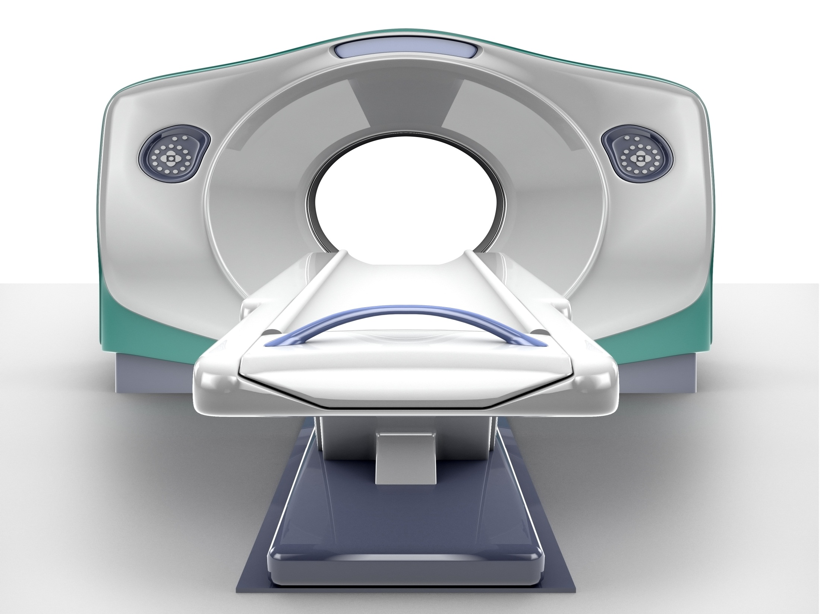
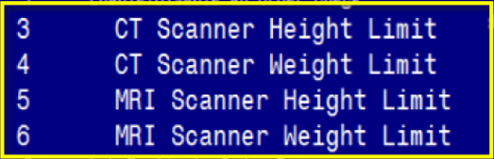
Notes:
The choices 3-6 are related to CT and MRI scanner. These options allow us to set order check alerts if the patient is too tall or weighs too much.
At my site this is set at the system level but you could set it at the division level if you are a multi-division site and have different types of devices at each site that have different parameters. For example, one CT machine at site A could have a weight limit of 350 pounds and a different machine at site B could have a weight limit of 400 pounds.

Slide 16
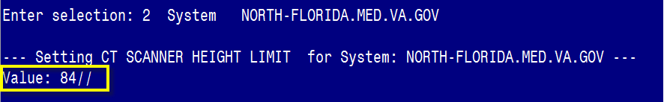
Notes:
As you can see the system level settings are for 84 inches
If you wanted to change the value, after the 2 forward slashes you would simply put in a different number.
Remember to always check to see if your change takes place appropriately by testing in CPRS. In order to test this, you would make your change, then go into CPRS to one of your test patients and ensure that your patient has the characteristics that would trigger the order check. For this example I would add vital signs that make the height greater than the limit of 84. Then you go and enter an order. In this example a CT order in the imaging package.

Slide 17
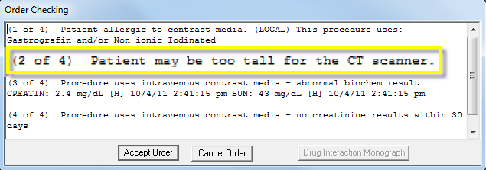
Notes:
This is what it looks like when I went to test the order check. The “patient may be too tall for the CT scanner”
The order check is displayed here after the provider accepts the order. The order check that triggers is called the
CT & MRI PHYSICAL LIMITATIONS and is set at the High Clinical Danger level.
You will also notice that for the test patients I used for examples, other order checks triggered as well. The provider may see several at once in the window. Providers should be educated to review all order checks to allow for appropriate clinical decision making.

Slide 18
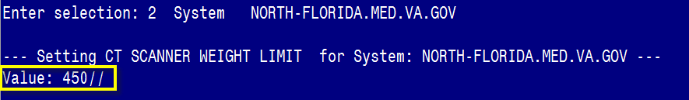
Notes:
The system level setting for weight limit is 450 pounds.

Slide 19
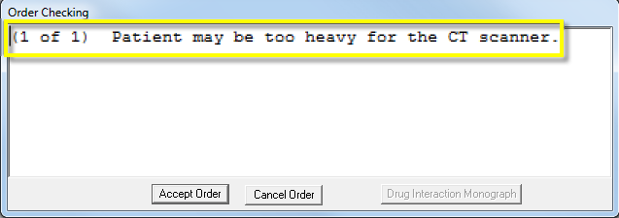
Notes:
The alert triggered for weight is shown here. The “patient may be too heavy for the CT scanner.”

Slide 20
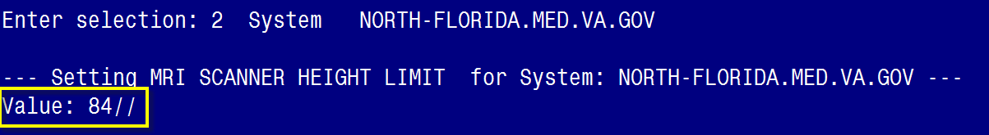
Notes:
We are now viewing the setting for the MRI height limit which is 84 inches at my site.

Slide 21
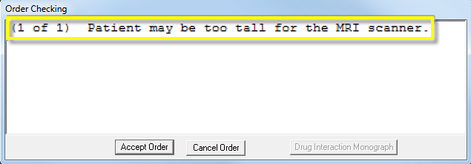
Notes:
And as you can see here, the patient is too tall for the MRI scanner.

Slide 22
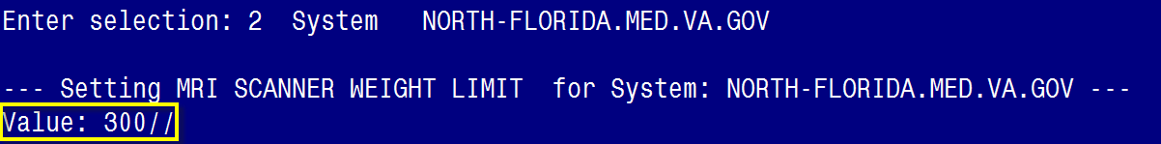
Notes:
And here is the weight limit for the MRI. Notice it is different than the CT scanner weight limit. This is because each machine is set differently based on manufacturer guidelines.

Slide 23
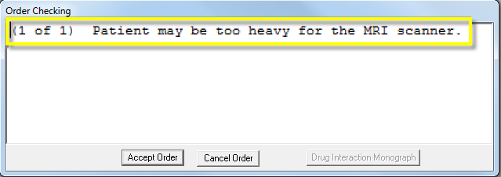
Notes:
And here you can see my patient may be too heavy for the MRI scanner.

Slide 24
Poll Question
How frequently have you modified order check settings?
    Never
    A few times
    Regularly
Notes:
You’ve had some opportunity to see the first few options on the menu. Now, I’d like to know what your experience is with this menu.
To answer this question, use the blue polling icon above my head. We’ll move on and come back to your results in just a moment.

Slide 25

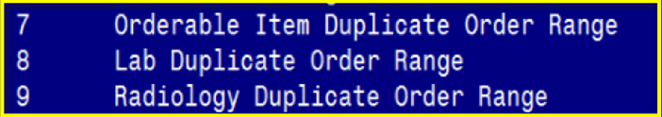
Notes:
We’ll look at duplicate order ranges in the next few screens, options 7-9. They all trigger the alert called Duplicate Order.
These menu options allow you to define a date range the computer will search back through to see if the same order was entered.
If it has been entered in that timeframe the order check will trigger to notify the provider. The provider can then choose to continue with the order if another order for the same item is needed or they can cancel it.

Slide 26
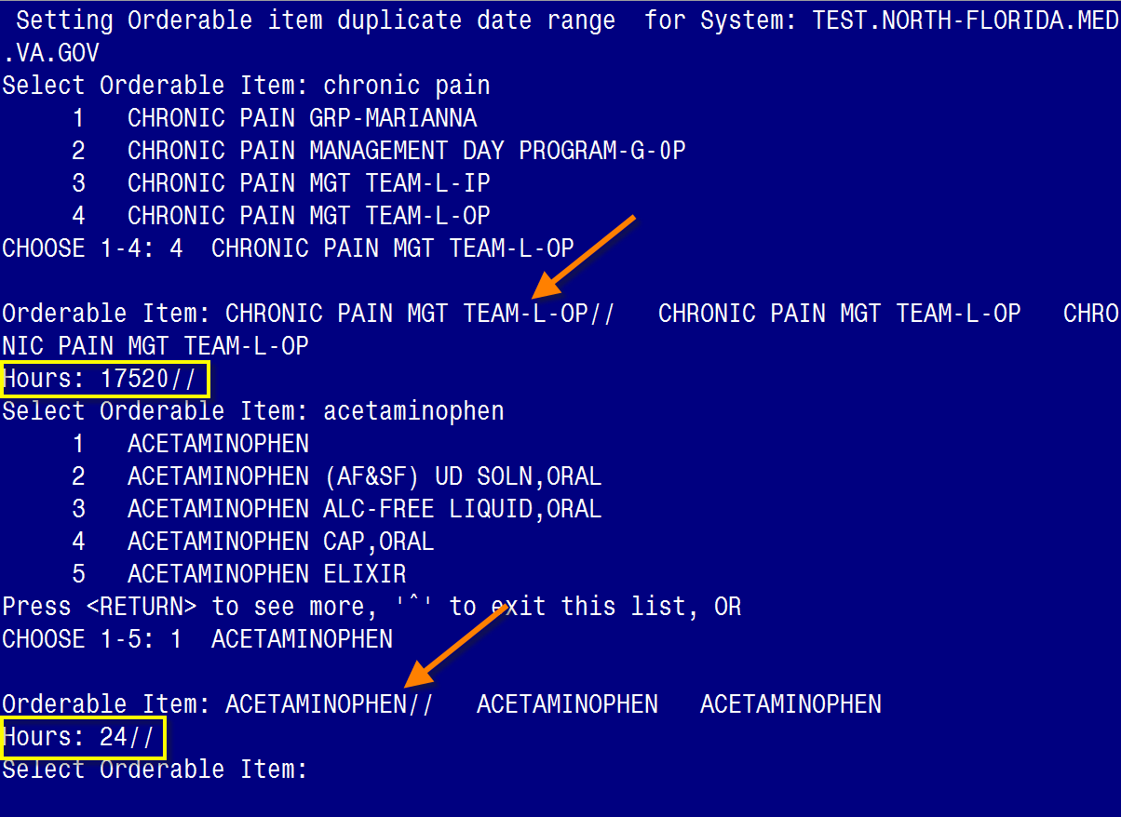
Notes:
The first one we’ll review is the orderable item duplicate order range. This would need to be set for each individual orderable item you wish to have the order check apply to.
The value is in hours so for the orderable item called CHRONIC PAIN MGT TEAM-L-OP which is a consult at my site. It is set for 17,520 hours or 2 years.
For Acetaminophen it is set for 24 hours.
The menu option does not affect medication duplicate order ranges as this is determined within the pharmacy package but if you have specific medication item that you want to address here because you want it different than the pharmacy set value, you can.

Slide 27
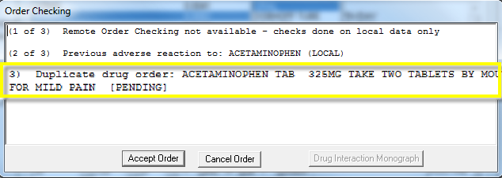

Notes:
This is a screen shot of triggering the duplicate order range for acetaminophen. I did this by writing an order for the medication and signing it and then writing another one. After I clicked to accept my order then this order check came up. You can see there are several in the window but I’ve highlighted the one for the duplicate drug order and at this point I can continue to accept my order or cancel it.

Slide 28
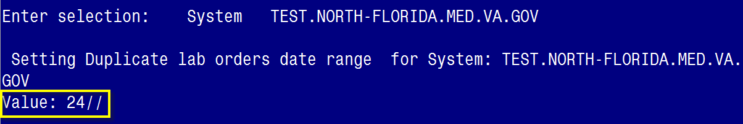
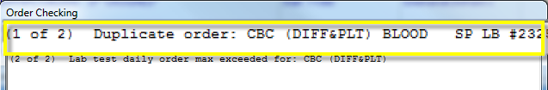

Notes:
The duplicate lab orders range is set across all lab orders. My site has set this for 24 hours and I have triggered the alert for a CBC order.
If you want to set a different number for a specific lab value, you would need to set that under the orderable item duplicate order range option we just looked at. I reviewed this at my site and I found several lab orders with different values. For example, barbiturates is set at 48 hours.
The order check does not apply to orders with a status of canceled, discontinued, expired, lapsed, discontinued/edit, or delayed.
Here’s an example of how you can customize order check settings for your site. Let’s say for the duplicate lab orders date range, the package setting is 48 hours, then you can set your system level at 24 hours and then go to the orderable item menu option (#7 that we described previously) to set a CBC item for 12 hours. This means that if a CBC is ordered 13 hours after the last one no order check would apply. To further customize this you could set an orderable item for CBC at a location level and set the ICU at say 3 hours allowing for greater flexibility.

Slide 29
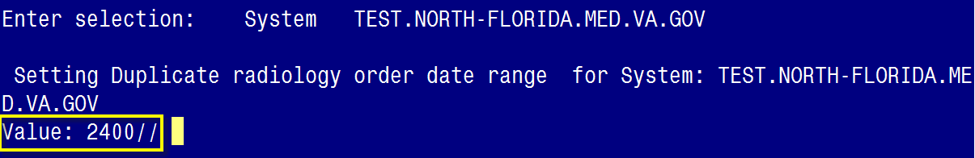
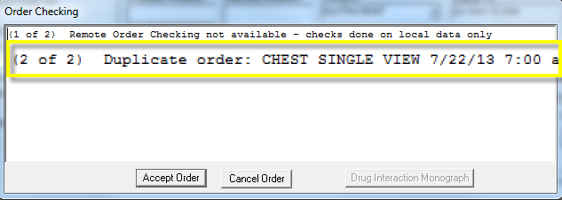
Notes:
Just like the lab duplicate order range set across the whole package, the radiology order date range option acts the same way. In this case it is set for 2400 hours which is 100 days.
Now let’s pause for a moment and take a look at our second poll results.

Slide 30
Poll Results
How frequently have you modified order check settings?
  Never
  A few times
  Regularly
Notes:
(Respond to the results, explain to the audience why their participation was helpful, or why it was a good learning point before moving on.)

Slide 31
Poll Results
How frequently have you modified order check settings?
  Never
  A few times
  Regularly
Notes:
Click to move on

Slide 32
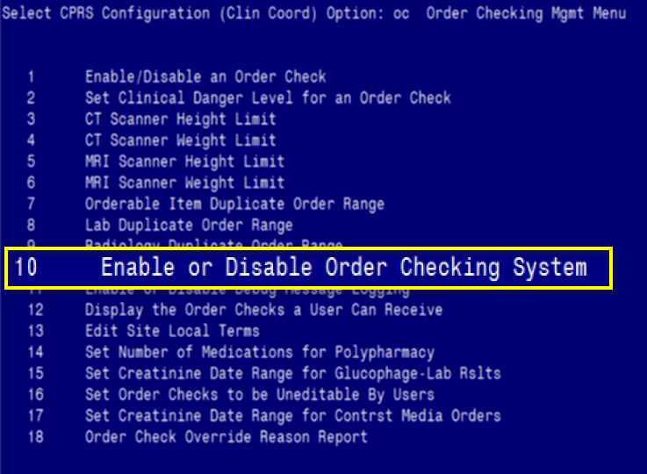
Notes:
Next we’ll take a look at the option to enable or disable the order checking system, #10.

Slide 33
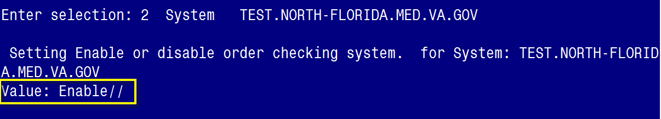

Notes:
This is a very important option to set. It’s like the power button for all order checking allowing you to enable or disable the order checking for your entire division or site. It is important to know about this in the case of a need to troubleshoot a system-wide problem. You may need to turn off order checks for a time to fix this problem.
I don’t have a specific example of when I had to turn off the whole system but it would definitely be a rare occurrence that you would need to do this.
Be sure to carefully monitor use of this option. Many people have made changes to options in VistA unwittingly simply because they were unfamiliar with the option or did not notice exactly where they were going and caused more of a problem than they meant to.

Slide 34
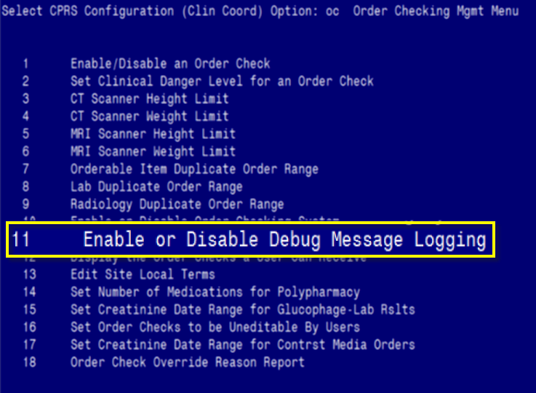
Notes:
The next option we’ll discuss is the Enable or Disable Debug Message Logging

Slide 35
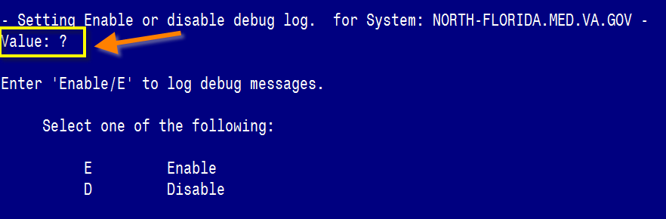

Notes:
As you can see at my site we have a null value in this field. The choices are to Enable or Disable.
If the value is enabled, the logging will collect information about all the order checks as they are triggered. When the debug global exceeds 5,000 entries, oldest entries are killed to make room for adding new entries.
You need to make sure not to use this function unless instructed to by support staff as this could quickly fill up system memory and cause more problems. This function should be used with caution.

Slide 36
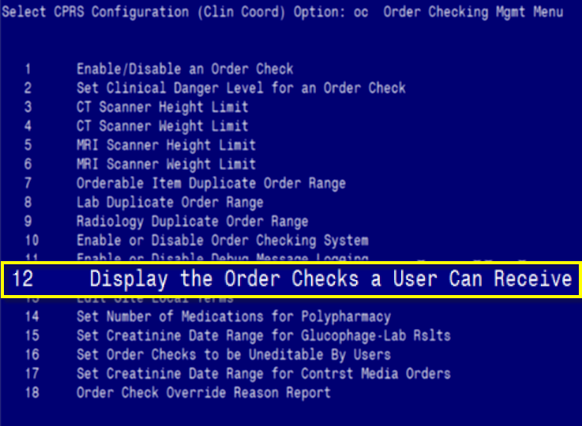
Notes:
The Display the Order Checks a User Can Receive menu option allow us to take a peek at any user’s personal settings for Order Checks

Slide 37
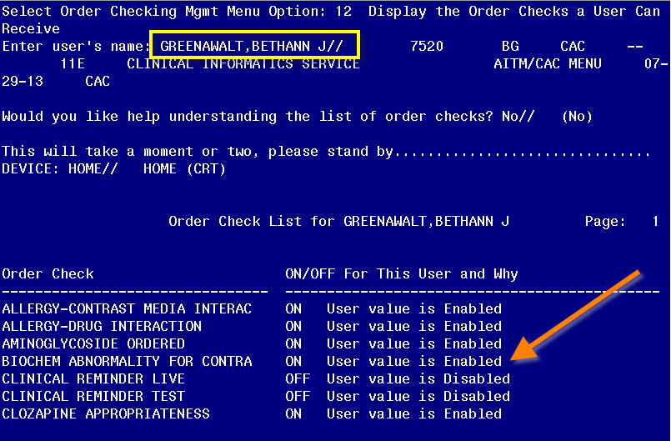
Notes:
The system defaulted to me. At the prompt after the forward slashes you would enter the name of the person you want to review. It is a menu for review only and not for editing. This would be helpful for troubleshooting if you have a user contact you that they are having problems with an order check.
As you can see most checks are enabled and a few of them are disabled.

Slide 38
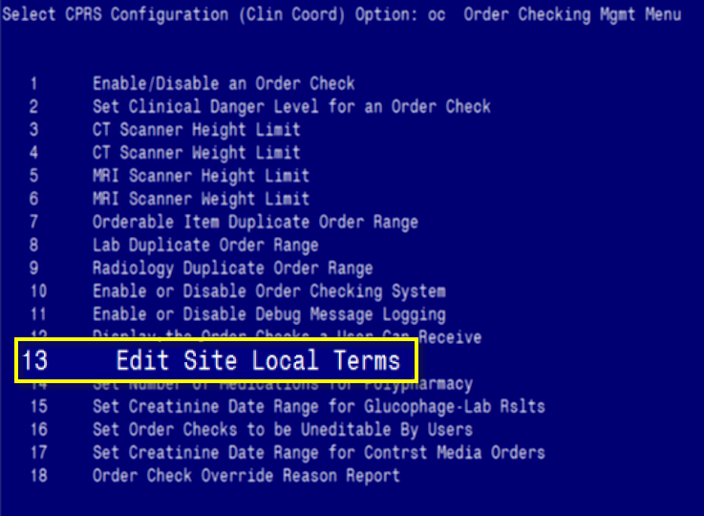
Notes:
Option #13 is to Edit Site Local Terms. This is where you go to map local items to predetermined national terms.

Slide 39
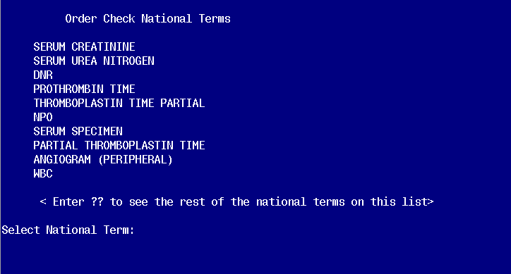
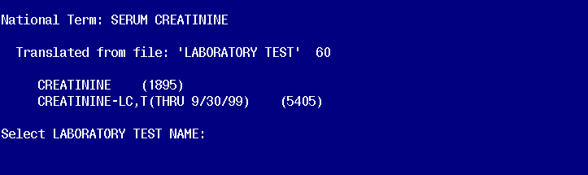
Notes:
This screen shot shows the 10 terms my site has chosen to map locally and then what tests we have mapped to the term for serum creatinine. When mapping any of these terms, you will want to contact the ADPAC of the services involved such as lab or nutrition services.
If you remember a few months ago, there was a patient safety alert to map the creatinine properly because the national term had been determined to have transposed values between Est. Creatinine Clearance and Serum Creatinine.

Slide 40
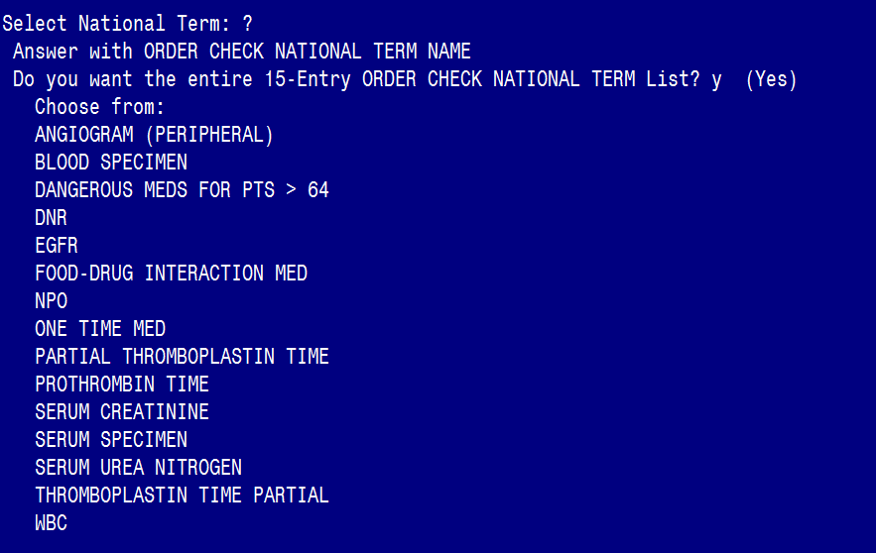
Notes:
Here I typed a “?” to see the list of all the 15 national terms that you can set.
The national terms are tied to specific order check alerts such as DANGEROUS MEDS FOR PT >64. This allows sites that have different names for things to be able to indicate what equates to one specific term. There can be multiple items mapped to one term.
The order check called DANGEROUS MEDS FO PT >64 will trigger after acceptance of orderable items for amitriptyline, chlorporpamide, or dipyridamole. These are meds that could be potentially harmful for older patients and the text that appears in the order check gives guidance to the provider of the problem and alternatives.

Slide 41
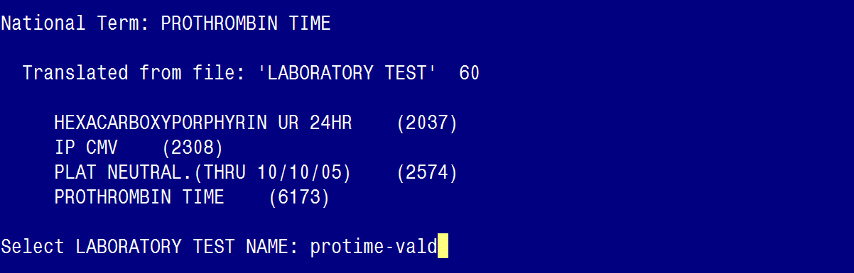
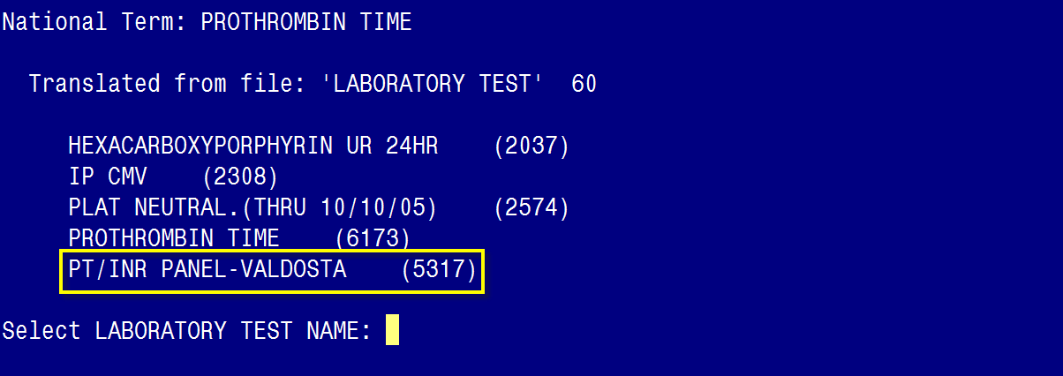
Notes:
In this example, I selected the Prothrombin Time national term in my test account to see what was mapped. To show you how to add to the term, you can see, I started typing a lab test called Protime-Valdosta and as soon as I hit Enter it added it to the list as you can see highlighted in the bottom screen capture on this slide. It did not have an echo-back Yes/No default as found frequently in many VistA options.
In this case, it just added it and as you can see, the name displayed is slightly different than what I typed in. VistA allows for synonyms in many options and I originally found the lab test name as PROTIME-VALDOSTA but here it entered it as PT/INR PANEL-VALDOSTA.
I did find out that you should not map a lab panel to terms. Only individual values.
As you can see here, this is exactly what I did, but in my defense when I searched for a test to add, it didn’t tell me it was a panel until after it was added. To remove it, type the name of the orderable item at the Laboratory test name prompt and it asks you if you want to remove it, with NO as the default. Enter Yes and the item is removed from the national term.

Slide 42
Poll Question
What is the function of the Edit Site Local Terms option?
    Creating new terms
    Mapping to national terms
    Adding to national terms
    Creating new local order checks
Notes:
Let’s take a moment and see if you were paying attention to the last order check menu option.
What is the function of the Edit Site Local Terms option?
Creating new terms
Mapping to national terms
Adding to national terms
Creating new local order checks
To answer this question, use the blue polling icon above my head. We’ll move on and come back to your results in just a moment.

Slide 43
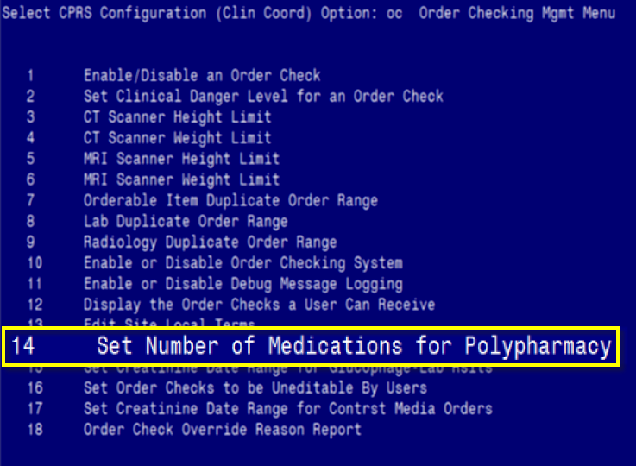
Notes:
Option #14 is the option to Set the Number of Medications a site identifies as Polypharmacy. Polypharmacy is the name of the order check that is triggered if there are too many medications on record. Medications with a status of expired, discontinued, deleted, or renewed are not counted. Supplies are not counted.

Slide 44
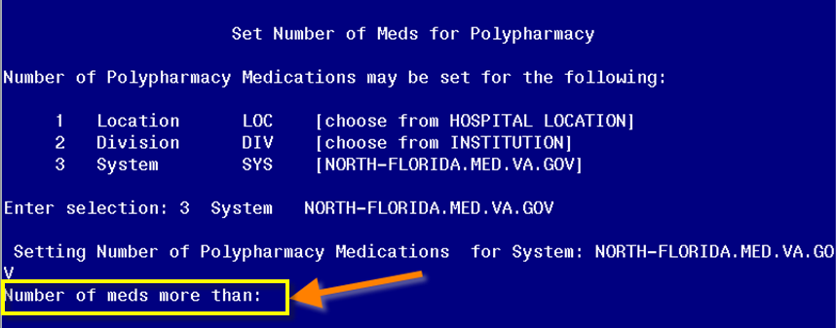
Notes:
Remember I am describing system settings. At NFSG, the polypharmacy order check is disabled so it makes sense that this option would be null here. The package level setting is for 7 drugs. You’ll notice that I do not have the package level settings on my menu options. This may or may not be the case at your site. Remember, each site allows permissions differently. If I needed to change a package level setting, I would contact an OI&T programmer for assistance.
I’m going to put a number of 9 at the system level and enable this alert to show you what the order check looks like when it is triggered.

Slide 45
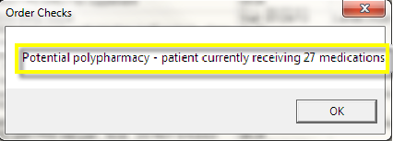

Notes:
This order check appears before the provider actually gets to the medication order window whereas many of the order check alerts appear after accepting an order. The provider will need to click OK or the X button to exit and go ahead to the medication order window. As you can see this poor patient has 27 medications ordered for them.
Now let’s pause for a moment and take a look at results of our poll.

Slide 46
Poll Results
What is the function of the Edit Site Local Terms option?
  Creating new terms
  Mapping to national terms
  Adding to national terms
  Creating new local order checks
Notes:
(Respond to the results, explain to the audience why their participation was helpful, or why it was a good learning point before moving on.)
I can see that most of you have chosen answer B which is correct. We use this option to map our local orderable items, results, tests, etc. to national terms.

Slide 47
Poll Results
What is the function of the Edit Site Local Terms option?
  Creating new terms
  Mapping to national terms
  Adding to national terms
  Creating new local order checks
Notes:
Click to move on

Slide 48
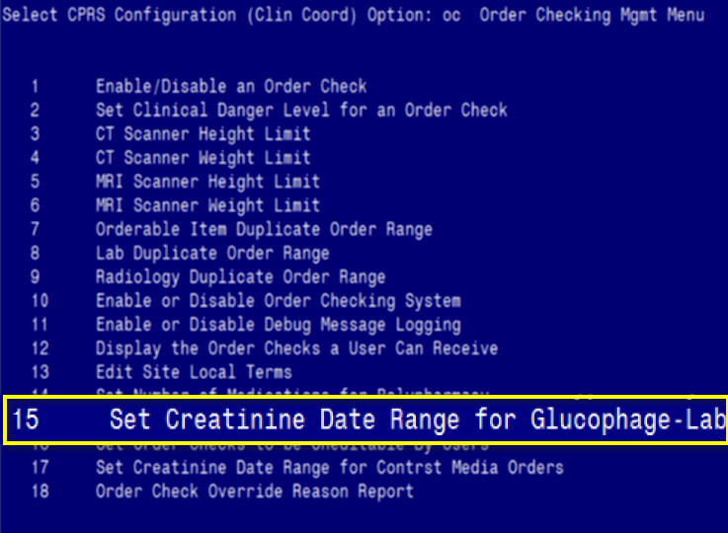
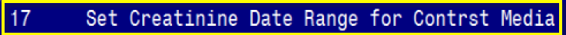
Notes:
Options #15 and 17 are similar so we’ll talk about them together. Both are related to creatinine date ranges.

Slide 49
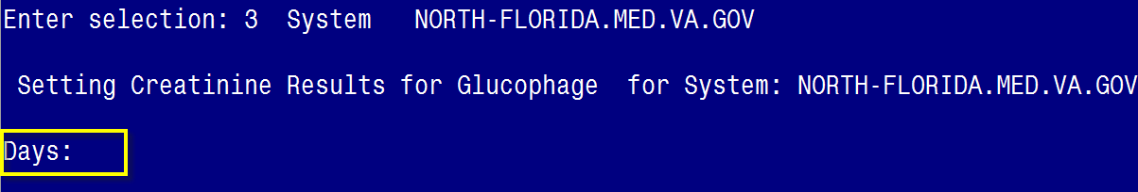
Notes:
This menu option will show the number of days back that VistA will look for a recent creatinine lab result. The order check that is associated with this menu option is GLUCOPHAGE-LEB RESULTS INTERATIONS.
There are two types of messages the provider could see. One if there is no creatinine results and the other if the result is greater than 1.5. The order check triggers when the provider selects a glucophage order.
At NFSG, my site has this set at the package level for 60 days but does not have a system setting level. Since I do not have access to change Package settings, I can’t view this here. In order for me to find out that my site had a package level setting, I went to the general parameters menu. We’ll talk a little more about general parameters later in the presentation.

Slide 50
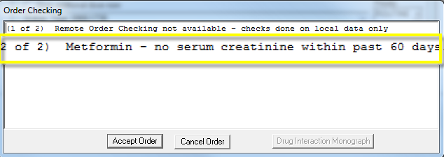
Notes:
Because my site did not choose to set a system level, the package level applies. This patient did not have a creatinine level within the past 60 days. It is important to routinely measure renal function of patients on metformin which is a diabetes management drug. At this point, the provider can choose to continue accepting the order.

Slide 51
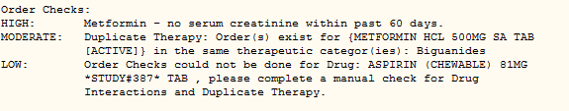
All Order Checks Viewable within Order Details
Notes:
I wanted to show you an example of where you can see a trail of order checks after the order is completed. The information is kept within the order file and the details are displayed in CPRS when you double-click on an order to view the order details. You can see that this particular order check is set at the HIGH danger level. You can also see there are several order checks run on this metformin order.

Slide 52
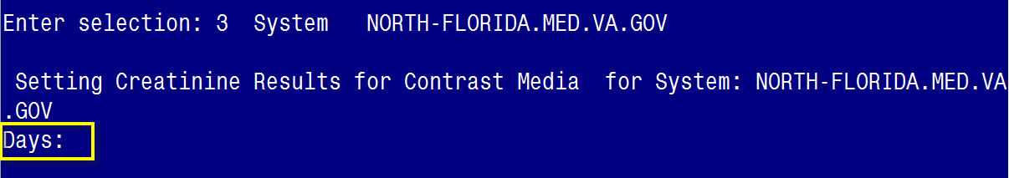
Notes:
The alert for Creatinine Results for Contrast Media can be set for a specific number of days when the computer looks back for the lab result. If there is no lab result within the date range it will trigger the alert for Biochem Abnormality for Contrast Media.
At my site, we’ve left the system level blank. The package level is set at 30 days and was the value that was exported when CPRS was initiated all those many years ago.

Slide 53
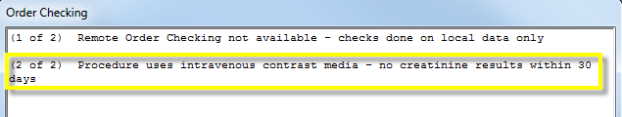
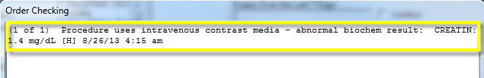
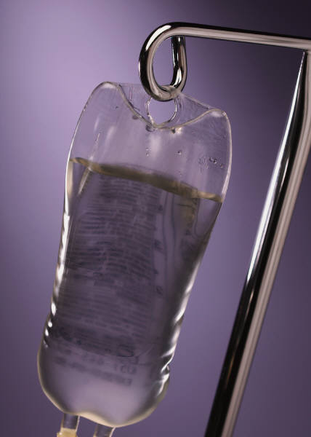
Two potential displays
Notes:
When I ordered a CT scan for the abdomen with contrast and hit the Accept button, if applicable, one of two order check displays could appear.
The top example indicates that the procedure uses intravenous contrast media and there are no recent creatinine results (30 days).
The second potential order check text is also displayed here. It indicates there is an abnormal biochem result and displays the actual level and the date/time of the lab test.

Slide 54
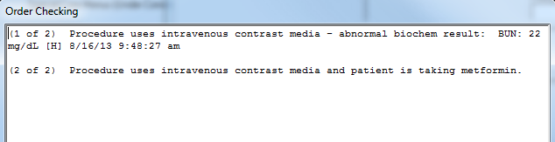
Glucophage & Contrast
Procedure uses intravenous contrast media and patient is taking metformin
Notes:
A related order check that may cause some confusion because it is similar to the last two order checks we discussed. This one is the Glucophage-Contrast media order check and warns the provider that the patient is taking metformin (or glucophage) and that the provider just ordered a radiology item that has IV contrast. The problem that can occur is lactic acidosis and to prevent this complication metformin should be withheld for 48 hours after the IV contrast and then restart if renal function is normal. So this alert helps the provider determine the continued need for the test and counsel the patient.

Slide 55
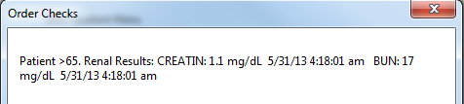

Creatinine Order Checks
Notes:
There are 4 order checks that are directly related to creatinine results. I wanted to take a moment to describe the different alerts because they could be important to your providers and a bit confusing to understand.
Glucophage-Lab Results and Biochem Abnormality for Contrast Media- are the two creatinine order checks we just covered in options #15 and 17 on our order checking management menu.
The two alerts on this screen are in addition to those and trigger when selecting an order dialog so it is viewable to the provider before they even enter an order.
The top one is the Renal functions over age 65- This alert is specific to patients over the age of 65 and simply displays the patient’s BUN and creatinine levels.
The other is the Estimated Creatinine Clearance- The order check will trigger if the value is less than 50 or it cannot be calculated It is calculated using a modified Cockcroft-Gault formula. For more information about this formula, check the CPRS Technical manual.

Slide 56

Notes:
The option to set order checks to be uneditable by users is #16 on our menu and will allow the Informatics staff to determine what options a user can turn on or off for themselves. This would apply to only those order checks that are enabled (remember menu option #1?)

Slide 57


Notes:
If the option for an order check is set for NO here that means the order check is Mandatory. If there is a YES in the value field, then the order check is enabled and the user can keep it enabled or disable it for themselves.
If the user disables the order check even though it is enabled for others, the order check will not be viewed or processed for that user.

Slide 58

Notes:
The last option, #18, on our menu is for creating a report on Order Check Overrides. This an administrative report tool for Clinical Informatics or system leadership staff to review reasons people use to override an order check.

Slide 59

Notes:
There are 5 different reports you can create to display details about order check overrides. In this example, I’ve chosen to look at option #1. You specify a date/time and a person’s name who overrode the order check. I’ve selected just one day and we’ll see the results on the next screen.

Slide 60


Notes:
As you can see it displays a lot of information about the order including the data/time of overriding, the text, the order check that was triggered, and the override reason. The override reason is the information the provider typed into the required field that we described earlier. Remember the override reason is only required on HIGH danger level alerts.
This report is focused on provider behavior in regards to order check management. It does not include the patient name in this report but does include the Order # so if you need to investigate further, you can go to fileman to search the order.

Slide 61

Notes:
We’ll also check the second option which will allow us to search a specific date range and type of order check. The order check I selected here is Critical Drug Interaction.
A critical drug interaction order check connects with the pharmacy package to determine if the patient is currently receiving a medication that will interact critically with a drug the provider just selected for ordering. The message indicates a critical drug-drug interaction and is a high danger level

Slide 62


Notes:
The results of this report are quite interesting. I reviewed several of them before capturing two of them here. Remember, the override reason is a blank text field in which providers can type pretty much anything. It is important to educate providers on what is appropriate to put here.
Being a nurse, I have a general understanding of what should be put here clinically speaking. If a site decides a specific order check is of HIGH danger level, then a reason other than “noted” should be input. I put an example of an appropriate response here as well, “Veteran has been taking medications without any untoward effects”.
Other inappropriate responses I saw on just this one day’s report were: “patient is concerned about refills”, “ARB”, “OK”, or even “GGGG”. Remember this is in response to an order check for a critical drug to drug interaction.
It may be important for sites to review these periodically to determine appropriate educational opportunities or response from pharmacy if inappropriate reasons are entered. Pharmacists also see the order checks and the provider responses before they verify the medication so they so they can follow up with the ordering provider if needed.

Slide 63
General Parameters
Start with ORK
Use LV Option
May Edit
Notes:
I mentioned previously that I had to use the General Parameters to find out some information. Now I’d like to take a short detour to the General Parameter options that are available to you.
A few points to remember are that all of the parameters related to order checks
Begin with ORK
The LV option is to list value and is the safest way to explore the general parameters menu as you won’t be able to accidentally make changes
If you need to edit an option from this menu, you would choose EP for Edit Parameters but the OC menu is the best place to go to make modifications to order checks
To get to the General Parameters menu, you can follow your menu pathway to the CPRS Configuration (IRM) menu. If you don’t have access to this menu, you may still have been given the general parameters as a secondary menu option. I always teach people to use the ^ (up caret) to try to find it so you can type up caret “Gen”.

Slide 64

Notes:
In this screen capture, I chose the LV option and typed in “ORK”. As you can see there is a list of 15 parameters here. These are very similar to the order checking management menu we just reviewed, including options like scanner height/weight limits, polypharmacy, clinical danger level, duplicate orders, etc.

Slide 65

Notes:
On this slide we’re looking at the Clinical Danger Level settings. As you can see here, there are system level and package level settings.
The technical manual indicates that a site should never modify the package level settings for the order check parameters. Sites can change the parameters at the system, division, or other levels.

Slide 66


Notes:
This is an example of a list of the values for the option for Orderable Item Duplicate Date Range. You can see what level the parameter is set at and the instance column displays the orderable item that is identified. The value is the number of hours that the computer will search back for to see if there is a duplicate order.

Slide 67

EP Edit Parameter Values
Notes:
What I’m going to show you now is how to edit one of these order check settings through the general parameters menu. Although you can make changes here, the order checking management menu was created for the CAC to have all the options at their fingertips in one location for easy view and entry.

Slide 68


Notes:
Here I chose to highlight the ORK CLINICAL DANGER LEVEL parameter, also known as option #2: Set Clinical Danger Level for an Order Check.
Remember if you type a “?” you can get the list that is already set.
All I did was type an “N” at the prompt and the No Allergy Assessment was selected and I entered High as the value.

Slide 69

Notes:
This is another example for setting an order check through the general parameter tools menu.
The ORK DUP ORDER RANGE OI is also commonly called the Orderable Item Duplicate Order Range, option #7.
As you can see here, it provides the same levels you have access to on the menu option. At the Select orderable Item prompt you can enter the name of the item you want to set. I typed Metformin and then selected #3. It asks if you want to add this. Enter “Yes” and then it echos back the orderable item with two forward slashes. Then I set the hours at 48.

Slide 70
Remote Order Checks
Allergy Contrast Media Interaction
Allergy-Drug Interaction
Critical Drug Interaction
Duplicate Drug Class Order
Duplicate Drug Order
Significant Drug Interaction
Notes:
Remote Order checks came about a few years ago with the institution of the Remote Data Interoperability or (RDI) project. This allows a site to link with other VA through the data that is kept in the Health Data Repository (HDR) and also with DOD facilities utilizing the Clinical Health Data Repository or (CHDR). There are a limited set of order checks available specifically in relation to medication ordering.
They include: Allergy Contrast Media Interaction, Allergy-Drug Interaction, Critical Drug Interaction, Duplicate Drug Class Order, Duplicate Drug Order, and Significant Drug Interaction
With the RDI, order checks are run against remote outpatient medications for all active outpatient meds or those that are expired or discontinued less than 30 days in the past.

Slide 71


Notes:
Here we see two different remote alerts.
The first shows an order check for an allergy to a drug that was entered at a Remote site. Note that if the allergy is marked at the local site and a remote site it will say in the parenthesis both local and remote. In this case, I was trying to show the value of having an allergy at another site, not the local one, so that way when the provider enters an order for a medication that they think is OK because there is no allergy identified locally, they are alerted to a potential danger by the remote site.
The second order check was chosen not just for the fact that there was a previous adverse reaction. It also triggered an alert for Duplicate Drug Order Check and in this case it actually displays the site name here.

Slide 72


Notes:
If CPRS does not receive a response from CDS (the Clinical Data Service) within a specified time, the above order check will display.
The reasons why this may happen are that
-HDR could be down
-There could be a LAN/WAN problem at your site
-The patient may not have a national identifier. The patient has to be matched with MPI (master patient index) for the remote order checking to take place.
This screen capture was taken from the test account as an example of what happens when remote order checking is not available. If this alert comes up in your live account, make sure that you can replicate the problem or find several other people who have this problem, and then enter a report to the national helpdesk.

Slide 73
Clinical Reminder Order Checks (CROC)
Sites Determine
Use Clinical Reminders
Create Rules to Trigger
Customize Text
Notes:
Clinical Reminders Order Checks, also known as “CROCs,” are specialized ways for a site to create their own order checks.
This process is beyond a basics level course in order checks. But I wanted to take an opportunity to let you know a little bit about clinical reminder order checks.
Each site can determine what clinical reminder order checks they want to create. For example, if a site determines a specific disease or medication needs to be brought to the attention of an ordering provider, the site can create a CROC.
To do this, you use the Clinical Reminders package.
And as the specialist, you would create reminder terms, orderable item groups and then specific rules to these terms that if applied and were true, the order check would appear.
You also get to specify exactly what text appears in the order check window to direct the provider on why the order check is triggered and what to do about it.
The example used in the CPRS User Guide is for narrow angle glaucoma. Create a reminder term for the diagnosis. Then create an orderable item group for antihistamines. When a provider orders an antihistamine on a pt. with narrow angle glaucoma the order check appears that says that the use of first generation antihistamines is contraindicated in the presence of narrow angle glaucoma.

Slide 74

Notes:
This is an example of the national Clinical reminder order check for Teratogenic Medications.
There is a large list of medications or drug classes that are identified as potentially causing untoward effects on a developing fetus. The alert triggers for any drugs that are in this term for females age 12-50 who do not have a hysterectomy or IUD. There is potential they could be pregnant. The alert makes the provider aware that pregnancy should be determined and counsel the patient that contraceptives should be used and if they do become pregnant, they should notify their provider right away.

Slide 75

Notes:
This is another example of a customized local clinical reminder order check for patients who have an iodine contrast allergy and the provider is ordering a radiology exam that will contain contrast media. While there is a current allergy-contrast media interactions order check that is triggered, there is not a lot of information. This customized CROC allows our site to insert extra information to alert the provider to this important situation and tells the provider what to do in this circumstance.

Slide 76


Notes:
Here is another example of a local one my site has been working on. G-6-PD is a hereditary disease that can cause hemolytic crisis if they receive certain drugs. This order check was created linking the diagnosis of G-6-PD and the group of drugs that could cause blood cells to be destroyed. If the provider orders one of the medications, this order check appears and gives the important information to the provider.

Slide 77
Personal Order
Check Settings
Review
Modify
Notes:
Remember option #16? Set Order Checks to be Uneditable by User.
This is one of the options that affects the order checks a user can receive or choose not to receive. We’re going to take a look at how clinical staff can review and then modify their own order check settings.

Slide 78

Tools Menu
Options
Notes:
To make the modifications, the user needs to go to the Tools menu and then choose options.

Slide 79

Order Checks Tab
Tools Menu
Options
Notes:
In the window that appears, the user will select the Order Checks tab.

Slide 80

Notes:
This window displays some of the available order checks a user can receive. Option #1 on our menu was to Enable/Disable an Order Check. If an order check was disabled then it would be disabled here. If the option is enabled and then marked as uneditable, it shows up here as Mandatory. If an option is enabled and marked editable with menu option #16, then the user can turn the order check on or off depending upon personal preference.
On this screen capture several options are “Off” and unchecked.

Slide 81

Change by checking the box
Click Apply to save changes
Notes:
Now on the bottom of this slide, you can see that I’ve checked the ones that were editable by user and they are now “On”. Be sure to click apply to save the changes you made.
In the case of my facility, you can see that most of the options are marked as Mandatory.

Slide 82
Troubleshooting
Unwanted
Unwanted
Locating
Updating
Notes:
Let’s take a few minutes to cover some examples of calls you may receive with order checks.
You could have problems with order checks that are Unwanted, Missing in action, providers who have difficulty locating information, and a lack of order checking being updated timely.
I’d like to go over these potential sticky points and investigate some possible outcomes.

Slide 83

Unwanted Order Checks
Notes:
You may hear from providers who wonder why they are receiving an order check. They don’t understand why it is coming up. It is an unwanted, annoying order check.
Some of the examples of these annoyances I received from other CACs include saline injection, prescription shampoos, and eye drops. What happens is that frequently the order check that triggers is for allergy-drug interactions and after some careful investigation, I’ve discovered the patient may have had an allergy to an obscure ingredient that is indirectly related to the offending drug causing the order check.
If a provider complains about this type of order check, ask them to provide a screen capture or at a minimum, the order number. You can go into CPRS to find out in the order details what order check was triggered. You can also go to fileman and inquire into the Order Check Instances file (file #100.05) by the order number. If you still remain unsure what the order check is related to, you can contact your pharmacy to see if there is anything they can do to find the associated drug information. It could be possible there is a mistake in the pharmacy package linking items that do not really belong together.

Slide 84

Missing Order Checks
Notes:
People could call reporting that an order check never appeared when they think it should. We’ll call that a missing order check.
In most cases, providers won’t know that the order check should be there, but there could be a possibility that the clinician thinks an order check should have triggered.
Maybe after ordering an antibiotic, the provider realizes the patient is allergic to another antibiotic in a related drug class but no order check triggered. If they notify you, you can delve deeper and research the chart. Did the person choose an allergy causative agent from the drug ingredient file? If this was done, the related allergy-drug interactions order check would not trigger because it is looking at drug classes and the allergy was only entered as an ingredient.
Basically, any time someone raises a question, the best option is to begin with the patient name, the order, and the order check. From there it may send you down the rabbit hole into other pathways including contacting pharmacy or lab ADPACs. Be sure to take as many notes as you can and use your options to phone a friend, poll the audience or your tools to give yourself a hint.

Slide 85

Locating Order Checks
Notes:
Staff may have trouble locating where they can find information about an order check.
Remember, they can find information out by viewing the order details and see what order checks were triggered, the danger level, the information text and any pertinent information like lab results.
If they don’t understand something, encourage them to call the CAC staff for clarification. Tools that you can use, aside from the order checking management menu, are the general parameters menu, fileman, and content from the va document library (the vdl) as much of the content for this class was found in the CPRS user guide and technical manual.

Slide 86

Updating Order Checks
Notes:
There could be issues that order checks are not triggered appropriately because the order check menu options should be updated. Remember the option to edit site local terms? If the pharmacy or lab package has updated certain items, there is potential that they are not mapped and therefore will not trigger an order check. When that patient safety item came out where we had to check all the mapping of the local items to the national terms, none of the CACs in my service had ever really done this before so it was an opportunity to learn more about order checking and review what was mapped to the terms.
I would suggest that your Informatics team implement a plan to periodically review the settings for many of these order check options. There should probably be interdisciplinary involvement to address issues and ideas. Like I mentioned before, much of what is found on this menu was originally set-up when CPRS began and there is often little need to return to the menu and make changes but routine review can prevent potential problems related to order checks.
It is important to have a general knowledge of this menu so that you are equipped to answer the periodic questions that can arise leading you to poke around this menu to see what your site has for current settings, problem solve and come up with appropriate resolutions.

Slide 87

Ask the Presenter
Notes:
Now that we are drawing to the close of our class, we’ll have time for you to ask some questions and get some answers. Thank you for allowing me the opportunity to present the content on order checks today.
If you haven’t submitted your questions yet, there is still time to do so by clicking on the orange “Ask The Presenter” icon. We’re going to show a brief announcement and be right back to answer your questions.
(Stand still and smile until you see the video come up full screen)

