Slide 1
Back to Basics: TIU/ASU
Rikkita Hughes
Notes:
Thank you (moderator)! I am happy to be here today.
--During this session I will be talking about the basic menus of the Text Integration Utilities also so known as ‘TIU” and Authorization/Subscription Utilities which is also known as “ASU”.

Slide 2
Objectives
The basic knowledge of the purpose of TIU
The basic knowledge of the purpose of ASU
Why they are critical to your clinical and administrative documents used at your facility
Notes:
Although our primary focus during this presentation will be on the TIU Maintenance Menu, I want to ensure at the end of this presentation you will meet these three objectives:
Objectives:
Know the basic knowledge of the purpose of TIU
Know the basic knowledge of the purpose of ASU
Know why they are critical to your clinical and administrative documents used at your facility

Slide 3
Poll Question
How long have you been a CAC?
Less than 1 year
1 - 4 years
5 years
Over 5 years
Other
Notes:
Now before we go any further I would like to ask a poll question.
How many of you viewing this presentation today have been a Clinical Applications Coordinator for:
Less than 1 year
1 - 4 years
5 years
Over 5 years
Other
The reason for this question is to give me a feel for who my target audience is and where I my area of concentration will be for this presentation. I want to ensure that I will assist you with meeting the objectives for this class.
I will give you a few more moments to select your answer.

Slide 4
Target Audience
Notes:
While you are submitting your answer I wanted to review the users of TIU and ASU and the major targeted Audience.
Many users benefit from TIU/ASU but this training will mainly benefit Clinical Application Coordinators (CACs), Automated Data Processing Application Coordinators (ADPACs), and end users such as clinicians, MIS Managers, Medical Record Technicians, and transcriptionists.
We will be discussing the role of the four major groups of TIU in the following slides.
Todays session is a “Back to Basic” training but you can get more extensive information on TIU and ASU in the following documents.
1. Text Integration Utilities (TIU) Implementation Guide
Text Integration Utilities & Authorization/Subscription Utility Installation Guide
Text Integration Utilities (TIU) Technical Manual
Authorization/Subscription Utility (ASU) User Manual
Now let’s take a moment and look at our poll results.

Slide 5
Poll Results
How long have you been a CAC?
Less than 1 year
1 - 4 years
5 years
Over 5 years
Other
Notes:
Now lets check our results to see the level of experience attending our session today.
I see that we have:
a.
b.
c.
d.
e.
I want to thank everyone for assisting me with this poll. Now that I know who is in the audience we will now continue with the presentation.

Slide 6
Poll Results
How long have you been a CAC?
Less than 1 year
1 - 4 years
5 years
Over 5 years
Other
Notes:
Click to move on.

Slide 7
What is TIU and Why Do We Need It?
Notes:
What exactly is Text Integration Utilities and its Purpose? Why exactly do we need it?
The purpose of Text Integration Utilities (TIU) is to simplify the access and use of clinical documents for both clinical and administrative VA personnel, by standardizing the way clinical documents are managed. Now, in connection with Authorization/ Subscription Utility (ASU), a hospital can set up policies and practices for determining who is responsible for or has the privilege for performing various actions on required VHA documents.
The initial release of Version 1.0 includes Discharge Summary and Progress Notes. Consult Reports was added with the release of Computerized Patient Record System also know as “CPRS”. TIU replaces and upgrades the previous versions of these VISTA packages. It has also been designed to meet the needs of other clinical application staff that address document handling.
TIU lets you continue to access Progress Notes and Discharge Summaries from Order Entry/Reporting Results (OE/RR) menus. The CPRS Graphical User Interface or many times referred to as “CPRS GUI” allows point-and-click access to all Progress Notes, Discharge Summaries, and Consults TIU documents.

Slide 8
Notes:
Lets review some of the Benefits of TIU –
a. Standardized and common user interface - allows
Clinicians to go through the same program to enter, review, and sign discharge summaries, progress notes, and other clinical documents that may be set up locally for processing through TIU.
b. Integration is when
Clinicians and management can search for and retrieve clinical documents more efficiently because documents reside in a single location within the database. This is also a benefit for other uses such as Incomplete Record Tracking, quality management, results reporting, order checking, research and many more actions.
c. Data Capture Flexibility is when:
TIU accepts document input from a variety of data capture methodologies. Those initially supported are transcription and direct entry. TIU allows upload of ASCII formatted documents into VISTA.
d. It provide Links to Other Packages which allows
TIU to interface, as appropriate, with such applications as Health Summary, Problem List, Patient Care Encounter/Visit Tracking, and Incomplete Record Tracking. CPRS further integrates VISTA packages and allows point and click switching between packages.
e. Another benefit is Improved management of Documents.
TIU has a file structure called the Document Definition Hierarchy for defining elements and parameters of a document. It allows:
Inheritance of document characteristics, such as signing, cosigning, visit linkage
Site definition of document characteristics
Shared components
Ownership (personal or class) of document definitions
Boilerplate text functionality
Interdisciplinary Note functionality.
Embedded “Object” functionality which can extract data from other VISTA packages and insert it into boilerplate text

Slide 9
Four Major Users of TIU
Clinicians
MRTs
MIS Managers
Transcriber
Notes:
As mentioned in our previous slide, out of the users of TIU we have four major users of TIU and they are:
Clinicians - It includes all of the options necessary for clinicians to manage their Progress Notes, Discharge Summaries, and other clinical documents which may be set up locally, either separately or in an integrated fashion.
Medical Record Technician (MRTs) - who completes the tasks of assuring that all discharge summaries placed in a patient’s medical record have been verified for accuracy and completion and that a permanent chart copy has been placed in a patient’s medical record for each separate admission to the hospital.
3. Medical Information Section (MIS) Managers - who has ultimate responsibility to see that MRTs complete their duties.
4. Transcriptionists or Transcriber - typically enter Providers’ discharge summaries, progress notes, or other documents: directly from dictation, or from uploaded transcribed ASCII documents in batch mode

Slide 10
Notes:
Although we will be focusing on the Four Major Users of TIU, there are other areas in your facility that benefits from the TIU software.
Another popular user of TIU include Remote Users such as Veterans Benefit Administration (VBA RO) personnel, Medical Administration Service staff, ADPACS and Supervisors.
They have the ability to access documents which have been completed (i.e., legally authenticated by signature or co-signature, if necessary), to facilitate processing of claims for our Veterans.

Slide 11
TIU Maintenance Menu Option
TIU Parameters Menu
Document Definitions (Manager)
Active Title Cleanup Report
TIU Alert Tools
Title Mapping Utilities
TIU Template Mgmt Functions
TIUHL7 Message Manager
User Class Management
Notes:
These are the following 8 menu options that you will see and hear explained today which will lay the foundation for the Basic knowledge needed for a Clinical Applications daily tasks.
They are:

Slide 12
TIU Parameters Menu
TIU
Maintenance
Menu
Option
Notes:
Work on the business of this slide – done a sample
1 TIU Parameters Menu ...

Slide 13
Notes:
Document Definitions (Manager) ...

Slide 14
Notes:
User Class Management ... (this option will be addressed under the ASU topic)

Slide 15
Notes:
TIU Template Mgmt Functions ...

Slide 16
Notes:
TIU Alert Tools

Slide 17
Notes:
Active Title Cleanup Report

Slide 18
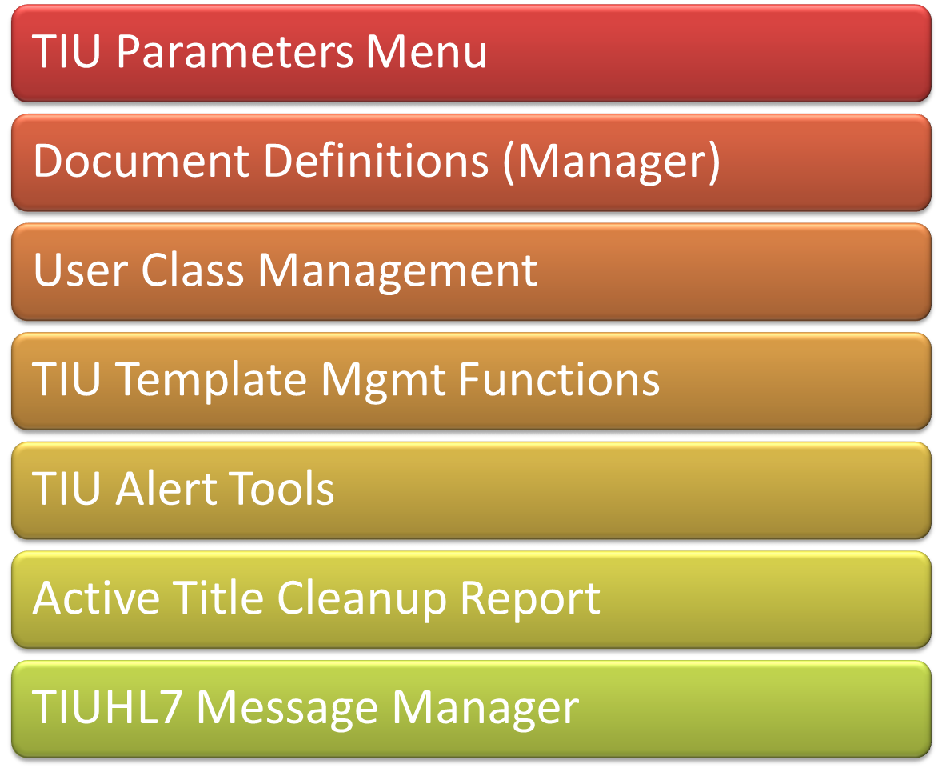
Notes:
TIUHL7 Message Manager and Title Mapping Utilities ...

Slide 19
TIU Maintenance Menu Option
Basic TIU Parameters
Modify Upload Parameters
Document
Parameters
Progress Notes Batch Print Locations
Division – Progress Notes Print Parameters
Notes:
The first menu that we will explore under the TIU Maintenance Menu is the TIU Parameters Menu.
What does it do? Well, this option allows the Clinical Coordinator or Application Specialist to set up either the Basic or Upload Parameters for TIU. This option also allows you to enter the basic or general parameters which govern the behavior of the TIU documents.
Lets review the first option under the TIU Parameters Menu .

Slide 20
TIU Parameters Menu
Notes:
The Basic TIU Parameters is an option that allows the user to enter the basic, or general parameters which govern the behavior of the Text Integration Utilities.

Slide 21
Basic TIU Parameters
Select INSTITUTION: SOUTH TEXAS HCS.,
ENABLE ELECTRONIC SIGNATURE: YES//
ENABLE NOTIFICATIONS DATE: MAY 26,1998//
GRACE PERIOD FOR SIGNATURE: 5//
FUTURE APPOINTMENT RANGE:
CHARACTERS PER LINE: 60//
OPTIMIZE LIST BUILDING FOR: performance//
SUPPRESS REVIEW NOTES PROMPT: YES//
DEFAULT PRIMARY PROVIDER: AUTHOR (IF PROVIDER)//
Notes:
When you select the Basic TIU Parameters option, you will get a screen like this one. To get started you will have to:
Select INSTITUTION: SOUTH TEXAS HCS., (If you have multiple sites that you are working with, you can simply select them all at this time.)
ENABLE ELECTRONIC SIGNATURE: YES// (which means you will be prompted to enter your electronic signature)
ENABLE NOTIFICATIONS DATE: MAY 26,1998// Note that This date indicates to TIU when to begin sending signature notifications (available/overdue for signature) to expected signers/cosigners. Notifications are sent beginning on this date, and only for documents
entered on/after this date.
GRACE PERIOD FOR SIGNATURE: 5// This is the number of days following transcription before an author or attending Physician is notified of a deficiency. If no grace period is entered, clinicians are not notified of overdue signatures.
FUTURE APPOINTMENT RANGE: This parameter determines how far in advance a future appointment may be selected when entering a document for outpatient care.
CHARACTERS PER LINE: 60// This value (default 60) is divided into the total number of 'actual‘ characters in a given transcribed document to derive the line count for that document. By 'actual' characters, we mean all printable ASCII characters, with multiple white space characters stripped. This prevents transcriptionists from "stuffing" line counts by adding white space.
OPTIMIZE LIST BUILDING FOR: performance// This parameter determines whether or not TIU list building functions invoke business rules, excluding from the list any documents the user is not authorized to see. Checking business rules in this way optimizes list building for security. It may be costly in terms of performance.
When optimized for performance (the default behavior of TIU), business rules excluding notes from view are bypassed when building lists of documents.
NOTE: This applies only to lists: when an unauthorized user attempts to view the contents of a document from the resulting list, he is prevented from doing so, with the following explanation:
Reviewing Item #1 You may not VIEW this UNSIGNED NURSE'S NOTE.
SUPPRESS REVIEW NOTES PROMPT: YES// Applies to Progress Notes only. When this parameter is set to YES, TIU suppresses the prompt which asks if the user wishes to see available progress notes before entering a new note. This parameter is overridden by the Personal Preference of the same name. If neither parameter is entered, the “Review Notes” prompt is NOT suppressed.
DEFAULT PRIMARY PROVIDER: AUTHOR (IF PROVIDER)// This parameter determines the behavior of the Primary Provider prompt for a standalone encounter. If the parameter has no value, the prompt has no default. If the parameter has value 0, the user is not prompted for primary provider. If the parameter has value 1, the default for the Primary Provider prompt is the site's default provider for the given location. If the parameter has value 2, the default is the author if the author is a provider; if the author is not a provider, the prompt has no default.

Slide 22
TIU Parameters Menu
Notes:
Modify Upload Parameters - This option allows the definition and modification of parameters for the batch upload of documents into DHCP or VistA

Slide 23
Modify Upload Parameters
Select INSTITUTION: SOUTH TEXAS HCS
ASCII UPLOAD SOURCE: remote computer//
UPLOAD PROTOCOL: KERMIT//
UPLOAD HEADER FORMAT: captioned//
RECORD HEADER SIGNAL: $HDR//
BEGIN REPORT TEXT SIGNAL: $TXT//
RUN UPLOAD FILER IN FOREGROUND: YES//
Now Select upload error alert recipients:
Select ALERT RECIPIENT: HUGHES,RIKKITA Y//
Now edit the DOCUMENT DEFINITION file:
Notes:
This is what you will see when you log into modify upload parameters. I will not go through each of these prompts but you will notice that they are set to default to what is set in your system. But on the next slide I will show you how you can get additional information on each of these prompts.
Modify Upload Parameters –
Select INSTITUTION: SOUTH TEXAS HCS
ASCII UPLOAD SOURCE: remote computer//
UPLOAD PROTOCOL: KERMIT//
UPLOAD HEADER FORMAT: captioned//
RECORD HEADER SIGNAL: $HDR//
BEGIN REPORT TEXT SIGNAL: $TXT//
RUN UPLOAD FILER IN FOREGROUND: YES//
Now Select upload error alert recipients:
Select ALERT RECIPIENT: HUGHES, RIKKITA Y//
Now edit the DOCUMENT DEFINITION file:

Slide 24
Example of “?”
UPLOAD PROTOCOL: KERMIT// ?
Select preferred upload protocol
Choose from:
a ASCII
k KERMIT
UPLOAD PROTOCOL: KERMIT// ??
This is the upload protocol used to transmit documents, with a for ASCII, or k for KERMIT
Choose from:
a ASCII
k KERMIT
Notes:
The beauty of Vista is that you can always enter a “?” at a prompt to gain information about that option and what it will allow you to do.
If you enter two “??”s then you will get additional information as you can see from the demonstration shown.
Lets go to our next option.

Slide 25
TIU Parameters Menu
This option lets you enter the parameters that apply to specific documents (i.e., Titles), or groups of documents (i.e., Classes, or Document Classes).
Notes:
Document Parameter Edit
This option lets you enter the parameters that apply to specific documents (i.e., Titles), or groups of documents (i.e., Classes, or Document Classes).
On the next slide you will see some of the parameters that you can apply to specific documents.

Slide 26
Select DOCUMENT DEFINITION: GI RESULT (FORM LETTER) DOCUMENT DEFINITION: GI RESULT (FORM LETTER)// GI RESULT (FORM LETTER)
REQUIRE RELEASE: NO//
REQUIRE MAS VERIFICATION: NO//
REQUIRE AUTHOR TO SIGN: YES//
ROUTINE PRINT EVENT(S): both//
STAT PRINT EVENT(S):
MANUAL PRINT AFTER ENTRY:
ALLOW CHART PRINT OUTSIDE MAS: YES//
ALLOW >1 RECORDS PER VISIT: YES//
ENABLE IRT INTERFACE:
SUPPRESS DX/CPT ON ENTRY: YES//
Notes:
I will Highlight key points on this slide
I have chosen to demonstrate a GI Result (Form Letter)
REQUIRE RELEASE is defaulted to NO// This parameter determines whether the person entering the document is required (and prompted) to release the document from a draft state upon exit from the entry/editing process.
Though designed for Discharge Summaries, release may be used for any kind of TIU document.
REQUIRE MAS VERIFICATION: NO// This parameter determines whether verification by MAS is required, prior to public access and signature of the document.
Though designed for Discharge Summaries, verification may be used for any kind of TIU document, and is particularly helpful for documents that are uploaded from a transcription service.
Allowable values are: 0 NO
1 YES, ALWAYS
2 UPLOAD ONLY
3 DIRECT ENTRY ONLY
Where 1 indicates that these documents require verification regardless of how they originate;
2 indicates that verification is required only when the documents are Uploaded;
and 3 indicates that verification is required only when documents are entered directly into VISTA.
Once again you can utilize your “?” feature to gain additional information for each of these prompts?

Slide 27
Now enter the USER CLASSES for which co-signature will be required:
Select USERS REQUIRING COSIGNATURE:
Now enter the DIVISIONAL parameters:
Select DIVISION: AUDIE L MURPHY MEMORIAL VAMC//
CHART COPY PRINTER: STXAGASTRO1PRT//
STAT CHART COPY PRINTER:
Select DIVISION:
If document is to be uploaded, specify Filing Alert Recipients:
Select FILING ALERT RECIPIENT:
Notes:
Now after you have finished setting up your document parameters you will be asked to:
Enter the USER CLASSES for which co-signature will be required: You can list as many that apply
Select USERS REQUIRING COSIGNATURE:
Now enter the DIVISIONAL parameters: (you can also enter as many locations that apply as well)
Select DIVISION: AUDIE L MURPHY MEMORIAL VAMC//
CHART COPY PRINTER: STXAGASTRO1PRT// This is set for my defaulted printer
STAT CHART COPY PRINTER:
Select DIVISION:
If document is to be uploaded, specify Filing Alert Recipients: This is where you would enter the name of the contact person for this document
Select FILING ALERT RECIPIENT:

Slide 28
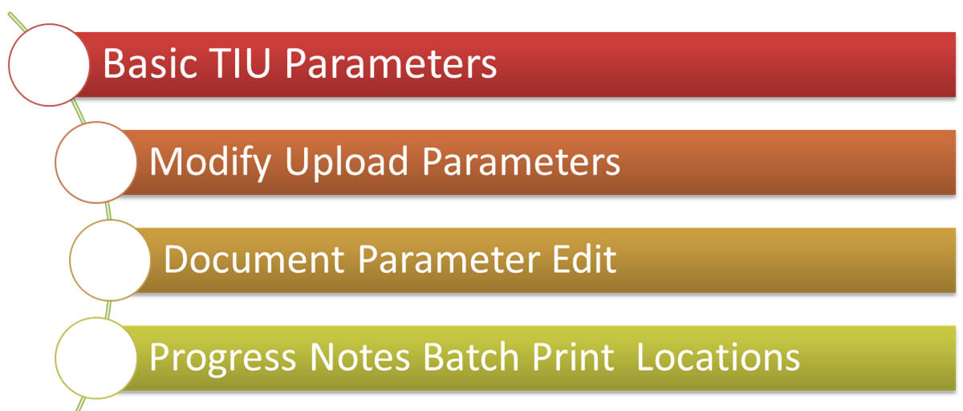
TIU Parameters Menu
Notes:
Our fourth option is Progress Notes Batch Print Locations

Slide 29
Progress Notes Batch Print Locations
Option for entering hospital locations used for [TIU PRINT PN OUTPT LOC] and [TIU PRINT PN WARD] options.
If locations are not entered in this file they will not be selectable from these options.
Notes:
This Option is for entering hospital locations used for [TIU PRINT PN OUTPT LOC] and [TIU PRINT PN WARD] options.
If locations are not entered in this file they will not be selectable from these options.

Slide 30
Progress Notes Batch Print Locations –
Select Clinic or Ward: 1 FLOOR RADIOLOGY
Are you adding '1 FLOOR RADIOLOGY' as a new TIU PRINT PARAMETERS (the 8TH)? No// (No) ??
Select TIU Parameters Menu Option: Progress Notes Batch Print Locations
Select Clinic or Ward: 1 FLOOR RADIOLOGY
Are you adding '1 FLOOR RADIOLOGY' as
a new TIU PRINT PARAMETERS (the 8TH)? No// Y (Yes)
PROGRESS NOTES DEFAULT PRINTER:
EXCLUDE FROM PN BATCH PRINT:
Notes:
Now lets look at this option as it will appear on your screen and let me Highlight a few key points for you
As you can see from the first prompt I took the default of “No” for adding the 1 Floor Radiology as my printing location and I used the “?” feature to find out exactly what is required at this prompt and it sent me back to the top menu/prompt.
In the second example I entered “Y” for Yes to add the 1 Floor Radiology as my printing location and you will notice that it moved me to the next prompt to enter my default printer.
I also have the option to exclude any printers that I do not want to print notes to, such as printers that are not in a secure location.

Slide 31
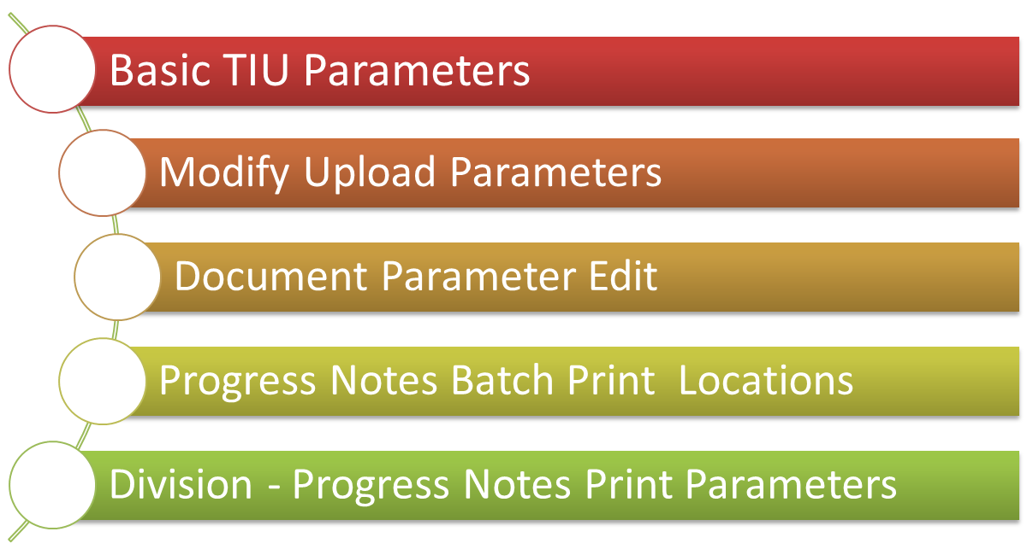
TIU Parameters Menu
Notes:
Our last option under the TIU Parameters Menu is Division Progress Notes Print Parameters

Slide 32
Division – Progress Notes Print Parameters
These parameters are used by the [TIU PRINT PN BATCH INTERACTIVE] and [TIU PRINT PN BATCH SCHEDULED] options.
Division - Progress Notes Print Parameters –
Select Division for PNs Outpatient Batch Print: AUDIE L MURPHY MEMORIAL VAMC
LOCATION TO PRINT ON FOOTER: STVHCS - ALMD//
PROGRESS NOTES BATCH PRINTER: STX-ABBREPORT1PRT
Notes:
Now with this option you can schedule your PNs to print at a Division level.
Select Division for PNS Outpatient Batch Print: AUDIE L MURPHY MEMORIAL VAMC
LOCATION TO PRINT ON FOOTER: STVHCS - ALMD// You may enter a new TIU DIVISION PRINT PARAMETERS, Notes for all locations under this division will print unless they are not excepted in the TIU PRINT PARAMETERS file (#8925.93) in field #3.
PROGRESS NOTES BATCH PRINTER: this printer will be presented as the default printer when printing out your progress notes.

Slide 33
Document Definitions (Manager)
Clinical Documents
Progress Notes
Discharge Summary
Clinical Procedures
Progress Notes
Nursing Notes
Nursing Notes
Dietician Notes
Psychologist Notes
ICU
Nursing Notes
Cardiology Nursing Notes
Eye Clinic Nursing Notes
Notes:
Now our second Option under the TIU Maintenance Menu is the:
Document Definition menu for Managers/OIT staff lets you create new entries, delete appropriate entries, copy entries, and edit entries, including Technical M fields and Upload fields. Editing Exception: National Standard entries cannot be edited/deleted on ANY menu.
For the purpose of this training today I have listed just a few of the Documents Classes that you would have in your system.

Slide 34
Document Definitions
Edit
Sort
Create
TIU Health Summary
Objects
Notes:
The Manager menu overrides Ownership for editing, but not for deleting entries; a manager can edit any entry regardless of owner, but must own an entry in order to delete it.
A manager can also Edit, Sort and Create document definitions and TIU and Health Summary Objects.
Now before we explore these options lets pause for a moment and take a poll question.

Slide 35
Poll Question
Which menu option allows the Clinical Coordinator or Application Specialist to set up either the Basic or Upload Parameters for TIU?
TIU Parameters Menu
Document Definitions
Notes:
Which menu option allows the Clinical Coordinator or Application Specialist to set up either the Basic or Upload Parameters for TIU?
A. TIU Parameters Menu -
Document Definitions
While you are selecting your answer I want to briefly discuss the Hierarchy of TIU Documents in your system.

Slide 36
Hierarchy Document
Class
Document Class
Title List
Title List
Notes:
Now we talked about the Hierarchy, so I want to show you what it should look like in your system.
This hierarchy provides the building blocks for Text Integration Utilities (TIU). It allows documents for instance “Titles” to inherit characteristics of the higher levels, Class and Document Class, such as signature requirements and print characteristics. This structure, while complex to set up, creates the capability for better integration, shared use of boilerplate text, components, and objects, and a more manageable organization of documents. End users, like your clinical, administrative, and MIS staff need not be aware of the hierarchy because they work at the Title level with the actual documents.
Keep in mind that it is really important that you know the Document Definition Hierarchy your site or service will use when editing or creating TIU documents.
This function is critical to the organization and future documents in each site’s implementation of TIU. A worksheet is provided in Appendix A of the TIU Implementation Guide to assist you in understanding the function of these three basic levels.
Class - A group of groups which may contain one or more CLASSES or DOCUMENT CLASSES. TIU exports a root Class, Clinical Documents, with the sub-classes of Progress Notes and Discharge Summary.
Document Class - A grouping which contains TITLES. Examples of document classes are: Medical Notes, Nursing Notes, Surgery Notes,
Title - A single entity at the lowest level. Titles define the actual Progress Notes or Discharge Summaries that you write (e.g., Endocrinology Notes, OPC/Psychology, Primary Care Notes, Dr. Jones’ Discharge Summaries, etc.).

Slide 37
Poll Results
Which menu option allows the Clinical Coordinator or Application Specialist to set up either the Basic or Upload Parameters for TIU?
TIU Parameters Menu
Document Definitions
Notes:
If you selected Option A, you are correct.
The Answer is A ….TIU Parameters Menu.

Slide 38
Poll Results
Which menu option allows the Clinical Coordinator or Application Specialist to set up either the Basic or Upload Parameters for TIU?
TIU Parameters Menu
Document Definitions
Notes:
Click to move on

Slide 39
Examples
Notes:
Now I want to show you samples of these Document Definition Menus and we will begin with Edit Document Definitions.

Slide 40
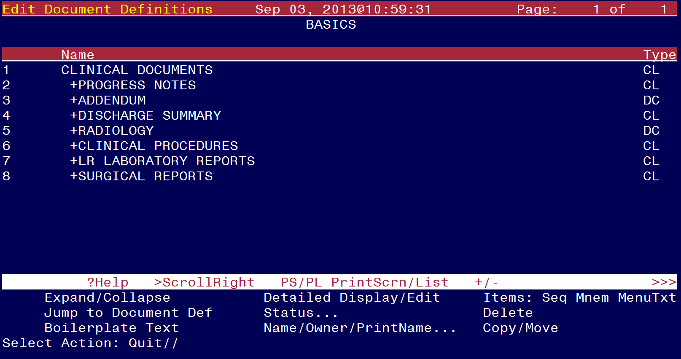
Notes:
Edit Document Definitions - This option lets you view and edit entries. Entries are presented in hierarchy order. Items of an entry are in sequence order, or if they have no sequence, in alphabetic order by menu text, and are indented below the entry. Since Objects don’t belong to the hierarchy, they can’t be viewed/edited using the Edit Options.
This is the screen you will see and now you can actually see the Hierarchy that I discussed in the previous screen. You have Clinical Documents as your Class List, then within this list your next level is Document Class which in turn has a sub group of clinical documents as well.

Slide 41
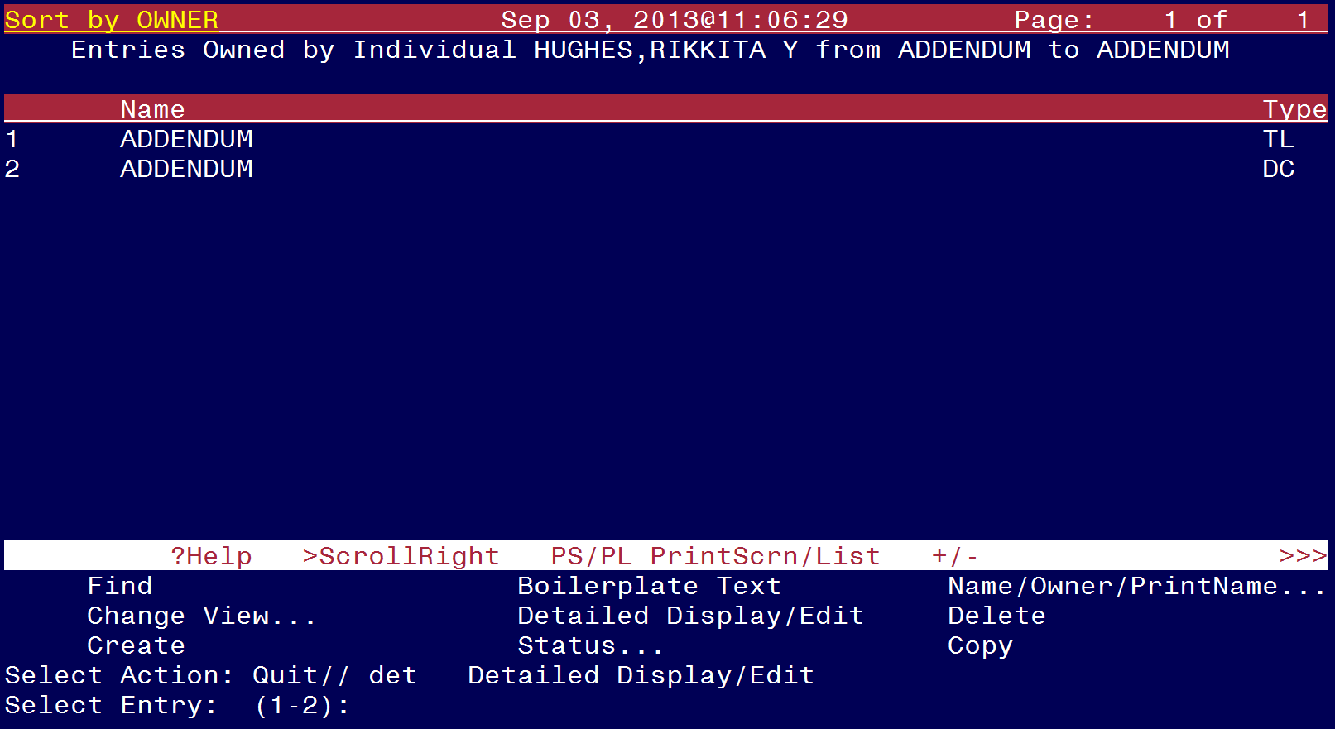
Notes:
Now for the Sort Document Definition option:
This option lets you view parts of the hierarchy by selected sort criteria. It displays the selected entries in alphabetic order by Name, rather than in hierarchy order. Depending on sort criteria, entries can include Objects. The Sort option lets you view and edit entries. Select Attribute: (T/O/S/U/P/A): Owner// ?
Enter the Attribute you want to sort by - T -Type, S-Status, P-Parentage, O-Owner, U-In Use, A-All Document Definitions
After you have completed answering your prompts for sorting your document this is what you will see listed on your screen.
Once again you have several prompts to chose from that will provide you with the view you need to complete your task.

Slide 42
Notes:
As you can see I have chosen to sort my documents on “Addendum” Document Class.
START WITH DOCUMENT DEFINITION: FIRST// addendum
GO TO DOCUMENT DEFINITION: LAST// addendum

Slide 43
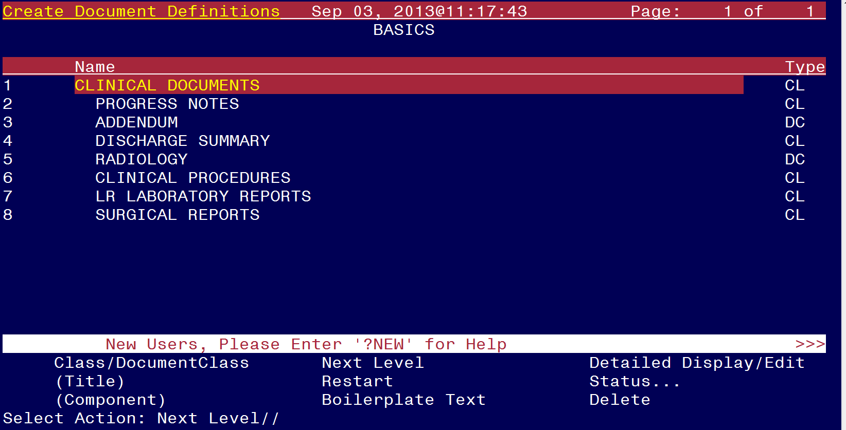
Notes:
The next menu is the Create Document Definition. As you can see the Hierarchy is still listed but you have a different set of options to choose from to create your new document definition.
This option lets you create new entries of any type (Class, Document Class, Title, Component) except Object, placing them where they belong in the hierarchy. Although entries can be created using the Edit and Sort options, the Create option streamlines the process. This option presents entries in hierarchy order, traversing ONE line of descent, starting with Clinical Documents at the top.
The Create option permits you to view, edit, and create entries, but only from within the current line of descent. The Create Option doesn’t let you copy an entry.

Slide 44
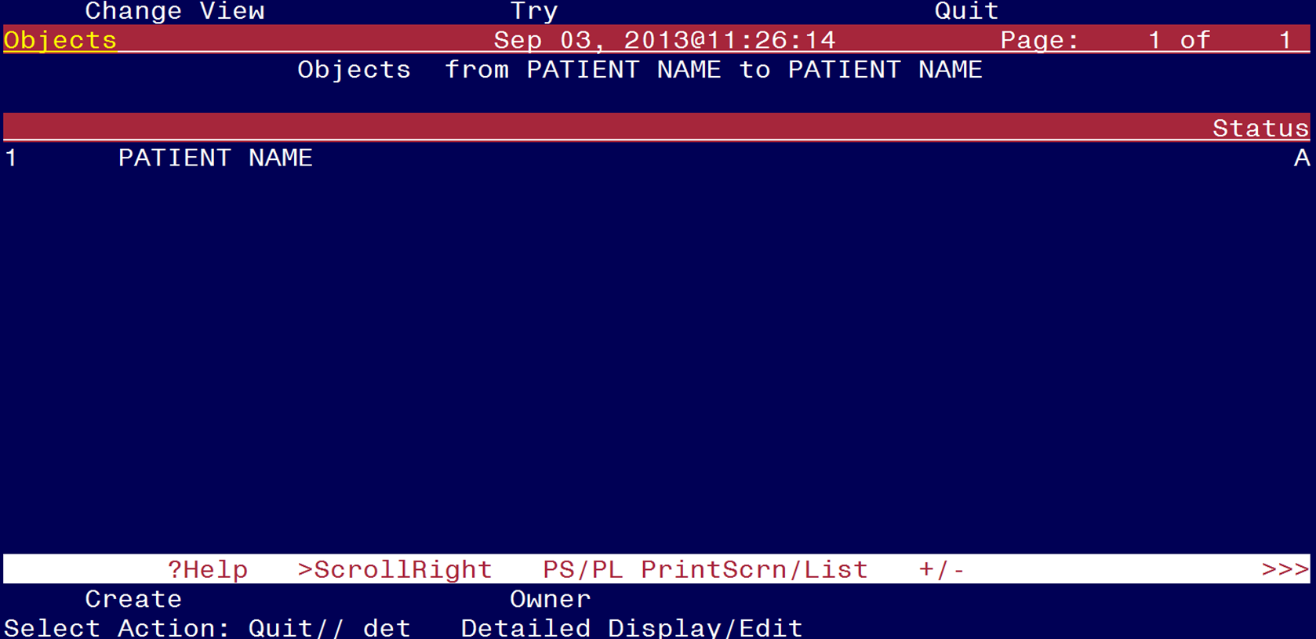
Notes:
I chose to create an object by the name of “PATIENT NAME”.

Slide 45
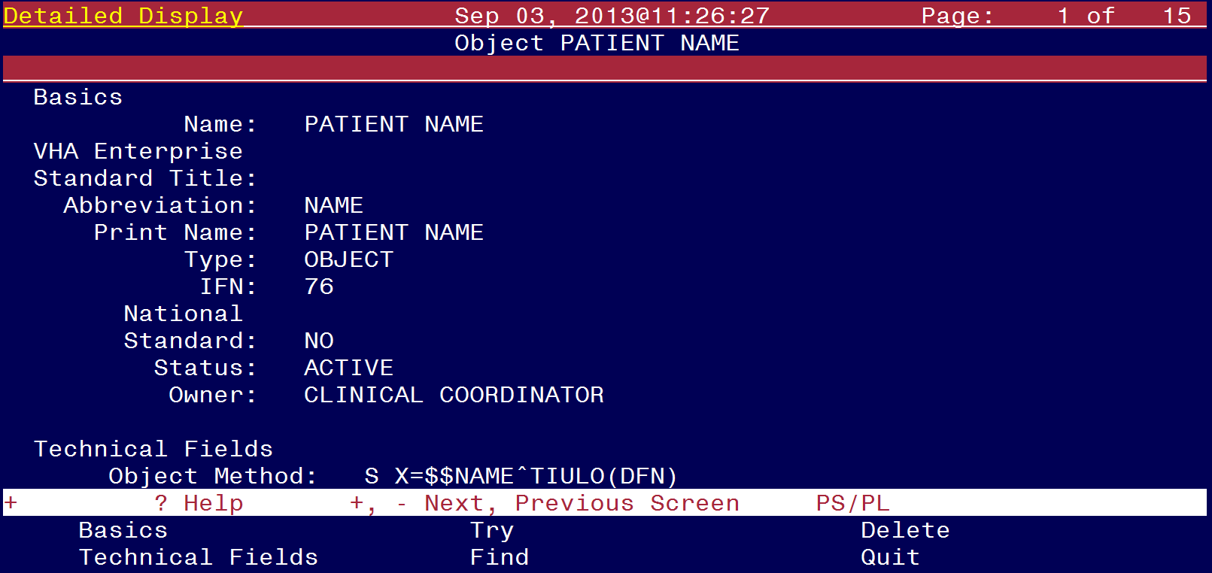
Notes:
You will need to set all of the parameters that you want to apply for that object and once it is all set up you can chose the “Try” button and this feature will let you know if there is anything technically incorrect that will prevent you from using it in your documents.

Slide 46
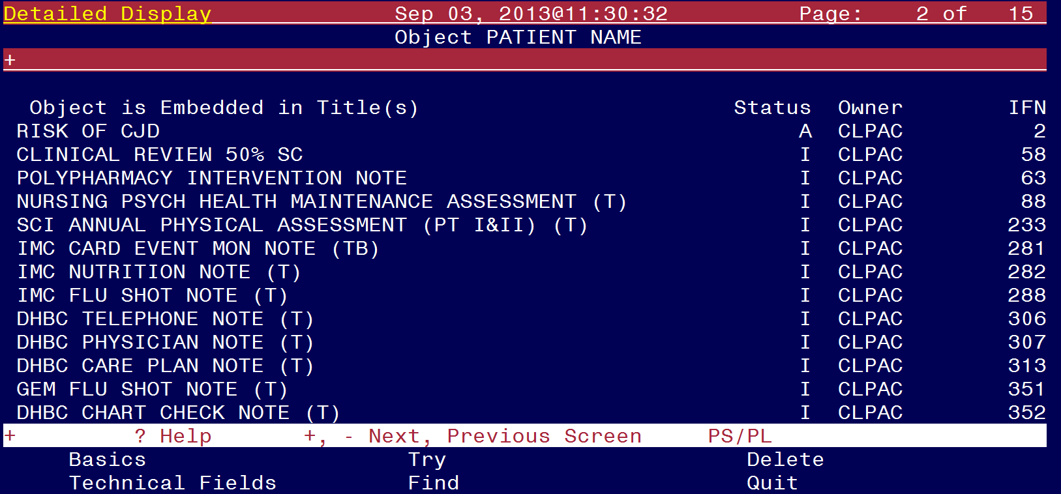
Notes:
Here you can see other listing of objects that have been created for various Notes within their system.

Slide 47
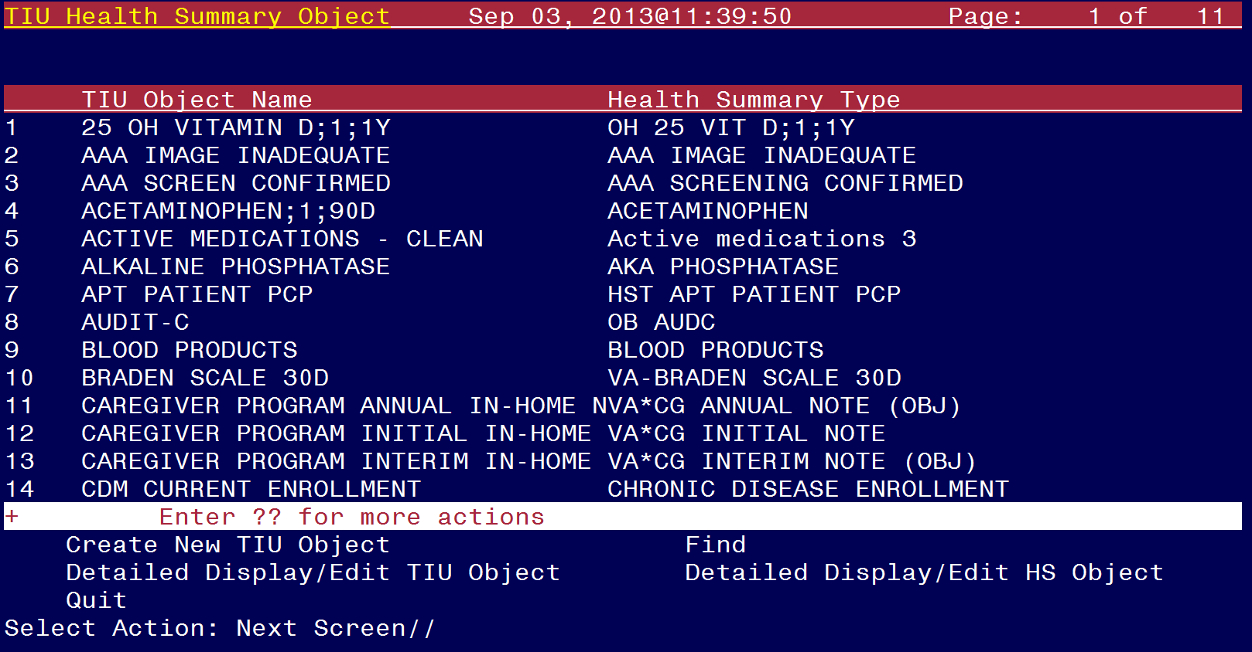
Notes:
The last option is “Create TIU/Health Summary Objects”.
As you can see from this list of TIU Health Summary Object there are many that have been created and you have several options to choose from to view them and also see the detailed aspect of how they were created.
The Create Objects option lets you create new objects or edit existing objects. First you select Start With and Go To values, and the existing Objects within those values are displayed in alphabetical order.
You have the choice to Create New TIU Object, Find, Detailed Display/Edit TIU Object, and Detailed Display/Edit HS Object

Slide 48
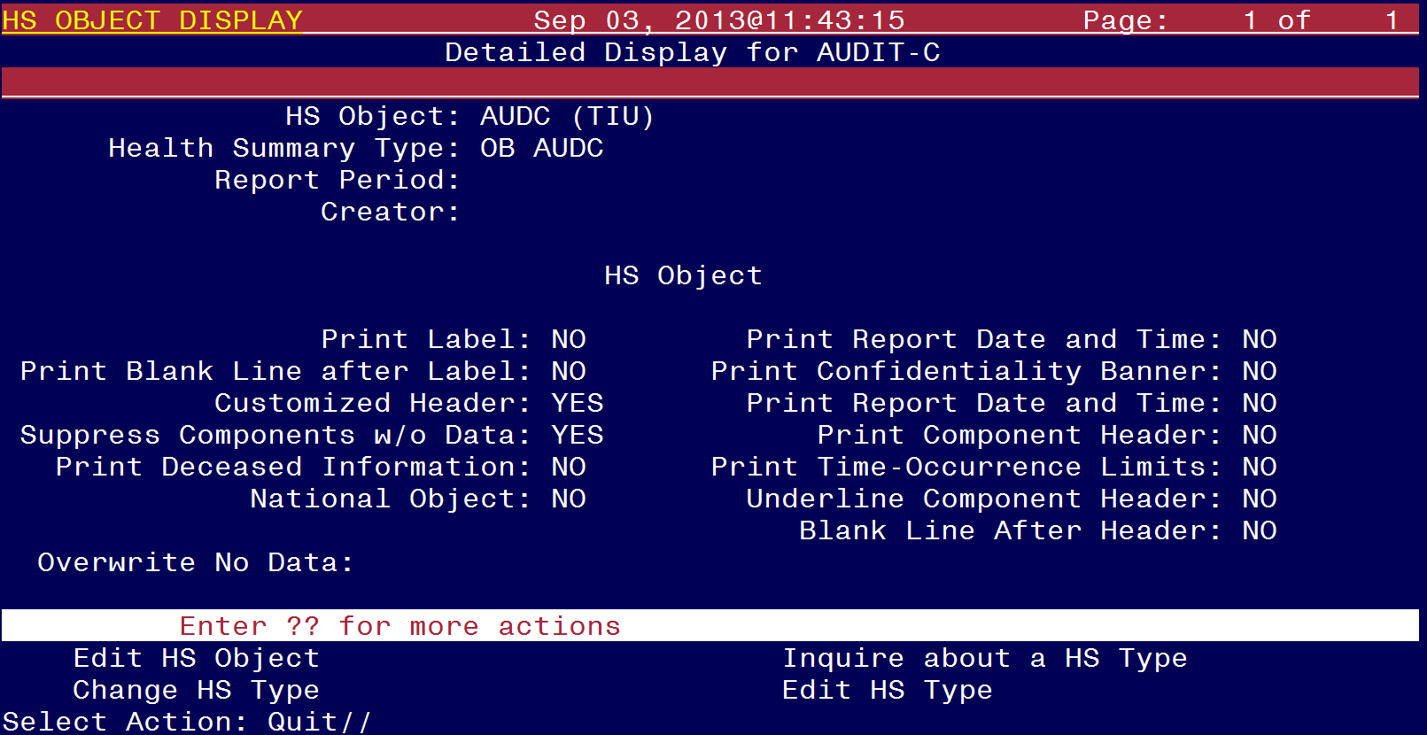
Notes:
I chose to see the detailed view of the Health Summary Object. From this screen shot you can see how it was created and the numerous options you have to select from to show how it will display in your Health Summary Document.

Slide 49
TIU Template Mgmt Functions
1. Delete TIU templates for selected user.
2. Edit auto template cleanup parameter.
3. Delete templates for ALL terminated users.
Notes:
The fourth Menu option for managing pre-defined templates created by your medical center is 'TIU Template Mgmt Functions‘ –
This option is a menu option which contains other options providing TIU template management functions to Clinical Applications Coordinators or other managers with access to the TIU MAINTENANCE MENU option.
You have 3 options to choose from and they are:
Delete TIU templates for selected user. - Enter/select user for whom templates will be deleted:
Edit auto template cleanup parameter. - Y/N auto cleanup upon termination may be set for the following levels: Division or System
Delete templates for ALL terminated users. - Delete all non-shared templates for all terminated users (Y/N)? NO//

Slide 50
TIU Alert Tools
1. Undictated
2. Unstranscribed
3. Unreleased
4. Unverified
5. Unsigned
6. Uncosigned
7. Completed
8. Amended
9. Purged
10. Deleted
11. Retracted
Notes:
The fifth menu under TIU Maintenance is the TIU Alert Tools option.
This option allows refresh and manipulation of TIU alerts, especially with respect to signatures. These tools are designed to assist Clinical Applications Coordinators and other users with TIU management responsibilities and to help control the backlog of unsigned notes. It accomplishes this by providing flexible control over alert generation.
You can select a document status for at least 11 categories that are listed for you.

Slide 51
UNSIGNED Documents 0 Documents
by (AUTHOR)
For (HUGHES, RIKKITA Y) from 7/24/13 to 7/31/13
No records found to satisfy search criteria.
Browse Edit
Change View Identify Signers
Combo Alert(s) Resend Alert(s)
Delete Alert(s) Third Party Alert(s)
Detailed Display
Select Action: Quit//
TIU Alert Tools July 31, 2013@14:24:09 Page 1 of 1
Patient Document Ref Date Status
Enter ?? for more actions >>>
Notes:
Here I have selected the Unsigned Documents option.
I did a search by Author, which I selected some one by the name of Hughes, Rikkita and then I selected a start and ending date of July 23, 2013
If I had some notes listed here I would be able to do the following actions:

Slide 52
TIU Alert Tools July 31, 2013@14:24:09 Page 1 of 1
UNSIGNED Documents 0 Documents
by (AUTHOR)
For (HUGHES, RIKKITA Y) from 7/24/13 to 7/31/13
No records found to satisfy search criteria.
Browse
Select Action: Quit//
Patient Document Ref Date Status
Enter ?? for more actions >>>
Notes:
BROWSE DOCUMENT—If authorized, presents a read only view of a selected document.

Slide 53
UNSIGNED Documents 0 Documents
by (AUTHOR)
For (HUGHES, RIKKITA Y) from 7/24/13 to 7/31/13
No records found to satisfy search criteria.
Browse
Change View
Select Action: Quit//
TIU Alert Tools July 31, 2013@14:24:09 Page 1 of 1
Patient Document Ref Date Status
Enter ?? for more actions >>>
Notes:
CHANGE VIEW—Allows entry new search criteria.

Slide 54
UNSIGNED Documents 0 Documents
by (AUTHOR)
For (HUGHES, RIKKITA Y) from 7/24/13 to 7/31/13
No records found to satisfy search criteria.
Browse
Change View
Combo Alert(s)
Select Action: Quit//
TIU Alert Tools July 31, 2013@14:24:09 Page 1 of 1
Patient Document Ref Date Status
Enter ?? for more actions >>>
Notes:
COMBINATION ALERTS—Allows the sending of new alerts for single or multiple documents to the expected signers (AUTHOR/ DICTATOR, EXPECTED COSIGNER/ATTENDING PHYSICIAN, and ADDITIONAL SIGNER(S)) and one or more third parties. RESEND rules outlined below apply for a document's expected signers.

Slide 55
UNSIGNED Documents 0 Documents
by (AUTHOR)
For (HUGHES, RIKKITA Y) from 7/24/13 to 7/31/13
No records found to satisfy search criteria.
Browse
Change View
Combo Alert(s)
Delete Alert(s)
Select Action: Quit//
TIU Alert Tools July 31, 2013@14:24:09 Page 1 of 1
Patient Document Ref Date Status
Enter ?? for more actions >>>
Notes:
DELETE ALERTS—Allows deletion of all the alerts for a single or multiple documents.

Slide 56
UNSIGNED Documents 0 Documents
by (AUTHOR)
For (HUGHES, RIKKITA Y) from 7/24/13 to 7/31/13
No records found to satisfy search criteria.
Browse
Change View
Combo Alert(s)
Delete Alert(s)
Detailed Display
Select Action: Quit//
TIU Alert Tools July 31, 2013@14:24:09 Page 1 of 1
Patient Document Ref Date Status
Enter ?? for more actions >>>
Notes:
DETAILED DISPLAY—If authorized, allows the viewing of document details.

Slide 57
UNSIGNED Documents 0 Documents
by (AUTHOR)
For (HUGHES, RIKKITA Y) from 7/24/13 to 7/31/13
No records found to satisfy search criteria.
Browse Edit
Change View
Combo Alert(s)
Delete Alert(s)
Detailed Display
Select Action: Quit//
TIU Alert Tools July 31, 2013@14:24:09 Page 1 of 1
Patient Document Ref Date Status
Enter ?? for more actions >>>
Notes:
EDIT DOCUMENT—If authorized, allows the editing of a selected TIU document. (Only Unsigned documents can be edited)

Slide 58
UNSIGNED Documents 0 Documents
by (AUTHOR)
For (HUGHES, RIKKITA Y) from 7/24/13 to 7/31/13
No records found to satisfy search criteria.
Browse Edit
Change View Identify Signers
Combo Alert(s)
Delete Alert(s)
Detailed Display
Select Action: Quit//
TIU Alert Tools July 31, 2013@14:24:09 Page 1 of 1
Patient Document Ref Date Status
Enter ?? for more actions >>>
Notes:
IDENTIFY SIGNERS—If authorized, allows the editing of the expected signers of a TIU document and removal of additional signers.

Slide 59
UNSIGNED Documents 0 Documents
by (AUTHOR)
For (HUGHES, RIKKITA Y) from 7/24/13 to 7/31/13
No records found to satisfy search criteria.
Browse Edit
Change View Identify Signers
Combo Alert(s) Resend Alert(s)
Delete Alert(s)
Detailed Display
Select Action: Quit//
TIU Alert Tools July 31, 2013@14:24:09 Page 1 of 1
Patient Document Ref Date Status
Enter ?? for more actions >>>
Notes:
RESEND ALERTS—Allows the regeneration of alerts for a single document or multiple documents; all alerts associated with each document are deleted before being resent. Previously sent 3rd Party Alerts would be deleted and need to be resent.
Alerts are sent appropriate to the document's status and only to expected signers as follows:
The Author/Dictator & Expected Co-signer/Attending— will only receive alerts if they have not signed.
Additional Signer(s)—will only receive alerts if the document has been signed.

Slide 60
UNSIGNED Documents 0 Documents
by (AUTHOR)
For (HUGHES, RIKKITA Y) from 7/24/13 to 7/31/13
No records found to satisfy search criteria.
Browse Edit
Change View Identify Signers
Combo Alert(s) Resend Alert(s)
Delete Alert(s) Third Party Alert(s)
Detailed Display
Select Action: Quit//
TIU Alert Tools July 31, 2013@14:24:09 Page 1 of 1
Patient Document Ref Date Status
Enter ?? for more actions >>>
Notes:
THIRD PARTY ALERTS—Allows the sending of new alerts for a single document or multiple documents to one or more third parties regardless of the document's status.
Business rules are checked and adhered to, so while anyone who has access to this option can use it, you may be blocked from certain functions such as viewing unsigned notes.

Slide 61
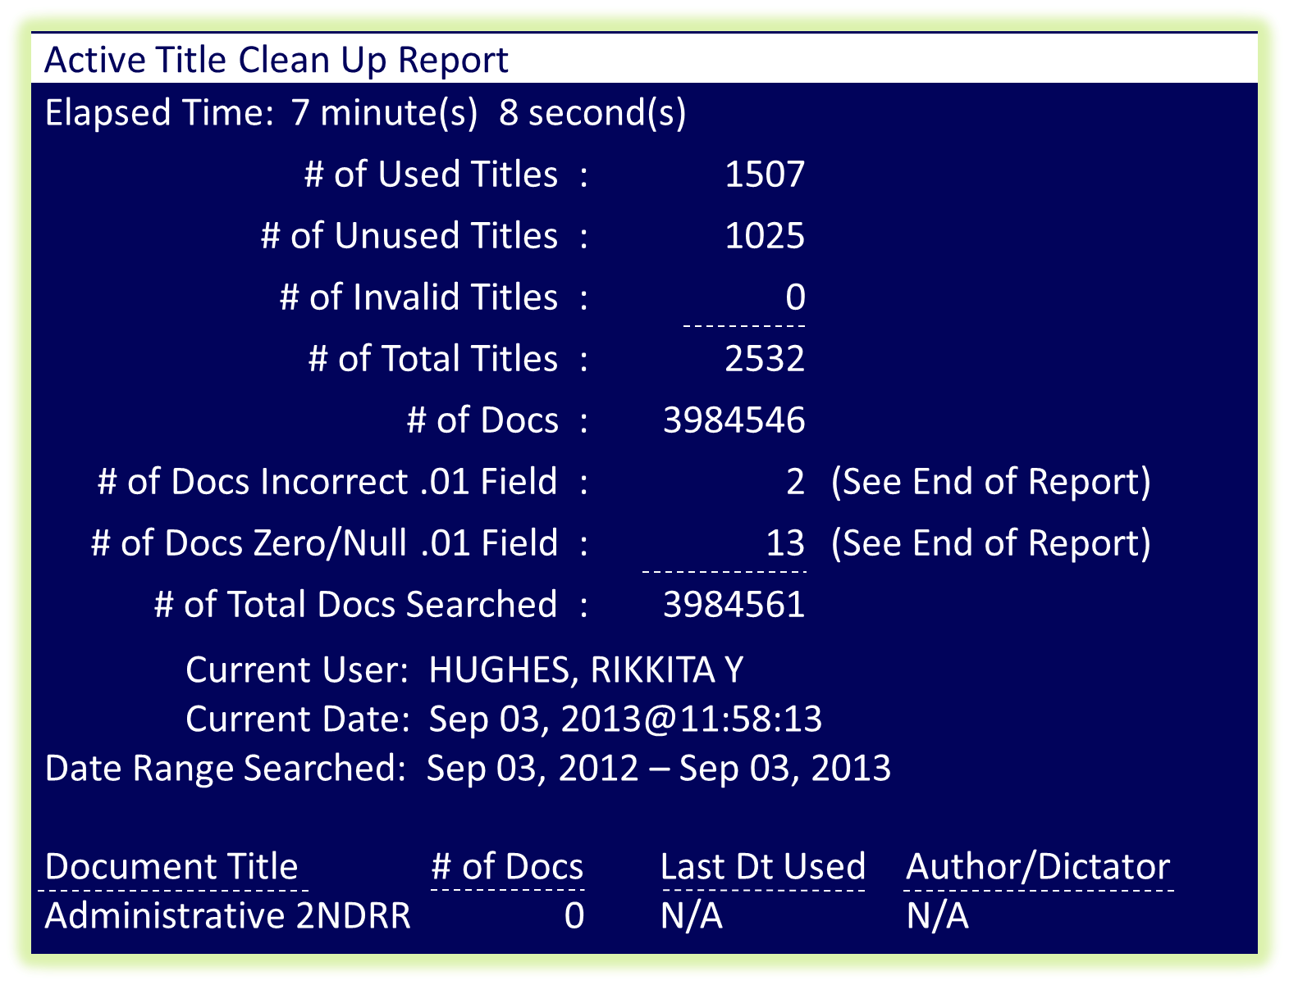
Active Title Cleanup Report
Notes:
The sixth option under the TIU Maintenance Menu is the Active Title Cleanup Report.
The report and cleanup utility will analyze the TIU Document Definition File (8925.1) and provide an automated process to inactivate the appropriate TIU titles.
When you run this report it would be advisable to send it to your spooler to allow you to continue to work on other tasks while this report is running in the background. Note: You will have to check with your IT Service to provide you with Spooler Access

Slide 62
TIUHL7 Message Manager July 30, 2013@21:47:54 Page 1 of 28
TIUHL7 Received Messages
Receiving Sending Message
1 REJECT1 JUL 24,2013@00:36:25 TIUHL7 HTAPPL Rejected
2 REJECT2 JUL 24,2013@02:06:48 TIUHL7 HTAPPL Rejected
3 REJECT3 JUL 24,2013@03:37:08 TIUHL7 HTAPPL Rejected
4 REJECT4 JUL 24,2013@05:07:28 TIUHL7 HTAPPL Rejected
5 REJECT5 JUL 24,2013@06:37:46 TIUHL7 HTAPPL Rejected
6 ACCEPT1 JUL 24,2013@07:06:01 MHV TIU MHV SM Accepted
7 ACCEPT2 JUL 24,2013@07:50:58 MHV TIU MHV SM Accepted
8 ACCEPT3 JUL 24,2013@07:51:59 MHV TIU MHV SM Accepted
9 REJECT6 JUL 24,2013@08:12:54 TIUHL7 HTAPPL Rejected
10 ACCEPT10 JUL 24,2013@08:41:19 MHV TIU MHC SM Accepted
View Message Delete Message(s)
Refresh Message List
Select Action: Next Screen//
Message ID Date/Time Processed Application Application Status
Enter ?? for more actions >>>
Notes:
The next option under the TIU Maintenance Menu is the TIUHL7 Message Manger Utility and it is used for viewing a message going in and out of the TIU Generic HL7 Interface.
The purpose of the HL7 Generic Interface is to create a Health Level Seven (HL7) line to Text Integration Utilities (TIU) that will support the upload of a wide-range of textual documents from Commercial-Off-the-Shelf (COTS) applications in use now and in the future at Veteran Administration (VA) Medical Centers. Projects that may work with the interface are the Remote Order Entry System (ROES) software used by the Denver Distribution Center (DDC), the Precision Data Solutions Transcription Service software, and the VA Home Telehealth software.
The project creates a single COTS/application interface specification to allow textual documents to be uploaded and displayed in CPRS. This allows clinicians to view information from the COTS package without leaving the patient’s electronic medical record.
Generic HL7 will not work with external software unless it is specifically set up to do so. The details of how to do this are contained in the Text Integration Utilities (TIU) Generic HL7 Handbook. This handbook describes the HL7 fields required for each document types and gives additional information on system features and vendor guidelines. To retrieve this document go to the VistA Document Library at (http://www.va.gov/vdl/), then click on CPRS: Text Integration Utility (TIU).

Slide 63
Title Mapping Utilities
Notes:
The 'Title Mapping Utilities' allows the Clinical Coordinator or IT Application Specialist the ability to map LOCAL TIU Titles to VHA Enterprise Standard Titles.
Map ACTIVE LOCAL Titles - This option allows CACs to map ALL local titles to the VHA Enterprise Standard Document Title Ontology, by iterating through all of the ACTIVE titles defined for the station. This is a necessary prerequisite to migrating document management to the HDR.

Slide 64
Title Mapping Utilities
Notes:
Selected Active Title Map – This option allows CACs to map specific local titles to the VHA Enterprise Standard Document Title Ontology, by selecting the ACTIVE title in question. The user may also select a previously mapped title, and re-map it, if necessary.

Slide 65
Title Mapping Utilities
Notes:
Mapping Workbench – This option allows the user to generate a list of Local TIU Titles by mapping status, user, and date range (where applicable), and to select titles for mapping/re-mapping to VHA Enterprise Standard Titles.
Enter a code from the list by selecting: M for mapped, U for unmapped (ACTIVE), F-failed mappings, A for active, I for inactive

Slide 66
Title Mapping Utilities
Notes:
Add/Edit Synonyms - This option allows the CAC (or designee) to extend the list of synonyms for any of the VHA Enterprise Standard Title Axis (i.e., Subject Matter Domain, Role, Setting, Service, or Document Type).
Let’s take a break and ask a poll question before I show you examples of some Synonyms you may have in your system.

Slide 67
Poll Question
Which option allows the regeneration of alerts for a single or multiple documents?
Edit
Change View
Resend Alert(s)
Third Party Alert(s)
Notes:
Which option allows the regeneration of alerts for a single document or multiple documents; all alerts associated with each document are deleted before being resent. Previously sent 3rd Party Alerts would be deleted and need to be resent.
A. Edit
B. Change View
Resend Alert(s)
D. Third Party Alert(s)

Slide 68
Add/Edit Synonyms
TIU LOINC ROLE SYNONYMS List? y (Yes)
Choose from:
ANP NURSE PRACTITIONER
ATTND ATTENDING
ATTNDG ATTENDING
TIU LOINC SERVICE SYNONYMS List? y (Yes)
Choose from:
ACTIGRAPHY DIAGNOSTIC STUDY
ADDMSSION ADMISSION EVALUATION
ADENOIDECTOMY OPERATIVE
Notes:
As you are submitting your answer lets review a sample of what some Synonyms may look like at your facility:
You may not be aware of the National matching program that uses a file of synonyms to aid it in determining potential matches of local titles to national titles. In many cases a site will have terms in their titles that describe situations that occur only at that site. To accommodate this, a file of local synonyms can be created.
For various roles for Clinicians:
ANP, will represent Nurse Practitioner
ATTND, will represent Attending or
ATTNDG, can also represent Attending
Now some Synonyms that you may see for various Services you will see:
ACTIGRAPHY representing Diagnostic Study services
ADDMISSION representing Admission Evaluation services
ADENOIDECTOMY can represent Operative services
The spreadsheet of National terms is posted on the TIU web site at the link that is listed here,
“ http://vista.med.va.gov/tiu/html/DataStandardization_Documents.html.
If you compare the terms in the Synonym List with terms you commonly use at your site and update the local synonym list accordingly, title matching will go much faster.
Now before moving on to the ASU Topic, lets review our results from our poll question.

Slide 69
Poll Results
Which option allows the regeneration of alerts for a single or multiple documents?
Edit
Change View
Resend Alert(s)
Third Party Alert(s)
Notes:
Which option allows the regeneration of alerts for a single document or multiple documents; all alerts associated with each document are deleted before being resent. Previously sent 3rd Party Alerts would be deleted and need to be resent.
Correct answer is C, Resend Alert(s)
Now we will move on to our next slide which will be reviewing Authorization Subscription Utility (ASU)

Slide 70
Poll Results
Which option allows the regeneration of alerts for a single or multiple documents?
Edit
Change View
Resend Alert(s)
Third Party Alert(s)
Notes:
Click to move on

Slide 71
What is ASU
and How Can It Help Us?
Provides tools for creating rules
Defines User Class Hospital-Wide
Defines behavior for TIU
Link User Classes with TIU
Document Definitions
Notes:
What is ASU Authorization/Subscription Utility and How Can it Help Us?
The Authorization/Subscription Utility (ASU) lets you define, populate, and retrieve information about User Classes (which can be defined hospital-wide or more narrowly for a specific service). It can be used across VISTA to replace and/or complement keys. You can link User Classes with TIU Document Definitions and document actions. CPRS actions such as ordering or signing can be linked with Document or Order type (e.g., Clinical Warning Note) and with User Classes (e.g., Provider Class). User Classes may be active or inactive.
You will see some examples during this presentation but lets check out some of the benefits of ASU.
ASU lets you define, populate, and retrieve information about User Classes. These User Classes can be defined hospital-wide or more narrowly for a specific service and can be used across VISTA to replace and/or complement keys.

Slide 72
User Class Management
Notes:
User Class Management – this is used with the ASU. We will cover these four options in the next slides.

Slide 73
User Class Management
Notes:
This option allows review, addition, editing, and removal of User Classes

Slide 74
User Class Management
Notes:
This option allows the review, addition, editing, and removal of individual members to and from User Classes.

Slide 75
User Class Management
Notes:
This option allows the review, addition, editing, and removal of individual members to and from User Classes as well

Slide 76
User Class Management
Notes:
The last option allows you to display all the Business rules for a given Document Definition, User Class, or User Role. You can then add, edit, or delete Rules, as appropriate. (This option is also known as the ASU Rule Browser, because you can browse back and forth among existing Business Rules, by various criteria.)

Slide 77
Select User Class Management Option: 1 User Class Definition
Select User Class Status: Active// Active
Start With Class: First//
Go To Class: Last//
Searching for User Classes……………………………..
User Classes Jul 31,203@13:39:28 Page: 1 of 14
Active User Classes 210 Classes
ACA ENCOUNTER GROUP ACA
Addiction Therapist
Administrator Coordinator AC
ADPAC ADPAC
ALLERGIST ALLRG
ANESTHESIOLOGIST ANES
Find Expand/Collapse Class Change/View
Create a Class List Members Quit
Edit User Class
Class Name Abbrev
+ Next Screen - Prev Screen ?? More Actions
Notes:
This is the screen that you will see when selecting a user class that is defaulted for “Active” status and you can also select the Inactive and All Users Classes as well. You can also see what abbreviation is set for that class name. From this screen you have the ability to “Create and Edit a User Class”.

Slide 78
List Membership by User
Current User Classes Jul 31,203@13:39:28 Page: 1 of 1
HUGHES, RIKKITA Y 6 Classes
TEMPLATE CREATOR 09/17/06
Shared Template Editor 09/17/06
Completer 09/17/06
CLINICAL COORDINATOR 09/17/06
ATTENDING PHYSICIAN 01/01/12
Administrators 12/28/08
Add Remove Quit
Edit Change View
User Class Effective Expires
+ Next Screen - Prev Screen ?? More Actions
Notes:
As you can see from this screen shot you are able to see the list of User Classes the user belongs to and the effective date she was assigned to these classes. You can Add, Edit or Remove a user from any of these classes under the List Membership by User option.

Slide 79
List Membership by Class
ANESTHESIOLOGISTS 12 Members
VA DOCTOR, ONE 09/21/10
VA DOCTOR, TWO 09/02/08
VA DOCTOR, THREE 07/01/10
VA DOCTOR, FOUR 06/22/09
VA DOCTOR, FIVE 11/06/08
VA DOCTOR, SIX 10/17/08
VA DOCTOR, SEVEN 07/12/08
VA DOCTOR, EIGHT 06/13/13
Add Remove Change View
Edit Schedule Changes Quit
Current User Classes Jul 31,203@14:44:22 Page: 1 of 2
Member Effective Expires
+ Next Screen - Prev Screen ?? More Actions
Notes:
When you select this option you can see from this screen shot that there are 12 providers in the Anesthesiologist User Class.
You can also see the date when they were assigned to the user class as well and notice that not only can you Add, Edit or Remove a user from this class but you can also do “Schedule Changes” for rotating residents, interns, and medical students.

Slide 80
Manage Business Rules
Notes:
You can manage the business rules by 3 categories: DOCUMENT DEFINITION, USER CLASS, and USER ROLE

Slide 81
List Business Rules by DOCUMENT DEFINITION 1 Rule
for TITLE CHART CHECK NOTE
An UNSIGNED (TITLE) CHART CHECK NOTE may BE AMENDED
by a NURSE
Find Edit Rule Change View
Add Rule Delete Rule Quit
Select Action: Quit//
ASU Rule Browser Aug 23, 2013@11:41:06 Page 1 of 1
** Item 1 Added**
Notes:
Now I have provided a sample of a Chart Check Note that I have assigned a business rule to. The rule applied states that an “UNSIGNED” Chart Check Note may BE AMENDED by a Nurse.
Keep in mind that the business rule could have easily stated that the “Amended, Completed, Deleted, Purged or other status that would be applicable, in applying the required business rule for the Chart Check Note in the place of “UNSIGNED”.

Slide 82
Poll Question
ASU is an application that allows sites to associate users with user classes, allowing them to specify the level of authorization needed to sign or order specific document types.
True
False
Notes:
Okay let’s pause for a moment and see what we have learned from the last set up slides:
ASU is an application that allows sites to associate users with user classes, allowing them to specify the level of authorization needed to sign or order specific document types and orderables.
True
False

Slide 83
TIU and ASU Relationship
TIU
Simplifies access and use of clinical documents for clinical and administrative VA personnel
ASU
Policies & practices for determining responsibility or rights for performing actions on required VHA documents
Implements User Class Hierarchy which identifies the roles different users fulfill within the hospital
Allows access Progress Notes and Discharge Summaries from Orderable Entry/Reporting Results (OE/RR) menus
Notes:
Before we review the results of the poll question lets do a recap of TIU and ASU:
TIU is used to simplify the access and use of clinical documents for both clinical and administrative VA personnel
ASU is used to set policies and practices for determining who is responsible or has the privilege for performing various actions on required VHA documents
TIU lets the user continue to access Progress Notes and Discharge Summaries from Order Entry/Reporting Results (OE/RR) menus
While ASU allows you to implement a User Class Hierarchy which is useful for identifying the roles that different users fulfill within the hospital
You can review the ASU Clinical Coordinator Manual or the TIU/ASU Implementation Guide for more information about ASU, its relationship to TIU, and its implementation.
Now let’s take a look at the poll results from our final question.

Slide 84
Poll Results
ASU is an application that allows sites to associate users with user classes, allowing them to specify the level of authorization needed to sign or order specific document types.
True
False
Notes:
Okay let’s pause for a moment and see what we have learned from the last set up slides:
ASU is an application that allows sites to associate users with user classes, allowing them to specify the level of authorization needed to sign or order specific document types and orderables.
A. True - Answer

Slide 85
Poll Results
ASU is an application that allows sites to associate users with user classes, allowing them to specify the level of authorization needed to sign or order specific document types.
True
False
Notes:
Click to move on

Slide 86
Ask the Presenter
Notes:
Thank you for attending the TIU_ASU session today and I hope you know the basic knowledge and purpose of TIU and ASU and know why they are critical to your clinical and administrative documents at your facility.
If you haven’t submitted your questions yet, there is still time to do so by clicking on the orange “Ask The Presenter” icon. We’re going to show a brief announcement and be right back to answer your questions.
(Stand still and smile until you see the video come up full screen)

