Slide 1
Workload Capture and Coding Keeping it Simple!
Sharon Castle, Pharm.D., BCPS
Chief, Pharmacy Service
Ralph H. Johnson VA Medical Center
Charleston, South Carolina
Notes:
Thank you Joe! I am happy to be here today to talk about Workload Capture and Coding for pharmacists.
I would like to remind everyone that you can click on the green download button above my head to download a copy of the slides.

Slide 2
BACKGROUND
Goal
Improve documentation of pharmacist encounters
Milestones
“160” approved for use as a primary stop code
Expanded the definition of encounter
Workload/Billing Workgroup formed in 2007
Notes:
1. Pharmacy Benefits Management (PBM) has been active since 2007 in establishing guidance on the consistent process for clinical pharmacy workload documentation
Original Group: Lori Golterman, Jan Carmichael, Sharon Castle
The goal of the original workgroup was to improve documentation of pharmacist encounters
We reached several Milestones during the first few years.
The clinical pharmacy stop code 160 was approved for use as a primary stop code
Also, we were able to expand the definition of an encounter for pharmacists

Slide 3
Pharmacy Benefits Management (PBM)
Standardization of clinic set-up will assist PBM by:
Identifying areas of practice for Clinical Pharmacy Specialists
Allowing easier aggregation and tracking of workload
Notes:
Recently, we have been focusing on consistent processes and standardization.
Standardization of clinic set-up will assist PBM by:
1. Identifying areas of practice for Clinical Pharmacy Specialists
2. Allowing easier aggregation and tracking of workload

Slide 4
Clinical Pharmacy Encounters FY07-FY13
Notes:
Credit: Samantha Wright, VISN 12
Educational sessions and training have led to a 3-fold increase in encounter documentation.

Slide 5
Inpatient Clinical Pharmacy Encounters FY07-FY13
Notes:
Let’s take a more detailed look at inpatient pharmacy encounters.
I frequently receive questions about inpatient encounters and as you can see, they have grown exponentially over the past several years.

Slide 6
Poll Question
What is your greatest concern regarding clinical pharmacy encounter documentation at your Medical Center?
A. Clinics are not set-up appropriately
Not all count workload is being encountered
We have no CHAR4 codes on our clinics
I have no concerns, we are doing well
Notes:
Now I’d like to ask a poll question to get an idea of what you are interested in learning about pharmacy workload capture.
What is your greatest concern regarding clinical pharmacy encounter documentation at your Medical Center?
To answer this question, use the blue polling icon above my head. We’ll move on and come back to your results in just a moment.

Slide 7
PBM Workload Capture SharePoint
New SharePoint Link
Notes:
A section of the Clinical Pharmacy Practice SharePoint has been dedicated to workload capture.
It contains PBM Guidance documents in addition to presentations and helpful links to information
It can be found at the following link: http://vaww.infoshare.va.gov/sites/ClinicalPharmacy/default.aspx
Click on the workload capture link at the bottom of the main SharePoint Screen

Slide 8
Notes:
We are now in the workload capture section.
In the left hand column, education on how to pull data and use basic workload reports is available.
Also, useful workload and reporting links for:
VSSC Clinic Stops and persons
DSS Cost and Workload Reports for Select Stop Codes
Clinical Pharmacy Program Office (CPPO) reports
Alpha Code reports

Slide 9
Notes:
In the second column, there are specific folders on key topics related to workload capture:
1. Billing and Coding (CBO coding Q&A Website)
2. Clinic Set-up and Encounters (PBM Guidance Document on workload capture, DSS workload capture document, 2013 educational powerpoint, how to set up an inpatient clinic)
3. Directives and Handbooks (Encounter Directive, Copays)
4. Specialty Guidance (E-Consults, Secure Messaging, Virtual Care, Shared Medical Appointments)

Slide 10
Clinical Pharmacy Practice SharePoint Workload Capture Page
Notes:
On the far right, facing your screen, you will find an annual report created by Samantha Wright that is broken down by facility and complexity.
These annual reports are always an excellent way to see how you are doing compared to other facilities of the same complexity.

Slide 11
Poll Results
What is your greatest concern regarding clinical pharmacy encounter documentation at your Medical Center?
Clinics are not set-up appropriately
Not all count workload is being encountered
We have no CHAR4 codes on our clinics
I have no concerns, we are doing well.
Notes:
Now let’s pause for a moment and take a look at your poll results.
What is your greatest concern regarding clinical pharmacy encounter documentation at your Medical Center?
Ad-lib to the audience results, then advance to move on.

Slide 12
Poll Results
Clinics are not set-up appropriately
Not all count workload is being encountered
We have no CHAR4 codes on our clinics
I have no concerns, we are doing well.
Notes:
(This slide is a cue to Tech Team that you’re moving on) “Click” again to move on

Slide 13
Key References
PBM Guidance Documents
Clinic Set-Up
Virtual Care Guidance
DSS Documents
Identifier reference
CHAR4 (alpha code) reference
Pharmacy Workload Collection Document
Notes:
It is very important for you to become familiar with certain key references related to workload capture in the VA.
PBM Guidance Documents: 1. Clinic Set-up 2. Virtual Care Guidance (currently updating)
DSS Documents can be found on the DSS website can be found in the notes section of the slide, which as a reminder can be downloaded by clicking on the green download button above my head.
There you can find the:
2. DSS Indentifier (stop code) Reference (on the DSS website) –
3. Char4 or (alpha code) reference
4. Pharmacy workload collection document which was created with DSS and HIMs
to answer many of the frequently asked questions by the field.
http://vaww.dss.med.va.gov/programdocs/pd_oident.asp
Website updated semiannually
DSS Pharmacy Workload Collection Document
http://vaww.dss.med.va.gov/programdocs/pd_clinictop.asp

Slide 14
Key Elements
PHARMACY WORKLOAD CAPTURE
Encounter?
Nature of Interaction
Clinic Set-Up
Coding
Notes:
There are certain key elements that affect pharmacy workload capture.
Is it an encounter?
What is the nature of the interaction? F2F, telephone, chart review, virtual modality
Clinic set-up is very dependent on the nature of the interaction!
Coding

Slide 15
PCE = Patient Care Encounter; professional contact between a patient and a practitioner
Encounter = outpatient or inpatient setting
Encounter = count workload
Patient Care Data Capture, VHA Directive 2009-002
Why document workload?
Notes:
What is a Patient Care Encounter?
A: Professional contact between a patient and a practitioner
Encounter = outpatient or inpatient setting
Encounter = count workload
1. Legal and professional obligations
2. Encourage consistency throughout VA Clinical Pharmacy Services to ensure count credit for clinical pharmacist services
3. Advance profession

Slide 16
Poll Question
Which of the following is NOT considered count workload?
Medication management F2F clinics
Medication management telephone clinics
Patient calling to request refills on medications
Pharmacist medication adjustments in inpatient (aminoglycosides, warfarin)
Nonformulary consults
Notes:
Now I’d like to ask another poll question.
Which of the following is NOT considered count workload?
To answer this question, use the blue polling icon above my head. We’ll move on and come back to your results in just a moment.

Slide 17
Encounter
Clinical Decision Making?
History Taken?
Documented?
Notes:
How do you know if it is an encounter, or “COUNT” workload?
*Count refers to activity that meets the definition of an encounter (PCDC VHA Directive 2009-002)
Count activity requires (3 ’s):
Documentation must include medical history 
Documentation must include clinical decision making 
A corresponding progress note in CPRS 
I receive a great deal of facility specific questions regarding count workload. You must remember that a professional contact at one facility may be count but at another facility it may be non-count.
*For example, medication reconciliation – at one facility the pharmacist may be taking a history AND making a clinical decision but at another facility, the pharmacist may only be taking a history. The latter would not be count workload.

Slide 18
Patient Care Encounter Disease State Management Clinics
Face to Face
Telephone
Virtual Care
Notes:
As most of you know, clinical pharmacy patient care encounters take on a variety of formats:
For example, Disease state management clinics can be face to face, telephone or virtual care.

Slide 19
Patient Care Encounter “Count Workload”
Inpatient consults
Aminoglycoside dosing/monitoring
Anticoagulation dosing/monitoring
Extensive medication education
Notes:
Other examples of patient care encounters are:
Inpatient consults such as aminoglycoside or anticoagulation dosing/monitoring
Extensive medication education can also be documented as an encounter.

Slide 20
Non-Count Workload
A patient requesting refills on a medication
Telephone follow-up < 7 days after a previous encounter
General education at the pharmacy window
Notes:
Let’s talk about some examples of NONCOUNT Workload:
1. A patient requesting refills on a medication
2. Telephone follow-up < 7 days after a previous encounter
3. General education at the pharmacy window
*Take with food or finish all of your antibiotic is not sufficient for count workload.
**Detailed medication reviews with patients or detailed education on insulin or inhaler teaching would be considered extensive medication

Slide 21
Poll Results
Which of the following is NOT considered count workload?
Medication management F2F clinics
Medication management telephone clinics
Patient calling to request refills on medications
Pharmacist medication adjustments in inpatient (aminoglycosides, warfarin)
Nonformulary consults
Notes:
Now let’s pause for a moment and take a look at your poll results.
Which of the following is NOT considered count workload?
Ad-lib to the audience results, then advance to move on.

Slide 22
Poll Results
Medication management F2F clinics
Medication management telephone clinics
Patient calling to request refills on medications
Pharmacist medication adjustments in inpatient (aminoglycosides, warfarin)
Nonformulary consults
Notes:
(This slide is a cue to Tech Team that you’re moving on) “Click” again to move on

Slide 23
PBM Clinic Set-Up Guidance
Stop Codes
CHAR4 (alpha codes)
Nature of Interaction
Notes:
After a decision is made that the clinical pharmacist intervention is count workload, a clinic must be set-up to document the encounter.
PBM has created a detailed document to assist in consistent clinic set-up.
Establishing the nature of the interaction is key in choosing appropriate stop codes.
Choosing the appropriate CHAR4 code is the final step in proper clinic set-up.
The link to the guidance document can be found in the notes section of these slides.

Slide 24
Nature Of Interaction
Encounter
Face To Face
Telephone
Chart Consult
Virtual Care
Notes:
The nature of the interaction for the encounter will affect clinic set-up and copays to patient.
Review PBM Guidance Document and work with your local DSS to ensure appropriate set-up.

Slide 25
Selection of Stop Codes/DSS Identifiers
DSS website
FY14 Summary of Active DSS Identifiers
Changes each year
Midyear changes/updates
Provides detail on each stop code/identifier
Primary, secondary or both
Definition provided for each stop code
Notes:
Selection of Stop Codes/DSS Identifiers
1. DSS website is a valuable resource
2. FY14 Summary of Active DSS Identifiers
Changes each year
Midyear changes/updates
3. Provides detail on each stop code/identifier
4. Primary, secondary or both
5. Definition provided for each stop code
http://vaww.dss.med.va.gov/programdocs/pd_oident.asp

Slide 26
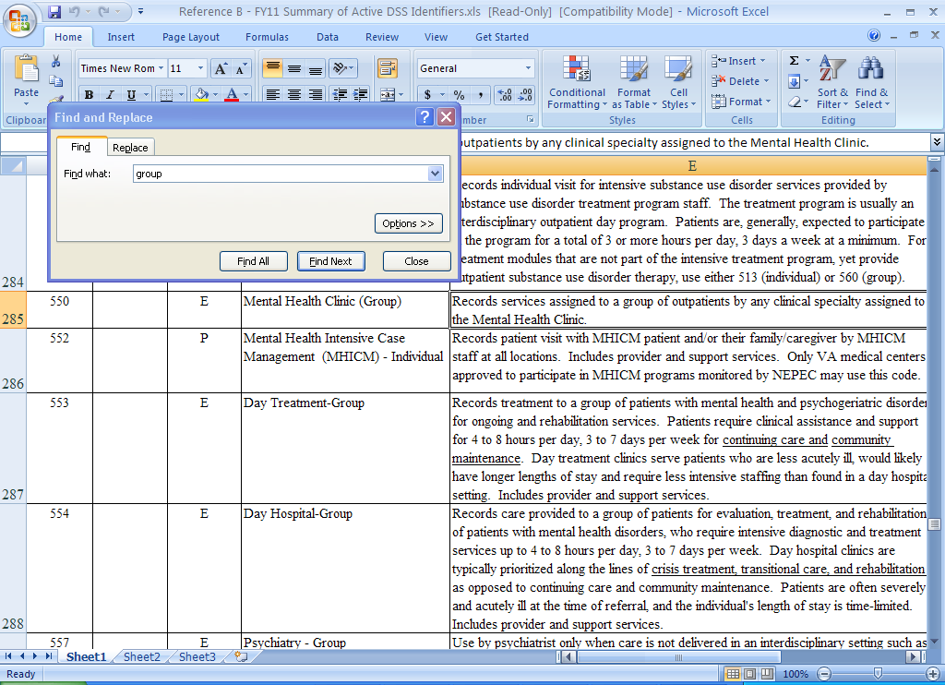
DSS Active Identifiers Use “Find” to Search For Key Words
Notes:
This is a downloaded version of the DSS Active Identifier reference.
I often receive questions about stop codes for certain pharmacy clinics or groups. As mentioned earlier, there is a PBM guidance document on clinic set-up. However, if what you are looking for is unique or not in the guidance document, you can easily use the “FIND” function to search for key workds.
In the example on the screen, I am searching for the key word, “GROUP”

Slide 27
Poll Question
You recently hired two pharmacists to do Medication Therapy Management (MTM) on your new Patient Aligned Care Teams (PACT).
The pharmacist will receive consults from the PACT MD and will see 15 patients for face to face visits on a daily basis. What is the correct stop code pair?
A. 323 (Primary Care)/160 (Clinical Pharmacy)
B. 160 (Clinical Pharmacy)/697 (Chart Consult)
C. 160 (Clinical Pharmacy)/No secondary stop
D. 160 (Clinical Pharmacy)/323 (Primary Care)
Notes:
Now I’d like to ask another poll question.
You recently hired two pharmacists to do MTM on your new Patient Aligned Care Teams.
The pharmacist will receive consults from the PACT MD and will see 15 patients for face to face visits on a daily basis. What is the correct stop code pair?
To answer this question, use the blue polling icon above my head. We’ll move on and come back to your results in just a moment.

Slide 28
Primary Stop Code
Designates the main clinical group responsible for the care
160
Notes:
The Primary Stop Code is the first 3 numbers of the DSS Identifier.
It designates the main clinical group responsible for the care of the patient
Pharmacy clinics should be given a primary stop code of 160
Note: There may be identified issues that require facilities to change the primary stop code from 160 to another code. If this occurs, it is imperative that the 160 stop code be used in the secondary position.
For example, some performance measures may only track primary stop codes. If the program office who created the performance measure did not include 160 in their tracking, you will need to use their codes. This can also be the case when program offices are tracking costs of programs – you may need to compromise in order for your facility to receive credit.

Slide 29
XXX
Secondary Stop Code
Notes:
Secondary Stop Code
Last three numbers of the DSS Identifier
Should be used to further define the practice setting
As mentioned previously, there may be identified issues that require facilities to change the primary stop code from 160 to another code. If this occurs, it is imperative that the 160 stop code be used in the secondary position.

Slide 30
Primary Stop Codes
160
176
160
176
Modality
Specific
147
338
178
Notes:
What are some common primary stop codes?
Face-to-Face:
160 – Clinical Pharmacy
176 - HBPC
Telephone has 3 commonly used primary stop codes and one MUST be used as a primary if it is a telephone encounter
338 – PACT telephone
147 – All other telephone besides PACT and HBPC
178 – HBPC telephone
Chart Consults
160 – Clinical Pharmacy
176 – HBPC
Certain areas may require deviation from this guidance for special funding or performance measure tracking

Slide 31
Common Secondary Stop Codes
Face To Face
323 (Primary Care)
317 (Anticoagulation)
Telephone
160 (Clinical Pharmacy)
Chart Consult
E-Consult
697 (Chart Consult)
Notes:
What are some common secondary stop codes?
Face to face:
323 (PACT/primary care)
317 (Anticoagulation)
Telephone
160 **HIGHLY ENCOURAGED or you will not know it’s a pharmacy telephone visit.
Chart Consult/E-consult
697 **Required** No other options
The PBM guidance document on clinic set up provides a great deal of primary/secondary stop code options.

Slide 32
Poll Results
You recently hired two pharmacists to do MTM on your new PACT. The pharmacist will receive consults from the PACT MD and will see 15 patients for face to face visits on a daily basis. What is the correct stop code pair
323 (Primary Care)/ 160 (Clinical Pharmacy)
160 (Clinical Pharmacy)/ (Chart Consult)
160 (Clinical Pharmacy)/ No secondary stop
160 (Clinical Pharmacy)/ 323 (Primary Care)
Notes:
Now let’s pause for a moment and take a look at your poll results.
What is your greatest concern regarding clinical pharmacy encounter documentation at your Medical Center?
Ad-lib to the audience results, then advance to move on.

Slide 33
Poll Results
323 (Primary Care)/ 160 (Clinical Pharmacy)
160 (Clinical Pharmacy)/ (Chart Consult)
160 (Clinical Pharmacy)/ No secondary stop
160 (Clinical Pharmacy)/ 323 (Primary Care)
Notes:
(This slide is a cue to Tech Team that you’re moving on) “Click” again to move on

Slide 34
CHAR4/ Alpha Code
Notes:
What is a CHAR4 Code? The CHAR4 code was previously called an ALPHA code
CHAR4 codes provide further granularity by clinic (it is NOT tied to each patient encounter)
A code is available for MOST major practice areas
See PBM Guidance Document on Clinic Set-Up for standardized use of CHAR4 codes
In this guidance, there are very specific details on the set-up of anticoagulation clinics and appropriate use of CHAR4 codes!
For example, DMPH – Diabetes pharmacist clinic would be used where diabetes is the only disease state being treated in the clinic; MTMP (Medication Therapy Management Pharmacist clinic) would be used as a broad category if you are doing multiple disease states or overall medication management in your clinic.
DSS must enter alpha codes in the DSS side of VISTA
The fileman field is called Clinic and Stop Codes
Field is not visible to us as part of the clinic profile
Please work with your local DSS staff for addition of alpha codes
Example: Inpatient Pharmacokinetics Clinic 160/697, PKPH
Facilities often ask me about the importance of CHAR4 codes. Do I really need to add them? For telephone and chart consult it is imperative so that we know what types of services are taking place in those clinics. It can also provide more granularity for face to face clinics as well. For example, 160/323 – clinical pharmacist in PACT, you may want more CHAR4 detail.

Slide 35
Face-to-Face Clinical Pharmacy Encounters Outpatient or Inpatient
Clinic set up as: 160/XXX
160/323 should be utilized for all PACT
Avoid codes: 160/000 , 160/160
A four character (CHAR4/alpha) code is ideal to further define the type of care being provided
Notes:
So, what would your clinic set up be for a face-to-face clinical pharmacy encounter?
Clinic set up as 160/XXX
160/323 should be utilized for all PACT
Clinics or disease management associated with specialty should be given secondary code for the specialty practice area
Avoid 160/000 unless a secondary stop code does not exist to define the care
Avoid 160/160 as it provides no useful information
A four character (CHAR4/alpha) code is ideal to further define the type of care being provided

Slide 36
Telephone Patient Care Encounters
338:
147:
178:
160:
Telephone Primary Care
Telephone Ancillary
Telephone HBPC
Secondary stop code for clinical pharmacy
Alpha codes (CHAR 4 codes)
Further delineate the pharmacist’s practice area
338/160 or 147/160 = What does this tell us?
Clinical pharmacy telephone but no insight into practice area
Notes:
Telephone encounters require specific telephone primary stop codes.
Primary stop codes commonly used by pharmacists include:
338: Telephone Primary Care
147: Telephone Ancillary
178: Telephone HBPC
Secondary stop code: 160 clinical pharmacy
Alpha codes (CHAR 4 codes): *USE*
Further delineate the pharmacist’s practice area
338/160 or 147/160 = Clinical pharmacy telephone but no insight into practice area

Slide 37
Chart Consult
Not Face to Face
Not Telephone
Not An E-Consult
Meets Definition of Count
Notes:
What are chart consults? It is easier to define chart consult by telling you what they are NOT -
Chart consults are NOT FACE to FACE
They are not Telephone
Chart consults are NOT and E-consult
The workload must meet the definition of count (history taken/clinical decision making)!
Chart consult workload must be encountered in a specific clinic set-up appropriately for chart consults.

Slide 38
Formal Consult
-OR-
Policy/Business Rule for Automatic Consult
Primary Stop Code: 160
Secondary Stop Code: 697
Notes:
Criteria for a chart consult clinic was established early in 2009 during our early discussions with DSS and HIMS on pharmacy workload capture.
Consult must be received - OR - a
Business rule (e.g., local medical center policy, committee decision) must exist to warrant an “automatic consult” to pharmacy.
*The original workgroup spent a great deal of time fighting for the ability to do a policy/business rule. The original rules required us to ask providers to enter a consult which was very counterproductive in situations where we had rules that allowed pharmacists to automatically consult on things. For example, aminoglycoside monitoring at many facilities is an automatic consult for pharmacy. We did not want our pharmacists to have to chase down physicians for an official consult.
*Note: See DSS “Pharmacy Workload Collection” document for additional details at: http://vaww.dss.med.va.gov/programdocs/pd_clinictop.asp
Primary stop code: 160 (176 if HBPC)
Secondary stop code: 697
Alpha (Char4) Code: *Important to Use*
Further delineate the pharmacist’s practice area.
160/697 = Clinical pharmacy chart consult but no insight into practice area

Slide 39
E-Consult versus Chart Consult
E-Consult
Consult
1 time
Chart
Auto consult
Recurring
NFs
Consult
Notes:
How can you really distinguish between an E-consult and a Chart Consult?
PBM has recently created more detailed E-Consult Guidance in coordination with The Office of Specialty Care based on many questions from the field.
The E-consult is a 1 time event that requires a consult to be placed where as
A chart consult is recurring and can be initiated by a consult or as we just discussed the “automatic consult” to pharmacy.
We will discuss this in more detail later in the presentation!

Slide 40
3 Key Ingredients to Clinic Set-Up
1 Stop
2 Stop
Char4
Provides Details Regarding Type of Encounter
Notes:
The 3 key ingredients to your clinic set up are choosing the appropriate:
Primary stop code
Secondary stop code
Char4 code
If chosen correctly, using the standardized clinic set-up guidance, it will provide details of clinical pharmacy practice for you locally.
It will also provide details on global pharmacy practice for your VISN and the National Program Office.

Slide 41
Understanding Copays
160 stop code = Basic Copay ($15)
Notes:
So, let’s shift gears and talk about how clinic set-up affects Veteran copays.
160 stop code = Basic Copay ($15)
Copay applies to face to face encounter
There is no copay for telephone or chart consult IF the clinics are set up appropriately
Two visits in 1 day?
Only 1 copay charged
Inappropriate to misrepresent clinic set-up to avoid a copay

Slide 42
Copay Scenario
Clinic set-up: 160 primary/323 secondary
Notes:
Let’s look at a common scenario:
-Pharmacist sees patient in PACT clinic
-Clinic set-up: 160 primary/323 secondary
-Progress note entered
-History and clinical decision making documented
Count (3 ’s)
Basic copay ($15) charged for 160 stop code

Slide 43
Copay Scenario #2
Clinic set-up: 160 primary/697 secondary
Notes:
Let’s discuss another scenario:
Pharmacokinetic intervention
Pharmacist reviews patient history/chart
Orders appropriate lab work
Ensures correct dosing/med
Clinic set-up: 160 primary/697 secondary
History and clinical decision making documented
Count (3 ’s)
The 697 secondary stop code for a chart consult will PREVENT a basic copay from being charged even though 160 is in the primary position.

Slide 44
Coding
Last piece of the puzzle…
Notes:
In order to complete the encounter, appropriate coding must be done – this is very important for billing of services.
Recently, the State of California has recognized pharmacists as providers which will further increase the ability to bill for clinical pharmacy services.

Slide 45
Medication Therapy Management
Services provided by a pharmacist to a patient during a face-to-face encounter that involve an assessment and intervention
Also used for chart consults and e-consults despite face-to-face definition
Notes:
Medication Therapy Management CPT codes can be used for services provided by a pharmacist to a patient during a face-to-face encounter that involve an assessment and intervention
Also used for chart consults and e-consults despite face-to-face definition

Slide 46
Medication Therapy Management
Initial 15 minutes with a new MTM patient
Each additional 15 minutes of an initial or subsequent MTM encounter; use in conjunction with 99605 or 99606
Initial 15 minutes with an established patient
99605
99606
99607
Notes:
The Medication Therapy Management CPT codes are:
99605: Initial 15 minutes with a new MTM patient
99606: Initial 15 minutes with an established patient
99607: Each additional 15 minutes of an initial or subsequent MTM encounter; use in conjunction with 99605 or 99606
Also used for chart consults and e-consults despite face-to-face definition

Slide 47
MTM Codes Inpatient/Chart Consults
Notes:
A CPT code is necessary to complete an inpatient or chart consult encounter
Inpatient/Chart consults are frequently not face to face
HIMS recommends pharmacy use the MTM codes as there are no other codes available for pharmacist use
Do not use additional minutes code (99607)
Mark clinic as nonbillable in MCCR package until payers recognize these services
Notify coding staff that pharmacy clinics with a secondary stop of 160 should not be billed

Slide 48
Billable/Non-billable Option
Work closely with billing staff to ensure billable clinics are marked billable
Not all facilities are aware that institutional fees can be billed for pharmacy clinics
Notes:
Option available in MCCR package
Work closely with billing staff to ensure billable clinics are marked billable
Not all facilities are aware that institutional fees can be billed for pharmacy clinics

Slide 49
Generic Recommendations
Face to face – mark billable
Non Face to Face (160/697) – mark non-billable
Mark clinic non-billable to avoid coding staff misinterpreting a note and thinking it is a face to face, billable clinic
Notes:
Option available in MCCR package
Generic recommendations
Face to face – mark billable
Non Face to Face (160/697) – mark nonbillable
Mark clinic nonbillable to avoid coding staff misinterpreting a note and thinking it is a face to face, billable clinic

Slide 50
Clinic Non-billable VISTA Option
Menu Option
MCCR System Definition Menu Option
Flag Stop Codes/Clinics for Third Party (FLTP)
Non-Billable OR Billable
A Stop/Clinic is assumed billable until it is flagged as non-billable
Stops the auto biller from creating bills for specified billable Stops/Clinics
Notes:
To mark a clinic non-billable the VISTA menu option is MCCR System Definition Menu Option.
Flag Stop Codes and Clinics for Third Party Billing
===============================================================================
FOR THIRD PARTY BILLING, THIS OPTION IS USED TO SET UP:
1. INDIVIDUAL OR A GROUP OF STOP CODES OR CLINICS AS:
a. NON-BILLABLE OR BILLABLE.
A Stop/Clinic is assumed billable until it is flagged as non-billable.
b. IGNORED BY THE AUTO BILLER. Stops the auto biller from creating
bills for specified billable Stops/Clinics.
2. ALL CLINICS TO BE:
a. IGNORED BY THE AUTO BILLER. Stops the auto biller from creating bills
for ALL clinics. Should only be used if the outpatient auto biller
is on but only a small number of Clinics should be auto billed.
b. BILLED BY THE AUTO BILLER. Resets all Clinics to be auto billed.
Use of this option will have an immediate effect on your billing operations
so you should have your work pre-planned before using this option.
Is this clinic Non-Billable for Third Party Billing? YES
Please enter the date this should become effective: 010108 (JAN 01, 2008)
DERMATOLOGY-TELEPHONE
Effective Jan 01, 2008 the above clinics will be Non-billable
and will NOT have bills created by the Third Party auto biller.
Is this correct, is it okay to proceed and file these entries? YES
Filing these CLINIC entries... . done
Select one of the following:
S STOP CODES
C CLINICS
A ALL CLINICS
Enter your choice: CLINICS
You may now enter the clinics that you wish to flag. Please note
all clinics that you select will be assigned the same effective
date and billable status and auto bill status.
Select CLINIC: DERMATOLOGY-TELEPHONE
Next CLINIC:

Slide 51
CPT Codes Non Physician Services - Telephone
98966: 5-10 minutes of medical discussion
98967: 11-20 minutes of medical discussion
98968 : 21-30 minutes of medical discussion
Notes:
CPT codes for telephone services should use the non-physician services code
98966 5-10 minutes of medical discussion
98967 11-20 minutes of medical discussion
98968 21-30 minutes of medical discussion

Slide 52
Virtual Care
Notes:
Virtual care modalities are becoming increasingly popular in the VA.
The benefits are wide-spread, providing benefit to the veteran and to the institution.
We will briefly touch on a variety of these modalities, including:
Secure messaging
E-Consults
Clinical Video Telehealth
Home Telehealth

Slide 53
Secure Messaging
160
719
98969
Primary stop code
Secondary stop code
CPT Code online assessment/ management
See PBM Guidance Document on Clinic Set-Up for further information
Notes:
Secure messaging is an excellent way to communicate with the patient via the computer.
This form of communication is extremely important to our younger, veteran population and has also become popular with our older veterans who have computers!
Primary stop code: 160
Secondary stop code: 719
CPT Code: 98969 (online assessment/management)
The service being reported with this code cannot be a continuation of a service that was provided within the previous seven days
See PBM Guidance Document on Clinic Set-Up for further information

Slide 54
E-Consults
Notes:
There has been a great deal of attention lately on E-consults. Recently, the clinical pharmacy program office released E-consult guidance to provide consistent use of e-consults throughout the system.

Slide 55
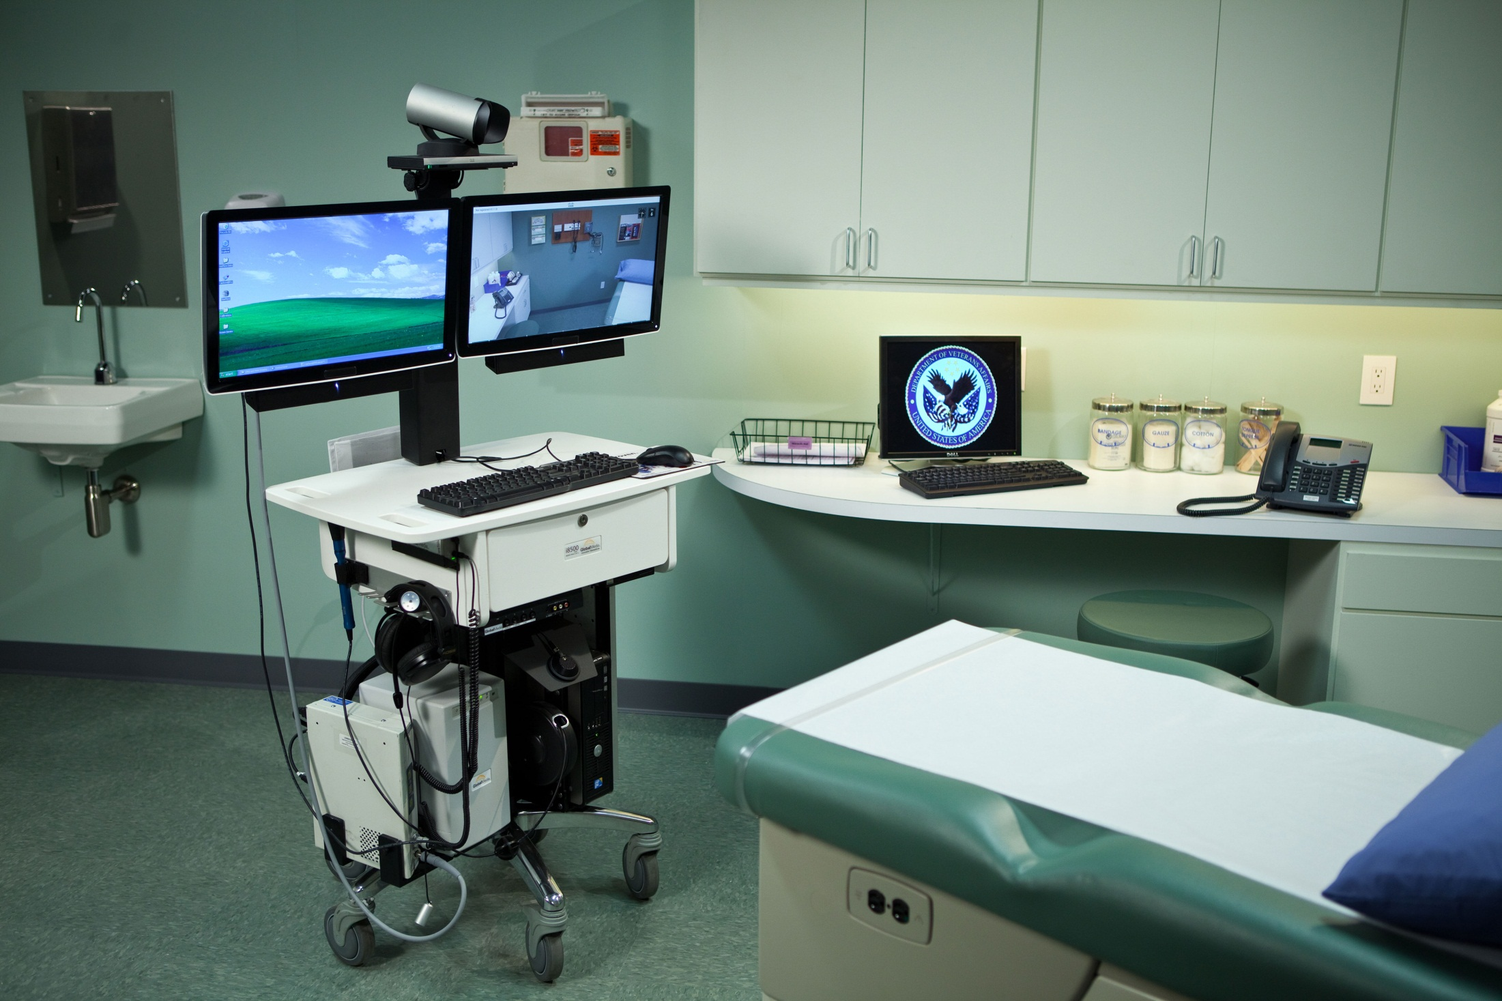
E-Consults
Consult from Provider to Provider
One-time episode of care
Patient must be informed
Used to capture encounterable workload
Requires a specific clinic set-up
Notes:
What is an E-consult?
http://vaww.infoshare.va.gov/sites/specialtycare/SCSTransformation/EConsult/default.aspx
Consult from Provider to Provider
One-time episode of care
Patient must be informed
A formal consent is not required. For example, the originating provider’s treatment plan may include that an E-consult will be placed and the patient agrees with the treatment plan.
Used to capture encounterable workload
Administrative questions and answers should not be placed through the E-consult system.
Requires a specific clinic set-up
*See PBM E-Consult Guidance or data definitions for E-consults on VSSC
https://securereports2.vssc.med.va.gov/ReportServer/Pages/ReportViewer.aspx?%2fTelehealth%2fVirtualCareModality&rs:Command=Render

Slide 56
E-Consults Appropriate Use
Medication Management Question
PACT provider to PACT pharmacist
PACT pharmacist to Specialty pharmacist
Medication Management question to a CPS at another facility
Notes:
Appropriate use of E-consults include:
1. Medication Management Question
2. Providers to PACT pharmacist (can be PACT provider to PACT pharmacist but do not to the detriment of the PACT model). Most facilities are saying PACT provider to PACT pharmacist for very involved/in depth questions.
3. PACT pharmacist to Specialty Pharmacist
4. Medication Management questions to a CPS at another facility.

Slide 57
E-Consults Inappropriate Use
Non-formulary or restricted drug consults
HBPC/Community Living Center (CLC) or similar recurring reviews
Clinical interventions from dashboard reviews
Antimicrobial stewardship monitoring
Notes:
Inappropriate Use of E-Consults are:
Non-formulary or restricted drug consults
While these consults do often answer a medication management question, they do not meet the intent of E-consults to increase access to specialty care.
Home Based Primary Care (or similar) chart reviews
Chart reviews by a pharmacist for HBPC are recurring and are not a single episode of care. Similar situations would be CLC, palliative care, etc.
Clinical interventions originating from dashboard reviews
These examples fit into a care coordination role. There is not a provider requesting a consult for a medication management issue and there is no patient consent for the process.
Antimicrobial stewardship monitoring programs
Antimicrobial stewardship monitoring programs generally have no consult and require continuous patient monitoring

Slide 58
Clinical Video Telehealth
“Business Plan for Clinical Pharmacy Services via Clinical Video Telehealth”
Notes:
Clinical Video Telehealth is another virtual modality we are using in the VA.
A website is available for the telehealth program and is included in the notes section of the slides:
http://vaww.telehealth.va.gov/
Also, The Clinical Pharmacy Program Office and Workload Capture Group are currently working on an update to the guidance.
Available by clicking on the green downloads button above my head
http://vaww.infoshare.va.gov/sites/ClinicalPharmacy/Clinical%20Specialty%20Pages/Virtual%20Care.aspx

Slide 59
Clinical Video Telehealth
Requires Two (2) Appointments
Patient Site
160
690
Provider Site
160
692
693
Same Station
Different
Station
Notes:
The most important thing to understand about Clinical Video Telehealth is that it requires two clinics:
160 will be the primary stop code
Originating Site/Patient Site (690)
Distant Site/Provider Site (692 should be used if the distant site is the same station and 693 should be used if it is a different station)
The distant site provides data required to complete the encounter for the originating site and the encounter must be completed at both sites to receive workload credit!

Slide 60
Home Telehealth
Program growth, frequent changes
Detailed guidance on documentation forthcoming in FY14
Notes:
In the past, home telehealth was known as care coordination/home telehealth or CCHT.
Oversight of home telehealth generally resides with a nurse leader; however, pharmacists may be involved to assist in medication management.
Patients enrolled self-report important vitals based on disease state, such as weight for heart failure, blood pressure and blood glucose.
We hope to provide detailed pharmacy guidance on this topic in FY14.

Slide 61
Home Telehealth (HT)
Operations manually available on the telehealth site
Pharmacist role may vary
Direct HT care coordination
Assist HT with Medication Management needs of the patient
Due to lack of pharmacy specific codes, excellent place to use alpha codes
Notes:
As stated, the pharmacists role in home telehealth may vary:
Direct coordination
Assist with medication management needs
For home telehealth, a detailed operations manual and coding manual is available on the telehealth website.
The link is available in the notes section of my slides.
http://vaww.telehealth.va.gov/pgm/ht/index.asp
http://vaww.telehealth.va.gov/pgm/ht/coding.asp
This operations manual provides information on appropriate clinic location names and appropriate clinic set-up.
Work with local DSS staff to ensure appropriate codes until guidance comes out for pharmacists in 2014.
DSS stop codes are selected based on the organizational structure of HT at each facility. The facility is required to choose Option 1 (separate service line) or Option 2 (integrated into an existing service line such as primary care or geriatrics).

Slide 62
Ask the Presenter
Notes:
If you haven’t submitted your questions yet, there is still time to do so by clicking on the orange “Ask The Presenter” icon. We’re going to show a brief announcement and be right back to answer your questions.
(Stand still and smile until you see the video come up full screen)

