Slide 1
ICD-10-CM
Conventions and Guidelines
Mary Johnson, RHIT, CCS-P
&
Jennifer Teal, MS, RHIA, CCS, CPC
AHIMA Approved ICD-10-CM/PCS Trainers
Notes:
Mary
Thank you Dawnell! Jennifer and I are happy to be here today to talk about the ICD-10-CM Conventions and Guidelines.
Facilities should have received AHIMA ICD-10-CM Coder Training Manuals which were provided for select staff at each of the VA Medical Centers. In this presentation, we will cover some of the content from the ICD-10-CM Overview section of those training manuals. For those of you that may not have the Coder Training Manual, that’s ok too. We are covering a broad overview of ICD-10-CM and you will still be able to follow along. This session will focus mainly on the ICD-10-CM conventions and guidelines, and a few chapter specific highlights. We will not get down into the specific coding scenarios covered in the training manuals. That material will be covered at a later date.

Slide 2

Introduction to ICD-10-CM
Changes, Structure
&
Format
Notes:
Image from: http://office.microsoft.com/en-us/images/results.aspx?qu=anxiety&ex=2#ai:MC900071389|
Jen
Many of you may feel like you are having a panic attach over the pending transition to ICD-10. In this presentation we hope to ease your fears by highlighting some of the distinct differences between ICD-9-CM and ICD-10-CM. By the end of the session, we hope that you come to realize that many of the basic underlying conventions and guidelines remain the same with ICD-10-CM. As with ICD-9, if you understand the conventions and guidelines, you should be able to apply them to any coding scenario.
If you have any questions along the way, you can submit them by clicking on the orange “Ask The Presenter” icon.

Slide 3

Poll Question
Are you feeling anxious about the transition to ICD-10?
    Very anxious
    Somewhat anxious
    Not at all anxious
    I can’t wait, I’m ready!
Notes:
Jen
Now I’d like to ask a poll question.
Are you feeling anxious about the transition to ICD-10?
Very anxious
Somewhat anxious
Not at all anxious
I can’t wait, I’m ready!
To answer this question, use the blue polling icon above my head. We’ll move on and come back to your results in just a moment.

Slide 4
ICD-9-CM ICD-10-CM
~ 13,000 Codes
Alpha (except V&E codes)
3-5 Digits
17 Chapters with 2 Supplements
3 Tables:
Hypertension, Drugs
& Chemicals, Neoplasms
~ 68,000 Codes
Alphanumeric
3-7 Characters
21 Chapters
2 Tables:
Drugs & Chemicals
Neoplasms
Notes:
Image from: http://office.microsoft.com/en-us/images/results.aspx?qu=compare&ex=1#ai:MC900435278|
Mary
ICD-10-CM represents a significant improvement over ICD-9-CM. The biggest change is the sheer volume of codes, going from approximately 13,000 codes in ICD-9-CM to approximately 68,000 codes in ICD-10-CM. The expansion provides the ability to offer codes that have a great deal more detail than was available in ICD-9.
I realize this slide looks intimidating – but hold on. . . .
ICD-10-CM consists of 21 chapters compared to 17 chapters in ICD-9-CM, and all codes are now alphanumeric.
Diagnosis coding under ICD-10-CM uses 3 to 7 characters instead of the 3 to 5 digits used with ICD-9-CM, but the format of the codes is similar.
Diseases and conditions of the sense organs (eyes and ears) have been separated from the nervous system diseases and conditions and have their own chapters in ICD-10-CM
To reflect current medical knowledge, certain diseases have been reclassified (or reassigned) to a more appropriate chapter in ICD-10-CM.
In contrast to ICD-9-CM which classifies injuries by type, ICD-10-CM groups injuries first by specific site (head, arm, leg, and such) and then by type of injury (fracture, open wound, and the like)
ICD-9-CM’s V and E code supplemental classifications are incorporated into the main classification in ICD-10-CM.
And last but not least, ICD-9-CM has 3 tables = hypertension, Drugs and Chemicals, and Neoplasms. In ICD-10, there are only 2 tables = Drugs and Chemicals, and Neoplasms. Later in this presentation we will discuss how the hypertension codes/rules have been tweaked.

Slide 5


ICD-9-CM
Let’s
Compare!
Category
Etiology, Anatomic
Site, Manifestation
ICD-10-CM
Category
Etiology, Anatomic
Site, Severity
Extensions
Notes:
Mary
Let’s take a look at the structure of the ICD-10-CM code. As you can see, the format is very similar to ICD-9, but longer in length. The first character of an ICD-10-CM code is an alphabetic letter. All the letters of the alphabet are utilized with the exception of the letter “U”.
The second character is numeric, and characters 3-7 can be alpha or numeric. As with ICD-9, a decimal is placed after the first three characters.
Personal experience – I attended an Ohio Heath Information Management Convention – Physician coding roundtable. My table had four attendees and all of us had coded more than 10 years – some like me had used ICD 8 – way back last century. We found we had such difficulty getting the correct code because we ‘old people’ forgot that you had to look for instructions at the place where the code was, at the beginning of the code section, at the beginning of the category and in the index. This is exactly how it works in ICD-9 – something we had all forgotten because we had a comfort level with ICD 9, we already knew what should be there. It was a gotcha moment.
Citation:
Barta, Ann; et al.. "ICD-10-CM Primer." Journal of AHIMA 79, no.5 (May 2008): 64-66.
http://library.ahima.org/xpedio/groups/public/documents/ahima/bok1_038084.hcsp?dDocName=bok1_038084

Slide 6
Poll Results
Are you feeling anxious about the transition to ICD-10?
    Very anxious
    Somewhat anxious
    Not at all anxious
    I can’t wait, I’m ready!
Notes:
Mary
Now let’s pause for a moment and take a look at your poll results.
The question asked was: Are you feeling anxious about the transition to ICD-10?
Very anxious
Somewhat anxious
Not at all anxious
I can’t wait, I’m ready!
(Respond to the results, explain to the audience why their participation was helpful, or why it was a good learning point before moving on.)
And now we’ll get back to our presentation – I’ll turn it over to Jennifer

Slide 7
Organization
Alphabetic Index to Diseases and Injury
Neoplasm Table
Table of Drugs and Chemicals
Alphabetic Index to External Causes of Injury
Tabular List
21 Chapters
Subchapters = Blocks containing 3 digit categories
Notes:
Jen
As you are thumbing through your ICD-10-CM book, you should notice that the look and feel is very similar to what you are used to with ICD-9. There are a few notable differences. You still have your Alphabetic Index, and your Tabular List. There is an Index to Diseases and Injuries as well as an Index of External Causes of Injuries.
As Mary mentioned, there are only two tables in ICD-10; the Neoplasm Table and the Table of Drugs and Chemicals. Another difference is that Morphology codes are not included in ICD-10-CM.
ICD-10-CM contains 21 chapters, as opposed to 17 in ICD-9. For some chapters the body or organ system is the axis of the classification, and with other chapters conditions are grouped together by etiology or nature of the disease process.
Chapter 20 and 21 of ICD-10 contain the codes that were Supplementary Classifications for External Cause of Injury (or E codes) and Factors Influencing Health Status (or V codes) in ICD-9 --- These sections are now part of the main tabular list in ICD-10-CM, they are no longer contained in a separate section in the Tabular List as they were in ICD-9.

Slide 8

This chapter contains the following BLOCKS…
D50-D53 Nutritional anemias
D55-D59 Hemolytic anemias
D60-D64 Aplastic & other anemias & other bone marrow failure syndromes
D65-D69 Coagulation defects, purpura & other hemorrhagic conditions
D70-D77 Other disorders of blood & blood-forming organs
D78 Intraoperative & postprocedural complications of the spleen
D80-D89
Certain disorders involving the immune mechanism
Notes:
Image from: http://office.microsoft.com/en-us/images/results.aspx?qu=block&ex=1#ai:MC900295859|
Jen
As I mentioned on the previous slide, we noted that there are now 21 Chapters, and within those chapters you will find a list of blocks contained within that chapter.
Mary: We can think of the blocks like a chapter outline.
That’s right. This is a good way to have a preview of the content for a given chapter. Here is an example of the blocks from Chapter 3, Diseases of the blood and blood-forming organs and certain disorders involving the immune mechanism (D50-D89).
In addition to reviewing the blocks at the beginning of each chapter, remember that you will want to review any instructional notes that pertain to that chapter as there are some instances where the chapter specific guidelines are listed only at the beginning of the chapter, but they need to be applied to the entire chapter. It is important not to overlook those guidelines. Kind of like your “gotcha” reminder earlier Mary. Many of us have memorized codes or become encoder dependent. We forget to stop and review all of the instructional notes and guidelines provided in the tabular list.

Slide 9
Poll Question
The first character of an ICD-10-CM code is:
    Either a letter or number
    Always a letter
    Always a number
Notes:
Mary
Now I’d like to ask another poll question.
The first character of an ICD-10-CM code is:
Either a letter or number
Always a letter
Always a number
To answer this question, use the blue polling icon above my head. We’ll move on and come back to your results in just a moment.

Slide 10
Combination Codes
Laterality
Episode of Care
Placeholder Character
OB - Use of Trimesters
Timeframes
Excludes Notes
Notes:
Image from: http://office.microsoft.com/en-us/images/results.aspx?qu=New&ex=1#ai:MC900105188|
Jen
Ok, now lets turn our attention to some of the new features that are noteworthy in ICD-10-CM. Shown here on this slide is some of the differences that we would like to draw your attention to.

Slide 11

Combination Codes
E10.42
Type 1 diabetes mellitus with diabetic polyneuropathy
I25.110
Atherosclerotic heart disease of native coronary artery with unstable angina pectoris
K50.112
Crohn’s disease of large intestine with intestinal obstruction
Notes:
Jen
Combination codes are not a new concept. However, there are many more combination codes in ICD-10, allowing a single code to capture both the condition and associated symptoms or manifestation. There are several examples on this slide but lets take a closer look at the diabetes example.
In the diabetes example on this slide you can see that a single code represents the type of diabetes, type 1, the body system affected, neurological manifestations, and the specific complication affecting that body system, such as polyneuropathy.

Slide 12
Combination Codes
T36.0X1D
Poisoning by penicillins, accidental (unintentional), subsequent encounter
T42.4X5A
Adverse effect of enzodiazepines, initial encounter
Notes:
Jen
Combination codes are also seen for poisonings and external causes where a single code represents the intent as well as the substance and episode of care. In the example of T36.0x1D, the code reflects the substance being penicillin, the intent being accidental poisoning, and the episode of care being a subsequent encounter.
The use of combination codes allows a single code to reflect a greater level of specificity and clinical detail than what was possible with ICD-9.
I also want to point out that you are seeing an example of the placeholder character X reflected in these codes. Mary will go a bit more into detail about the significance of that placeholder in just a moment.

Slide 13
Poll Results
The first character of an ICD-10-CM code is:
    Either a letter or number
    Always a letter
    Always a number
Notes:
Jen
Now let’s pause for a moment and take a look at your poll results.
We asked what the first character of an ICD-10-CM code is:
The correct answer is B, always a letter. The first character of an ICD-10-CM code is an alphabetic letter. All the letters of the alphabet are utilized with the exception of the letter “U” which has been reserved for future expansion. The second character is always numeric, and characters 3-7 can be alpha or numeric. As with ICD-9, a decimal is placed after the first three characters.
And now we’ll get back to our presentation – Mary, back to you!

Slide 14
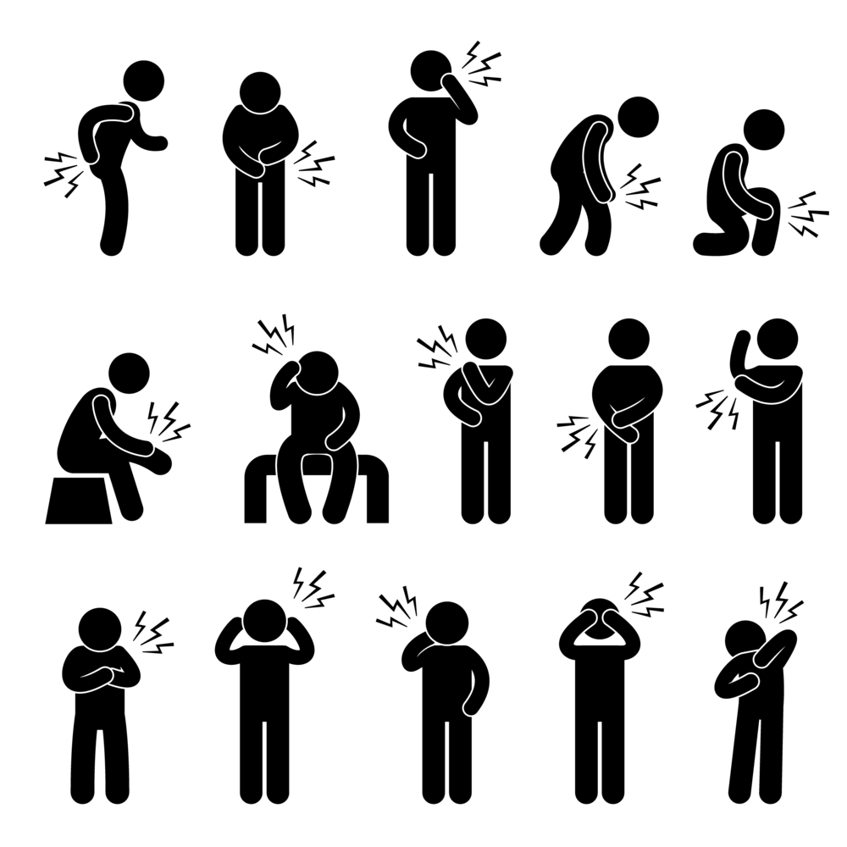
Laterality
S50.00
Contusion of unspecified elbow
S50.01
Contusion of right elbow
S50.02
Contusion of left elbow
Notes:
Image from: http://office.microsoft.com/en-us/images/results.aspx?qu=elbow&ex=1#ai:MP900426458|
Mary
Some ICD-10-CM codes indicate laterality, specifying whether the condition occurs on the left, right or is bilateral. If no bilateral code is provided, such as with the example shown on this slide, and the condition is bilateral, assign separate codes for both the left and right side. If the side is not identified in the medical record, assign the code for the unspecified side. You will notice the slide demonstrates the unspecified elbow contusion.

Slide 15
Episode of Care
A initial encounter
D subsequent encounter
S sequela
Notes:
Mary
Episode of Care is a new concept in ICD-10. In the areas of Obstetrics, Injuries, and External causes, you will find the Episode of Care represented by the seventh character. The episode of care represents whether this is an initial encounter, subsequent encounter, or a sequela. The 7th character option can provide different information on the services being delivered For example, there are many more choices for the 7th character in the area of fractures –healing, malunion, etc. Jennifer will show you an example of that when we cover the chapter on Injuries.
When appending the episode of care designation – the ICD 10 code MUST be seven characters long. Often times the diagnosis code is three, four or five characters long and as such the codes will require a Placeholder Character (x) for characters preceding the 7th character in order to add the appropriate episode of care which must always be in the 7th character position. BUT – more information on the X code we will get to shortly.
JEN
You might be wondering what constitutes an initial encounter vs. subsequent encounter vs. sequela.
7th character “A”, initial encounter is used while the patient is receiving active treatment for the condition. Examples of active treatment are: surgical treatment, emergency department encounter, and evaluation and treatment by a new physician.
7th character “D” subsequent encounter is used for encounters after the patient has received active treatment of the condition and is receiving routine care for the condition during the healing or recovery phase. Examples of subsequent care are: cast change or removal, removal of external or internal fixation device, medication adjustment, other aftercare and follow up visits following treatment of the injury or condition.
A sequela is the residual effect (condition produced) after the acute phase of an illness or injury has terminated. There is no time limit on when a sequela code can be used. Sequela replaces the term Late Effect which was used in ICD-9. 7th character “S”, sequela, is for use for complications or conditions that arise as a direct result of a condition, such as scar formation after a burn. The scars are sequelae of the burn. When using 7th character “S”, it is necessary to use both the injury code that precipitated the sequela and the code for the sequela itself. The “S” is added only to the injury code, not the sequela code. The 7th character “S” identifies the injury responsible for the sequela. The specific type of sequela (e.g. scar) is sequenced first, followed by the injury code.
MARY
Thanks Jennifer. One thing to note is that aftercare codes are not used in ICD-10 since the 7th character reflects the specific episode of care. What that means – if the treatment is for a fracture – the fracture code, itself, will be used at the initial encounter and every subsequent encounter until it is healed and no longer warrants treatment.
In this example, in ICD-9 we coded the fracture only at the initial visit and then used aftercare codes. In ICD-9 if we had used the fracture codes during the aftercare period, it would appear as if the patient had a new fracture. ICD-10’s rule is very different, but makes sense.

Slide 16

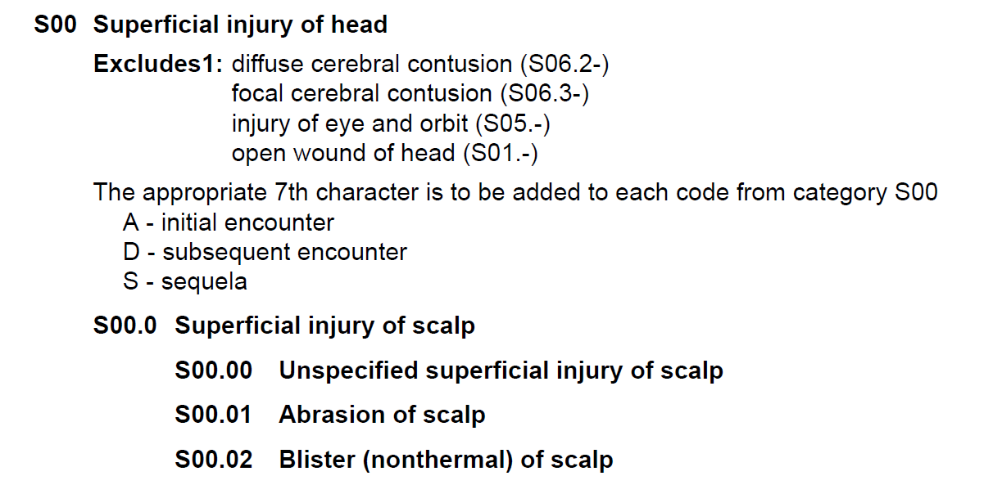
Placeholder Character
ICD-10-CM Tabular List of Diseases and Injuries 2013
Notes:
Image from: http://office.microsoft.com/en-us/images/results.aspx?qu=X&ex=1#ai:MC900439584|
Mary
Ok – that previously mentioned place holder character code to be used with ICD 10. Think of this as ‘X’ marks the spot.
As noted in the discussion on episode of care – the episode of care characters, A, D, S, are always in the seventh character location. In the event the ICD 10 code, which identifies the patient’s disease/injury, is less than seven characters long – the code could have only three, four or five characters - the “X” is used as a placeholder to allow for the expansion and provides us the ability to report all seven characters.
There are several categories where the placeholder character X will be used. Examples of some of the different categories would be poisoning, adverse effect and under dosing codes, injuries, etc.
Jen: So Mary, looking at the example on this slide, I see that code S00.01 for Abrasion of the scalp is only 5 characters. In order to apply the 7th character, we would need add the placeholder X as the 6th character, and then add the appropriate 7th character.
That’s right Jennifer. Again – when using an episode of care extension, the code itself must always have seven characters. Where a placeholder is needed the X must be used in order for the code to be considered a valid code. The valid code choices in this scenario would be either S00.01XA if it were an initial encounter, S00.01XD if it were a subsequent encounter, or S00.01XS if the encounter was for a sequela associated with the initial injury.
This statement that could be repeated over and over as the concept is completely new – but yet similar to the need to add a fifth digit. In the event we don’t add the placeholder code, using the above example, only six characters would be reported – S00.01D. This would be considered an incomplete code and unacceptable.

Slide 17

Use of
Trimester
O09.211 Supervision of pregnancy w/ history of pre-term labor, first trimester
O09.212 Supervision of pregnancy w/ history of pre-term labor, second trimester
O09.213 Supervision of pregnancy w/ history of pre-term labor, third trimester
O09.219 Supervision of pregnancy w/ history of pre-term labor, unspecified trimester
Notes:
Image from: http://office.microsoft.com/en-us/images/results.aspx?qu=pregnancy&ex=1#ai:MP900448533|
Mary
Obstetrics codes now include the use of trimesters instead of weeks.
Trimesters are counted from the first day of the last menstrual period. They are defined as follows:
1st trimester- less than 14 weeks
2nd trimester- 14 weeks to less than 28 weeks
3rd trimester- 28 weeks until delivery
The slide provides us a look at how trimesters are coded along with a code for unspecified as to number of weeks or trimesters.
The expectation is that the provider will enter that level of information at every visit – which trimester or number of weeks. Of course we know that won’t always happen and instead of immediately selecting the unspecified diagnosis we could review the health record and make the determination of which trimester based on the reported date of the last menstrual period.

Slide 18

Changes in
Timeframes
Acute myocardial infarction – time period changed from 8 weeks to 4 weeks
Time frame for abortion versus fetal death changed from 22 weeks to 20 weeks
Notes:
Mary
Some of the time elements we have been using ‘forever’ are being changed. A perfect example and one that will be the most impacting will be the codes for acute myocardial infarctions. The MI codes are used for encounters occurring while the myocardial infarction is equal to, or less than, four weeks old, including transfers to another acute setting or a post acute setting, and the patient requires continued care for the myocardial infarction. Recall that in ICD-9-CM, the timeframe for an acute MI was 8 weeks or less. In ICD 10 the time frame was cut in half – 4 weeks.
Other categories with a change in the timeframe for reporting is abortion versus fetal death, which goes from 22 weeks in ICD-9 to now only 20 weeks in ICD-10-CM. If the fetus expires before 20 weeks it is considered an abortion (spontaneous abortion and miss-carriage are one and the same) and if over 20 weeks it is considered a fetal death.
Before we move on, a quick reminder that if you have any questions, be sure to use the orange ask a presenter “Ask The Presenter” icon above my head. We will answer your questions at the end of the presentation.

Slide 19
Poll Question
Which of the following is the correct code for an initial encounter for treatment of electrocution? The code for electrocution is T75.4.
    T75.4A
    T75.4XA
    T75.4XXA
    T75.4
Notes:
Jen
Here is another question from your ICD-10-CM Coder Training Manual by AHIMA.
The ICD-10-CM code for electrocution is T75.4 and requires the use of a seventh character to identify the encounter. Which of the following is the correct code for an initial encounter to treat the electrocution?
To answer this question, use the blue polling icon above my head. We’ll move on and come back to your results in just a moment.

Slide 20

ICD-9-CM Excludes Note
Should not be used in conjunction with the code from which it is excluded
OR
May be used together with an excluded code
Notes:
Image from: http://office.microsoft.com/en-us/images/results.aspx?qu=question&ex=1#ai:MC900078622|
Mary
Let’s step back and look at the excluded convention in ICD-9. In the tabular list of ICD 9 an excludes note under a code indicates that the terms excluded from the code, are to be coded elsewhere. However, the meaning of excludes in ICD-9 can be a bit ambiguous.
In some cases the codes for the excluded terms should not be used in conjunction with the code from which it is excluded. Clear as mud???? An example of this is a congenital condition excluded from an acquired form of the same condition. The congenital and acquired codes should not be used together.
In other cases, the excluded terms may be used together with an excluded code. An example of this is when fractures of different bones are coded to different codes. Both codes may be used together if both types of fractures are present. Typically both fractures are not present at the same time, hence the exclusion.

Slide 21
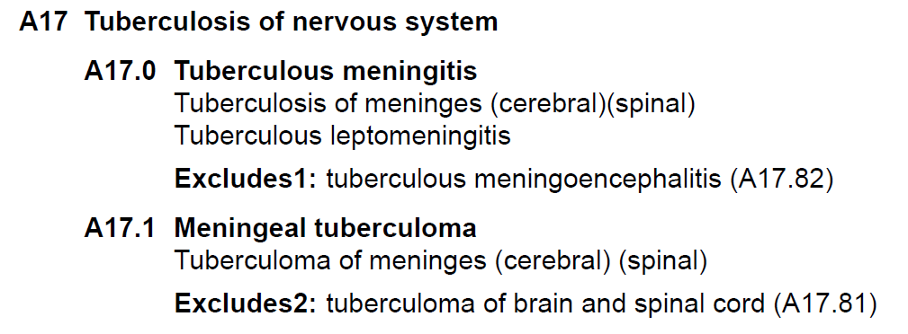
ICD-10-CM Excludes Notes
ICD-10-CM Tabular List of Diseases and Injuries 2013
Notes:
Mary
Now – let’s look at how ICD-10-CM has defined the convention – and to start, please note ICD 10 has two separate types of Excludes notes definitions.
Excludes1
A type 1 Excludes note is a pure excludes note. It means “NOT CODED HERE!” An Excludes1 indicates that the code excluded should never be used at the same time as the code above the Excludes1 note. An Excludes1 is used when two conditions cannot occur together, such as a congenital form versus an acquired form of the same condition.
Excludes2
A type 2 Excludes note represents “Not included here.” An excludes2 indicates that the condition excluded is not part of the condition represented by the code, but a patient may have both conditions at the same time. When an Excludes2 note appears under a code, it is acceptable to use both the code and the excluded code together, when appropriate.
Jen: Ok Mary, if I am following the guidelines correctly, using the example on the slide here, I would never use codes A17.0 and A17.82 together. Since there is an Excludes1 note, this means that those two conditions listed cannot occur together. I could however use A17.1 and A17.81 together when appropriate, if the patient had both of these conditions since tuberculoma of the brain and spinal cord (A17.81) is not included in tuberculoma of the meninges represented by A17.1.
You’ve got it Jennifer. With Excludes1, the two conditions cannot occur together and with Excludes2 they may occur together – similar to the ICD 9 examples only in ICD 10 both examples have an individual name – Excludes 1, Excludes 2

Slide 22
Poll Results
Which of the following is the correct code for an initial encounter for treatment of electrocution? The code for electrocution is T75.4
    T75.4A
    T75.4XA
    T75.4XXA
    T75.4
Notes:
Mary
Now let’s pause for a moment and take a look at your poll results. The question asked what the correct code is for an initial encounter for treatment of electrocution. The correct answer is C, T75.4XXA.
Recall that the seventh character must always be the seventh character in the data field. If a code that requires a seventh character is not six characters long, a placeholder X must be used to fill in the empty characters. So in this case, since the code for electrocution, T75.4, is only 4 characters long, you must add a placeholder X for characters 5 and 6 in order to use the appropriate 7th character for initial encounter.
And now we’ll get back to our presentation – Jennifer, take it away.
Slide reference: AHIMA ICD-10-CM Coder Training Manual, 2013 Edition, page 85.

Slide 23
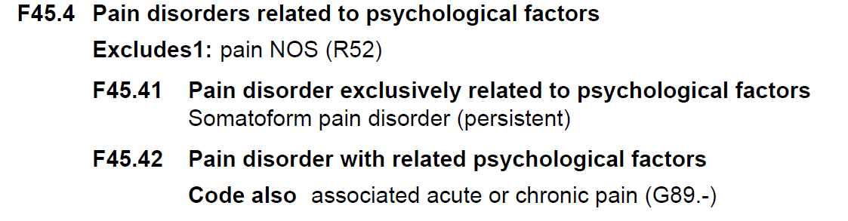
Code Also Note
Notice the dash (-) which denotes additional digit required
ICD-10-CM Index to Diseases and Injuries 2013
Notes:
Jen
A “code also” note instructs that two codes may be required to fully describe a condition, but this note does not provide sequencing direction. This is one of the new coding conventions with ICD-10-CM. Again, a code also not does not give you direction as far as sequencing. You would follow other coding guidelines, such as selection of the principal diagnosis, to determine the sequencing.
Also make note the dash after G89.- on this slide. ICD-10 uses a dash to indicate that additional characters are required.

Slide 24
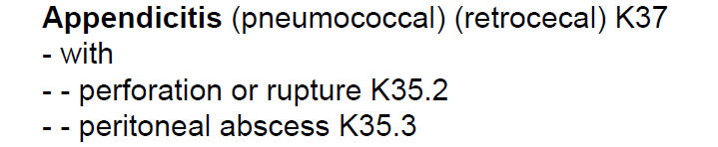
Default Code
ICD-10-CM Index to Diseases and Injuries 2013
Notes:
Jen
A code listed next to a main term in the ICD-10-CM Alphabetic Index is referred to as a default code. This is also a new coding convention with ICD-10-CM.
The default code represents that condition that is most commonly associated with the main term, or is the unspecified code for the condition. If a condition is documented in a medical record such as appendicitis, without any additional information, such as acute or chronic, the default code should be assigned.

Slide 25

Borderline Diagnosis
Borderline
diabetes mellitus
R73.09
Notes:
Image from: http://office.microsoft.com/en-us/images/results.aspx?qu=sick&ex=1#ai:MC900433824|
Jen
If the provider documents a "borderline" diagnosis at the time of discharge, the diagnosis is coded as confirmed, unless the classification provides a specific entry. If a borderline condition has a specific index entry in ICD-10-CM, like the borderline diabetes example shown on this slide, it should be coded as such.
Since borderline conditions are not uncertain diagnoses, no distinction is made between the care setting (inpatient versus outpatient).
Whenever the documentation is unclear regarding a borderline condition, coders are encouraged to query for clarification.

Slide 26
Poll Question
When an Excludes2 note appears under a code, it is acceptable to use both the code and the excluded code together.
    True
    False
Notes:
Mary
Let’s ask another poll question. I covered Excludes instructional notes a few minutes ago. So the question is:
When an Excludes2 note appears under a code, it is acceptable to use both the code and the excluded code together, when appropriate.
Select A for True or B for False.
Remember, to answer this question, use the blue polling icon above my head. We’ll move on and come back to your results in just a moment.

Slide 27

Chapter Specific
Highlights
Notes:
Image from: http://office.microsoft.com/en-us/images/results.aspx?qu=highlight&ex=1#ai:MC900389740|
Jen
Now that we have provided an introduction and overview of the ICD-10-CM Conventions and Guidelines, lets touch a little bit on the chapter specific highlights. And please note – on the slides where you se the words “RESERVED”, that means that at this time there aren’t any published guidelines for that particular chapter, but the expectation is that there will be changes in the future. Remember, the ICD-10-CM Coder Training Manual covers each of the chapters in more detail than what we will cover today. Be sure to take a look and complete some of the coding cases that were included. Remember, the answers to the coding cases from the Coder Training Manual are provided in the back of the book, so that you can check your work.
Remember, if you have any questions during our presentation, you can submit them by clicking on the orange “Ask The Presenter” icon.
Before we more on to the chapter specific highlights, I’d like to offer a suggestion for becoming familiar with the differences in guidelines…(JEN give example of the side-by-side PDF comparison)

Slide 28
Chapter 1: Certain Infectious and Parasitic Diseases (A00-B99)
New Guideline: Infectious agents as the cause of diseases classified to other chapters
New Guideline: use additional code for associated drug resistance (Z16)
Sepsis replaces septicemia throughout Chapter 1
No default code for “urosepsis”
Notes:
Image from: http://office.microsoft.com/en-us/images/results.aspx?qu=New&ex=1#ai:MC900105188|
Jen
Chapter 1 contains a new guideline titled, Infectious agents as the cause of diseases classified to other chapters. Certain infections are classified in chapters other than Chapter 1 and no organism is identified as part of the infection code. In these instances, it is necessary to use an additional code from Chapter 1 to identify the organism.
Many bacterial infections are resistant to current antibiotics. It is necessary to identify all infections documented as antibiotic resistant. There is a new guideline to assign a code from category Z16, Resistance to antimicrobial drugs, following the infection code if the infection code itself does not identify drug resistance.
Here is another change. In ICD-10, there is no default code for “urosepsis” – If the documentation states urosepsis, you must query the provider. Do they mean sepsis, or do they mean UTI for example.
Finally, many codes in this chapter have been expanded to include manifestations.

Slide 29
Here’s an Example
Infections of the skin and subcutaneous tissue (L00-L08)
Use additional code (B95-B97) to identify infectious agent.
L03.011 Cellulitis of right finger
B95.8 Unspecified staphylococcus as the cause of diseases classified elsewhere
Notes:
Jen
Here is an example of the new guideline pertaining to infectious agents as the cause of diseases classified to other chapters.
The guideline requires that a code from category B95, Streptococcus, Staphylococcus, and Enterococcus as the cause of diseases classified to other chapters, or B96, Other bacterial agents as the cause of diseases classified to other chapters, or B97, Viral agents as the cause of diseases classified to other chapters, is to be used as an additional code to identify the organism.
In the example on this slide, the patient has cellulitis caused by a staph infection. As a result, we would assign one code for the cellulitis, and a second code to identify the staph as the cause.

Slide 30

Chapter 2:
Neoplasms (C00-D49)
Several new guidelines added to Chapter 2.
Be sure to review!
Notes:
Image from: http://office.microsoft.com/en-us/images/results.aspx?qu=Magnify&ex=1#ai:MC900437797|
Jen
One significant change with this chapter is that morphology codes are not included in ICD-10-CM while they were in ICD-9. “M” codes in ICD-10-CM actually represent codes from Chapter 13, Diseases of the musculoskeletal system and connective tissue.
There are also several new guidelines in this chapter, so you will want to be sure to review them.
One significant change is related to anemia associated with a malignancy. The ICD-10-CM guidelines state, “When the admission or encounter is for management of an anemia associated with the malignancy, and the treatment is only for anemia, the appropriate code for the malignancy is sequenced as the principal or first-listed diagnosis followed by the appropriate code for the anemia.
Mary: This is in direct contrast to the ICD-9-CM guidelines which requires that the appropriate anemia code is designated as the principal diagnosis, followed by the appropriate code(s) for the malignancy.

Slide 31
Poll Results
When an Excludes2 note appears under a code, it is acceptable to use both the code and the excluded code together.
    True
    False
Notes:
Jen
Now let’s pause for a moment and take a look at your poll results.
The question was: When an Excludes2 note appears under a code, it is acceptable to use both the code and the excluded code together, when appropriate.
The correct answer is True (A).
A type 2 Excludes note represents “Not included here”. An Excludes2 note indicates that the condition excluded is not part of the condition represented by the code, but a patient may have both conditions at the same time.
And so. . . Remember Excludes 1 – Not coded here
Excludes 2 – Not included here
(Respond to the results, explain to the audience why their participation was helpful, or why it was a good learning point before moving on.)
And now we’ll get back to our presentation – Mary, it’s all yours.

Slide 32
Chapter 3: Disease of the Blood and
Blood-forming Organs (D50-D89)
Chapters 3 & 4 swapped in ICD10-CM compared to ICD-9-CM
Guidelines reserved for future expansion
RESERVED
Notes:
Mary
Interesting tidbit to note – there aren’t any specific guidelines for Chapter 3 – which is diseases of the blood and blood forming organs ; however you will find that the guidelines – rules if you will – are actually outlined in Chapter 2, which Jennifer just shared with us. Chapter 2 provides guidelines for coding anemia associated with malignancies and for anemia associated with chemotherapy, immunotherapy, and radiation therapy all of which fit very nicely for Chapter 3 – diseases of the Blood and Blood forming Organs.
NOTE – this slide has ‘Reserved’ written on it, and earlier Jennifer told us that this indicated that no chapter guidelines have been published yet, but expect future changes to occur.

Slide 33
Chapter 4: Endocrine, Nutritional, and Metabolic Diseases (E00-E89)
5 Categories for DM
Single code often reflects manifestations and complications
No controlled or uncontrolled
Notes:
Image from: http://office.microsoft.com/en-us/images/results.aspx?qu=New&ex=1#ai:MC900105188|
Mary
Chapter 4 is for the endocrine, nutritional and metabolic disorders – and with ICD-10-CM there are 5 categories for DM.
1. Diabetes mellitus due to underlying condition
2. Drug or chemical induced diabetes mellitus
3. Type 1 diabetes mellitus – type 1 includes conditions such as brittle DM or juvenile onset
4. Type 2 diabetes mellitus – think of type 2 as being caused by insulin deficiencies – adult onset
5. Other specified diabetes mellitus which includes conditions such as diabetes mellitus due to genetic defects, postpancreatectomy diabetes mellitus, post procedural diabetes mellitus, or secondary diabetes mellitus NEC.
You will also find a prevalent use of combination codes within this chapter. A single code often reflects manifestations and complications.
Also note, Diabetes is no longer classified as controlled vs. uncontrolled in ICD-10-CM as it was with ICD-9-CM.
Jen: How many times did we have to query the provider for clarification on whether the patient’s diabetes was currently under control or not. Interesting that it will no longer be a determining factor for classifying diabetes in ICD-10.

Slide 34
Let’s Compare!
Patient presents with diabetic retinopathy, DM type II.
ICD-9
250.50, 362.01
Type 2 diabetes mellitus with ophthalmic manifestations
ICD-10
E11.319
Type 2 diabetes mellitus with unspecified diabetic retinopathy without macular edema
Diabetic retinopathy NOS
Notes:
Mary
Diabetes – let’s compare the differences.
In ICD 9 the diabetes code of 250.5x - Diabetes with ophthalmic manifestations prompts us to use an additional code to identify the manifestation – such as retinopathy – 362.0x.
In ICD 10 the code E11.319 represents type 2 diabetes with unspecified diabetic retinopathy – without macular edema – one code says it all.
Of course in ICD-9 and ICD 10 we are advised to add an additional code for the current long-term use of insulin. In ICD 9 the code would be V58.67 and in ICD 10 the code would be Z79.4
Slide reference:
ICD-9-CM Coding: Theory and Practice with ICD-10, 2013/2014 Edition
By Karla R. Lovaasen, RHIA, CCS, CCS-P and Jennifer Schwerdtfeger, BS, RHIT, CCS, CPC, CPC-H
Elsevier Saunders

Slide 35
Chapter 5: Mental, Behavioral and Neurodevelopmental Disorders (F01-F99)
There are now guidelines for this chapter in ICD-10-CM where there weren’t any in ICD-9-CM.
Notes:
Image from: http://office.microsoft.com/en-us/images/results.aspx?qu=New&ex=1#ai:MC900105188|
Mary
One significant change in the classification of conditions in this chapter is that for substance use/abuse/dependence, “continuous” or “episodic” are no longer part of the classification. Also note that when a patient has a history of drug or alcohol abuse/dependence, it is coded as “in remission” rather than using the history of V codes as in ICD-9-CM. Codes for “in remission” are based on the clinical documentation, and the ICD-10-CM guidelines provide a hierarchy of which code to use for scenarios when the documentation refers to use, abuse and dependence of the same substance You would only assign one code based on the hierarchy in the guidelines. For example, if both use and abuse are documented, assign only the code for abuse. If both abuse and dependence are documented, assign only the code for dependence – all of which is defined within the tabular list.

Slide 36
Chapter 6: Diseases of the Nervous
System (G00-G99)
Chapter 6 in ICD-9-CM
EXPANDED
to
Chapters 6, 7 & 8 in ICD-10-CM
Guidelines for dominant/nondominant side.
Notes:
Mary
Some of the conditions in this chapter, such as hemiplegia and hemiparesis, require identification of whether the dominant or nondominant side is affected. The primary change is that ICD-10-CM Guidelines now provide instruction for coding when the affected side is documented but not specified as dominant or nondominant, and the classification system does not indicate a default code – such as NOS.
According to the guidelines, when the affected side is documented, but not specified as dominant or nondominant and there is no default code in the classification, code as follows:
For ambidextrous patients, the default should be dominant.
If the left side of the body is affected, the default is non-dominant.
If the right side of the body is affected, the default is dominant.

Slide 37
Chapter 7: Diseases of the Eye and Adnexa (H00-H59)
New Chapter
Codes offer greater specificity and laterality
Guidelines reserved for future expansion
RESERVED
Notes:
Mary
Entirely new chapter , Chapter 7, providing an entire chapter on eye and adnexa conditions and you will find some categories have undergone title changes to reflect the terminology used today. For example, ICD-9 uses senile cataract while ICD-10 utilizes the descriptor age-related cataract. Many of the classifications have to do with the expansion of characters to provide for laterality. Right side, left side, bilateral sides for diseases of the eye and adnexa and as such the list of codes exploded.
Gentle reminder- ‘Reserved’ means that there aren’t any guidelines published yet for this chapter, so be on the lookout for them in the future.

Slide 38
Chapter 8: Diseases of the Ear and
Mastoid Process (H60-H95)
Guidelines reserved for future expansion
Codes offer greater specificity and laterality
Many “code first underlying disease” notes
RESERVED
Notes:
Mary
Chapter 7 was dedicated to eye conditions so it stands to reason that the diseases of the ear and mastoid process have their own chapter – Chapter 8. The more significant changes with this chapter is that you will notice that many of the codes offer greater specificity and include laterality.
Chapter 8 of ICD-10-CM is organized into the following blocks making it easier to distinguish diseases of the various parts of the ear and mastoid process.
H60-H62 Disease of external ear
H65-H75 Disease of middle ear and mastoid
H80-H83 Disease of inner ear
H90-H94 Other disorders of ear
H95 Intraoperative and post procedural complications and disorders of ear and mastoid process, not elsewhere classified.
There are no chapter-specific guidelines for this chapter but there is an expectation of future changes/updates as noted with the chapter of the eye.
Alright Jennifer, do you want to take it over from here?

Slide 39
Chapter 9: Diseases of the Circulatory System (I00-I99)
I10 Essential (Primary) Hypertension
Includes:
High Blood Pressure
Hypertension
(arterial)(benign)(essential)
(malignant)(primary)(systemic)
Notes:
Image from: http://office.microsoft.com/en-us/images/results.aspx?qu=New&ex=1#ai:MC900105188|
Jen
One major change to this chapter is the fact that the type of hypertension is no longer required (benign, malignant, unspecified). As a result, the hypertension table has been eliminated.
You will notice on this slide that both benign and malignant are nonessential modifiers. This means that the presence or absence of those terms do not change the code selection.
Mary
Ah – nonessential modifiers – this was a convention in ICD-9-CM as well, of course with hypertension they have added benign and malignant as nonessential modifiers thus as Jennifer just said – this means their presence or absence does not change the code selection, right Jennifer?
Yes, that’s right Mary. In addition, the guideline for Elevated Blood Pressure has been removed from ICD-10-CM. The Alphabetic Index in ICD-10-CM instructs you to “see also Hypertension” unless specified as an elevated blood pressure reading without diagnosis of hypertension.

Slide 40
More on Chapter 9
ICD-9-CM:
410 - Acute myocardial infarction
ICD-10-CM:
121 – ST elevation (STEMI) and non-ST elevation (NSTEMI) myocardial infarction
Notes:
Jen
As we mentioned a bit earlier, the timeframe for coding an acute MI in ICD-10-CM is now equal to, or less than, four weeks old whereas it was eight weeks in ICD-9-CM. The episode of care concept has been eliminated. ICD 10 CM classifies acute MI into two categories, initial Acute MI or subsequent Acute MI, regardless of the episode of care. Continued care after the 4 week initial care timeframe is reported with the appropriate aftercare code.
You will also note terminology changes which reflect more current medical practice, such as the term AMI in ICD-9-CM changes to STEMI and NSTEMI in ICD-10-CM.
There are also new guidelines for Atherosclerotic Coronary Artery Disease and Angina; and Subsequent acute myocardial infarction. Since there have been several changes to this chapter with ICD-10-CM, you’ll want to be sure to take a good look at the guidelines for this chapter in ICD-10-CM.

Slide 41
Poll Question
All categories are 3 characters in ICD-10-CM.
    True
    False
Notes:
Mary
Now I’d like to ask another a poll question.
True or False? Similar to ICD-9-CM, all categories are 3 characters?
To answer this question, use the blue polling icon above my head. We’ll move on and come back to your results in just a moment.

Slide 42

Chapter 10: Diseases of the Respiratory System (J00-J99)
New Instruction Notes
New Guideline for Ventilator Associated Pneumonia
Asthma Terminology
Notes:
Image from: http://office.microsoft.com/en-us/images/results.aspx?qu=lung&ex=1#ai:MC900287105|
Jen
This chapter contains some new instruction notes related to coding respiratory conditions. When a respiratory condition is described as occurring in more than one site and is not specifically indexed, it should be classified to the lower anatomic site. For example, tracheobronchitis would be classified to bronchitis.
There are also several instructional notes directing you to Use an additional code, where applicable, to identify:
exposure to environmental tobacco smoke (Z77.22)
exposure to tobacco smoke in the perinatal period (P96.81)
history of tobacco use (Z87.891)
occupational exposure to environmental tobacco smoke (Z57.31)
tobacco dependence (F17.-)
tobacco use (Z72.0)
ICD-10-CM now provides a guideline for Ventilator Associated Pneumonia, where ICD-9 did not. According to these new guidelines, code J95.851 for Ventilator associated pneumonia, should be assigned only when the provider has documented ventilator associated pneumonia (VAP). An additional code to identify the organism should also be assigned. Do not assign an additional code from categories J12-J18 to identify the type of pneumonia.
Code J95.851 for Ventilator associated pneumonia should not be assigned for cases where the patient has pneumonia and is on a mechanical ventilator and the provider has not specifically stated that the pneumonia is ventilator-associated pneumonia. If the documentation is unclear as to whether the patient has a pneumonia that is a complication attributable to the mechanical ventilator, query the provider.
Another change is that ICD-10-CM classifies asthma according to the severity; intermittent, mild persistent, moderate persistent and severe persistent.

Slide 43
Chapter 11: Diseases of the Digestive System (K00-K95)
Guidelines Reserved for Future Expansion
Terminology Note
RESERVED
Notes:
Jen
Here is another chapter where the guidelines are reserved for future expansion. Of note with this chapter, there has been a change in terminology. The term “Hemorrhage” is used when referring to gastric ulcers. Bleeding on the other hand is used when referring to gastritis, duodenitis, diverticulosis, and diverticulitis.
The classification of Crohn’s disease has been expanded to the fourth, fifth, and sixth characters in contrast to ICD-9-CM. The expansion at the fourth character level specifies the site of the Crohn’s disease, the fifth character indicates whether a complication was present, and the sixth character further classifies the specific complication. I showed an example of this earlier when we discussed combination codes. This is another example of how ICD-10-CM provides a greater level of detail in the codes.

Slide 44
Let’s Compare!
Patient treated for Crohn’s disease of the small intestine with a small bowel obstruction.
ICD-9
555.0, 560.9
ICD-10
K50.012
Crohn's disease of small intestine with intestinal obstruction
Regional Enteritis Small Intestine
Intestinal Obstruction NOS
Notes:
Jen

Slide 45
Chapter 12: Diseases of the Skin and Subcutaneous Tissue (L00-L99)
Ulcers
Dermatitis
Eczema
Notes:
Shutterstock Image ID:74584075
Jen
Chapter 12 covers conditions such as ulcers, dermatitis, and eczema. While ICD-9-CM did add a subcategory for pressure ulcer stages in FY 2009, and two codes were required to code this specificity. In ICD-10-CM, ulcer stages are classified on severity, which is designated by stages 1-4, unspecified and unstageable. Codes from category, L89, Pressure ulcer, are now combination codes that identify the site of the pressure ulcer (including laterality) as well as the stage of the ulcer. You will assign as many codes from L89 as needed to identify each of the pressure ulcers the patient may have.
There are several ICD-10-CM guidelines specific to ulcer staging, which you should review and become familiar with.
Instructions for coding dermatitis and eczema have been expanded in Chapter 12. For example, the note “in this block the terms dermatitis and eczema are used synonymously and interchangeably” has been added to categories L20-L30.
With the formation of new categories for allergic and irritant contact dermatitis, new instructions on which condition to code first, that is the drug or substance, have also been created.

Slide 46
Poll Results
All categories are 3 characters in ICD-10-CM.
    True
    False
Notes:
Jen
Now let’s pause for a moment and take a look at your poll results.
The question was: True/False, Similar to ICD-9-CM, all categories are 3 characters?
The correct answer is True. Although the codes may be longer in length, ICD-10-CM codes follow the same basic structure as the ICD-9 codes. All categories are 3 characters. A three-character category that has no further subdivision is equivalent to a code. Codes may be 3, 4, 5, 6 or 7 characters.
I know we are covering a lot of material here. If you have any questions, remember to use the orange “Ask The Presenter” icon.
And now we’ll get back to our presentation – Mary, back to you.

Slide 47
Chapter 13: Diseases of the Musculoskeletal System and Connective Tissue (M00-M99)
Gout Moved Here
from Endocrine chapter in ICD-9-CM
New Guideline for Osteoporosis
Notes:
Image from: http://office.microsoft.com/en-us/images/results.aspx?qu=Magnify&ex=1#ai:MC900437797|
Mary
Are we having fun yet? Are you still awake out there???
Chapter 13 – disease of the musculoskeletal system has added many more subchapters, categories, and codes than ICD-9-CM. Also – there are conditions added to this chapter not previously associated with diseases from the musculoskeletal system - such as gout which has moved from the endocrine chapter in ICD-9-CM to Musculoskeletal in ICD-10-CM.
Most of the codes within Chapter 13 have site and laterality designations. The site represents the bone, joint or the muscle involved.
For some conditions where more than one bone, joint or muscle is usually involved, such as osteoarthritis, there is a “multiple sites” code available. For categories where no multiple site code is provided and more than one bone, joint or muscle is involved, multiple codes should be used to indicate the different sites involved.
There are new guidelines specific to Osteoporosis (with or without pathological fracture). Osteoporosis is a SYSTEMIC condition, meaning that all bones of the musculoskeletal system are affected. Therefore, site is not a component of the codes category M81 codes for Osteoporosis without current pathological fracture and code category M80 for Osteoporosis with current pathological fracture with instructions to identify the site of the fracture, not the osteoporosis.

Slide 48
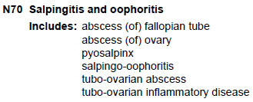
Chapter 14: Diseases of Genitourinary System (N00-N99)
Many “includes” notes provided for clarification
ICD-10-CM Tabular List of Diseases and Injuries 2013
Notes:
Mary
Throughout Chapter 14, disease of the GI system, there are new INCLUDES notes that help to clarify the types of disorders that are classified to the various categories. The example on the slide is for the category N70 to indicate that it also includes abscess of a fallopian tube or ovary. Another example would be under category N95, there is a note stating that menopausal and other perimenopausal disorders due to naturally occurring menopause and perimenopause are classified here.
You will also find many instruction notes throughout this chapter, such as:
-- Code also any associated kidney failure
-- Use additional code to identify infectious agent
-- Code also associated underlying condition
-- Coder first any associated (certain) condition
-- Use additional code to identify kidney transplant status
Doesn’t that sound familiar – code also use additional code . . .

Slide 49

Chapter 15:
Pregnancy, Childbirth, and the Puerperium
(O00-O9A)
Notes:
Image from: http://office.microsoft.com/en-us/images/results.aspx?qu=birth&ex=1#ai:MC900301286|
Mary
The final character for most codes within chapter 15 for pregnancy, childbirth and the puerperium identify the trimester of pregnancy instead of episode of care (delivered, antepartum, postpartum) as was the case with ICD-9-CM. We had discussed this change earlier in the presentation. In the event there is an obstetrical complication during an admission when the delivery occurs AND there is an “in childbirth” code option for the obstetric complication being coded, the “in childbirth” code should be assigned.
Guidelines have been added for preexisting conditions compared to conditions that are due to the pregnancy. Also of note there are new guidelines for Sepsis and septic shock complicating abortion, pregnancy, childbirth and the puerperium; Alcohol and tobacco use during pregnancy, childbirth and the puerperium; Poisoning, toxic effects, adverse effects and under dosing in a pregnant patient; Pregnancy associated cardiomyopathy; and Abuse in a pregnant patient – one of which directs us to use two codes – one defines the pregnancy and the other code defines the complication.
Also note that gestational diabetes coding guidelines have been revised as it pertains to indicating insulin use or not – which we did with ICD 9. In ICD-10- the code itself reflects either diet controlled or insulin controlled.

Slide 50
Let’s Compare!
Patient presents with pregnancy induced hypertension at 32 weeks, she is treated and sent home.
ICD-9
642.33
Transient hypertension of pregnancy, antepartum condition or complication
ICD-10
O13.3
Gestational hypertension without significant proteinuria, third trimester
Notes:
Mary
Another ‘let’s compare ICD 9 to ICD 10 opportunity – noting our use of trimester versus an antepartum condition. In ICD-9-CM, the code 642.33 code indicates that the condition occurred in the antepartum period – within the none months of the pregnancy. In ICD-10-CM, code 013.3 (PROUNANCE ZERO ONE THREE DECIMAL THREE) gives us the clarification that the condition occurred in the third trimester and not earlier in the pregnancy.
Jen – Mary, let’s stop and remind folks that since ICD-10 uses both alpha and numeric characters, you need to be careful to distinguish between characters such as OH and Zero, and “eye” and ONE for example. The correct ICD-10-CM code on this slide is O13.3 with an OH. Remember, the ICD-10-CM codes will always start with a letter as the first character.
Slide reference:
ICD-9-CM Coding: Theory and Practice with ICD-10, 2013/2014 Edition
By Karla R. Lovaasen, RHIA, CCS, CCS-P and Jennifer Schwerdtfeger, BS, RHIT, CCS, CPC, CPC-H
Elsevier Saunders

Slide 51

Chapter 16: Certain Conditions
Originating in the Perinatal Period (P00-P96)
Codes in this chapter are never used on the maternal record.
These codes may be used throughout the life of the patient if the condition is still present.
Notes:
Mary
Next, we move on to chapter 16 of ICD-10-CM to discuss conditions originating in the perinatal period. According to ICD-10-CM, the perinatal period is defined as before birth through the 28th day following birth. These codes are used on the infant’s record, never on the mother’s record – perinatal is the reference to the infant. The conditions may be used throughout the life of the patient if the condition is still present - as long as the condition originated in the perinatal period – such as congenital renal failure.

Slide 52
Chapter 17: Congenital Malformations, Deformations and Chromosomal Abnormalities (Q00-Q99)
New Arrangement
Updated Terminology
Greater Specificity
Q35.1 Cleft hard palate
Q35.3 Cleft soft palate
Q35.5 Cleft hard palate with cleft soft palate
Q35.7 Cleft uvula
Q35.9 Cleft palate, unspecified (Cleft palate NOS)
Notes:
Mary
The arrangement of the congenital malformations, deformations, etc have been grouped into subchapters or blocks making it easier to identify the type of conditions classified. As we know that is certainly not true of the ICD 9 structure. ICD-10-CM organizes the congenital conditions by body system.
Modifications have also been made to specific categories that bring the terminology up-to-date with current medical practice. For example cystic kidney disease contains these conditions/terms:
-- congenital renal cyst
-- polycystic kidney, infantile type
-- polycystic kidney, adult type
AND there are classification changes that provide greater specificity than found in ICD-9-CM for conditions such as cleft hard palate, cleft soft palate, cleft hard palate with cleft soft palate, cleft uvula, cleft palate, unspecified \NOS.
Wow – long day – back to you Jen.

Slide 53
Chapter 18: Symptoms, Signs, and Abnormal Clinical and Laboratory Findings, not elsewhere classified (R00-R99)
ICD-9-CM
General Coding Guidelines
for Signs and Symptoms
ICD-10-CM
Chapter Specific Guidelines
Notes:
Image from: http://office.microsoft.com/en-us/images/results.aspx?qu=Magnify&ex=1#ai:MC900437797|
Jen
Ok, we are reaching the home stretch here. Moving on to Chapter 18. ICD-9-CM did not have chapter specific guidelines for this chapter. Instead, the guidelines for coding signs and symptoms were found under the General Coding Guidelines. ICD-10-CM now has Chapter specific guidelines for signs/symptoms, so be sure to review them.

Slide 54
Chapter 19: Injury, Poisoning and
Certain Other Consequences of External Causes (S00-T88)
Injuries
Burns
Poisoning
Other external causes
Notes:
Image from: http://office.microsoft.com/en-us/images/results.aspx?qu=poison&ex=1#ai:MC900293216|
Jen
You will find that this chapter encompasses two alpha characters; the S codes cover various types of injuries related to a single body region while the T codes cover injuries to unspecified body regions as well as poisonings and certain other consequences of external causes.
At the beginning of this chapter in the tabular list, there is an instructional note to Use secondary code(s) from Chapter 20, External causes of morbidity, to indicate cause of injury. Codes within the T section that include the external cause do not require an additional external cause code.
Most categories in chapter 19 have a 7th character requirement for each applicable code. Most categories in this chapter have three 7th character values (with the exception of fractures): A, initial encounter, D, subsequent encounter and S, sequela. Categories for traumatic fractures have additional 7th character values.
I also want to point out that ICD-10-CM makes a distinction between burns and corrosions and that there are new guidelines

Slide 55
Injuries
Injuries to the head
Injuries to the neck
Injuries to the thorax
S00-S09
S10-S19
S20-S29
Notes:
Jen
In ICD-10, injuries are grouped in categories by body part rather than the nature of the injury. Following the site, injuries are further subdivided based on the type of injury, such as superficial injury, open wound, fracture, etc.
New for ICD-10 is that you will code the injury not just during the initial treatment, but you code it the entire time the patient is receiving care.
Mary: That’s right Jennifer, as I mentioned earlier, the seventh character reflects the episode of care such as initial, subsequent, or sequela. As a result, you will not use aftercare codes for conditions such as injuries or poisonings where the seventh characters are provided to identify subsequent care.

Slide 56
Fractures
S82.001 Unspecified fracture of right patella
S82.002 Unspecified fracture of left patella
S82.009 Unspecified fracture of unspecified patella
Notes:
Jen
Here we are showing an example of a fracture category, S82.0, Fracture of the patella. We have choices for laterality, either right, left or unspecified. We also need to add a 7th character before we have our final code, and I’ll show you the 7th character options for this category on the next slide.
Before I go to the next slide, I also want to mention some new guidelines for fractures in ICD-10-CM. The guidelines state that a fracture not indicated as open or closed should be coded to closed. Also, a fracture not indicated whether displaced or not displaced should be coded to displaced.
Ok lets move to the next slide and take a look at the options we have for our 7th character in this scenario.

Slide 57
The appropriate 7th character is to be added to all codes from category S82
A – initial enc. for closed fracture
B – initial enc. for open fracture type I or II, initial enc. for open fracture NOS
C – initial enc. for open fracture type IIIA, IIIB, or IIIC
D – sub. enc. for closed fracture w/routine healing
E – sub. enc. for open fracture type I or II w/routine healing
F – sub. enc. for open fracture type IIIA, IIIB, or IIIC w/routine healing
G – sub. enc. for closed fracture w/delayed healing
H – sub. enc. for open fracture type I or II w/delayed healing
J – sub. enc. for open fracture type IIIA, IIIB, or IIIC w/delayed healing
K – sub. enc. for closed fracture w/nonunion
M – sub. enc. for open fracture type I or II w/nonunion
N – sub. enc. for open fracture type IIIA, IIIB, or IIIC w/nonunion
P – sub. enc. for closed fracture w/malunion
Q – sub. enc. for open fracture type I or II w/malunion
R – sub. enc. for open fracture type IIIA, IIIB, or IIIC w/malunion
S – sequela
Notes:
Jen
These are the 7th character choices for the Fracture of the patella code that I showed on the previous slide.
Now I know this is a busy slide, but I wanted to give you another example of the 7th character extensions that we have been mentioning. While most of the time you will find only three choices for either initial, subsequent, or sequela, in this example here with fractures, you will notice that there are many more options for the 7th character than what we have seen on other categories. Here the 7th character represents not only the episode of care being initial, subsequent, or sequela; but also notice that the 7th character provides the detail on the type of fracture, whether the fracture is open or closed, and routine healing versus malunion or nonunion.
Care of complications of fractures, such as malunion and nonunion, should be reported with the appropriate 7th character for subsequent care with nonunion (K, M, N,) or subsequent care with malunion (P, Q, R).

Slide 58

Poisoning
Notice the new column labeled “Underdosing”
Underdosing
T48.5X6
T48.5X6
Table of Drugs and Chemicals
Notes:
Jen
Also included in this chapter are poisonings and certain other consequences of external causes. Many of these codes are combination codes that include the drug as well as a description of intent in a single code.
Another major change is that ICD-10 includes the concept of underdosing which was not part of the ICD-9-CM classification for poisonings, adverse effects, and toxic effects. Underdosing is defined as taking less of a medication than is prescribed by a provider or the manufacturer's instructions with a resulting negative health consequence. When utilizing the table of Drugs and Chemicals, you will now find options for:
-- Poisoning, Accidental (unintentional)
-- Poisoning, Intentional self-harm
-- Poisoning, Assault
-- Poisoning, Undetermined
-- Adverse effect, and
-- Underdosing
Before moving on to our next chapter I’d like to point out that ICD-10-CM contains a new guideline for Adult and child abuse, neglect and other maltreatment; as well as a new guideline for Pain due to medical devices.

Slide 59
Chapter 20: External Causes of Morbidity (V01-Y99)
Classification of environmental events and circumstances as the cause of injury, and other adverse effects.
Always used secondary to a code from another chapter.
Review the guidelines!
Notes:
Jen
Codes in this Chapter capture the cause of the injury or health condition, the intent (unintentional or accidental; or intentional, such as suicide or assault), the place where the event occurred, the activity of the patient at the time of the event, and the person’s status (that is, civilian, military). There are numerous guidelines applicable to this chapter, so be sure to review them.
GUIDELINE CHANGE! Assign the external cause code, with the appropriate 7th character (initial encounter, subsequent encounter or sequela) for each encounter for which the injury or condition is being treated, not just the initial encounter as was the guideline for ICD-9-CM.
The place of occurrence, activity, and external cause status codes are still only assigned during the initial encounter for treatment.

Slide 60
Here’s an Example
Patient was burned by hot grease in her kitchen. She presents for a dressing change. She was treated for 2nd degree burns to her left forearm several days ago.
T22.212D – Burn of second degree of left forearm, subsequent encounter
X10.2XXD – Contact with fats and cooking oils
Z48.00 – Encounter for change or removal of nonsurgical wound dressing
Notes:
Jen
The seventh character D is used to indicate the subsequent encounter for the burn as well as the external cause. The X placeholder is used in the external cause code because the seventh character is required. X10.2 is only 4 characters long, therefore you must add a placeholder character X in the 5th and 6th position in order to assign the 7th character D for subsequent encounter.
Remember, in ICD-10-CM you are going to addd the external cause code EVERY TIME THE PATIENT IS SEEN FOR THIS CONDITION. This is very different from ICD-9 where we only used the “E” codes on the initial encounter.
Slide reference: AHIMA ICD-10-CM Coder Training Manual, 2013 Edition, page 153.

Slide 61
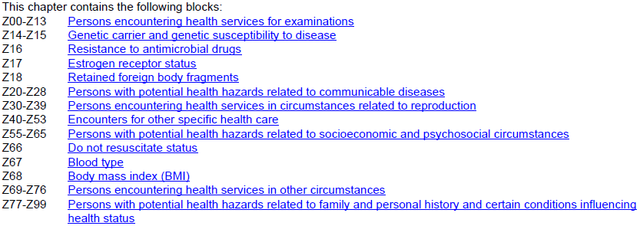
Chapter 21: Factors Influencing Health Status and Contact with Health Services (Z00-Z99)
Notes:
Jen
Codes from this chapter are what we were familiar with as V codes in ICD-9-CM. These codes are to be used for circumstances other than a disease, injury or external cause classifiable elsewhere in ICD-10-CM. On the slide you will see the specific blocks covered in this chapter. You might have noticed that we have a new category, Z67, to reflect Blood Type.

Slide 62
References
ICD-10-CM Coder Training Manual, 2013 Edition
AHIMA Press
ICD-9-CM Coding: Theory and Practice with ICD-10, 2013/2014 Edition
Elsevier Saunders
ICD-10-CM Primer. Journal of AHIMA 79, no.5 (May 2008): 64-66.
Notes:
Jen:
Whew! Now I feel like we just got off of a whirlwind train ride. Remember, much of the material that we covered today coincides with the ICD-10-CM Overview section of the AHIMA ICD-10-CM Coder Training Manual. The workbook contains many more review questions covering the coding conventions and guidelines than what we have covered here today. Be sure to go back and work through the exercises to check your understanding.

Slide 63

Ask the Presenter
Notes:
Jen
I know that was a lot of material to cover. We hope that we have pointed out many of the similarities between ICD-9 and ICD-10 and have put your mind at ease regarding the transition. Remember, as long as you know the basic coding conventions and guidelines, you will be successful in ICD-10-CM coding.
One final reminder, if you haven’t submitted your questions yet, there is still time to do so by clicking on the orange “Ask The Presenter” icon. We’re going to show a brief announcement and be right back to answer your questions.
(Stand still and smile until you see the video come up full screen)

