Slide 1

Nuts and Bolts of ICD-10
for the Non-Coder
Pamela Heller, RHIA
Director, National Health
Information Management Program Office
AHIMA Approved ICD-10-CM/PCS Trainer
Shelley Weems, MSHI, RHIA, CCS
Health Information Management Specialist
AHIMA Approved ICD-10-CM/PCS Trainer
Notes:
Pam:
Thank you Melinda! Shelley and I are happy to be here today to talk about ICD-10 and break it down for those that don’t work with it everyday like Health Information Management staff.
This presentation is only going to review the basics of finding an ICD-10 code. We’re not going to get into the weeds with coding examples as coding is very complex. But, once we’ve completed the presentation, everyone should have a basic idea of how to look up a code for use in your everyday jobs.
Shelley:
Just a couple of housekeeping items before we get started as Melinda noted earlier: You’ll notice several buttons or icons above our heads at the top of the screen. Starting on the far left, the green icon may be used to download our current presentation. We also have handouts in the download area above. In addition, you’ll see an icon for Facebook and Twitter where you can share your thoughts with your colleagues. And please, like us on Facebook.

Slide 2

Poll Question
What is your current position?
    Doctor/Surgeon/Resident
    Data/Research Analyst
    Administrative (Supervisor/clinic clerk/Administrative Officer/Fee Basis/Registration)
    Coder
    Revenue/CPAC Staff
    Other
Notes:
Shelley:
Pam, but before we get started, I’d like to ask our first poll question. We would like to get a feel for who we have in attendance today.
So our poll question is, what is your current position at the VA?
Doctor/Surgeon/Resident
Data/research analyst
Administrative (Supervisor/clinic clerk/Administrative Officer)
Coder
Revenue/CPAC Staff
Other
To answer this question, use the blue polling icon above my head. We’ll move on and come back to your results in just a moment.

Slide 3

Prepare for implementation
ICD-10 Background
Uses of coded data
How to look up a code
Notes:
PAM:
Thanks Shelley. Now, let’s talk about the objectives for this presentation. We hope that when you walk away from our presentation, you have a brief background on ICD-10 CM and PCS. How VA uses the coded data, how to look-up an ICD-10 code, and what the VA has done to prepare for the implementation of ICD-10. We will also let you know about other valuable training opportunities that are available to all VA employees.
Shelley, why don’t you start us off by telling everyone about ICD-10 and how we got to this point.

Slide 4

What is coding?
Notes:
Shelley:
Sure Pam. The International Classification of Diseases, or ICD, is the standard used throughout the world for classifying causes of mortality and for reporting data nationally, and reporting it to the World Health Organization. ICD-9 is 30 years old and has outdated terms and is sometimes inconsistent with current medical practice. The transition to ICD-10 is occurring because ICD-9 produces limited data about a patients’ medical conditions and hospital inpatient procedures.
The code sets are composed of numbers and/or letters that identify specific diagnoses and procedures on claims and encounter forms based on the clinical documentation. Code sets adopted under HIPAA include ICD-10-CM for Diagnostic codes, ICD-10-PCS for inpatient hospital procedures, and CPT/HCPCS for physician and other clinical staff health services, medical supplies, orthotics, and durable medical equipment.
Pam:
ICD-10-CM is the United States’ clinical modification of the World Health Organization’s ICD-10. The term “clinical” is used to emphasize the modification’s intent: to serve as a useful tool in the area of classification of morbidity data for the indexing of health records, medical care review, ambulatory and other healthcare programs, as well as for basic health statistics. To describe the clinical picture of the patient, the codes must be more precise than those needed only for statistical groupings and trend analysis. ICD-10-CM far exceeds its predecessors in the number of concepts and codes provided. The disease classification has been expanded to include health-related conditions and to provide greater specificity at the sixth and seventh character level. The sixth and seventh characters are not optional and are intended for use in recording the information documented in the clinical record.

Slide 5


Implementation
NO
SOONER
THAN…
Notes:
Shelley:
ICD-10 is the Health Insurance Portability and Accountability Act, otherwise known as HIPAA, mandated code sets. The original implementation deadline for transitioning to ICD-10 in the United States was October 1, 2013. However on April 1, 2014, there was a second change to the compliance date under the Protecting Access to Medicare Act of 2014, which stated that the Secretary may not adopt ICD-10 prior to October 1, 2015. ICD-10-CM diagnoses codes will be used by all providers in all health care settings.
The granularity of ICD-10 is vastly improved over ICD-9 and will enable greater specificity in identifying health conditions. It also provides better data for measuring and tracking health care utilization and the quality of patient care. When ICD-10-CM/PCS is implemented, it will not affect the use of CPT or HCPCS codes.
Pam, could you show everyone the difference between ICD-9 and ICD-10? Even though, they may not have to actually code a complete record, they still need to know how to recognize the difference between the code sets.

Slide 6
ICD-9-CM | ICD-10-CM
~13,000 Codes | ~68,000 Codes
Numeric (except V & E codes) | Alphanumeric
3 – 5 Digits | 3 – 7 Digits
17 Chapters with 2 Supplemental | 21 Chapters
No Laterality | Laterality (Identifies Right & Left sides)
3 Tables Hypertension Drugs & Chemicals Neoplasm | 2 Tables Drugs & Chemicals Neoplasm
DIAGNOSIS CODES
Notes:
PAM:
I’m sure that everyone already knows that ICD-9 has a lot of diagnosis codes, but in ICD-10 there are nearly 5 times as many diagnosis codes. Let’s make a quick comparison between ICD-9 and ICD-10-CM. As I just stated, the first difference is in the number of available codes in ICD-9 versus ICD-10.
In ICD-9-CM diagnosis coding, the first digit could be either alpha or numeric and the remaining codes must be numeric. However, in ICD-10-CM, the first digit will always be alpha, the second digit will always be numeric, and the remaining codes may be either alpha or numeric. ICD-9-CM codes have 3 to 5 characters, while ICD-10-CM codes may be 3 to 7 characters.
ICD-10 also uses a placeholder character “X”. This placeholder is used for certain codes to allow for future expansion.
ICD-10-CM also allows for increased detail. Such as the inclusion of clinical concepts that don’t exist in ICD-9, such as we can now report under dosing and blood alcohol level. Another added detail is the inclusion of laterality with many of the codes, such as left, right, bilateral.
Postoperative complications have been expanded so that a distinction is now made between intraoperative complications and post procedural disorders. With this increase in detail, the provider will need to be specific in his/her progress note in order to determine the level of specificity for the code.
The orders of some chapters have also changed, some titles have been renamed, and conditions have been grouped differently.

Slide 7
ICD-9 Procedures | ICD-10-PCS
All digits are numeric | Alpha & Numeric
3 – 5 Digits | 7 Characters
Decimal is after 2nd digit | No Letters “O” & “I”
PROCEDURE CODES
Notes:
Shelley:
Now let’s look at a comparison of ICD-9 procedure codes to the ICD-10-Procedure Code System. One thing to keep in mind, is that like the ICD-9 procedure codes, the ICD-10-PCS codes are only for inpatient coding. So, these codes will primarily be used by coders, Fee Basis clerks, and CPAC staff.
The ICD-10 procedure codes are made up of 7 characters using both alpha and numeric characters. While ICD-9 procedure codes are made up of digits and use a decimal after the second digit, ICD-10-PCS is made up of both alpha and numeric digits and does not use decimals.
In addition, the letters “O” and “I” are not used in ICD-10-PCS to avoid confusion with the numbers zero and one. Because of the complexity of coding ICD-10 PCS codes, once sufficiently trained, a coding specialist can use the code tables to "build a code" from the 7 characters based on certain documented features of the procedure performed, including the root operation, which is the objective of the procedure and the surgical approach.
Pam… with all of the changes, increases in the level of complexity, and so forth, how is all this information being used?

Slide 8
Use Coded Data for…
Patient Care
Reimbursement
Provider Comparison
Case Mix
Research and Disease Registries
Notes:
Pam:
As many already know, collecting health information is nothing new. Once collected, ICD coded data can be used by various health care providers and decision makers to monitor the health of individuals and populations, as well as contribute to the analysis of the healthcare system.
Data that is reported from coding based on clinical documentation can help to improve patient outcomes by providing information about the best methods of treatment for conditions. Common complications, adverse reactions, and co-morbidities associated with diseases or procedures can be identified and considered when treating patients or developing standard protocols for disease management. A portion of the information is utilized for mandatory reporting of quality measures and is derived from coded data. The greater level of detail in the new code sets includes laterality, severity, and complexity of the disease conditions, which will enable more precise identification and tracking of specific conditions.
Based on clinical documentation, diagnosis codes when linked to procedure codes, provide evidence that services performed are medically necessary. Coded information is then communicated to payers to help obtain appropriate payment for hospitals or individual practices.
Shelley:
Coded data may also be used to compare physicians to physicians and hospitals to hospitals regarding patient outcomes.
Strategic plans, budgets, and operational decisions for hospitals or physician practices often consider information based on the analysis of coded data. The specificity of coding within ICD-10-CM will identify diseases and conditions in greater detail, which will allow organizations to more clearly identify common illnesses—and their severity—for their patient population.
Coded data also provides information for research and registries. If you look at coding performed within VA at the facility level, we use these codes to help track and trend care delivery needs for patients with similar conditions, such as Agent Orange, Traumatic Brain Injury, and Spinal Cord Injury.

Slide 9
Poll Results
What is your current position?
    Doctor/Surgeon/Resident
    Data/Research Analyst
    Administrative (Supervisor/clinic clerk/Administrative Officer/Fee Basis/Registration)
    Coder
    Revenue/CPAC Staff
    Other
Notes:
Shelley:
Pam, before we move on to the coding basics, let’s take a look at the poll results. I asked what your current position is at the VA?
Doctor/Surgeon/Resident
Data/Research Analyst
Administrative (Supervisor/clinic clerk/Administrative Officer)
Coder
Revenue/CPAC Staff
Other
It looks like the majority of people are …… but it looks like we have a pretty good representation from each group.
.

Slide 10

Poll Results
What is your current position?
    Doctor/Surgeon/Resident
    Data/Research Analyst
    Administrative (Supervisor/clinic clerk/Administrative Officer/Fee Basis/Registration)
    Coder
    Revenue/CPAC Staff
    Other

Slide 11
Basic Steps of Coding
Look up main term in the Alphabetic Index
Note all parenthetical terms, cross references, or other instructions in the Index
Verify code in the Tabular List
Read all instructional notes
Review coding conventions and any chapter specific coding guidelines
Confirm and assign the correct code
Notes:
PAM:
Thanks Shelley. Now, let’s go through the basic steps that should be followed when assigning codes. When coding, the first step is to identify all main terms included in the diagnostic statement in the health record. Next, locate the main term in the Alphabetic Index and refer to any sub-terms. Main terms represent diseases, conditions, nouns and adjectives while sub-terms add additional information such as site, etiology, or clinical type.
Follow any instructions or cross references found in the Alphabetic Index, then verify the selected code in the Tabular List. Follow any instructional notes found in the Tabular List as well as the official coding conventions and guidelines. Confirm and assign the correct code to the highest level of specificity, up to a total of seven characters if applicable.
Based on what I just described about finding a code, some people may think that coding is simple, but, depending on the documentation available, it can be really difficult. The more detail and specifics provided in the health record, the easier it is to find the correct code without having to query the provider. And speaking of the importance of clinical documentation…tomorrow, there will be a presentation on ICD-10 and Clinical Documentation Improvement at 1:00 pm Eastern.

Slide 12

“
A JOINT EFFORT
healthcare provider and
between the
the coder
is essential to achieve complete
“
and accurate documentation, code assignment, and
reporting of diagnoses and procedures.
Notes:
PAM:
The ICD-10-CM Official Guidelines for Coding and Reporting are a set of rules that have been developed to accompany and complement the official conventions and instructions provided within ICD-10-CM itself. They have been approved by the four organizations that make up the Cooperating Parties for the ICD-10-CM: the American Hospital Association (AHA), the American Health Information Management Association (AHIMA), the Centers for Medicare and Medicaid Services (CMS) and the National Center for Health Statistics (NCHS).
According to the Official Guidelines that accompany ICD-10-CM, a joint effort between the healthcare provider and the coder is essential to achieve complete and accurate documentation, code assignment, and reporting of diagnoses and procedures. The importance of consistent, complete documentation in the health record cannot be overemphasized. Without such documentation, accurate coding cannot be achieved. The progress note for the visit should be reviewed to determine the specific reason for the encounter and the conditions treated.
The guidelines also provide additional instruction for the coder. Think of them like the rules of the road for coding.

Slide 13
Poll Question
Coded Data is used for which of these?
  Patient Care
  Research and Disease Registries
  Reimbursement
  Case Mix
  All of the above
Notes:
Shelley:
Pam, let’s ask another poll question.
Earlier, we discussed the uses of coded data. So let’s see if our viewers can tell us what ICD codes are used for.
A. Patient Care
B. Research and Disease Registries
C. Reimbursement
D. Case Mix
E. All of the above.
To answer this question, use the blue polling icon above my head. Also, just a reminder that if you have other questions relating to our discuss, you should use the orange “ask the presenter” icon also located above my head and we’ll answer them at the end of the presentation. We’ll move on and come back to your results in just a moment.

Slide 14

Alphabetic Index to External Causes of Injury
Neoplasm Table
Alphabetic Index
Alphabetic Index to Diseases and Injury
Table of Drugs and Chemicals
Divided into Blocks
Tabular List
21 Chapters
Notes:
PAM:
We understand that some of you may have books and some may prefer to use an online resource. So, lets talk for a minute about the organization of the code book. The Alphabetic Index is divided into two parts. The Index to External Causes of Injury and the Index to Diseases and Injury. Similar to ICD-9-CM, within the Index of Diseases and Injury there is a Neoplasm Table and a Table of Drugs and Chemicals.
The tabular list in ICD-10-CM contains 21 chapters. For some chapters the body or organ system is the axis of the classification. Other chapters group together conditions by etiology or nature of the disease process. Chapters are further subdivided into subchapters, or blocks, that form the foundation of the code. Each chapter in the Tabular List begins with a summary of the block to provide an overview of the categories within the chapter.
Shelley:
Similar to ICD-9-CM, there is no national requirement for mandatory external cause code reporting. However, in the absence of a mandatory reporting requirement, you are encouraged to voluntarily report external cause codes, as they provide valuable data for injury research and evaluation of injury prevention strategies. Documentation of external causes also helps determine whether the patient encounter may be due to an accident, poisoning, overdose, or other reasons. If the encounter is due to an accident, the episode of care may be billable to a third party payer as a Tort or Humanitarian claim. Remember, any reimbursement from the third party payer goes back to the local facility.
Each health care encounter should be coded to the level of certainty known for that encounter. If a definitive diagnosis has not been established by the end of the encounter, it is appropriate to report codes for signs and/or symptoms in lieu of a definitive diagnosis. When sufficient clinical information is not known or available about a particular health condition to assign a more specific code, it is acceptable to report the appropriate unspecified code. However, it is inappropriate to select a more specific code that is not supported by the health record documentation or conduct medically unnecessary diagnostic testing to determine a more specific code.

Slide 15
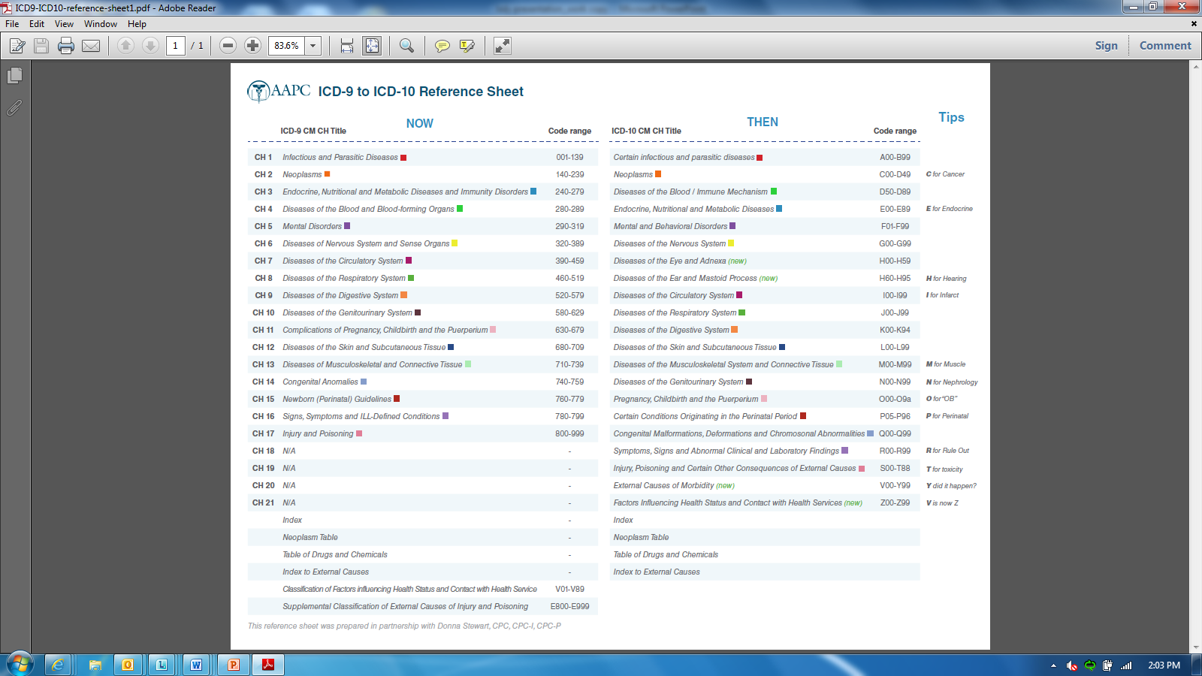
ICD-9 and ICD-10 Comparison
Notes:
Shelley:
Let’s take a look at this one page reference that will help people transition between the ICD-9 code set and ICD-10. It shows a comparison of how the code sets are organized with easy color coding to help you find what you’re looking for. I know you can’t read this on the screen here, but we’ve made it available as a handout in the download section.

Slide 16
Notes:
Shelley:
Let’s take a closer look at an example. We’ve zoomed in here on the first line, for chapter 1. You’ll notice that NOW Chapter 1 of ICD-9 is titled Infectious and Parasitic Diseases and is color coded red. Whereas, Chapter 1 of ICD-10 (THEN – which means future in this case) is titled Certain infectious and parasitic diseases and is also color coded red. So, in this example, note that the titles are similar, but the code ranges are now very different, 001-139 versus A00-B99. Also, ICD-10-CM codes will always begin with a alpha character.

Slide 17
Notes:
Shelley:
It also has mnemonic tips, such as “C” for cancer and “H” is for hearing, to help you remember where the new codes are located.
Remember, this information is available on the handout under the download section.

Slide 18
Notes:
PAM:
Before we leave the chart, let’s take a closer look at another example. As you can see now, in ICD-9, Congenital Anomalies are under Chapter 14 and the code range is 740 – 759. Then, in ICD-10, Congenital Malformations, Deformations and Chromosomal Abnormalities use the code range of Q00 – Q99. Notice that the Chapter title has also been changed and Chromosomal Abnormalities has been added, as well as the changed code range.
When you take a closer look at this handout later, you’ll also note that three new chapters have been added: Factors Influencing Health Status and Contact with Health Services, Diseases of the Eye and Adnexa, and Diseases of the Ear and Mastoid Process.
We hope that this reference sheet will be beneficial when searching for a code and that it helps point you in the right direction. This reference has been provided by the American Academy of Professional Coders (AAPC).
Now, we’re going to move to the online resource that is available. But, before we do, let’s take a look at the poll results.

Slide 19
Poll Results
Coded Data is used for which of these?
  Patient Care
  Research and Disease Registries
  Reimbursement
  Case Mix
  All of the above
Notes:
Shelley:
A few minutes ago, we asked what is coded data used for?
Patient Care
Research and Disease Registries
Reimbursement
Case Mix
All of the above.
Those that selected E are correct. Coded data is used for all of these things and much more.

Slide 20
Poll Results
Coded Data is used for which of these?
  Patient Care
  Research and Disease Registries
  Reimbursement
  Case Mix
  All of the above
Notes:
CLICK TO NEXT SLIDE

Slide 21

Notes:
PAM:
Some of you may not be familiar with this page. Seen here is the Health Information Management Intranet page. If you don’t use it regularly, you may not have noticed that we gave it a new look a few of months ago. The HIM site contains loads of resources associated with health information management and the various departments within HIM and projects that HIM is currently working on or supports.

Slide 22

Coding > ICD-10 Project
Notes:
PAM:
There is a page specifically for the ICD-10 project, which is located under the “CODING” tab/drop down menu.
The link will be available on the “reference” slide for those that may want to save it as a “favorite”. Shelley, why don’t you show everyone how to use the online reference that is available on the ICD-10 Project page.

Slide 23
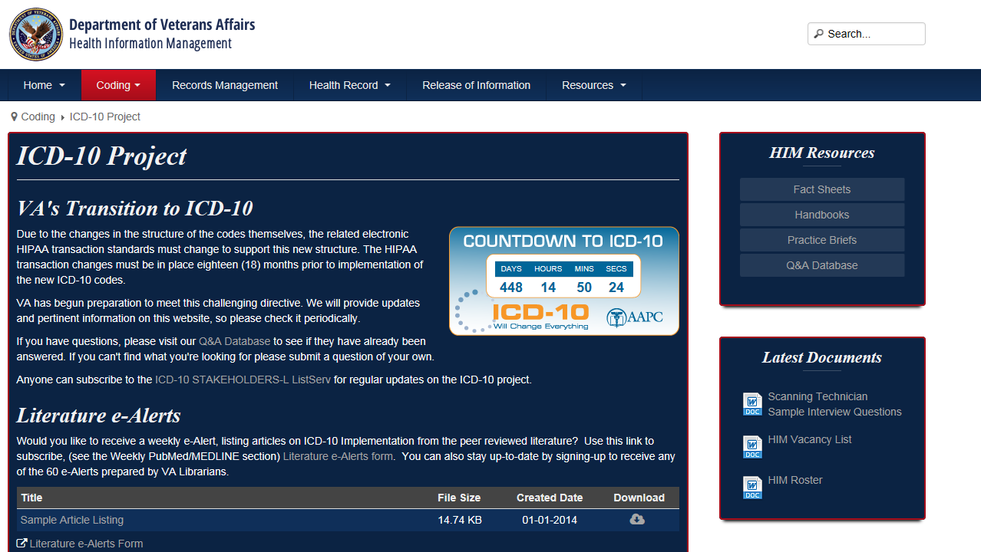
Notes:
Shelley:
On the ICD-10 Project page, we have online resources that are available to all VA employees. Here is a screen shot of the ICD-10 Project page.
While you can’t see everything on this page, it contains a great number of resources, including literature e-Alerts that help you stay up to date on latest developments. It also contains general information documents such as the ICD-10 Implementation and Communication plans. There is information about the site readiness assessment, training resources, and links to external resources.
One of the neatest features on this page is perhaps the site facility sharing corner, where you can find documents shared by various sites to show how they are moving forward with implementation. Whether you use another site’s documents as templates for your own implementation, or simply browse the documents for ideas, we definitely recommend you check it out.
PAM:
And speaking of site examples of successful implementation, you may want to check out the next session today, at 1pm EST, on Dual Coding, which provides examples of the steps for a successful ICD-10 Dual Coding Program from implementation to outcomes.

Slide 24
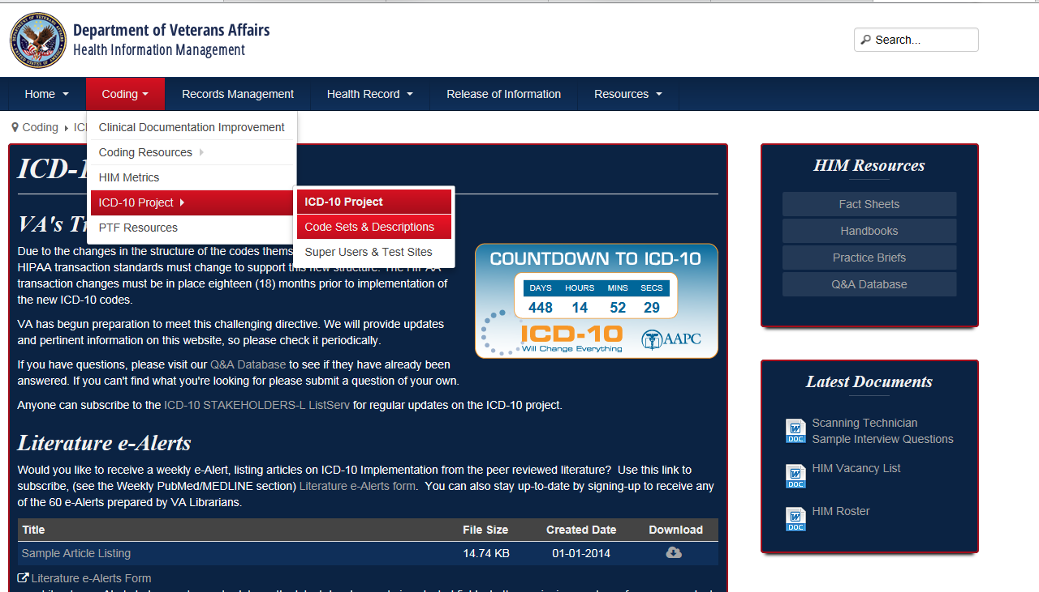
Coding > ICD-10 Project > Code Sets & Descriptions
Notes:
Shelley:
While it’s a little hard to see here, under the “ICD-10 Project” subpage in the drop down menu is another subpage entitled “Code Sets and Descriptions”. Here, you can access an electronic version of the code sets.

Slide 25
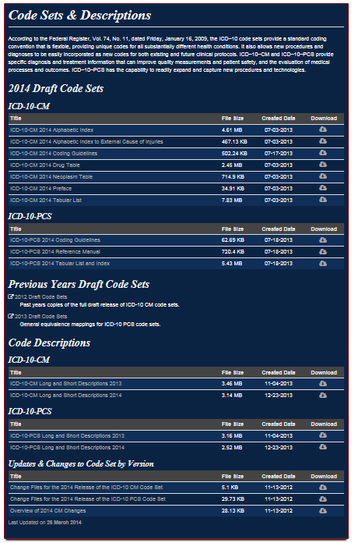
Notes:
Shelley:
On the Code Sets & Descriptions page, you’ll see the 2014 Draft Code Sets. This includes, the coding guidelines, the alphabetic index, and the tabular List (index) for both ICD-10-CM and ICD-10-PCS. Also, included are the ICD-10-PCS tables that will primarily be used by HIM coders.
[CLICK FOR ANIMATION]
If you look further down the page, the code descriptions and change files between 2013 and 2014 are also available.
[CLICK TO DELETE YELLOW BOXES]
Once you get to this page, to look up a diagnosis code, click on the ICD-10-CM 2014 Alphabetic Index code set to open the file.

Slide 26
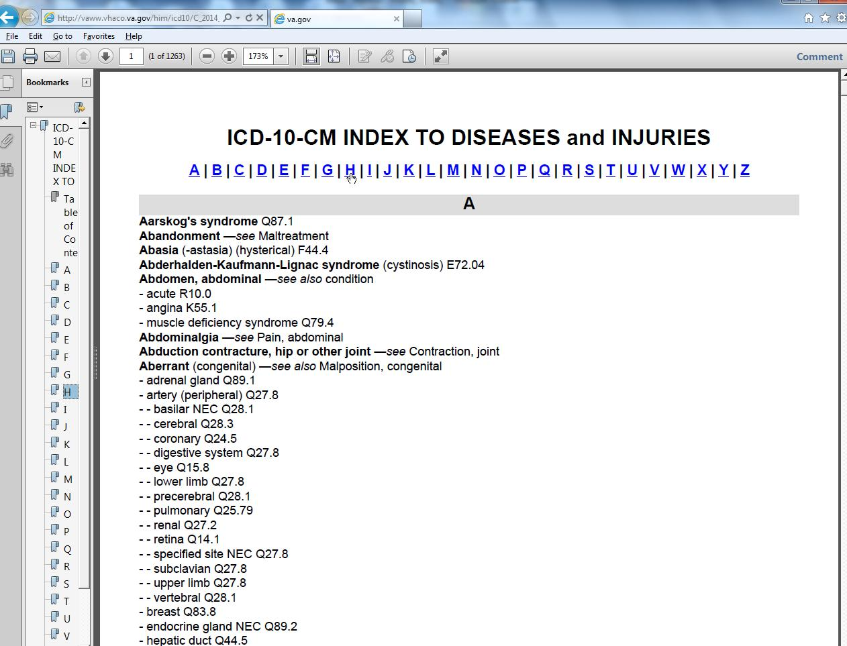

Navigate
Notes:
Shelley:
When the ICD-10 alphabetic Index opens, you’ll notice the alphabet at the top of the page, which you can use to jump to the words that begin with that letter. To find a code, you will need to navigate one level at a time…
[CLICK FOR ANIMATION]
…starting with the main term first. Then navigating each level of sub-terms until the full diagnostic statement is described.

Slide 27
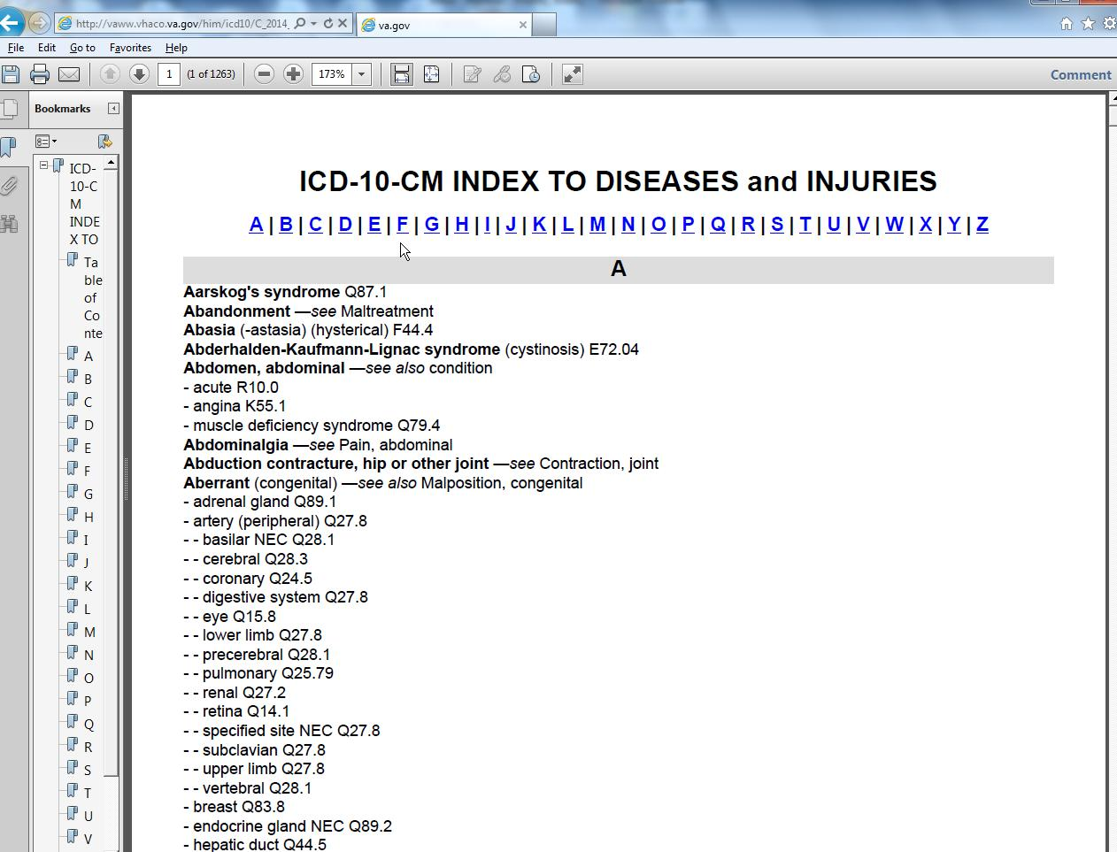
Non-essential modifiers
Main Term
Sub term – level one
Default Code / Partial Code
Sub term – level two
Notes:
Shelley:
The Diagnosis Alphabetic Index is organized and structured to look up diagnoses. In bold print, you will find what the Center for Medicaid and Medicare Services, or CMS, refer to as “main terms”. These are left justified, and in bold print. Notice the spaces, indented by the hyphens. Each hyphen (space) represents a sub-term level, very similar to a decision tree. Terms in parenthesis next to main terms or sub-terms are referred to as non-essential modifiers. Take a look at the word “aberrant” with a non-essential modifier of congenital. Under aberrant, you see the level one sub-terms adrenal gland and artery. Beneath artery, you see level two sub-terms, basilar, cerebral, coronary, etc…
A medical diagnosis can typically be found by breaking down any medical concept into nouns and adjectives. The first step is to locate the nouns.

Slide 28
see
mandatory
see also
not mandatory
Notes:
Shelley:
Within the alphabetic index there is more guidance available with the see and see also references. Think of them as cross references. The See reference is mandatory in order to find a code value. The See also reference is not a mandatory instruction but rather suggested or recommended if needed.
Pam, now that I’ve gone over the guidelines, could you take us through the steps required for coding congestive heart failure?

Slide 29
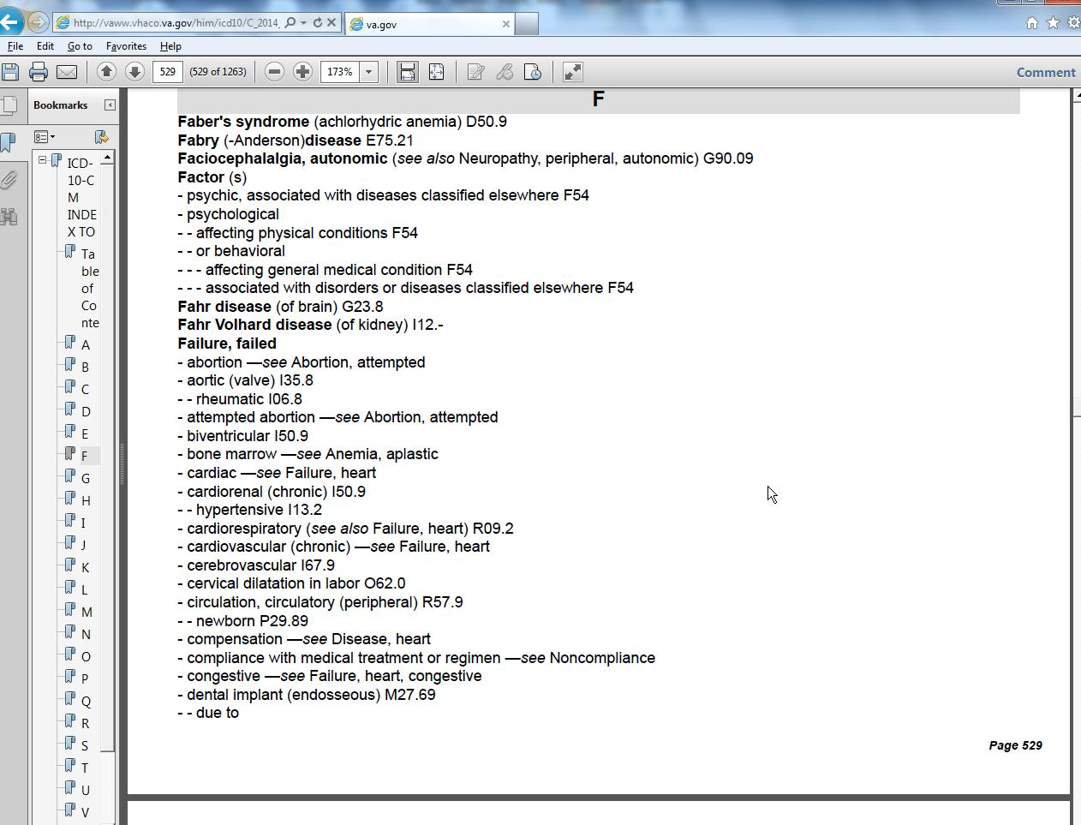
Congestive heart failure
1
Code:
2
Notes:
PAM:
To code congestive heart failure, you begin by looking up the word “failure”. Notice that below the word “failure”, there are further indented and hyphenated sub-terms. Scan down to the sub-level term of “congestive”. Beside that term is a “See” instruction telling you that you must go to the Main term, Failure, and then sub-term levels heart and congestive.

Slide 30
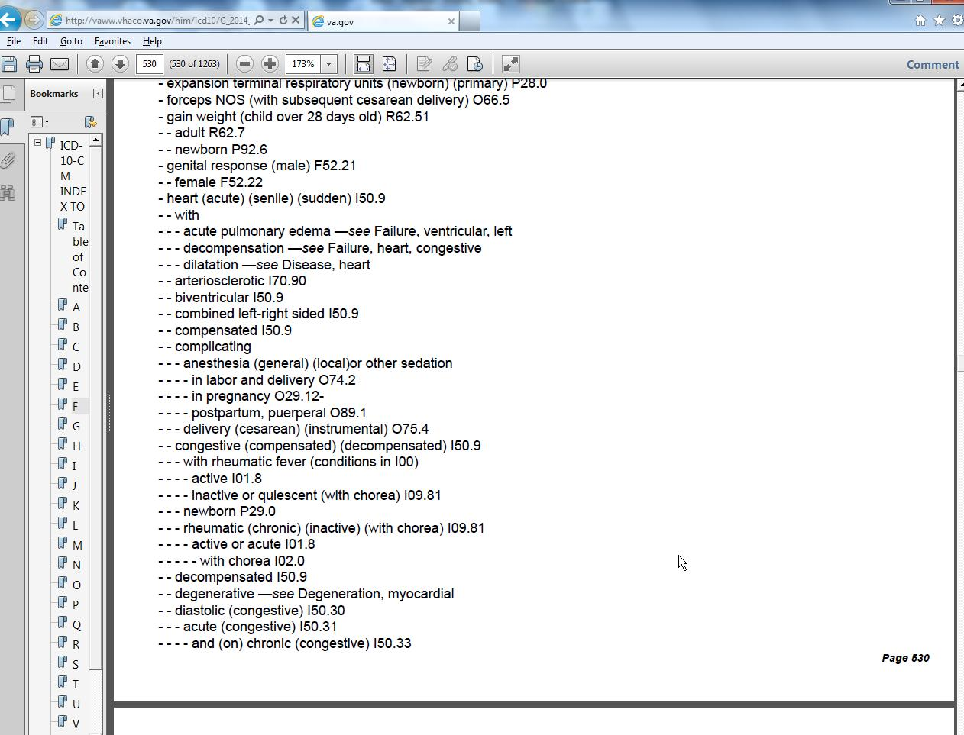
Use of sub-terms and non-essential modifiers
3
4
Default Code / Partial Code
Notes:
PAM:
Since the “see” instruction told you to go to the sub-term of “heart”, once you get to that term, you must then move further down the list and locate the next sub-term level, “congestion”. It gives you the code I50.9.

Slide 31
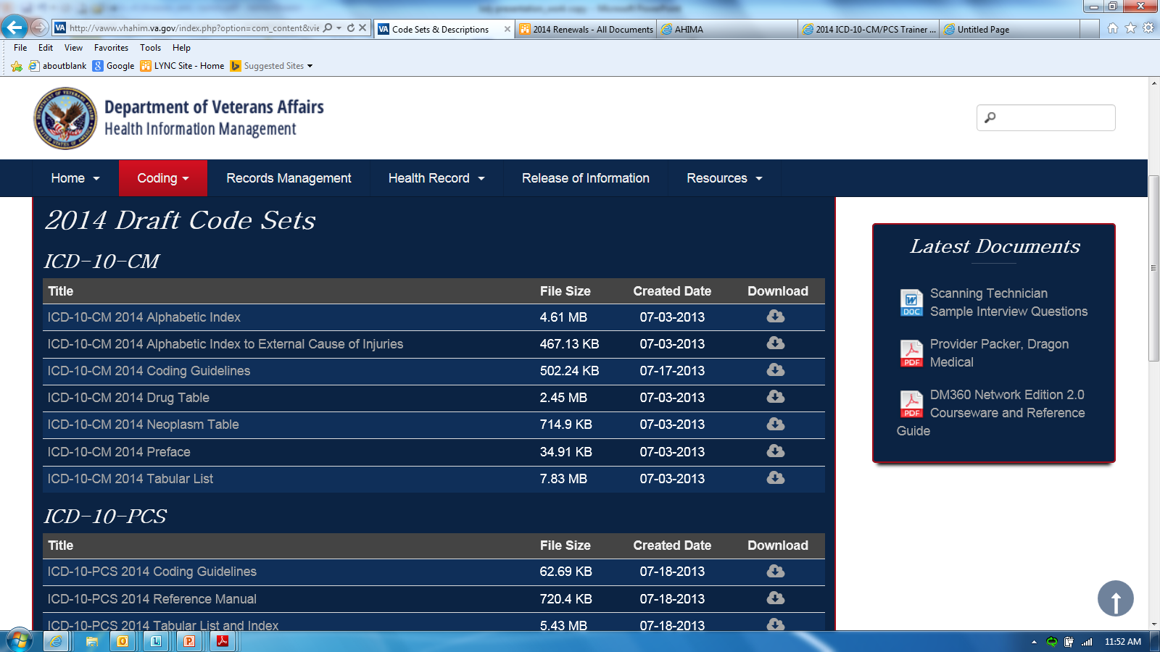
Notes:
Shelley:
But, we can’t stop there! We now have to open the ICD-10-CM 2014 Tabular List. Make sure that you don’t click on the ICD-10-PCS Tabular list by mistake since we are trying to find the diagnostic code.
The Tabular list is where you verify the code selection, I50.9, that was given in the Alphabetic Index. The Tabular List includes a chronological list of codes divided into chapters based on body system or condition.

Slide 32
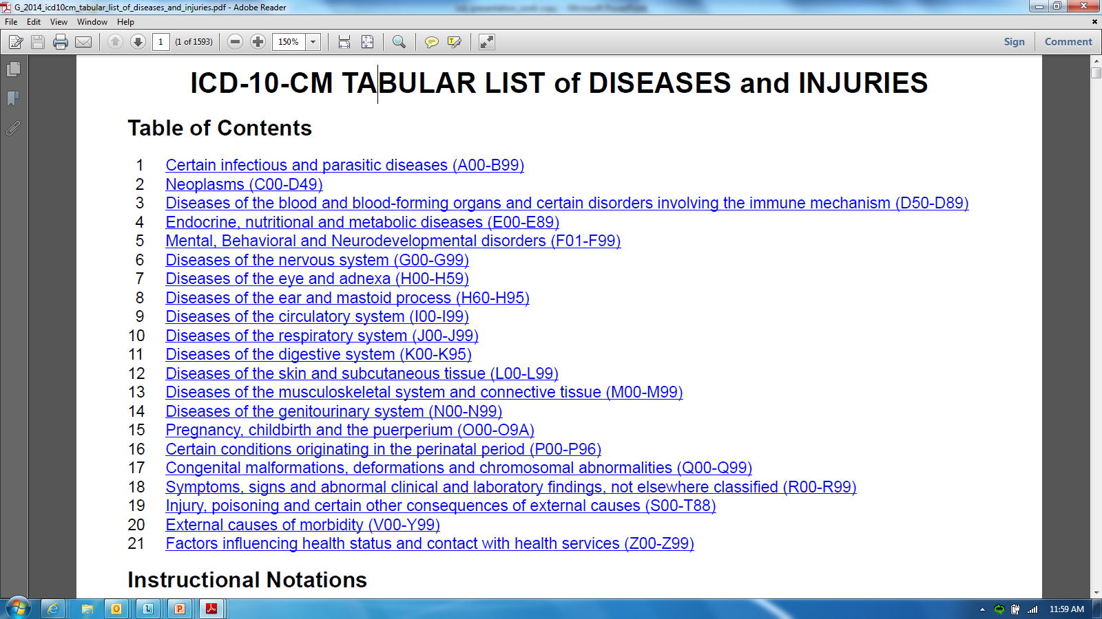
First
Always look up diagnostic terms in ALPHABETIC INDEX
Verify code in TABULAR LIST
Second
Notes:
Shelley:
Pam, I’d like to emphasize to everyone that for complete and accurate coding, you must always start by looking up diagnostic terms in the Alphabetic Index, and then verify the code number in Tabular List, ensuring that any instructional notes that accompany the code are reviewed and enforced as applicable. The Official Guidelines for Coding and Reporting which provides direction on coding conventions and guidelines and that the adherence to the official coding guidelines is required under the HIPAA.

Slide 33
First
Always look up diagnostic terms in ALPHABETIC INDEX
5
Verify code in TABULAR LIST
Second
Notes:
PAM:
That’s right Shelley. Now, let’s take a closer look at the tabular list. The tabular list is organized by code value. Using the ‘Default’ code or partial code value from the alphabetic index, I50.9, the next step is to verify or find fully specified code that should be assigned. Navigate to the code value by clicking on the link for Chapter 9, Diseases of the circulatory system (I00 – I99).

Slide 34
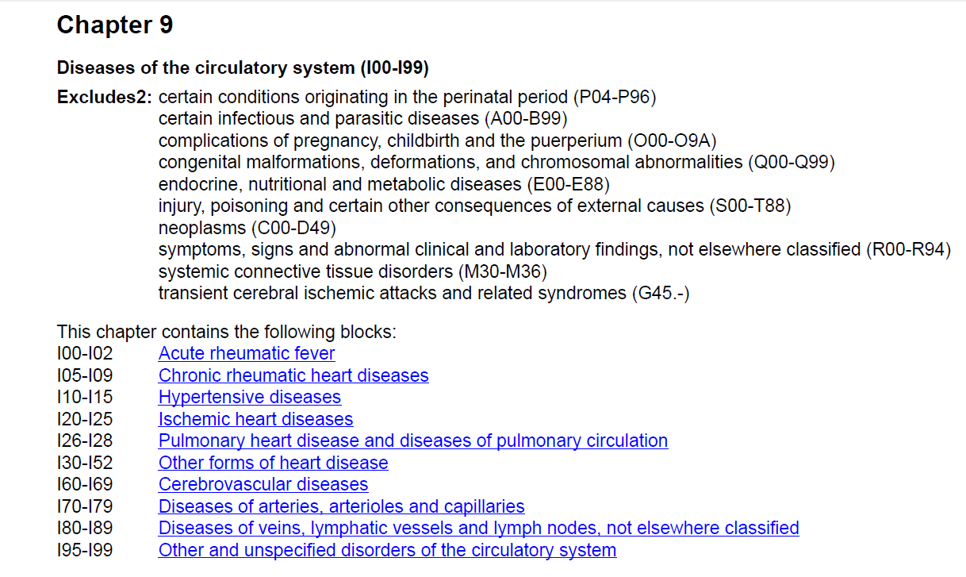
Excludes2 note
Blocks
Notes:
PAM:
Once you’ve clicked on the appropriate chapter title, it will take you to the beginning of the chapter. As you look at that page, you’ll note that further down the page, the chapter is broken down further into blocks. On this page, you can see that there is an Excludes 2 note.
ICD-10-CM has two types of excludes notes. Each type of note has a different definition for use but they are all similar in that they indicate that codes excluded from each other are independent of each other. Let me explain what those are before we go further.
A type 1 Excludes note is a pure excludes note. It means “NOT CODED HERE!” An Excludes1 note indicates that the code excluded should never be used at the same time as the code above the Excludes1 note. An Excludes1 is used when two conditions cannot occur together, such as a congenital form versus an acquired form of the same condition.
A type 2 Excludes note represents “Not included here”. This indicates that the condition excluded is not part of the condition represented by the code, but a patient may have both conditions at the same time. When an Excludes2 note appears under a code, it is acceptable to use both the code and the excluded code together, when appropriate.

Slide 35
Partial Code I50.9
falls within …
I30-I52
5
Notes:
PAM:
Okay, going back to our demonstration, click on the block that contains the code that you found when using the alphabetic index, I50.9.

Slide 36
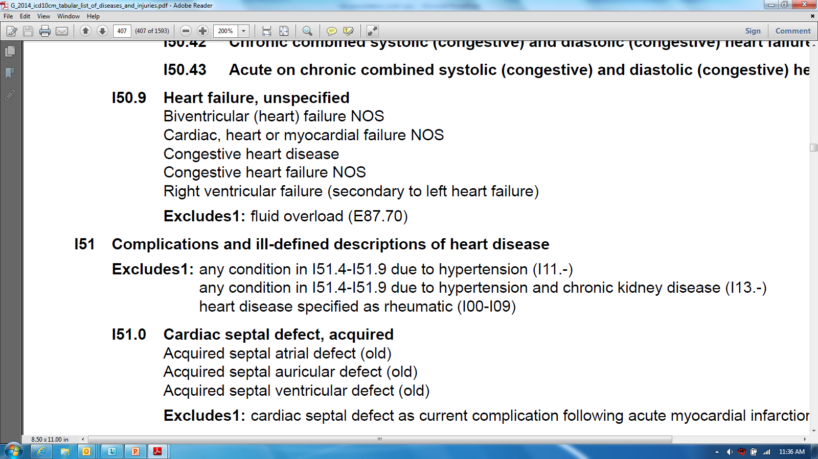
Notes:
PAM:
Locate the code, I50.9. Below the code, you’ll see a list of diagnoses that fall within this code. There is also an Excludes 1 note that tells you that fluid overload should not be coded with congestive heart failure. Remember that a type 1 Excludes note is a pure excludes note. It means “NOT CODED HERE!”

Slide 37
Poll Question
Is it essential to use both the Alphabetic Index and Tabular List when locating and assigning a code?
  True
  False
Notes:
Shelley:
Pam, let’s ask our next poll question. And this time we have a true and false question.
Is it essential to use both the Alphabetic Index and Tabular List when locating and assigning a code?
True
False
To answer this question, use the blue polling icon above my head. We’ll move on and come back to your results in just a moment.

Slide 38

INSTRUCTIONAL TERMS
“Code first”
“Use additional code”
“In diseases classified elsewhere”
“Code also”
“Includes”
Notes:
Shelley:
Let’s go over a few more instructional terms that you’ll sometimes see.
Certain conditions have both an underlying etiology and multiple body system manifestations due to the underlying etiology. For such conditions, the ICD-10-CM has a coding convention that requires the underlying condition be sequenced first followed by the manifestation. Wherever such a combination exists, there is a “use additional code” note at the etiology code, and a “code first” note at the manifestation code. These instructional notes indicate the proper sequencing order of the codes, etiology followed by manifestation.
In most cases, the manifestation codes will have in the code title, “in diseases classified elsewhere.” Codes with this title are a component of the etiology/ manifestation convention. The code title indicates that it is a manifestation code. “In diseases classified elsewhere” codes are never permitted to be used as first-listed or principal diagnosis codes. They must be used in conjunction with an underlying condition code and listed after the underlying condition.
There are manifestation codes that do not have “in diseases classified elsewhere” in the title. For such codes, there is a “use additional code” note at the etiology code and a “code first” note at the manifestation code and the rules for sequencing apply.
In addition to the notes in the Tabular List, these conditions also have a specific Alphabetic Index entry structure. In the Alphabetic Index, both conditions are listed together with the etiology code first followed by the manifestation codes in brackets. The code in brackets is always to be sequenced second.
“Code first” and “Use additional code” notes are also used as sequencing rules in the classification for certain codes that are not part of an etiology/ manifestation combination.
PAM:
A “code also” note instructs that two codes may be required to fully describe a condition, but this note does not provide sequencing direction.
“Code first” notes are also under certain codes that are not specifically manifestation codes but may be due to an underlying cause. When there is a “code first” note and an underlying condition is present, the underlying condition should be sequenced first.
When the word “Includes” appears immediately under a three character code title, it is to further define or give examples of the content of the category. These terms are the conditions for which that code is to be used. The terms may be synonyms of the code title, or, in the case of “other specified” codes, the terms are a list of the various conditions assigned to that code. The inclusion terms are not necessarily exhaustive. Additional terms found only in the Alphabetic Index may also be assigned to a code.

Slide 39
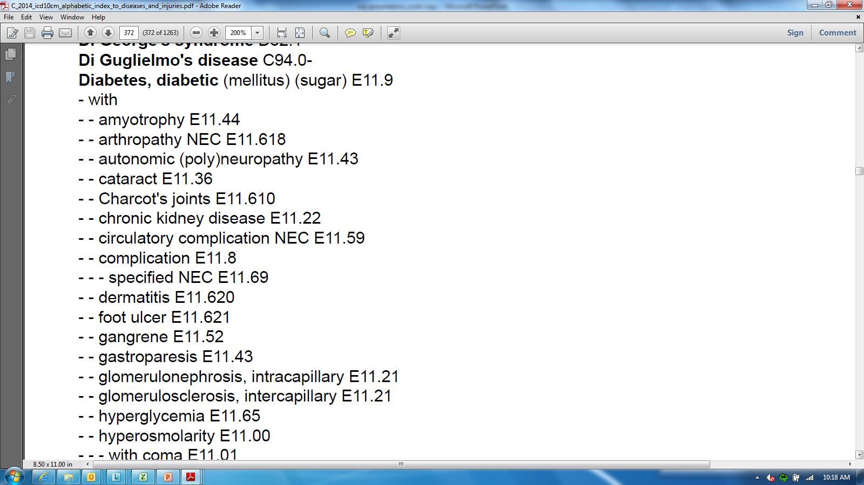


1
2
Notes:
Shelley:
Let’s walk through a scenario. An elderly gentleman comes to the VA for treatment of his insulin dependent diabetes. He’s noticed that he has an ulcer on his foot and wants it to be looked at while he’s there. The ulcer is located on his right heel and appears to involve only the skin.
The first thing you need to do, is look up the main term of the patient diagnosis. Note that when you find Diabetes, it has an indented sub-term of “with”. So, you scan down the list of items to foot ulcer.

Slide 40
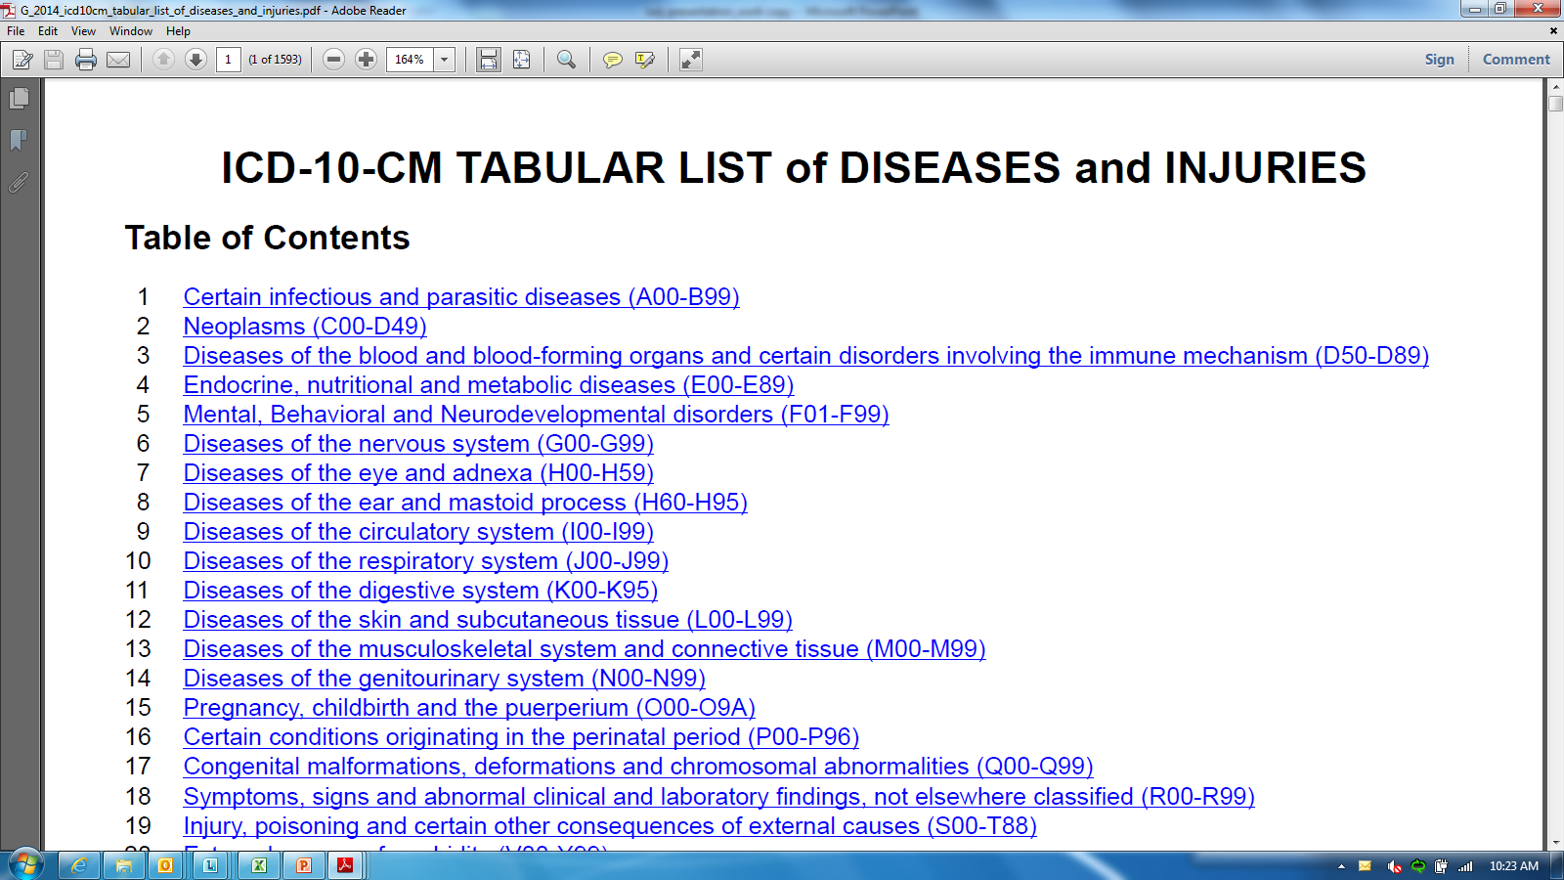
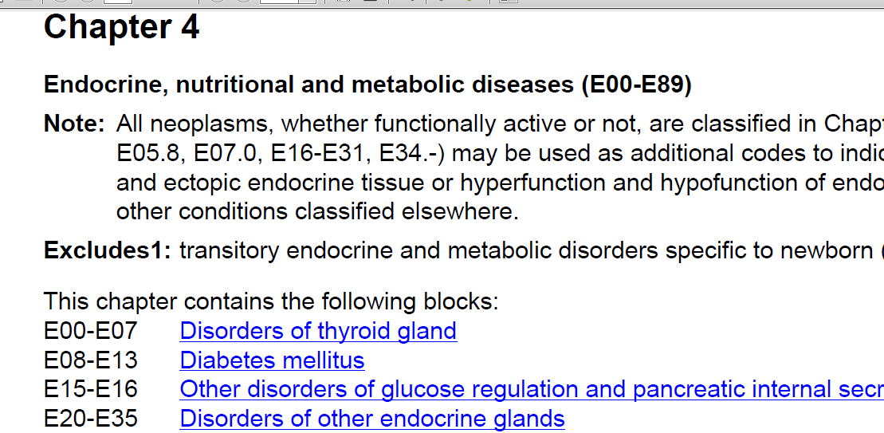
3
4
Notes:
Shelley:
Next, we look up the code in the tabular list. E11.621 can be found in Chapter 4 – Endocrine, nutritional and metabolic diseases (E00-D89). Click on the chapter title and it will take you to the beginning of Chapter 4. Make sure to read all of the notes at the beginning of the chapter. According to Chapter 4, you can see that the chapter is broken down further into blocks. You can find diabetes mellitus within the block E08-E13. Click on the block title when diabetes mellitus is found.

Slide 41
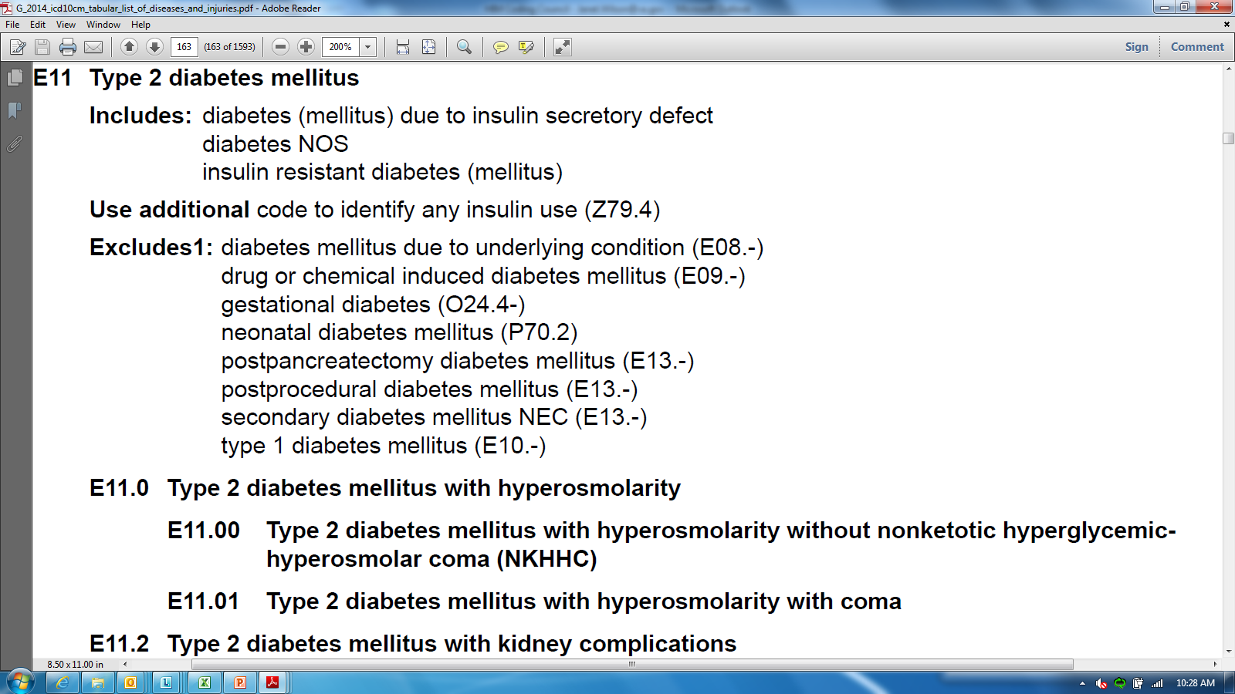
Includes
Use additional code
Excludes
Notes:
PAM:
By clicking on the block title, it will take you to the beginning of that section. At that point, you should scroll down until you come to the main term diabetes.
Once you are comfortable navigating though the index, you can use the document search function. But, for now, we recommend that you scroll down. Notice all of the notes at the top of this section that we mentioned a few slides ago.

Slide 42
Includes
Use additional code
Excludes
Notes:
PAM:
You should note that E11 includes diabetes (mellitus) due to insulin secretory defect, diabetes not otherwise specified, and insulin resistant diabetes.

Slide 43
Includes
Use additional code
Excludes
Notes:
PAM:
You should use the additional code Z79.4 to identify that the patient uses insulin.

Slide 44
Includes
Use additional code
Excludes
Notes:
Shelley:
And Pam, did you see the Excludes1 note? Just to remind everyone again, Excludes1 means that if any of the conditions below are present, they should “NOT BE CODED HERE!”. That’s a lot to remember!

Slide 45
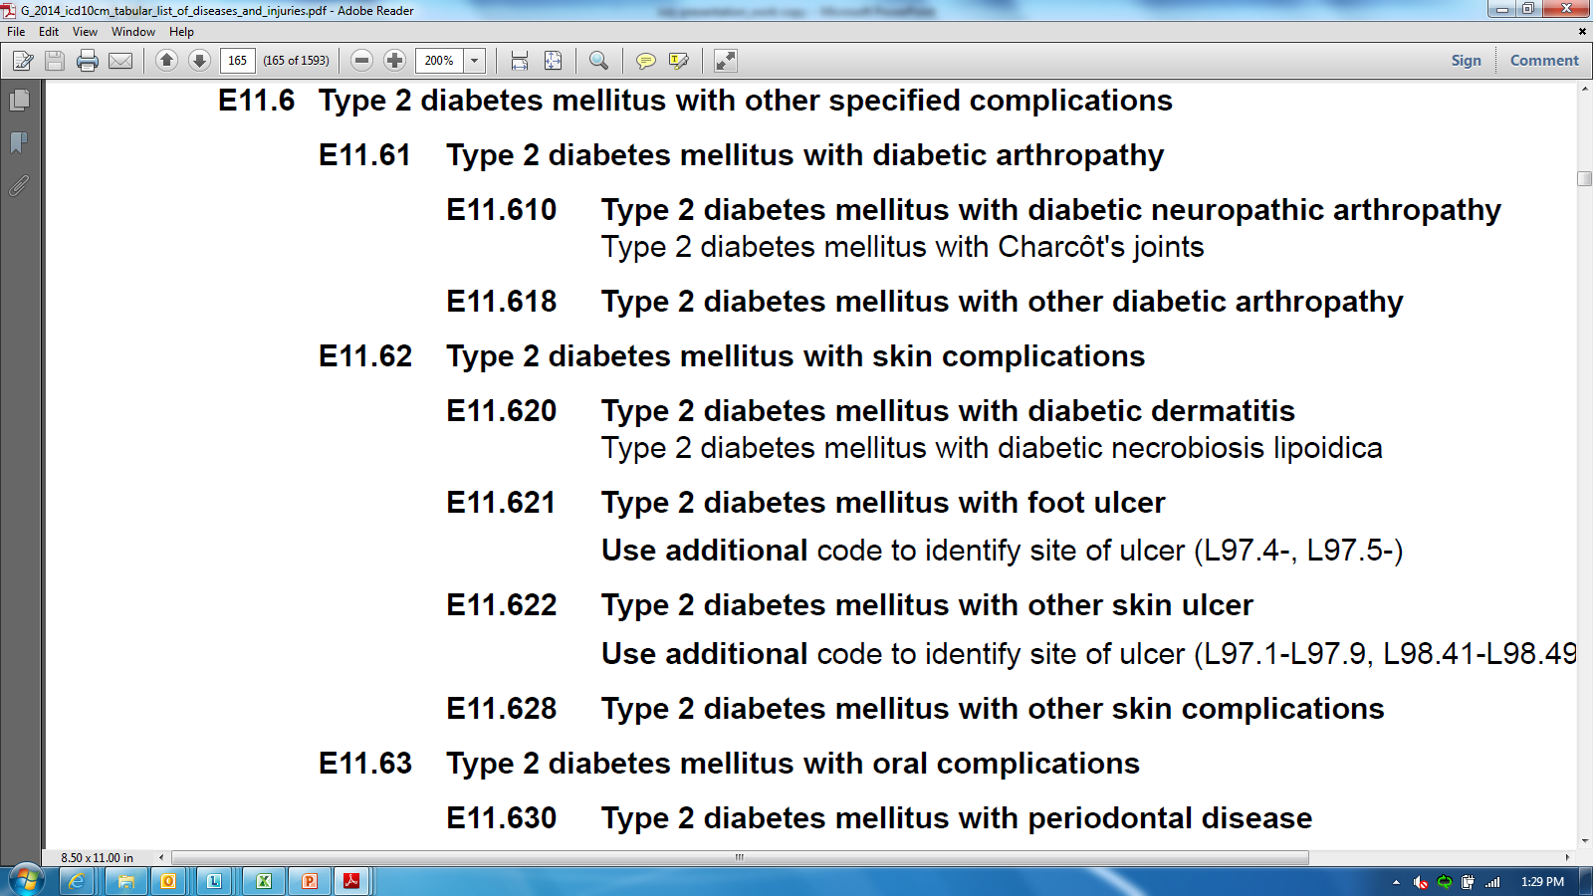
Notes:
Shelley:
After all of the notes have been read, scroll down until you find the full code E11.621 that you originally started out with. Remember, that code? It seems so long ago! Notice that under the code there is another note that says to Use additional code to identify site of Ulcer (L97.4-, L97.5-).
Okay, so far we have E11.621 for Type 2 diabetes mellitus with foot ulcer, Z79.4 for insulin use,

Slide 46
Notes:
Shelley:
…and now we need to find the code for where the ulcer is located.

Slide 47
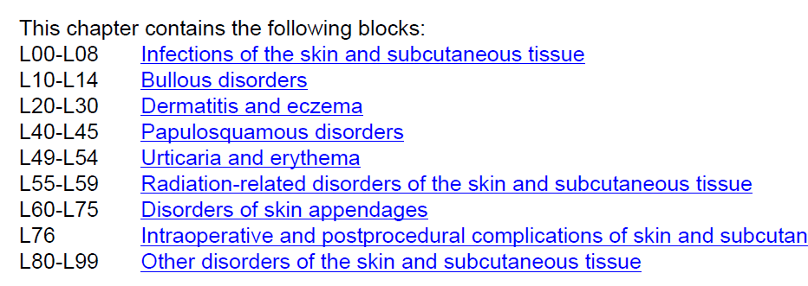
Notes:
PAM:
So, we now need to go back to the beginning of the Tabular, click on the Chapter that contains L97. Then scan the blocks, and click on the block containing L97.

Slide 48
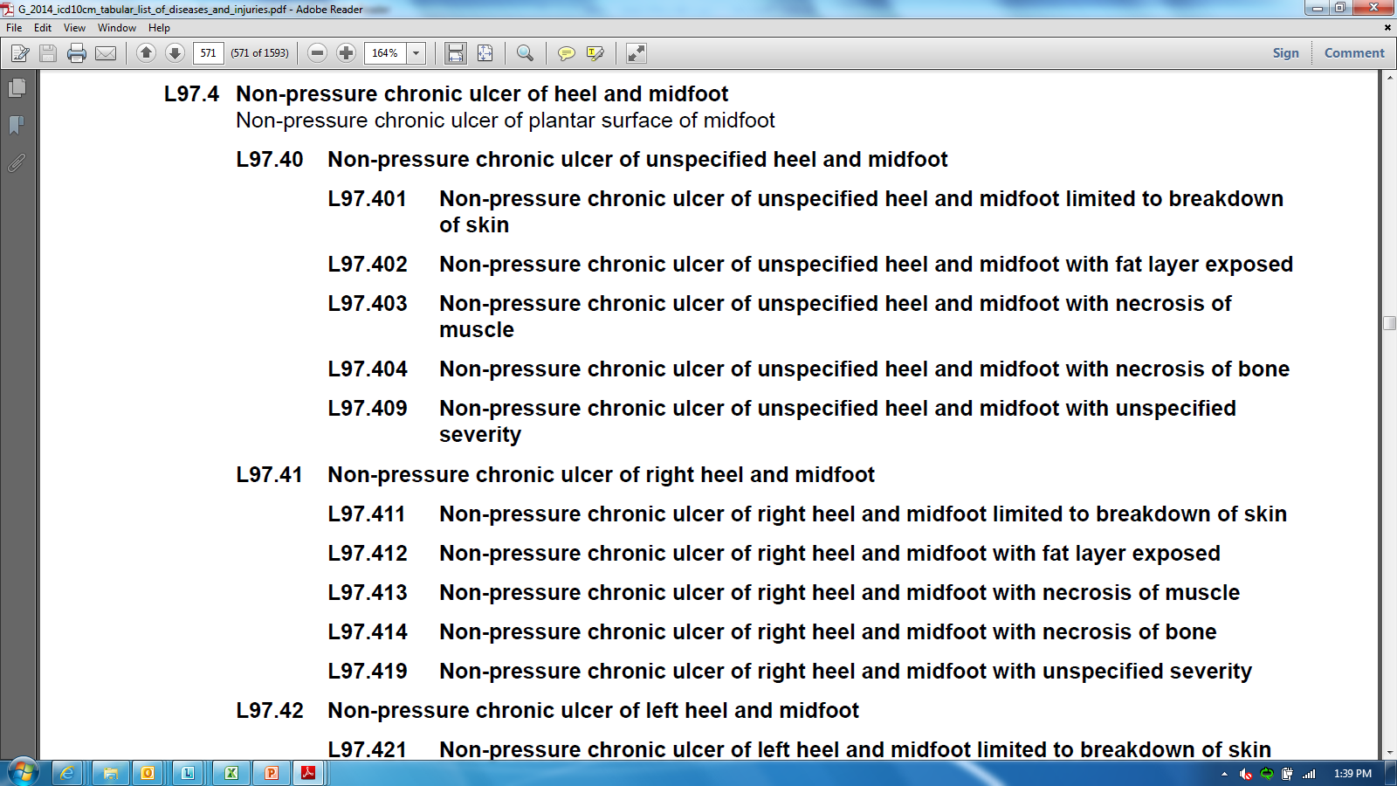
Notes:
PAM:
Once you get to the tabular section that has L97.4, L97.5, start scanning down the page until you find the appropriate code that covers the diagnosis for the ulcer.

Slide 49

E11.621
for Type 2 diabetes mellitus with foot ulcer
Z79.4
long term (current) use of insulin
L97.411
to show where the ulcer is located
Notes:
Shelley:
So, our scenario was about an elderly gentleman that went to the VA for treatment of his insulin dependent diabetes with an ulcer on his right foot. The ulcer was located on his right heel and appeared to involve only the skin. Our final diagnoses are:
E11.621 for Type 2 diabetes mellitus with foot ulcer
Z79.4 Long term (current) use of insulin and
L97.411 to show where the ulcer is located, which was a non-pressure chronic ulcer of the right heel and mid-foot limited to the breakdown of the skin.
Although this may seem like a lot to go through to find the appropriate diagnostic codes, the information obtained from these codes is important and used for a variety of purposes that we mentioned earlier in our presentation. But once you become familiar with the codes in a particular specialty, it should become easier. And for those of you that use encounter forms, most of the codes should be available there.

Slide 50

ICD-10-PCS codes
used only in the inpatient setting
Notes:
Shelley:
Pam… I’m tired now! That’s a lot of work just to find the codes for one patient. I hope we haven’t scared anyone off yet.
Now that we’ve gone through how to find a diagnostic code, let’s take a quick look at ICD-10-PCS. As we stated earlier, ICD-10-PCS codes are only used in the inpatient setting. So unless you’re a coder, you probably won’t ever need to look up a procedure this code set. Professional services will continue to be coded using CPT.

Slide 51
Poll Results
Is it essential to use both the Alphabetic Index and Tabular List when locating and assigning a code?
  True
  False
Notes:
PAM:
Before we get too involved in PCS, let’s take a look at the last poll results. A few minutes ago, Shelley gave you a true or false question. True or False, is it essential to use both the Alphabetic Index and Tabular List when locating and assigning a code?
The audience responded _____. The answer is True.
The Alphabetic Index does not always provide the full code. Selection of the full code, including laterality and any applicable 7th character can only be done in the Tabular List.

Slide 52
Poll Results
Is it essential to use both the Alphabetic Index and Tabular List when locating and assigning a code?
  True
  False
Notes:
CLICK TO NEXT SLIDE

Slide 53
Character Meanings
1
2
3
4
5
6
7
Root Operation
Body System
Section
Body Part
Approach
Device
Qualifier
Notes:
PAM:
Okay, let’s dive head first into PCS coding. All codes in ICD-10-PCS are seven characters long. Each character in the seven-character code represents an aspect of the procedure, as shown in the diagram.
The first character in the code determines the broad procedure category, or section, where the code is found.
The second character defines the body system—the general physiological system or anatomical region involved. Examples of body systems include Lower Arteries, Central Nervous System, and Respiratory System.
The third character defines the root operation, or the objective of the procedure. Some examples of root operations are Bypass, Drainage, and Reattachment.
The fourth character defines the body part, or specific anatomical site where the procedure was performed. The body system (second character) provides only a general indication of the procedure site. The body part and body system values together provide a precise description of the procedure site. Examples of body parts are Kidney, Tonsils, and Thymus.
The fifth character defines the approach, or the technique used to reach the procedure site. Seven different approach values are used in the Medical and Surgical section to define the approach. Examples of approaches include Open and Percutaneous Endoscopic.
Depending on the procedure performed, there may or may not be a device left in place at the end of the procedure. The sixth character defines the device. Device values fall into four basic categories: Grafts and Prostheses, Implants, Simple or Mechanical Appliances, Electronic Appliances.
The seventh character defines a qualifier for the code. A qualifier specifies an additional attribute of the procedure, if applicable. Examples of qualifiers include Diagnostic and Stereotactic. Qualifier choices will vary depending on the previous values selected.

Slide 54
ICD-10-CM
uses Alphabetic and Tabular Indices
ICD-10-PCS
uses only Tabular Tables and Index
Notes:
Shelley:
Now that your head is spinning from all of that information, let me add a little more. Unlike ICD-10-CM, where you look up a main term in the Alphabetic Index and then confirm the code in the Tabular Index, PCS uses only Tabular Tables and Index.

Slide 55
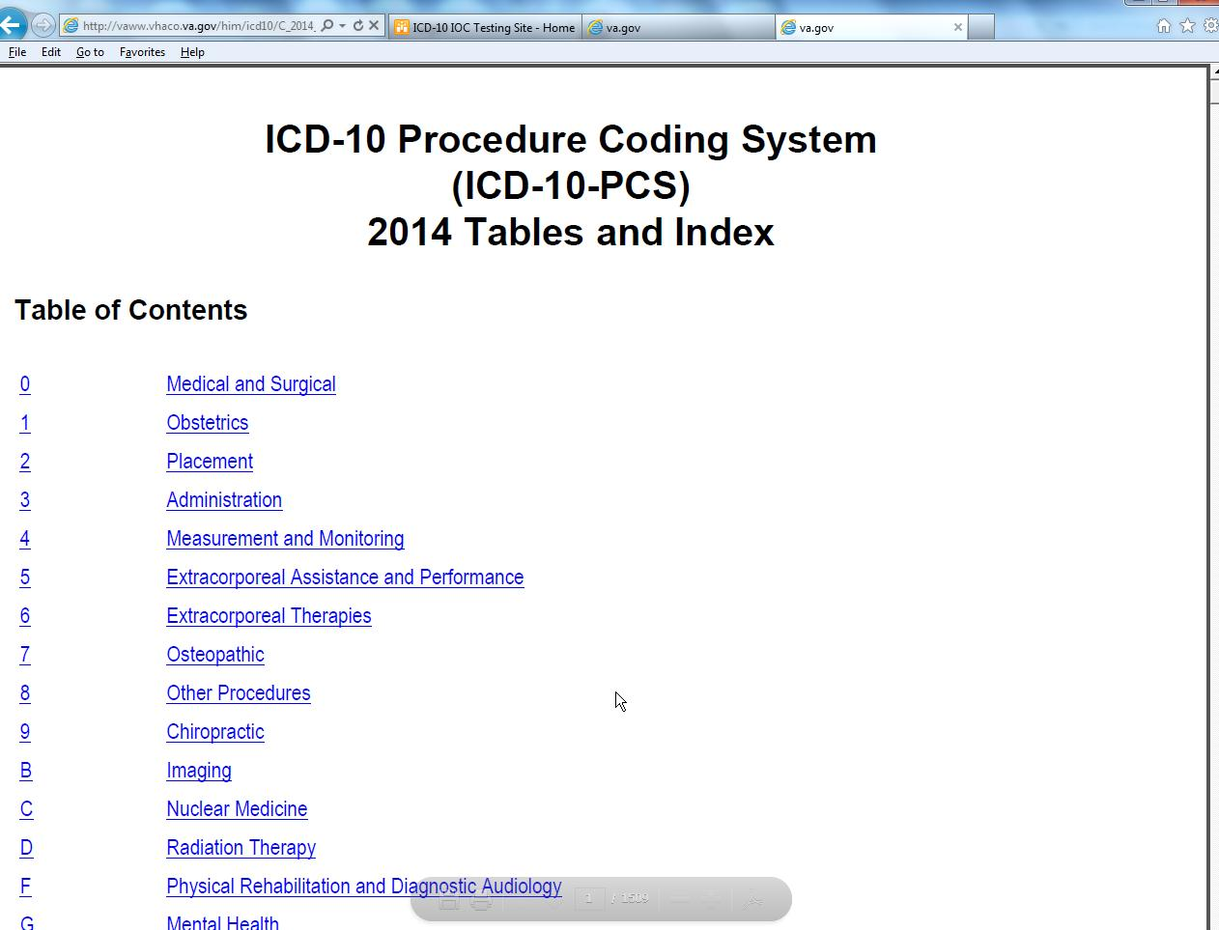
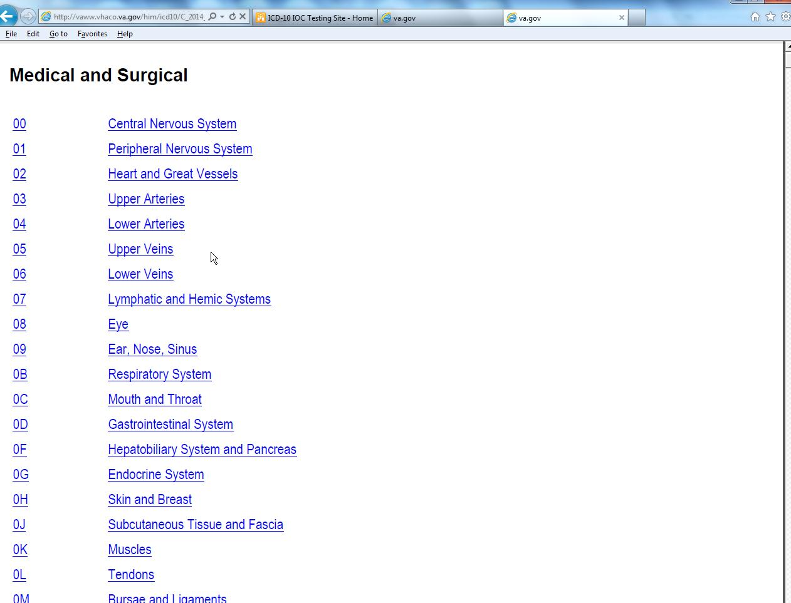
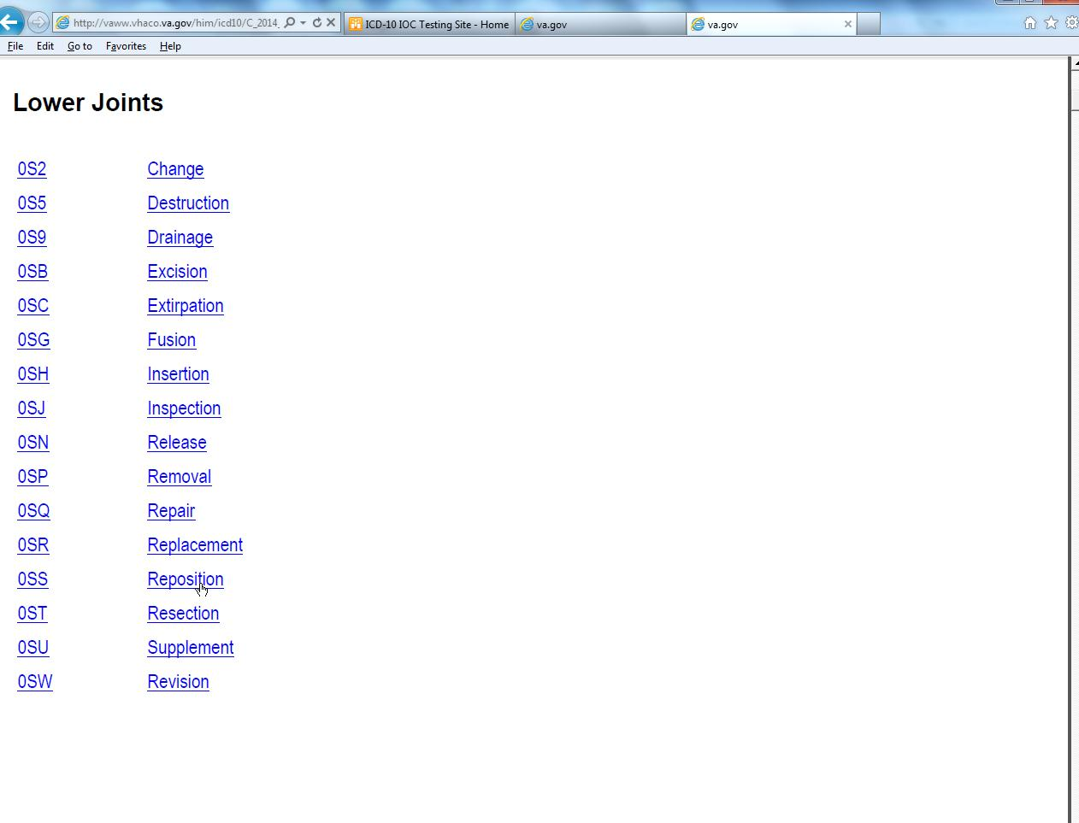
1
2
3
Section
Section
Body System
Body System
Root Operation
Root Operation
Notes:
Shelley:
The index can be used to find procedure names and methods similar to the process for ICD diagnosis. PCS requires 7 character values for every procedure code with each character representing a unique detail of the procedure.
With experience, in ICD-10-PCS the code values can also be determined by navigating directly to the tables using the ‘build a code’ method. This method requires the user to select a character value beginning with the section, body system, and root operation in order to find the appropriate table.
Once you open the 2014 ICD-10-PCS Tabular Index and Tables file on the ICD-10 Project page, a Table of Contents will display. Click on the link that best describes the procedure or section where it has been performed.

Slide 56
Notes:
PAM:
In this example, we are going to locate the procedure code for an open fracture reduction, displaced fracture of left ankle. We first need to click on Medical and Surgical in the Table of Contents.

Slide 57
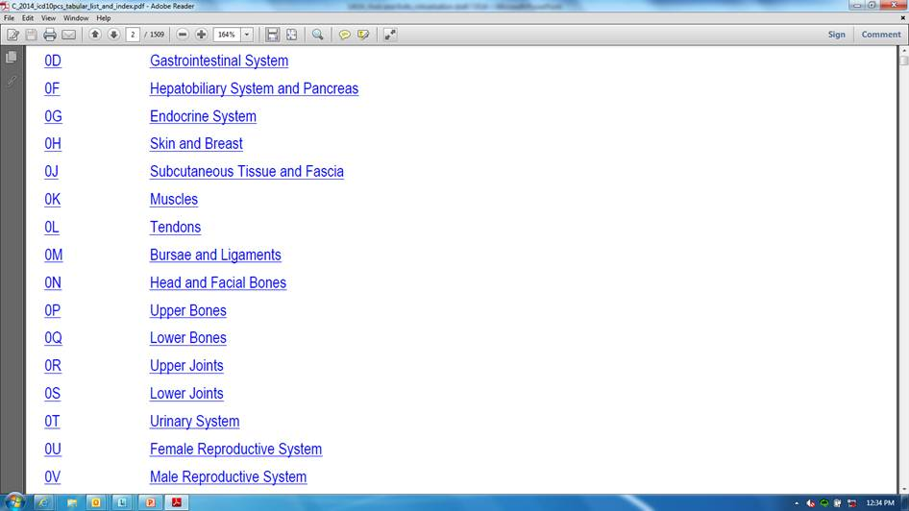
…
Notes:
PAM:
Once you click on that link, it will jump to that section of the reference where you then select the body system involved. We are going to choose the body system: Lower Joints.

Slide 58
…
Notes:
PAM:
Clicking on the body system will then jump to the section where root operations are displayed. You must then select the root operation for the procedure performed. We’ll select “Reposition”, or 0SS.

Slide 59
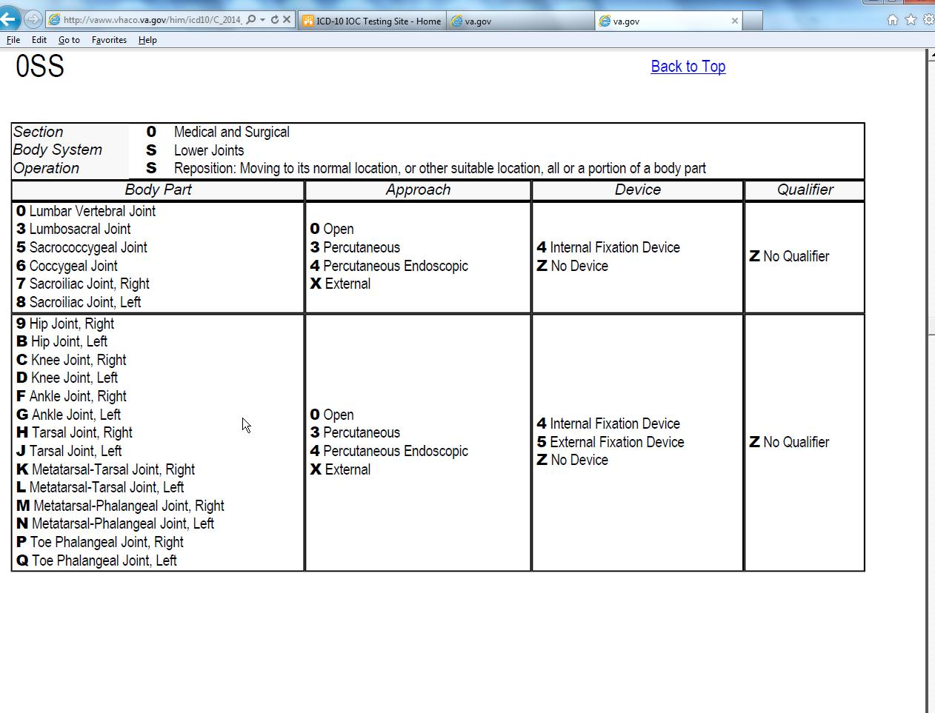
Notes:
PAM:
Either through the use of the index or by determining the values for Section, body system and root operation, you must then go to the PCS table. Notice that the table contains the letters that we previous found on the last slide.

Slide 60
0SSGXZZ
Notes:
PAM:
Now you need to find the correct section or row by identifying the value represented by character 4: the body part specifically then identify the Approach, Device, and Qualifier. When using the table, you should always go from left to right. Some of the code tables can continue to the next page so careful review should be taken to ensure consideration of all possible values. Notice the terminology differences that will be used in PCS. Clinical staff will not be requested to utilize new terminology in their documentation, the coder will have the ability to utilize existing documentation to determine the correct definition and terms within PCS. The final code for this procedure is 0SSGXZZ .
As we stated earlier, anyone other than HIM coders, will probably never have an occasion to use ICD-10-PCS.
Shelley:
Pam, I can just hear all the sighs of relief echoing through the local facilities.

Slide 61
Poll Question
Select the correct coding system for the following code: 0DTF0ZZ
    ICD-9-CM
    ICD-10-CM
    ICD-10-PCS
Notes:
PAM:
Shelley, before we move on, this seems like a good place to ask another poll question.
Select the correct coding system for the following code: 0DTF0ZZ?
ICD-9-CM
ICD-10-CM
ICD-10-PCS
To answer this question, use the blue polling icon above my head. Also, just a reminder that if you have other questions relating to our discuss, you should use the orange “ask the presenter” icon also located above my head and we’ll answer them at the end of the presentation. We’ll move on and come back to your results in just a moment.

Slide 62
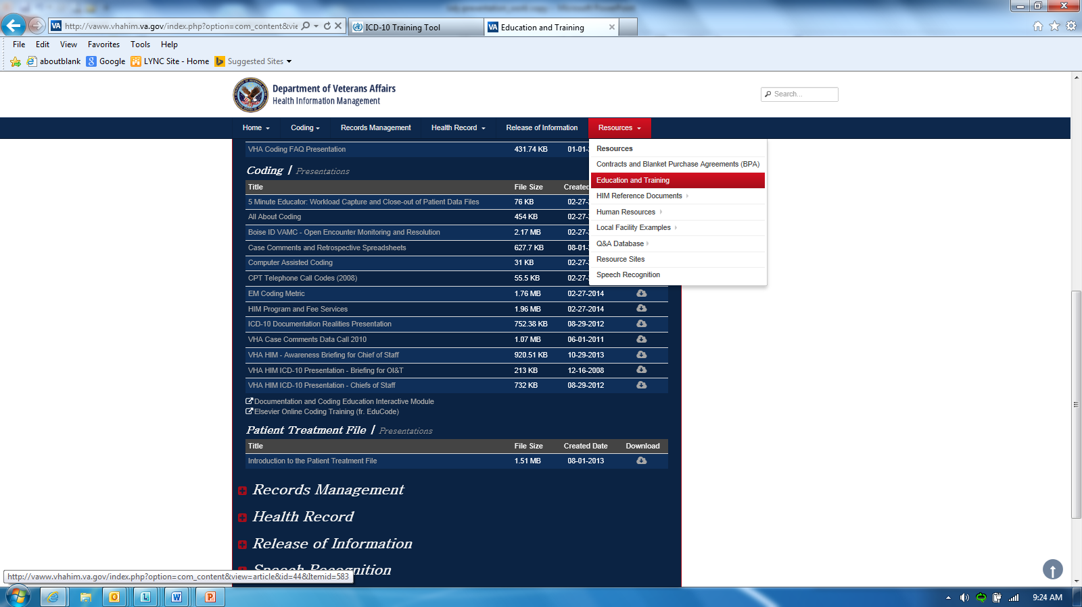
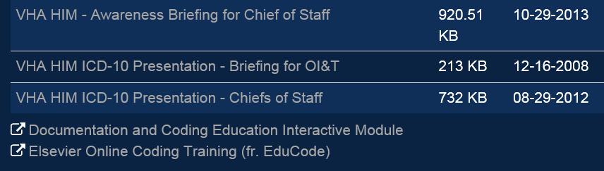
Notes:
Shelley:
Now that we’ve gone through the basics of ICD-10, we would like to show you other opportunities in which you can learn more about ICD-10. Under the Education and Training page on the HIM website, you will find plenty of information on ICD-10, specifically under Coding. The Coding Council will continue with their in-depth Coding Round tables that will allow for time to actually code cases during the presentation. In addition to these presentations, you will find a link to the Elsevier Online Coding Training, formerly known as EduCode. By clicking on the link, you will leave the VA intranet. This training is available 24 hours, 7 days a week to any VA employee. It is available outside of our firewall if you want to do some of the training from home. The course work is also accredited for coders and providers continuing education units.
Education and Training: http://vaww.vhahim.va.gov/index.php?option=com_content&view=article&id=44&Itemid=583

Slide 63
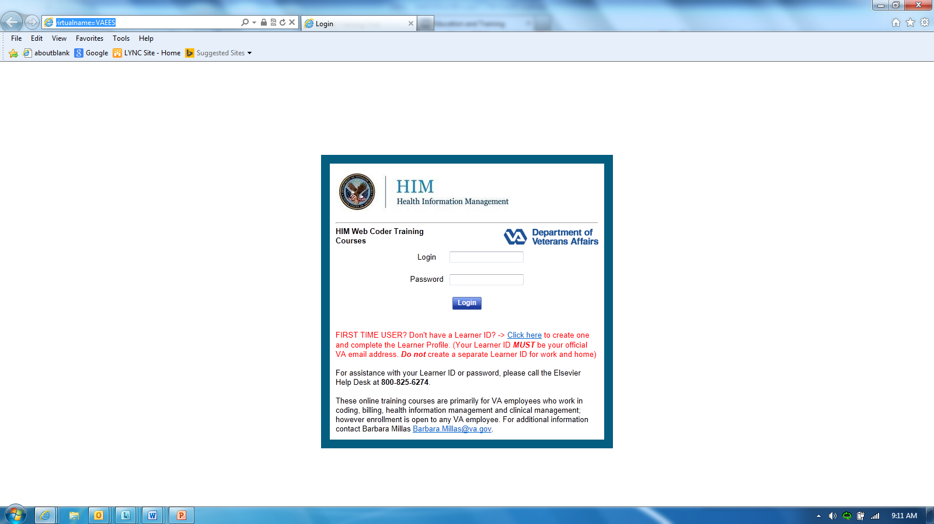
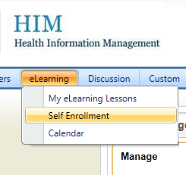
1
2
Notes:
PAM:
If you have never logged into the Elsevier, you can create an account. Your Learner ID must be your VA email address and these courses can be viewed from work or home. If you have questions, you can contact your Elsevier Administrator, which in most cases, is usually located in HIM at your facility. Otherwise, you can contact Barbara Millas from the National HIM Program Office.
Once you have established you account, go to the elearning menu and select “Self Enrollment”.

Slide 64
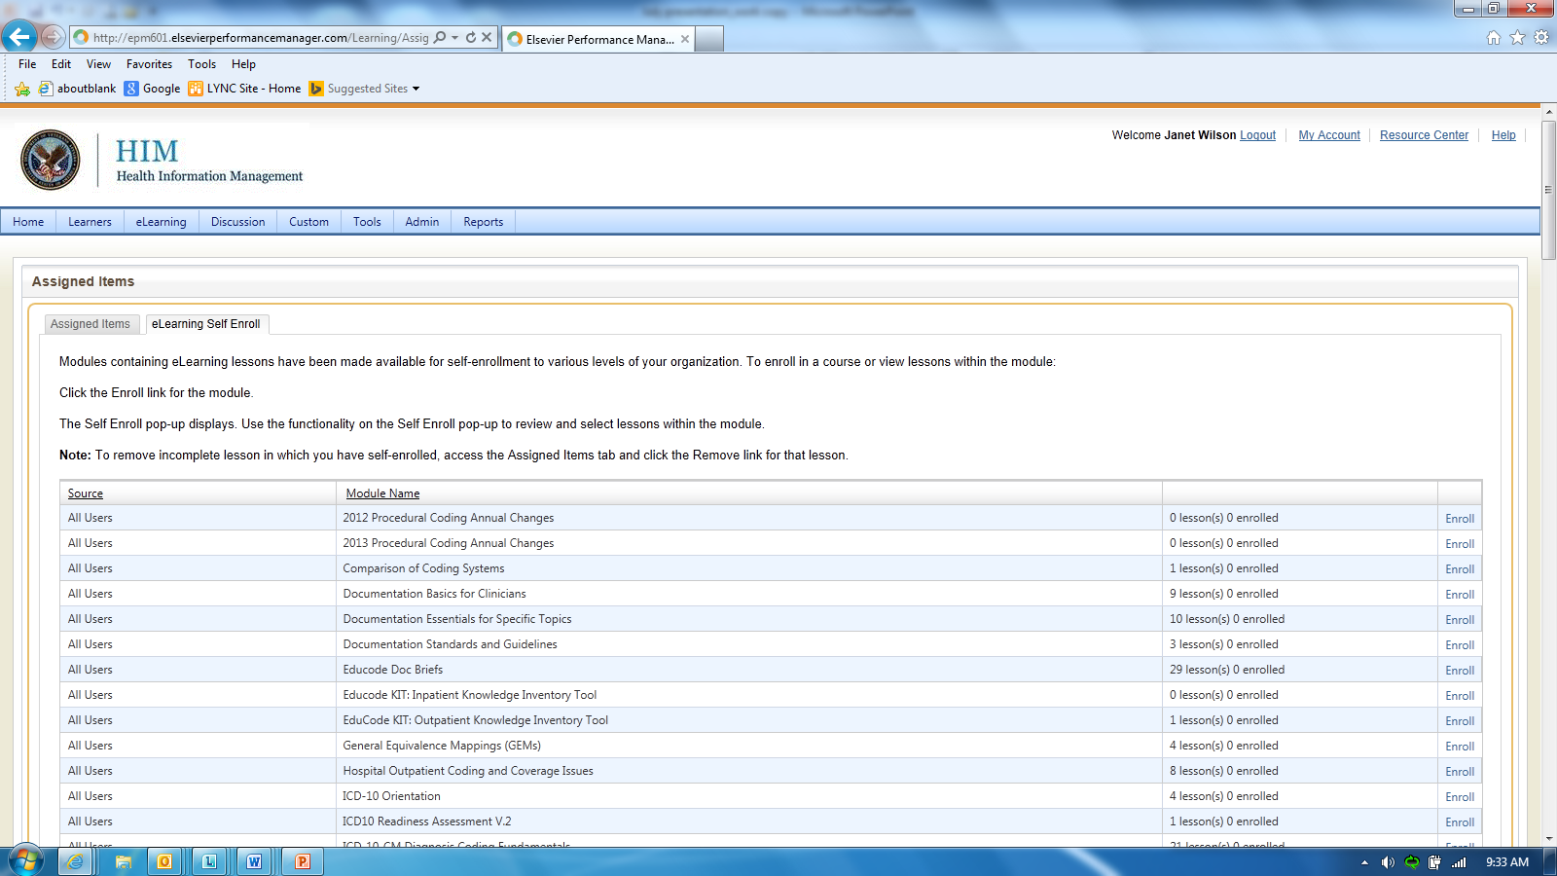

Notes:
PAM:
On the “Self Enrollment” page, you’ll be able to see a list of available lessons.
There are three classes offered to the non-coder. One online class for management staff, one for clinical staff, and one for all others. To select the lesson that you would like to enroll in, click on the word “Enroll”.

Slide 65
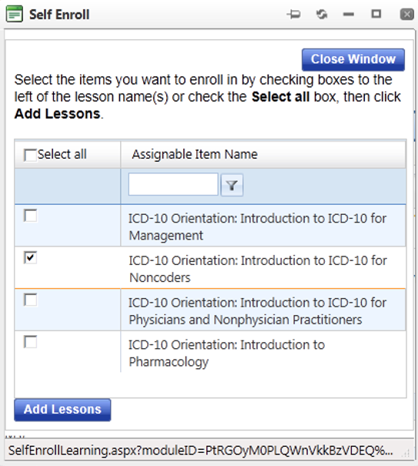
Notes:
PAM:
After selecting the course that you want to enroll in, select “Add Lessons”. At that time, it will enroll you in the selected class or classes. You can then close the smaller window.

Slide 66
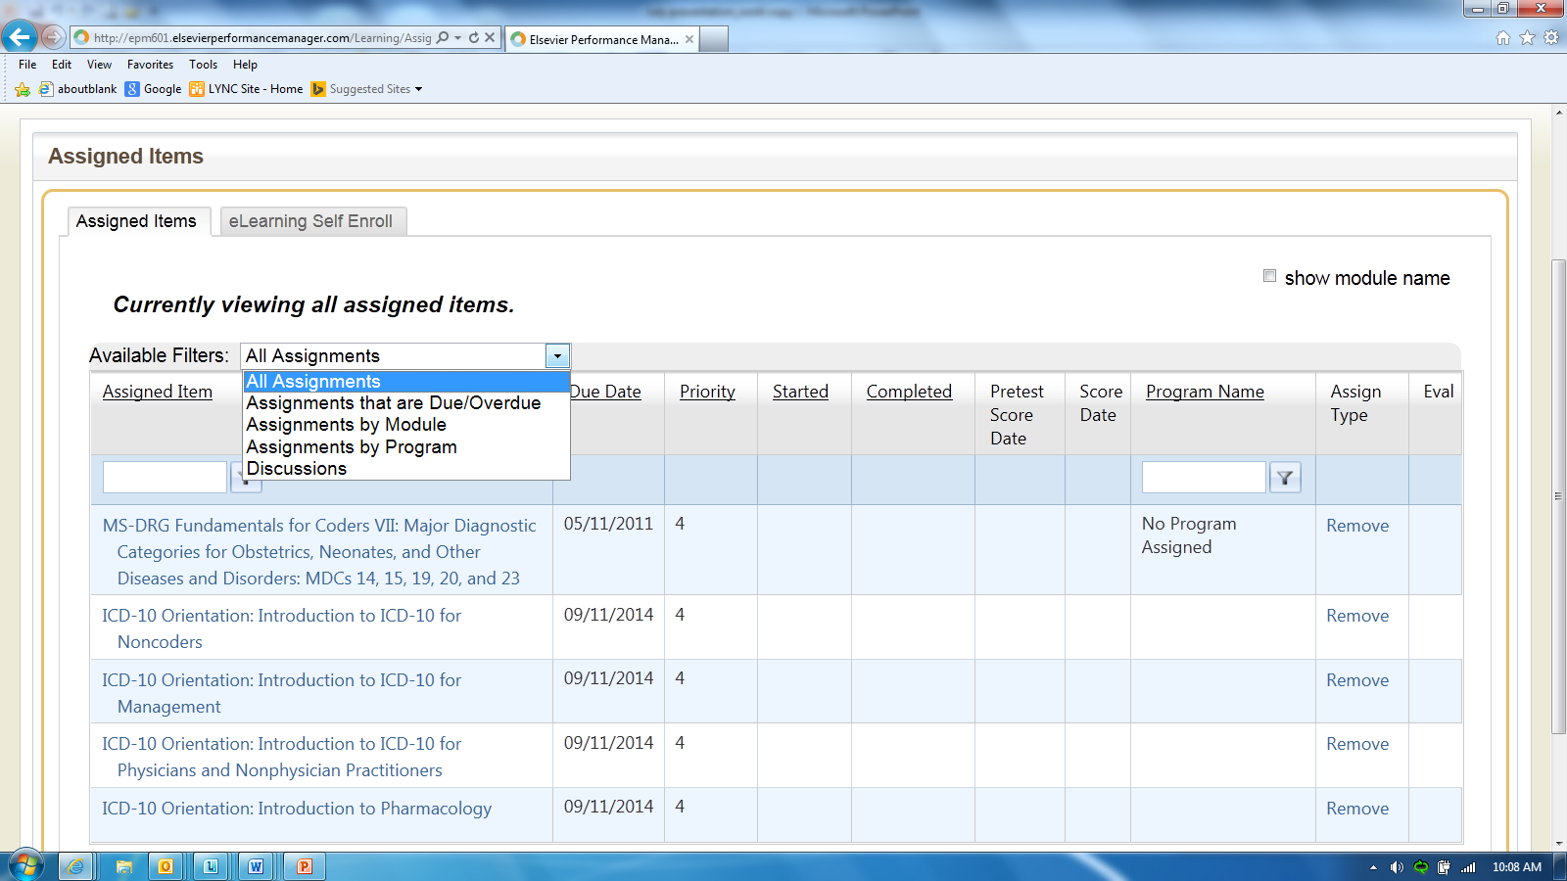
Assigned Items tab
Available Filters drop-down
  “All Assignments” option
Notes:
PAM:
To see what you have been assigned, click on the “Assigned Items” tab and select “All Assignments” from the dropdown box. The screen will update and a list of assigned classes will appear.

Slide 67
Poll Results
Select the correct coding system for the following code: 0DTF0ZZ
    ICD-9-CM
    ICD-10-CM
    ICD-10-PCS
Notes:
Shelley:
Pam, let’s stop real quick to see what everyone answered for the last poll question.
We asked you to select the correct coding system for the following code: 0DTF0ZZ?
ICD-9-CM
ICD-10-CM
ICD-10-PCS
The majority chose….
The correct answer is C. ICD-10-PCS.

Slide 68
Poll Results
Select the correct coding system for the following code: 0DTF0ZZ
    ICD-9-CM
    ICD-10-CM
    ICD-10-PCS
Notes:
CLICK TO NEXT SLIDE

Slide 69
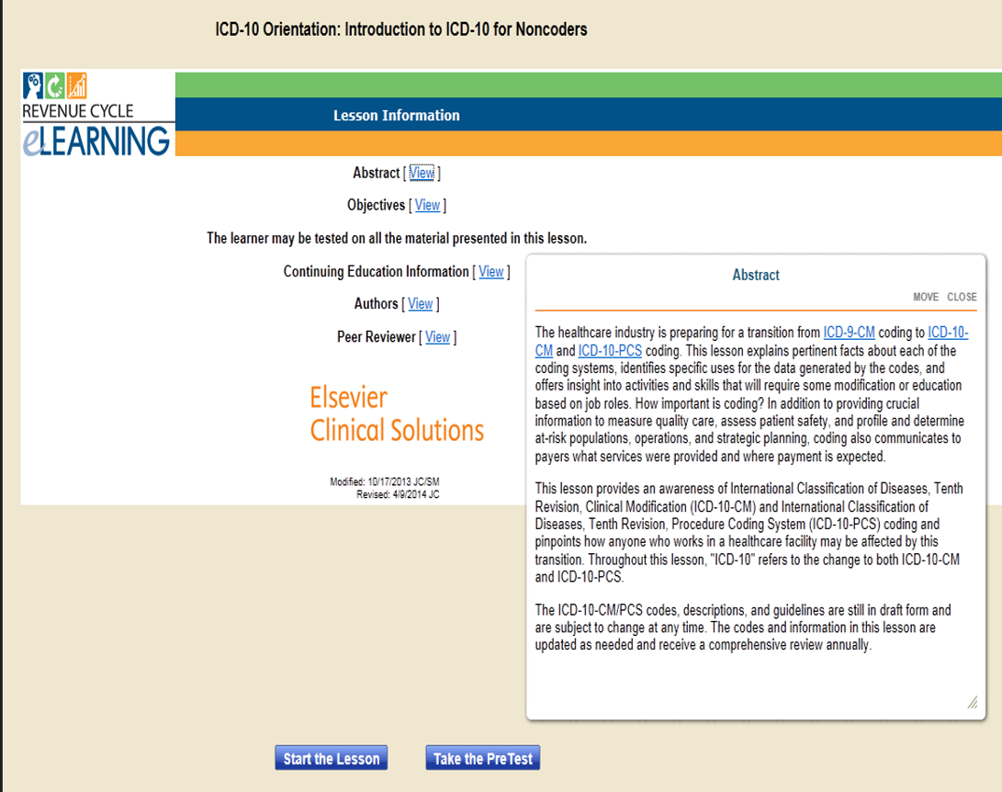
Notes:
Shelley:
Okay, back to Elsevier. To enter the course, click on the title of the course.

Slide 70
Notes:
Shelley:
Before beginning the course, if you want more detailed information about the class, click on one of the options shown.

Slide 71
Notes:
PAM:
Next, click to either “Start the Lesson” or “Take the Pre Test”.
Taking the pre-test will give you a good idea of your knowledge-base before you start the course. There are 10 questions in this test. Be sure you have enough time to complete it before you continue. If you exit before completing the exam, all unanswered questions will be scored as incorrect.
Some tests require additional materials, such as calculators or coding manuals, so make sure that you have these available if they are appropriate for the lessons you are working in. Remember, if you don’t have an actual code book, you do have access to the online references on the HIM ICD-10 Project page.

Slide 72
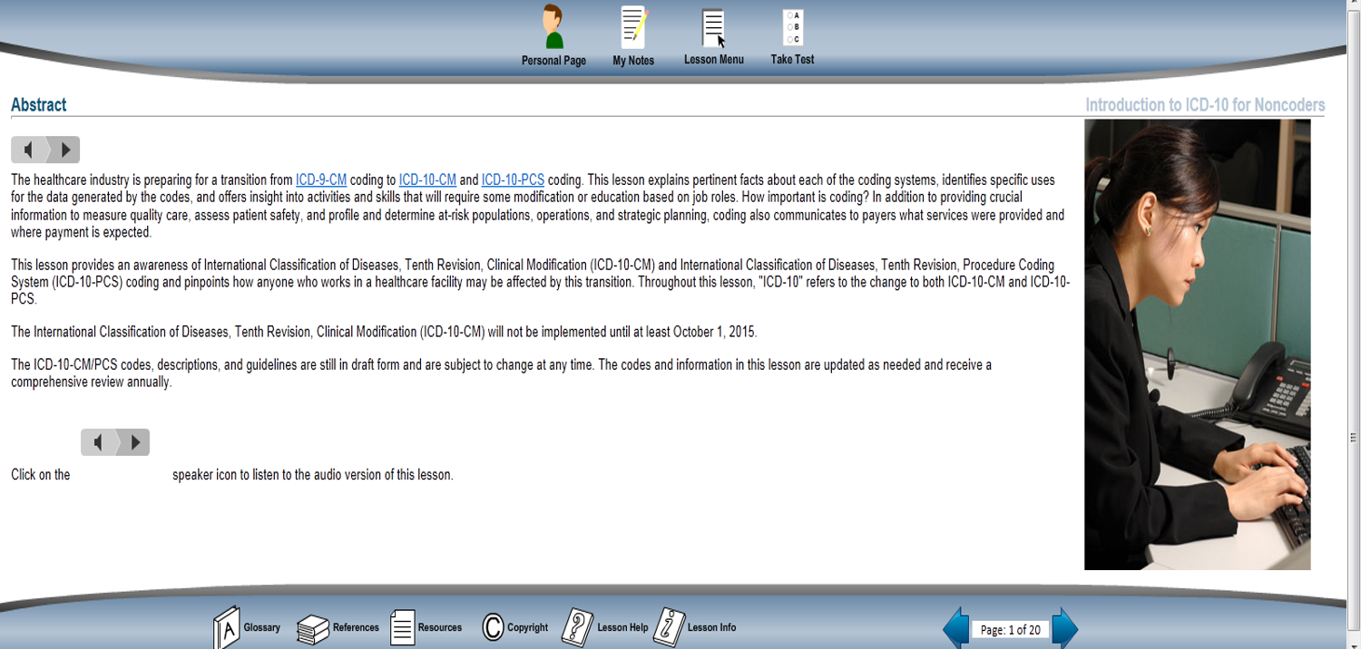
Notes:
PAM:
Once you have begun the course, you can go to your personal home page, make notes, go to the course menu or take the test.

Slide 73

True/False
Multiple Choice
Fill-in-the-blank
Notes:
Shelley:
Once you complete the course, you can then take the test or return to your personal page. Tests are comprised of True/False, Multiple Choice, and Fill-in-the-blank questions. Tests are scored based upon the number of questions you answer correctly from all of those in the test.
Some fill-in-the-blank questions may require multiple answers. This is common with the ICD-9-CM or HCPCS/CPT Coding lessons that require you to code an actual case study. When you must enter more than one answer, separate your answers with EITHER a space OR a comma. You cannot use both of these methods in a single question. It is best to get in the habit of using either spaces OR commas to separate your answers. Mixing the separators will result in questions being scored incorrectly.
If you are ready to begin, click Take Test in the menu above.
If you have the availability to take this test but would rather take it later, click Personal Page in the menu above to return to your home page.

Slide 74
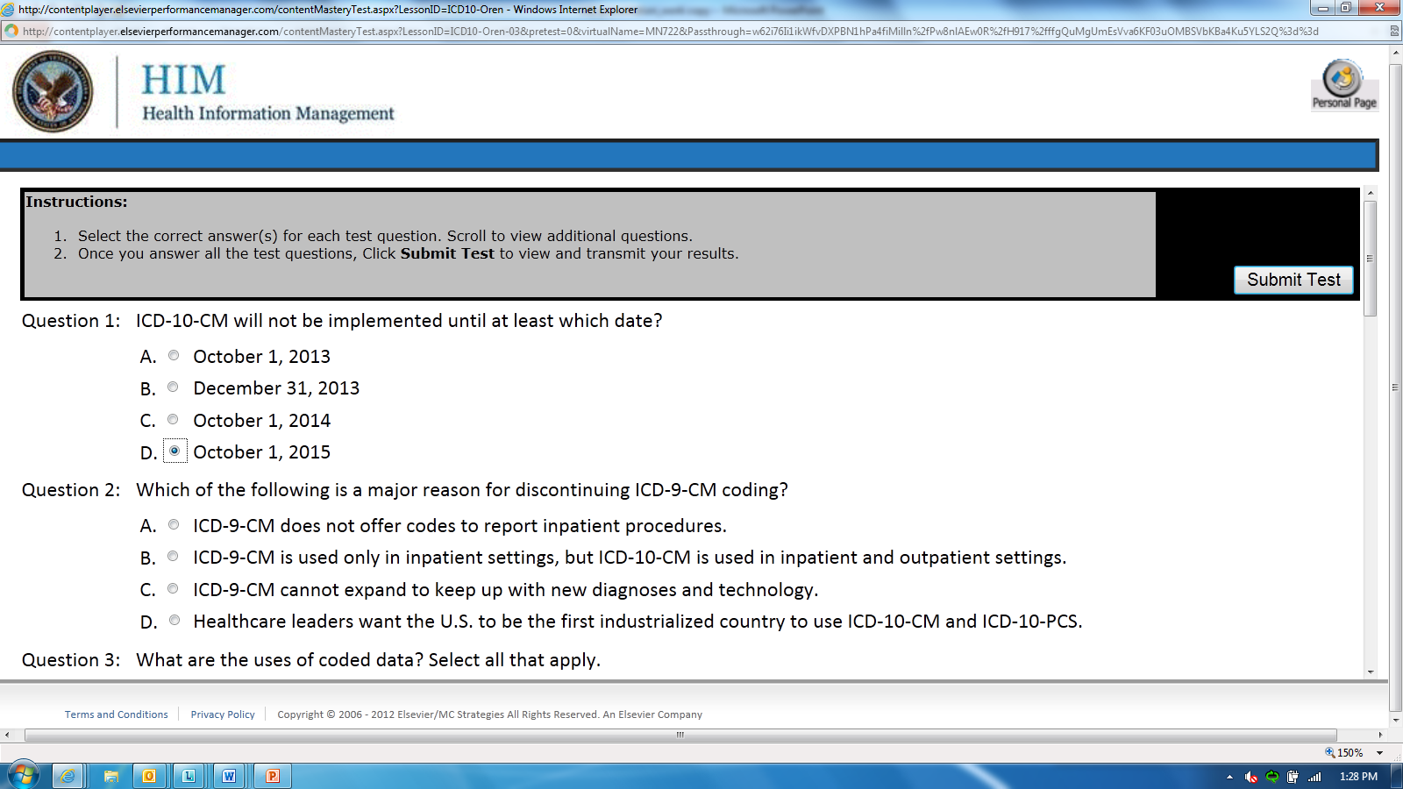
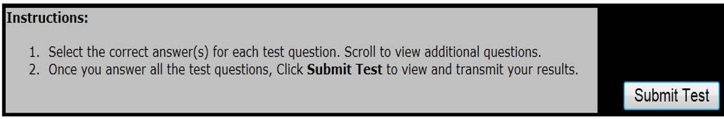
Notes:
PAM:
If you choose to take the test, click the “Submit Test” icon at the top of the screen once you finish.

Slide 75
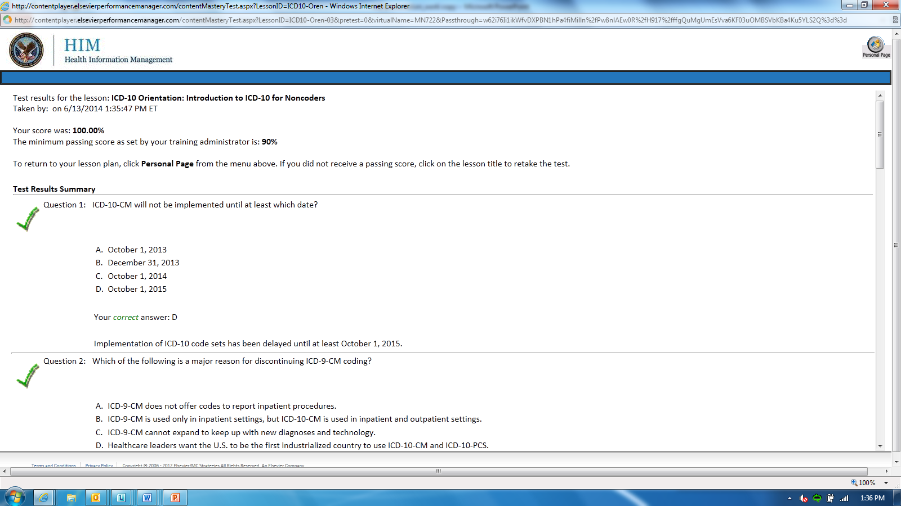
Notes:
PAM:
Once you submit the test, your results will display in the left hand side of the page. The Elsevier administrator is responsible for setting the minimum passing percentage. Click the Personal Page icon in the right hand corner to return to the page where your assignments are listed.

Slide 76
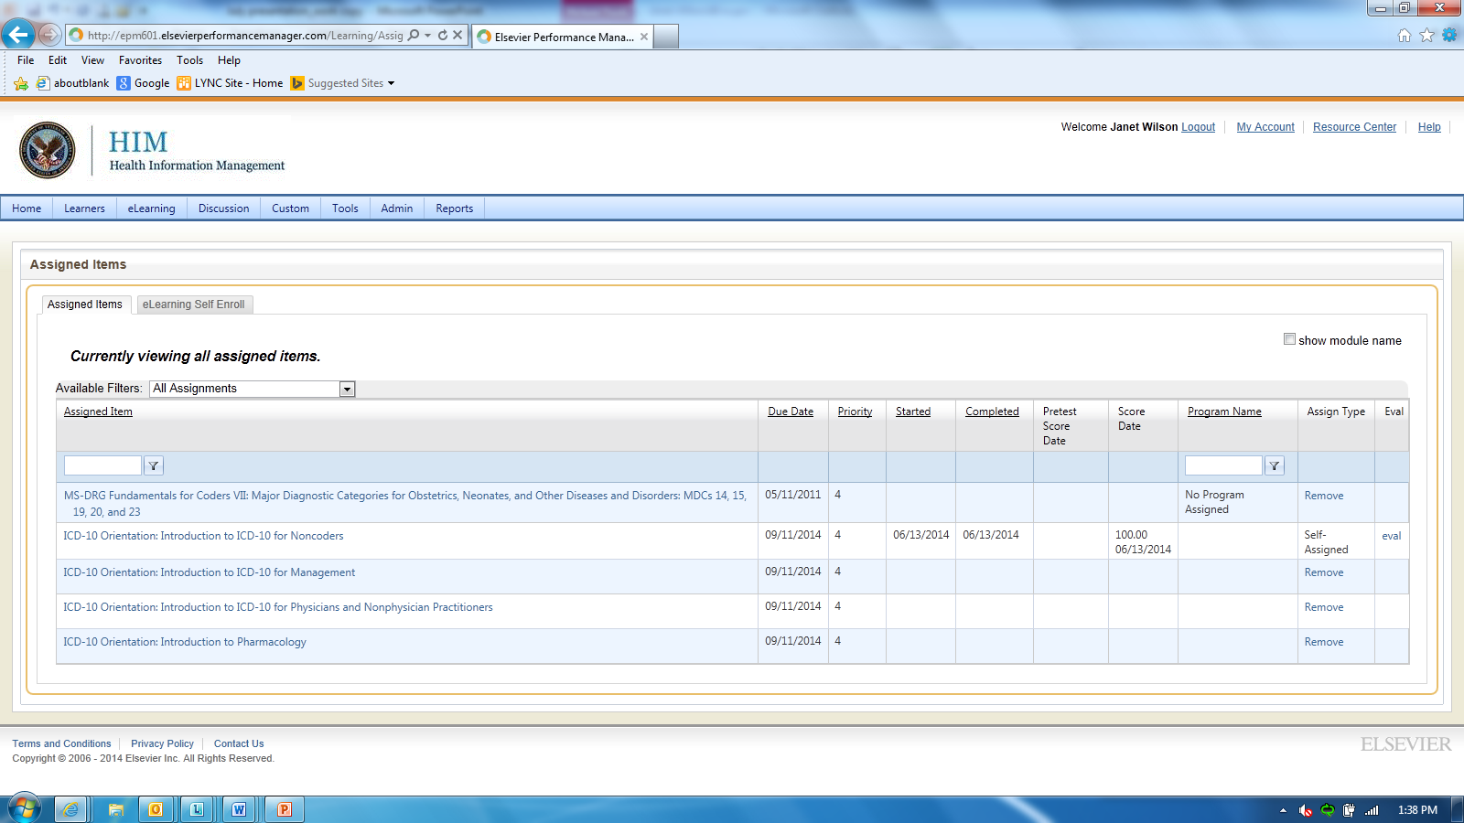
Notes:
Shelley:
When you go back to your personal page, the course that you just took will show was completed, the date that it was completed, and the score for the test. If you wish to receive a CEU certificate for completing the course, you much complete the evaluation.

Slide 77
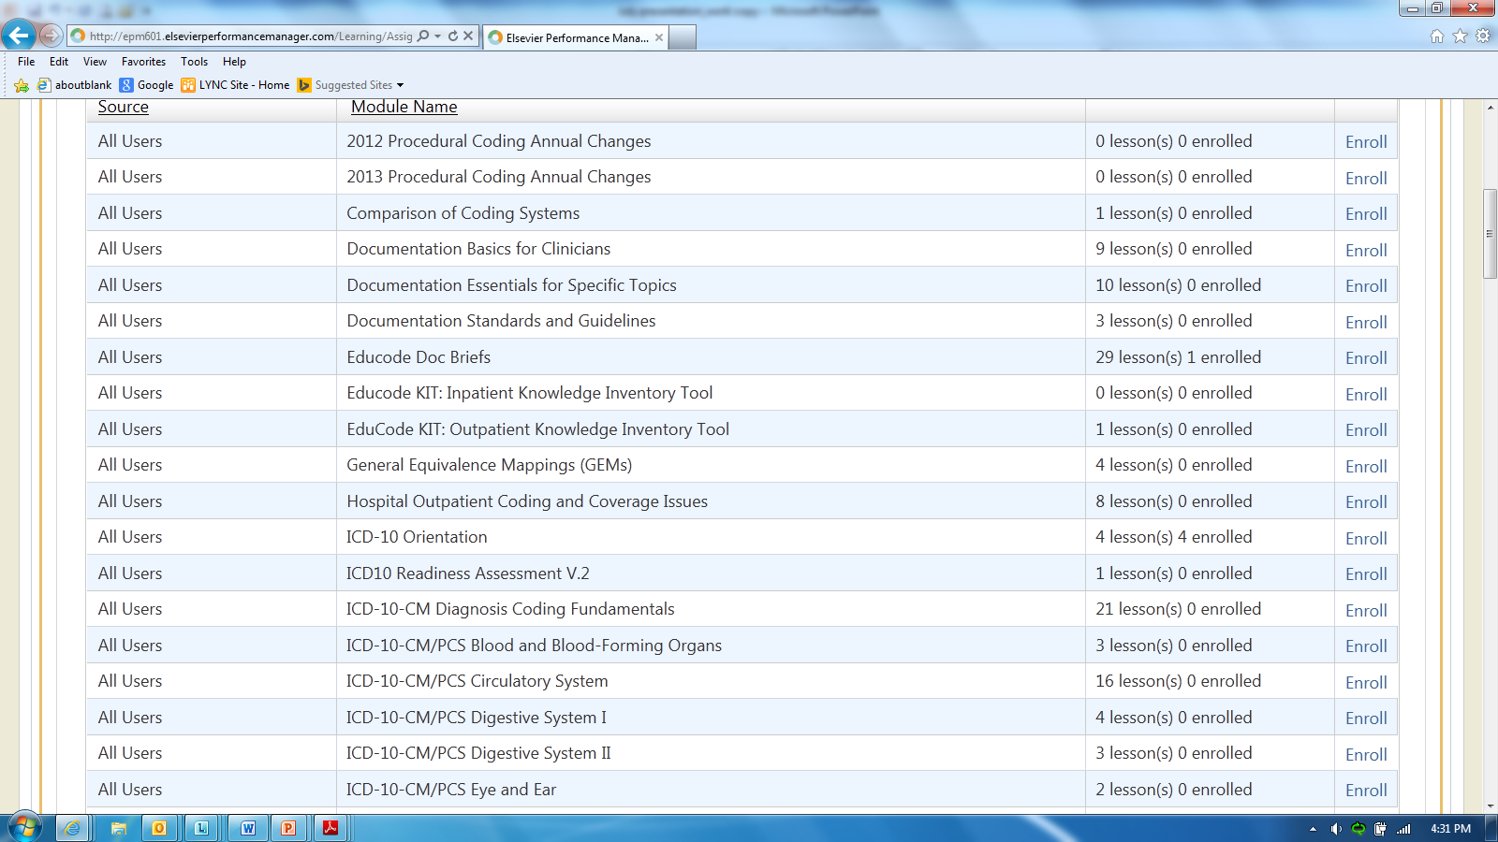
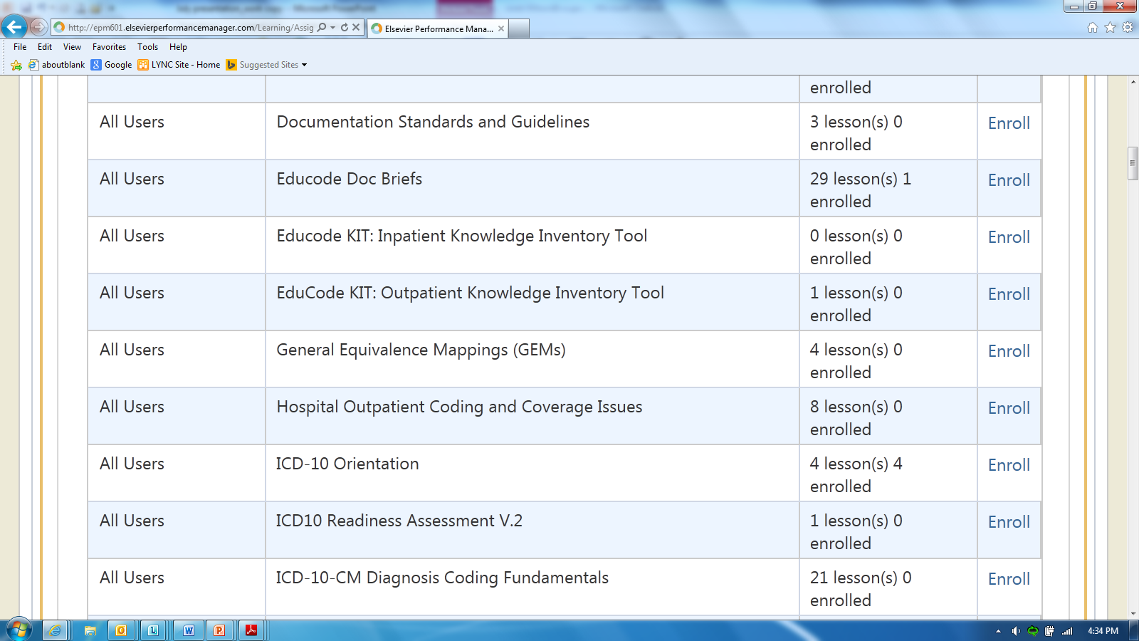

Educode Doc Briefs
Notes:
PAM:
One other item that is available through Elsevier that we would like to mention, are lessons called “Educode Doc Briefs”. There are 29 lessons available. Each lesson focuses on specific diseases and focuses on the clinical documentation needed from physicians to accurately code and report that specific illness.

Slide 78
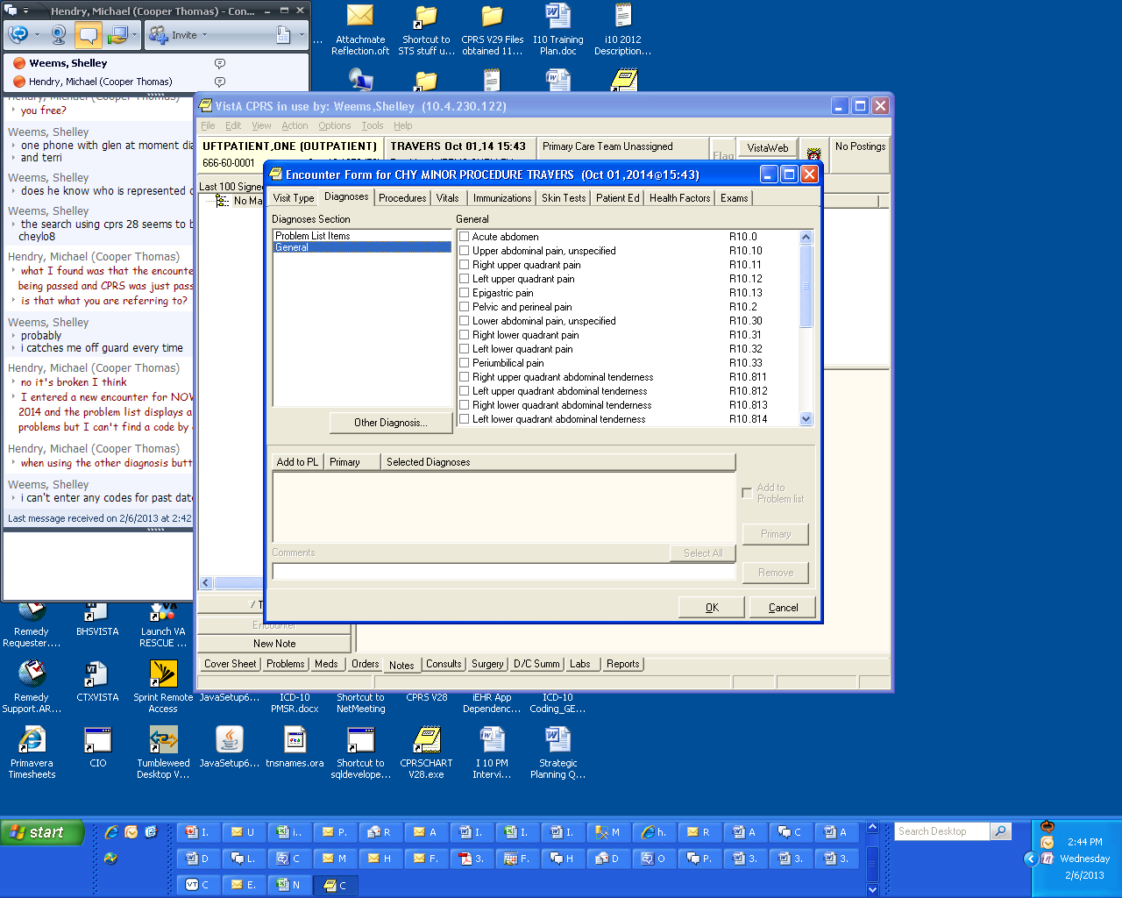
HIM Encounter Forms
Notes:
PAM:
HIM has been working hard to provide training, useful tools, and updating national encounter forms. Many have asked, how are providers going to navigate through ICD-10 with approximately 70,000 codes to choose from and only one correct answer.
One tool that they use to today and will utilize in the future are the encounter forms. If you are going to continue utilizing local encounter forms, your facility will be responsible for updating and deciding content for each form.
Shelley:
Pam, I would also like to mention a couple of online courses that are available on MyVeHU Campus, On-demand.
The first one, The Basics – Building and Editing Encounter Forms - This HIM/ICD-10 sponsored class is designed to give the step by step basic tools needed to compile the information, build/update, and effectively use encounter forms.
And the second, ICD-10 Clinical Reminders and Encounter Forms will walk participants through the process of updating existing clinical reminders and local encounter forms using ICD-10 codes.

Slide 79





ICD-10 Software Remediation – July 23, 3pm ET
Monthly HIM Coding Round Tables
Clinical Documentation Improvement Modules
@ MyVeHU Campus
Training
Notes:
PAM:
Shelley is also giving a presentation this afternoon entitled ICD-10 Software Remediation. This ICD-10 class will provide an overview of the software enhancements within 25 of the 37 VistA applications that required upgrades or modifications to handle the ICD-10 code set. Changes that affect the end user, such as the clinicians, will be fully outlined.
Additionally, the HIM CDI Council is currently developing training modules for CDI. Thus far, they have recorded four of the modules, which will be available through TMS. They are:
*Introduction to Clinical Documentation Improvement
*The Clinical Documentation Improvement Review Process
*Physician Query Tracking
*CDI & Respiratory Disease
The remaining modules are still in development and an announcement will be made to the field when they become available.
As a reminder, tomorrow there will be a presentation on ICD-10 and Clinical Documentation Improvement at 1:00 pm ET.

Slide 80

VHA Literature e-Alerts
ICD-10 Implementation MEDLINE
Information Technology News e-Alert
Notes:
Shelley:
In addition to all the training that is available, there are two Literature e-Alerts. These Literature e-Alerts are prepared by VA Central Office Library staff. The first one is a recurring MEDLINE literature search on ICD-10 implementation and the second Literature e-Alert follows IT news, including ICD-10.
If you download the presentation, you’ll find the link for subscribing to them. The link will take you to the VHA National Desktop Library Literature e-Alerts page where you can sign up for the e-alerts.
Sign up at http://www.va.gov/library/JournalAlert.asp

Slide 81

How can you prepare?
Notes:
PAM:
We’re often asked how facilities can prepare for ICD-10 implementation. The best thing that you can to to help you prepare for ICD-10 implementation is to review the ICD-10 monthly site assessment to gauge what still needs to be done from an ICD-10 perspective. One of the items that you should focus on are addressing any ICD-9 coding backlogs.

Slide 82

References
Notes:
SHELLEY:
Once again, in the downloadable presentation, we’ve provided several references where you can find additional information available on ICD-10, including the HIM Intranet site, the ICD-10 Intranet site, the ICD-10 list serv, and links to CDC and CMS pages. If you haven’t already, click on that green downloads icon now and download the PPT.

Slide 83


Ask the Presenter
Notes:
PAM:
Well, we have made it through the nuts and bolts of ICD-10 coding. Hopefully we’ve help you put some of the pieces together. I know that there was a lot of material to cover, and we want to thank you for joining us today. We tried to highlight specific content and emphasize where the similarities and differences exist.
Remember, as long as you know the basic coding conventions and guidelines, you will be successful in ICD-10 coding. There are a lot of resources available where you can learn more about ICD-10.
One final reminder, if you haven’t submitted your questions yet, there is still time to do so by clicking on the orange “Ask The Presenter” icon. We’re going to show a brief announcement and be right back to answer your questions.

Slide 84
HIM Intranet site: http://vaww.vhahim.va.gov/
HIM ICD-10 intranet site: http://vaww.vhaco.va.gov/him/icd10.html.
Join the ICD-10 LISTSERV to receive periodic updates: http://vaww.listserv.va.gov/scripts/wa.exe?SUBED1=ICD-10_STAKEHOLDERS-L&A=1.
Centers for Disease Control and Prevention: http://www.cdc.gov/
Centers for Medicare and Medicaid Services: http://cms.hhs.gov/

