Slide 1

Building and Editing Encounter Forms
The Basics:
Rebecca England, MHA, RHIA
Chief, HIM
Dawn O’Connor, CPC
Health Informatics Specialist (CAC)
Notes:
151601138
REBECCA
Thank you and welcome. Today we are going to cover the basics of building and editing encounter forms in VistA as I know this is a hot topic for the field as we approach the transition to ICD 10.
Dawn, I know at our site encounter forms can be a big problem if they are not maintained properly. Our HIMS staff members get calls each week about problems that providers find when they try to encounter a patient. They often say my procedure codes are gone, I have to select a type of visit and a procedure code for every encounter, or the new one as our providers are moving towards capturing their inpatient encounters, they call saying they have no codes available for them to select to close the encounter.
DAWN
Those are just a few of the issues that come up at the local level I am sure! We get numerous emails throughout the months from various sites requesting new forms and modifications to existing forms. It sometimes is a little overwhelming keeping up with all the requests. Sometimes when we are contacted by a site they might request a change or suggest that a new form be created, but they don’t provide any history or rationale for why they are submitting the request.
REBECCA
I know I’m just now cleaning out all those cobwebs I might have when it comes to the day to day HIMS operations, I think it has been about 11 years since I have been involved at my facility with the updates to encounter forms. And even then I had a very hands on Business Office ADPAC and Assistant Chief Business Office that were the “data types” and knew all the in’s and out’s of editing and building encounter forms. I can honestly say that after the Coding Council completes our portion of the review of new and existing forms, I have NO idea how the forms get to FORUM and I definitely don’t know how to assist a site with exporting and installing them. So do you think after today I’ll understand a little more? I really think some in the field think I have been pulling their leg when I tell them I have “no clue” and they will have to wait for you to return to the office!
************************************************************************************************

Slide 2

New Encounter Form Requests
Modification to Existing Form Requests
Pairing of ICD and CPT Encounter Forms
Quarterly National Form Export Process
Copying Encounter Forms from Toolkit
Assigning Forms to Clinics
Editing Forms
Notes:
30778666
DAWN
Maybe today we can help our viewers see “clearly” as we provide them with a better understanding of what goes on behind the scenes. Our course today has been developed to walk you through the processes for new encounter form requests and requests for modifications to existing forms. We will go over the quarterly national form export process and then I am going to demonstrate through the use of step-by-step screen shots, how you can copy encounter forms from the Toolkit, how to assign forms to clinics and finally some step-by-step instructions on building and editing your forms.
REBECCA
Well, like I said a minute ago, I’m considering myself a “newbie” when it comes to all this block editing, assigning a form to multiple clinics – so do you think our viewers should really try to get all the detailed step-by-step instructions down today during the presentation, or should they just take a “watch and learn” approach, taking some notes, and then come back and watch it again, maybe while practicing with an actual form?
DAWN
I think the best approach is to “watch and learn” as you said with today’s session, take a few notes, then bring it up “on demand” when it is available and walk through the steps, preferably in the test account, and practice your form editing and building skills.
************************************************************************************************

Slide 3

Poll Question
Who at your site is responsible for managing the encounter forms?
  HIM
  OIT
  Health Informatics Specialist (CAC)
  Program Application Specialist (ADPAC)
  Other
Notes:
DAWN
How about we start off with our first polling question before we dive into the presentation. Use the blue polling button above our head to cast your answer to our questions today. Our question is “Who at your site is responsible for managing the encounter forms?” Is it HIM, OI&T, a Health Informatics Specialist, or CAC , your service ADPAC, or maybe someone completely different?
REBECCA
Dawn, while we wait to see the results, how about let’s start discussing the different processes involved in support of the national encounter forms.
***********************************************************************************************

Slide 4
National Encounter Form Process
New Requests
Modification Requests
Review Process
Notes:
REBECCA
The first process I’ll go over today is related to how to request a new encounter form, then we will review field requests for modifications and finally I’ll go over the steps utilized by the Coding Council members to complete the quarterly reviews. Hopefully reviewing some of the steps involved in these processes with our viewers will help simplify and streamline future requests submitted to the council.
***********************************************************************************************

Slide 5

Local Changes
Updated Codes
New Service
Notes:
79295812
REBECCA
Do you often feel like this poor man when your providers call wanting to make changes to the encounter forms associated with their clinic profiles? Do you keep having to make local changes to the national forms each quarter when they are updated? Have the new quarterly updates to CPT been distributed? Or maybe VA has implemented a new service for our veterans. Remember when we started doing telehealth, E consults, or CCHT? All of these are valid reasons that you might want to request a new national encounter form be developed for the field. Do you know how you would go about doing this? I say, let’s call Dawn, right???
DAWN
Well, I am always happy to provide that support, but I think you might need to go over the preferred method in a little more detail.
REBECCA
Ok, I believe I touch on this in just a few minutes, but I still say calling you is “my” first step!
***********************************************************************************************

Slide 6
Poll Results
Who at your site is responsible for managing the encounter forms?
  HIM
  OIT
  Health Informatics Specialist (CAC)
  Program Application Specialist (ADPAC)
  Other
Notes:
DAWN
Ok, let’s go back to the results of our polling question, who at your site is responsible for managing the encounter forms? It appears that the majority of the responses are ____________________ (look at results). (I anticipate a variety of responses) Wow, I think the responses we have here goes to show you that every VA is a little bit different.
REBECCA
I think you are right there Dawn! I think this supports the variation in detail that is often provided to us when sites make requests related to the national encounter forms. So, how about we get back to discussing the encounter form review process.
***********************************************************************************************

Slide 7

Poll Results
Who at your site is responsible for managing the encounter forms?
  HIM
  OIT
  Health Informatics Specialist (CAC)
  Program Application Specialist (ADPAC)
  Other
Notes:
Click to next slide

Slide 8

Do Your Homework submit a sample encounter form
Notes:
113958073
REBECCA
Ok, so do our viewers know how to request a new form? The first step we recommend is to DO YOUR HOMEWORK!!! I can’t foot stomp this enough. Why do you think we need a new form? Is it specialty specific? Are you making a lot of modifications to existing forms at your site? Like I mentioned a minute ago, did VA venture into a new service area. If your encounter forms are not managed by the HIMS department, you will want to involve them in this process. Once you think you have identified a need for a new encounter form, to make the review process go smoother and quicker, create a sample form for submission to myself and Dawn. Some good resources for gathering background information for new form requests could be your site’s VERA coordinator or your Decision Support Staff which I think is called Managerial Cost Accounting now days, they are still DSS to me. You will need to specify the type of provider or specialty it will be used by, then submit your requests to the Chair of the VHA HIM Coding Council, which right now is me, Rebecca England.
DAWN
Just in case you decide to do something crazy and leave the council, our viewers can always check out the current list of Coding Council members on the HIM website. Just click on the HOME button, then select “Councils”, then you will select Coding Council.
REBECCA
Well, many of you know that managing the national encounter forms is one of those “additional duties as assigned” for Dawn, Copying her on the messages would be great, but just in case you are not sure who manages the encounter forms, you can always contact the national HIM Program Office staff for assistance is locating that individual.
***********************************************************************************************

Slide 9

HIM Home Page
Coding
Coding Resources
Encounter Forms
Available National Encounter Forms
Notes:
146775356
DAWN
Rebecca, I think our viewers need to think about this first step before submitting requests though, go and check the list of available national encounter forms first before submitting a request.
REBECCA
I think that is a great recommendation, sounds like what we have in place for the Coding Council Q&A database now, staff cannot just go to the site and submit their question without first searching to see if it has already been answered in the past. Researching like this really cuts down on duplication. Dawn, with the switch of the VHA HIM Website recently, I’m not certain our viewers know where to find the encounter form information, it took me a few minutes to locate it as I was preparing for this presentation.
DAWN
Once you go to the new HIM homepage you will click on the Coding tab, then coding resources, then encounter forms.
***********************************************************************************************

Slide 10
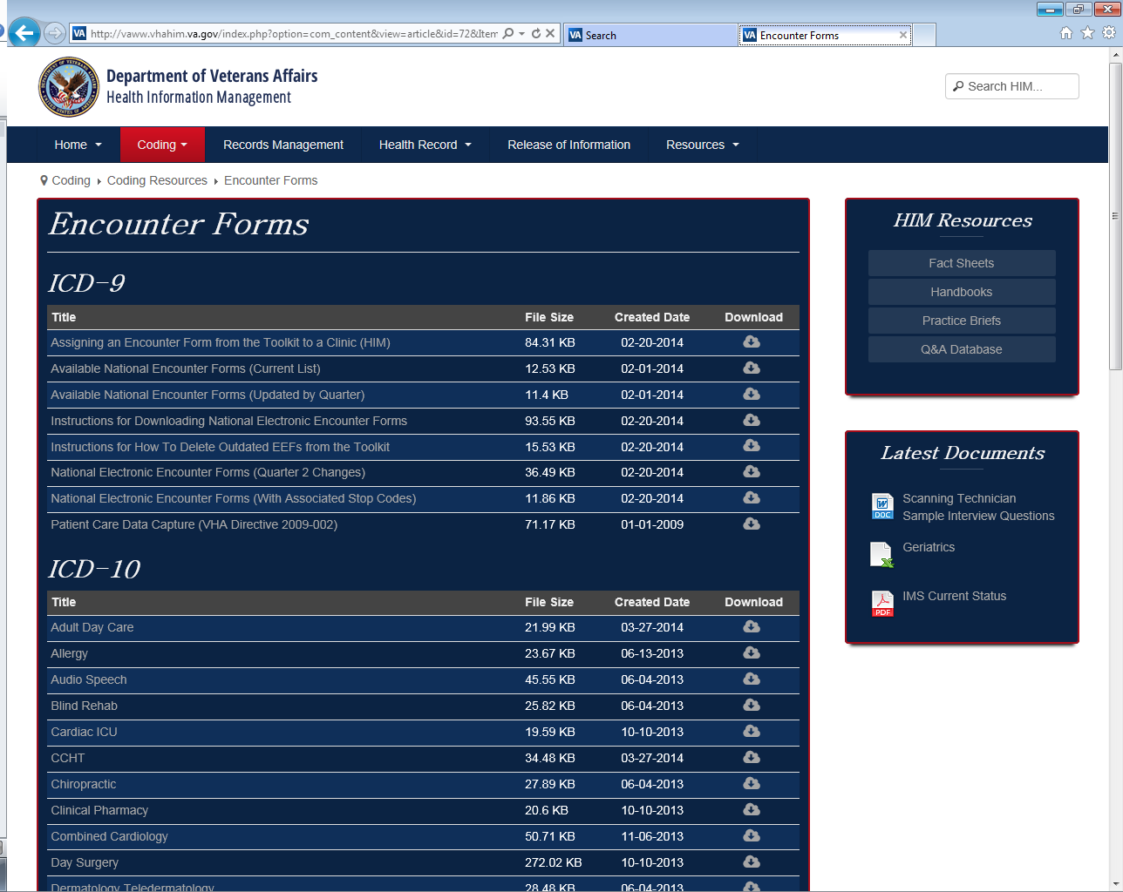

Available National Encounter Forms (Current List) …
Notes:
REBECCA
There are 2 sections on this page one titled ICD 9 and the other titled ICD 10. In the top section under the ICD 9 heading, the second listed document is the current available national encounter forms list.
DAWN
Rebecca, I wonder if our viewers know how many forms there really are available for use? I sort of know this off the top of my head, but I think you said you had to go and look when preparing for this session.
REBECCA
Yes I did and I was surprised!!! Did you know that there are 95 different forms available out there for use! That is A LOT!!! Now I can see why our ICD 10 Implementation team asked us to stop developing new ICD form as they were working on the conversions. Our Coding Council members have to review both the ICD and CPT forms for each of these every quarter – which is why we like it when the AMA only publishes minimal changes!
DAWN
Sometimes though we also get a little bit of a break on the encounter forms, often an ICD block can be paired up with “many” CPT blocks, so instead of all having a 1 to 1 ICD to CPT block match, several of the individual ICD blocks are used in conjunction with MANY CPT blocks. For Example the National Mental Health ICD block is used with the national addiction therapy, the psychologist, and mental health nursing forms.
***********************************************************************************************

Slide 11


“New” Form Request
Sample encounter form
Rationale for request
Specialty or specific service for utilization
Clinical POC for follow-up questions
Notes:
REBECCA
Yes, it is nice when we can narrow down the work list just a little bit in order to make you happy and meet the development deadline. So, for our audience out there, after you have done your homework, researched and found that the form you are looking for does NOT exist, you have your list of suggested codes and descriptors to include on the form, your rationale for the request, and you have identified the specialty or specific service that will utilize the form. You are now set to email the information to Dawn and I!!!
DAWN
I know the Council’s “preferred” method to receive sample forms for review is for the submitter to use an Excel worksheet, but the site may already have the form developed and in use. For my part, that’s even better! There is a way to Export the form so that I can review it.
REBECCA
I’m not as technically savvy at that process, so I’ll have to defer to you to cover that method.
DAWN
I have actually developed a reference tool that will be available for download when the presentation is available on demand.
REBECCA
That’s great to hear. We would like to remind submitters though, if you have had input from your clinical providers as you developed the form, having their name and contact information provided at time of submission is very helpful in case the Council has any questions about the request.
***********************************************************************************************

Slide 12


Modification to Existing Form Request
  Wrong Code (typo!)
  Wrong Description
  Quarterly Updates
  Provider Requested
Notes:
129591497
REBECCA
Ok, so let’s move on to requesting modifications to existing forms. There are numerous reasons that someone might request a modification to an existing form. Someone finds that we have the wrong code or description on the form. We tend to find typos quite frequently, as we get these notifications from the field we forward them to the Council member assigned to review that form quarterly. Another reason you might request a change is that maybe your site makes modifications to a national form and then here we go with the quarterly updates and you have to make the changes again, and again, and again… Maybe you are not the only one doing this!
DAWN
Often times you also might get requests from your providers to add a specific code, or your site might be doing new procedures that are emerging in the medical field. For these types of changes, you can simply email your requests to myself and Rebecca. I take these changes and go into the file that the we use to complete the quarterly updates and document the requested changes so that you, me and the council members aren’t having to comb through hundreds of emails looking for a needle in a haystack.
***********************************************************************************************

Slide 13

Quarterly
Review Process
Notes:
DAWN
So Rebecca, what sets the quarterly review process in motion, other than me sending you an email with a deadline date identified?
REBECCA
I know, I kind of cringe every time I see an email from you pop up with “encounter forms” in the subject line!! I’m always like – oh no it is that time again, and here I go scrambling to see which council members are on leave or assigned to other time sensitive projects so that we can be sure they all get reviewed. We know that we won’t see too many updates to the ICD portion of the encounter forms until we transition fully to ICD 10, but the AMA does issue quarterly updates to CPT. Council members review these changes and screen their assigned forms to see where additions, deletions or modifications need to be made. Just a reminder that we don’t always make the changes that are requested, especially if the changes will really only be used by one site. After the council members make their changes they upload completed worksheets to our SharePoint site and notify Dawn that we are finished. She just always hopes we are somewhere close to the original due date she has given us!
***********************************************************************************************

Slide 14


Don’t
Reinvent the Wheel
Notes:
DAWN
Ok, so what do you and the other council members do when I tell you that we have a new form request? What steps do you take to evaluate the need and develop a form?
REBECCA
Well first, we HOPE that a sample form either from the VistA toolkit or in an Excel workbook has been provided – like the old saying goes, why re-invent the wheel! We will review what is submitted, the rationale for why the site feels this should be a national form, and then vote on it. If a sample form is not submitted, but the rational is valid for creating one, first the council members will contact any appropriate HIM Program staff members to see if there are any national workgroups, etc. already working on data capture guidance, or other national concerns that we need to take into consideration. If none, we will query our own sites to see if there is a “start” of a form that can be used. We often do data requests from the data warehouse to get the top 100 diagnosis and procedure codes for the identified service or specialty.
DAWN
I know the council members then work on formatting and grouping the codes into logical blocks. I’ll go over how these can be arranged on the actual forms a little later.
REBECCA
I know the Council members often times seek out input from their own sites clinical staff if we do not have a point of contact with various national program offices. We do try to get them to review and provide input as they are the ones that are going to be using the form as we roll them out. Once we are done, we let Dawn know they are ready for development, she then goes and works her magic.
***********************************************************************************************

Slide 15


Export Process
Updated in VistA
Placed to the VistA Toolkit
Exported to “FORUMSHOPALL”
Email Blast sent to VHA HIM Mailgroup
Notes:
DAWN
Once I am notified of completion I go into the sharepoint and validate that all the changes are clear to me, then I go and as Rebecca said, work my magic on the forms.
REBECCA
Yes it is magic to me, because after we update the sharepoint, you magically have them ready to go to the field about a week later!
DAWN
Yes, the updates are completed in the “master” VistA toolkit, and then the routine is packed and exported to FORUM SHOP ALL. Then to wrap it all up, we send out an email blast to the field letting you know that the quarterly updates are completed and highlight any new forms and forms that had modifications made to them.
I think this might be a good time for our second polling question.
***********************************************************************************************

Slide 16
Poll Question
Is your site using the national encounter forms?
  Yes, all of the forms
  Yes, some of the forms
  No, none of the forms
Notes:
DAWN
I know all sites complete the monthly ICD 10 assessment survey on the website and there are several questions related to encounter forms but, let’s take a look at it in real time during this presentation. Don’t forget to use the blue polling button above our heads to submit your responses. So let’s see – “Is your site using the national encounter forms?”
Yes, all of the forms
Yes, some of the forms
No, none of the forms
***********************************************************************************************

Slide 17


Retrieval Process
Retrieve encounter forms from Forum, Shop, All
Extract encounter forms from your VistA e-mail
Run the inits
Import the encounter forms into the facility encounter form toolkit
Notes:
REBECCA
Ok, so I bet you are wondering, so what do you do next, after you have received the email stating the forms are available in Forum. Your OI&T staff will have to assist you in retrieving these forms from Forum, ShopAll. It is recommended that the updated forms are made available at your site within 30 days of release. There are detailed step-by-step instructions on the retrieval process that are located on the VHA HIM webpage under the same section we reviewed earlier, coding resources, encounter forms.
I have a question though, the instructions say in step 3 you will “run the INITS”, I’m at a loss, can you tell me, and our audience what this means and does?
DAWN
Running the INITS means that the system is going to start running the routine that contains all the element of the encounter forms that are contained in the exported message.
REBECCA
Ok, hopefully that makes a little bit of sense to our viewers, I guess this is why we get our OI&T folks to help with this process. Finally they will import the encounter forms into the facility encounter form toolkit and notify your HIMS or other staff member identified locally to perform the updates.
***********************************************************************************************

Slide 18
Deleting Outdated Forms
  “Select Action: Next Screen//”
  “Search for:”
  “Find Next 'V1 CARDIAC STRESS TEST-10/07'? Yes//” prompt
  “Select Action: Next Screen//”
  “Select Form:”
  “Are you sure V1 NUC MED STRESS TEST-01/10 should be deleted? NO//”
enter SL (Search List)
  enter name of EEF to delete
  enter NO
  enter DF (Delete Form)
  type in number of form to delete
  enter YES
Notes:
DAWN
I know some folks have asked in the past how to delete outdated encounter forms from their toolkit. Can you walk them through this or would you like me to?
REBECCA
I think I can take this one, but for reference for our viewers there are instructions on how to do this on the HIM Website as well, that is where I went to review for this session. First it is recommended that you print a list of the current encounter forms that are contained in your toolkit. Maybe print to your screen so that you can capture it and put them into Excel so you can sort and do a review. One way to delete outdated encounter forms is to open your encounter form toolkit, then at the “select action” prompt you enter the letters “SL”. Then at the “search for” prompt enter the name of the encounter form you want to delete, maybe copy it from the spreadsheet that you downloaded them to. Then at the “find next” prompt it shows the form name you enter “NO”, then your select action will be DF for delete form, then at select form, type in the number of the form you want to delete and answer yes to “are you sure form name should be deleted? Answer yes, and continue doing this for all forms you need to delete.
***********************************************************************************************

Slide 19
Poll Results
Is your site using the national encounter forms?
  Yes, all of the forms
  Yes, some of the forms
  No, none of the forms
Notes:
DAWN
What about the results of our poll? Let’s see who is using these forms we pour our hearts and souls into each quarter! Well, it looks like _______________________________(adlib for responses.)
***********************************************************************************************

Slide 20

Poll Results
Is your site using the national encounter forms?
  Yes, all of the forms
  Yes, some of the forms
  No, none of the forms
Notes:
Click to next slide

Slide 21

How do I……..
Notes:
REBECCA
I know I receive a ton of questions and emails related to encounter forms each quarter and they all start out “how do I…” I think our audience can fill in the blank with whatever first comes to mind for them. During the next part of our presentation, hopefully as Dawn guides us through the “weeds” with her “how to” part of the presentation, you will be able to take some notes and get answers to those “how do I” questions.
So, without further ado, Dawn take it away!
***********************************************************************************************

Slide 22
Back to Basics
101
Encounter Forms
Notes:
DAWN
During this part of the presentation we will be discussing the basics of encounter forms. We will discuss topics like the difference between copying and assigning encounter forms, different ways to edit encounter forms, how to change the appearance of the encounter form blocks and finally we will discuss the new ICD-10 block.
***********************************************************************************************

Slide 23
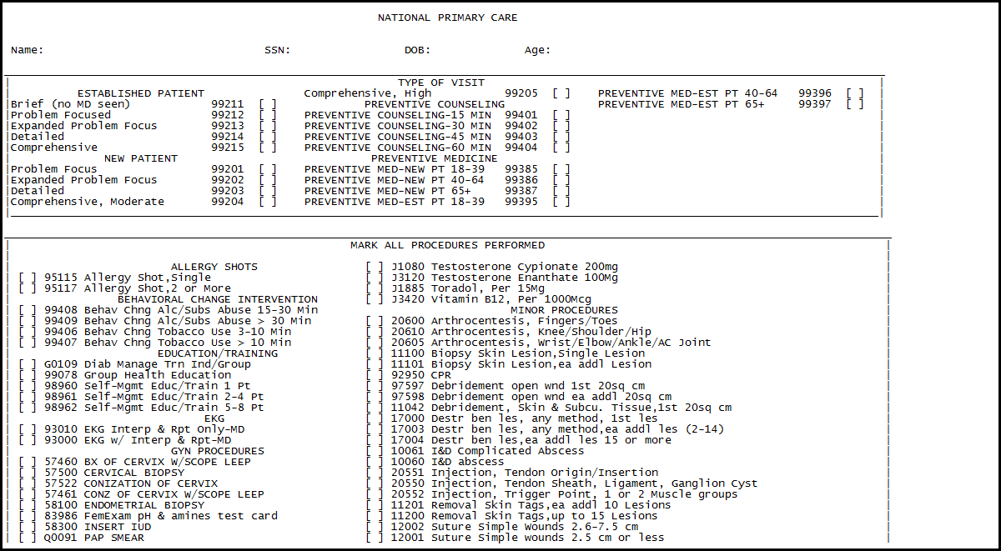
Encounter Forms
Notes:
DAWN
Before starting I would like to request that during this part of the presentation you watch and take notes rather than following along in VistA. I will be covering quite a few topics and feel that you will get the most value by taking notes now and then following along in VistA when the presentation is available on demand.
REBECCA
Just a note for the viewers, you really should not be able to “read” this slide, we just copied in an encounter form for the background as we transition into the “how to” section. So don’t think you are missing something, or need an eye exam.
***********************************************************************************************

Slide 24
“Copy Form”
… from the encounter form toolkit
… from a clinic setup
*
*
Original Form does NOT change when copied form is changed
Notes:
[Rebecca]
So, let’s dive right in, one question that I get quite often is how to assign an encounter form from the encounter form toolkit to a clinic. Could you give us some insight on that topic?
[Dawn]
You’re right that is a topic that is very important and sometimes can be a bit confusing.
When an encounter form is imported into the toolkit, either from the National encounter form workgroup or from another facility, it must be copied first before it can be assigned to a clinic.
Copying a form from the toolkit only has to be done one time and then that copied form can be assigned, as many times as needed, to a clinic or multiple clinics.
One benefit of copying the toolkit form is that any changes made to the copied form will not be made to the original form in the toolkit.
You can think of the toolkit forms as the master form and as such that form will always be a clean form.
[Rebecca]
Just to clarify, the builders only have to copy a specific encounter form from the toolkit one time and then can assign the copied form to as many clinics as needed. Is that correct?
[Dawn]
Yes that is exactly right!
I would like to also point out that you can also copy an encounter form from the encounter form clinic setup option.
You can copy an encounter form that is currently assigned to a clinic and assign the copied form to a different clinic. The copied form rules would still apply here also…the original copied form will not change when the copied form is changed. This is a nice option for creating customized encounter forms for a specific provider.
[Rebecca]
Wouldn’t creating customized encounter forms for specific providers create a lot of work for the builder?
[Dawn]
Absolutely, if your facility wishes to create customized encounter forms for your providers please keep in mind that this will require a lot of maintenance. Each customized form will have to be updated whenever there is a code change.
***********************************************************************************************

Slide 25
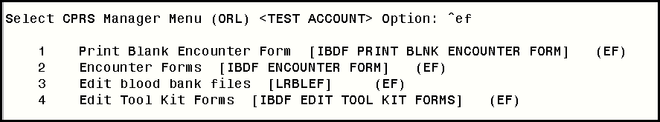
2 Encounter Forms [IBDF ENCOUNTER FORM] (EF)
Notes:
DAWN
Now let’s talk about how to actually copy an encounter form from the encounter form toolkit and then assign it to a clinic.
First, use the option Encounter Forms [IBDF ENCOUNTER FORM]
***********************************************************************************************

Slide 26

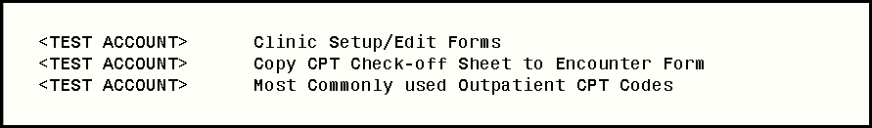
Edit Encounter Forms
Clinic Setup/Edit Forms
Notes:
DAWN
Then edit encounter forms
Select Clinic Setup/Edit Forms option
***********************************************************************************************

Slide 27
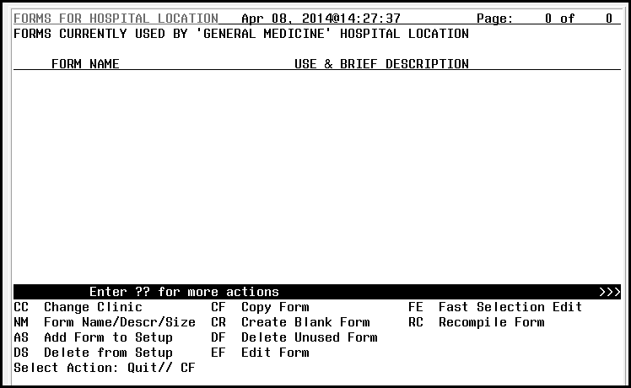
CF Copy Form
Notes:
DAWN
Once you have entered the name of the clinic that you want to associate an encounter form to you will see this window.
Select the option Copy Form (CF)
***********************************************************************************************

Slide 28
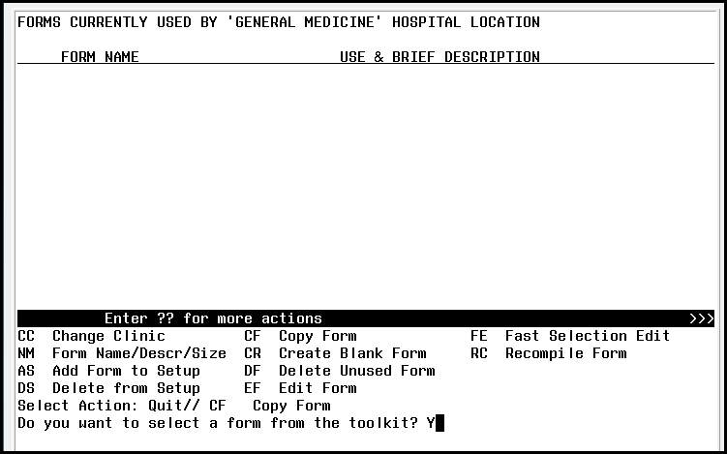
Do you want to select a form from the toolkit? Y
Notes:
DAWN
Answer Yes to the question, Do you want to select a form from the toolkit
***********************************************************************************************

Slide 29
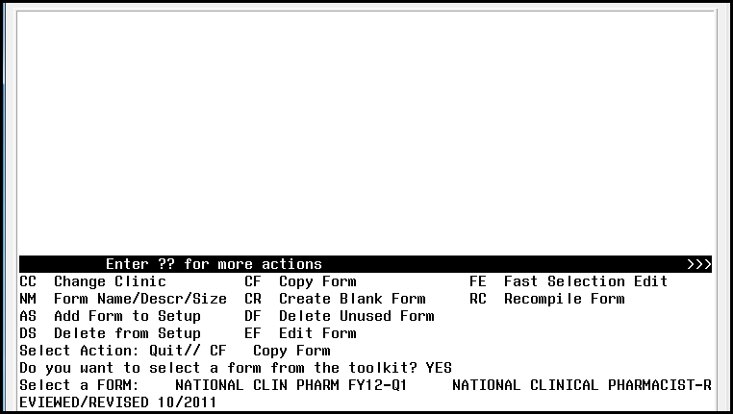
Select a FORM:
Notes:
DAWN
At the prompt “Select a FORM” enter the name of the encounter form that is in the encounter form toolkit. In this example I have chosen the National Clin Pharm FY12-Q1 encounter form.
***********************************************************************************************

Slide 30
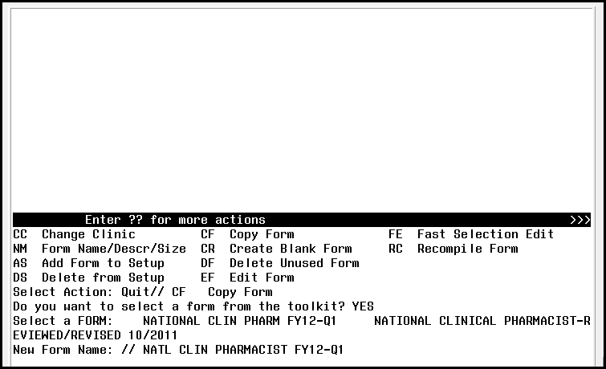
!
New Form Name:
Notes:
DAWN
The system will now ask you to enter a new name for the form. The new form that you are copying will be the form that is assigned to the clinic. When selecting a new name be sure it identifies the purpose of the form. It is also a good idea to have some way to identify when the form was last updated so you are sure to use the most current encounter form available for that clinic and/or service.
***********************************************************************************************

Slide 31
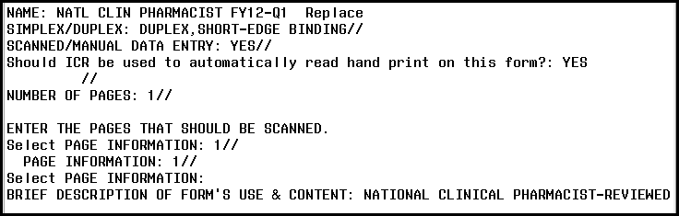
Default
Select:
Notes:
[DAWN]
You will select the default selection for the next several prompts. Most of these are items that are no longer used since the encounter forms are now electronic and not printed on a daily basis. When copying a form, the prompts will default to what was used in the original encounter form.
You should also change the brief description of form’s use and content prompt, if different then the use of the original encounter form.
[Rebecca]
This prompt is also a good place to enter the date that the encounter form was last reviewed and/or updated. This information can be very helpful to have handy if asked during an inspection.
***********************************************************************************************

Slide 32
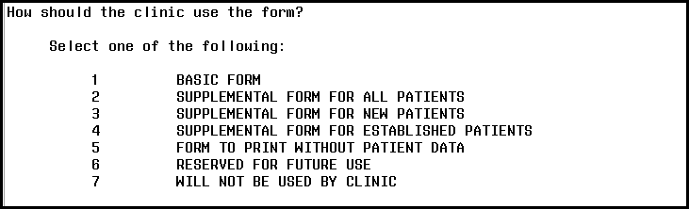
How should the clinic use the form?
Notes:
[DAWN]
Enter how the form will be used in the clinic. The most common use is Basic form but you can use the copied form in other ways also.
***********************************************************************************************

Slide 33
Poll Question
A team concept should ALWAYS be used when building and/or editing encounter forms.
  True
  False
Notes:
REBECCA
We would like to poll the audience to find out if you use a team concept when building and/or editing encounter forms at your site.
Use the blue polling button above our head to cast your answer to our poll question.
Our question is “A team concept should ALWAYS be used when building and/or editing encounter forms?”
Ok audience, in your opinion, is this statement true or false?
DAWN
We’re going to move on with our presentation and come back in a few minutes to take a look at the poll results.
***********************************************************************************************

Slide 34
“Assign a Form”
… from one clinic to other clinics
… from encounter form toolkit
… from encounter form CLINIC SETUP
**Changes to one form
WILL affect
all clinics using form**
Notes:
DAWN
An assigned form comes from the encounter form clinic setup option rather than the encounter form toolkit. You can use any form that is already assigned to a clinic and assign it to another clinic. The important thing to remember about assigning the same form to multiple clinics is that any changes you make to one form will affect all the clinics that use this form.
***********************************************************************************************

Slide 35
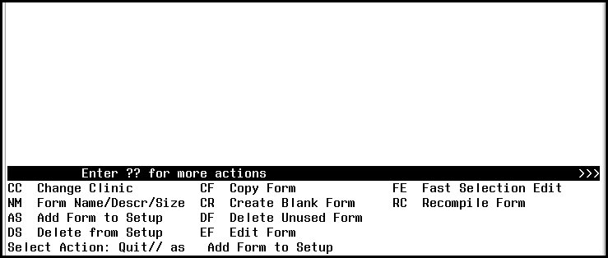
Select Action: Quit// as Add Form to Setup
Notes:
DAWN
At the Select Action prompt enter Add Form to Setup (AS)
***********************************************************************************************

Slide 36
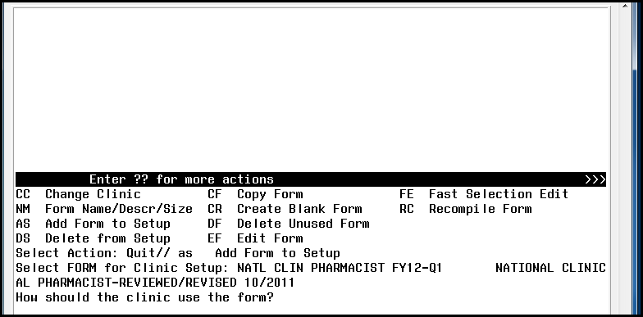
How should the clinic use the form?
Notes:
DAWN
Enter the name of the form that you would like to assign to the clinic
The prompt of how the form should be used for the clinic will appear once the name of the encounter form is entered
***********************************************************************************************

Slide 37
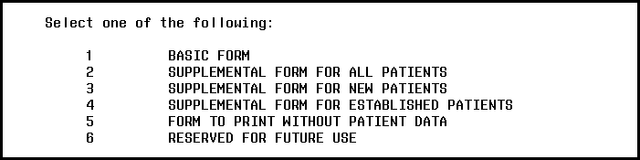
Only 1 form
can be assigned for each use
Notes:
You will select how you want to use the encounter form – you can only have one form assigned for each of these uses.
***********************************************************************************************

Slide 38
Poll Results
A team concept should ALWAYS be used when building and/or editing encounter forms.
  True
  False
Notes:
DAWN
let’s go back to the results of our polling question.
Our last polling question asked if a team concept should ALWAYS be used when building and/or editing encounter forms?
REBECCA
It appears that the majority of the responses are ____________________ (look at results).
I think that Dawn will agree that it is so important to work with a team when building and/or editing encounter forms. You will want to include the builder, coders, end-users, clinic builders and any representatives that have an interest in the content of the encounter forms. Working as a team will assist in creating a better encounter form and a better encounter form means end-user satisfaction, better data collection and better reimbursement process.
***********************************************************************************************

Slide 39

Poll Results
A team concept should ALWAYS be used when building and/or editing encounter forms.
  True
  False
Notes:
CLICK TO NEXT SLIDE

Slide 40
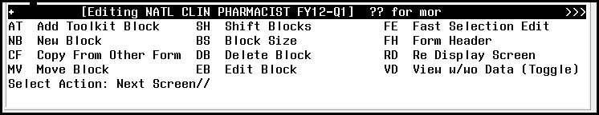
“Edit Form”
Edit Block
Add Toolkit Block
New Block
Copy From Other Form
Block Size
Notes:
DAWN
Now that we have an encounter form assigned to the clinic, let’s look at how we can edit that form.
These are the available items that are in the edit form option. During this presentation we will be discussing the basic items such as Add Toolkit Block, Edit Block, and Fast Selection Edit.
I would like to encourage all of you to try the other options on your own when you feel comfortable. One point I really need to stress…if you are not the person who routinely works on encounter forms PLEASE get approval from the encounter form manager BEFORE making any changes to any encounter forms.
***********************************************************************************************

Slide 41
Edit Block
vs.
Fast Selection Edit
Notes:
DAWN
Let’s start by discussing the options to edit a block on the encounter form.
REBECCA:
Is there a time when builders should make changes to existing encounter forms and/or build new encounter forms?
DAWN:
If possible it is always best to work on the encounter forms when the least amount of end-users are on the system. Editing the forms during non-peak hours will cause the least amount of interruption to the end-users and patient care.
There are two options that can be used to edit a block on the encounter form – Edit block and Fast Selection Edit.
***********************************************************************************************

Slide 42
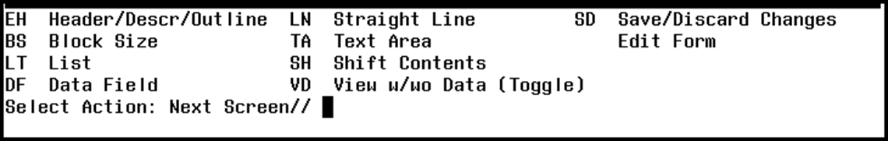
Edit Block
EH Header/Descr/Outline
BS Block Size
LT List
Notes:
DAWN
These are the available items that are in the edit block option. I will be discussing options used to change the block name/description, change the block size, edit items in a block and to change the appearance of the block.
The other items available are more advanced items and again I would like to encourage you to try these options on your own when you feel comfortable with the basic options.
REBECCA:
Don’t forget to talk to the encounter form manager at your site before trying the other options.
***********************************************************************************************

Slide 43
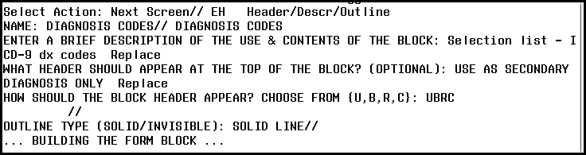
EH Header/Descr/Outline
Change the name of block
Describe contents of block
Describe appearance of block
Notes:
Let’s look at the Header/Description/Outline menu item. This option is used to change the name of the block, enter a description of the contents of the block and the appearance of the block.
***********************************************************************************************

Slide 44

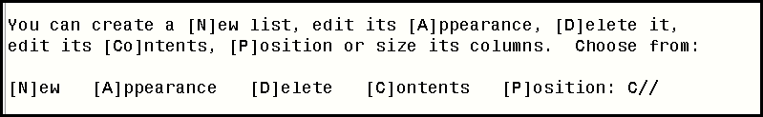

LT List
Edit the [A]ppearance
Edit the [C]ontents
Change the [P]osition and size of columns
Notes:
The next item that I would like to discuss is the list item. List is used to describe the block and or groups within the block. The list menu item can be used to change the appearance of the list, edit the contents and change the position/size of the list columns.
***********************************************************************************************

Slide 45
LT List
Notes:
Let’s look at how we can change the appearance of the groups within the block.
Select List (LT) at the Select Action prompt
***********************************************************************************************

Slide 46
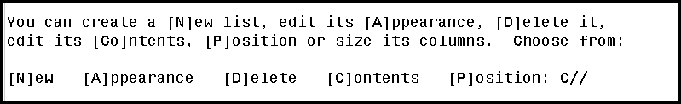
LT List
[A]ppearance
Notes:
The first item that we will look at is how to edit the appearance of the block.
At the prompt change the default of C to A for appearance.
***********************************************************************************************

Slide 47
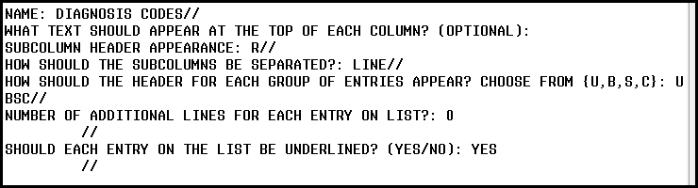
LT List
[A]ppearance
NAME:
Notes:
The first prompt shows the name of the block – this is the default name of the block or the name that was changed in the Header/Descr/Outline menu item.
The rest of the prompts are defaulted but you can change them if desired…remember this is how your end-users will see the encounter form in CPRS.
***********************************************************************************************

Slide 48
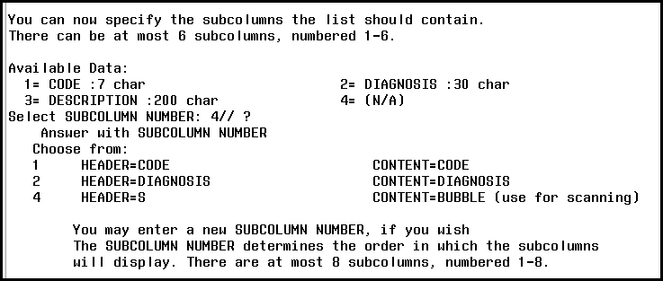
Add subcolumns (6 max)
Change length of data
Limit 132 characters per row!!
Notes:
This section is very useful…you can change a lot of real estate here.
You can add new subcolumns, change the length of the data for each subcolumn, etc.
In this example, the available subcolumns in my block are code (ICD-9), Diagnosis (Code description) and S (Secondary Diagnosis). I could add additional subcolumns such as P (Primary Diagnosis) or A (Add to Problem List).
Remember that you only have 132 characters for each row so make sure that you have enough space for all the subcolumns.
(Rebecca)
Let me interrupt you, is this where I could change the length of a code description?
(Dawn)
Good question, as a matter of fact this is where that can be done.
***********************************************************************************************

Slide 49
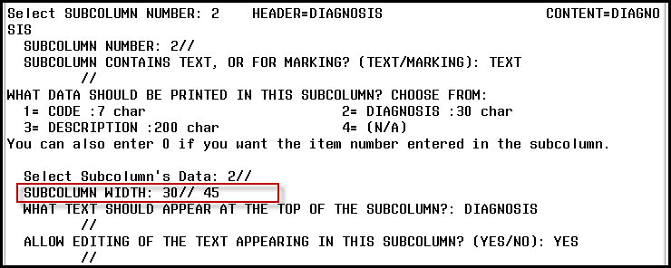
Notes:
At the prompt Select SUBCOLUMN NUMBER: enter the number of the item that cooresponds to the diagnosis description. In this case that would be subcolumn #2.
At the WHAT DATA SHOULD BE PRINTED IN THIS SUBCOLUMN? Select #2 (Diagnosis) which is defaulted at 30 characters. You can change the width at the SUBCOLUMN WIDTH prompt…as an example I have changed the subolumn width from 30 characters to 45 characters.
***********************************************************************************************

Slide 50
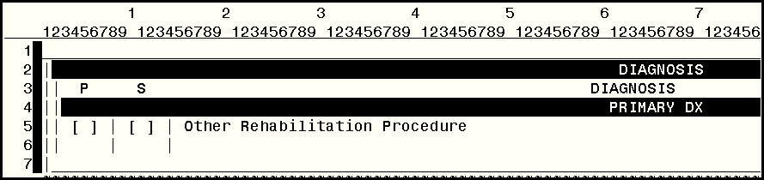
P
(Primary)
S
(Secondary)
Notes:
[Rebecca]:
Ok, I have another question, if my block is for a primary diagnosis only, could I remove the S (secondary) check-box?
[Dawn]:
Yes, that can be done at this option.
Suppose I have a block that currently has P (primary) and S (secondary) check boxes but the name of the block is primary diagnosis. It would make sense for me to remove the secondary diagnosis checkbox.
***********************************************************************************************

Slide 51
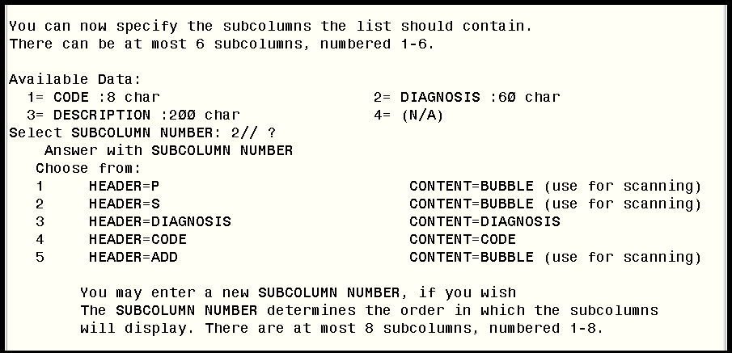
Notes:
In order for me to remove some of the subcolumns, I would use the menu option List/Appearance, discussed in the previous slides. At the subcolumn number prompt I want to enter a question mark to view what subcolumn are currently displayed in the block.
In this example, I have P, S, Diagnosis, Code and Add as subcolumns.
***********************************************************************************************

Slide 52
To delete the “S” (Secondary) subcolumn, enter “2” for subcolumn #, then @
Notes:
Since I want to delete the subcolumn that displays the checkbox for S (secondary) I would enter 2 at the at the prompt Select Subcolumn Number. At the default, indicated by two forward slashes, I will enter the @ sign. Answer yes if you want to delete subolumn 2 from the block.
***********************************************************************************************

Slide 53
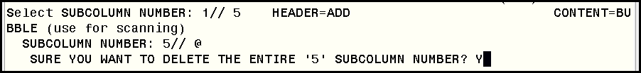
To delete the “S” (Secondary) subcolumn, enter “2” for subcolumn #, then @
To delete the “Add” subcolumn, enter subcolumn #, then @
Notes:
I would also like to delete the Add subcolumn from the block.
At the subcolumn number prompt I would enter the number of the subcolumn that represents the Add checkbox (in this example it is subcolumn 5).
I will enter the @ sign to delete the subcolumn number and answer yes to the question regarding deleting the entire subcolumn number 5.
***********************************************************************************************

Slide 54
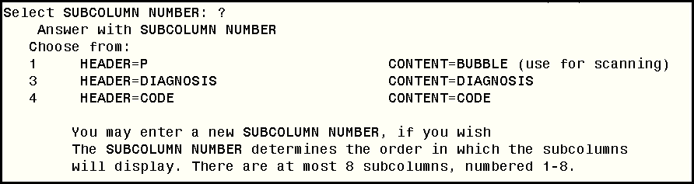
To delete the “S” (Secondary) subcolumn, enter “2” for subcolumn #, then @
To delete the “Add” subcolumn, enter subcolumn #, then @
Enter “?” at Select Subcolumn Number prompt
Notes:
Now if I enter a question mark at the Select Subcolumn Number prompt it displays only the P (primary), Diagnosis and Code subcolumns.
***********************************************************************************************

Slide 55
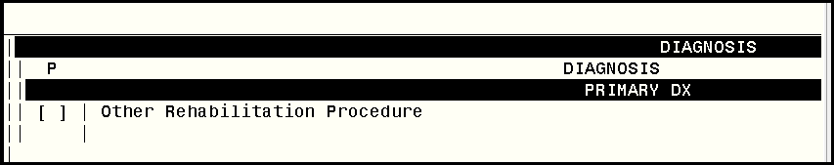
Before
After
Notes:
Now when I view the block I only see the information that I want to display – which the primary diagnosis checkbox, the code description and the code.
[Rebecca]:
I like how that works, very straight forward and you can see how it will be laid out.
***********************************************************************************************

Slide 56
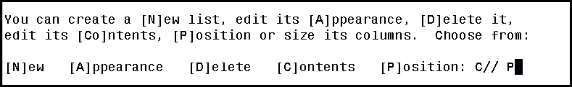
LT List
[P]osition or size
Notes:
Next, the item Position/Size in the list menu is used to change the position or size of the columns within the block. Let’s take a look at how this menu item works.
At the prompt change the C default to P for Position.
***********************************************************************************************

Slide 57
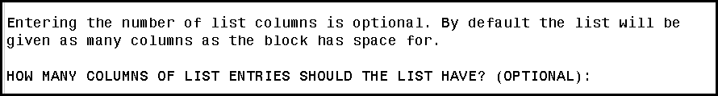
LT List
[P]osition or size
How many columns?
Notes:
The encounter form will automatically give the block as many columns as the block has space for depending on the number of diagnoses that you enter but we can change this if we want/need to.
***********************************************************************************************

Slide 58
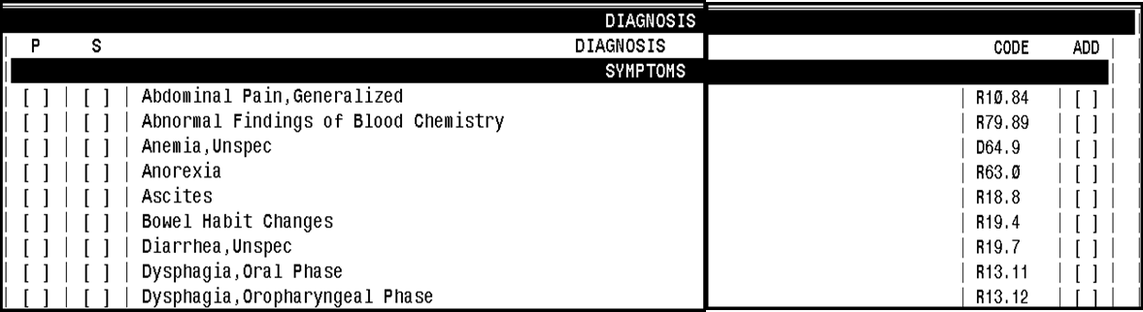
What if I want to change my block from
1 column → 2 columns
Notes:
Let’s say that we have our block set up for one column but we’ve decided that we want to change that to two columns.
***********************************************************************************************

Slide 59
HOW MANY COLUMNS … SHOULD THE LIST HAVE? 2
2
Notes:
Enter 2 at the question How many columns of list entries should the list have.
***********************************************************************************************

Slide 60
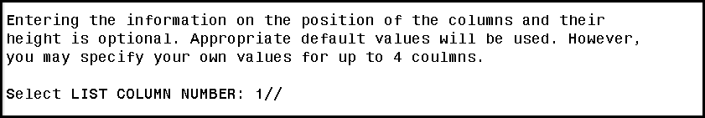
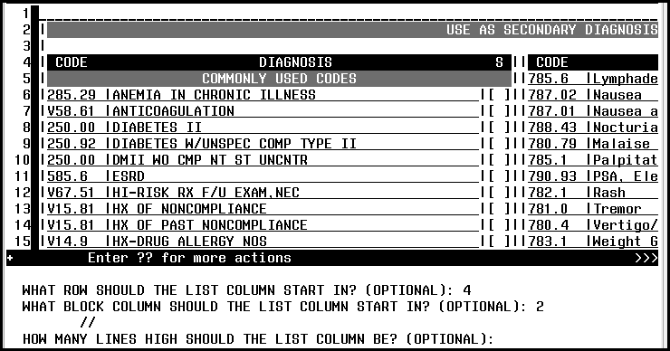
COLUMN 1
Notes:
Let’s look at column 1 first. At the Select LIST COLUMN NUMBER: enter 1
***********************************************************************************************

Slide 61
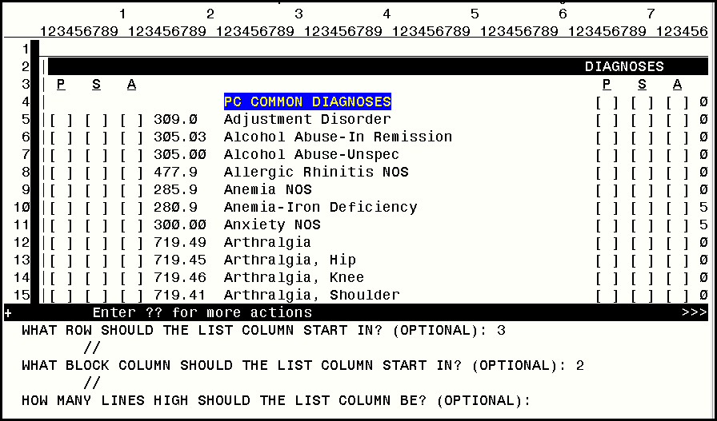
ROW
COLUMN
Notes:
The first prompt you come to asks you “What Row Should the List Column Start In?” Here enter the row you want the list to start in, it should always be after the description row. In this example, I want to start the list in row 3
The next prompt asks “What Block Column Should the List Column Start In?” You will enter the column that you want the list to start in. It should never start in column 1 as this is where the block line starts. Finally you are asked “How Many Lines Should the List Column Be?” This is optional and I usually leave it blank as the block will automatically fill in the column.
***********************************************************************************************

Slide 62
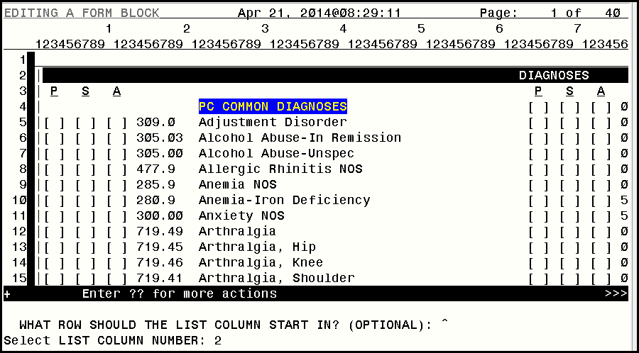
COLUMN 1
COLUMN 2
Notes:
Now let’s look at the second column.
At the Select List Column Number: enter 2
***********************************************************************************************

Slide 63
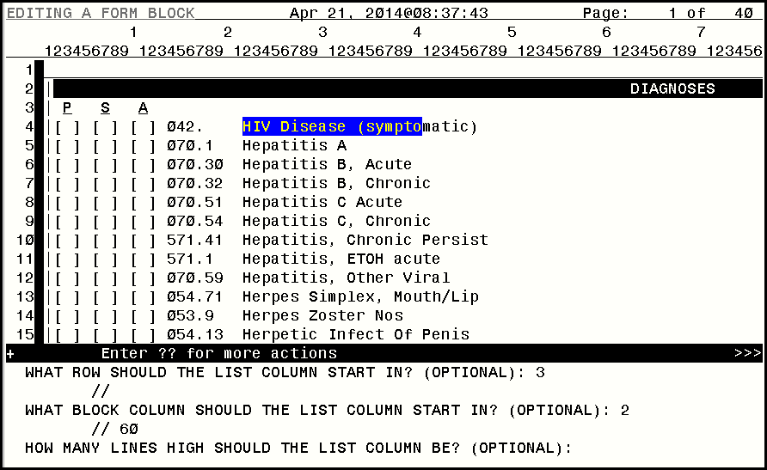
COLUMN 2
Notes:
The first prompt for the second column asks you again “What Row Should the List Column Start In?” Here enter the same row number that you started column 1 in. In this case we started in row 3. The next prompt asks “What Block Column Should the List Column Start In?” Enter the number that the second column should start in. In this example I want to start it at column 60. Finally you are asked “How Many Lines Should the List Column Be?”, again this is optional and I usually leave it blank.
***********************************************************************************************

Slide 64
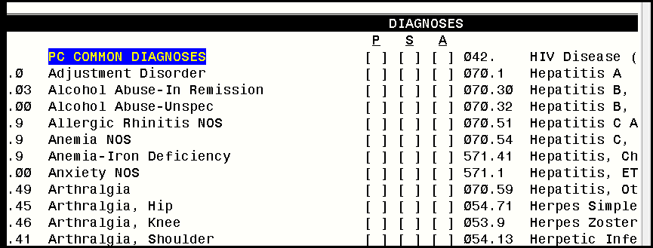
COLUMN 1
COLUMN 2
Notes:
Now my block has two columns instead of the single column that I had before.
***********************************************************************************************

Slide 65
Edit Contents
LT List
Notes:
Now, let’s look at how we can change the content of the groups within the block.
Select List (LT) at the Select Action prompt
***********************************************************************************************

Slide 66
LT List
[C]ontents
Notes:
At the prompt accept the default of C for Contents.
***********************************************************************************************

Slide 67
Edit List
Add Group
Delete Group
Group’s Contents
Group Header/Order
Format All
Resequence List
Notes:
At this menu we are able to add a new group to the block, delete a group, add blank line, format all content , resequence the content, change the group header and/or group order and edit the group’s content. During this presentation I will discuss how to edit the content and also how to format the content. However, I encourage all of you to try all of the other items in this option when you feel comfortable.
Rebecca
Just a reminder… Don’t forget to talk to the encounter form manager at your site before trying the other options.
If you download this presentation, we have given you a brief description of each of the options.
Add Group – add new group to the block
Delete Group – delete group to the block
Group’s Contents – edit existing group
Group Header/Order – change the display and/or order of the groups
Format All – change the appearance of the groups
Resequence List – change the order of the items within the group
***********************************************************************************************

Slide 68
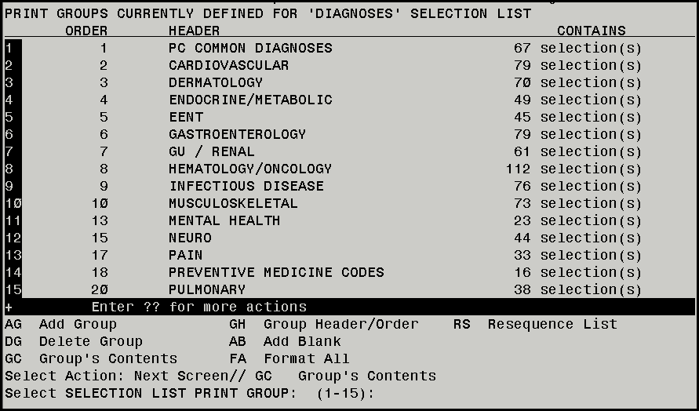
Select Action: Next Screen// GC Group’s Contents
Notes:
REBECCA
So, what if I want to add a selection to one of the groups in the block. What action do I take?
DAWN
At the Select Action prompt I would type GC for Group’s Contents.
***********************************************************************************************

Slide 69
Select SELECTION LIST PRINT GROUP: (1-15):
Notes:
The system will then prompt me to select the group that I want to add the code to. In this example, I will select 1 (PC COMMON DIAGNOSES) group.
***********************************************************************************************

Slide 70

AS Add Selection
Notes:
At the Select Item(s) prompt type AS (Add Selection)
***********************************************************************************************

Slide 71
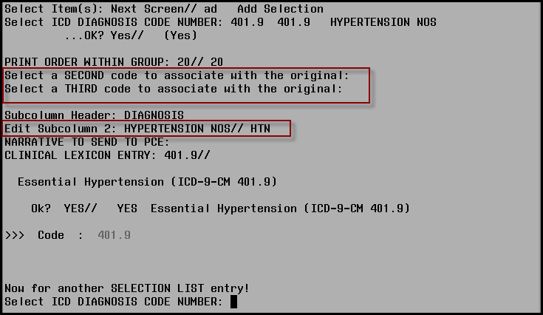
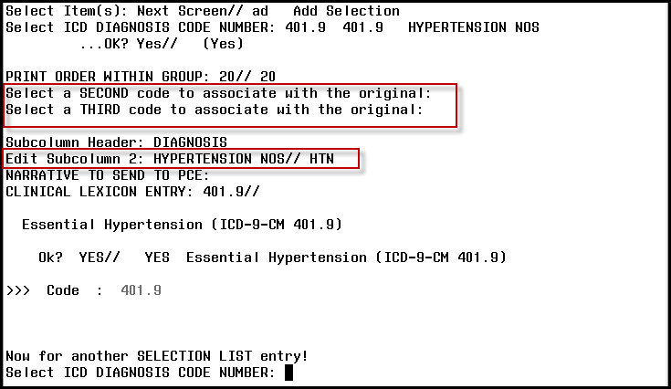
Notes:
At the ICD DIAGNOSIS CODE NUMBER: enter the code that you would like to add. In this example, I’m going to add 401.9 (HTN)
Print Order within Group – select the default number
***********************************************************************************************

Slide 72
Notes:
Select Second Code to associate with the original – you can enter an associated code here if applicable. This code will automatically populate PCE whenever the original code is selected…remember this will happen for any clinic that is using this encounter form.
REBECCA
This is a great item when adding codes that should always have a second code associated with it. A good example would be a diabetic code like diabetic retinopathy. The first code would be the diabetic retinopathy code and the second code would be the retinopathy code.
DAWN
Select a Third code to associate with the original – This functions the same way as adding a second code above.
***********************************************************************************************

Slide 73
Notes:
DAWN
Edit Subcolumn 2: HYPERTENSION NOS – the system will default to the lexicon code description but you can change it here to make it more end-user friendly. For example, I’ve changed the lexicon code description to HTN – this description is what the end users will see in CPRS.
Narrative to Send to PCE: <enter>
Clinical Lexicon Entry: 401.9// <enter>
Select ICD Diagnosis Code Number: We can keep adding codes to this group
(Rebecca):
Is there a way to change the actual appearance of the codes in the group?
(Dawn),
Yes, we can use the option Format All to do that.
***********************************************************************************************

Slide 74
FA Format All
Notes:
At the Select Item(s) prompt type FA (Format All)
***********************************************************************************************

Slide 75
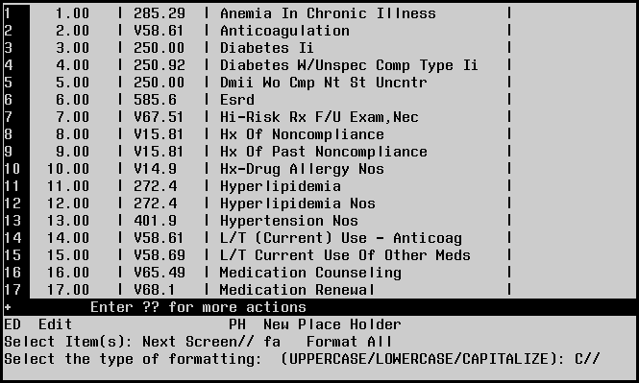
Select the type of formatting: (UPPERCASE/LOWERCASE/CAPITALIZE): C//
Notes:
At the type of formatting: you will have a choice of all Uppercase, all Lowercase or Capitalize all.
As you can see the contents are currently capitalized
***********************************************************************************************

Slide 76
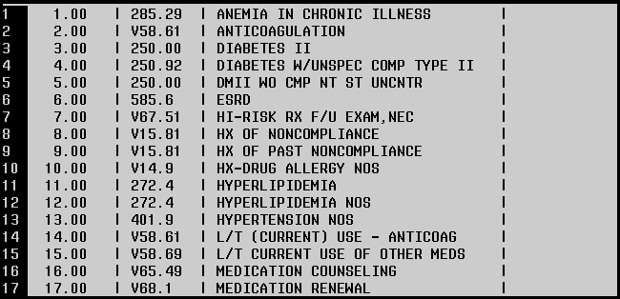
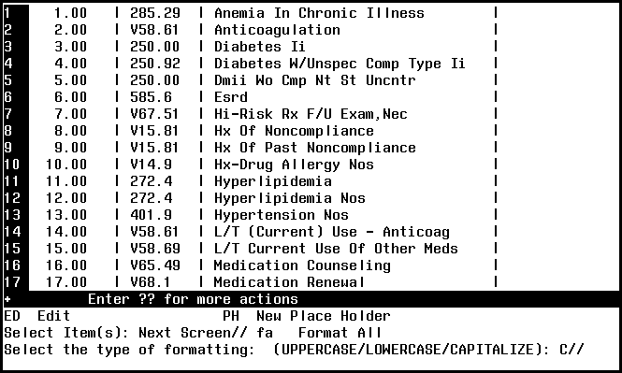

Select the type of formatting: (UPPERCASE/LOWERCASE/CAPITALIZE): C// U
Notes:
I want to change them to uppercase so at the Select the type of formatting prompt I will select U for uppercase
Now as you can see the group’s content is all in uppercase rather than capitalized.
Remember that I did this just for this group so the content in the other groups may still be capitalized.
***********************************************************************************************

Slide 77
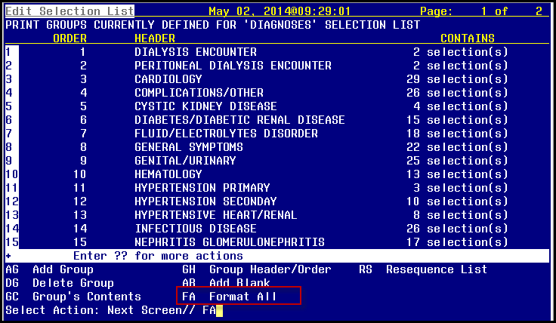
FA Format All
Notes:
If I wanted to format all the groups within the block, I would use the option Format All at the main edit contents menu instead of at the group’s contents option.
***********************************************************************************************

Slide 78
FE Fast Selection Edit
Group Add
Group Copy
Group Delete
Group Edit
Resequence Group
Add Selection
Edit Selection
Delete Selection
Format All
Notes:
Now, let’s talk about another way to edit the blocks in the encounter forms. The next option that I would like to take a look at is the Fast Selection Edit (FE). This is a nice option to use if you just want to edit the codes in the block. Fast edit doesn’t have the options to edit the appearance of the block like the Edit Block option does.
REBECCA
Again, if you download this presentation we’ve provided a brief description of the items available in the Fast Edit Selection for your reference:
Add Selection – Add codes to any group within the block
Edit Selection – Edit codes within the block
Delete Selection – Delete codes within the block
Format All – Change the appearance of all codes within the block
Group Add – Add a new group to the block
Group Copy – Copy a group from another form
Group Delete – Delete a group from the block
Group Edit – Edit the name/order of a group in the block
Resequence Group – Resequence the order of the codes within the group(s)
***********************************************************************************************

Slide 79

“Add Selection”
AS Add Selection
Notes:
DAWN
So now let’s add a code selection to one of the groups in our block.
At the Select Action prompt enter AS for Add Selection.
***********************************************************************************************

Slide 80
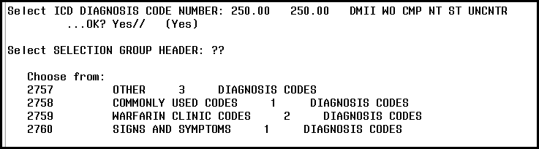
AS Add Selection
Select ICD DIAGNOSIS CODE NUMBER: 250.00
Select SELECTION GROUP HEADER: ??
Notes:
I want to add the diagnosis code for diabetes to one of my groups. At the Select ICD Diagnosis Code Number prompt I will add 250.00. Notice the next prompt asks me for the Selection Group Header that this code should be added to. This is different than how a code is added to a group when I am using the edit block menu option.
At the Selection Group Header prompt I will enter the group that I want to add the diabetes code to. If I’m not sure which group to add the code to I can enter double question marks to display the groups that are available. I’m going to select Other as the group.
***********************************************************************************************

Slide 81
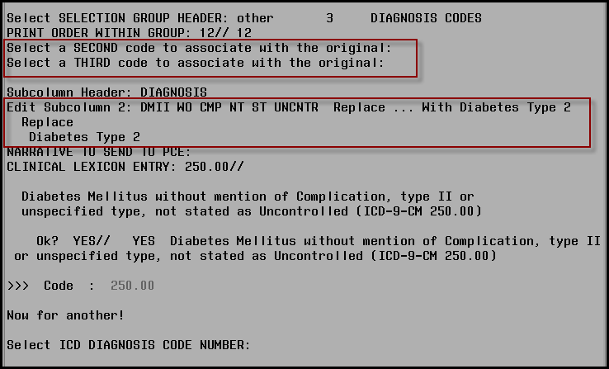
PRINT ORDER WITHIN GROUP: 12// 12
Notes:
Print Order within Group: I can just select the default that is shown
All of the rest of the prompts in the option work the same way as they do in the edit a block option.
***********************************************************************************************

Slide 82
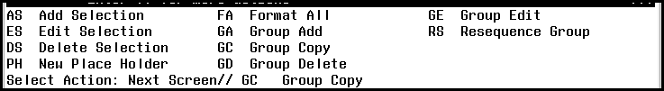
Group Copy
is available in the “Fast Selection Edit” menu
Notes:
(Rebecca):
Is there a fast way to copy a group from one encounter form to this encounter form?
(Dawn):
Yes, there is. One of the options in the Fast Selection Edit is Group Copy (GC). This option allows you to copy a group or groups from another block on an encounter form.
***********************************************************************************************

Slide 83
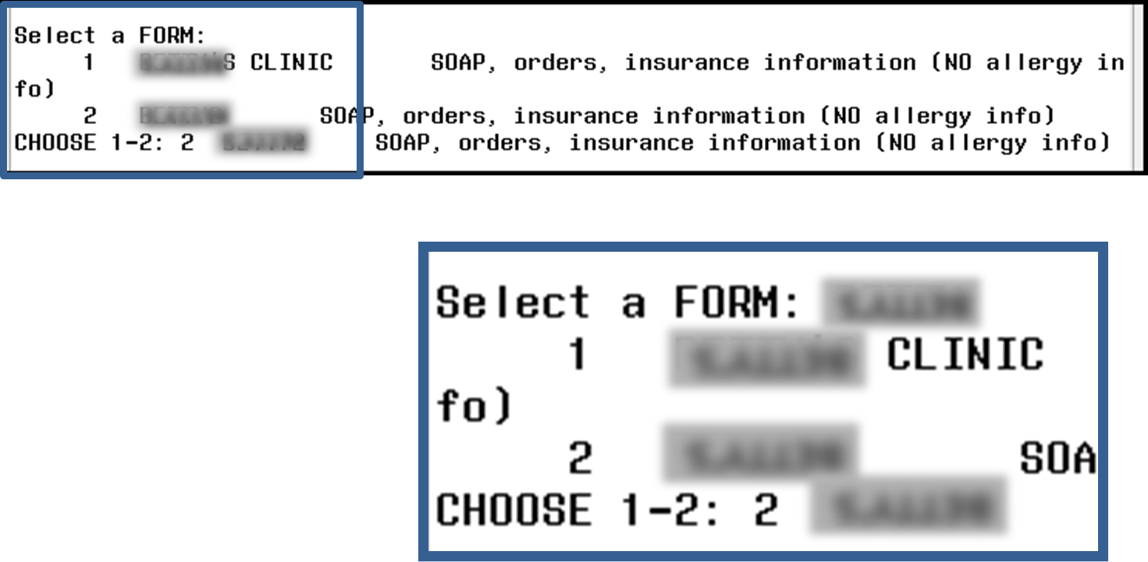
Notes:
Select the form that you want to copy a group from
***********************************************************************************************

Slide 84
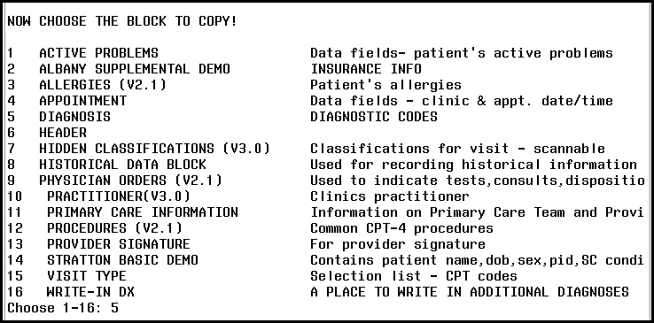
NOW CHOOSE THE BLOCK TO COPY:
Notes:
Select the block that has the contents of the group
***********************************************************************************************

Slide 85
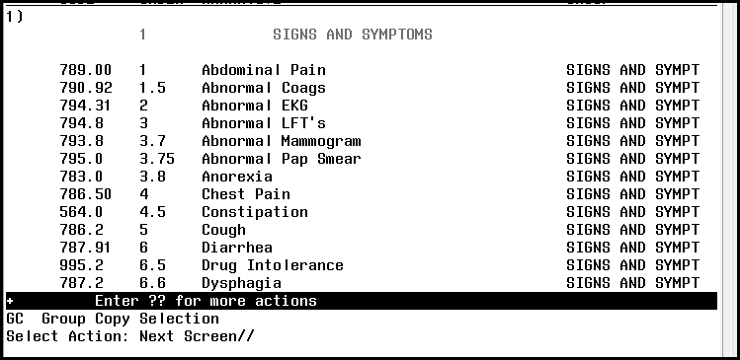
GC Group Copy Selection
Select Action: Next Screen//
Notes:
Select the group that you want to copy. In this example we see the first group (signs and symptoms) from the diagnosis block on the form.
I can copy as many groups from this form on to the form I’m working on through this option. Once I make all my selections those groups will be inserted into the block on my current encounter form.
***********************************************************************************************

Slide 86
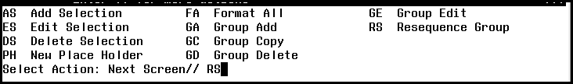
Resequence Group
can be found in both the “Edit Block” and “Fast Selection Edit” menus
Notes:
(Rebecca):
So, is there a way to change the order of the codes in a group?
(Dawn):
Yes, there is a resequencing option to do this. This option can be found in both the edit block and fast selection edit menus.
***********************************************************************************************

Slide 87
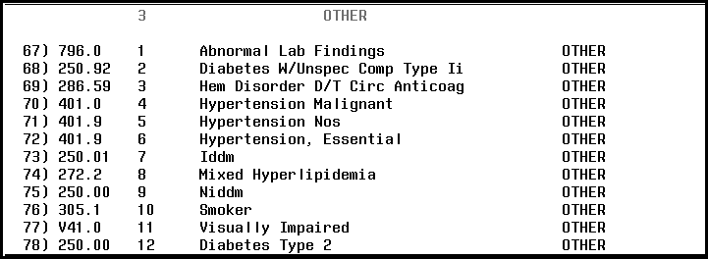
What if I want to resequence this list from
Numerical → Alphabetical?
Notes:
Currently my group is built exactly as I entered the codes but let’s say that I want to change that so the group is in alphabetical order.
***********************************************************************************************

Slide 88

RS Resequence Group
Notes:
At the Select Action prompt I would select RS (Resequence Group)
***********************************************************************************************

Slide 89
RS Resequence Group
Enter name of group you want to resequence
Notes:
Enter the name of the group that you want to resequence. You can enter as many groups as you want to resequence at this time.
***********************************************************************************************

Slide 90

RS Resequence Group
Enter name of group you want to resequence
Select how to resequence
(DIAGNOSIS)
Notes:
Select how you want to resequence them – by the code number or by the diagnosis description. In this example I’m going to select diagnosis description.
***********************************************************************************************

Slide 91

Alphabetical or Numerical?
GROUP/PLACE HOLDERS or GROUP?
Notes:
Select to either have them in alphabetical or numerical order. This will all depend on which subcolumn you choose to resequence. I’m going to select Alphabetically.
Then select if you want to resequence the group or the group/place holders. I’m selecting Group/Place Holders for this example.
***********************************************************************************************

Slide 92


Notes:
Now the Other group is in Alphabetic order.
***********************************************************************************************

Slide 93
Poll Question
All sites can begin to work on the ICD-10 encounter form content BEFORE the ICD-10 codes are implemented.
  True
  False
Notes:
DAWN
I think this is a good time to ask the audience another poll question
REBECCA
Great idea. Our next question is “Can all sites begin to work on the ICD-10 encounter form content BEFORE the ICD-10 codes are implemented?” Please indicate if that is a true or false statement using the blue polling button above our head.
DAWN
Let’s move on with our presentation and come back in a few minutes to take a look at the results
***********************************************************************************************

Slide 94
Why can’t I see all the codes in my block?
Notes:
Rebecca:
I often get questions asking why the some of the codes don’t show when printing the encounter forms. Do you know why that is? I know it really isn’t common practice these days for sites to be printing paper encounter forms, but I guess we would have occasions related to contingency plans, sites might have the occasion to.
Dawn:
The most likely culprit is the block size.
***********************************************************************************************

Slide 95


Block Size
There are entries that do not fit on the DIAGNOSIS CODES list! Make more room…
Notes:
When you can’t see all the codes on a printed encounter form or if you see this message, which says “THERE ARE ENTRIES THAT DO NOT FIT ON THE DIAGNOSIS CODES LIST”, when editing an encounter form it means that the block size isn’t big enough for the amount of codes that are included in that block. You will have to change the size of the block.
***********************************************************************************************

Slide 96

BS Block Size
Notes:
Use the option BS for Block Size
***********************************************************************************************

Slide 97

BS Block Size
Select blocks to change (DIAGNOSIS CODES)
Notes:
Select the block that needs to be changed. In this case we need to make the diagnosis codes block larger.
***********************************************************************************************

Slide 98
Notes:
Currently we know that the bottom of the block is set at 114. We need to increase this so that it can display all the codes.
***********************************************************************************************

Slide 99
Move the bottom of the block to a new row so all the code entries fit
Notes:
Let’s change it to 125 and we will leave the right margin of the block at the default.
Now all the codes will fit into the block. I can tell that they will fit because I know longer see the message that states there is not enough room for all the codes to display.
***********************************************************************************************

Slide 100
Poll Results
All sites can begin to work on the ICD-10 encounter form content BEFORE the ICD-10 codes are implemented.
A. True
B. False
Notes:
DAWN
Let’s go back to the results of our polling question that all sites can begin to work on the ICD-10 encounter form content BEFORE the ICD-10 codes are implemented.
It appears that the majority of the responses are ____________________ (look at results).
REBECCA
All sites can begin to work on the ICD-10 content for their local encounter forms. The codes themselves can not be entered onto the encounter forms until the lexicon patch containing the ICD-10 codes is released but each site can start gathering the ICD-10 replacement codes and saving them to a document. This will make things a lot easier when the lexicon patch is released and will save you a lot of time. This is also a good time to work within the team concept.
DAWN
There is a lot of work that will need to be done to update your local encounter forms with the ICD-10 codes so starting earlier is very beneficial.
REBECCA
Can you tell us, will the National Encounter Forms be updated with the ICD-10 block?
DAWN
Yes, they will. Starting in either in Fiscal Year 15 , depending on the release date of the lexicon patch, the national encounter forms that are exported will contain both the ICD-9 block and the ICD-10 block. We plan to release 24 encounter forms containing the ICD-10 block each quarter.
***********************************************************************************************

Slide 101
Poll Results
All sites can begin to work on the ICD-10 encounter form content BEFORE the ICD-10 codes are implemented.
A. True
B. False
Notes:
CLICK AGAIN TO MOVE ON

Slide 102


functions the same as the ICD-9 Block
ICD-10 Block
Notes:
DAWN
Let’s take a peek at the new ICD-10 block that will be available at all facilities sometime during the summer of 2014.
The ICD-10 block will have the same functionality as the ICD-9 block.
When the ICD-10 codes are activated, October 1, 2015 the current implementation date, you will want to make sure that your encounter forms contain BOTH the ICD-9 diagnosis block and the ICD-10 diagnosis block. This will allow the correct code to be presented depending on the date of the encounter. An encounter dated before October 1, 2015 will display ICD-9 codes and an encounter dated after September 30, 2015 will display ICD-10 codes. Each site should determine a date, after October 1, 2015, when to remove the ICD-9 block from the encounter forms.
You will be able to start adding the ICD-10 block and ICD-10 codes to your local encounter forms when the lexicon ICD-10 and AICS patches are released.
***********************************************************************************************

Slide 103

ADD
ICD-10 block to current
encounter forms to use ICD-10 codes
Notes:
In order to use the ICD-10 codes, you will have to add the ICD-10 block to your current encounter forms. This is done by using the option AT (Add Toolkit Block).
***********************************************************************************************

Slide 104

You must have both an ICD-9 and ICD-10 block on your encounter form
Notes:
DAWN
The ICD-10 Diagnoses block will be located near the end of the tool kit block list.
REBECCA
Ok, so just to be clear once we transition to ICD 10, we must have both an ICD-9 and ICD-10 blocks on our encounter forms.
DAWN
Yes, the correct code will display to the end-user depending on the date of the encounter.
***********************************************************************************************
***********************************************************************************************

Slide 105

Length of code descriptions
Search for codes
Adding a range of codes
ICD-10
Notes:
The differences with the ICD-10 block is the length of the code descriptions, how to search for ICD-10 codes and adding a range of ICD-10 codes to the block.
***********************************************************************************************

Slide 106


ICD-9
ICD-10
default length of the code subcolumn
30
characters
60
characters
Notes:
The default length of the code subcolumn is be set at 60 characters instead of 30 characters that is currently used with ICD-9 codes. This length can be changed the same way that the length is changed with the ICD-9 subcolumns. Since the length of the description is twice a long as the length of the ICD-9 code descriptions, your ICD-10 block will probably be built as one column making your encounter form much larger.
***********************************************************************************************

Slide 107

Z85.038
Notes:
Here is an example of why the length of the codes has changed for ICD-10 codes. Let’s add the Z85.038 ICD-10 code to a group in the ICD-10 block.
***********************************************************************************************

Slide 108
Z85.038
Personal history of
malignant neoplasm of large intestine
Longer description of code can display with new 60-character default length
Notes:
As you can see, not only is the code itself larger but the description of the codes are much longer. You will be able to change the description in the subcolumn to something shorter but having 60 characters as the length default will be very helpful when displaying the description to the end-users. Since ICD-10 codes are much more specific than ICD-9 codes it will be important to display as much of the description as possible.

Slide 109
Adding a range of codes (Wildcard)
Search for codes
Length of code descriptions
Search for codes
Adding a range of codes
ICD-10
Notes:
Let’s discuss searching for ICD-10 codes within the ICD-10 block

Slide 110

Search for ICD-10 codes using the wildcard
*
Notes:
We can now search for ICD-10 codes by using the wildcard – which is the asterisk. You will have to enter at least 3 of the first characters and followed by the asterisk. The system will search for all the codes that start with those first 3 characters. You will have the option of adding all the codes in the search or selecting from the list.
***********************************************************************************************

Slide 111
Length of code descriptions
Search for codes
Adding a range of codes
ICD-10
Notes:
Adding a range of codes from the wildcard search is new with the ICD-10 block.
***********************************************************************************************

Slide 112

Select ICD-10 DIAGNOSIS CODE … : (1-11): 3, 4, 10, 11
Notes:
I can add all the codes from the wildcard search or I can add selections from the search. In this example I’m selecting 4 of the 11 codes found to my group. This is a nice feature when I want to add a bunch of codes with on search.
***********************************************************************************************

Slide 113

Change code description before adding
Notes:
You will be able to change the code description before adding each of the ICD 10 codes to the group.
***********************************************************************************************

Slide 114


System will display new codes added to group
Notes:
Once you’ve gone through each selection the system will display the new codes that were added to the group.
***********************************************************************************************

Slide 115

New forms
Quarterly updates
Encounter form basics
  Copying
  Editing
  Assigning
ICD 10 blocks
Notes:
REBECCA
Obviously I could not take notes while we were presenting, but wow you covered a lot of technical “how to’s” with this presentation. I don’t think we have had detailed encounter form set up and editing training available for the field in a really long time. I hope this session today answered a lot of the “how do I” questions that our audience had. We covered how to request new forms and updates or modifications to existing forms. You provided us with some excellent detailed screen shots with instructions on encounter form basic actions such as copying forms, editing blocks, and assigning forms to clinics.
DAWN
And don’t forget, we touched on how sites can prepare their forms for the ICD 10 blocks. Remember, you can always come back later and watch this presentation again, maybe even while trying your hand at editing a form, in the test account that is!
***********************************************************************************************

Slide 116

Ask the Presenter
Notes:
REBECCA
If you haven’t submitted your questions yet, it’s not too late. Just use that orange ask the presenter icon above my head. We’re going to a brief announcement and then we’ll be right back to answer all your questions.
STAND STILL AND SMILE

