Slide 1


SAIL
Strategic Analytics for Improvement and Learning:
How to Understand and Use the Information for Healthcare System Improvement
Ron Freyberg Yu-Fang Li
Notes:
RF
Good Morning and thank you Melinda. Dr. Li and I are extremely happy to be on the MyVeHU campus this morning to talk to everyone about SAIL – Strategic Analytics for Improvement and Learning. We are going to share with you the background and history of the development of the SAIL report and show you many of the tools and features of the report that will help you identify opportunities for improvement at your facility.
Yu-Fang
Before we get started, we would like to acknowledge the entire SAIL team: Dr. Peter Almenoff, Director of Operational Analytics & Reporting, Office of Informatics & Analytics leads the SAIL development team; Tim Ramirez, Melinda Bishop and Lane Oesting are all VSSC developers who work on different parts of the reports; David Hall, and Jun Wang are statisticians/analysts in the OAR Innovations and Development section and Jessica Hill, an analyst that works with Ron in Field Based Analytics.

Slide 2

Poll Question
What is your current role?
  Executive or Clinical Leadership
  Quality Management/Performance Improvement
  Systems Redesign
  Clinical
  Administrative or Technical Professional
Notes:
RF
Before we get started, we’d like to get an idea of who you are…
What is your current role?
Executive or Clinical Leadership
Quality Management/Performance Improvement
Systems Redesign
Clinical
Administrative or Technical Professional
To answer this question, use the blue polling icon above my head.

Slide 3
High Performing Organization
Accountability system
Leadership style
Focus on results
Culture of collaboration
Shared sense of purpose
Notes:
RF
We are all challenged daily with ensuring consistent high performance in quality and safety across all clinical services provided in VHA. Some of the key organizational attributes in becoming a high-performing organization are a shared sense of purpose, leadership style, an accountability system, a focus on results, and a culture of collaboration.
I think we can all agree that our shared sense of purpose in VHA is providing the best, quality care for our Veterans with a goal toward continuous improvement. We see a variety of leadership style in VHA but top-performing organizations often have leadership who are passionate about quality, safety and service and also have an authentic hands-on style. Top performing organizations also accept responsibility for quality, safety and service and this sense of accountability is transmitted throughout the organization. High performing institutions also use measurement to set goals and support the fundamental systems redesign to improve processes and outcomes. Finally, a strong culture of collaboration among administration, physicians, nurses and other professional staff and the use of multidisciplinary teams to solve problems and drive improvement is evident in the top performing institutions. These five attributes are important toward a goal to becoming a high-performing, data-driven organization.

Slide 4
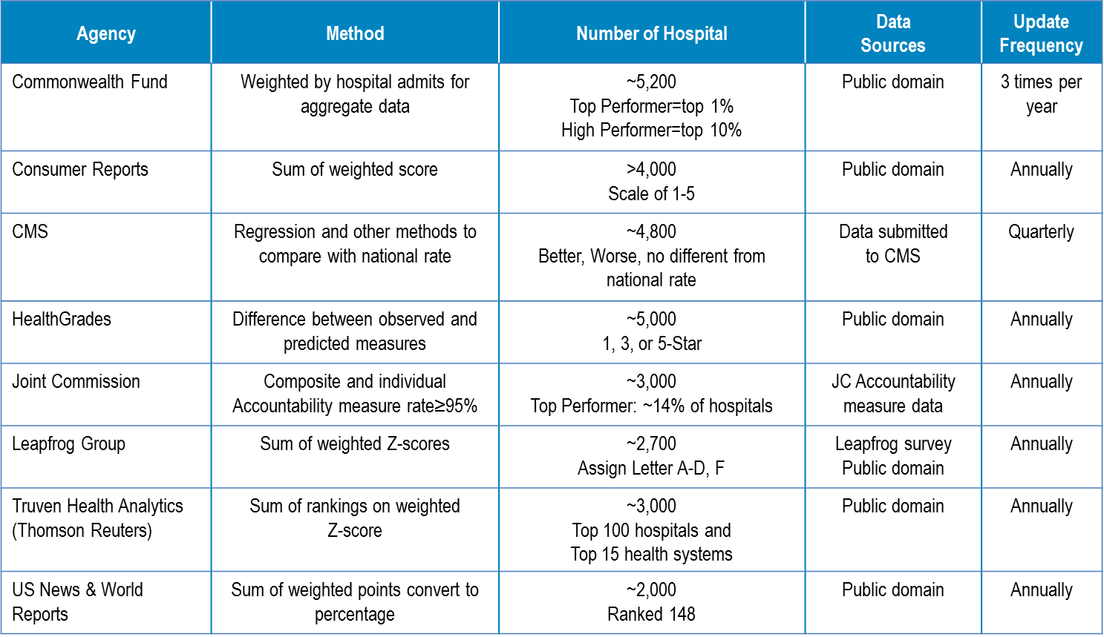
Notes:
RF
There are currently several major hospital rating systems used to evaluate private sector hospitals. This slide summarizes a few of the more broadly cited systems. They all have their advantages and disadvantages.
Most reporting agencies use weighted scores and some type of percentile cut-offs to divide medical facilities into groups based on their performance. Some report the absolute ranks of the hospitals, some like (CLICK) HealthGrades, use a star system, (CLICK) Leapfrog will assign a letter grade so you can actually get an ‘F’ if you are on the bottom.
(CLICK) The development of SAIL was based on the Truven Health Analytics system, another system that assigns stars as ratings,
The findings are often updated on an annually basis and reflect quality of care at inpatient care settings because there are limited outpatient health data submitted to agencies such as CMS and Joint Commission.
Not surprisingly, the different ranking systems can provide highly disparate results for the same hospital, due to the differences in methodologies.
Now let’s take a look at your poll results.

Slide 5

Poll Results
What is your current role?
  Executive or Clinical Leadership
  Quality Management/
  Performance Improvement
  Systems Redesign
  Clinical
  Administrative or
  Technical Professional
Notes:
So let’s see who is in our audience today.
(Ad-lib to the audience results, then advance to move on.)

Slide 6
Poll Results
What is your current role?
  Executive or Clinical Leadership
  Quality Management/
  Performance Improvement
  Systems Redesign
  Clinical
  Administrative or
  Technical Professional
Notes:
(Click to cue the studio to move on)

Slide 7
Truven Health Analytics
15 Top Health Systems
In-hospital mortality index
Complications index
Patient safety index
Inpatient performance measure
30-day mortality rate
30-day readmission rate
Adjusted length of stay
HCAHPS patient rating of hospital performance
Notes:
YL
In June 2011, the Office of the Secretary of Veterans Affairs (OSVA) asked the Office of Analytics and Reporting (OAR) to review the Truven Top Health Systems study and develop a prototype model that would allow VAMCs to benchmark internally with peer hospitals and externally with the private sector.
Truven publish their reports on a yearly basis. In the year 2014 report, the Truven model uses publicly available data (such as measures from CMS Hospital Compare) from 338 health systems, consisting of 2654 short term, acute care, non-federal hospitals. Hospitals are ranked using 8 inpatient quality measures and a composite score measured as a weighted sum of individual measure ranks. The 8 quality measures include in-hospital and 30-day mortality, hospital complications, Patient safety indicators, inpatient performance measures (ORYX), 30-day readmission rates, adjusted length of stay and patient satisfaction data from the HCAHPS survey.
One shortcoming of the Truven rating system is that it does not use any outpatient data in its methodology.
An interesting note about Truven is that unlike some other rating systems, there is no fee to market the honor of being on their top hospital or top health system list. When you see a hospital advertising that they are #1 on the US News Best Hospitals, that hospital is paying for the right to market that fact, which is really not a good incentive.

Slide 8
Compared to Truven health systems, VA overall performs better in:
In-hospital mortality
CHF 30-day mortality
inpatient core measures
Notes:
YL
In the original request to look at this model, we were asked to see how the VA compares to the private sector. So in the initial development of the VA adapted model we took only the data in the Truven model for which we had similar data in the VA system and made the comparison. If we do that same comparison today based on data from FY2014Q1, we see that the in-patient mortality rates in the VA are better, as do the 30-day risk standardized mortality rate for CHF and inpatient core measures.

Slide 9
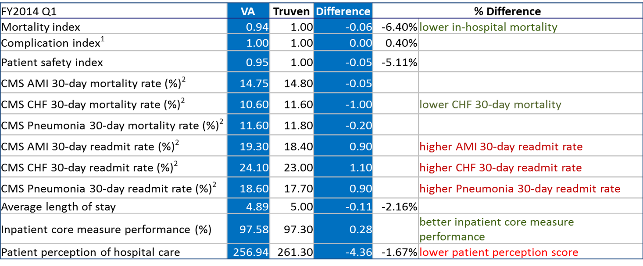
Notes:
YL
Here is a summary of the comparison to the private sector. The first blue column shows you the median, or the 50th percentile, VA value for each measure, followed by the corresponding value from Truven. The absolute difference is given in the second blue column. If the difference was statistically better, it is denoted by green text in the % Difference column; statistically worse results are denoted by red text.
(CLICK) The higher CMS readmission rates for CHF, AMI and PNA are really not a surprise; we have seen this trend since the VA began participating in the CMS Hospital Compare program.
(CLICK) The interesting one that everyone tends to talk about is that we tend to do better on the ORYX inpatient core measures. Although statistically significant, the difference is actually quite small – 97.6 vs. 97.3. The difference used to be bigger but has smaller over the past few years.
(CLICK) Patient satisfaction is one that we see change from year to year. This year we are a little worse than the private sector, but this difference tends to fluctuate from year to year.
This comparison is based on FY14Q1 data but what we have seen is that in general the differences between the VA and private sector on these measures is getting smaller.

Slide 10
SAIL
Strategic Analytics for Improvement and Learning
VA adaptation
Outpatient Care
Access to Care
Employee Satisfaction
Efficiency Metrics
Notes:
RF
The previous comparison of VA to private sector using Truven methodology was based only on the measures we have in common. But the VA has much more robust data available, so we decided to adapt the Truven model to use a broader set of healthcare data available to us. So we included some additional inpatient measures, added data on outpatient care, employee satisfaction, access to care, and efficiency metrics.
The resulting set of metrics were then grouped into 9 individual domains using factor analysis. Eight of the 9 domains are in quality and 1 for efficiency as you will see here in a minute.
We also added an adjustment for medical center complexity using the OPES hospital complexity groupings. So if you are a 1a, 1b, 1c, etc. we adjust for that. We also include the IPEC ICU level as another peer grouping adjustment.
So after several iterations and extensive reviews of other evaluation systems and feedback from VACO senior leadership, Program Offices, focus groups, and VISN/Facility stakeholders, the model eventually evolved into SAIL, the Strategic Analytics for Improvement and Learning Value Model
SAIL is now a quarterly refreshed, web-based model that reports domain and individual measure results at the VISN and facility level. It includes hyperlinks to patient level drill down tools, longitudinal trend charts, statistical process control charts and reports with benchmark measures.
SAIL has developed into a really nice, robust tool to identify improvement opportunities and we will show you many of the features of the tool in this presentation.

Slide 11
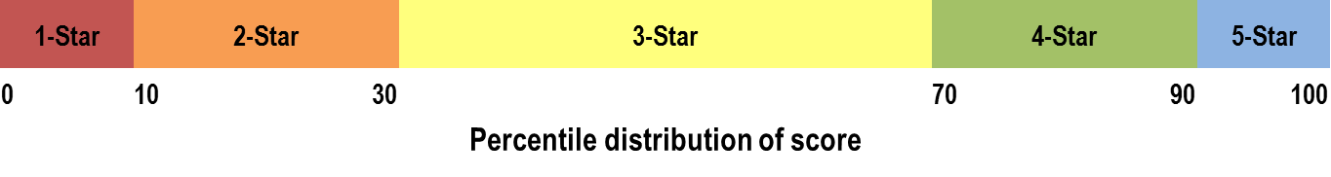
SAIL
Strategic Analytics for Improvement and Learning
VA adaptation
Assign rating of 1- to 5-Star for overall Quality
Notes:
RF
SAIL uses a star system to assign a rating to each VISN and medical center. Each VISN and facility is assigned a rating of 1 to 5 stars according to percentile distribution of its overall Quality. Facilities falling into the bottom 10th percentile are assigned 1 star; between the 10th and 30th percentiles are 2 star facilities; 3-star facilities fall within the 30th and 70th percentile; 4-stars between the 70th and 90th percentiles and finally, the 5-star facilities are those in the top 10th percentile.
A couple of caveats to the rating systems are if you are a 1 star hospital, we look at the 8 inpatient metrics against the private sector benchmarks that we showed earlier. If the 1-star facility performs better than Truven’s bottom 20% health systems, it gets promoted to 2 stars.
On the other end, if you are a 5 star facility and your inpatient and/or 30-day mortality is in the 80th percentile or greater, that is high mortality, you will get demoted to a 4 star facility. The idea here is that it is difficult to classify a hospital as a high performing 5 star facility if an outcome as important as mortality is one that you are performing badly.
In theory it is possible to have no 1 star facilities if the bottom of the VA is better than the bottom of private sector. So it is not necessarily true that there will always be 10% of the facilities with 1 star.

Slide 12
1
Clinical Quality / Safety
Data
Cleanup
Preparation
Integration
Methods
Modeling
Analysis
Scoring
Ranking
Tool Development
Web Based Visual Display
Appealing to Stakeholders from the Senior Leadership to providers
Efficiency / Productivity
Waste Reduction
2
Data Streams
3
Patient and Employee Satisfaction
4
External Benchmarks
Targeted initial private sector domains. Added additional metrics for balanced med center and VISN review
Data from AITC, CDW, program offices, other federal/private sector (benchmarks)
Update data/metric definitions
Clean raw data sets and prepare for modeling
Consult program offices to ensure conform to program specific reporting rules
Factor analysis to determine domains
Convert metric values to Z-scores, adjusted for MC complexity
Ranking based on sum of weighted Z-scores
Benchmark across time and facilities
Improvement tools to identify strengths and opportunities
Significant education and training program
at the national , VISN, and medical center level
VISN and site specific deep data dives with potential solutions
Process
Timing
QUARTERLY
Notes:
YL
As you might imagine, the process of developing and refreshing SAIL every quarter is quite involved.
At the first step, we added on top of Truven’s inpatient quality metrics with additional metrics on inpatient and outpatient quality and safety, efficiency, patient and employee satisfaction, and access to provide a balance view of facility and VISN
Next, we take data from Austin Automation Center, CDW, Program Offices and publically available private sector data, went through a series of data cleaning and preparation to create analytic data sets
Then we convert each metric to a standardized score. This step is important because we have metrics presented as %, score, and ratio. It will be difficult to combine them in their original forms without some standardization to have them measured on the same scale. The creation of standardized scores are done within the facility’s complexity peer group to adjust for a hospital complexity level.
The standardized scores are then grouped into domain scores and domain score into composite scores for quality and efficiency. We assign equal weight to domains and also equal weight to metrics within a domain.
Over the past couple years, we have provided many educational sessions to facilities, VISNs, Program Offices, national leadership groups, many involve providing deep dive into the data accompanying recommendations for improvement

Slide 13
SAIL Value Model includes
26 measures with a total weight of 100 each for quality and efficiency.
Notes:
YL
The VA-SAIL Value model has a total of 26 measures grouped into 9 domains, with 8 domains in Quality and 1 domain in Efficiency.
The Quality and Efficiency domains are evaluated separately. The relative performance in Quality does not impact the relative performance of Efficiency, and vice versa.

Slide 14
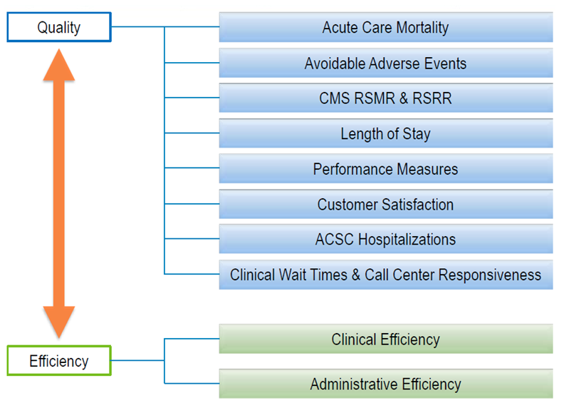
Notes:
YL
Here is a list of the Quality and Efficiency domains. For those of you already familiar with SAIL you might notice that this list has changed recently from previous versions of SAIL.
In Quality, we have
acute care mortality (both in-house and 30-day mortality)
Avoidable adverse events (this is new and it contains HAI, PSIs and hospital complications)
The CMS risk standardized mortality and readmission measures
Adjusted length of stay
Inpatient and outpatient performance measures (a subset of ORYX/HEDIS measures)
Customer satisfaction (patient satisfaction, employee satisfaction and nursing turnover)
Ambulatory Care Sensitive Conditions
And wait time for primary care, specialty care and mental health care, as well as call center responsiveness measures, including speed in picking up calls and abandonment rate
For Efficiency we consider the Clinical and Administrative efficiencies as a single domain and it is based on the Stochastic Frontier Analysis measure produced by OPES.
Each of these domains are then weighted such that the sum of the weights equals 100%.

Slide 15
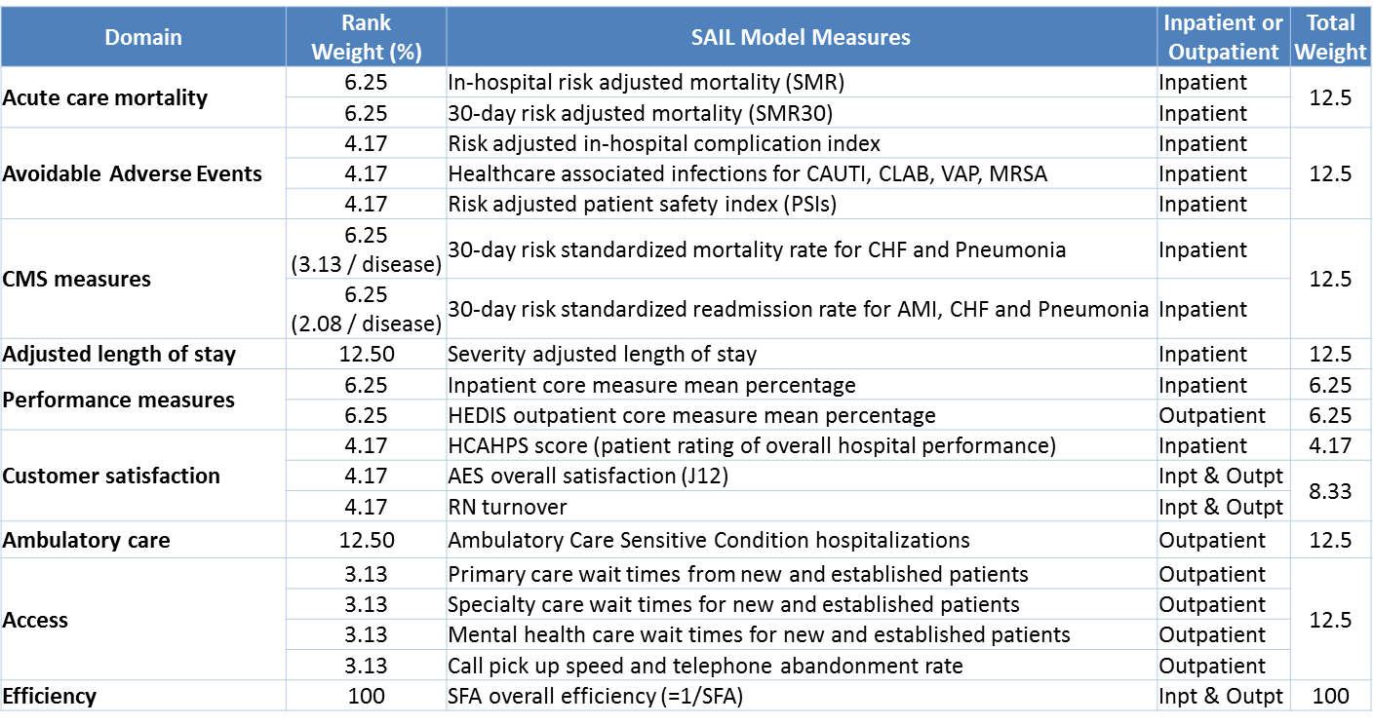
Notes:
RF
Here is a list of the 26 measures included in the SAIL model grouped into the 9 SAIL domains. The first 8 domains in the list make up the Quality composite and the Efficiency domain is based only on the SFA analysis.
About 35% of the model is outpatient, which is good considering the private sector rating systems don’t include any outpatient care measures. We will eventually include HCAHPS for outpatient care once that data is provided to us, hopefully in the next quarter. This will put us close to 40% outpatient measures which is a pretty good balance for the model.
What is important here is to look at the weights associated with each of the measures when you are trying to identify what to work on at your facility. If you are going to focus on a single CMS measure which is only 2-3% of the overall weight in the SAIL model, and put a lot of resources into that single area, you are not likely going to get a big return with regard to movement in the SAIL model. Our advice is generally to look at the weights but prioritize according to what’s important to the medical centers and the veterans, what are some things you have in place that you can work on quickly,
The other thing to remember when choosing what to work on is that improvements in one domain may also affect some others. Significant improvements in the avoidable adverse events (PSIs, HAIs and complications) could also have an effect on reducing length of stay, for example. So those type of relationships should also be considered when selecting improvement priorities.

Slide 16
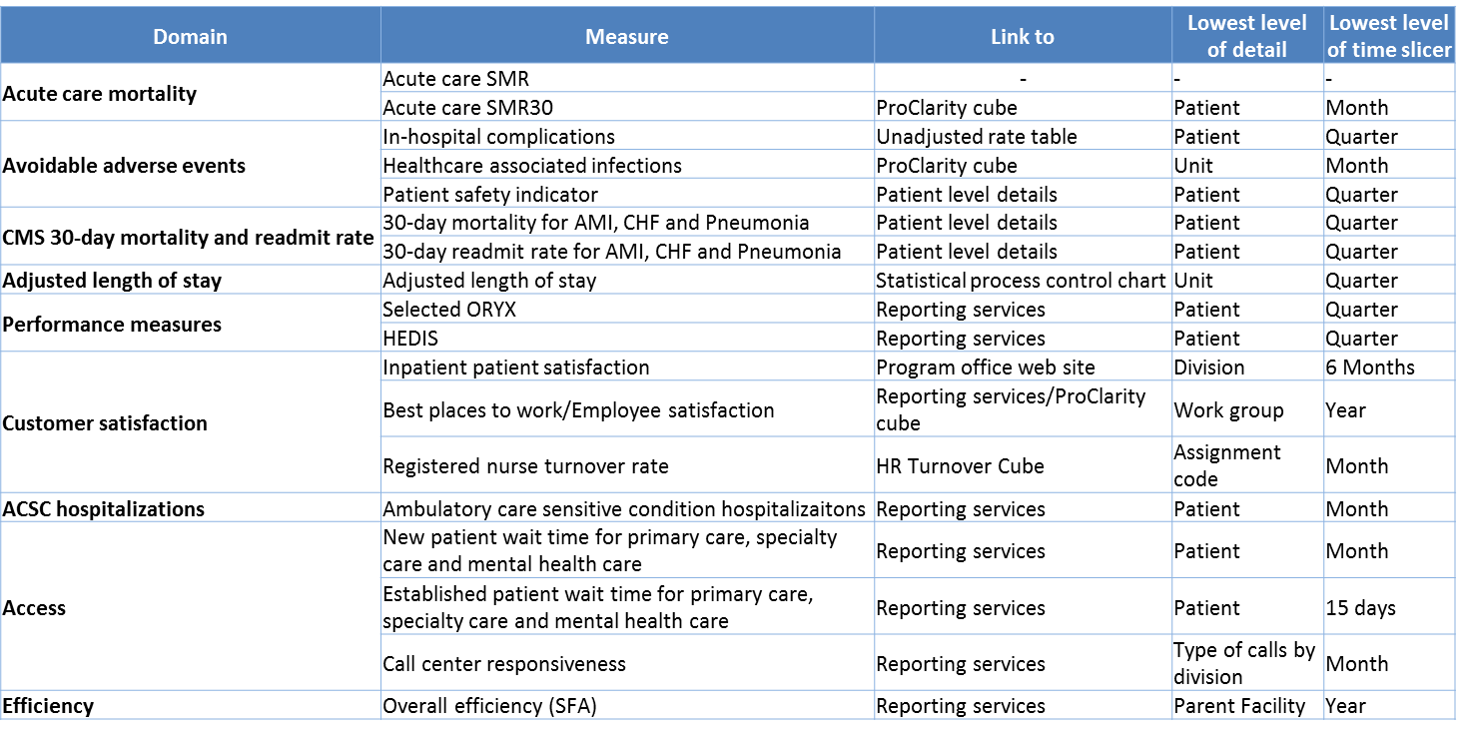
Notes:
RF
There are several drill down resources available to you on the vast majority of the measures used in SAIL.
This slide shows you the different modalities of drill down along with the lowest level of detail and time period available to drill down. Many of the measures have drill down capabilities down to the patient level. Some do not go down to patient level due to the nature of the data reported, such as HAI – that data is only collected in aggregate form at the unit level, although the patient level information should be available from your local IC department who enter that data.

Slide 17
Methodology updates
since FY 2012, Q3:
Divided medical facilities into 4 groups
Estimated Z-scores
Promoted 1-Star facilities to 2-Star
Demoted 5-Star to 4-Star
Incorporated Present-On-Admission
Added 19 non-acute care facilities to SAIL report
Notes:
YL
SAIL has been through several methodology updates based on the feedback received from the field, Program Offices and the VACO senior leadership. Here are a few highlights:
The hospitals are divided medical facilities into 4 groups based on OPES complexity level and IPEC ICU level
Calculate the standardized scores or Z-scores of individual metrics within the facility peer group to adjust for difference in hospital complexity
Promoted 1-Star facilities to 2-Star if they have the most number of metrics perform better than bottom quintile health systems in Truven’s study
Demoted 5-Star facilities to 4-Star if acute care SMR and/or SMR30 are in the 80th percentile, that is high mortality, and promote equal number of 4-Star facilities to 5-Star
Incorporated Present-On-Admission in in-hospital complication measure and completed data validation
Added 19 non-acute care medical/surgical facilities to SAIL report as ad hoc hospitals, so that they can benchmark with other facilities on available metrics

Slide 18
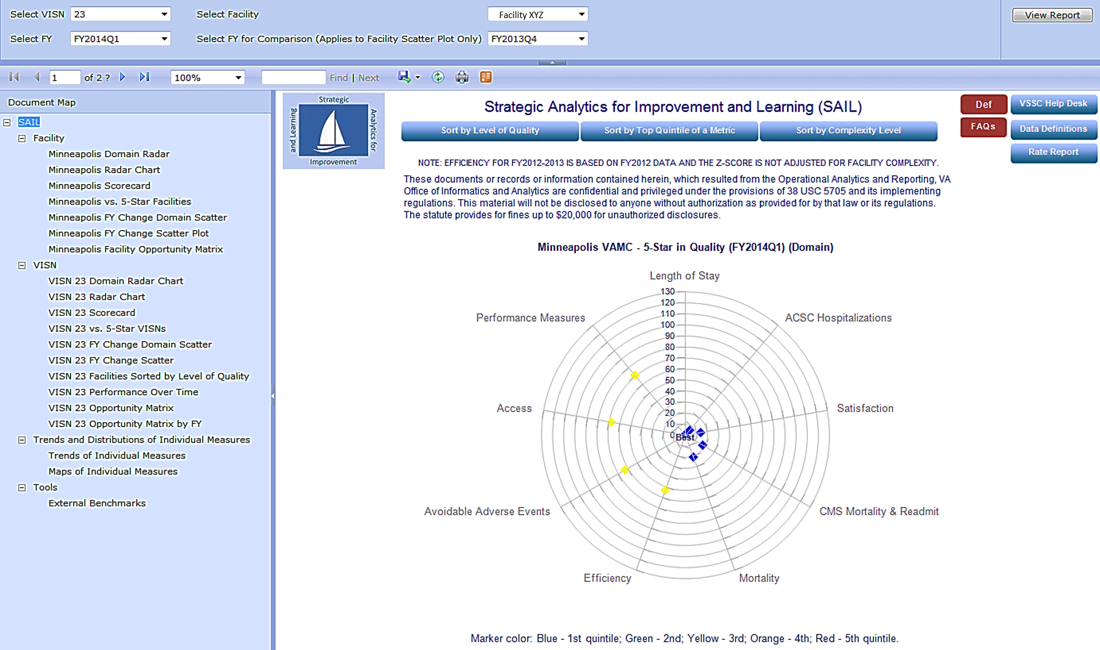
Facility XYZ
Facility XYZ
Facility XYZ
Facility XYZ
Facility XYZ
Facility XYZ
Facility XYZ
Facility XYZ
Notes:
YL
This is the main page of the SAIL report available from the VSSC web site. Every VA employee with a valid computer account can access this report. There is no approval for access required.
The report is divided into 3 sections
On the top are a set of filters where you decide which VISN, facility and time period of the report you want to review. Remember to click “View Report” on the right to refresh the report.
The center is the domain radar diagram of the selected facility. There are several button on the top that will lead you to other reports, such as return a list of hospitals by selected Quality designation, or hospitals in the top 20% of a selected metrics, or Quality star designation of hospitals for a selected complexity grouping.
On the side are a additional buttons to open data definitions, FAQs and reporting rating page.
To the left is the document map – or you can consider it as the table of contents. It’s divided into 4 sections where you’ll find facility and VISN reports, tools such as trend charts, maps, and external benchmark data from different quality reporting agencies
Click on a item on the document map will take you to the specific report page

Slide 19
Poll Question
When did you first hear about SAIL?
  Less than a month ago
  6 months ago
  1 year ago
  More than 1 year ago
  Never heard of SAIL until today
Notes:
YL
Let’s try another poll question.
When did you first hear about SAIL?
Less than a month ago
6 months ago
1 year ago
More than 1 year ago
Never heard of SAIL until today
To answer this question, use the blue polling icon above my head.

Slide 20
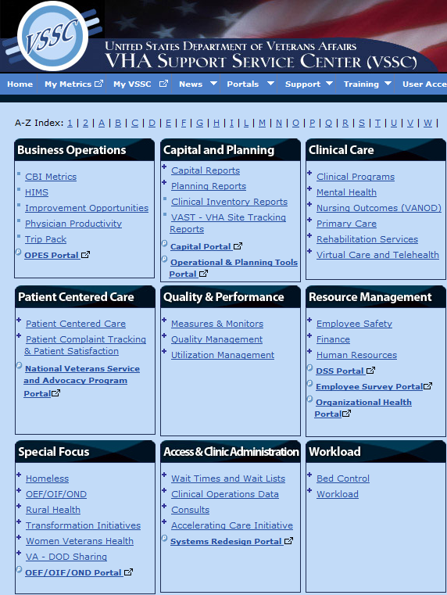
http://vssc.med.va.gov/
Notes:
RF
You can access the SAIL report through the VSSC website. If you click on Quality Management in the center square, you will get a list of reports.

Slide 21
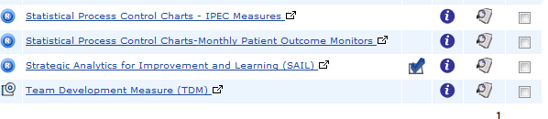
http://vssc.med.va.gov/
Notes:
RF
SAIL is currently second from the bottom in the list. Click on that link and…..

Slide 22
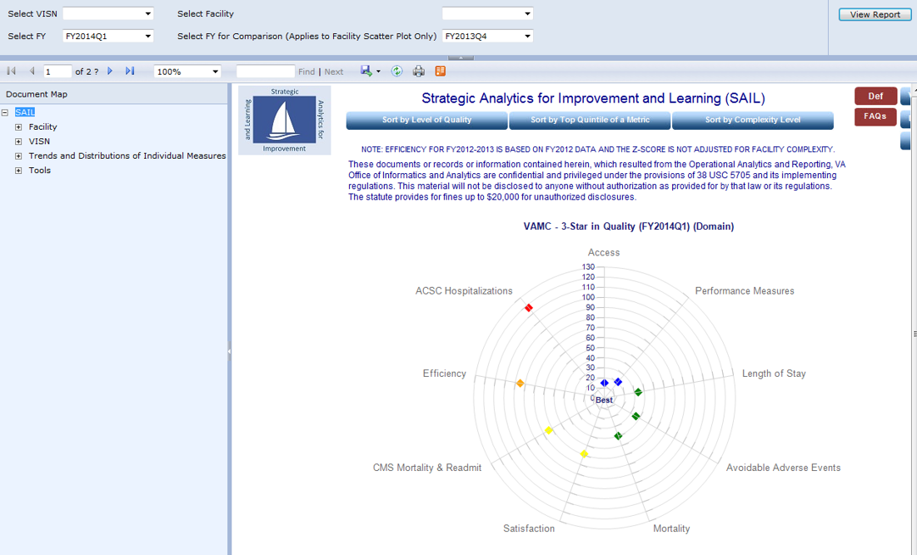
http://vssc.med.va.gov/
Notes:
RF
…..the SAIL report will open to your own VISN and facility.

Slide 23
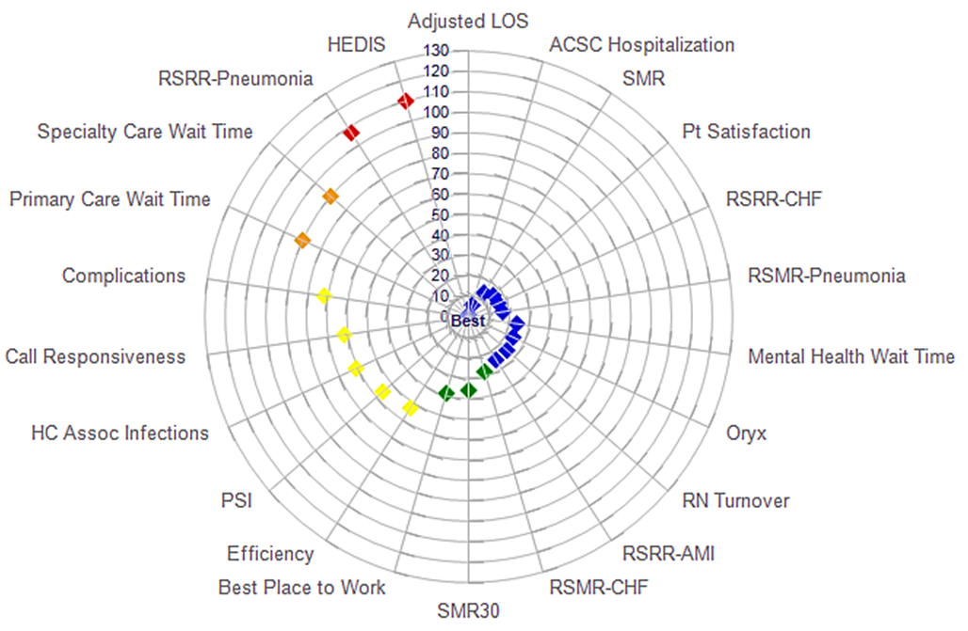
Radar Diagram
of 5-Star Quality Facility
Notes:
RF
The first thing you will see when you open up the SAIL report is a radar diagram. This happens to be a radar diagram for a 5-Star Quality facility.
Around the outer ring of the diagram you will see, in this case, the individual quality and efficiency measures (we do also provide a radar diagram for the measures at the domain level). The inner concentric circles on the diagram represent the relative ranking of your facility out of 128 facilities used in SAIL.
For instance, if you look at adjusted LOS at the top of the graph and follow the spoke down to the marker, you see that this facility is at the dead center of the radar diagram, meaning it is ranked well under 10th out of the 128 facilities. Now the HEDIS measure on the other hand, falls on the ring representing 110th out of 128 facilities and suggests that this might be an area to investigate.
The colors of the markers on the diagram represent the 5 quintiles of facility rankings. The blue markers indicate that the facility ranking on those measures falls in the top 20% of facilities (roughly in the top 25 medical centers); green indicates the second quintile or between 20-40% and so on until you get to the red which represents the bottom 20% of facilities.
You can see that in a five star facility which this represents, you will see a somewhat tight spiral and the problem areas (the orange and the red) really don’t start appearing until about 10:00, if you picture this as a clock.

Slide 24
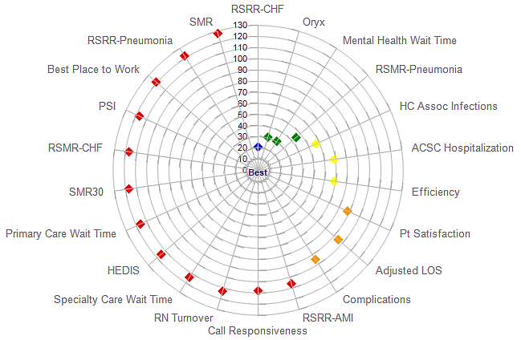
Radar Diagram
of 1-Star Quality Facility
Notes:
RF
Now compare that to a radar diagram of a 1-Star Quality facility, which this diagram represents.
You see a much more open spiral here, with fewer blue and green measures. Plus, you see the orange and red starting a lot sooner, around 4:00, compared to the five star facility.
So this facility has a lot of opportunities to choose from. This is where you will want to balance the priorities of your medical center, with the weights of the individual measure and the relationships between the measures in order to identify what to start working on first in order to improve performance.
So the radar charts a nice way to see at a glance how you compare to other facilities in the different measure in SAIL.
Next, Dr. Li will show you what we refer to as the scorecard, but before we get into that, let’s go look at our poll results:

Slide 25
Poll Results
When did you first hear about SAIL?
  Less than a month ago
  6 months ago
  1 year ago
  More than 1 year ago
  Never heard of SAIL
  until today
Notes:
RF
Ad-lib to the audience results, then advance to move on.

Slide 26
Poll Results
When did you first hear about SAIL?
  Less than a month ago
  6 months ago
  1 year ago
  More than 1 year ago
  Never heard of SAIL
  until today
Notes:
(Click to cue the studio to move on)

Slide 27
Notes:
YL
There are 2 internal benchmark tables on SAIL report. The first is called the scorecard where we list each metric value of a hospital with the best 10% cut-off of that metric in the VA. Let’s go full screen with this slide so you can take a closer look while I explain the columns:
The first column list the domain and metrics on SAIL. The blue text means it’s hyperlinked. Click on the domain and metric name bring you to another report or tool prepared by Program Offices.
The 2nd column is the facility value. This are the raw values. Most of the metrics uses rolling 12 month or yearly data, with a few exceptions such as PSIs, disease specific 30-day mortality and readmission rates uses rolling 3 year data.
The Benchmark column lists the best 10% cut-off of a metric in the VA. It may be 10th or 90th percentile depends on preferred direction for the metric. For example, we would prefer to see lower value for mortality. The benchmark will be set as the 10th percentile or the lower 10% cut off.
Next to Benchmark is the Distribution of a metric. We show the 10th, 50th and 90th percentile based on the 128 core-hospitals.
Score calculated based on formula in the Note column. The score column is adapted using a method by CommonWealth Fund. It is used a reference to show how far a facility is from the best 10% facilities in the VA. The score itself is not used for Star Designation.

Slide 28
Notes:
YL
This is the second internal benchmark table where a facility is compared against the average of the 5-Star facilities
It is organized similar to the scorecard
The benchmark column is now the average of the 5-star facilities
We then present the difference between a facility’s score and the average of 5-Star hospitals, percentage difference, and note whether the difference is statistically significant.
When prioritizing which areas to invest improvement effort first, it may be helpful to also consider whether a difference is clinically or practically significant.

Slide 29
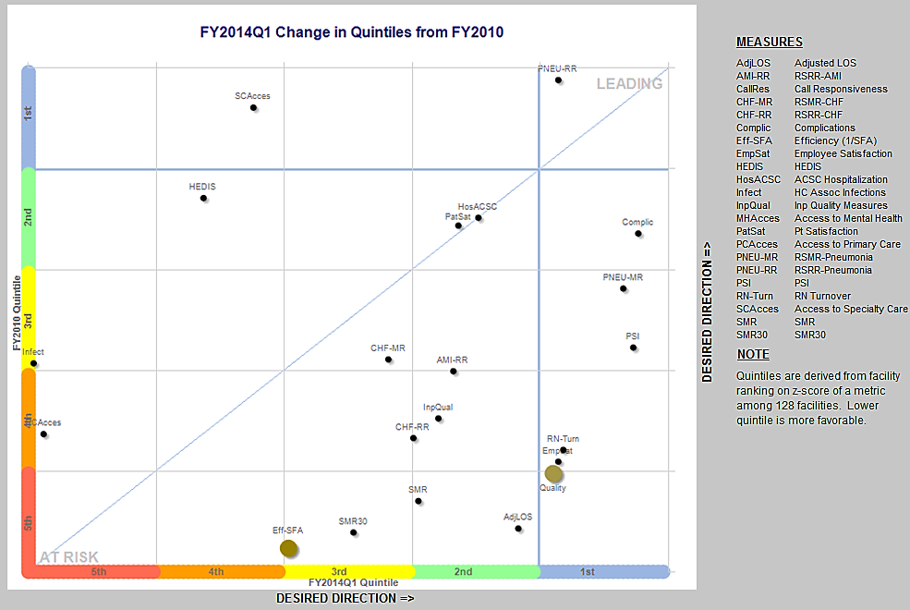
Quality
Notes:
YL
This is what we call the scatter plot. There are two of them each for facility and VISN. What we’re seeing is a metric level scatter plot. There is another one is presented at the domain level.
Scatter plot is used to look at which direction and how far a metric has moved between two time periods. The one on the screen shows changes between FY2010 and FY2014Q1.
The Y axis represents quintile designation in more distant time. In our example, FY2010.
The x axis represents quintile designation in more recent time. In our example, FY2014Q1.
We present the quintile using color band where blue is the best 20% and red the bottom 20%
The small dots are individual quality metric and then we have a big dot for overall Quality and another big dot for efficiency.
Dots in the lower half of the diagonal line suggest that some improvement have been made during the time and dots on the upper half of the diagonal line may have deteriorate a bit.
So how do I know which areas have shown improvement? Let’s use the big Quality dot as an example.
First, let’s put a horizontal line from the Quality dot to the y-axis. (CLICK)
Here we see the Quality was in the bottom 20% in FY2010.
Next, let’s put a vertical line from Quality to the x-axis. (CLICK)
Here we see the Quality is in the best 20% in FY2014. It’s a pretty significant improvement moving from bottom 20% to top 20% over a 3 year time period.
The facility has also make great improvement in the Efficiency, moving from nearly bottom in the VA to the middle quintile.

Slide 30
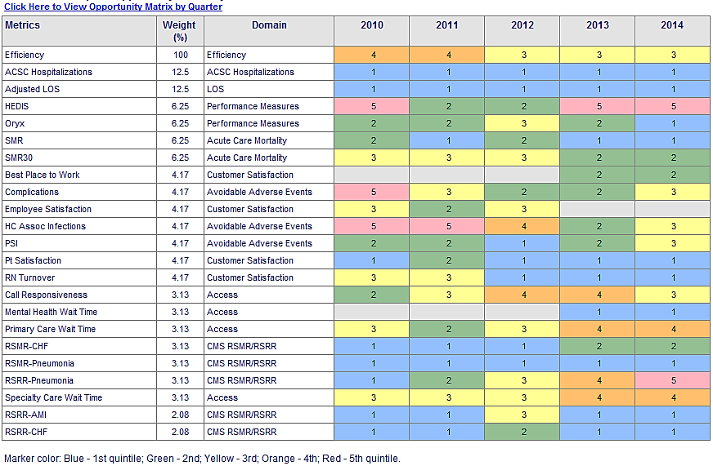
Notes:
RF
Here is another visual way to look at your data. We call this the Facility Opportunity Matrix and it summarizes your facility's rankings over time.
You will find each of the individual SAIL measures in the first column, followed by their respective weights and associated domains,
The colors of the cells are consistent with those used on the radar diagrams, so the blue cells represent being in the top 20% of the facilities and the red represent the bottom 20%. The numbers in the cell tell you which quintile you fall with 1 being the first quintile or top 20% and 5 being the 5th quintile or bottom 20%.
This is really nice way to visualize your performance over time. For example, look at the risk standardized readmission rate for pneumonia (4th measure from the bottom). Look how in 2010 this facility was in the top 20% of all facilities on this measure, but then steadily decreased in ranking over the next 4 years, going from blue to green, to yellow, orange and red.

Slide 31
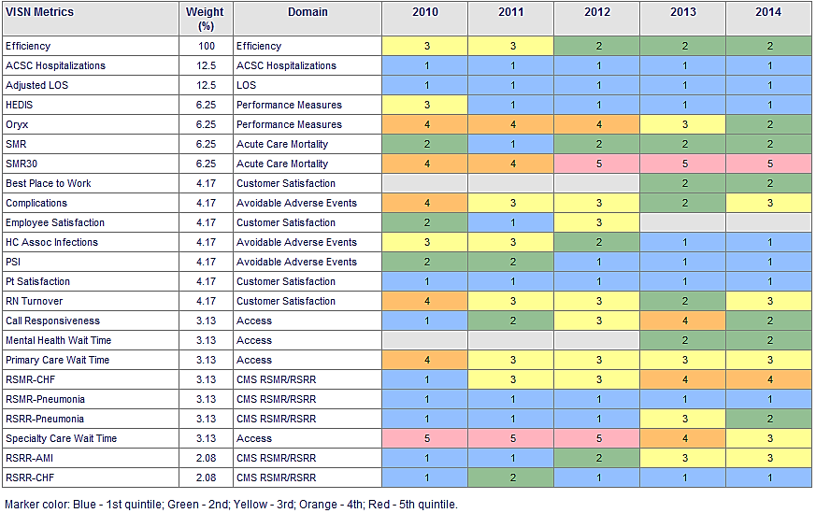
Years
2.08
Notes:
RF
Here is the VISN Opportunity Matrix across time. It is interpreted the same as the facility opportunity matrix, but represents the rankings aggregated at the VISN level over time. This can be used to identify possible VISN level initiatives, but should not be used by itself since you cannot tell if it is truly a VISN wide problem or due to one or two individual facilities.
Take for example the acute care mortality measure, SMR30. This VISN appears to struggle some with that measure. But is it all facilities within the VISN or just a few that is driving their ranking?
So for that, we have the same matrix but by each facility within the VISN

Slide 32
Facilities
2.08
Notes:
RF
Here is the VISN Opportunity Matrix by facility
This view is for one particular time period. The first column again lists the individual measures and the colors show the VISN level ranking for that time period. Again you have the weights associated with each measure and its respective domain. And then you have each facility in the VISN listed and their corresponding rankings represented by color and quintile.
If we look at SMR30 again, you see that 3 of the 5 facilities are in the bottom quintile and one is actually a top performer. So perhaps one could investigate what that top performer in the VISN is doing that might be shared with those others who do not appear to be doing as well and help them get better.

Slide 33
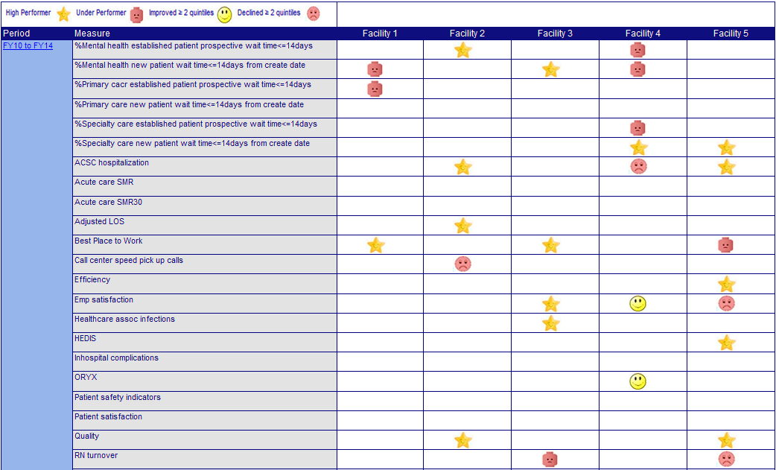
VISN level facility relative performance over time
Notes:
YL
This is what we call the happy face and sad face chart. We use 4 icons to show whether a facility substantiated their performance or had significant changes in specific area.
This chart is displayed at the VISN level, with each facility within the VISN listed on separate columns.
On the first column, you’ll see a blue hyperlink text with time period. In our example, this chart show the changes between FY2010 and FY2014.
The next column is a list of metrics reported on SAIL.
For each metric and each facility in the VISN, we give a Star if the facility continued to be in the best 20% in the VA during the time period and a square face if continued to be in the bottom 20%.
We give a happy face if the facility has improved 2 quintile or 40% in their position during the time; and a sad face if deteriorated 2 quintile.

Slide 34
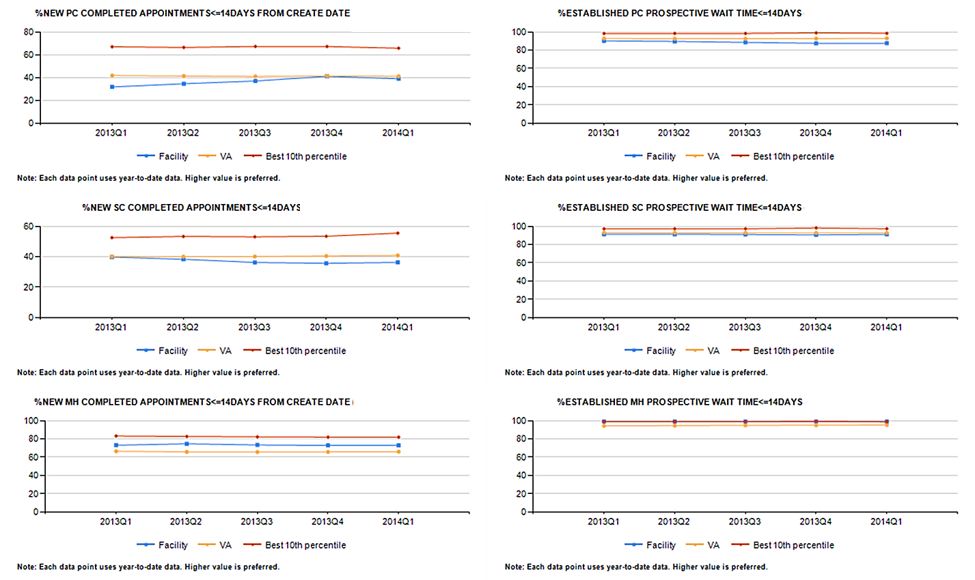
Notes:
YL
We also include trend charts to show changes over each reporting periods on SAIL.
There are 3 lines on the trend chart – the facility is represented by the blue line, the VA average is the orange line and the best 10th percentile cut-off is the red line.
At the bottom of the chart, we note whether a higher or a lower value is preferred for the specific metric.
Here we’re seeing a trend chart for new patient completed appointment within 14 days for primary care.
Despite the VA average and best 10% lines has minimal change from FY13 to FY14, the facility was able to make improvement over time, from lower than VA average in FY13Q1 to about VA average in FY14Q1.

Slide 35
Benchmark data from other reporting agencies
Provide benchmark data in SAIL Value Model
Some not measured in same way as SAIL
Different sets of quality metrics
Lag time behind data reported on SAIL
Data may vary across public reports of healthcare quality
Definition of top vs. bottom performers also vary
Notes:
RF
Private sector benchmark data from other reporting agency are also included in the SAIL Value Model
There are several things to keep in mind as you use the benchmark data to compare to your facility.
As we discussed previously, the methodologies used by the various rating systems are not measured the same way as we do with SAIL. The individual metrics themselves may also not be measured in a similar way.
You also need to pay attention to the data sources used by each system and the timeliness of the data. Publicly available data often has a lag time behind data reported on SAIL
And remember that the different reporting agencies define top vs. bottom performers differently

Slide 36
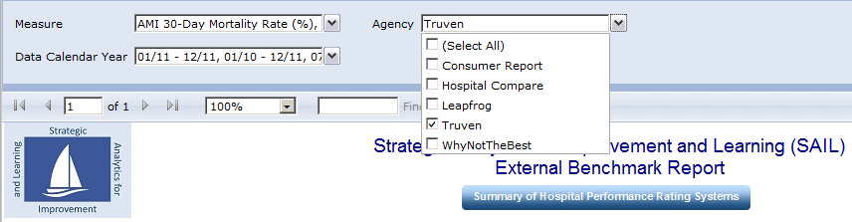
Benchmark data from other reporting agency
Notes:
RF
The benchmark data report can be accessed from the document map on the left of the SAIL report. Just select External Benchmarks under the Tools section.
You can select one or more measures from the first drop down – you have approximately 90 measures from which to choose.
There are 5 systems from which to choose to display: Consumer Reports, CMS Hospital Compare, Leapfrog, Truven and Why Not the Best.
You can also select the time frame for the selected measures.
The other thing I want to point out on this report is the button titled ‘Summary of Hospital Performance Rating Systems’. This will take you to a very nice report prepared by Dr. Chad Cross and Dr. Steven Wright from the Office of Performance Measurement. Nine hospital rating systems are summarized and includes
A brief description of the various sources from which data are selected for use in the rating system.
A list of metrics used in calculating the hospital rating.
Inclusion and exclusion criteria and any special notes on scoring (where appropriate).
Detailed information on scoring, weighting, and ranking.
The web address and an active internet hyperlink for each rating system.

Slide 37
Reporting Agency | Facility Type | Measure | Unit | Data Year | US Average | Top 1 % | Top 5 % | Top 10 % | Top 25 % | Top100 Hospitals | Non-Top 100 Hospitals
Hospital Compare | Hospital | CMS 30-day Mortality Rate for AMI | % | 07/08 -06/11 | 15.5
Truven | Hospital | CMS 30-day Mortality Rate for AMI | % | 07/08 -06/11 |  |  |  |  |  | 14.8 | 15.4
WhyNotTheBest | Hospital | CMS 30-day Mortality Rate for AMI | % | 07/08 -06/11 | 15.5 | 12 | 13.1 | 13.6 | 14.5
Hospital Compare | Hospital | CMS 30-day Mortality Rate for CHF | % | 07/08 -06/11 | 11.6
Truven | Hospital | CMS 30-day Mortality Rate for CHF | % | 07/08 -06/11 |  |  |  |  |  | 11.1 | 11.5
WhyNotTheBest | Hospital | CMS 30-day Mortality Rate for CHF | % | 07/08 -06/11 | 11.6 | 8.2 | 9.2 | 9.8 | 10.7
Hospital Compare | Hospital | CMS 30-day Mortality Rate for Pneumonia | % | 07/08 -06/11 | 12
Truven | Hospital | CMS 30-day Mortality Rate for Pneumonia | % | 07/08 -06/11 |  |  |  |  |  | 11.1 | 11.9
WhyNotTheBest | Hospital | CMS 30-day Mortality Rate for Pneumonia | % | 07/08 -06/11 | 12 | 8.5 | 9.5 | 10 | 10.9
Hospital Compare | Hospital | CMS 30-day Readmission Rate for AMI | % | 07/08 -06/11 | 19.7
Truven | Hospital | CMS 30-day Readmission Rate for AMI | % | 07/08 -06/11 |  |  |  |  |  | 18.9 | 19.6
WhyNotTheBest | Hospital | CMS 30-day Readmission Rate for AMI | % | 07/08 -06/11 | 19.7 | 16.3 | 0.173 | 17.9 | 18.7
Hospital Compare | Hospital | CMS 30-day Readmission Rate for CHF | % | 07/08 -06/11 | 24.7
Truven | Hospital | CMS 30-day Readmission Rate for CHF | % | 07/08 -06/11 |  |  |  |  |  | 23.6 | 24.7
WhyNotTheBest | Hospital | CMS 30-day Readmission Rate for CHF | % | 07/08 -06/11 | 24.7 | 20.6 | 0.219 | 22.6 | 23.5
Hospital Compare | Hospital | CMS 30-day Readmission Rate for Pneumonia | % | 07/08 -06/11 | 18.5
Truven | Hospital | CMS 30-day Readmission Rate for Pneumonia | % | 07/08 -06/11 |  |  |  |  |  | 18.2 | 18.5
WhyNotTheBest | Hospital | CMS 30-day Readmission Rate for Pneumonia | % | 07/08 -06/11 | 18.5 | 15.3 | 0.162 | 16.7 | 17.4
Notes:
RF
Here is an example of the external benchmark report.
Let’s look at the CMS 30-day risk standardized mortality rate for AMI. You can see we have benchmark data from 3 different systems: CMS Hospital Compare, Truven and Why Not the Best.
But note that the same data is summarized differently by the 3 systems: CMS Hospital Compare and Why Not the Best both give you the US National average for the AMI mortality rate (15.5). Truven gives you the average of the top 100 hospitals as well as the average of the hospitals not in the top 100. WNTB also gives you the average of the top 1, 5, 10 and 25% of the hospitals in their system.
So this is an easy way to get at external private sector benchmark data without having to go to each individual website yourself to extract.

Slide 38
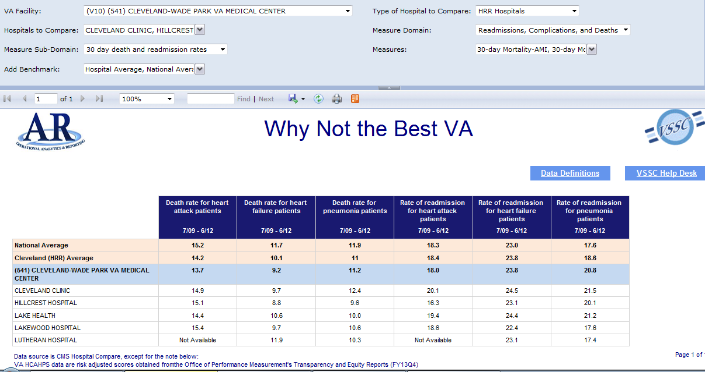
COMING SOON!
Notes:
RF
Here is a sneak preview of a new external benchmark report that we are working on. The underlying data source for this report is the publically reported CMS Hospital Compare data in which VA participates.
There are 3 measure domains from which to select on this report.
Readmissions Complications and death (shown here), the CMS risk standardized mortality and readmission rates for CHF, AMI and PNA, as well as the CMS hospital wide readmission rate and the CMS readmission rate for hip/knee surgery.
Survey of Patient Experiences (or the HCAHPS), and
Timely and Effective care (CMS process measures for AMI, HF, PNA and SCIP)
What you will be able to do is compare your medical center a couple of different ways. This screen shots shows a comparison of your facility with private sector hospitals in your hospital referral region. When you select to compare by HRR, you will be presented with a list of private sector hospitals in your area with which to compare. But you can also compare your facility to other VA’s of the same hospital complexity peer group. So, for example, if you are a 1b facility, you can compare yourself to other 1b facilities in the VA.
This report will become available soon.

Slide 39
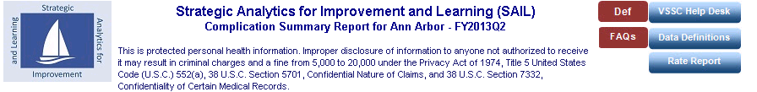
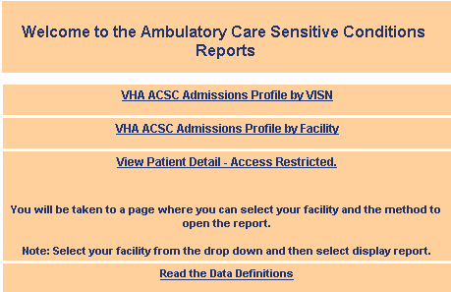
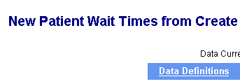
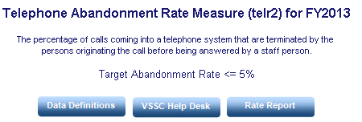

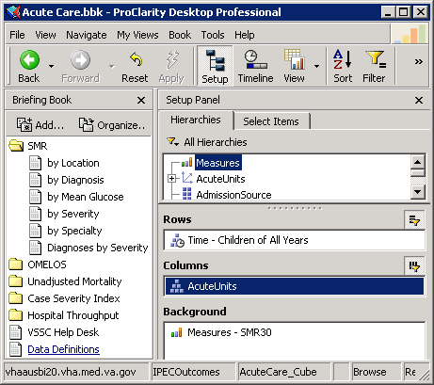
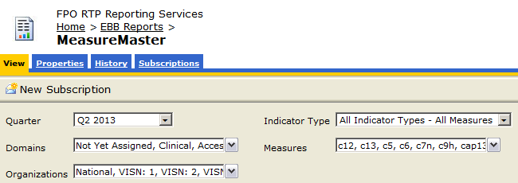

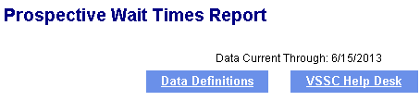
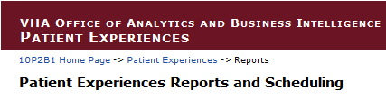

Notes:
YL
SAIL is a complex system with many quality and efficiency metrics, and embedded with hyperlinks to additional improvement tools and reports prepared by Program Offices. To best use the information, it is important to have a good understanding of the data sources used for the metrics and how the metrics are defined or calculated. It is highly recommended that we read the data definition document to get a picture of how the report and metrics works. Many of the questions you may have later on may have been laid out in these documentations.

Slide 40
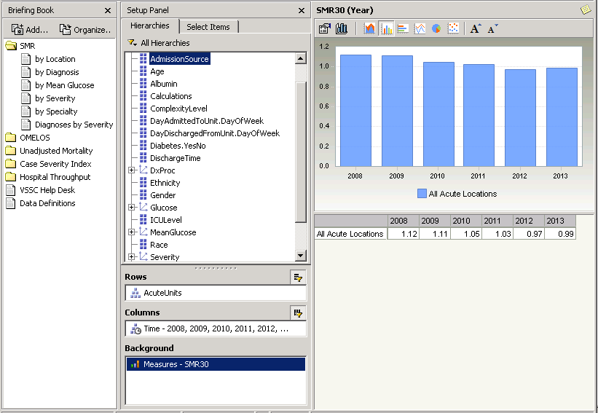
ProClarity
Cube
Slice & dice
the data
Notes:
YL
This is a snapshot of the ProClarity cube, which is a very popular tool in the VA.
Generally, ProClarity cube is organized in a way so that we can slice and dice the data using parameters, such as age, gender, diagnosis, facility complexity level, to identify opportunities or get a deeper understanding of the data.
Some of the ProClarity cube has built in function to return a list of patients who experienced specific outcomes while receiving treatment. Users with permission to access PHI/SSN level data will be able to obtain the list right from the cube.

Slide 41
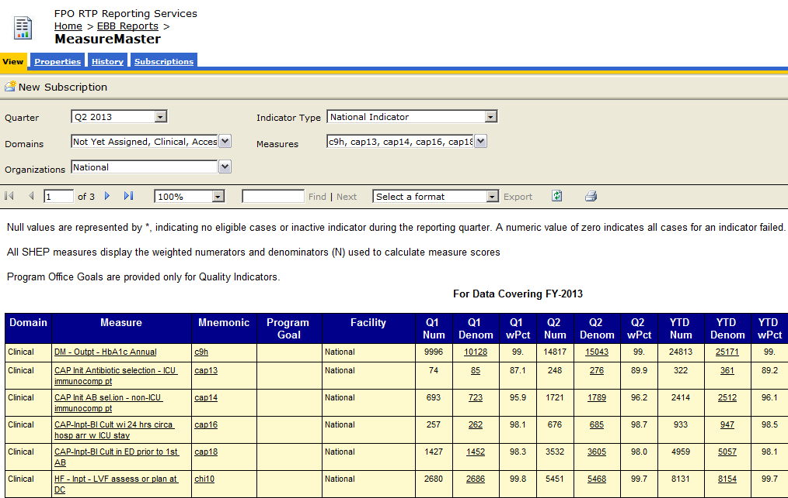
Notes:
YL
This is a snapshot of the Performance Measure report prepared by the Office of Performance Measurement. Like other reports built by Reporting Services, there are a few filters on the top where users can select to return a report of interest. Places that is underlines meaning it’s hyperlinked and click on these places will open another report or tool. Some of the reports can also return patient level data for users with permission to access PHI/SSN level data.

Slide 42
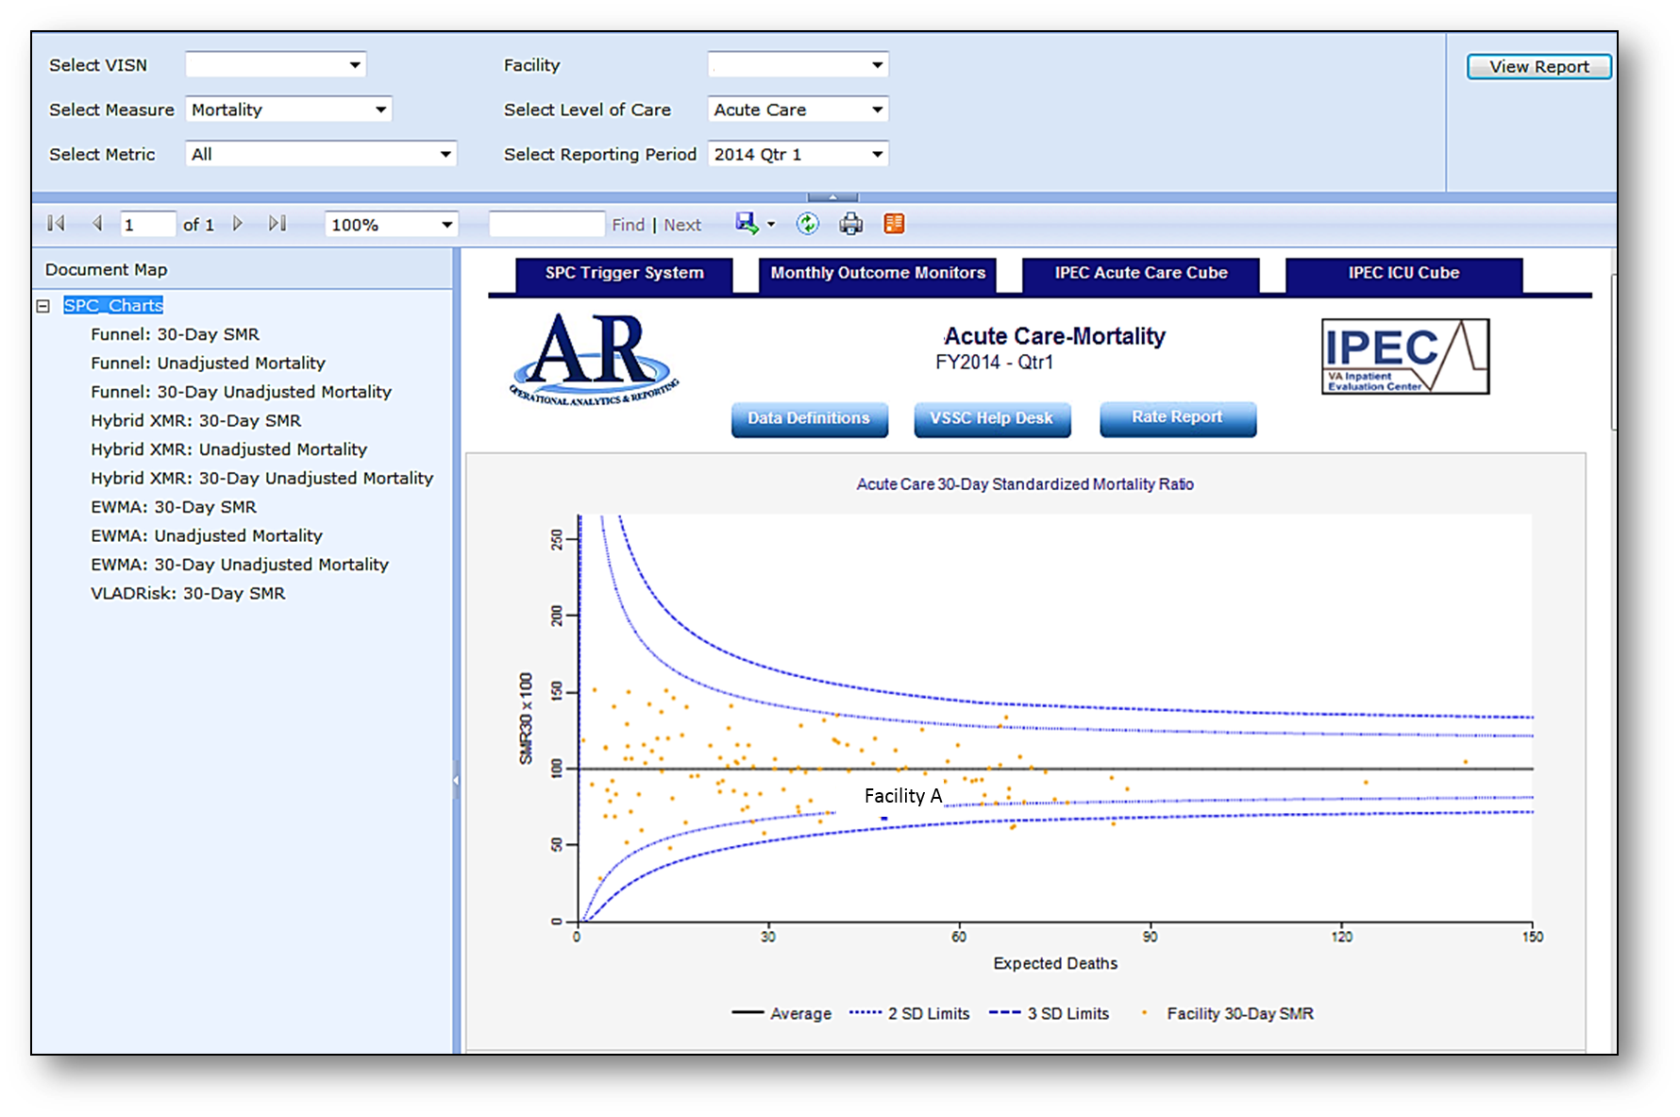
Notes:
RF
Statistical process control charts for the quarterly IPEC measures are also available through SAIL. From the scorecard page that we showed earlier, if you click on either the hyperlink for Acute Care Mortality or the hyperlink for Adjusted Length of Stay, you will navigate the IPEC SPC Charts. Here you can dynamically get SPC charts for risk adjusted mortality and length of stay for both acute care and ICU.
This example is a funnel chart. A funnel chart will give you a cross sectional view of your data at a specific point in time. The dots here represent individual medical centers. The dashed lines represent control limits set to 2 and 3 standard deviations. If your facility falls outside of those control limits, it suggests it might be something to investigate.
Other statistical process control charts give you a good way to look at variation over time.

Slide 43
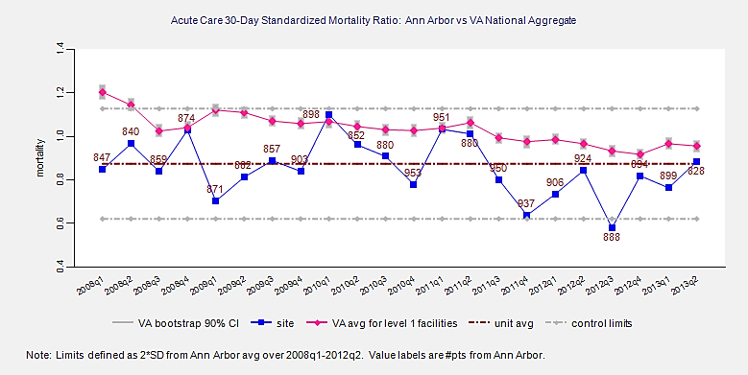
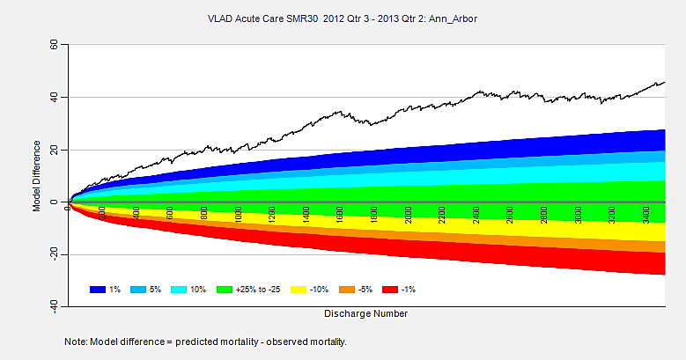
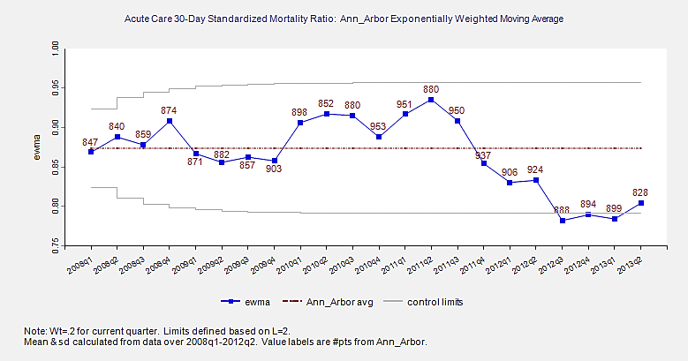
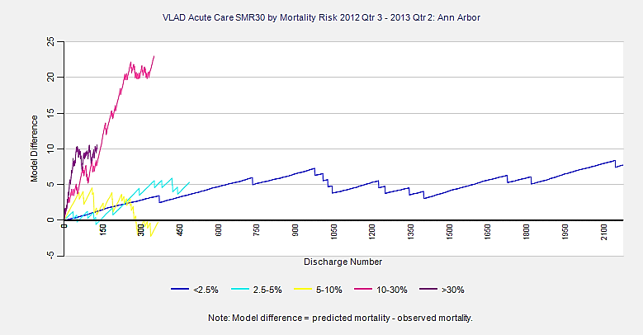
Notes:
RF
Here you see a few examples of SPC charts that show you performance over time for the acute care 30-day risk adjusted mortality.
In the upper left, you see a hybrid XMR chart. It displays the SMR30 measure for each of the measured quarters, along with the VA average and control limits.
The bottom left SPC chart is called an exponentially weight moving average chart. Because EWMA is more sensitive to small persistent changes than the hybrid XMR chart, it is often used as a companion of the XMR.
The upper right chart is a variable life adjusted display or VLAD chart. The VLAD charts give a visual display of the collective diﬀerence between predicted and observed measures over time. Better than predicted outcome will be represented by your line being in the green or blue (or above in this example). Worse than predicted outcomes will see your facility line drifting downward into the yellow and red areas.
The last graph in the lower right is also a VLAD but it illustrates performance broken down by predicted risk.
If you want more information on SPC charts you can go to the FBA SharePoint site at http://fba.vssc.med.va.gov On our May FBA Monthly call, we did a presentation on SPC charts and have posted the slide deck from that presentation there. The link to the FBA SharePoint is in the speaker notes from today’s presentation which you can download using the button above my head.

Slide 44
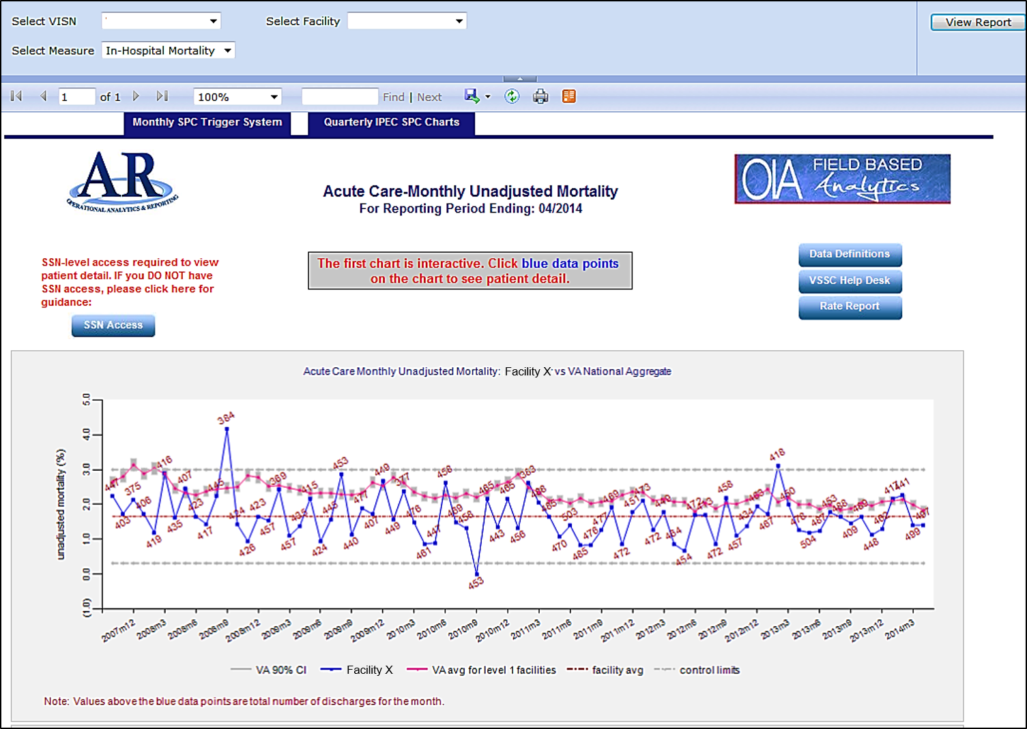
Notes:
RF
The previous SPC charts were created using the IPEC quarterly measures. Because these risk adjusted measures are only reported quarterly, we created these monthly SPC charts for unadjusted mortality and length of stay to use as surrogate measures between reporting periods. These charts are updated monthly using data from the CDW and using IPEC business rules.

Slide 45
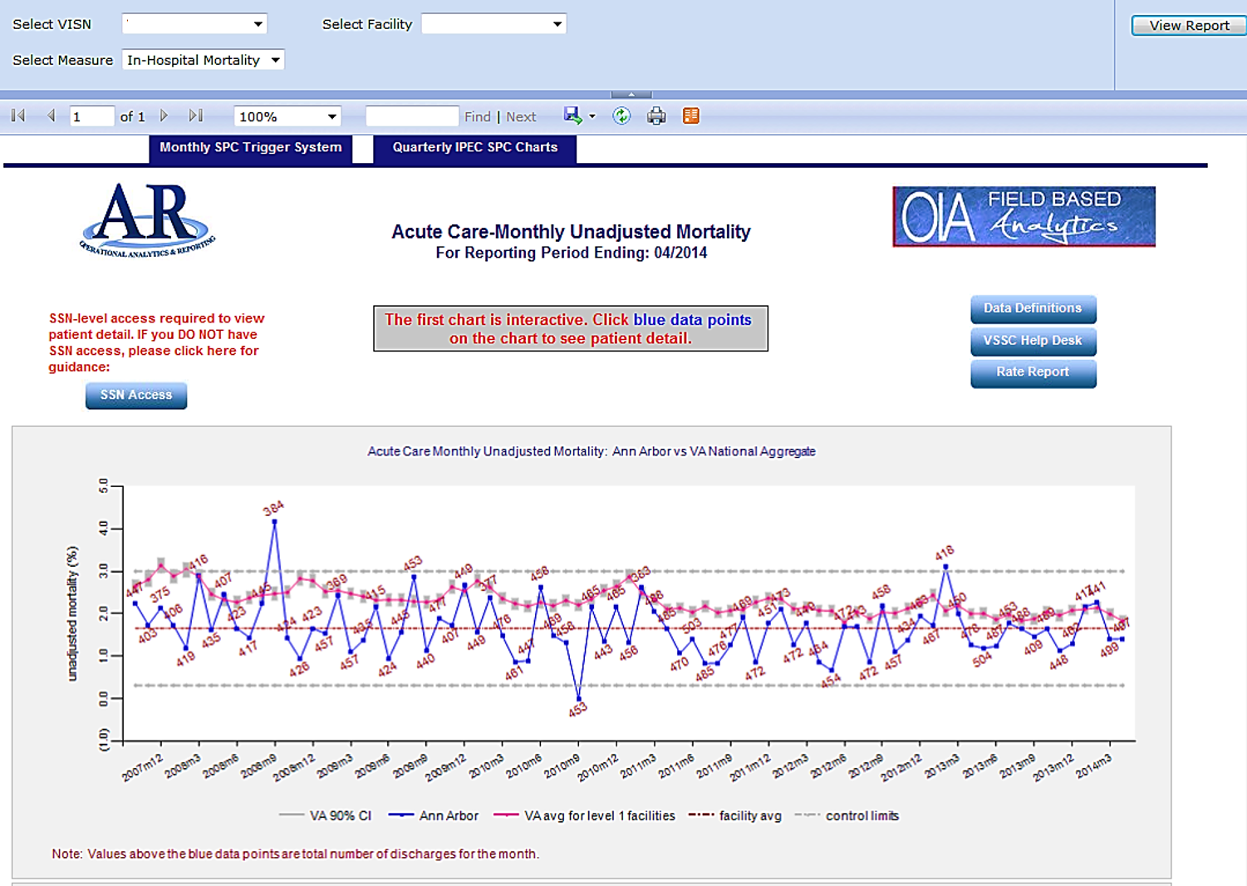
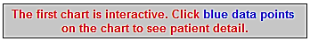
Notes:
RF
One new feature on these monthly SPC charts is when you click on one of the blue dots, which represent the measure value for a given month, you will be taken to a patient level drill down report for the discharges that month. Provided of course that you have PHI access on the VSSC products.

Slide 46
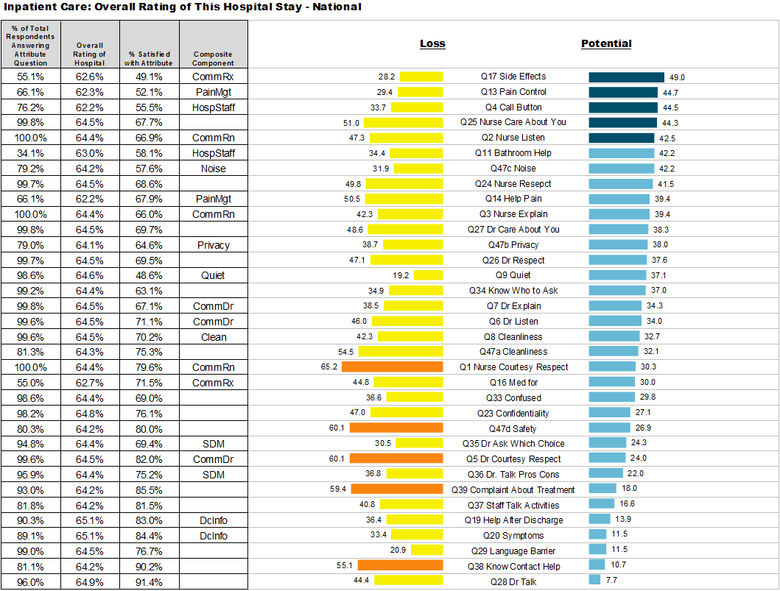
Improvement
tools for
patient satisfaction
Attributable
Effects
Reports
Notes:
YL
For people interested in identify opportunities to improve patients perception of hospital care, you may find it helpful to review the Attributable Effect Reports put together by the Office of Performance Measurement. This report is available at the VA national, VISN and facility level.
I’ll bring your attention to the colored chart areas.
The column “Loss” shows the relative importance of Inpatient SHEP questions in keeping patients who are happy with the hospital care to continue remaining happy. The orange bars highlighted the most important areas for a specific facility or VISN.
The column “Potential” shows the relative importance of SHEP questions in turning patients who are not happy with the care received to become happy. Similar to the Loss column, the 5 dark blue bars highlight the most important items to focus on for the facility.
A more detailed explanation about the charts and the data presented on the chart can be found in the rest of the document.

Slide 47
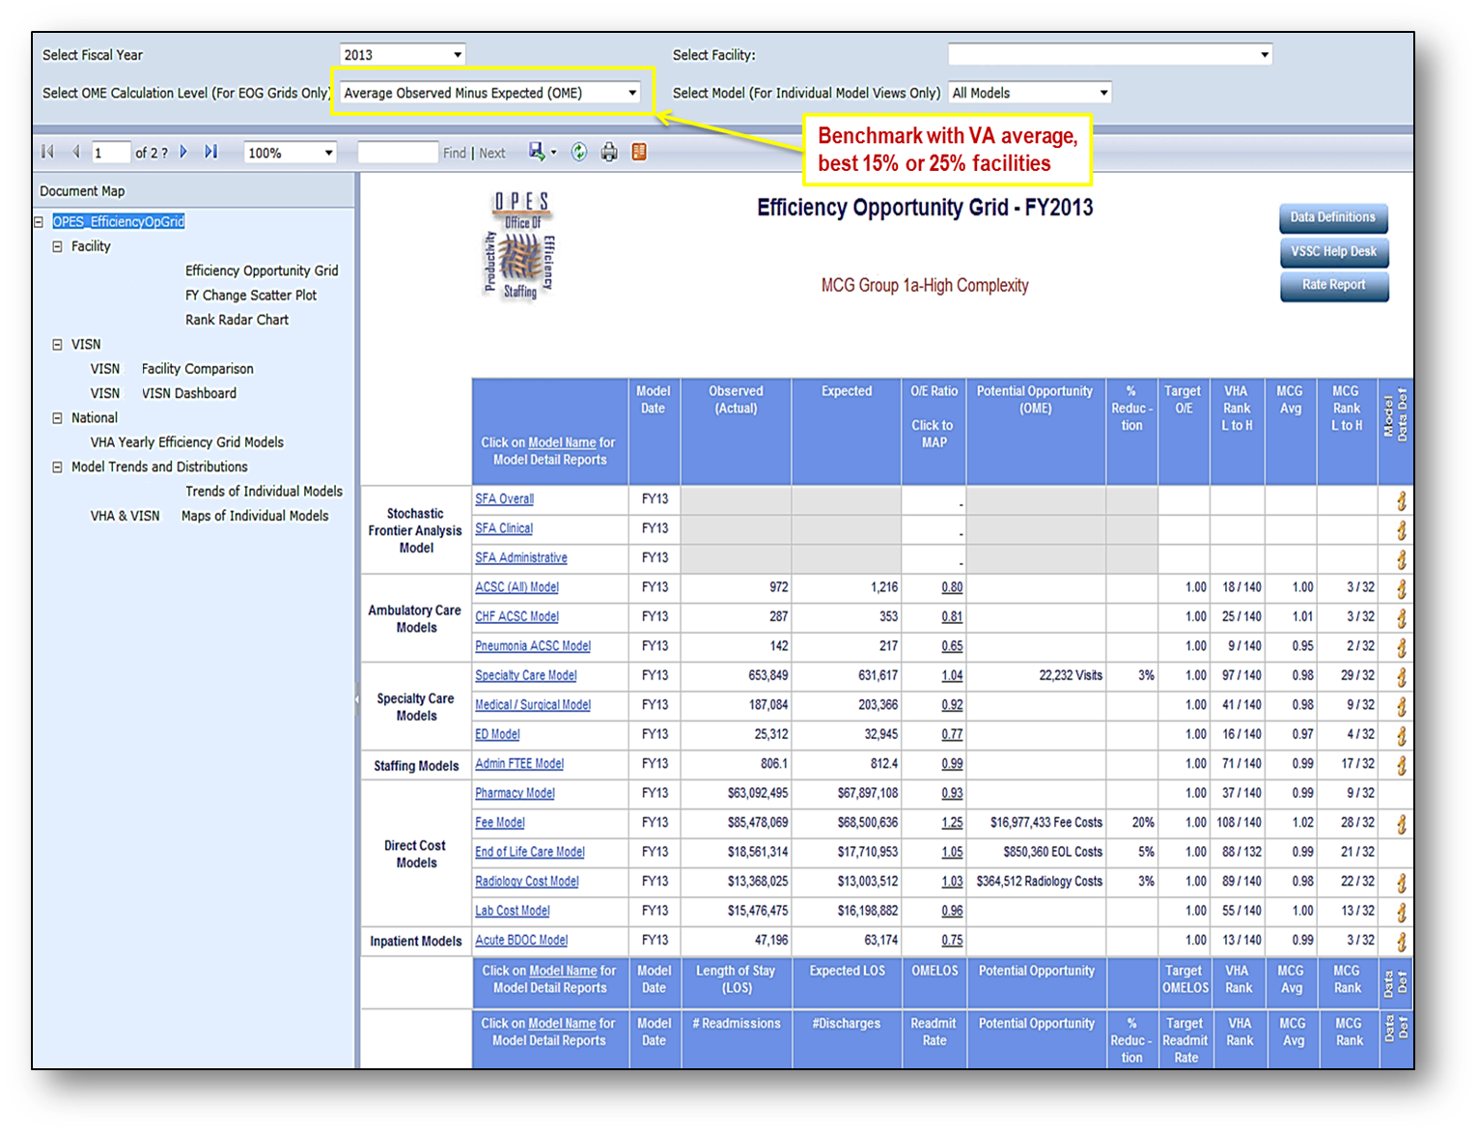
Efficiency
Opportunity
Grid
Notes:
YL
This is a snapshot of OPES’s Efficiency Opportunity Grid. Like other reports built by Reporting Services, there are a series of filters to select facility and time you’d like to review.
For this specific report, facility will have the option to select whether they want to benchmark with the VA average, or the best 15% or best 25% in the VA.
In the center is the 16 efficiency models prepared by OPES. For each model, it lists the actual cost or encounters with the expected cost or encounters and the opportunities available to improve efficiency.
On the left are specific reports available at the facility and VISN level and additional tools for different purposes

Slide 48
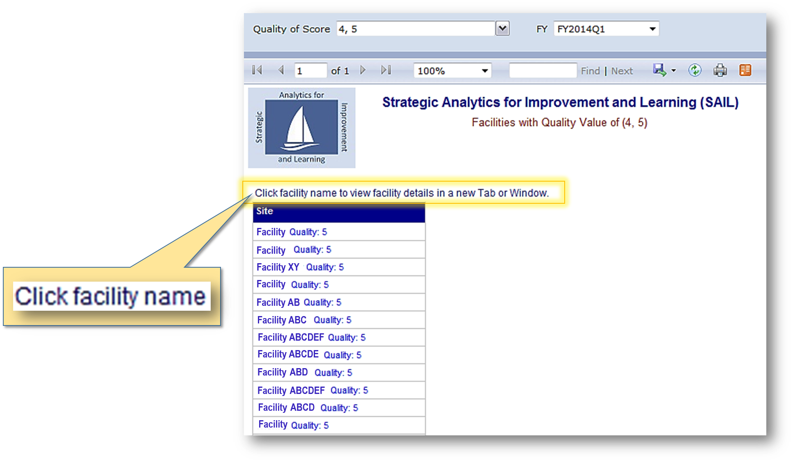
Filter facilities by
Star rating in Quality
Notes:
YL
If you still remember, there are three blue button on the main page of the SAIL report, each returns a list of facilities for different purpose.
This is the report that return a list of hospitals with selected Quality Star designation.
What’s show on the screen is a list of hospitals where received 4- and 5- Star designation in FY2014Q1.
The facility names are hyperlinked. Click on the name will open the facility’s repot.

Slide 49
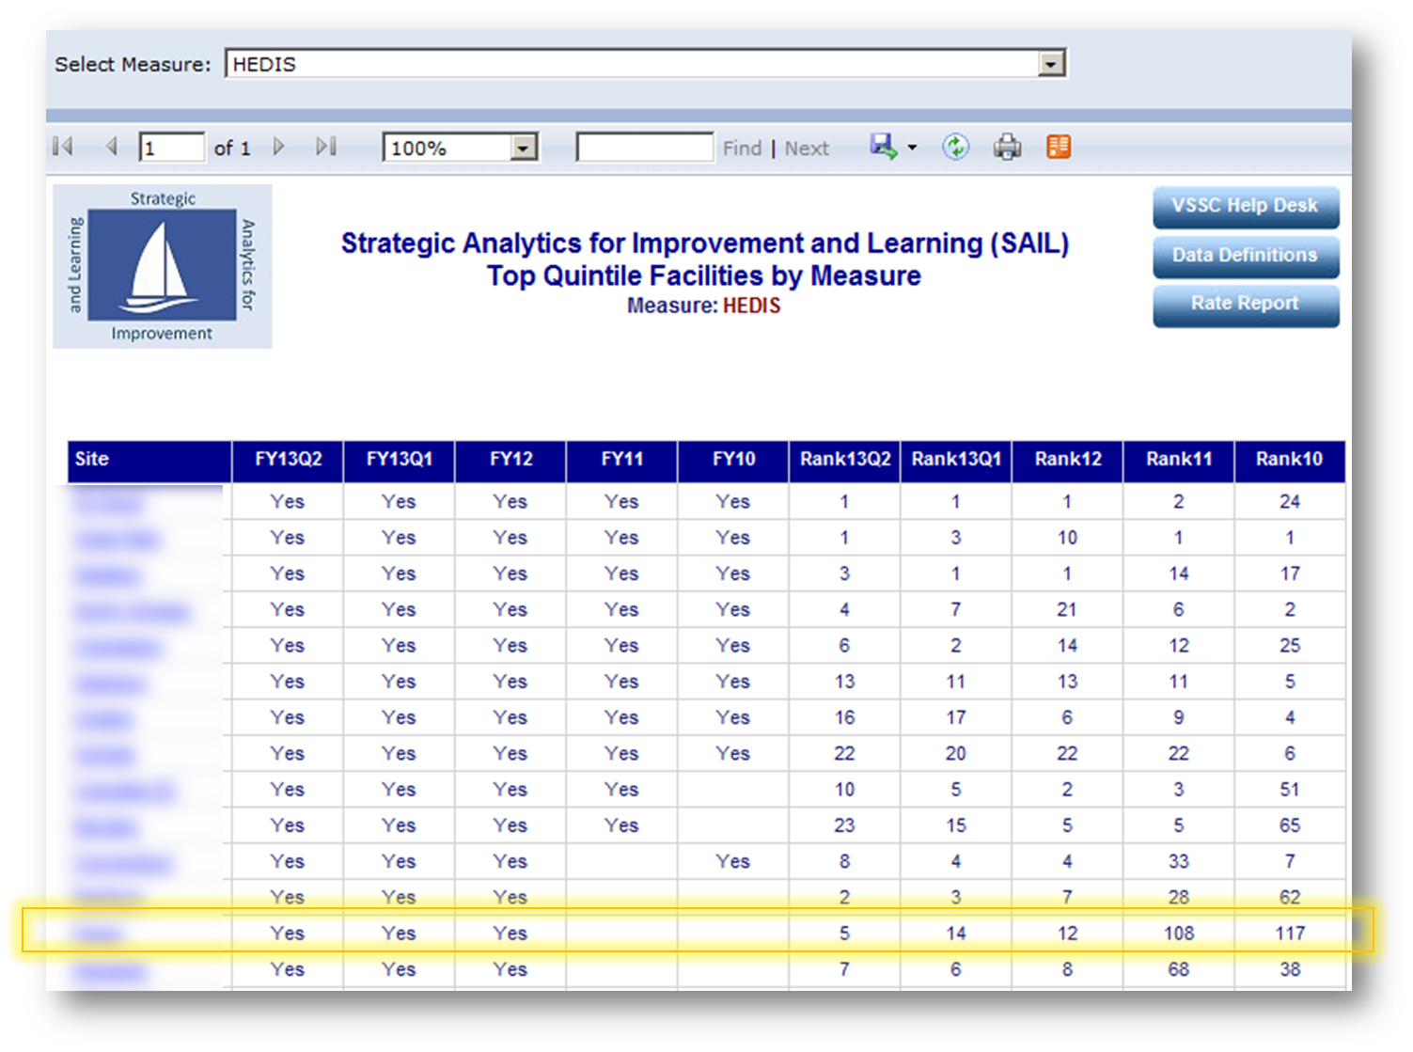
Identify top
quintile facilities
of individual metrics
Notes:
YL
This is another report that return the list of hospitals whose selected metric is in the best 20% in the most current reporting period.
Here we see a list of hospitals whose HEDIS score is in the best 20% in FY13Q2. The table also list whether the facilities were also in the best 20% for HEDIS in prior reporting periods and their numeric ranks in the VA.
This table is helpful if you have improvement opportunity in specific areas and you’re interested in getting touch with facilities doing well in these areas.
There are two groups of hospitals you may want to get in touch - those always doing well and those making dramatic improvement over time. I would think the latter may be able to share some great stories and strategies than the former. For example, the highlighted facility appears to improved from #117 in FY2010 to #5 in the VA. Some of the things they’ve done to improve the care process may be helpful lessons to learn from.

Slide 50
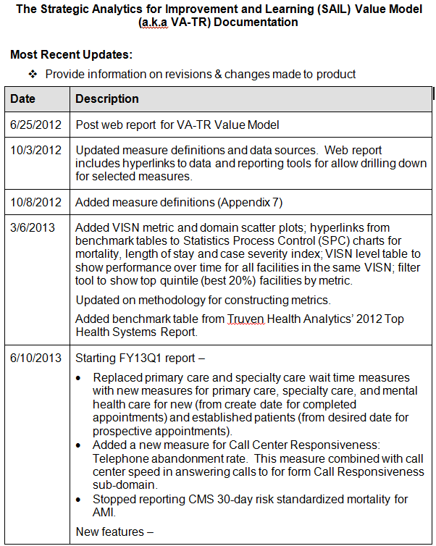
Data Definition Document
Notes:
RF
On every page of the SAIL report, you can access a comprehensive data definition document that provides information including
Purpose / rationale of SAIL and a description of its development
All of the individual measures along with the corresponding data sources and frequency of refresh
Directions for using product
Methodology updates and new features with each release
Self-paced training web site

Slide 51
Poll Question
How often do you access the SAIL report?
  Daily
  Weekly
  Monthly
  Quarterly
  I am afraid of SAILing
Notes:
RF
Time for our third and final poll question.
How often do you access the SAIL report?
Daily
Weekly
Monthly
Quarterly
I am afraid of SAILing
To answer this question, use the blue polling icon above my head.

Slide 52
Determining “Improvement”
Did the hospital improve on the metric itself irrespective of rank? (assuming it had realistic room to improve)
Did the hospital improve on both the metric and the rank?
(we get the permutations)
Notes:
RF
So how do you use SAIL to determine improvement? I think it is important to look not only at your ranking to determine improvement but also at the movement in the measure itself. Remember that middle percentile range for 3-star hospitals is between 30 and 70 percent. So it is conceivable that a 3-star facility could start around the 69th percentile and over time drop to 31st percentile but still remain a 3-star facility. So clearly the measure is not showing improvement but that is not reflected in the star rating.
So you really need to look at the different permutations associated with your ranking and the direction of change in the individual measures.

Slide 53
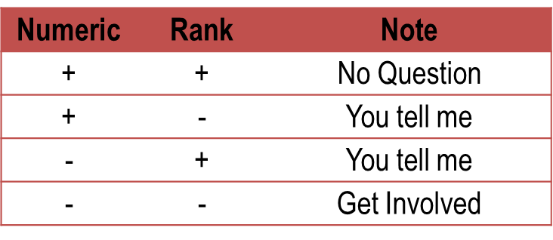
Determining “Improvement”
Acknowledge/reward hospitals that improve numerically and by rank
Notes:
RF
Let’s look at the different permutations.
If your ranking has gotten better and measures have gotten better, there is no question that you are improving.
If you ranking has gotten worse and the values have gone in the wrong direction, there is also no question – you need to get involved in improving in those areas.
But we also see these other 2 permutations. If your number actually gets better, but your ranking actually gets worse it probably means that even though you have improved, the rest of the VA is also improving but at a faster pace. Conversely, if your number actually gets worse, but your ranking gets better, it probably means that even though you see a decline in the measure, the rest of the VA is also declining but at a faster pace.
So it is important to understand these different scenarios and act when you need to but also acknowledge/reward hospitals that improve numerically and by rank

Slide 54
Focus on What’s Important
Focus on most important issues to achieve greatest impact
Involve multi-disciplinary partners
Activities to help prioritize efforts:
  Review data collected during assessment
  Guiding questions
  Criteria for considering priorities
  Process to select priorities
  Discuss and finalize priority issues
  Communicate and execute priorities
Notes:
YL
Here are some of the suggestions from the literature about quality improvement
Focus efforts and resources on the most important issues to achieve the greatest impact
Involve multi-disciplinary partners (leaders and stakeholders) to get holistic approaches and minimize silos
Several activities could help to prioritize efforts
Find a skilled, neutral facilitator
Have the team review data collected during assessment of needs and resources
Prepare guiding questions
Decide the number of priority to work on, with limited resources, not everything can be a priority
Define the criteria for considering priorities
Decide the process to select priorities
Have the team discuss and finalize priority issues
And finally communication and execute priorities
Let’s see how often you all access the SAIL Report

Slide 55
Poll Results
How often do you access the SAIL report?
  Daily
  Weekly
  Monthly
  Quarterly
  I am afraid of SAILing
Notes:
YL
Ad-lib to the audience results, then advance to move on.

Slide 56
Poll Results
How often do you access the SAIL report?
  Daily
  Weekly
  Monthly
  Quarterly
  I am afraid of SAILing
Notes:
(Click to cue the studio to move on)

Slide 57
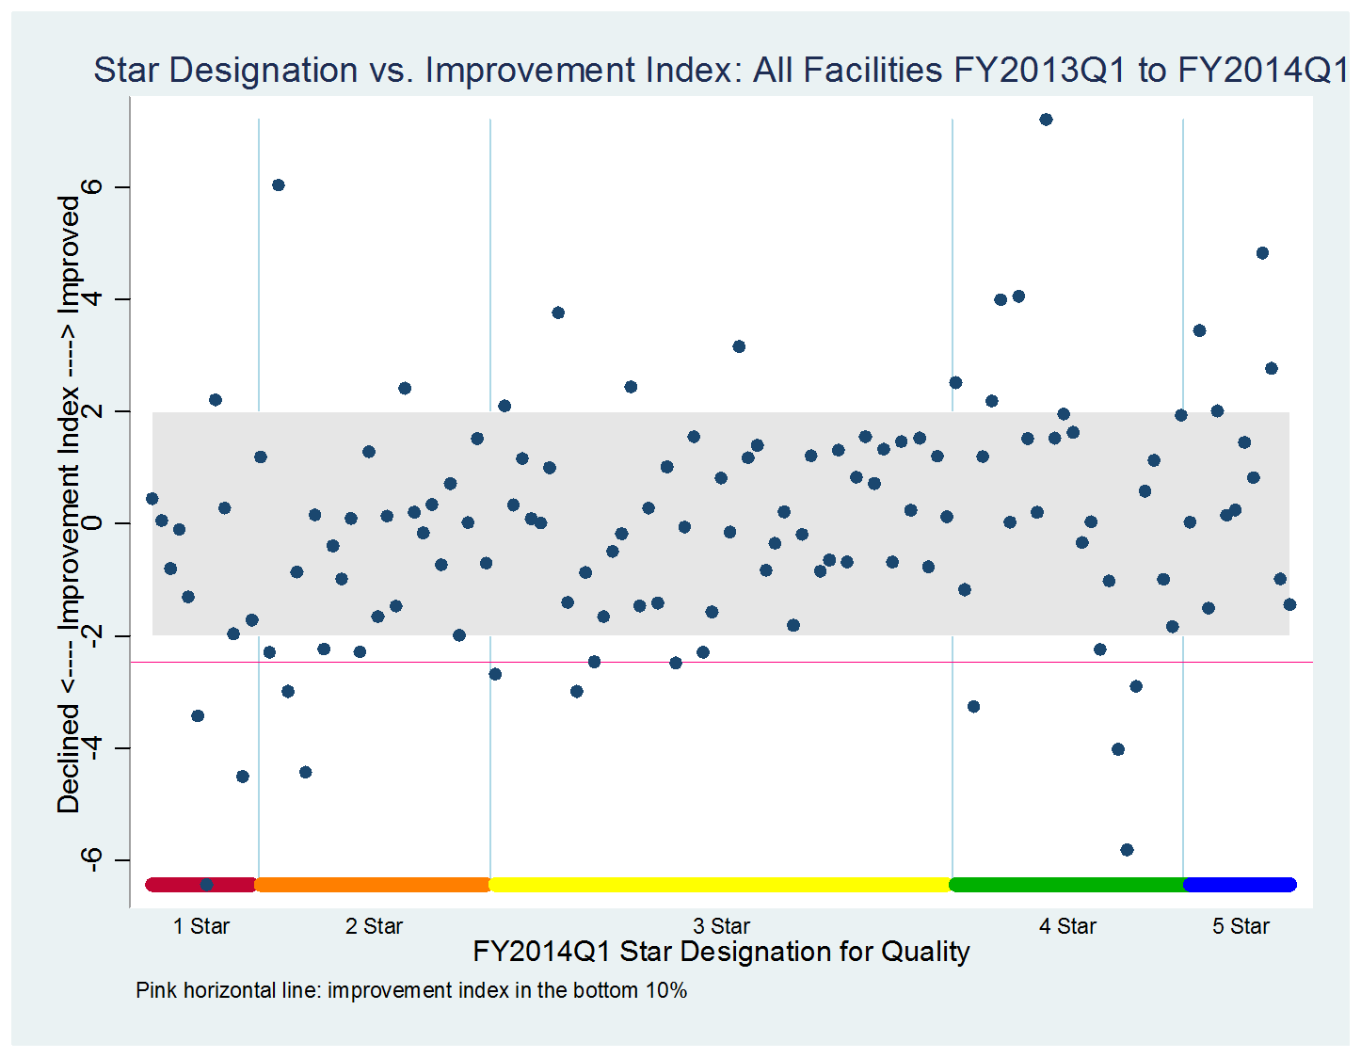
Facilities with small change in overall quality; about 60%
of facilities
Notes:
YL
At this point, most part of the SAIL report is focusing on the relative performance of hospitals. Like Ron has show you before, improvement should consider both relative and absolute changes.
Our office is working on a few projects to find ways to display improvement. Here I’m going to show you a couple examples.
The First on the screen is a plot of Star designation vs. Improvement Index.
Here the improvement index on the Y-axis is a score combining the changes in the raw metric values and changes in relative metric ranking. A positive improvement index suggests improvement and a negative value suggests decline in performance.
The X-axis is the Quality star designation in the most recent quarter. The dots represent individual hospitals.
We put a large gray area in the center, which covers about 60% of hospitals. For these hospitals, we’re not certain whether the changes are real negative or positive.
I’d like to bring your eyes to the upper right corner where we have several 5-Star hospitals above the grey area. Theoretically, 5-Star hospitals would have less room than other hospitals to make additional improvement. It’s amazing to see we have 5-Star facilities that continue to strive to make additional improvement.
On the other hand, we’ll also worry about facilities below the grey area or the pink line. It’ll be important for these hospitals to get a good understanding of where the opportunities exist and take actions to make improvement. Or they may not be able to sustain their performance or will be a risk of further deteriorating in performance.
Improvement Index – consider relative performance and change in metric value over time

Slide 58
Notes:
YL
This is another version of improvement index, where we use each VISN or facility as its own benchmark.
The Y-axis is the average percentage point changes between 2 time points, in our example, FY2010 and FY2014Q1.
The X-axis the Quality composite score distribution or the Star designation.
Again, we’re see some high performing facilities are able to make additional improvement over time, despite the smaller room for making additional improvement.

Slide 59

Notes:
RF
The last thing we want to highlight is the newly released website called RAFT – Reporting and Field Analytics Training.. The goal of RAFT is to provide a user friendly centralized location that will provide analytics training for the field on how to use reports, data, products and tools. This site incorporates all VSSC training, FBA training, and training from other sites and program offices.
But what I want to point out is under Case Scenario Training, you can find a couple of educational modules on individual measures used in SAIL. They provide detailed information on measure definition, data sources, tools for drill down and references for improvement.
Here you can also find additional training on SAIL in the form of webinars and PowerPoint presentations. The link to RAFT is in our speaker notes and I encourage you to check out the site:
http://raft.vssc.med.va.gov/
You may also want to check out the VeHU presentation on RAFT that was recorded recently, titled “Taming the Data Beast - Finding VHA Data and Using It Effectively in Your Role.” You can do that by entering “RAFT” into the search box from the On-Demand area when you enter the campus. In the session, you will learn more about the development and use of the RAFT site.

Slide 60

Ask the Presenter
Notes:
We are here today to answer your questions. If you haven’t already, be sure to submit yours using the orange “Ask The Presenter” icon. We’re going to show a brief video and be back to take your questions.

