Slide 1

VHA Innovation
Enterprise Implementation Projects
Allison Amrhein
Kit Teague
Notes:
Rosie intro- Use twitter hashtag: #VAInnovates- Moderator intro Kit Teague and Allison Amrhein (reads bios)- welcome Allison
Ad lib thanks to Rosie
Let’s get started with some fun interaction. Using the red chat button above my head to tell me how you define “innovation” and “implementation”. Anything goes, so be honest and share. We’ll come back to your answers in a bit during a social media check in with the Director of Training Strategies and VeHU social media correspondent, Becky Monroe.

Slide 2

Poll Question
Who do we have participating in the session today?
    Clinicians
    IT staff
    VHA Program Office staff
    Other
Notes:
We’re going to move on with a bit more fun.
To answer this question, use the blue polling icon above my head. We’ll move on and come back to your results in just a moment.

Slide 3
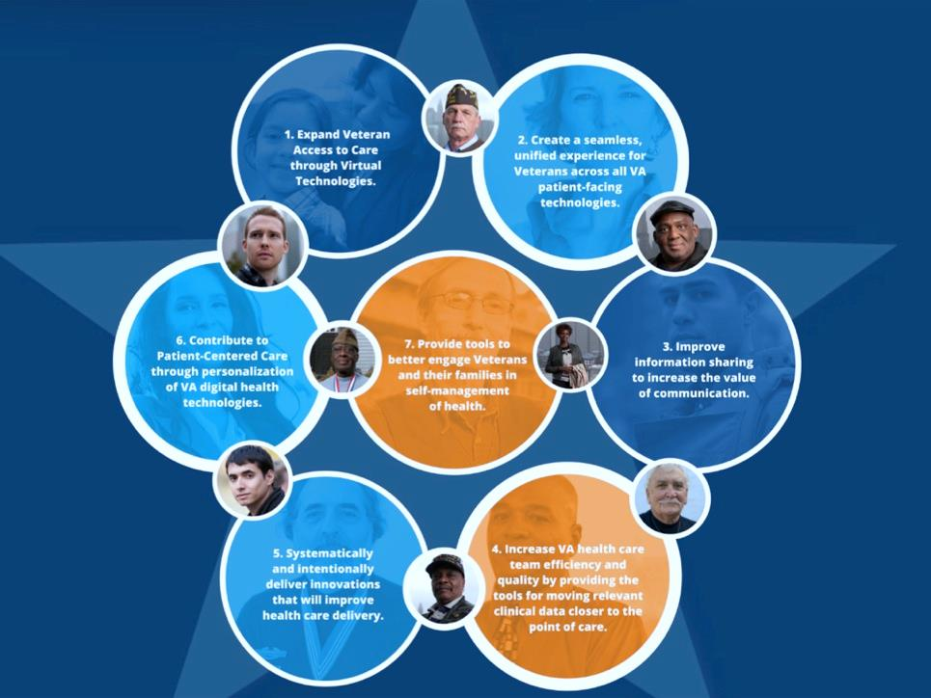
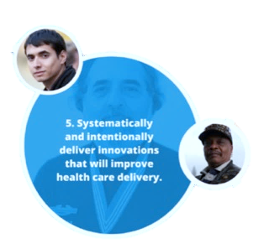
Notes:
Allison- the office of Connected Health has 7 aspects to its mission and innovation is mentioned in #5 in this graphic:
(click for animation)
Systemically and intentionally deliver innovations that will improve health care delivery; which is exactly what we aim to do through our 3 innovation portfolios: grassroots, strategic and laboratory.
The grassroots portfolio is home to the employee innovation competition, where you, VA employees, submit innovation ideas that are narrowed down from thousands (last year there were around 4000), then to around 100 and finally to around 20 that are eventually piloted. The industry portfolio is home to the industry innovation competition which follows another process to bring in academia and the private sector to pilot innovations to solve some of VA’s highest needs. The laboratory portfolio consists of the innovation sandbox, which allows software developers a safe place to “play” to see how their product interacts with VistA test data.

Slide 4

Notes:
Allison- Let’s introduce the VHA Innovation Program before we move on further. The Innovation Program is located under the Office of Connected Health & the Office of Informatics and Analytics.
The office of Connected Health focuses on the collection of technologies that enable the extension of the health care relationship beyond the traditional in-person encounters that for so long have been the centerpiece of patient/provider interactions.
Connected Health technologies include telehealth, telemedicine, patient portals, mobile health applications (mHealth), wearable monitoring devices and other technologies that connect patients to their health care team or health resources.
In addition to the innovation program, the office of connected health also includes the web and mobile health and myhealthevet program offices.

Slide 5
Poll Results
Who do we have in the audience today?
  Clinicians
  IT staff
  VHA Program Office staff
  Other
Notes:
Allison- Now let’s pause for a moment and take a look at your poll results.
Ad-lib to the audience results, then advance to move on.

Slide 6
Poll Results
Who do we have in the audience today?
  Clinicians
  IT staff
  VHA Program Office staff
  Other
Notes:
Click to Cue for the studio to move on

Slide 7

Notes:
Allison- As you know, the title and topic of this session today is innovation enterprise implementation, so let’s dive back into it with those definitions I asked you at the start of the session.
Allison- According to Meriam Webster, innovation is defined as “The application of better solutions that meet new requirements, in-articulated needs, or existing market needs.” Today’s session isn’t just a discussion or display of innovation; it is focused on implementing successful innovations out into our “existing market”- the VA field.
Ad lib check-in with Becky- let’s do innovation first. Becky? What about implementation?

Slide 8

Plan
Execution
Implementation
Notes:
Again according to Meriam Webster, implementation is defined as “the realization of an application, or execution of a plan, idea, model, design, specification, standard, algorithm, or policy.” Where a plan meets execution. We are trying to do just that with some of our most successful innovation projects.

Slide 9

VHA Vision
Patient-centered
Engaged, collaborative teams
Integrated environment
Prevention & education
Population health
Notes:
Allison- Every innovation project chosen for pilot and enterprise implementation is part of a bigger picture. Let’s start at the top of the chain; The innovative projects we’ll discuss today specifically relate to the following aspects from VHA’s vision:
VHA will continue to be the benchmark of excellence and value in health care and benefits by providing exemplary services that are both patient centered and evidence based.
This care will be delivered by engaged, collaborative teams in an integrated environment that supports learning, discovery and continuous improvement.
It will emphasize prevention and population health and contribute to the nation's well-being through education, research and service in National emergencies.

Slide 10
Connected Health Vision
Seamless, unified experience
Information sharing, improved communication
Patient-centered care via digital tech
Tools to engage Veterans
Increase team efficiency by providing tools
Notes:
Allison- The office of connected health’s vision also directly relates to our innovation projects:
Providing a Seamless, unified experience
Enabling Information sharing, improved communication
Providing Patient-centered care via digital technology
Providing Tools to engage Veterans
And Increase team efficiency by providing helpful tools

Slide 11
Innovation Program Vision
Experimentation & testing
Nurture innovation
Improve efficiency
Transform ideas into prototypes
Notes:
Allison- Finally, even more trickle down occurs and aspects of the innovation program’s vision can be seen throughout all our projects:
Experimentation & testing
Nurturing innovation
Improving efficiency
Transforming ideas into prototypes

Slide 12

VHA Vision
Innovation Program Vision
Connected Health Vision
Notes:
Allison- When you put the visions of each group together, they all overlap to produce a few common elements that are crucial to success on each level.

Slide 13

Efficient, seamless & collaborative environment
Create and provide patient-centered tools
Improved information sharing and communication
Innovation Enterprise Implementation Projects
Notes:
Allison- These common elements include establishment of an efficient, seamless & collaborative environment, creation and provision of patient-centered tools, and improved information sharing and communication. With these elements in mind, the Innovation Program chose 7 innovation projects in 2013 to move forward from a pilot or prototype phase, into a broader production environment. We call these our Innovation Enterprise Implementation Projects.

Slide 14

How Do We Choose?
Notes:
Allison- Of course the projects go through a more critical review to be chosen. The ISB is given nominations and has the ability to suggest a project of their own. After a vote, the nominated projects go through to VHA senior leadership for a final recommendation. They provide a recommendation on which projects to move forward to the VA Center for Innovation. The VHA Innovation Program discusses funding options with VACI and they accept/decline the recommendations. Final projects move forward at that stage for development and eventually deployment.
Before I bring on my fellow innovation coordinator to introduce the 2013 innovation enterprise implementation projects, let’s have a check-in with Becky on the social media chatter right now. Don’t’ forget to use the hashtags #vVeHU and #VAInnovates when tweeting using the icon above my head.
Becky what’s the major trend right now on twitter during this session?

Slide 15
2013 Innovation Enterprise Implementation Projects
RAPTOR
AWARE (Alert Watch and Response Engine)
Chemotherapy Ordering and Management System (COMS)
Remote Mental Health Intake and Assessment (e-Screening)
Advanced Environmental Controls for Veterans with Severe Disabilities
Multi-Sensory Environment for Special Care Units
TBI Clinical Decision Support (CDS)
Notes:
Allison- Let’s dive into the 2013 projects and bring out my colleague and co-presenter today, Kit Teague.
Ad-lib greeting and entrance
Kit- The first round of Innovation Enterprise Implementation Projects includes the following 7 efforts:
Radiology Protocol Tool Recorder (or RAPTOR)
Alert Watch and Response Engine (or AWARE)
Remote Mental Health Intake and Assessment (or e-Screening)
Advanced Environmental Controls
Multi-Sensory Environment for Speciality Care
TBI Clinical Decision Support
And the Chemotherapy Ordering and Management System (or COMS)
Allison- During the remainder of the session today, we’ll go into detail about each of these important projects; including the latest status of each and we’ll also announce the 2014 projects chosen so far this year to start work very soon.

Slide 16
RAPTOR
Purpose
Automating a paper-based, error-prone manual process
Goal
Deploy RAPTOR at four clinical sites over 24 months
Status
Recently started user acceptance testing
Project Details
A web-based imaging protocol tool that records decisions in VistA/CPRS.
Notes:
Kit-First up is RAPTOR.
RAPTOR was originally a 2010 employee innovation competition winner, from a radiologist out of Seattle.
RAPTOR is tailored to optimize advanced medical imaging protocoling at VHA facilities.
Currently, VA Radiologists review all clinical orders for advanced diagnostic imaging, such as CTs or MRIs and assign specific protocol instructions directing how each examination must be performed so that the clinical questions are answered.
This is a highly error-prone, paper-based process that can takes weeks to complete.
Allison- By leveraging open source tools and standards, RAPTOR has capitalized on opportunities for interactivity between VHA information systems to maximize radiologist protocoling effectiveness while preserving productivity and simultaneously assuring safety through automated identification of risks of some imaging studies for some patients. RAPTOR leverages VHA’s Class I Medical Domain Web Services (MDWS) to interact and extract information from Veterans Health Information Systems and Technology Architecture (VistA). Clinicans put an imaging order into CPRS. The order shows up in RAPTOR. The radiologist reviews the order and protocols. The decision and basis for decision is recorded in VistA/CPRS via RAPTOR.

Slide 17
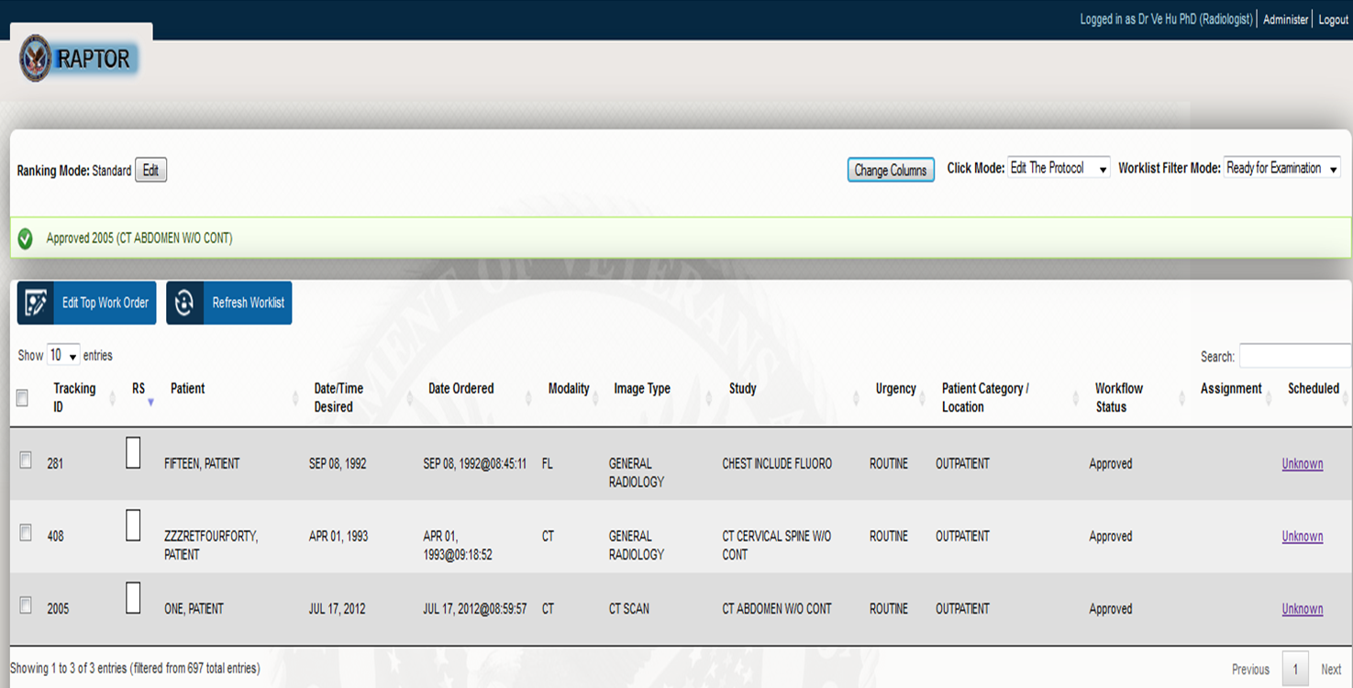
Notes:
Kit- Here you can see the RAPTOR worklist dashboard.
Excuse me Allison, I’m going to scoot on over here to get a closer look.
This is main screen that radiology staff see when attempting to manage local patient workflow.
This dashboard clearly displays the patient’s name, the date the study was ordered and is due, the type of image and study ordered, the level of urgency, and workflow status of the order making it easy for radiology staff to manage patients.
The flexibility of the RAPTOR dashboard is very special feature of the software.
Physicians can organize by specialty, priority, etc.
Allison- The goal for RAPTORs enterprise implementation is to first deploy the software at 4 sites, Puget Sound, Fresno, Tucson and Portland, in a 21 month period. In the initial prototype for RAPTOR, it had not been on the live VA network, so a great deal of additional development and work has to go into the new effort to deploy it on the network and see how it performs before even further deployment nationally.
The RAPTOR team recently completed it’s 3rd milestone and recently finished UAT planning and actually started UAT with clinicians at each site.

Slide 18
AWARE
Purpose
Provide measurements and tracking of cancer-related diagnostic test results
Project Details
Tracks and responds to abnormal labs that lack timely follow-up
Goal
Pilot AWARE at Charleston and Long Beach VAMCs
Status
AWARE is slated to go into production in Charleston on June 30
Notes:
Allison- The second project is the Alerts Watch and Response Engine or AWARE. AWARE is a highly configurable software product to improve measurement and tracking critical diagnostic test alerts and follow-up actions for clinicians, and to provide system-wide data to key constituencies, such as patient safety managers.
AWARE can increase patient satisfaction by Improving Patient awareness, Increasing provider engagement;
Improving Quality of Care by providing a mechanism to consistently provide Follow-up to Abnormal Labs on a timely basis; and
Reduce cost by Improving staff efficiency and reducing organizational risk.

Slide 19
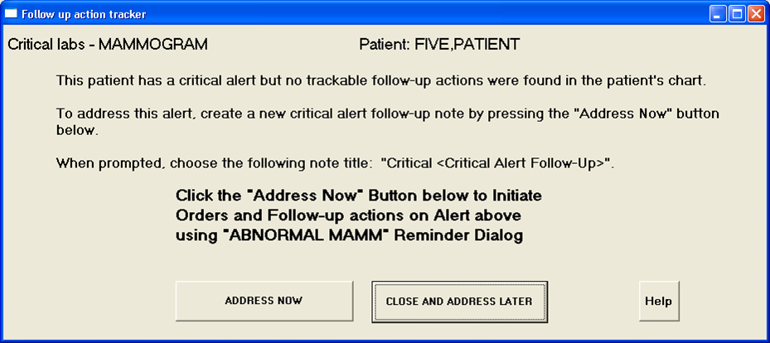
Notes:
Kit- A reminder tool, like the one shown here, appears if a critical alerts is detected in the CPRS tracking file, but no accompanying follow-up order is found.
If a provider chooses “Address Now”, a reminder dialogue box with health factor generation appears.
Again, AWARE was not tested initially in a VA production environment, so the deployment goal is for the software to be installed and tested in production at 2 sites: Charleston and Long Beach.
AWARE launched in Charleston on June 30th and is currently running smoothly.

Slide 20
e-Screening
Purpose
Accelerate enrollment for mental health care
Project Details
Web-based remote intake form for mental health assessments
Goal
Implement the application at 5 sites: San Diego, Los Angeles, Long Beach, Las Vegas, Loma Linda
Status
Software under development
Notes:
Allison – Next up is the remote mental health intake assessment form or e-screening. The e-screening application accelerates the process for enrolling patients into mental health care by using a web-based intake form to perform mental health assessments on returning OEF/OIF Veterans. The innovation enables clinicians to perform mental health screenings remotely.
Kit- This project was initially a 2010 industry competition effort.
Now, Over a 24 month period, the deployment team will work to implement this project in a production environment at five different clinical sites on the west coast.
The software is still under development at this time, with over 12 months left in the effort.

Slide 21
Advanced Environmental Controls
Purpose
Provides tools to better control inpatient surroundings
Project Details
Leverages touch screen, voice activation, sip n’ puff, head tracker, and eye gaze technologies
Goal
Deploy to 23 VHA SCI Centers over 3 years
Status
Completed the installations at Syracuse, Houston, and the Bronx. Hines installation will wrap up at the end of July
Notes:
Allison- The 4th project today is the advanced environmental controls. Advanced Environmental Controls were initially installed in 60 SCI beds at the Memphis VA Medical Center and piloted for one year as part of the 2011 VA Employee Innovation Competition. Advanced Environmental Controls aims to improve the quality of life for SCI Veterans by providing them with tools they need to better control over inpatient hospital surroundings. The project leverages touch screen, voice activation, sip n’ puff, head tracker, and eye gaze technologies to enable SCI Veterans to call for the nurse, adjust bed position, dial/receive telephone calls, control television settings, surf the web, and access electronic entertainment such as e-books and computer games.
Kit-The project team will create and coordinate customized equipment orders to meet the unique needs of each site based on their patient population and existing equipment, and will work with local Biomedical Engineering and SCI staff to coordinate installation and training on how to use the equipment.

Slide 22
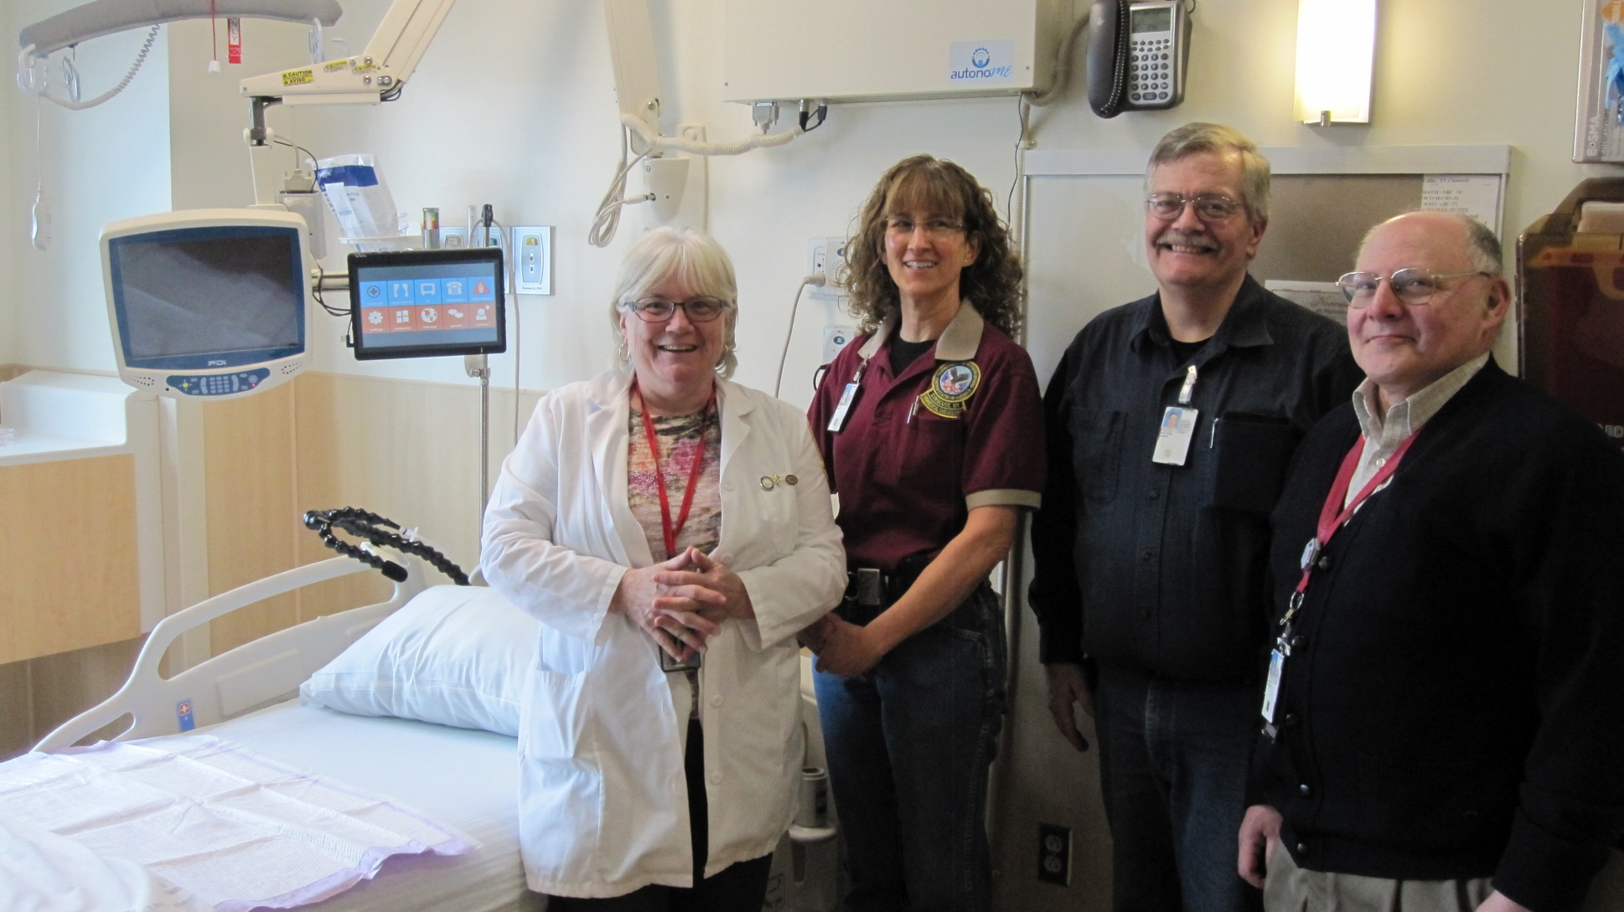
Syracuse VAMC ECU Team
Notes:
Allison- Advance Environmental Controls will first be deployed to four VHA SCI Centers in the first year and 19 VHA SCI Center over the next 2 of the 3 project years. In year 1, the SCI Centers at Houston, Bronx, Hines and Syracuse VA Medical Centers will be receiving the Advanced Environmental Control technology. Pictured is an environmental control unit and the awesome team at the Syracuse SCI Center.
Kit, I know you are the IC for this project, tell me more about the current status and project from your perspective.
Kit – This is a great project to be a part of, Allison.
Currently, we have completed the installations at Syracuse, Houston, and the Bronx and the Hines installation will wrap up at the end of July.
Right now, we are about two months ahead of schedule heading into the first option year.
I’ve had a chance to visit each of the sites we have installed this technology and the feedback I have received from both Veterans and VA staff has been overwhelmingly positive.
The Veterans I’ve spoken with are happy with the new level of independence this technology provides them.
Irrespective of their disability, Veterans are able to control their TV, adjust the bed and lights, make and receive telephone calls, and surf the internet all without the help of a nurse or another caregiver.
VA staff, such as nurses, are happy with the new technology as they believe it reduces the amount of time they spend assisting patients with routine tasks thus increasing their availability to provide clinical care.
This project is truly a win-win for both Veterans and VA staff.
Allison- thanks Kit it sounds awesome and I know you enjoy working as the IC for this project. We have a short video now on the ECU project. Take a look and we’ll be back in a few.

Slide 23
Multi-Sensory Environment
Purpose
Enhance treatment of dementia and Alzheimer’s disease
Project Details
The project leverages Snoezelen therapy
Goal
Install multisensory environment equipment at 53 clinical sites
Status
31 equipment installation sites (approximately 60%) are complete
Notes:
Allison- Another exciting non-IT project is the multi-sensory environment for specialty care units. This project also originated from the 2011 employee innovation competition. The project leverages Snoezelen therapy. A SNOEZELEN MSE incorporates a specialized selection of sensory equipment and materials that may help patients adapt their responses to sensory stimulation and to advance education and therapy goals. Each SNOEZELEN MSE is tailored to meet the needs of specific populations according to age and ability. The blend of sights, sounds, textures, aromas, and motion provide stimulation of the primary sensory systems and may be modified to meet each participant’s sensory needs.
Kit- The end goal here is to install multisensory environment equipment at 53 clinical sites.
We will train providers in the use of the equipment to provide Snoezelen Therapy to dementia patients at each facility, and train several users at each facility that can instruct other care providers in the best practices for providing care to dementia patients.
And equally as important, we will be collecting outcomes data to evaluate the impact of this project on key quality of care measures.
Multi-sensory Environment Innovation is in the tenth month of an 18 month implementation. As of July, approximately 60% of site installations are complete, and approximately 47% have gone through the three day dementia training course.

Slide 24

Multi-Sensory Environment Innovation
Notes:
Multi-Sensory Environment Innovation
Allison-
We have a short video on this fantastic innovation project. Check it out and we’ll be back in a few minutes.

Slide 25
TBI CDS
Purpose
Rapidly assess TBI treatment strategies and incorporate new clinical guidelines
Project Details
Create a clinical decision support (CDS) system collected from rehabilitation and TBI treatments
Goal
Deploy the CDS at 5 VA Polytrauma Rehabilitation Centers
Status
Development is underway
Notes:
Allison- Ad lib return from video.
The TBI clinical decision support application is next up. TBI CDS was originally a 2010 industry innovation. Now, in the enterprise implementation phase we will design, install, test, and train users on a customized rehabilitation-based TBI CDS system to treat Veterans in VA Polytrauma centers. The project also includes development and maintenance of a data dictionary, integration of the TBI CDS with VistA Computerized Patient Record System (CPRS) and an analytical statistical capability. In addition, the application will provide a web-based remote access function to assure that remote patients can access required forms through My HealtheVet.
Kit- This was the last of our 2013 projects to get started, but we are blazing ahead to deploy the software at 5 polytrauma centers in the first 12 months.
The second 12 months includes plans to deploy to an additional 20 polytrauma centers.
Development is still underway and moving forward for a fall 2014 release into VA facilities.

Slide 26
COMS
Purpose
Access and query the chemotherapy-related clinical data
Project Details
Automated tool enabling end-to-end tracking of chemotherapy regimen
Goal
Test the application in a production environment at Durham and Puget Sound VAMCs
Status
On track for fall 2014 deployment into VAMCs
Notes:
Allison- Finally, last but not least is the chemotherapy ordering management system or COMS. COMS was also originally a 2010 industry competition project. COMS is an automated tool that enables end-to-end tracking of a patient’s chemotherapy regimen including pharmacy orders, order templates, provider notes, end of treatment summaries, and a database of relevant information. Clinicians can use the tool to access and query the chemotherapy-related clinical data needed to meet a variety of reporting needs.
Kit- Like some of the other prototype applications, COMS wasn’t originally tested in a live production environment either.
The goal, of course, is to successfully make that happen at the Durham and Puget Sound VAMCs.
The Project is proceeding as planned.
The COMS deployment team has engaged OI&T in Puget Sound and Durham to discuss deployment of COMS system in fall 2014.
In addition, COMS will be presented at the 2014 Association of VA Hematology/Oncology conference in September.

Slide 27
Poll Question
Which project are you most interested in?
    RAPTOR
    AWARE
    Advanced Environmental Controls
    Multi-Sensory Treatment
    Other
Notes:
Allison- Ad lib poll
Again, to answer this question, use the blue polling icon above my head. We’ll move on and come back to your results in just a moment.

Slide 28
2014 Innovation Enterprise Implementation Projects
After Visit Summary
Mobile Distance Hearing Aid Application
Hazardous Pharmaceuticals
Park a Prescription
REVAMP
Veteran “X”
Notes:
Kit- Finally today, we’ll end with the exciting news on the 2014 innovation enterprise implementation projects that are in the pipeline.
Allison- read the project list

Slide 29
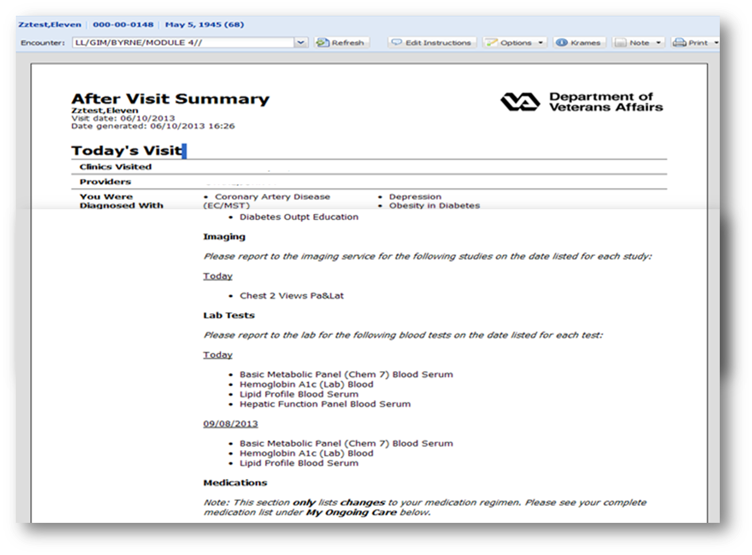
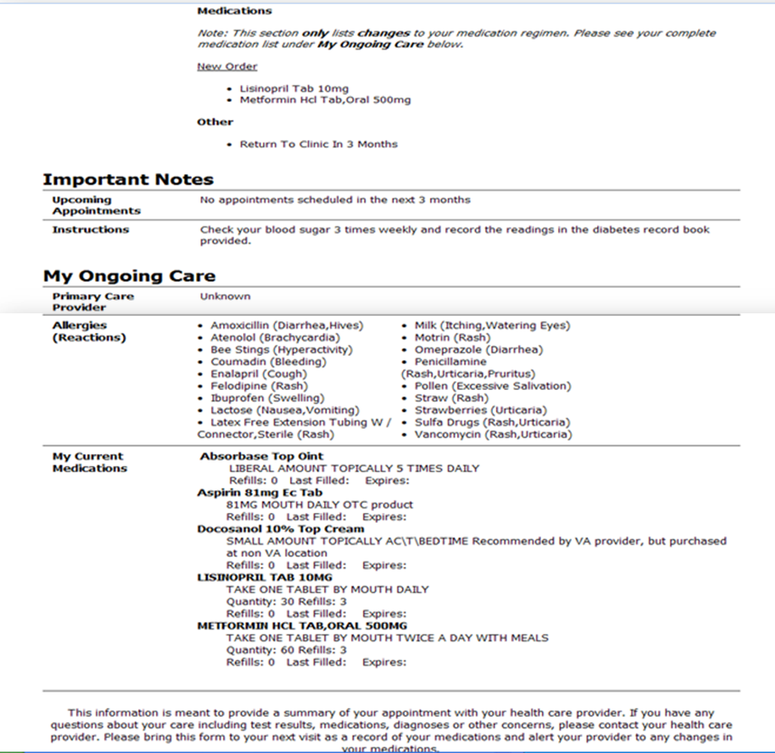
After Visit Summary
Notes:
Kit- AVS
After Visit Summary is a web-based tool that works with CPRS to summarizes key medical information from outpatient visits by automatically populating a patient-centered print out with diagnoses, treatment instructions, orders, lab results, medications, and future appointments.
I don’t know about you, but I could benefit from something like this.
When I go to the doctor, he tells me so many things during my visit (your overweight, get more exercise, eat right, blah blah blah). I can’t remember everything once I get home.
When I get home, my wife always asks me “What did the doctor say, honey?” My standard reply is “I don’t know something about my weight, exercise, blah blah blah.”
If I had something like AVS, I could just hand her the print out and be done with it. What a relief.
Kidding aside, this is a great project that has the potential to improve treatment plan adherence.

Slide 30
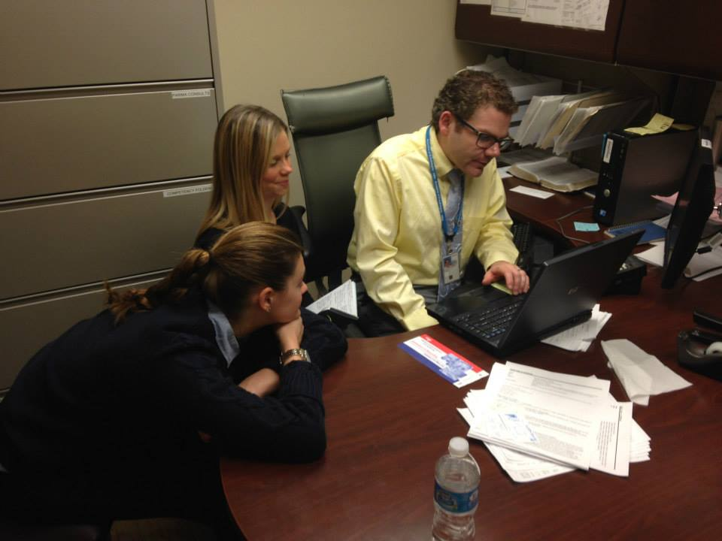
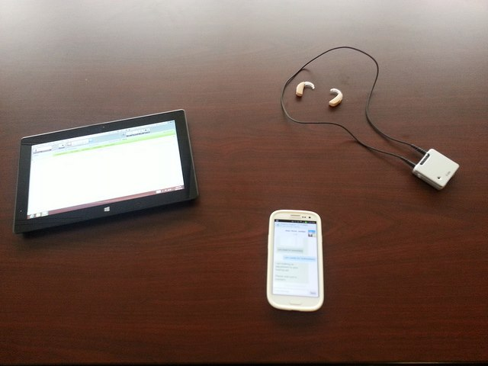
Mobile Distance Hearing Aid Application
Notes:
Allison-
Industry competition project
Pilot in cleveland
Connects patient on smartphone, android, app (or tablet) to their audiologist
Patient can be anywhere with wifi and it even worked on 4G and 3G, while the audiologist is at a CBOC or VAMC
Recently chosen and still under development to flush out the requirements but we are very excited about it.
The experience with the project was extremely positive and I cant wait for it to continue and hope to be part of it. The patients loved it and the time and effort it saved them.

Slide 31
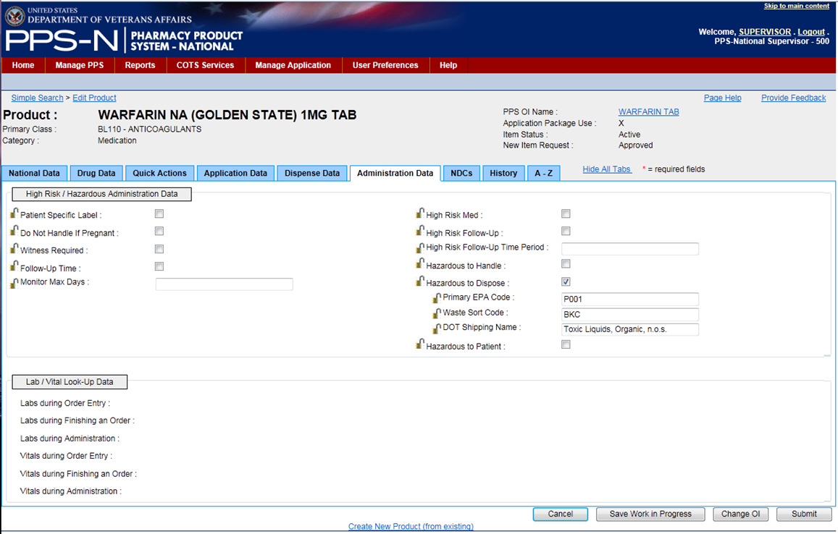
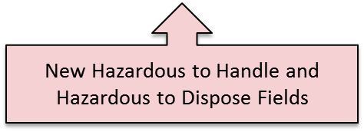
Hazardous Pharmaceuticals
Notes:
Kit- HazPharm
Currently, there are no uniform computerized warnings or flags in the VA healthcare computer system to identify hazardous pharmaceuticals in order to ensure proper handling or disposal.
This results in putting both VA pharmacy and nursing staff at risk of hazardous exposure and prevents proper dispose of hazardous drugs which can harm the environment and ultimately result in costly fines from the EPA.
The Hazard Pharmaceuticals innovation resulted in prototype modifications to several VA pharmacy-related systems in order to help VA staff identify potential handling or disposal precautions.
This is a great project that will ultimately improve VA staff safety and protect the environment.

Slide 32
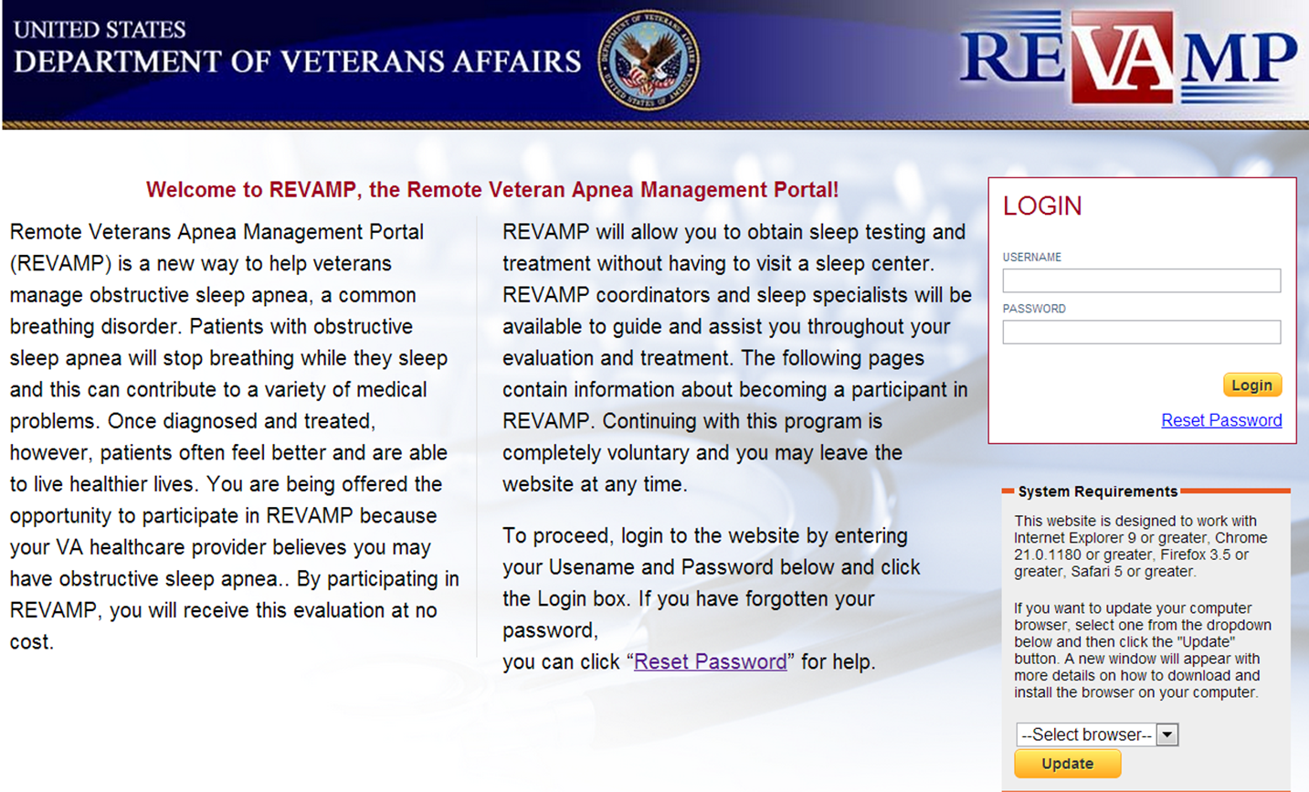

REVAMP
Notes:
Allison-REVAMP
REVAMP is A web-based clinical management pathway for veterans with obstructive sleep apnea. It allows for:
Validated questionnaires completed online- which eliminates paper forms, increases symptom reporting, accessibility of outcomes,
Online videos instructing Veterans how to perform their home sleep test, which replaces in-person instruction,
Treatment with auto-adjusting positive airway pressure (autoPAP), which eliminates the need for additional sleep testing,
Wireless transmission of home autoPAP data to REVAMP website, which enables patients and providers to monitor treatment results and allows remote pressure changes on home unit
In addition it includes the- Clinical management by phone calls and video teleconferencing, which increases clinical efficiencies; reduces patient travel and lost work hours and Auto-generation of progress notes and integration with CPRS, which increases clinical work-flow efficiencies

Slide 33
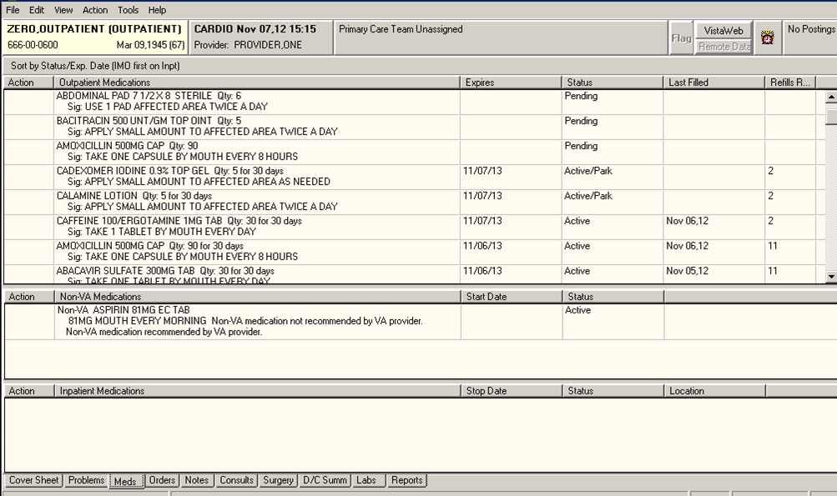
Park a Prescription
Notes:
Kit – Park an Rx
One of the limitations of the existing VA pharmacy computer system is that it does not allow a user to update a prescription without generating a fill.
Anytime a provider needs to update the schedule, dosing, number of remaining refills, or enter a new prescription, an order for a fill is automatically generated regardless of whether the prescription is actually needed.
This creates several problems.
First, it makes medication reconciliation nearly impossible.
Second, it confuses patients when they receive multiple bottles of the same medication and can result in medication errors.
Third, it creates a tremendous amount of waste and results in Veterans being charged for medications they did not request.
The Park a Prescription innovation resulted in prototype modifications to several VA pharmacy-related systems in order to allow providers to “park” a prescription, placing it in a “hold until requested by patient or provider” status.
This is a great project that will ultimately improve medication reconciliation in the VA and reduce medication errors and waste.

Slide 34

Veteran “X”
Notes:
Allison- Veteran X
This is a peer-led, Veteran-centered group that presents a scenario of a fictitious Veteran who has an abundance of social issues, including: mental illness, addiction, poor physical health, homelessness, economic hardships, and family issues.
Many Veterans do not understand the process of developing a treatment plan, and therefore have trouble playing an active part in establishing the goals and objectives of treatment. This results in a staff-driven, rather than recovery oriented Veteran-centered treatment planning. This is a major benefit of peer support.
Veteran X was actually part of a VHA Innovation Program VeHU session last month with myself, as well as Innovation Program director Chuck Brown and Portfolio Director Michael Cortright. We introduced the VHA Innovation Program Mental Health and Wellness and Resource Bundle, which is an intranet site for VA employees to utilize resources we’ve pulled together from some of our most successful complementary mental health and wellness innovation projects. For more on Veteran X, check out that achieved session on My VeHU Campus On Demand.

Slide 35
Poll Results
Which project are you most interested in?
  RAPTOR
  AWARE
  Advanced Environmental Controls
  Multi-Sensory Treatment
  Other
Notes:
Allison- Alright, let’s finish up with the results of the last poll.
Ad lib results

Slide 36
Poll Results
Which project are you most interested in?
  RAPTOR
  AWARE
  Advanced Environmental Controls
  Multi-Sensory Treatment
  Other
Notes:
Click to cue the studio

Slide 37
Contact the VHA Innovation
Program vhainnovationprogramsupport@va.gov
Notes:
Allison- Ad lib close
We’d like to check-in with Becky one more time to say goodbye. Ad lib with Becky

Slide 38

Ask the Presenter
Notes:
Thank you all again for your time. We are happy to answer any questions about these exciting projects.
If you haven’t submitted your questions yet, there is still time to do so by clicking on the orange “Ask The Presenter” icon. We’re going to show a brief announcement and be right back to answer your questions.
(Stand still and smile until you see the video come up full screen)

