Slide 1
Mobile Development in the
VA Mobile App Environment
Chris Collins-Wooley
Technical Writer
Mary Lou Glazer
Change Manager

Slide 2
Notes:
The Department of Veterans Affairs (VA) is dedicated to being a transformational leader in 21st Century health care delivery. To underscore this commitment, VA has established a multi-faceted program charged with developing Web and mobile health (mHealth) applications (Apps) for Veterans, Caregivers and VA care teams.

Slide 3
Mobile Application Environment (MAE)
Coordination
Tracking
Monitoring
Documentation
Collaboration
Notes:
The VA mobile app project life cycle relies on widespread coordination, continuous project tracking and detailed documentation by developers, managers, business owners, compliance bodies and other stakeholders. These activities take place in VA’s Mobile Application Environment, an online management system with user-friendly tools that promote collaboration and allow for ongoing project monitoring.

Slide 4
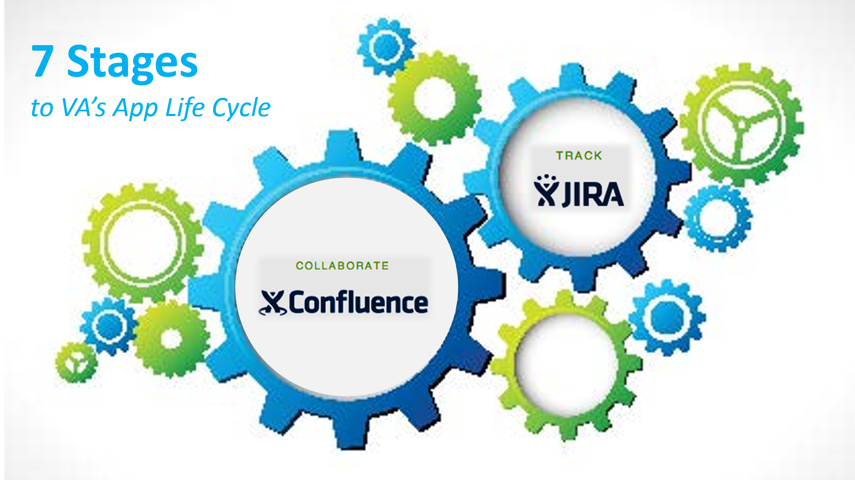
Notes:
Today we’re going to walk through the 7 stages of VA’s mobile application lifecycle– they are planning, development, compliance, Pre-production simulation, IOC field testing, release, and sustainment –
We will also get familiar with its key components:
JIRA, a tracking system that captures and organizes issues, assigns work, and follows team activity.
Confluence- We will describe how to maintain project documentation in the project's Confluence wiki space

Slide 5
Do you have an MAE JIRA account?
Poll Question
Yes
No
Notes:
But first I’d like to ask another poll. I’d like to know how many of you have a MAE JIRA account.
This will help me understand how familiar you are with the spaces we’re talking about today, and how much time to spend going over each section.

Slide 6
PLANNING
Need Defined
Discovery Request Project Initiation
Notes:
PLANNING:
First stage of VA's Development Life Cycle. It begins with defining a need and ends with Governance board approval.
The three phases in Planning are: Discovery, Request, Project Initiation. We’re going to go over all three of these now.

Slide 7
PLANNING
Does this App
address a need?
Discovery
Notes:
If you are planning on entering an app request, DISCOVERY is the first component.
There are several items you will want to think about during the Discovery phase.
First you want to Identify a need
Will this App improve VA-related job performance or patient health outcomes?

Slide 8
PLANNING
?
MAE
Does it already
exist in
the MAE
Discovery
Notes:
Does this App already exist?
Compare your idea to VA approved Apps.
There may be an opportunity for collaboration.
We are working on a public facing link that will include a list of apps in our Intake Planning stage , our Development stage and will include apps that are VA Branded.
*Do we want to include this also?*
If you are internal you should be looking at IDRP NSRD, Requisite Pro depositories and Class III

Slide 9
PLANNING
Gather the details…
?
Discovery
Notes:
Gather the details required to make the Request.

Slide 10
PLANNING
Decide on a platform…
?
Discovery
Notes:
Decide which platform (or platforms) best suit satisfying the App's job.

Slide 11
PLANNING
Consider funding and resources
?
Discovery
Notes:
Research funding and resource possibilities. If you or your organization can provide funding or people to develop or sustain the App, gather this information. If you have no resources, VA may provide them if we approve your App request.

Slide 12
Do you have an MAE JIRA account?
Poll Results
Yes
No

Slide 13
Do you have an MAE JIRA account?
Poll Results
Yes
No
Notes:
CLICK TO NEXT SLIDE

Slide 14
Request
PLANNING
Notes:
After Discovery you should be ready to Submit a Request, which is our second phase in the PLANNING stage.
The Mobile app request is made by completing one of the Web forms on the WMS Initiation Page.
You must complete your request in one session, so be prepared.
Before you begin: Summarize idea and gather documentation to support your app request

Slide 15
Get Organized FIRST
PLANNING
Request
Notes:
When you’re gathering your thoughts and ideas, and all the documentation, there are some things you want to consider:
You will want to List the Apps Functional Requirements-
The better you define your deliverables now, the less trial and error occur during the development and release part of the process. We suggest you break down the deliverables into their discrete tasks.
Break down what you want the app to do and how you want the app to perform For example, there may be an education part of the app and then another part that requires patient input.
Gather other pertinent documents that you might want to attach to the request form such as:
PMAS artifacts and design documents
Wire Frames, story boards, Sustainment Plan and if you have
Preliminary Compliance reviews.

Slide 16
Summarize your idea
PLANNING
Request
Name the App
Identify the job for which the App is a tool
Identify the VA App's primary function
Identify Subject Matter Experts
Identify a Product Owner
Identify Sustainment resources
Notes:
Think of a Name for the App. : (Choose a name that is brief and explicit. Your Request Submission will use this name during processing, although there may be a need to change it later.)
Ie goals…..
There will be a description field requiring you to:
Identify the job for which the App is a tool. Identify the App's primary function. What jobs must it perform? If you have a BRD, you will want to have that ready to attach to the request web form.
Identify Subject Matter Experts (SMEs), if you know them. Identify a Business Owner, if you know her or him. Identify Sustainment resources, if you or your organization can provide them.
The web form will also cover questions regarding PHI and PII, Which Business Sponsor Office is supporting the app?, Who or What is the intended audience is for the app?. Some of these questions can be answered after the app request is made.

Slide 17
SUBMIT a request…
…by completing one of the Web forms on the WMS Initiation Page
PLANNING
Request
Notes:
After Summarizing your ideas you are ready to submit your request by completing one of the web forms on the WMS Initiation Page. The link is available on the download button. Which form you use depends on whether you plan to help develop the app yourself, or if you or your organization can contribute resources toward its development. We in WMS call this the Intake stage. (is this important to the audience or is this just internal

Slide 18
Notes:
Let's review the different types of requests on our initiation page…
Have the VA build an app - Choose this request type if the Requestor has no funding or resources to build an App. (Example: Let's say you are a nurse in California who educates Veterans about Diabetes. You have a really fine web program but you want to reach out to more Veterans using a mobile app. You have no idea how to code or where to get funds. This is the request you would use.
Certify an app you have already built to carry the VA brand. Choose this request type if the Requestor has already developed an App and wants to make it an official VA App (Examples: Why would you use this Request? You are a team of Cardiologist in Texas and you have an app your group has been using to connect with your patients. You would like to get it VA Branded and learn more about the process.
Start Building an App for which you have funds and resources - Choose this request type if the Requestor has a contract or funds and has resources to build a mobile app using the VA's mobile App processes and policies Example: Perhaps you are an Audiologist at the Portland VA. You and your action packed team have an idea for an App to help Veterans. You've put alot of work in, applied and received funding (PACT, System Redesign, VISN grants, Organization funds,for example) and even connected with recommended developers. Here is where you would make a request, especially if you haven't starting building yet. You would want to learn about VA compliance/certification and how to get VA Branded.

Slide 19
Notes:
There are two other webforms on the initation page that we use in Web and Mobile solutions.
User Registration Use this form if you want to join an existing MAE development project. Examples of applicants include, Business Owners, Developers, Project Managers.
Request a VA Mobile App Environment (MAE)
This is a request to the development and test environments of the MAE and/or if your app requires connectivity to the VA network.
You might use this to request a new Wiki space, a new Stash code repository, or new FishEye installation. Do not use this form if you already have JIRA access and simply want permission to access a project. If you are a JIRA user and would like access to a particular project, please request access from the Project manager.

Slide 20
Initiation
PLANNING
App Request
Web and Mobile Solutions (WMS) screens the request
Notes:
Once you’ve submitted your request, we move into the INITIATION phase, the third and final phase in PLANNING.
It starts off with Screening/Pregoverance Prep:
Screening: VA's Web and Mobile Solutions team (WMS) screens the initial Request to ensure that it is legitimate. If an Initial Request fails screening, WMS closes the Request and Notifies the Requestor.
If the Request passes screening, someone from WMS will contact you to review the request and explain the Web and Mobile Applications approval process.

Slide 21
Requestor completes the
Business Sponsor Agreement
Initiation
PLANNING
Notes:
If the requestor has funds and resources to build the app, the Requestor completes the Business Sponsor Agreement. The document clearly defines expectations of the app, identifies the Business Sponsor and defines a sustainment plan.
The BSA document identifies the Requestors expectations about the app project and the project's understanding and commitment to the several areas, including SCOPE, CONSTRAINTS, CODE TESTING, ACCESSIBILITY TESTING
**************
The BSA document identifies the Requestors expectations about the app project and the project's understanding and commitment to the following areas:
Project Planning Background
Overview of the System
Business Sponsor
Stakeholders
Objectives
Scope
Constraints
Cost Estimate
Proposed Schedule with Milestones
Quality Control and Performance Measures
Code Testing
Usability Review
Accessibility Testing
Performance Testing
Risk Management
Assumptions
Certification Process
Acceptance
Deployment Planning
Sustainment Planning
WMS reviews the Business Sponsor Agreement and solicits any missing information from the Requestor.

Slide 22
APP APPROVAL PROCESS
Initiation
PLANNING
Notes:
Let’s talk about the App Approval Process.
While we continue to prepare for the Governance Board we are still in the Pre Governance prep stage of the process.
Before the request goes before the Governance Board, a Mobile Application Management Team reviews the request for its more technical elements and seeks to have any remaining questions answered by the requestor.

Slide 23
Who is the Business Sponsor?
Does this App align with the VA Mission?
What is the sustainment plan?
Notes:
In preparing for presentation to the MAMT, the requestor will need to answer a few specific questions
They are:
Who is the business sponsor?
Does this App align with the VA Mission. (Strategic Plan) We would need a complete description including requirements of the app.
What is the Sustainment commitment: Every VA App is required to have a Sustainment Plan that outlines how the App will be maintained and how users will be supported. VA Web and Mobile Solutions (WMS) requires that a Sustainment Plan be provided for each App before it is deployed.

Slide 24
Identify a
Business Owner
Notes:
When Identifying a Business Owner…
determine if someone within the VA can represent the App during development. This person needs to be someone in a decision-making position in the VA.
A Business Sponsor or their designee needs to be connected to each App and to participate in the development of the App. Actually, they need to be involved in all stages of the Product Life Cycle.
The Business Owner is also responsible for a Sustainment Plan.
*******************
Developers building the app do not always know intuitively what the Clinicians or Providers are asking for. To avoid the potential of having the application completed and the original requestor or Business Owner replying, “No, that’s not what I asked for” he/she needs to be involved. If it is a Pharmacy App, then someone at a high level and the ability to make decisions from Pharmacy, a Patient Safety App someone from Patient Safety, Mental Health, someone from Mental Health and so on.
The Business Owner is also responsible for a Sustainment Plan.

Slide 25
Provide Veterans personalized, proactive, patient-driven health care.
Achieve measurable improvements in health outcomes.
Align resources to deliver sustained value
to Veterans.
Notes:
The next thing you need to consider before MAMT review is Does the app align with the VA Mission?
Consider your organization’s strategic goals.
Most of our App requests are from VHA. In these cases, you want to think about VHA’s strategic goals:
Provide Veterans personalized, proactive, patient-drive health care.
Achieve measurable improvements in health outcomes.
Align resources to deliver sustained value to Veterans.

Slide 26
How will the app be sustained and by whom?
Notes:
The third question the Mobile Application Management Team is looking to have answered is
Do you have a Sustainment Plan? How will the app be sustained and by whom?

Slide 27
Does this App qualify for Medical Care Funding?
Notes:
For those of you asking for WMS funding, you will also need to determine if the proposed app, qualifies for Medial Care Funding.
FDA definition is as follows:
When the intended use of a mobile app is for the diagnosis of disease or other conditions, or in the cure, mitigation, treatment, or prevention of disease in man, or is intended to affect the structure or any function of the body of man, the mobile app is a device.
This “device” would qualify for Medical Care Funding.

Slide 28
Mobile Applications Governance Board (MAGB) Review and Approval
Notes:
Up until now we have been working in the pre governance prep part of the process.
With the Business Sponsor agreement and the 3 questions completed, and the MAMT technical review and approval complete, we now move into the Governance Board Approval part of the process.
At this point the Request is put before the Mobile Applications Governance board.
A decision whether to move the app forward in the process is then made and if the stakeholder is not present, they would be notified at this point.

Slide 29
Poll Question
What are the three questions that the Governance Board needs answered?
1. Identify the Business Sponsor, Project Manager and Developer.
2. Identify the Business Sponsor, Does this meet the VA Mission(Strategic Plan), What is the Sustainment Plan?
3. Identify the Business Sponsor, Does this meet the VA Mission(Strategic Plan)?, Identify the App Name and color.
Notes:
So let’s review.
What are the three questions the governance board needs answered?

Slide 30
“Approved App Pool”
Contract
In-house
Notes:
Once the App Request is approved by the Governance board, it moves into the "Approved App Pool”
This is more or less a “pool” or pick list of approved Apps.
If resources are available from the Mobile App development teams to support the request, the App may be selected for internal development though OIT.
If not, WMS may pursue funding a Request with an external contract. The majority of apps are contracted. These apps get put into PMAS increments and are scheduled out about a year in advance.

Slide 31
Notes:
So where is all this information tracked?
JIRA is a project tracking tool owned by Alassian, a privately held company founded in 2002. Offices within the VA have different meanings for the term Project. Here, we apply the term Project to indicate an individual App.
JIRA is a based on issues.
Issues are organized into Projects containing components and versions. In Web and Mobile solutions, we use JIRA for managing our intake requests and our app projects as they go through the Project life cycle.
Remember, prior to the approved JIRA Project, the issue is in the intake phase. Access to the Intake phase is provided for administrative staff and is useful for staff that may need to know the status of an app request prior to approval into a project.

Slide 32
Approved App
JIRA
Intake
Notes:
Think of a JIRA Project as a basket or container.
Each App request begins as an Issue.
As a app request is approved by our governance board, and selected to build, the request is moved over from INTAKE to a JIRA project.
The JIRA project contains a variety of issues including the original request, compliance issues, bugs, tasks, etc.
The requestor becomes the designated administrator.
He/she receives an email stating that they are responsible for providing access to members of the team as needed. Examples of users needing access would include developers, Business Owners, compliance staff, and other reviewers such as Verification and Validation.
Permissions/roles??

Slide 33
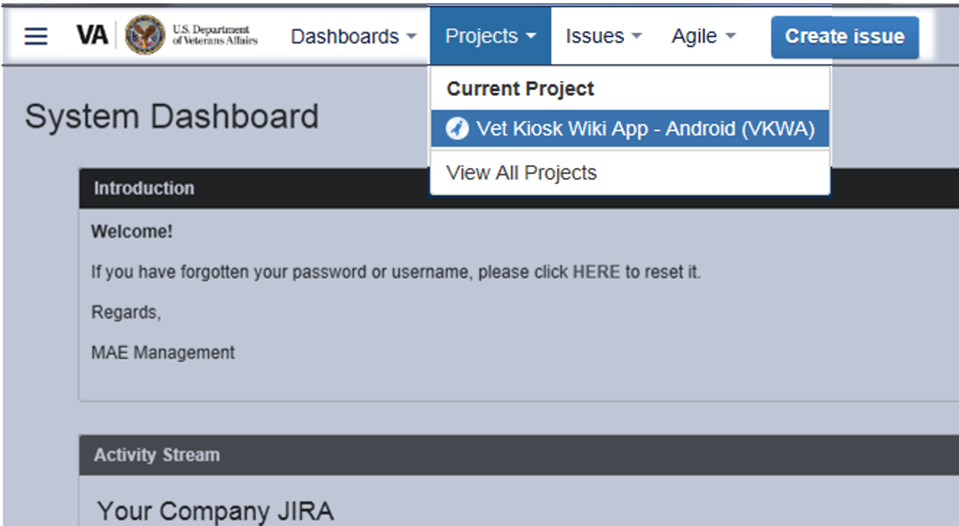
Notes:
Setting up a Project:
There are several ways to locate a project.
We can go to the navigation bar at the top of the page and find the “Projects” menu option
Choose a Project from the Drop Down. This will display projects you have access to. Choosing a project takes you to the Project Summary Page for that project.
Depending on the user and how many projects you are working on, you may have several projects listed here. In this case, we only see “Vet Kiosk Wiki App” so let’s go ahead and click on that.

Slide 34
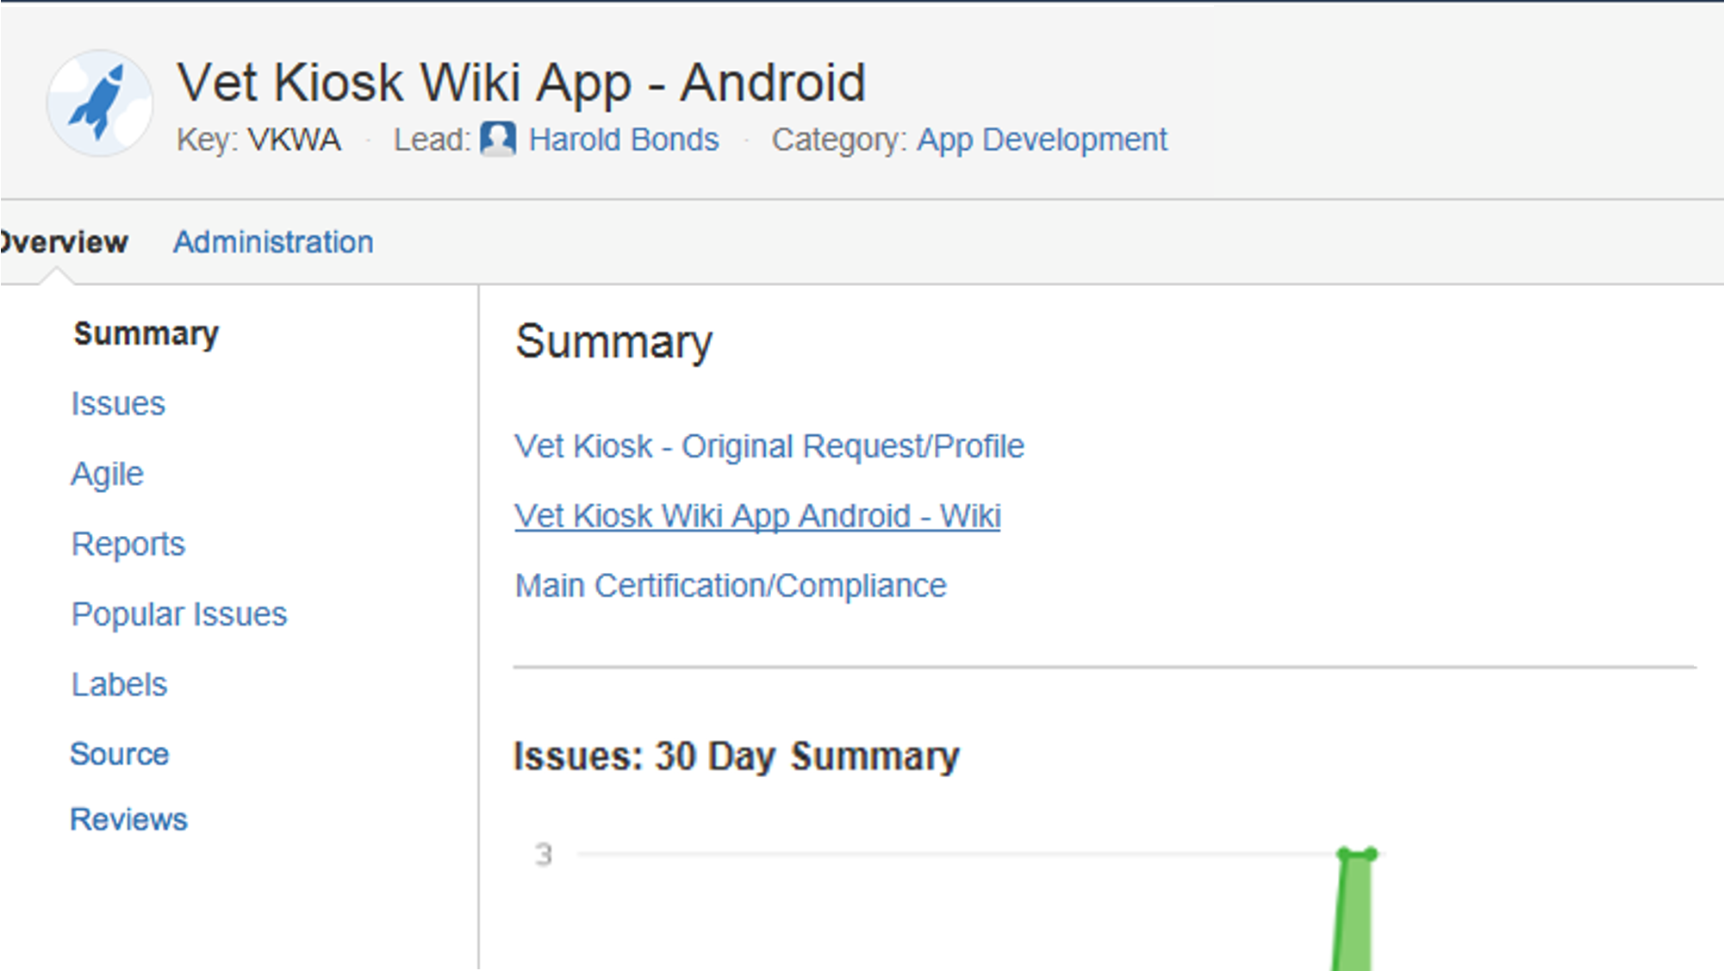
Notes:
This is the main page – or SUMMARY page. I want to call your attention to a few features on this page.

Slide 35
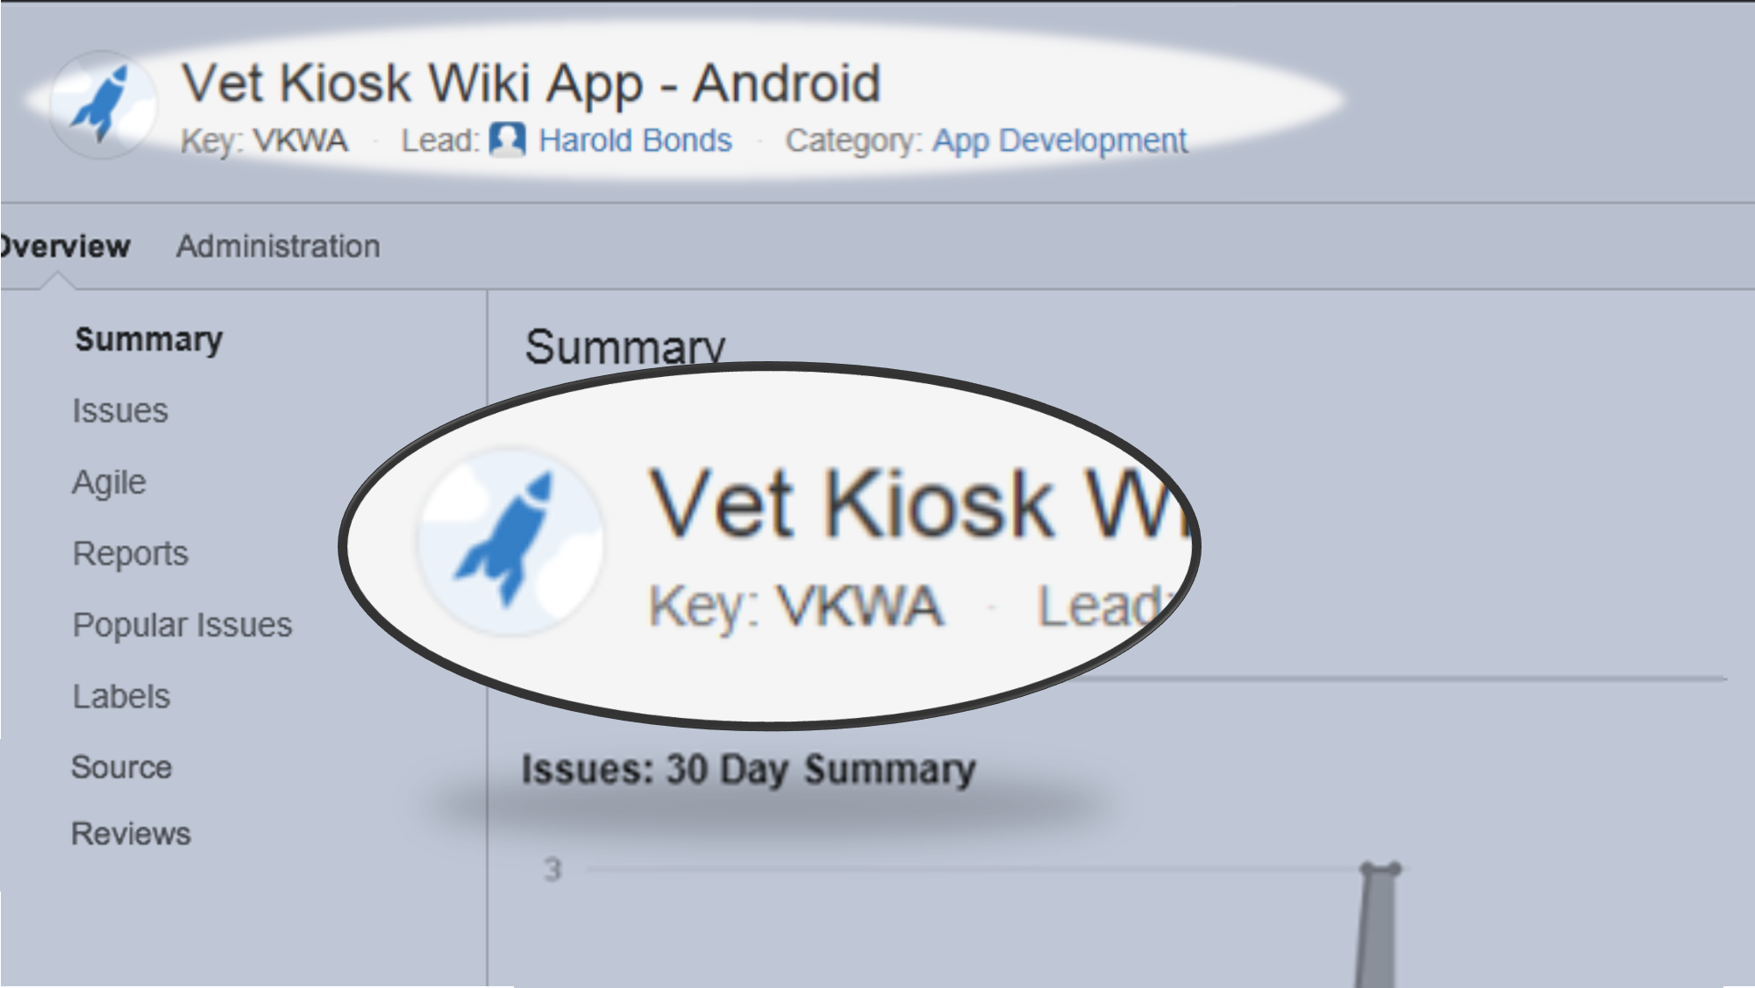
Notes:
First, let’s take a look at the top. You will see the Project name, Project Key, Project Lead.
I want to focus on the KEY for a minute, in this case VKWA. When a project is created in JIRA, it assigned an identifier or key.
The project key is the only true way to identify an app. App names sometimes change or Apps may be grouped together due to phases, improvements or other reasons,. The project key is the way you can know for sure you are correctly identifying the right App Project. For example, SQ=Stay Quit, DMA-Diabetes Mobile App. CRA- Cardiac Rehab App. I want you to remember the key VKWA because we’re going to see it a few more times as we walk through these pages.

Slide 36
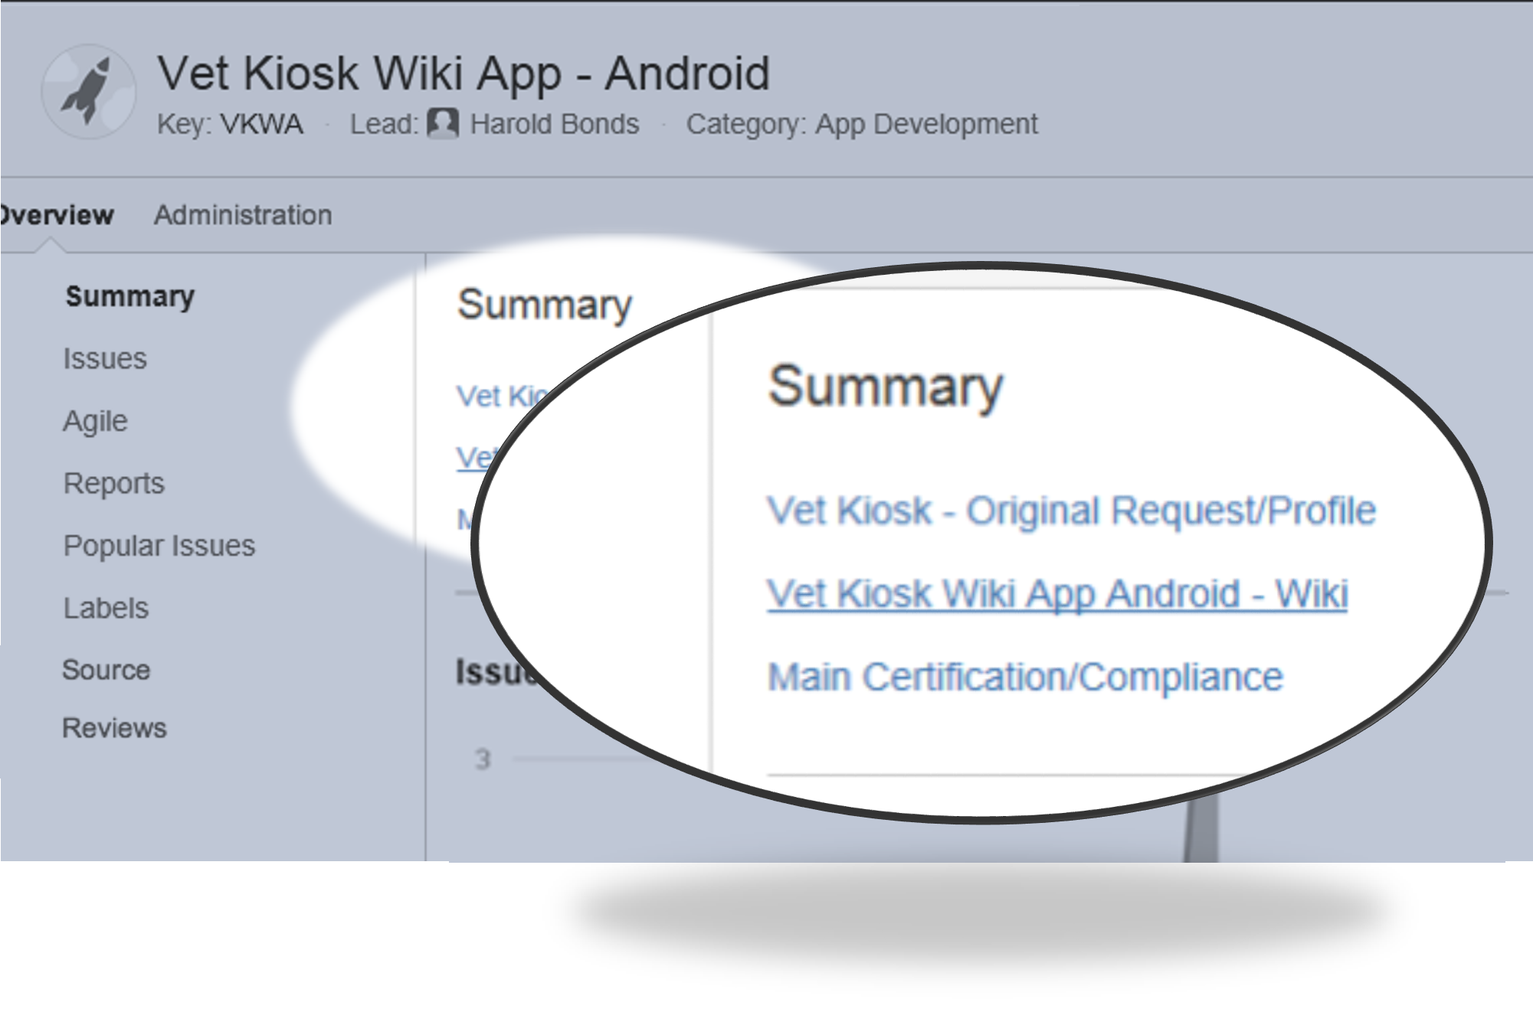
Notes:
Next, you’ll see links to:
Original Request which is copied over from the intake request with all the attachments included
All the information that was filled out in the intake side the request is copied over to the issue type, Original Request. (twice) This is my favorite issue type because so much information about the app can be obtained by looking at the Original Request and by creating filters from fields on this issue type.
Fields such as …Project Manager, Business Sponsor, Type of App, the answers to the questions prepared to the MAMT, Target Audience, Type of data stored, Mobile App Classification. Plus the attachments that were included when it was first entered and any comments that where added.
Often myself or other members of the WMS team will add a comment that an email was sent, or they awaiting an answer to a question. Comments are one way allow staff with access to this project aware of any news.
Looking back at the Project summary page you will also see a Link to the project wiki where all the related content is maintained. We will cover that in more detail later on.
Compliance Issues
In JIRA, compliance issues will be monitored using the Certification/Compliance issue type. This is where comments will be added to monitor engagement and progress with compliance bodies and is a place to upload final and interim reports of compliance approval.

Slide 37
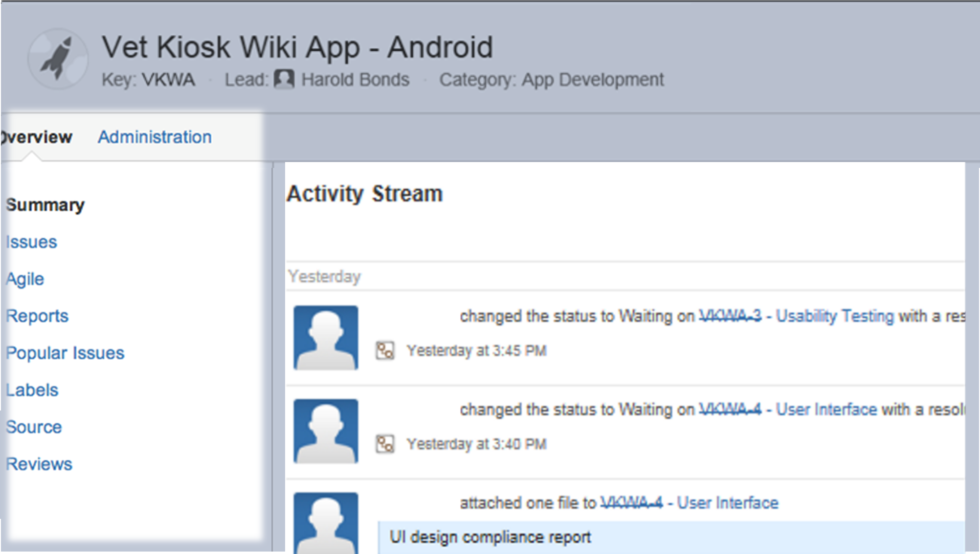
Notes:
Below these links you will see an Activity Stream. This could be helpful to see what activity has taken place recently on the Project and which user was working in the Project. Having access to a project will enable you to see activity such as a Project Manager, changing the status from planning to development, a developer may have entered a bug, Compliance staff or project manager may have entered content for a compliance issue, attachments uploaded etc.
On the top left side of the page you will see both the Overview link and the Administrative Link.
The Administrative link is used by the Project Manager to add users and make administrative changes to the project.
Right now we’ve clicked on the Overview link.
Below it you will see a column on the left side displaying a list of items including issues.

Slide 38
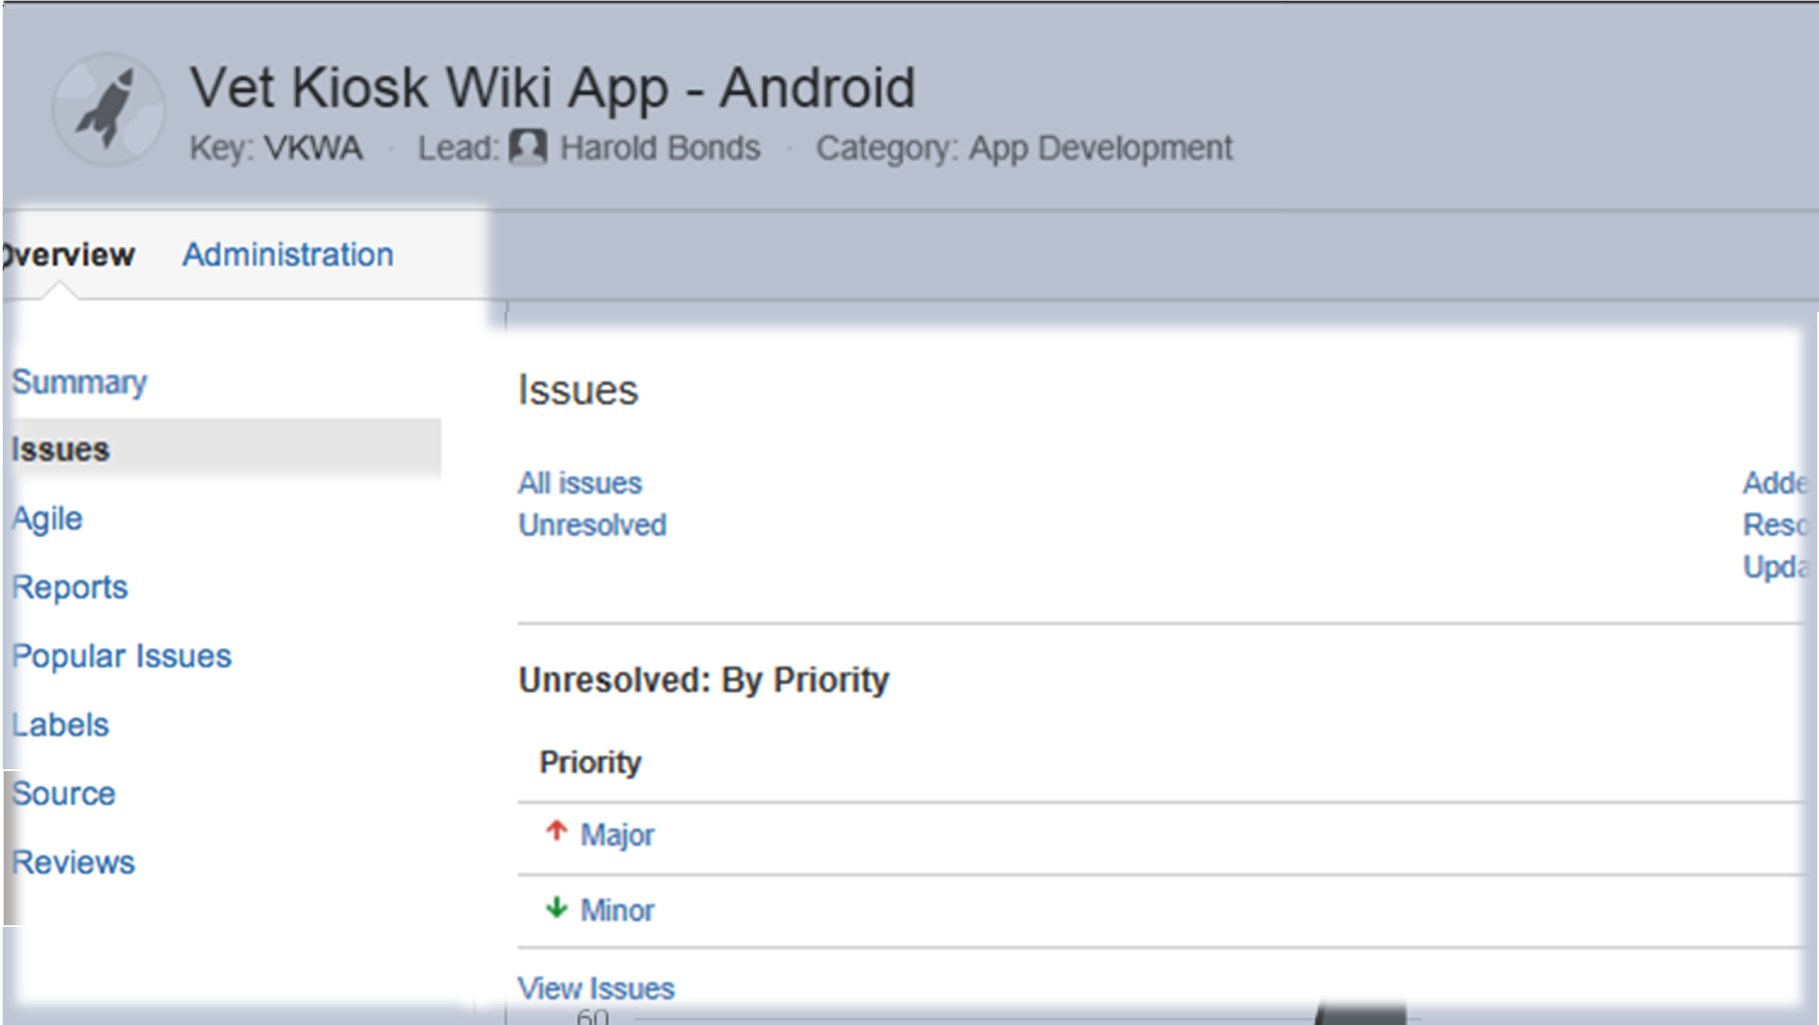
Notes:
You can click on issues and navigate to the issues page containing all of the project issues, resolved or unresolved. Now, we can’t see the whole page here, so I’m going to zoom out.

Slide 39
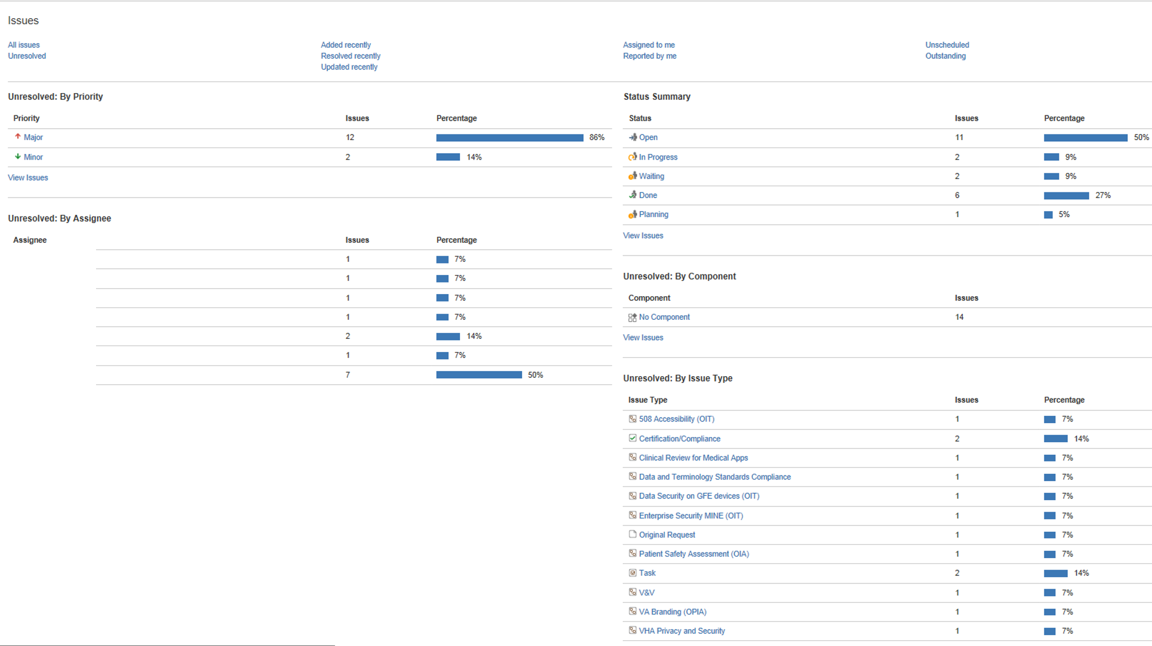
Notes:
This is a snapshot of the Vet Kiosk Wiki App. I know this is too small to see, so let’s focus on the bottom right.

Slide 40
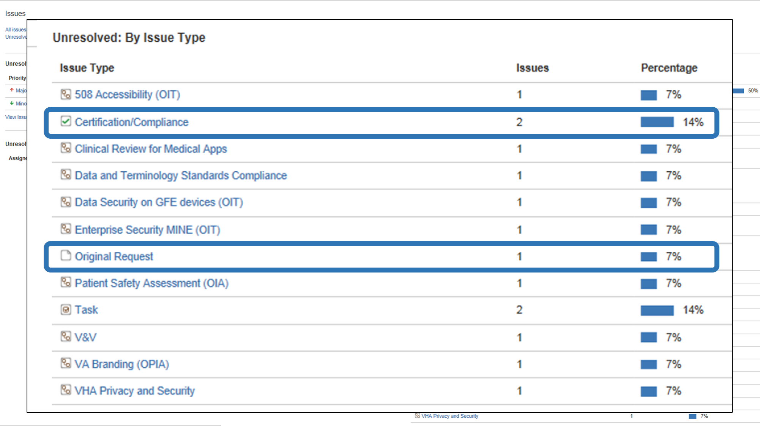
Notes:
To look at unresolved issues BY Issue Type
Two items I want to point out here are the Original Request and the Certification/Compliance Issue. Since we are changing and improving all the time, your Project Summary may not contain your Original Request Link. Remember the three links we just showed you on the Project Summary page? If you are an administrator you can edit the page and place the Original Request link here by copying it from the list of unresolved issues. If you are not an administrator or project manager, you can ,at least, view the Original Request here in the Unresolved Issue Type list..
In some cases the “original request” link may open to more than one original request. Some projects are grouped together due to phases or other reasons determined by WMS management.

Slide 41
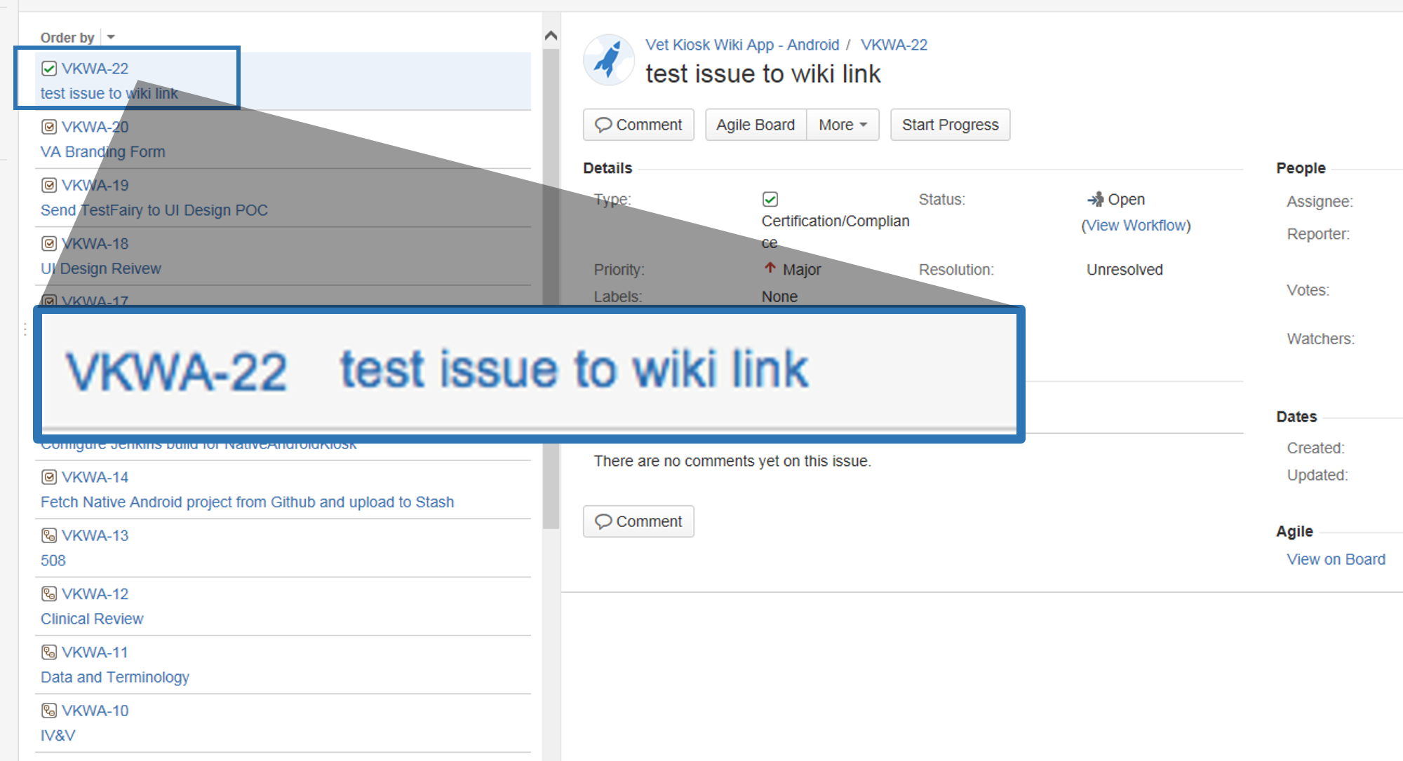
Notes:
Notice the key VKWA. This key will be attached to every issue for this project.

Slide 42
Notes:
Okay, let’s navigate back to the Summary page. And switch gears a bit.
We’ve become more familiar with the JIRA Project page. Now let’s click on that wiki link I pointed out earlier and take a closer look at the wiki page.

Slide 43
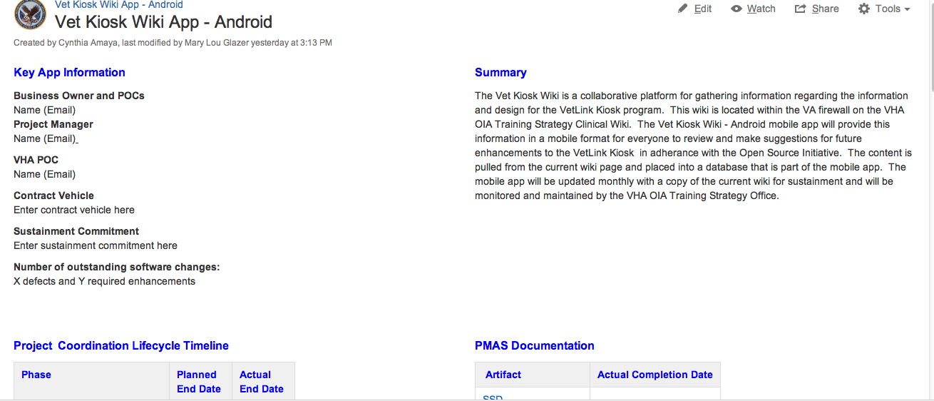
Notes:
We’re now on the Vet Kiosk Wiki App cover page. Again, I know this is small. You don’t need to read the details. I just wanted you to get familiar with the look of this page.
You've heard of Wikipedia. A wiki is a web application which allows people to add, modify or delete content in collaboration with the other team members. All Project content should be kept in the project wiki. Once you have your MAE JIRA account, and have been given access by the Project Manager, you will have access to this content.
A wiki template will be used to aid in organization of your project. The project wiki cover page starts with a listing of key staff members and a project summary that is populated by the Project Manager. The cover page also displays tables that show pertinent dates related to PMAS, compliance, Risks and Project life cycle.

Slide 44
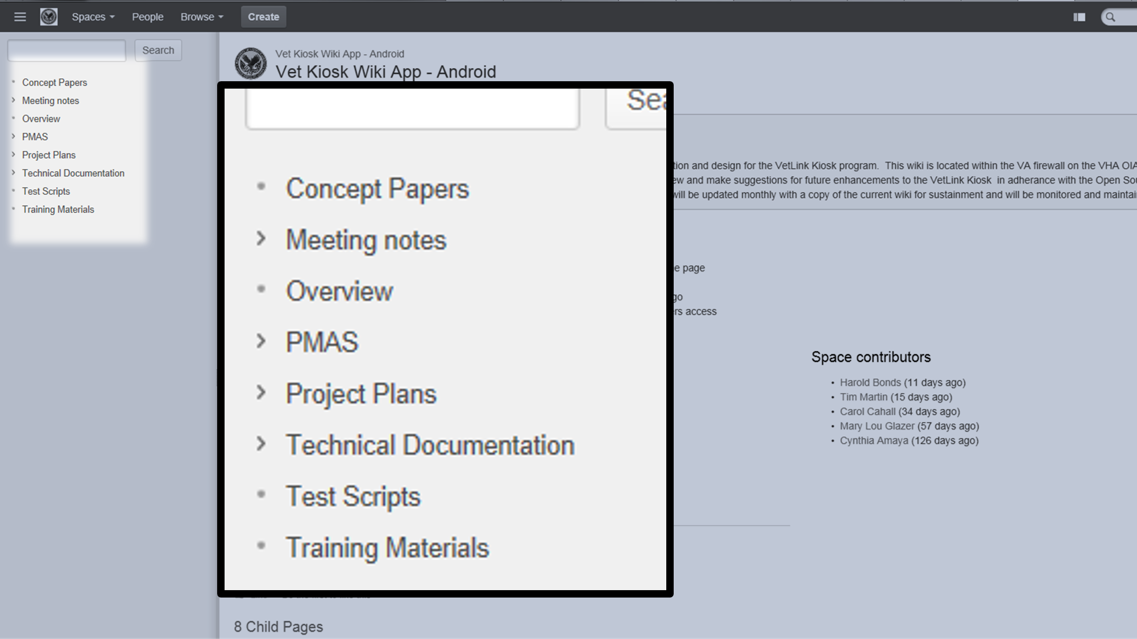
Notes:
On the left side of the page we’ll see a menu of options we can navigate to – these are CHILD PAGES that have been set up. We’re on the Summary page now, but you can also select
Concept paper meeting minutes technical documents PMAS Overview

Slide 45
Notes:
Templates have been created to aid the user in adding content. If we click on this CREATE button at the top of the page, a pop up box is will open with several templates.
Users are able to up load and import the available templates as child pages. From this screen, you can then scroll down to the correct template
There are templates for all the PMAS documents including Requirements Specification Document, System Design Document. There are also templates for the V & V testing intake form, and many of the Compliance form templates such as privacy and security and the 508 testing.
If you want to upload a template:
You must first make sure you are on the right parent page, before you click on the create button. For most of the templates the parent page is the wiki summary page.

Slide 46
Notes:
One template I’d like to call your attention to is the MA Required Artifacts Template. This acts as a snap shot and guide to finding the right template for the known required artifacts, including the PMAS artifacts
Note that this page now lists all artifacts known to-date
If it isn’t in your PMAS child page already, you should use the create button find the template and upload to a new child page.

Slide 47
Planning Phase
Request, Initiation and Approval
MAMT and MAGB
Approval Process
JIRA and WIKI
Introduction to the project space
Notes:
To review,
we have gone over the Web and Mobile applications Planning phase including request, initiation and approval. Reviewed the MAMT and the MAGB and how the request becomes a Project.
We’ve discussed the JIRA project wiki and the templates provided there.
Now let’s switch gears and dive into how to search JIRA.

Slide 48
Quick Search
Basic Search
Advanced Search
Searching in JIRA
Notes:
There are at least three methods for searching JIRA. Quick Search, Basic Search and Advanced Search. The quick search is the fastest way to define search criteria. However, it is less precise than other search methods for complex queries

Slide 49
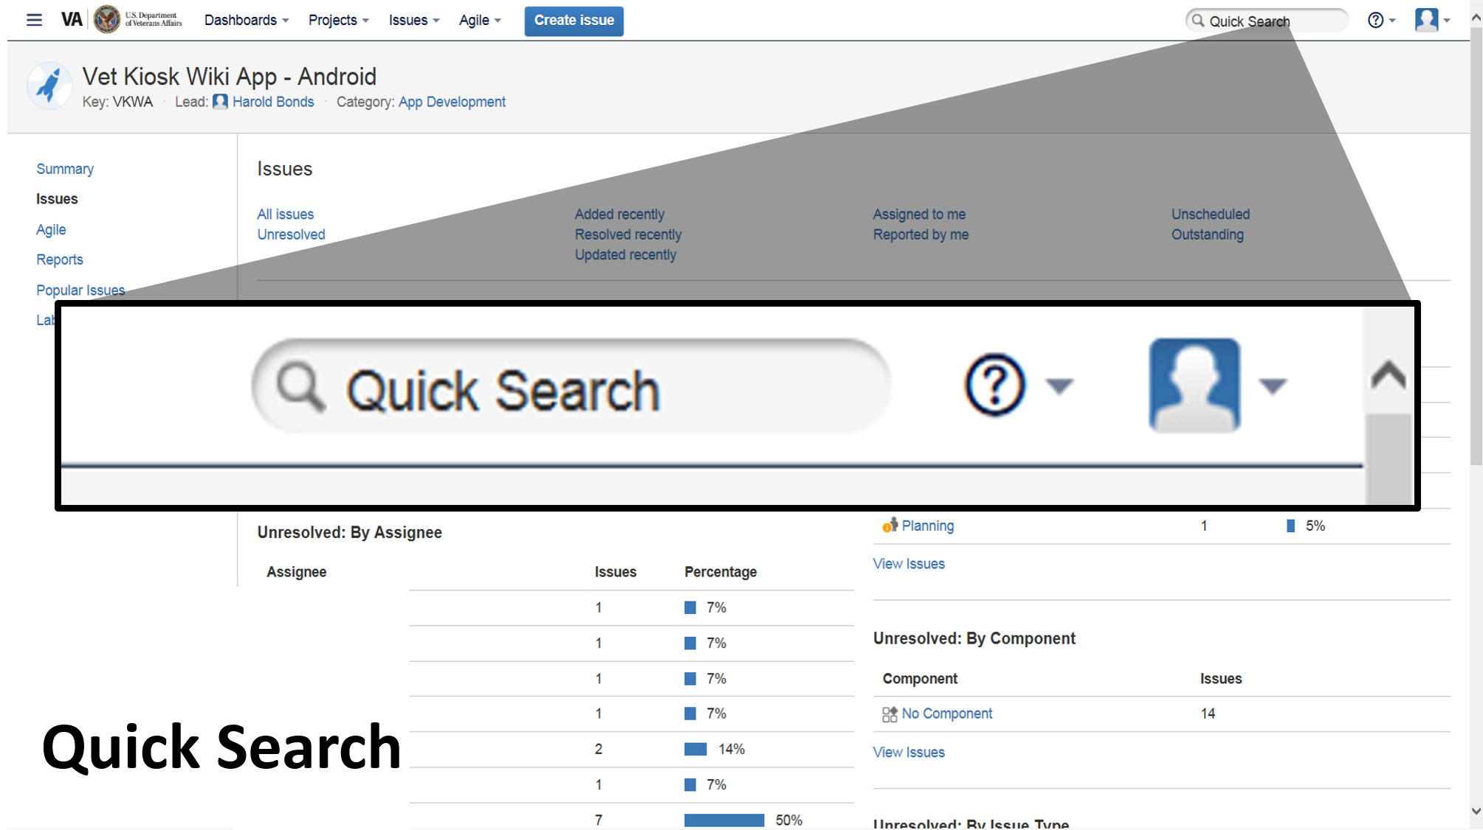
Notes:
The Quick Search is a powerful tool which will search across the issues and their fields in addition to the comments. The trouble with this is that it is like searching google. You will receive too many hits including open and closed issues, issues types including risks, bugs and everything that touches the keyword that you have entered.

Slide 50
Notes:
You can, however, place a issue key into this box and it will bring up just that one issue.
Here you could see that the key WMSIN-1048 brings up just one issue, which is a request for the Women’s Health Diary Phase 2 application.

Slide 51
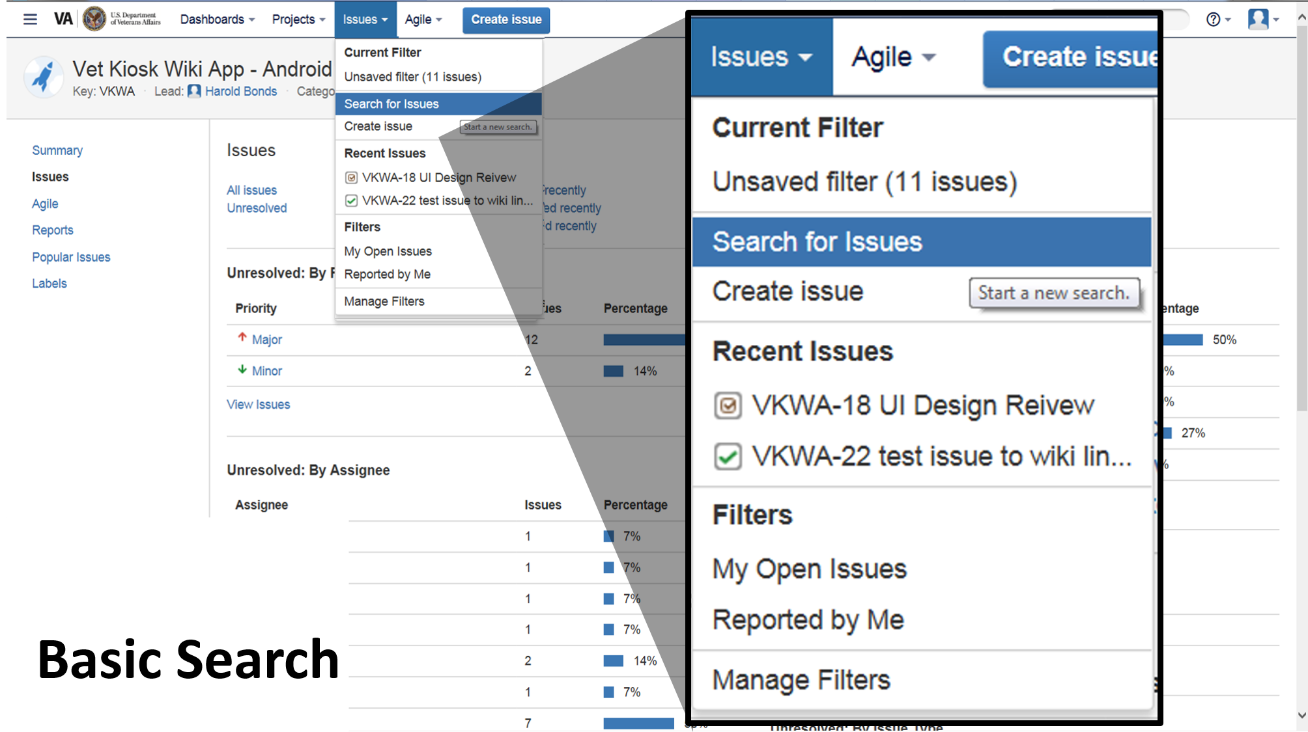
Notes:
The basic search provides a user-friendly interface that lets you define complex queries, without needing to know how to use JIRA Query Language (JQL). Once you create a basic search you can then switch to advanced to view the JQL behind the search.
To do a basic search, you’re going to click on the ISSUES drop down menu at the top of the screen and select “SEARCH FOR ISSUES”

Slide 52
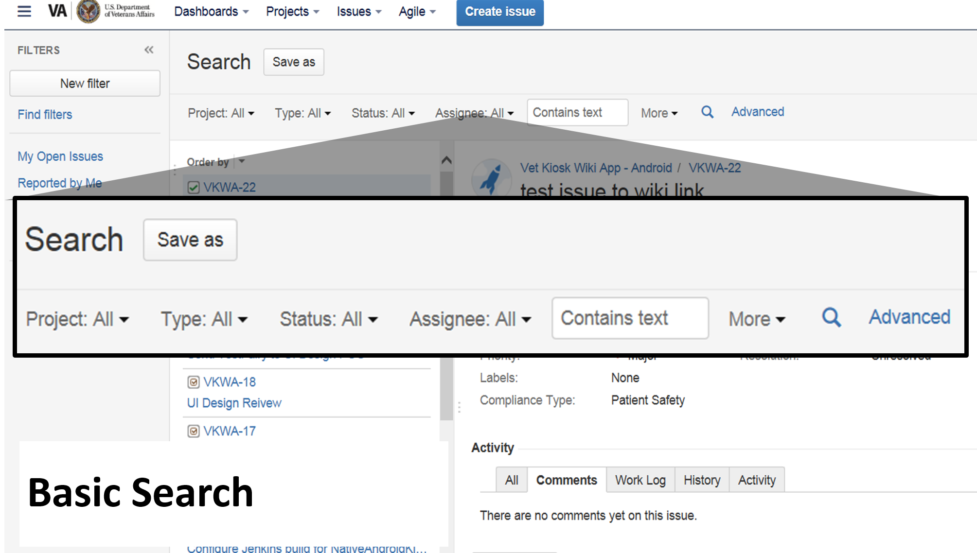
Notes:
This will pull up the basic search bar. You’ll notice several drop down menus that allow you to narrow your search.
Use the TYPE drop down menu and choose the issue type “original request” to search for a project. If it is not among the choices simply start typing “original request”
You can also use the drop down choice called More to choose any of the fields in any of the issues to limit your search. Examples include “app will collect veteran entered data” or “app contains a EULA”.
I might search for a group of projects in a contract or all the projects that have a particular Project Manager. I might even search for all the request type issues that have a Business Requirements Document completed. In these circumstances I would still filter it by that issue type “original request” first.
Disclaimer.
As we are working hard to use the system to it’s best advantage, it is important for the project manager to keep the original request up to date so that these searches report correctly.

Slide 53
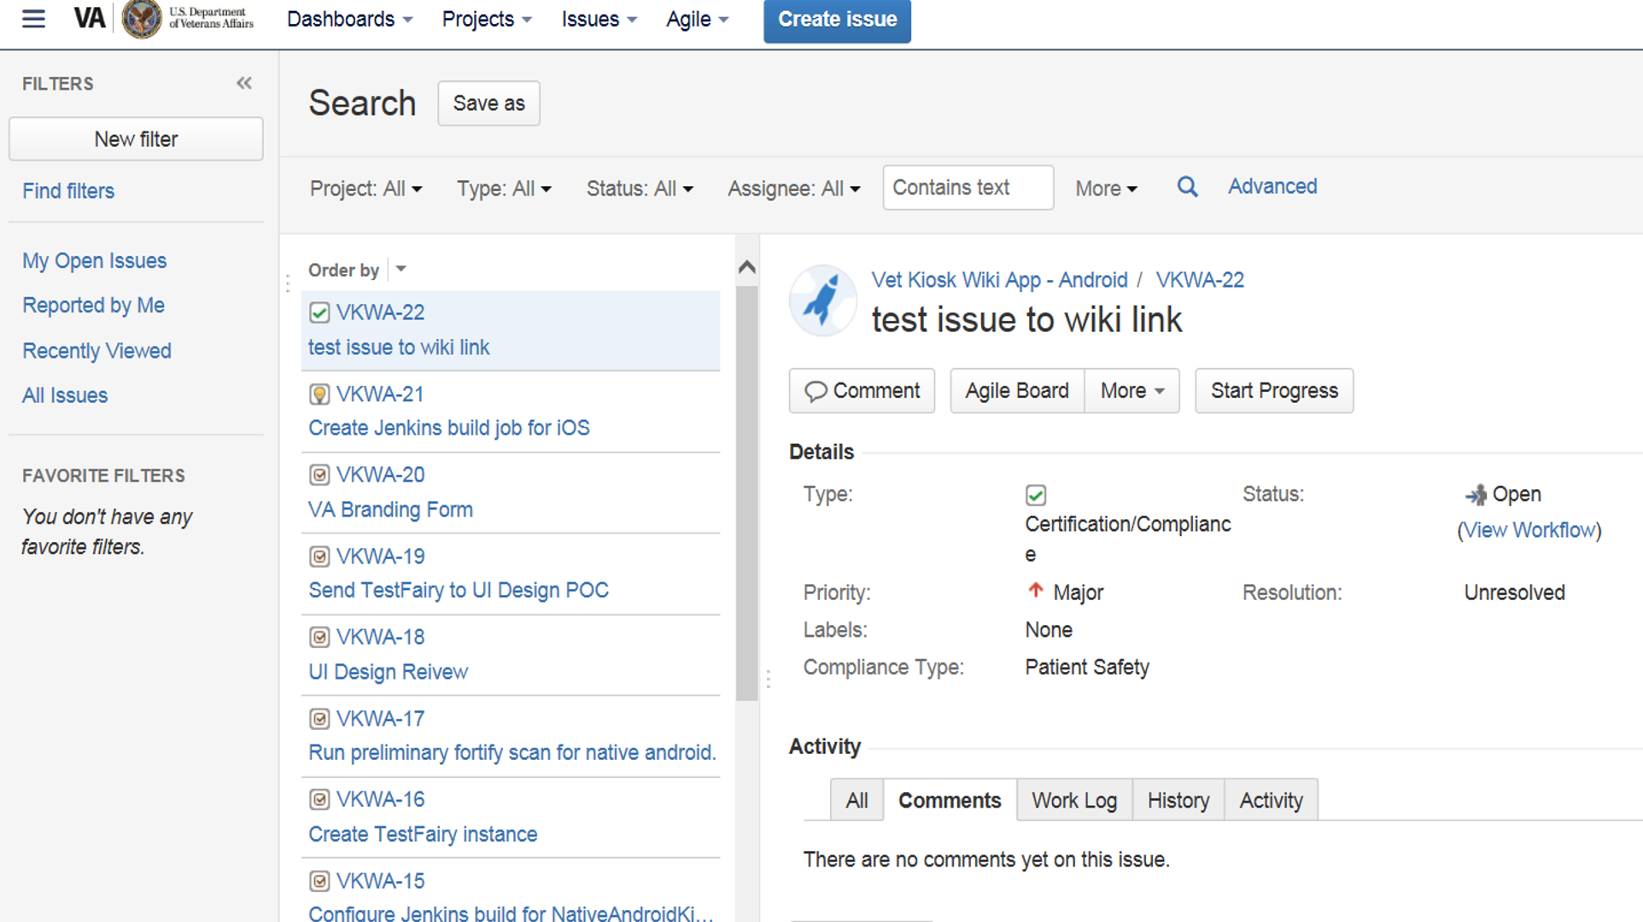
Notes:
To switch from basic to advanced search, click the basic or advance link next to the search criteria.

Slide 54
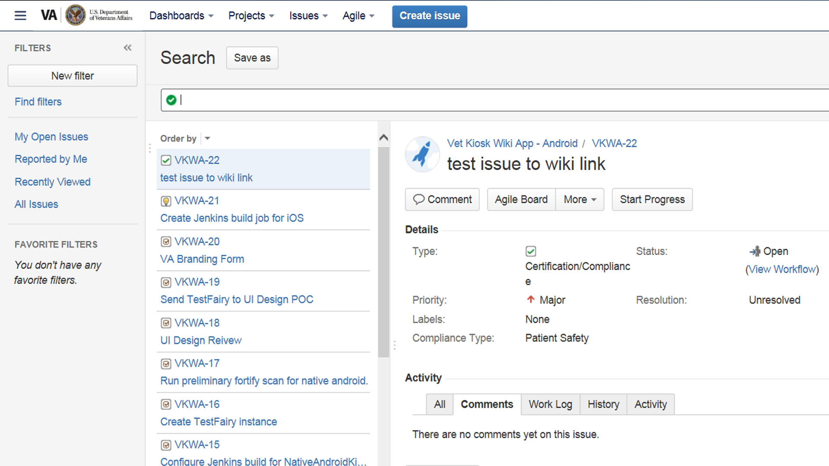
Notes:
The advanced search is the most specific way to search JIRA you need to know how to construct structured queries using the JQL to use this feature.
Let’s take a look at the Advanced search and see what the JQL looks like.

Slide 55
issuetype in ("Original Request", "Request: Build App w/ Contract Dollars (Hv Funds-Resources)", "Request: Have App Certified", "Request: Have VA Build App") AND status in ("Approved App Pool", "Create JIRA Project", Planning, Development, "Compliance Review", Sustainment, "V&V", UAT, "Field Test/IOC Evaluation”)
Notes:
Here is an example of a search I created in the Basic Search. We are viewing it now in the Advance Search so that we can see how it was built and what is behind the search.
This is a search that will display all the mobile applications in the intake phase AND the project phase and can be used to compare new requests to requests and projects already in the system. I call this search -- Mobile Apps Inventory
TIP:
When I have completed my choice on the basic search drop down menus , I switch to advanced where I could then see the JQL and perhaps tweak my search.
I use advanced to see exactly what my filter contains or to take a look at the details of the filters others have created
This is one way to use the advanced search in combination with the basic search.

Slide 56
saved searches of issues in JIRA
Filters
Notes:
Once you’ve searched for an issue in JIRA like we just did, you can SAVE that search as a filter to use later.
Filters help you keep track of your Projects and issues such as bugs, compliance, project status, risks etc.
You would create a filter the same way you search for issues.
Here is what you can do with JIRA filters: Share and email search results
Create lists of favorite filters
Have search results emailed to you according to your preferred schedule
View and export the search results in various formats (RSS, Excel, etc)
Display the search results in a report format
Display the search results in a dashboard Gadget
If you have saved a search previously (i.e. as a filter) and want to run it again, you can

Slide 57
To save this filter…
issuetype in ("Original Request", "Request: Build App w/ Contract Dollars (Hv Funds-Resources)", "Request: Have App Certified", "Request: Have VA Build App") AND status in ("Approved App Pool", "Create JIRA Project", Planning, Development, "Compliance Review", Sustainment, "V&V", UAT, "Field Test/IOC Evaluation") AND "Mobile App Classification" in ("1Very Low", 2Low, 3Medium, 4High)

Slide 58
Notes:
Here is a question that comes up often:
As a Project Manager, can I see a list of all the Projects I oversee and their status? Absolutely!
We can create a filter for that. But before you create a filter, you’ll want to search to see if one already exists. I’ll show you how to do that in a minute, but first let’s create a filter.
We’re going to create that project manager search and save it as a filter which we will use later in Chris’s part of the class.
To create a filter in the Basic search, select the issues button on the top of the screen. A drop down menu will appear. From here you can select "search for issues".

Slide 59
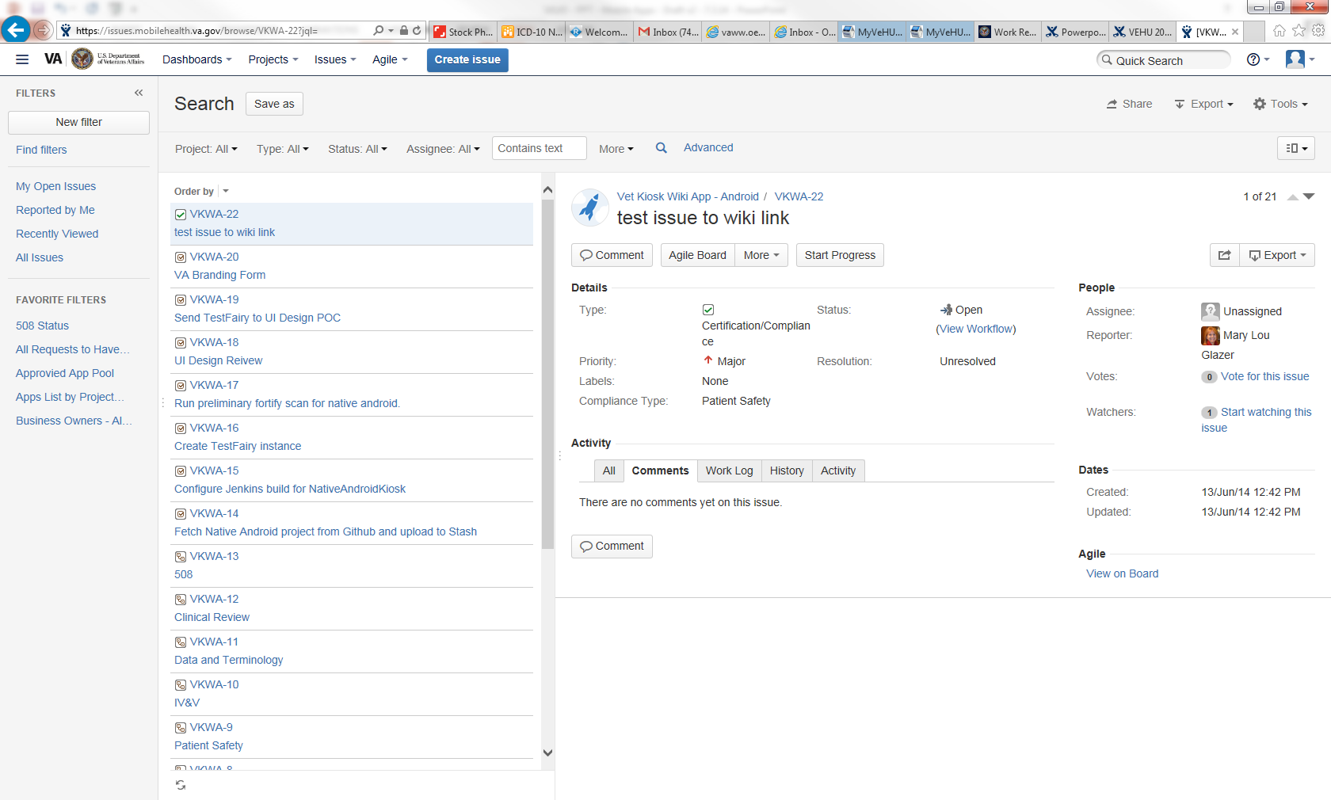
Notes:
Next choose Issue type = original request.
If you don't limit your filter this way, it results will include all issue types. By choosing the Original request you will have results for one hit per project.

Slide 60
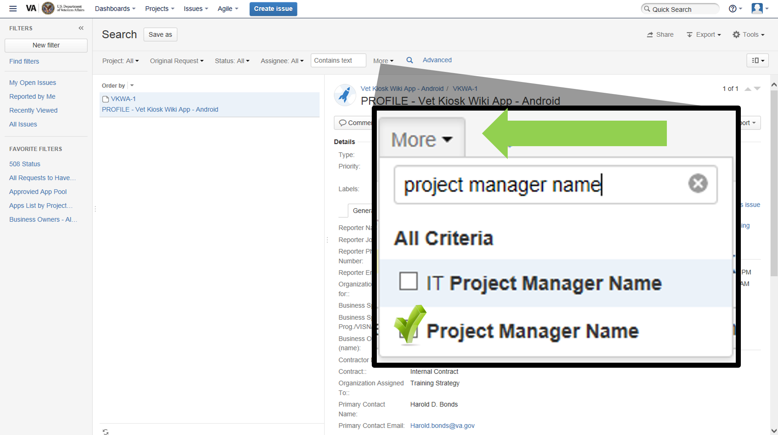
Notes:
Remember "More" is a drop down menu that displays all the fields that you can limit your results further. Here we are going to use the MORE drop down and choose the field Project manager name.
If it is not there, start typing project manager in the text box in the MORE drop down.

Slide 61
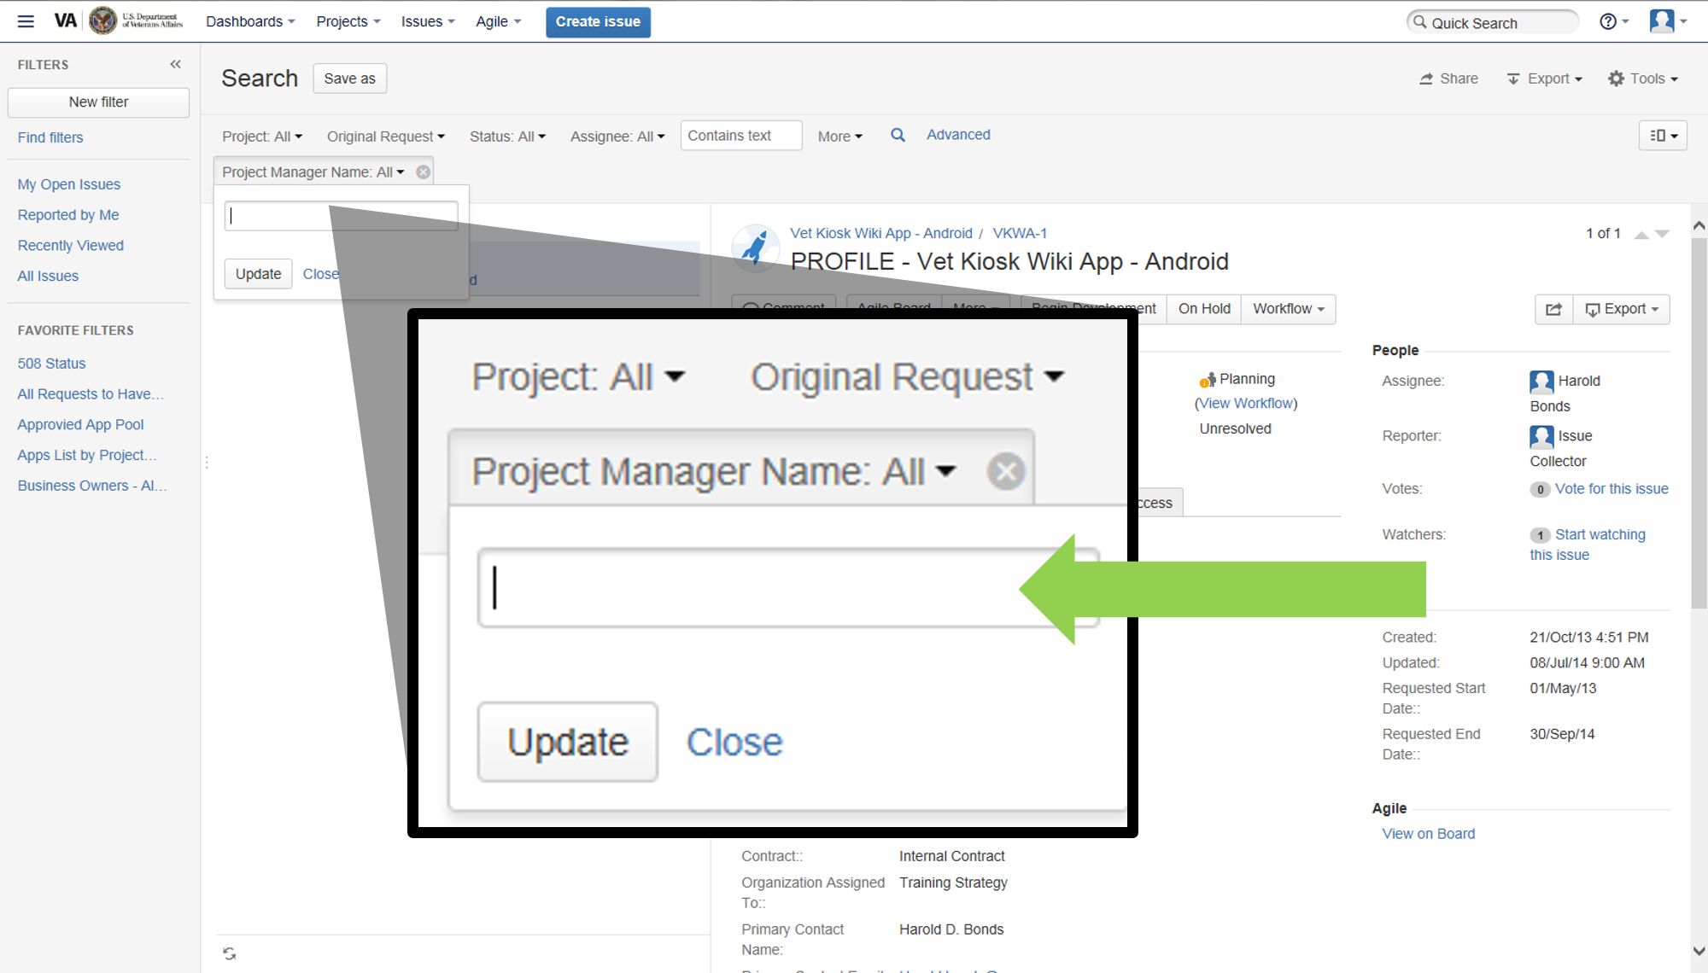
Notes:
Next a text box will appear that will enable you to add the PM name. I’m going to type in Harold Bonds, one of our project managers. Next choose update button.

Slide 62
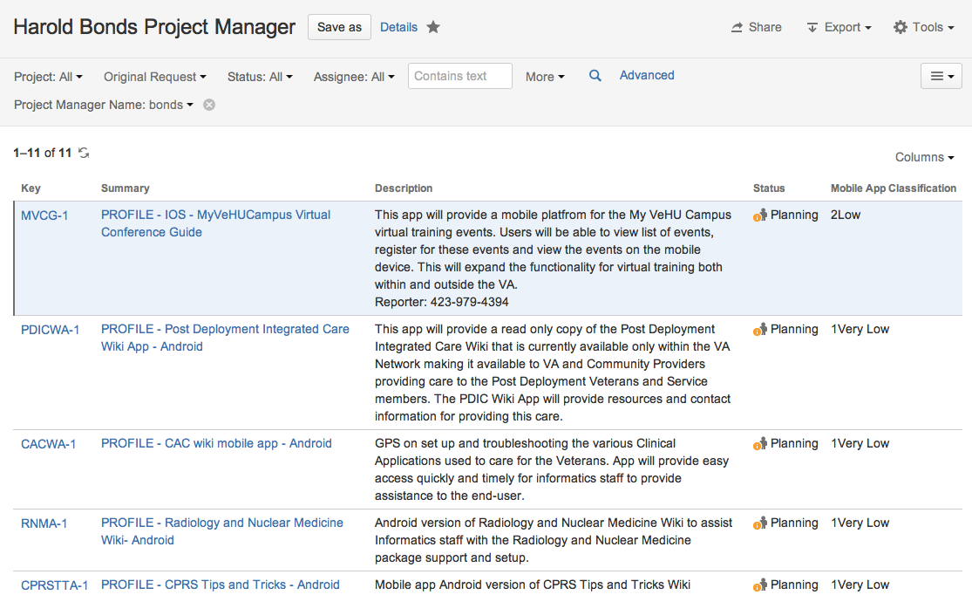
Notes:
Your filter will create a list of projects that the PM is responsible for.
Go ahead and save it by choosing the SAVE AS button at the top.

Slide 63
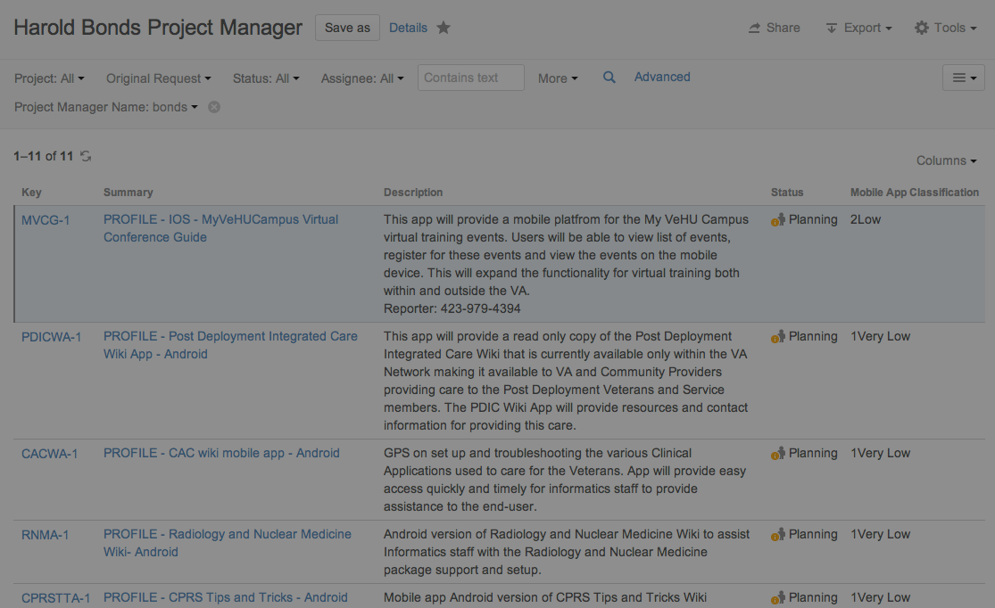
Harold Bonds Project Manager
Notes:
It is going to ask you to name that search filter. Let’s name it Harold Bonds Project manager - then select SUBMIT.

Slide 64
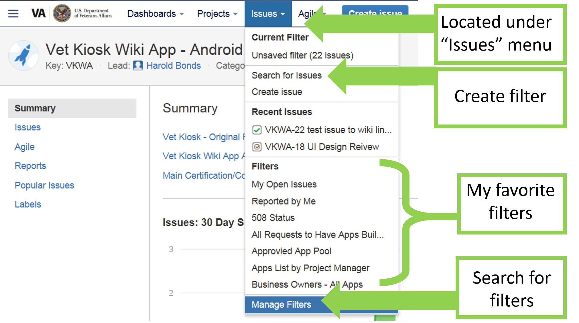
Notes:
There are a lot of already saved filters that you can access in JIRA. So before trying to create a new filter, see if there’s already one out there.
To add an already created filter as a favorite using the Manage Filters page:
To get there you’re going to click on the “Issues” drop down menu.
We want to search for a filter right now so we’re going to choose Manage Filters – it’s the last choice on the drop down.

Slide 65
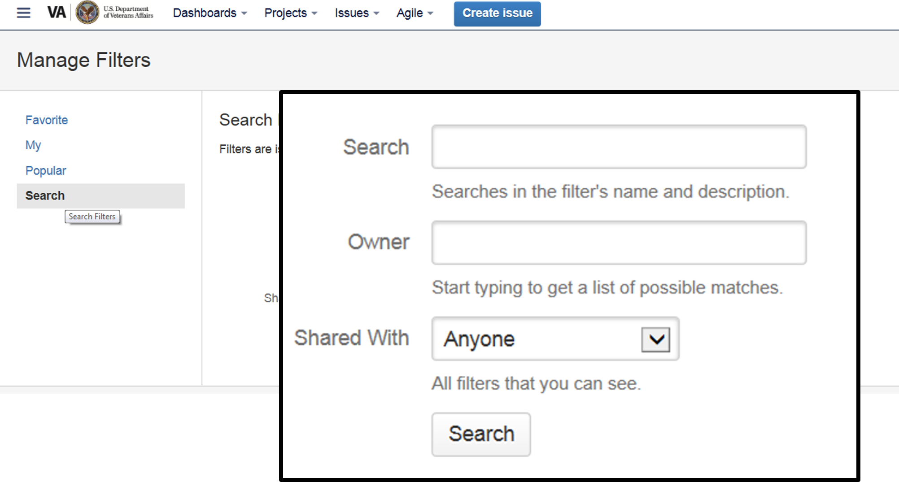
Notes:
Look on the left side of the screen you will see four choices: Favorites, My, Popular and Search.
If you created the filter, it is listed under the My tab, otherwise use the Search tab to find by name.
Choose Search.
Next, locate the filter you wish to add as a favorite.
You can search by filter name, or by owner – that’s the person who created the filter.
Let’s search my name. If we type in Mary Lou Glazer, all of my filters will pop up

Slide 66
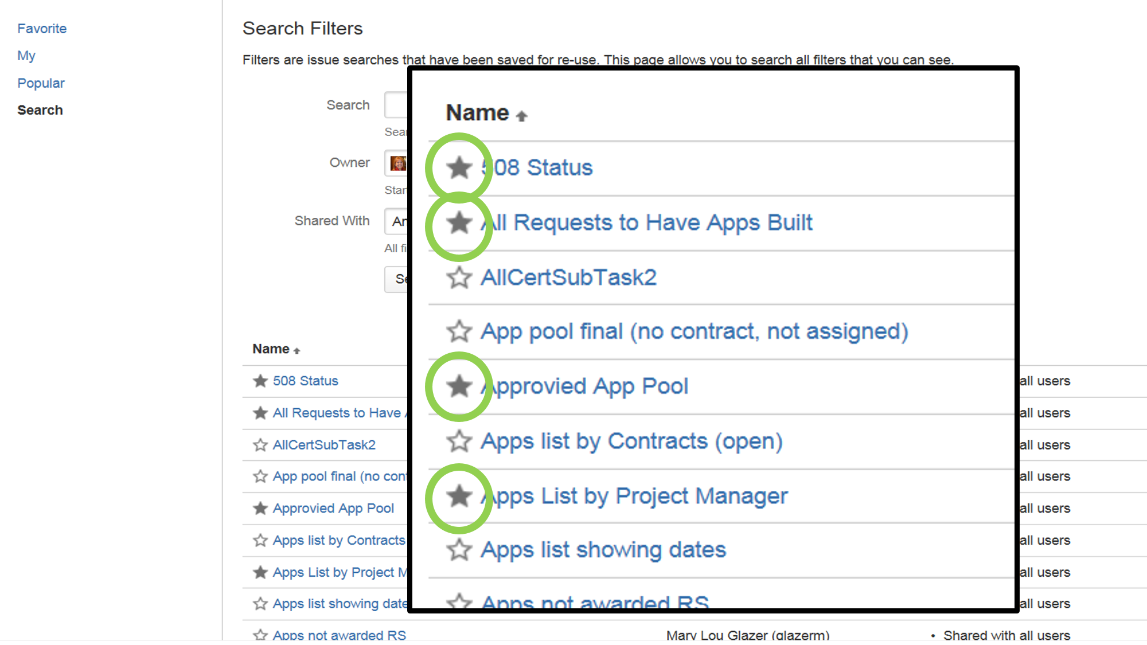
Notes:
And now you can add any of these filters to your list of favorites by clicking on the star to the left.
Here you see 4 apps have been selected or “STARRED” and so from now on when you go to your list of favorite filters, you will see them there. This is pretty much the same as adding a favorite website to your favorites in your web browser.

Slide 67
Dashboards
Customizable pages of chosen filters
Notes:
The last thing I want to go over with you today before handing the stage over to Chris is Dashboards.
A Dashboard is a customizable page that shows a a set of chosen filters.
Examples of Dashboards include:
Dashboards for Project Managers that display status of all the projects they are assigned.
Compliance status for Projects.
You can set up a dashboard displaying a variety of information for one Project.
You can customize your dashboard by adding charts, gadgets or widgets.

Slide 68
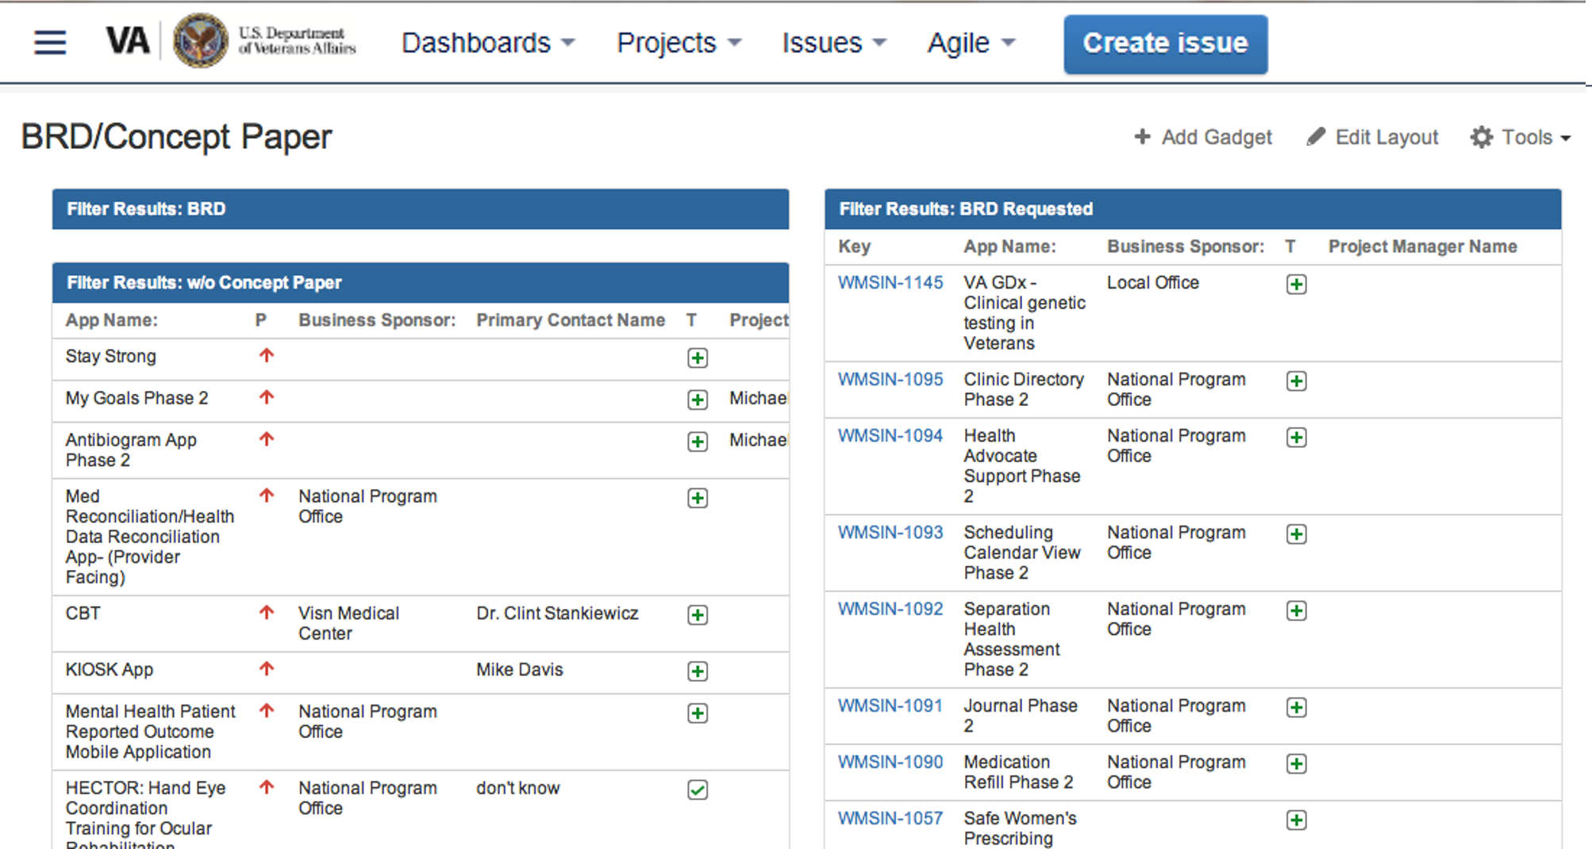
Notes:
Here we are looking at a Dashboard that shows several filters related to BRD’s and concept papers.
You can personalize and create multiple dashboards.
change layout including colors, edit content
Dashboards can make your life a lot easier when trying to track multiple projects.
You can copy dashboards, share them, create as many as you need.
Additionally, you can use filters already created by me or other staff members. We saw how to search for filters.
I have a dashboard that displays all app requests which can be shared with a variety of staff including those that need to know which apps will be needing requirements.

Slide 69
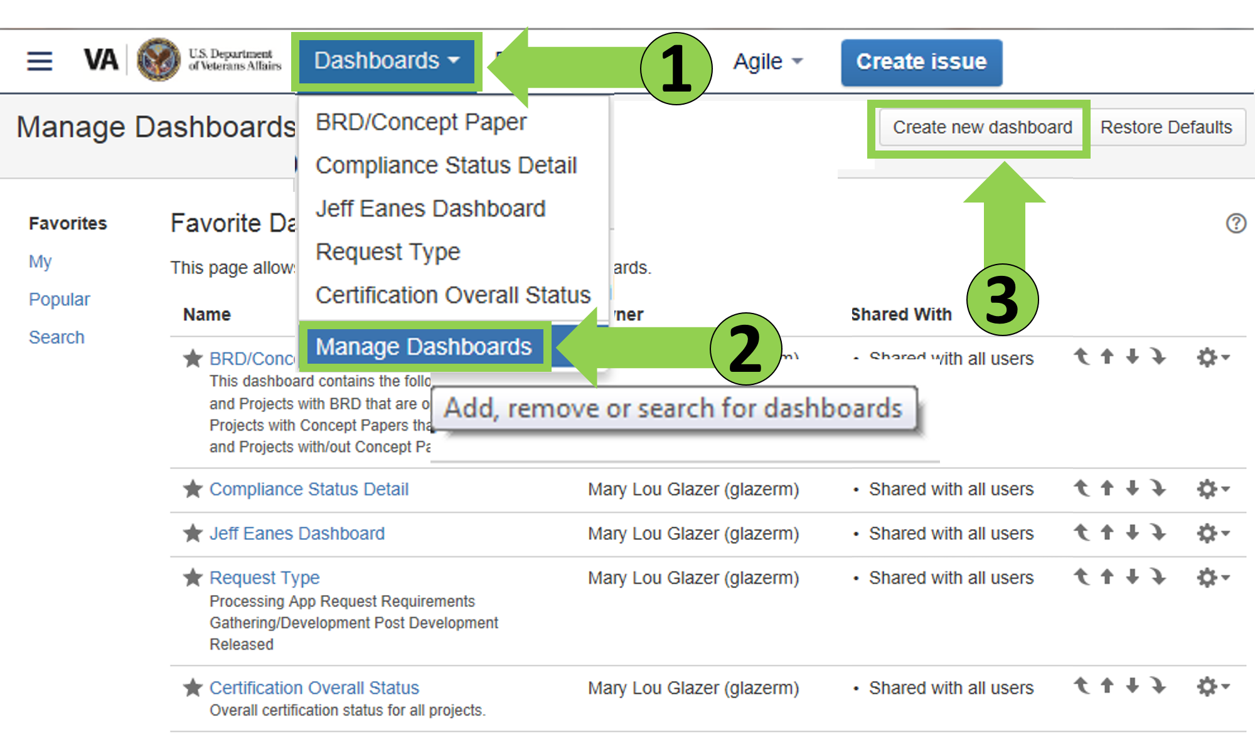
Notes:
You can search for Dashboards the same way you search for filters. To search for a Dashboard go to the Dashboard button at the top left of the page. A drop down will appear. Select Manage Dashboards.
Selecting a Dashboard as a favorite is also accomplished the same way you save a favorite filter. Once you locate the Dashboard you want, select the star to the left of the name to make it a favorite.
Let’s go ahead and create a Dashboard
Navigate to the manage dashboards page.
Once you get to your Manage Dashboards screen, Choose the create new dashboard choice on the top right.

Slide 70
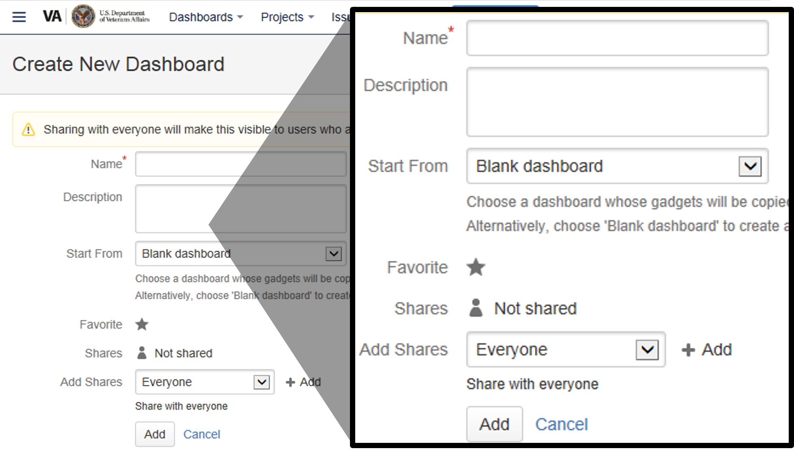
Notes:
A new screen will appear, Name the dashboard, enter a description if you like, We are essentially creating a blank board. We can add filters and gadgets later.
Share it as you wish by choosing the dropdown menu to add shares or leave it at Everyone and click Add.

Slide 71
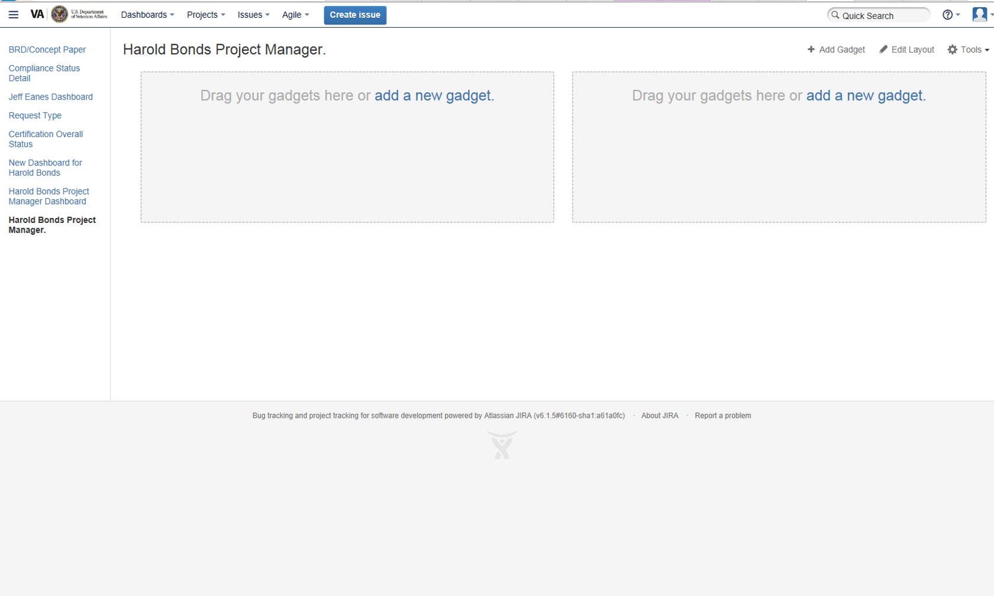
Notes:
Here is what our new black dashboard will look like. You can see here that there is a link called add a new gadget. We’ll discuss a few gadgets in a moment.

Slide 72
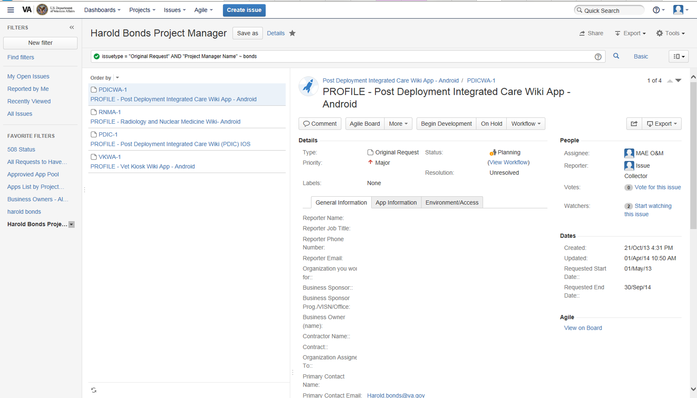
Notes:
Now that I have a Dashboard, I’m going to take this filter we created before called “Harold Bonds Project Manager” and share it to my new Dashboard..
Remember to locate the filter,
Go to issues, manage issues, search for the Harold Bonds Project Manager filter if you haven’t already selected it as a favorite.
Do you want to import filters others have created or see Dashboards others have created?
It is important here to note that you would have had to make the filter a favorite in order to view it on the Dashboard. I sometimes get questions from staff stating that they can see the Dashboard but not the content in it. That’s because you have to make the filter a favorite first.

Slide 73
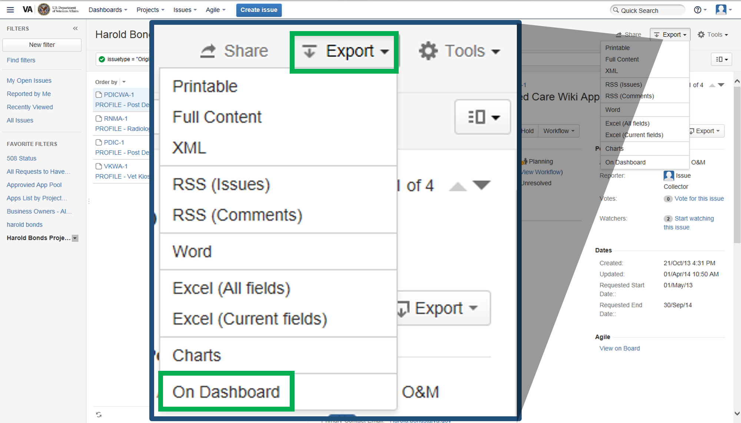
Notes:
This time choose the export drop down and choose
On Dashboard.
If you have several Dashboards, simply choose the one you want the filter to save to.
Now we’re going to go to the dashboard and take a look at the gadgets you could use.

Slide 74
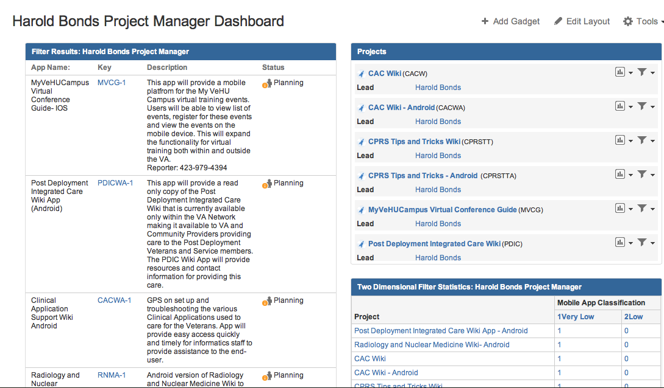
Notes:
Looking at the Dashboard we created we can see we have several different gadgets.

Slide 75
Notes:
On the left is the filter we just imported showing a listing of all Harold Bonds Projects.

Slide 76
Notes:
The gadget on the top right called Projects. Here I have selected Harolds projects from a drop down to display.

Slide 77
Notes:
And last on this Board I’ve used another gadget to display Harold’s Projects and their mobile classification.

Slide 78
Notes:
Let me show you how to add these gadgets.
On the top right of this page you’ll see the “Add Gadgets” button. When you click on it…

Slide 79
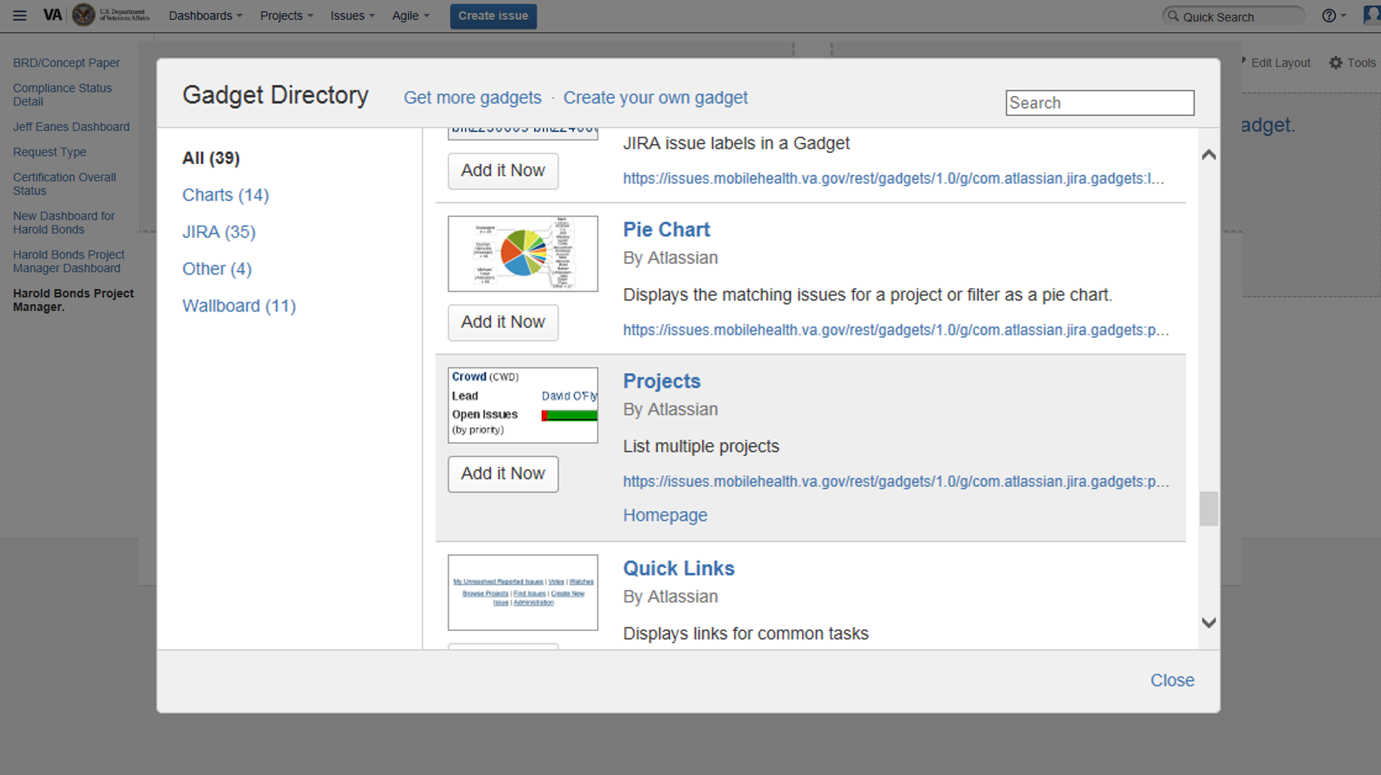
Notes:
…this pop up box will display.
There are a ton of different options in here. I’m not going to go through them all now. Get familiar with them when you have some time. In this screenshot you can see the “ project” gadget. I used that to add the “Projects” section to my dashboard that I just showed you.

Slide 80
Planning
Development
Compliance
Sustainment
Release
Perform Pre-Production Simulation
Perform IOS Field Testing
VA’s App Life Cycle
Notes:
Mary Lou:
Okay, so we’ve just finished walked through the PLANNING stage of the app development process, and we started touching on the DEVELOPMENT STAGE. We started looking at how to use the MAE JIRA to track and manage your App as it goes through its life cycle from conception to release and sustainment. I’m going to hand it over to Chris at this point, because there’s still a lot of ground to cover before an app is released. He’s going to walk you through the remaining phases of the process, explain why we have this new software development lifecycle, and show you a few more advanced features in the wiki space.
Welcome Chris on stage.
Chris:
Thank you Mary Lou
As Mary Lou said earlier, there are the seven stages to VA’s Mobile App development process. The Project Management Accountability System (PMAS) architects are working with Product Development’s Mobile App Processes team and Connected Health to create a new workflow.
Planning, which Mary Lou covered.
So I’ll start with the development stage
And then we’ll briefly cover
Compliance Review
Pre-Production Simulation
IOC Field Testing
Release
Sustainment
The processes in this workflow are changing all the time. We are applying it to the frontier apps already in the pipeline, and are constantly improving the workflow as we find best practices.

Slide 81
VA has optimized the MAE JIRA project tracking system for
agile development
Notes:
VA assists development by supplying the resources and management support to develop a VA App. VA resources include development tools and environments as described by Shawn Hardenbrook and Brian Olinger at a previous VeHu session.
Agile Methodology
For VA App development, VA subscribes to agile development methodology. VA has optimized the MAE JIRA project tracking system for agile development: Epics and stories, sprints and scrums. We define functional and nonfunctional requirements as JIRA issues, including generating all required documentation, adhering to compliance best practices, and passing all milestones. The MAE JIRA workflow aligns with the VA App project life cycle. Regardless of the methodology you follow to write the App code, when you upload your code to the MAE, VA manages its testing and release in an Agile-based project framework.

Slide 82
Agile methodology is FLEXIBLE
Notes:
For VA App development, VA subscribes to agile development methodology. VA has optimized the MAE JIRA project tracking system for agile development. Which is a rapid software development methodology.
************************
We define functional and nonfunctional requirements as JIRA issues, including generating all required documentation, adhering to compliance best practices, and passing all milestones. The MAE JIRA workflow aligns with the VA App project life cycle.
Regardless of the methodology you follow to write the App code, when you upload your code to the MAE, VA manages its testing and release in an Agile-based project framework.

Slide 83
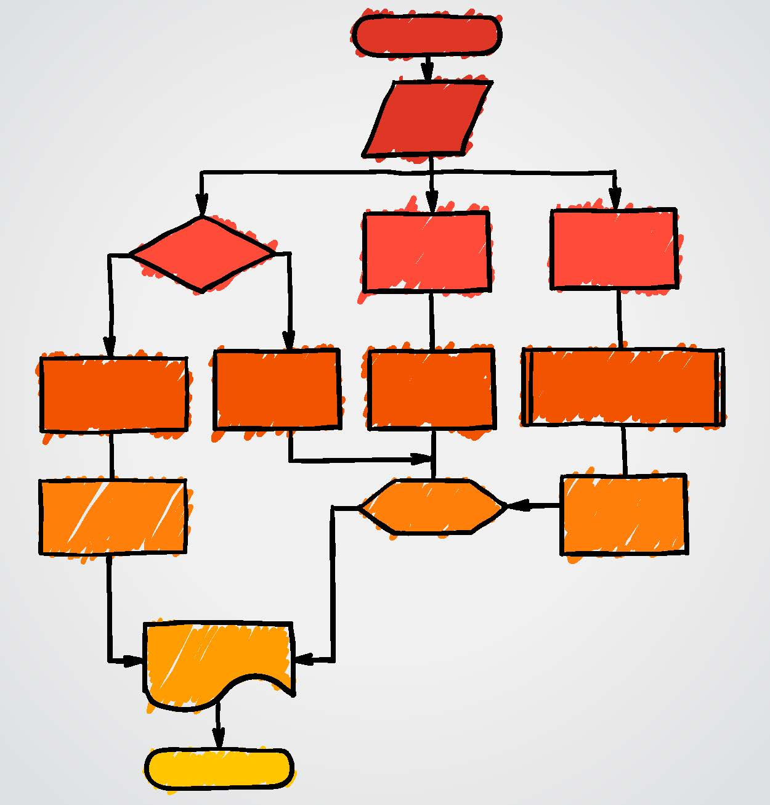
VA’s Project Management Accountability System (PMAS) Mobile App development workflow
Notes:
The presentation PPT which is available in the downloads, includes details about all of the major tasks identified in the PMAS mobile app workflow.
******************
We’ve provided a copy of the current approved workflow in the Downloads. And we’ve also provided the link to where it’s housed online which can be used to access future versions. As long as you have VA credentials, you can access the link.
If you have VA credentials, you can view the latest workflow here:
http://vaww.oed.wss.va.gov/process/maps/propath_process_146.pdf

Slide 84
Kick-off Meeting with Stakeholders
DEVELOPMENT
Notes:
The Project Manager organizes a kick-off meeting with the development team stakeholders to define a roadmap and vision for the App
***********************************
Hold a Kick-off Meeting
The Project Manager organizes a kick-off meeting with the development team stakeholders:
Business Owners
Subject Matter Experts
Project Manager
Scrum Master
Scrum team
In Agile terminology, the purpose of the kick-off meeting is to hold a kanban. At the meeting, define a roadmap and vision for the App:
Establish communication processes and tools used for all scrum team members.
Define its business objectives (Business Epics)
Define its architectural requirements and constraints (Architectural Epics)
Draft a high-level outline of three to six month deliverables.

Slide 85
Populate
the JIRA Project
DEVELOPMENT
Notes:
Populate the MAE JIRA Project
To conform to VA requirements, the project team tracks every conceivable detail, including compliance requirements and documentation requirements, in the MAE JIRA system.
However, the JIRA tool also supports agile development with the ability to document epics, features, user stories, acceptance criteria, risks, tasks, bugs, and more. At this point the team should review the use of the tool and build out the project's agile planning boards:
Align the Business Requirements with epics, new features, and stories in the App's JIRA project and add them to the project Backlog.
Devise unit tests for new features and stories.
Add tasks to the JIRA Scrum Board.
Identify any possible dependencies and link the task for the given top level task.
Assign tasks to sprints.

Slide 86
Conduct Sprint 0
DEVELOPMENT
Set up your MAE development environment.
Install toolsets.
Mock up a demo and present it to the stakeholders.
Incorporate feedback from the demo into the project tasks.
Identify any environment shortcomings.
zero
Notes:
Then you want to conduct sprint 0 where you set up your environment and make sure it works. The VAMF may need adjusting to accommodate your App in which case you need to submit a request for modification.
****************************
Conduct Sprint 0
The development team conducts a Sprint 0 to test the system and to gather enough information to scope the App. The team again reviews the App's business requirements and reviews the design documentation for the VA Mobile Framework (VAMF: see About the Mobile App Environment and Services).
Conduct Sprint 0:
Set up your MAE development environment.
Install toolsets.
Mock up a demo and present it to the stakeholders.
Incorporate feedback from the demo into the project tasks.
Identify any environment shortcomings that require modifying the MAE VAMF. If the team identifies required changes or additions to the VAMF, a change request should be initiated to ensure this dependency is identified and planned for early. The internal site, MAE Change Control Procedure provides the instructions for logging a change request. Changes to the VAMF require architectural reviews with internal and enterprise architects, so identify and pursue these requests as early as possible.

Slide 87
the App’s deliverables and adjust
Notes:
Once you’ve conducted spint 0 you may need to adjust your deliverables
*****************
Scope the App
Based on the results of Sprint 0, revisit the App's deliverables. The initial business requirements document may contain a greater scope of functionality than is practically achievable in the App's planned schedule. (Or, there may be time to expand the App's functionality.) Adjust the plan to accommodate a reasonable set of deliverables that fits the App's overall schedule and obtain agreement to the scoped requirements from all project stakeholders. Adjust the backlog accordingly.

Slide 88
Develop the App
Notes:
During development there are two important things that have to occur
You want to be coding to spec – do the best you can to follow all the compliance bodies review guidelines
Run your code through fortify scan
********************
Develop the App
The development team conducts a series of agile sprints to develop the App. In each sprint:
The developers code the sprint's targeted stories.
Quality Assurance engineers run the unit tests.
The team collaborates with the Compliance Review bodies to avoid potential issues. The team develops the documentation required by the Project Management Accountability System (PMAS). Your project's wiki comes with instructions and templates for these documents, which VA refers to as PMAS artifacts.
The team ensures the App works within the VA Mobile Framework (VAMF) architecture and MAE environments. If issues are found, a Change Request to the Mobile Application Management Team (MAMT) is submitted. See the MAE Change Control Procedure on the internal MAE network for guidance.
At the conclusion of each sprint, the team holds a sprint review to demonstrate the App to the stakeholders and compliance reviewers.
***********
Talking point for #3, collaborating with the Compliance bodies.
How the project team collaborates with the Compliance is still evolving. Many of the Compliance Review bodies welcome the chance to see what you're up to but the partners are looking for ways to improve these communications.
There is a recent development that makes staying in compliance during development much simpler. OI&T has taken the Compliance Review reports coming back on the frontier projects and reverse-engineered all of the bodies' tests checklists into a set of "Enterprise Non-Functional Requirements" (NFRs) and added them to the MAE JIRA Projects as individual issues. Now developers can look at each NFR and see if the App's code is going to pass review. This is a hugely significant step and should greatly improve the code quality coming out of the Development stage.
**If you find this App varies from the NFRs, you need to contact the compliance body …**

Slide 89
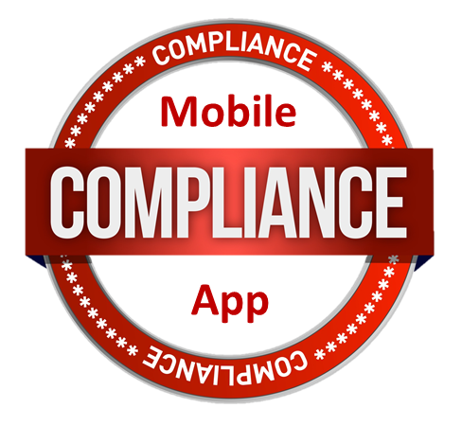
Notes:
Once youre done with development, you move into compliance.
There are 12 official compliance bodies.
Compliance bodies review the App to ensure it meets VA software standards. These bodies ensure your app is safe, secure, privacy is protected, and the app is efficacious.
If you’d like to read about each of these Compliance Review bodies, we’ve provided a PDF in the downloads with a summary of each body’s reviews.
*****************
Risk Level Determines Review Level Not all VA Apps undergo a complete review by all Compliance Review Bodies. Some Apps pose little or no risk of harm to users or the VA The Mobile App Governance Board assigns a risk level category to every Request they approve for development. The V&V review confirms the App has the correct category assignment. The category determines the thoroughness of the review. VA maintains a matrix for determining the risk level for each App.
Most Compliance Review Bodies are willing to conduct an informal review early in Planning or Development.
The Compliance Review stage begins when you hand the code off to Verification and Validation.
********************************
About the Compliance Bodies
Every VA Mobile App must undergo the following reviews (or be granted waivers) to ensure it meets all VA software standards:
About Verification and Validation: This review ensures that the App's code is free of bugs and meets all of its business requirements. The App must pass the Validation and Verification review before proceeding with any other reviews.
About Code Review: VA scans your App code with the Fortify scan tool and performs other tests to ensure it meets VA coding standards.
About the Clinical Review: If your App handles clinical evidence the Mobile Applications Governance Board arranges for an an independent clinical review when it approves the Request.
About the Data and Terminology Standardization Compliance Review: This team evaluates and interprets the App's data terms and ensures they map to standardized terms. The review team follows VA and Health Level 7 (HL7) standards.
About the Data Security Compliance Review: This review ensures that the VA can place the App on VA Government Furnished Equipment (GFE), and the information that may reside on the device is secure.
About the Enterprise Security Compliance Review: This review examines the App's source code to ensure there are no security risks and it is suitable for operating within the VA network.
About the Patient Safety Assessment: This review provides analysis and assessment of health care information technology patient safety issues based on specific combinations of user, task, technology, and environment of use.
About the Privacy and Application Data Security Compliance Review: This review ensures that Personal Health Information (PHI) and Personal Identification Information (PII) are appropriately protected and the data entered into the mobile device is appropriately secured.
About the Section 508 Compliance Review: This review ensures that the App meets Federal law requiring that individuals with special needs can use it.
About the User Interface Compliance Review: This review verifies that the Application App meets all required VA User Interface standards for Apps.
About the VA Branding Compliance Review: This review ensures that the colors, fonts and logos used in the App comply with the standards outlined in the VA Mobile App style guide.
About User-Centered Design: This review ensures a positive, meaningful and valuable user experience.
About Enterprise Systems Engineering: (ESE) provides central systems engineering services and management of a technical framework promoting one technology vision across VA, which supports system optimization, integration and interoperability throughout the enterprise.
*******

Slide 90
Verification and Validation (V&V)
Notes:
Hand off to Verification and Validation (V&V)
When we wrote this session, you first went to V&V. That may change, but the V&V team can still help you get started in the Compliance Review stage. There are some notes in the presentation PPT about V&V, and the Compliance Review handout describes V&V in more detail.
When the development team completes its sprints and the stakeholders are satisfied with its functionality, the Project Manager notifies the Product Development office's V&V team that the App is ready to move into the next stage of the project lifecycle. This workflow is the working draft of the PMAS V&V stage. If you have an MAE JIRA account, we’ve provided a link in the downloadable ppt where you can view the related documentation and backslides.
The V&V Team notifies the remaining Compliance bodies of an app's status in the review process and provides their findings.
While V&V coordinates reviews with the Compliance bodies, the App's Project Manager is responsible for pushing the App through.
**************************
If you have a MAE JIRA account, view the related documentation and backslides here:
https://wiki.mobilehealth.va.gov/display/PDFMA/MADW-4+Perform+Verification+and+Validation

Slide 91
Perform Pre-Production Simulation
Kick off User Functionality Test Meeting
Install or Download Product
Test Product
Document and Submit Findings
Review and Prioritize Findings
Provide Concurrence
Notes:
When you pass Compliance, your App moves into the Preproduction Simulation stage of the workflow. This is where you install the App in a simulated production environment and have the Subject Matter Experts bang on it to ensure it still does the job it’s supposed to do.
******************
The VA is currently updating and streamlining the process for conducting a preproduction simulation. We will be updating this section regularly as these processes are finalized. If you have an MAE JIRA account I’ve provided a link in the downloads for you to view the internal Release Stage procedures
These are the Simulation tasks in the latest workflow:
The App's Subject Matter Experts hold a User Functionality Test Meeting.
End users install or download the App.
End users test the App.
End users document and submit their findings.
The Project Manager reviews and prioritizes the simulation findings.
The Product Owner provides concurrence with the findings.
******************

Slide 92
Perform Initial Operating Capability (IOC) Field Testing
Notes:
After the Preproduction Simulation, the App moves to the recently added IOC Field Test stage. This is like a Beta: you put the App in a production environment and have target end users test it. Most apps won’t require a complete entry-to-exit IOC but all Apps require a field test.
**************
The VA is currently updating and streamlining the Initial Operating Capability (IOC) Field Test process. We will be updating this section regularly as these processes are finalized. If you have an MAE JIRA account I’ve provided a link in the Downloads where you can view the latest internal IOC workflow
These are the general IOC Field Test tasks:
The VHA Release Management Team for Initial Operating Capability (IOC) determines if the App requires IOC Entry Approval. For some very-low risk Apps, passing Compliance Review is sufficient.
If it does not require IOC Entry Approval, the Project Manager prepares an IOC exit document.
If it does require an IOC field test, the Project Manager submits the IOC Artifacts to obtain VHA Release Management approval for IOC entry.
The Release Manager submits a request for a field test.
The Information Technology Operations Manager installs the field test system components.
End Users test the App. For Mobile Apps, IOC Field Testing does not necessarily occur at sites; End Users may be from multiple sites.
When the App passes all testing, the Project Manager submits the App for VHA Release Management and Enterprise System Engineering approval.
******************************
Delete??:
Contact VHA RMT for IOC
Develop Artifacts for IOC
Submit for IOC Entry Approval
Resolve Issues
Schedule Field Test Start
Communicate Field Test Schedule
Release Application for Field Test
Install System Components
Test Product
Triage and Disposition of Defects and Issues ***
Perform Development and Testing for Remediation (only necessary if doesn’t pass IOC)
Submit for IOC Exit

Slide 93
Releasing and Sustaining a VA App
Review
Deploy
Sustain
Notes:
The Release and Sustainment stages
After field testing, your App is ready for release. But it doesn’t end there.
When you release your App you implement your sustainment plan. You provide support and user feedback.
*************
Project Manager conducts Milestone 2 review
Release Manager executes Deployment Plan
Release Manager also executes Sustainment Plan – includes Help Desk
**********************
<a href="http://www.shutterstock.com/gallery-790342p1.html?cr=00&pl=edit-00">Bloom Design</a> / <a href="http://www.shutterstock.com/?cr=00&pl=edit-00">Shutterstock.com</a>

Slide 94
Poll Question
Which of the following is a new stage in the VA App Lifecycle:
Desupport
Adolescence
Quality Assurance (QA)
IOC Field Test
Quality Control (QC)
Notes:
Okay, let’s see if you were paying attention.
Which of the following is a new stage in the VA App Lifecycle?
Desupport
Adolescence
Quality Assurance (QA)
IOC Field Test
Quality Control (QC)

Slide 95
Working in the
wiki
Notes:
When the MAE administrators set up an App JIRA project, they also create a Confluence wiki for it. You can author all of the project's business in the wiki space. It's easier to organize documentation in a wiki than on a shared drive or in JIRA itself, and since most project teams have members from different offices inside and outside the VA, it is the easiest way to author and share content.
I encourage you to take the Confluence getting started tutorials to learn your way around. Click the Question Mark icon in the top toolbar and choose Online Help.
****************
The links change with every new Confluence release (VA always updates to new release), so here is the typical navigation to the latest online help:
Click the Question Mark icon in the top toolbar and choose Online Help. The Confluence Documentation Home page opens.
Choose the Online Help link under Getting Help.
Read all of the sections in the Getting Started column. If you are not a Space Administrator, you can skip the Admin tutorial.
Look at the Popular topics. I recommend that you also read the Import content topic.

Slide 96
Wiki Keyboard Shortcuts
Exporting Wiki Content
Managing Notifications
Ordering Wiki Pages
About Wiki Spaces
Wiki Macros
Notes:
Wikis
Mary Lou explained earlier how each project comes with a wiki space.
The MAE wiki environment is like a shelf of books. Each App project has its own wiki space, which is the book on that project.
You store your project documentation in the wiki for convenience, but in fact you can create and maintain all of your documentation as wiki pages. And that’s good because they’re so easy to use and the content is so easy to access.
There are other things you can do. You can, for instance, keep your meeting notes in the wiki. You can identify active issues and track them here. Periodically you’re going to have to version some of your documentation. It’s easy in the wiki to identify a particular version or take a snapshot of the whole space by exporting it and then you have an idea of where a project was at a certain milestone or significant stage in the lifecycle.
I want to show you a little more about what you can with a wiki.
Wikis have certain advantages for technical communication. The structure allows you to reuse content from one source and it’s nonproprietary so it’s portable to many different formats.

Slide 97
Poll Results
Which of the following is a new stage in the VA App Lifecycle:
Desupport
Adolescence
Quality Assurance (QA)
IOC Field Test
Quality Control (QC)
Notes:
Alright, looks like the poll results are in….
Ad lib about poll results
Okay, let’s get back to the wiki.

Slide 98
Poll Results
Which of the following is a new stage in the VA App Lifecycle:
Desupport
Adolescence
Quality Assurance (QA)
IOC Field Test
Quality Control (QC)
Notes:
CLICK TO NEXT SLIDE

Slide 99
About Wiki Spaces
Notes:
Wikis are such a good collaboration environment that we use them for other efforts besides just project documentation.
The Compliance bodies have their own space where we encourage them to publish their specs.
The PMAS Mobile App workflow initiative has a space where we are developing our procedures and best practices.
The MAP team has several spaces where they develop process documentation, develop required document templates, record lessons learned, and many other topics.
Connected Health has a space for maintaining the outward-facing developer portal content.
The Connected Health Development team has a Developer Help Home space that is very handy.
We used a space to develop this VeHu session. Mary Lou and I use a space for our weekly status reports.
You can see all the spaces you have permission to see by selecting Spaces and then choosing Space directory.
***********

Slide 100
Organize content into knowledge bases
Notes:
27584143
Technical communicators look to organize content into knowledge bases. Knowledge bases are like data bases except knowledge bases handle human language in its entirety instead of in its measurable parts. A knowledge base has several important characteristics: It's portable, which means non-proprietary, standard open-source metadata you can transform into other markup languages and appliances; it's structured, which means the information has an object-oriented organization; and it's single-sourced, which means you write a topic once and you use it everywhere. The Atlassian Confluence wiki meets all of these criteria right out of the box.
Because it's portable, you can render it to just about any output format without altering the original. Because it's structured, it is re-usable in part or in whole. Instead of copying or rewriting a topic, you just reference the original source. Because it's single-sourced, it has an owner responsible for maintaining it. If you always reference the source, your information cannot get out of synch.

Slide 101
Wiki Keyboard Shortcuts
Add a link to another page
[ (enter page name)
Insert a macro
{ (enter macro name)
Mention a coworker
@ (enter first or last name)
Notes:
Now I’m going to show you some Keyboard shortcuts that we’ll use in a minute.
There are many keyboard shortcuts that are easy to learn and can significantly improve your authoring efficiency. We’re going to be using them in a few minutes for some of the other things we can do in wiki.
A few examples are:
Add a link to another page: Enter a square bracket open ([) and start typing the page name.
2. Insert a macro: Enter an open curly bracket ({) and start typing the macro name. Confluence suggests matching macro names.
3. Mention a coworker: Enter the At symbol (@) and start typing the first or last name.
Confluence shows matching MAE account names
*********
To view the complete list from any wiki page, click the question mark symbol on the right of the top toolbar and select Keyboard Shortcuts.

Slide 102
Managing Wiki Notifications
Notes:
The first thing I want to show you is how to manage Notifications
You get notifications and you push them to others. When you create, edit or comment on any wiki page, Confluence assumes you want to know about any other activity on that page. S s by default, it sends you an email notification of any subsequent activity on that page. If you chose to watch a space, you automatically get emails about all activity on all of the space's pages. Pretty soon the notifications start to overwhelm your VA mail inbox. There are a couple of ways to regain control of your inbox.

Slide 103
Notes:
You can always view All of your Notifications by clicking the Notifications symbol next to your avatar, you can see a list of all of the notifications sent to you.

Slide 104
Notes:
Now to stop watching irrelevant pages, click on your avatar in the upper right corner

Slide 105
Notes:
On your profile page choose WATCHES

Slide 106
Notes:
Your Watched Spaces and Pages list opens. Stop watching the spaces and pages you don’t need to watch.

Slide 107
Notes:
You can choose to Get the Daily Updates instead
Daily updates is one a day email…
From your Profile page:
Select Settings.

Slide 108
Notes:
Select Email.

Slide 109
Notes:
If you think you want to change any of the settings, click the Edit button at the bottom of the list.
Select Daily Updates. Confluence sends you an automated message every night summarizing all of the activity in all MAE spaces. It's very revealing.
While you're here, take a look at the other options.
CLICK SUBMIT.

Slide 110
Notes:
Stop Spamming your Coworkers
You might have noticed that every time someone edits a page you're watching you get an email notification, and then you get another notification a minute later. You’ve all probably gotten a string of email notifications in short order because people tend to save a page, discover they need to fix something, make a minor edit, and then save it again. Which is fine but you don’t have to spam your coworkers with notifications

Slide 111
Manage edit notifications
Notes:
When you edit a page, you can control who Confluence notifies. If you're making minor edits to a page, consider deselecting the Notify watchers check box before you click the Save button. If you're consciencious about it, when you do choose to notify watchers, your coworkers will know you aren't crying wolf.
Also, notice the What did you change? field.

Slide 112
Notes:
I’ve included additional instructions in the presentation PPT about how to make sure someone sees a page.
*********************
Pushing Notifications
There are ways to ensure someone does see your activity on a page.
Sharing
A direct way to notify MAE users about a page is by sharing the page with them.
Click the Share item and then start entering the name of an MAE team member. Confluence displays matching names as you type. Select the matching name and start entering the next. Add a note about why they might want to see the page, and then click Share.

Slide 113
Notes:
Inserting a Coworker's Name
You can also push a notification to a user by inserting their MAE user name in the page or in a note.
Click the +Insert button in the edit mode toolbar and choose the User Mention option. Then start typing a name. Confluence autocompletes matching names for you to choose.
Use the keyboard shortcut: Enter the At symbol (@) and start typing a name.

Slide 114
Ordering Wiki Pages
Ordering Wiki Pages
Notes:
Confluence orders child pages alphabetically by default. A lot of people have trouble with that. You can re-order pages as you create them, but it’s clunky. The handout includes instructions for dragging and dropping pages into a new structure.
*************
To reorder pages, choose Browse and then Pages.
Choose Tree in the top row of menu items.
Click the right angle bracket beside the space’s home page to expand the nested page list.
Expand as many nested pages as necessary to reorder the pages.
Drag a page to another location. Confluence automatically fixes all incoming and outgoing links to the page.
You can move any page by dragging it to a new position in the tree

Slide 115
Notes:
Macros
Macros are Confluence scripts that run behind the scenes. There are many excellent macros that you can insert into your wiki pages and I encourage you to look through the library. The handout shows how to insert a JIRA issue onto a wiki page but I’m going to jump ahead to showing you how to insert the JIRA filter Mary Lou created earlier.
*****************
There are many useful wiki macros that save as XHTML scripts in the page metadata. For example on project home page – I might want a collection of open issues or a pie chart of results. I can use embedded JIRA filters to do all this. (ad lib about all the stuff you told Jess on the phone).
Today I’m going to show you guys how to embed a link to a JIRA issue so that someone can quickly and directly navigate to that issue page and also embed a JIRA filter in your wiki page.
************************************************
Embedding a link to a JIRA issue
To add a link in a wiki page to an MAE JIRA issue:
Copy the issue identifier to the clipboard.
Open the wiki page, click Edit, and place the insertion point where you want the issue link.
Type the { character. The Macro Selector opens.
Start typing JIRA. The Selector shows JIRA-related macros.
Select the JIRA logo macro. A dialog box opens asking for the JIRA issue.
Paste the JIRA identifier in the field and click the search icon. The macro displays the identifier in a list.
Select the issue identifier and save.
Save the page and test the macro.
Embedding a JIRA filter
To embed a JIRA filter output on a wiki page:
Copy the filter identifier to the clipboard.
Open the wiki page, click Edit, and place the insertion point where you want the issue link.
Type the { character. The Macro Selector opens.
Start typing Filter Results. The Selector shows the JIRA Filter Results macro.
Select the Filter Results macro. A dialog box opens asking for the filter name.
Paste the filter identifier in the field and click the search icon. The macro displays the identifier in a list.
Select the issue identifier and save.
Save the page and test the macro.

Slide 116
1
Notes:
First let’s go over how to embed a link to a JIRA issue.
Head to your wiki space page – whatever parent or child page you want to embed your link on.
Here I’ve actually created a child page entitled “Adding a link to a MAE JIRA issue to a wiki page” for the sake of this little demo.
Choose edit…

Slide 117
Notes:
Remember those keyboard shortcuts we looked at earlier?
The keyboard shortcut for macros is the squiggly bracket you see on the screen here.
Type the { character. The Macro Selector opens.
Start typing JIRA. The Selector shows JIRA-related macros.
Select the JIRA logo macro.

Slide 118
3
4
Notes:
A dialog box opens asking for the JIRA issue.
Here I’ve started in that key from earlier – VKWA-1. I hit search and it displays the search results. I check the issue I want and hit insert.

Slide 119
4
Notes:
Preview and or save

Slide 121
1
Notes:
Okay, we’re going to do something similar – but this time we’re embedding a filter instead of a link.
Head to your wiki space page – whatever parent or child page you want to embed your filter on.
Here I’ve actually created a child page entitled “Embedding a JIRA Filter macro” for the sake of this little demo.
Remember that filter you guys created with Mary Lou earlier? Entitled “Harold Bonds Project Manager”? Why don’t we embed that in our wiki space. To get started ….
1. Click on that edit button in the top right corner

Slide 122
2
Insert a macro
{ (enter macro name)
{
Notes:
2. Select where on the child page you would like to insert the filter, click, and start typing {.
When you type the bracket, this drop down menu will appear. You can open the macro browser if you want. OR just start typing “filter results”

Slide 123
3
Notes:
3. Select FILTER RESULTS

Slide 124
4
Notes:
This is where you need to know your filter identifier – or in other words your filter name. So we’re going to start typing “Harold Bonds Project Manager”

Slide 125
Notes:
Customize how the filter displays. Here, we accept the default configuration.

Slide 126
Notes:
Make sure to set your refresh interval so that the filter updates any time any changes are made ….

Slide 127
Notes:
Always a good idea to preview….
And then click Insert.

Slide 128
Notes:
Doesn’t look like much when you insert it. But this more or less just a placeholder for the filter data.

Slide 129
Notes:
If you click on the box you’ll get these options to either edit or remove. You can edit the macro or remove it at any time.

Slide 130
Notes:
And this is what your filter actually looks like – your output. If you set the refresh, Any time Harold becomes project manager for a new project it will show up here.

Slide 131
Wiki Content
Exporting
Notes:
You can export one or more wiki pages, or a whole wiki space into several formats. For PDF exports, you can control the look and feel of the content.
I’ve put together a handout that describes exporting your page, pages, or the parts or all of a wiki space to several formats. In fact, we made all of the downloads we’ve provided today using these instructions.
Click on the Green download button to get a handout with PDF Export instructions tailored to the MAE.
************
You can also export a page, multiple pages, or a whole space to HTML, XML, Word, or PDF.
WHAT ARE BENEFITS OF THIS? WHY MIGHT PEOPLE WANT TO DO THIS?
Handout:
https://wiki.mobilehealth.va.gov/download/attachments/26777635/WPD-ExportingWikiContent-080714-1710-422.pdf?api=v2

Slide 132
Ask the Presenter
Notes:
We’ve talked a lot about JIRA and Confluence features, but it’s important to know that all of the Mobile App partners has been so busy pushing the existing Apps through the pipeline, we have only implemented a fraction of what they can do. We’ll be adding more features as we go along.
If you haven’t submitted your questions yet, it’s not too late to do so. Just use that orange ask the presenter icon above my head to ask your questions now. We’re going to show a brief announcement and then Mary Lou will be joining me on stage again so that we can answer your questions.
(STAND STILL AND SMILE)
*****************
The governance board in combination with Kathy and Neil make the decision to prioritize.

