Slide 1

ICD-10 and Dual Coding
Steps to Success
Elena Miller
Tina Schumacher
Notes:
Tina - Thank you moderator (moderator’s name here). We are so glad to be here today to discuss ICD-10 and Dual Coding Steps to success!
During today’s session we will outline the steps necessary for a successful ICD-10 Dual Coding Program.
We will also provide tools including examples of a Business Case, staffing analysis and tracking forms to help you assure program success.
Most industry experts agree dual coding should be an integral part of your overall ICD-10 implementation plan. Today, we will work through with you the steps for a successful ICD-10 Dual Coding Program from implementation to outcomes.
The session will also include steps to setting up the program using a phased approach which we will target in detail.
We will also discuss data derived from the study and how each station can individualize what type of data collection method would work best for you.
A copy of today’s presentation as well as many of the tools we will be discussing today can be down loaded for your use using the green download button above my head.
Elena is going to start us off today by asking our first polling question.

Slide 2

Poll Question
Who do we have in the audience today?
    Coder
    Coding Supervisor
    HIMS Chief
    Other
Notes:
Elena -
Thanks Tina….Now that you have heard a little bit about us and our program today, we would like to get to know you. To do that, we would like to poll our audience today to see who we have with us.
Coder
Coding Supervisor
HIMS Chief
Other
To answer this question, use the blue polling icon above my head. We’ll move on and come back to your results in just a moment.

Slide 3

&
VISN 2 VISN 9
Notes:
Elena ---
Before we start moving through today’s presentation we would like to give a shout out of thanks to Lisa George in VISN 2 and Kathy Hart in VISN 9 who assisted us greatly with this presentation by sharing their VISN’s plans, tools and ideas.
Throughout today's presentation we will be referencing many of their valuable tools and process which they have generously shared not only with us, but with you our audience as well.
You will see a variety of tools used throughout the presentation, these are examples of works completed and in progress to aid you in your planning process not only for dual coding but for ICD-10 prep in general.
So again, to Lisa and Kathy……Thank you!!!

Slide 4

ICD-9
ICD-9
&
ONE time
&
ONE coder
ONE encounter
ICD-10
ICD-10
Notes:
Tina - Most of us would describe dual coding as coding a record in both the ICD-9 and ICD-10 code sets.
Sounds simple enough right? But let me throw a little wrench in it by discussing a couple of different methods being used in dual coding projects across the country. Throughout today’s presentation you will hear us say that there really is no “cookie cutter” approach to dual coding.
Elena - That’s right Tina, it’s just like the saying you’ve seen one VA, you’ve seen one VA…we can say the same for dual coding; one dual coding project does not equal the other….looking at the methodology alone, we will see that right off the bat!
Tina --According to Lisa Fink and Kathy Johnson in their Emerging Best Practice ebook on the subject, there are actually numerous methodologies for dual coding…let’s talk about a few of those on the next slide.

Slide 5





Dual Coding Methods
Use of temporary staff for dual coding
Simultaneous dual coding by one coder
Dual coding of one chart by two coders
Dual coding and inter-rater reliability
Notes:
Tina - The first one is - simultaneous dual coding by one coder ---the coder first codes the chart in I-9 and then goes directly to coding the same chart in I-10 ---Definitely the most popular and probably most cost effective choice, however there are great points to consider in all of the following methods as well.
Dual coding of one chart by two coders ---If one of the goals of your facility is to assess additional resources required in the coding of ICD-10, production time should be measured by using two coders to do the dual coding, one coding with ICD-9 and one with ICD-10. This method will reduce the bias of reviewing the same record twice.
Elena
3. Use of Temporary Staff for Dual Coding: Use temporary or outsourced staff to code in ICD-9 and submit claims while regular coding staff code 100 percent of discharges in ICD-10 for three to six months prior to the October 1, 2015. This approach has the potential to make the transition a smoother process for the coders and physicians as they will have worked out the challenges prior to the go-live date. This method provides data for multiple uses to include financial modeling, testing and reporting.
4. Dual Coding and Inter-rater Reliability: With this method several coders code the same record in ICD-10. This method allows for coders to practice, but it also enables the study results to be used to establish a measure of reliability. When several coders code the same record, followed by an educational discussion about the matching and mismatching codes selected, the degree of agreement among coders can be measured. Results from inter-rater reliability studies can be used for developing an organization’s ICD-10 policies and procedures, as well as the quality and productivity standards that the coders will be expected to meet. This method is a good choice if the goals of the project are more educational in nature.
Tina - We will circle back around to these when discussing implementation planning but for now let’s move on to discuss additional benefits.
*************************
Resource: Dual Coding in Preparation for ICD-10: Emerging Best Practice

Slide 6

Decrease in coding productivity
Reduction in the flow of revenue
from 16,000
to 155,000
Notes:
Tina - Why are we putting such an emphasis on doing this in VHA?
National statistics depict an overall decrease in coding productivity as well as a reduction in the flow of revenue for all organizations that are affected by the implementation of ICD-10. This is primarily due to the fact that ICD-10 has over 155,000 codes as compared to approximately 16,000 within ICD-9.
A successful transition to the new code structure will require all VHA facilities to be well-versed and sufficiently experienced with ICD-10.
Health Information Management (HIM) professionals, Coders, and VA Providers will need to devote a significant amount of time and VA resources to make certain the transition period is positive and their ICD-10 confidence levels are high.
You have heard the saying ….see one, do one, teach one… we can apply this concept to learning ICD-10 as well. Most of us by now have been exposed to learning ICD-10 by the “book”….and at one time, we also learned to code ICD-9 that way as well…for some of us, it has been longer than others.
Elena , I am sure you can relate and if you think back to those days, you remember what it was like to go through the coding classes thinking great, I got this, I know how to code, right….and then you got your first coding job and…..surprise, the documentation you coded in the “books” didn’t quite match the reality you were seeing come across your desk!
Elena ----Exactly…..and well here we all are, back to the same …although, not to that extreme as we do have experience on our side.
Dual coding gives us the practical experience ahead of time….so we aren’t just walking in the door to a new job once we are live!
Tina will discuss about some additional benefits on the next slide.

Slide 7

Notes:
Tina
When implementing dual coding in an organized and structured manner, the strategy has a multitude of benefits; none more important than ensuring a seamless transition from ICD-9 in order to prevent a negative impact to VA’s revenue stream and workload capture.
Dual coding will also add:
Supervisor validation of staff productivity related to ICD-10, as well as an awareness of potential staffing, training, and clinical documentation needs and
A facilitation method to increase communication with VA Providers and coding staff.
Now Elena, lets circle back with the results of our first polling question.

Slide 8
Poll Results
Who do we have in the audience today?
    Coder
    Coding Supervisor
    HIMS Chief
    Other
Notes:
Elena ----Now let’s pause for a moment and take a look at your poll results.
Elena to speak to results.
Tina --- Thanks everyone, glad to see so many of you with us today, now lets move on and talk about some additional benefits to get you excited about dual coding at your site.

Slide 9

Poll Results
Who do we have in the audience today?
    Coder
    Coding Supervisor
    HIMS Chief
    Other
Notes:
CLICK TO NEXT SLIDE

Slide 10
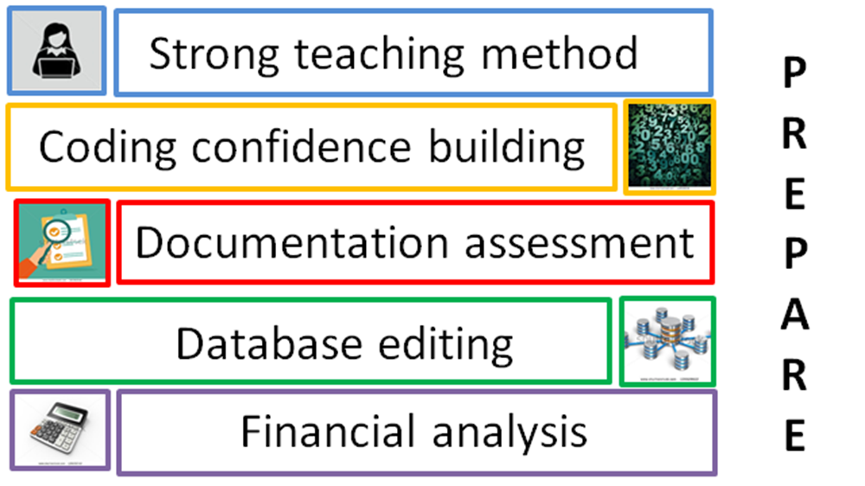





Notes:
Tina - We have heard Centers for Medicare & Medicaid Services (CMS) say that ICD-10 implementation will be budget-neutral.
Well, that just means CMS’s budget will be budget neutral and not necessarily ours. There will be winning and losing service lines within our facilities, rendering a potential loss or gain in third party and VERA revenue for the VA.
Dual coding can offer our service lines the opportunity to learn where those discrepancies may exist and how their documentation can provide the means to keep that at bay and ensure they are getting the proper workload credit for everything they are doing.
We will explore some of these benefits in today’s presentation and if you want to explore that topic further, consider tuning in to VEHU tomorrow to watch the session titled …CDI for ICD-10 where Dr. Deborah Meesig, Chief of staff at the Chillicothe VA and I will go into this topic in great detail.
Be sure and register for the session….and did I mention there will be free CMEs offered to providers as well for this session, so be sure and get the word out to your providers ….as Dr. Meesig says…everyone loves free CME’s!
Elena …I know I love those free CME’s as well… now let’s start down the road of establishing a great foundation to begin your dual coding strategy..
Slide Reference:
Preparation for ICD-10
Best practices to accomplish dual coding.
By Bonnie S. Cassidy, MPA, RHIA, FAHIMA, FHIMSS

Slide 11

Establishing the Foundation
AHIMA Approved ICD-10 Trainers
ICD-10 Super Users
ICD-10 Training Plan
Baseline Metrics
Learning Lab
Provider Education
Performance Standards
Notes:
Elena - Okay, so this may all sound great in theory. But let’s look at some real life applications of Dual Coding by VISNs who decided to embrace the approach. Dual coding began for some stations when they were asked to participate in the VHA Learning Lab .
VISN 9’s approach to a “Dual Coding” Program came about in a round about way and evolved over the past several years in anticipation of ICD 10. Their adoption of the Dual Coding process was perhaps influenced by their participation in the Learning Lab. Though Kathy Hart told us she believes it was always on the back burner just waiting for the timing to be right and would have happened anyway.
Tina -For the VISN 9 Consolidated Coding Unit as well as with many of you, the foundation may begin with sending some to the ICD 10 Training Academy to become AHIMA approved ICD 10 trainers.
In addition many of you also heeded the call from the National HIMS Office to appoint Super Users to assist in rolling out training to staff.
Of course, it almost goes without saying but it is essential that a coding program have baseline metrics established for measuring productivity and quality.
Elena - We hope all of you registered and will tune in for Friday’s VEHU session when Pam Heller and Shelley Weems will present a session titled Avoiding ICD -10 Coder Productivity Loss. In this presentation you will learn all about the lab several of our VISNs participated in.
By now I am sure you are all wondering., just how do I get started…we will explore this in a phased approach over the next several slides…

Slide 12
Phase 1
Pre-Implementation
Phase 2
Implementation
Phase 3
Post Implementation
Notes:
Tina - It is always easier to work through any Implementation using a three phased approach, which is how we will walk through the dual coding process with you today.

Slide 13



Pre-Implementation
Facility
Coder
Provider
Education, Training Resources, Analysis
Notes:
Tina–In the pre-implementation phase we will walk through what each facility needs to plan in terms of :
Staffing analysis and budgeting
Coder Education Plans
Coder Training Resources and a
Business Plan to put it all together
We will go through all of these in detail.

Slide 14

Implementation
Notes:
Elena- Next we will move to Implementation including topics and tools to aid in the:
Strategy – including ongoing assessments and monitoring
Data Collection
Data Analytics

Slide 15

Post Implementation
Notes:
Tina – And lastly we will explore Post Implementation – or as I like to say, reaping the rewards. This will put it all together and outline the future in regards to provider education by monitoring their documentation; and reviewing encounters to be sure providers are prepared for ICD -10 in order to assure good workload capture.
Then we will also circle back around to Coding Education and discuss lessons learned to continue to monitor and audit ICD-10 coding accuracy and ensure staffing levels are up to speed when the new system begins.
Elena is going to get us started with the first phase on the next slide.
*******************************************************

Slide 16


Pre-Implementation
Complete a staffing analysis
Notes:
Elena - Let’s begin with pre-implementation:
Pre Implementation can begin with a good staffing analysis. What does your coding workforce look like today and how can you accomplish your daily workload currently while adding the additional education opportunity that comes with dual coding?
How much time can you allot to each coding professional for dual coding each week? Will you need to add to your current staffing to combat the productivity loss? Will you need to pick up a coding contract during the preparation time to allow your current staff to spend additional time concurrent coding.

Slide 17

Fill vacancies now
Consider coder retirement
Outsource
Pre-Implementation
Notes:
Elena - What is the picture of your current staff? Fill any vacancies you have in advance for a smoother transition to ICD-10. This will ensure coders are trained and ready for implementation and then identify coders who are planning on retiring and perhaps have them focus on I-9 rather than on I-10.
If you are lucky enough to bring on new ICD-10 trained staff, you may want to consider keeping them solely on ICD-10 as part of your dual coding plan as we saw in methodology # 4 in the previous slides.
Realizing budgetary factors may force your staffing hand, it is important to start those conversations now, giving administration a clear picture of your staffing needs and working with the budgetary restraints to come to a workable plan.
Tina Do you have current backlogs? Is it time to consider external coding contracts to assist your facility in decreasing the backlog now and to assist with any overflow needs once transition occurs.
Consider using the coding contract to work on current workload while allowing current staff to dual code on a more consistent basis as we saw in one of the methodologies a few slides back.

Slide 18

50-70%
reduction
in inpatient productivity
Notes:
Tina - Once we transition to ICD-10, inpatient productivity is expected to decrease by 50 -70%. Therefore, facilities should first determine their current staffing needs for ICD-9. Then determine, based on a 50-70 % reduced productivity rate, how many additional inpatient coders will be needed to accomplish that same workload but in ICD-10.

Slide 19
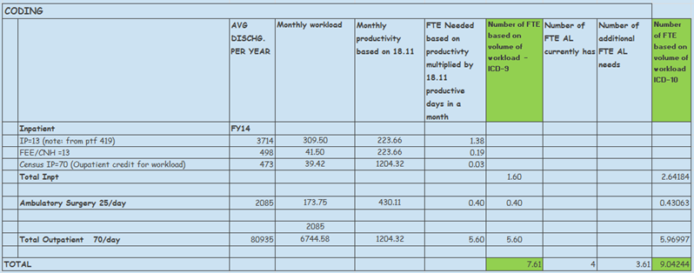
Staffing Methodology
Notes:
Elena - To assist facilities with determining staffing needs, here is an example of VISN 2’s staffing tool which assesses how many inpatient, outpatient and surgery coders are needed.
This tool uses productive days in a month based on total work hours and excludes education, vacation, and holidays.
This staffing methodology can be utilized not only to determine current ICD-9 staffing needs but to project ICD-10 staffing needs. This can be accomplished by utilizing the anticipated reduction in inpatient coding productivity .
Now that we have completed our staffing analysis, let’s move on to talk about coder training plans which is also a vital component to pre-implementation.

Slide 20
Phase 1: Coding Core Competencies
Coder Training Plan
Phase 2: ICD-10-CM AHIMA Training Practicum
Phase 3: Educode
Notes:
Tina ---Many of you are already well on your way to establishing a great coder training program and have certainly taken advantage of all of the nationally offered training available to VHA which we will reference later in the program.
Elena, let’s walk through one VISN’s training plan in detail with our audience today to give them some great ideas of what to incorporate to ensure they are covering all training bases.
Elena –Great idea Tina and to do that today, we will be walking through VISN 9’s CCU ICD 10 Training Plan, providing our audience with the visuals on the screen.

Slide 21
Phase 1: Coding Core Competencies
Coder Training Plan
Phase 2: ICD-10-CM AHIMA Training Practicum
Phase 3: Educode
Notes:
Elena - Individualized Learning Plans were developed for all coding staff to be delivered in 3 phases:
Coding Core Competencies
ICD 10 practicum
Elsevier Training

Slide 22
Phase 1: Coding Core Competencies
Goal is to establish a
in medical
terminology, anatomy,
pathology and pharmacology
foundation
Notes:
Elena - Since VISN 9 has a staff of nearly 60 FTEE is was essential that they had a means of tracking completion of each phase of their ICD 10 training program.
Phase I of the plan was Coding Core Competencies which was intended to establish a good foundation for each coder in medical terminology, anatomy, pathology and pharmacology, these types of lessons were assigned by the Elsevier Administrator and each coder’s progression to completion was tracked during the course of the year.
They met that goal at the end of FY 13.

Slide 23
Phase 2: ICD-10-CM AHIMA Training Practicum
Face-to-face
training that is
interactive and hands-on
Notes:
Tina - Phase II of the ICD 10 Training Plan was the AHIMA Training Practicum which involved face-to-face classroom training of each chapter of the AHIMA ICD 10 Training Manual.
This training was more interactive with staff and involved hands-on exercises as well as discussion.
They wanted to take their time with this phase especially now that the ICD 10 implementation date has been moved to October 2015. Again, they created a means to track each coder’s progression to completion during the course of the year.

Slide 24
Phase 3: Educode
Staff are allowed ONE HOUR each week to work on lessons and modules of their choice
Notes:
Tina- And finally, the 3rd phase of VISN 9’s ICD 10 Training Plan is Elsevier. Staff are allowed an hour each week to work on lessons and modules of their own choosing and report their activity on their weekly productivity report.
Time spent on coding educational activities is deducted from actual coding productivity time. This activity is tracked every week to encourage coders’ participation and to reinforce our commitment to meeting their goal of preparedness.
Elena, can you share Tampa’s plan with the audience today…

Slide 25
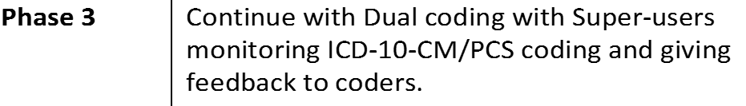
Sample of a training plan
Notes:
Elena—This is another example of a training plan. When creating a training plan you have to factor in your FTEE, size and level of your facility, and the amount of time you’re able to dedicate for training .
VISN 8 decided to take the training in phases and used our AHIMA Approved Trainers to provide training to all coders. This plan that was done in phases as well and allowed concentration on particular chapters and to follow up on facility based training. For every facility the training plan is going to be different, you can make it as simple or complex as you need.

Slide 26
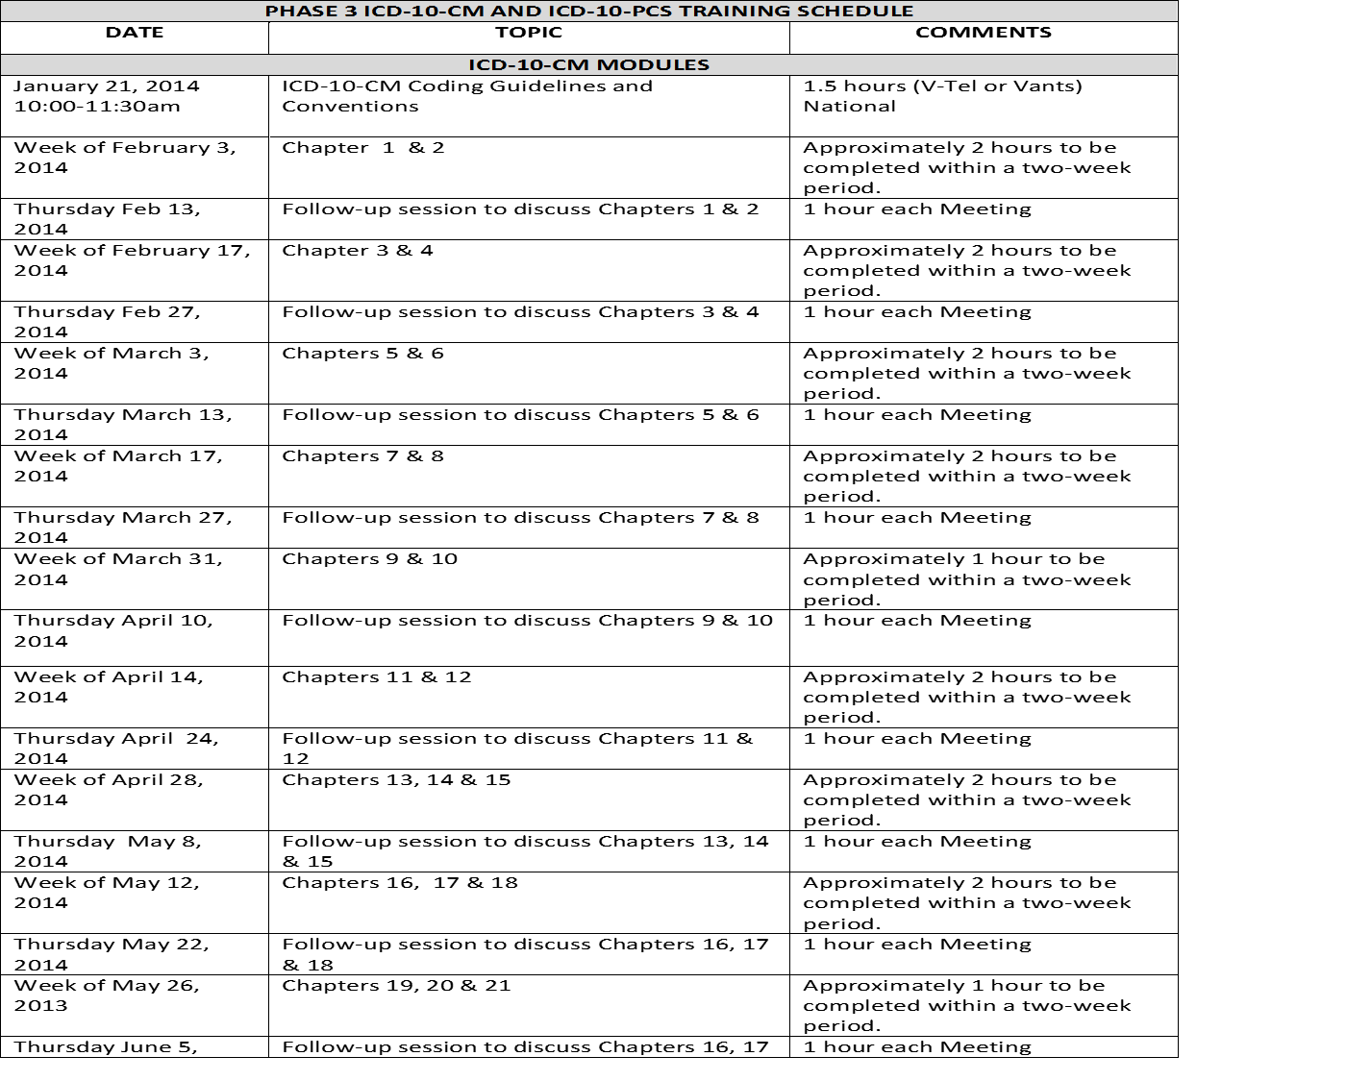
Phase 3
Notes:
Elena-Here we outlined what we are training on and the date the training will be accomplished. Although this training plan was done in phases it shows you the exact month and day the training will take place.
A training plan can include onsite training, VEHU, Elsevier, Nuance, and other outside resources. Tampa uses games like Coding Jeopardy, Coding Feud, Hollywood Coding, or even puzzles to make the learning fun and interactive. Facilities really have to determine what is going to work best for their staff.

Slide 27
Take advantage of Coding Education Resources at no cost to VHA employees
Elsevier
VeHU
Coding Roundtables
Nuance Webcasts
Elsevier
vVeHU
Nuance Webcasts
Coding Roundtables
Notes:
Tina - Next, as we discussed earlier, lets review some additional training opportunities offered at no cost to all VHA employees.
Currently, the following coder education resources are available and may be utilized at no cost to facilities and we have included all the links for you to these on the reference page at the end of the presentation.

Slide 28
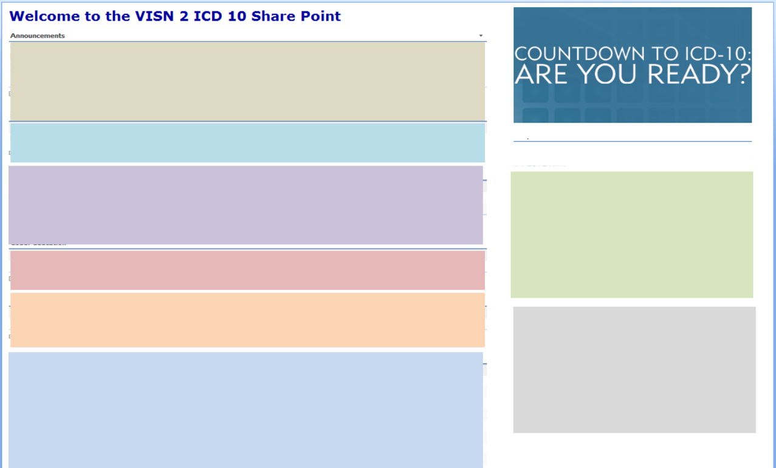

SharePoint
  VHA ICD-10 Education
  ICD-10 Resources/Links
  VISN or Local Coder Education
  VISN or Local Provider Education
  ICD-10 Newsletters
?
What should I put on my SharePoint site?
Notes:
Tina -Another recommended step is to develop an ICD-10 SharePoint during the pre-implementation phase.
A SharePoint is recommended to house anything ICD-10 related that may be utilized by Coders or Providers. Examples of what to post on the SharePoint include:
VHA ICD-10 Education
Include any additional ICD-10 Resources/Links
VISN or local Coder Education
VISN or local Provider Education
******************************************************************************************************
NOTES :
Any VHA ICD-10 Education
Either the actual VHA Training Materials such as the Coding Roundtable handouts, etc. or the hyperlink to the VHA HIM website for these references
Include any additional ICD-10 Resources/Links such as:
AHIMA, AAPC, CMS, VeHU, Elsevier, etc.
Any VISN or local Coder Education
For example, VISN 2 Blackboard Modules or other training materials developed
VISN or local Provider Education
For example, VISN 2 Specialty Specific ICD-10 Blackboard Modules
VISN or locally developed ICD-10 Newsletters or any purchased from a national coding organization, i.e. AAPC
Additional talking points for SharePoint:
SharePoint can include individual facility folders to post:
Strategic planning and minutes for any meetings related to ICD-10
Timeline and checklist of everything needing to be implemented and any due dates for each
This will facilities to track their pre-implementation progress and ensure for a smoother transition to ICD-10

Slide 29
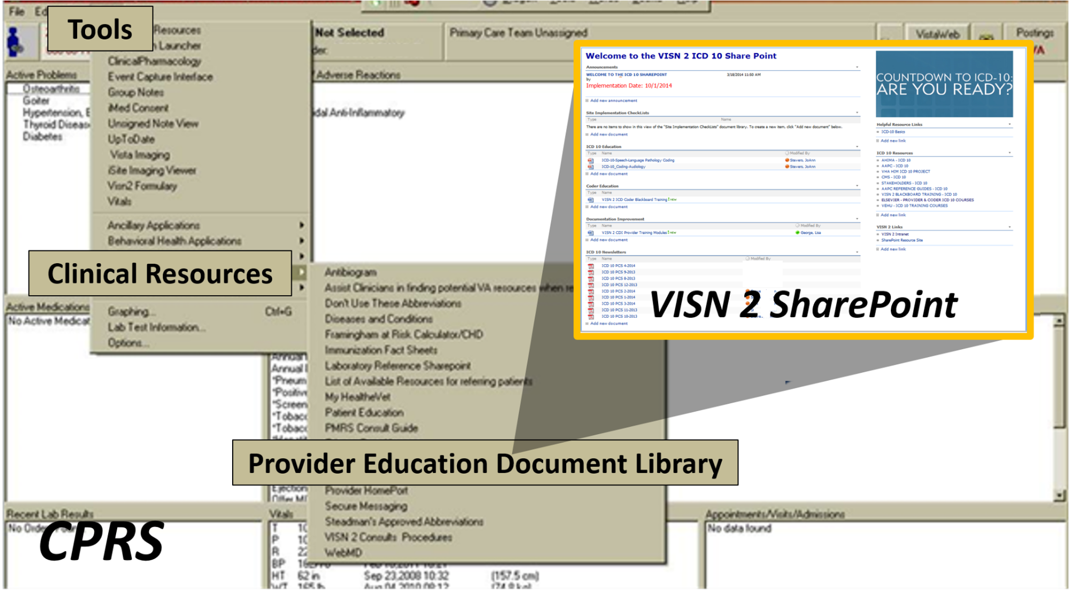
Notes:
Elena - Here is an example of VISN 2’s SharePoint which can be accessed via a direct link from the CPRS Resources Tools menu for easier access by Providers.
Here providers can utilize any references or specific links to education such as VeHU sessions.

Slide 30

There’s no cookie cutter approach to implementation
Notes:
Elena - There is no “cookie cutter” approach when it comes to dual coding implementation. We gave you some great examples of methodologies in the first few slides to think about.
Tina - Bottom line is that each facility will have to determine what will work well for them.
Elena - That’s right, and that is why we are trying to give you all the considerations you need to get started on planning for yours today. Tina, as I recall your VISN actually created a Business Plan to outline the importance of the project.

Slide 31
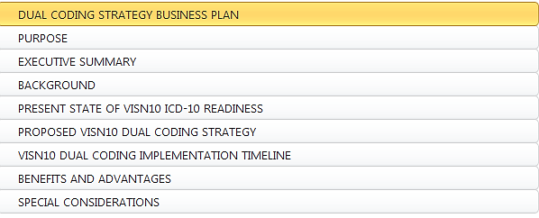

Notes:
Tina - We did Elena, my office wrote a business plan outlining our efforts and created inpatient and outpatient coding capture tools designed to gather specific elements related to the information we are looking to glean from the practice.
These include time differentials in both inpatient and outpatient, difficult code assignments, and provider documentation deficiencies.
We have included a copy of our Business plan in the Downloads for you and will also show and share with you some of our capture tools a little later in the presentation.
This is a great place to remind you as well, that all of our materials from this class are available for download using the green button located above my head, so be sure you take advantage of those.

Slide 32

VISN10 DUAL CODING IMPLEMENTATION TIMELINE
February, 2014
  Business Plan and VISN Dual Coding Tool distribution to the following committees for review and comment:
    VISN10 ELC Business Practice Work Group (BPWG)
    VISN10 BPWG HIM and Coding Sub-Councils
March, 2014
  Business Plan and VISN Dual Coding Tool distribution to the following committee for review and comment:
    VISN10 ICD-10 Steering Committee
April, 2014
  Presentation to the VISN10 ICD-10 Steering Committee.
July, 2014
  Business Plan and VISN Dual Coding Tool distribution to the field with the intent for facilities to create individual site-specific dual coding strategies.
Notes:
Tina - We included in our plan a communication outline and timeline to specify specific target dates. Of course at this time none of us anticipated that the implementation would be delayed when we first started working on this last year. Many of my sites had already started when we received word of the delay. Many have continued on with the project, although scaling back the time spent a bit.
Soon we will be going back to the drawing board to revisit our milestones again in order to reposition ourselves and enhance our plans for the coming year. While I think most of us were disappointed in the delay. It has given us all the chance to re-group our initial efforts and strategize for the future.

Slide 33

How much
time will
each
coder
spend on
dual coding?
Notes:
Elena - When developing a dual coding plan consider what you want to accomplish and then proceed to set goals much like those we have outlined already in the presentation. Keeping this in mind the decision of how much time to allow for the dual coding task is one of the first crucial elements in building your plan.
Tina - Much of this will be decided as you construct the methodology you will use. Remember back to the beginning of our presentation and consider each one, for example, in simultaneous dual coding by one coder where the coder first codes the chart in I-9 and then goes directly to coding the same chart in I-10, will you allow each coder 1 hour a day, 5 hours a week, 1 day a week to code assigned encounters in ICD 9 and ICD 10?
OR will your facility choose the dual coding of one chart by two coders methodology, and if so, how much time can you devote to that plan per day or week?
Elena - Will you use Temporary Staff for Dual Coding, allowing your staff to spend even more time coding in ICD-10 or will you deploy the Dual Coding and Inter-rater Reliability method where several coders code the same record in ICD-10. This method allows for coders to practice, but it also enables the study results to be used to establish a measure of inter-rater reliability. When several coders code the same record, followed by an educational discussion about the matching and mismatching codes selected, the degree of agreement among coders can be measured.
Results from inter-rater reliability studies can be used for developing an organization’s ICD-10 policies and procedures, as well as the quality and productivity standards that the coders will be expected to meet. This method is a good choice if the goals of the project are more educational in nature, and in the long term should lead to better data quality as evidenced by a high rate of inter-rater reliability.
Tina - Whatever the method you choose to implement it is important to consider having staff use a productivity tool for time spent coding in ICD 10 to calculate their actual ICD 9 productivity. This would enable some freedom to work on encounters without the additional stress of having a set number to code each day.
Also be sure to consider ICD 10 training activities as outlined by your facility as well as staff meetings and any other duties.
Creating an environment of learning and practice will decrease anxiety and to build coding staff confidence in ICD-10 activities.

Slide 34
To begin…
  100% inpatient records
Pick a date!
  30 surgery and outpatient
  encounters per week
  2 inpatient records per week
  Lead Coder/Supervisor audits 50%
  10 surgery and outpatient encounters per week
…Closer to ICD10 Transition
  Lead Coder/Supervisor audits 100%
Notes:
Elena - To add to that Tina….the next area to consider with regards to ICD-10 dual coding strategy is the quantity and types of charts to include in the process.
First, facilities may want to pick a date to begin dual coding. Consider having coders dual code just a couple of records each week. For example, inpatient coders could code 2 records, surgery and outpatient coders could code 10 records each. For outpatient, it may be beneficial for coders to start dual coding by specialty.
Tina - Utilizing a ICD-10 recording tool, which we will show examples a little later in the presentation. The coders can input ICD-10 codes for further monitoring and review by their Lead Coder/Coding Supervisor. This will allow for all dual coded records to be reviewed for accuracy.
This will also help to identify any coder educational opportunities which may be needed and to ensure once transition occurs, facilities have confidence that records will be coded accurately.
Elena - Dual coding will provide ongoing exposure to ICD-10 and continue to improve coder knowledge and confidence. It will also assist with identifying any documentation improvement opportunities.

Slide 35




Individualized
Coding staff will implement Dual Coding August, 2014
Each coder will code 2 hours every Tuesday and Thursday
5 coders (according to tour) will dual code with the Simulator in the AM Tuesday and Thursday.
5 coders (according to tour) will dual code with the Simulator in the PM Tuesday and Thursday.
1 Lead coder will dual code at least 3 hours in the AM or PM Fridays schedule permitting.
1 Coding Supervisor will dual code at least 3 hours in the AM or PM Fridays schedule permitting.
T/Th
T/Th
Notes:
Tina - We, like everyone else are currently revising our plans to stretch our implementation across another year. We have decided to continue the dual coding scaling back a bit on our original plan so coding staff can stay fresh with the knowledge they have acquired learning the ICD-10 code set.
We anticipate that there will be many challenges that we will face as we continue dual coding.

Slide 36
Tampa’s Dual Coding Timeline
Notes:
Elena - Well, Tina let’s look at Tampa’s timeline each quarter the amount of cases increase. There are a set amount of encounters that coders will be expected to code per week and as the time moves forward, coding in ICD-10 will get easier.
A lot of the cases in the outpatient setting are repetitious with regards to the diagnosis and the coder familiarity will increase their speed in coding records. This all takes time, but starting now will pay off in decreasing a significant amount of productivity loss.

Slide 37

Monitoring
Outpatient coders code 4 charts a week
Inpatient coders code 2 charts a week
Coding monitor sheet turned into Specialist on designated days for review and feedback
Notes:
Elena- Supervisors or auditing staff should plan to monitor 100% of the cases coded for accuracy in the beginning. Understanding that this information can be used to track and trend per coding professional. We will show a few ways to track on the next few slides, but after about 6 months you should be able to scale back the monitoring to about 50% of cases coded.
As you move forward you should see that the trending will show that you are truly building skill level coders and will set your unit up nicely once you go live.
Supervisors or auditors will need to set up meetings with the coders to review what is found on the reviews –they may need to do group training or one on one training ….or simply implementing a piece of I10 in with your monthly training. Doing all or part of this will assist in building confidence in the coders and preparing them for I10

Slide 38
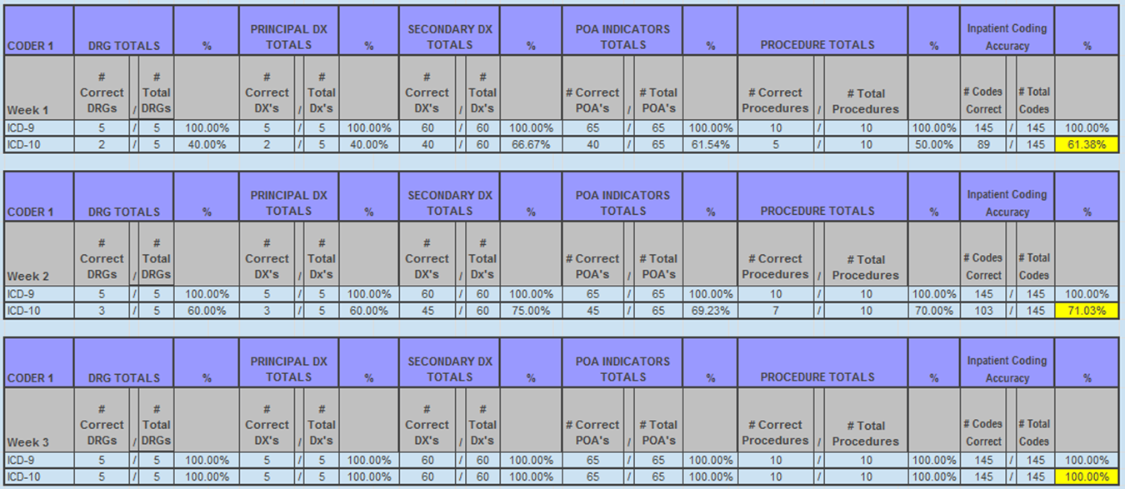
Notes:
Tina - In this monitoring tool example, 5 inpatient cases are monitored each week per coder.
Utilizing the coding collection tool, the person monitoring accuracy can populate this coder accuracy tool in an effort to keep track of both ICD-9 & ICD-10 accuracy. The first line in this tool is the coder’s I-9 accuracy. The second line is the I-10 accuracy.
By comparing the two, you can identify whether there is both an I-9 and I-10 educational opportunity or whether just ongoing I-10 education is needed. The expectation is that with experience the coder’s I-10 accuracy should continue to increase until they reach and maintain the expected level of accuracy. The goal is to have coders meet the accuracy standard prior to ICD-10 transition.

Slide 39
Monitoring
Tracking Coder Accuracy
% ICD-10 Accuracy
/
/
/
/
/
/
/
/
/
Notes:
Elena - Here is an example of an accuracy tracking monitor; note the upward trend in coder accuracy which is to be expected as coders gain experience and knowledge.
As you can see here if all goes right this year, this plan will have worked and the coder will be on track to an exceptional coding accuracy rate in ICD-10, something we all want to achieve.

Slide 40
Dual Coding Collection Tools
ICD-10-CM Coding Worksheet
    Patient demographics
    ICD-10-CM codes
    CPT codes
    Coder Case Comments
    Questions, comments, issues
Notes:
Tina -As part of a good overall plan, you will definitely need a way to collect all of the data gleaned during the project. We have a few examples to get you started and remember these can be downloaded for your use by clicking on the green download button above my head.
Elena - This is an example of the worksheet used by each coder participating in the Learning Lab study for each outpatient encounter coded in ICD 10. Each encounter was captured electronically using a Coding Review Worksheet designed to simulate entering codes, case comments etc. into Nuance software.
VISN 9 CCU Coding Compliance staff populated the general information from each day’s work completed including number of ICD 9 vs ICD 10 codes used, time spent, questions, comments, and documentation issues onto a SharePoint.

Slide 41
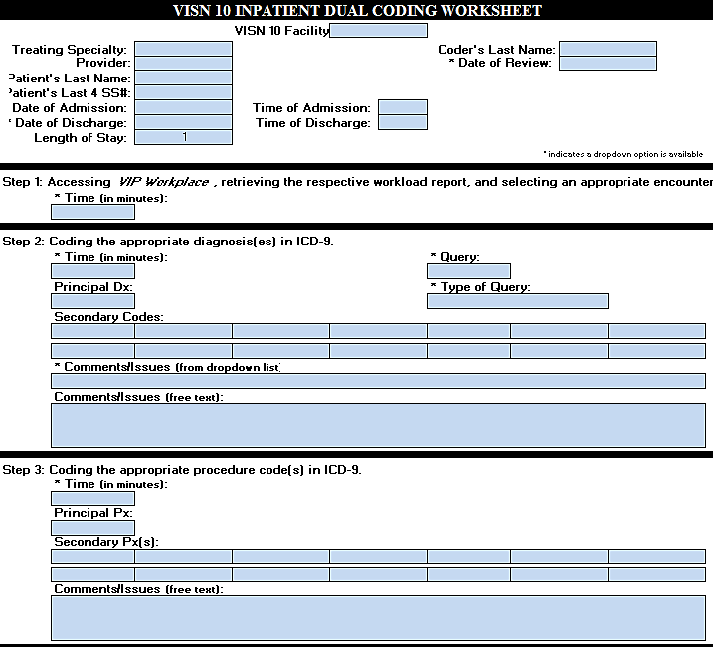
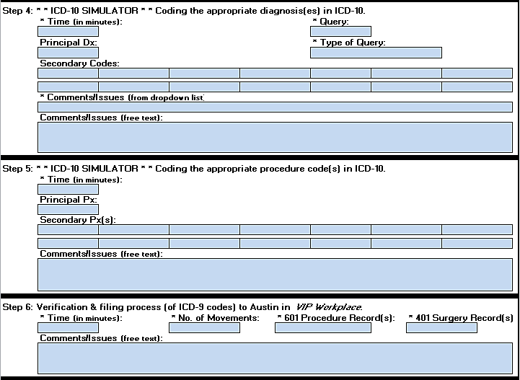
Capture Tool
Notes:
Tina - This is an example of the tool we are using in my VISN. This is an excel spreadsheet developed to track numerous elements. Within the spreadsheet there is also a summary tab, that will tabulate multiple instances of worksheets to use in data analysis.
Our suggestion with this form is to utilize separate worksheets for each type of clinic specialty on the outpatient side.
For example - Set up a SharePoint to house them with separate folders for each type of encounter such as Cardiology, Urology,
Primary Care, etc.
This might seem like a lot of work up front however it will enable you to easily glean service specific information that will be vital when preparing your provider training in the future.
In addition, there will be specific ICD – 10 chapter questions that will arise when coding these charts…this way you will also have your list of coder, questions, comments and concerns tallied per service for targeted training sessions in the future.

Slide 42

Systematic Collection should be specialty specific and type specific
House data sheets on SharePoint and internal shared drives
Notes:
Elena -Each facility would want to start collecting data on the dual coding from ICD-9 to ICD-10. A SharePoint site is a great way to store this information and making it available for responsible parties to view.
This will allow for a better analysis on your sites dual coding process. The reporting and collection course may need to be adjusted as you move along, but the information gathered can also be used to assist with future training of coders and providers.

Slide 43
Poll Question
What do you think will be the most beneficial outcome of dual coding?
    Coder Productivity Measure
    Provider Educational Preparation
    Coder Education
    Coder Staffing Analysis
Notes:
Elena: Now I’d like to ask a poll question.
What do you think will be the most beneficial outcome of dual coding?
Coder Productivity Measure
Provider Educational Preparation
Coder Education
Coder Staffing Analysis
To answer this question, use the blue polling icon above my head. We’ll move on and come back to your results in just a moment.

Slide 44


How do we analyze all that we’ve learned?
Notes:
Tina - Once you are knee deep in your project and have some time and data under your belt, it will be time to start the analysis piece to celebrate your successes and retool any elements that need further interventions.
Let’s go through some of those over the next several slides.

Slide 45

How do we analyze all that we’ve learned?
Notes:
Elena – By using a 4 step approach you can:
Determine the coder’s level of outcome you desire to be achieved; this must be appropriate to what the coder codes, fits the coder’s skill level; allowing the coder to be able to achieve the productivity standards set forth by the facility.
Using the data collected form the monitoring reports you should be able to determine; was the dual coding beneficial in increasing the coders level of education, and did the dual coding assist with the provider education and documentation.
Start analyzing the data collected to be used to assist in putting together your provider and coder specialty specific training sessions.
Begin to use the results in decisional factors such as staffing, workflow and productivity measures.
TINA - Now is a good time to take a good look through your coder’s audits; are they coding at the numbers where they should be with minimal errors? Are your coders doing queries on notes where the documentation is lacking?
Compare what was coded first phase to second phase etc. to ensure the staff is retaining the education provided and coding accordingly.

Slide 46
VHA Learning Lab 2012 Results
64.5% decrease in productivity
6.6% decrease in productivity
Notes:
Tina - On Friday, Shelley Weems and Pam Heller will be walking us through a presentation titled ICD-10 Avoiding Coder Productivity Loss, session 14146;. During this session you will hear the results of the “learning lab” that VHA held back in 2012. The results indicated a 64.5% drop in inpatient productivity and a 6.6% in outpatient productivity.
You can use this as a baseline to see if your results come in line with that study.
In fact there are many sources out there that we found as well when preparing for this session, right Elena?

Slide 47
50-70%
drop in productivity expected
Notes:
Elena - There sure are Tina, by in large, most of the articles out there showing around a 50% to 70 % productivity loss, in fact many cite Canada’s loss as a basis to set US expectations; however keep in mind that Canada does not have PCS nor does it use the same clinical modification that the US does; so hearing that 50 – 70 % productivity loss becomes a very real possibility.
Tina – I agree, and this is where the dual coding exercise and subsequent analysis and post implementation will become a real value added exercise. By performing the exercise coders will gain confidence and practical experience that will combat productivity loss.
Using the dual coding study will allow HIMS Chiefs and Coding Supervisors to take another circle back to their staffing analysis factoring in the productivity loss experienced through the study and using that to forecast the needs of the department.

Slide 48
Poll Results
What do you think will be the most beneficial outcome of dual coding?
    Coder Productivity Measure
    Provider Educational Preparation
    Coder Education
    Coder Staffing Analysis
Notes:
Elena ----
Now let’s pause for a moment and take a look at your poll results.
Speak to results..
Thank you for your answers…now lets move on and discuss more on plan implementation

Slide 49
Poll Results
What do you think will be the most beneficial outcome of dual coding?
    Coder Productivity Measure
    Provider Educational Preparation
    Coder Education
    Coder Staffing Analysis
Notes:
CLICK TO NEXT SLIDE

Slide 50

How do I determine reasonable performance standards for Dual Coding?
Notes:
Tina - New coding standards may need to be established in conjunction to working with AFGE and coding staff to set realistic measures.
The VA as a whole anticipate the decrease in productivity when ICD-10 is implemented. The Dual Coding process will create a reliable data source for assessing the impact on outpatient coding productivity for your coding staff. The data can be used to determine a reasonable productivity standard that should be in place when I-10 goes live.
Elena-Well, Tina in previous Learning Lab data predicts a 64.5% drop in inpatient productivity and a 6.6% in outpatient productivity but you may find that due to strengths and weaknesses of individual coders, the impact may be either greater or less for your department .
It is also important that productivity standards be adjusted based on the coder’s grade and experience level. Each facility in conjunction with AFGE may want to initiate a sliding scale standard working up to full levels over the course of FY 16.

Slide 51

Notes:
Elena -Use the data and knowledge gained to further your educational efforts with both your coding and provider staff. There are several ways to use what was collected and turn it into a valuable learning experience.
If you collected per specialty ---you could hold workshops for each specialty –by going over tough cases and outline concepts learned, talk about ways to teach provider documentation addressing what was missing in the notes to these specialty services.
Make it a team effort- by getting coders involved in dual coding now will strengthen their understanding of what’s really involved with ICD 10.
Building up their attention to detail--- that is a MUST for coders and clinical staff. It will also reinforce that documentation must be more detailed in order to support the code set expansion.
Managers can also hold frequent group meetings with coders to share their experiences and brain storm “gold standards” or “best practice” environment that will result in greater confidence and less fear of ICD 10.

Slide 52

Diagnosis-specific documentation issues
Coder codes
as unspecified
Provider documents diagnosis
How do we fill this gap?
Notes:
Tina - During the course of the VHA Dual coding project back in 2012, the V9 Coding Compliance Staff reviewed the questions and documentation issues that were noted by coders during the course of the project.
There appeared to be a trend that although a diagnosis was documented by the provider, if there had been more detail given, they could have coded it to a more specific code. Many times the coding staff had to use an unspecified code because of the lack of specificity in the documentation.

Slide 53

A separate list was generated outlining coding and documentation guidance for coders for specific diagnoses.
Notes:
Tina - This is an example of a list created from information gleaned from the learning lab from one VISN.
These diagnoses outline documentation requirements that would include evidence of the location and whether the condition was acute or chronic.
The list included gout, bursitis, joint pain, hearing loss and osteomyelitis. This information was further reviewed and discussed with the coder participants during weekly meetings. This is just one example of the type of good educational information you can glean from completing a dual project.
Elena - This type of information is vitally important to share with your providers, especially when you collect and share with an emphasis on specialty specific.

Slide 54


Don’t forget
Provider Education
Notes:
Elena - Part of your VISN and facility ICD-10 transition plan should also include Provider education. If provider documentation is lacking and making it difficult for ICD-9 code assignment, it will only get worse with ICD-10.
You can use the coders queries to determine which areas the providers need additional training.
When coders are performing dual coding they are also a resource and can assist the supervisor or auditor in identifying providers who’s documentation is lacking.
Tina-When providing education to Providers, distinguish documentation vs. coding and introduce the new ICD-10 Specialty Specific Encounter Forms that are currently being developed.
Sharing these encounter forms now will give providers an idea of what the new code set and code descriptions look like. Stress the important of their documentation matching their code selection when capturing workload.
Elena - Additionally, you may want to consider developing specialty specific provider training modules which will help to streamline the provider learning curve.
Include diagnoses and procedures relevant to their specialty as well as general documentation tips. Providers can begin immediately to provide the documentation specificity needed for ICD-10 code assignment.
This will actually assist in more precise ICD-9 code assignments and therefore, should not be delayed until the ICD-10 transition takes place.
Lastly, consider implementing a CDI program which will benefit your facility not only with current ICD-9 practices but ultimately with ICD-10.

Slide 55

Notes:
Tina - On the slide you can see an example of a training matrix with courses recommended by the National HIM Office for each stakeholder.
This matrix is placed on a SharePoint and updated regularly with available courses from various platforms such as Elsevier, VeHU, Coding Roundtables and locally developed training.

Slide 56
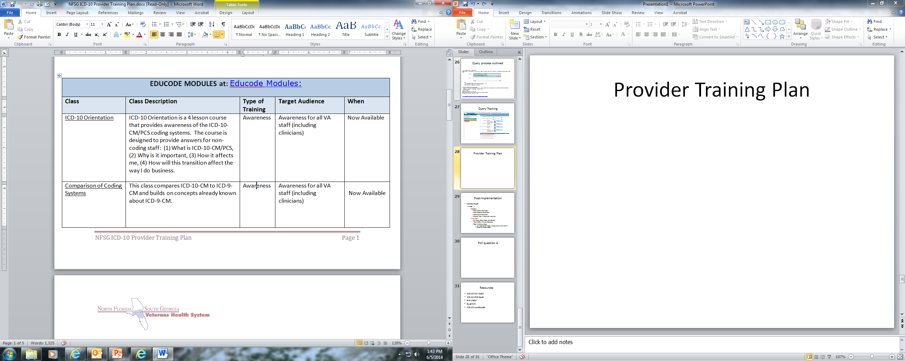
Provider Training Plan
Notes:
Elena - A provider’s training plan should be tailored to their specialty. If you go about using a generic presentation or training plan it will lose some of them.
What we like to do in Tampa is called the “Road Show” and that is educating providers by service and specialty on encounter completion and ICD-10. The training is presented with actual encounters from their service on what is needed from them when ICD-10 comes around.
It shows them encounters and how it is coded in ICD-9 and what is needed in order to code for ICD-10. Tampa has been doing the “Road Show” since December 2013 and have trained over half of the hospital.
Once the training has been completed the coders are encouraged to query the providers as if they were already coding in ICD-10 to assist them in documenting appropriately.
Our auditor then goes back and review the services notes to see if what was trained on is being done. A final report is sent to the chief of the service with outline of audit results and request for additional training (sometimes one on one) with the providers.

Slide 57

VISN
Resources-modules
Monthly coding training
SharePoint
Newsletters
VeHU
Elsevier
Provider to coder training
Simulator
Nuance webcast
Notes:
Tina - Resources are important not only for the coders, but providers as well. They have to know where to go if they need information. Each facility should make their providers aware that there are resources that they can use. The VA has a lot of valuable tools and resources for our providers to use. Although it may be hard initially getting them to log on or to attend training your clinical champion and CDI specialist will play a huge part in getting the information out to them.

Slide 58
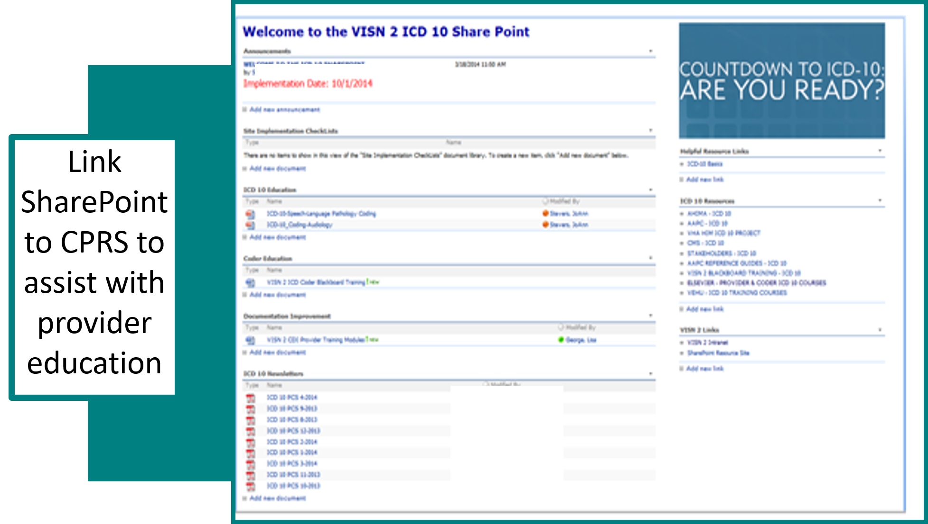
Notes:
Tina - Again, each facility may want to set up a SharePoint connected to a CPRS link to assist providers with education and lessons learned from your dual coding activities as they pertain to provider documentation.

Slide 59

Clinical Documentation Improvement Training
Notes:
Elena -Many facilities have a CDI Specialist and they are an asset in the transition from ICD-9 to ICD-10. While you may have the Coding supervisor or lead coders training your coding staff you can have your CDI specialist focus on the provider side.
There are several educational resources available to them through the CDI Council and Elsevier. The CDI Specialist can use queries and dual coding audits to determine their provider training focus. They can then request with the service that is having documentation issues a training session. Training as explained in the previous slides can be tailored to that specialty by the CDI Specialist.

Slide 60

Use the list to identify provider and coder training needs and analyze progress
Notes:
Tina – By using the list of documentation issues collected during the course of the project to guide provider training opportunities in the future, your facility can streamline provider specialty specific training based on the data deficiencies collected during the study.
If there are still deficiencies noted in the documentation or the coding then additional training needs to be given.
Elena - It has always been an issue that providers and coders do not speak the same language. The VHA HIM CDI website has numerous tools to assist coders, CDI specialists, and providers. These tools can be printed and distributed among staff. By utilizing these tools and continuing to work with providers on documentation issues we can begin to bridge the gaps that exist moving forward towards ICD -10.
Again, a reminder to tune in tomorrow at 1 where Tina and Dr. Meesig will be discussing ICD -10 and clinical documentation improvement in detail.

Slide 61
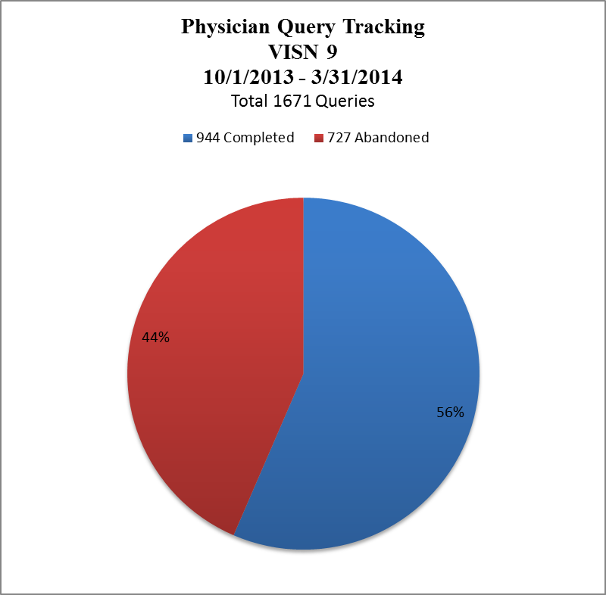


44%
56%
Notes:
Tina:- Another tool sites can use to bridge the gap in the physician coder language barrier is The Provider Query Tracking located in the Nuance software; this tool allows for standardized communication with clinical staff and tracks progress of query completion rates.
To give you an example of how this tool can be beneficial we will look to VISN 9s implementation.
Through the first half of FY 14 a total of 1671 queries were sent by VISN 9 coding staff to clinical staff resulting in a 56% completion rate. This data is reported on a regular basis to VISN Leadership and site specific data was shared with each Medical Center’s Leadership.

Slide 62
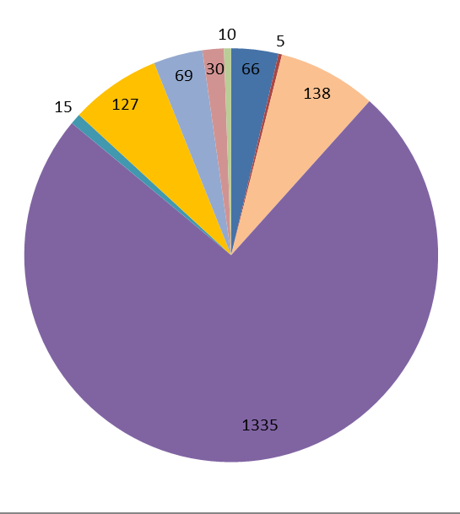
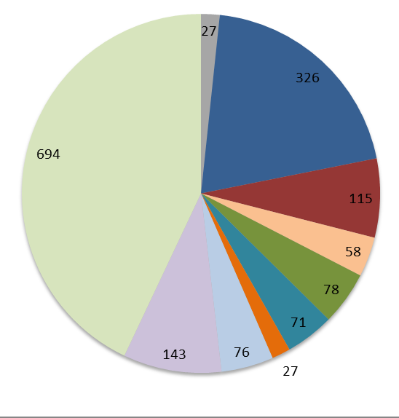
What types of queries are being sent to clinical providers?
78 “Insufficient Documentation” Queries
1335 “Insufficient Documentation” Queries
FY13
FY14
Notes:
Elena: -Leadership was very interested in knowing what types of queries were being sent to clinical providers and had asked for a drill down of the data in FY 13.
Most of the queries sent were in the category of insufficient documentation, which again prompted the question of what exactly was contained in that particular category.
In 2014, they were able to further define the types of queries sent which helped clinical staff understand and put into perspective documentation issues that needed their attention. The physician query process is extremely important in clinical documentation improvement and the development of educational topics for provider training.
It is quite possible that once ICD 10 is implemented that certain other PQT categories such as “Diagnoses” may expand while others diminish. A good predictor of a category shift might be identified during the dual coding implementation phase as documentation issues are identified.

Slide 63
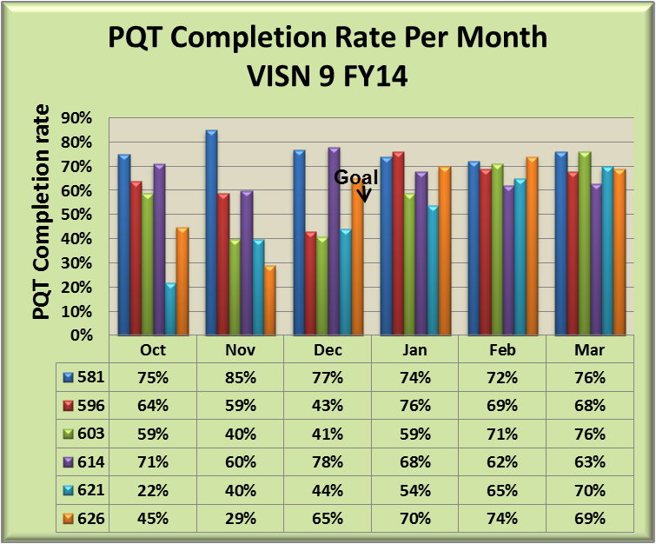

PQT Completion Rate
Comparison by Facility
VISN 9 FY14
Goal of 50%
PQT Completion Rate
Notes:
Tina - In support of their Clinical Documentation Improvement Plan VISN 9 made it a priority to track the PQT completion rate by site throughout FY 2014 despite the fact that there is no national benchmark to measure it against.
They set 50% as an imaginary target to at least establish a baseline from which to measure progress throughout their Network. Although they struggled in the early part of the Fiscal Year, all sites had a PQT response rate well above the 50% mark.
Using these types of data throughout the year, has helped them to focus their training efforts with Providers on issues that have the greatest impact and will eventually make the transition to ICD 10 much easier.

Slide 64

Notes:
Elena - Well Tina, we have thrown a lot of information to our audience today; let’s take a minute or two to summarize what we have presented today.
I think it is a given that all the HIMS folks out there understand the value of a dual coding project in order to create a “real world” learning environment for coding staff as we prepare to tackle the challenges of this new coding set.
Tina - As we discussed there is no right or wrong way to do this, what is important though is that you begin to put a plan in motion that allows you to glean all the necessary information you will need to be successful in the transition to ICD- 10 next October.
We discussed the value and importance of gathering data from the process to use for future education, not only for coding staff but especially to assist you as you prepare providers at your station for the upcoming changes. Keep in mind, we are not setting out to teach providers ICD-10, we are here to ensure they are documenting appropriately so that we, the coding staff can appropriately append the correct code. I would definitely argue that one of the best ways to do that will be to participate in a dual coding effort.
The decision to delay ICD -10 gives us another full year to monitor and analyze the results of this process as we move into the final phases of implementation planning and go live in October of 2015.
******************

Slide 65

Notes:
Tina: Elena, the secret of getting ahead is getting started as we see on the screen.
Remember, no one plan is going to work for every facility. We hope we gave you some ideas and information to help get you started today.
Elena: I agree Tina, and I think once our audience starts to put a plan together they may need to adjust and tweak it along the way. That is the nature of learning. The key is just getting started!

Slide 66

Ask the Presenter
Notes:
Tina:
One last reminder, we’ve provided several additional resources either as separate handouts, or links in the downloadable PPT. Please take some time to go to the green downloads icon and download those documents. There’s a lot of useful information at your fingertips.
And now,
If you haven’t submitted your questions yet, there is still time to do so by clicking on the orange “Ask The Presenter” icon. We’re going to show a brief announcement and be right back to answer your questions.
(Stand still and smile until you see the video come up full screen)

Slide 67
References
Dual Coding in Preparation for ICD-10: Emerging Best Practice, Lisa Fink, MBA, RHIA, CPHQ and Kathy M. Johnson, RHIA
  http://www.carecommunications.com/filebin/images/pdfs/Dual-Coding-in-Preparation-for-ICD-10.pdf
Preparation for ICD-10, Best practices to accomplish dual coding, Preparation for ICD-10 on ADVANCE for Health Information Professionals, Bonnie S. Cassidy, MPA, RHIA, FAHIMA, FHIMSS
  http://health-information.advanceweb.com/Features/Articles/Preparation-for-ICD-10.aspx
VHA HIM Website
  http://vaww.vhahim.va.gov/index.php?option=com_content&view=featured&Itemid=101

Slide 68
References and Resources
    Elsevier Learning Modules
    https://login.elsevierperformancemanager.com/systemlogin.aspx?virtualname=VAEES
vVeHU
  https://www.myvehucampus.com
Coding Roundtables
  http://vaww.vhahim.va.gov/index.php?option=com_edocman&view=category&id=40&Itemid=713
Nuance Web Conferences
  http://www.nuance.com/support/Clintegrity360-government/index.htm

