Slide 1
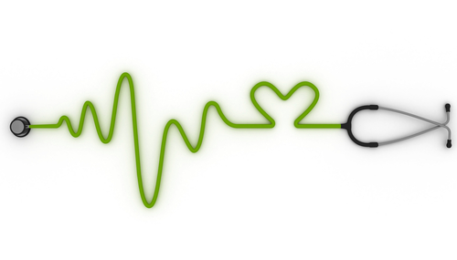
Reducing Alarm Fatigue In Cardiac Monitoring
Karen J. George, DNP, RN, CEN, VHA-CM
&
Colleen Walsh-Irwin, DNP, RN, ANP, CCRN
Notes:
Karen: Thank you Rosie. We are happy to have everyone join us today.
Colleen:
We hope you will find the information helpful.

Slide 2
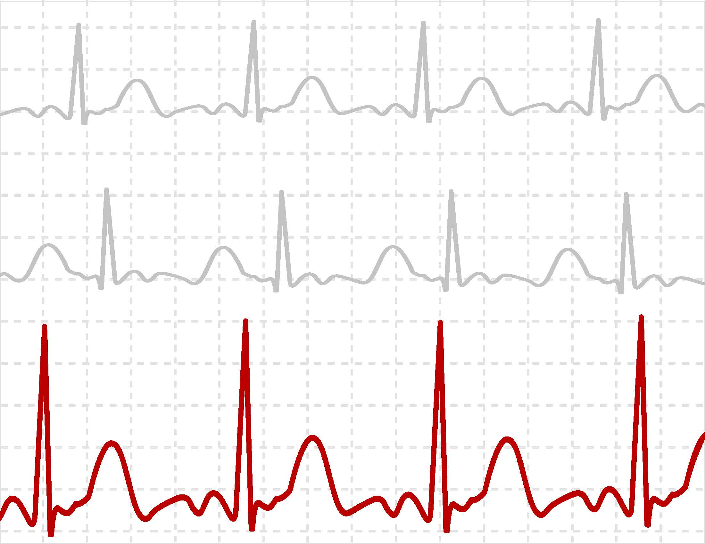
Objectives
Notes:
Colleen: Lets start with our objectives:
At the end of this course, participants will be able to:
Discuss the contribution of alarm fatigue to unsafe hospital conditions.
Analyze methods to reduce alarm fatigue related to cardiac monitors and
Develop a plan to measure improvements in reducing alarm fatigue related to cardiac monitoring.
So, You know a bit about us now let’s find out a little about our audience.

Slide 3

Poll Question
What is your position?
RN
LPN
Nurse Manager
Nurse Educator
Monitor Technician
Other
Notes:
Karen
What is your position?
RN
LPN
Nurse Manager
Nurse Educator
Monitor Technician
Other
Colleen:
Go to the blue poll button above my head. We will get back to your answers in a few minutes.
While we are waiting for our responses, we will introduce our first case study.

Slide 4

John
Notes:
Karen
John, a 70 year old Vietnam veteran was admitted for “skipped heart beat”.
He and his wife have been married for 30 years.
They have 4 children and 3 grandchildren.
Colleen:
The provider told Joe and his wife that the expectation was Joe would just “be in the hospital overnight.”
John was admitted to 3W, a medical-surgical telemetry unit. He was placed on a cardiac monitor.
Karen
The nurse educated him on what monitoring would entail.
During the night Becky, the night staff , noted Joe developed a second degree type II heart block with a ventricular rate of 30. The nurse assessed the patient .
John’s blood pressure was 120/70. Although he felt like he was having skipped beats, he denied light headedness, chest pain, or shortness of breath.
Colleen
The nurse notified the provider.
The decision was made to transfer John to a higher level of care.
While preparing for transfer, the bradycardia alarms at the central station were turned off because it was alarming so much.
There was a delay in transfer.
The staff became busy. John’s nurse had been called into another patient’s room.

Slide 5
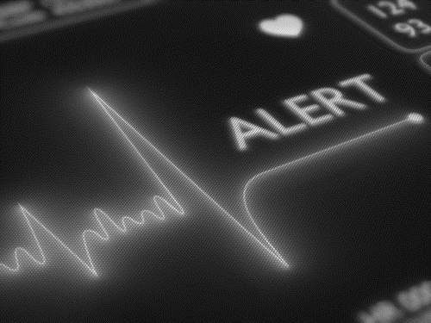
John
Notes:
Karen
Twelve minutes later, the asystole alarms went off.
John was found unresponsive.
A code blue was called.
Resuscitation efforts failed.

Slide 6

Notes:
Karen
Anytime there is an unexpected patient death, investigations occur. Lessons learned may then be implemented to improve quality and safety of patient care.
Colleen:
For John’s case, a review of the central station alarms showed he experienced a drop in ventricular rate in the 20s just prior to asystole.
If the bradycardia alarms had not been turned off, this would have been noticed earlier prompting the staff to recheck the patient.
Earlier patient reassessment could have averted John’s death.
Karen
Cases have been reported where cardiac monitoring has been ordered but monitoring has been removed for the patient to shower.
Patients were left unattended and later found unresponsive or deceased.
Colleen
Consider this- when patient’s clinical status indicates the need for cardiac monitoring, yet the patient’s are sent for tests unmonitored, has the standard of care been altered?
Is this practice truly safe patient care?
More about this later when we discuss policies.

Slide 7



Overall, up to 99% of alarms are considered false
Alarm fatigue is the number one hazard to patients
ECG monitoring is cornerstone of cardiac care
Some individuals turn off alarms
False alarms leads to misdiagnosis
#1
Notes:
Karen
Alarm fatigue is the number 1 patient safety hazard.
We have to consider what alarms are false and what alarms are truly actionable.
Studies show up to 99% of alarms are false.
ECG monitoring is the cornerstone of cardiac care in hospitals.
The over use of technology in healthcare actually contributes to false alarms.
Colleen
Consider the cardiac monitored patient who does not meet criteria for monitoring.
Placing patients on cardiac monitoring who do not meet criteria for monitoring and are kept on it for days increases the number of alarms that have to be addressed.
Many of these alarms do not lead to any changes in the patient’s clinical care, yet take time away from care delivery to other patients because of time and effort to answer excess alarms.
Karen
Multiple cases exist within the literature related to individuals turning off or ignoring alarms related to cardiac monitoring.
Alarms may be turned off or ignored by someone far from the patient’s bedside as is the case of remote telemetry monitoring where the monitoring occurs far from actual patient care.
In some facilities, central station monitoring may occur on another floor or even another building.
The alarms may be turned off without considering the patient’s clinical status . Decisions to de-activate or turn off alarms may be made only to stop alarm sounds.
Colleen: Poor processes may be in place. Or Good processes may be in place, yet ignored.
Evidence-based recommendations may or may not be incorporated into efforts to prevent alarm fatigue or to ensure cardiac monitoring is performed correctly.
Evidence based methods exist to decrease false alarms related to cardiac monitoring.
False alarms generated by incorrect: skin preparation, electrode placement, or lead selection may lead to mis-diagnosis or unnecessary procedures.
This is the focus of our presentation.
Now, let’s check on your poll responses

Slide 8
Poll Results
What is your position?
RN
LPN
Nurse Manager
Nurse Educator
Monitor Technician
Other
Notes:
Now let’s pause for a moment and take a look at your poll results.
What is your position?
RN
LPN
Nurse Manager
Nurse Educator
Monitor Technician
Other

Slide 9

Poll Results
What is your position?
RN
LPN
Nurse Manager
Nurse Educator
Monitor Technician
Other
Notes:
Click again

Slide 10

Background
Notes:
Colleen
Data exists related to alarm conditions and patient deaths.
Johns Hopkins Hospital reported “58,764 alarm conditions or 350 alarm conditions/bed/12 days”
In 2014 a Boston Medical Center reported they had 90,000 alarms in one week on 1 unit alone.
Even more studies are available which address patient harm related to clinical alarms.
Karen
Deaths has been reported
The Pennsylvania Safety Authority during June 2004 and December 2010 noted 35 patient deaths with 102 associated potential contributing factors to those deaths
In regards to the Food and Drug Administration, The Manufacturer and User Facility Device Experience (MAUDE) database revealed 73 alarm related deaths with 33 attributed to physiologic monitors between March 1, 2010 and June 30, 2010
The Joint Commission has reported over 80 deaths and 13 serious alarm-related injuries.
Colleen
All of these alarms lead to sensory and cognitive overload, with staff becoming desensitized to alarms---even critical alarms. As you said Karen, this has led to patient injury and deaths.

Slide 11
Human Factors
Job
Environment
Individual
Target
Notes:
Karen-
Multiple studies, PI and QI projects identify issues with alarm fatigue.
Human factors play a huge part related to alarm management. Human factors looks at the overlap of the job, individual and interaction with the environment.
When we look at human factors contributing to alarm fatigue, we have to look at all three of these..
Colleen
To mitigate or prevent alarms, we need to look at assessing how these overlap, then design and create processes from the experience of the end-user.
For cardiac monitoring, we must also consider the impact on safe, timely, effective, efficient, and patient-centered care. This is appropriate to look at when discussing clinical alarms especially when looking at what can be accomplished to decrease distractions and interruptions.

Slide 12

Notes:
Karen
Sometimes multiple processes are developed to prevent errors. Consider the Swiss cheese model is by James Reason. Think of slices of swiss cheese with each slice representing a safety processs. Multiple processes create layers of defense. Even when we write the best processes, there may be holes in those processes. If the holes align, errors can occur which can impact patient safety.
Consider processes related to cardiac monitoring.
Colleen
Holes occur secondary to latent conditions or active failures. First of all, consider how standards and best evidence is or is not implemented. Are policies updated, processes followed, or ongoing improvements made. Do we encourage raising the bar to the best evidence or accept less than the highest standard?
*******************************************************
https://www.google.com/search?as_st=y&tbm=isch&hl=en&as_q=Model+James+Reason+1991+The+book+reference+is+Reason+J+1990+Human+Error+Cambridge+University+Press+Cambridge&as_epq=Swiss+Cheese&as_oq=&as_eq=&cr=&as_sitesearch=&safe=images&tbs=sur:fm#imgdii=_
Swiss cheese citation: The original source for the Swiss Cheese illustration is: “Swiss Cheese” Model – James Reason, 1991. The book reference is: Reason, J. (1990) Human Error. Cambridge: University Press, Cambridge

Slide 13

Factors that lead to non-compliance
Notes:
Karen
Multiple human factor components contribute to alarm fatigue.
These include but are not limited to:
Lack of awareness or understanding of current policies and procedures.
Lack of adherence.
Colleen
Other factors that lead to noncompliance include:
Lack of end-user engagement when policies and procedures are written
Time pressure to get the job done and
Lack of adequate training.
All of these can contribute to or result in negative events.

Slide 14




Human Factors lessons from other high risk fields
Notes:
Karen
Human factors can contribute to dangerous conditions.
Nearly all events and near misses in other high risk fields (such as nuclear power plants, space shuttle disasters, etc) start with an unintentionally unsafe act. Nobody sets out to intentionally make mistakes, yet mistakes do happen.
Colleen: That’s true , Karen, no one gets up in the morning or goes to work thinking “I’m going to make a mistake today or I’m going to harm a patient”.
Karen:
To prevent unsafe acts requires commitment at all levels:
It requires following policies and procedures. And giving safety absolute priority.
You need to look at the culture in your facility. Address the cultures: Is everyone treated justly and fairly.
Colleen
You want to create a work environment that includes a culture where people feel safe.
Develop and maintain a culture where staff are comfortable in reporting unsafe acts and conditions at any point and time.
We need to make it easy to report and communicate safety issues.
We need to develop a learning culture with persistent consistency in commitment to safety that is continuously monitored.
And Create an informed culture where staff are encouraged to learn, share, and grow in order to mitigate issues.
Karen:
Individuals need to understand potential consequences of policy deviations. Such as the case of our patient Joe where the alarms were turned off.
So we have talked about our objectives, presented some background studies, and discussed human factors. So now let’s see who is addressing the problem.
***********************************

Slide 15
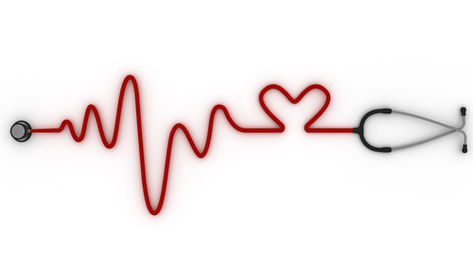
  Clinical alarms as a priority
  Establish alarm management policies
  Educate staff
  ID important alarm signals
Notes:
Colleen: In 2013, the Joint Commission issued a report which addresses deadlines for hospitals to address components related to clinical alarms. I’ll briefly discuss each of these. This will all be available in the download section where our slides and speaker notes will be available.
During 2014, hospitals must identify the most important alarm signals to manage based on the following:
• Input from the medical staff and clinical departments
• The risk to patients if the alarm signal is not attended to or if it malfunctions
• Whether specific alarm signals are needed or unnecessarily contribute to alarm noise and alarm fatigue
• The potential for patient harm based on internal incident history and then they need to
• Align practice with evidence-based guidelines
Karen
As of January 1, 2016, facilities need to establish policies and procedures for managing the alarms which address the following
• Clinically appropriate settings for alarm signals
• When alarm signals can be disabled or changed
• Who in the organization has the authority to set alarm parameters, to change alarm parameters, and to set alarm parameters to “off”
• The policy/procedures need to state who is responsible for monitoring and responding to alarm signals
• and Checking individual alarm signals for accurate settings, proper operation, and detectability
Colleen
Finally, by January 1, 2016, facilities need to ensure all staff received education specific to clinical alarms.
And there needs to be in place a plan for ongoing education that should reflect current evidence based guidelines.
So now lets take a look at who else is addressing clinical alarms.

Slide 16
Who is addressing the danger?
Association for the Advancement of Medical Instrumentation (AAMI)
Emergency Care Research Institute (ECRI)
Top 10 Health Technology Hazards
Healthcare Technology Foundation
World Health Organization
National Center for Patient Safety
Notes:
Karen
Multiple agencies both nationally and internationally are looking at clinical alarms.
Two organizations, the Association for the Advancement of Medical Instrumentation (AAMI) and the Emergency Care Research Institute (ECRI) are key leaders in the movement.
In 2004, the American College of Clinical Engineering (ACCE) addressed the impact of clinical alarms on patient safety. Others followed including the World Health Organization and the National Center for Patient Safety.
Clinical alarms have been listed in the top 10 health care technology hazards by many organizations.
Colleen:
Since the earliest studies, around the 1990s, on clinical alarms, increased technology with alarms, and increased use of technology in healthcare has resulted in increased patient injuries related to alarms as we discussed previously.

Slide 17
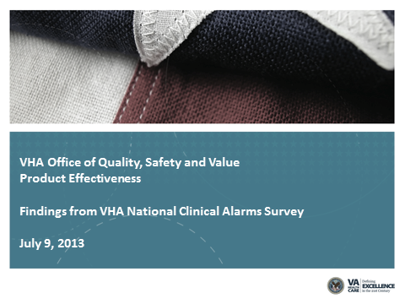
Notes:
Karen:
There is widespread acknowledgement of the problem of clinical alarm fatigue and the consequences to patient care throughout the healthcare industry. The VHA recognized the problem.
A Clinical Alarms Workgroup was formed. In 2013, results were reported.
Colleen
Data was collected from 2,845 respondents during the survey administration period of February 27 through March 22, 2013.
The goal of the assessment included establishing a broad baseline measure of the severity of the clinical alarm problems at VHA facilities.
They gathered and continue to make recommendations to address alarm fatigue.
And work continues at each VHA facility to combat this issue.
Karen
The high number of false or non-actionable alarms often results in clinicians becoming desensitized to them.
This may result in the turning off alarms, lowering the volume of alarms, or ignoring alarms completely.
So, Colleen, you have another case study for us?

Slide 18

Melinda
Notes:
Colleen,
Melinda, a 65 y/o Navy nurse was admitted to an step down unit for atypical chest pain and vague lightheadedness. She had no previous cardiac history and was in good health up until the day of admission. She was accompanied by her daughter.
She was placed on a cardiac telemetry monitor. She reassured her daughter that she would be fine and set her home to look after her grandchildren.
At the change of shift (days to evenings), the staff noticed a leads off alarm.
There was no rhythm on the screen.
After report, 15 minutes later, the RN entered the room and found the patient unresponsive.
A code blue was called. Patient was placed on a monitor and found to be in asystole.
Karen
Staff at the central station had noticed the leads off alarm.
There was a breakdown in communication between the monitoring staff and the frontline staff.
No one realized the critical urgency or impact of a leads off alarm.
It’s easy when one is busy to assume the patient is OK, and thus delay acting on these alarms.
Delays in this case resulted in patient harm.
Leads off alarms where there is no rhythm available for monitored patients, requires an urgent response.
Colleen: The policy at this facility indicated a leads off alarm would be responded to the same as an asystole alarm. Joint Commission will always hold us to our policy so it’s important that you are familiar with your policy.

Slide 19
“There is a great difference between having excellent procedures on paper and having procedures that are understood and applied consistently by all staff.”
Notes:
Colleen:
There is a great difference between having excellent policies and procedures on paper and having procedures that are understood and applied consistently by all staff.
Good intentions with great policies do not always translate into practice.
If procedures are not valued, shortcuts or ‘work arounds’ will begin to be practiced.
This could lead to further degradation of safety standards…leading to a culture in which even vital and fundamental safety procedures are no longer viewed as important.

Slide 20


Policies
Procedures
&
Notes:
Karen
When developing policies and procedures, it is essential to include frontline staff.
The key is to create policies, training, and education which help individuals understand the importance as related to safe patient care.
Since we are talking about clinical alarms and cardiac monitoring, it is important you follow policies adopted by your facility.
And those policies need to reflect best evidence and guidelines. If you have a policy, does it reflect current practices for patients who are on monitoring when they shower or leave the unit?
Colleen
In relation to telemetry policies, in 2012, the Office of Nursing Services Cardiovascular Field Advisory Committee, of which Karen and I are members of, completed a review of 70 VHA telemetry policies from across the country. It was surprising that despite the fact that we are one integrated health network, no two policies were alike.
Our team performed a literature review looking at the best evidence.
A telemetry policy guideline was developed and is available on the Office of Nursing Service Field Advisory products website.
The link will be available in the green download icon.
Karen
Remember, updates are essential.
Since the Field Advisory Group’s work, new information has surfaced specific to skin preparation. We will address these updates later in our presentation. Let’s look at another poll question.

Slide 21
Poll Question
If you have a cardiac monitoring policy, does it include skin preparation?
Yes
No
I don’t know
Notes:
Colleen
If you have a cardiac monitoring policy, does it include skin preparation?
Yes
No
I don’t know.
Go to the blue poll button above my head. We will get back to your answers in a few minutes. While we are waiting for our responses, let’s go over the VHA Audit on cardiac monitoring.

Slide 22
VHA Audit
72%
of nurses did not use any skin preparation prior to electrode placement for cardiac monitoring
Notes:
Colleen:
In 2011 an audit developed by the Office of Nursing Service Cardiovascular Field Advisory Committee surveyed VA nurses and monitor techs found that 72% of respondents indicated that they did not use any skin preparation prior to electrode placement for cardiac monitoring.
A poor skin prep can result in noise and artifact contributing to false alarms or cause electrodes to fall off as was the issue with our case study example, Melinda.
A lead’s off alarm occurred.
When patient’s are not being monitored as indicated, critical events can occur and go unnoticed.

Slide 23
PULSE Trial
15%-27%
of the time, limb electrodes were placed incorrectly
of the time, chest electrodes were placed incorrectly
77%
Notes:
Karen:
In speaking of best evidence related to cardiac monitoring, a leading nurse researcher, Marjorie Funk led a team to look at cardiac monitoring practice to the standards. The Practical Use of the Latest Standards of Electrocardiography or PULSE trial provided excellent information.
Colleen:
The PULSE trial is a multi-site randomized clinical trial evaluating the implementation of American Heart Association practice standards for ECG monitoring on nurses’ knowledge, quality of care, and patient outcomes.
The study found that 15%–27% of the time limb electrodes were placed incorrectly and 77% chest electrodes were placed incorrectly.
The trial will evaluate if an on-line education program will improve adherence to standards and ultimately improve patient safety.
Now let’s pause for a moment and take a look at your poll results.

Slide 24
Poll Results
If you have a cardiac monitoring policy, does it include skin preparation?
Yes
No
I don’t know
Notes:
Poll results

Slide 25
Poll Results
If you have a cardiac monitoring policy, does it include skin preparation?
Yes
No
I don’t know
Notes:
Click again…

Slide 26
Lead II, Misinterpreted as VT
Notes:
Karen
This strip was actually presented that the patient was being monitored in Lead II, but it was actually V1. Strip was interpreted by staff as Ventricular Tachycardia. It was reported that the patient was having runs of Ventricular Tachycardia when in fact he was not.
In addition to the PULSE trial, other researchers address correct electrode placement and skin preparation.
Correct lead placement is essential in cardiac monitoring and must be addressed in policy and training.
Incorrect lead placement or failure to implement evidence-based skin preparation can lead to a rhythm being misinterpreted as VT.
Colleen:
Patients have had unnecessary procedures, including cardiac catheterizations and defibrillators implanted because of incorrect information from telemetry strips.

Slide 27
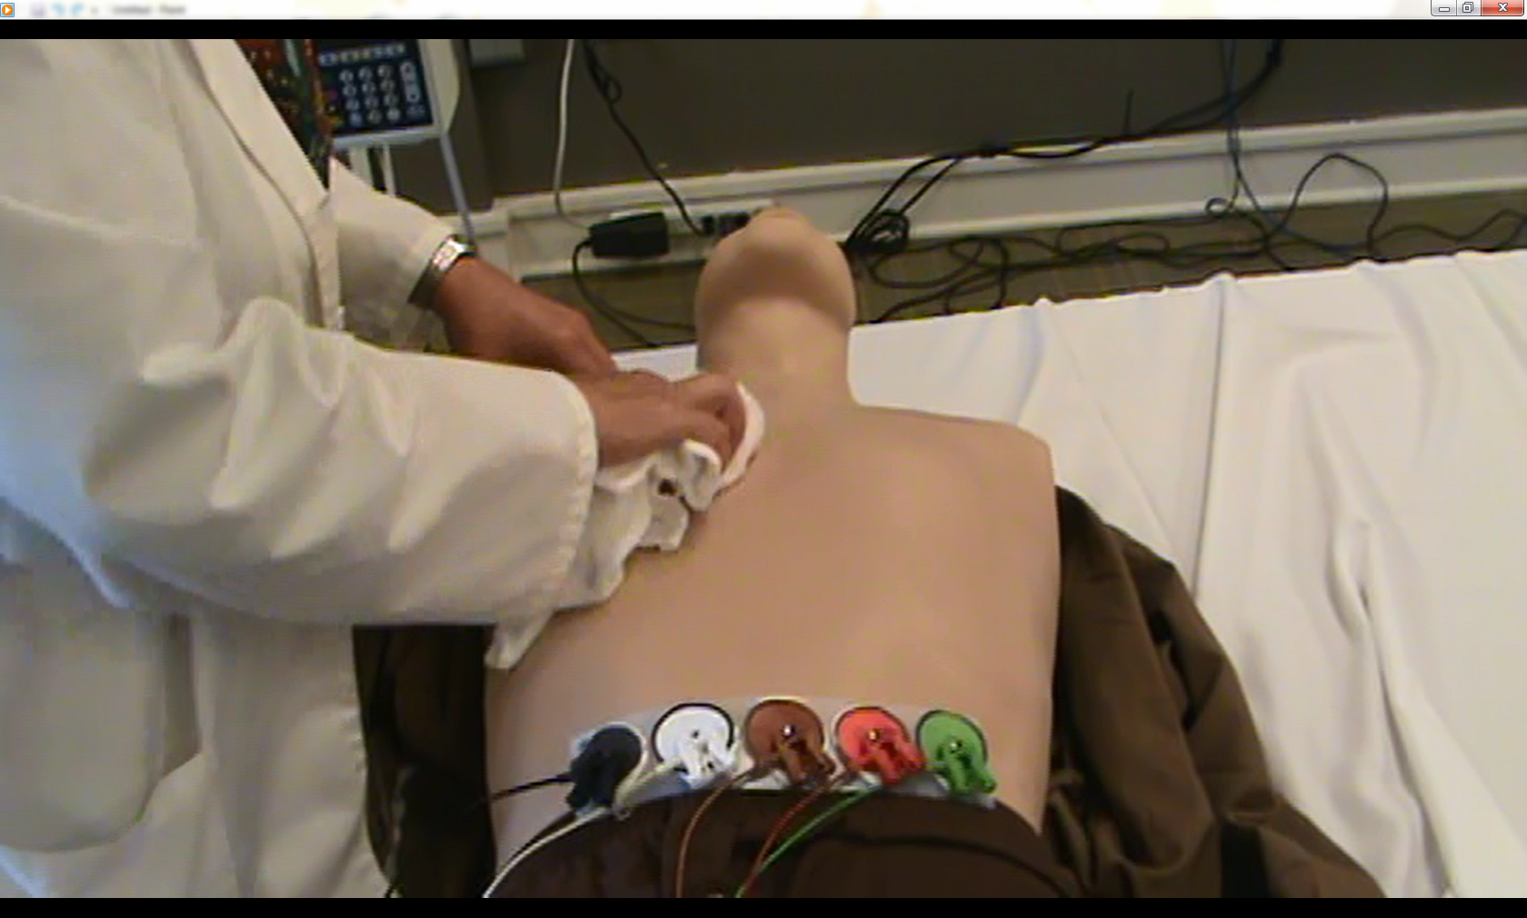
Skin Preparation
Notes:
Colleen:
In the 2004 Guidelines for in-hospital cardiac monitoring of adults, alcohol was recommended as a skin preparation method. Studies on clinical alarm mitigation have re-looked at the practice. In 2013, alarm management was addressed at the National Teaching Institute for Critical Care. Included in presentations were updates to skin preparation stating that alcohol should not be used because it results in drying and irritation of the skin.
Karen
Let’s talk about the evidence related to preparing for cardiac monitoring.
Consider if you could decrease cardiac alarms by approximately 50% with simple steps why not?
Let’s review some steps to decrease alarms:
Keep electrodes in their sealed package until ready for use. Do not leave electrodes outside their package as drying of electrodes may occur, may sure when you open the package you don’t tear off the re-sealable part.
When ready to perform cardiac monitoring, perform patient education.

Slide 28
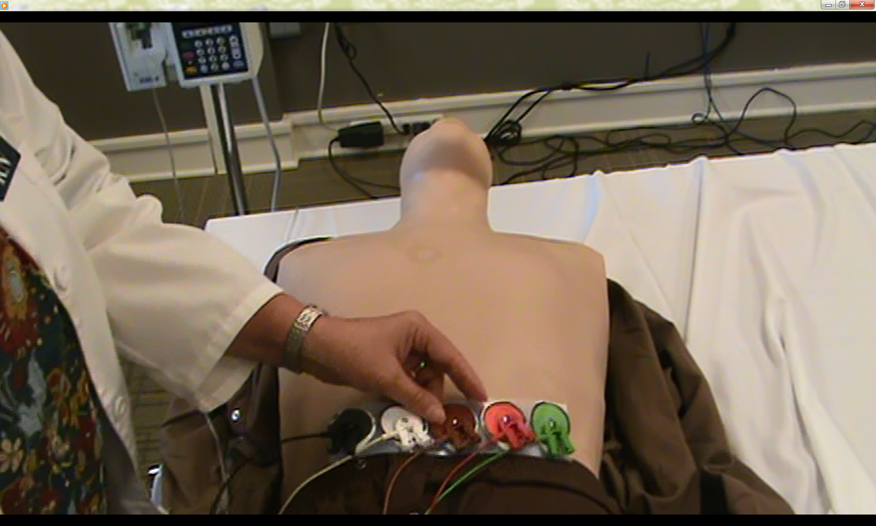
Attach Wires to Electrodes
Notes:
Colleen:
Clip, do not shave the skin in the areas of electrode placement. You can use a clipper or blunt nose scissors. Clip the hair as close to the skin as possible.
Clean the skin with soap and water, use a washcloth to briskly rinse off, then dry each electrode site using a rough gauze or wash cloth.
By cleaning the skin correctly, you can avoid chemical reactions between the sticky part of the electrode and the oils on the patient’s skin. Cleaning the skin this way will improve the conduction between the electrode and the skin, which in turn will reduce false alarms. Taking a few extra minutes up front will go a long way in saving time addressing unnecessary alarms and constantly replacing electrodes that fall off.
Karen
Attach the electrodes to the lead wires before you attach the electrodes to the patient’s chest. This is for two reasons, first it is more comfortable for the patient. And secondly, because it is less likely that the conductive gel will leak out from the center and actually make the electrode less likely to adhere to the patient adequately. Carefully place electrodes in their correct anatomical position.
Firmly seal the electrodes by pressing around the outside edge.
This practice decreases the risk of pockets of air that can develop if the gel center is disrupted. Disruption of the gel center contributes to artifact. This decreases artifact and thus less time spent on managing false alarms.
Colleen-
Finally, monitor those only with indications for monitoring with adjustments of alarms specific to the patient’s clinical condition. Cardiac monitoring should be discontinued when it is determined it is no longer necessary.
A video which demonstrates proper skin preparation and lead placement is available in the green download icon.

Slide 29
Correct Electrode Placement
Electrode Name | Position
RA | Right Infraclavicular fossa
LA | Left Infraclavicular fossa
LL | Below left rib cage
RL | Below right rib cage
V1 | Fourth intercostal space Right Sternal border
Notes:
Karen
Carefully place electrodes in their correct anatomical position and intent of monitoring.
Colleen:
The arm electrodes go in the infra clavicular fossa on the respective sides. This is the soft spot just below the clavicle.
The leg electrodes go below the rib cage on the respective sides of the abdomen
Karen:
Chest lead placement is critical.
The chest lead is placed at the 4th intercostal space RIGHT of the sternum. Remember it’s the right side, where the V1 lead is on a standard 12 lead EKG.
Let’s take a look at how this looks.

Slide 30

Notes:
Colleen
The Guideline for in-hospital cardiac monitoring of provides an excellent diagram of correct, standard 5-lead placement of electrodes.
Correct placement of the chest electrode is essential. So let’s talk about how do you find that.
Measure down from the clavicle (position of 1st rib) or from the Angle of Louis (2nd rib) to find the 4th ICS
The V1 position looks at the septum of the heart and is critical in looking at wide QRS rhythms.
Misplacement by 1 intercostal space can reflect an incorrect picture.
The picture may be clear, however, instead of looking at the septum, another area of the heart is viewed---thus, leading potentially to mis-diagnosis and unnecessary procedures.
Karen
Picture of the Grand Canyon
Note, electrodes are not placed over the ribs or bones which can contribute to electrical interference.
In patients with large breast tissue, place over or under the breast tissue in the correct anatomical position.
Daily, remove the old electrodes. Assess the skin.
Repeat the skin prep and replace electrodes.
In addition, ensure the correct lead is selected appropriate to what you are monitoring for.
Make sure the monitored lead is noted on the rhythm strip. Remember the cardiac monitor does not “know” where the electrodes are placed. Electrode placement is essential. If you are monitoring in V1, the chest electrode must be in the V1 position.
Remember to keep electrodes in their foiled, sealed package prior to use.
Finally, monitor those only with indications for monitoring with adjustments of alarms specific to the patient’s clinical condition.

Slide 31
Manufacturer Errors
Notes:
Colleen:
A word of caution. Manufacturer’s errors exist. We have noticed pictures on some manufacturers telemetry boxes reflect incorrect placement of V1. Note, on this diagram, the chest electrode is placed in the V2 position.
The diagram fails to align with guideline recommendations for standard 5 lead placement.
A review of this manufacturer’s Instructions for use actually described the correct placement yet the diagram indicates incorrect placement.
Karen:
Consider the confusion when training staff. More so, consider the impact on patient care since we are now monitoring in V2 instead of V1. Remember, correct chest electrode placement for standard 5-lead monitoring, is the 4th ICS right of the sternum---just like V1 on an EKG. When manufacturer’s errors are noticed, evaluate and present best evidence and guidelines to the manufacturers. Follow up with and follow through until resolution.
Now that we have the patient attached to the monitor, we need to decide on the correct lead selection.

Slide 32
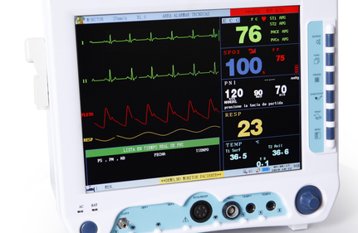
Lead Selection
Notes:
Colleen:
Selecting the right lead to monitor the patient in is essential.
The evidence supports monitoring in Lead II and III for atrial arrhythmias, and
Lead V1 for wide QRS rhythms.
V3 or Lead III is recommended if ST segment monitoring is used for monitoring in acute coronary syndrome when the specific vessel is not known. Lead V3 is located halfway between Lead V2 and V4 at the 4th or 5th ICS left of the sternum.
Karen:
Always remember when monitoring, the equipment does not know the placement of the electrodes. If you move the chest lead to V3, you must make sure this is communicated and documented on the rhythm strip. Make sure the rhythm strips include what lead is monitored and that indeed those leads reflect correct placement of electrodes.
Colleen:
If the amplitude of the EKG strips are small, if the strip fails to be positive in leads where it should be positive, or negative in leads where it should be negative, consider incorrect lead placement or lead reversals. Karen, can you discuss this?

Slide 33
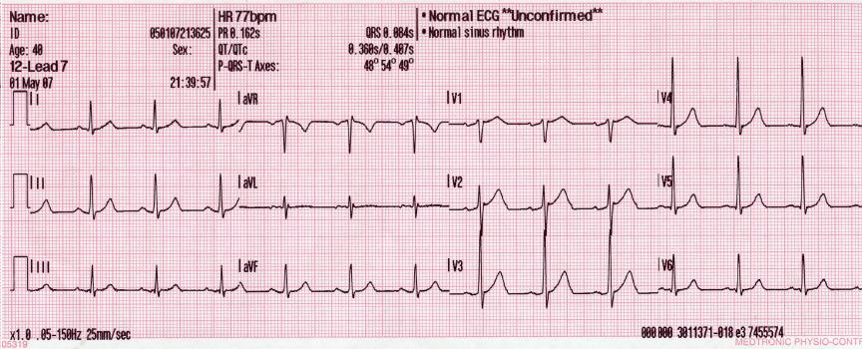
Notes:
Karen, Sure. Thank you Colleen. Although this is a 12 lead and we are discussing cardiac monitoring,
p-waves are positive here. Lead II and III should be upright, positive leads. If Lead II or III is negative, look for why.
If the amplitude of the monitoring lead or leads are small or squatty, or if asystole alarms are occurring when a rhythm is seen on the monitor, review the following steps
Assess the patient
Recheck skin prep and proper lead placement as Improper lead placement is a major contributor to non-clinical causes of low amplitude. Low amplitude can cause bradycardic or asystole alarms because the monitor cannot see the complexes.
Then, Check to see if the leads are reversed.
Utilize the relearn function on the central station.
Finally, consider switching from multi-lead analysis to single lead analysis (if your equipment has this option).

Slide 34
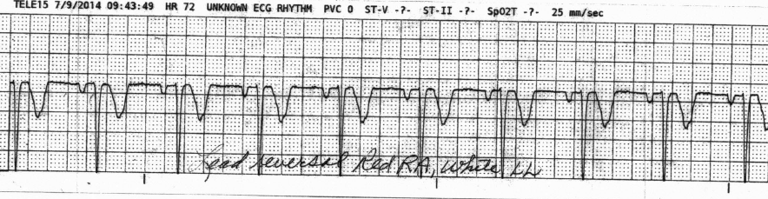
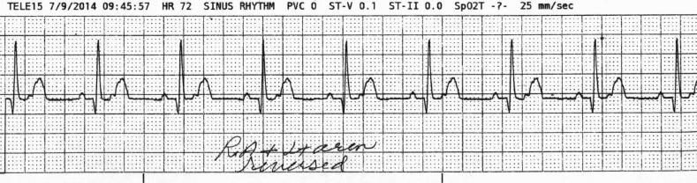
Notes:
Colleen
Here is an example of lead reversal. Note in the top strip, the complexes are reversed because the RA and LL leads are reversed.
The 2nd strip is correct appearing complexes for Lead II placement.
This drives home the point of correct electrode placement.
***************************************************
Key points related to Lead Reversals
When tracings in Lead II appear with small voltage, suspect reversal of RA and RL reversal
When tracings in “Lead II” are inverted, suspect RA and LL reversal
When Lead I and Lead II look more inverted, suspect reversal of RA and LL
When P lead I is greater than P in Lead II, consider reversal of LA and LL
A clockwise reversal of RA, LA, and LL can result in upright Lead I, mostly negative in II and III
A counter clockwise reversal of RA, LA, and LL may result in mostly negative patterns in Lead I, II, and upright in Lead III.
Always review if there is a negative P-QRS in Leads I & II,
P-QRS in leads I and AVL opposite to V5 and V6
If a squatty or near flat lead exists in Lead I, II, or III, evaluate placement

Slide 35
Notes:
So let’s take a look at V1.

Slide 36
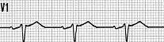
Notes:
Karen
Here is another. The top strip was presented as “V1”. This strip shows upright complexes more typical of Lead II or Lead III.
Look closely at the 2nd strip. This strip accurately reflects a V1 complex.
Lead reversals or incorrect placement can result in inverted complexes (positive complexes when the complexes should be negative or visa versa).
We talked about lead selection, now lets discuss daily electrode changes.

Slide 37
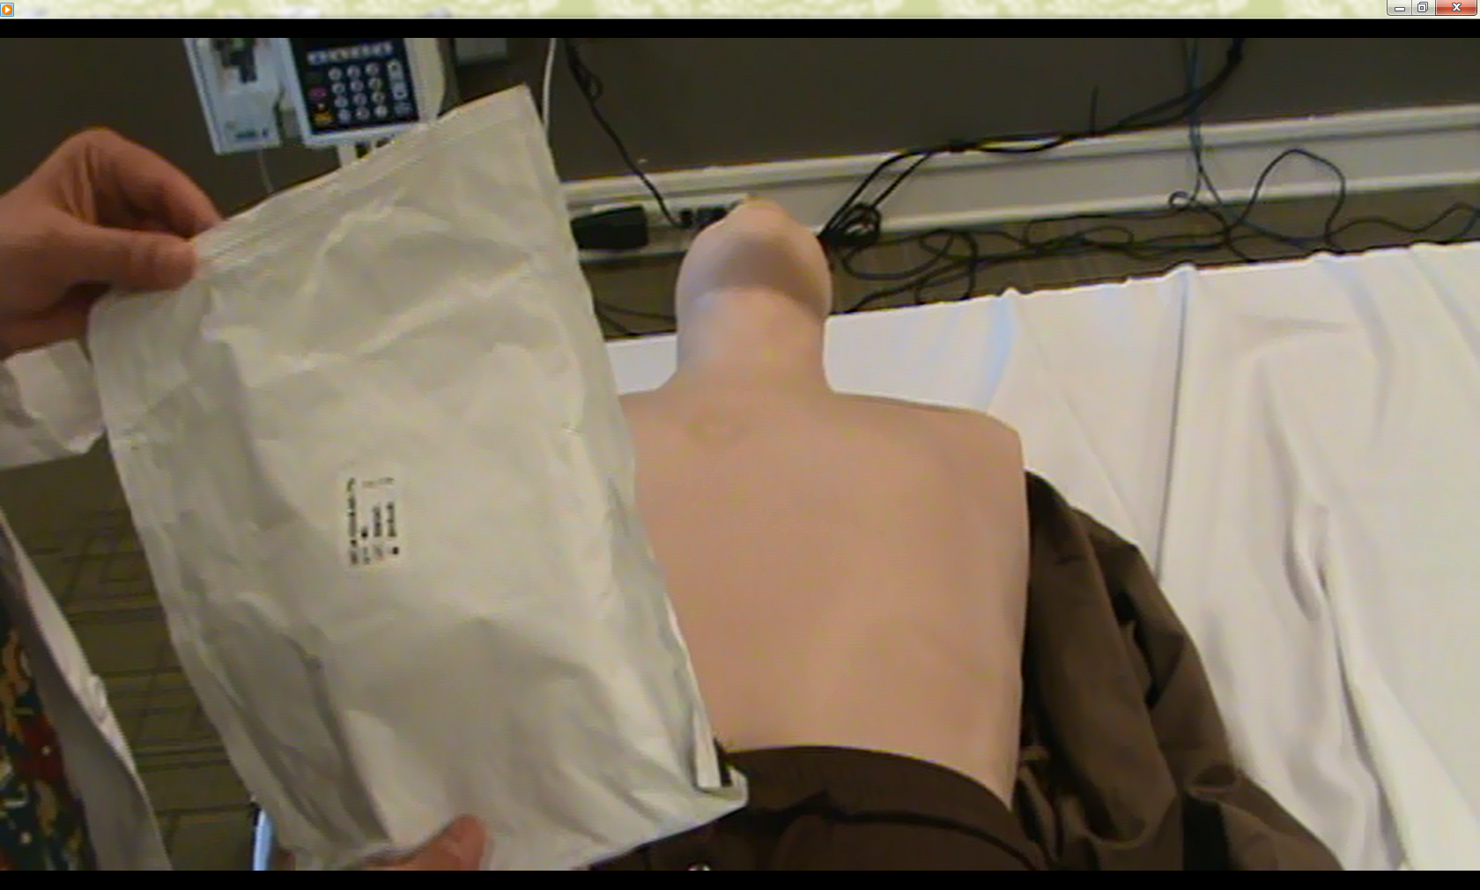
Daily Electrode Change
Notes:
Colleen
To review: Decreasing false and nuisance alarms has to become a priority. The American Association of Critical Care Nurses in their AACN Practice Alert address key points in decreasing alarms. The Practice Alert includes references to studies which showed that daily electrode change contributed to decreasing alarms related to cardiac monitoring.
Karen:
For daily electrode changes: Keep electrodes in their sealed package until ready for use. Remove old electrodes and assess the skin. Provide proper skin preparation.

Slide 38
Notes:
Colleen. As I said earlier, Clip, do not shave hair.
Make sure you clean the skin with soap and water, rinse and scrub dry
Connect the wires to the electrodes prior to connecting electrodes to the patient.

Slide 39
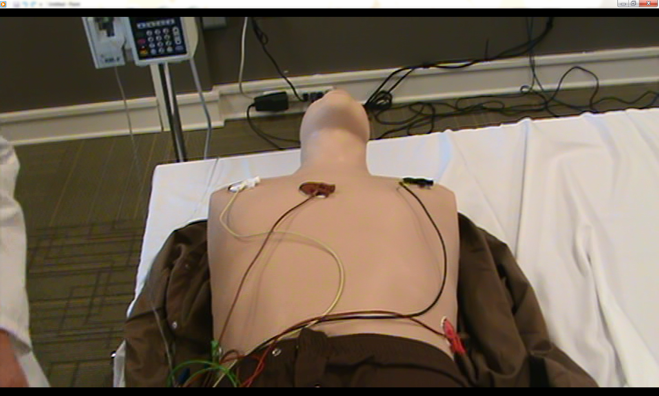
Notes:
Colleen
Ensure correct placement of electrodes.
Karen
With remote telemetry monitoring, verify signal reception and quality to the central station.
Now let’s talk about alarm settings.

Slide 40
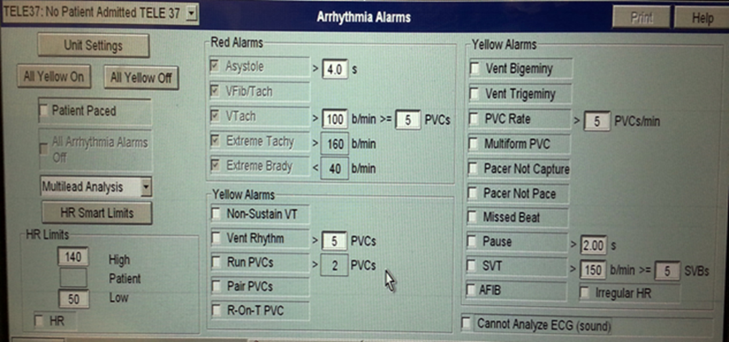
Notes:
Colleen
The key in preventing unnecessary alarms with cardiac monitoring is customizing alarm parameters to the patient.
Adjust with changes in patient condition. Activate pacemaker alarms only when the patient has a pacemaker.
And, when the patient has a pacemaker, remember to activate the failure to pace and failure to capture alarms.
Consider how to optimize alarms by decreasing duplication.
Karen
Note in this example . Here you have multiple areas where you can set high and low heart rate alarms. You also have an SVT alarm with a high heart rate setting. Also look at the multiple settings for PVC alerts. Work with your interprofessional team to optimize these settings. Remember, adjustments to yellow alarms should be made with the patient’s clinical status in mind. Think about what clinical conditions may cause each of the yellow alarm limits.
Colleen
For example consider a patient on beta blockers who’s normal heart rate runs 50. The patient is stable at this rate or even when he dips in the mid 40s. The unit policy or default parameters is 60-120. An order is needed from the provider to adjust the alarms---individualized to the patients rate. For an example, the provider may order set low HR alarm to 45.
Another example would be a patient with Atrial fibrillation with RVR (rate of 125). An order is needed to set the alarm parameters individualized to the patient.
Karen
Again, decrease redundancy in alarms.
Another way to decrease alarms is to optimize types of alarms
High priority. These are usually pre-set, critical alarms.
Consider changing other alarms from warning to advisory status.
Collaborate with the interprofessional team to reassign priority levels.
Colleen
Remember, most yellow alarms should be adjusted based upon the patient’s clinical status.
Address in policy who may set or adjust alarms—remembering alarms should be individualized to the patient within 1 hour of assuming care. The individual who adjusts the alarms must have the authority, be academically or experientially prepared.

Slide 41
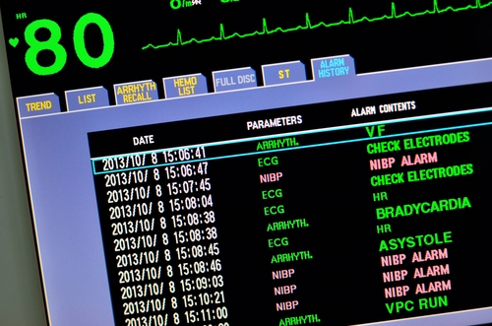
Notes:
Karen
Avoid setting alarms to the unit.
Units may establish baseline settings, but cardiac monitoring is about the patient.
Individualize alarms to the patient’s clinical condition.
Colleen
Here’s another example: Harold was admitted with pauses greater than 2 seconds. This was his normal rhythm. Baseline unit settings were initially set to alarm for pauses greater than or equal to 2 seconds. To avoid excess and unnecessary calls to staff, the nurse needs to collaborate with the provider to obtain an order to set the alarm parameters to alert for pauses specific to what the provider is looking for.
Isa, These pics are just ideas ☺

Slide 42

Ongoing education related to cardiac alarms
Notes:
Karen
Let’s now talk about education. Make sure individuals are fully trained not only on rhythm interpretation but on the equipment and processes related to alarm settings and responses. Ensure staff can translate arrhythmia training into clinical practice. Taking a standardized approach to rhythm interpretation, understanding the importance of skin preparation, lead selection, and proper electrode placement is essential.
Colleen
Consider staff who have just been trained on cardiac rhythms, who are pulled to the central station, yet they have not been trained on the central station equipment and processes. VHA Nurse 1 was trained 6 months ago on central station processes and rhythm interpretation. Many changes have occurred. Consider the challenges this nurse may face with having to monitor 20-30 patients on a central screen.
Karen
Or, think about an ICU RN pulled to work on the central telemetry station. The equipment used in the ICU was Manufacturer A’s equipment. The central station equipment was Manufacturer B’s. The ICU RN was expected to watch20-30 telemetry monitored patients on a system where competency on the actual equipment had not been completed. This presents a potentially dangerous situation.
Colleen
To ensure quality care in cardiac monitoring, it is essential there is a plan for
Initial and ongoing competencies which applies to all components of monitoring.
Although arrhythmia interpretation is essential, so is understanding and implementing proper skin preparation, lead placement, lead selection and alarm processes.
Karen
Staff who care for the cardiac monitored patient must consistently demonstrate best practices in working with the various monitoring equipment. They need to realize in practice what is presented in processes and policies. And, policies, processes, training, and education must be updated to best practice.
Colleen
Monitoring with intention should be a priority. Only monitor those patients who meet criteria for monitoring and discontinue monitoring when no longer appropriate for clinical care. Standardize to the guidelines and best evidence through building of interprofessional teams.

Slide 43

Interprofessional teams
Notes:
Colleen
Build cardiac monitoring interprofessional teams to address alarms specific to cardiac monitoring.
Include biomedical engineering in optimizing alarm settings (warning and advisory alarms)
Evaluate processes to quantify cardiac monitoring alarms pre and post process improvements.
Include alarm communication process improvements.
Karen-Marjorie Funk et al 2013 addressed utilization of ECG monitoring. The authors reported of 4,678 observations of 3,250 patients in 17 hospitals, 26% of the patients had no indication for monitoring. Cardiac monitoring is a costly healthcare resource whereby practice should align with clinical care. The results of the PULSE trial reinforced the over utilization of this costly resource.
Colleen: In 2011, the American Association of Emergency Medicine issued a clinical practice statement on telemetry bed usage for patients with low risk chest pain. “Telemetry bed availability is a valuable and scarce hospital resource that should be used in an efficient and appropriate fashion. Currently, most hospitals mandate that all patients being evaluated for ACS require telemetry monitoring. However, the literature does not support this practice for all patients presenting with chest pain. In fact, based on the ACC/AHA guidelines, the validated Goldman risk scoring system, and the literature evaluating the utility of telemetry for low risk chest pain patients.
Karen: The AAEM endorse the following recommendations: 1) Developing a more standardized definition of low-risk chest pain will be useful for future studies on the utility of telemetry monitoring. 2) The subset of chest pain patients who can be safely discharged from the ED has yet to be fully identified.”
Work closely with the interprofessional team to address optimize utilization.
****************************
Nursing, Biomedical Engineering, physicians
Order sets-Meaningful use
Utilization
Monitor only those appropriate for clinical monitoring
Monitor with intention-to the evidence
Monitor only as long as clinically appropriate

Slide 44
Quality Improvement Example
Eliminated duplicate alarms (high heart rate OR tachycardia-using one, not both)
Decreased alarms by 43%
Notes:
Colleen
Many quality improvement projects are listed in the literature. One important one is a study done on a
15-bed medical progressive care unit.
They counted 16,953 alarms over the course of 8 days, this included pulse oximetry alarms
They Eliminated duplicate alarms (high heart rate OR tachycardia-using one, not both)
And Individualized alarms to patient to actionable alarms
By doing this they decreased nuisance alarms by 43% which resulted in 9,647 less alarms. Can you imagine how much time would be saved by decreasing that amount of alarms?

Slide 45
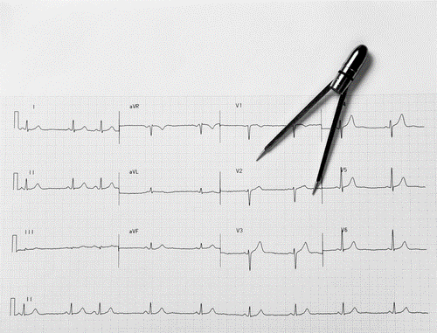
Measuring processes
Notes:
Karen
Develop and implement processes to monitor compliance to established policies.
Develop a system whereby feedback occurs related to current processes whereby improvement changes can be made to optimize patient care.
Some examples for measuring processes related to cardiac monitoring include: an electrode audit and lead placement tool developed by the American Association of Critical Care Nurses.
Colleen:
The audit tool is available at www.aacn.org
Enter the search term “dysrhythmia”
There is a practice alert posted at AACN specific to dysrhythmia monitoring. As we have discussed, skin preparation has changed. The AACN dysrhythmia practice alert dated 2008 continues to reflect the use of alcohol. Cross reference to the AACN Alarm Management Practice Alert which includes current recommendations of soap and water for preparing the skin.
Karen
Consider implementing skin preparation surveys for employees. One of our Transition to Practice (Nurse residents) built their evidence-based practice project around a survey for employees. The survey included questions such as: have you read the policy, been trained, then select the proper skin preparation. The results were interesting and demonstrated the need for reinforcement of policies and processes.
Colleen.
Consider alarm software to monitor processes to quantify alarm numbers prior to and post implementation of processes to decrease alarms.
Finally, consider handoff communication tools among central station personnel and an online documentation logs whereby alarms and staff notifications are recorded and reviewed.
Karen
Review data obtained from process monitoring. Align improvements to new evidence and reflect revision dates. Remember, alarm fatigue has been found to contribute to patient harm.
******************************************************************
On Resource list.
AACN audit tool American Association of Critical Care Nurses. Electrode placement and Lead Selection (2008). American Association of
Critical-Care Nurses Retrieved from
http://www.aacn.org/WD/Practice/Docs/PracticeAlerts/Electrode_Placement-Lead_Selection_Audit_Tool_04-2008.pdf

Slide 46

Summary
EKG Placement
Notes:
Karen- so let’s summarize. And remember these slides as well as our speaker notes are available in the download section and can be accessed by clinking on the green download button above my head.
In order to decrease alarms and therefore decrease alarm fatigue you need to do four things.
Colleen
1- Proper skin prep cannot be emphasized enough. This goes a long way to reduce noise and artifact.
2- Proper electrode placement, you need to ensure you are getting the picture you want.
3- Change electrodes daily. I know this can seem like a lot of extra work, but if it decreases alarms it will save you time in the long run. Plus it is important for patient safety.
4-Monitor with intention:
Correct lead on the monitor for the patient’s rhythm
Monitor only those patients who meet criteria and discontinue monitoring when no longer appropriate,
you don’t need to be answering nuisance alarms for patients who really don’t need to be monitored in the first place.
And individualize alarms to the patient.

Slide 47

Summary
Reduce Alarm Fatigue
Notes:
Karen:
Provide initial and ongoing education related to alarm devices.
Establish interprofessional teams to address alarms
Monitor all processes and remember continuous improvement.

Slide 48

Summary
Key is Patient
Safety
Notes:
Colleen and Finally remember
Alarm fatigue presents a major safety issue
It is the #1 technology hazard to patients
Opportunities do exist to reduce false alarms related to cardiac monitoring
More technology isn’t the key—Patient safety is.

Slide 49

Ask the Presenter
“Authorizations are on file for the names used in this presentation, but all clinical indications presented are entirely fictitious.”
Notes:
Karen: If you haven’t submitted your questions yet, there’s still time to do so by clicking on the orange ask the presenter icon. We’re going to show a brief announcement, but we’ll be right back to answer your questions
(stand still and smile until you hear video)

