Slide 1
Back to Basics: Health Summary
Rikkita Hughes
Notes:
Thank you Becky! I am happy to be here today to talk about Health Summaries.

Slide 2
Notes:
The Health Summary package integrates clinical data from the Veterans Health Administration Information Systems Architecture (VistA) ancillary packages into patient health summaries which can be viewed online or printed as reports.
There is a technical manual on Health Summaries that is available for use on the Vista Document Library @ http://www.va.gov/vdl/. This manual can be used as a technical reference guide for IT Service, ADPACs, and Clinical Coordinators.
Please note that this manual has been revised to describe changes that have been made, through patches, to Health Summary V. 2.7 since its release in 1994.

Slide 3
Objectives
Learn how to create a Health Summary
Learn how to edit/manage a Health Summary
Learn how to perform basic troubleshooting in a Health Summary
Notes:
As you go through the presentation today it is my hope that you will learn these 3 things, how to:
Create a Health Summary
Edit/Modify a Health Summary
Perform basic troubleshooting in a Health Summary

Slide 4
What is a Health Summary?
Notes:
A health summary is a user-customized, clinical summary report consisting of patient information, also known as “components” which I will be explaining more in the presentation.
Each component presents the most currently available summary data from one of the ancillary packages for a given patient, with optional limits by time, number of occurrences, and selection items.
There are at least 23 packages that provide data to a Health Summary:
Some of those packages are:
Packages Providing Data
Automated Med Info OE/RR (Order Entry/Results Reporting
Exchange (AMIE) Outpatient Pharmacy
Allergy Tracking System Patient Care Encounter (PCE)
Clinical Reminders Problem List
Consults Progress Notes
Dietetics Radiology
Discharge Summary Registration
Inpatient Medications Scheduling
Lab Social Work
Medicine Surgery
Mental Health VISTA Imaging
Nursing (Vital Signs)
Now before we go any further I would like to do a poll to find out who my targeted audience is for this presentation today .

Slide 5
Poll Question
Have you ever created or built a Health Summary?
Yes
No
Notes:
Have you ever created or built a Health Summary?
YES
NO
I will give you a moment to submit your answer. While you are doing that let us explore the Value of Health Summaries..

Slide 6
Health Summary Value
Notes:
What is the primary value of “Health Summaries”?
They provide important information to healthcare providers about a patient's condition and more importantly is to remember that the individual patient is the focus of health summaries.
Health summaries can also be printed or displayed for groups of patients as well. The data displayed covers a wide range of health-related information such as demographic data, allergies, current active medical problems, and laboratory results.
There are a great deal more reasons why health summaries prove to be very valuable in the day to day treatment of our patients.
Now let’s pause for a moment and take a look at your poll results.

Slide 7
Poll Results
Have you ever created or built a Health Summary?
Yes
No
Notes:
Have you ever created a Health Summary?
YES
NO
I see we have more users that have created health summaries than those who have note. Hopefully as we continue in the presentation the experienced CACs will find to be a refresher presentation and for those who have not created a health summary will find this as a great starting point to understanding as well as creating health summaries. Now lets continue with what is needed to create a health summary.

Slide 8
Poll Results
Have you ever created or built a Health Summary?
Yes
No
Notes:
Click to move on

Slide 9
Component
Objects
User Preferences
Parameters
Types
Notes:
These are parts that make up the Health Summary package
Health Summary Component
Health Summary Type
Health Summary Objects
Health Summary User Preferences
Health Summary Parameters

Slide 10
Type
National
User Defined
System Defined
Notes:
There are three major classes of Health Summary types,
National (remote data view),
user defined and
system defined
Health Summary Type – is a structure containing defined components and unique characteristics with occurrence and time limits, and selection items that is used to print health summaries for patients. When a “permanent” Health Summary is created, its type, as defined by the owner/creator, and is saved in the Health Summary Type file (142).
This file contains the structure of a health summary. Components from the Health Summary Components file (142.1) may be selected and restricted by number of occurrences or time limits. The original creator of a type of Health Summary is the owner of that type. Health summaries that are “owned” may not be modified or deleted by anyone except the Clinical Coordinator. “Owned” Health Summaries may be used by other users to print patient information.

Slide 11
Components
Components and their behavior are specified by records in the Health Summary Component file (142.1).
Notes:
Health Summary Components:
Component is the summarized patient data extracted from various VistA software packages. Or Elements of data from VISTA packages that make up the health summary report (e.g., Demographics, Progress Notes, Problems List, Vital Signs etc.).
Components and their behavior are specified by records in the Health Summary Component file (142.1).
This file contains all components which may be used to create a Health Summary. These entries are typically defined by a programmer. Components which represent packages that are not in use may be disabled, so they will not be selected by users to build new types of health summary reports.

Slide 12
Health Summary Objects are stored in file 142.5, along with a series of flags that determine how a Health Summary Object will be displayed.
Objects
Notes:
Health Summary Objects:
This file contains Health Summary Types that are to be embedded into another document as an object. The bulk of this file is made up of display flags which control how the object is to be embedded into the other document.
Health Summary Objects are stored in file 142.5, along with a series of flags that determine how a Health Summary Object will be displayed.

Slide 13
User Preferences
This file determines how the list of Health Summary Types for the CPRS GUI report tab is to be organized (APPEND or OVERWRITE) for user selection.
Notes:
Health Summary User Preferences:
This file determines how the list of Health Summary Types for the CPRS GUI report tab is to be organized (APPEND or OVERWRITE) for user selection.
Remember there are three major classes of Health Summary types, National (remote data view), user defined and system defined.
User and system Health Summary Types are defined in the Kernel Parameters file. Append creates a single list, removing duplicates, and keeps the National Health Summary types group together. Overwrite stops building the list once a single group of Health Summary Types (User or System) is added to the list.

Slide 14
Parameters
Prompt for Action Profile
Include Bar Code on Action Profiles
Include Comments on Labs
Spool
Error Message Recipient
Short HS by Location Cover
Notes:
Health Summary Site Parameters:
This file contains any site parameters that apply to the Health Summary package.
Currently there are six site parameters:
PROMPT FOR ACTION PROFILE;
INCLUDE BAR CODE ON ACTION PROFILES;
INCLUDE COMMENTS ON LABS;
SPOOL DEVICE
ERROR MESSAGE RECIPIENT;
SHORT HS BY LOCATION COVER
Print an Outpatient Pharmacy Action Profile in tandem with a Health Summary.
Print bar codes when Action Profiles are printed.
Present Lab comments at display indicating comments are available for the Lab Chemistry and Hematology, the Lab Cumulative Selected, and the Lab Tests Selected components, or present the !! symbol to indicate comments are available for the Chemistry and Hematology and Lab Tests Selected components.
Specify a spool device where requests will be stored . (a virtual device)
Change the number of times each location prints on the cover sheet from 6 times to 1 time.

Slide 15
Health Summary PARTS
Component
Objects
User Preferences
Parameters
Types
Notes:
Okay now that I have shared some parts of a health summary Let’s take a moment to take a poll question.

Slide 16
Poll Question
What part of Health Summary extracts patient data from various VistA software packages?
Health Summary Type
Health Summary Component
Health Summary Preference
Notes:
What part of Health Summary extracts patient data from various VistA software packages?
Health Summary Type
Health Summary Component
Health Summary Preference

Slide 17
Notes:
While you are casting your answer, let me point out that sites are encouraged to submit NSR for new components (or enhancements to existing components) that they believe will be useful on a national basis. The Health Summary Expert Panel (EP) will evaluate these requests. If the EP approves the request, these new components will be provided as patches or in a future version of the Health Summary package, depending on the priority that is given to the request.
Sites have the option to create new components for Health Summary to provide for their site-specific needs. This may be an enhancement to one of the components that Health Summary provides, it can be a totally new one that accesses DHCP data that Health Summary currently doesn’t provide a component for, or it can be one to access non-DHCP supported (Class III software) packages.
NOTE: Please be aware that locally created components are not supported by National VISTA Service (NVS) or Systems Design and Development (SD&D).
Okay let’s take a look at the results from our last question!

Slide 18
Poll Results
What part of Health Summary extracts patient data from various VistA software packages?
Health Summary Type
Health Summary Component
Health Summary Preference
Notes:
Wow! I looks as though I did not lose you on “the parts of Health Summary”
What part of Health Summary extracts patient data from various VistA software packages
Health Summary Type
Health Summary Component (ANSWER)
Health Summary Preference

Slide 19
Poll Results
What part of Health Summary extracts patient data from various VistA software packages?
Health Summary Type
Health Summary Component
Health Summary Preference
Notes:
Click to move on

Slide 20
Health Summary Menus
Health Summary Menus
Coordinator Menu
Enhanced Menu
Mainten-ance Menu
Summary Menu
Objects Menu
Overall
Menu
Notes:
Please note that the order of the reports may be different depending on the configuration of your site.
Let’s take a stroll through some of the menus that are available to the Clinical Application Coordinators and what they can use them for when working with Health Summaries.
There are 6 Health Summary Menus that the CACs have assess too. (Need a photo art displaying them)
1 Health Summary Coordinator's Menu [GMTS COORDINATOR]
2 Health Summary Enhanced Menu [GMTS ENHANCED USER]
3 Health Summary Maintenance Menu [GMTS IRM/ADPAC MAINT MENU]
4 Health Summary Menu [GMTS USER]
5 Health Summary Objects Menu [GMTS OBJ MENU]
6 Health Summary Overall Menu [GMTS MANAGER]

Slide 21
Coordinator’s Menu
1. Print Health Summary Menu
2. Build Health Summary Type Menu
3. Set-up Batch Print Locations
4. List Batch Health Summary Locations
5. CPRS Reports Tab Health Summary Types List Menu…
Notes:
1 Health Summary Coordinator's Menu [GMTS COORDINATOR]
This option is used by individuals who have the capability to build their own Health Summary Types. It has all of the capabilities of the 'Health Summary Users Menu' with the addition of the 'Build Health Summary Type Menu' and the option to set parameters for nightly batch printing of Health Summaries by Location.
1 Print Health Summary Menu ...
2 Build Health Summary Type Menu ...
3 Set-up Batch Print Locations
4 List Batch Health Summary Locations
5 CPRS Reports Tab 'Health Summary Types List' Menu ...

Slide 22
Enhanced Menu
1. CPRS Reports Tab 'Health Summary Types List' Menu
2. Ad Hoc Health Summary
3. Create/Modify Health Summary Type
4. Delete Health Summary Type
5. Hospital Location Health Summary
Notes:
2 Health Summary Enhanced Menu [GMTS ENHANCED USER]
This option allows the user to print Health Summaries based on pre-defined Health Summary Types as well as Ad Hoc Summaries. The user may also list existing Health Summary Types and Health Summary Components and may inquire about the structure of a Health Summary Type. This option also allows the user to create or delete his own Health Summary Types.
1. CPRS Reports Tab 'Health Summary Types List' Menu ...
2. Ad Hoc Health Summary
3. Create/Modify Health Summary Type
4. Delete Health Summary Type
5. Hospital Location Health Summary

Slide 23
6. Information Menu ...
7. Patient Health Summary
8. Range of Dates Patient Health Summary
9. Visit Patient Health Summary
Notes:
2 Health Summary Enhanced Menu [GMTS ENHANCED USER]
6. Information Menu ...
7. Patient Health Summary
8. Range of Dates Patient Health Summary
9. Visit Patient Health Summary

Slide 24
Maintenance Menu
1. Disable/Enable Health Summary Component
2. Create/Modify Health Summary Components
3. Edit Ad Hoc Health Summary Type
4. Rebuild Ad Hoc Health Summary Type
5. Resequence a Health Summary Type
Notes:
3 Health Summary Maintenance Menu [GMTS OI&T/ADPAC MAINT MENU]
This menu is for IRM staff or Clinical Coordinators who help implement and maintain Health Summary. Options on this menu are described in the Health Summary Technical Manual which can be found on the Vista Document Library @ http://www.va.gov/vdl/
This option will provide the OI&T staff with a set of tools for Health Summary implementation and maintenance
1 Disable/Enable Health Summary Component
2 Create/Modify Health Summary Components
3 Edit Ad Hoc Health Summary Type
4 Rebuild Ad Hoc Health Summary Type
5 Resequence a Health Summary Type

Slide 25
6. Create/Modify Health Summary Type
7. Edit Health Summary Site Parameters
8. Health Summary Objects Menu...
9. CPRS Reports Tab 'Health Summary Types List' Menu
10. CPRS Health Summary Display/Edit Site Defaults ...
Notes:
6 Create/Modify Health Summary Type
7 Edit Health Summary Site Parameters
8 Health Summary Objects Menu...
9 CPRS Reports Tab 'Health Summary Types List' Menu ...
10 CPRS Health Summary Display/Edit Site Defaults ...

Slide 26
Summary Menu
1. Patient Health Summary
2. Ad Hoc Health Summary
3. Range of Dates Patient Health Summary
4. Visit Patient Health Summary
5. Hospital Location Health Summary
6. Information Menu
7. CPRS Reports Tab ‘Health Summary Types List’ Menu
Notes:
4 Health Summary Menu [GMTS USER]
This menu is for users who only need to print or display health summaries.
This menu allows the user to print Health Summaries by Patient or Hospital Location with a pre-defined Health Summary Type, or print Health Summaries for patients, based on ad hoc Health Summary definitions. Th
e user may also use the Information Menu to list and inquire about Health Summary Types and Health Summary Components.
This menu does not contain the options which allow the user to create or delete his/her own Health Summary Types.
1 Patient Health Summary
2 Ad Hoc Health Summary
3 Range of Dates Patient Health Summary
4 Visit Patient Health Summary
5 Hospital Location Health Summary
6 Information Menu ...
7 CPRS Reports Tab 'Health Summary Types List' Menu ...

Slide 27
Objects Menu
1. Create/Modify Health Summary Object
2. Inquire about a Health Summary Object
3. Test a Health Summary Object
4. Delete Health Summary Object
5. Export/Import a Health Summary Object ...
Notes:
5 Health Summary Objects Menu [GMTS OBJ MENU] it allows you to, we talked about these earlier in the presentation, however with this option you can:
1 Create/Modify Health Summary Object
2 Inquire about a Health Summary Object
3 Test a Health Summary Object
4 Delete Health Summary Object
5 Export/Import a Health Summary Object ...

Slide 28
Overall Menu
1. Health Summary Coordinator's Menu ...
2. Health Summary Enhanced Menu ...
3. Health Summary Menu ...
4. Health Summary Maintenance Menu ...
Notes:
6 Health Summary Overall Menu [GMTS MANAGER]
1 Health Summary Coordinator's Menu ...
2 Health Summary Enhanced Menu ...
3 Health Summary Menu ...
4 Health Summary Maintenance Menu ...
But for the purpose of this training we are going to focus on menu number 1 “Health Summary Coordinator's Menu [GMTS COORDINATOR]
” to walk you through how to Create/Modify Health Summary Components

Slide 29
1. Health Summary Menu [GMTS USER]
2. Health Summary Enhanced Menu [GMTS ENHANCED USER]
3. Health Summary Coordinator’s Menu [GMTS COORDINATOR]
4. Health Summary Maintenance Menu [GMTS IRM/ADPAC MAINT MENU]
Notes:
Before we demonstrate how to create/build a health summary let me share with you who should get the Health Summary Menus?
The Health Summary Overall Menu [GMTS MANAGER] contains four menus.
1. Health Summary Menu [GMTS USER]
2. Health Summary Enhanced Menu [GMTS ENHANCED USER]
3. Health Summary Coordinator’s Menu [GMTS COORDINATOR]
4. Health Summary Maintenance Menu [GMTS IRM/ADPAC MAINT MENU]
You should assign these menus as follows:
1. Give the Health Summary Menu [GMTS USER] menu to users who only need to print or display health summaries.
2. Give the Health Summary Enhanced Menu [GMTS ENHANCED USER] menu to users who need to create, modify, or delete their own health summary types, in addition to printing health summaries.
3. Give the Health Summary Coordinator’s Menu [GMTS COORDINATOR] menu to users who need to print or display health summaries, and who will also need to create, modify, or delete health summary types, and set up nightly batch printing at specified locations.
4. Give the Health Summary Maintenance Menu [GMTS IRM/ADPAC MAINT MENU] to IRM/IT staff or the Clinical Coordinator for any implementation and maintenance issues in Health Summary. This menu contains options to disable/enable health summary components for selection/display, create/modify new health summary components, edit and rebuild the Ad Hoc Health Summary Type, resequence the components in a health summary type, create/modify a health summary type, delete a health summary type, and edit health summary site parameters.
5. If an IRM staff member or the Clinical Coordinator needs access to all menus, give the Health Summary Overall Menu [GMTS MANAGER] to those users rather than assigning each menu option separately.

Slide 30
Poll Question
Which menu gives access to ALL menus?
Health Summary Overall Menu
Health Summary Menu
Health Summary Enhanced Menu
Notes:
Which menu gives access to all menus?
A. Health Summary Overall Menu
B. Health Summary Menu
C. Health Summary Enhanced Menu

Slide 31
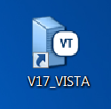
Create/Modify Health Summary Components
Notes:
Create/Modify Health Summary Components
The following sample dialogue can assist you in creating your own local health summary components.
Log into your Vista “Pre-Production” account also known as your “Test” Account. It is always wise to create your Health Summaries in the Test account in order to avoid any errors in your “Production” or “Live” account.

Slide 32
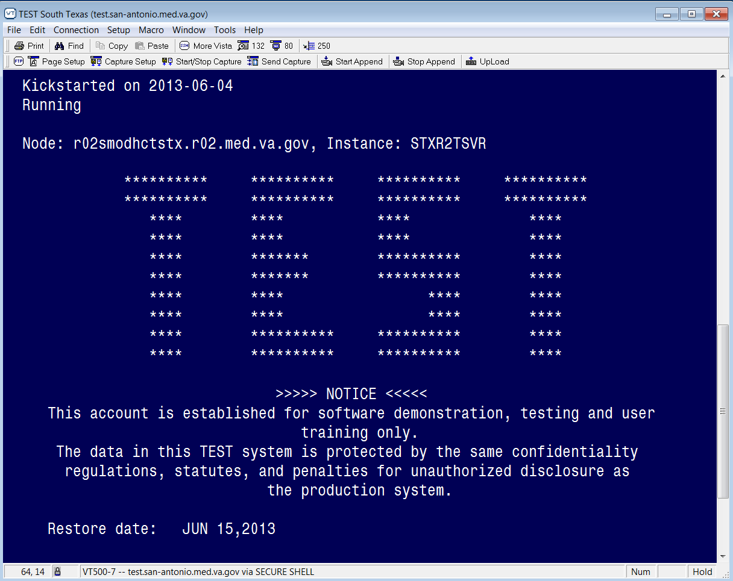
Notes:
This is one way for sure that you can tell if you are in your “TEST” or “Pre-Production” account.
While I check the poll results this will give you an opportunity to open up your account and follow along with this presentation.

Slide 33
Poll Results
Which menu gives access to ALL menus?
Health Summary Overall Menu
Health Summary Menu
Health Summary Enhanced Menu
Notes:
Wow! I looks as though I did not loose you on “the parts of Health Summary”
What part of Health Summary extracts patient data from various VistA software packages
Health Summary Type
Health Summary Component (ANSWER)
Health Summary Preference
Thank you for taking the poll and now let us continue with our presentation

Slide 34
Poll Results
Which menu gives access to ALL menus?
Health Summary Overall Menu
Health Summary Menu
Health Summary Enhanced Menu
Notes:
Click to move on

Slide 35
Notes:
At your primary menu option, you can use your up carrot symbol “^” by holding down your Shift key and pressing your number “6” key and type in “Health Summary” and this will allow you to “jump” directly to the Health Summary menu options.
As you can see the menu option what we want to select is number 1, “Health Summary Coordinator’s Menu”

Slide 36
Notes:
Once you have selected the Health Summary Coordinator's Menu, you will get your submenus and then you can select the “Build Health Summary Type Menu “.
You will use the options in the Build Health Summary Type menu to create health summary types consisting of the components you designate or have been asked to create by a health summary user.

Slide 37
Notes:
You can type in the first 3 or 4 letters of the option that you want access “in this demonstration type build health” then hit “enter” and then your choices will appear. For this presentation we will type “build health” to pull of the “Create/Modify Health Summary Type option.
Remember: It is the health summary type that determines what information is included on a health summary. The Build Health Summary Type menu contains five options of which three of these are menus which are:
Health Summary Objects Menu
Information Menu
Print Health Summary Menu

Slide 38
Create Health Summary Type Example
Copying
Scratch
Notes:
Now we will go into how to Create Health Summary Type
I will be demonstrating two examples:
In the first example, a health summary type that is created by copying components from an existing health summary type.
In the second example, a new health summary type that is built from scratch.

Slide 39
Copying Example
Notes:
In the first example - Creating a health summary type by copying from an existing summary (assuming you have the GMTSMGR key):
Remember we selected the “Build Health Summary Type Menu” option

Slide 40
Notes:
Just to reiterate, by selecting the “Create/Modify Health Summary Type”
The User can:
Create a new health summary type by copying all or a few components from an existing health summary type.
Create a new health summary type from scratch, by selecting components one at a time and defining the occurrences, time limits, and selection items.
Modify an existing health summary type.

Slide 41
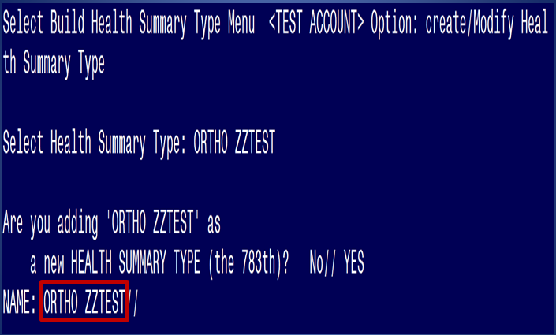
Notes:
The next step is to select a new name for a Health Summary Type. For this exercise I have chosen ORTHO ZZTEST
ORTHO ZZTEST is the NAME of the Health Summary Type. This name will appear in the health summary header. The word “CONFIDENTIAL” will appear in front of this name and the word “SUMMARY” will appear at the end to complete the header.
Name entered: ORTHO ZZTEST
Generated Health Summary header: CONFIDENTIAL ORTHO ZZTEST SUMMARY

Slide 42
Notes:
3. Enter a title if you wish to replace NAME with the title in the health summary header. For example, if you enter the Name as ORTHO, and the Title as Outpatient Treatment, the header that will be shown will be CONFIDENTIAL OUTPATIENT TREATMENT SUMMARY.

Slide 43
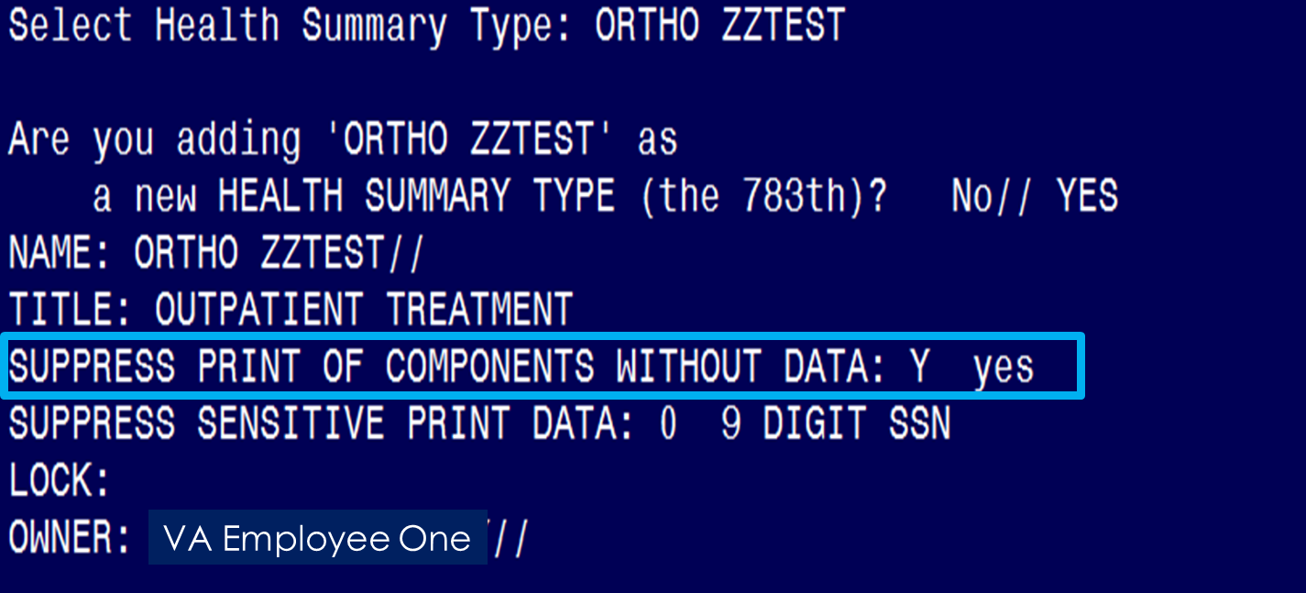
Notes:
Enter yes or no to the prompt about whether to suppress components’ headings when those components don’t contain data.
For health summary types that are displayed on the screen, this component will still be displayed with a “No data available” message. This is done to eliminate confusion that may occur when jumping between components.

Slide 44
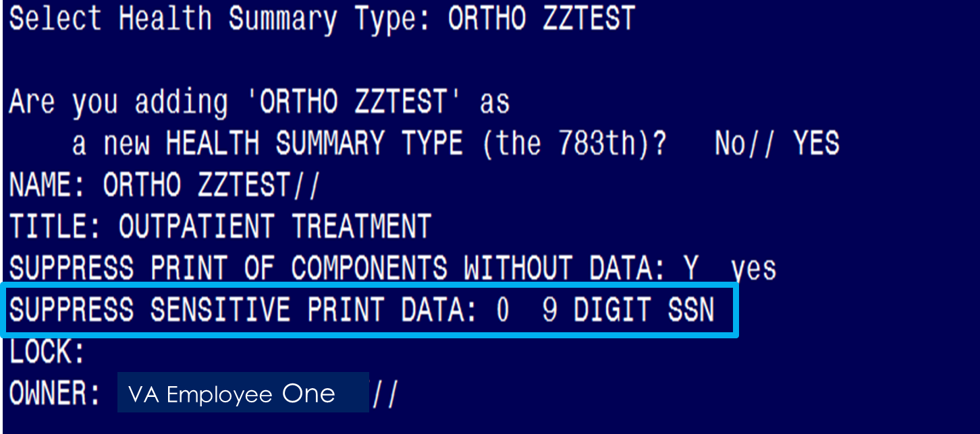
Notes:
5. Enter 0, 1, or 2 to the prompt about suppressing sensitive print data. Depending on the response to this question, the SSN/DOB information will appear in one of the following formats on printed Health Summaries.
0. Full 9 digit SSN and full DOB
1. 4 digit SSN and No DOB
2. No SSN and No DOB

Slide 45
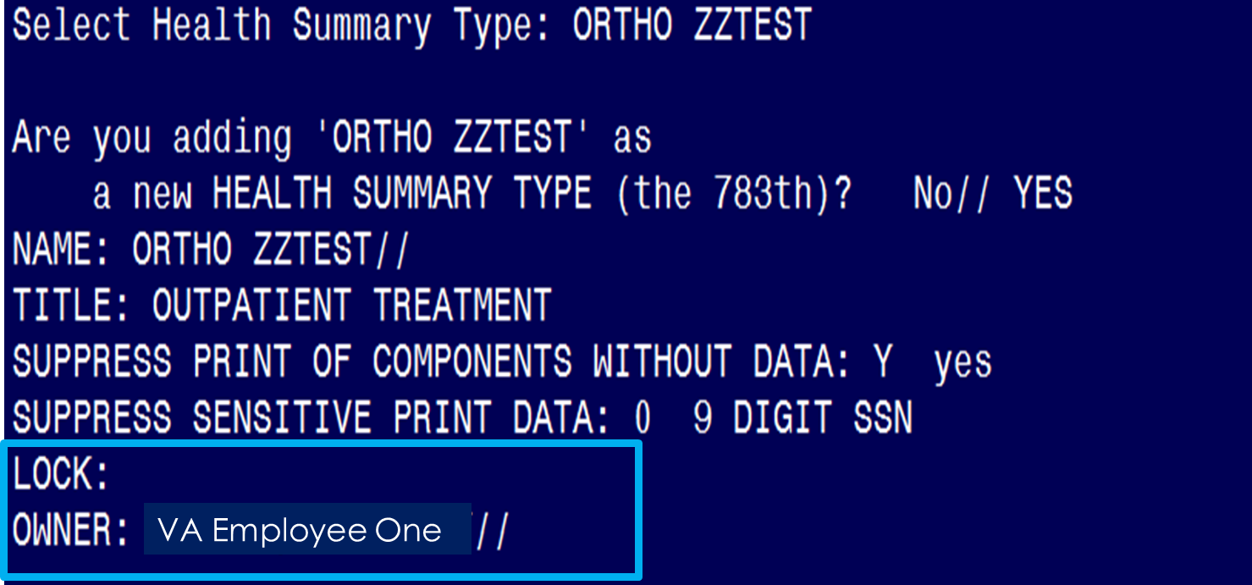
Notes:
6. Enter Lock and Owner, if appropriate.
Enter a LOCK if you wish to restrict edit/delete access to your health summary type. You must hold the GMTSMGR security key to enter a lock. You are automatically considered the owner, unless you hold the GMTSMGR key. If you hold the GMTSMGR key you have to designate yourself or someone else as the owner.

Slide 46
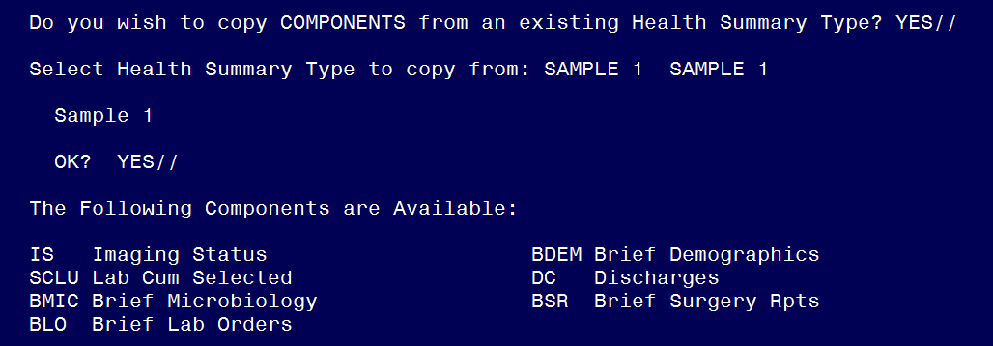
Notes:
7. If you want to copy components from an existing Health Summary Type, accept the default at the “Do you wish to copy COMPONENTS from an existing Health Summary Type?” question and then hit your enter key.
After you hit your enter key type in the name of the component that you want to copy and as you can see for this example I selected “SAMPLE 1” since I know it has all the components that I want for this Health Summary Type.
Hit your enter key at the OK? YES// prompt and then you will see a list of your components under the “Sample 1” Health Summary Type.

Slide 47
Notes:
Okay now you can select the components you want to include in your new type.
Remember you can only select components to copy that are already a part of the “SAMPLE 1” health summary type.
If you need to add a component that is “NOT” in the SAMPLE 1 health summary type, you can do so at the next “Select COMPONENTS(S):” prompt
For this exercise we are going to can enter “ALL” at this prompt to select all the components in the this health summary type.
Then you will receive the message “Loading components into the Health Summary Type with defaults”
Next you will received the “Do you wish to review the Summary Type structure before continuing? NO// YES” (which is defaulted to NO but type YES)

Slide 48
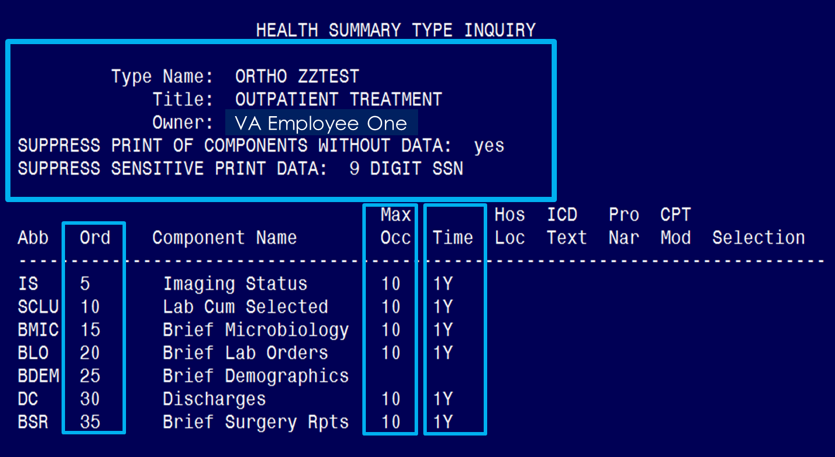
Notes:
You will then see a list of the parameters you have chosen, followed by a list of the components and their selection items.
Type Name: ORTHO ZZTEST
Title: OUTPATIENT TREATMENT
Owner: HUGHES, RIKKITA Y
SUPPRESS PRINT OF COMPONENTS WITHOUT DATA: yes
SUPPRESS SENSITIVE PRINT DATA: 9 DIGIT SSN
Also, you can see the sequence or order of your components in addition to the Max Occ and Time limit.

Slide 49
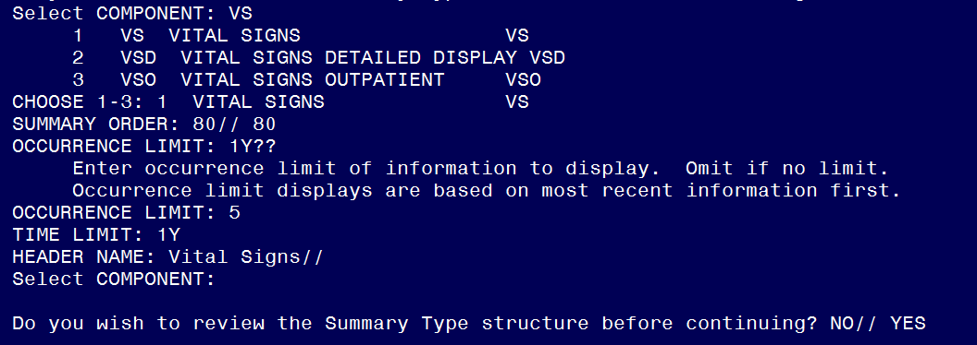
Notes:
Now after you hit the enter key you can now enter components that “are not” in the SAMPLE 1 Health Summary Type.
You will also be prompted to enter the SUMMARY ORDER, OCCURRENCE LIMIT, TIME LIMIT, and HEADER NAME, and then asked if you wish to review the Summary Type structure.
I chose to enter VS for “Vital Signs” as a new component and noticed that it provided me with 3 options so I am selected “1” for Vital Signs
Notice the 1Y?? Here and that is to show that when you enter information that is not appropriate for that prompt it has a delicate way of letting you know that it is looking for a different type of input and it is followed up with a brief description as well. Then it will provide you another opportunity to enter the correct information that is appropriate for that prompt and in this case I chose 5 occurrences.
Next I entered 1Y as my Time Limit (notice no ??)
Next is the default of “Vital Signs” shows as the “Header Name”
And finally another opportunity to enter a “new” component. When you are done with your components you will get the:
“Do you wish to review the Summary Type structure before continuing? NO// YES”

Slide 50
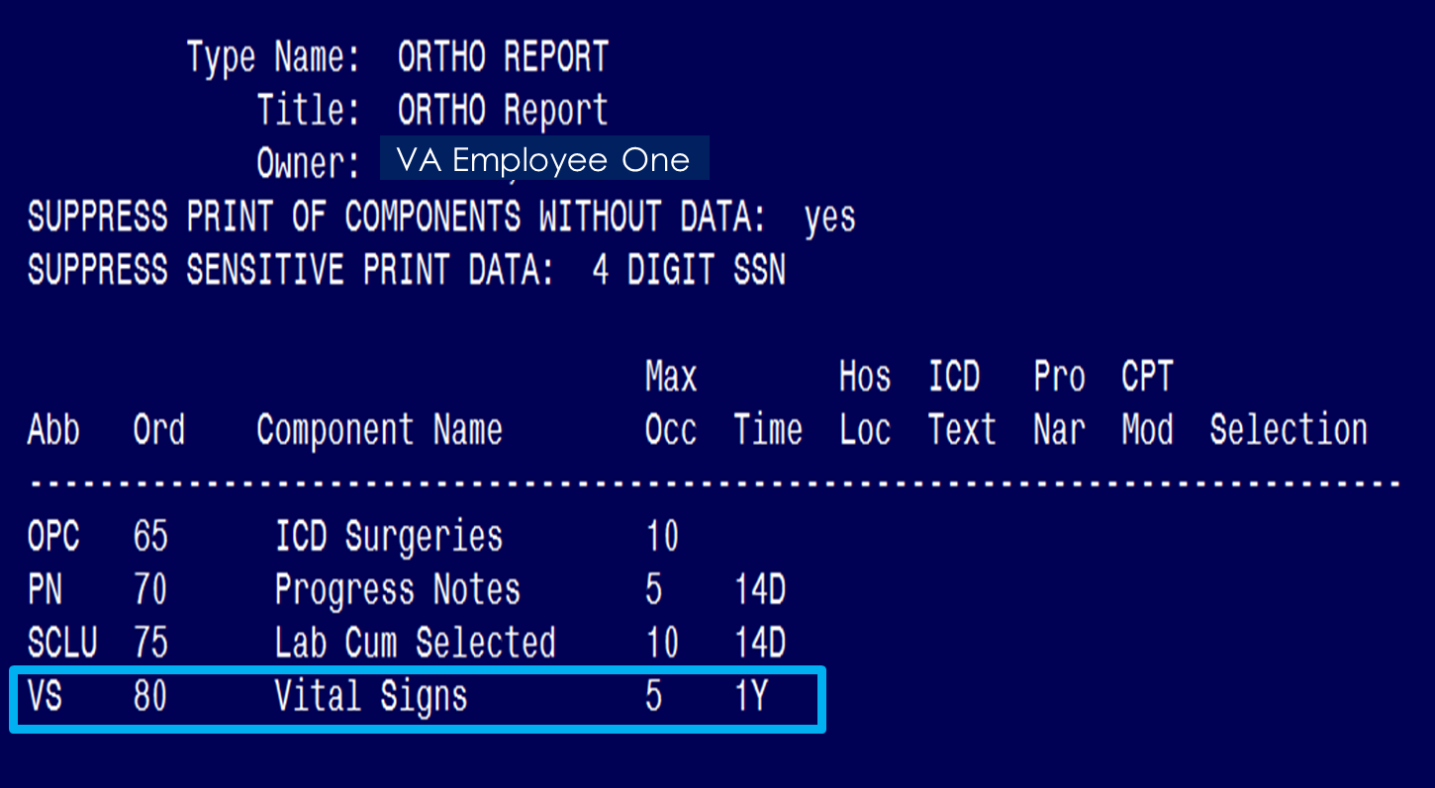
Notes:
Once again you will get a complete print out of your selections and you can also see the new component “VS” for Vital Signs is now a part of ORTHO Report and now you are complete with “Building” your health summary by using the copying method.
Now we are going to demonstrate the how to “Build/Create” a health summary from Scratch.

Slide 51
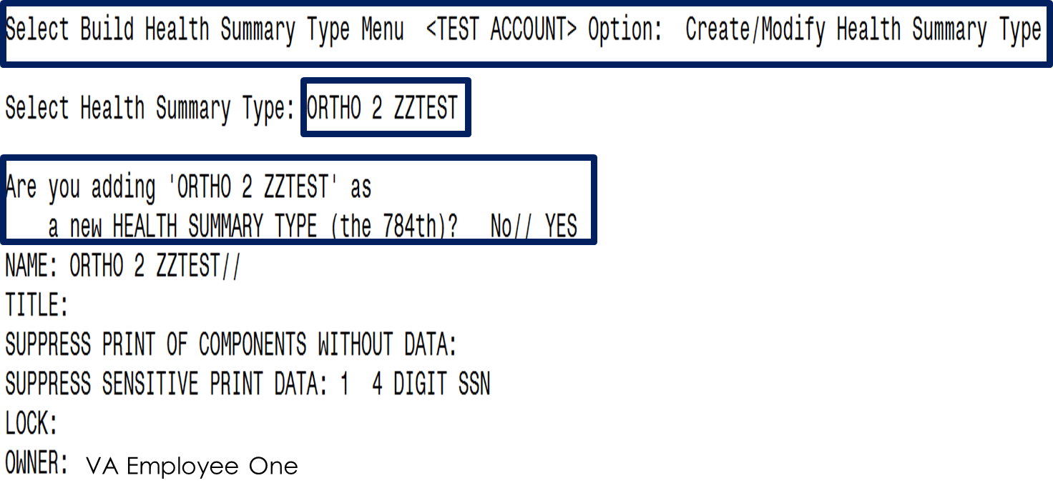
Scratch Example
Notes:
Example 2 — Creating a Health Summary Type from scratch:
You will simply go back to your “Create/Modify Health Summary Type option under the “Build Health Summary Type Menu”
At the “Select Health Summary Type:” prompt you will provide your new name and notice that I have selected “ORTHO 2 ZZTEST” as the NAME of my new Health Summary Type.
Remember that this name will appear in the health summary header. The word “CONFIDENTIAL” will appear in front of this name and the word “SUMMARY” will appear at the end to complete the header. Also, notice that it ask “Are you adding “ORTHO 2 ZZTEST” as a new HEALTH SUMMARY TYPE” with the default of sequence (see the 784th listed?). You will simply type YES to accept the new name.
Name entered: ORTHO 2 ZZTEST
Generated Health Summary header: CONFIDENTIAL ORTHO 2 ZZTEST SUMMARY

Slide 52
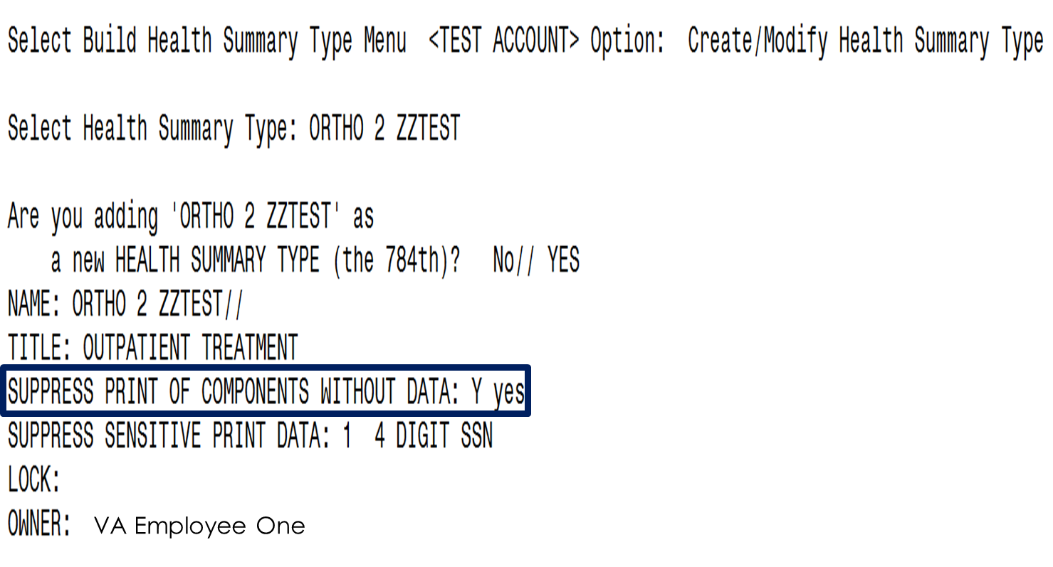
Notes:
Now you see “ORTHO 2 ZZTEST” as the default component name.
Enter yes or no to the prompt about whether to suppress components’ headings when those components don’t contain data.
For health summary types that are displayed on the screen, this component will still be displayed with a “No data available” message. This is done to eliminate confusion that may occur when jumping between components

Slide 53
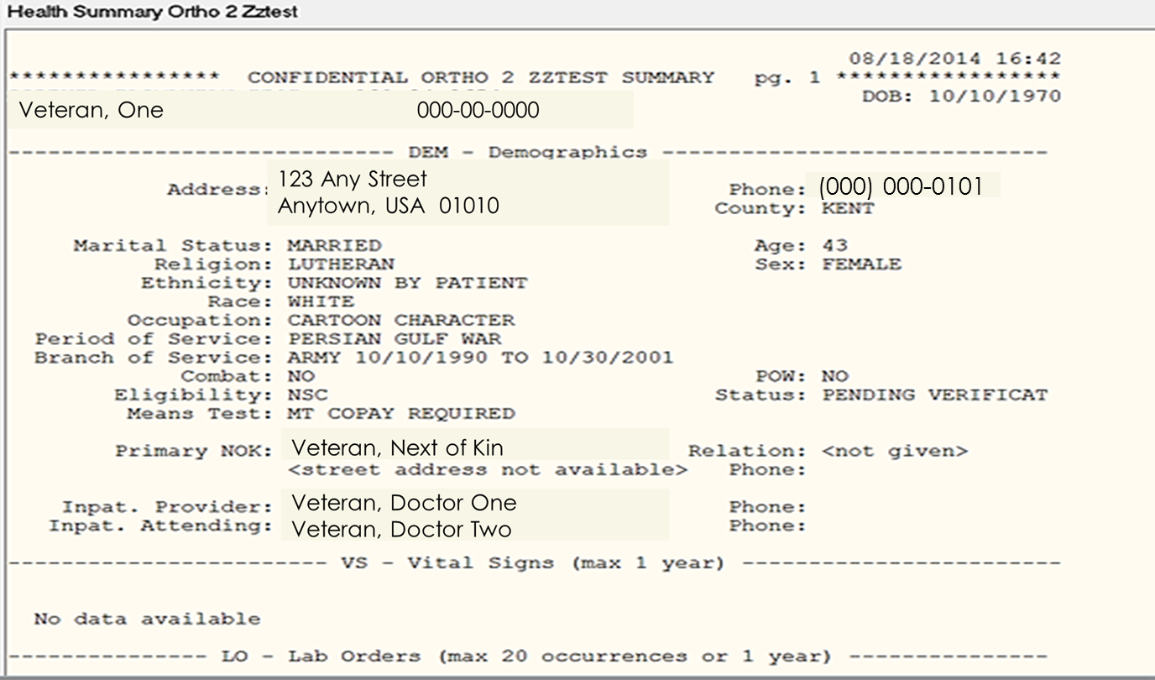
Notes:
Just a quick look at what the “SUPPRESS PRINT OF COMPONENTS WITHOUT DATA” prompt will show if there is no data. Notice the statement “No data available” under the VS – Vi9tal Signs heading? This is what happens when you select YES for the “SUPPRESS PRINT OF COMPONENTS WITHOUT DATA” .

Slide 54
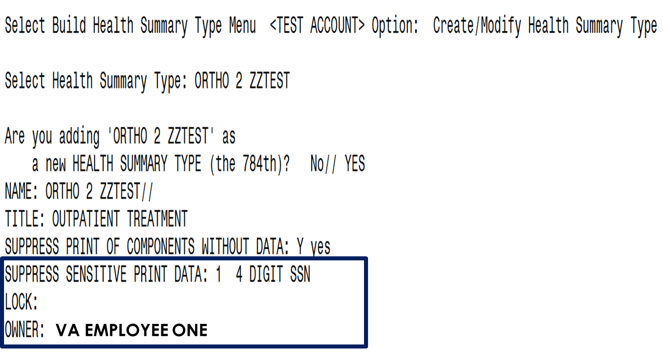
Notes:
Notice for this component I selected to have the patient’s sensitive data show up as the 4 digit SSN as oppose to the 9 Digit format from the previous example.
I show not to apply a “Lock”: and it is already defaulted to my name.

Slide 55
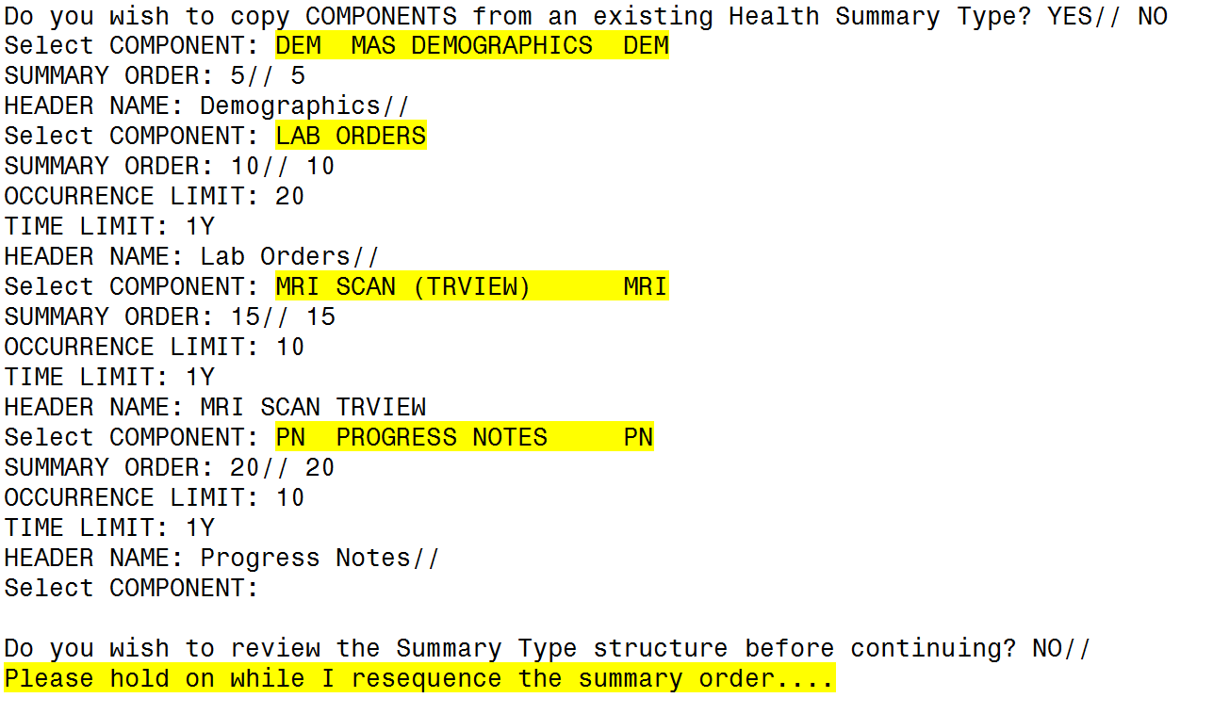
Notes:
Okay we will spend a little time on this slide because it is key to creating your new “Health Summary Type”:
You will notice the difference in building a Health Summary Type when using already established components and creating one from scratch when you type “NO” at the prompt that ask you “Do you wish to copy COMPONENTS from an existing Health Summary Type? YES// NO”,.
This will enable you to start the process of building/creating your own report from scratch!
Notice that I selected a few components: The first one is:
DEM for MAS Demographics, the Summary Order is defaulted for “5” so I kept that one and I kept the default header name as “Demographics” as well
LAB for LAB ORDERS, Summary Order is defaulted for “10” so I kept that one and notice that it gives me the “Occurrence Limit” and I entered “20” and it also gave me the option of “Time Limit” which I selected “1Y” and I kept the default header name as “Lab Orders” as well
MRI SCAN – Once again I answered the prompts (15 for Summary Order, 10 for Occurrence Limit, 1Y for Time Limit and kept the default header of MRI SCAN TRVIEW
Last component is the PN for “PROGRESS NOTES” and noticed that I answered all of the prompts again.
You will receive that beautiful option “Do you wish to review the Summary Type structure before continuing? NO// “ if you don’t want to review it just accept the default of now and then you will get the other beautiful message “Please hold on while I resequence the summary order....”
Now you have completed building/creating your new Health Summary Type”
However; if you chose “Yes” to the “Do you wish to review the Summary Type structure before continuing? NO// YES” then this is what you will see,

Slide 56
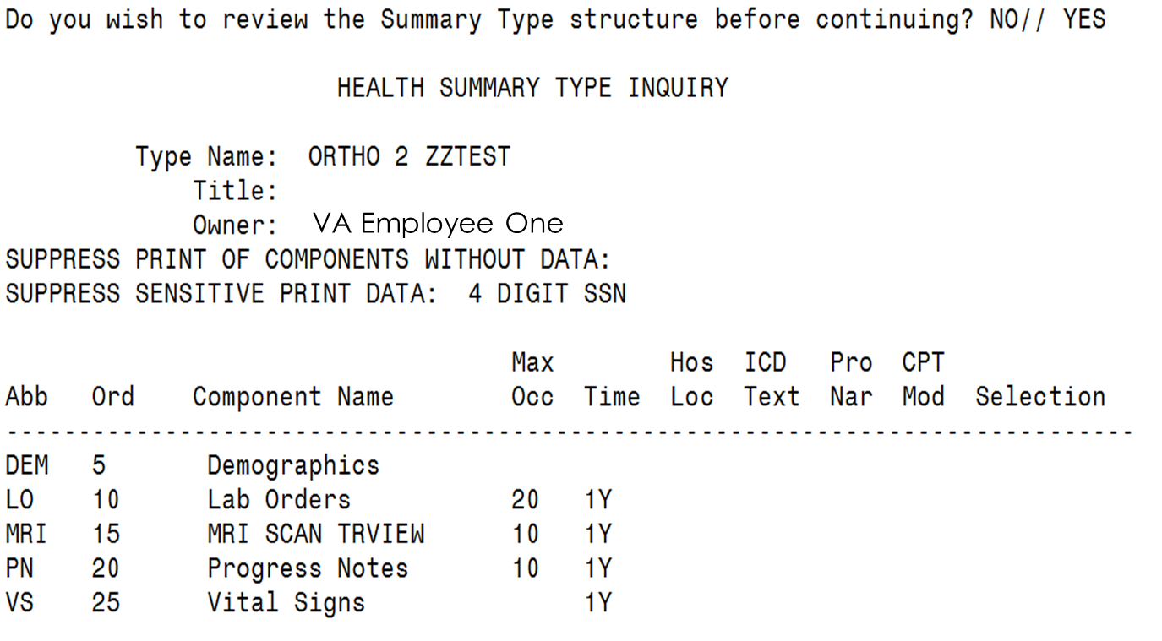
Notes:
Now you can see the overall view of your Health Summary Type and all the options that you selected.
You will have another opportunity to view your Header, type Name, Title (which we did not select one) and of course the name of the owner. Also notice we did not choose to suppress components with without data but we did chose to suppress the sensitive patient data with just showing the 4 digit SSN.
Lastly you can see the components that we created as well.
Once you are through reviewing your Health Summary Type, you can hit your enter key and it will take you back to the “Select COMPONENT:” prompt.

Slide 57
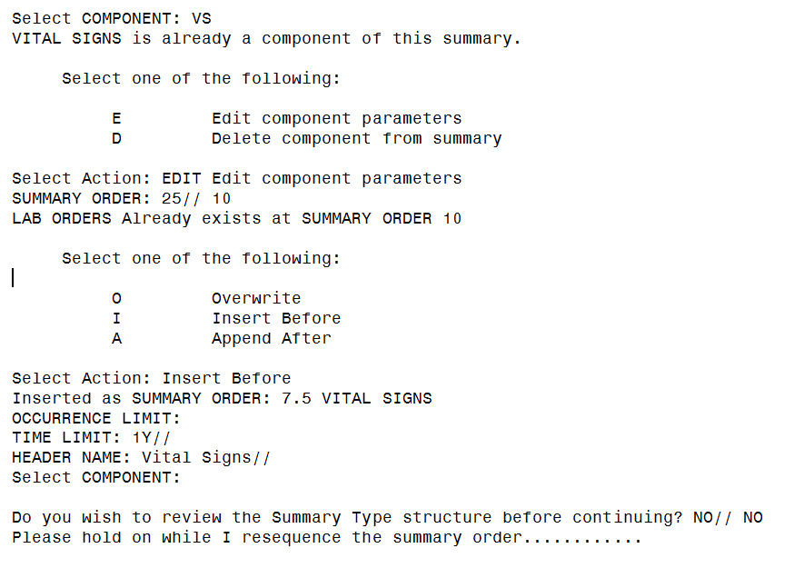
EDITING A HEALTH SUMMARY
Notes:
Now we will look at an example of how to “Edit” a health summary.
On this option to edit a Health Summary, I selected the VS (Vital Signs) component and because it is already a part of my Health Summary Type it recognizes it and tells me that it is already a component of this summary.
Then it ask me to select one of the “two” options to either “Edit or Delete” the component.
I am choosing to “Edit” it and I will simply change the Summary Order from “25” to “10” and because there is already a component listed at sequence 10 it tells me that and then offers me an opportunity to select to “overwrite that default, insert before “10” or set it to proceed after “10” which in this case is “Append After”.

Slide 58
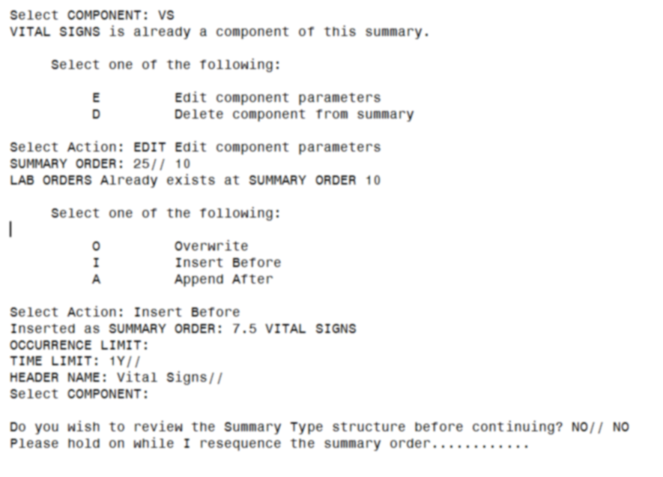
Notes:
Noticed that I selected “Insert Before”. Now you can see that it provided the order of 7.5
I also kept the same defaults of the “Occurrence Limit, Time Limit of 1Y and the Header Name “Vital Signs”.
Now that I am done with editing my component, I will take the default to not review the Summary Type Structure and allow it to resequence the summary order.

Slide 59
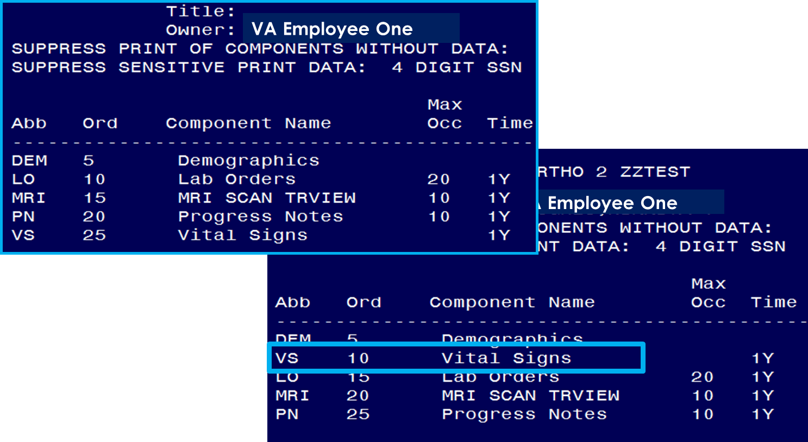
Order Before/ After Edit
Notes:
Now you can see with the editing of the VS (Vital Signs) the order of their appearance on the report is different.

Slide 60
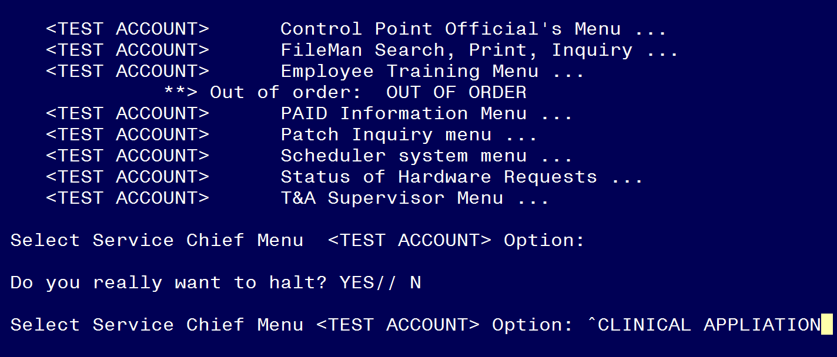
Reviewing Your Component
Notes:
At your main prompt you can jump to your “Clinical Application’s You will select the following Menus:
Clinical Applications Coordinator Menu

Slide 61
Notes:
Next you will select the CPRS Manager Menu

Slide 62
Notes:
Then that will bring you to CPRS Configuration Menu

Slide 63
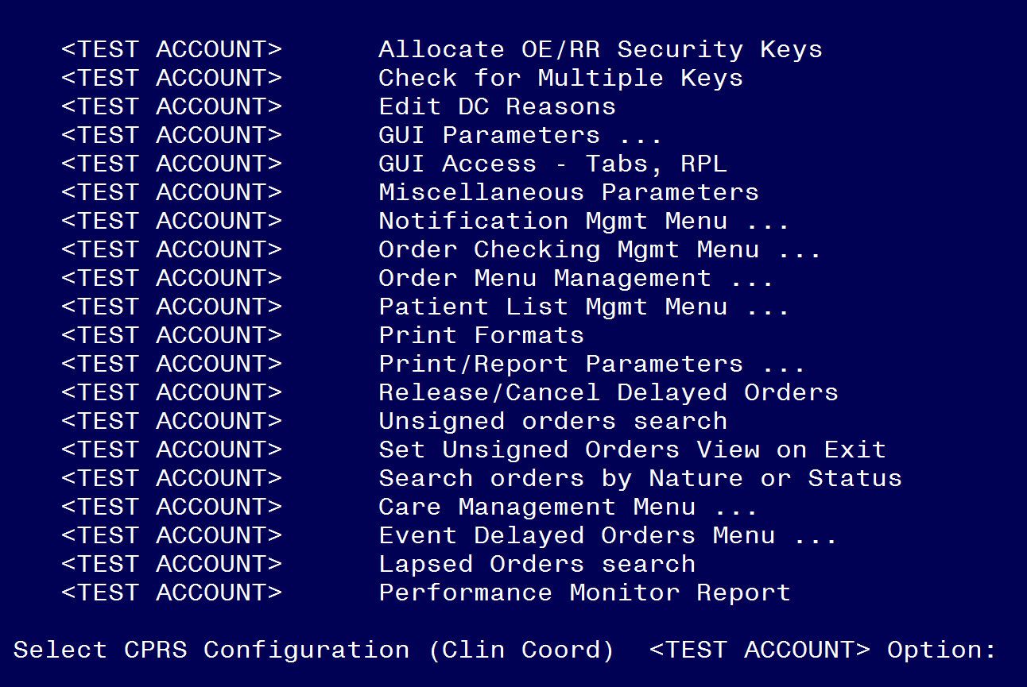
Notes:
You may have a host of other menus available to you but we are particularly interested in the “GUI Parameters ...” menu.

Slide 64
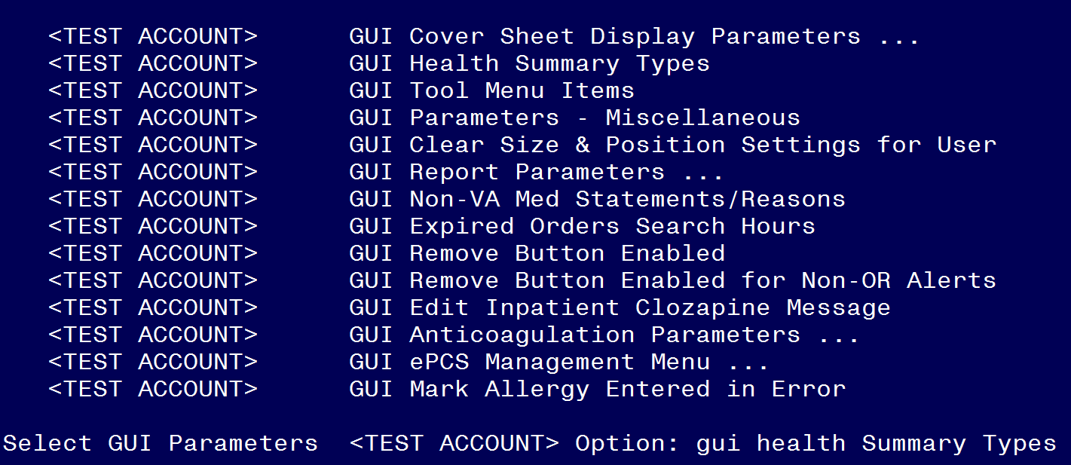
Notes:
That will bring you to the “GUI Health Summary Types” menu and type that in at your prompt

Slide 65
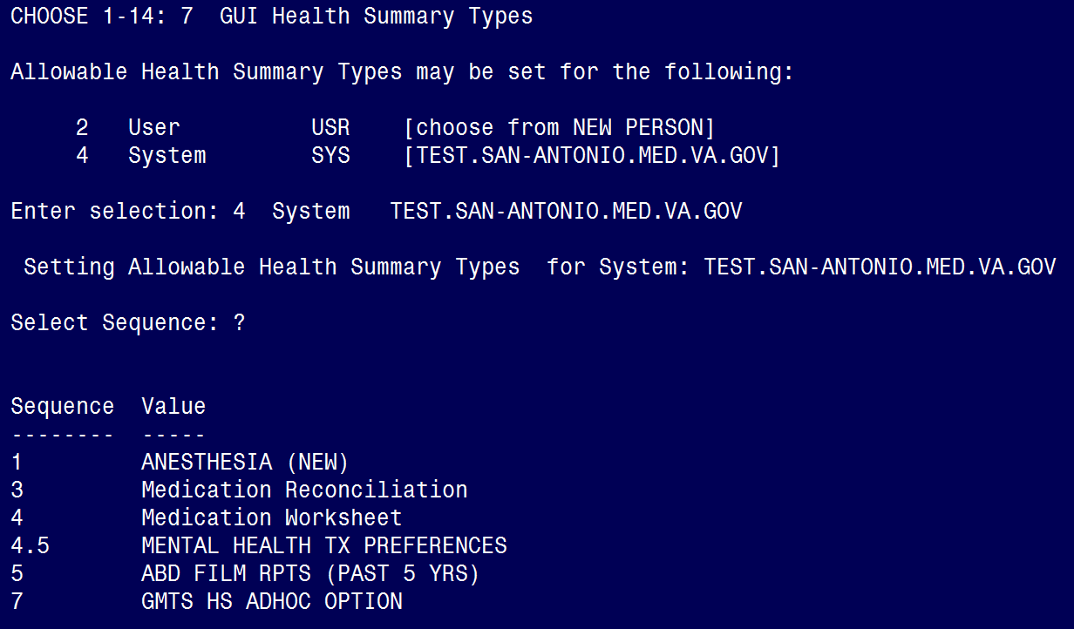
Notes:
No you will come the screen that will allows you to set the “Allowable Health Summary Types” for a “user” or “system” and I chose to set it as “System”.
2 User USR [choose from NEW PERSON]
4 System SYS [TEST.SAN-ANTONIO.MED.VA.GOV]
Enter selection: 4 System TEST.SAN-ANTONIO.MED.VA.GOV
Setting Allowable Health Summary Types for System: TEST.SAN-ANTONIO.MED.VA.GOV
It also asked me for a sequence and because I am not sure where I want to place it I will enter a “?” at the Select Sequence: prompt.
I am viewing the order of the sequence values
Sequence Value
-------- -----
1 ANESTHESIA (NEW)
3 Medication Reconciliation
4 Medication Worksheet
4.5 MENTAL HEALTH TX PREFERENCES
5 ABD FILM RPTS (PAST 5 YRS)
GMTS HS ADHOC OPTION
I notice that there is not a “2” taken so I will chose it.

Slide 66
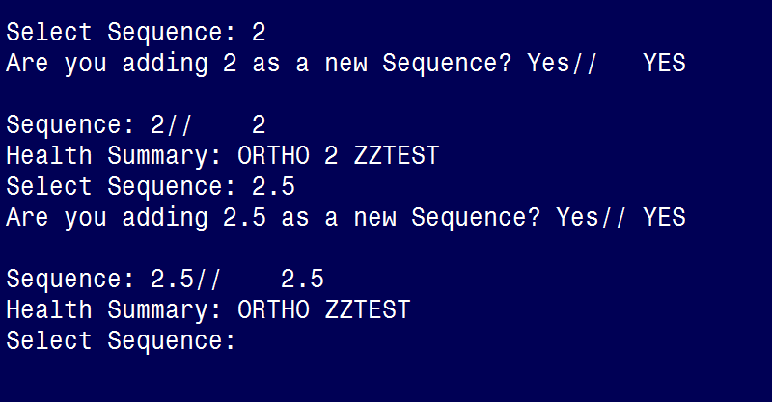
Notes:
I have chosen “2” and it knows that there is not one so it asks if I am adding “2” as a new Sequence and I take the default of “YES”.
You can see from this screen shot that I added two Health Summary Types and I selected the numbers 2 and 2.5 as my sequence numbers.

Slide 67
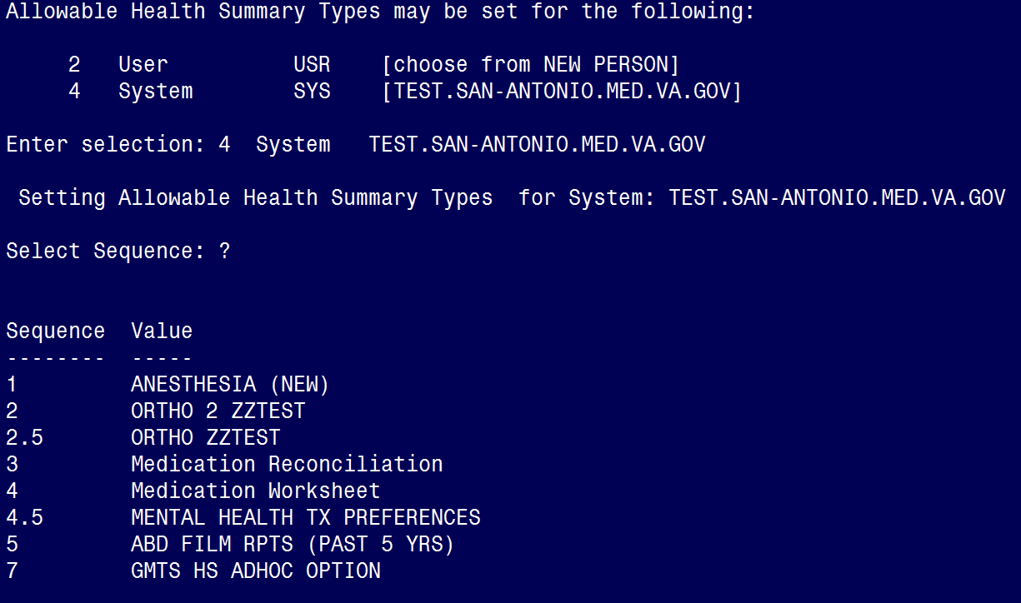
Notes:
When I go back to review them the new sequence is showing up in VistA.
That completes the entry or this process to have them added to the CPRS Reports Tab.

Slide 68
Notes:
Now as a side note, “if” jumping between menus is allowed at your facility how I entered the “^” symbol and typed GUI Health Summary Types” to bypass all the other 4 steps and go directly to the “GUI Health Summary Types” menu. This is just another short cut if you are familiar with your menus.

Slide 69
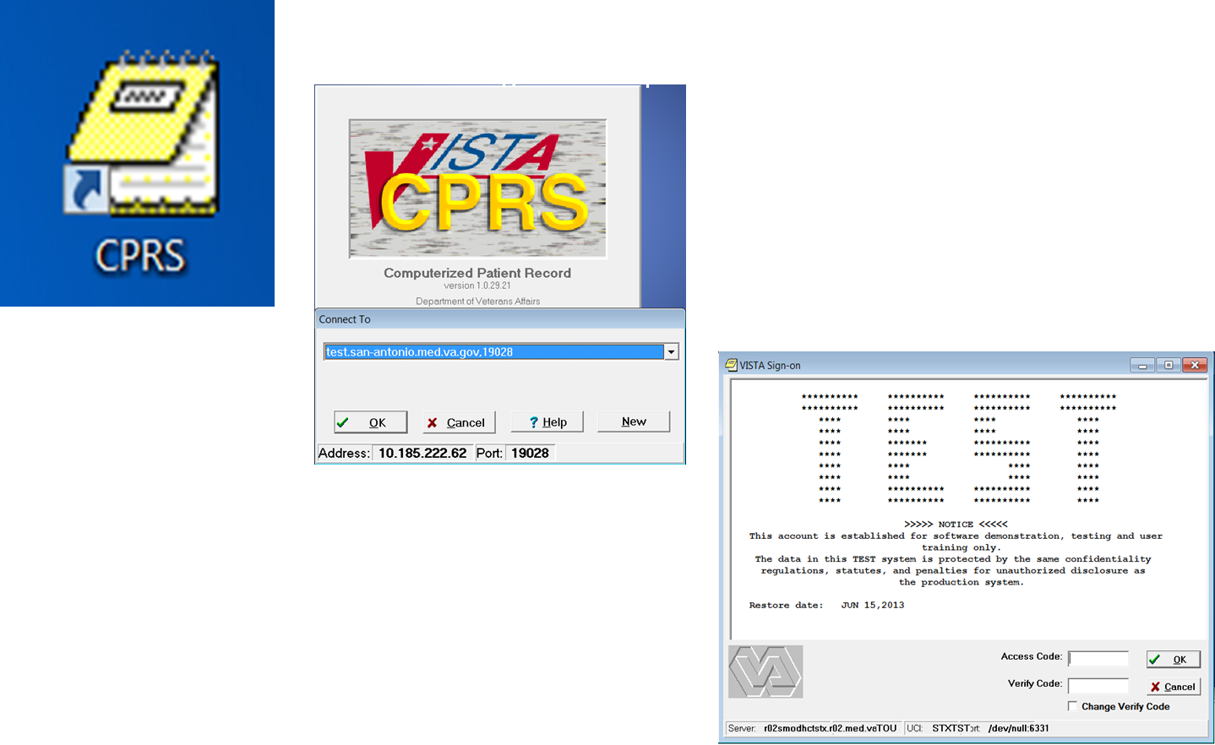
From Vista to CPRS Reports Tab
Notes:
Log into CPRS and I am doing it under the Pre-Production or Test account since this is where I created the Health Summary Type and Components.

Slide 70
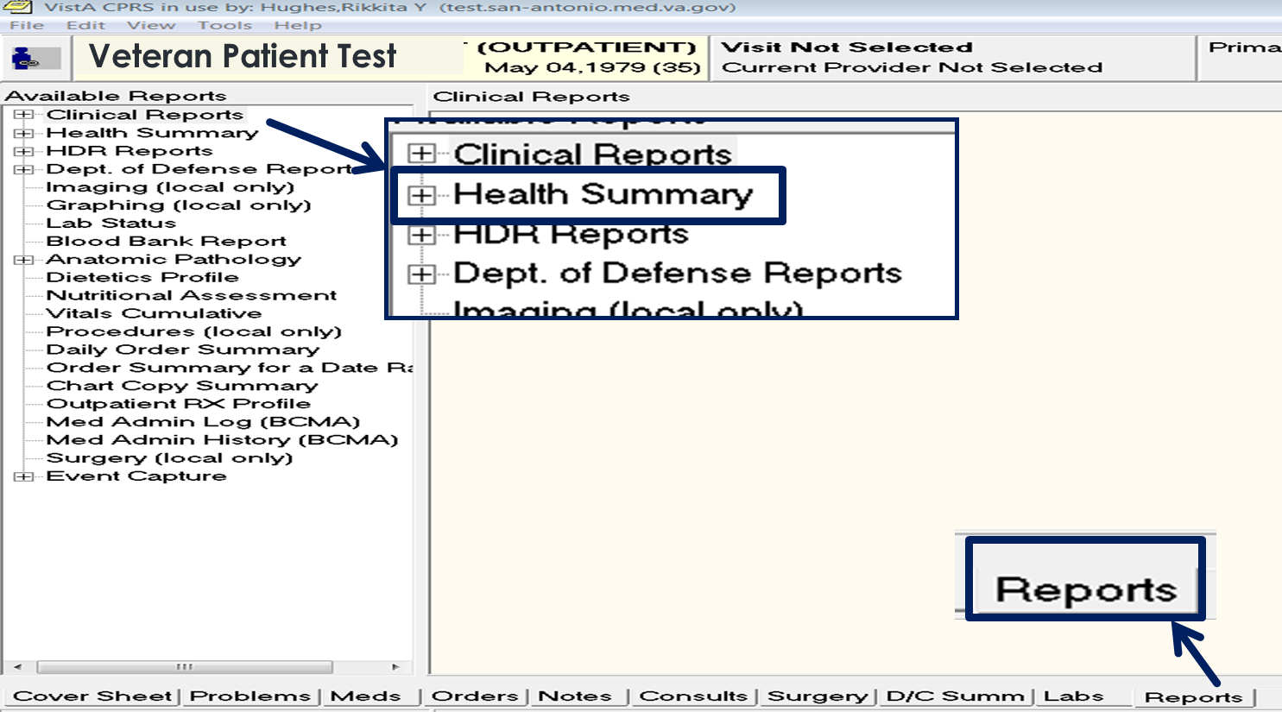
Notes:
Once you have selected your patient click on the “Reports Tab”. Then Select the “Health Summary” tree and if you click on the “+” sign it will expand the tree so that you can see all of your available reports.

Slide 71
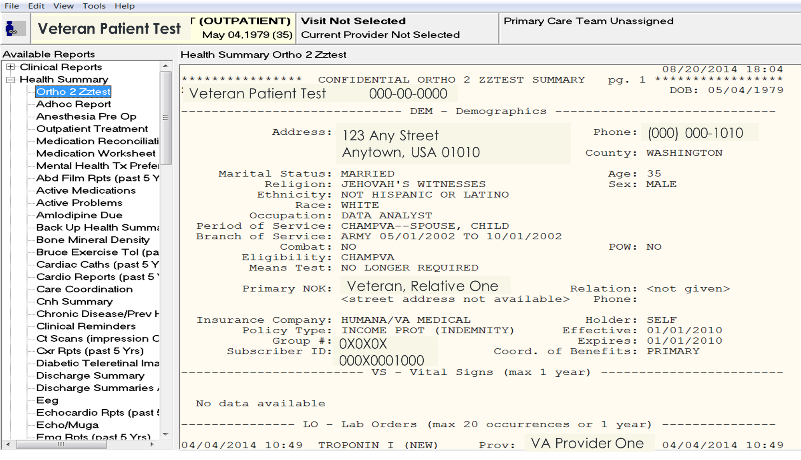
Notes:
Now that the “Health Summary” Tree is expanded you can the “Ortho 2 ZzTest” report show up under “Available Reports”

Slide 72
TROUBLESHOOTING HEALTH SUMMARY
WHEN INCORRECT DATA OR NO DATA SHOWING
PRINTING HEALTH SUMMARY
APPEND AND OVER OPTIONS
NO SHOW OF HEALTH SUMMARY ON CPRS REPORTS TAB
Notes:
The Health Summary application has been a pretty stable package for a while but a few tickets that have been received in the past is:
WHEN INCORRECT DATA OR NO DATA SHOWING
PRINTING HEALTH SUMMARY
APPEND AND OVER OPTIONS
NO SHOW OF HEALTH SUMMARY ON CPRS REPORTS TAB

Slide 73
WHEN INCORRECT DATA OR NO DATA SHOWING
Notes:
1. WHEN INCORRECT DATA OR NO DATA SHOWING - if you are copying a component into a Health Summary Type, you may want to check to see if that component is has all the correct options properly filled out to ensure that you are pulling the right limits and occurrence. Also, make sure that you are not selecting a component that has been edited or deleted from a summary

Slide 74
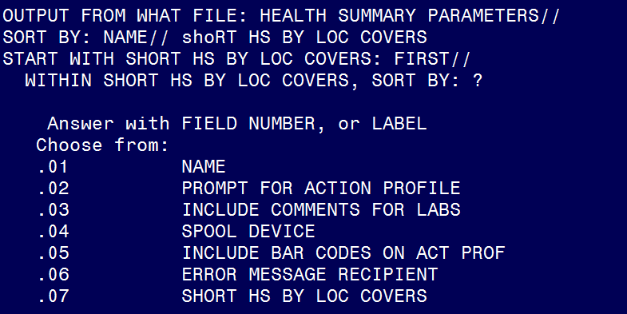
PRINTING A HEALTH SUMMARY
Notes:
2. PRINTING A HEALTH SUMMARY – There have been requests to shorten the printing (this is a feature that is used when you know that your site is going to experience a downtime) as a backup until the system is fully functioning. Patch GMTS*2.7*88 was installed to add a new field, “SHORT HS BY LOCATION COVER (#.07), to the HEALTH SUMMARY PARAMETERS FILE (#142.99)

Slide 75
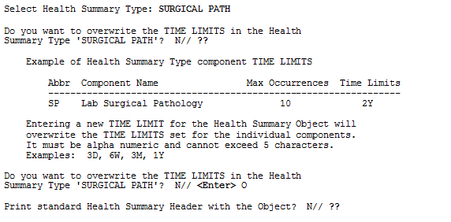
APPEND AND OVERWRITE OPTIONS
Notes:
3. APPEND AND OVERWRITE OPTIONS - These two options have been known to cause issues at the User Level. Remember that the under the 142.98 Health Summary User Preferences this file determines how the list of Health Summary Types for the CPRS GUI report tab is to be organized (APPEND or OVERWRITE) for user selection. There are three major classes of Health Summary types, National (remote data view), user defined and system defined. User and system Health Summary Types are defined in the Kernel Parameters file. Append creates a single list, removing duplicates, and keeps the National Health Summary types group together. Overwrite stops building the list once a single group of Health Summary Types (User or System) is added to the list. So be sure you know which option you want to use for our personal use.

Slide 76
NO SHOW OF HEALTH SUMMARY ON CPRS REPORTS TAB
Notes:
4. NO SHOW OF HEALTH SUMMARY ON CPRS REPORTS TAB – if you are not seeing your Health Summary Report show up on the CPRS tab go back and check all of our prompts to ensure that you answered with a sequence and most importantly if you added it at the User Level with the intent to added it at the System level.

Slide 77
EDITING A HEALTH SUMMARY
Notes:
Now we will look at an example of how to “Edit” a health summary.
On this option to edit a Health Summary, I selected the VS (Vital Signs) component and because it is already a part of my Health Summary Type it recognizes it and tells me that it is already a component of this summary.
Then it ask me to select one of the “two” options to either “Edit or Delete” the component.
I am choosing to “Edit” it and I will simply change the Summary Order from “25” to “10” and because there is already a component listed at sequence 10 it tells me that and then offers me an opportunity to select to “overwrite that default, insert before “10” or set it to proceed after “10” which in this case is “Append After”.

Slide 78
Poll Question
I have a better understanding of a Health Summary Report?
Yes
No
Yes, but I need to practice more
Notes:
I Have a Better Understanding of a Health Summary Report?
Yes
No
Need To Practice More To Create One

Slide 79
Health Summary Resources
VA Software Document Library
http://www.va.gov/vdl/
CPRS Health Summary Technical Manual
CPRS Health Summary User Manual
Notes:
Remember that you can visit the VA Software Document Library or some of you may know it as the Vista Document Library.

Slide 80
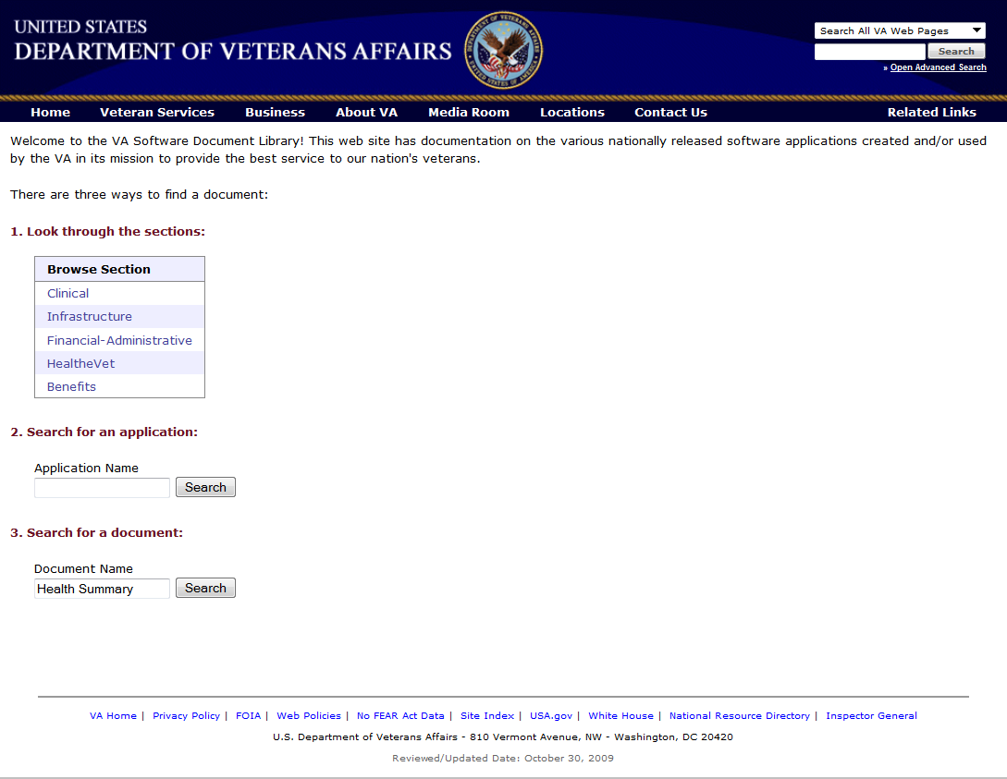
Notes:
You can type in the name “Health Summary” in the #3 “Search for a document” option under the “Document Name” and click on the “search” button and you will see the list of all the documents pertaining to Health Summary appear.
Lets take a look at our poll results.

Slide 81
Poll Results
I have a better understanding of a Health Summary Report?
Yes
No
Yes, but I need to practice more
Notes:
I am very interested to see what we have learned from the last set up slides:
I Have a Better Understanding of a Health Summary Report?
Yes
No
Need To Practice More To Create One

Slide 82
Poll Results
I have a better understanding of a Health Summary Report?
Yes
No
Yes, but I need to practice more
Notes:
Click to move on

Slide 83
Ask the Presenter
Notes:
Well we are out of time for today’s presentation and although we did not get to troubleshooting Health Summaries, please submit your questions if you have particular question and we will try to get it answered for you.
If you haven’t submitted your questions yet, there is still time to do so by clicking on the orange “Ask The Presenter” icon. We’re going to show a brief announcement and be right back to answer your questions.
(Stand still and smile until you see the video come up full screen)

