Slide 1
Non VA Care Coordination
Model and Processes
Bonnie A. Lupo, MS, FNP-BC – Clinical Program Analyst
Clinical Business Systems Office (CBSO)
Chief Business Office

Slide 2
Agenda
History
Scope
Deployment
Future State
Notes:
Hello and Welcome, Thank you for joining us today from your busy schedules to learn about Non VA Medical Care Coordination (NVCC) Model and Processes.
Some of you may already know about NVCC from prior information, and some of you may be part of a Champion or Sister Facility that is deploying or has deployed NVCC processes OR some of you may be hearing about NVCC for the first time by attending this presentation.
Whatever the reason you are here, we are happy to have you, and will be providing information about our HISTORY of where NVCC was derived, Our Scope which involves the CORE Processes and Tools,
I will review our Deployment Plan with our most Current updates as well as a
High Level Overview or Future State Health Claims Processing or HCP.
You will hear me reference Non VA Medical Care Coordination as “NVCC” at times throughout the presentation and will see it some of today’s slides as well. After this initial introduction, we will review each process of the NVCC model and then at the end of the presentation with help from Maureen Wallace, take you out with a LIVE Demonstration to our Non VA Medical Care Coord Website which is found on the National Non VA Care Program Website or NNPO, formerly known as NFPO or the National Fee Program Office, now known as “Non-VA Medical Care Program Office”. I know there is a joke in there somewhere about he VA and all its acronyms but we won’t have time today.
There is a great deal of important information to cover today about Non VA Medical Care Coordination and hope you hang in there with me, If the person next to you that is snoring, please feel free to nudge them..

Slide 3
A Health Claims Efficiency (HCE)
Transformational Initiative
History
Goals
To improve the efficiency, communication and
effectiveness of Non-VA Care processes
Scope
Five core business processes
  Consult Management (Referral Review)
  Appointment Management &
  Clinical Documentation Management
  Hospital Notification
  Unauthorized & Mill Bill
  Claims Adjudication
  Appeals Management
Notes:
The history of Non VA Care Coordination emerged from:
A Health Claims Efficiency or HCE Transformational Initiative per
- The MANAGING VARIATION WORKGROUP PER THE UNDER SECRETARY IN MARCH 2010
- This Workgroup was charged to evaluate BUSINESS AND CLINICAL PROCESSES ACROSS VHA TO IDENDIFY GAPS AND BARRIERS WITH IN VHA SYSTEM (not just Fee Basis). Other areas that were evaluated were: Accreditation, Commodities, Beneficiary Travel, Specific Purpose Funded Programs and Facilities Automation programs and processes.
The Research conducted found organizational variations existed across VHA and the need to reduce or eliminate it completely was required.
So, WHAT DID THEY FIND OUT ABOUT FEE BASIS Non VA Care Coordination? Well, pretty much the same thing
That there were several gaps and barriers in processes, and efficiencies in caring for Veterans who were eligible for Non Care Services (meaning obtaining services outside the VA).
The Managing Variations Work Group Found:
- MINIMAL STANDARDIZATION OF NON VA CARE PROCESSES and USE OF STANDARDIZED TOOLS IN MANAGING OUR
VETERANS
- LACK OF STANDARDIZED CONSULT TEMPLATES with multiple VERSIONS ACROSS VHA WITH POOR NATIONAL STANDARDS
- LACK OF Dedicated CINICAL RESOURCES – assigned to Non VA Programs
- INCONSISTENT PROCESSES FOR OBTAINING CLINICAL DOCUMENTATION from the Non VA Care Provider and review by the VA Provider.
This increased risk for POOR OUTCOMES, lack of continuity of Care AND “LOST TO FOLLOW UP” SCENARIOS.
So after the results from the HCE, the GOALS for Non VA MedicalCare Coordination Initiative were established and was for:
National Deployment for Non VA Care Coordination to support standardized business processes and tools within all Non VA Medical Care Programs across VHA in order to reduce or eliminate variations and Provide consistent and equitable delivery of non VA Care to eligible Veterans. TO IMPLEMENT STANDARDIZED BUSINESS PROCESSES AND TO REDUCE OR ELIMANTE PROGRAM VARIATIONS ACROSS VHA.
These initiatives in turn would:
IMPROVE PATIENT CARE COORDINATON AND ENSURE A VETERAN – CENTERED CARE ENVIRONMENT ALONG WITH FISCAL RESPONSIBIILTY
- FACILITATE AND COORDINATE THE VETERAN’S NON VA CARE,
- CLOSING THE LOOP BY ENSURING CARE WAS PROVIDED,
- SUPPORT DOCUMENTATION WAS RECEIVED FOLLOWING NON VA CARE SERVICES COMPLETED BY THE Non VA Care Provider,
and APPROPRIATE FOLLOW UP WAS SCHEDULED AND THE VETERAN RETURNED TO THE VA HEALTH CARE FACILITY FOR ONGOING CARE AND TREATMENT.
Dedicate CLINICAL PERSONEEL TO SUPPORT CONSISTENT FUNCTIONS SUCH AS:
Clinical Case Reviews, Coordination of Non VA Care,
- Support Appropriate and Timely patient transfers from a community Non VA facility to a VA medical center and enhance communication
with all pertinent stakeholders vested in the veteran’s care and status.
Scope
Non-VA Referral Review: Standardization of fee consults/referrals in support of future IT automation
Appointment Management: Improved customer service, coordination and Veteran provider selection/preference
Hospital Notification: Consistent model for documentation, tracking and coordination of patients in community health care facilities
Unauthorized & Emergency Care (Mill Bill) Claims Adjudication: Standardized process for adjudicating unauthorized/Mill Bill claims
Appeals Management: Standardization of process and tools used to track and facilitate appeals
The NVCC model addresses each of these weaknesses by establishing standardized business processes and tools.
The Goals just reviewed were vast and so very important in caring for our Veteran’s and keeping them centered in their care. The following scope meeting these goals by establishing the 5 Core Business processes called the Scope and they are:
Scope
Consult Mgt (Referral Review)
Appointment Management and Clinical Documentation
Hospital Notification
Unauthorized & Mill Bill Claims Adjudication and
Appeals Management
Each of these processes will be discussed in further detail later on in the presentation.

Slide 4
Project Timeline
Oct. 2010
Jan.-> Sept. 2011
Oct. 2011
Sept 2013
Notes:
KNOW THAT YOUR’E MORE FAMILIAR WITH THE ROOTS OF NON VA CARE COORDINATION, I WILL GIVE YOU SOME BACKGROUND ON THE DEVELOPMENT OF THE PROCESSES AND TOOLS THAT MAKE UP THE Non VA Care MODEL TODAY BUY LOOKING AT OUR NVCC TIMELINE.
The NON VA CARE COORDINATION MODEL WAS DEVELOPED WITH SIGNIFICANT INPUT FROM THE FIELD.
CURRENT STATE PROCESSES AND TOOLS INCLUDING STANDARD OPERATING PROCEDURES AND CORRESPONDENCE SAMPLES WERE COLLECTED AND EVALUATED IN ORDER TO DEVELOP THE CURRENT NVCC MODEL.
In OCTOBER 201O: A WORK SHOP WAS HELD WITH PARTICPATION FROM NON VA CARE PROGRAM STAFF FROM ACROSS VHA.
THE FRAMEWORK FOR THE NVCC MODEL WAS CREATED DURING THIS MEETING AND THE WORK GROUPS CONTINUED TO DEFINE PROCESSES AND TOOLS OVER THE FOLLOWING MONTHS.
Then from JANUARY 2011 THRU SEPEMBER 2011: FOUR FACILITIES PILOTED THE NVCC MODEL: 3 FROM VISN 11, AND 1 FACILITY FROM VISN 18. THERE WAS CONTINUOUS FEEDBACK BETWEEN OUR PILOT SITES AND OUR CBO NVCC TEAM. THE FINDINGS WERE DOCUMENTED, EVALUATED AN USED TO DEFINE ODAY’S NVCC FINAL PROCEDURES.
In OCTOBER 2011: ENTERPRISE DEPLOYEMNT OF THE NVCC MODEL WAS IMPLEMENTED WITH VISN 16 as our BETA SITE FACILITY and started us off with National Enterprise Deployment of NVCC and is currently underway. As of today’s presentation, there are 3 Champion Facilities remaining to Deploy NVCC Processes.
ENTERPRISE DEPLOYMENT TO VISN WIDE FACILITIES COMPLETION DATE AT THE END OF FY 2013.

Slide 5
Enterprise Deployment Strategy
Implementation Approach:
  Deploy to a single Champion Facility (one) per VISN
  Champion facility and VISN BIM, with support from CBO NVCC Team, implemented the NVCC model to remaining facilities within the VISN
Notes:
Leverage a train-the-trainer approach at each VISN:
- Each Leadership in each VISN selected a Champion facility;
The CBO NVCC team works with the designated facility POC and VISN Business Implementation Manager (BIM) to facilitate training and education thru weekly meetings in order to provide
Technical support to identified CAC’s and ADPAC’s for installation of CPRS templates and successful implementation of NVCC processes also during that time frame.
The Champion facility and VISN BIM, with support from the CBO NVCC team, were responsible to roll out the processes and tools to its sister facilities.
- The CBO NVCC team provided continuous support during pre-implementation, implementation and post implementation phases of the initiative.

Slide 6
Non VA Care Coordination Model Core NVCC Processes
Veteran
Referral Review
Appt Mgt/ Pre-Post Calls
Appeals Mgt
Clinical Review for Emergency Claims
Hospital Notification
Notes:
As indicated on this slide, these are the core processes associated with the Non-VA Care Coordination Model and as you notice in our depiction of the NVCC Model, the Veteran is continuously centered in their care.
For each process, CBO NVCC Team has developed detailed Standard Operating Procedures and associated Process Guides to assist Non VA Care program staff.
As a side note all the Procedural documents and other useful materials can be on our NVCC Website, which is found under the National Fee Program Office (NFPO) Website and will offer a Live demonstration at the end of the presentation.
The core processes will be covered in detail a bit further in the presentation.

Slide 7
Scope
Objectives
1
1
Consult / Referral Management
Utilize standardized consult templates and review procedures
2
2
Facilitate appointment scheduling; improve timeliness of receipt of clinical documentation
Appointment Management
& Clinical Documentation Management
3
Standardize processes for Clinical Review for Emergency Claims
(Unauthorized
and Mill Bill
claim adjudication), Hospital Notification,
and Appeals
3
Veteran & Externally Initiated Processes
Notes:
The Non-VA Care Coordination Model includes three primary focus areas:
1. Consult/Referral Management
2. Appointment and Clinical Documentation Management and
3. Veteran and Externally Initiated processes
The objectives of national deployment are to establish standardized business processes and tools within all non-VA care programs across VHA. The goal is to provide consistent and equitable delivery of non-VA care to eligible Veterans.

Slide 8
1
Consult / Referral Management
Initial decision to utilize non-VA services
Referral creation and evaluation utilizing standardized consult/referral templates
Administrative eligibility determination & clinical review
Appropriate justification and authorization
Cost estimation entered in FBCS
Notes:
The first, is Consult/referral management, which begins with the VA provider decision to utilize non-VA care services, selection of a standardized Non VA Care consult / referral template in CPRS and continues through the local NVCC Team’s administrative and clinical referral review process to either, approve or deny the authorization and cost provide cost estimation. More information for the Referral Review Process will be discussed later on.

Slide 9
2
Appointment Management
& Clinical Documentation
Management
Appointment scheduling, tracking, pre and post-appointment patient contact
Clinical documentation management, including document request, receipt, medical record entry and provider notification
Correspondence generation and management
Notes:
Appointment Management has a two-fold objective – first, to engage and assist the veteran to identify and select a community provider, and schedule an appointment, and second, to have the ability to track appointments, no shows, cancellations and ensure the veteran receives the necessary, authorized non-VA care.
A standardized authorization notification to the non-VA provider includes a request that supporting documentation be returned to VA within a specified time frame.
Appointment scheduling in VistA Appointment Management non count clinics allows VA to track patient appointment compliance and return of clinical documentation after completion of the appointment.
We have found that some facilities are already performing appointment management procedures. However, this may be a resource challenge for those facilities not currently scheduling non-VA appointments. Several of the
NVCC pilot facilities adopted an interim strategy by implementing appointment scheduling for select high volume or high cost specialty clinics. Additional specialties were added as staff members became more skilled with the procedures

Slide 10
3
Veteran & Externally Initiated Processes
Claim adjudication for unauthorized / Mill Bill claims
Appeals
Hospital notifications
Controlled correspondence
Revenue support
Notes:
Veteran and externally initiated processes include claims adjudication, appeals, hospital notifications and revenue support.
Emergency Care (Unauthorized and Mill Bill) claims submitted for VA payment consideration are received and retrospectively evaluated for potential VA payment. Fee regulations and clinical criteria are applied and a payment decision is documented in FBCS. The
NVCC standardized process for adjudication will ensure consistency and equitable payment decisions.
An appeal is initiated when a claimant disagrees with a VA decision to deny a benefit. The appeal process is time sensitive and regulated by law. It’s imperative that the appeals procedures be followed and documented precisely.
The hospital notification procedure is initiated when VA is notified of a Veteran’s admission to a non-VA health care facility. The CBO Non-VA Care Coordination team will provide Guidance to your team on how they can support your revenue process for billing for non-VA care.

Slide 11
Project Scope Recap
1
Consult / Referral Management
2
Appointment Management
& Clinical Documentation Management
3
Veteran & Externally Initiated Processes
Notes:
To recap the Project Scope, the primary focus areas of the NVCC model is comprised of 3 critical process areas:
Consult referral management,
Appointment Scheduling and documentation,
And third; processes initiated from sources external to VHA Fee programs. For example, the Administrative Appeal process, Unauthorized and Mill Bill claims and hospital notification.

Slide 12
NVCC Enterprise Benefits & Metrics
1. Enhanced Communication
2. Increased Operational Efficiency
3. Increased Satisfaction
4. Enhanced Decision Making
Notes:
NON VA CARE COORDINATION MODEL HAS NATIONAL METRICS AND THE ENTERPIRSE DEPLOYMENT METRIC PLAN MEASURES KEY PERFORMANC MEASURES FOR NON VA CARE COORDINATION
IT WAS DEVLEOPED IN COLLABORATION WITH PRODUCT EFFECTIVENES BENEFITS REALIZATION TEAM AND THE RESULTS ARE REPORTED THROUGH CBO PURCHASED CARE TO THE UNDER SECRETARY OF HEALTH.
National Metrics serves as a guide to determine the benefits of implementing NVCC processes. The specific Benefit Category is listed as:
Enhanced Communication
Increased Operational Efficiency
Increased Satisfaction (not just our Veterans but the front end users and stakeholders involved in NVCC process) and
Enhanced Decision Making

Slide 13
Benefit | Metric | Target | Data Source | Baseline?
2. Increased Operational Efficiency (cont.) | 2.4 - Percent of non-VA care scheduled appointments that result in cancellations | 10% or less | VistA Appt Mgmt | No
 | 2.5 – Average number of days from FBCS authorization to appointment scheduled | 7 days | FBCS & VistA Appt Mgmt | No
 | 2.6 - Average number of days from referral submission to clinical approval | 5 days | CPRS | No
 | 2.7 – Average number of days from FBCS authorization to date of appointment | 25 days | FBCS | Yes, for all 23 sites
 | 2.8 - Percent of FBCS authorizations entered after care provided | 10% or less | FBCS | Yes, for all 23 sites
 | 2.9: Average number of days from referral submission to appointment scheduled date using VistA Appointment Manager (VAM) | 14 days | VistA | TBD
Notes:
YOU CAN SEE A SAMPLE OF THE METRICS UNDER EACH CATEGORY OF THE 4 BENEFITS WITH PROJECTED TARGETS AND WHERE THE INFORMATION IS OBTAINED FROM.
METRICS WERE PULLED STARTING 60 DAYS FOLLOWING DEPLOYMENT AT A FACILITY .
METRICS ARE UPDATED EACH FISCAL YEAR. Following were metrics captured during FY 2013 until April 2014.
Metric 2.2: Average number of days from referral submission to closure using the “Non-VA Care Consult Result Note”
**Metric 2.7: Average number of days from FBCS authorization to date of service (DOS)
**Metric 2.8: Percent of FBCS authorizations entered after care provided
Metric 5.1: Number of “Non-VA Hospital Notification Progress Notes” created
Metric 5.2: Number of “Non-VA Care Coordination Progress Note” created
Metric 5.3: Number of referrals with a “Non-VA Care Consult Result” Note
If you’re interested in reviewing this information in depth, you can find it on our website – the link is available when you download the copy of this presentation. http://vhahacnonva.vha.med.va.gov/nvcc/

Slide 14
“Future State”
The Health Claims Processing (HCP) system is a future state IT solution with Referral & Authorization and Claims components
  Currently in development
  Contains automated features
  Aligned with NNPO and NVCC processes and tools
Notes:
The Health Claims Processing System or HCP is a future state IT solution that encompasses Enrollment and Eligibility, Referral Authorization System (known as RAS), and Claim Processing.
It is currently under development with some early releases later in 2013 pertaining to some automations in the Referral Authorization System and it will continue to be developed over the next several years and aligns with NNPO and NVCC Processes and tools.

Slide 15





Current State Processing
NVCC Staff Manually Review Consult/Referral in CPRS and Manually Enter Authorization in FBCS
VA Providers
Enters Standardized
Consult/Referral in CPRS
VA Providers
CPRS
NVCC Staff
CPRS
NVCC Staff
FBCS
Notes:
THIS SLIDE REPRESENTS A HIGH LEVEL OVERVIEW OF CURRENT STATE (WHAT IS HAPPENING NOW IN VHA)
With Manual processing OF CONSULT/REFERRALS IN CPRS AND ENTERING INTO FBCS WITH MANUAL COMMENTS TO VA PROVIDER AND NON VA CARE PROGRAM STAFF.

Slide 16


With Healthcare Claims Processing…
Certain Non-VA Referrals Are Automatically Reviewed and Authorized in RAS
VA Providers Enter Standardized
Referrals in CPRS
Lessen Need for NVCC Staff Involvement
VA Providers
CPRS
Improved Quality of Veteran Care
RAS
Notes:
This slides shows a depiction of Non VA Care Coordination as a precursor to HCP or Healthcare Claims Processing with use of the NVCC standardized referral model required to support future automation through the introduction of RAS - Or Referral Authorization System.
A Consult / Referral is placed in CPRS and interfaces with RAS which supports application of business rules applied and determined to Pend or Auto Approve the Authorization. The workspace in which RAS exists, is a work space that allows Bi-Directional processes and communication to occur between CPRS and RAS.
The Patient would still require contact, coordination and facilitation of their Non VA Care Appt but a claim may go thru the system untouched by manual intervention with applied business rules and alignment of required criteria.

Slide 17
Key Deployment Roles & Responsibilities and Interdisciplinary Team
Medical Center Leadership Team
Non VA Care program Manager/Supervisor
Medical Center Technical Staff
Other Medical Center Support Services
NVCC End-Users
CBO NVCC Deployment Team
Notes:
NON VA CARE COORDINATION REQUIRES SEVERAL VA ROLES TO SUPPORT THE SUCCESSFUL IMPLEMENTATION OF THE NVCC MODEL
It is an Interdisciplinary approach to management of Veterans eligible for Non VA Care Services and all the processes involved.
THIS IS NOT AN INCULSIVE LIST AND AS YOU CAN SEE INOLVES MULTIPLE DISCIPLINES WITH ROLES AND RESPONSIBLITES REQUIRING EXTENSIVE COMMUNICATION AND COMMINTMENT FROM ALL.
EVERY ORGANIZATION HAS A DIFFERENT ORGANIZATIONAL STRUCTURE AND WORK FLOW RELATED TO FEE, UM/UR, AND CLINICAL INVOLVEMENT. NON VA CARE COORDINATION IMPLEMENTATION IS FLEXIBLE BASED ON THE FACILITIES ORGANIZATION STRUCTURE ON WHO WILL PERFORM THE VARIOUS ROLES AND PROCESSES WITHIN NVCC. THE SPECIFIC ROLES OF NVCC WILL BE DETERMINED BY LOCAL FACILITY LEADERSHIP – FEE, CLINICAL, HIM AND OTHER ENTITIES INVOLVED IN NVCC.
Medical Center Leadership Team: Ensure availability & adequate participation of Champion Facility staff; Communicate NVCC initiative to appropriate stakeholders throughout the facility
Non VA Care program Manager/Supervisor: Collaborate with CBO NVCC Deployment Team to coordinate major deployment activities; Identify & ensure availability of Fee Unit staff for training; Participate in training activities
Medical Center Technical Staff: Collaborate with CBO NVCC Deployment Team to install standardized CPRS templates and create VistA non-count clinics; Ensure end-users have appropriate systems access & configuration
Other Medical Center Support Services: Become familiar with NVCC model and provide support during the deployment on an as-needed basis (e.g., HIM, IRM, DSS, etc.)
NVCC End-Users: Complete all required NVCC training events; Perform NVCC processes (e.g., Fee unit personnel, Transfer Coordinators, VA Providers, etc.)
CBO NVCC Deployment Team: Collaborate with Champion Facility leadership team, key POCs, and end-users to deploy the NVCC model; Provide remote and on-site support during and after the deployment

Slide 18
Resources
Process Guides
Standard Operating Procedures
Manager's Guide
Technical Manuals
Referral Templates
Other Training Materials & References
All of these artifacts and more are posted on the CBO
NVCC Deployment Web Site
Notes:
The CBO NVCC website houses process guides, manager’s guide, a technical manual, referral templates, standard operating procedures, deployment materials, deployment schedule, and misc resources and links to supporting information.
Process Guides: Provide a high-level summary of the core NVCC processes, including a process flow diagram and table of major roles & responsibilities
Standard Operating Procedures: Provide detailed, step-by-step instructions for performing the NVCC processes
Manager's Guide: Provides and overview of the NVCC initiative, processes, roles, responsibilities, tools, supporting artifacts, and management reports; Includes helpful tips & references
Technical Manuals: Provide instructions & tips for installing the standardized NVCC CPRS templates (consult & progress note); Identifies end-user system & configuration requirements
Referral Templates: Include the standardized CPRS templates (e.g., consult/referral & progress note) to be installed during the deployment
Other Training Materials & References: Include training presentations, Frequently Asked Questions, deployment checklists, and other artifacts developed to support the VISN and Medical Centers with deploying NVCC
Each staff member would benefit from understanding their role in NVCC with familiarizing themselves with that particular Process Guide and Associated SOP along with other resources available on the NVCC Website
All of these artifacts and more are posted on the CBO website: http://vhahacnonva.vha.med.va.gov/nvcc/
and we will have LIVE Demonstration at the end of the presentation of our website. The next slide is picture of the NVCC website.

Slide 19
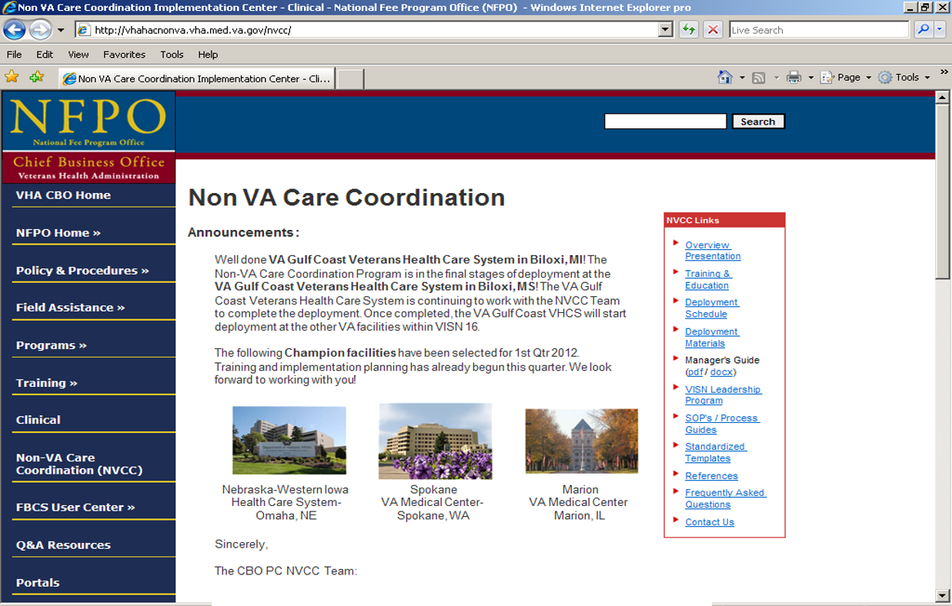
Non VA Care Coordination Website
Notes:
A LIVE DEMO Will be conducted at the end of the presentation to offer a tour of the NVCC Website and our artifacts and tools

Slide 20

Non VA
Medical Care Coordination (NVCC)
Model
Notes:
NOW THAT YOU HAVE A BETTER UNDERSTANDING OF WHERE NVCC CAME FROM,
HOW NVCC WAS DEVELOPED AND OUR TIMELINE AND CURRENT DEPLOYMENT SCHEDULE AND PLAN TO HAVE VISN WIDE COMPLETION BY END OF SE 2013,
WE WILL NOW GO THRU EACH PROCESS IN THE NON VA CARE COORDINATION MODEL TO HIGHLIGHT THE BUSINESS AND CLINICAL PROCESSES REQUIRED TO CARE FOR OUR VETERANS APPROVED AND AUTHORIZED FOR SERVICES OUTSIDE THE VA.

Slide 21
NVCC Model
Veteran
Referral Review
Appt Mgt/ Pre-Post Calls
Appeals Mgt
Clinical Review for Emergency Claims
Hospital Notification
Notes:
THERE ARE 5 CORE PROCESSES OF THE NVCC MODEL
You will notice there are 5 CIRCLES REPRESENTING EACH PROCESS.
APPT MGT AND PRE-POST CALLS GO HAND IN HAND AND DISCUSSED AT THE SAME TIME AND PLACED TOGETHER FOR DISCUSSION PURPOSES IN THE PRESENTATION.
AS YOU NOTICE IN OUR DEPICITION OF THE NVCC MODEL THE VETERAN IS CONTNUOUSLY CENTERED IN THEIR CARE.

Slide 22
Our Goal
Standardized Processes
Fiscal Responsibility
Veteran Centered Care
Notes:
TO REVIEW THE GOAL OF NVCC:
IS TO STANDARDIZE PROCESSES
Decreasing variability across VHA
Keeping the Veteran Centered in all aspects of Care to obtain Non VA Care Services with facilitation and coordination of services with
Obtaining clinical documentation, and
keeping the VA Provider in the communication loop regarding the outcome of the Non VA Care Services and
Capturing the Veteran back at the VA for ongoing care.
And Fiscal responsibility by closing the loop on authorized Obligations when care is completed

Slide 23
NVCC Referral
Review
Notes:
NVCC REFERRAL REVIEW

Slide 24
Referral Review Process
Veteran
Referral Review
Appt Mgt/ Pre-Post Calls
Appeals Mgt
Clinical Review for Emergency Claims
Hospital Notification
Notes:
THE FIRST PROCESS OF THE NVCC MODEL IS REFERRAL REVIEW AND BEGINS ONCE A VA PROVIDER SUBMITS A STANDARD NON VA CARE CONUSULT/REFERRAL TO THE NVCC TEAM,
WHERE THEN ADMINISTRATIVE AND CLINICAL REVIEWS ARE COMPLETED AND EITHER APPROVED OR RETURNED TO THE ORDERING PROVIDER FOR FURTHER INFORMATION OR AN ALTERNATE CARE PLAN.
THIS PROCESS HAS VARIOUS COMPONENTS AND CPRS TOOLS THAT WILL BE DISPLAYED.
THAT ADDRESSES:
RECEIPT BY THE IDENTIFIED NVCC TEAM OF A STANDARD CONSULT / REFERRAL GENERATED BY VA PROVIDERS TO REQUEST NON VA CARE SERIVCES
STANDARDIZED PROCESS TO PERFORM ADMINISTRATIVE ELIGIBILITY AND CLINICAL REVIEW BY THE IDENTIFIED NVCC TEAM BEFORE NON VA CARE SERVICES ARE AUTHORIZED
COMMUNICATION WITH THE VA PROVIDER ORDRING THE CONSULT/REFERRAL OR OTHER ANCILLARY VA STAFF IS IMPORTANT IF AN ALTERNATE CARE PLAN IS REQURED TO BE SURE THE VETERAN RECEIVES THE APPROPRIATE CARE.

Slide 25
Who is Involved in Referral Review?
NVCC TEAM
VETERAN
VA PROVIDER
Notes:
Discuss the stakeholders
As you can see from the depiction, the veteran is largest and most important part of the Referral Review Process along with his or her VA Provider and the NVCC Team;
VA Provider places the standardized Non VA Care Consult/Referral
and it is forwarded to the NVCC Team or appropriate Service Chief/Chief of Staff to determine if VA services or NON VA Services are required and to review for administrative and clinical review.
Each organization will have to develop its own process flow for ordering and performing eligibility reviews and Authorizing or denying NON VA CARE Consult/Referrals based on their organizational structure

Slide 26
Referral Review Process
Standardized Non VA Care Consult Template placed by VA Provider
Administrative and Clinical Review Completed
Use of Non VA Care Coordination Note if Required
Notes:
THE FIRST PROCESS OF THE NVCC MODEL THAT ADDRESSES:
RECEIPT BY THE IDENTIFIED NVCC TEAM OF A STANDARD CONSULT / REFERRAL GENERATED BY VA PROVIDERS TO REQUEST NON VA CARE SERIVCES
STANDARDIZED PROCESS TO PERFORM ADMINISTRATIVE ELIGIBILITY AND CLINICAL REVIEW BY THE IDENTIFIED NVCC TEAM BEFORE NON VA CARE SERVICES ARE AUTHORIZED to ensure the Veteran is eligible for services
COMMUNICATION WITH THE VA PROVIDERS OR OTHER ANCILLARY VA STAFF IF AN ALTERNATE CARE PLAN IS REQURED TO BE SURE THE VETERAN RECEIVES THE APPROPRIATE CARE.
IF NON VA SERVICES ARE APPROVED AND AUTHORIZED AND FURTHER COMMUNICATION OR COORDINATION IS REQUIRED, THE NVCC TEAM INITIATES A NVCC CARE COORDINATION NOTE (PRE-AUTHORIZED SERVICE) TOOL.

Slide 27
Referral Review Process
Standardized Non VA Care Consult Template placed by VA Provider
Administrative and Clinical Review Completed
Use of Non VA Care Coordination Note if Required
Notes:
VA Provider places the standardized Non VA Care Consult /Referral
Forwarded to the NVCC Team identified to review and evaluated that the information is complete.
If any information is missing, it should be returned for more specific information in order to perform further Referral Review Process.

Slide 28
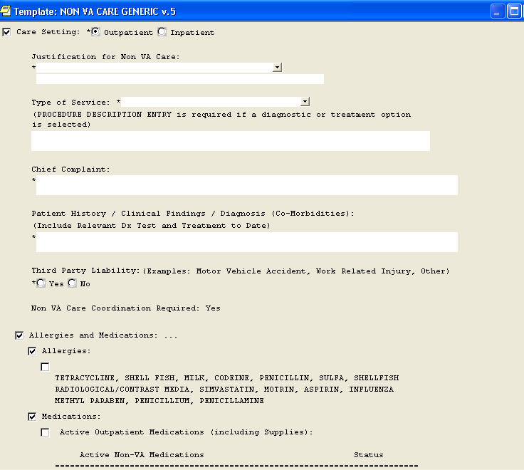
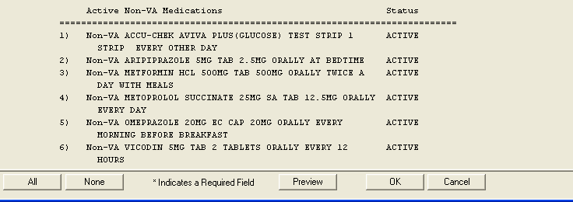
REQUIRED COMMON ELEMENTS
Local Decision to auto-populate or omit from NVCC Consult
Notes:
THIS IS A STANDARDIZED NON VA CARE CONSULT / REFERRAL WHICH CONTAINS the NON VA CARE COORDINATION MODEL REQUIRED
common elements found standard across VHA and aligns with future state processes
ANY Facility Information can be placed directly under the common elements in the consult / referral.
allergy and medication objects that are either adopted or omitted per each facilities decision to use at their site.

Slide 29
REQUIRED COMMON ELEMENTS
Notes:
STANDARDIZED NON VA CARE CONSULT / REFERRAL
COMMON ELEMENTS: * note the astrix make the question required and will not be able to complete until answer. This is an area where questions or sequence of criteria cannot be altered due to the need for standardization
Every Consult / Referral will have a
Standard Name: NON VA CARE always as the precursor and any specialty is after the name NON VA CARE
Again, all facilities are allowed to place specific Facility Information Below Common Elements
To Review the required criteria:
JUSTIFICATION for NON VA CARE: Required to answer based on by a prior OIG findings to support why VA services could not be utilized.
Chief Complaint: self explanatory but what the patient is experiencing for request of NON VA CARE Services
Pt History… : self explanatory but what the patients history leading to need for NON VA CARE Services
Third Party Liability question required to determine further investigation for revenue purposes.
NON VA CARE COORDINATION REQUIRED: Default to YES always – Future State element
All sections must be complete and understandable of what the provider is requesting, if not complete return with comments on the consult with required information missing.
If the site will not utilize allergies or medications objects, Place Facility Information Below Common Elements
If Allergies and medications kept, Place Facility Information Below Common Elements

Slide 30
Local Decision to auto-populate or omit from NVCC Consult
Notes:
Allergies / Medications auto populate option is a Local Decision to keep as part of the consult / referral information when entering the information. It would be up to the facility if they wanted the option to auto-populate the information in their NON VA CARE Consult / Referrals.
There are check boxes if both allergies and medications are to be auto populated or a choice for one or the othe.r
Again any facility specific consult information can be placed below the common elements and prior to the Allergies and Medications.

Slide 31
Referral Review Process
Standardized Non VA Care Consult placed by VA Provider
Administrative and Clinical Review Completed
Use of Non VA Care Coordination Note if Required
Notes:
Once the consult/referral is submitted and properly completed Administrative Eligibility and Clinical Review Completed
The next few slides will give detail on the variables reviewed in the Referral Review process related to Administrative Eligibility for a Veteran to receive VHA benefits and Clinical Review for Medical Necessity, determination of where services are to be obtained and clearly identify what services are being authorized.

Slide 32
Verifying Administrative Eligibility
What Does This Mean?
Review Current Eligibility Status in
CPRS and VistA
Enrollment status?
Priority Group Status?
ChampVA or Tricare?
Notes:
Administrative Eligibility:
What does mean? Its not the Veteran showing up and being seen in our facilities…verification requires a thorough review of the electronic medical record and or vistA
View “PATIENT INFORMATION” screen in CPRS and/or VistA.
Verify that “Enrollment Status “ is “verified “
If “Enrollment Status “ is “Pending,” contact local Eligibility Service (HAS, MAS, Patient Services) to verify patient is eligible for VHA care.
If the following remark is displayed: “Priority Group 8 Reject, Enrollment ended mm/dd/yyyy “ contact local Eligibility Service to verify eligibility status.
Is Patient TRICARE or CHAMPVA? - If patient is TRICARE (not dual eligible as Veteran and TRICARE) or CHAMPVA only, cancel the Consult/Referral, enter comment, return consult to ordering provider and view alert TRICARE or CHAMPVA Program Coordinator/POC).
Does screen display “Means Test Due?” If YES, refer to Eligibility Service (HAS, MAS, Patient Services) Do not delay care due to Means Test Due, follow local policy

Slide 33
Required Documentation Eligibility Verification
Once Eligibility is determined,
findings are documented on the
NON VA CARE CONSULT
“Administrative Eligibility Verified”
Notes:
If Veteran is not eligible for VHA benefits, a comment is entered on the consult with need for communication to the Provider and appropriate eligibility staff to support if eligibility can be completed. Use of Additional signers to place all involved should be used when the comments are entered. An Alternate Care Plan Tool can be used for communication and will look at that shortly.
If there is a means test due, it should not stop continuing the NVCC process for verifying clinical eligibility as part of the NVCC process. A call or correspondence should be made to Eligibility that a reminder displayed on the veteran’s chart. IF enrollment shows as pending, a call must be made to verify the current status of the veteran before confirmation of eligibility.
Add any additional signers are also placed in order to communicate a pending consult such as Tricare or ChampVA in order to decrease the risk of losing the patient to lack of action can be made at that time as well.
IF the veteran is deemed eligible after the proper checks, then a Comment is entered into the Consult / Referral as: “Administrative Eligibility Verified.” This entry supports that a standardized process was followed to ensure proper verification of eligible or ineligible status.

Slide 34
What Involves Clinical Review?
Determine Medical necessity
VA resources available?
Duplicate consult?
Document service(s)
Cancel/Deny Consult with ACP
Notes:
DETERMINE MEDICAL NECESSITY?:
After Administrative Eligibility is completed and verified that the Veteran was eligible for VHA benefits, the Consult/Referral is forwarded to the identified NVCC Clinical Staff for determination of medical necessity of the services requested.
Some facilities are incorporating Interqual criteria are part of their approval process but it is not currently part of the NVCC model.
Delegation of Authority may be required for each NVCC Clinical Reviewer and has to be established and approved on file thru the COS office.
This allows the identified Clinical NVCC Staff authority to approve and authorize NON VA CARE service under specifically established guidelines and scope under the COS authority.
VA RESOURCES AVAILABLE?: This will be discussed in the next slide in more detail but NVCC Clinical Staff understanding VA and NON VA Care resources available.
NVCC Clinical Review Staff who are assigned to the Referral Review Process will need to have a clear understanding of their facilities current VA Clinic availability or process to determine this.
They will also need to have a clear understanding of other types of NON VA CARE Services at their facility to guide where Non VA Care can be obtained. This will be discussed further in the next slide.
DUPLICATE CONSULT?: and Continuity of Care
A Clinical Review may also look at continuity of care, meaning did the patient already see someone for the same issue and it was an oversight on the part of or the ordering Provider and should the patient be referred back for updated care. A communication to the Provider can be made on the consult.
At the same time review of prior Consult/Referrals are completed to decrease duplication of financial obligations.
An example would be a Provider placing a Mammography consult 8 months prior during an office visit and placing another Consult/Referral during today’s office visit not realizing 2 Consults would be opened as an obligation. It would be determined there were no new issues and a comment placed to Cancel/Deny the consult with need to possibly extend the original consult date in order to compllete the services. It would still be related to the same EOC (Episode of Care).
DOCUMENT SERVICE(S)?:
Once Clinical Review supports NON VA CARE Services are required and approved a comment is placed on the CONSULT/REFERRAL specifically confirming “Clinical Review completed” with specific guidance of what services have been authorized to include consult, follow up visits, labs or other ancillary associated procedures.
Example: “Clinical Review completed. Pt authorized for 1 Orthopedic Consult for right wrist pain, and 2 follow up appointments.”
Cancel/Deny Consult with ALTERNATE CARE PLAN (ACP):
IF services are available within the VA, or an incorrect Consult/Referral was placed, a comment is entered on the Consult/Referral and forwarded to the ordering provider for concurrence as a Cancelled/Deny consult. Once concurrence is documented the consult/referral is Cancelled/Discontinued.
Add any additional signers to make them aware of a pending consult such as Tricare or ChampVA in order to decrease the risk of losing the patient to lack of action.
The Non VA Care Coordination Note may be utilized for an ACP (Alternate Care Plan) and communicated to appropriate persons if needed and found in CPRS. This will be reviewed shortly.

Slide 35
Medical Review Hierarchy
To Identify VA or Other Services
VA HEALTH CARE FACILITIES
Sharing Agreements / DoD or University Affiliation
Non-VA
Medical Care
PC3/ Contract
Notes:
The Identified NVCC Clinical Review staff or NVCC Team at your site will need to understand their current VA Clinic availability at their facility
(Each Organization may have different gatekeepers to make determination of clinic services, types of procedures available at their VA, and medical necessity.
At your facility it may be a Chief of Staff, Service Chief, Fee Chief or a NVCC RN with Delegation of Authority that would make the initial determination for Medical Necessity and where Services are available, or the Service Chief or Chief of Staff would forward onto the Clinical NVCC Team for further review.
IF it is determined there are NO local VA or Sister Facilities to provide the requested services then other options to obtain care are evaluated in a specific order or HIERARCHY.
These types of services are pursued in this order:
VA
DoD or Other Federal Healthcare Agencies
Sharing Agreements or University Affiliations
Contracts
And then if it is determined that there are no services that meet the specific hierarchy criteria, Non VA CARE Services are approved.
If services are available on the pyramid above Non VA Care Services a comment is placed on the Consult/Referral with explanation and need for Alternate Care Plan.
Once concurrence is documented by the VA Provider the Consult/Referral can be Discontinued.
An Ordering Provider may ask for a second review for the services requested with more information provided.
Do NOT Discontinue a Consult until you have confirmation back from the ordering VA Provider.
This supports the services requested are still being obtained via another venue and the Veteran is not lost to follow up.
On a side note, there is now a Clinical Inventory Tool out on the NNPO Website that is available to VISN facilities to use as a tool to learn about all VA services available nationally. Each VISN is required to fill out the proper certification paperwork to receive the access to the tool.

Slide 36
Referral Review Process
Standardized Non VA Care Consult placed by VA Provider
Administrative and Clinical Review Completed
Use of Non VA Care Coordination Note if Required
Notes:
In the Referral Review Process now that the Non VA CARE services were administratively and clinically authorized there is a tool that will assist further coordination and facilitation of the Veteran’s Pre-Authorized Non VA Care Services if needed.

Slide 37
NON VA CARE COORDINATION
REFERRAL REVIEW TOOL
Progress Note Template located in CPRS and initiated as needed
Not necessary for every Non VA Care Consult/Referral
Place Additional Signers on Template to communicate the Veteran’s status regarding Pre-Authorized Non VA Care Services
Notes:
Tool for Pre-Authorized Care
This tool was developed for CPRS to be utilized by the NVCC Team and or VA Clinical and any ancillary staff that may need to communicate information regarding the pre-authorized care outside of the VA.
It serves a purpose of communication and understanding of what occurs with our Veterans when authorized for PRE-Authorized Non VA Care Services.
The Care Coordination Tool is multi-faceted for different focus and use to:
Facilitate, track, coordinate and communicate information between NVCC Team, Clinical /Ancillary POC’s at the VA regarding their status during the receipt of NON VA CARE Services.
Multiple use note when PRE-Authorized NON VA CARE services required. The note is a standardized tool to track, facilitate, coordinate and communicate specific care for the Veteran when required beyond NVCC process.
The next slide shows the different Sections for Pre-Authorized Non VA Care Services within the Non VA Care Coordination Note.

Slide 38
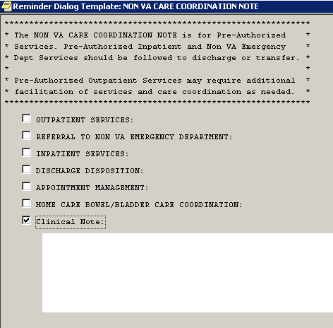
NON VA CARE COORDINATION
PROGRESS NOTE TEMPLATE
Notes:
This is a multiple use note for PRE-Authorized NON VA CARE services when further communication is required to manage the Veteran. This is not required for all consult/referrals but optimal when additional services are required, and for tracking of Pre-Authorized Inpatient services to follow the Veteran thru that Episode of Care thru to Discharge home.
The note is a standardized tool to track, facilitate, coordinate and communicate specific care for the Veteran when required beyond NVCC process.
It is created as an HISTORICAL VISIT so no encounter is generated
The really great feature about this note is the ability to “MAKE ADDENDUM” which keeps all the entries and sectioned information under what I call the ‘Mother Ship Note” so anyone can open the note in CPRS and follow the progress. Additional Signers are placed for any VA provider or ancillary staff that needs to understand what is occurring with the VA patient and their status.
The pertinent Sections:
Outpatient (Pre-authorized)
Non VA Care Emergency Dept
Home Care Bowel and Bladder
Inpatient (Pre-authorized)
Appt Mgt
Alternate Care Plan
Sections for
Pre-Authorized Care:
Outpatient
Example: Veteran has mild dementia, is authorized for a Colonoscopy and was approved for a pre-consult visit due to high risk issues, need for extended prep, poor family support and his wife was recently hospitalized. The Outpatient section could be used to help the patient complete the care and additional services needed by initiating the section of the Progress Note and communicate to pertinent VA staff involved in the Veteran’s care and follow that patient thru to completion of procedure.
Non VA Care Emergency Dept specifically addresses when
A Veteran is seen in the VA Emergency room or VA CBOC and sent directly to NON VA CARE Emergency Dept. A Consult can be placed at that time with the NVCC Team assigned to being notified on the Consult in odder to contact the Non VA Care Emergency Dept to verify status to determine admission or discharge status. If admitted to Observation or Inpatient this note can used and then the Veteran followed under the INPATIENT Services section thru to transfer back to the VA facility or DC home.
Continued Stay Review entries are PLACEd IN FBCS CLINICAL TRACKING if ADMITTED TO OBSERVATION or INPATIENT
Home Care Bowel and Bladder
This tool communicates specific information required Bowel and Bladder home care services for this pre-authorized service. Identifies who is the caregiver and the timeframe for the EOC with clinical note section to update their status and progress.
Example. Veteran requires services either by a family member (Non-Professional Caregiver) or Certified Caregiver name.
Inpatient
Initiated when Veteran Pre-authorized for inpatient services – planned admission and requires follow thru (continued stay reviews) to transfer or DC home.
Must Enter the status (continued stay review) in FBCS Clinical Tracking.
Example. Veteran authorized for Total Knee Replacement and followed by the Inpatient section thru to discharge.
To NOTE: This section is also utilized if the Veteran is admitted from Non VA Emergency Dept. or VA CBOC and admitted.
Alternate Care Plan
Progress note section used to communicate to other VA Clinical/Ancillary Staff when Veteran is not eligible for Non VA Care services i.e., Tricare, ChampVA, changes in status , etc. Acknowledgement of ACP required by ordering Provider.
Example. Veteran requires Services but is ChampVA patient, he moved to another state, hospitalized, utilizing other Third party insurance, etc.
**MAKE ADDENDUM COMMANDS are required for any users following up on the Veteran’s status and additional signers can be placed for appropriate communication as well as keeping entries contained under the initial Care Coordination note for capture of a veteran’s timeline of Non VA Care services.

Slide 39
Referral Review Process Summary
Standardized Non VA Care Consult Template placed by VA Provider
Administrative and Clinical Review Completed
Use of Non VA Care Coordination Note if Required
Notes:
REFERRAL REVIEW Process Summary:
STANDARD CONSULT / REFERRAL GENERATED BY VA PROVIDERS TO REQUEST NON VA CARE SERIVCES
ADMINISTRATIVE ELIGIBILITY AND CLINICAL REVIEW BY THE IDENTIFIED NVCC TEAM BEFORE NON VA CARE SERVICES ARE AUTHORIZED to ensure the Veteran is eligible for services
COMMUNICATION WITH THE VA PROVIDERS OR OTHER ANCILLARY VA STAFF IF AN ALTERNATE CARE PLAN IS REQURED TO BE SURE THE VETERAN RECEIVES THE APPROPRIATE CARE.
Use of the Non VA Care Coordination Note is a tool utilized for certain Pre-Authorized Non VA Care Services in order to communicate need for additional services, or the Veteran requires tracking, further facilitation and coordination of care during the identified time frame or Discharge to home. Use of make addendum feature and additional signers keep the communication timeline in one area in CPRS.

Slide 40
Appointment Management
Pre and Post Calls
Notes:
Next Process of the NVCC Model is Appointment Management with Pre and Post Calls
Discussing 2 processes at the same time as they can be integrated with actions for both at the same time.

Slide 41
NVCC Appointment Management Process
Veteran
Referral Review
Appt Mgt/ Pre-Post Calls
Appeals Mgt
Clinical Review for Emergency Claims
Hospital Notification
Notes:
The Appointment Management Process begins when a NVCC team member receives notification of an approved Non VA Care Consult/Referral within CPRS and Non VA healthcare services are authorized within FBCS.
The process encompasses: contacting the patient/Non VA provider/scheduling/check-out the appointment(s) for the Veteran with the Non VA provider; and ends once all required clinical documentation is received from the Non VA provider; the appropriate documents are scanned into VistA Imaging; the Non VA Care Consult Result Note is selected to close the associated CPRS Non VA Care Consult/Referral.

Slide 42
Who is Involved in Appointment Management?
Veteran
Non VA Provider
NVCC Team
VA Provider
Notes:
Who is involved in Appt Mgt?
The Veteran again is Center in his/her Non VA Care
VA Provider and Veteran interact and Veteran is cared for in a VA clinic
VA Provider places the standardized Non VA Care Consult when it is determined from their perspective that NON VA CARE Services are required
Forwarded to the NVCC Team identified to review for administrative and clinical review and if eligible – Appt Mgt processes are initiated by the identified NVCC Team staff at each facility.

Slide 43
Appointment Mgt Process Flow
NVCC Team Receives Approved Consult
Authorization Initiated in FBCS
Veteran and Non VA Provider Contacted
Appt Scheduled/Entered into VistA Appt Mgt and FBCS Auth Completed
Patient Appt Letter and Non VA Provider Letter Sent with Auth
Call Veteran to confirm care completed
Obtain Clinical Documentation
Records Scanned into CPRS with NVCC Consult Result Note and Consult Closed
Notification Sent to Ordering VA Provider via CPRS
Notes:
Appt Mgt Process Flow
Each organization structure and leadership will determine who will perform these specific functions of:
Receiving the approved consult / referral and Initiating the Authorization in FBCS,
contacting the veteran and Non VA Care Provider,
placement of Appt in VistA Appt Mgt,
Completing the Authorization in FBCS once it is determined the Veteran’s preference for a Non VA Provider and the
Sending the correspondence to both Veteran and Non VA Provider which includes the Pt Appt Letter with Authorization and Non VA Provider Letter and Authorization sent to the Non VA Provider,
Then verifying completion of the Non VA Care services by following Appt List generated out of Vista Appt Mgt and contacting the Veteran post services,
and obtaining clinical documentation from the Non VA Provider,
And scanning records into CPRS and closing the consult.

Slide 44
Documents / Tools Utilized in
Appointment Management
NVCC Team
VA Provider
Veteran Non VA Provider
PHONE
FBCS
VistA Appt Mgt
CPRS Non VA CARE Patient Appt Letter
Copy of Auth
Non VA Provider Auth Letter
Non VA Consult Result Note
Notes:
Highlights the relationship between the NVCC TEAM with VA PROVIDER, VETERAN CENTERED IN THE PROCESS working with the NON VA PROVIDER
THE VA Provider is kept in the loop with comments (as few as possible) made on the Consult
or if a NON VA CONSULT RESULT NOTE WAS INITIATED IN THE REFERRAL REVIEW PROCESS
AOD and 7332 - Accounting of Disclosure and Protected Info
So the Tools and Documents that are required are:
FBCS with SUSPEND FEATURE
PHONE
VistA Appointment Management
CPRS NON VA CARE Patient Appointment Letter
Copy of Authorization
WORD Document – NON VA PROVIDER AUTHORIZATION LETTER
CPRS NON VA CARE CONSULT RESULT NOTE

Slide 45
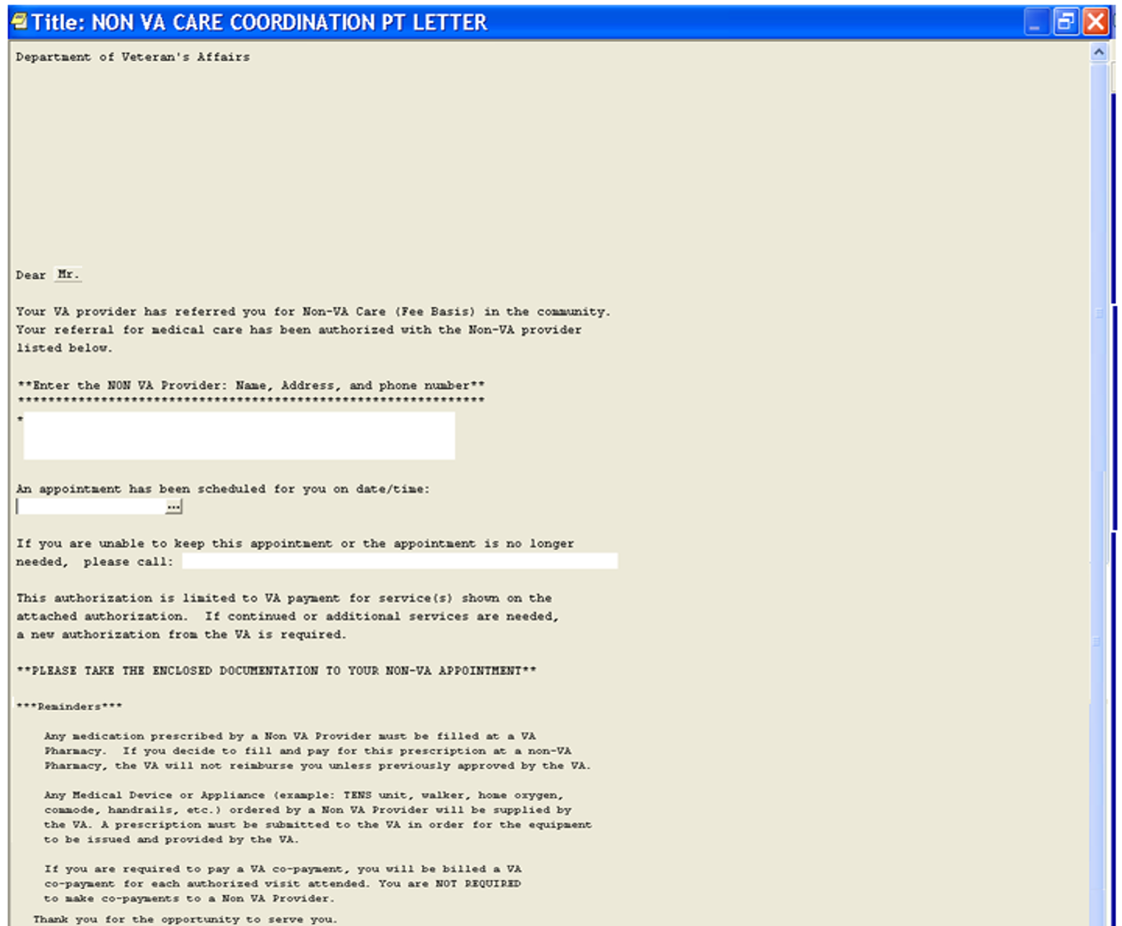
Notes:
NON VA CARE COORDINATION
PATIENT APPOINTMENT LETTER
Standardized Letter to be sent to VA Patient with Authorization
HOUSED IN CPRS
Objective is not to edit this letter to keep per NNPO guidance for guidance and communication to the VETERAN regarding their appt
REMINDER SECTION:
Medication information if prescribed by a NON VA Provider (with Prescriptive Authority Process if needed)
If Medical Devices or Appliances are required, how to obtain from the VA and what is required
Co-payment information and a NON VA Provider will not request a copayment. However they may be billed a copayment from the VA based on their SC status.
DO NOT SIGN in CPRS unless your facility has an Administrative Document Class Title assigned or Administrative Tab
There is guidance found in the Appt Management SOP regarding Admin Doc Class Title from Health Information Management Dept or HIM.

Slide 46
Notes:
NON VA PROVIDER AUTHORIZATION LETTER
A copy of the Authorization and Letter is sent to the Non VA Provider
This letter is required by NNPO National Non VA Care Program Office
Word Document with intent to have generated out of FBCS in the future for ease to create an send to the NON VA CARE Provider.
Once the Authorization is completed and the Pt Appointment is scheduled, a copy of the Authorization and this Letter is sent to the Non VA Provider.
This letter is required by NNPO as standardized communication to Non VA Providers.
It provides the Provider detailed guidance regarding
the Veteran’s authorized services, timeframes,
prescriptive information – formulary medications,
payment guidance on placing the VA in their own system with proper Name, Payer ID number,
EDI information, proper forms, paper claims processing guidance and
where to sent clinical documentation once services are complete.
The Letter is a Word Document and can be placed in local process per each facility leadership guidance.
ANY VA MEDICAL DOCUMENTATION IS SENT TO THE NON VA PROVIDER FROM THE VA NVCC TEAM or Designated STAFF REGARDING THE VETERAN ACCOUNTING OF DISCLOSURE (AOD) Tracking entry must Completed per HIM GUIDANCE. Any documentation that is released out to the community for a Veteran has to be accounted for if a Veteran contacts the VA inquiring where their medical records have been released and for meeting OIG criteria.
IF ANY PROTECTED 7332 Information regarding the patient is required, this must also be identified with proper release of information from the Veteran in the form of an ROI package or HIM driven Tracking mechanism.
IT is recommended for anyone new to these processes to request education from your local HIM points of contacts for establishing a accounting of Disclosure process and ROI educational update. It protects the Veteran and the VA.
For more detail in regards to contract guidelines and ROI, see the NVCC Appt Mgt SOP.
________________________________________________________________________________End Bonnie’s Note

Slide 47
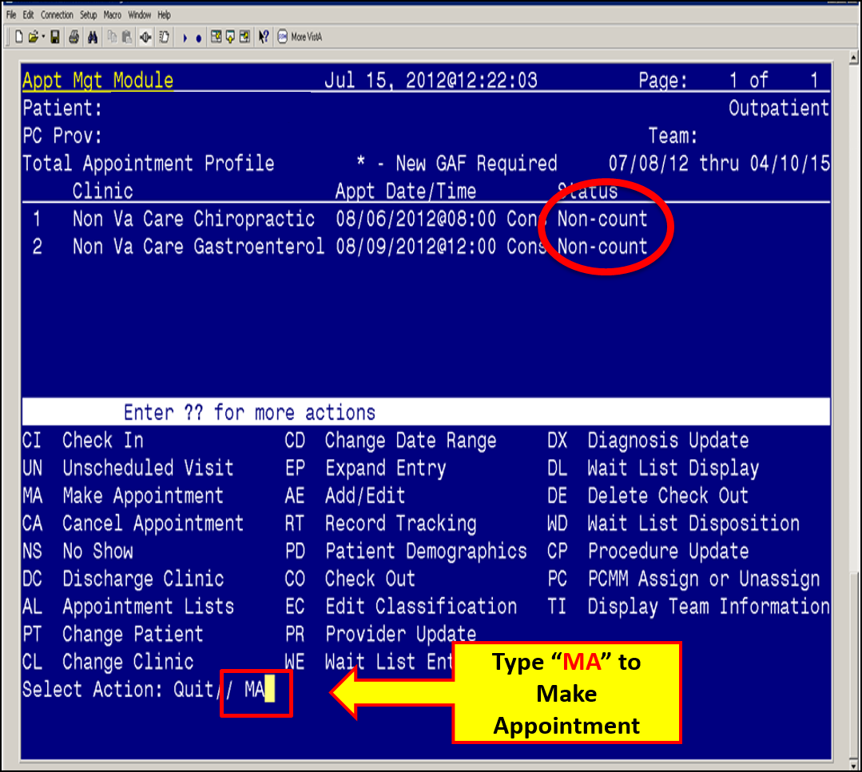
Notes:
Another process in the NVCC Appt Mgt Model is Scheduling the Appointment in VistA Appt Mgt – non count clinic
This is a screen shot of the Make Appt function for the designated NVCC Team Members who will be assigned to contact the Veteran and place the Appointment in VistA non count clinic which is linked to the NON VA CARE CONSULT in CPRS
Once the Veteran is given a preference of a Non VA Care Provider, the Appt date and time are facilitated in conjunction with the Non VA Care Provider in an individual or 3-way phone call. The appt information is placed in VistA Appt Mgt and used as a PLACE HOLDER. The 1st scheduled appt is the only appt to be placed in VistA Appt Mgt. Services that require multiple services such as Physical Therapy, Cardiac Rehab or pain clinic appts do not require multiple entries.
The Non Count Clinics are linked to the NON VA CARE CONSULTS in CPRS.
The Appt Information is transferred to the Consult when linked properly in VistA Appt Mgt.
REMINDER: An Appointment is Suspended in FBCS if the patient has the ability to select their NON VA CARE PROVIDER if there is no other NON VA CARE Service such as: DoD, Sharing Agreement - University Affiliation, or Contract available
Once they select and the appointment is confirmed, the Authorization should be completed in FBCS and sent out with the Pt Appt Letter and Non VA Provider Letter

Slide 48
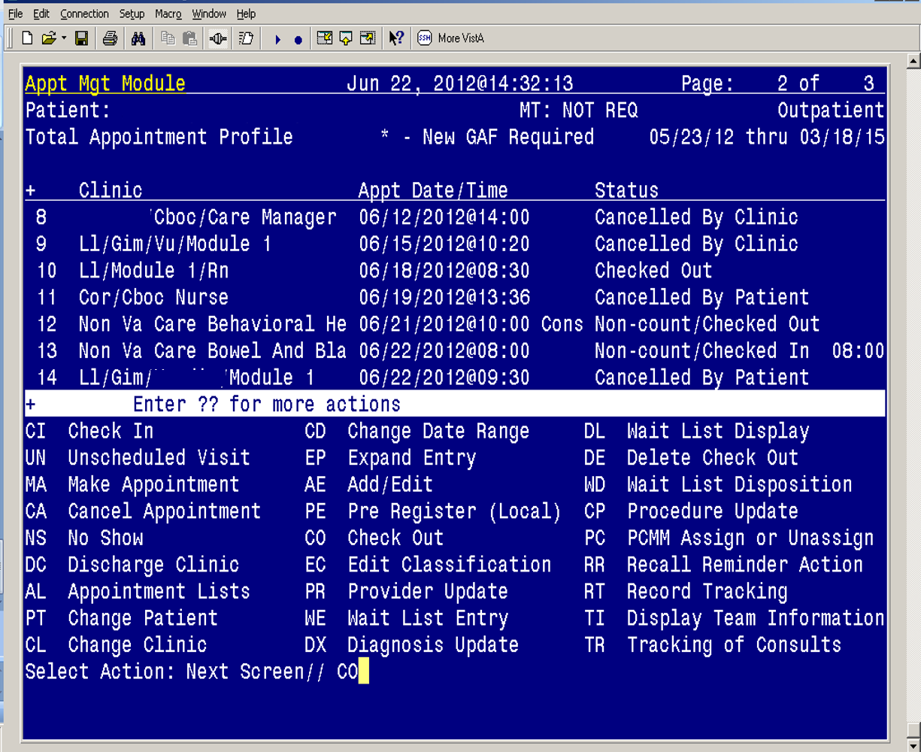
Type “CO” to CHECK OUT
Notes:
Prior to Checking out an Appt, an APPT LIST CAN BE CREATED TO DETERMINE WHEN A PATIENT HAS A PENDING APPT or should have attended the appt for a post phone calls to be made to the Veteran. The NON VA Provider is contacted if Clinical Documentation has not been received.
This slide illustrates the required CHECK OUT process in VistA Appt Mgt
Place Date and Time of Appt attended plus 1 hour.
So….Verify the Appt was attended from:
- VistA Appt List Report.
- Place a Post Appt Call to the Patient.
- Obtain the Clinical Documentation from the Non VA Provider.
Perform Check Out (CO) in Appt Mgt. to confirm the date and time the Patient attended the Appt to close the loop of care.
This information is found also in the Appt Mgt SOP

Slide 49
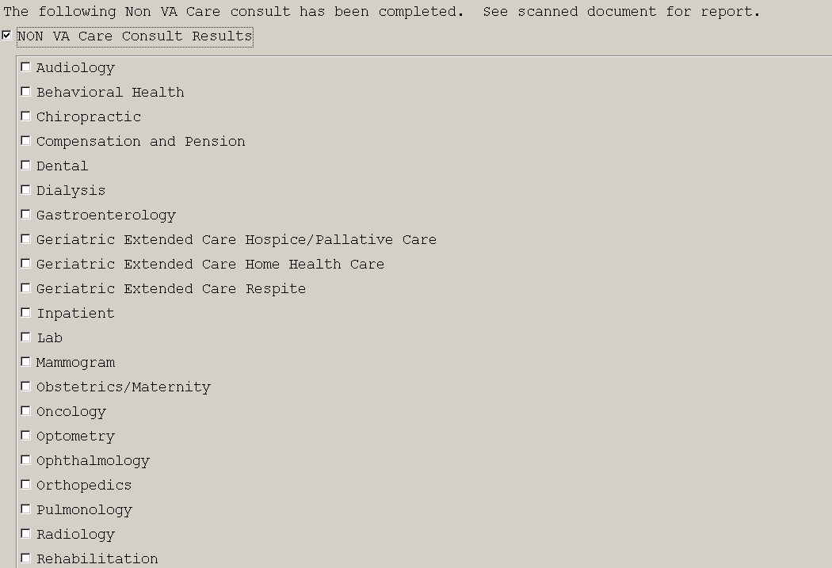
Notes:
Now that it was determined the Patient attended the NON VA CARE Appt, was checked out in VistA Appt Mgt, and clinical documentation was returned, the consult is then closed with the STANDARDIZED: NON VA CARE CONSULT RESULT NOTE
Obtain Required Clinical documentation from Non VA Provider regarding the EOC (Episode of Care).
Scan the received clinical documentation per local policy and utilize the Non VA Care Consult Result progress note template in CPRS; by linking the NON VA CONSULT RESULT NOTE to the Consult, notes will be attached and closes the Consult.
3. This step can be completed by various staff within Fee, HIM, and can be scanned into Doc Manager and/or directly into VistA Imaging in CPRS.
The ordering VA Provider will be notified when the Consult is closed and will be able to view the documentation.
This step can be completed by various staff within Fee, HIM, and can be scanned into Doc Manager and/or directly into VistA Imaging in CPRS.
Scanned Document processes are based on Local process such as Doc Manger or VistA imaging.
The NON VA CARE CONSULT RESULT NOTE MUST BE UTILIZED for EVERY NON VA CARE CONSULT CLOSING after the initial documentation is received and is one of the NATIONAL METRICS for tracking of Progress note titles. Other Specialties can be added to the document based on the Consult/Referrals each site has developed from the Generic COMMON Elements NON VA CONSULT.
______________________________________________________________________________End Bonnie’s Notes___

Slide 50
Appointment Mgt Process Flow Recap
NVCC Team Receives Approved Consult
Authorization Initiated in FBCS with Cost Estimation
Veteran and Non VA Provider Contacted
Appt Scheduled/Entered into VistA Appt Mgt and FBCS Auth Completed
Patient Appt Letter and Non VA Provider Letter Sent with Auth
Call Veteran to confirm care completed
Obtain Clinical Documentation
Records Scanned into CPRS with NVCC Consult Result Note and Consult Closed
Notification Sent to Ordering VA Provider via CPRS
Notes:
So to recap the Appt Mgt Process – understand each organization will determine who will perform these specific functions of
Initiating, suspending, and Completing the Authorization in FBCS and Cost Estimation (which is external to NVCC process at this time),
contacting the veteran and Non VA Care Provider,
placement of Appt in VistA Appt Mgt,
Send correspondence to both Veteran and Non VA Provider
Verifying completion of services and obtaining clinical documentation,
scanning records into the system and closing the consult with the Non VA CARE Consult Result Note and attaching the clinical documentation.

Slide 51
NVCC Hospital
Notification
Notes:
The next NVCC Process we will discuss is Hospital Notification

Slide 52
NVCC Hospital Notification Process
Veteran
Referral Review
Appt Mgt/ Pre-Post Calls
Appeals Mgt
Clinical Review for Emergency Claims
Hospital Notification
Notes:
Non-VA Care Hospital Notification Process
Again…discuss Veteran is centered in the process and involves other members of the NVCC Team highlighted in the next slides

Slide 53
Hospital Notification Process
Goal
Tool
Non VA Care Hospital Notification Progress Note template in CPRS
Follow Veteran’s status after notification of Veteran admitted to a Non VA Care Emergency Dept. or Inpatient Facility
Sections in note that address several areas such as Continued Stay Reviews
Transfer back to VA or follow thru to Discharge Home
Notes:
The Non-VA Care Hospital Notification Process begins:
When the VA receives notification of a Veteran admitted to a Non VA Facility ER or
Inpatient.
The Transfer Coordinator, AOD (Administrative Officer of the Day), Clerk or any other VA medical staff member can initiate the note and place additional signers for communication.
The Notification can be directly from the NON VA CARE FACILITY OR the Veteran himself, Family Member, Friend, outside Social Worker, Case Manager, or any ancillary staff
This process is an ongoing evaluation of the Veteran status during the stay at the NON VA CARE Facility after it has been determined there is a potential the VA may be responsible for payment related to the NON VA CARE admission.
The Veteran does have a choice to utilize VA benefits if eligible, and if he chooses other payment options, the VA would not cover the services.
The NON VA CARE Facility has 72 hours to notify the VA of Veteran's admission and the VA could make the determination at that time to pre-authorize that EOC based on the eligibility status and clinical condition surrounding that admission.

Slide 54
Who is Involved in Hospital Notification Process?
Veteran
Non VA Facility
NVCC Team/ Transfer Coordinator
VA Provider and Ancillary VA Staff
VA Hospitalist
Notes:
Veteran
Non VA Facility
NVCC Team / Transfer Coordinator
VA Provider and Ancillary VA Staff
VA Hospitalist

Slide 55
Hospital Notification Note
Call from Non VA Facility
Hospital Notification Note Initiated
Additional Signers placed for follow up
Transfer Coord / NVCC Team
Determines Eligibility
VA Provider NVCC Team
Coordinates and facilitates transfer to VA with VA Provider/ Hospitalist OK
Continued Stay Reviews completed
Notes:
The Hospital Notification Progress Note Template is initiated in CPRS
to track initial information and begins ongoing continued stay reviews of the Veterans status while in the Non VA facility.
The Notification can be directly from the NON VA CARE FACILITY OR the Veteran himself, Family Member, Friend, outside Social Worker, or Case Manager.
The person receiving the information ie., Administrative Officer of the Day, PSA/Clerk at the VA or CBOC places the known NVCC Team/Transfer Coordinator on as additional signer to notify that follow up is required to check on the veteran’s status from an eligibility and clinical status.
The NVCC Team/Transfer Coordinator staff determines eligibility before ongoing status continues.
“72 Hour Rule”
The NON VA CARE Facility has 72 hours to notify the VA of Veteran's admission and the VA could make the determination at that time to pre-authorize that EOC based on the eligibility status and clinical condition surrounding that admission.
There is minimal interface between FBCS and CPRS and it is required to track any contact of a Veteran when we are notified, and document continued stay review in FBCS for tracking of the Business systems side of the VA along with CPRS.
The Veteran does have a choice to utilize VA benefits if eligible, and if he chooses other payment options, the VA would not cover the services. However, the Clinical staff may wish to follow the patient themselves in order to capture them back after their Discharge from the Non VA Facility.
Continued Stay Reviews are completed with the goal to either transfer back to the VA or follow to discharge to home.
VA Clinical and Ancillary staff involved in the Veterans Care can be added to the note as: Additional Signers, i.e., VA Providers, Social Work, Discharge Planners, Case Managers, Mental Health, to keep updated on the Veterans Status.
Information is also placed in FBCS Clinical Tracking at that time to follow the care and outcome of the Veteran.
There is minimal interface with CPRS and FBCS and duplicate entry is required in FBCS for each Clinical Stay Review Entry.

Slide 56
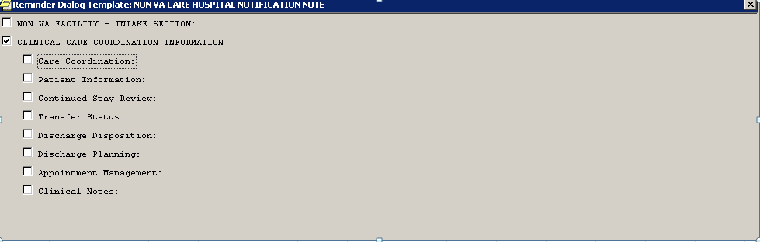
NON VA CARE HOSPITAL NOTIFICATION
PROGRESS NOTE TEMPLATE
Notes:
Here is the Face page of the NON VA CARE Hospital Notification Note:
2 Sections allow for information surrounding the notification and ongoing facilitation, coordination, and tracking of the Veterans status. It can be used by multiple users and addresses multiple processes during the Veteran’s Inpatient stay at the non va care facility. This note created as NEW NOTE for initial Intake Section, then anyone after making an entry would use “MAKE ADDENDUM” just as the CARE COORDINATION NOTE FOR Non VA Care Coordination for Pre-Authorized Services.
NON VA FACILITY - INTAKE SECTION
CLINICAL CARE COORDINATION INFORMATION related to the admission.
The first section – INTAKE SECTION can be initiated by an AOD (Administrative Officer of the Day), Clerks, Transfer Coordinators or any other VA medical staff member who receives notification of Veteran in a Non VA Care Facility.
This section does not require Clinical decision making and requires information pertaining to the Facility contacting the VA, the reason they were admitted, the POC name calling, and the diagnosis they were admitted under if known, along with a comment section.
Identified NVCC Staff would be placed as additional signers for ongoing follow up i.e., Transfer Coordinators, Transfer Clerks, Bed Czars, etc.. And they would use MAKE ADDENDUM to document further entries in the note to keep it contained under what I call the “Mother ship Note.”
NON VA CARE HOSPTIAL NOTIFICATION NOTE - CLINICAL CARE COORDINATION INFORMATION
Again, the User facilitates communication by use of Additional Signers:
Clinical and Ancillary staff at VA receive info re: Veteran’s Clinical, Transfer or Discharge Status
Care Coordination Section
Determining Administrative Eligibility or communicate Ineligible Status and document in FBCS
as “Does not meet criteria for relevant regulatory authority.”
The entry in CPRS should say: “Does not meet criteria for eligibility for USC 1703 or 1728” and be sure to identify the
proper authority reference.
Patient Information
Section to determine the Veteran’s status following the INTAKE information
Facilities have completed both CARE COORDINATION AND PATIENT INFORMATION at once.
Continued Stay Review
Perform Clinical Review and document outcome in Clinical Tracking in FBCS
Place additional signers vested in the Veteran’s care: PCP, SW, Case Mgrs, Mental Health
Transfer Status
Coordinate Transfer of Veteran to VA Facility or Veteran refusal to transfer
Discharge Planning
Track and place additional signers to Discharge Planning activities
Appt Mgt
Self Explanatory
Clinical Notes:
Self Explanatory
For this section use:
MAKE ADDENDUM COMMANDS are required for any users following up on the Veteran’s status.
MAKE ADDNEDUM to have the Note contained in CPRS under one “Mother Ship” Note Title

Slide 57
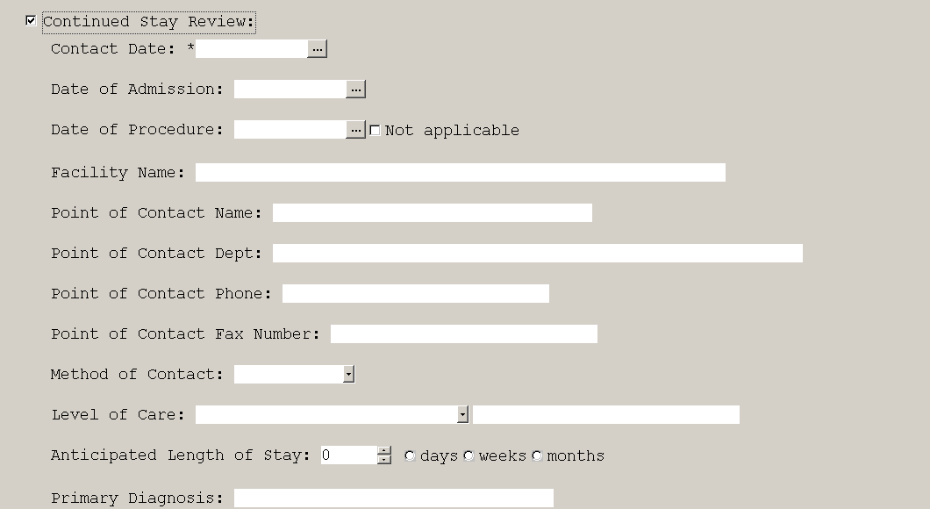
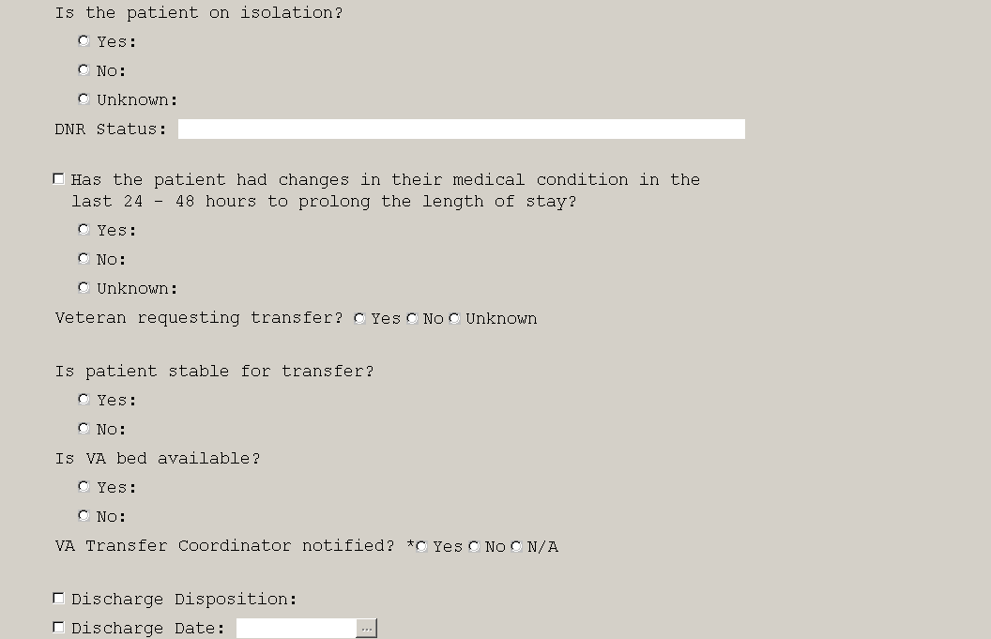
Notes:
NON VA CARE HOSPTIAL NOTIFICATION NOTE - CLINICAL CARE COORDINATION INFORMATION
Again, the User facilitates communication by use of Additional Signers:
Clinical and Ancillary staff at VA receive info re: Veteran’s Clinical, Transfer or Discharge Status
This slide demonstrates the Continued Stay section after following is care is determined and can be used multiple times as users perform:
Continued Stay Review
Perform Clinical Review and document outcome in Clinical Tracking in FBCS
Place additional signers vested in the Veteran’s care: PCP, SW, Case Mgrs, Mental Health

Slide 58
Hospital Notification Process Summary
VA Notified of Veteran at Non VA Facility
Hospital Notification Note Initiated
NVCC Team Transfer Coordinators alerted in CPRS
Eligibility Determined
Continued Stay Reviews with FBCS entries completed
Veteran transferred to VA or follow to DC Home
Notes:
The Non VA Care Hospital Notification Process begins when VA
receives notification of a Veteran admitted to a Non VA Facility ER or
Inpatient.
The Hospital Notification Progress Note is initiated in CPRS
to track initial information and
Note is forwarded to the NVCC Team/Transfer Coordinator to
Determine eligibility and
Continue ongoing Clinical Stay reviews of the Veterans status
while in the Non VA facility.
Continued Stay Reviews are completed with each entry into Clinical Tracking into FBCS.
There is limited interface between CPRS and FBCS and duplicate entry is required.
Additional Signers involved in the Veteran’s care can be added at the time for
notification of the Veteran's status, i.e., VA Providers, Social Work, Discharge
Planners, Case Managers, Mental Health, etc.
Hospitalists are part of the process to capture the Veteran back for transfer to the VA
If unable to transfer back, the Veteran is followed to DC home with additional signers to Clinical POC’s involved in care, PCP, DC Planners, Case Manger, etc.
Continued Stay Review information is also placed in Clinical Tracking in FBCS with each Continued Stay Review.

Slide 59
Clinical Review For Emergency Claims
Notes:
The Unauthorized and Mill Bill Process occur after services have been completed and an externally initiated process following VHA policy and guidelines.

Slide 60
NVCC Clinical Review for
Emergency Claims Process
Veteran
Referral Review
Appt Mgt/ Pre-Post Calls
Appeals Mgt
Clinical Review for Emergency Claims
Hospital Notification
Notes:
Here is the Unauthorized and Mill Bill Process in the NVCC model and see that the Veteran or claimant is again centered in their care.
Unauthorized and Mill Bill claims submitted for VA payment or coverage consideration are received and retrospectively evaluated for potential VA Payment or Mill Bill.
NVCC Standardized processes for adjudication will ensure consistency and equitable payment decisions and supports adherence to current VHA policy and guidelines.

Slide 61
Who is Involved in Unauthorized and Mill Bill Claims?
Veteran Claimant
Claims Processing Team
NVCC Team
VA Provider
Notes:
Who is Involved in Unauthorized and Mill Bill Claims?
Veteran or Claimant placing the claim – this also could be a Veteran representative, Non VA Provider, etc.
NVCC Team Performs Administrative Eligibility and Clinical review of Claim or Claim Adjudication
VA Provider performs the second level review as necessary per local policy
Claims Processing Team – Takes Actions in accordance with outcome of claim adjudication process and appropriate correspondence letter.

Slide 62
Clinical Review for Emergency Claims Process
NVCC Team Receives Claim with No VA Authorization
Administrative and Clinical Review completed
Denial or Approval of Claim determined
Determination Letter Sent to Veteran
Notes:
Process requires access to Fee Basis Claims System (FBCS) - Doc Manager & Verification Module.
Administrative Eligibility review is completed along with review of the claim and supporting documents.
The Claim is approved or denied per VA policy and document the determination in FBCS Clinical Tracking (Approval or Denial).
The Payment is authorized if approved.
3. Appropriate Denial correspondence must be sent to the Veteran (Patient) per policy.

Slide 63
Notes:
Unauthorized and Mill Bill Process Summary
Since this process is policy driven and Non VA Care Coordination has not made any modifications to this required process, the Flow diagram is from our Process Guides that supports VHA Policy.
The NVCC Team is supporting that VHA Policy is followed to completion with appropriate process.

Slide 64
Administrative Appeals Management
Notes:
The Appeals Mgt Process is a Veteran or Claimant - Externally Initiated Process and occurs after Non VA Care services have been completed. The process follows strict guidelines and VHA policy.

Slide 65
NVCC Appeals Management Process
Veteran
Referral Review
Appt Mgt/ Pre-Post Calls
Appeals Mgt
Clinical Review for Emergency Claims
Hospital Notification
Notes:
An Appeal would be initiated if a Veteran or Claimant submits a NOTICE OF DISAGREEMENT or (NOD) to the VA Medical Center
and would initiate the Appeals Management Process supported within the NVCC model.

Slide 66
Who is Involved in Administrative Appeals Management Process?
Veteran Claimant
NVCC Team
Claims Processing Team
Board of Veterans Appeals (BVA)
Notes:
Who is Involved in Admnistrative Appeals Mgt Process?
Veteran or Claimant submits the Notice of Disagreement (NOD) – this also could be a Veteran representative, Non VA Provider, etc.
NVCC Team Receives and the reviews the Notice of Disagreement and,
Enters the NOD into the Appeals Tracking Worksheet (which can be found on the on the NNPO (NFPO) Website) or own local facility spreadsheet and
Enter the Appeal into FBCS Clinical Tracking then
Prepare an Appeals Folder
1st Level review of appeal is completed
It may require 2nd level appeals and
if required, prepares documentation for submission to the Board of Veterans Appeals (BVA) per approved procedures.
Claims Processing Team – Receives and processes claim for payment if original decision is overturned by NVCC Team
The Veteran or Claimant is notified of decision

Slide 67
Administrative Appeals
Management Process
NVCC Receives Request or NOD and places in FBCS and Tracking Worksheet
Appeals Folder created and 1st Level Review of Claim completed
Second Level Review if Required - Local or (BVA)
Veteran/ Claimant Notified of Decision
If Claim Reversed it is Reopened and Sent to Claims for Processing
Notes:
Non VA Care Appeals Management Process Stakeholders Roles and Responsibilities
NVCC Team receives and reviews the Notice of Disagreement (NOD)
Collects, documents, and tracks all pertinent information associated with the appeal
Adjudicates the NOD via the established VHA policy and guidelines, including reconsideration procedure
Communicates the adjudication decision to the claimant
Veterans Health Administration (VHA) “Duty to Assist” (Procedure Guide 1601G.01.2.1b)
Prepares documentation for submission to the Board of Veterans Appeals (BVA) per approved procedures
Medical Center Claims Staff
Receives and processes claim for payment if original decision is overturned by NVCC Team
Board of Veterans Appeals
Renders final decision regarding formal appeals and notifies appropriate VHA healthcare facility
NON VA CARE COORDINATION APPEALS MANAGEMENT PROCESS SUMMARY
The Appeals Management process begins when a NVCC team member receives a Request for Reconsideration and/or a Notice of Disagreement from a claimant (e.g., Veteran, Veteran representative, vendor, etc.).
The process ends once the final decision regarding the appeal is rendered (either locally or by the Board of Veterans Appeals) and the claimant is notified of the decision with appropriate correspondence per VHA policy.

Slide 68
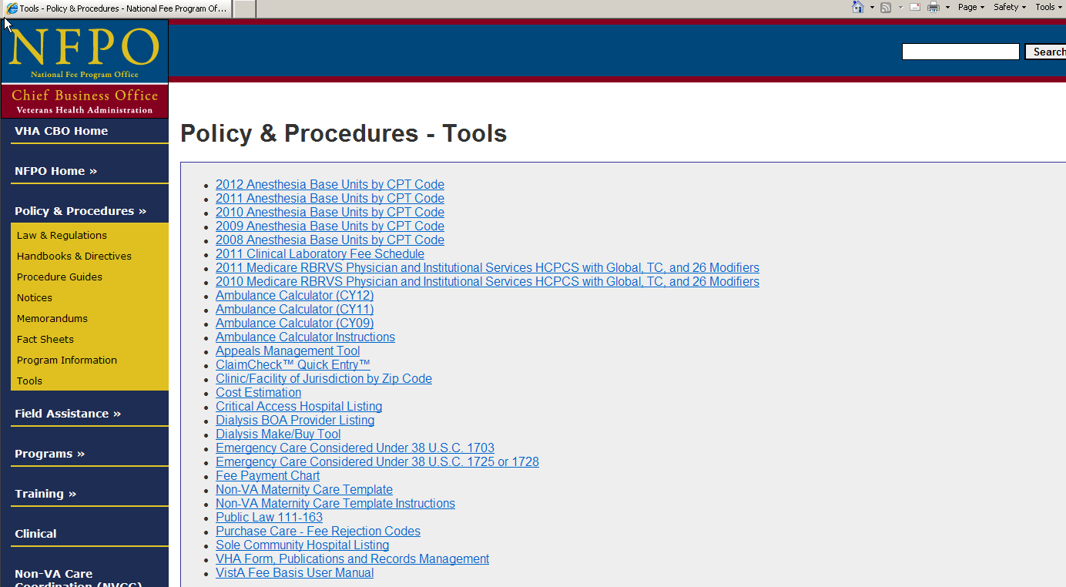
NNPO APPEALS MANAGEMENT TOOL – DIY (DO IT YOURSELF) UPLOAD
NNPO APPEALS MANAGEMENT TOOL
Notes:
Non VA Care Coordination Appeals Tracking Spreadsheet
1. The Process requires access to Fee Basis Claims System (FBCS), entering the information into a Tracking Worksheet (NVCC Spreadsheet can be utilized), and prepare an Appeals Folder.
2. Reopen Claim & Route to Claims Processing: If the Request for Reconsideration is approved and the original decision is reversed, document the reversal in FBCS Clinical Tracking.
3. Notify Claimant and Other Appropriate Parties of Decision: Generate the necessary correspondence to notify the appropriate parties of the outcome of the review.
Microsoft Appeals Mgt Tool - Status and features: available on NFPO web site

Slide 69
Notes:
Appeals Management Process Summary
NON VA CARE COORDINATION APPEALS MANAGEMENT PROCESS SUMMARY
The Appeals Management process begins when a NVCC team member receives a Request for Reconsideration and/or a Notice of Disagreement from a claimant (e.g., Veteran, Veteran representative, vendor, etc.). The process ends once the final decision regarding the appeal is rendered (either locally or by the Board of Veterans Appeals) and the claimant is notified of the decision
Since this process is policy driven and Non VA Care Coordination has not made any modifications to this required process, the Flow diagram is from our Process Guides that supports VHA Policy.
The NVCC Team is supporting that VHA Policy is followed to completion with appropriate process.

Slide 70
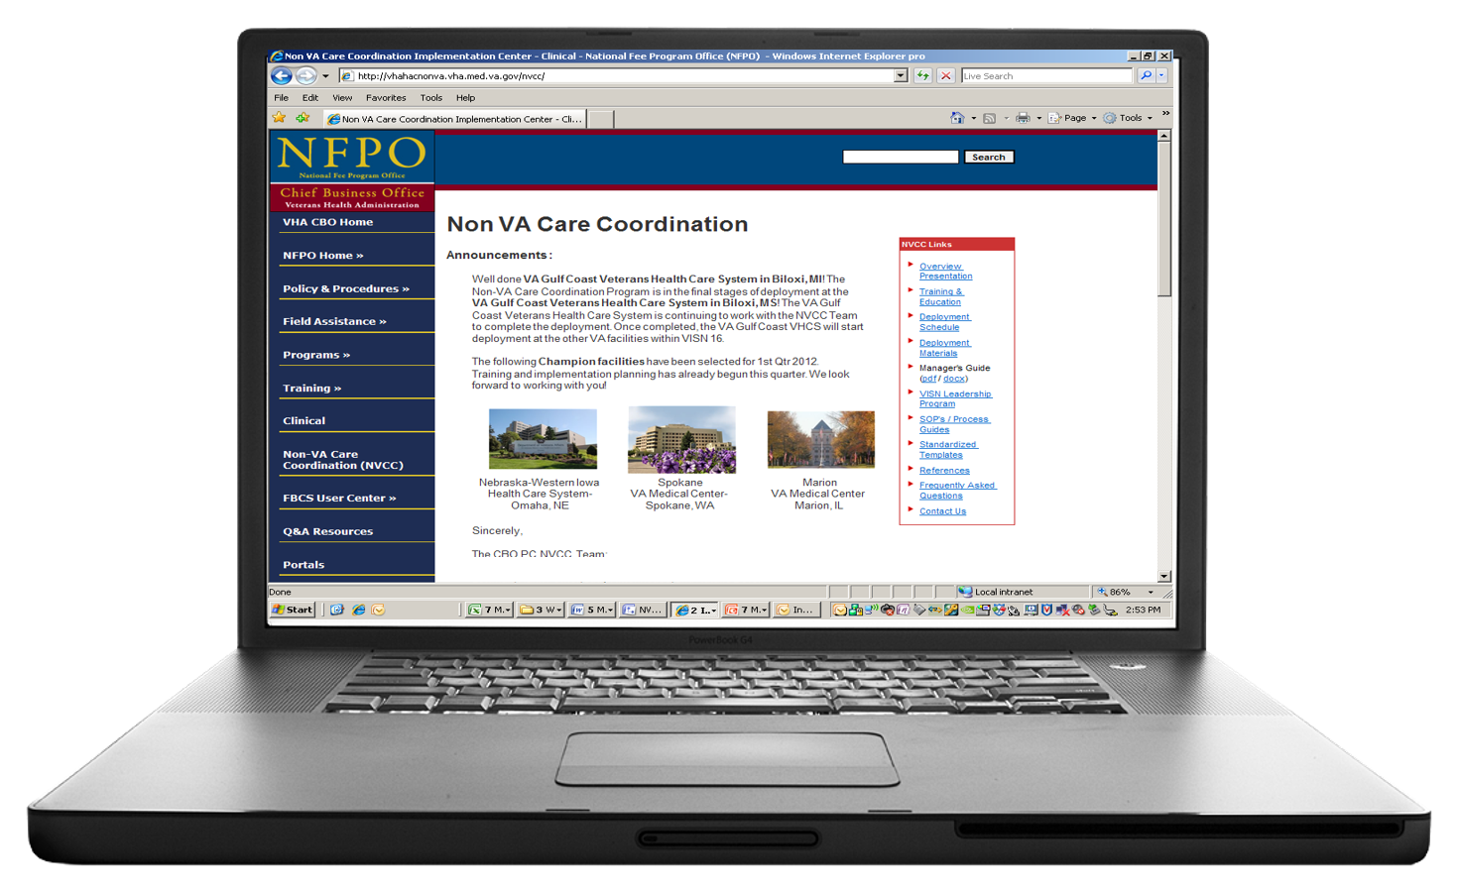
LIVE DEMO of NVCC WEBSITE
Notes:
We will now have this opportunity to show you the Non VA Care Coordination Website in a Live Demonstration with the assistance from Maureen Wallace – Program Analyst from the Non VA Care Coordination Team and show you our Artifacts and tools that can assist you in implementing a successful Non VA Care Coordination Team and standardized processes.

Slide 71

Ask the Presenter
Notes:
This concludes our presentation, there is still time to submit your questions to “ask the Presenter” Icon. We will now break for a brief video and be back to answer your questions live.

