Slide 1



-
I
C
D
1
0
D
O
C
U
M
E
N
T
A
T
I
O
N
Deborah Meesig, MD, JD
Chief of Staff, Chillicothe VAMC
Tina Schumacher, RHIA
VISN 10 Business Implementation Manager
Notes:
Dr. Meesig:
Thank you (moderator name)!
We are happy to be here today to talk about medical record documentation. This session was first intended to be all about ICD-10, however with implementation delayed again to October 1, 2015 , we are going to focus on both good documentation principals along with some focused ICD-10 concerns

Slide 2


Effect of documentation on patient care
Specific documentation highlights for ICD 10
Bridging the gap between clinical and coding language
Notes:
Dr. Meesig:
Documentation in the patient’s health record is essential in today’s healthcare environment. Obviously the primary intent of the record is to provide a source for documenting the care received during a hospital stay or outpatient encounter. A well-documented record clearly and thoroughly paints a picture of the care rendered. It leads to excellent continuity of care by providing this picture to those following the patients care, and enhances continuity of care for patients through improved, more precise, and complete clinical documentation
Tina:
Documentation in the health record is also used to evaluate the adequacy and appropriateness of patient care, provide clinical data for research and education, support reimbursement, medical necessity, quality of care measures, and public reporting for healthcare services rendered.
Many of these uses are data driven and the data derived from it comes from assigning specific code sets to the verbiage of these diagnoses and procedures documented in the record. On October 1, 2015, this clinical classification system will undergo a major overhaul with the implementation of ICD-10.
Dr. Meesig:
During today’s presentation we will give you some tools to bridge the gap between clinical and coding language, especially as it relates to the new ICD -10 codes set. The delayed implementation date gives us another year to concentrate on provider documentation improvement initiatives, some of which we will be highlighting throughout the presentation.

Slide 3

Poll Question
Who do we have in the audience this afternoon?
    Provider
    Coder
    HIM Management
    Other
Notes:
Tina:
Now I’d like to ask a poll question. Now that you have learned a little bit about us and the objectives of our presentation today, Dr. Meesig and I are interested in knowing you! To do that, we would like to poll our audience to see who we have with us today.
To answer this question, use the blue polling icon above my head and let us know who you are.
Provider
Coder
HIM Management
Other
We’ll move on and come back to your results in just a moment.

Slide 4

better clinical documentation promotes
better care
Notes:
Dr. Meesig
Many physicians believe that documentation is not very important because it is not directly related to patient care. These attitudes describe the challenge HIMS professionals have when they work to train physicians in clinical documentation. The code sets they work with are driven by our documentation in our patients health records.
The truth is, better clinical documentation promotes better care. Think about the last time you tried to pick up a patient who was previously cared for by another clinician. Was the documentation adequate to tell you a complete picture about the patient? Or were you frustrated trying to figure out what happened?
Tina:
Documentation in the health record is also used to evaluate the adequacy and appropriateness of patient care. Documentation that is specific and sufficient lays the foundation for the success of our healthcare delivery system. The challenge here in training providers is to ensure the training provided is clear, concise and specific to your needs.
We encourage providers to work hand in hand with your HIMS departments and work to develop a sustained relationship with them. They can teach you not only the documentation necessary for ICD-10, but to better improve your documentation habits in general.
Dr. Meesig:
One of our objectives for today’s presentation discusses bridging the gap between clinical and coding language. Simply put, coders and physicians speak different languages. Clinicians speak and document in clinical terms, coders code in diagnostic terms. We need to bridge the gap between the two.
Today we will assist you with what you need to learn in documenting your patient’s care by creating meaningful words to describe your patient’s condition.

Slide 5

Why switch to ICD-10?
Notes:
Tina:
Why in the world do we need to switch to ICD-10?
Well if you really think about it a minute, ICD 9 is over 34 years old; outdated in terms of medical technology and advances of today. How far has medicine come in the last 5 or 10 years; yet alone in the last 34 since ICD-9 began. ICD 9 is simply outdated to the way you practice medicine today, and to that light some of the documentation habits you already have will actually be reflected in ICD 10. A good example of that is STEMI/NSTEMI for myocardial infarctions as you have been using that terminology for years and now ICD 10 is catching up with you!
Dr. Meesig----
What providers need is for you to help us say it in terms that can be easily applied to the diagnostic terms you coders need to capture the appropriate code set.
Tina:
We are going to explore further in this presentation how much impact ICD 10 will have on your documentation practices, which will vary depending on your specialty. Most of the new concepts introduced in ICD-10 codes are concepts that all providers should be documenting now.
Remember the coder’s mantra…..if it was not documented, it was not done.
Now let’s take a few minutes to see who we have with us today.

Slide 6
Poll Results
Who do we have in the audience this afternoon?
    Provider
    Coder
    HIM Management
    Other
Notes:
Tina……
Dr. Meesig it looks like we have a variety of audience members today , thank you to all the providers listening today we appreciate you’re the time you took to tune in. Since the majority of the audience today is mostly HIM folks we ask that you make sure you let the providers at your facility know this presentation will be recorded and available at My VeHU campus.
Dr. Meesig: Yes, I would encourage you to use this presentation as part of your education to providers perhaps send this to them first and then follow up with them to address specifics for their particular specialties.
Now let’s continue on with today’s presentation.

Slide 7

Poll Results
Who do we have in the audience this afternoon?
    Provider
    Coder
    HIM Management
    Other
Notes:
NOT A DUPLICATE. DO NOT DELETE.

Slide 8

Why is documentation so important?
Patient Care
Research
Severity of Illness
Provider Comparison
Payment
Public Health Programs
Strategic Planning
Notes:
Tina….
Why is provider documentation so important?
The chart above depicts a multitude of reasoning. First and foremost, as Dr. Meesig spoke of previously, good documentation reflects good patient care. This care is then evidenced by creating a health record that clearly depicts the diagnoses and procedures your patient had during an encounter. HIMs folks call that “painting a picture of the patient and his/her clinical needs”.
The coded data provides the data set that is used for research and registries and drives severity of illness and risk of mortality indices. It provides evidence that services performed are medically necessary, aids public health administrators to monitor disease, provides support for strategic planning, supports the reporting of quality measures, and aids budget and operational decision making for hospital systems and physician practices.

Slide 9

Buzz
“Due to”
“Associated with”
“Exacerbation of”
“Possible”
“Probable”
“Likely”
“Rule-out”
What is the underlying cause?
Words
Notes:
Tina:
Before we start getting into the specifics of documentation, and the nuances of ICD -10 in particular, we would like to discuss some general documentation guidelines, and more specifically, the use of what we have coined here as “documentation buzz words”.
As we have spoken about already, coders cannot assume connections between diseases, manifestations of diseases, or cause and effect relationships unless they are specifically documented as such by providers.
Dr. Meesig:
This is where the use of “buzz words” are greatly needed in provider documentation to show those connections with your “words”. Paint us a picture of those connections.
Tina:
For example to me as a coder, type 2 DM documented in a progress note on a patient who also has “neuropathy pain” does not define the link between the DM and the neuropathy. The provider must explicitly show the link in their documentation. Phrases like DM2 with diabetic neuropathy make that link.
Dr. Meesig:
I was always told not to use ‘rule out’ – and now we are telling you on the inpatient side of the house to use rule out, possible, likely due to, and vague terms like that. These buzz words allow the coders to code information that we suspect and are treating for or working up, but might not yet be able to prove via testing results .
It will be reflective of the care you are rendering to say that someone has bacterial pneumonia even though you didn’t grow anything in the micro lab, because the patient clearly according to your knowledge and expertise has a bacterial pneumonia and in fact they are responding to the antibiotics that you ordered for them to treat it. Of course it always makes you feel better to be able to say that the pneumonia was due to Klebsiella – so if it was don’t forget to say so! Tina and I will be discussing pneumonia documentation in detail a little later in the presentation.
Tina: That’s right Dr. Meesig, we will definitely drill that one in a few minutes, but for now, I would like to clarify the buzz words for inpatient use verses outpatient settings.
On the inpatient side coders can and will code conditions that are that are documented at the time of discharge as “probable” “suspected”, “likely”, “questionable”, “possible”, or “still to be ruled out”.
Dr. Meesig:
I like to say it is taking credit for what you are treating and perfectly acceptable by coding guideline. If you only remember one thing from today’s presentation, remember the buzz words and use them.
This is where it gets a bit confusing to providers, though, because on outpatient encounters, coders cannot code probable, possible likely, etc. They can only code definitive diagnoses.

Slide 10





Good Habits: Documentation
Document underlying cause
Cause-effect relationships
Patient response to treatment;
status at discharge
“Probable”
“Possible”
“Likely”
“Suspected”
“Rule-out”
Findings, interventions, treatments;
medical necessity
Notes:
Tina:
To illustrate in another manner, and to expand on the buzz words, I adapted this chart from the Elsevier doc briefs to outline and emphasize many key general good documentation habits to ensure your words paint a thorough picture of your patients conditions.
Dr. Meesig
Most of the documentation tips in this slide would be best implemented in the discharge summary – findings, interventions and treatments. And then there is my favorite pet peeve – condition at discharge. How much did that stroke patient improve before they went home? Was that surgery patient eating solid food? When someone is trying to follow you in the care of the patient these are things they need to know.
Tina:
Now let’s move on to discuss ICD- 10; specifically, its structure and changes in the code set.

Slide 11
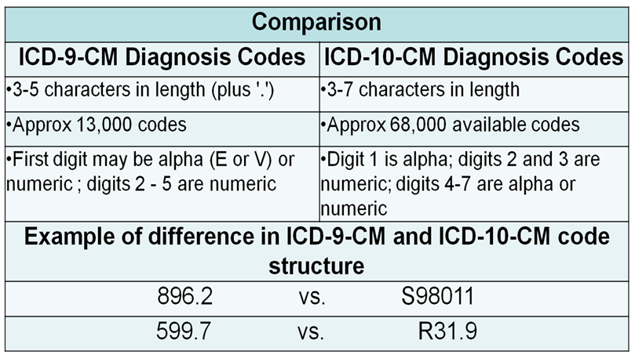
ICD 10 Structural Differences
Notes:
Tina:
This comparison slide outlines the structural differences between ICD 9 and ICD 10. The second line is usually where you hear everyone groan and gasp, 68,000 codes? Really??
But hold on, because we are going to break that down for you into a more manageable palette in the next slide to give you a more “realistic” look at the expansion.
Dr. Meesig:
Remember, the need for this expanse has come as medicine has greatly moved forward over the last 30 years since ICD-9’s development. ICD-10 will allow for this expansion.

Slide 12
Putting it in to Perspective
Putting it in perspective
Category | # ICD-9 Codes | # ICD-10 Codes
Laterality | Increase of 46% | 25,626
Injuries and poisoning | 2,572 | 39,675
Musculoskeletal | 892 | 6,327
External Causes | 1,291 | 6,812
Notes:
Tina:
The great expansion in the ICD-10 code set, is seen in these 4 areas with 50% of the new codes being related to injuries .
In the injury and poisoning section we see the largest growth; from 2,500 to over 39,000. Although this sounds ridiculous and may make orthopedists and ER docs want to go running for cover, in reality, this is just a matter of adding laterality, episode of care, and site specific detail to the vast amount of injuries. All contusions, sprains, strains, fractures, etc. are all expanded to two, three or four levels of detail.
Every time you add a level of detail, the increase gets multiplied across all the codes that use that level of detail.
Dr. Meesig:
Multiply this by every type of injury imaginable ; and there you have it - over 39,000 codes in this section alone; and that in itself is almost half of the expansion. Knowing this should ease your fears.
We will walk through some specific examples for this section later in the program.

Slide 13

Elsevier Doc Briefs
Online
Documentation basics
CME
Notes:
Tina:
Much of our material today as well as the tip sheet we have provided for you is available via the Elsevier training portal. Our reference slide at the end of today’s presentation gives you the link to the Elsevier website.
Dr. Meesig:
All VHA employees have access to online training courses from Elsevier. These include some great modules geared specifically toward providers. They are titled Doc Briefs and they are just that, short 12 – 16 slide modules geared toward assisting providers with documentation basics for 26 topics.
Tina:
Providers can also receive CMEs for viewing and answering the test questions at the end, then you can simply print your CME certificate; as each Doc Brief is worth .5 CMEs.
Dr. Meesig:
I love free CME’s!

Slide 14
Documentation Principles
Infectious disease
Neoplasm
Diabetes
Mental health
AMI
Heart Failure
Hypertension
Asthma
Injuries
Fractures
Chronic kidney disease
Drug Underdosing
Cerebral Infarctions
AMI
ICD-10-PCS
Notes:
Tina :
Our journey today will incorporate these topics in a systematic approach. This is a suggested route of educational opportunities when teaching ICD -10 in general to providers. I should rephrase that actually; we are not going to teach providers ICD 10. Our goal today is to teach you the specific documentation principles necessary for the coding staff to assign the correct codes.

Slide 15
Infectious Disease
Origin of bloodstream infection
Organisms causing the infection (always specify if determined)
Severity of the infection
  Progression from localized infection of another organ or body site
  Infected device, implant, or graft (specify type and location)
  Postprocedural (specify the procedure)
  Other (specify)
  Generalized (origin unknown)
  Childbirth or abortion
  Newborn
  Bacteria
  Mycoses
  Viruses
  Fungi
  Parasites
  Others
  Bacteremia – positive laboratory finding of organism in blood without symptoms of inflammation or infection
  Sepsis-systemic bloodstream infection
    Bacterial toxemia / Generalized infection / Pyemia / Septicemia
  Severe sepsis
    Sepsis with organ dysfunction / Sepsis with septic shock /
    Systemic inflammatory response syndrome
Resource table from Elsevier Doc Briefs
Notes:
Dr. Meesig:
We will start first with infectious disease. At first glance, this slide looks like a lot of charting. However we are going to break it down into practical examples for you. The chart is meant to assist you as a reminder of the elements necessary to completely capture charting of infectious disease.

Slide 16
Infectious Disease
Origin of bloodstream infection
Organisms causing the infection (always specify if determined)
Severity of the infection
  Progression from localized infection of another organ or body site
  Infected device, implant, or graft (specify type and location)
  Postprocedural (specify the procedure)
  Other (specify)
  Generalized (origin unknown)
  Childbirth or abortion
  Newborn
Notes:
Dr. Meesig:
When there are signs of an infectious disease with your patients, you begin to cover with broad spectrum antibiotics based on the patient’s presenting symptoms.
You may already know the origin of the infectious source, if so, be sure to document it especially if you “suspect” and are treating empirically for it. Is this an infection from an infected device or implant? If so, coding needs you to document as such; the same for a post procedural infection. Please specify the procedure and tie the infection to the post procedural state.
Tina:
In short, always include the origin of the infection, if known, or the suspected origin.
For instance, for a Bladder or Urinary infection that becomes systemic leading to sepsis, it is vital to include the statement ‘sepsis from a urinary source’ and list the causative organism if known.
Again a good way to chart this would be sepsis from a urinary source, suspected e-coli, or another way to say that would be E. coli urinary sepsis - DO NOT chart UROSEPSIS

Slide 17
Infectious Disease
Origin of bloodstream infection
Organisms causing the infection (always specify if determined)
Severity of the infection
  Bacteria
  Mycoses
  Viruses
  Fungi
  Parasites
  Others
Notes:
Dr. Meesig:
Besides the origin, document as well the organism causing the infection, or the organism you suspect to be causing the infection, for example, bacteria, virus, or fungus.
Tina:
Keep in mind you, as the physician, do not need to have a positive blood culture to diagnosis a septic patient, you can document a suspected, likely, or probable infection because you are treating it as if it exists.

Slide 18
Infectious Disease
Origin of bloodstream infection
Organisms causing the infection (always specify if determined)
Severity of the infection
  Bacteremia – positive laboratory finding of organism in blood without symptoms of inflammation or infection
  Sepsis-systemic bloodstream infection
    Bacterial toxemia / Generalized infection / Pyemia / Septicemia
  Severe sepsis
    Sepsis with organ dysfunction / Sepsis with septic shock /
    Systemic inflammatory response syndrome
Notes:
Dr. Meesig:
Also list the severity level of the infection. Is this sepsis with severe sepsis – a sepsis with organ dysfunction? You should also document the type of organ dysfunction –hepatic, respiratory for example , and tie the sepsis to that in your documentation.
We will have some specific examples on the next slide.
Tina:
The ICD-9 term “septicemia” has been replaced with the term “sepsis” in ICD-10. There will be dozens of new sepsis codes that differentiate between “Sepsis” and “Severe Sepsis”.
A term the coder would like you to wipe from your vocabulary is bacteremia, which in coding is nothing more than an abnormal lab finding. It is not considered a diagnosis, and coders cannot “assume” you mean sepsis in its place. If your patient is septic ---use the term sepsis, give the origin, the organism and the severity.

Slide 19

“Meningococcal sepsis”
“Group A streptococcal sepsis with acute respiratory failure”
“MRSA-infected hip prosthesis with osteomyelitis and sepsis”
“Severe sepsis with septic shock and acute renal failure”
Notes:
Dr. Meesig:
Here are some great examples of well documented infections.
Note documentation of the type of sepsis, using the connector word “ with”, and adding the severity of the sepsis and other related conditions.

Slide 20
Pneumonia
Type of Pneumonia
Causative Organism
Document underlying conditions and/or suspected causes
  Aspiration
  Bronchopneumonia
  Lobar pneumonia
  Interstitial
  Lipid
  Allergic
  Hypostatic
  Bacterial
  MRSA or MSSA
  Viral
  Other (candidiasis, mycoses, fungal, etc.)
  “due to”, “secondary to”, “caused by”, “resulting from”, etc.
  Example: “Lobar pneumonia due to Escherichia coli”
Notes:
Tina:
Now we get to the pneumonia tips.
This is often a problematic diagnosis for coders to code because of the lack of specificity documented. Often we see “CAP” or “pneumonia” documented in the record without specificity as to the type of causation. When documenting pneumonia always specify the causative organism if know or what you suspect.
Dr. Meesig:
The vast majority of patients will not require hospitalization for a community acquired pneumonia. Patients requiring hospital stays for pneumonia are usually admitted for IV antibiotic therapy. Often this is a bacterial pneumonia, however it is difficult to obtain a good sputum cultures. Keep in mind providers do not need to have a sputum culture to diagnose a bacterial pneumonia. We as physicians know this is a bacterial pneumonia in nature, but we may not know the exact causative organism. However, we are treating to cover the bacteria using a broad-spectrum antibiotic. In these cases it is perfectly acceptable to document probable bacterial pneumonia, bacterial pneumonia, or likely bacterial pneumonia; remember to use your “buzz” words to add specificity to your documentation.
On the next slide Tina is going to walk us through the VERA implications of this as well as they are quite remarkable.

Slide 21
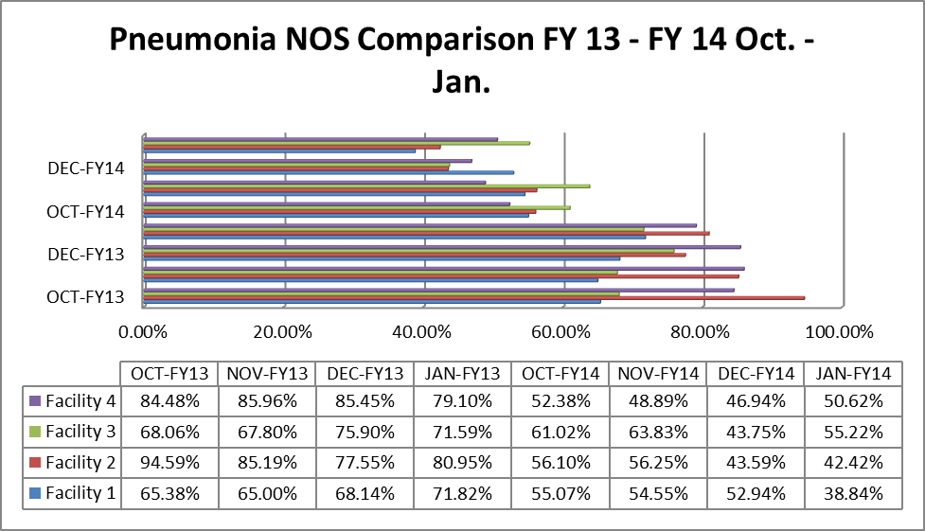
Not Otherwise Specified Pneumonia Improvement
JAN-FY14
42.42%
94.59%
Notes:
Tina
In VISN 10, where Dr. Meesig and I both work, we noted a significantly high rate of “not otherwise specified” pneumonia. The not-otherwise specified pneumonia diagnosis is what results from not documenting the type of pneumonia, the causative organism, and the underlying conditions or causative factors.
VISN 10 began a campaign to educate providers on proper documentation using clinical documentation specialists and coding professionals at the various facilities. You can see from the graph the improvement that we made in our pneumonia documentation over the next year. Facility 2 reduced their NOS substantially from 94% in October 2013 to 42% in January 2014 , a remarkable 52% reduction.
Dr. Meesig:
This is just properly documenting the care that we are providing, so we can get proper credit for our work. The difference in VERA reimbursement between non-specified and many specified pneumonias is substantial, as well, which we will explore on the next slide.

Slide 22
VERA Category 6
$ 21,730
VERA Price Group 6 – High Cost Pneumonia
-
$ 2,729
Vera Price Group 2 – Basic Pulmonary Disease
$ 19,001
The Value Difference
Notes:
Dr. Meesig:
If you remember from the last slide the changes in the coding of specific pneumonia diagnoses, you can appreciate the amount of potential VERA reimbursement associated with a pneumonia that is not otherwise specified versus a specified high cost pneumonia which equates to $19,000.
Tina:
Most of our facilities decreased their not-otherwise-specified pneumonia diagnoses by approximately 30 percentage points with our initiative. Not every one of these cases would fall into the highest reimbursement category, but that is still a huge change in the reimbursement, just based on a few well-specified words in the medical record.
Dr. Meesig:
Keep in mind that there is not anything improper about this, it is just proper documentation which leads to appropriate payment for the care that we are providing!

Slide 23
OLD
  “Sepsis from urinary source”
  “Urinary sepsis due to e coli”
  “Septic due to e-coli urinary infection”
UROSEPSIS
NEW
Notes:
Dr. Meesig:
And now some words on documentation to NOT use.
Urosepsis is an old outdated term we are trying to get rid of. Providers sometimes use the word urosepsis to define sepsis from a urinary source, again, it may be inherent to us providers that the term is interchangeable with sepsis, however, coding staff cannot make that judgment call, and must strictly code from provider documentation - so it is important for you to document in diagnostic terminology.
Tina:
The term urosepsis in ICD-9 codes to a UTI and is not even included in the ICD-10 index nor does it coincide with any individual code in ICD 10. If you do not want to be visited with a “provider query” from the coding or CDI staff, avoid the term. If your patient is septic, say so, and give the origin, if known, or what you suspect to be the origin.
Dr. Meesig:
Another implication to the above is the difference in severity of illness and risk of mortality indices. You can bet there is a huge difference to both when differentiating between UTI and sepsis. Be clear to avoid looking like your patient died from a UTI, when they really had severe sepsis from a urinary source with respiratory failure.

Slide 24
Poll Question
Which of the following terms should be used if a diagnosis/disease is not yet confirmed but is being treated and investigated?
    Probable
    Possible
    Likely
    Suspected
    All of the above
Notes:
Dr. Meesig:
Now it is time for another poll question.
Which of the following terms should be used if a diagnoses/disease is not yet confirmed but is being treated and investigated?
To answer this question, use the blue polling icon above my head to log your answer.
We’ll move on and come back to your results in just a moment.

Slide 25
Neoplasms
Behavior
  Primary malignancy; Metastases; Benign, in-situ, uncertain behavior, or unspecified
Location
  Specific body site or part; Tissue type (skin, connective, lymphatic, neuroendocrine)
Cell Type
  Carcinoma; Kaposi’s sarcoma; Burkitt’s lymphoma; Melanoma; Mesothelioma; Osteosarcoma
Acuity
  Acute or chronic; Not having achieved remission; In remission; In relapse; Recurrent; History of (eradicated)
Notes:
Dr. Meesig:
Moving on to Neoplasms, we again look for specificity in documentation. With neoplastic disease it is important to speak to the behavior, location, cell type and acuity level of the disease you are treating.
Tina:
Most of the differences between ICD-9 and ICD-10 with neoplasms is due to detail. In ICD -10 we see classification of neoplasms based on sex, laterality, and site specific body part determinations. This is the first chapter where laterality comes into play of great significance.
It is especially important in these cases to understand how your documentation can affect these assignments in ICD-10 and how you can assure you are getting your words across and into data collection and for cancer registries as well.
Dr. Meesig:
Keep in mind as we go through these examples, that with neoplasms you need to ensure that acute and chronic findings, signs and symptoms, clinical indicators, and complicating factors are not only documented but linked to underlying neoplastic conditions.
Remember our slide with the magic words to describe this linkage; let us refresh you here:
Due to, likely due to, because of, associated with, and, with!

Slide 26

“Small cell lung carcinoma with
acute respiratory failure”
“Stage IA melanoma of the
right lower leg”
“Acute nose bleed due to Chronic Lymphocytic Leukemia with thrombocytopenia”
“Acute bowel obstruction due to obstructing rectal adenocarcinoma”
Notes:
Tina:
On this screen you see some examples of good documentation for neoplasms. Note the use of the words “with” and “due to”
Also see how identifiers of cancer type are used, like small cell lung carcinoma and chronic lymphocytic leukemia.
And when it is known, staging is also a good term to include as well.

Slide 27

Metastatic
  Metastatic colon cancer with localized spread to the omentum
  Lung carcinoma with metastatic disease to the left upper lobe of the liver
  Ovarian adenocarcinoma with metastases to the pelvis
Notes:
Tina…
If the malignancy is metastatic, clearly identify which site is primary and which site/sites are secondary. Often times we coders see documentation in “problematic terms” for us such as metastatic colon cancer. This leaves us guessing which site is the primary and which is the secondary, again, this is inherent to providers who understand the order for the patient you are treating.
Dr. Meesig:
Please take care in documenting by using the terms to and from to identify the spread from one site to the other (secondary). This will take the guesswork out of it for coding staff and enable them to clearly recognize the relationship and order of the malignancies.
*************************************************************************************************************************
NOTES:
Problem Term
Metastatic colon cancer
Metastatic liver disease
Metastatic carcinoma of the lung
Metastatic bone tumor
Explanation
Cannot tell from these phrases if the site listed is the primary or secondary site
Better terminology
Metastatic colon cancer with localized spread to the omentum
Lung carcinoma with metastatic disease to the left upper lobe of the liver
Ovarian adenocarcinoma with metastases to the pelvis

Slide 28
Poll Results
Which of the following terms should be used if a diagnosis/disease is not yet confirmed but is being treated and investigated?
    Probable
    Possible
    Likely
    Suspected
    All of the above
Notes:
Dr. Meesig:
Now lets take a look at those poll results, Tina, and see what folks have answered to our poll question.
Which of the following terms should be used if a diagnoses/disease is not yet confirmed but is being treated and investigated?
The correct answer is of course E, all of the above. Remember these are some of the buzz words we spoke of during the beginning of the presentation and can always be used by providers when a diagnosis is not yet confirmed but is still under treatment and investigation.
Now lets move on to speak about blood loss anemia.

Slide 29

Poll Results
Which of the following terms should be used if a diagnosis/disease is not yet confirmed but is being treated and investigated?
    Probable
    Possible
    Likely
    Suspected
    All of the above

Slide 30

Blood Loss Anemia
  Acute anemia due to blood loss
  Acute blood loss anemia
  Acute post hemorrhagic anemia due to acute blood loss following surgery
**Document blood products given**
Notes:
Tina:
Blood loss anemia is perhaps the most queried for conditional relationship query out there. This causes confusion among providers and coders alike.
If a patient with acute bleeding loses enough blood to become anemic, the diagnosis of acute blood loss anemia is appropriate.
Dr. Meesig I have had surgeons tell me in the past that they do not want to document acute blood loss anemia because they perceive that as being a “complication” to the surgery, can you discuss this briefly with our audience?
Dr. Meesig :
We are often reluctant to use acute blood loss anemia as we fear it may be perceived to be adverse patient care, however, this is not the case in most instances as it is often a “normal” post operative condition due to the type of surgery. If my patient looses enough blood to become anemic, then the diagnosis of acute blood loss anemia is appropriate. Even if the amount of blood lost after surgery is expected and routine with that type of surgery like orthopedic procedures. Again, acute blood loss anemia is still present if anemia occurs in these cases.
Concerned surgeons like myself need to be reassured that the code for acute blood loss anemia is not classified as a “complication of surgery”, and that adding it when appropriate will not adversely impact a surgeon's complication rates or quality scores.
Tina:
I think where the confusion comes in is when we are talking about the diagnosis of “postoperative hemorrhage” which may result in coding of a surgical complication.
Blood loss anemia after surgery does present coding challenges. Just because the acute blood loss anemia may follow a surgical event does not mean it is a postoperative complication.
The provider must document the cause and effect relationship to the blood loss. The provider must document that the blood loss was related to the surgery AND that it complicated the procedure or hospital course.
Coders need to explicitly follow coding guidelines in this area carefully, the “complication” code for post-op hemorrhage should not be assigned unless the physician, usually the surgeon, clearly indicates that the hemorrhage was due to, or was a result of, the procedure.
The term “post – op” does not establish this connection unless the provider explicitly indicates such by identifying the cause and effect relationship in the chart.
Post – op is used to describe a condition occurring after surgery, like fever, ileus, urinary retention, etc… Complication codes are for conditions that are unexpected and not commonly associated with the procedure.
Dr. Meesig
If it did happen unexpectedly, it happened, if it is in the post op note, you should put it in the operative report and be sure to document in the discharge summary as well.
Also be sure be to clearly document when ordering blood products in your progress notes. Blood transfusion is not required to substantiate the diagnosis of acute blood loss anemia. However, if a transfusion is necessary, acute blood loss anemia is almost certainly present, and if it is not documented and the coding staff sees that blood products were given you can certainly expect one of those queries to be coming your way.

Slide 31
E
ICD-10
Diabetes Mellitus
E08 - Diabetes mellitus due to underlying condition
E09 - Drug or chemical induced diabetes mellitus
E10 - Type 1 diabetes mellitus
E11 - Type 2 diabetes mellitus
E13 - Other specified diabetes mellitus
Notes:
Dr. Meesig:
Now let’s switch our discussion to Diabetes. Diabetes is probably one of the most common diagnoses we see with our patient population and ICD-10 does bring significant changes to the classification of this disease in the new system. In ICD -10, there are five categories for diabetes mellitus in ICD-10-CM as you see on the slide. No longer is diabetes classified as “controlled” or “uncontrolled” as we have become accustomed to.
Tina will show us some of the detail over the next few slides.

Slide 32
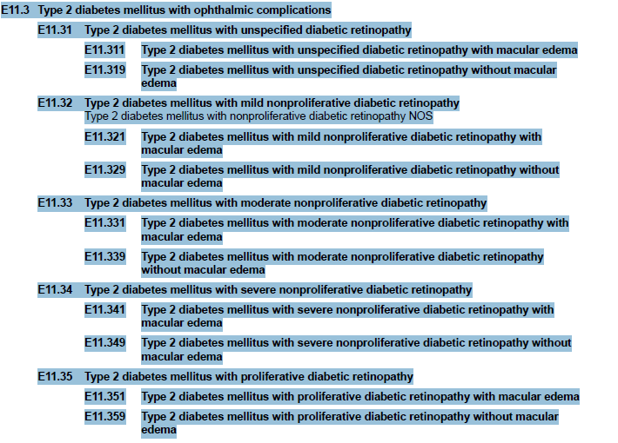
Combination Codes Add Specificity
A+
E11.341 Type 2 diabetes mellitus with severe nonproliferative diabetic retinopathy
with macular edema
Type 2 DM with severe nonproliferative diabetic retinopathy and macular edema
Buzz word use – with
Notes:
Tina
The importance with documenting diabetes is to identify first, the type as we listed on the previous slide.
After that, it is all about the manifestations and complications associated with diabetic disease.
It is vitally important to use your buzz words here to again show the relationship of the diabetes and those manifestations.
The difference is with ICD-10 we will be able to capture the manifestations and complications in one code to include the diabetes itself.
We have a great documentation example here on our slide . In this case, the diabetic retinopathy with the macular edema is connected to the Diabetes. In addition, the diabetic type is specified as type 2 and the non-proliferative diabetic retinopathy is also documented as severe.
The provider here let us know very specifically using the connector word “with” that the retinopathy and macular edema are a manifestation of the DM. This provider gets an A+ for sure!

Slide 33
Diabetes
Type or Cause
  Type 1, Type 2, Due to drugs or chemicals, Due to underlying condition, Other specified diabetes
Body System Complications
  Kidney complications, Neurological complications, Opthalmologic complications, Skin/ulcer complications
Combination Codes
  Chronic kidney disease, Foot ulcer, Hypoglycemia without coma
Notes:
Meesig:
In ICD -10 diabetic complications are much more specific.
Creating this link is not difficult, remember our Buzz words we listed at the top of the presentation; short and sweet connectors.
For example:
Chronic Kidney disease, stage 4, due to diabetic neuropathy
Type 2 diabetes mellitus with diabetic peripheral angiopathy without gangrene
*************************************************************************************************************************
NOTES:
Type or cause
–– Type 1
–– Type 2
–– Due to drugs or chemicals
–– Due to underlying condition
–– Other specified diabetes
Body system complications related to diabetes,
Kidney complications
Neurological complications
Ophthalmologic complications
Skin/ulcer complications
Combination Codes include diabetes and the complication, such as:
–– Chronic kidney disease
–– Foot ulcer
–– Hypoglycemia without coma

Slide 34


Mental, Behavioral and Neurodevelopmental Disorders
Alcohol and Drug – Use, Abuse, Dependence
Psychoactive Substances
Nicotine Dependence
Major Depression
Notes:
Tina:
Moving on to mental health, in this section we will see many combination codes to describe drug and alcohol use and associated conditions such as psychosis, withdrawal, and sleep disorders.
When documenting, the key words to use in your documentation are use, abuse or dependence.
Providers need to state the pattern of harmful usage (dependence, abuse or use) and its current clinical state (uncomplicated, intoxication, remission, etc.) In addition, also document the relationship to any identified mental, behavioral, or physical disorder or its relevance to the patient’s status or encounter.
Detoxification should also be documented in orders and in the progress notes, including the drugs or substances used and their administration.

Slide 35
Substance Use Section
DSM-V
ICD-10
Notes:
Dr.Meesig:
A major difference between the DSM-5 and ICD-10 involves the Substance Use Section. While the DSM-5 eliminates the distinction between chemical abuse and dependence, the ICD-10 retains the categories of use, abuse, and dependence. There are significantly more substance use diagnoses in the ICD-10 than there are in the DSM-5. Because diagnoses in the DSM-5 have numerous possible iterations in the ICD-10, clinicians expecting a one-to-one code match need to be aware this is not the case.

Slide 36
Psychoactive Substances
Opioid
Cannabis
Sedative
Alcohol
Cocaine
Other Stimulant
Hallucinogen
Other….
Inhalant
Nicotine
Notes:
Tina:
Again,
It is very important to document the psychoactive substance as it pertains to use, abuse and dependence.
ICD-10 categorizes those into the 10 different categories you see on the slide.
Also remember to ask your self this…
Is there a current acute manifestation, or is there a chronic disorder resulting from longer-term use of the substance?
If so, please document as such by using your connector words to show the relationship.
For example: Opioid dependence with withdrawal…establishes all three:
the substance,
the dependence
the acute manifestation of withdrawal
********************************************************************************************************************
NOTES:
Alcohol related disorders
Opioid related disorders
Cannabis related disorders
Sedative, hypnotic or anxiolytic related disorders
Cocaine related disorders
Other stimulant related disorders
Hallucinogen related disorders
Nicotine dependence
Inhalant related disorders
Other psychoactive substance related disorders
Other diagnostic factors that should be documented include:
Intoxication
Mood disorder
Psychotic disorder
Other
Other complicating factors may include:
Delirium
Delusions
Hallucinations
Perceptual disturbance
Sexual dysfunction
Sleep disorder
Anxiety

Slide 37
305.1
Tobacco Use Disorder
ICD-9
ICD-10
  F17.210 Nicotine dependence, cigarettes
  F17.220 Nicotine dependence, chewing tobacco
  F17.290 Nicotine dependence, other tobacco product
Notes:
Dr. Meesig:
Tobacco use disorder is important to capture in the social history and if you are treating a current causal condition. In ICD-10 nicotine dependence replaces tobacco use disorder, and there are over 20 codes for nicotine dependence.
We need to specify if the patient is engaging in the use of tobacco or has developed a dependence on tobacco or nicotine. Specific documentation is needed on the type of tobacco product used and whether or not there are nicotine-induced disorders such as remission or withdrawal.
Tina: bottom line…Gone is the catch all code 305.1.

Slide 38
Depression
Psychotic features
Episode
Single
Recurrent
With
Without
Partial
Full
Mild
Moderate
Severe
Remission Status
Severity
Notes:
Meesig:
Depression documentation will not see significant changes from ICD-9 to ICD-10 .
Clinicians should continue to document depression by episode, severity, with or without psychotic features, and remission status.

Slide 39

Circulatory System
Heart Failure
Atherosclerosis
AMI
Cerebrovascular Infarction and Hemorrhage
Hypertensive Diseases
Notes:
Dr. Meesig:
Moving on to the circulatory system, These are conditions that we also see a lot of. In Heart Failure for example, we need to specify the systolic or diastolic type. Without this, we lose it as a complicating condition when it isn’t the principle diagnosis. Tina will elaborate on the next slide….

Slide 40
Heart Failure
Type
Acuity
Cause and Effect
Documentation must clearly identify the cause-and-effect relationship between heart failure and hypertension and/or kidney disease
Use your Buzz words!
Notes:
Tina:
Heart failure has been a problematic area for coders for years so we would be remiss not to mention it during today’s presentation. The classification of heart failure does not change in ICD-10 . As Dr. Meesig mentioned, providers need to specify the following when documenting heart failure:
the type of failure - systolic or diastolic
the acuity or chronicity- such as acute, exacerbation, chronic, etc.
And finally, when there is a cause-and-effect relationship between the heart failure and other systemic diseases, use the buzz words to establish the relationship. An example might be “exacerbated systolic heart failure with chronic kidney disease”.

Slide 41

Atherosclerosis
Major anatomic site
Native or bypass graft
Laterality
Complications
Notes:
Dr. Meesig:
In atherosclerosis, combination codes have been expanded to capture secondary disease processes.
It is important to identify the disease first by the type of disease and its severity, for example, peripheral vascular disease. Then identify the anatomical site, such as abdominal aortic aneurism, or left femoral arterial stenosis.
Specifying whether the atherosclerosis is in a native vessel or bypass grafts is important, and if it is a bypass graft, is it autologous or non-autologous, biological or non-biological. Of course don’t forget laterality, left or right, and associated complications and manifestations, such as a non-healing foot ulcer or claudication.
Putting it all together, an example would be - Atherosclerosis of non-autologous biological bypass graft of the extremities with intermittent claudication other extremity.

Slide 42

Myocardial Infarctions
Type
a subsequent episode of care for MI is considered within
4 weeks
Location
Date
New
Initial or Subsequent
Notes:
Meesig:
Regarding Acute Myocardial infarction, remember our earlier reference. This is where ICD-10 actually catches the coding up to current documentation. To start with , Acute Myocardial Infarction is classified as a STEMI or NON-STEMI. We have recognized MI’s in this manner for quite some time, but ICD-9 does not have coding to correspond to these designations. Again, in documentation the location is important, such as anterolateral wall or true posterior wall.
And whether it is the initial MI or a subsequent one occurring within 4 weeks also should be documented. The time frames for subsequent MI for ICD-10 is 4 weeks, but in ICD-9 it is 8 weeks. This is another difference.
*************************************************************************************************************************
NOTES:
Type
STEMI
NSTEMI
Location
Anterolateral wall
True posterior wall
Date
ICD 10 classifies an acute myocardial infarction to 4 weeks or less
Initial or Subsequent
New concept in ICD-10
Subsequent is a new MI occurring within 4 weeks of an initial MI

Slide 43

CVA Documentation Basics
Document DOMINANT/NON-DOMINANT
in addition to LEFT or RIGHT
Type
Location
Vessel
Laterality and Hand Dominance
Notes:
Tina:
Moving on to CVAs. In order for CVAs to be reported accurately in ICD 10—providers must document the type, location and vessel involved to fully describe the CVA and capture the specificity, this is no change from ICD-9 . The addition we see with ICD 10 is the further classification of dominant/non dominant identification for hemiparesis and weakness due to the stroke. Providers will need to document which is the patient’s dominant side!
******************************************************************************************************************
NOTES:
Document - Dominant/Non-dominant in addition to Left or Right for hemiparesis and weakness due to strokes
If dominant side is not documented use the following default guidelines:
For ambidextrous patients, the default should be dominant.
If the left side is affected, the default is non-dominant.
If the right side is affected, the default is dominant
Type
Hemmorrhagic
Infarction
Ruptured cerebral aneurysm
Stenosis or occlusion without infarction
Location
Subarachnoid (what artery)
Subdural
Intracerebral
Vessel
Carotid artery
Cerebral artery
Communicating arteries (anterior & posterior)
Precerebral artery
Laterality & Hand Dominance
Left
Right
Bilateral

Slide 44
Cerebral Infarction
“Cerebral infarction DUE TO _______”
Type
Location
Vessel
Laterality and Hand Dominance
Notes:
Tina:
This chart depicts some of the detail in ICD 10 regarding cerebral infarctions. What I want you to note on this slide is the importance of the buzz words “due to” in every diagnosis code here. These diagnoses are “due to” thrombosis in the various arterial distributions, but in other cerebral infarction diagnoses it may be “due to” hemorrhage, or “due to” embolism. You get the picture.
We should be starting to see some themes in the documentation basics here. Again with stroke, the type and location are needed.
Ask yourself? Is the stroke hemorrhagic, thrombotic, embolic, stenotic, or resulting from an aneurism? And by location NOW we are not talking about right or left, although you need to state the laterality too, we are referencing the location or distribution of the blood vessel in the brain that is blocked or bleeding, or is it a subdural or intracerebral bleed.

Slide 45
“Complete artherosclerotic occlusion of the middle cerebral artery with infarction”
“Spontaneous subarachnoid hemorrhage due to a ruptured berry aneurysm”
“Multiple localized points of intracranial hemorrhage secondary to warfarin-induced coagulopathy”
“Intraventricular hemorrhage caused by hypertensive encephalopathy”
“Multiple localized points of intracranial hemorrhage probably secondary to heparin-induced coagulopathy”
Notes:
Dr. Meesig:
So here we have some more good documentation examples. Note the use of the buzz words again – with, due to, and caused by; the type of stroke - occlusion, or hemorrhage – and their modifiers - complete, spontaneous, and multiple localized; the location – middle cerebral artery; and complicating factors – “probably secondary to” heparin induced coagulopathy. We generally list most of these diagnoses, but we don’t always string them together to properly attribute them to the cause-and-effect. And we often don’t use the modifiers that you see. It’s like the difference between fourth grade English class and twelfth grade. It is important for us to learn to use these modifiers, or have the clinical documentation specialist help us with them.

Slide 46

Stroke Late Effects
Identify specific late effects
  Aphasia, dysphagia (specify level of involvement), neglect, monoparesis, hemiparesis (dominant or nondominant side), quadriparesis, etc.
Are they still present at discharge or have they cleared?
Notes:
Meesig:
Now we are back to my pet peeve – what did the patient look like on discharge? How much did they improve during their hospital stay? For the provider taking over the patient’s care after you, this is important information. It is also important for the coders to properly code the diagnosis.
It is also important to document whether the stroke is acute on admission or a chronic condition. If it is an acute stroke, what are the residual effects that the patient is still manifesting at discharge. As in pneumonia, we will see that late effects of stroke affect the VERA reimbursement by quite a bit.

Slide 47
VERA Stroke Hierarchy
+
Primary Dx
Stroke, CVA,
Occlusion
Secondary Dx
=
Specialized Care (7)
VERA Class # 37 – Reimbursement Factor - $16,373
Notes:
Tina:
As Dr. Meesig said, the documentation of stroke late effects plays a big role in VERA reimbursement. For patients discharged from an inpatient setting with a primary diagnosis of acute stroke, CVA or occlusion, followed by a secondary residual condition commonly seen such as aphasia, dysphagia, hemiplegia and hemiparesis, they will have a classification of specialized care, putting the patient into Vera Class #37.
If there is no residual condition documented the patient falls to a basic vesting class for cardiovascular disease with reimbursement value so to speak at $2729 per case.
The VERA stroke class has a value of $16, 373 , which you can see is much higher. Makes sense though as VERA is recognizing that it will cost more to take care of the patient’s residuals following a stroke with ongoing care. If you miss documenting those residuals however during the inpatient stay….the extra value will be lost.
Dr. Meesig:
So as you can see, this documentation is very important to your VA for you to get it right. Again, it is not gaming the system but proper documentation to get proper credit for the work that you are doing.

Slide 48

Hypertension
Document underlying causes and complications
I10
Notes:
Meesig:
Tina thought it was funny that the code of hypertension is I-10, which is what the coders use for short to designate ICD-10. However, documenting for hypertension does not need to cause you stress, frustration or even hypertension. Probably a place to start would be documenting high blood pressure without a diagnosis of hypertension, if you have a patient with mildly elevated blood pressure who has not developed any sequela. Heart disease, kidney disease, heart and kidney disease, you get the idea, are key to documenting the association. Here we use our buzz words again to connect the conditions. And don’t forget to add the history of use of or exposure to tobacco.
**************************************************************************************************************************
NOTES:
ICD-10 Hypertension Code Series: I10 – I15.x
Comorbidities Present
Hypertensive heart disease
Hypertensive Chronic Kidney Disease (CKD)
Hypertensive heart and CKD
Secondary hypertension
Underlying condition
Indicate as appropriate
With / without heart failure
Type of heart failure
Stage of CKD
History of use, current use of, or exposure to tobacco
Distinguish between hypertension and high blood pressure without diagnosis of HTN

Slide 49

Respiratory
Notes:
Tina:
Moving on to respiratory diseases –COPD is a very common diagnosis at the VA. Documentation of COPD should reflect the stage of lung disease for accurate coding.
We already discussed pneumonia. We didn’t, however, discuss ventilator-associated pneumonia. Along with the respiratory failure that required the ventilator in the first place, Ventilator Associated Pneumonia should be clearly documented in addition to the organism involved.
**********************************************************************************************************************
NOTES:
Documentation should reflect the stage of lung disease for accurate coding
COPD:
Stage I- Mild COPD – mild airflow limitations
Stage II- Moderate COPD worsening airflow limitation
Stage III- Severe COPD Worsening airflow limitations
Stage IV- Very Severe COPD

Slide 50
Asthma
Severity
Acuity
Type
Mild intermittent
Mild persistent
Moderate persistent
Severe persistent
  With or without acute exacerbation
  With or without status asthmaticus
  Uncomplicated
  Allergic extrinsic
  Atopic
  Cough variant
  Eosinophilic
  Exercise-induced bronchospasm
  Extrinsic allergic
  Nonallergic
  Wood
Resource: Elsevier Doc Briefs - Asthma
Notes:
Dr. Meesig:
Moving on to asthma. ICD 10 classifies asthma by The National Heart, Lung, and Blood Institute (NHLBI) asthma severity classification scale, identifying first the severity , so in order to correctly capture and assign the codes we need you to document the severity of the asthma, whether with the specific words noted on the slide, or by describing in the note frequency of attacks.
This is a noted change from the ICD- 9 classification, which is merely intrinsic and extrinsic. The challenge here in documentation will be the conscious effort on the part of the provider, and our challenge to you, to start incorporating the words persistent and intermittent when describing asthma severity levels.
With regard to acuity, ICD‐10 distinguishes between uncomplicated cases and those in exacerbation. An acute exacerbation is a worsening or decompensation of a chronic condition, it is not equivalent to an infection superimposed on a chronic condition. You may need to clarify the relationship between asthma, bronchitis and possibly COPD if indicated. Most adults with asthma will not require an inpatient admission. If the patient is admitted, ask yourself if there are indicators of acute respiratory failure that need to be documented.
If you know the type of asthma, document that too. The cause of asthma is not always known, it may just be intrinsic. And don’t forget to document exposure to or use of tobacco along with the type of tobacco product!

Slide 51
Severity Levels of Asthma
Asthma
Mild intermittent asthma
uncomplicated
with (acute) exacerbation
with status asthmaticus
Mild persistent asthma
uncomplicated
with (acute) exacerbation
with status asthmaticus
Moderate persistent asthma
uncomplicated
with (acute) exacerbation
Notes:
Tina:
ICD-10 further categorizes asthma into severity categories such as those listed on the slide. Further it specifies the acuity level as uncomplicated, exacerbated, and/or with status asthmaticus.
Again with asthma it is important to use the connector word “with” to show the specificity. It is also important to connect asthma to its underlying cause as we will see in some of the examples on the next slide.

Slide 52
“Intrinsic moderate persistent asthma most likely secondary to multiple episodes of bronchitis as a child”
“Severe persistent asthma caused by severe allergies to dust and mold”
“Exercise-induced intermittent asthma with status asthmaticus which started this afternoon during his afternoon run”
Notes:
Tina:
In these examples here we see how to put together the severity, acuity and type. Let’s breakdown the last example– exercise-induced is the type, intermittent designates the severity of the asthma, and status asthmaticus states the acuity.
Also note our buzz words in these examples as well – most likely secondary to, caused by, and with, and the great descriptor of the exercise induced asthma.

Slide 53
Digestive Disorders
Crohn’s Disease
Ulcerative Colitis
Hemorrhoids
Notes:
Meesig:
Now we will address digestive disorders. ICD-10 classifications have been expanded to identify secondary disease processes: for example, Crohn’s disease of the small intestine with fistula, or with bowel obstruction. Ulcerative colitis with Hemorrhage resulting in acute blood loss anemia. Hemorrhoids with perianal venous thrombosis.
I can tell you that as a colo-rectal surgeon I cared for plenty of people with thrombosed hemorrhoids, and I never called them “hemorrhoids with perianal venous thrombosis”. But if it means that doing so will be a better reflection of the patient care I provided, you bet that I would use the extra words!

Slide 54

Skin and Subcutaneous Tissue
Disease
Severity
Anatomic site
Type of lesion
Laterality
Notes:
Dr. Meesig:
Another disease that is seen a lot in the VA is skin cancer. We use the same type of documentation with skin cancer that we would use for other neoplasms, including the cell type, location, and stage or presence of metastasis if indicated.
Other skin lesions that are not cancer, or that we do not know yet if they are cancer, can be designated as having uncertain behavior. Of course, if you know the cell type you should always give it. With skin lesions the location and size are more important than ever. Many patients will have more than one skin lesion, so it is even more important than ever to be as descriptive as possible when describing the location of the lesion you are concerned about.

Slide 55
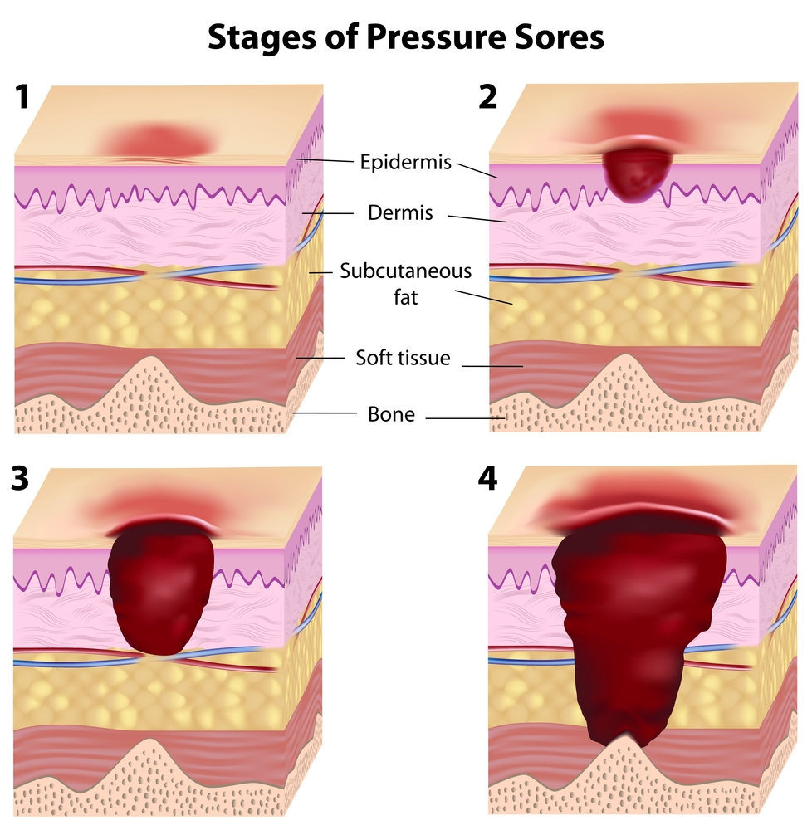
Pressure Ulcers
Anatomic Site
Severity of Stage
L89
NonPressure Ulcers
Anatomic Site
Laterality
Severity of Stage
L97
Notes:
Tina:
Moving on to ulcers; ICD 10 uses combination codes in this category because they report the pressure ulcer, the anatomic site, and the stage of the pressure ulcer. The severity of the pressure ulcer is reported using the National Pressure Ulcer Advisory Panel (NPUAP) staging which we have detailed for you in our presentation notes.
It is very important for physicians to document the diagnosis of pressure ulcer to include the anatomic site; and don’t forget laterality when applicable.
In this rare occasion, the pressure ulcer stage may be assigned by coding based on medical record documentation from nursing documentation, usually the wound care nurse. However, again, the associated diagnosis or pressure ulcer must be documented by the patient’s provider.
Accurate staging documentation is critical with pressure ulcers as they are considered on the CMS list of Hospital Acquired conditions.
***************************************************************************************************************************
NOTES:
Stage 1: Pressure pre-ulcer skin changes limited to persistent focal edema
Stage 2: Pressure ulcer with abrasion, blister, and partial thickness skin loss involving epidermis and/or dermis
Stage 3: Pressure ulcer with full thickness skin loss involving damage or necrosis of subcutaneous tissue
Stage 4 : Pressure ulcer with necrosis of soft tissues through to underlying muscle, tendon, or bone
Non-pressure ulcers are classified differently. Non-pressure ulcers are classified by the anatomic site, including laterality, but the staging system that applies to the pressure ulcerations of the skin does not apply to non-pressure ulcers. Instead, the severity is measured by the degree of erosion through the tissues, from the skin to the bone and the actual depth of the ulceration.

Slide 56

Injuries in
ICD-10
Grouped by BODY PART instead of TYPE OF INJURY
More specificity
7th category extensions indicate initial, subsequent, sequela
Notes:
Dr. Meesig:
When it comes to injuries, this is where we get the most expansion of the numbers of codes in ICD-10. Injuries are coded by body part, type of injury, laterality, episode of care, and other more specific designators depending on the type of injury.
The initial encounter is self-explanatory, but extensions of the initial encounter are used while the patient is receiving active treatment for the injury. These include emergency room encounters by various providers, later initial evaluation and treatment by a new provider and surgical treatment.
Subsequent encounter is used after the patient has received initial treatment for the injury and is receiving routine care during the healing and recovery period. Examples include: aftercare and follow up visits, cast changes and/or removal, removal of internal or external fixation device, etc..
Sequela is assigned to complications or conditions that arise as a direct result of an injury. An example of this would be treatment for a scar formation after a burn injury, or a non-union from a fracture.

Slide 57

INJURIES
Fractures
Laterality
Episode of care (7th character)
Notes:
Dr. Meesig:
The trauma surgeons I’m afraid are responsible for a large part of the expansion in the injury area. As we discussed earlier, almost half of the code expansion in ICD-10 is due to the injury codes. The trauma surgeons were interested in getting better information for their registries and their research. Also as we discussed earlier, this is one of the reasons for the ICD-10 expansion, to improve on registry and research capabilities.
Laterality is a big contributor, and the episode of care too. There is a lot of detail in the type of fracture, more than just open fracture or closed, but comminuted, spiral segmental, I could go on. When you begin to layer all this information to the seventh level, that is where the numbers of codes really add up!
Tina:
Again, for all injuries the important documentation pieces to ensure you incorporate are:
Site, type, laterality, cause, and a clear indication of the episode of care you are providing at that encounter.

Slide 58
S52.351B
  32 year old seen today with displaced, compound comminuted fracture of the right radial shaft. It is a type II open fracture.
Compound
Right
Radial Shaft
Type II
Open
Laterality
specific location
Gustillo classification allowing for the assignment of the 7th character
Notes:
Tina:
In this scenario you can see that there are five different words used to modify this fracture – displaced, compound, comminuted, right, and radial. An orthopedic surgeon likely would use all of those words to describe that fracture, especially if they are the one operating on it, but until ICD-10, it wouldn’t be captured this specifically in the coding. Now with ICD -10, it will, and so you see a glimpse of why we have over 39,000 codes in the injury section; all of them have this level of detail associated.
************************************************************************************************************************
Scenario taken from the Instructors edition of the AHIMA ICD-10-CM Training Manual – 2011.

Slide 59


Gustilo Fracture Classification
7th character identifies the type of open fracture
Impacts categories S52, S72, and S82
Notes:
Dr. Meesig:
As if the injury section wasn’t complicated enough; one further addition.
The seventh (7th) character in some fractures will identify the type of open fracture using the Gustilo Fracture Classification.
Coders will need to have documented the type of open fracture according to the scale to properly assign the correct code.

Slide 60
Genitourinary
Chronic Kidney Disease
Stage | Description (Kidney damage with:)
Stage l | …a normal or slight increase in GFR
Stage II | …a mild decrease in GFR
Stage III | …moderate decrease in GFR
Stage IV | …severe decrease in GFR
Stage V | …Kidney failure
ESRD | Kidney failure requiring chronic hemodialysis or awaiting transplant
ICD-10 Cat. (N18.1 – N18.6)
Serum CR (< 0.9 - > 4.5)
eGFR Level (>90 - < 15)
Notes:
Dr. Meesig
Chronic kidney disease is our next topic. Chronic kidney disease in ICD-10 is divided into stages the same as we see now in ICD-9. Clinicians must document the stage of the kidney disease by using the National Kidney Foundation’s staging guidelines. This is important to show the severity of illness your patient is experiencing. The stage is dependent on the amount of kidney damage, the serum creatinine and the GFR.
Along with the stage of chronic kidney disease, you should also document the acuity. Possible diagnoses might be stage III chronic kidney disease with acute exacerbation, or end-stage renal disease with the patient currently on hemodialysis awaiting transplant.

Slide 61
Sneak Peek
Notes:
Tina:
This slide demonstrates again the importance of staging in the ICD-10 hierarchy. The codes are assigned based on the stage. If there is no stage, it may become unspecified. We have already seen what happens to documentation if the diagnosis is unspecified.
In order to capture the true severity and acuity of your patient, make sure you identify the stage. You want to assure your work value capture caring for that end-stage renal disease patient on dialysis is accurate and does not show the diagnosis in the chart was chronic kidney disease, unspecified.

Slide 62

Chronic Kidney Disease
Hypertensive chronic kidney disease, stage 4
Stage 2chronic kidney disease secondary to type 2 DM
ESRD as a result of polycystic kidney disease
Notes:
Tina:
It is also important to document the underlying condition known to or suspected to cause the chronic kidney disease. Again, use the “connector” words to identify the cause in your patient’s health record. Such as those listed in the example her providing great documentation.
*****************************************************************************************************************
NOTES:
Remember to also document all conditions that either contribute to or are caused by the CKD such as:
Acute kidney injury (failure)
Anemia
Heart failure – and please remember to indicate systolic or diastolic
Are there complications of hemodialysis or the hemodialysis catheter
Cystic disease as in the example above – is it Fibrocystic, polycystic
HTN
Obesity

Slide 63

Complications
Notes:
Dr. Meesig:
Ask yourself if there are complications of hemodialysis or the hemodialysis catheter or fistula.
Also be sure to document all complications of renal disease and/or failure, such as: anemia of chronic kidney disease, secondary hyperparathyroidism of renal origin, or severe protein calorie malnutrition.

Slide 64
PCS
ICD 9 | ICD 10
3-4 numbers | 7 alpha-numeric characters
Approximately 3000 codes | Approximately 87,000 codes
Based on outdated technology | Reflects current usage of medical terminology and devices
Limited space for adding new codes | Flexible for adding new codes
Lacks detail | Very specific
Lacks laterality | Has laterality
Generic terms for body parts | Detailed descriptions for body parts
Lacks descriptions of methodology and approach for procedures | Provides detailed descriptions of methodology and approach for procedures
Lacks precision to adequately define procedures | Precisely defines procedures with detail regarding body part, approach, and any device used, and qualifying information
ICD-10: Detailed Procedural Coding
Notes:
Tina:
This brings us to the procedure codes. If you thought we had a lot of diagnosis codes in ICD-10, the procedure codes have them beat – going from approximately 3,000 to approximately 87,000!

Slide 65
PCS
Approach
Device
Qualifier
Notes:
Tina:
The ICD-10 procedure codes contain only 3,121 unique terms that are used to form the 87,000 procedure codes. They are structured as tables, in which key attributes of the procedure are combined together to create the code.
When the tables are constructed, there are seven different approach terms to report the method employed, such as open, endoscopic or percutaneous.
Regarding devices, only devices that remain in place after a procedure is complete are included in the coding. Examples include stimulator generators, synthetic substitutes, and internal fixation devices.
Dr. Meesig:
Then the qualifier character is used to indicate additional information that may be needed to describe the complete picture, such as:
the use of the term “diagnostic” to show that an excision was a biopsy
the type of tissue used in the transplant, such as living-related, living-unrelated, or cadaveric
the location of the distal anastomosis of the bypass graft such as a femoral-popliteal bypass graft.
*********************************************************************************************************************
NOTES:
According to Section A11 of the official ICD-10-PCS coding guidelines, physicians are not required to use the terms specific to ICD-10-PCS; however, documentation must provide enough detail for coders to equate the documentation to the specific PCS definitions. For example, when the physician documents "partial resection," the coder can independently correlate "partial resection" to the root operation Excision without querying the physician for clarification. If the coder is not able to correlate documentation to the ICD-10-PCS terms, the physician will need to be queried for more information.

Slide 66
ICD-10-PCS Documentation Specifics
Same operation on different body parts
Specify
Document
Distinguish
Different procedures on same body part
“To” and “From” for bypass procedures
Subdivisions of body parts
Type of graft and material used
Intent of and exact approach for
When and why conversion done
Diagnostic biopsy performed before open procedure
Notes:
Dr. Meesig:
When documenting, due to the nature of the operative report, usually most surgeons already document with enough specificity to report ICD-10 PCS. This screen shot explores some key points to keep in mind when documenting your operative report.
But let me point out a couple tricky parts.
First, specifying the same procedure done on different body parts will require two separate codes to report, for example, excision of a lesion from the right upper arm and right hand.
Second, clearly distinguish when different procedures are performed on the same body part, an example of this would be excision of a colonic lesion and creation of colostomy site.
We have included additional items for consideration in our notes that you can download from today’s presentation using the green button located over my head.
****************************************************************************************************************
NOTES:
If you need to convert the operative approach, state when and why the conversion is being done, for example, a laparoscopic procedure being converted to open. At what stage of the laparoscopic procedure did you decide to convert? Why did you feel this was necessary? Most surgeons will already document this in the operative report.
For some procedures, a diagnostic biopsy might be done initially to decide what more to do in the operating room. For example, a breast biopsy might be converted to a more extensive lumpectomy and axillary node sampling if the biopsy shows cancer.
Most vascular surgeons are accustomed to documenting the location of the proximal and distal anastomosis in a bypass graft. This can be as simple as stating “from” the femoral “to” the popliteal artery. Even though it is a no-brainer for a physician, it still should be stated clearly for the coder. This also goes for the graft used; the type of graft and material used should be spelled out in the operative report. Just because the circulator nurse pulls a sticker off the package in the medical record, doesn’t mean that the coder can go there for the information.
Finally, it is important for the surgeon to state the intent of each procedure along with the actual technical description of the procedure. The coder may not pick up on your jargon. The exact approach for the procedure should be included as well, such as a retro-peritoneal flank incision versus an abdominal approach for a nephrectomy.
Due to the nature of the operative note, usually most are documented already with enough specificity to report ICD 10 PCS. This screen shot does explore some points to keep in mind and ensure you include in your operative note.
Tips from Educode …..Introduction to ICD-10 for Physicians and Nonphysician Practitioners
Specify when the same operation is performed on different body parts and specifically identify each body part
Clearly distinguish when different procedures are performed on the same body part for different reasons
State when and why a conversion of the surgical approach was done
Document when a diagnostic biopsy is performed before an open procedure instead of as a component of the definitive procedure
Clearly document subdivisions of body parts
Indicate “to” and “from” fro bypass procedures
State the type of graft and material used
Specify the intent of each procedure, along with the actual technical description of the procedure itself
Specify the exact approach used for the specified procedure
Eponyms will no longer be used in ICD-10 –Coders will not be able to find a code based on the person who invented it such as a whipple…and in many cases coders will need to use several codes to fully describe a procedure that used to be reported with 1 in ICD-9.

Slide 67

Next Steps
VHA ICD-10 Website
VHA HIM CDI Educational Sessions
Development of Local CDI Programs
Elsevier Doc Briefs
CMS Website
Notes:
Tina:
During today’s presentation, we have only scratched the surface of good clinical documentation practices.
Even though we have a reprieve until October 1, 2015, for ICD-10 implementation, it isn’t too soon to start preparing now. As you have seen today, there is a lot to learn!!
There are many resources for you to educate yourself on ICD-10 and good documentation principles in general. Some of them are listed in this slide. In addition many facilities are developing their own Clinical Documentation Improvement programs with guidance from the National HIMS CDI Council which has many great resources and training opportunities available via the HIMS National website and in TMS.
Also as mentioned in the presentation The link for the Elsevier Doc Briefs is on the resources slide at the end.

Slide 68

Resources
Elsevier Doc Briefs located at:
  https://login.elsevierperformancemanager.com/systemlogin.aspx?virtualname=VAEES
Notes:
References:
Richard F. Averill, MS and Rhonda Butler, CCS, CCS-P, Misperceptions, Misinformation, and Misrepresentations, Journal of AHIMA/June2013 available at :
http://journal.ahima.org
Jennifer Avery CCS, CPC-H, CPC, CPC-I, Cheryl Ericson, MS, RN, CCDS, CDIP, The Clinical Documentation Improvement Specialist’s Guide to ICD-10
OptumInsight, INC., 2014 ICD-10-CM Clinical Documentation Improvement Desk Reference
White Paper ---AMA – June 2012 What You Need to Know for the Upcoming Transition to ICD-10
Written by the AMA CPT Medical Informatics Department
Elsevier Doc Briefs available at :https://login.elsevierperformancemanager.com/systemlogin.aspx?virtualname=VAEES

Slide 69


Ask the Presenter
Notes:
Dr. Meesig;
We would like to thank you for joining us for today’s presentation. Remember if you haven’t submitted your questions yet, there is still time to do so by clicking on the orange “Ask The Presenter” icon. We’re going to show a brief announcement and be right back to answer your questions.

