Slide 1
Utilizing SharePoint to Enhance Pharmacy Operations, Communication and Data Measures
Shawn M. Saunders, Pharm.D.
Notes:
155

Slide 2
2010
Notes:
In this presentation, we will be discussing SharePoint 2010. If your site has 2007 or 2013 – don’t worry - the applications we will build today are possible on all versions.

Slide 3
Check with your local IT, ADPACs and ISOs
Notes:
A quick notice before we get started – Each site may have different policies– so always check with your management, IT, ADPACs and ISOs for approval before working on these solutions at your local site →

Slide 4
Objectives
Why SharePoint?
Review some demo pharmacy applications to show you the capabilities
Build one of the applications together
Review how to export data from a SharePoint list to create reports
Provide access to additional training resources and tutorial videos
Notes:
-- First of all, our main objective today is to show you the value of SharePoint for pharmacy departments. -- We will review some real SharePoint pharmacy applications
-- Then we will show, step-by-step how to build one of these solutions.
-- We will show you how to export data to create reports from a SharePoint list
-- Last, we will wrap up by providing a link to a webpage with tutorial videos so you can build these and other ideas at your site →

Slide 5
Poll Question
What is your experience level with SharePoint?
I am a beginner, just starting to learn
I use SharePoint often, but do not know how to develop items
I am an advanced user and developer
Notes:
Before we get started, we want to poll the audience to see what experience people have on SharePoint.
Use the BLUE button above my head to answer the poll question →

Slide 6
Why
for Pharmacy?
Notes:
The first thing we want to go over – is why we feel SharePoint is valuable →

Slide 7
Notes:
#1 … We need to Bridge the Gap. We often see new third party solutions that solves some of our problems … but with our fiscal limitations– we can’t purchase all of them … so we need to find ways to use our existing resources.
Most private, third-party applications cost around $10,000 per year/per site. So think of how those costs would translate nationwide if several sites buy them across the country . Luckily, we can create applications in SharePoint that reach the same goals – so we can bridge the gap and meet our business needs.

Slide 8
Notes:
What about Cost of making these solutions with SharePoint over a third party solution? Luckily, there is no additional cost to use SharePoint and create these solutions we will talk about today . It is already part of our software suite.
… and better yet … we can scale these solutions to multiple sites without a negative impact on our budget→

Slide 9
Poll Results
What is your experience level with SharePoint?
I am a beginner, just starting to learn
I use SharePoint often, but do not know how to develop items
I am an advanced user and developer
Notes:
Before we go on to talk about more details, let’s review our polling results.
Ad lib the results

Slide 10
Poll Results
What is your experience level with SharePoint?
I am a beginner, just starting to learn
I use SharePoint often, but do not know how to develop items
I am an advanced user and developer
Notes:
(Cue to Tech Team that you’re moving on) “Click” again to move on

Slide 11
What about the time investment to build these apps?
Notes:
What about the time investment to build these apps? 10 years ago, if you needed to create a new web-based form to collect data from your team – we would have to contact web developers, IT which could take some time … but today, with SharePoint we can create a simple, web-based form and go-live in less an hour. Which is something we will do at the end of this presentation. An example … Let’s say Quality Management identified an high-risk issue that you need your team to track and trend. You could create a web-based form and roll-out to your department the same day to start tracking that issue .

Slide 12
SharePoint Designer
User Access
Notes:
User Access is also a great feature with SharePoint over a third party option. With SharePoint, everyone in our national directory can be added with a few clicks – just like you would on an Outlook email message . We don’t need to create new users, maintain or change lost passwords – which can take a significant amount of time with a third-party app … especially if a user forgets their password on the overnight shift … when you are not available. With a third party option – you need a super user to handle these issues 24/7 →

Slide 13
Information Security
Notes:
What about Information Security?
With third party applications … many of them require storage of information off-site … which in many cases is not permitted … or approved … BUT with SharePoint … the data stays within our firewalls and allows us more flexibility … and safety of our data.→

Slide 14
Notes:
What if you built some online forms and apps – and now you want to take things to a step further with automated emails, automated steps. Would that cost the VA money at that point? →

Slide 15
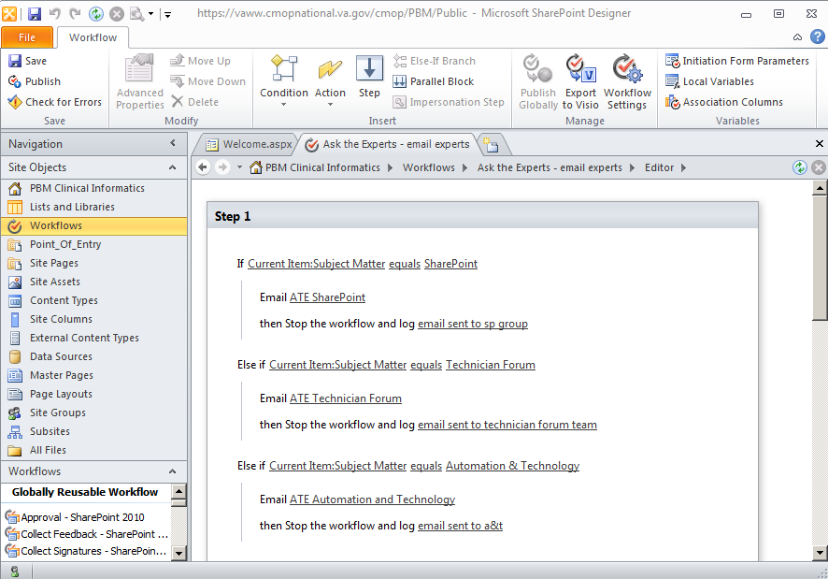
SharePoint Designer
Notes:
Luckily, the answer is no. The software to do this is called … SharePoint Designer and it is free software.
We won’t be covering how to build in SharePoint Designer today – since this is focused on beginners and intermediate users - but we will have tutorial videos on our demo site for our advanced users on how to do this.
For beginners -- once you know how to build and maintain the SharePoint apps we will show you today -- and become your local SharePoint expert ... You can consider requesting permissions and approvals with your local management about these advanced options →

Slide 16
Notes:
What about the learning curve– how much time will it take me to learn how to do this ? On the plus side, with each new release – SharePoint is becoming very similar to using Microsoft Word. Since SharePoint integrates with Microsoft Office products … If you can learn Excel and Word … you can learn SharePoint.
The great part ... With SharePoint – is that we aren’t adding a new, independent software platform that we have to learn from scratch … think of SharePoint as adding a new layer of features to Word or Excel … and another tool in your toolbox to go paperless and save more time→

Slide 17
Don’t worry
Notes:
As we go along … If you feel lost or overwhelmed anytime during this presentation … please, don’t worry. →

Slide 18
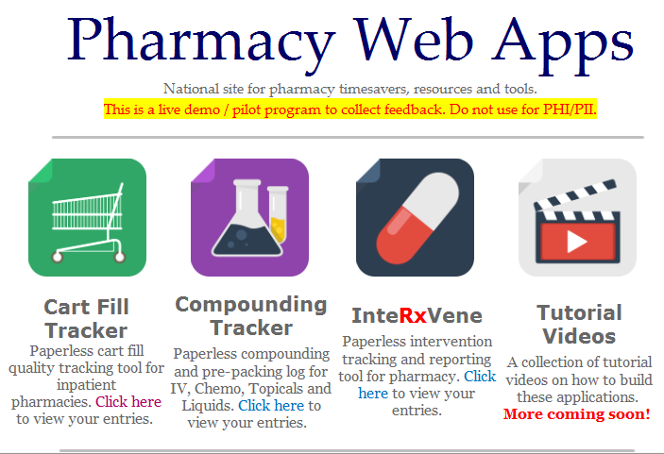
Notes:
We are creating a library of step-by-step, how to videos on building these applications – that will cover every detail.
We want to create a resource that is realistic for busy, front-line teams … So … we will keep all videos 5 – 10 minutes each.
The videos are on our demo site … so you will need to save or bookmark the website address to view them later -- be sure you use the green download button above my head and download the Word Document titled Website links document. The link will not be emailed to you after the presentation … so I recommend you download that document. If all else fails, always feel free to send me an email.
So sit back and relax during this presentation – and not worry too much about taking notes. →

Slide 19
Notes:
… and when you sit down to watch the how-to videos and still have questions … all you need to do is click the yellow question box on the top right of the page. An email message will go direct to our team to help you. →

Slide 20
Notes:
So … now that we have covered why we think SharePoint is valuable … and you know that everything we cover will be broken down into short videos …
Let’s jump in to show you some real examples that can be used in our VA pharmacies.
In this presentation … we will present a challenge or issue … and then we will show you a SharePoint solution and how it works. So let’s get started →

Slide 21
Pharmacy Issue
Notes:
Pharmacy Issue # 1 →

Slide 22
Notes:
A local, paper compounding log for the IV room was lost with patient information. We also received notice that new regulations dissuade us from recording patient identifiers on paper systems.
So we need to create an electronic, paper-less solution. We researched a third-party solution but we do not have the $10,000/year cost available for the subscription. →

Slide 23
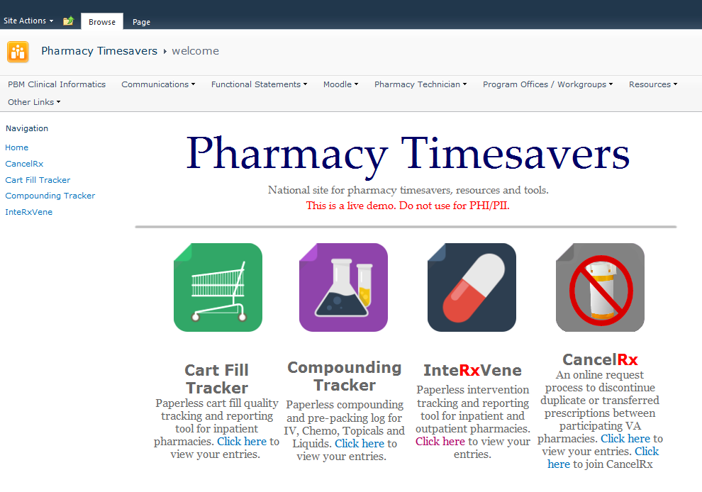
Notes:
The solution we created here is called the Compounding Tracker. This will take our paper compounding logs for IVS, Prepacking, Chemo, Oral liquids and so forth … and make them paperless.
So we are going to click on that icon to open up the form -->

Slide 24
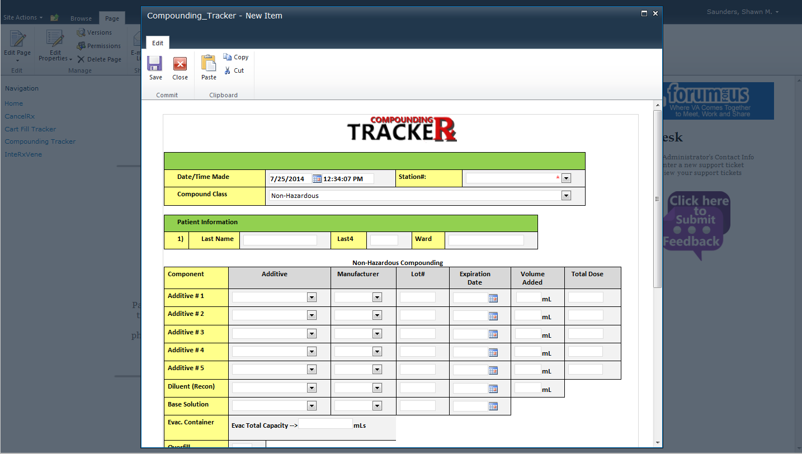
Notes:
Here you can see the form pops up and hovers over the existing page →

Slide 25
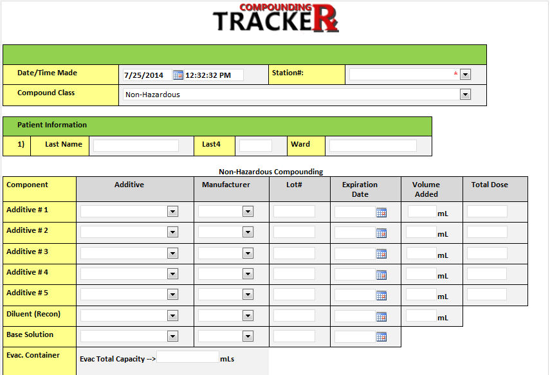
Notes:
So taking a closer look at the form … a team member would fill out the same fields required by a paper compounding log. →

Slide 26
Notes:
We use a quick drop-down field to choose if the item is a chemo, topical, iv and so forth … →

Slide 27
Notes:
We then enter in the patient identifier and →

Slide 28
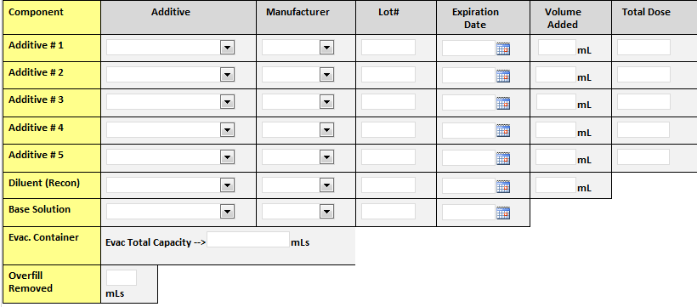
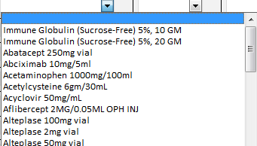
Notes:
Then the user will enter in everything you would see on a typical compounding log ---
Such as additives, manufacturer, lot and so on
We added quick drop-down boxes to save some time →

Slide 29
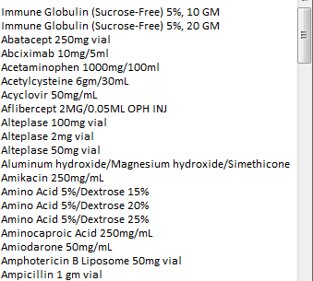
Notes:
For the additive field – the user only has to enter the first few letters and the list will automatically sort to the additive and strength →

Slide 30
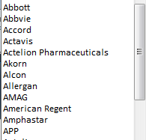
Notes:
Same for the manufacturer field … and so on … →

Slide 31
Notes:
The rest of the fields include lot#, expiration date and so forth … →

Slide 32
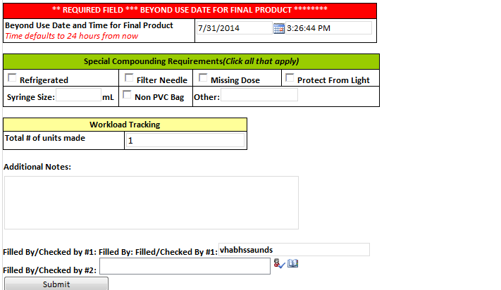
Notes:
We have a beyond use date that auto calculates to 24 hours, which is most common for high risk compounds used at this site →

Slide 33
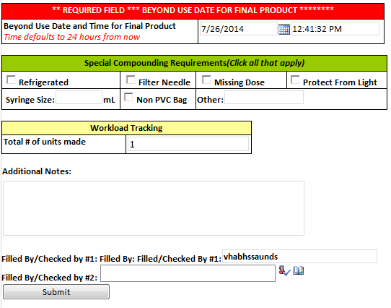
Notes:
We can also add any special circumstances worth mentioning such as missing dose, special syringes used, etc … →

Slide 34
Notes:
We ALSO added a field to record the # of units. This field allows us to pull reports to determine accurate workloads. We can run a quick report to see how many bags are compounded per hour – and determine any bottlenecks to make sure we have enough staff to compound, check and deliver these items . →

Slide 35
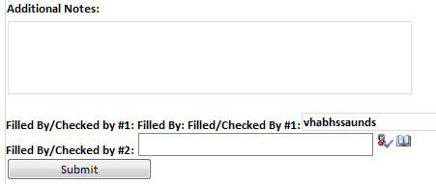
Notes:
Lastly, we have the notes field … and fields to record who filled and checked the items …
The FILLED BY field automatically populated based on the active user – and they can pick the 2nd check from an active directory – which is similar to looking up a user in an Outlook email …
This makes things easier – esp. when you are trying to determine initials on paper logs … this form makes it much easier to determine →

Slide 36
Notes:
Once it is completed – we hit submit and the entry is filed → →

Slide 37
Notes:
The user is returned back to the home page to jump between applications …-->

Slide 38
Notes:
To view the entries we can click on the Compounding Tracker navigation on the left -->

Slide 39
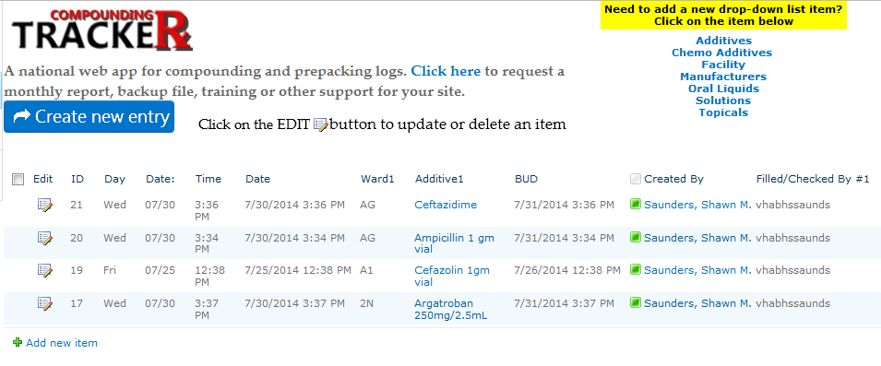
Notes:
And that will show you a list of all of the entries in descending order … →

Slide 40
Nursing Teams
Notes:
This application has major benefits over a paper log - especially when you have decentralized staff fielding questions from nurses and physicians. This allows the pharmacist to check on the status from anywhere in the facility and see if their missing dose or chemo is being worked on, or ready. You could also provide nurses access to check if they wish.
In some applications – we have automatic emails sent to nursing teams when a chemotherapy agent is ready or being delivered -->

Slide 41
Notes:
AND … if you ever have a medication recall – we can quickly download a report and find any recalled lot # and tie it to a patient. Otherwise, we would have to sift through piles of paper records locally or from our record warehouse. →

Slide 42
Notes:
And if you are ever worried about a team members forgetting to enter critical information, such as a lot #, or other important information? →

Slide 43
Notes:
This is where we could use the more advanced features with SharePoint Designer and create automatic emails.
we can create an automatic email to the individual and supervisor for any criteria we choose … esp. a missing lot # like in this example … →

Slide 44
Notes:
All of this saves us time over a paper system … and we are also improving our data quality by having immediate notifications of deficiencies – The great part is that SharePoint does most of the work for you … →

Slide 45
Notes:
When we replace the paper form with this – we are automatically recording data that was not previously available … so we can now run reports. I find this data more useful than running a typical fileman report since it captures direct measures from the compounding team →

Slide 46
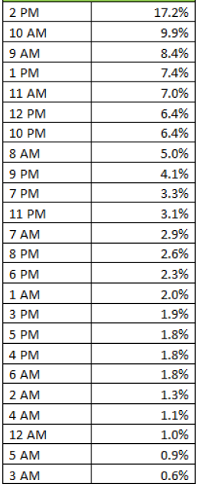
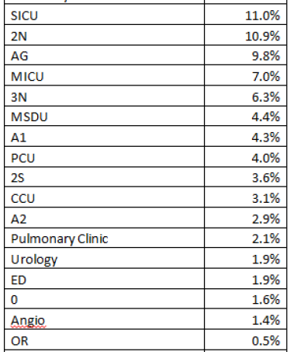
Monthly Workload Report
Notes:
This is a quick example of some reports you can pull from and create with the Compounding Tracker … This would be using Excel …
At the top – simply compares the total number of units you are compounding each month … to determine if workloads are changing … so you can react and change staffing levels … →

Slide 47
Hourly Workload Report
Notes:
You can also determine what hours are the busiest … to make sure you have adequate checking and compounding staff available – and can adjust other aspects of your organization …
In this example … 2-3pm and 10-11am represent over 27% of all workloads →

Slide 48
Area Workload Report
Notes:
In this quick report … it will determine the workload per area … in this case SICU and 2N represent 21.9% of our compounding operation →

Slide 49
Monthly Workload Report
Notes:
With Excel – you can customize your reports to fit your needs … and the great thing about SharePoint … is that if you determine there is something you need to measure that is not on the form … you can just add it … It is a very flexible way to obtain and measure data
For those that are not comfortable with Excel … We will be adding a series of tutorial videos that will show you step-by-step – how to create reports from these lists … and you can apply this to any other ideas you may have as well →

Slide 50
Notes:
So to recap Issue # 1 →

Slide 51
Notes:
we took our paper compounding log and made the Compounding Tracker … and we added a new level of data measures, patient safety tools, and some time savers … and that wraps up the quick demo on that issue and solution. →

Slide 52
Poll Question
What is your experience level with creating Pivot Tables in Excel?
I am a beginner, just starting to learn
I know how to create pivot tables, but could use a little help
I am an Excel expert
Notes:
Before we move one -- we want to poll the audience to see what experience people have with Excel. This will help us determine what type of tutorial videos to create after this presentation …
Use the BLUE button above my head to answer the question …. →

Slide 53
Pharmacy Issue
Notes:
Now we are moving onto Issue # 2 --- We need to track pharmacist interventions.→

Slide 54
Notes:
Your pharmacy wants to expand the decentralized program with rounding pharmacists and clinical technicians, but we do not have any solid data to justify the proposal.
We have CPRS notes, but they do not represent EVERY intervention and the true impact of the pharmacist and clinical technicians. Time is very limited to be able to enter in data from paper forms →

Slide 55
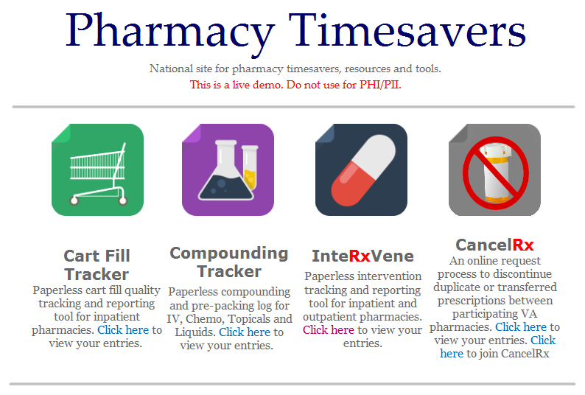
Notes:
“InteRxVene” is the application we will look at next.
In this example – the need was to create a way for a pharmacist or technician to record an interventions in about 30 seconds or less – so let’s take a look at the form →

Slide 56
Poll Results
What is your experience level with creating Pivot Tables in Excel?
I am a beginner, just starting to learn
I know how to create pivot tables, but could use a little help
I am an Excel expert
Notes:
Before we go on to talk about more details, let’s review our polling results.
Ad lib the results

Slide 57
Poll Results
What is your experience level with creating Pivot Tables in Excel?
I am a beginner, just starting to learn
I know how to create pivot tables, but could use a little help
I am an Excel expert
Notes:
(Cue to Tech Team that you’re moving on) “Click” again to move on

Slide 58
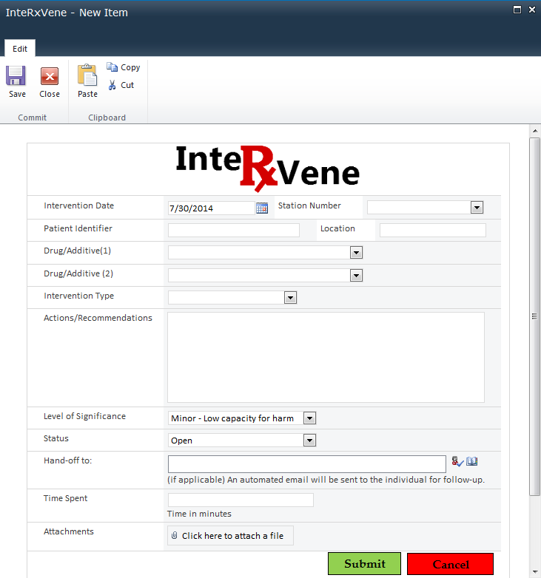
Notes:
When you click on the icon … the intervention form pops-up on the screen …
The team member will enter in the patient identifier →

Slide 59
Notes:
The drug / additive can be customized as a quick drop down list to save time →

Slide 60
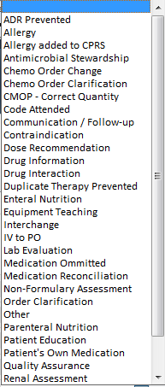
Notes:
What type of intervention was made →

Slide 61
Notes:
Any comments or actions taken – →

Slide 62
Notes:
We also have a field to record the level of significance →

Slide 63
Notes:
And we also note if the status is OPEN, CLOSED and so forth …→

Slide 64
Notes:
And at the end of the form – we will click submit and the intervention is recorded →

Slide 65
Notes:
Once the user submits … they are returned back to the home page – so they can use the other apps quickly.
If you would like to view your interventions … →

Slide 66
Notes:
Click on InterVene in the left navigation bar -->

Slide 67
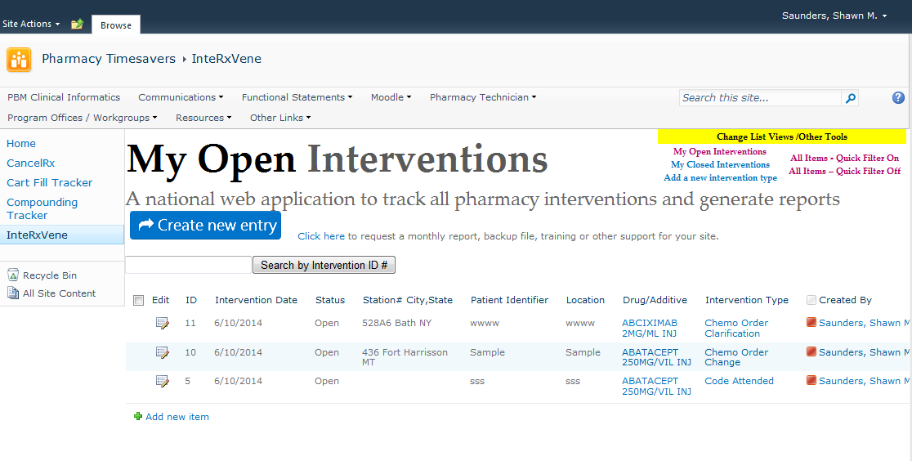
Notes:
This will bring you to a list of all of your pending interventions that you left open …
So it is a great way to keep track of items you need to follow-up on or complete -->

Slide 68
Notes:
And if you want to update the status of an entry – all you need to do is click on the edit button to the left of each item -->

Slide 69
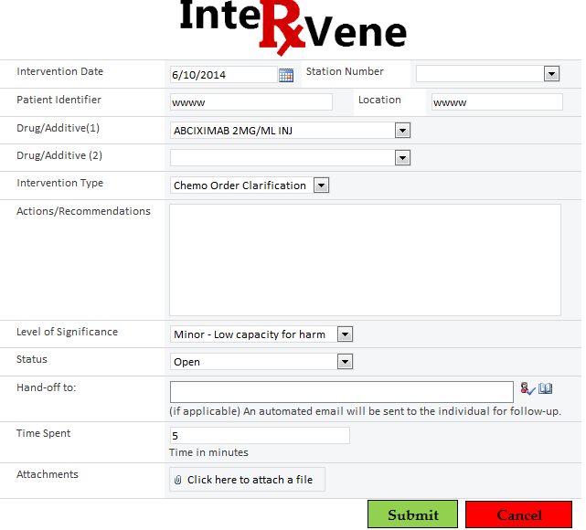
Notes:
When you click on the EDIT button … it will re-open the existing form
You can change the status to closed or any other changes needed and click submit to save it back to the list -->

Slide 70
Take this application
a step higher
Notes:
If you wanted to take this application a step higher with some automation …. One idea would be to allow users to hand-off an intervention to another team member →

Slide 71
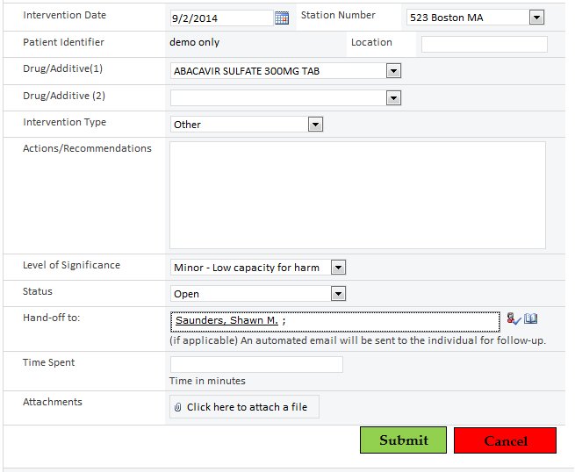
Notes:
A situation where this would apply is – if you are working days and need to hand-off an intervention to an evening pharmacist or technician.
In that case – you would enter their name in the field called “hand-off to” … and save the form. This will trigger some automation -->

Slide 72
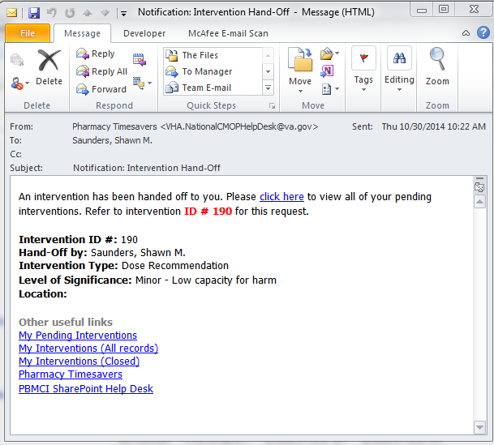
Notes:
We could create this automatic email using SharePoint Designer. Here is an example of the email the team member would receive … The email will have everything they need to act on it but without any patient information … so it remains HIPPA compliant →

Slide 73
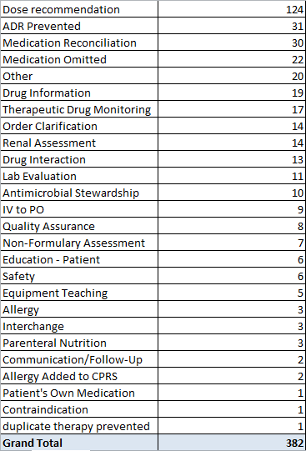
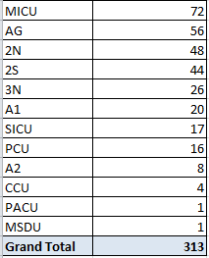
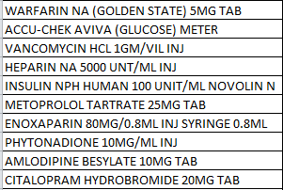
Sample Intervention Report
Top Intervention Types
Top Areas
Top 10 Medications
Notes:
If we export the data to Excel – we can run some quick pivot charts in less than 5 minutes to produce some very useful information.
In this case – we have the top interventions, top admission locations, and top 10 medications for this block of data … →

Slide 74
Notes:
So to recap issue # 2 … we created an application to record, track and hand-off pharmacy interventions within our team.
So now, let’s take a look at Pharmacy Issue # 3 →

Slide 75
Pharmacy Issue
Trying to save time by going paperless
Notes:
In this example… we have a paper process in place … but it has become too time consuming for the pharmacy supervisor…
So let’s see how we can resolve this with SharePoint→

Slide 76
Notes:
In this example, our team checks the technician cart fills every day … and as they are checking they take notes on a paper form…→

Slide 77
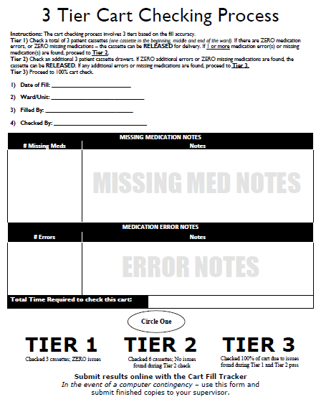
Notes:
Here is a sample view of the form we use … and we record how many missing medications and med errors we find and resolve
When we are done with the check …. We complete the form and pass it along to the supervisor →

Slide 78
Notes:
The problem is … that this can take several hours each week to sort and enter →

Slide 79
Notes:
In addition, once the data is entered … the supervisor needs to hand a copy to each employee – because it is not best practice to collect information without sharing it .
In my time as supervisor, I would spend about 4-6 hours per week shuffling papers and trying to provide copies to everyone →
So, how can we improve this process with SharePoint? →

Slide 80
Notes:
The solution we will look at is called the Cart Fill Tracker. This is also the application we are going to build step-by-step together today.
This allows your team to enter in data after they check a cart … so let’s click on that icon to see the form →

Slide 81
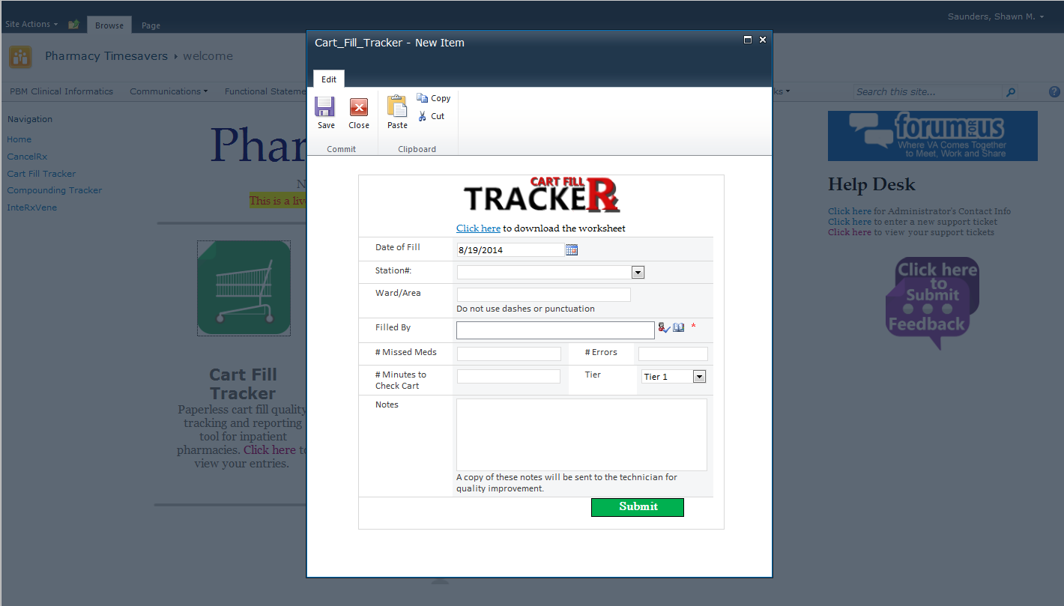
Notes:
When you click on the icon … the form pops-up … →

Slide 82
Notes:
You enter in the date you checked the cart … this field defaults to today to save a few clicks →

Slide 83
Notes:
We enter the nursing area we filled the cart for →

Slide 84
Notes:
Who filled the cart →

Slide 85
Notes:
And some measures … such as the # missing medications and #errors the check resolved. →

Slide 86
Notes:
The checker can enter in some notes to the individual, such as “great work” … or an area for improvement →

Slide 87
Notes:
When you are done – you can click submit and the data will be submitted and you will be returned to the home page →

Slide 88
So how are we saving time?
Notes:
So how are we saving time? First off, the paper form is gone. So we are saving money on paper goods and ink.
Second, the supervisor no longer has to enter in the information since the team is already doing it →

Slide 89
Notes:
Next … in the background – we have some automation with SharePoint Designer that will take care of the step that the supervisor had to sort papers and chase down all of their employees to hand them a stack of papers →

Slide 90
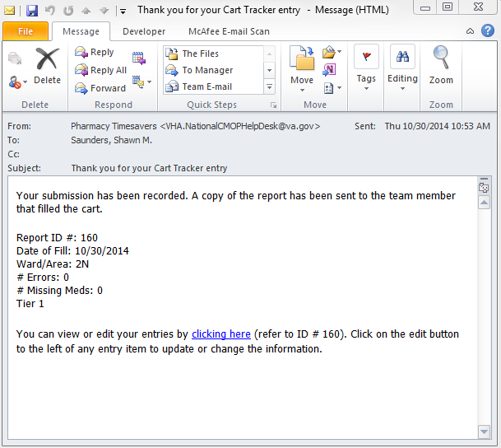
Notes:
Everytime a user enters a new cart check … an automatic, anonymous email is sent directly to the technician that filled the cart … to let them know how they did … and any suggestions and notes from the checker … so the supervisor’s workload has gone from 4 hours per week to zero and we have improved employee communications. →

Slide 91
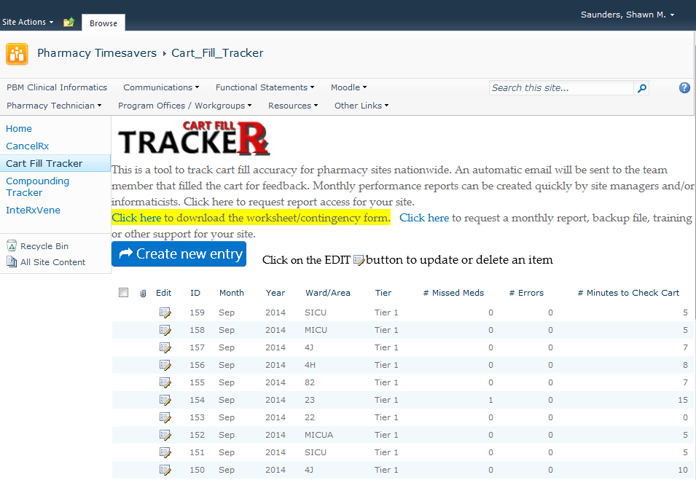
Notes:
The supervisor can also quickly run reports to see how the department is doing each month - how many errors and missed medications are prevented by checking and so forth … →

Slide 92
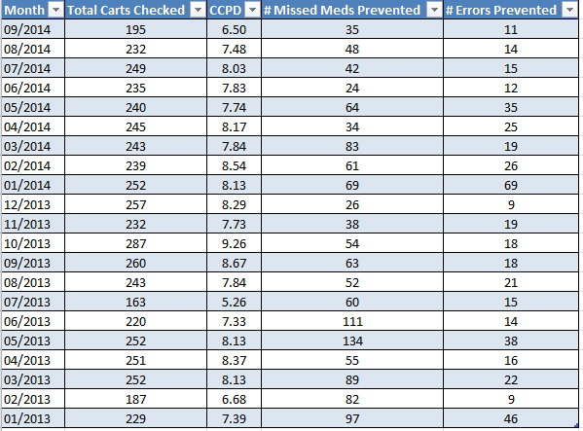
Sample Cart Fill Quality Report
Notes:
Here is an example of a sample report you could run --- and collect each month to see how your site is doing ---
In this example … ->

Slide 93
Sample Cart Fill Quality Report
Notes:
We look at the total number of carts checked each month … and determine how many carts are being checked each day …
This can be helpful to determine if any carts or form entries are slipping through the cracks -->

Slide 94
Sample Cart Fill Quality Report
Notes:
We can then compare, month to month, how many missing medications we are catching … -->

Slide 95
Sample Cart Fill Quality Report
Notes:
And last, how many medication errors we are catching …
And you can use this data … to determine if system changes are needed … esp. with sound alike look alike stock placement and so forth -->

Slide 96
Notes:
Some of you may be asking about employee privacy? Can everyone see my performance on a SharePoint site?
SharePoint has some great privacy settings for lists. This special setting will only allow users to see ONLY what THEY enter, and and NO ONE ELSE’s entries. So employee privacy is not compromised. So if you and I enter something into this list … I won’t be able to see your entry – and you cannot see mine.
If a manager needs to see ALL entries, we can add special permissions to allow that ability without impacting the privacy setting mentioned. →

Slide 97
Notes:
So … a quick re-cap on the Issue # 3 … The Cart Fill Tracker -- we removed a paper log, saved the supervisor time, and improved communication with our team.
The Cart Fill Tracker is the application we will build together today …→

Slide 98
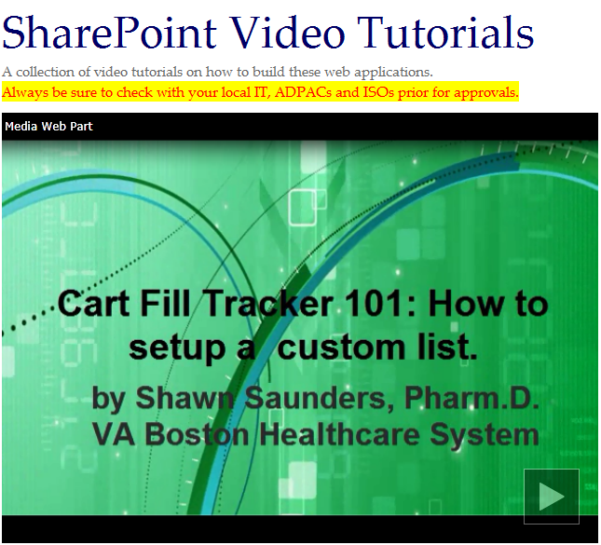
Bookmark the Site
Notes:
Bookmark the site. At the end of the presentation you will not get an email containing the link to our demo site … so be sure to download the information before the end of the presentation by clicking on the GREEN download button above my head. Look for a Word Document called WEBSITE LINKS. →

Slide 99
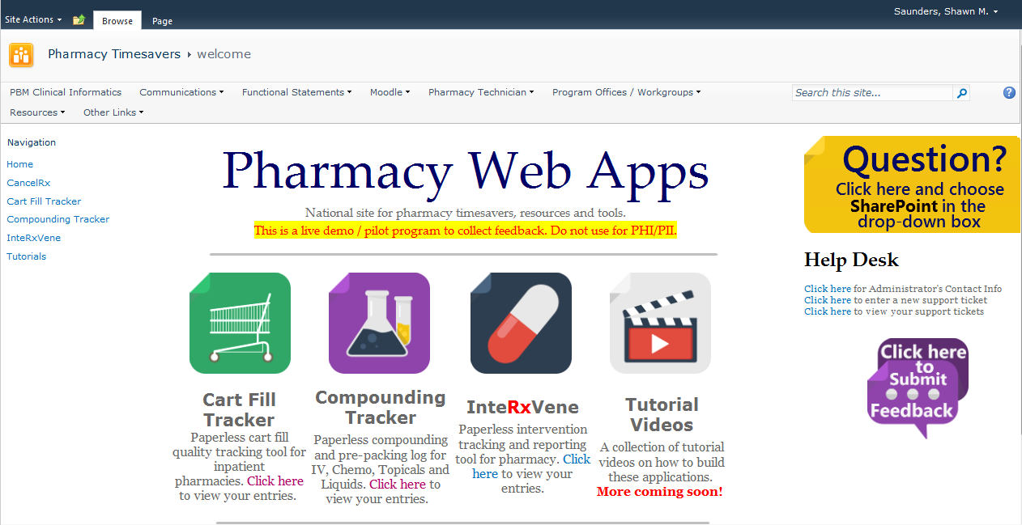
Notes:
So let’s start building one of the applications →

Slide 100
Notes:
Before we get starting building … I am going to run through a few areas that will make the development experience a little easier for beginners.
I will also review what permission level you need to start working on these items …
For some of you, this may be review … →

Slide 101
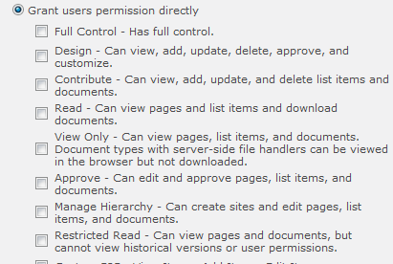
Notes:
First off … let’s review what level of permissions you will need to work on these solutions …→

Slide 102
Notes:
If you have access to a site … and can see it’s content … you most likely have “Read” access – which is highlighted here.
This enables users to view pages and list items, and to download documents. →

Slide 103
Notes:
The next level up is Contribute … and this allows users to be able to add, edit and delete documents and list items … this is usually the setting you would give someone that manages the content of the site …
But, they still cannot – create the applications we will talk about today →

Slide 104
Notes:
The next level is Design … and this is where we open up the doors for a user to be able to design and create new lists and libraries in SharePoint … You can also customize pages and styles … and this would be the minimum level of access you would like to request →

Slide 105
Notes:
The highest level is FULL CONTROL … and this would be ideal for the long-term … but if not … request Design permissions and you will be able to get started and build the options we will be working on today … →

Slide 106
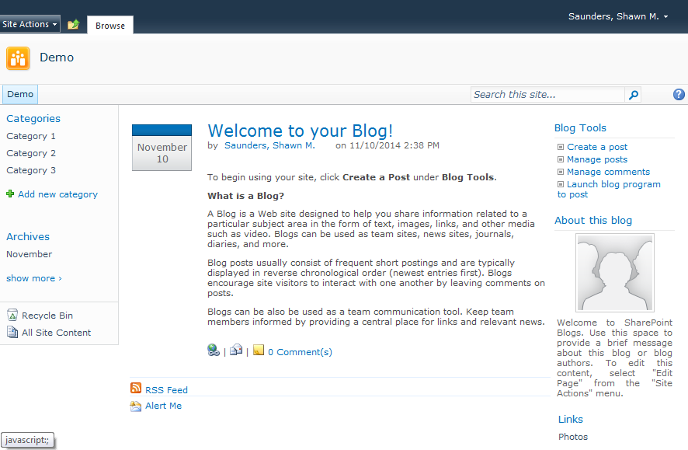
Notes:
Now that we covered PERMISSIONS … let’s cover 3 important tips … to help make your development experience more enjoyable. →

Slide 107
Notes:
The first thing I want to review, is navigating around a SharePoint site …and here we have a basic, blank blog site …
There is a button at the top of all SharePoint sites … that is often overlooked – that is a great time saver to jump around your site →

Slide 108
Notes:
Next to SITE ACTIONS on the top left … you will see a folder with a green UP arrow … this button is a great tool …
What does it do? →

Slide 109
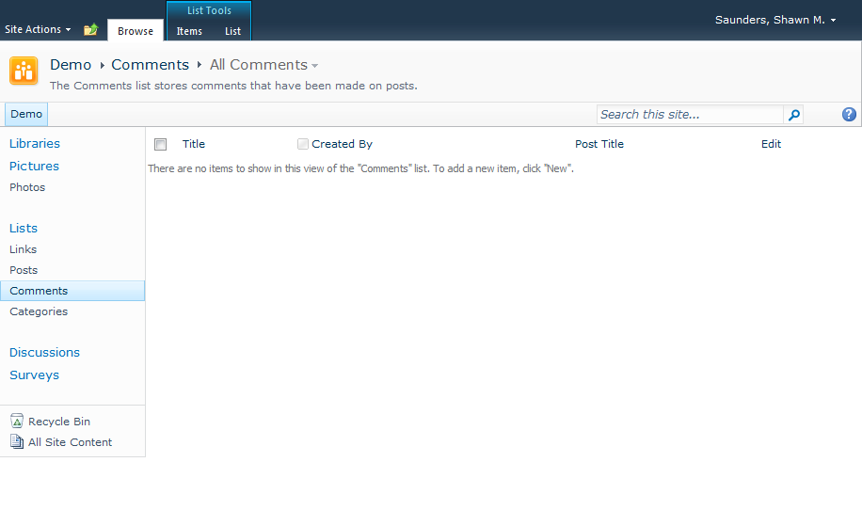
Notes:
So let’s say you are on a SharePoint site … and you made one too many clicks and now you are lost in the site and need to get back to the home page … →

Slide 110
Notes:
The navigation bar on the left … doesn’t have a quick and easy button to go back to the home page … →

Slide 111
Notes:
This is where the Navigate Up button becomes really useful …
When you click on it … →

Slide 112
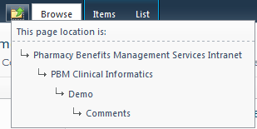
Notes:
It will provide you with a breadcrumb trail to get back home … It will give you a path of sites that go all the way back to the parent site …
In this case … we would click on DEMO and it would bring us right back to the home page … →

Slide 113
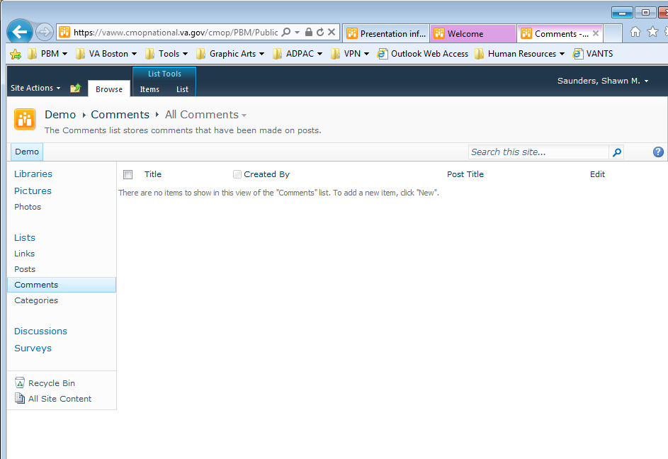
Notes:
There is also another breadcrumb trail back to the home page – right at the top of the page …. … →

Slide 114
Notes:
You can click on DEMO here to go back to the home page also … →

Slide 115
Notes:
Now that we know how to get back home … let’s take a look at another area that is important to know about →

Slide 116
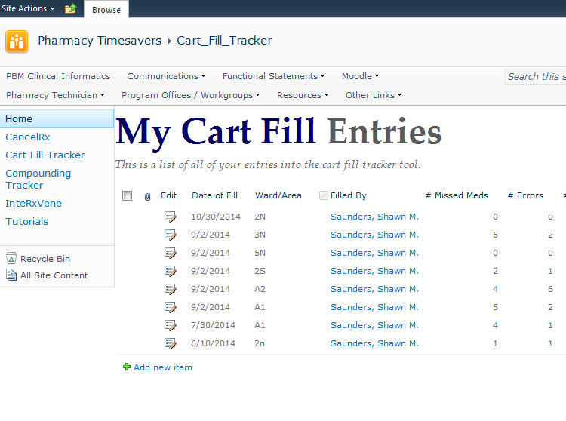
Notes:
The next area in SharePoint to understand is called the Ribbon … This is an area that was created to make using SharePoint very similar to using Microsoft Word or Excel … so to help this make sense … let’s jump to a Microsoft Word Document to take a look at what the Ribbon area is … ->

Slide 117
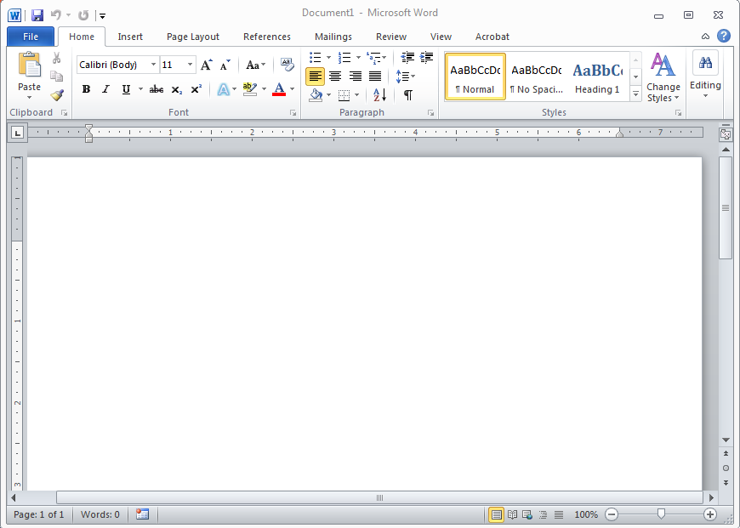
Notes:
Here is a blank Word Document …
So where is the Ribbon?

Slide 118
Notes:
It is just a fancy name for the area at the top … that has several tabs for editing the document …
like the Home Tab, Insert Tab and so forth … →

Slide 119
?
Notes:
If we come back to our SharePoint demo here … We do not see anything at the top that looks like the ribbon
This is because SharePoint likes to hide sections to keep your experience relevant and space efficient … If you don’t need the options, it will automatically hide them … →

Slide 120
Notes:
But – if you click anywhere in the list below … SharePoint will know that you want to work on that list …
So let’s click somewhere on that list to see what happens →

Slide 121
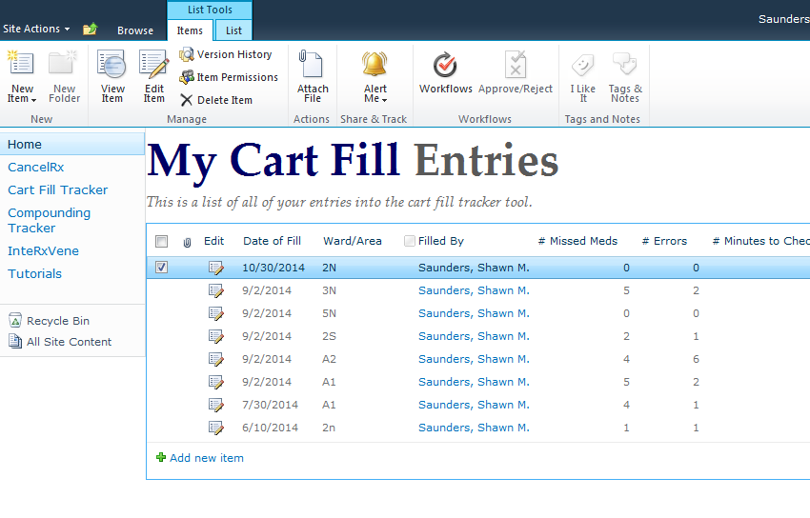
Notes:
At the top … you will see a suite of options appear … with a couple tabs … which is the SharePoint Ribbon. SharePoint reacts to your actions.
It looks similar to the Word Ribbon … and will contain all of the options we need. We will use this section to change settings on in the presentation. For now, just remember – that this area needs to be activated by you – otherwise it will be hidden →

Slide 122
Notes:
The last thing I want to show you … is how we get “BACK STAGE” … where all of the settings and tools are hiding.
This is where we do a lot of our work to build and develop lists and applications
This option is called SITE ACTIONS →

Slide 123
Notes:
You can find this on the top, left hand corner of a SharePoint Site
In 2007, it happens to be on the right hand-side instead …
When you click on SITE ACTIONS … →

Slide 124
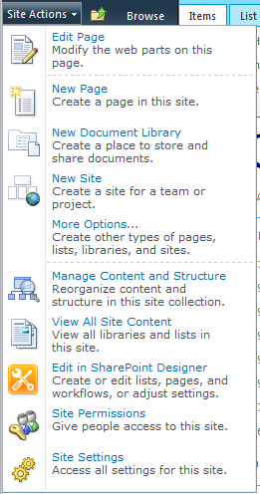
Notes:
You will get a list of ACTIONS that you can take …
At this point … I just want you to know where the button is … and that this is what we will be using to do a lot of our building
in SharePoint. We will walk through several steps later on with this button … →

Slide 125
Notes:
So … to recap … the three things to remember are
The Ribbon, Site Actions …. And NAVIGATE UP ….
Now that we have those covered … we can start building our first application →

Slide 126
Notes:
We are going to start with a blank blog site …
The type of site template you start off with does not matter for these applications … →

Slide 127
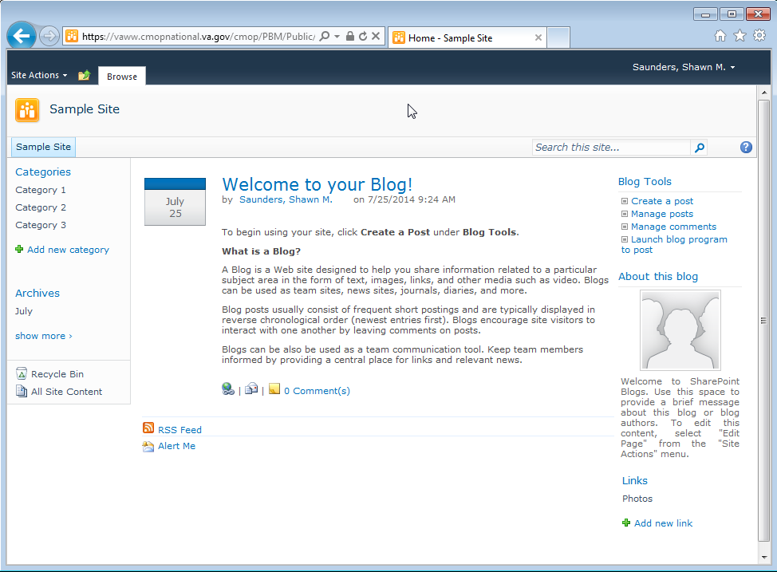
Notes:
Once we have out blank site … we are going to create something called a “Custom List” … which is really very similar to an Excel Spreadsheet with columns and rows … so don’t get sidetracked by the SharePoint’s terminology →

Slide 128
Notes:
Located on the top left hand corner of the screen – you will see a button called “Site Actions” … you will use this a lot … for almost all building and settings … →

Slide 129
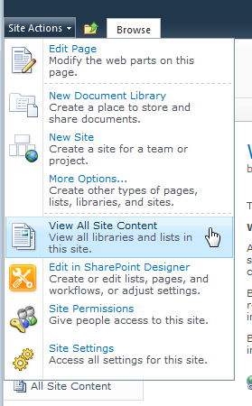
Notes:
When you click on Site Actions … it will open up a menu with several options →

Slide 130
Notes:
We are going to choose “View All Site Content” – this will show us everything contained within our site – and it will allow us to create items too →

Slide 131
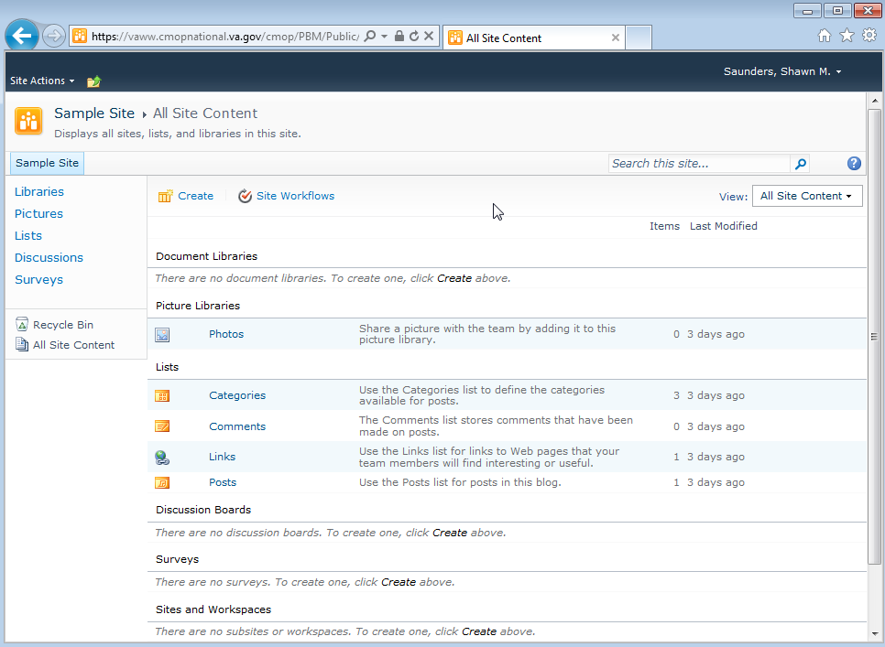
Notes:
Once you click on that … you will see a page with all of the items within your site … and since this is a new site, there is not much to see … →

Slide 132
Notes:
The important thing here … is that there is a button up top that says “Create” … it is very easily overlooked … but this is where all of our building will take place …→

Slide 133
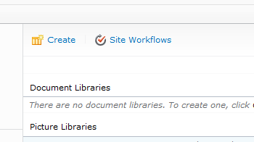
Notes:
So try this a few times so you do not forget how to find the “Create” button →

Slide 134
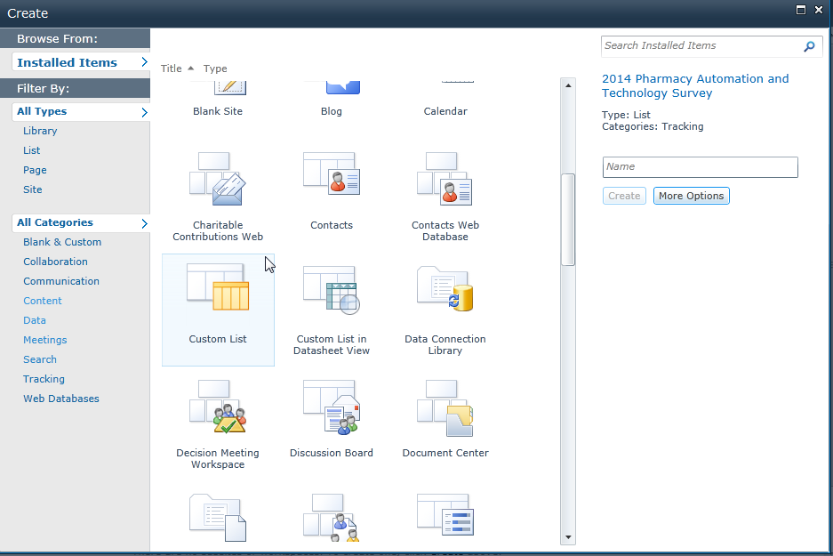
Notes:
Once you hit the Create button – a new screen will pop-up and ask you what you would like to create … there will be several options from new sites and multiple different applications to scroll through …
In this instance – we are going to scroll and find the Custom List →

Slide 135
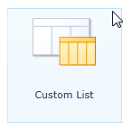
Notes:
We are going to click on Custom List to get started →

Slide 136
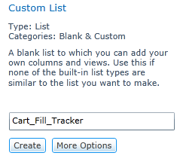
Notes:
Once you select Custom List … we need to create a name for the list on the right panel … →

Slide 137
Notes:
and we are just going to call this Cart Fill Tracker →

Slide 138
Notes:
Once you enter the name we can click “Create” →

Slide 139
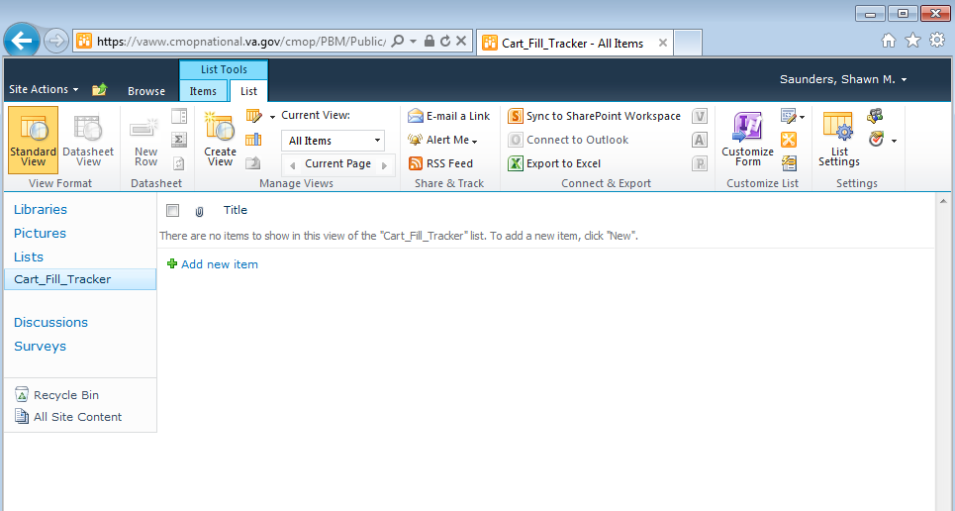
Notes:
That will create a very basic custom list … At this point, you will see a blank spreadsheet with two columns, one called the “Title” column and the other is an “Attachments” column – shown here with a little paperclip.
If you wanted to take a quick peek at what the user entry form looks like so far, you could click on
Add New Item … →

Slide 140
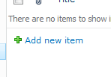
Notes:
On the bottom of the form … →

Slide 141
Notes:
A new entry form would pop-up that only has one field, the title field. →

Slide 142
Notes:
So, now that we have the custom list setup …
I want to stop and review a something I found very frustrating when I started learning SharePoint.
There are a couple settings that need to be fixed on all lists and forms – that can be VERY frustrating for anyone just starting out. This will apply to almost anything you build in a SharePoint list or library – so I want to really emphasize it so you don’t get frustrated or sidetracked later when you start building →

Slide 143
Notes:
Title field. This is really one of the most annoying items about SharePoint.
This field comes standard for every new list or form you create. It is a required field … and you cannot delete it. Most often times you do not need a “Title” field for forms. So that is why I want to take some time now to show you how to fix this. →

Slide 144
Hide The Title Field
Notes:
When you build a new list … the first step should be to hide the title field
And – we need to fix it in 2 separate places in our settings →

Slide 145
Hide The Title Field
Remove it from the Form
Notes:
The first place is to remove it from the FORM …

Slide 146
Hide The Title Field
Remove it from the Form
Remove it from the View
Notes:
Then we need to remove it from the VIEW …

Slide 147
Notes:
So what does that mean? Overall, we have 2 different areas where the TITLE field is hiding from us … It wont go away that easily …
The first one is the VIEW – and that is pretty much what you see on this page … it has all of the columns and information from your list … You can see we have a Title field in this VIEW … →

Slide 148
Notes:
The next area is the FORM… that we use to enter the data … To see the current form, all you need to do is click on “Add New Item” and the form will pop up … →

Slide 149
Notes:
On our form -- we can see the Title field … so this is the 2nd area that we need to figure out – how to get rid of that Title field … →

Slide 150
Notes:
so let’s start by removing the title field from the form we just looked at … To do this … click on the list settings button on the top right →

Slide 151
Notes:
This will bring you to a page with all of the settings for your custom list … and the setting we are concerned with most for the title field is “Advanced Settings” →

Slide 152
Notes:
The Advanced Settings area is very important for many features … so we will click on Advanced Settings to take a look →

Slide 153
Notes:
On this screen – the first option you will see is “Allow Management of Content Types” … the wording is a bit confusing.
But what this is really asking is … Would you like the ability to change columns? In our case, we do.
The default is set to “No” … and we need to change this to “Yes” we will activate several important features. This is a very important step →

Slide 154
Notes:
So we will change the setting to “Yes” and then click “Ok” →

Slide 155
Notes:
After you click “OK” you will be returned to the settings page … but what has really changed?
You may or may not notice a new section has appeared … →

Slide 156
Notes:
The content Types section is now active … and this will allows us to change columns in our list and forms …
If you do not activate this section … this area will be hidden and we will be forever stuck with the title field.
So, now that this is active --- let’s walk through how to hide the title field … →

Slide 157
Notes:
On the left, you will see a content type called “Item” in the list …
We are going to click on that →

Slide 158
Notes:
After you click on ITEM – you will see a list of all of the columns near the bottom of the page →

Slide 159
Notes:
Within that list – we finally see where the TITLE column has been hiding from us. It is not the easiest thing to find … so run through this a few times and it will be a breeze →

Slide 160
Notes:
We will click on the title column to finally Zap it →

Slide 161
Notes:
Within the Title column settings … we have 3 options … →

Slide 162
Notes:
We can make the column required, optional or hidden …
Where is the delete option? Unfortunately – there is no delete option for the Title field. This is one of the only columns you cannot delete in SharePoint. So don’t waste time trying to find it. You wont.
In this case, the best we can do is to make it a hidden field. So we will click on HIDDEN and then click OK →

Slide 163
Notes:
So, now we are back at our list … The title field is still showing in our VIEW – because we haven’t addressed that part yet. But what about our form? Is it gone? →

Slide 164
Notes:
To check – we will click on “Add New Item” to open up the form →

Slide 165
Notes:
And luckily it’s gone … Step 1 is completed. →

Slide 166
Notes:
Now we have to get rid of the Title field from the VIEW →

Slide 167
Notes:
To do this, we are going to work in a new area of settings …
At the top, under List Tools … you will see a collection of options →

Slide 168
Notes:
This area tells us what the name of the Current View is – which is “All Items” …
All Items is the standard view name for all new lists – you will see that often →

Slide 169
Notes:
You will also see an option that says “Modify View” and that is what we need to do in this case – we want to modify the view --- so we are going to click on that option … →

Slide 170
Notes:
This brings us to a page where we can customize what we see for the ALL ITEMS view. →

Slide 171
Notes:
And we can see that we have 2 fields activated in this view … the Attachments and the Title field which makes sense – because that is what we see on the All Items view page right now … →

Slide 172
Notes:
Taking a peek back at our list … we see the Title field … and the little paperclip represents the attachments field →

Slide 173
Notes:
So … right now we have 2 fields activated in this view … shown by the check-boxes →

Slide 174
Notes:
So all we need to do is unclick the TITLE field and ATTACHMENT field then click OK at the top of the form and they will be removed from the view …
But before we do that … I just want to share my personal preference to stage a new list … and that is to uncheck everything BUT activate the EDIT box. I feel this is the best starting point for all new lists … but you will form your own preferences over time.
So, we will select that and click OK →

Slide 175
Notes:
Now, back at our list … we can see that we no longer have the title or attachment column … just the EDIT field. →

Slide 176
Notes:
And now our form is a blank slate to start building our Cart Fill Tracker … →

Slide 177
Poll Question
In a SharePoint list, the Title field cannot be deleted. It can only be hidden.
True
False
Notes:
Before we move one -- we want to poll the audience with a question to reinforce some important points →

Slide 178
Notes:
Coming back to building our Cart Fill Tracker ….
Here is a copy of the finished product for the Cart Fill Tracker …
so the next step is that we want to add all of the fields for data collection …→

Slide 179
Notes:
the button we are going to use to start building is located in the ribbon →

Slide 180
Notes:
Right at the top of the list – you will see some options under the List Tools →

Slide 181
Notes:
Within the list tools – there is an options called “Create Column” →

Slide 182
Notes:
And we will click on that option to get started --- but let’s check out our poll results before we start adding columns …. →

Slide 183
Poll Results
In a SharePoint list, the Title field cannot be deleted. It can only be hidden.
True
False
Notes:
Before we go on to talk about more details, let’s review our polling results.
Ad lib the results

Slide 184
Poll Results
In a SharePoint list, the Title field cannot be deleted. It can only be hidden.
True
False
Notes:
Before we go on to talk about more details, let’s review our polling results.
Ad lib the results

Slide 185
Notes:
Review of title field settings – if needed for poll results →

Slide 186
Notes:
So coming back to where we left off with the Cart Fill Tracker … we were about to add some columns to our form …
When you click on CREATE column … it will open up a new pop-up to create our first column …
We are going to create the “Date” field for the day the cart was filled →

Slide 187
Notes:
So we will enter the column name “Date” →

Slide 188
Notes:
You then need to choose the type of information you are working with … and we will choose “Date and Time” →

Slide 189
Notes:
Then if we scroll down we will see additional options like “Require that this column contains information” … this is a useful setting to avoid missing data →

Slide 190
Notes:
We then need to choose the Date and Time Format --- we will choose “Date only” for this form →

Slide 191
Notes:
If you want this field to default to “Today’s Date” you can click that box at this point ….. This will save the user a few clicks →

Slide 192
Notes:
And then we see an options that says “Add to default view” …
What this is asking … is Do you want to ADD this column to your home page for the list? Let’s take a look at what that means →

Slide 193
Notes:
So if we check that box that says “Add to DEFAULT VIEW” …. That just means it will show up here for everyone to view … →

Slide 194
Notes:
And that is what we would like … so we will leave that option checked … →

Slide 195
Notes:
When we finish, we will click “Ok” →

Slide 196
Notes:
Now we can see that we have the Date column on our default view →

Slide 197
Notes:
And if we peeked at the form so far … we would see that we have the Date field active … →

Slide 198
Notes:
So now let’s add the nursing unit that the cart was filled for -- so we will hit “Create Column” again →

Slide 199
Notes:
We will name this “Ward” →

Slide 200
Notes:
For the column-type – we will choose a new information type called “Choice” … which will create a drop-down list for user to choose from →

Slide 201
Notes:
If you scroll down – you can enter in the list of areas or wards – we will just enter A1, A2, and A3 as examples →

Slide 202
Notes:
And then you can choose what type of display you would like – we will use a drop-down list for this option →

Slide 203
Notes:
You can choose a default value, or leave it blank so the user has to choose an item →

Slide 204
Notes:
And then click “Ok” to create the column →

Slide 205
Notes:
So here is our list so far with the Date and Ward Columns …
The next field we need to add is who filled the cart …
We would again click “Create Column” within the List tools →

Slide 206
Notes:
We will enter the name of the column as “Filled By” →

Slide 207
Notes:
We will choose “Person or Group” for the information type – this will allow us to lookup a user just like we do in an Outlook email →

Slide 208
Notes:
In the option called “Show Field” – we can choose several options – but in this case, we want the user’s name --- so we will use “Name (with presence) … Presence just refers to Microsoft Lync status for instant messaging – the little green or yellow status indicator if they are online or away →

Slide 209
Notes:
Then we click ok – and go onto making the next column →

Slide 210
Notes:
The Filled By column is now active →

Slide 211
Notes:
We will select “Create Column” again →

Slide 212
Notes:
We will call this column – “# Missing Medications” …
We will choose number for the data type →

Slide 213
Notes:
We will then choose number as the data type →

Slide 214
Notes:
For the number field we can choose if you want decimals or not … we will just use the “Automatic” option for this sample →

Slide 215
Notes:
We can choose a default value of “0” to save users time if they do not find any issues →

Slide 216
Notes:
And click “OK” to create the column →

Slide 217
Notes:
The # Missing Medications column is now active
I cheated a bit for the presentation – and added a # Errors column since the settings are identical to the Missing Medications column →

Slide 218
Notes:
The last column we need to add … is the notes field – so we can share comments with the technician or pharmacist that filled the cart.
We will click on “Create Column” →

Slide 219
Notes:
We will call this column, “NOTES” →

Slide 220
Notes:
The column type will be “Multiple Lines of Text” to allow sufficient space for comments →

Slide 221
Notes:
You can choose how many lines of text you would like to provide
We will just use the default of 6 →

Slide 222
Notes:
The next setting is “Add to Default View” and you will notice, in this case, that I UN-SELECTED it …
The reason is … if you have multiple lines of text showing on your main page view – it will get very messy and misaligned – so I always remove it from my default views to keep the view clean / organized. You can always view the information by clicking on each item in the list →

Slide 223
Notes:
We will then click OK to finish off all of the columns we need →

Slide 224
Notes:
So we finally have all of the columns we need … now let’s take a look at the form … →

Slide 225
Notes:
We can do that by clicking on the “ADD NEW ITEM” button at the bottom of the list →

Slide 226
Notes:
And here is a Fully Functional Form for users to enter a Cart Fill Tracker item --- and we would be ready to Go Live at this point. You could technically go paperless at this point … →

Slide 227
Notes:
We will enter in some mock information and click SAVE … →

Slide 228
Notes:
You can see that our information now appears in the list … and it is full functional.
But there is one thing missing – that would make it complete to roll out to your team →

Slide 229
Notes:
On our demo site … shown here … we have some extra info at the top of the page with instructions for our users …
I will refer to this as the header section of the list … and it will help new visitors to your page with instructions and other info …
So I am going to show you how to add a basic header section to our new custom list … so we have a complete product →

Slide 230
Notes:
And how we do this … is by using some settings backstage under SITE ACTIONS
We have to add a new section to our page … in order to do this … →

Slide 231
Notes:
When you click on SITE ACTIONS … a drop down menu will appear with several options ….
And what we will choose this time, is EDIT PAGE because we need to add a new section to our list page →

Slide 232
Notes:
After we click EDIT page … you will see that the page looks a little different … and there is a new section that says “Add a Web Part”
In this case – we want to add a new web part that is called a CONTENT EDITOR WEB PART so we can add some information at the
Top of our page --- so we need to click on “ADD A WEB PART” to get started →

Slide 233
Notes:
When you click on ADD A NEW WEB PART … it will bring you to a page with all of your options … and types of web parts you can add …

Slide 234
Notes:
When you click on ADD A NEW WEB PART … it will bring you to a page with all of your options … and types of web parts you can add …
We are looking for something called a CONTENT EDITOR WEB PART … →

Slide 235
Notes:
To find that … we need to look under a category called MEDIA and CONTENT … and you can remember that since it has CONTENT in the name →

Slide 236
Notes:
So let’s click on MEDIA and CONTENT from the categories listing →

Slide 237
Notes:
This will bring up all of the media and content web parts … →

Slide 238
Notes:
If we take a closer look … you will see a web part called CONTENT EDITOR and that is exactly what we want to choose →

Slide 239
Notes:
To finalize your selection --- just click on the ADD button on the right →

Slide 240
Notes:
Now we are back to our list …. →

Slide 241
Notes:
And the new CONTENT EDITOR WEB PART is located right at the top of your list
The great thing about this type of web part … is that it is very easy to use and does not require you to know formatting languages like HTML →

Slide 242
Notes:
In the center of the web part – it will say CLICK HERE TO ADD NEW CONTENT … and that is what we will do to make our header section →

Slide 243
Notes:
You can type in text – just like you would in a Word document … →

Slide 244
Notes:
You will notice the RIBBON at the top will activate … and it will have all of the options you would see in a Word document … so it is very easy to customize the header section … just like you would in Microsoft Word … →

Slide 245
Notes:
When you are done … all you need to do is click on the PAGE tab at the top of the RIBBON →

Slide 246
Notes:
And then stop editing … →

Slide 247
Notes:
And here is the finished product with a header section … and at this point … you would be ready to release the product to your team … →

Slide 248
Notes:
And … when you sit down to create this header section … we have a 7 minute video that walks through what we just did on our tutorial page …
If you haven’t already downloaded the website links – you can do so by clicking on the green download button above my head …. →

Slide 249
Cart Fill Tracker 102:
How to setup a header
Notes:
Cart Fill Tracker 102: How to setup a header. →

Slide 250
Notes:
So a quick re-cap on what we have built so far …
We took a paper form to check carts and converted it into an online form to go paperless …. →

Slide 251
Notes:
So we have created a cart fill tracker together – and a few other applications …
The major benefit over paper is that these solutions are capturing data that was not available before … and this can be used to create reports. In the next few slides, I will show you how to export data from a SharePoint list … so you can create reports with Excel.
I entered in a weeks worth of mock entries for myself to show you how we would run a report for an employee →

Slide 252
Notes:
So if you came to the Cart Fill Tracker … you would see a bunch of mock entries I put into the tracker →

Slide 253
Notes:
So to run a report … it is much easier than most people think … →

Slide 254
Notes:
There is an area within the List Tools at the top of the page →

Slide 255
Notes:
That contains an option called “Export to Excel” →

Slide 256
Notes:
All we need to do is click on “Export to Excel”
But there is an important tip to remember here … *** What you see is what you get … If the data is not showing on the VIEW page … it will NOT export into Excel … so if you need additional data … you will need to create a custom view to do that … which I will cover in a few moments …
For now … let’s just click on Export to Excel … →

Slide 257
Notes:
When you hit Export to Excel … keep an eye out for a message bar down the bottom of the page →

Slide 258
Notes:
We highlighted it a bit here … →

Slide 259
Notes:
We will want to click on Open or Save … whatever your preference is …
We will choose Open in this example →

Slide 260
Notes:
You will get a Microsoft Security Notice warning since you are connecting your desktop Excel application to online data →

Slide 261
Notes:
We will proceed by clicking Enable →

Slide 262
Notes:
And here you can see – all of the data that was in our view was imported directly into Excel. From here you can use calculations and pivots to create a myriad of graphs and measures for your department.

Slide 263
Notes:
With a few clicks to run a pivot chart – you can quickly see how your department is doing each week.
In this example – we would have prevented 73 missing meds …
We prevented 35 med errors
And invested 5.6 hours of staff time →

Slide 264
Notes:
So coming back to my comment about “What you see is what you get!” when you export reports .. →

Slide 265
Notes:
So here is our current view … we have 5 columns … so when we export data … what will we get? →

Slide 266
Notes:
We will get 5 columns --- and only what is showing on that page →

Slide 267
Notes:
Let’s say we just added a new field called “# Minutes to check cart” and we also want that in our report …
So if it is not in the current VIEW … you need to create a special view for data exports …
Let me show you how to do that … →

Slide 268
Notes:
When we are back to our list … if you activate the ribbon … we are looking for a button called “Create View” →

Slide 269
Notes:
This button is in the same area as the Modify View we worked on earlier …
We will click on Create View … →

Slide 270
Notes:
The next page will bring us to a bunch of options for creating a new custom view … →

Slide 271
Notes:
The option we will use for this example … is at the bottom … It states “Start from an Existing View” …
This is a useful option since it will copy everything we have there … and just change the columns.
If you made a fancy header section … this is a great time saver … since it will copy that too … →

Slide 272
Notes:
So we will click on All Items to copy and modify that view →

Slide 273
Notes:
The first thing we need to do is give it a name … In this case I will call it “Data-View” … →

Slide 274
Notes:
It will give you an option … to make this the new default view … This would override the “All Items” view … in this case … we don’t want to do that … so we will leave it unselected →

Slide 275
Notes:
The next area … allows you to make your new custom view public or private … If this is really only for your use … choose PERSONAL VIEW here … It’s a great way to make custom views for your work that no one else can see … →

Slide 276
Notes:
The next area will look familiar to when we were Modifying the View earlier on … in this example … we can check or uncheck whatever we want to show in this custom view … we can also change the order of items on the right …
We will be adding the # Minutes to check cart in this example →

Slide 277
Notes:
The next section allows you to decide how you want to sort your list … you can choose any criteria you want →

Slide 278
Notes:
The next section allows you to add filters … this is a VERY useful section to create very specialized views based on any criteria you like →

Slide 279
Notes:
As you can see … the options go on and on … it is very customizable … so if you have any questions as you go along … feel free to email me … and we will send along some information and resources …. →

Slide 280
Notes:
Once you are happy with the settings … all you need to do is click OK to complete the view →

Slide 281
Notes:
You will be returned to your NEW custom view … and how you know this is →

Slide 282
Notes:
You will see the view name at the top of the page … →

Slide 283
Notes:
If you click on it … you will see all of the available views …
We have the All Items view … and the new one we just created called “Data View” … and this is a great way to jump between views … →

Slide 284
Notes:
And when you have the correct view for your data export … just click on Export to Excel and you will have all of the data you need … →

Slide 285
Notes:
To quickly recap …. Your data export will be controlled by what can you see in your view …
Just remember – what you see is what you get ! →

Slide 286
Notes:
To learn more on how to insert create reports like we showed you … you can visit our tutorial video page and we will be adding a series of videos on how to run these reports … which will be available when you have time to sit down and get started →

Slide 287
SharePoint Designer
Notes:
Throughout the presentation, we mentioned a few advanced features – where you could create an automatic emails and so forth. This is completed by using software called SharePoint Designer. This software does require approvals from your local management and IT … My recommendation is to learn how to build these lists – get very comfortable with SharePoint … and when you are ready for the next level – you will know.
When you do get to that point, and you have approval … we will have a series of videos available on how to build automation with SharePoint Designer on our tutorial site. →

Slide 288
Notes:
We have covered a lot today … Hopefully you have a better impression on how we can use SharePoint to go paperless and save time and money.
SharePoint is a great skill to master … you will learn not only about SharePoint – but eventually several areas of front-end web development. Most leaders in IT agree, that basic skills in Front-End Web Development will be useful for almost every profession in the near future … so get a kick start … →

Slide 289
85%
Notes:
And if you think this is too much to learn … or too complicated … I want to wrap-up with something I found re-assuring at a very large, private web-developer seminar … they polled the entire audience of advanced professionals to see how often developers actually knew what they were doing when they were coding a new project or developing a new item … →

Slide 290
85%
DID NOT KNOW
Notes:
85% admitted, anonymously, that they often do not know what or how to complete the project …
So, if you feel like part of the 85% … don’t worry … You are in the majority – of even the most advanced web developers in the country … →

Slide 291
Notes:
And as you get started, please remember that we are here to help … Use the Questions button on the tutorial page to send us questions … or any feedback you have … We would love to hear from you … →

Slide 292
www.bit.ly/vapharmacy
Notes:
Here is a shortened website link … you can write down to access our demo SharePoint site and all of the tutorial videos we will be posting.
Please feel free to access it … and click on each of these applications to test them and enter in some information to see how they work.
→

Slide 293
Notes:
If at any time you get an Access Denied screen when you try to visit the site … →

Slide 294
Notes:
Click on the Request Access button to send us a request and we will take care of it for you … →

Slide 295
Ask the Presenter
Notes:
If you haven’t submitted your questions yet, there is still time to do so by clicking on the orange “Ask The Presenter” icon. We’re going to show a brief announcement and be right back to answer your questions.
(Stand still and smile until you see the video come up full screen)
[erase these notes and add your own!]

