Slide 1
Marcia Pickard & Shane McNamee
&
JLV
eHMP
JLV
eHMP
Enterprise Health Management Platform
Joint Legacy Viewer
Notes:
Shane: [Intro]

Slide 2
PURPOSE
Notes:
Purpose
So let’s go ahead and ask our first poll question…

Slide 3
POLL QUESTION
What is the most common type of health data that you frequently need to see?
Clinical notes
Discharge summaries
Laboratory results
Medications
Notes:
I’d like to know: What is the most common type of health data that you frequently need to see?
Clinical notes
Discharge summaries
Laboratory results
Medications
In order to answer this poll question, you can select the BLUE POLLING ICON just above my head and submit your answer choice. We’ll move on and come back to your poll results in a moment.

Slide 4
Integration of Health Information Exchange (HIE)
Clinical Decision Support
Veteran
Customizable user interface increases efficiency
Data-driven Population Health decision support
Notes:
HIE Integrated
Data displayed in the primary record regardless of location (DoD, Walgreens, Community Health Partners)
“Bed Side Analytics”
• Outcome management based on risk adjustment for illness burden
Drive towards standards based Semantic Interop → Clinical decision support
–
Customizable user interface for workflow efficiency
Volume of data rapidly increasing, must find ways to mitigate increasing “cognitive burden”
Flexible, modular data display with user control to support desired workflow
– Data driven Population Health decision support
• Clinical
• Managerial/resource
• Public health

Slide 5
Veteran
Interoperability
Notes:
Expectations have changed
As patients we expect our data is there when we …
Looks like our poll results are in!
================================================================================
By 2017, we
will have an architecture and framework that supports the lifetime longitudinal record, interoperability, care coordination, meaningful use and partnership
Acronyms:
DoD – Department of Defense
IHS – Indian Health Service
VBA – Veterans Benefits Administration

Slide 6
POLL RESULTS
What is the most common type of health data that you frequently need to see?
Clinical notes
Discharge summaries
Laboratory results
Medications
Notes:
I asked: What is the most common type of health data that you frequently need to see?
Clinical notes
Discharge summaries
Laboratory results
Medications
[discuss results]

Slide 7
POLL RESULTS
What is the most common type of health data that you frequently need to see?
Clinical notes
Discharge summaries
Laboratory results
Medications
Notes:
Pause…advance slide

Slide 8
Federal Partners
Integrated Architecture & Services
DoD
User Experience
Care Coordination Framework
Standard Data Model
National Data Standards
VBA
External
Community Health Partners
Notes:
By 2017, we
will have an architecture and framework that supports the lifetime longitudinal record, interoperability, care coordination, and partnership
Vision
A user experience that integrates information for improved quality and effective clinical decision taking
Multi-provider information sharing tailored to the patient's clinical condition, care goals, and physician best practices
Provides the capability for clinicians and researchers to define and manage patient population data. A patient population is a cohort formed by applying specific criteria (e.g., age, weight, disease, allergies, location). "Rural Diabetic Veteran ages 55-65 exhibiting macular degeneration" would be a type of patient population
Management of activities that improve human and material resource utilization and clarify plans of care
Explicit incorporation of patient goals in the care plan, to support patient-defined terms of success
Enterprise-wide deployment
Acronyms:
DoD – Department of Defense
IHS – Indian Health Service
VBA – Veterans Benefits Administration

Slide 9
DoD
VA
Data Sharing
Notes:
Our Systems are deeply intertwined:
From content call: (S) VA & DoD buy tremendous amount of healthcare from each other! = we MUST share info well together
==============
Slide content;
Business Case for VA & DOD Data Sharing
VA and DoD to treat patients in close proximity or at co-located facilities
Joint venture sites
Sharing agreements (Polytrauma)
VA and DoD support a Reserve/Guard medical care continuum
Care in VA post-demobilization
Care in Military Health System (MHS) when remobilized
DoD Servicemembers come to VA post-separation
Continuity of care
Determination of benefits

Slide 10
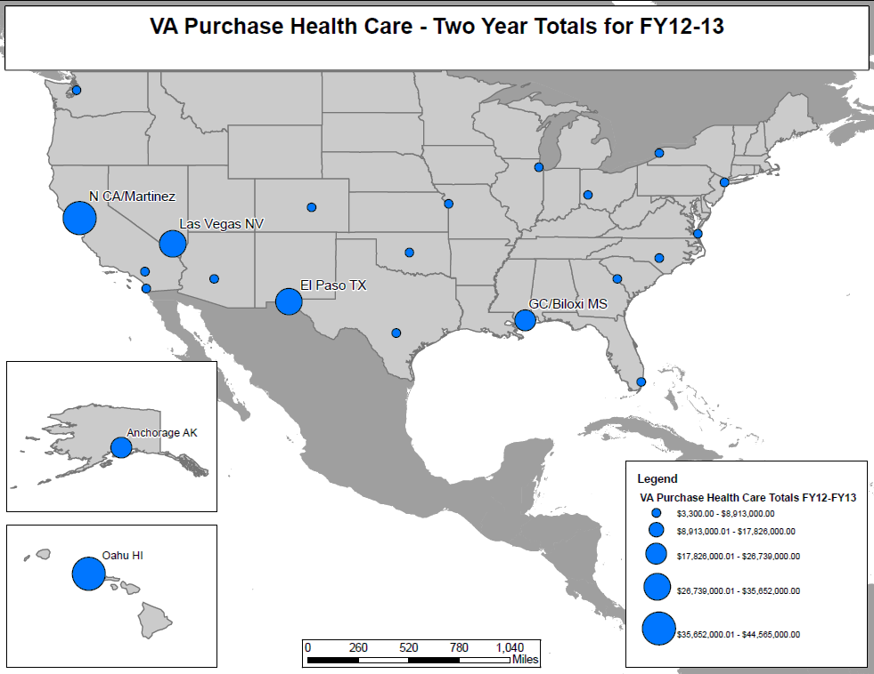
VA Purchase Health Care
FY12-FY13 Total
$212M
Notes:
VA Purchase Health Care – Two Year Totals for FY12-13
Need total
============
HIMSS v1 Information interoperability

Slide 11
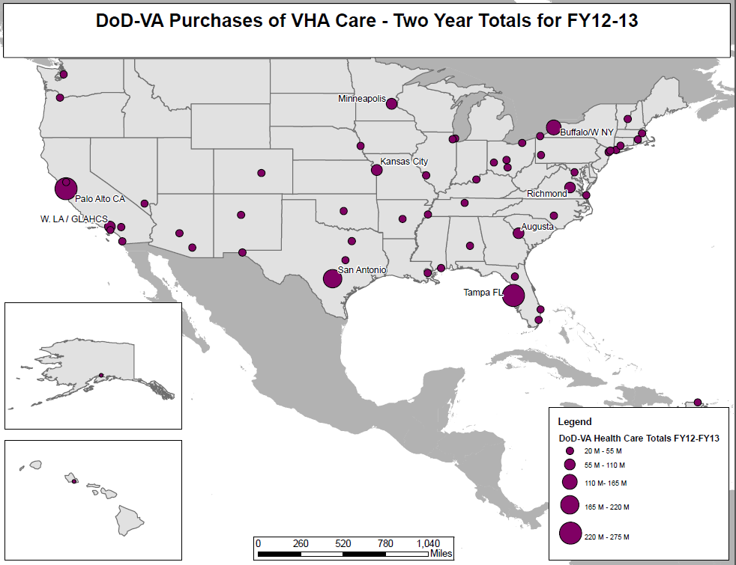
DoD-VA Purchase of VHA Health Care
FY12-FY13 Total
$1.6B
Notes:
DoD purchased $1.6 Billion in care from VA in last two fiscal years (collections)

Slide 12
79% of Veterans see private health care providers.
Notes:
The benefits that we hope to realize include providing real time access to critical health information needed at the point of care, eliminating the need for patients to hand carry copies of their health records from provider to provider.
In addition, access to shared health information has the potential to reduce duplicate tests and procedures as well as reducing the potential for adverse events related to drug/drug interactions for patients receiving multiple prescriptions from various sources.
=======================
Slide content
Did you know that 79% of Veterans see private health care providers?¹
External Health Information Exchange
Enables clinicians to make more informed decisions
Reduces the need for patients to carry paper records between health care providers
Provides immediate access to additional health care information during an emergency
Supports Population Health Management
Helps others meet Meaningful Use criteria
External Health Information Exchange Can Ultimately Equal
Improved patient care and health outcomes
Fewer duplicate tests
Increased patient safety (e.g. medication reconciliation)
Improved Care Coordination
Reduced phone calls to follow-up and track referrals
Timely access to critical information
Saved time, money, and other resources for Veterans and VA staff
Expedited results notifications
Enhanced Security and Privacy
¹Per the 2010 Survey of Veteran Enrollees’ Health and Reliance Upon VA, VA, Office of Policy and Planning, July 2011

Slide 13
VA Business Case: Sharing Data with Private Sector Providers
VA
Non-VA
VLER
Veteran Health Information Exchange
Reduces need for Veterans to hand carry records
Reduces duplicate testing
Increases safety by providing comprehensive health information
Empowers Veterans through consent preferences
Notes:
VLER SLIDE DECK:
The Virtual Lifetime Electronic Record (VLER) Health program includes two Veteran Health Information Exchange services to share health data between VA and non-VA health care providers – improving care coordination for Veterans
Because most Veterans who receive VA care also receive medical treatment in the community (this could be on their own or by VA sending them to a non-VA provider), there are significant opportunities to share health information*
VLER Health VA Direct is designed to be more secure and efficient than faxing, mailing, or hand-carrying health information.

Slide 14
Virtual Lifetime Electronic Record
(VLER)
VA
Non-VA
Exchange – VA and non-VA providers retrieve health information
Direct– VA users send and receive encrypted health information with non-VA partners
Notes:
VLER SLIDE DECK:
The Virtual Lifetime Electronic Record (VLER) Health program includes two Veteran Health Information Exchange services to share health data between VA and non-VA health care providers – improving care coordination for Veterans
Because most Veterans who receive VA care also receive medical treatment in the community (this could be on their own or by VA sending them to a non-VA provider), there are significant opportunities to share health information*
VLER Health VA Direct is designed to be more secure and efficient than faxing, mailing, or hand-carrying health information.

Slide 15
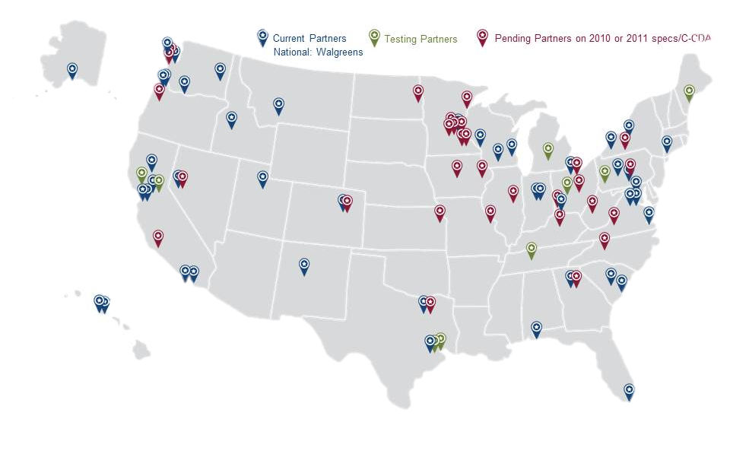
Non-VA Partner Health Data Sharing
VLER
Notes:
VLER SLIDE DECK:
29 Non-VA Partners Actively Sharing Veterans’ Health Data with VA Clinicians

Slide 16
WHAT
is
Veteran
JLV
JLV
Notes:
[remove eHMP] & incorporate VistA 4 graphic
=====
Vision
– Veteran-centric design:
Patient data belongs to the patient
Should accompany them to all clinical encounters

Slide 17
Integrated read-only view of health data
VA, Department of Defense (DoD) & VA VLER partner sources
JOINT LEGACY VIEWER

Slide 18
Significant improvement in system efficiency
Supports VA, VBA, DoD users and workflows
Web-based GUI
Easy-to-learn user interface
BENEFITS
&
FEATURES
JOINT LEGACY VIEWER
Notes:
Features
Web-based Delivers health data from multiple Composite Health Care System, AHLTA Clinical Data Repository and VistA* hosts
Key data domains mapped to National Standard codes, such as SNOMED-CT, LOINC, and RxNorm. These mappings enable correlations (normalization) between DoD and VA data.
Easy-to-learn, intuitive user interface with customizable widgets and configurable layout
In production, 508 certified, piloted by >800 unique users
Benefits
More complete understanding of patient health status
Significant improvement in latency and system efficiency as compared to existing viewers
Supports VHA, Veterans Benefits Administration (VBA) and DoD users and workflows
Reduces printing, scanning and faxing of paper records

Slide 19
“Make like things look alike…”
NATIONAL DATA STANDARDS
Notes:
[Shane mentioned a better screenshot will be provided] -2/5/15
==============
Allergy
Immunizations
Laboratory results
Medications
Radiology Exams
History (Social, Family, PMH)
Notes
Problem List
Vitals
Orders
Community Health Summaries

Slide 20
VHA
VBA
DoD
CURRENT JLV USERS
Notes:
================
High utilizers of Bidirectional Health Information Exchange (BHIE) (e.g., VistAWeb, Computerized Patient Record System (CPRS) Remote Data View) and other viewers – who seek VA-wide and DoD data to support their workflows
VHA
Polytrauma team members
Federal Recovery Coordinators
Compensation and Pension (C&P) clinicians
Clinicians serving dual consumers (e.g., DoD retiree receiving Tricare and VA care) or Veterans discharged from Active Duty since 2002
VBA
Veterans Service Representatives and Rating Veterans Service Representatives
Military Records Specialists
DoD
Integrated Disability Evaluation System (iDES) clinicians
Medical Evaluation Board (MEB) clinicians

Slide 21
MAY 2013 to JAN 2015
2,110 Unique Users of JLV
40,252 JLV Logins
69,057 Records Viewed
JLV CUMULATIVE USAGE
Notes:
JLV Implementation began MAY 2013

Slide 22
EXPANSION PLAN
Notes:
NEXT STEPS
================================
JLV is available at all VA Medical Centers as of October 1, 2014
In a phased sequence
Individual users across the VA enterprise will be invited to use the application by email
Users will be prioritized based upon their current utilization of interagency (BHIE) data
As more capacity becomes available, JLV will continue to expand the number of VA users until reaches HEC approved 2,500 limit

Slide 23
Capacity Allocation
Rollout Throttling
Instrumentation Key to Success
E X P A N S I O N P L A N
Notes:
=============================
Capacity Allocation
Users will be invited to access JLV based on an analysis of current BHIE transaction volume data. We will then target invitations to users by name in this group, on a rolling basis starting in mid-October 2014.
Rollout Throttling
The data driven roll out process will be throttled, up or down, based on stability and success metrics to be determined before the process begins in October 2014.
Instrumentation key to success
System instrumentation and dashboard capability is key to the success of the data driven rollout, and ability to make real time decisions for deployment throttling.

Slide 24
JLV v2.2 Access Controls
VA approved users
Consistent with DoD Access Procedures
A C C E S S C O N T R O L S
Notes:
=====================
Access Controls:
JLV v2.2 access will be controlled through an authorized user list (“white list”) based on individual PIV certificate identification.
All VA approved users must be:
Health Care Providers
Benefits Professionals
Consistent with DoD access procedures

Slide 25
JLV: driven by clinicians to improve access to data
User Feedback: critical factor and key driver in application improvements
USER-CENTERED DESIGN
Notes:
================================
END USER FEEDBACK
The JLV application was created initially in the field and driven by clinicians to improve access to data from other facilities
User feedback has been the key driver in improving the application
Feedback for JLV 2.2 will be captured
SuS Survey
JLV Newsfeed
New Service Requests
Email

Slide 26
J L V T R A I N I N G
Notes:
======================
Objectives
Provide high quality training that optimizes use of distance learning technologies in order to provide the most flexible training to users independent of schedule and geographic location.
Prepare JLV end users with necessary information to integrate the use of JLV into existing workflows with minimal disruption.
Equip Help Desk personnel to support JLV end users
Methods
Training module will be available in the VA Talent Management System (TMS)
Live interactive webinars through FY15Q1

Slide 27
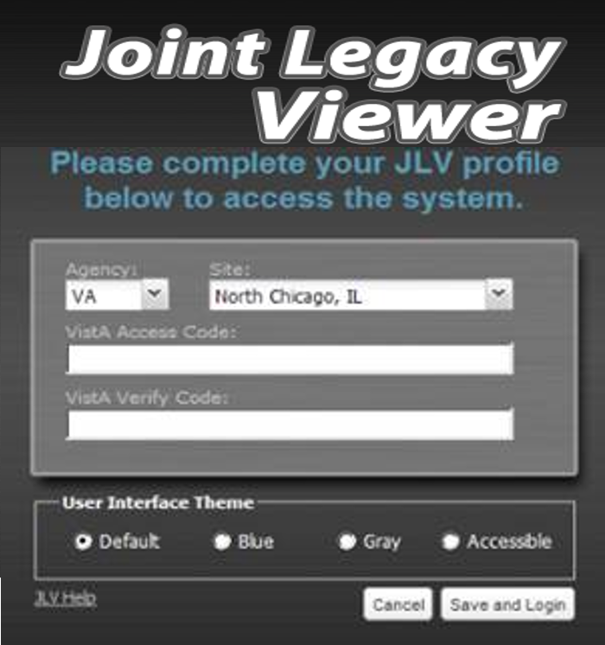
Initial Login
JLV joint legacy viewer
Notes:
Your initial Login will look different than subsequent Login screens. You will be asked to set your color scheme, your agency and your location the first time around – we’ll cover that later. To make this presentation viewable on this media we’ll be using the “Blue” color theme.

Slide 28
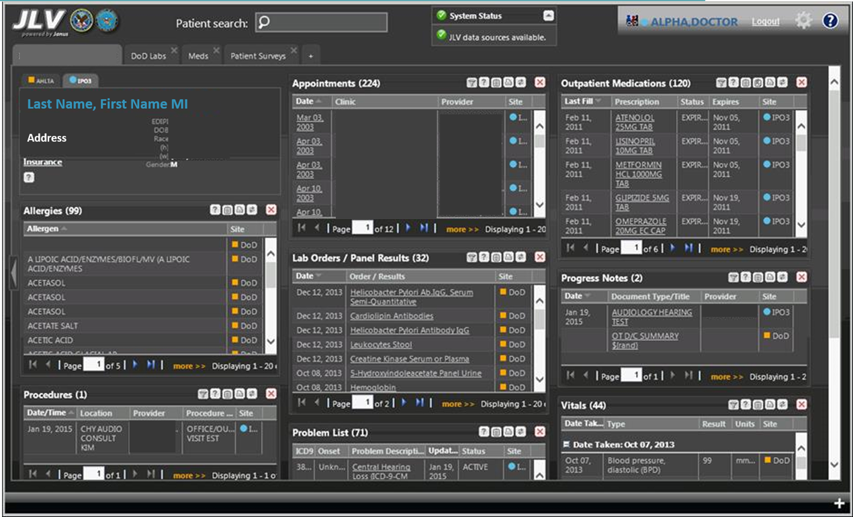
Dashboard
JLV joint legacy viewer
Notes:
Why don’t we go FULLSCREEN HERE?
The Help Menu can be accessed by clicking on the Question mark icon in the upper right hand corner of the screen.. The cover page will also display the contact information for your Service Desk on the first page.
The Help menu contains extensive information on all topics and controls within JLV. Topics can be chosen from the table of contents in the left pane. These topics open in a separate window as an overlay for reference. . The topic window can then be closed by clicking on the red X in the upper right corner.
Alright, we can bring it back.

Slide 29
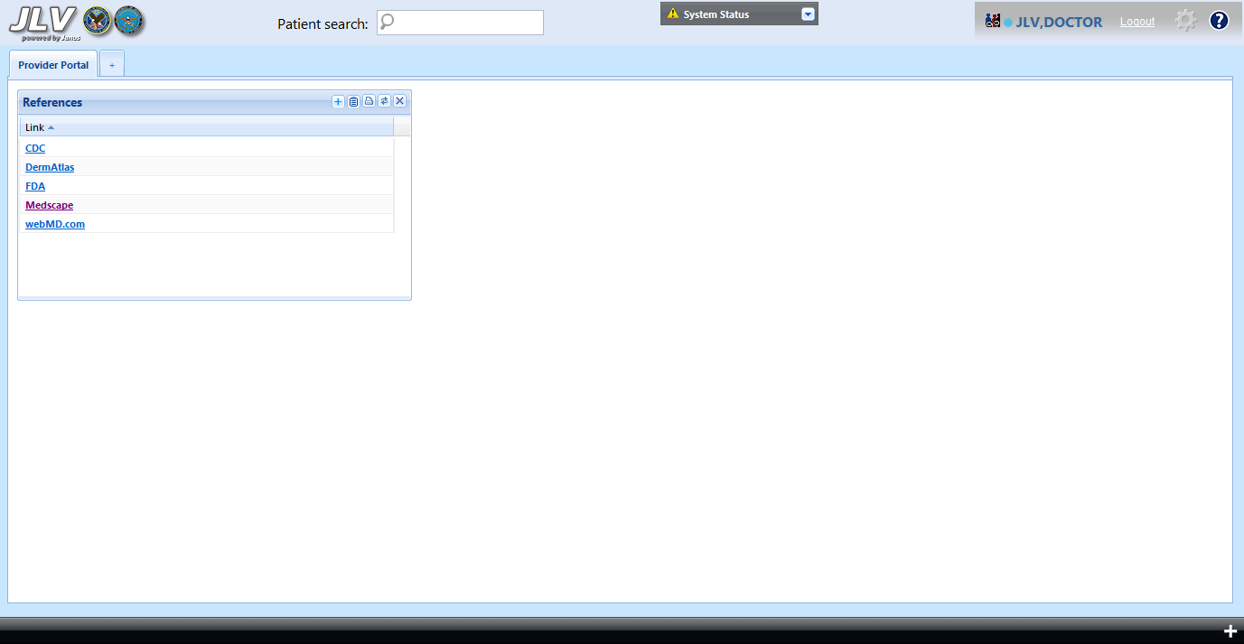
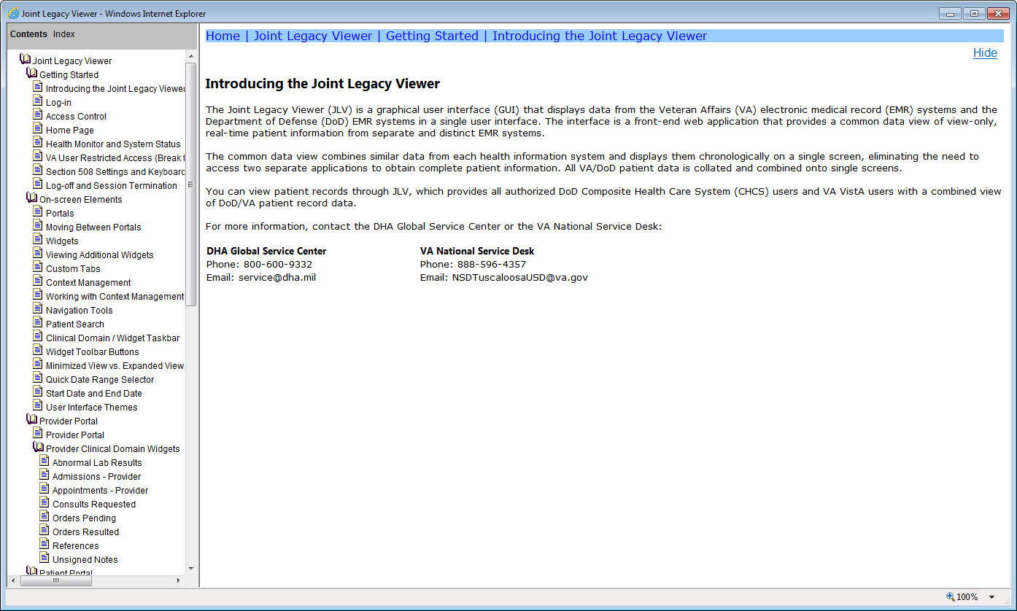
Help Menu
JLV joint legacy viewer
Notes:
The Help Menu can be accessed by clicking on the Question mark icon in the upper right hand corner of the screen.. The cover page will also display the contact information for your Service Desk on the first page.
The Help menu contains extensive information on all topics and controls within JLV. Topics can be chosen from the table of contents in the left pane. These topics open in a separate window as an overlay for reference. . The topic window can then be closed by clicking on the red X in the upper right corner.

Slide 30
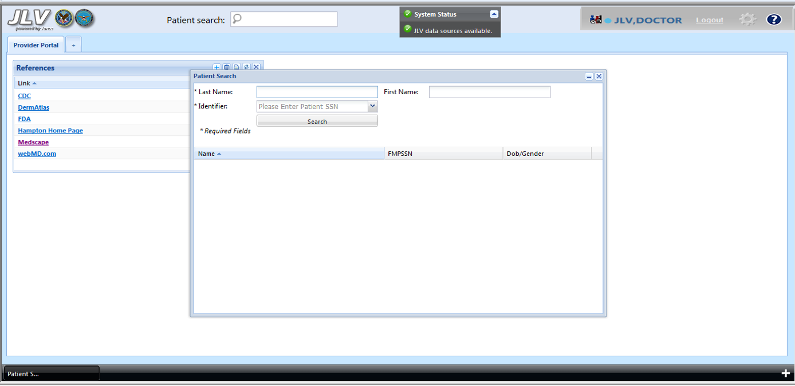
Patient Search Tool
JLV joint legacy viewer
Notes:
To access the real power of JLV, you will need to enter the Patient Portal.When JLV is launched, you may go directly to the Patient Portal.This happens because JLV is aware of the patient selected in other context aware applications such as CPRS or VistA Imaging. Similarly, if the patient is changed in CPRS while JLV is open, JLV will change to the new patient.
You may select a patient in JLV at any time by clicking on the Patient search tool located at the top of the application, just left of center.
When the patient search window opens, the required fields are the last name and the full social security number.
For the time being, a full social security number is required to meet security requirements for patient identification and to speed up the search for your patient since sites throughout all of the VA and DoD are being queried. Work is being done to simplify patient search.

Slide 31
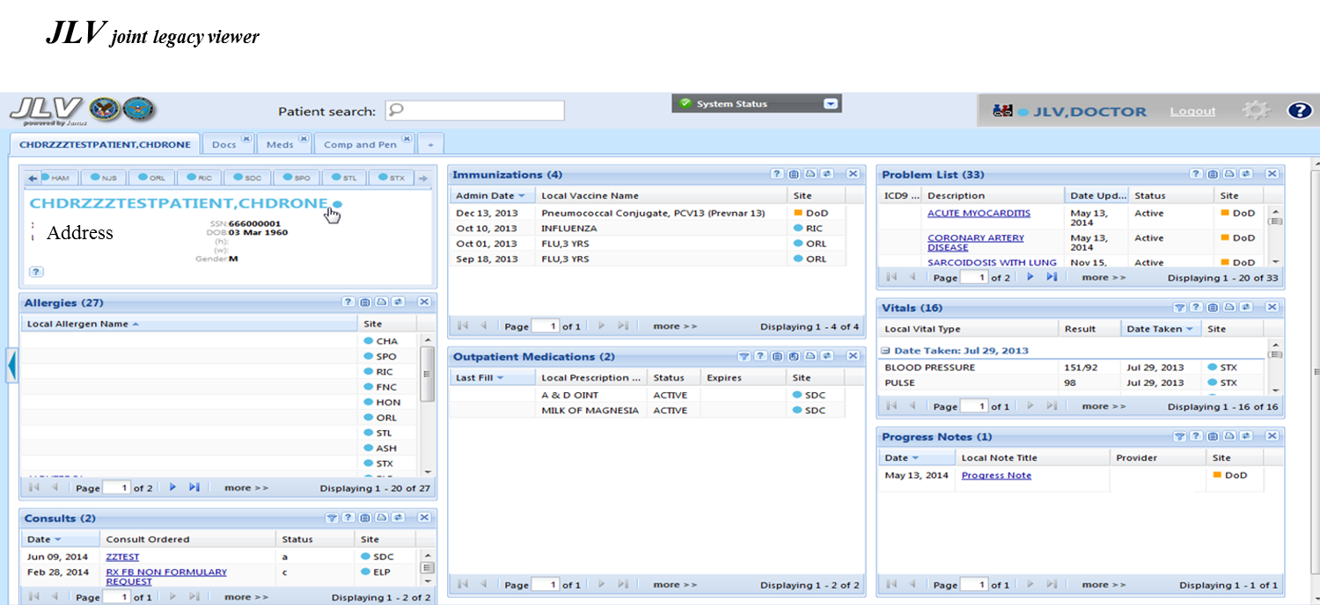
Patient Demographics
Notes:
After reviewing the alerts, the Patient Portal is presented. The first tabbed workspace has a persistent patient demographic area in the upper left.
This area includes sub tabs just above the patient name that show all sites of care for this patient. The blue dots indicate the presence of registration data from VA sites and the orange squares indicates that DoD registration information is available. Hovering your mouse over a VA 3-letter identifier will display the full name of the site.

Slide 32
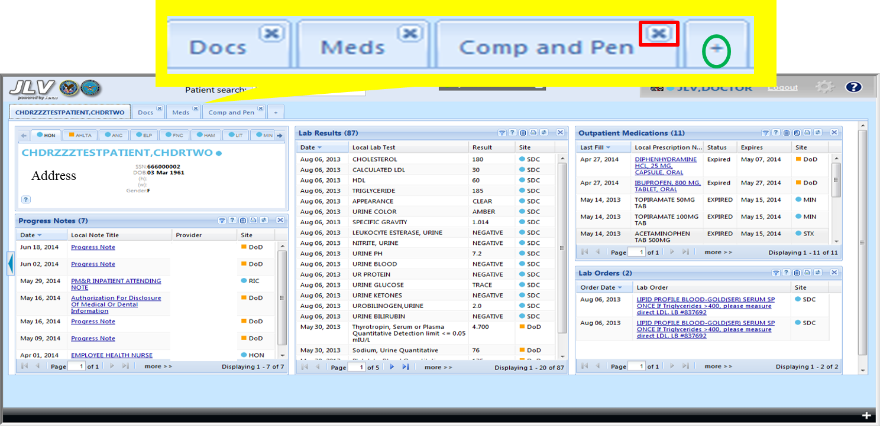
Tabs
JLV joint legacy viewer
Notes:
The patient portal is made up of tabbed, user-defined workspaces on which you may add patientdata widgets. We’ll explore widgets in more detail later.
One default Tab represented by the Patient Name will always be present. This tab and any user-created tabs appear in the upper left of the application window. To create new tabs, click on the plus sign to the right of the existing tabs.
Each new tab will create a blank page in the Patient portal for you to populate with widgets that suit your workflow. If you need examples of useful layouts, please refer to your online resources.
Tabs may be removed by clicking the X in the upper right hand corner.This will delete the tab from your workspace. Once deleted, you will not be able to restore this tab. You will have to rebuild it.
A final note on the patient portal; there is a thin arrow on the left of the screen that will allow you to ‘swipe’ back to the provider portal or to view your provider-centric widgets such as the references widget

Slide 33
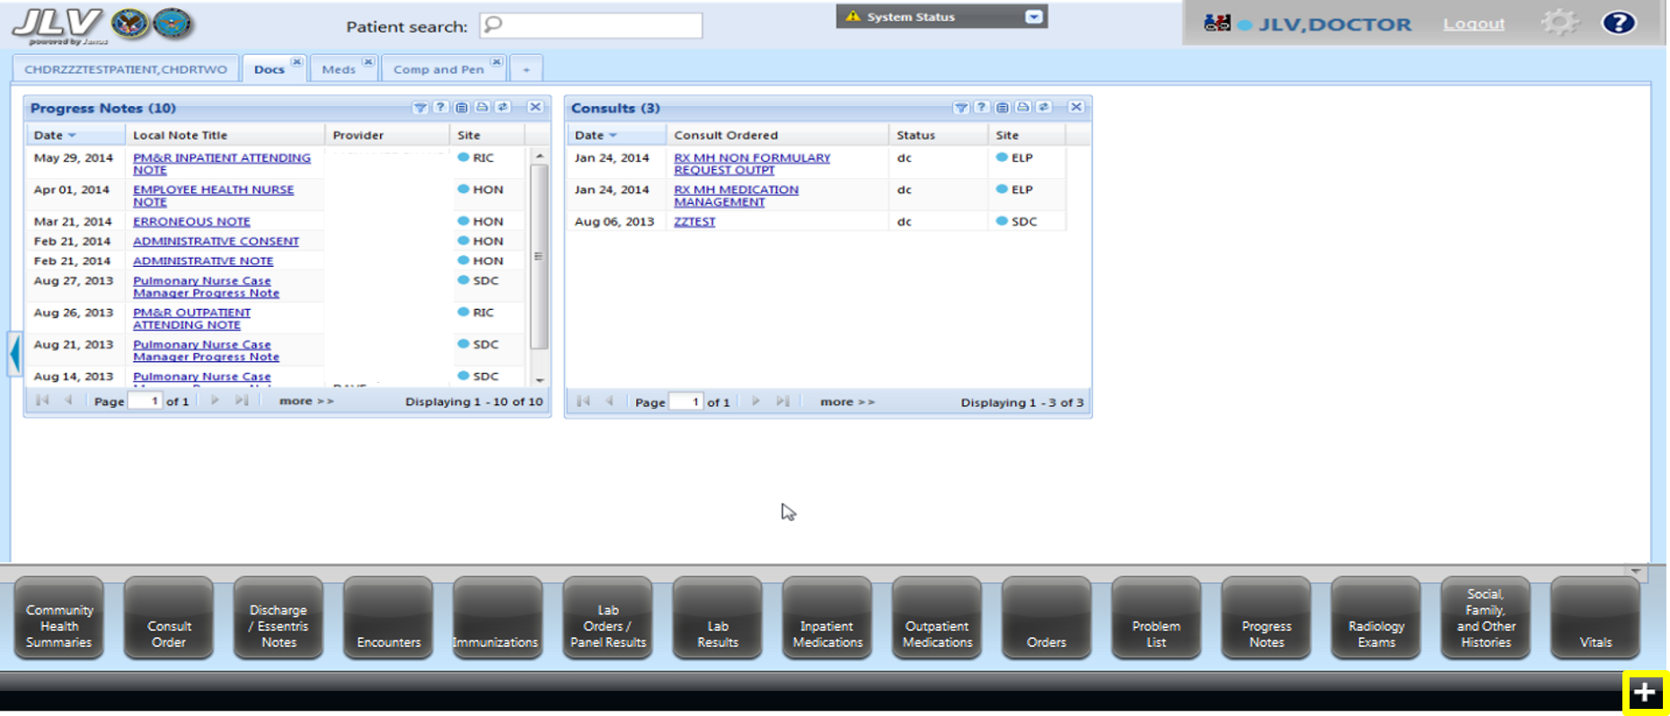
Widget tray
JLV joint legacy viewer
Notes:
A list of all available widgets can be accessed by clicking on the plus sign in the lower right corner of the page. This action opens a pop up task bar called the widget tray.

Slide 34
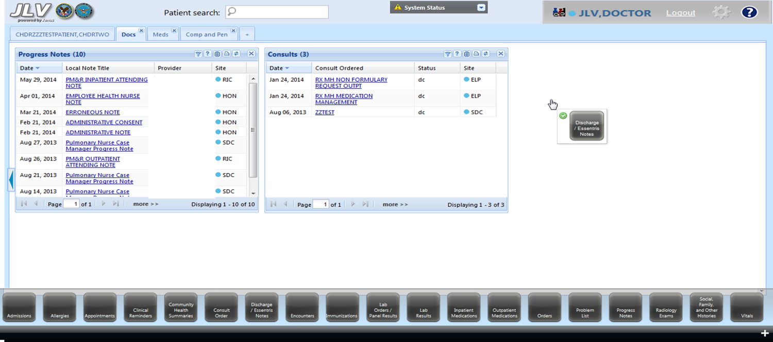
Widgets adding
JLV joint legacy viewer
Notes:
Widgets can be dragged and dropped in to any one of three columns in your tabbed workspace.
To add a widget, left click on a widget in the widget tray and drag it to the desired location and release.

Slide 35
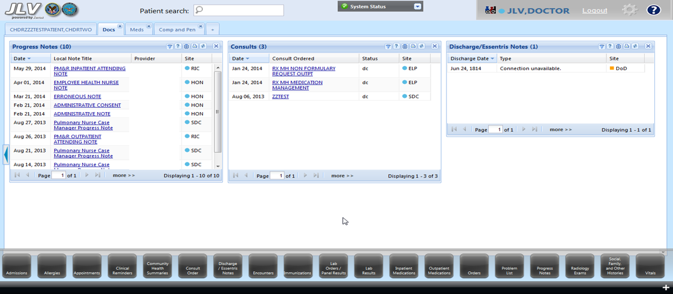
New Widget added
JLV joint legacy viewer
Notes:
This widget is now part of the tab until removed by clicking on the x in the upper right.
Widgets are easily resized, moved or deleted. Changes made to a widget filter, such as date range on one tab will not carry over to other widgets on the same tab page.
Similarly, changes made to a widget on one tab do not carry over to widgets on other tabs even if they have the same name. This holds true for widget size, position, and any data filters you apply, like the date range. Each tab page is independent of the other.
Widgets combine data from many data sources so you must pay attention to the context in which they are displayed. In this example, the Discharge/Essentris Notes widget contains VA discharge summaries and DoD Essentris notes which include several types of inpatient notes, including the discharge summary.

Slide 36
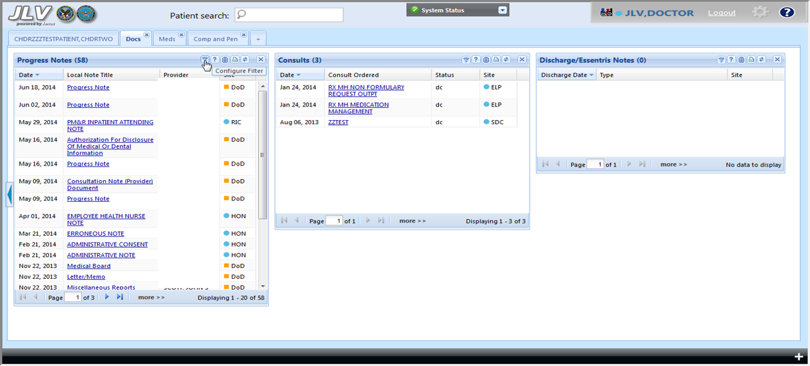
Widget Filters
JLV joint legacy viewer
Notes:
Widget filters help organize the data for ease of use The most common type of filter modifies the date range. To use this feature, click on the filter cone icon, in the upper right of the widget. Date filters vary slightly depending on the data type.

Slide 37
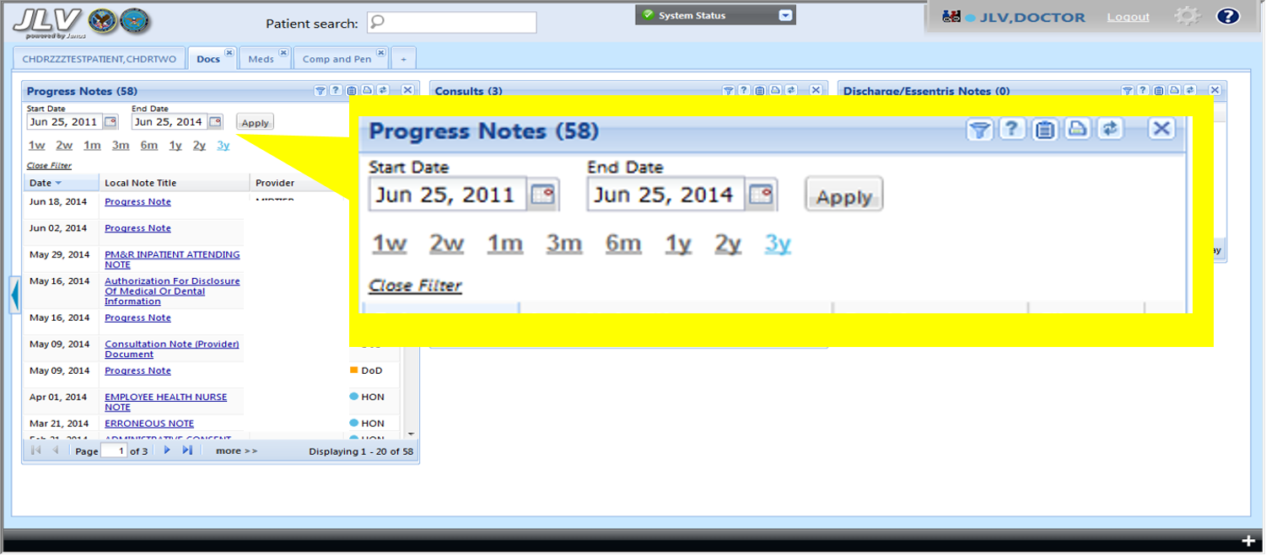
Widget Filters
JLV joint legacy viewer
Notes:
This graphic shows a date filter dialog with several options. The select filters range from 1 week to 3 years. Custom date ranges can be created by changing the start and end dates in the edit box. . Change these by highlighting the digits you want to change or use the calendar tool by clicking on the calendar icon.

Slide 38
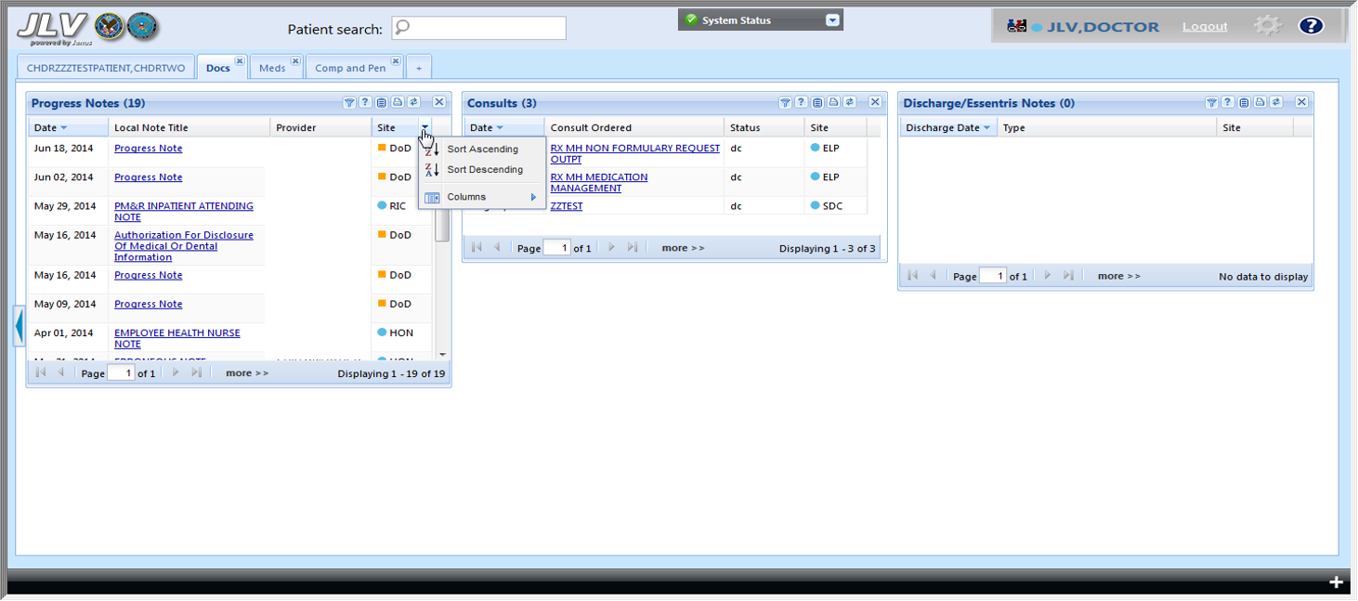
Widget Sorting
JLV joint legacy viewer
Notes:
Sort columns by clicking on the header and specify sorting in ascending or descending order.

Slide 39
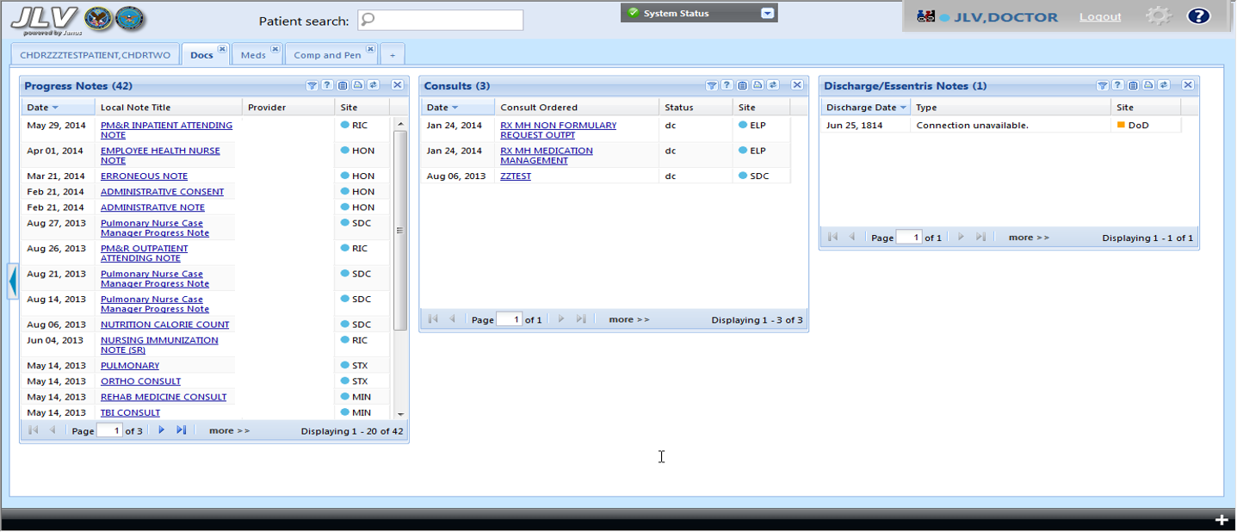
Widget Page Controls
JLV joint legacy viewer
Notes:
At the bottom of each widget are page controls allowing you to view all data in that widget if the number of rows of data exceeds that of the widget display. The ribbon indicates the number of pages in that widget and provides navigation tools. The most important of these is the more>> link.

Slide 40
Widget Expanded Display
JLV joint legacy viewer
Notes:
Most widgets have a more>> link at the bottom, next to the page controls. Clicking on this link will bring up an expanded widget view

Slide 41
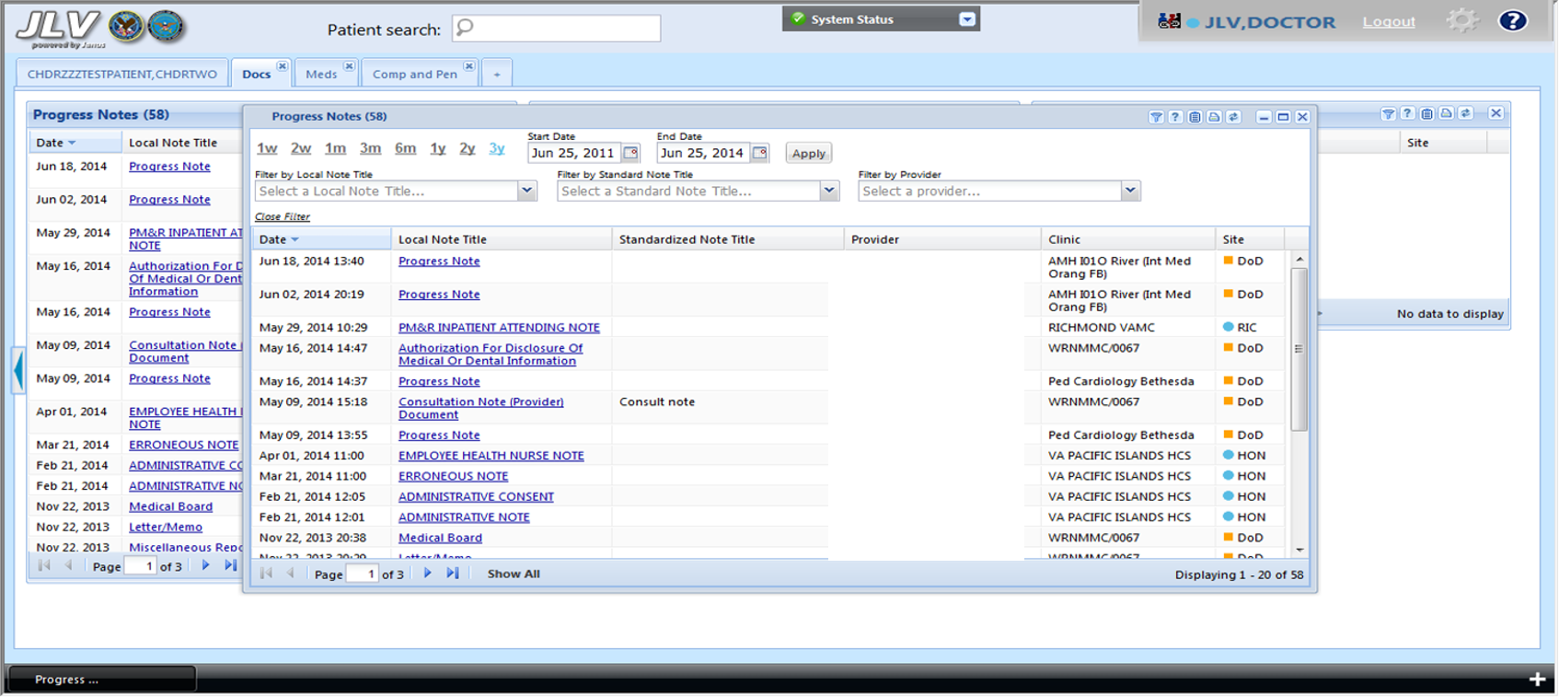
Widget Expanded Display
JLV joint legacy viewer
Notes:
Expanded widgets may have automatic filtering tools to assist in locating data. In this expanded progress notes widget, the filters for local note title, standard note title and Provider are automatically applied to the data retrieved within the selected date range.
Clicking on drop arrows of these filters will display unique titles or unique providers associated with these notes.
At the top of each drop list is the ‘All’ selection which restores the original list of notes retrieved from the specified date range
And now I’d like to introduce my colleague Marcia….

Slide 42
V I S T A E V O L U T I O N
FY2015
eHMP
JLV
VLER
HMP
Notes:
MARCIA:
The stand-alone JLV application is only a waypoint on the path to a state of the art, interoperable, standards based ERH –
this is the Enterprise Health Management Platform.
We need to bring all these things together under one platform. This will also include CPRS. The longer term plan is for eHMP to replace CPRS.
By the end of FY2015, Version 1 of eHMP will be delivered and include robust features, including all JLV functionality.
SHANE: Current JLV functionality available in eHMP
Seamless interoperability for VA and DoD standards-based health data
Provides an integrated, chronological view of real-time electronic health record information from all VA and DoD facilities where a patient has received care
Incorporates semantically normalized data where mappings are available
MARCIA: Current HMP functionality available in eHMP
Google-like search across a patient’s record
Context-aware infobuttons that provide patient-specific, evidence-based information related to medications
Medications Review combines disparate data domains and provides access to order history, refill history and renewal due date
Timeline Events
SHANE: Current eHMP Functionality from Virtual Lifetime Electronic Record (VLER) Health
Provides Access to Community Health Continuity of Care Documents (CCD)
Provides a summary of current/pertinent historical information about a patient from a specific facility
Content Modules include: patient/person information, allergy/ drug sensitivity, problem list, medications (outpatient and self-reported meds), lab results (hematology/chemistry) vital signs, immunizations, encounters, information source, next of kin, and surgeries/procedures

Slide 43
“Improve access to health care & provide an exceptional patient experience, every time.”
- Blueprint for Excellence
Enterprise Health Management Platform
Notes:
MARCIA: A major strategic focus for VA right now is the Blueprint for Excellence
Which is a framework for action based on a number of touchstones, including:
VA Strategic Plan
VHA Strategic Plan
VA Health Care Modernization Study
Veterans Access, Choice and Accountability Act of 2014
In 2015 two key elements for healthcare are to:
Improve access to health care and provide an exceptional patient experience, every time.
Improvement in these areas will increase Veterans’ confidence in the VA and ensure their loyalty.
eHMP is contributing to the patient experience by providing a modern application with enhanced capabilities.
The goal is to enhance support to clinicians and increase the quality of their time spent with patients
SHANE – talk about the impact on physician/patient experience
integrate
http://www.va.gov/HEALTH/docs/VHA_Blueprint_for_Excellence.pdf

Slide 44
Enterprise Health Management Platform
Integration of Health Information Exchange (HIE)
Clinical Decision Support
eHMP
Customizable user interface increases efficiency
Data-driven Population Health decision support
Notes:
MARCIA: Shane talked about VistA Evolution earlier. It is clear that eHMP is a cornerstone of this program.
eHMP will be able to replace much of the functionality found in several other important applications such as JLV and CPRS, but the ultimate goal is to move well beyond the capabilities of our current systems. eHMP will introduce several important new paradigm to increase the sophistication of our systems.
eHMP will be patient-centered so information is organized around patients and follows them through all phases of their healthcare.
eHMP is specifically designed for coordination and communication across entire healthcare teams for a seamless patient experience.
And eHMP will increasingly provide evidence-based knowledge at the point of care to support clinical decision making.
Going back to some of the overarching goals of VistA Evolution mentioned earlier by Shane…eHMP is very central to achieving these goals.
SHANE:
eHMP will be interoperable with EHR systems of the Department of Defense (DoD) and other healthcare partners to give providers a complete picture of a patient’s care and treatment history.
MARCIA:
The eHMP user interface is flexible and modular with user controls and customization to support desired workflow. The goal is to decrease cognitive load and increase efficiency, which can lead to improved experiences for both providers and patients.
SHANE:
As we drive towards standards based Semantic Interoperability, eHMP will take full advantage and provide enhanced Clinical Decision Support at the point of care.
MARCIA:
eHMP will also provide data analytics capabilities to support Population Health Decision Support.

Slide 45
Enterprise Health Management Platform
CPRS
eHMP
JLV VistA Web
Notes:
MARCIA:
eHMP is the infrastructure and user interface that will replace Computerized Patient Record System (CPRS) as VA’s primary point of care application. Over time, more and more CPRS functionality will be available in eHMP. There will be a period of time where both systems will exist and be used at the same time. Users may have options at times of which system they use, but gradually use of eHMP will be mandated, and parts of CPRS will be turned off. Eventually eHMP will completely replace CPRS.
Ask Shane – “Shane, one of the questions I get asked occasionally is why in the world do we want to replace CPRS? It is a great system.”
SHANE: talk about why replace CPRS
More functionality
Simplicity

Slide 46
POLL QUESTION
What does eHMP stand for?
A. Enterprise Health Management Platform
B. Electronic Health Management Platform
C. Evolved Health Management Platform
Notes:
We’d like to know if you’ve been listening ☺
What does eHMP stand for?
A. Enterprise Health Management Platform
B. Electronic Health Management Platform
C. Evolved Health Management Platform
In order to answer this poll question, you can select the BLUE POLLING ICON just above my head and submit your answer choice. We’ll move on and come back to your poll results in a moment.

Slide 47
Clinician-facing application
Integrates VA/DoD interoperability infrastructure
Simplifies access to complete patient history
Provides health information from VA, DoD, & external health partners
Displays longitudinal patient information
eHMP version 1
At a Glance…
Notes:
MARCIA;
Next I would like to give you a quick glance at what will be in the first version of eHMP.
eHMP Version 1 is a read-only clinician facing application that incorporates functionality from both JLV and HMP
Shows longitudinal patient information
Allows clinicians to use comprehensive patient data and images more easily
And, it integrates several functionalities into the VA/DoD interoperability infrastructure to support the VistA Evolution Program’s interoperability commitment
SHANE: These capabilities will give clinicians simplified access to Veterans’ complete patient history from VA, DoD and health partners shown in a single reliable and secure interface
MARCIA;
eHMP Version 1 is the first step towards releasing a software package that will be a CPRS replacement
It offers features not available in other products that will benefit clinicians immediately such as Google-like Search, enhanced Medication Reviews, Infobuttons, community Continuity of Care Documents, Timeline Events about a patient’s history, and an integrated, chronological view of real-time information
From this point forward, the Roadmap for eHMP is laid out for development of additional functionality and new releases approximately every six months. We have established a number of incremental goals, for example, on is to have the majority of outpatient physicians using eHMP instead of CPRS by the end of 2016. Then in 2017 eHMP will focus on replacement of the majority of inpatient capabilities.
During this time, the eHMP platform will become accessible by other developers and vendors so that they may develop specialized or complementary application based on eHMP technologies and interfaces. It is our hope that this will open the door for many open source contributions.
Now let’s get back to those poll results…

Slide 48
POLL RESULTS
What does eHMP stand for?
A. Enterprise Health Management Platform
B. Electronic Health Management Platform
C. Evolved Health Management Platform
Notes:
We asked: What does eHMP stand for?
A. Enterprise Health Management Platform
B. Electronic Health Management Platform
C. Evolved Health Management Platform
And it looks like…. [speak to results]

Slide 49
POLL RESULTS
What does eHMP stand for?
A. Enterprise Health Management Platform
B. Electronic Health Management Platform
C. Evolved Health Management Platform
Notes:
PAUSE….then advance slide

Slide 50
Phased Development & Release of eHMP
Notes:
MARCIA: Now I would like to talk about the schedule for development and release of the first version of eHMP.
eHMP is following a phased development and release process that starts small and then builds to ensure performance and functionality are ready for the enterprise.
Phased deployments have proven more successful than deploying entire major systems at once. Phasing deployment allows users and leadership to make adjustments on a smaller scale, while building user confidence and realizing incremental benefits.
The stages of phased development and release are:
Iterative development work in two week sprints with 1 or 2 eHMP Partner Sites (SHANE elaborate)
Release to small group of Initial Operating Capability (IOC) sites
Release by VISN to lead site in each VISN (perhaps by Region)
Release to all sites in each VISN
Iterative development work continues with Partner Sites during release, preparing for the next release

Slide 51
FY15 eHMP Release Schedule
IOC
6 Locations
Portland, OR
Indianapolis, IN
Hampton, VA
Loma Linda, CA
San Diego, CA
San Antonio, TX
Notes:
MARCIA: The release of eHMP Version 1.1 is already underway.
Starting in January 2015, Six eHMP Initial Operating Capability (IOC) Sites began evaluating eHMP
Hampton, San Antonio, Indianapolis, San Diego, Loma Linda, Portland
At each of these sites we are working with a very small number of testers, approximately 4 or 5 people.

Slide 52
FY15 eHMP Release Schedule
July 2015
30 Locations
Portland, OR
Indianapolis, IN
Hampton, VA
Loma Linda, CA
San Diego, CA
San Antonio, TX
Notes:
MARCIA:
We are now preparing for the release of eHMP to an additional 24 Early Adopter sites, at least one in each VISN, by July 2015
Again, at each of these sites we will only work with a small number of testers. The main point of these first releases is to establish the technical framework and configurations for future releases.
During these early releases, development work will continue. There will be a version 1.2 of eHMP ready for deployment in August. At that time we will begin to train end users and move to enterprise deployment.

Slide 53
FY15 eHMP Release Schedule
Dec 2015
All Locations
Notes:
MARCIA: By the end of December 2015, ehMP Version 1.2 will be released to all 152 VA locations.
The number of users at each site will still be small to begin, approximately 25 users in a clinical setting. Based on system performance and site readiness, we will then determine the pace for adding more users.
Continued development and release of new capabilities throughout FY16 and 17
We are so excited about the progress that has been made, and what will occur over the next few years.
Next…back to Shane to show us what the first version of eHMP looks like.

Slide 54
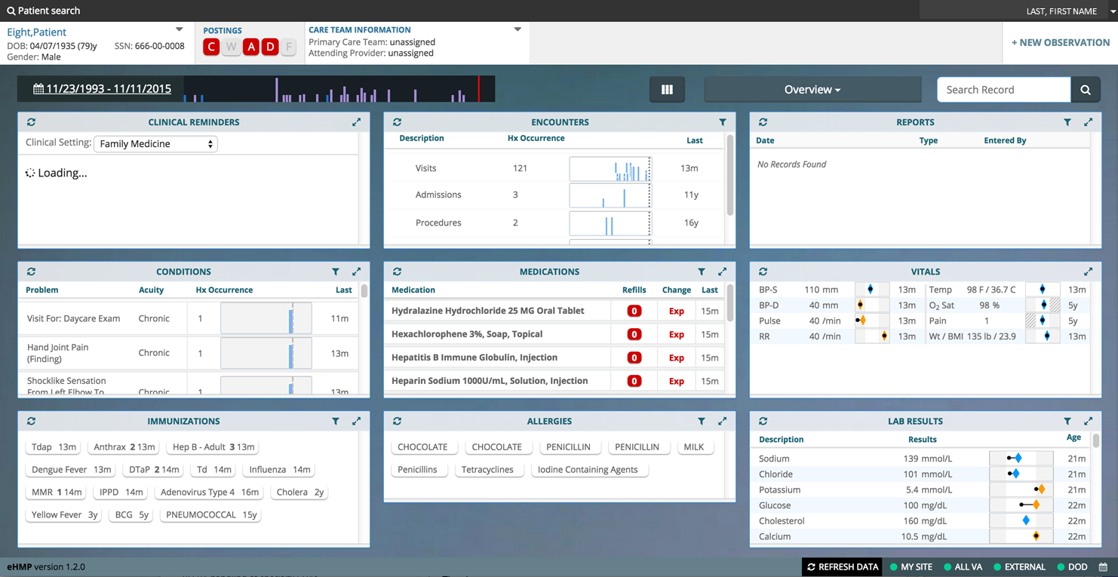
Notes:
Let’s go full screen on this one as well:
[once finished, give cue to pull ppt back]
And we can bring this slide back now.

Slide 55
GLOBAL PATIENT SEARCH
Search and view VA and/or DoD patient data
Notes:
Ability to search for and select a patient as follows:
The user is able to enter search criteria to locate a patient that is registered in the user’s local VistA instance
The user is able to enter search criteria and locate a patient that is registered in another local VistA instance subject to VA privacy and access guidelines
The user is able to search for and locate a VA or DoD patient’s data subject to VA privacy and access guidelines
The user is able to select the patient and view their VA and DoD clinical data
This is a screenshot of the different ways a user can search for a patient.

Slide 56
RECORD SEARCH
Notes:
Enables the user to search a patient’s stored clinical documentation using a particular word or text string, which includes searching against the following clinical data domains:
Notes
Labs
Problem List
Medications
Allergies
This screenshot shows how to conduct a search and how the results will populate.

Slide 57
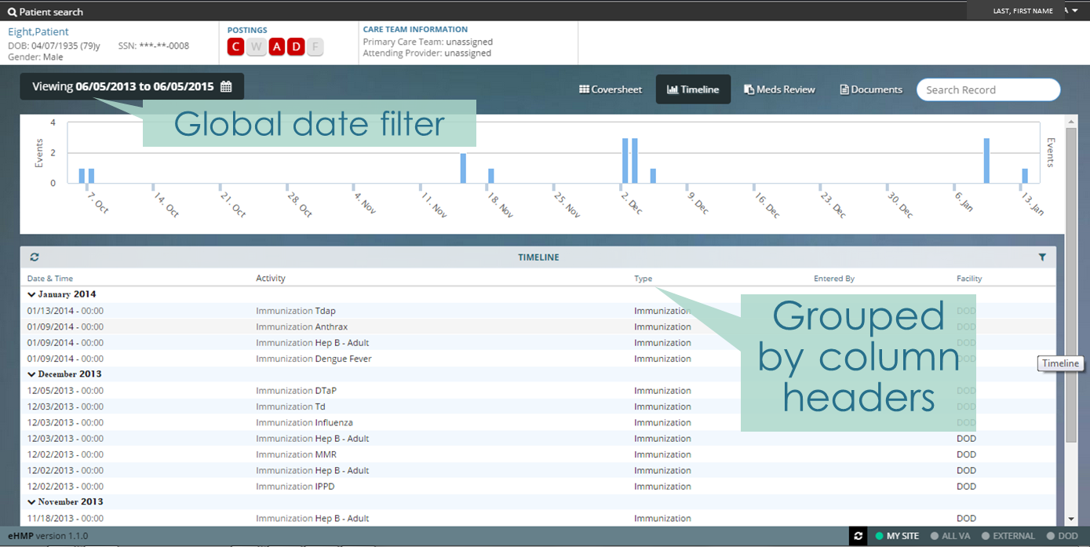
TIMELINE VIEW
Notes:
The Timeline View provides users with information on the patient’s visit history. The information can be filtered by zooming in on a date range or clicking on a column header.

Slide 58
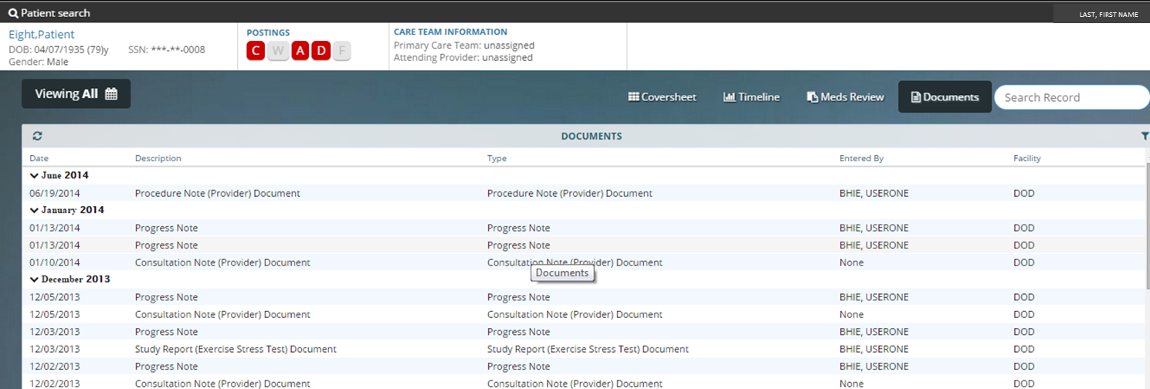
DOCUMENTS VIEW
Notes:
The Documents view provides users with a list of multiple categories of documentation from all sites.
=======================================
Group by column
Detail view integration - Imaging/Rad notes, Consults/Procedure reports, CWAD Documents
Date filtration

Slide 59
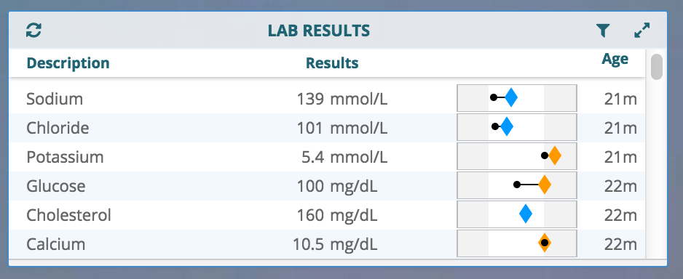
Notes:
New

Slide 60
Notes:
New

Slide 61
To care for him who shall have borne the battle, and for his widow and orphan
“
Abraham Lincoln
”
Notes:
SUMMARY SLIDE

Slide 62
ASK THE
PRESENTER
Notes:
And that’s the end of our formal presentation – if you haven’t submitted your questions yet, you still have time. Go to the ORANGE ASK THE PRESENTER ICON above our heads to submit your question. We’ll take a short break and be back in just a moment.
[STAND STILL AND SMILE until you hear “mic clear”]

Slide 63
Learn More About VistA Evolution & eHMP
Visit the VistA Evolution Share Point site http://go.va.gov/vista_evolution
Visit the eHMP Share Point site
http://vaww.oed.portal.va.gov/pm/iehr/vista_evolution/eHMP
Sign up for VA ForumForUs Community by e-mailing rachel.wiebe@va.gov
JLV Newsfeed Link
https://vaforumfor.us/groups/jlv-newsfeed

