Slide 1
VHA Consult Reporting How to Use this Report
THIS DOCUMENT PROVIDEs DIRECTIONS FOR UTILIZING THE vha Consult Reporting. All current documentation related to consult business rules and tasks can be accessed via this report

Slide 2
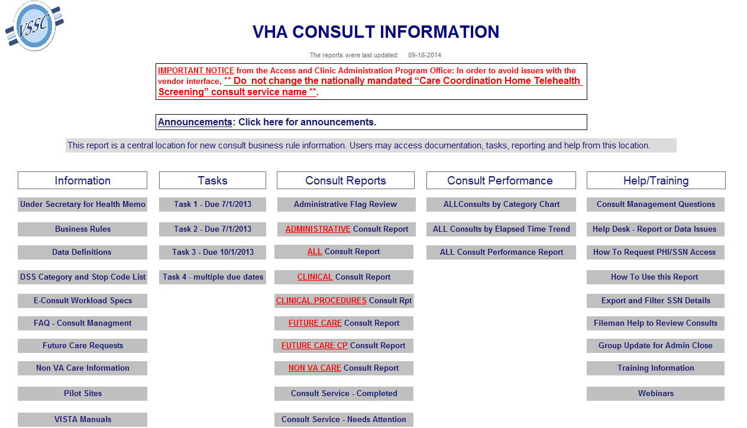
The VHA Consult Information Report provides links to consult information and reporting. The information is grouped by columns of Information, Tasks, Consult Reports, Consult Performance Reports and Help/Training. Important Notices and Announcements can be found at the top of the page.

Slide 3
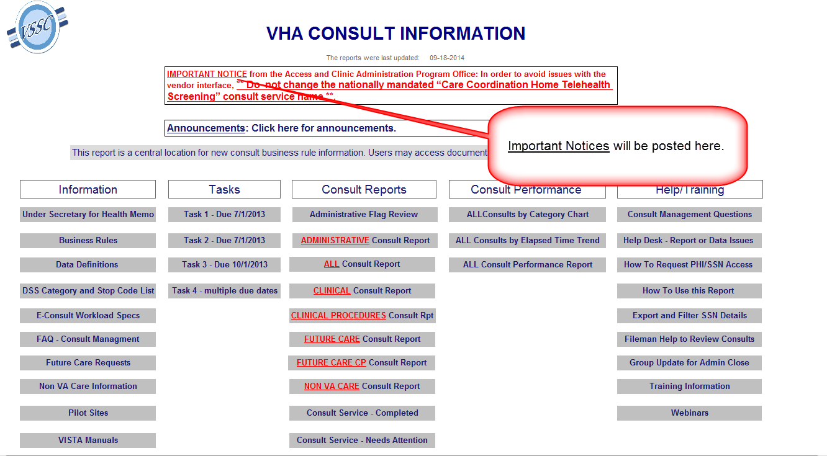

Slide 4
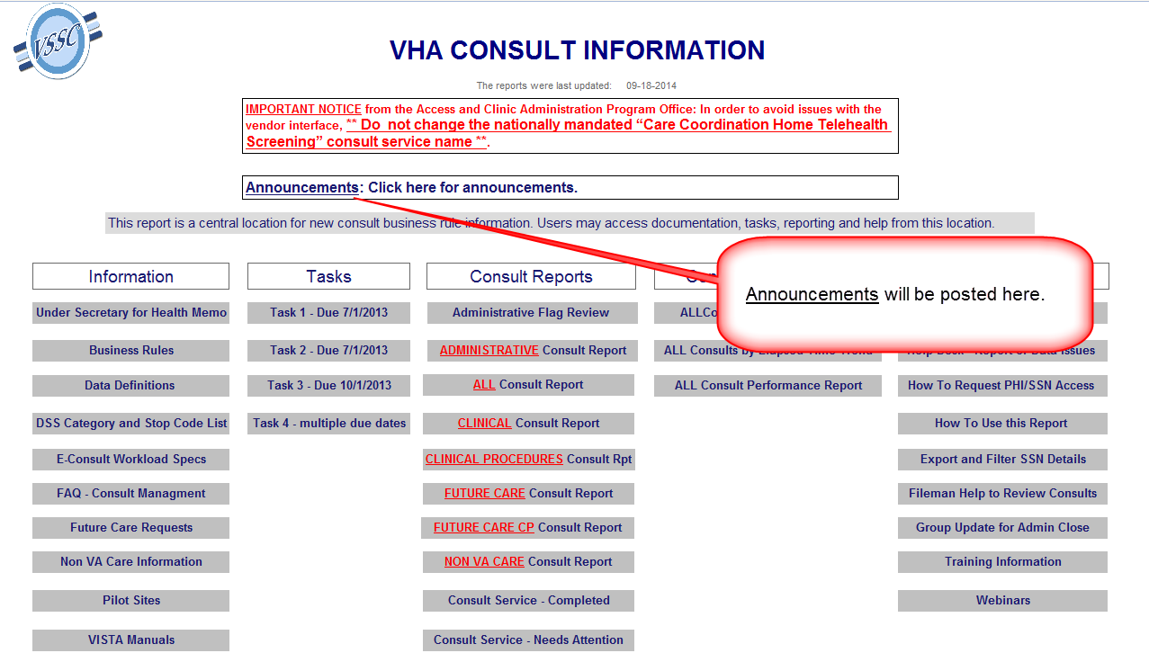

Slide 6
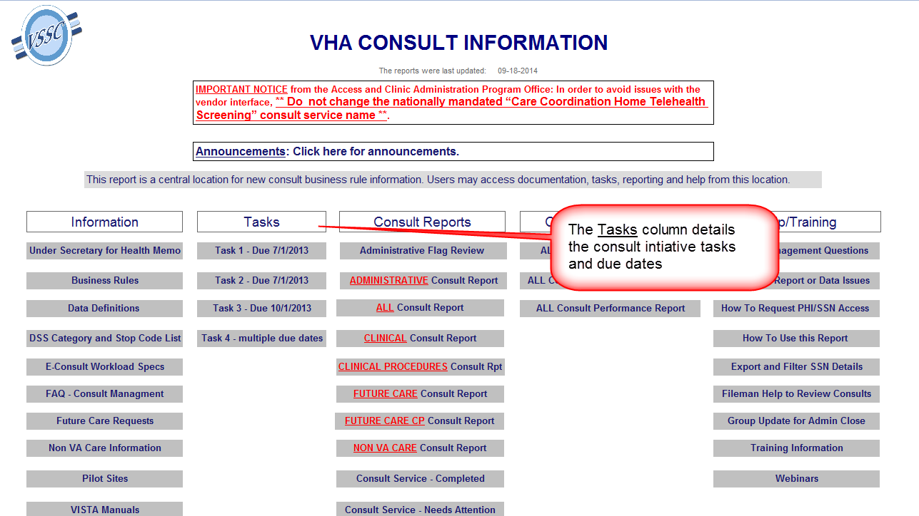

Slide 9
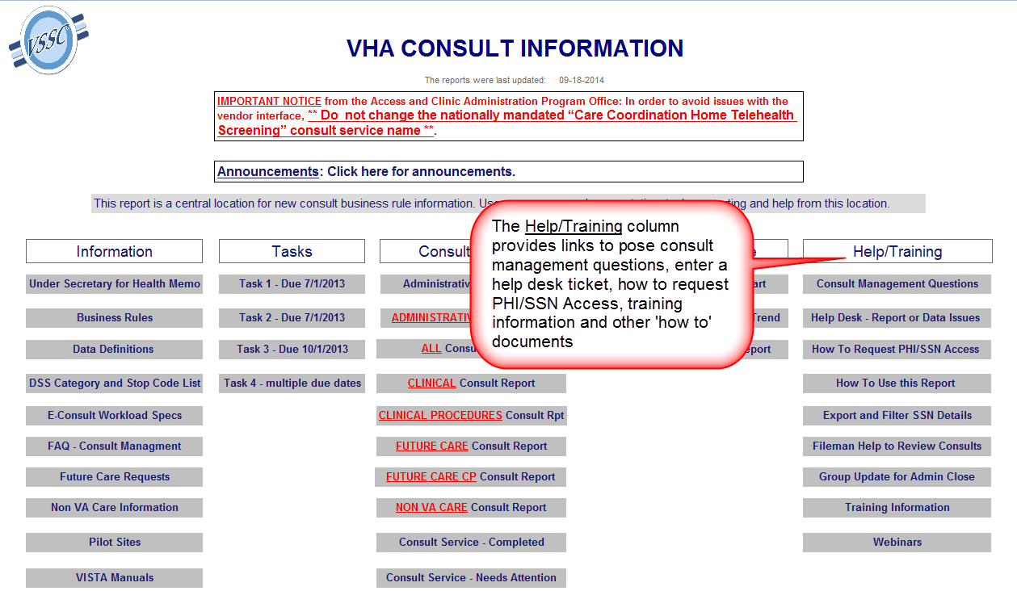

Slide 10
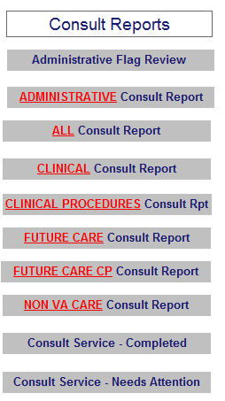
The Consult Reports are described in the following slides. The Administrative, All, Clinical, Clinical Procedures, Future Care, Future Care CP and Non VA Care Consult Reports are built with similar structures so they will not be repeated in detail.

Slide 11
Consult Report Groups are determined by the use of consult service business rule naming conventions and/or flags. The following outlines the logic for consult service classification. All open consults are reported.
Administrative: The administrative flag is used to identify Administrative consult services.
All: This report includes all consults (including prosthetics)
Clinical: Clinical Consults are identified using the consult service naming conventions for Inpatient, Outpatient or Inter-facility. Future Care clinical consults are added to this report once the earliest date has been reached. Consult Services with multiple types or missing types are reported here as well.
Clinical Procedures: Consult services are classified as Clinical Procedure Services when the name is prefixed with ‘CP’. Future Care clinical procedure consults are added to this report once the earliest date has been reached.
Future Care: Consult services are classified as Future Care Services when the Future Care naming convention is used. The earliest date field should be completed with the date the care is due. Consults are moved from this report to the Clinical Consult Report once the earliest date is reached.
Future Care CP: Consult services are classified as Future Care CP Services when the name is prefixed with ‘CP’ and the Future Care naming convention is used. The earliest date field should be completed with the date the care is due. Consults are moved from this report to the Clinical Procedure Consult Report once the earliest date is reached.
Non VA Care: Consult services are classified as Non VA Care Services when the NON VA CARE naming convention is used. The administrative flag should be set to ‘yes’ and stop code 674 should be assigned to the consult service.

Slide 12
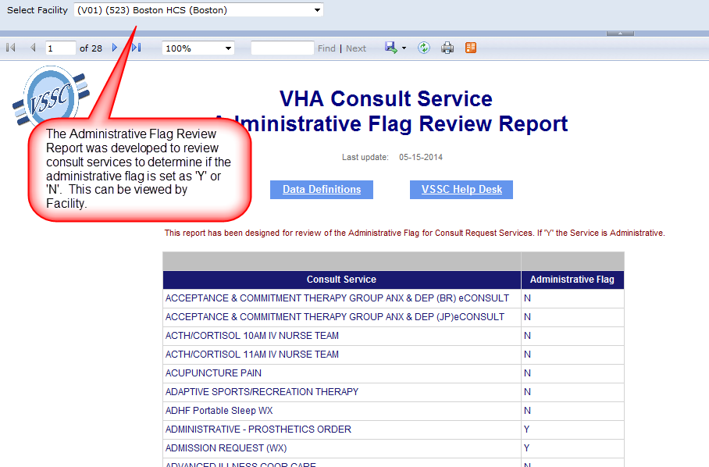

Slide 13
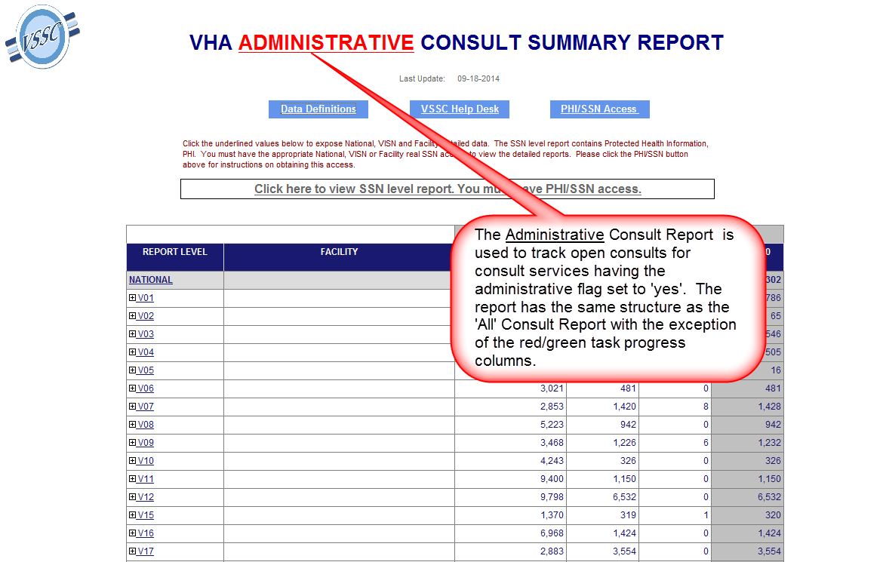

Slide 14
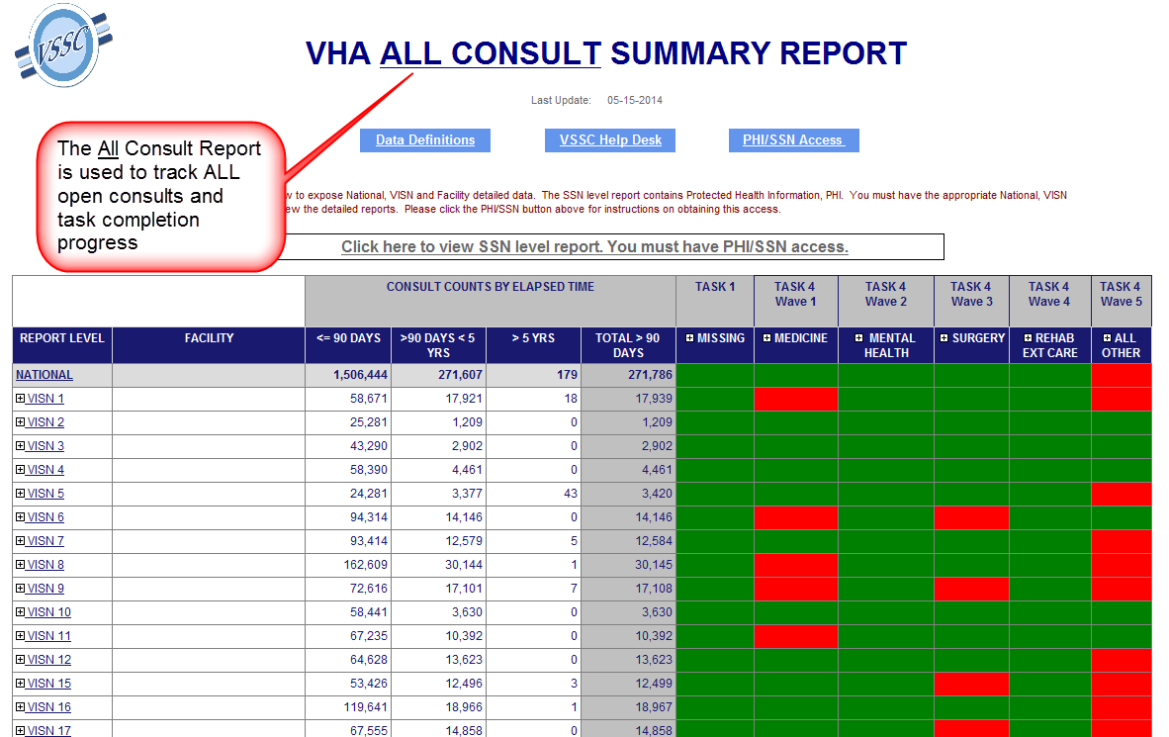

Slide 15
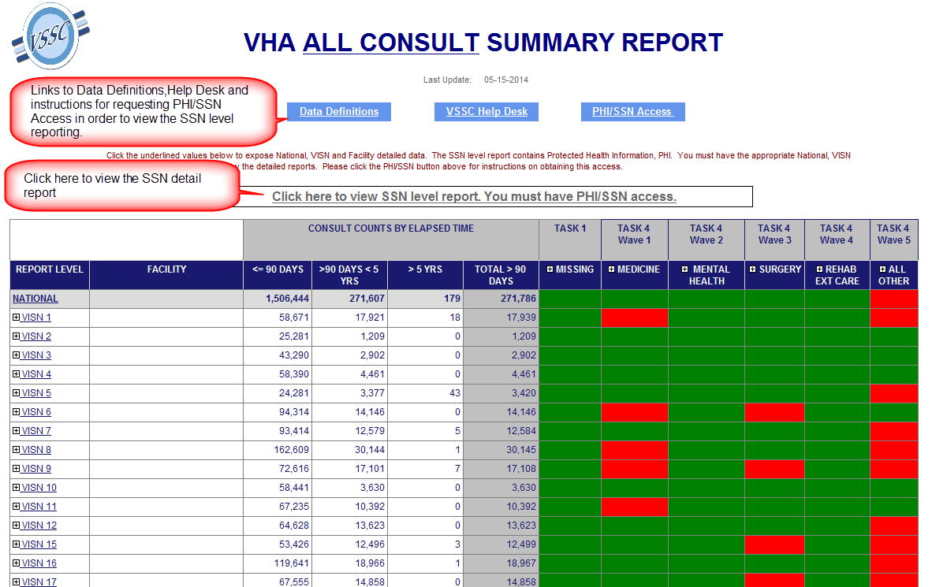

Slide 16
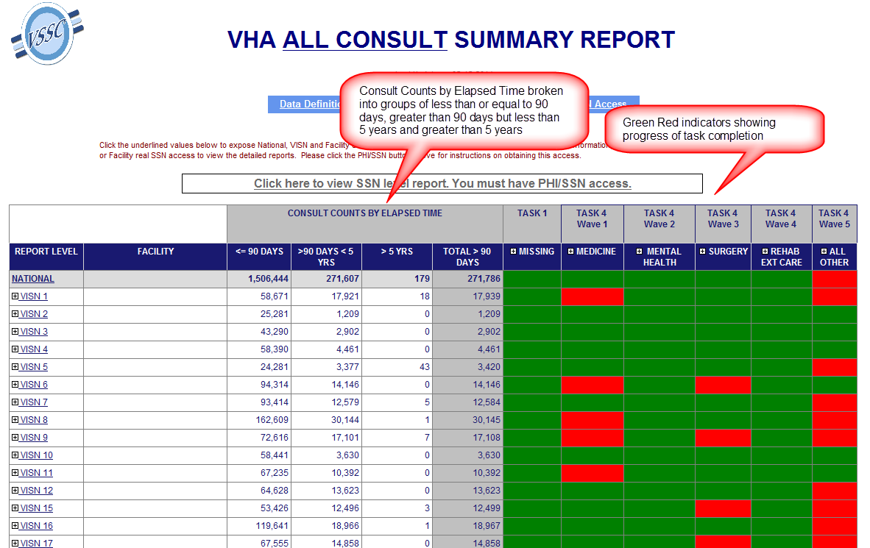

Slide 17
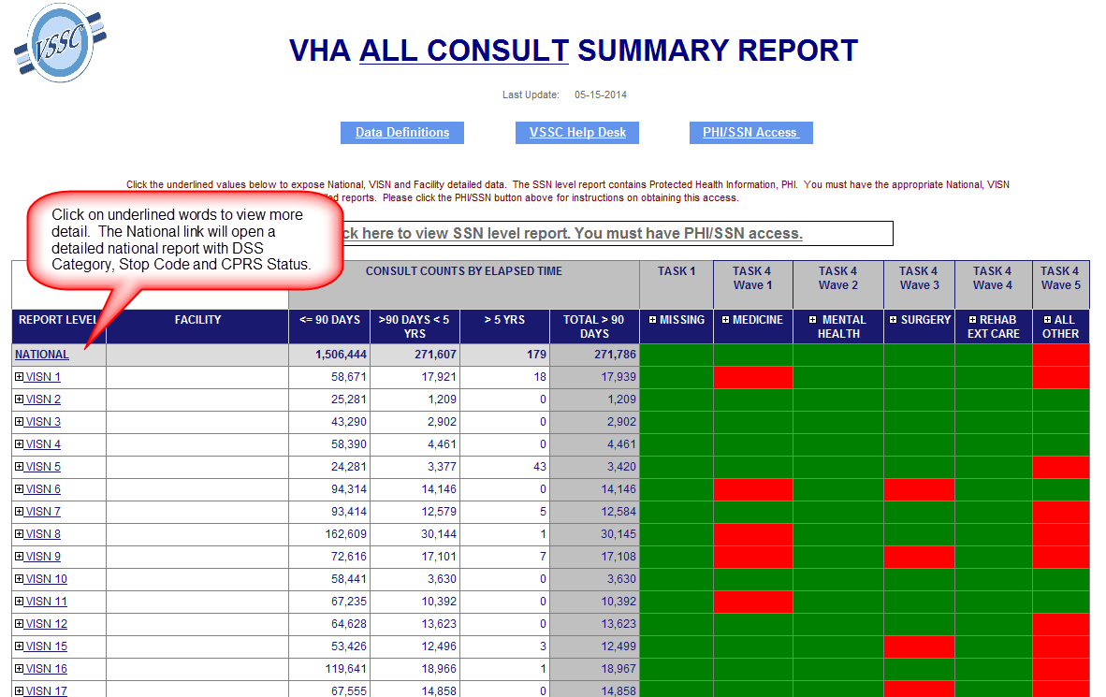

Slide 18
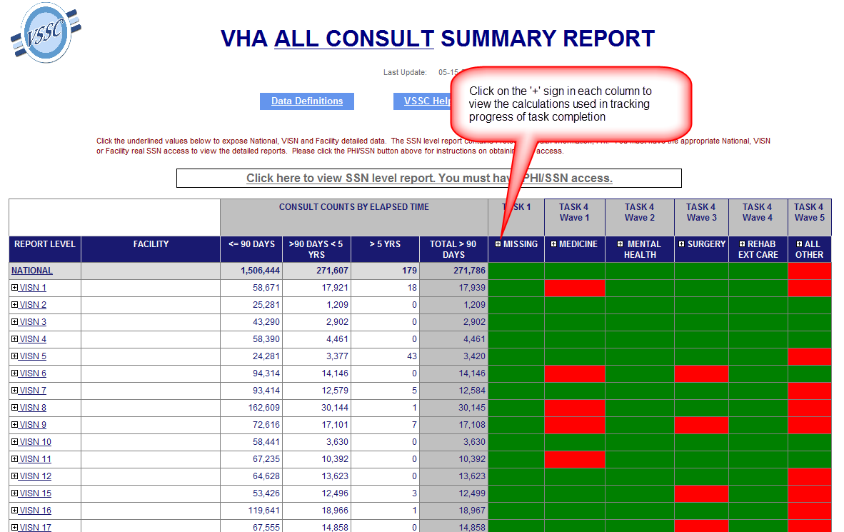

Slide 19
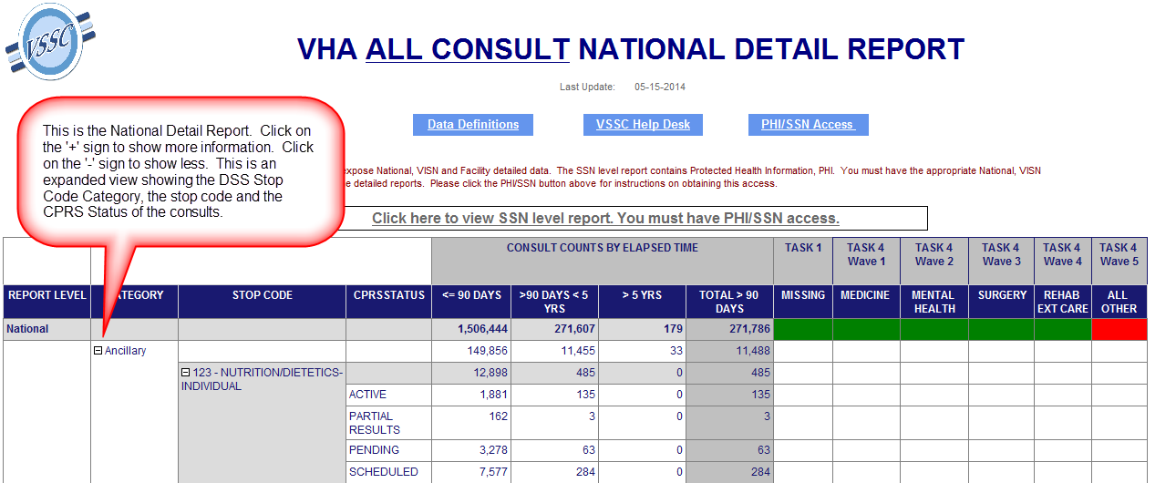

Slide 20
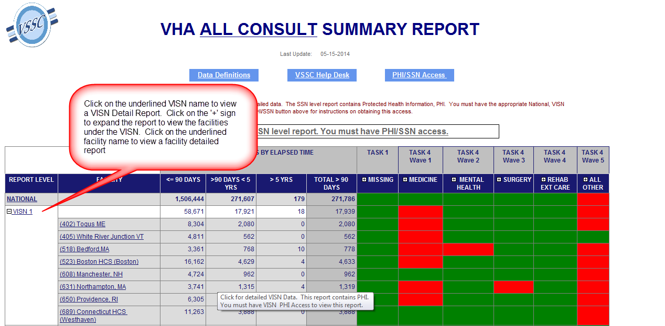

Slide 21
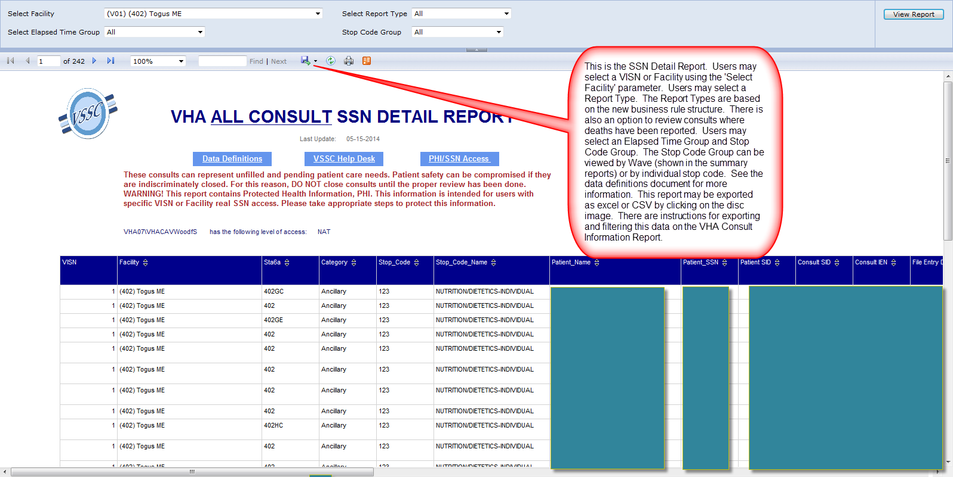

Slide 22
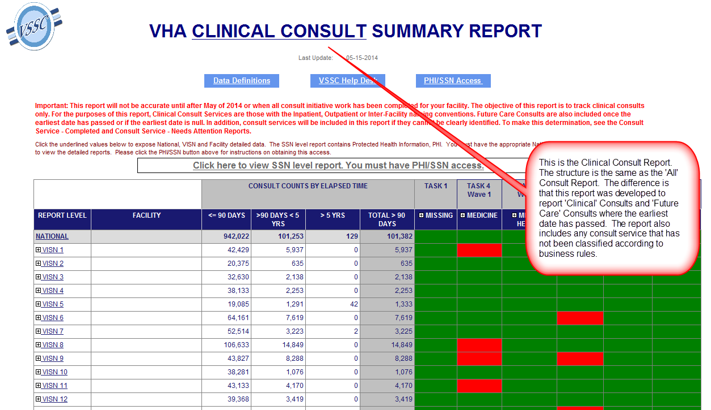

Slide 23
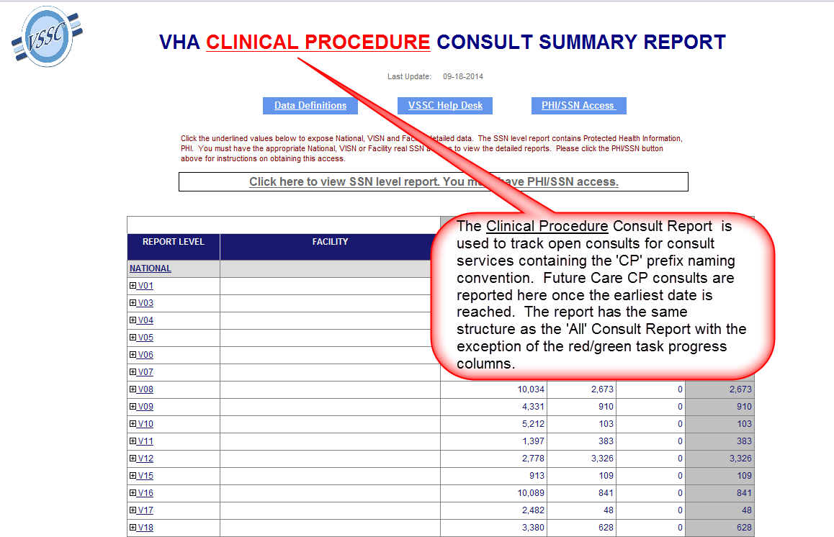

Slide 24
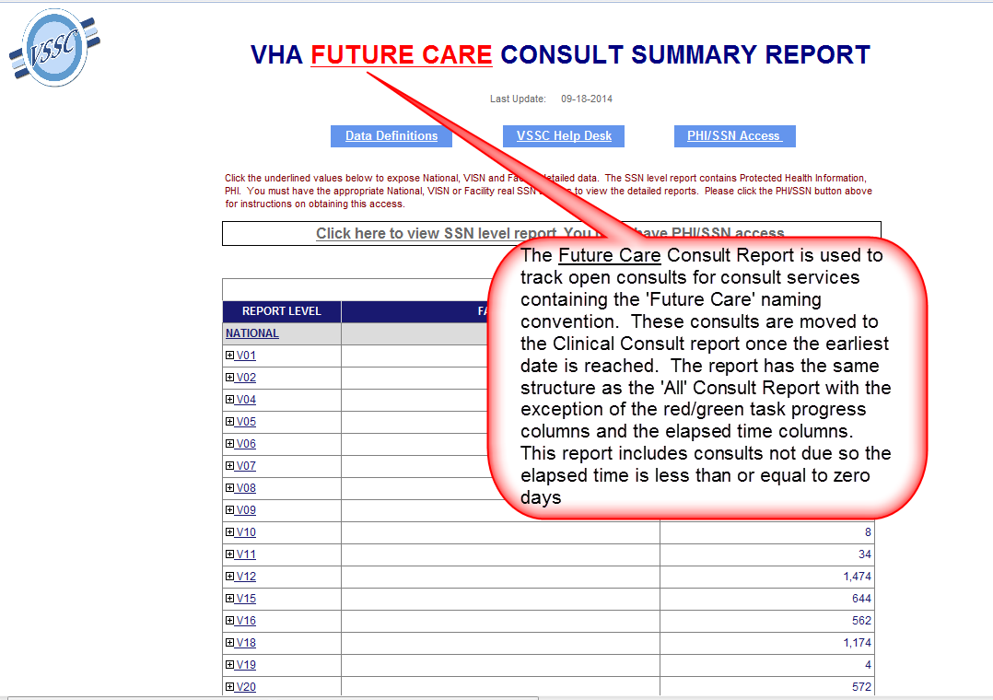

Slide 25
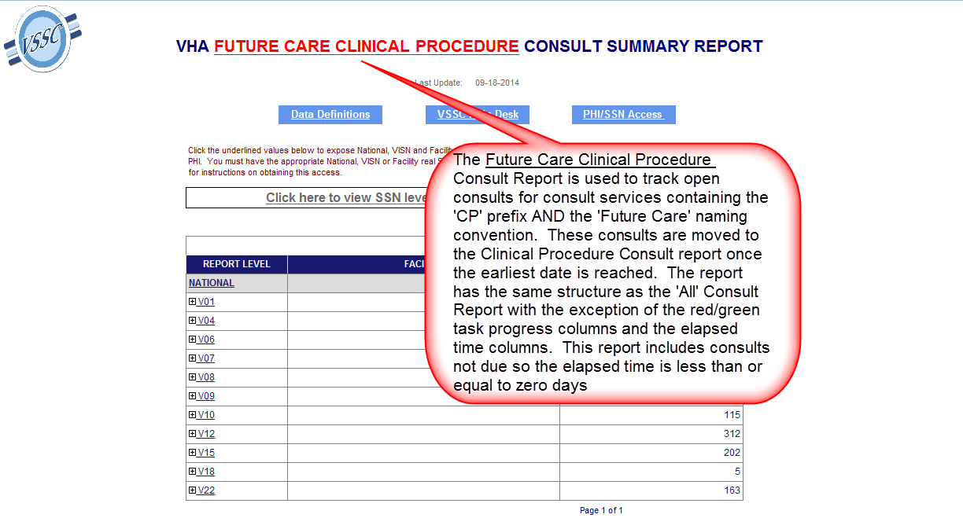

Slide 26
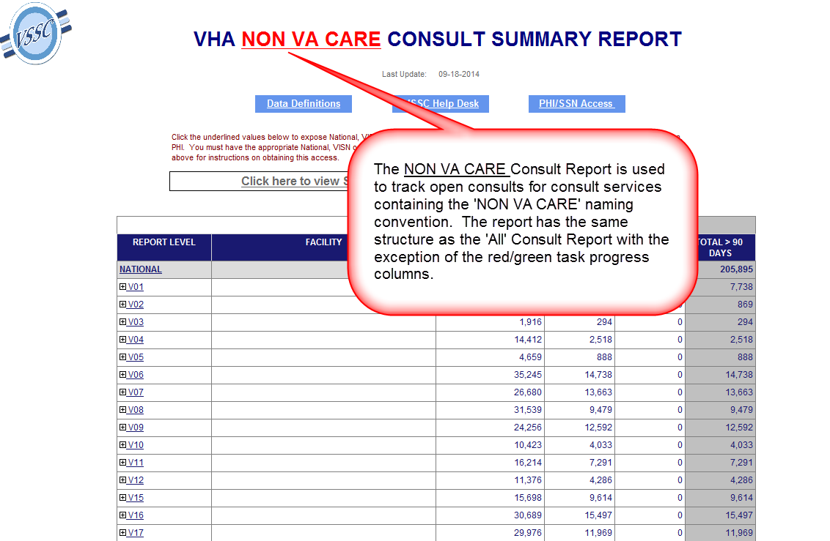

Slide 27
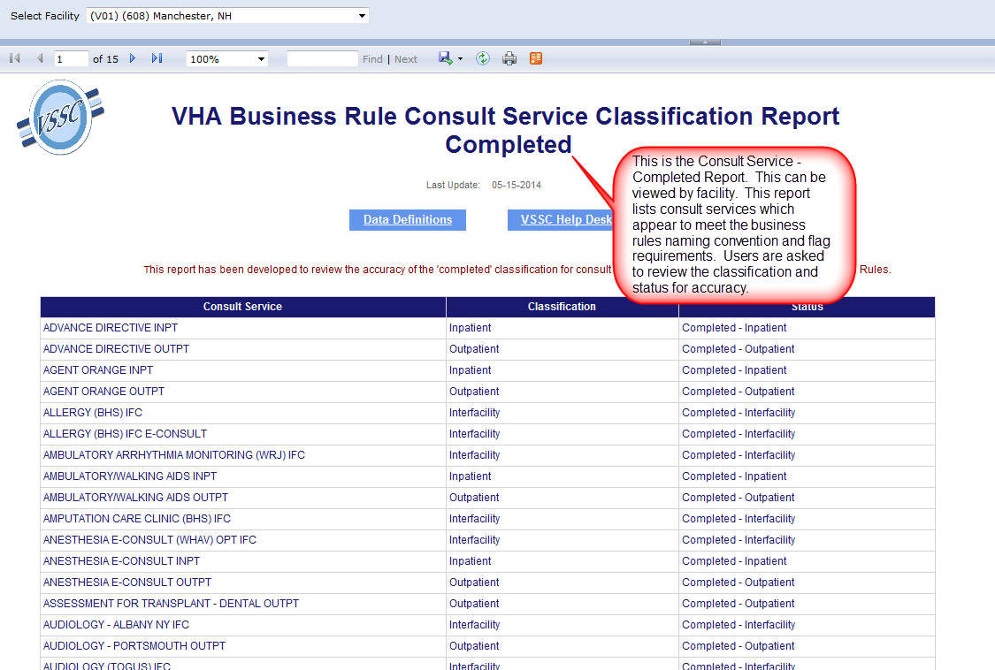

Slide 28
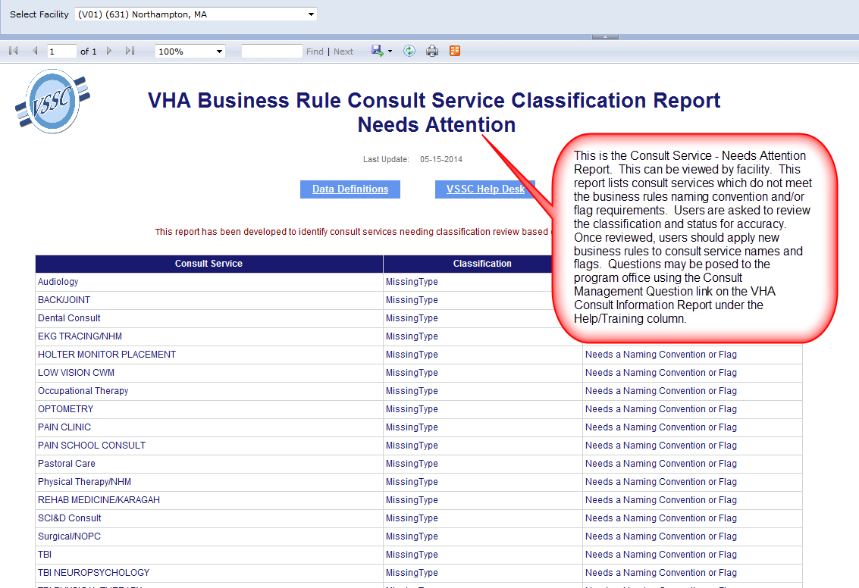

Slide 29
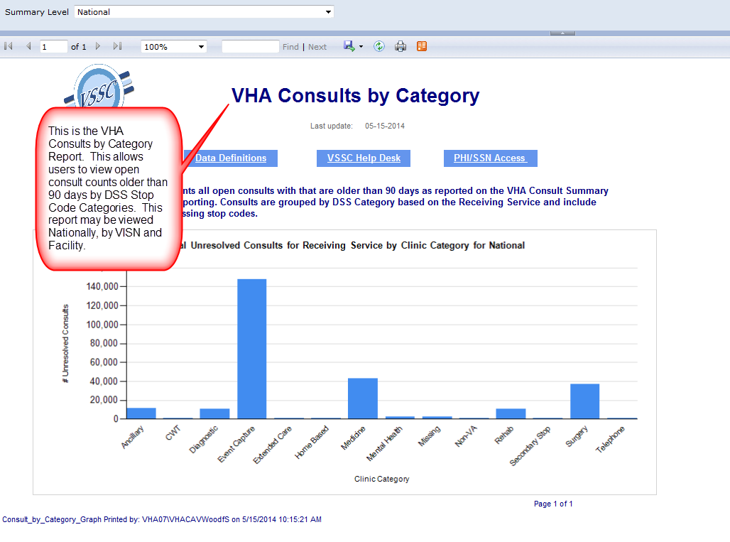

Slide 30
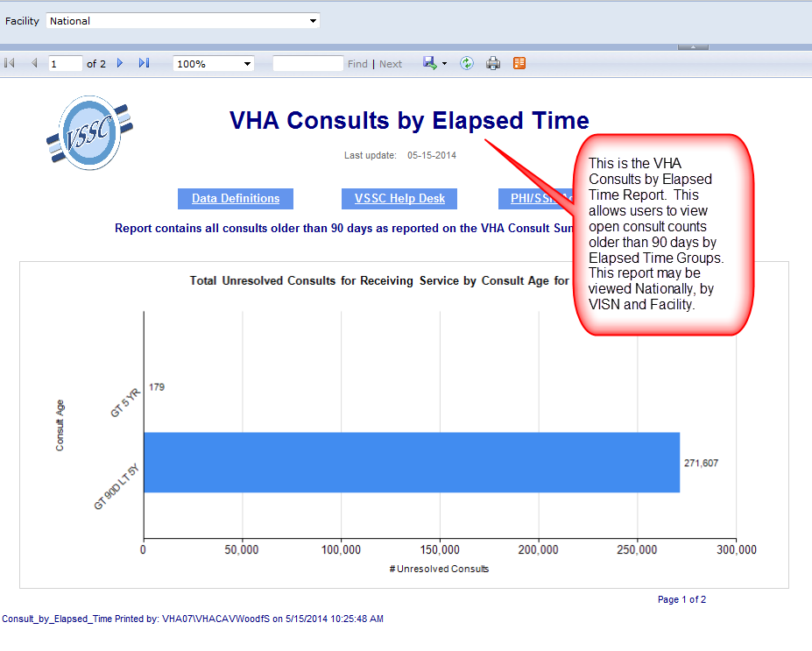

Slide 31
