Slide 1
Open API and Open Architecture Working Group (OA2-WG) *DRAFT*
Open Architecture Usage Scenario: Component Based Development
February 20 2019

Slide 2
Agenda for February 20, 2019
The Goals for Healthcare IT Products
The Open API/Open Architecture Approach
Review “reused” system engineering terms/concepts discussed earlier
CBSA – A definition by analogy
The OA2WG’s Proposed “Framework”, an Open Architecture for HIT

Slide 3
Goals for Healthcare IT Products
For the HIT application consumer and user, enable the industry to:
  Reduce procurement cost
  Increase quality of HIT by reducing risk of errors, known and unknown
  Increase performance & usability
  …SIMULTANEOUSLY!
Accomplish this by using Open API’s, in an Open Architecture, employing Reusable HIT Components to:
  Reduce the difficulty and complexity of learning how to build new HIT applications
  Allow new developers, designers, maintainers, and the investors who develop the organizations that supply HIT products to succeed in the HIT industry
  … by opening the HIT market to new developers with existing IT skills, and reducing the risk in investing in HIT; while increasing competition to lower cost and increasing value

Slide 4
The Open API/Open Architecture Approach
Open Architecture and Open API’s
  Allowing all participants(?) to contribute to HIT development
Component Based Software Assembly (CBSA)
  Reduce cost and increase quality by leveraging quality tested components that have already been developed; instead of re-inventing the wheel
Integrated Development Environments (IDE) and Software PlugIns/Wizards
  Reuse design architecture in the same way we reuse individual components; for lower cost, higher quality with the added advantage of greater interoperability

Slide 5
“Reused” System Engineering Terms/Concepts
Application Programming Interface (API)
  An interface allowing integration of new software with an existing system
Open API
  An API that allows integration with multiple similar systems, which supply the same services and function with a common interface
  Open API’s can be used to specify a component that is itself Open Source, or components that are proprietary
Open Architecture
  A system architecture that leverages multiple Open API’s (as well as proprietary API’s) to define an architecture of multiple similar systems
Component Based Software assembly
  A approach to build systems from pre-built components using Open API’s & system development toolset, or Integrated Development Environment (IDE)
IDE plugins aka Wizards
  A application domain (in our case HIT domain) specific customization of an IDE that leverages Open API’s, components that implement those API’s, an open Architecture, and assembly tools to create new systems in that domain

Slide 6
Component Based Software Assembly (CBSA)
Examples of building from kits, versus building from “frameworks”
  BTW, we need a better term then “frameworks”
CBSA build news products from:
  A set of reusable software components, each of which implements a part of a HIT application which multiple systems have in common (e.g.ID patient, or create appointment, or list available radiology studies for a specific patient)
  A set of “Open API’s”, each of which allows us to control a set of reusable software components which perform similar functions
    Each individual component which supplies the functions defined in the Open API is an implementation, or instantiation of that Open AP
  An Open Architecture, which is an architecture of a HIT application which uses Open API’s to integrate multiple reusable components together to build MULTIPLE applications
  Tools and guidance in how to use CBSA resources to build applications

Slide 7
Component Based Software Assembly
Defined by Analogy
Model Trains Example
Electronics Example

Slide 8
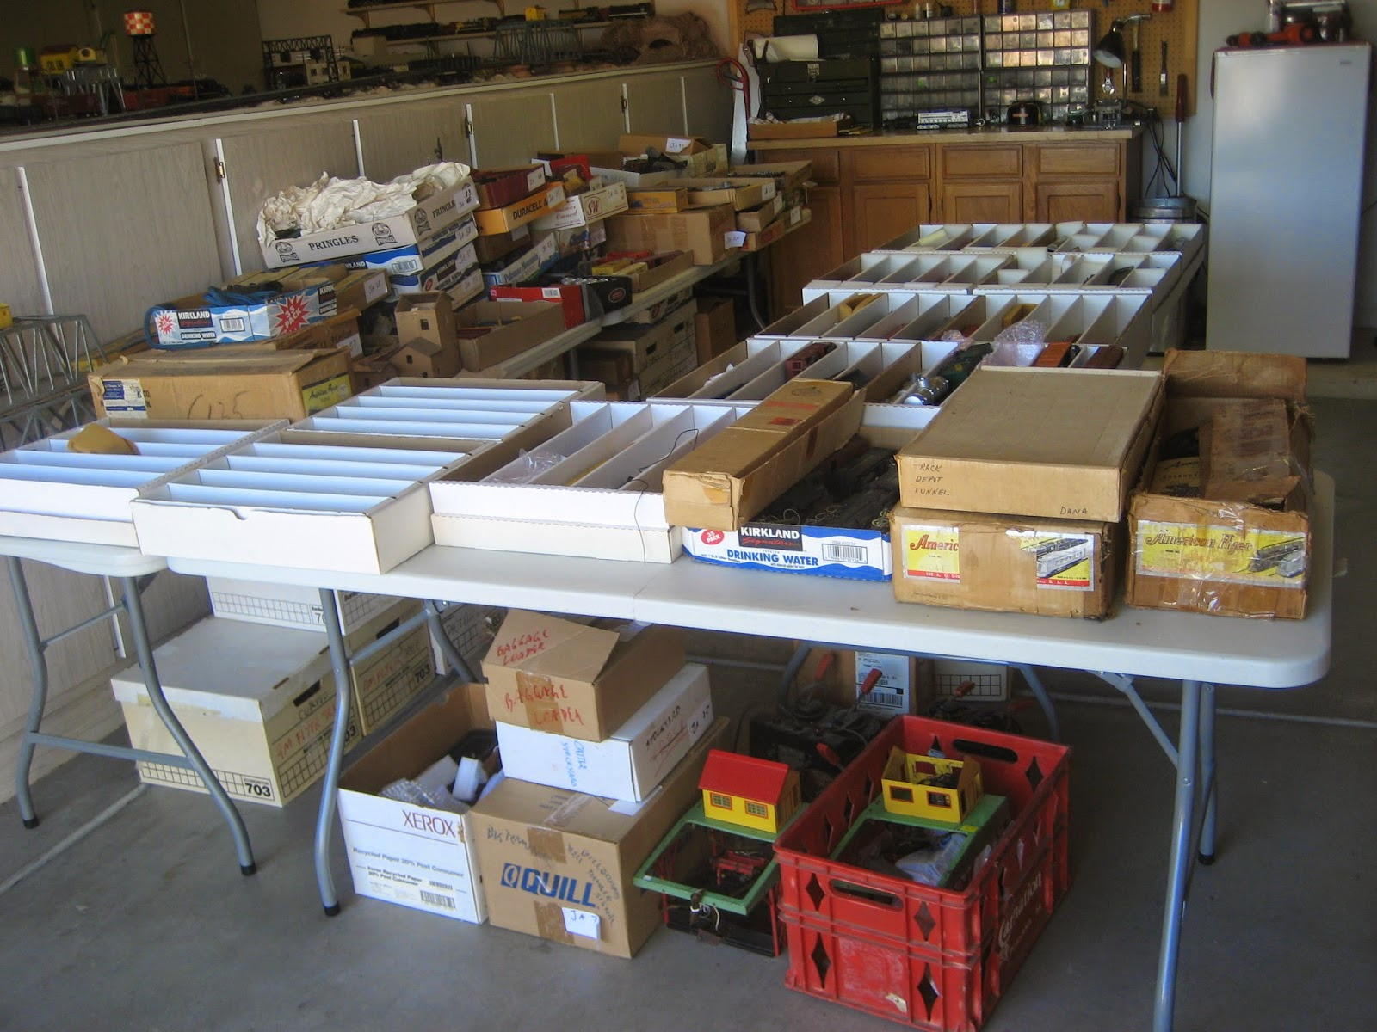
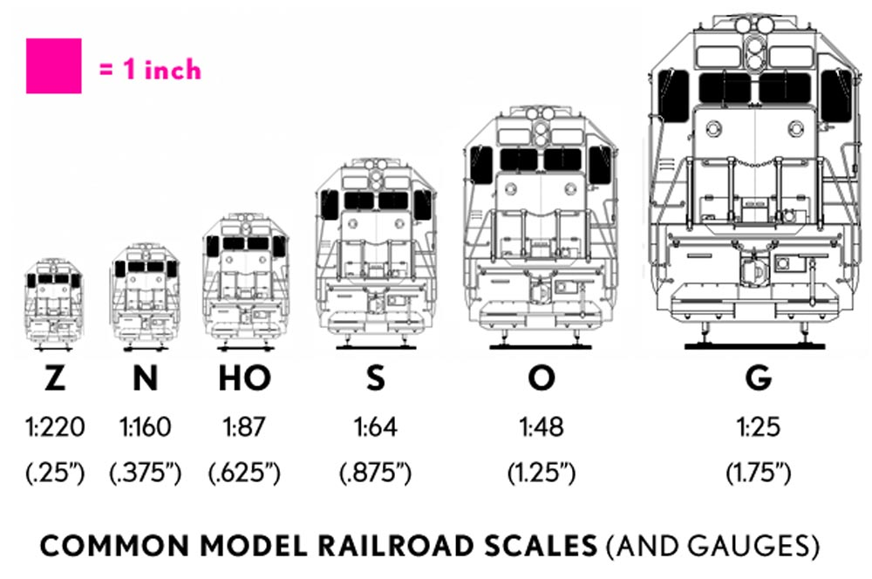
Model Train Components

Slide 9
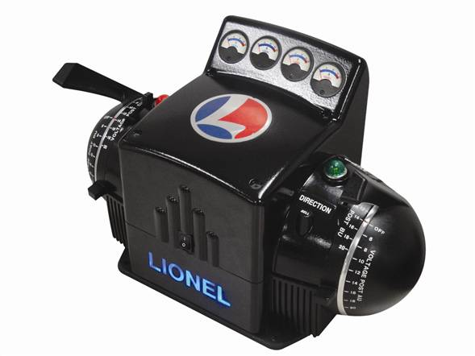
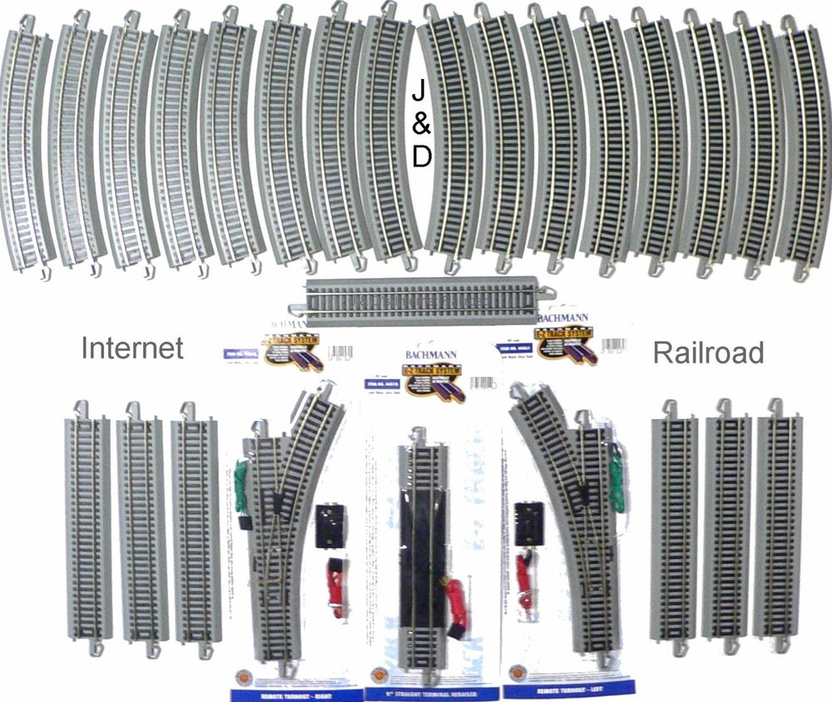
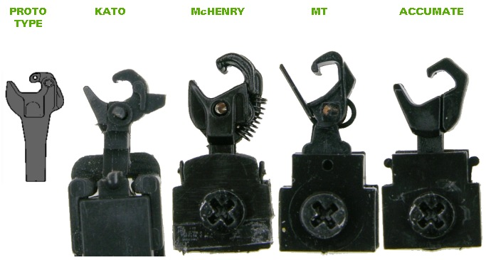
Model Train Open Architecture(s) – one per gauge
This is the interface

Slide 10
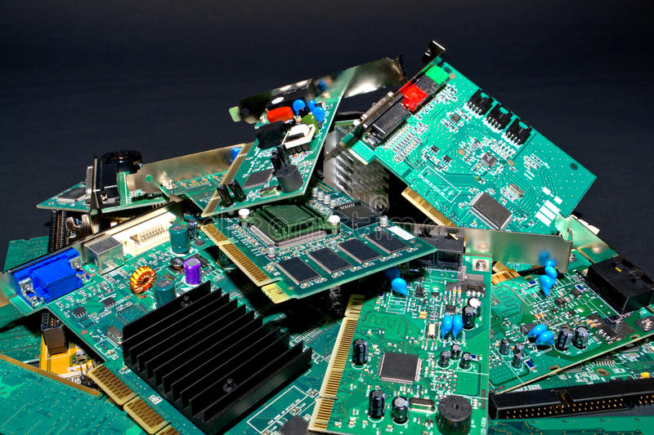
Electronic Components

Slide 11
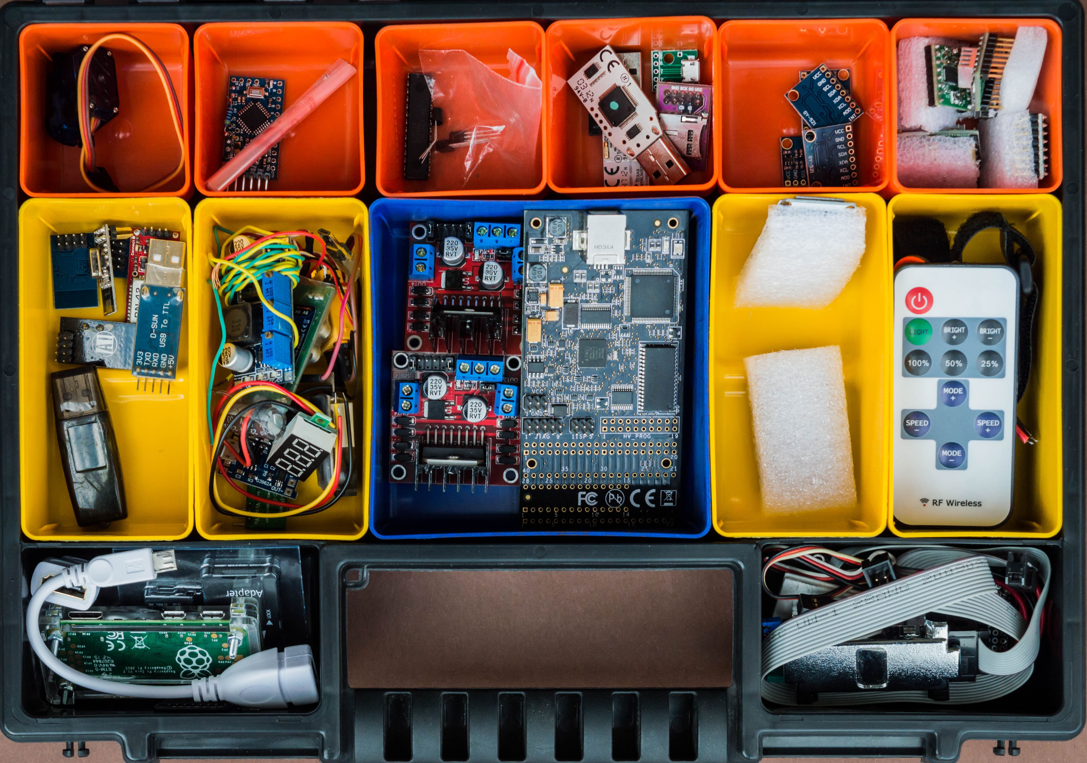
Categorized Electronic Components

Slide 12
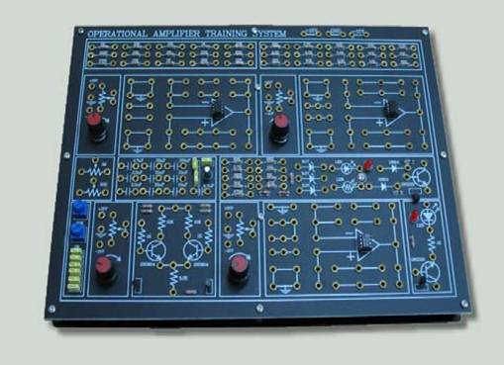
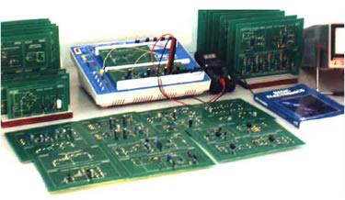
An Open Architecture for Electronics (2 actually)

Slide 13
Our “Framework”, a HIT Open Architecture
To define our HIT CBSA solution, we must define, identify or create:
  What are our standards interfaces, aka HIT Open API’s
  What are our HIT CBSA reusable components, which are implementations of those Open API’s?
    Remember, there is a one to many relationships between a Open API, and the set of components which implements EACH of those Open API’s
  What is our Open Architecture which guides how to integrate multiple reusable components, through their respective Open API’s to build new HIT applications?
  What tools and guidance will we collect and/or create to help developers build new HIT applications from our HIT CBSA “framework”?
And to manage complexity, how will we scale down and limit the scope of our HIT CBSA Framework Version #1?

Slide 14
Time to get to work, ready?
Unless we have been very good in moving quickly, at this point we’ll only preview the next slides
  We’ll actually try to answer these questions next meeting
  That has th advantage of letting you think about it, and possibly write up some notes, or collect some useful information.
Last question First
  And to manage complexity, how will we scale down and limit the scope of our HIT CBSA Framework Version #1? (see next two slides from January)

Slide 15
Using CBSA to Build New Apps from Open Architecture
Define a single design pattern, which can be instantiated through a family of applications
  Be careful to define SEI “family of apps” and “UML/Gang of 4” design patterns
Design that pattern, its commonalities and variations
Identify the common components that can be used to build applications that are variants of that pattern
Collect existing reusable components (those that we can acquire and use)
Build new components to be reusable, where feasible
Assemble a set of system development tools that will streamline the process of implementing a member of that design pattern “family”
Build new applications using the pattern, assembled (in part) from those reusable components (and new ones) assembled using that toolset

Slide 16
What are our standards interfaces, aka HIT Open API’s?

Slide 17
hat are our HIT CBSA reusable components?

Slide 18
What are our HIT CBSA reusable components, the implementations of those Open API’s?

Slide 19
What is our Open Architecture?
Which Open API’s will support it?
Dependencies and responsibilities of Components that implement those API’s
Protocols for physically integrating components

Slide 20
What tools and guidance will we collect and/or create?
Component Libraries
“valid” Component Based Software “Editors”
Automated, architecture and component driven tools

