Slide 1
Synthea
Jason Walonoski
Notes:
Approved for Public Release; Distribution Unlimited. Case Number 16-2025

Slide 2
What
Synthetic Patient Simulation
Synthea is an open-source synthetic patient generator that simulates the medical history of synthetic patients.
High Quality Health Records
Our mission is to output high-quality synthetic, realistic but not real, patient data and associated health records covering every aspect of health.
Freely Available
The resulting data is free from legal, cost, privacy, and security restrictions for a variety of secondary uses in academia, research, industry, and government where realistic (but not real) data is sufficient

Slide 3
Why
High demand for EHR datasets
Non-clinical or secondary uses including software development, testing, clinical training, policy analysis, where realistic (but not real) data is sufficient
Lack of Access
EHR datasets are difficult to obtain
Costs and Demand
Anonymized records are being bought and sold by federal and state health departments, hospitals, health insurers, pharmacists, general practitioners, government lobby groups, law firms, charities, marketers
Risks
Real patient records carry privacy, confidentiality, consent, policy, and legal risks that effectively prevent use
Real patients fear exposure of their intimate health data including lifestyle, family history, and mental health information
Not Anonymous
Deidentified and anonymized records have been successfully reidentified

Slide 4
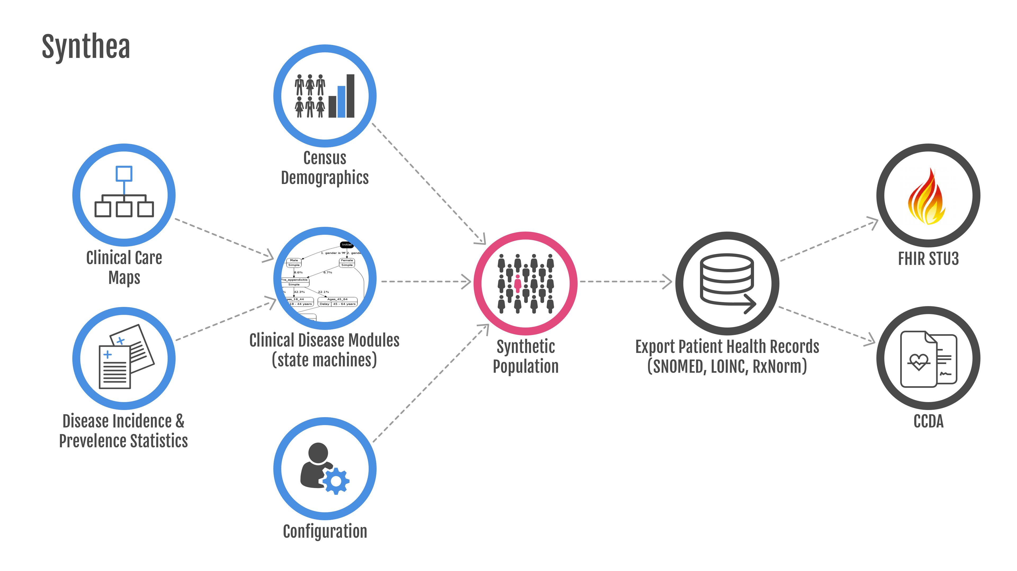
Synthea Architecture

Slide 5
Diseases
 | Top 10 Reasons Patients Visit PCP | Top 10 Years of Life Lost
1 | Routine infant/child health check | Ischemic Heart Disease
2 | Essential Hypertension | Lung Cancer
3 | Diabetes Mellitus | Alzheimer’s Disease
4 | Normal Pregnancy | COPD
5 | Respiratory Infections (Pharyngitis, Bronchitis, Sinusitis) | Cerebrovascular Disease
6 | General Adult Medical Examination | Road Injuries
7 | Disorders of Lipoid Metabolism | Self-Harm
8 | Ear Infections (Otitis Media) | Diabetes Mellitus
9 | Asthma | Colorectal Cancer
10 | Urinary Tract Infections | Drug Use Disorders (limited to Opioids)
Notes:
Years of Life Lost is from the Global Burden of Disease (GBD) for the United States in 2015

Slide 6
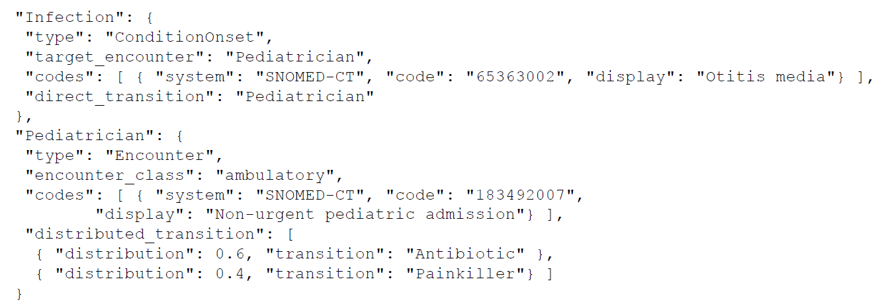
Modules are written in JSON

Slide 7
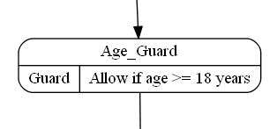
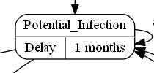
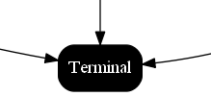
Control States control the flow
Notes:
The control states manage starting, terminating, and delaying the progression through a module state machine. Control states are also used to conditionally control module flow and
to read/write attributes on the patient.

Slide 8
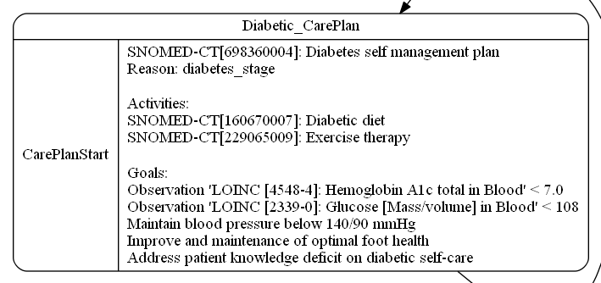
Clinical States drive disease and care
Notes:
Clinical states introduce encounters, symptoms, conditions, medications, observations,
and care plans to the EHR.

Slide 9
Appendicitis

Slide 10
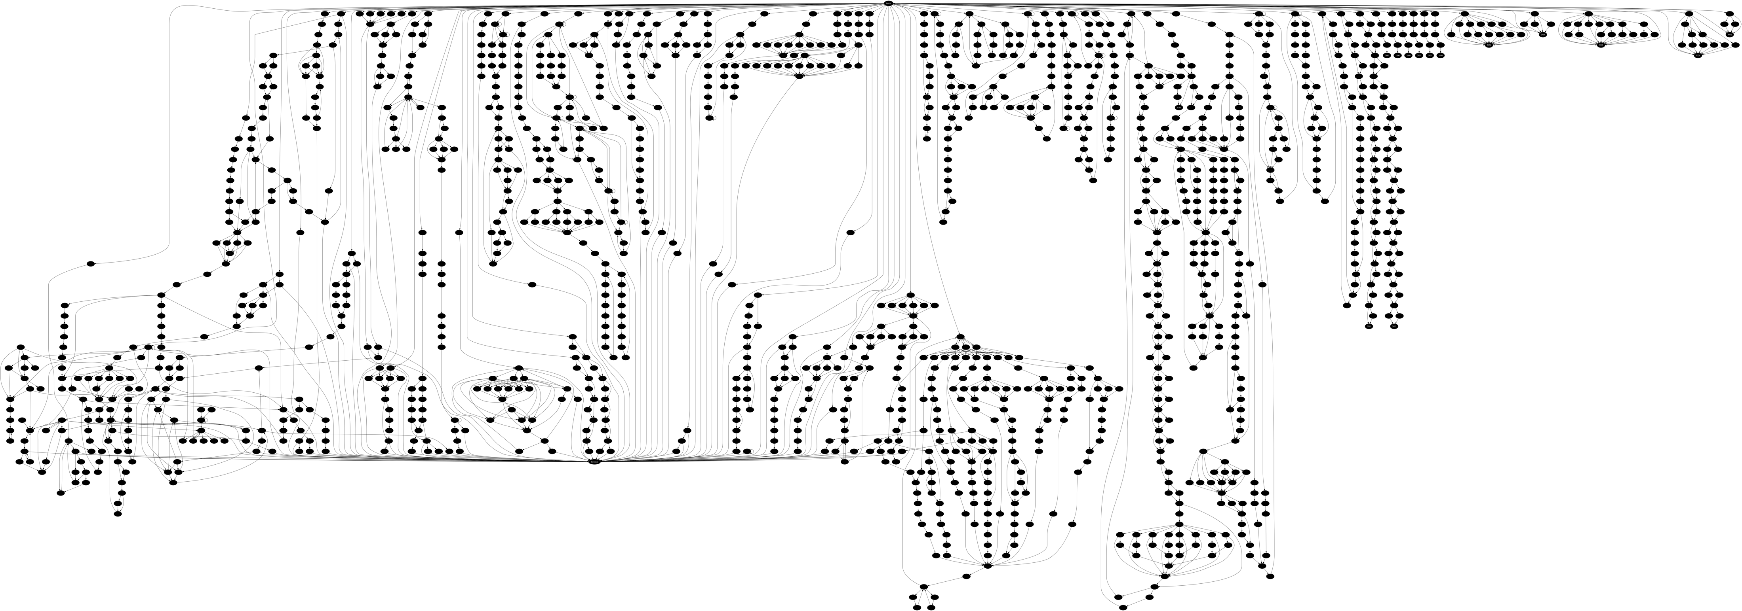
Disease Models (as of November 2017)
Appendicitis
Notes:
1488 nodes
Red outline is Appendicitis module from previous slide

Slide 11
Model Validation
External validation of models
Tom Gallagher (University of Montana)
Kuda Dube (Massey University [NZ])
Scott McLachlan (Massey University [NZ])

Slide 12
SyntheticMass

Slide 14
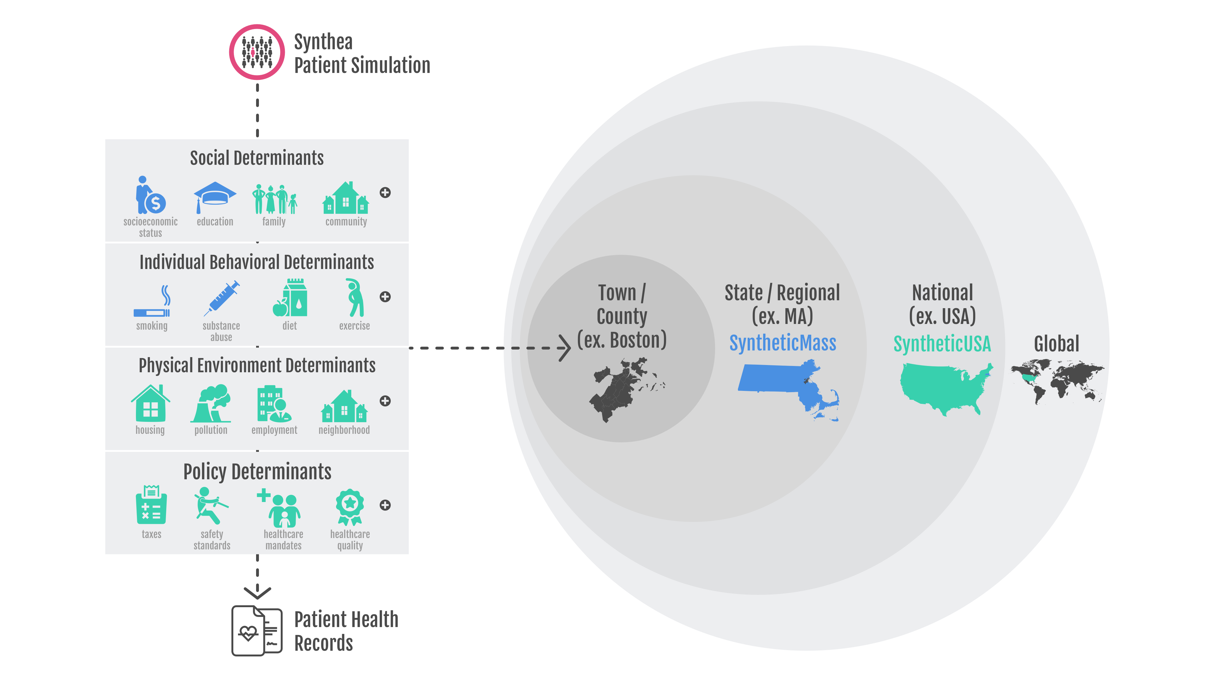
Synthea Vision for the Future

Slide 15
Not just patient records…
Access to Care
Modeling healthcare facilities and utilization
Calculates individual access
Health Outcomes
Calculates Quality Adjusted Life Years (QALY) and Disability Adjusted Life Years (DALY)
Quality Measures
Cost and Price
Modeling claims insurance coverage
Medicaid, Medicare, Dual-Eligible, Private, None
Cost to individual and family burden (annual and lifetime)
Health System costs

Slide 16
How are people using Synthea?
Software Development and Integration
AMIA Datathon, March 2017
HL7 FHIR Connecathon 15, May 2017
PULSE@MassChallenge
IHIC Datathon, Athens October 2017
Education
Data for students and researchers
Georgia Tech, WPI, UC Denver, Cornell, Tufts
Data Analysis
Model validation, Tool and Model development before real data
Performance Testing
Testing systems at scale with millions of records

Slide 17
Open Source Resources
Contact: Jason Walonoski
jwalonoski@mitre.org
Synthea
https://github.com/synthetichealth/synthea
https://github.com/synthetichealth/synthea_java
Module Editor
Demo: https://synthetichealth.github.io/caremaps-react/
Code: https://github.com/synthetichealth/caremaps-react
SyntheticMass
Browse: https://syntheticmass.mitre.org
FHIR: https://syntheticmass.mitre.org/fhir/metadata
Download: https://syntheticmass.mitre.org/download.html

Slide 18
Community Contributed Synthea Modules
Pregnancy
Birth
Homelessness and Community Health Centers
Epilepsy

Slide 19
BACKUP

Slide 20
Example Module – Appendicitis

Slide 21
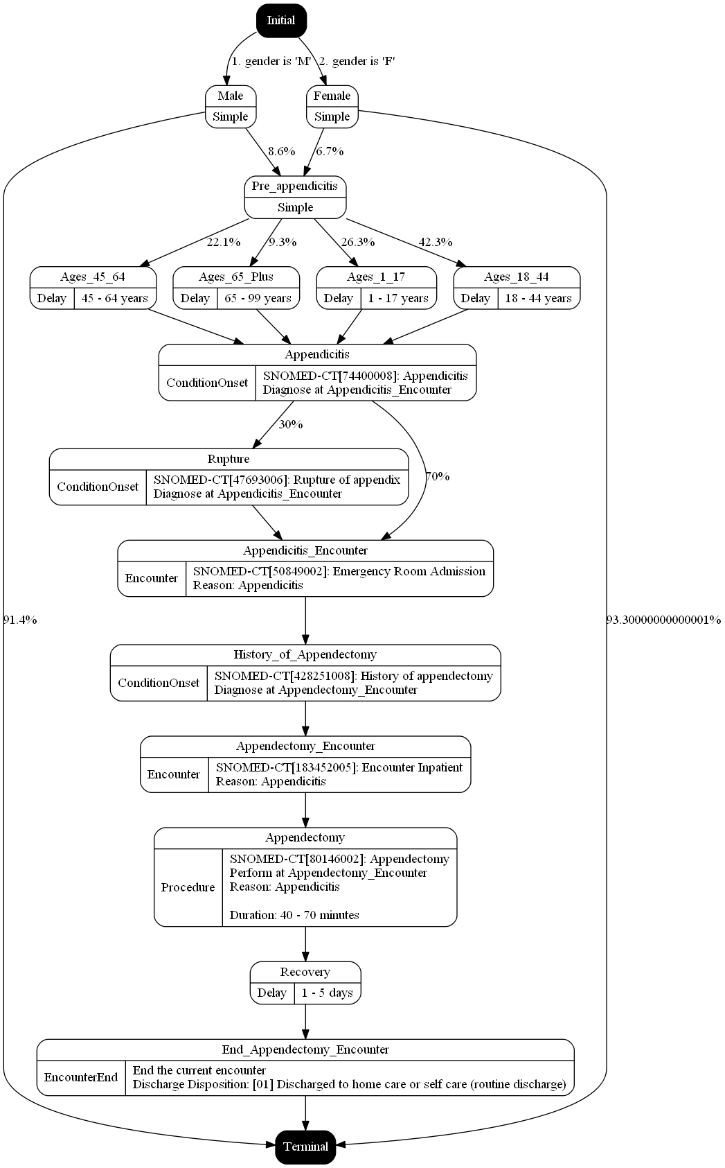
Smith292, John949
Born: March 25, 1947
Gender: Male
Encounters:
Conditions:
Procedures:
Notes:
Start up at the top

Slide 22
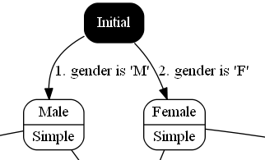
Smith292, John949
Born: March 25, 1947
Gender: Male
Encounters:
Conditions:
Procedures:
Current Date of Simulation: March 25, 1947
Notes:
Modules always start at an “Initial” state

Slide 23
Smith292, John949
Born: March 25, 1947
Gender: Male
Encounters:
Conditions:
Procedures:
Current Date of Simulation: March 25, 1947
Notes:
From there we have a conditional transition based on the patient’s gender, which in this case is Male so we transition to the state named Male

Slide 24
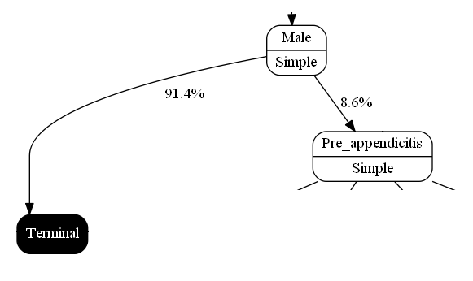
Smith292, John949
Born: March 25, 1947
Gender: Male
Encounters:
Conditions:
Procedures:
Current Date of Simulation: March 25, 1947
Notes:
Now we’re at the Male state, which has a distributed transition of 91% to the terminal state and around 8.6% to the Pre-appendicitis state. According to the NIH, about 8.6% of men get appendicitis in their lifetimes.

Slide 25
Smith292, John949
Born: March 25, 1947
Gender: Male
Encounters:
Conditions:
Procedures:
Current Date of Simulation: March 25, 1947
Notes:
So we roll a die/flip a coin, and this patient goes on to the Pre-appendicitis state.

Slide 26
Smith292, John949
Born: March 25, 1947
Gender: Male
Encounters:
Conditions:
Procedures:
Current Date of Simulation: March 25, 1947
Notes:
Now from the pre_appendicitis state, we have another distributed transition so we do another dice roll

Slide 27
Smith292, John949
Born: March 25, 1947
Gender: Male
Encounters:
Conditions:
Procedures:
Current Date of Simulation: March 25, 1947
Notes:
And the patient goes into the “Ages_65_plus” state. Per the NIH approximately 9.3% of appendicitis cases happen in people over the age of 65.

Slide 28
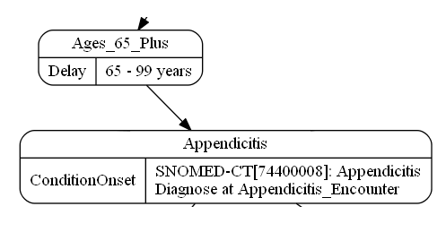
Smith292, John949
Born: March 25, 1947
Gender: Male
Encounters:
Conditions:
Procedures:
Current Date of Simulation: March 25, 1947
Notes:
Now from the Ages_65_Plus state, this is a “Delay” state, so the system does another dice roll to pick a time between 65 and 99 years to decide when to proceed. In this example I have the system pick a little over 66 years

Slide 29
Smith292, John949
Born: March 25, 1947
Gender: Male
Encounters:
Conditions:
Procedures:
Current Date of Simulation: July 23, 2013
Notes:
And now we’re 66 years in the future, the baby is all grown up, and we’ve moved into the Appendicitis state. This is a ConditionOnset state, which means the condition exists in the patient but hasn’t necessarily been diagnosed yet. In this case we’ll diagnose it at the encounter later in the module.

Slide 30
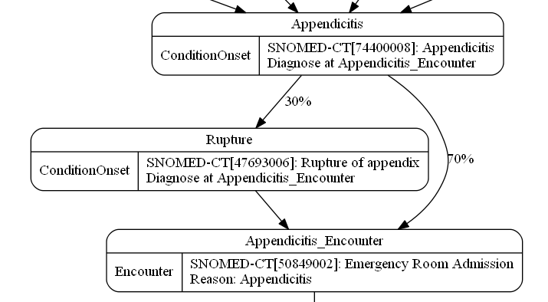
Smith292, John949
Born: March 25, 1947
Gender: Male
Encounters:
Conditions:
Procedures:
Current Date of Simulation: July 23, 2013
Notes:
Now from the Appendicitis state, there’s a 70% chance of going straight to the Emergency room encounter, of a 30% chance of the appendix rupturing. We do another dice roll

Slide 31
Smith292, John949
Born: March 25, 1947
Gender: Male
Encounters:
Conditions:
Procedures:
Current Date of Simulation: July 23, 2013
Notes:
And the patient goes to the Rupture state, which again is a ConditionOnset state that hasn’t been diagnosed yet.

Slide 32
Smith292, John949
Born: March 25, 1947
Gender: Male
Encounters:
Emergency Room Admission,
July 23, 2013 →
Conditions:
Appendicitis, Diagnosed July 23, 2013
Rupture of appendix, Diagnosed July 23, 2013
Procedures:
Current Date of Simulation: July 23, 2013
Notes:
And then we go forward to the Encounter state, for the Emergency Room. Here, the previous conditions are diagnosed and added to the medical record.

Slide 33
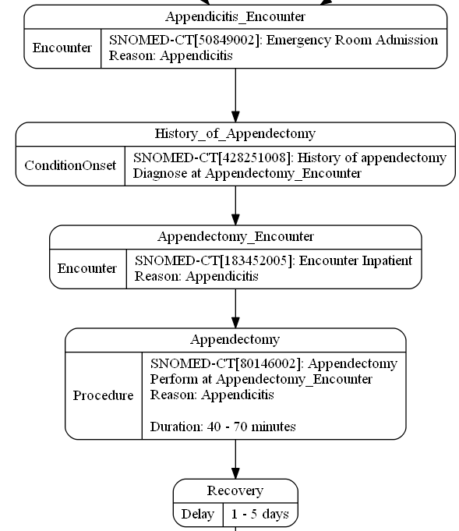
Smith292, John949
Born: March 25, 1947
Gender: Male
Encounters:
Emergency Room Admission,
July 23, 2013 →
Conditions:
Appendicitis, Diagnosed July 23, 2013
Rupture of appendix, Diagnosed July 23, 2013
Procedures:
Current Date of Simulation: July 23, 2013

Slide 34
Smith292, John949
Born: March 25, 1947
Gender: Male
Encounters:
Emergency Room Admission,
July 23, 2013 →
Conditions:
Appendicitis, Diagnosed July 23, 2013
Rupture of appendix, Diagnosed July 23, 2013
Procedures:
Current Date of Simulation: July 23, 2013

Slide 35
Smith292, John949
Born: March 25, 1947
Gender: Male
Encounters:
Emergency Room Admission,
July 23, 2013 → July 23, 2013
Inpatient Encounter,
July 23, 2013 →
Conditions:
Appendicitis, Diagnosed July 23, 2013
Rupture of appendix, Diagnosed July 23, 2013
History of appendectomy, Diagnosed July 23 2013
Procedures:
Current Date of Simulation: July 23, 2013

Slide 36
Smith292, John949
Born: March 25, 1947
Gender: Male
Encounters:
Emergency Room Admission,
July 23, 2013 → July 23, 2013
Inpatient Encounter,
July 23, 2013 →
Conditions:
Appendicitis, Diagnosed July 23, 2013
Rupture of appendix, Diagnosed July 23, 2013
History of appendectomy, Diagnosed July 23 2013
Procedures:
Appendectomy, Performed July 23, 2013
Current Date of Simulation: July 23, 2013

Slide 37
Smith292, John949
Born: March 25, 1947
Gender: Male
Encounters:
Emergency Room Admission,
July 23, 2013 → July 23, 2013
Inpatient Encounter,
July 23, 2013 →
Conditions:
Appendicitis, Diagnosed July 23, 2013
Rupture of appendix, Diagnosed July 23, 2013
History of appendectomy, Diagnosed July 23 2013
Procedures:
Appendectomy, Performed July 23, 2013
Current Date of Simulation: July 23, 2013

Slide 38
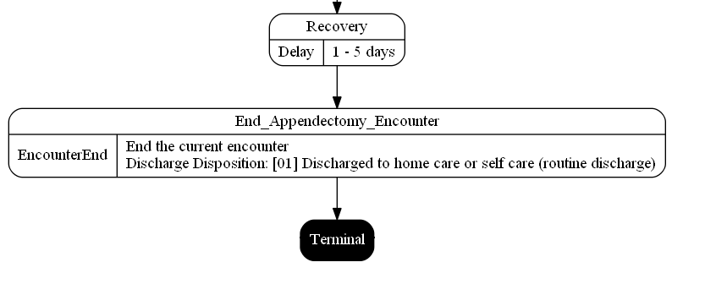
Smith292, John949
Born: March 25, 1947
Gender: Male
Encounters:
Emergency Room Admission,
July 23, 2013 → July 23, 2013
Inpatient Encounter,
July 23, 2013 →
Conditions:
Appendicitis, Diagnosed July 23, 2013
Rupture of appendix, Diagnosed July 23, 2013
History of appendectomy, Diagnosed July 23 2013
Procedures:
Appendectomy, Performed July 23, 2013
Current Date of Simulation: July 23, 2013

Slide 39
Smith292, John949
Born: March 25, 1947
Gender: Male
Encounters:
Emergency Room Admission,
July 23, 2013 → July 23, 2013
Inpatient Encounter,
July 23, 2013 → July 27, 2013
Conditions:
Appendicitis, Diagnosed July 23, 2013
Rupture of appendix, Diagnosed July 23, 2013
History of appendectomy, Diagnosed July 23 2013
Procedures:
Appendectomy, Performed July 23, 2013
Current Date of Simulation: July 27, 2013

Slide 40
Smith292, John949
Born: March 25, 1947
Gender: Male
Encounters:
Emergency Room Admission,
July 23, 2013 → July 23, 2013
Inpatient Encounter,
July 23, 2013 → July 27, 2013
Conditions:
Appendicitis, Diagnosed July 23, 2013
Rupture of appendix, Diagnosed July 23, 2013
History of appendectomy, Diagnosed July 23 2013
Procedures:
Appendectomy, Performed July 23, 2013
Current Date of Simulation: July 27, 2013

